Slide 1


Expected beam induced heat load on the beam screens
G. Iadarola, E. Metral, G. Rumolo, G. Skripka
Many thanks to:
G. Arduini, D. Berkowitz Zamora, S. Claudet, R. De Maria, P. Dijkstal, P. Fessia, L. Medina,
L. Mether, A. Perin, B. Salvant, R. Tomas
HL-LHC Annual Meeting, 14-16 November 2016, Paris

Slide 2
Outline
Introduction
  A few cross-checks
Heat load estimates
  Arcs
  Inner triplets
  Twin-bore IR magnets
Backup scenarios (8b4e and hybrid schemes)

Slide 3
Outline
Introduction
  A few cross-checks
Heat load estimates
  Arcs
  Inner triplets
  Twin-bore IR magnets
Backup scenarios (8b4e and hybrid schemes)

Slide 4
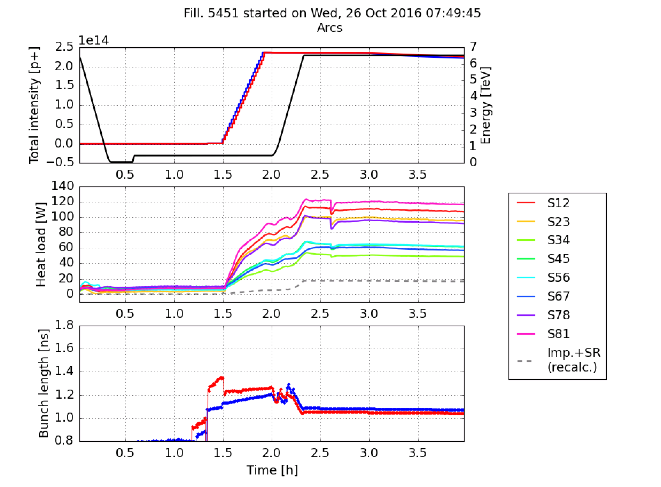
Introduction
Heat load on the arc beam screens have been one of the major performance limitations during the 2015-16 run
    Important to understand how this will evolve for the HL-LHC era
    Working in collaboration with WP9 on a complete survey of the heat loads expected on the beams screens of all cold elements (more in the contribution by S. Claudet)
Situation at the end of 2016 p-p run:
  Available cooling capacity for the beam screens of the order of 8 kW/arc (corresponding to 160 W/half-cell)
Load from impedance and synchrotron radiation within 15% of the available capacity
  Strong load from e-cloud amounting to a large fraction of the available capacity (especially for S12, S23 and S81)
Avg. per half-cell

Slide 5
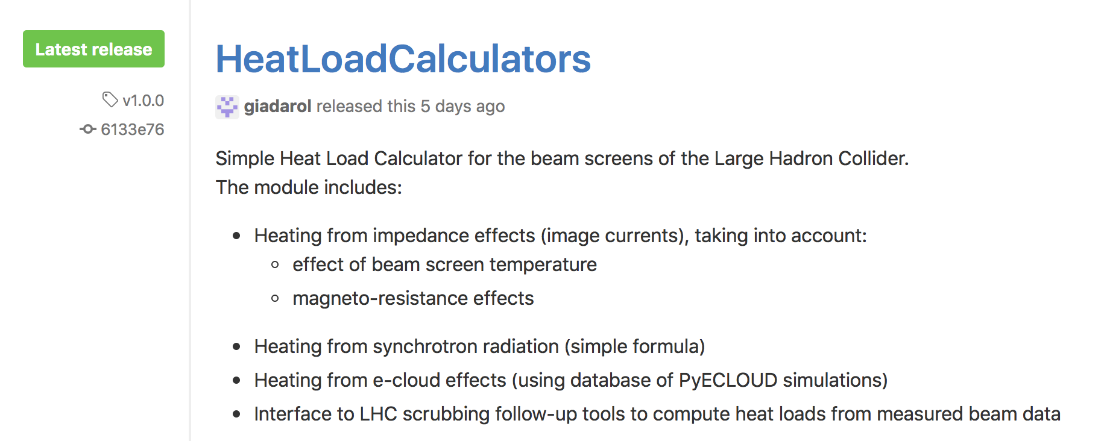
Introduction
A simple tool has been developed for the evaluation of the different heat load contributions in the different operational scenarios
Available at: https://github.com/giadarol/HeatLoadCalculators/

Slide 6
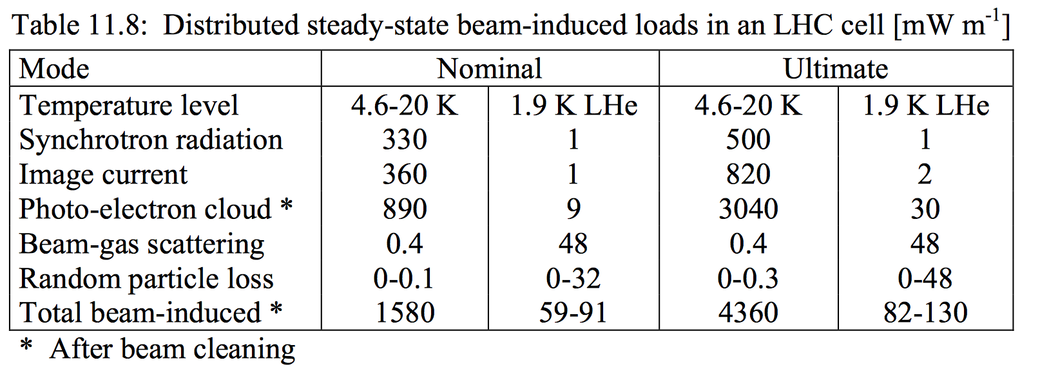
A few cross-checks: synchrotron radiation
Method presently implemented :
  Compute energy loss per particle and per turn (formula)
  Rescale to get total power loss (P = E_{loss}*N_{beam}/T_{rev})
  Assume that it is all deposited in the arcs (divide by 8*L_{arc} to get average deposited power)
Estimation for nominal LHC beam (173.0 mW/m/beam) consistent values in LHC Design Report:
Values here are for 2 beams

Slide 7
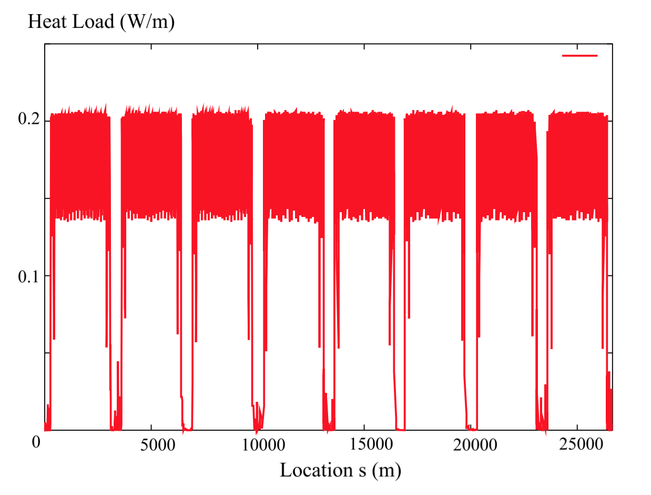
A few cross-checks: synchrotron radiation
Method presently implemented :
  Compute energy loss per particle and per turn (formula)
  Rescale to get total power loss (P = E_{loss}*N_{beam}/T_{rev})
  Assume that it is all deposited in the arcs (divide by 8*L_{arc} to get average deposited power)
Estimation for nominal LHC beam (173.0 mW/m/beam) consistent values in LHC Design Report:
Present
estimate

Slide 8
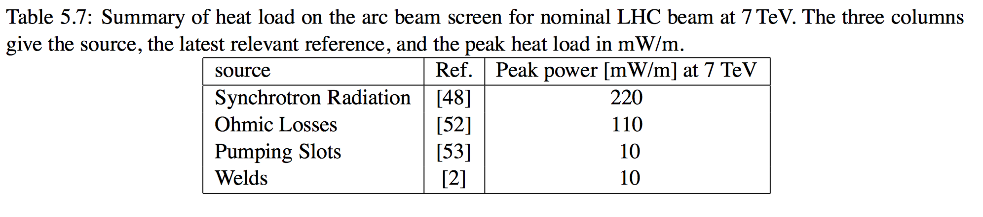
A few cross-checks: impedance
Classical resistive-wall formula:
  Resistivity evaluated taking into account:
    Dependence of temperature
    Dependence on magnetic field
    Different values evaluated for dipoles, quadrupoles and drifts
  Effect of the longitudinal weld in the beam screen
Estimation for nominal LHC beam (115 mW/m/beam) consistent values in LHC Design Report:
Values here are for 1 beam
Larger values are reported in Chapter 11 of the LHC-DR, being investigated by the impedance team…

Slide 9
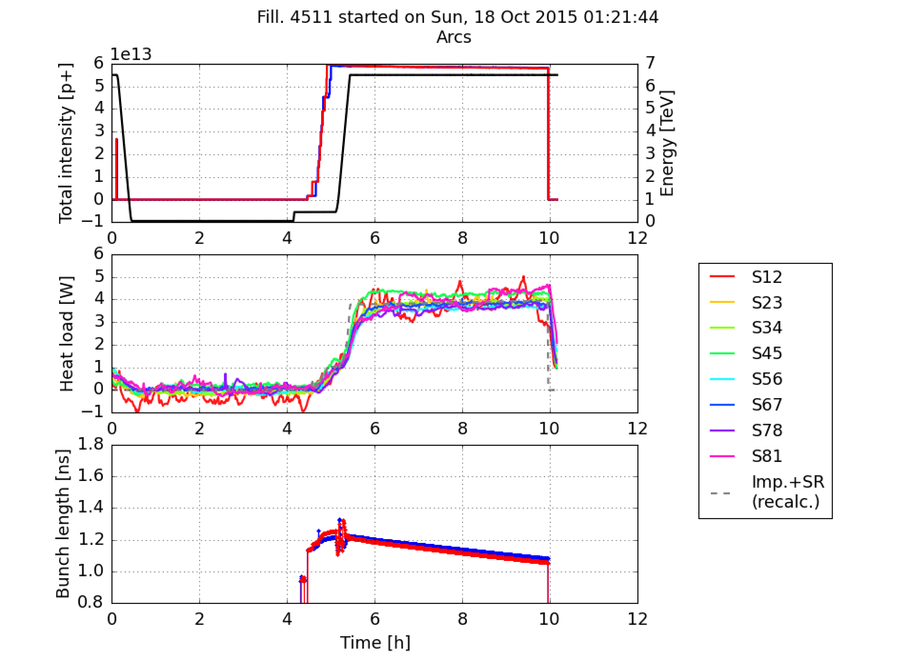
A few cross-checks: experimental data
Estimations from impedance and synchrotron radiation agree very well with data collected during machine operations with large bunch spacing (no e-cloud expected)
Bunch spacing: 100 ns, b*=90m run in 2015

Slide 10
Outline
Introduction
  A few cross-checks
Heat load estimates
  Arcs
  Inner triplets
  Twin-bore IR magnets
Backup scenarios (8b4e and hybrid schemes)

Slide 11
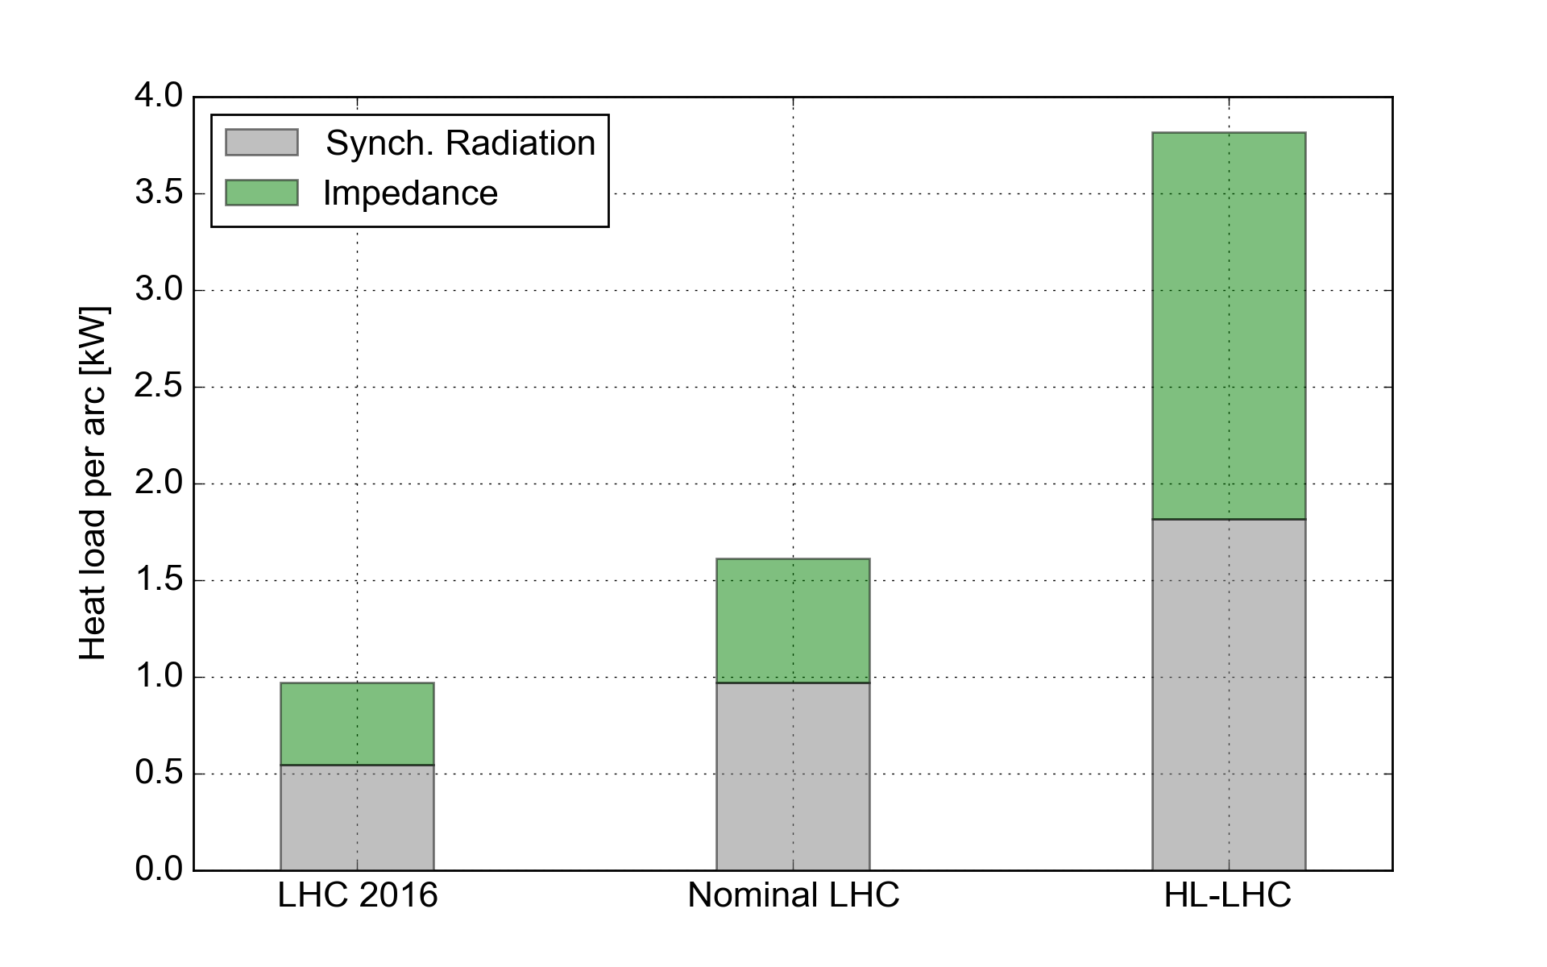
Heat loads in the arcs: impedance and synchrotron radiation
With HL-LHC beam parameters (Table V 6.1.0, 25 Oct. 2016) a significant fraction of the available cooling capacity will be used for impedance and synchrotron radiation load
  significantly less margin to cope with the e-clouds

Slide 12
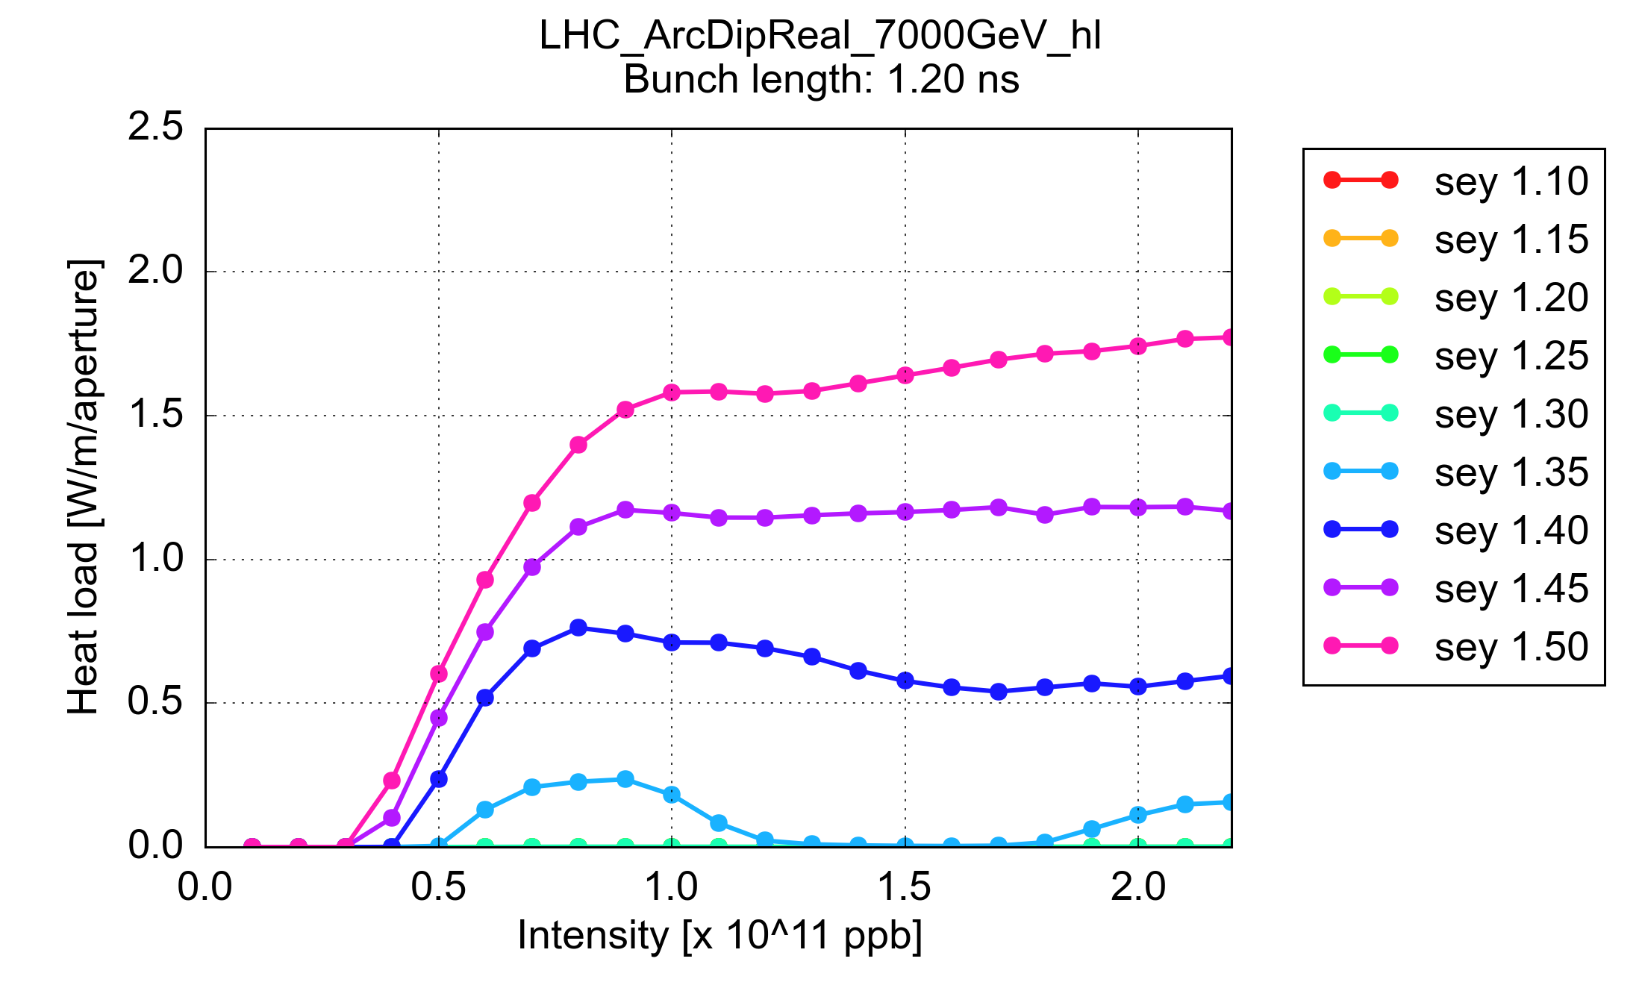
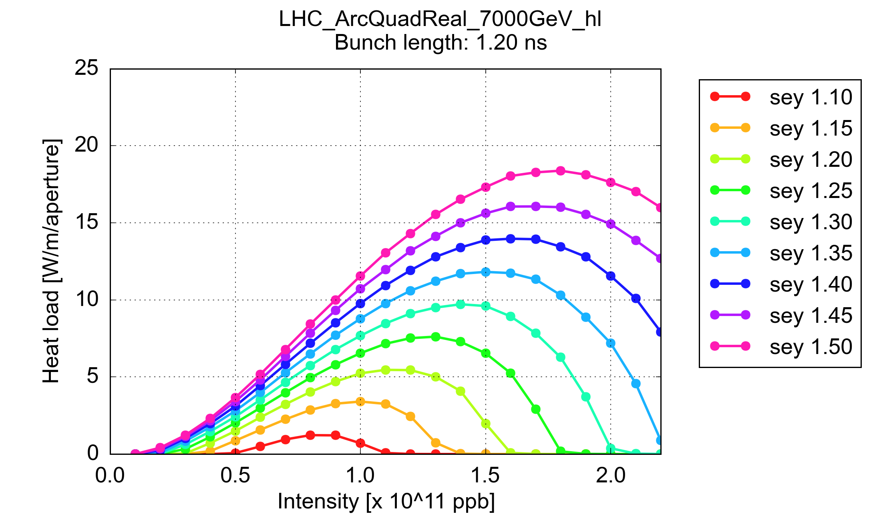
Heat loads in the arcs: electron cloud
The contribution from the e-cloud depends on the Secondary Electron Yield (SEY) that will be achieved through beam induced scrubbing
Heat load from e-cloud scales non-monotonically with bunch intensity
  → Start of fill might not be the most critical moment
Arc dipole
Arc quadrupole

Slide 13
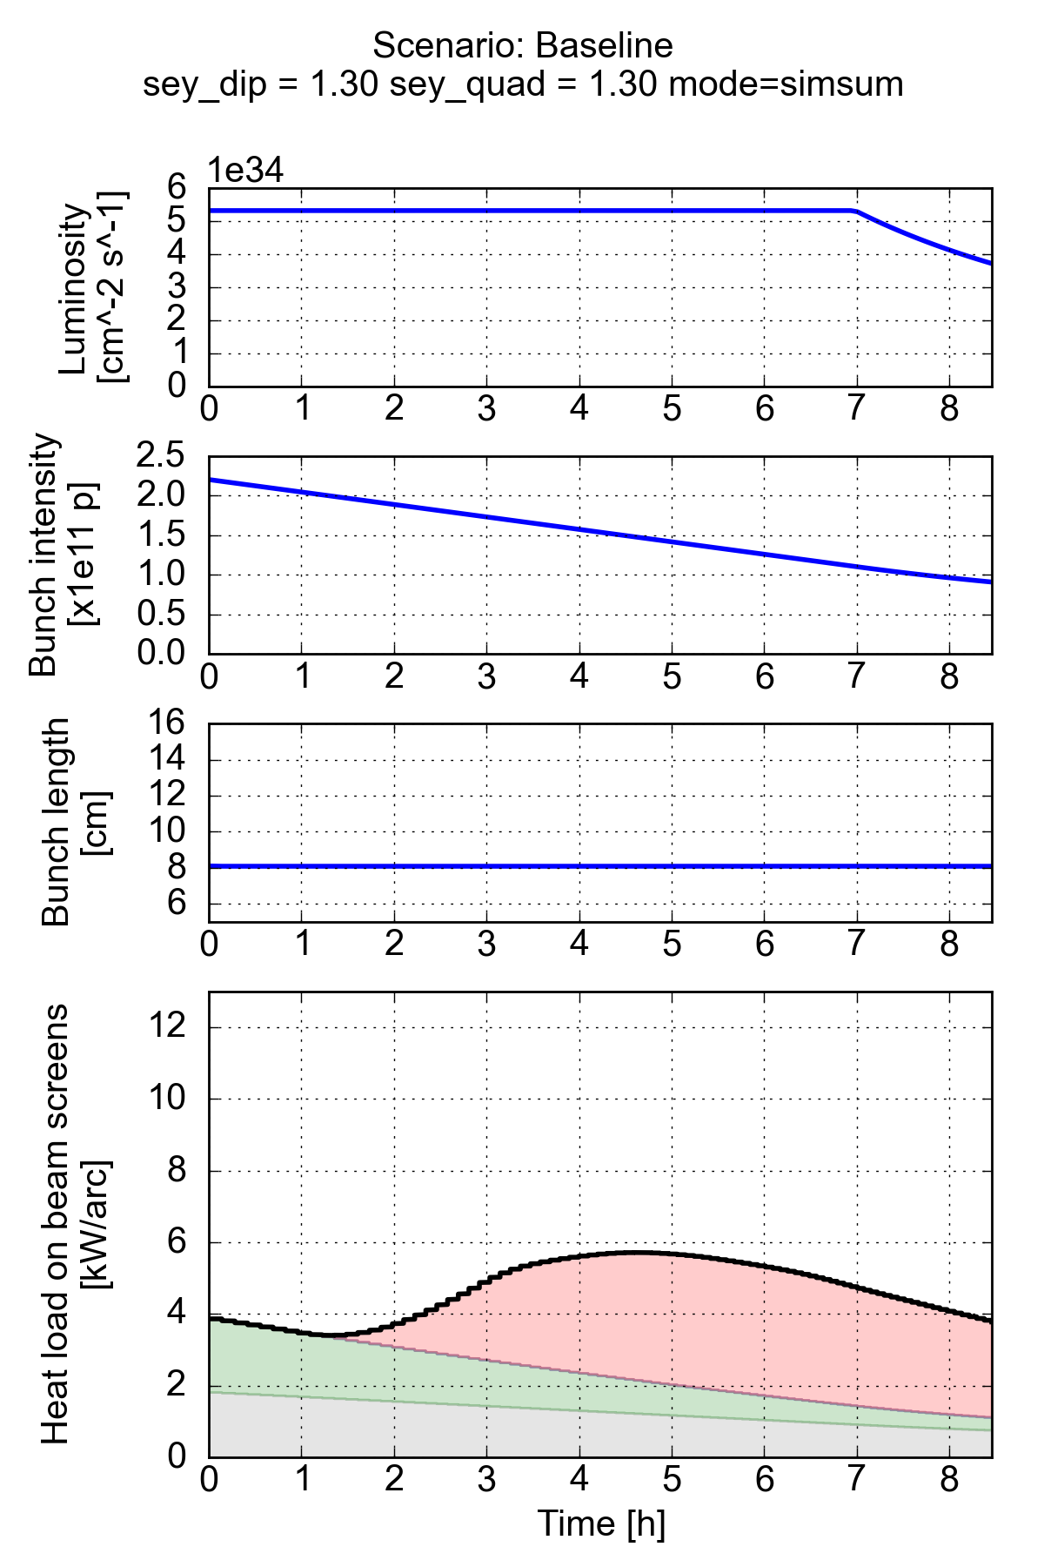
Heat loads in the arcs: evolution during the fill
Different contributions estimated all along the fill:
Heat load increasing in the first part of the fill
Even assuming full e-cloud suppression in the dipole magnets (SEY_{dip} = 1.3) remaining heat load amounts to a large fraction of available cooling capacity
SEY_{dip} = 1.3, SEY_{quad} = 1.3
e-cloud quad.
e-cloud dip.
Impedance
Syn. radiation

Slide 14
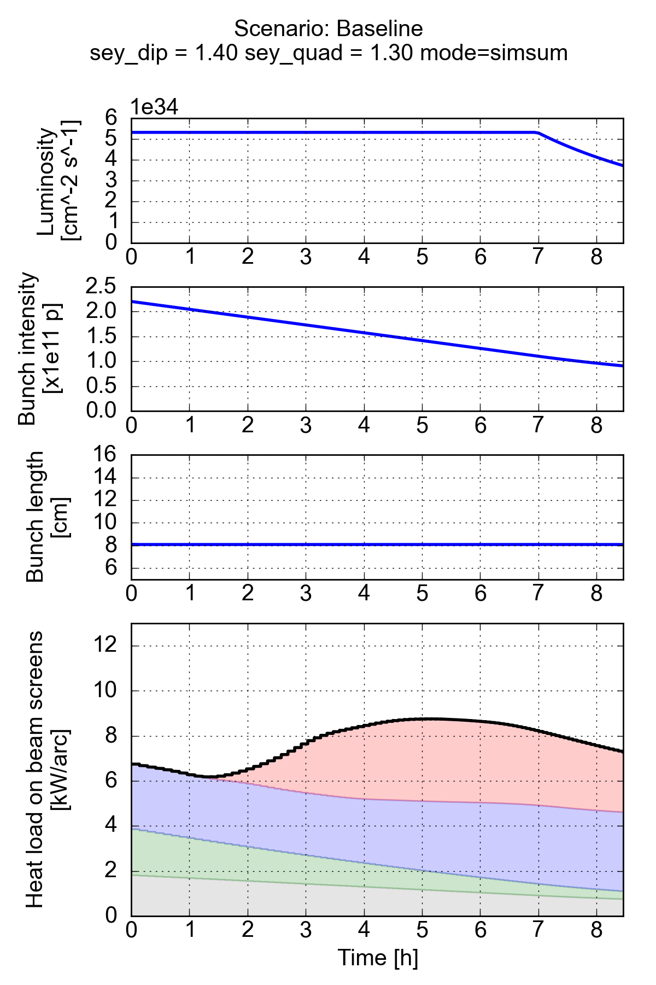
Heat loads in the arcs: evolution during the fill
Different contributions estimated all along the fill:
Heat load increasing in the first part of the fill
Even assuming full e-cloud suppression in the dipole magnets (SEY_{dip} = 1.3) remaining heat load amounts to a large fraction of available cooling capacity
The situation becomes even tighter assuming SEY_{dip} = 1.4 (as presently estimated from heat load in the LHC)
Effect of e-cloud in dipole correctors, multipoles and drift sections still needs to be added…
SEY_{dip} = 1.4, SEY_{quad} = 1.3
e-cloud quad.
e-cloud dip.
Impedance
Syn. radiation

Slide 15
Outline
Introduction
  A few cross-checks
Heat load estimates
  Arcs
  Inner triplets
  Twin-bore IR magnets
Backup scenarios (8b4e and hybrid schemes)

Slide 16
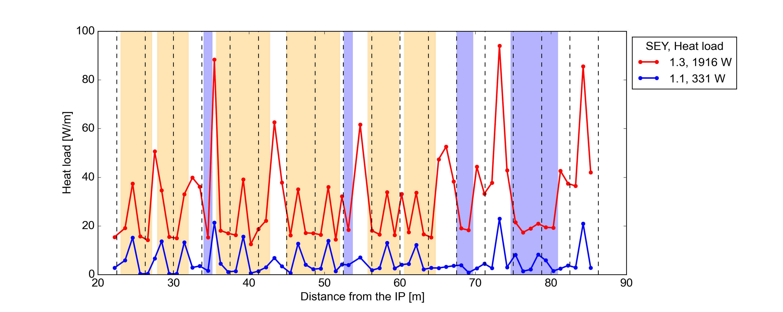
Inner triplets in IR1&5
Dipole
Quadrupole
Estimates updated to present optics (HL-LHC v1.2) and beam screen design
Structure is longitudinally sliced to account for different properties at the different locations for the two counter-rotating beams (arrival times, beam size, beam position)
e-cloud buildup simulated in the main magnets, in the dipole correctors and in the drift spaces (multipole correctors are simulated as drift for the time being)

Slide 17
Inner triplets in IR1&5
Dipole
Quadrupole
Main observations:
Surface treatment with SEY<=1.1 (e.g. a-C coating) provides a significant e-cloud mitigation compared to a copper like surface
The e-cloud tends to be less strong at the location of the long-range encounters
Very high heat loads densities are observed for SEY=1.3 at drift sections far from LR encounters → need to crosscheck heat load expected from non coated parts (interconnects, BPMs)

Slide 18
Outline
Introduction
  A few cross-checks
Heat load estimates
  Arcs
  Inner triplets
  Twin-bore IR magnets
Backup scenarios (8b4e and hybrid schemes)

Slide 19
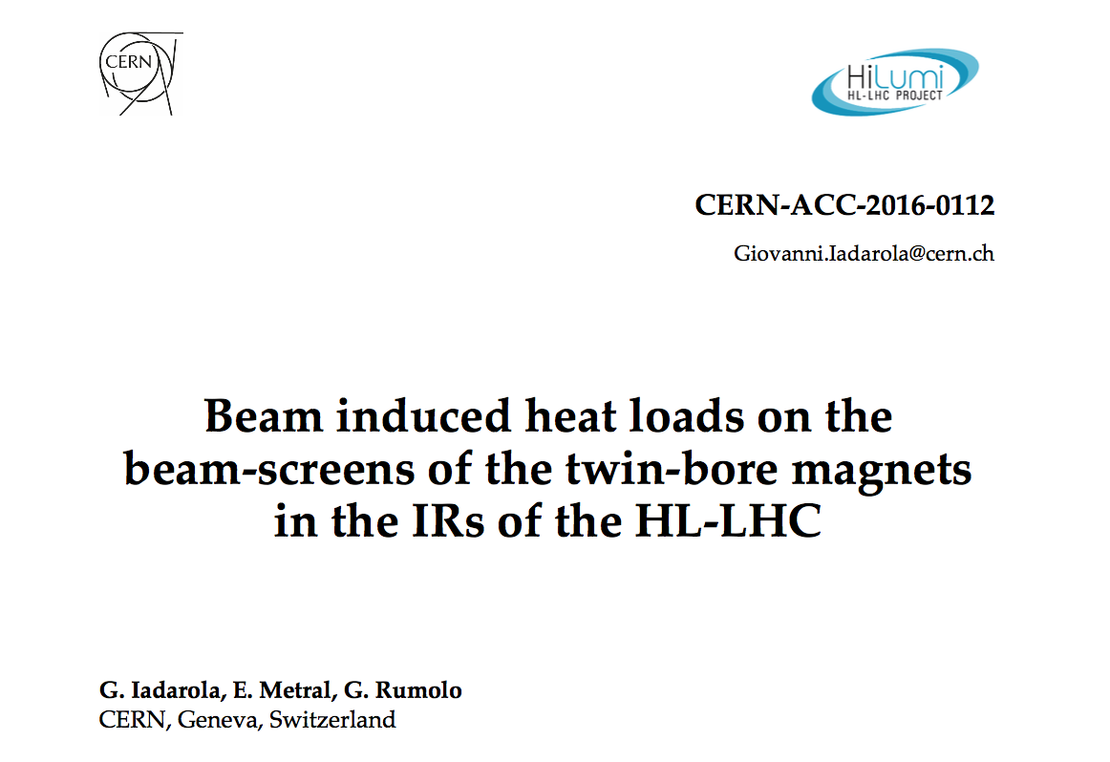
Other cold elements in the Insertion Regions
Heat load estimates have been carried out also for all cold twin-bore magnets in the insertion regions
The main results are available at: https://cds.cern.ch/record/2217217?ln=en

Slide 20
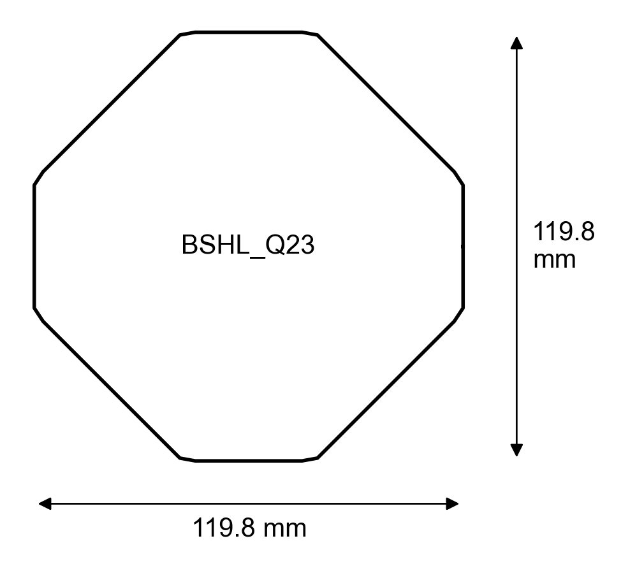
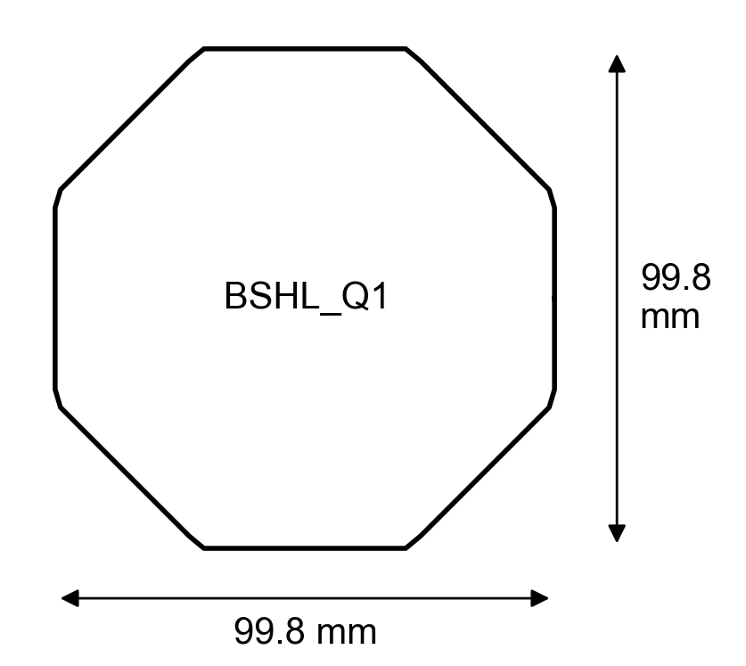
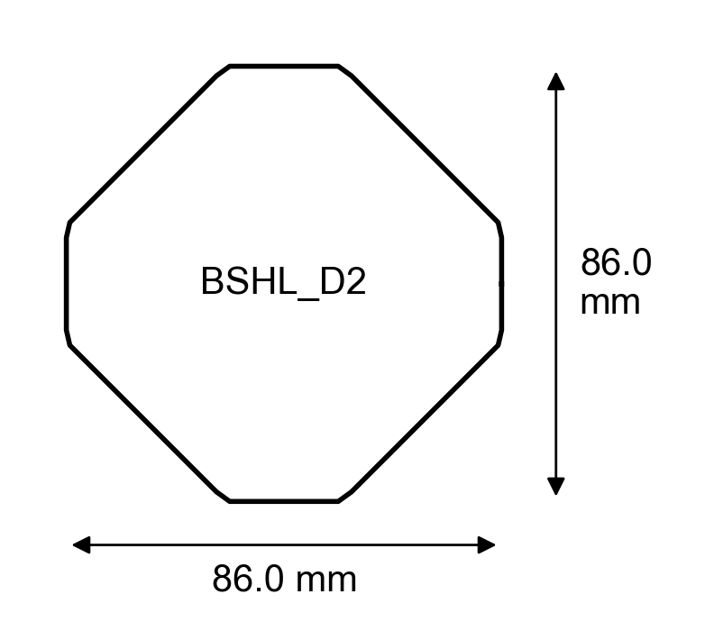
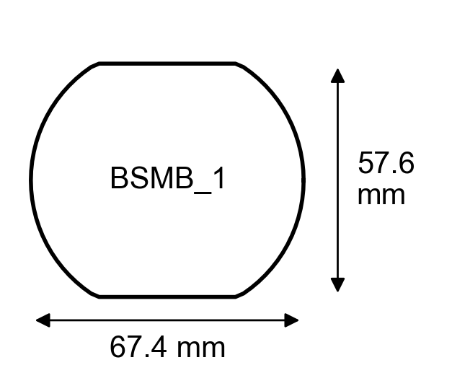
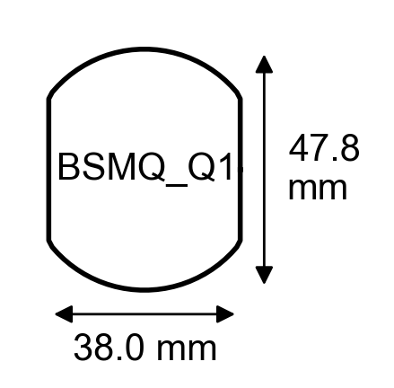
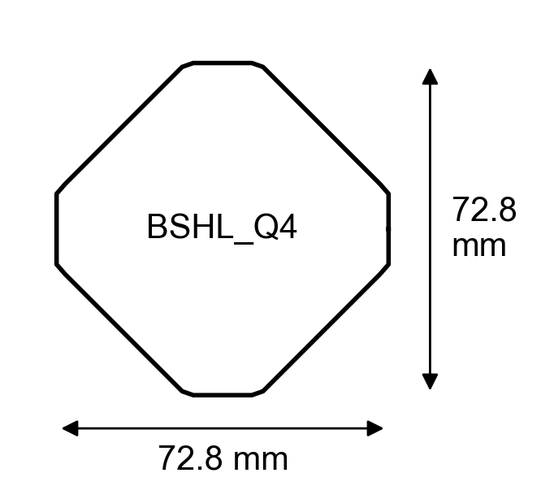
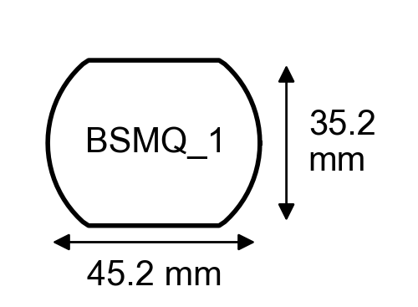
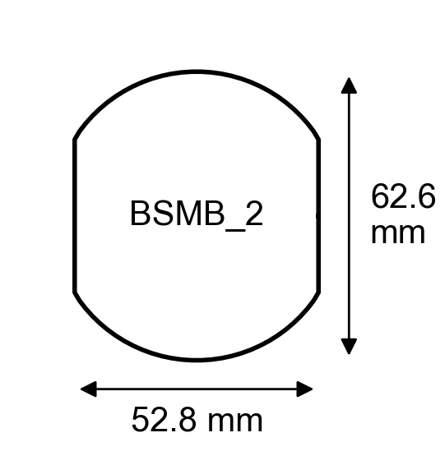
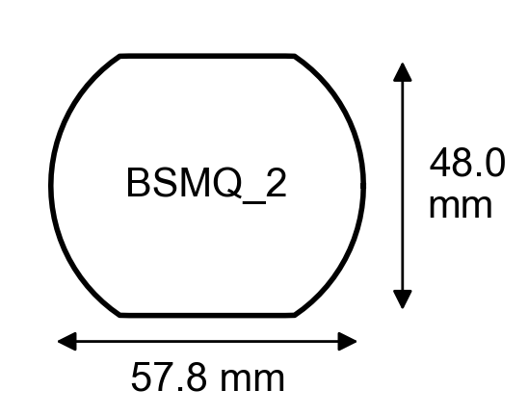
HL-LHC beam screens
Naming convention used in the following

Slide 21
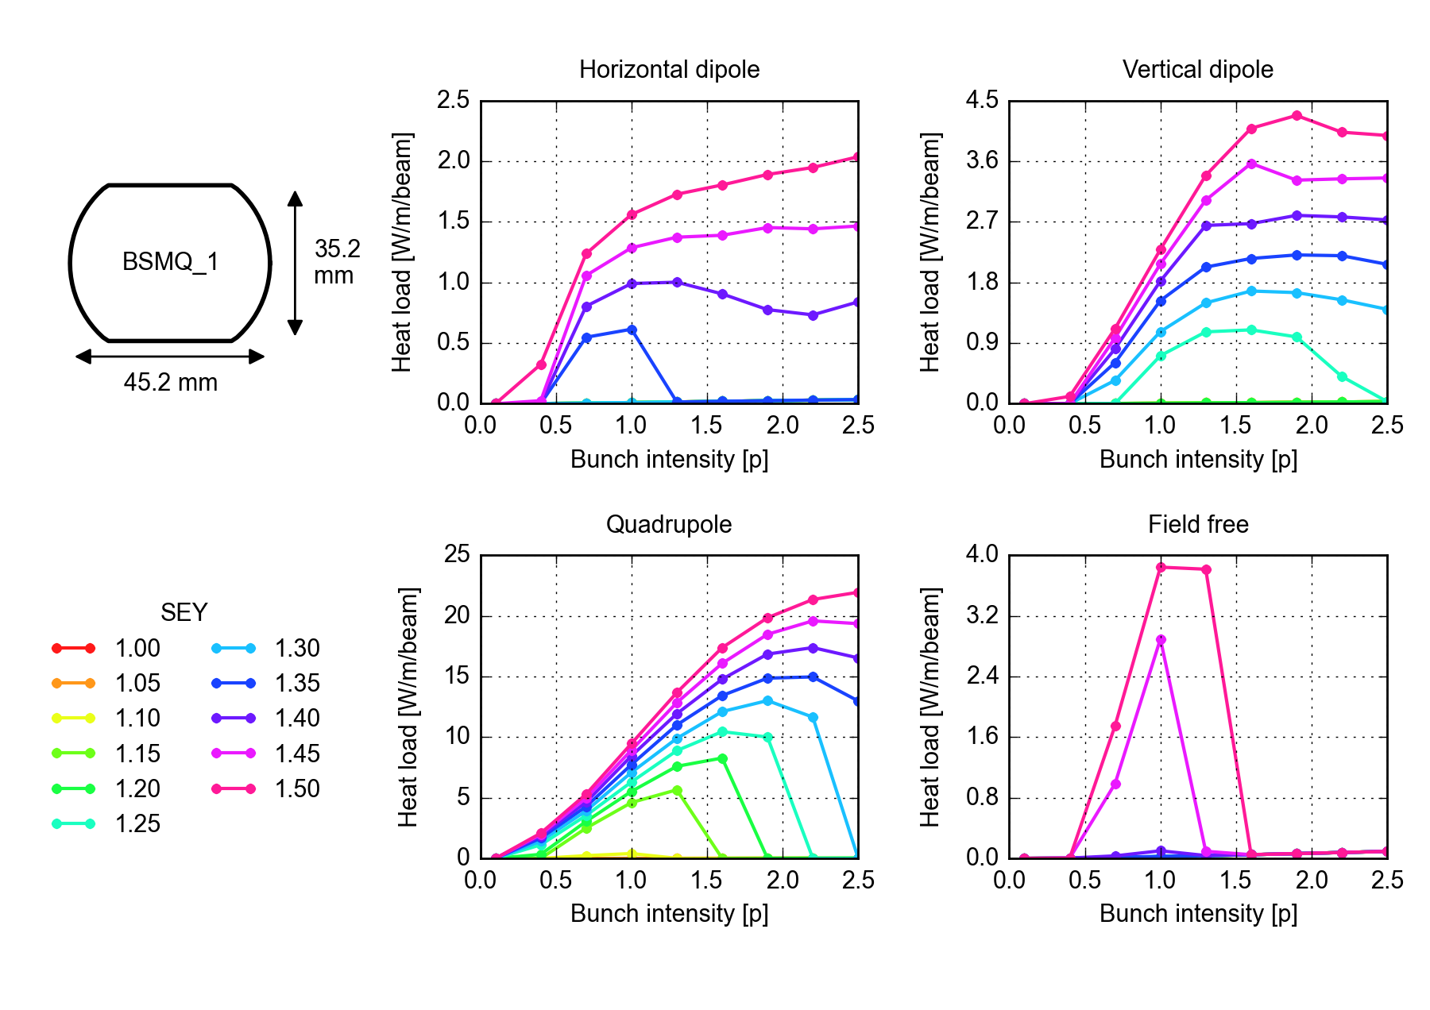
Other cold elements in the Insertion Regions
For each chamber type the heat load from e-cloud has been evaluated for different magnetic field configurations, generating this kind of plots

Slide 22
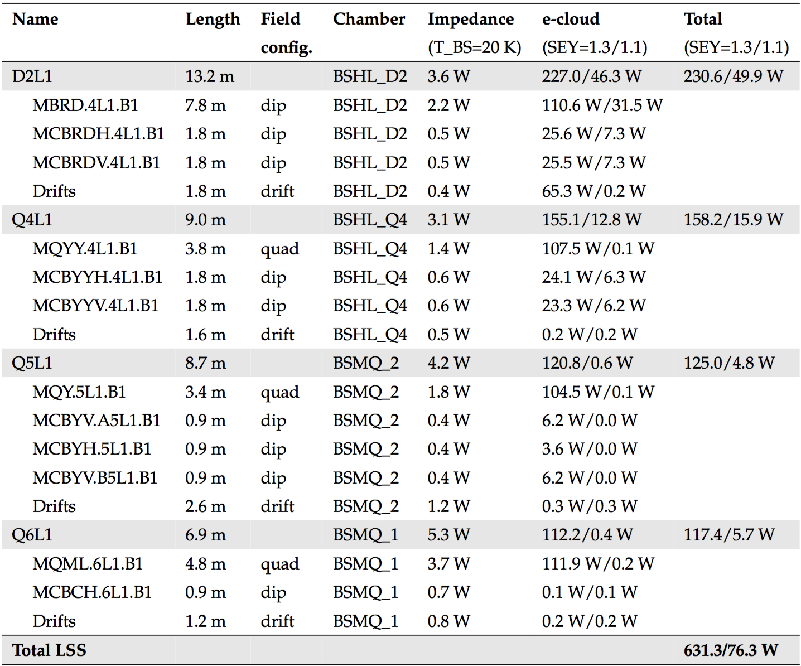
Other cold elements in the Insertion Regions
Generated a table for each IR, combining the estimates from impedance and e-cloud effects (synchrotron radiation negligible in the Long Straight Sections)
Dipole correctors and “drifts” can be non-negligible w.r.t. total!
For SEY =1.3 e-cloud contribution is dominant
Surface treatment providing SEY=1.1 very effective in reducing the heat load

Slide 23
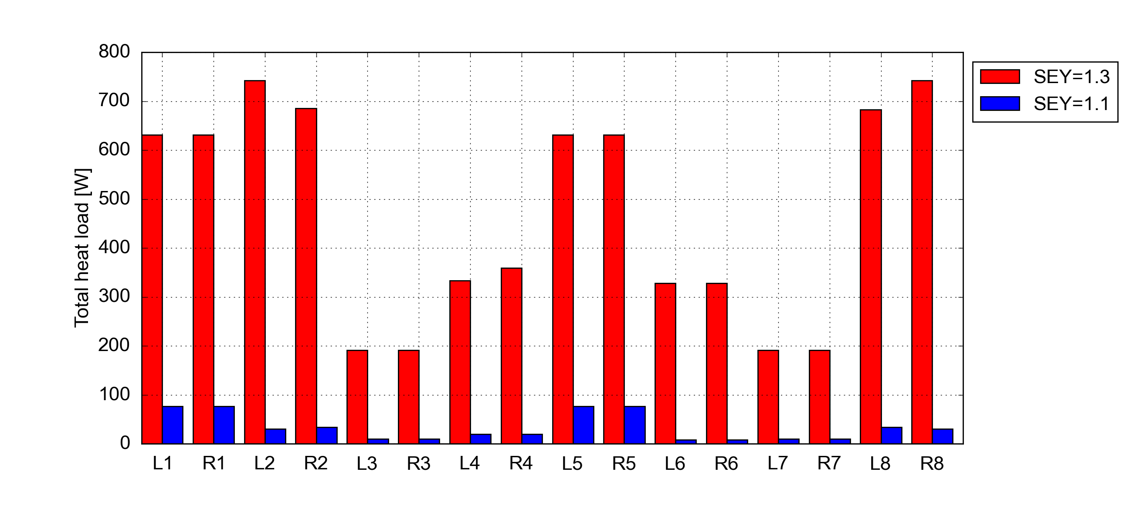
Other cold elements in the Insertion Regions
Expected heat loads for all Insertion Regions:
The experimental IRs are by far the most critical, with heat loads of ~1 kW per side (including ITs)
  Less margin for e-cloud in the arcs in the arcs sharing the same cryoplants
Surface treatment allowing for SEY<=1.1 provides a large heat load reduction

Slide 24
Outline
Introduction
  A few cross-checks
Heat load estimates
  Arcs
  Inner triplets
  Twin-bore IR magnets
Backup scenarios (8b4e and hybrid schemes)

Slide 25

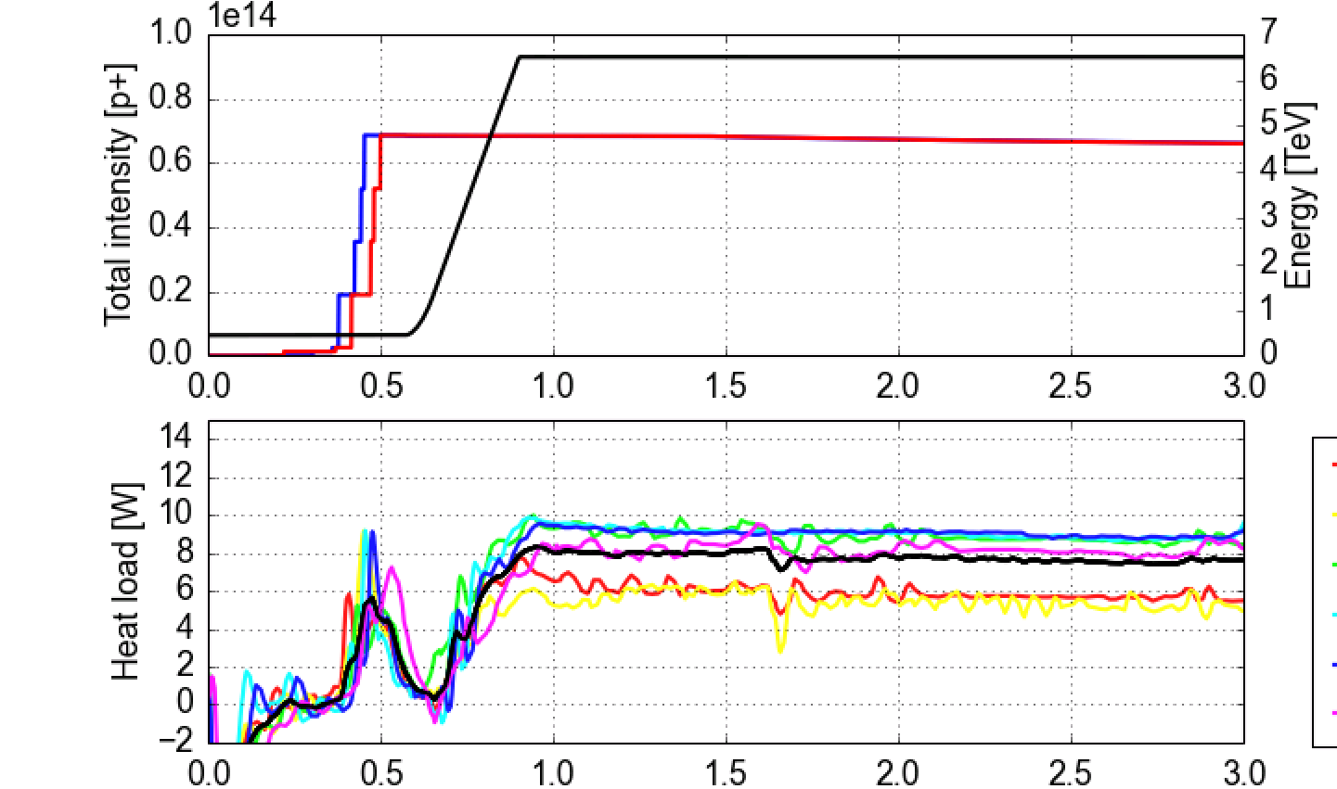
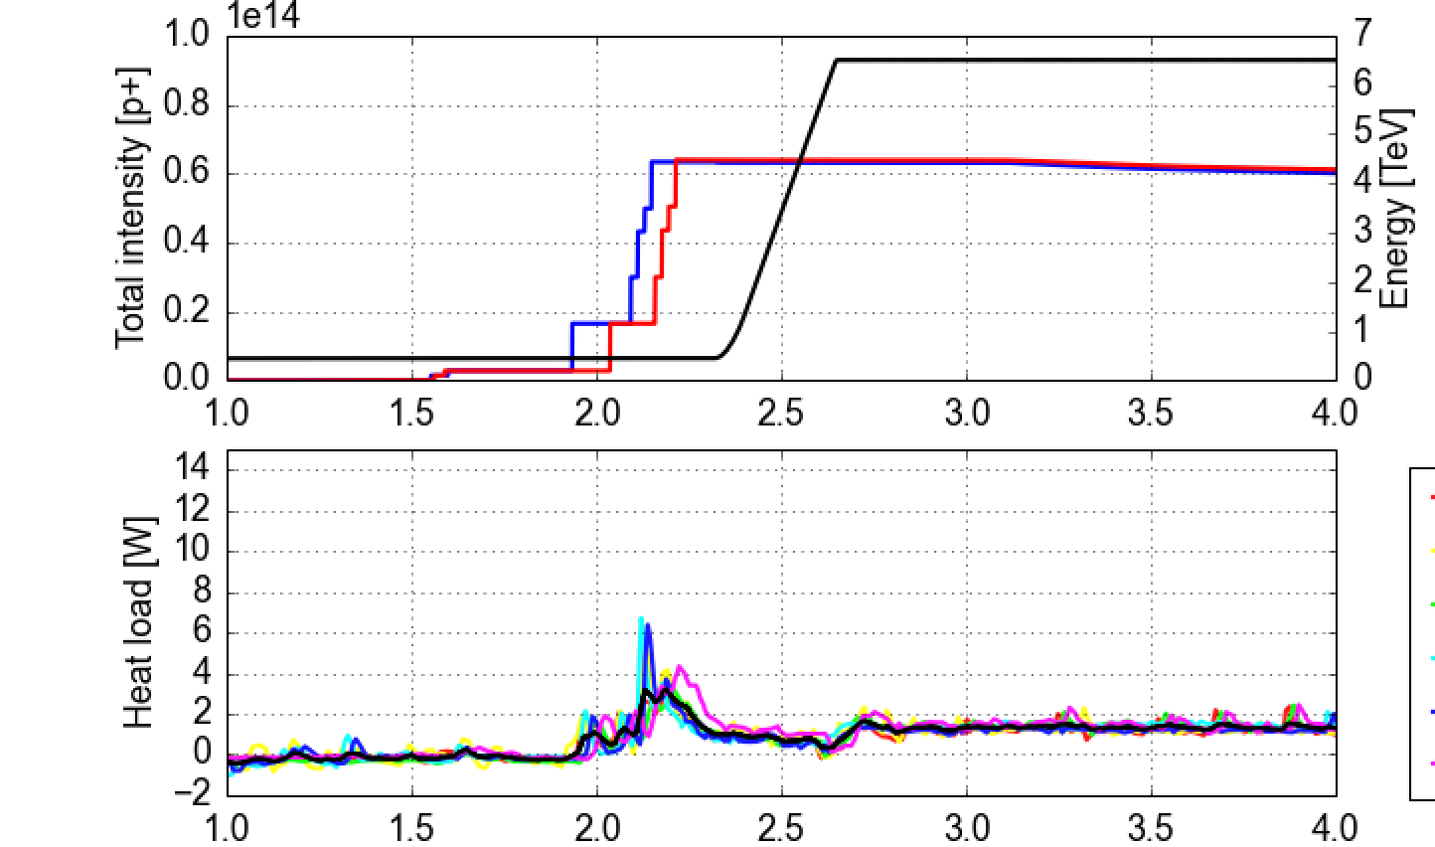
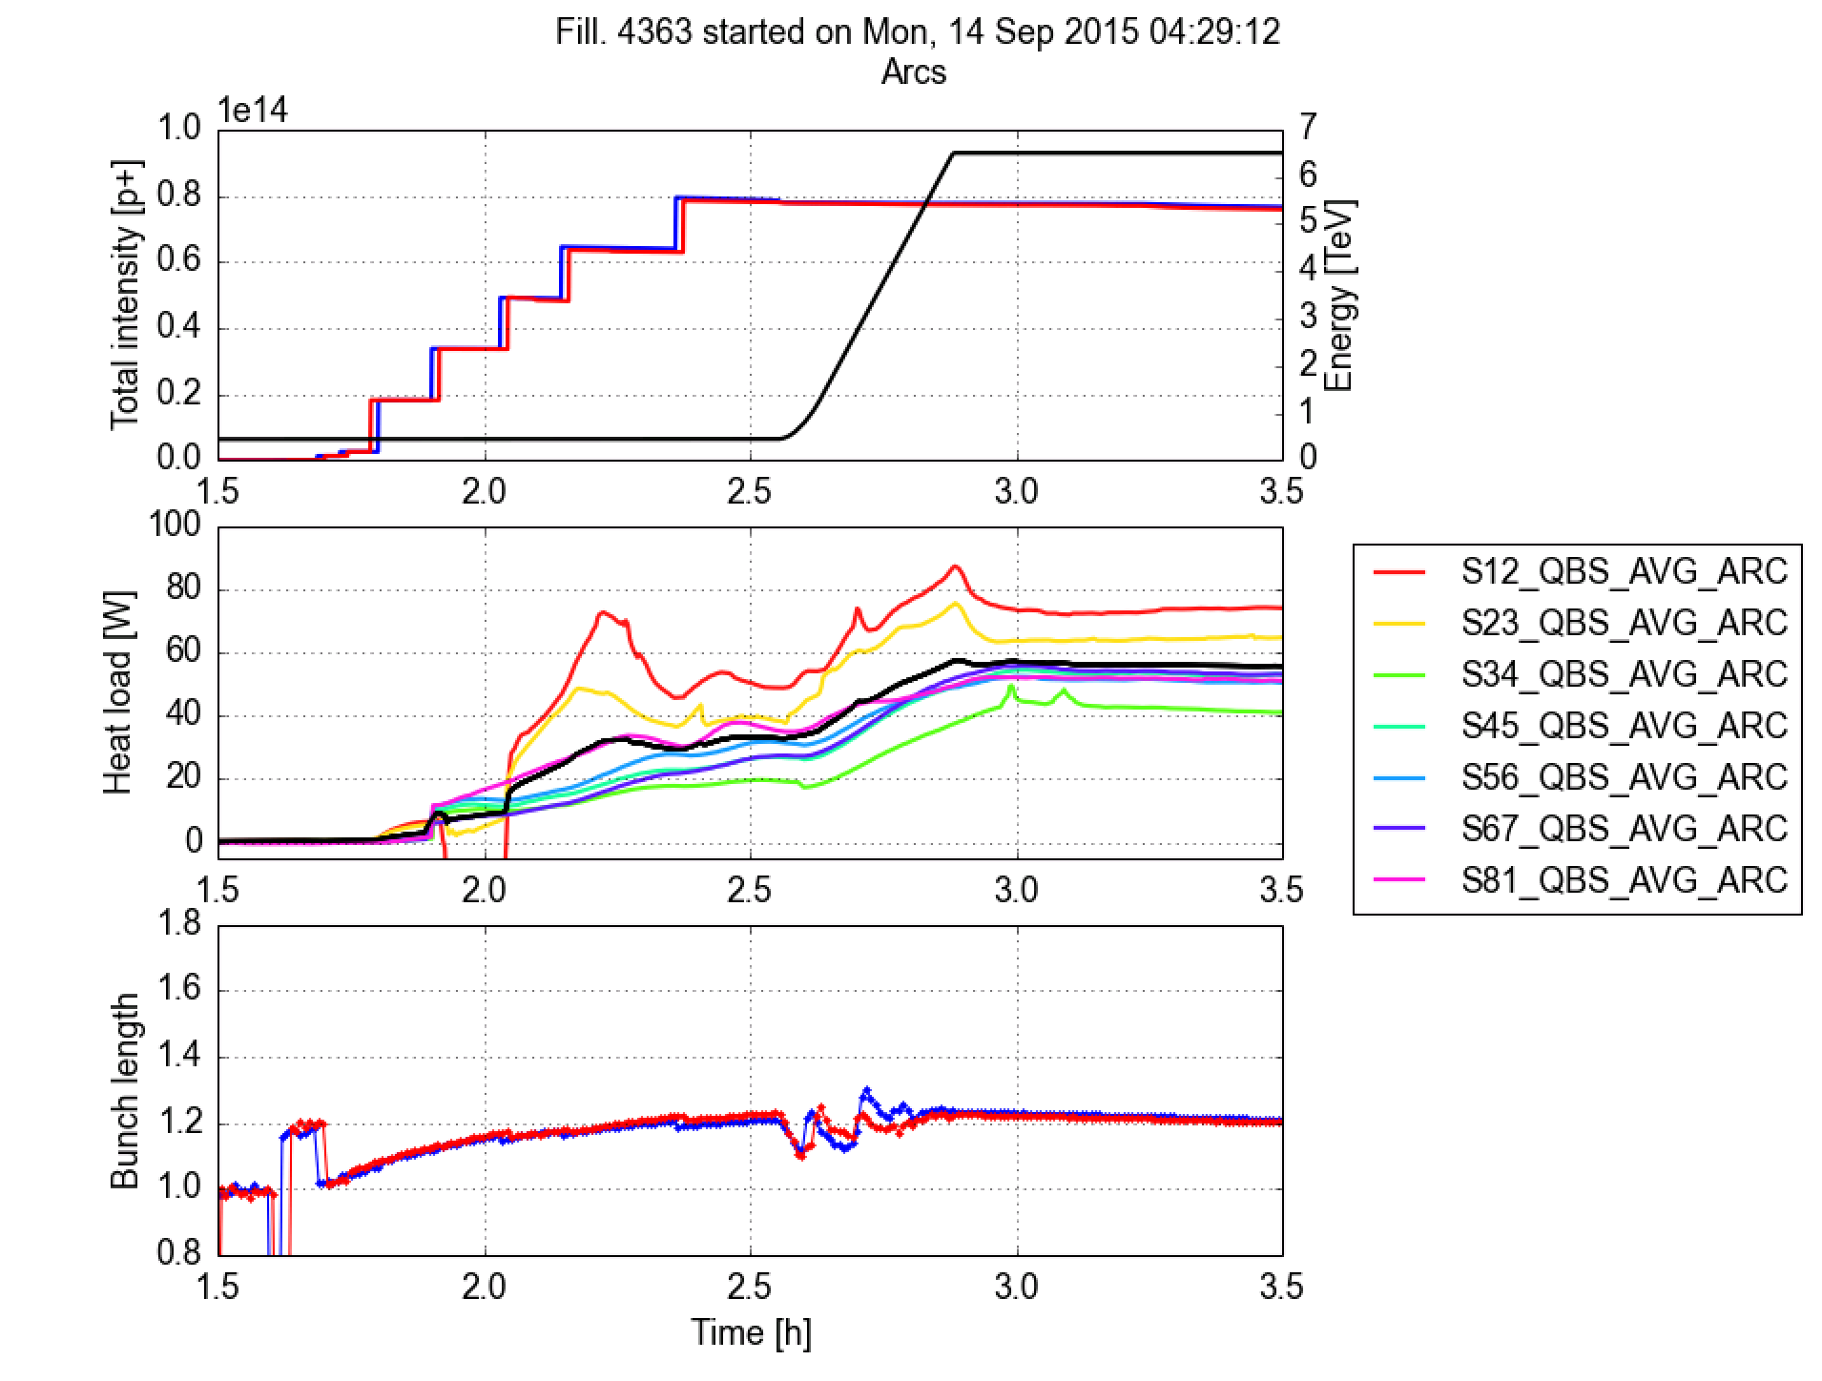
8b+4e scheme
Filling pattern designed to suppress the e-cloud build-up (lower thresholds expected from simulations)
  Confirmed experimentally in the LHC in 2015
  Included in the HL-LHC TDR as backup scenario in case issues with e-cloud
Up to ~1900b. in the LHC
Standard 25 ns beam
“8b+4e” beam
Dipoles (instrumented cells in S45)
Dipoles (instrumented cells in S45)
Average
Impedance+synch. rad

Slide 26
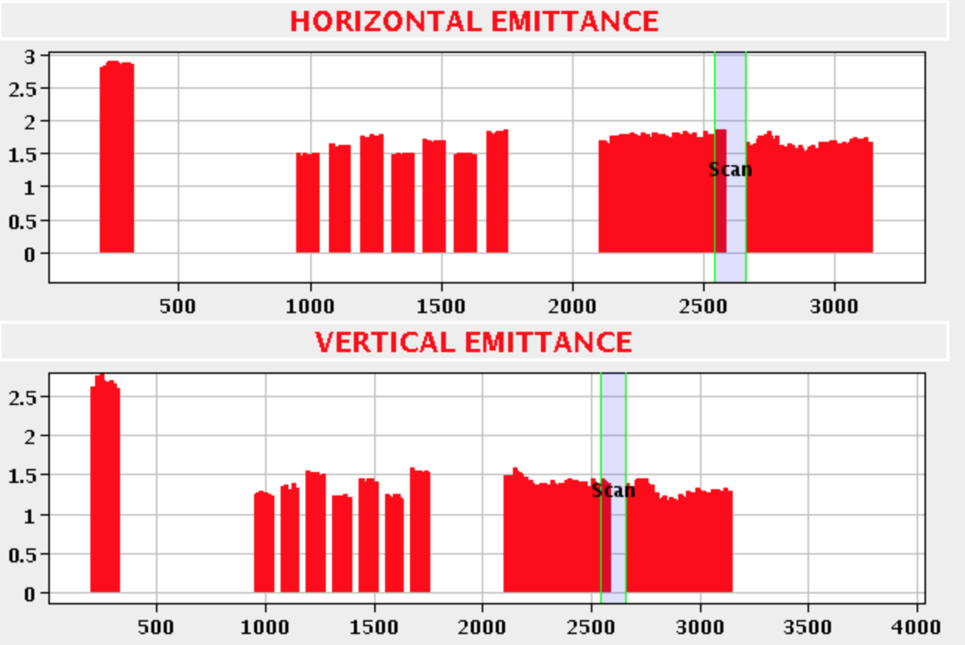
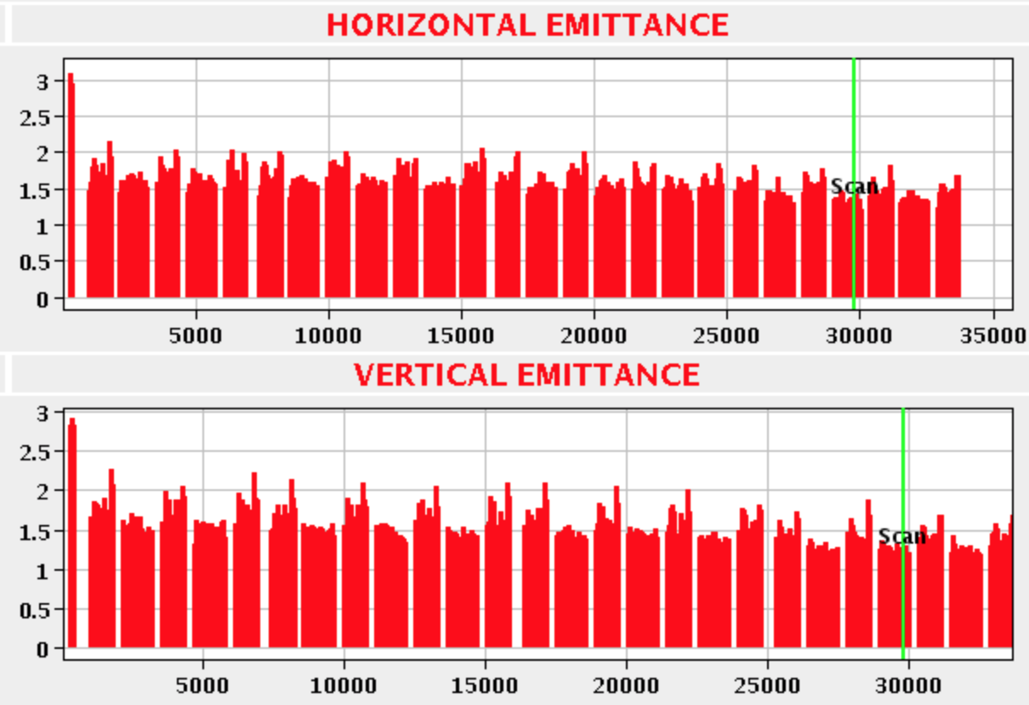
Tests combined filling schemes
In 2016 we explored possibilities to further minimize the loss of performance in case of limitations on the beam screen heat loads are encountered
The strategy is to combine standard 25 ns trains and 8b4e trains in order to adapt the heat load to the available cooling capacity
  Tested in the LHC with 1908 bunches (share 45% 8b4e vs. 55% 25ns BCMS)

Slide 27
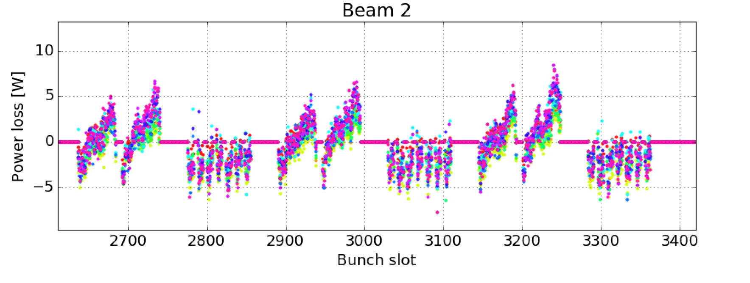
Tests combined filling schemes
In 2016 we explored possibilities to further minimize the loss of performance in case of limitations on the beam screen heat loads are encountered
The strategy is to combine standard 25 ns trains and 8b4e trains in order to adapt the heat load to the available cooling capacity
  Tested in the LHC with 1908 bunches (share 45% 8b4e vs. 55% 25ns BCMS)
Stable phase data showed that e-cloud buildup from standard beam does not “leak” into the 8b4e trains

Slide 28
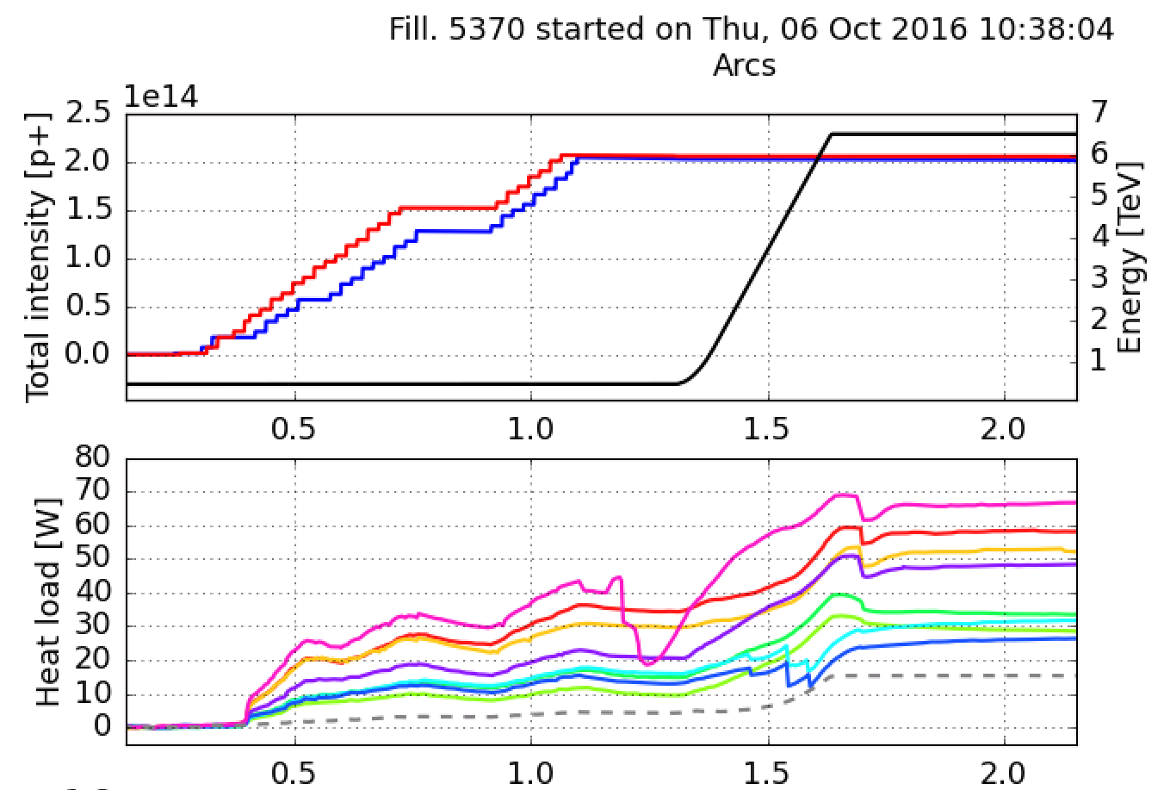
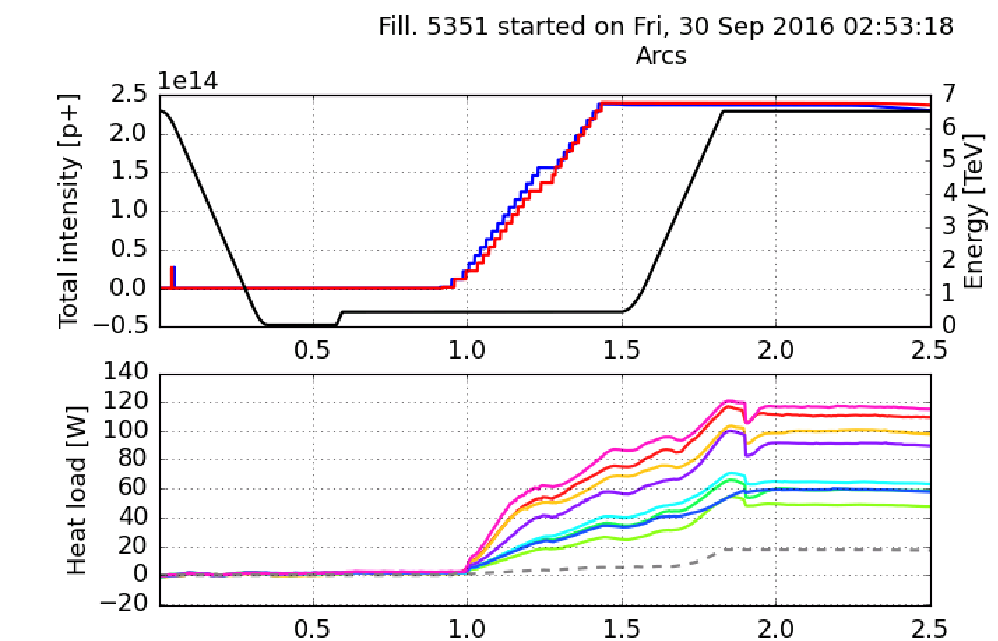
Tests combined filling schemes
In 2016 we explored possibilities to further minimize the loss of performance in case of limitations on the beam screen heat loads are encountered
The strategy is to combine standard 25 ns trains and 8b4e trains in order to adapt the heat load to the available cooling capacity
  Tested in the LHC with 1908 bunches (share 45% 8b4e vs. 55% 25ns BCMS)
Stable phase data showed that e-cloud buildup from standard beam does not “leak” into the 8b4e trains
On the most critical sector observed 40% heat load reduction at the price of 15% loss in number of bunches
Combined scheme
25 ns (BCMS)

Slide 29
Summary and conclusions
The LHC operation with 25 ns beam in 2015-16 has shown that beam induced heat loads on the beam screens, due primarily to e-cloud, can pose significant performance limitations
In collaboration with WP9 we are performing a detailed survey of all heat loads on the beam screens expected for the HL-LHC era
  Tools being used for this analysis have been cross-checked w.r.t. estimates made at the time of the LHC design and with experimental data
The arc beam screens will constitute a major load for the cryoplants:
  Even assuming that full e-cloud suppression is achieved in the dipoles through scrubbing, remaining load from impedance, synchrotron radiation and e-cloud in the quadrupoles will require a large fraction of the available capacity
    Scrubbing recovery after Long Shutdowns will be challenging!

Slide 30
Summary and conclusions
Estimates for the Inner Triplets in IR1&5 have been updated with present optics and beam screen design and including field free spaces and dipole correctors
  Surface treatment (SEY<=1.1) confirmed to provide strong reduction of the heat load
Heat loads have been estimated also for all the twin-bore magnets in all IRs
  Experimental IRs are by far the most critical and can have a non-negligible impact on the cooling capacity (in particular those around point 2 and 8 where no cryogenics upgrade is planned) available in the arcs sharing their same cryoplant
After experimental validation in 2015, the 8b4e scheme has been included in the TDR as backup scenario in case of limitations from the e-cloud
  Possibility of hybrid schemes to further reduce the loss of performance have been tested successfully in the LHC in 2016

Slide 31
Thank you for you attention!

Slide 32
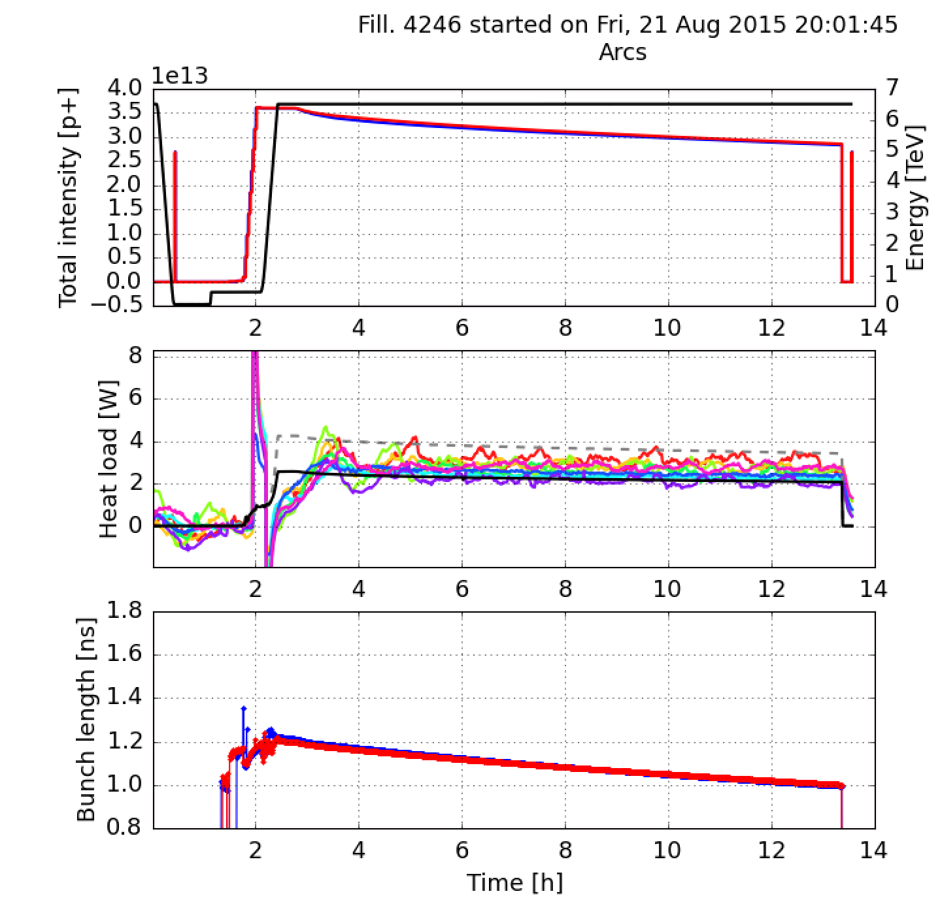
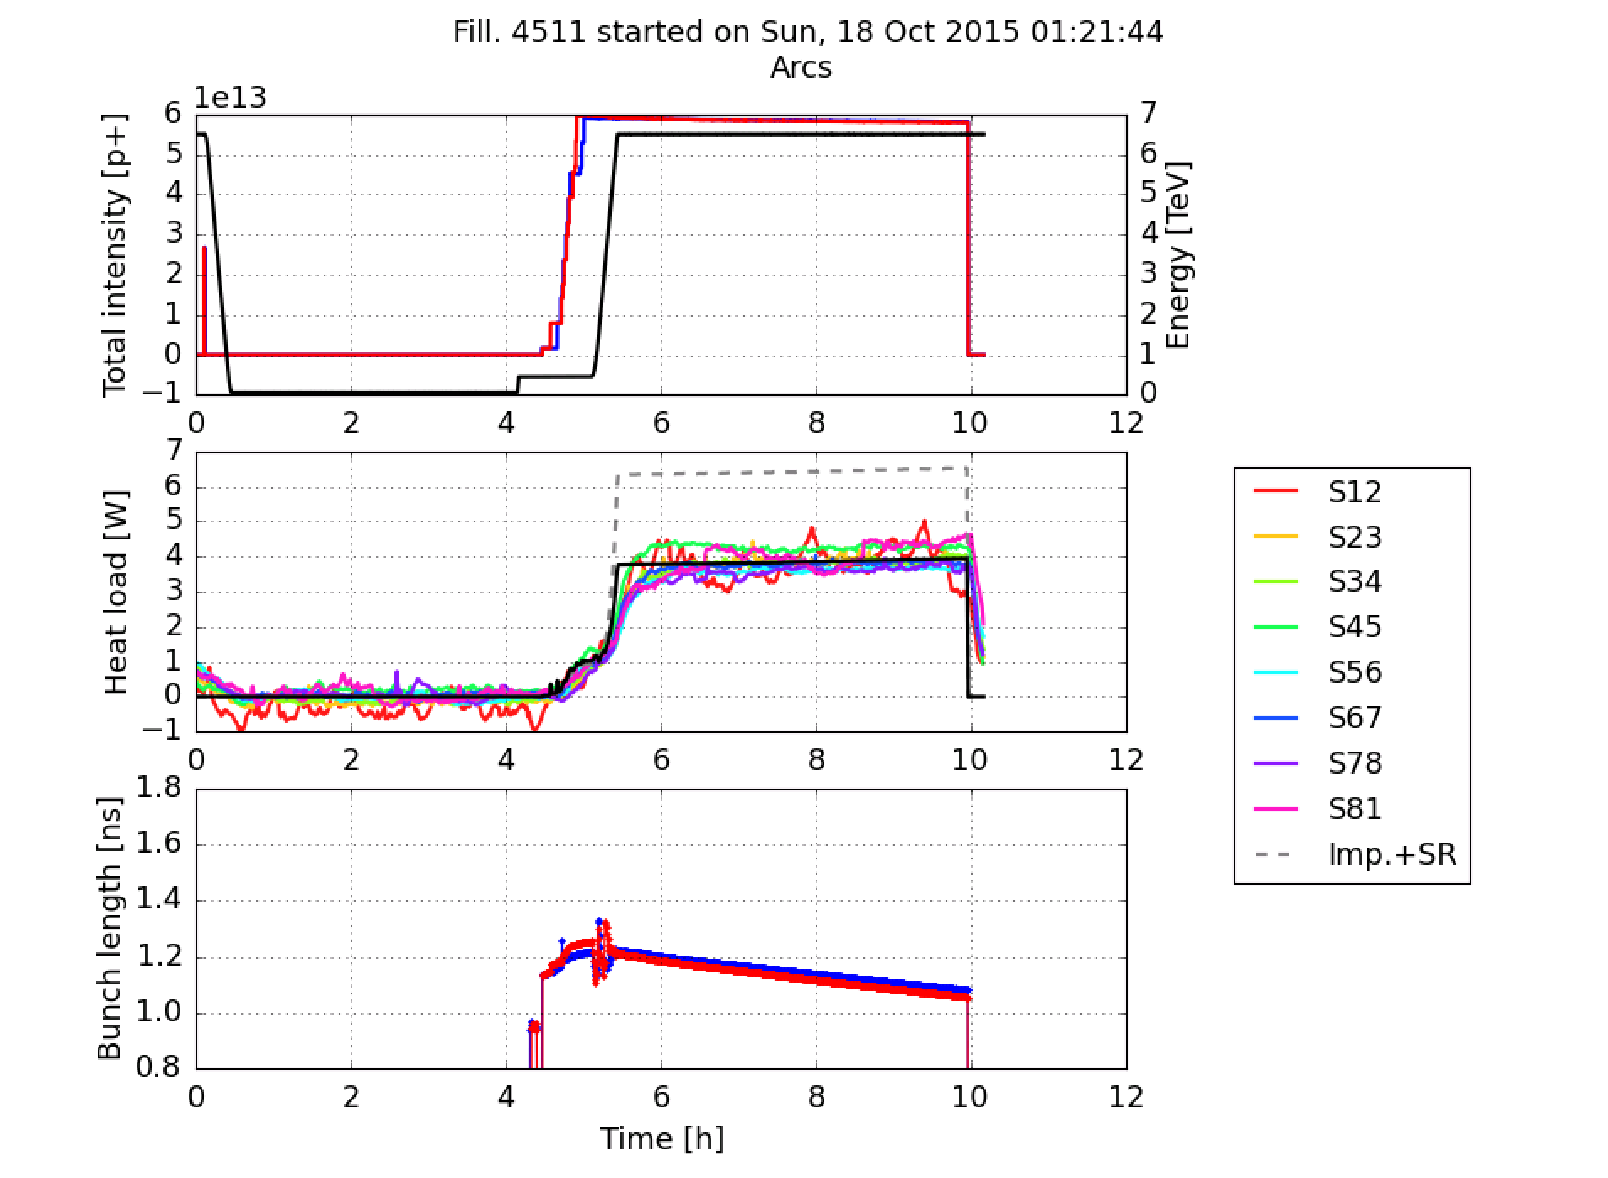
Comparison against machine data
More here
50ns, physics 2015
Measured:
Timber
(SR overestimated by factor 2, different assumptions for impedance)
Calculated:
HeatLoadCalculators
Module (used now)

Slide 33
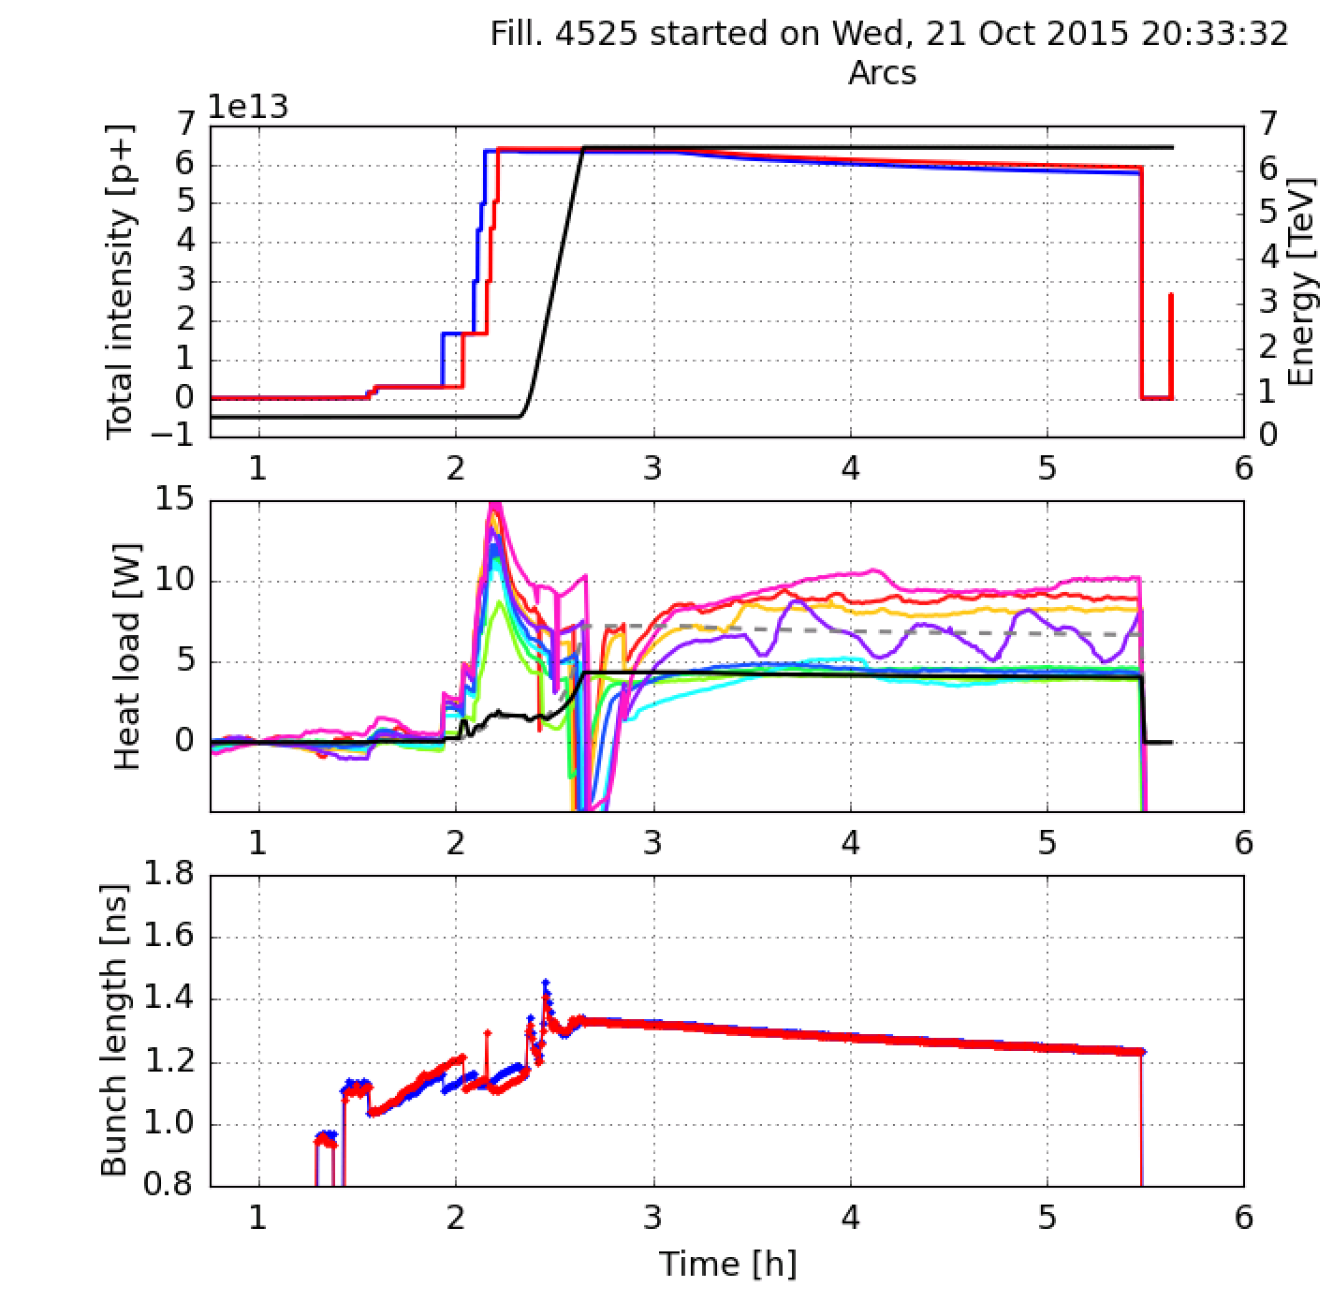
Comparison against machine data
More here
8b4e test 2015
Measured:
Timber
(SR overestimated by factor 2, different assumptions for impedance)
Calculated:
HeatLoadCalculators
Module (used now)

Slide 34
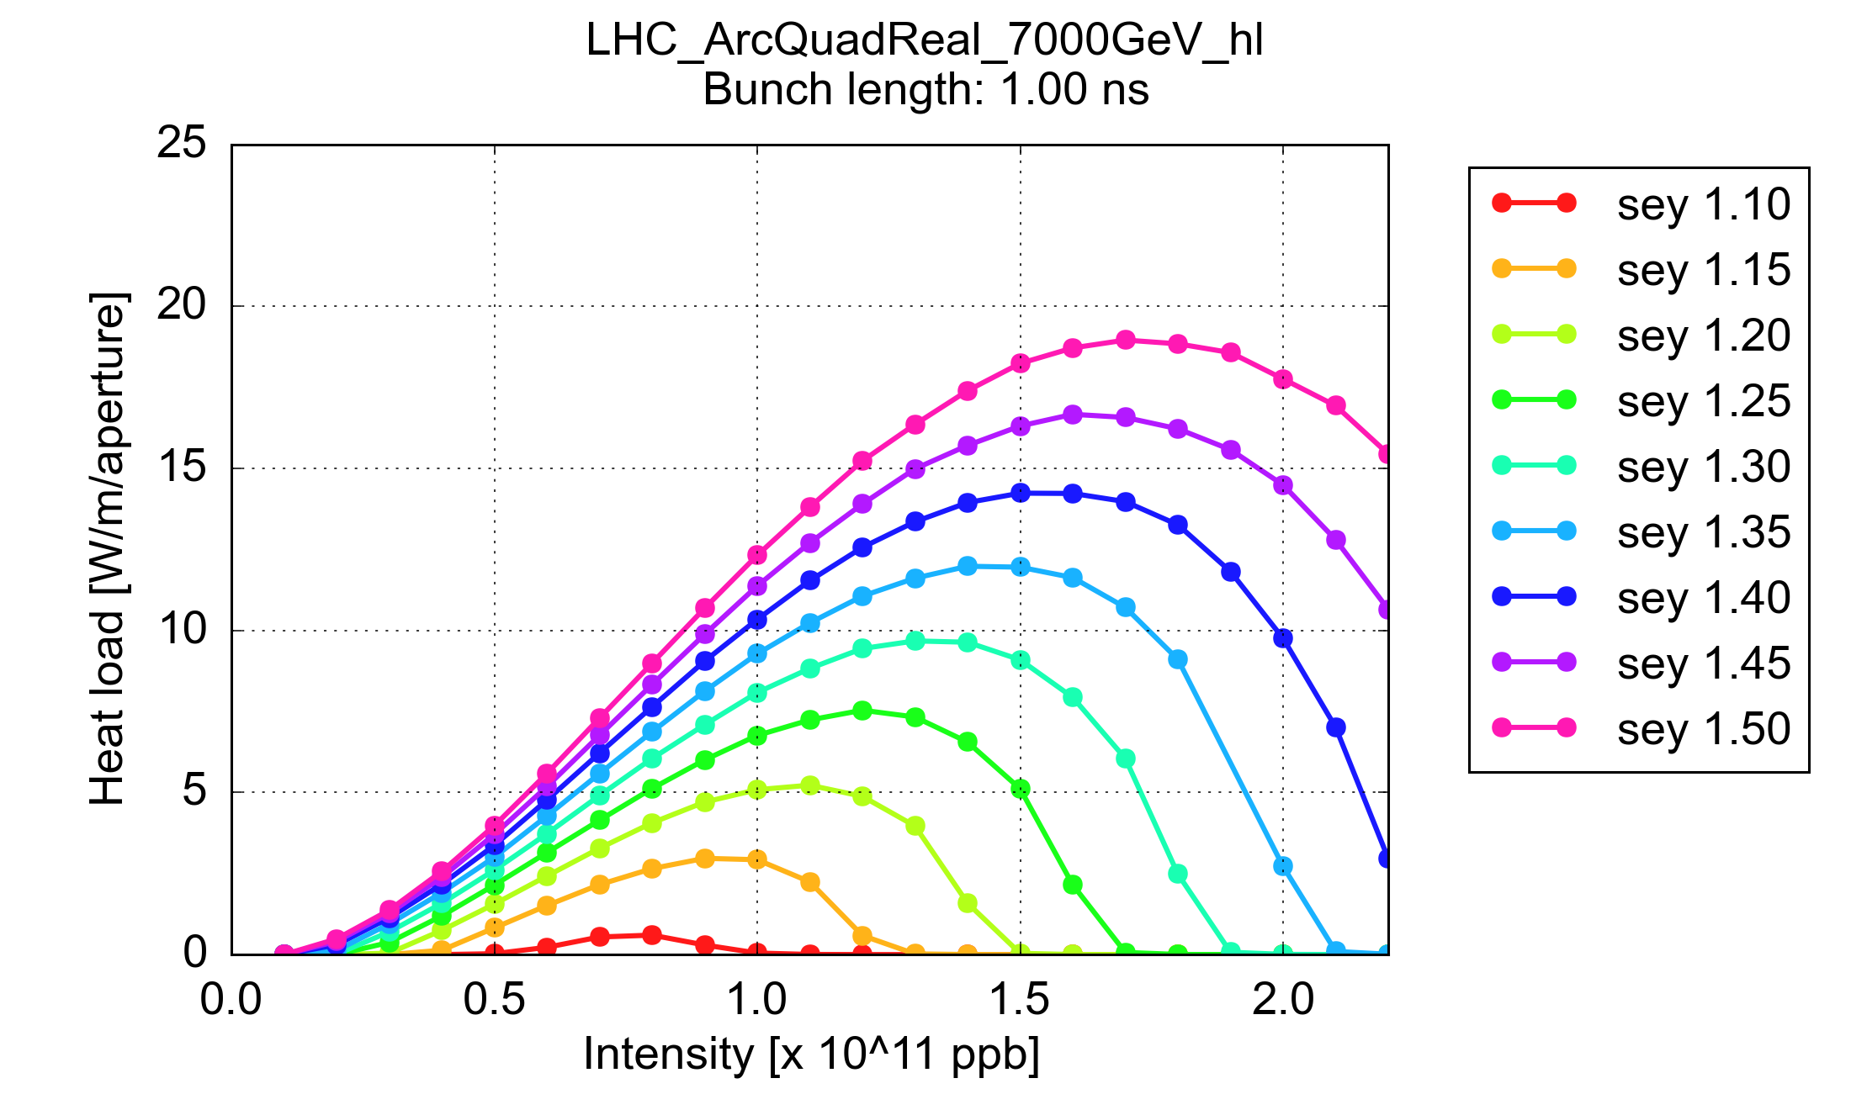
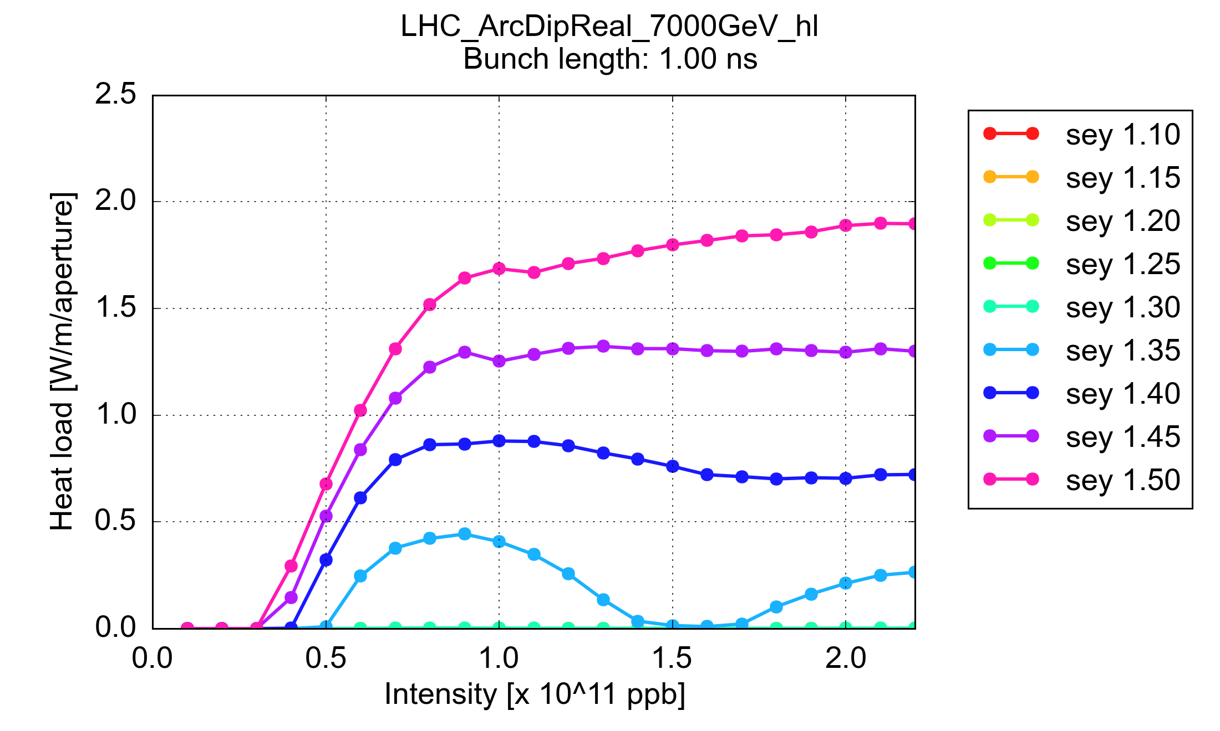

Slide 35
e-cloud quad.
Impedance
e-cloud dip.
Syn. radiation

Slide 36
Output from the HeatLoadCalculators module – Nominal LHC:
Evaluated scenario: Design report
- Beam energy 7000.0 GeV
- Bunch intensity: 1.15e+11 p
- Bunch length (4*sigma): 1.00 ns
- N. bunches: 2808
Heat load contribution:
- Impedance load (average half-cell): 115.0 mW/m/beam
- Synchrotron radiation load (average half-cell): 173.0 mW/m/beam
Impedance contribution breakdown:
- Impedance load in the dipoles: 119.5 mW/m/beam
- Impedance load in the quadrupoles: 105.2 mW/m/beam
- Impedance load in the drifts: 91.7 mW/m/beam

Slide 37
Output from the HeatLoadCalculators module – HL-LHC:
Evaluated scenario: HL-LHC
- Beam energy 7000.0 GeV
- Bunch intensity: 2.20e+11 p
- Bunch length (4*sigma): 1.20 ns
- N. bunches: 2748
Heat load contribution:
- Impedance load (average half-cell): 313.4 mW/m/beam, 1.76 kW/arc
- Synchrotron radiation load (average half-cell): 323.9 mW/m/beam, 1.81 kW/arc
Impedance contribution breakdown:
- Impedance load in the dipoles: 325.7 mW/m/beam
- Impedance load in the quadrupoles: 286.6 mW/m/beam
- Impedance load in the drifts: 250.0 mW/m/beam

