Slide 1


Effects on the beam core
from hollow e-lens
Miriam Fitterer, G. Stancari, A. Valishev (Fermilab)
R. Bruce, S. Papadopoulou, G. Papotti, D. Pellegrini, S. Redaelli, D. Valuch, J. F. Wagner (CERN)
Many thanks to
G. Apollinari, V. Shiltsev (Fermilab), O. Brüning, A. Rossi, L. Rossi, D. Perini (CERN) and the OP team

Slide 2
Outline
Principle of hollow e-lens
Effects on the beam core
LHC MD on effects on the beam core in case of pulsed e-lens operation
Conclusion and Outlook

Slide 3
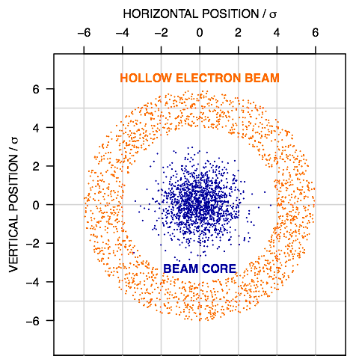
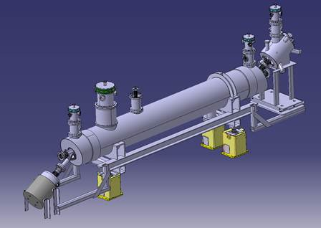
Principle of HEBC
proton beam (p-beam) traveling inside a hollow electron beam (e-beam)
hollow profile of e-beam => p-beam core (ideally) not affected
halo particles kicked to higher amplitudes by electromagnetic field of e-beam => cleaning of halo particles
D. Perini
Gun + Solenoid
G. Stancari
magnetically confined, low-energy e-beam
tunable transverse kicks of approx. 0.3 µrad
e-beam
superconducting
solenoid
p-beam
Correctors
Collector

Slide 4
Effects of HEL on beam core
for a perfect uniform, radially symmetric e-beam profile, the field at the beam core is zero and the HEL does not effect the beam core!
residual field at p-beam core from e-lens bends and profile imperfections
pulsed operation of HEL increases diffusion in tails:
  random mode: uniform modulation of current
  resonant mode: pulse e-lens every n^{th} turn -> drives n^{th} order resonances [1]
  particularly interesting for separated beams, in which case halo removal rates are small but a fast removal is needed e.g. before the squeeze [2,3]
in case of pulsed operation noise is induced on the p-beam originating from the e-lens bends and e-beam profile imperfections
[1] A. Valishev, Simulation Study of Hollow Electron Beam Collimation for LHC, FERMILAB- TM-2584-APC
  [2] M. Fitterer, G. Stancari, A. Valishev, Simulation Study of Hollow Electron Beam Collimation in HL-LHC, FERMILAB-TM-2636-AD

Slide 5
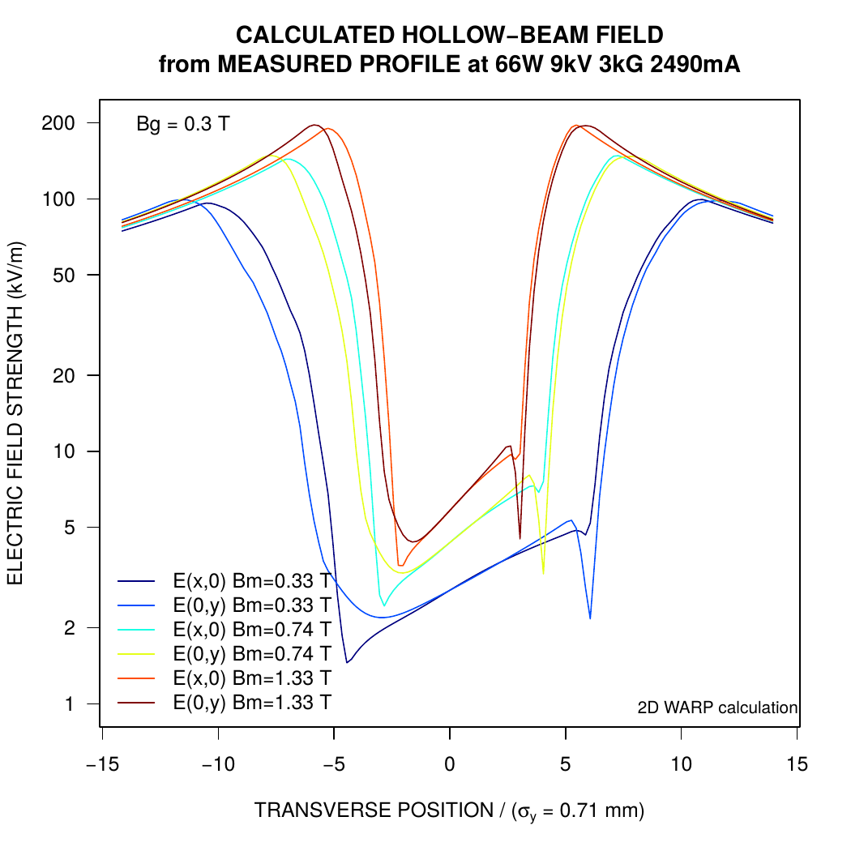
Effects of HEL on beam core
Estimates for HL-LHC e-lens design parameters [3]:
E_{p-beam}=7 TeV, E_{e-beam} = 10 keV, I_{e-beam} = 5 A, L_{e-lens} = 3 m, B_{main solenoid} = 5 T
Noise due to uncompensated kicks from e-lens bends [4]:
estimate based on derivation of symplectic map for e-lens bends [5], scale to design parameters, assume 10% fluctuation between entrance/exit kick
Noise due to profile imperfections [4]:
scaled from measured profile, kick increases linearly with main solenoid field
G. Stancari
[3] G. Stancari, V. Previtali, A. Valishev, R. Bruce, S. Redaelli, A. Rossi, B. S. Ferrando, Conceptual design of hollow electron lenses for beam halo control in the Large Hadron Collider, FERMILAB-TM-2572-APC, CERN-ACC-2014-0248
  [4] M. Fitterer, G. Stancari, A. Valishev, Effect of pulsed hollow electron-lens operation on the proton beam core in LHC, FERMILAB-TM-2635-AD
[5] G. Stancari, Calculation of the Transverse Kicks Generated by the Bends of a Hollow Electron Lens, FERMILAB-FN-0972-APC

Slide 6
Experiment at the LHC
Motivation:
derive limits on tolerable kick from profile imperfections and e-lens bends
effects depending on non-linear dynamics in general difficult to predict precisely in simulations -> verify simulations with experimental results
first test of resonant mode as random mode is to first order white dipole noise (better understood from analytical formulas and other experiments at the LHC)
LHC experiment - resonant mode:
first test at injection with Q’=15, I_{octupoles}=+19.6 A
kick in first order can be modeled as dipole kick, higher orders neglected
dipole kick with almost arbitrary frequency spectrum can be applied bunch-by-bunch with the kickers of the LHC transverse damper (ADT), H and V not synchronized
use low intensity bunches in order to reduce emittance growth due to IBS (N_{b}=0.7x10¹¹, ε_{N}=2.5 µm => 4.6 %/h emittance growth), in MD emittances were around 2.5-3.5 µm

Slide 7
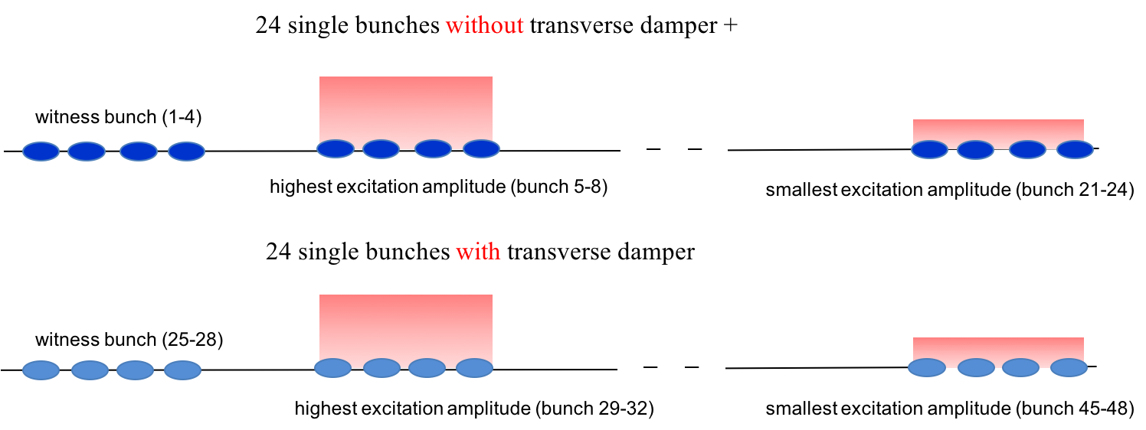
Experiment at the LHC
LHC experiment – resonant mode:
filling scheme to test different excitation amplitudes and effect of transverse damper

Slide 8
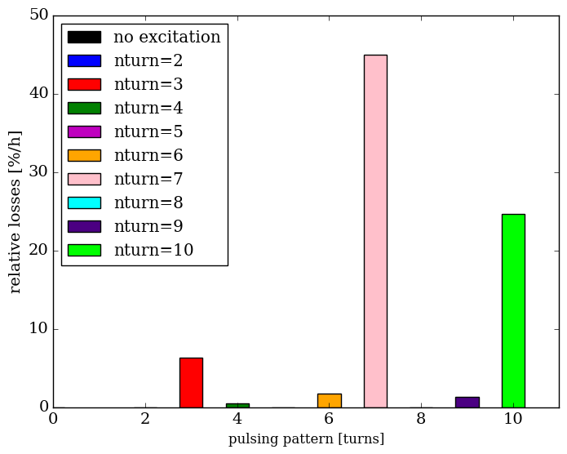
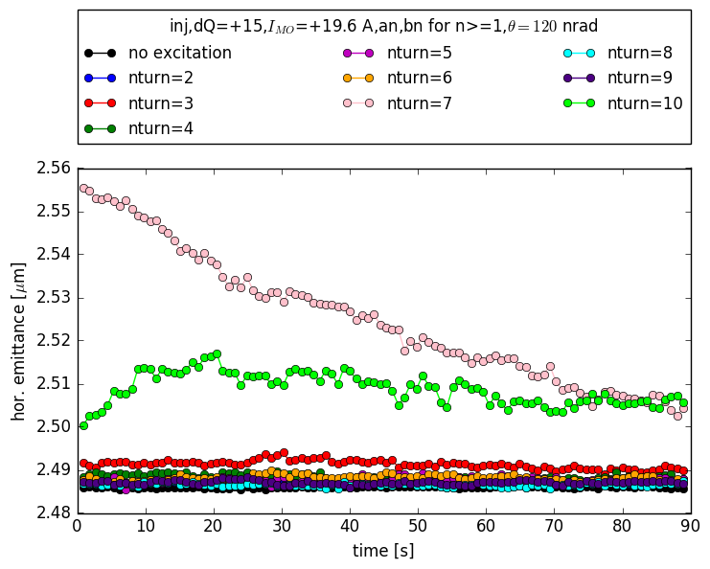
Simulation results
120 nrad, pulsing every 7th and 10th turn:
large losses + decrease of bunch length
  -> mainly longitudinal losses
adjustment of beam distribution over first 10⁴ turns
  -> emittance growth
similar observation also without magnet errors
  -> losses and emittance behavior driven by sextupoles, octupoles and high chromaticity
120 nrad, other pulsing patterns:
small or no losses
no change in emittance
12 nard: no visible effect

Slide 9
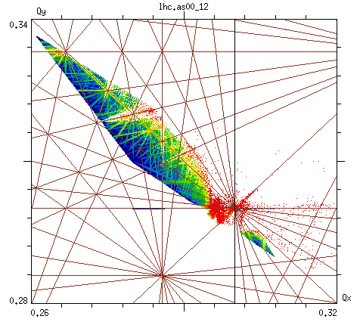
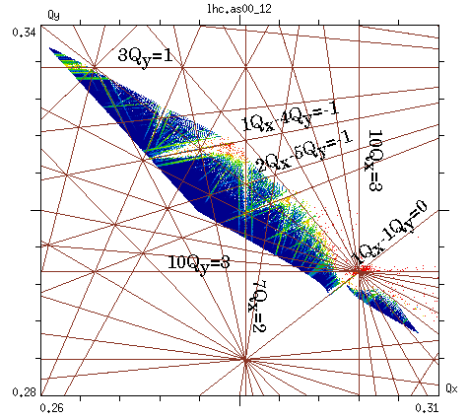
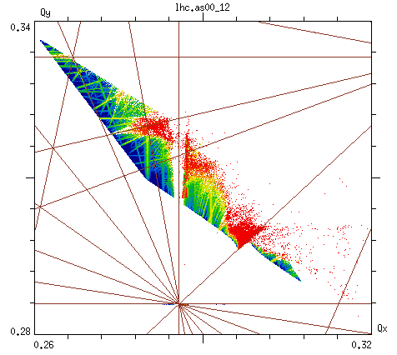
Simulation results - FMA
7th turn pulsing H+V
10th turn pulsing
H+V
no excitation, no errors
7th turn pulsing drives 7Q_{x} resonance
10th turn pulsing drives 10Q_{x} and 10Q_{y} resonance

Slide 10
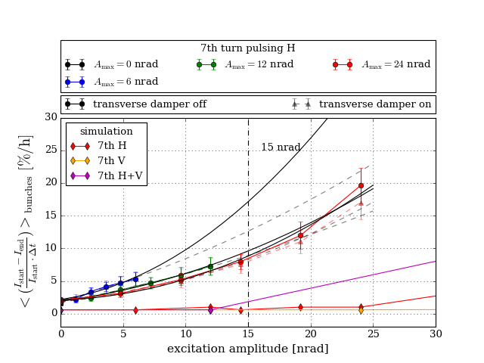
First experimental results – 7th turn H
excitation of 7Q_{x} resonance
quadratic scaling of losses
no effect of transverse damper
maximum excitation amplitude was increased from 6 nrad to 24 nrad ⟹ the distribution is already changed for 12 and 24 nrad (smaller losses)
higher losses than predicted by simulations
between 7-17%/h losses for 15 nrad

Slide 11
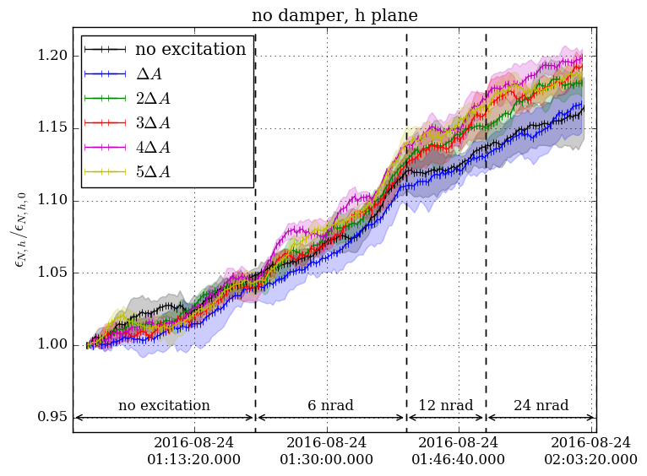
First experimental results – 7th turn H
increase of emittance growth by ~7%/h in H over full excitation length, no increase in V
amplitude scaling not obvious
similar emittance growth also with transverse damper

Slide 12
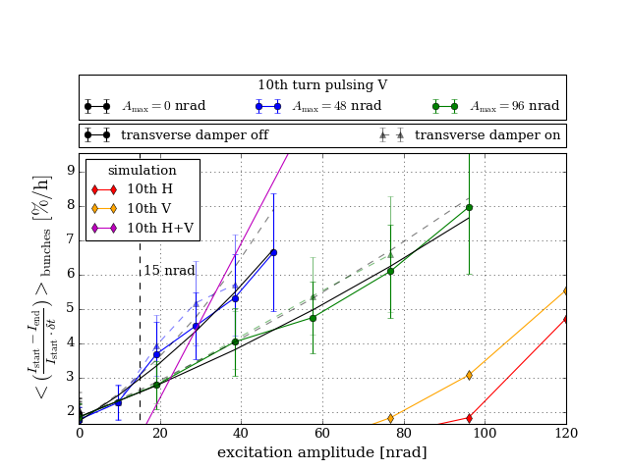
First experimental results – 10th turn V
excitation of 10Q_{y} resonance
much smaller losses: 10th turn: 7%/h for 48 nrad 7th turn: 20%/h for 24 nrad
higher losses than in simulations
between 2-3%/h losses for 15 nrad

Slide 13
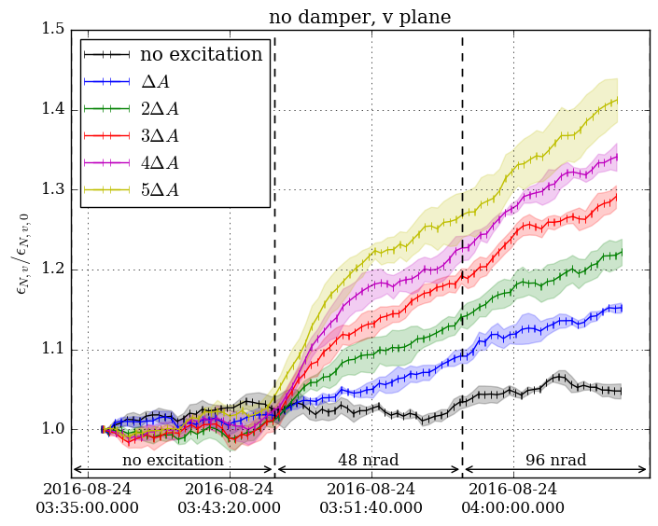
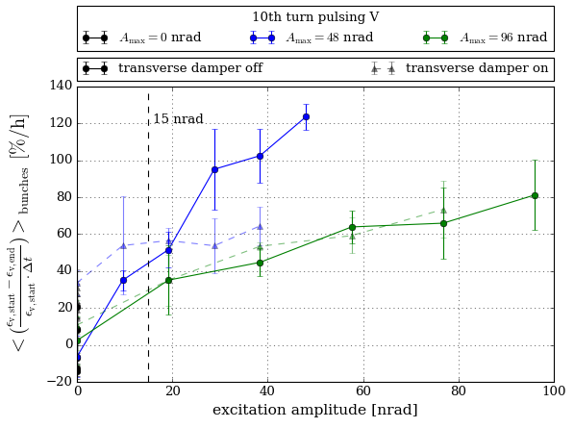
First experimental results – 10th turn V
“fast” and “slow” regime
similar emittance growth also with transverse damper
slow regime
fast regime
between 27-55%/h emittance growth for 15 nrad in V, no emittance growth in H

Slide 14
First experimental results – n^{th} turn
other pulsing patterns
8th turn H, 24 nrad max. amplitude:
  around 4%/h emittance growth in H, no emittance growth in V
  no losses
3rd turn H, 3rd turn V, 24 nrad max. amplitude
  no emittance growth
  no increased losses
small effect for these pulsing patterns agrees with prediction from simulations

Slide 15
Conclusion
DC operation: no effect on the beam core is expected from the hollow electron lens
pulsed operation (random, resonant): due to e-lens bends and profile imperfections noise can be introduced
experiment at LHC to test resonant mode:
  sensitivity to pulsing patterns in terms of losses could be reproduced in experiment
  losses and emittance growth are much larger than the values predicted by simulations, reasons could be:
    diffusion processes like e.g. IBS are neglected
    non-gaussian distributions
    simulations only for one seed = one machine configuration
experimental results for the estimated kick amplitude of 15 nrad
pulsing pattern | exp. losses (15 nrad) [%/h] | exp. max. emit. growth (15 nrad) [%/h]
7th turn H | 7-17 | ~7 (only H)
10th turn V | 2-3 | 27-55 (only V)
15 nrad are not negligible!

Slide 16
Next steps
Analysis:
BSRT profile analysis in order to better understand beam distribution
losses from diamond detectors in order to cross-check FBCT data
Future MDs:
repeat MD for remaining pulsing patterns + random mode
repeat MD at flat top
e-beam profile measurements of new e-gun + WARP simulations for propagation in solenoid for a better estimate of residual kick
Simulations:
understand better differences between experimental and simulation results
modeling of e-lens bends and profile imperfections, consider also higher harmonics
study effect on beam core for different HL-LHC scenarios

Slide 17
Thank you for your attention!
Collector
Gun

Slide 18
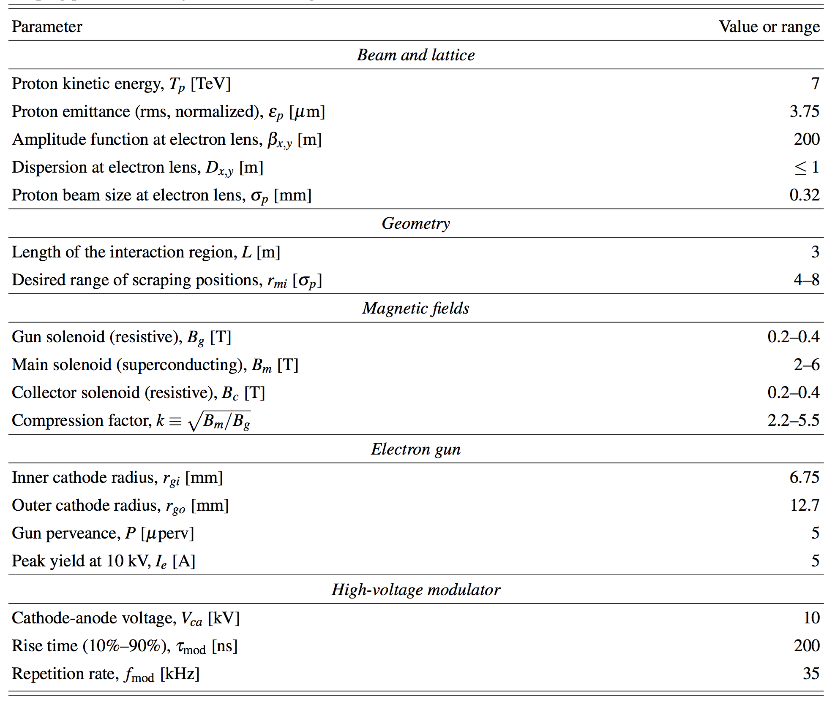
HEL Design Parameters
Collector
FERMILAB-TM-2572-APC, CERN-ACC-2014-0248

Slide 19
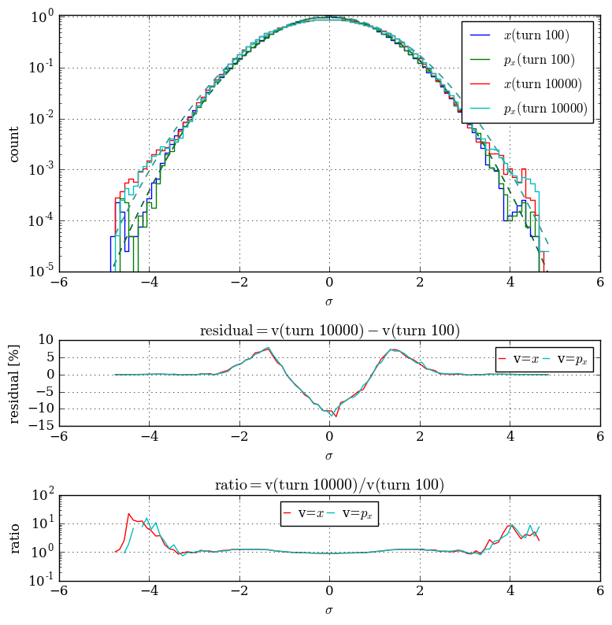
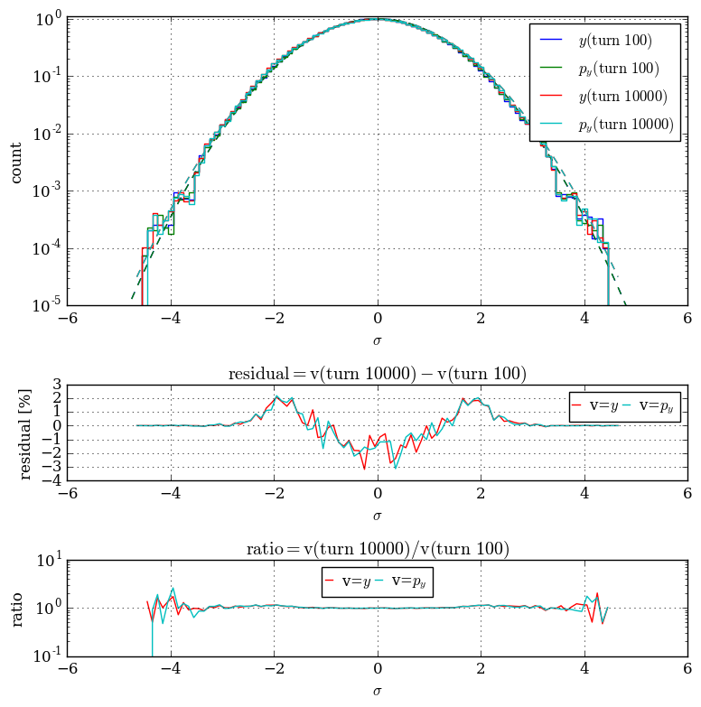
Change distribution 7th and 10th turn pulsing
Collector
7th turn pulsing H+V
10th turn pulsing H+V

Slide 20
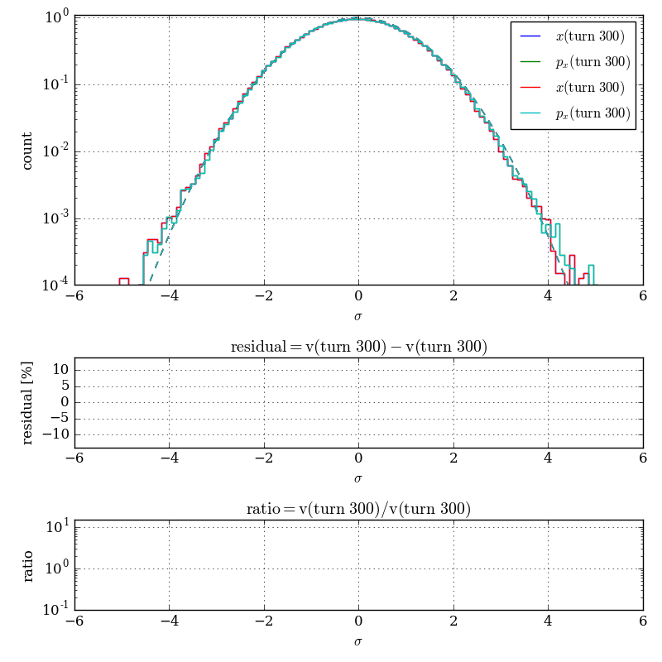
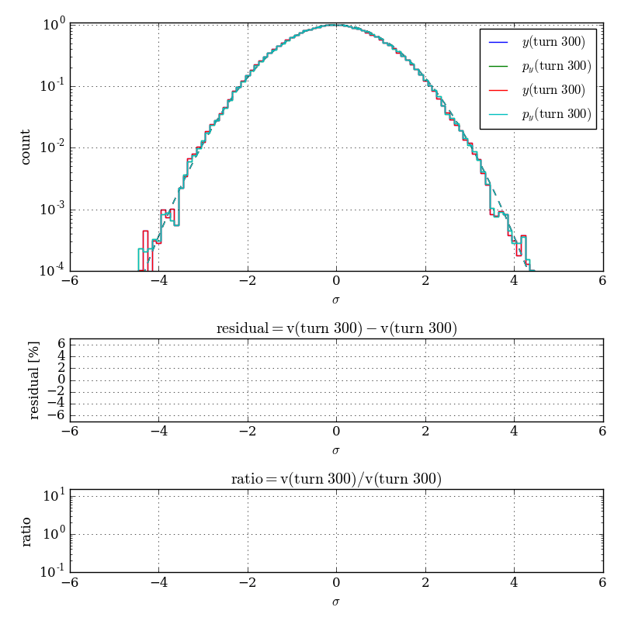
Change distribution 7th and 10th turn pulsing
Collector
7th turn pulsing H+V
10th turn pulsing H+V

Slide 21
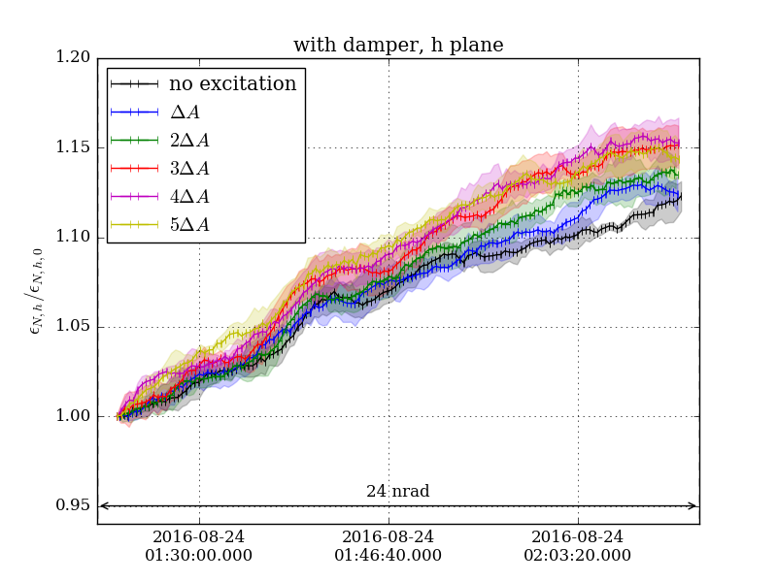
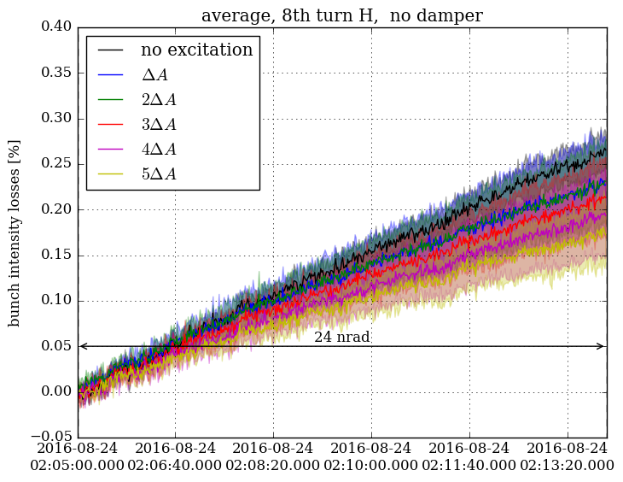
First experimental results – 8th turn H
no increased losses
increase of emittance growth by ~4%/h in H, no increase in V

Slide 22
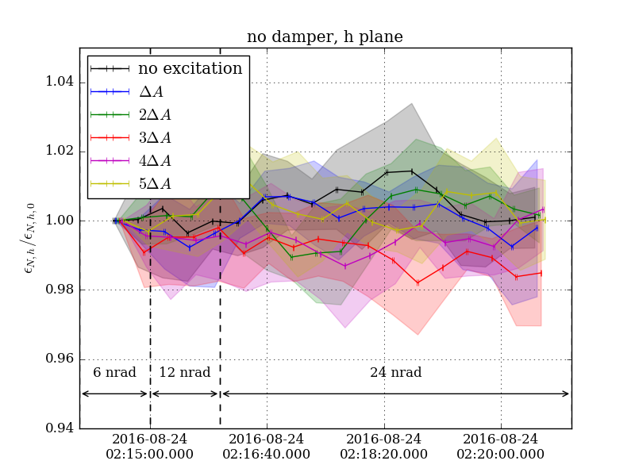
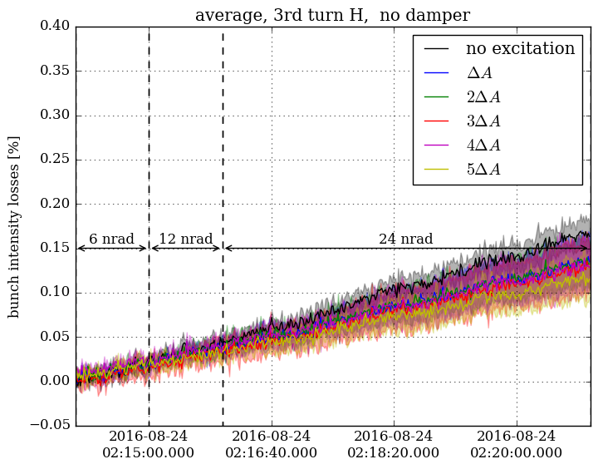
First experimental results – 3rd turn H
no increased losses
no emittance growth

Slide 23
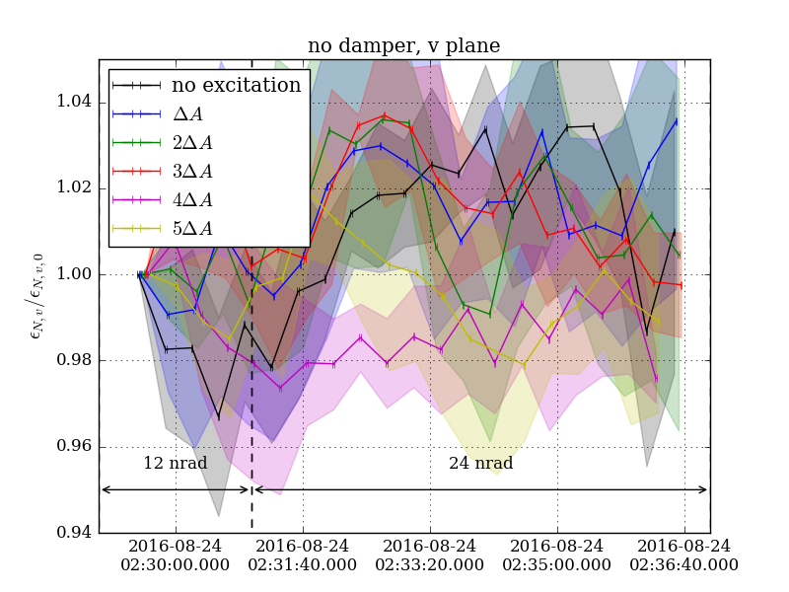
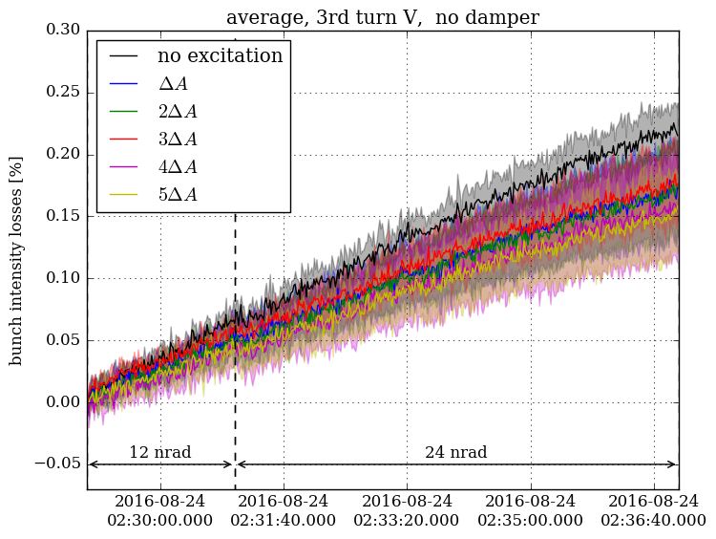
First experimental results – 3rd turn V
no increased losses
no emittance growth

