Slide 1
Update On Powering Of Inner Triplet Circuit
Hugues Thiesen – Samer Yammine on behalf of HL-MCF
6th HL-LHC Collaboration Meeting
15 November 2016
Paris, Espace St Martin
Input from contributors of the Magnet Circuit Forum: Felix Rodriguez Mateos, Emmanuele Ravaioli, Susana Izquierdo, WP2, WP3, WP6a, WP6b, WP7, WP9, WP15, WP16, WP17
https://espace.cern.ch/project-HL-LHC-Technical-coordination/MCF

Slide 2

Contents
01 HL-LHC Inner Triplet Circuits
02 Powering of the Main Quadrupole Circuit
03 Quench Protection of the Main Quadrupole Circuit
04 Conclusion

Slide 3
01
HL-LHC Inner Triplet Circuits

Slide 4
HL-LHC Magnet and Circuit Layout

Slide 5
HL-LHC Inner Triplet Circuits
Definition:
  All circuits powered by the DFHX
Main Circuits:
  Main quadrupole circuit: Q1, Q2a, Q2b, Q3
  D1 circuit
Orbit Correctors of MQ:
  MCBX
Superferric High Order Correctors
  MQSX
  MCSX/MCSSX
  MCOX/MCOSX
  MCDX/MCDSX
  MCTX/MCTSX

Slide 6
HL-LHC Inner Triplet Circuits
MQ Circuits:
  1 main circuits per IP
    18 kA / Unipolar in Current – 2Q
  3 trim circuits par IP
    2 x 2 kA / Bipolar in Current – 4Q (Q1 and Q3)
    1 x 0.12 kA / Bipolar in Current – 4Q (Q2a)
Magnet Protection (E = 41 MJ):
  Outer Layer Quench Heaters
  CLIQs
  Inner Layer Quench Heaters

Slide 7
HL-LHC Inner Triplet Circuits
D1Circuits:
  1 circuits per IP
  13 kA / Unipolar in Current – 1Q
Magnet Protection:
  Quench Heaters (E = 2.3 MJ)

Slide 8
HL-LHC Inner Triplet Circuits
Orbit Corrector Circuits:
  6 circuits per IP
  2 kA / Bipolar in Current – 4Q
Magnet Protection:
  Quench Heater (baseline)
  Energy Extraction (Option – 90 to 320 kJ)

Slide 9
HL-LHC Inner Triplet Circuits
SHOC Circuits:
  9 circuits per IP
  0.12 or 0.2 kA / Bipolar in Current – 4Q
Magnet Protection:
  PC crowbar (E < 2 kJ)
  Energy Extraction (Option)

Slide 10
HL-LHC Inner Triplet Circuits
Circuits for HiLumi | Magnet Type | Number of circuits per IP side | I_nominal (7 TeV) [kA] | I_ultimate [kA] | L per circuit [mH] | R per circuit [mΩ] | Time constant [s] | E [kJ] | Protection
Triplet Q1, Q2a, Q2b, Q3 | MQXFA / MQFXB | 1 | 16.5 | 17.82 | 255 | 0.264 | 965.91 | 40487.9 | OQH + CLIQ + IQH
Trim Q1 | - | 1 | 2 | 2 | 69 | 1.44 | 47.92
Trim Q3 | - | 1 | 2 | 2 | 69 | 1.44 | 47.92
Trim Q2a | - | 1 | 0.12 | 0.12 | 58.5 | 13.372 | 4.37
Orbit correctors Q2a/b - vertical | MCBXFB | 2 | 1.6 | 1.73 | 59 | 1.512 | 39.02 | 88.3 | QH (+ EE)
Orbit correctors Q2a/b - horizontal | MCBXFB | 2 | 1.47 | 1.59 | 135 | 1.656 | 81.52 | 170.6 | QH (+ EE)
Orbit correctors CP - vertical | MCBXFA | 1 | 1.6 | 1.73 | 109 | 1.728 | 63.08 | 163.1 | QH (+ EE)
Orbit correctors CP - horizontal | MCBXFA | 1 | 1.47 | 1.59 | 247 | 1.728 | 142.94 | 312.2 | QH (+ EE)
Superferric, order 2 | MQSXF | 1 | 0.182 | 0.2 | 1247 | 9.853 | 126.56 | 24.9 | PCC
Superferric, order 3, normal and skew | MCSXF / MCSSXF | 2 | 0.105 | 0.12 | 118 | 13.372 | 8.82 | 0.8 | PCC
Superferric, order 4, normal and skew | MCOXF / MCOSXF | 2 | 0.105 | 0.12 | 152 | 13.372 | 11.37 | 1.1 | PCC
Superferric, order 5, normal and skew | MCDXF / MCDSXF | 2 | 0.105 | 0.12 | 107 | 13.372 | 8.00 | 0.8 | PCC
Superferric, order 6 | MCTXF | 1 | 0.105 | 0.12 | 229 | 13.372 | 17.13 | 1.6 | PCC
Superferric, order 6, skew | MCTSXF | 1 | 0.105 | 0.12 | 52 | 13.372 | 3.89 | 0.4 | PCC
Separation dipole D1 | MBXF | 1 | 12 | 12.96 | 27 | 0.27 | 100.00 | 2267.5 | QH

Slide 11
02
Powering of the Main Quadrupoles Circuit

Slide 12
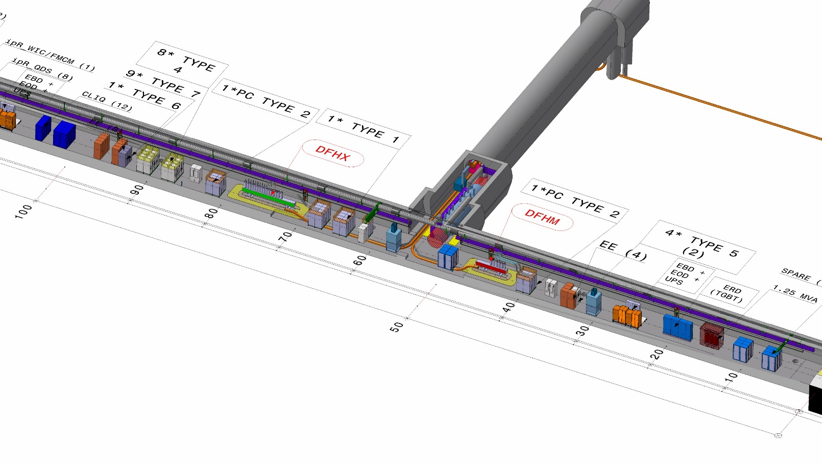
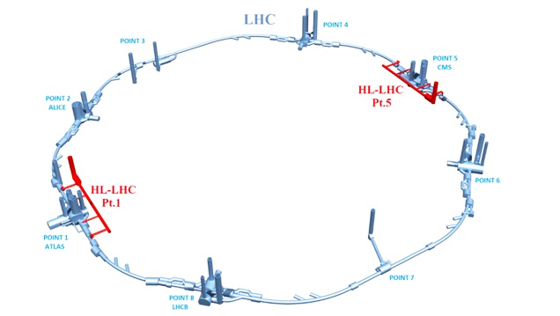
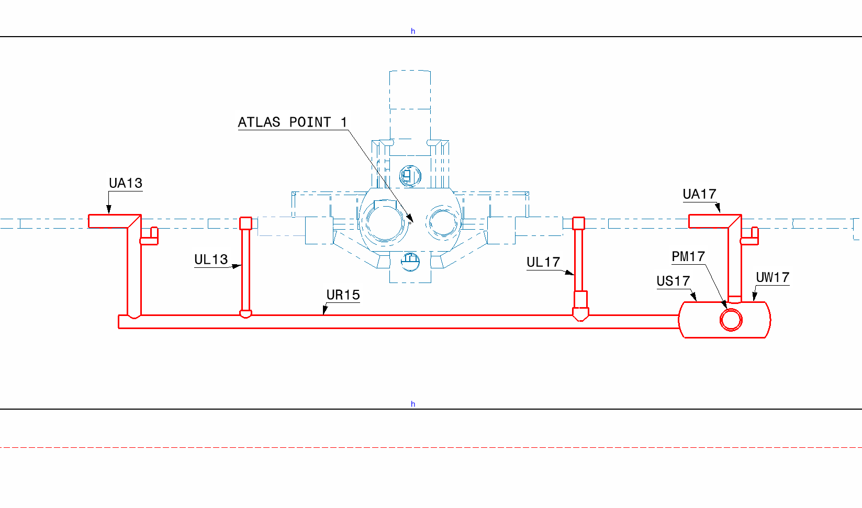
Power Converters for the MQ Circuit
Inner triplet PCs will be placed in the URs at points 1 and 5

Slide 13
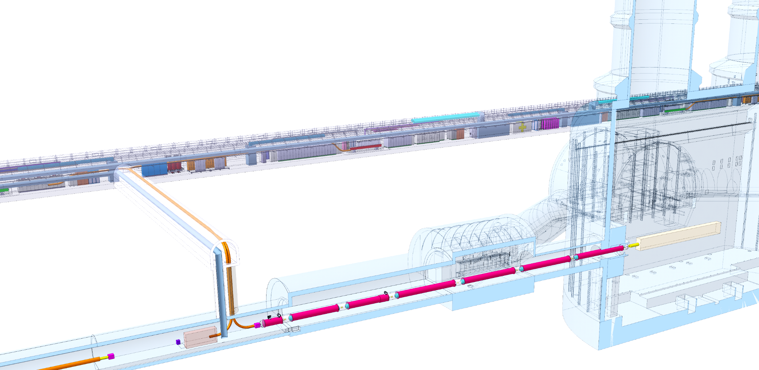
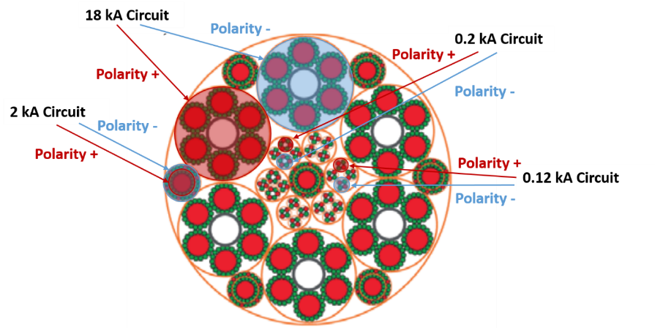
Cold Powering of the MQ Circuit
PCs → DFHX → DSH (SC Link) → DFX → Magnets (via busbars)
DFHX
SCLink DSHX
SCLink DSHX
Q1
IP
Q2b
Q2a
DFX
Q3
D1
CP
For Illustration (not latest version)

Slide 14
Cold Powering of the MQ Circuit
Gas Helium Cooling in DFHX and DSHX
Liquid Helium Cooling in DFX

Slide 15
Powering of the MQ Circuit
8V ?
1 Main Power Converter:
  Q1, Q2a, Q2b and Q3 powered in series
  [18 kA / ±8 V]
3 Trim Power Converters:
  2 x [±2 kA / ±10V] (Q1 and Q3)
  1 x [±0.12 kA / ±10V] (Q2a)
τ = 1 ks
Total Energy of 41 MJ
Warm Diodes over Q2b for Quench Protection (not necessary for warm powering)
Circuits for HiLumi | Magnet Type | I_nom (7 TeV) [kA] | I_ultimate [kA] | L per circuit [mH] | R per circuit [mΩ] | Time constant [s] | di/dt* [A/s] | V_PC [V] | E [kJ] | R Crowbar [mW]
MQ (Q1, Q2a, Q2b, Q3) | MQXFA / MQFXB | 16.5 | 17.82 | 255 | 0.264 | 965.91 | 13.8 | ±8.2 | 40488 | ?
Trim Q1 | MQXFA | 2 | ±2 | 69 | 1.44 | 47.92 | 1.5 | ±3.9 | 10956 | tbd
Trim Q3 | MQXFA | 2 | ±2 | 69 | 1.44 | 47.92 | 1.5 | ±3.9 | 10956 | tbd
Trim Q2a | MQXFB | 0.12 | ±0.12 | 58.5 | 13.372 | 4.37 | 0.1 | ±2.4 | 9288 | tbd
Q2b | MQXFB |  |  | 58.5 |  |  | 13.8 | ±0.8 | 9288
* Estimated value to be verified by WP2

Slide 16
Powering of the MQ Circuit
Maximum Output Voltage of Power Converters
V_qx = R_qx * I_qx + L_qx * didt_qx + L_q1*didt_q1 + L_q2a*didt_q2a + L_q3*didt_q3 ~ 8.2V
V_q1 = R_q1 * I_q1 + L_q1 * didt_q1 + L_q1*didt_qx ~ 3.9 V
V_q2a = R_q2a * I_q2a + L_q2a * didt_q2a + L_q2a*didt_qx ~ 2.4 V
V_q3 = R_q3 * I_q3 + L_q3 * didt_q1 + L_q3*didt_qx ~ 3.9 V
V_q2b = + L_q2b*didt_qx ~ 0.8 V

Slide 17
Powering of the MQ Circuit
Powering Failure Simulation (No Quench)
A
C
D
B
E
No Looping Current in Trim Circuits Even if Crowbar Resistances = 0 due to Relatively High Trim Cable Resistance:
  RcableQX = 0.264 mΩ
  RcableQ1 = 1.44 mΩ
  RcableQ2a = 13.4 mΩ
  RcableQ3 = 1.44 mΩ

Slide 18
Powering of the MQ Circuit
Water Failure and Main Converter Crowbar Resistance
Introduction of 30 V Crowbar Resistance
Energy Dissipated in Free-Wheeling Thyristor = 11.5 MJ
Energy Dissipated in DC Cables = 30 MJ → ΔT = 86 °C in case of water failure
Energy Dissipated in Free-Wheeling Thyristor = 2.12 MJ
Energy Dissipated in DC Cables = 5 MJ → ΔT = 15 °C in case of water failure
Energy Dissipated in Crowbar Resistance = 34 MJ

Slide 19
03
Quench Protection of the Main Quadrupole Circuit

Slide 20
Quench Protection of the MQ circuit
Outer layer (OL) quench heaters
  In the baseline
  Can protect the magnet at all current levels (T_{max}=320 K) and provide some redundancy.
Inner layer (IL) heaters
  In the baseline
  In combination with the OL quench heaters, the hot spot temperature can be reduced by 90 K (T_{max}=230 K).
  Work in progress to address issues of reliability (linked to coil manufacturing).
  CLIQ
    In the baseline
    In combination with the OL quench heaters, the hot spot temperature can be reduced by 90 K (T_{max}=230 K)
    Work in progress to address open questions:
    Assess the long-time reliability and availability
    Impact on other elements of the circuit, for instance the superconducting link.

Slide 21
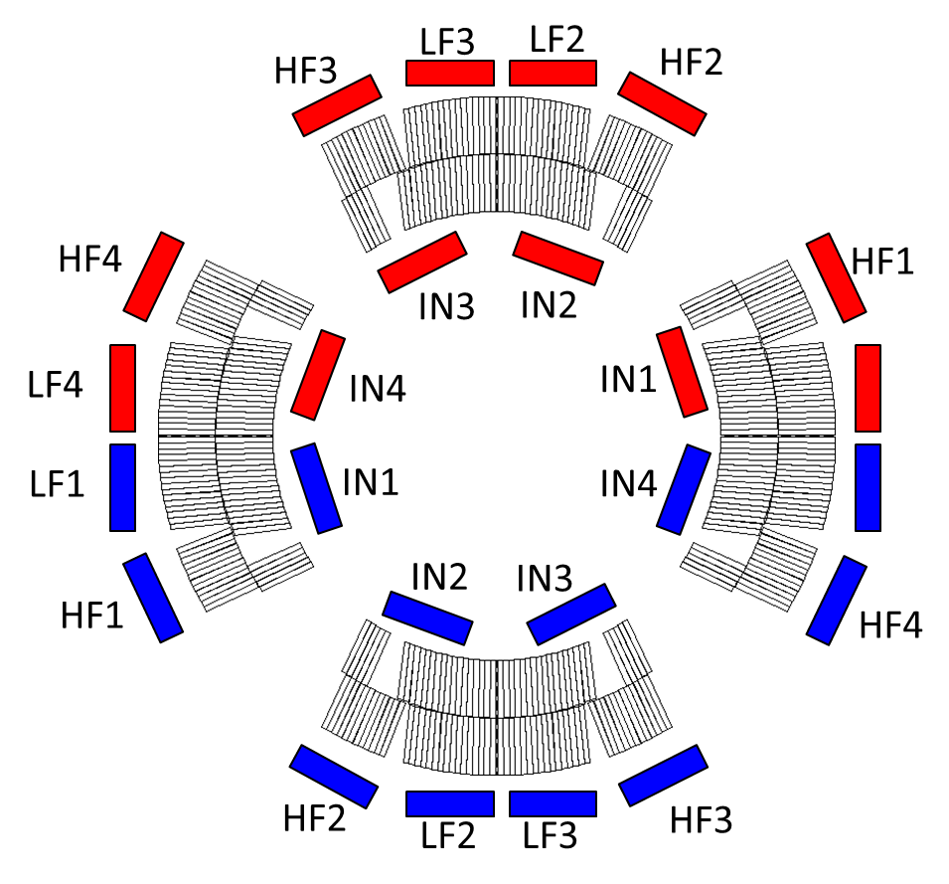
Quench Protection of the MQ circuit
Quench heaters (OL or IL)
  Quench provoked by thermal diffusion.
  Electrically separated from the coils.
  CLIQ
    Quench propagation by current oscillations.
    Electrical interaction with the powering circuit (warm and cold)

Slide 22
Quench Protection of the MQ circuit
CLIQ
  2 x 600V CLIQ units per MQXFA magnet
  1 x 1 kV CLIQ units per MQXFB magnet
600V
1kV
600V
1kV
600V
600V
2 magnets in series
300 V per pole
1 magnet
500 V per pole
2 magnets in series
300 V per pole

Slide 23
Quench Protection of the MQ circuit
Quench Simulations: Synchronised Quench without Initial Trim Currents
I_{ms} = 16.5 kA
I_{ts1} = 0 A
I_{ts2a} = 0 A
I_{ts3} = 0 A
A
C
D
B
E
The behaviour of the magnets are similar (Quench resistance development)
No issue if the quenches of the 4 MQ are synchronised
No over-current through leads

Slide 24
Quench Protection of the MQ circuit
Quench Simulations: Synchronised Quench with Initial Trim Currents
I_{ms} = 16.5 kA
I_{ts1} = -2 kA
I_{ts2a} = -0.12 kA
I_{ts3} = -2 kA
A
C
D
B
E
Currents estimated through the SC Link/Leads:
Leads B and D see 2 kA
Lead C sees 0.1 kA

Slide 25
Quench Protection of the MQ circuit
Quench Simulations: Worst Case Scenario Considered (Conservative Case)
  Case of the non-detection of a quench is not considered
  The case considered is one full magnet (i.e. 4 poles) quenches by effect of beam
  Quench protection system needs:
    15 ms to detect the quenchion
    +1 ms to fire the CLIQ modules (16 ms after the quench)
    +5 ms to fire the QH (20 ms after the quench)

Slide 26
Quench Protection of the MQ circuit
Quench Simulations: Worst Case Scenario Considered
I_{ms} = 16.5 kA
I_{ts1} = -2 kA
I_{ts2a} = -0.12 kA
I_{ts3} = -2 kA
A
C
D
B
E
High overcurrent through the SC Link/Leads:
Leads B and D see 4.4 kA for an eq. time = 120 ms
Lead C sees 3.2 kA for an eq. time = 100 ms

Slide 27
Quench Protection of the MQ circuit
Quench Simulations: Worst Case Scenario Considered
  Attempt 1 to reduce the currents through the leads: Increasing the crowbar resistances
RcrowQ1 = 15 mΩ
RcrowQ2a = 80 mΩ
RcrowQ2b = 80 mΩ
RcrowQ3 = 15 mΩ
C
D
E
A
B
I_ms = 16.5 kA
I_ts1 = -2 kA
I_ts2a = -0.12 kA
I_ts3 = -2 kA
Maximum current decrease of less than 200A in the trim circuits → Low impact (MIITS and current peaks)

Slide 28
Quench Protection of the MQ circuit
Quench Simulations: Worst Case Scenario Considered
  Attempt 2 to reduce the currents through the leads: Introducing cold diodes
A
B
C
D
E
Zoom on Trim Currents
RcrowQ1 = 15 mΩ
RcrowQ2a = 80 mΩ
RcrowQ3 = 15 mΩ
Diode Vf = 6 V
I_ms = 16.5 kA
I_ts1 = -2 kA
I_ts2a = -0.12 kA
I_ts3 = -2 kA
I_{C} <= Vf/0.08Ω <= 75A
I_{B} < 500 A
I_{D} < 400 A

Slide 29
Cold diodes Status
Long development programme was conducted for the LHC
Design aspects:
  Radiation tolerance
  Electrical properties (turn-on, forward and reverse voltage characteristics)
  Thermal property (endurance for long time constants and long term behavior)
  Cryogenic temperature operation
Main issue for inner triplet diode integration: Radiation tolerance
  Radiation resistance limit for the LHC diode (diffusion type): ~2 kGy, 10¹³n.cm⁻²
  Epitaxial diodes (tested more than 20 years ago) up to ~ 50 kGy, 10¹⁵ n.cm⁻²
    Studies interrupted when revised (much lower) radiation calculations were presented, together with the success with diffusion diodes
    Needed to stack them to have sufficient margin for ramping, had reduced reverse voltage capabilities and were much more expensive

Slide 30
Proposed Solutions
These results are being confirmed at present
If results are confirmed, two solutions could be considered:
  Cold diodes with present equipment design
    More compact than dipole diodes since time constants are 1000 times lower
    Studies undergoing for radiation exposure in the inner triplet zone (till the DFX)
    Complex integration
  Redesign of equipment to withstand the high transitory over-currents
    Over-currents of 2-3 kA in leads for an equivalent time of 100-150 ms
Adding a resistance in the crowbar of the main converter may have implications to be analyzed.
Final layout due date: End of the 2016 in the MCF

Slide 31
04
Conclusion

Slide 32
Conclusion
IT circuits powering scheme has been presented
IT main quadrupole circuit is complex due to its interconnectivity
Circuit layout definition is in final stage
Protection scheme to be finalized when tests are done
For quench detection and protection instrumentation, see R. Denz’s talk

Slide 33
Thanks for your attention

