Slide 1

Transverse Damping Requirements
Elias Métral for the instability team (and BE-ABP-HSC section)
6th HL-LHC Collaboration Meeting, Paris, 15/11/2016

Slide 2
Contents

Slide 3
Contents
Introduction

Slide 4
Contents
Introduction
Predicted beam stability without e-cloud

Slide 5
Contents
Introduction
Predicted beam stability without e-cloud
Highest bunch brightness reached so far

Slide 6
Contents
Introduction
Predicted beam stability without e-cloud
Highest bunch brightness reached so far
News on destabilising effect of linear coupling

Slide 7
Contents
Introduction
Predicted beam stability without e-cloud
Highest bunch brightness reached so far
News on destabilising effect of linear coupling
Is leveling by transverse offset a viable option?

Slide 8
Contents
Introduction
Predicted beam stability without e-cloud
Highest bunch brightness reached so far
News on destabilising effect of linear coupling
Is leveling by transverse offset a viable option?
E-cloud induced instabilities

Slide 9
Contents
Introduction
Predicted beam stability without e-cloud
Highest bunch brightness reached so far
News on destabilising effect of linear coupling
Is leveling by transverse offset a viable option?
E-cloud induced instabilities
Conclusion

Slide 10
Introduction
From the Joint LARP CM26 / Hi-Lumi Meeting, SLAC, 19/05/2016

Slide 11
Introduction
From the Joint LARP CM26 / Hi-Lumi Meeting, SLAC, 19/05/2016
  Linear coupling can have a destabilising effect on beam stability: simulations confirmed by a dedicated study with a single bunch

Slide 12
Introduction
From the Joint LARP CM26 / Hi-Lumi Meeting, SLAC, 19/05/2016
  Linear coupling can have a destabilising effect on beam stability: simulations confirmed by a dedicated study with a single bunch
  Beam instability / stability with a transverse offset should be measured (beam stability predicted with sufficient damper)

Slide 13
Introduction
From the Joint LARP CM26 / Hi-Lumi Meeting, SLAC, 19/05/2016
  Linear coupling can have a destabilising effect on beam stability: simulations confirmed by a dedicated study with a single bunch
  Beam instability / stability with a transverse offset should be measured (beam stability predicted with sufficient damper)
  Without e-cloud, a sufficient margin should exist for beam stability

Slide 14
Introduction
From the Joint LARP CM26 / Hi-Lumi Meeting, SLAC, 19/05/2016
  Linear coupling can have a destabilising effect on beam stability: simulations confirmed by a dedicated study with a single bunch
  Beam instability / stability with a transverse offset should be measured (beam stability predicted with sufficient damper)
  Without e-cloud, a sufficient margin should exist for beam stability
  E-cloud is the main worry

Slide 15
Introduction
From the Joint LARP CM26 / Hi-Lumi Meeting, SLAC, 19/05/2016
  Linear coupling can have a destabilising effect on beam stability: simulations confirmed by a dedicated study with a single bunch
  Beam instability / stability with a transverse offset should be measured (beam stability predicted with sufficient damper)
  Without e-cloud, a sufficient margin should exist for beam stability
  E-cloud is the main worry
    What is the role of e-cloud in the instabilities observed since 2015?

Slide 16
Introduction
From the Joint LARP CM26 / Hi-Lumi Meeting, SLAC, 19/05/2016
  Linear coupling can have a destabilising effect on beam stability: simulations confirmed by a dedicated study with a single bunch
  Beam instability / stability with a transverse offset should be measured (beam stability predicted with sufficient damper)
  Without e-cloud, a sufficient margin should exist for beam stability
  E-cloud is the main worry
    What is the role of e-cloud in the instabilities observed since 2015?
    Can simulations explain the observations?

Slide 17
Introduction
From the Joint LARP CM26 / Hi-Lumi Meeting, SLAC, 19/05/2016
  Linear coupling can have a destabilising effect on beam stability: simulations confirmed by a dedicated study with a single bunch
  Beam instability / stability with a transverse offset should be measured (beam stability predicted with sufficient damper)
  Without e-cloud, a sufficient margin should exist for beam stability
  E-cloud is the main worry
    What is the role of e-cloud in the instabilities observed since 2015?
    Can simulations explain the observations?
    What will happen for HL-LHC?

Slide 18
Predicted beam stability without e-cloud

Slide 19
Predicted beam stability without e-cloud
Nominal collimator settings for HL-LHC parameters and machine components for the present baseline: 2 CC/beam/IP side and low-impedance collimators in LSS7. Assumed here DQW cavities and machine at the end of the pre-squeeze => Further work has been done to reduce the impedance of a remaining HOM at 920 MHz by a factor ~ 20 (new table from 21-10-2016 used)

Slide 20
Predicted beam stability without e-cloud
Nominal collimator settings for HL-LHC parameters and machine components for the present baseline: 2 CC/beam/IP side and low-impedance collimators in LSS7. Assumed here DQW cavities and machine at the end of the pre-squeeze => Further work has been done to reduce the impedance of a remaining HOM at 920 MHz by a factor ~ 20 (new table from 21-10-2016 used)
Beam is stable for a current in the Landau octupoles (LOF) < ~ 300 A, what ever the sign and even if the transverse tails would be cut down to ~ 3 σ

Slide 21
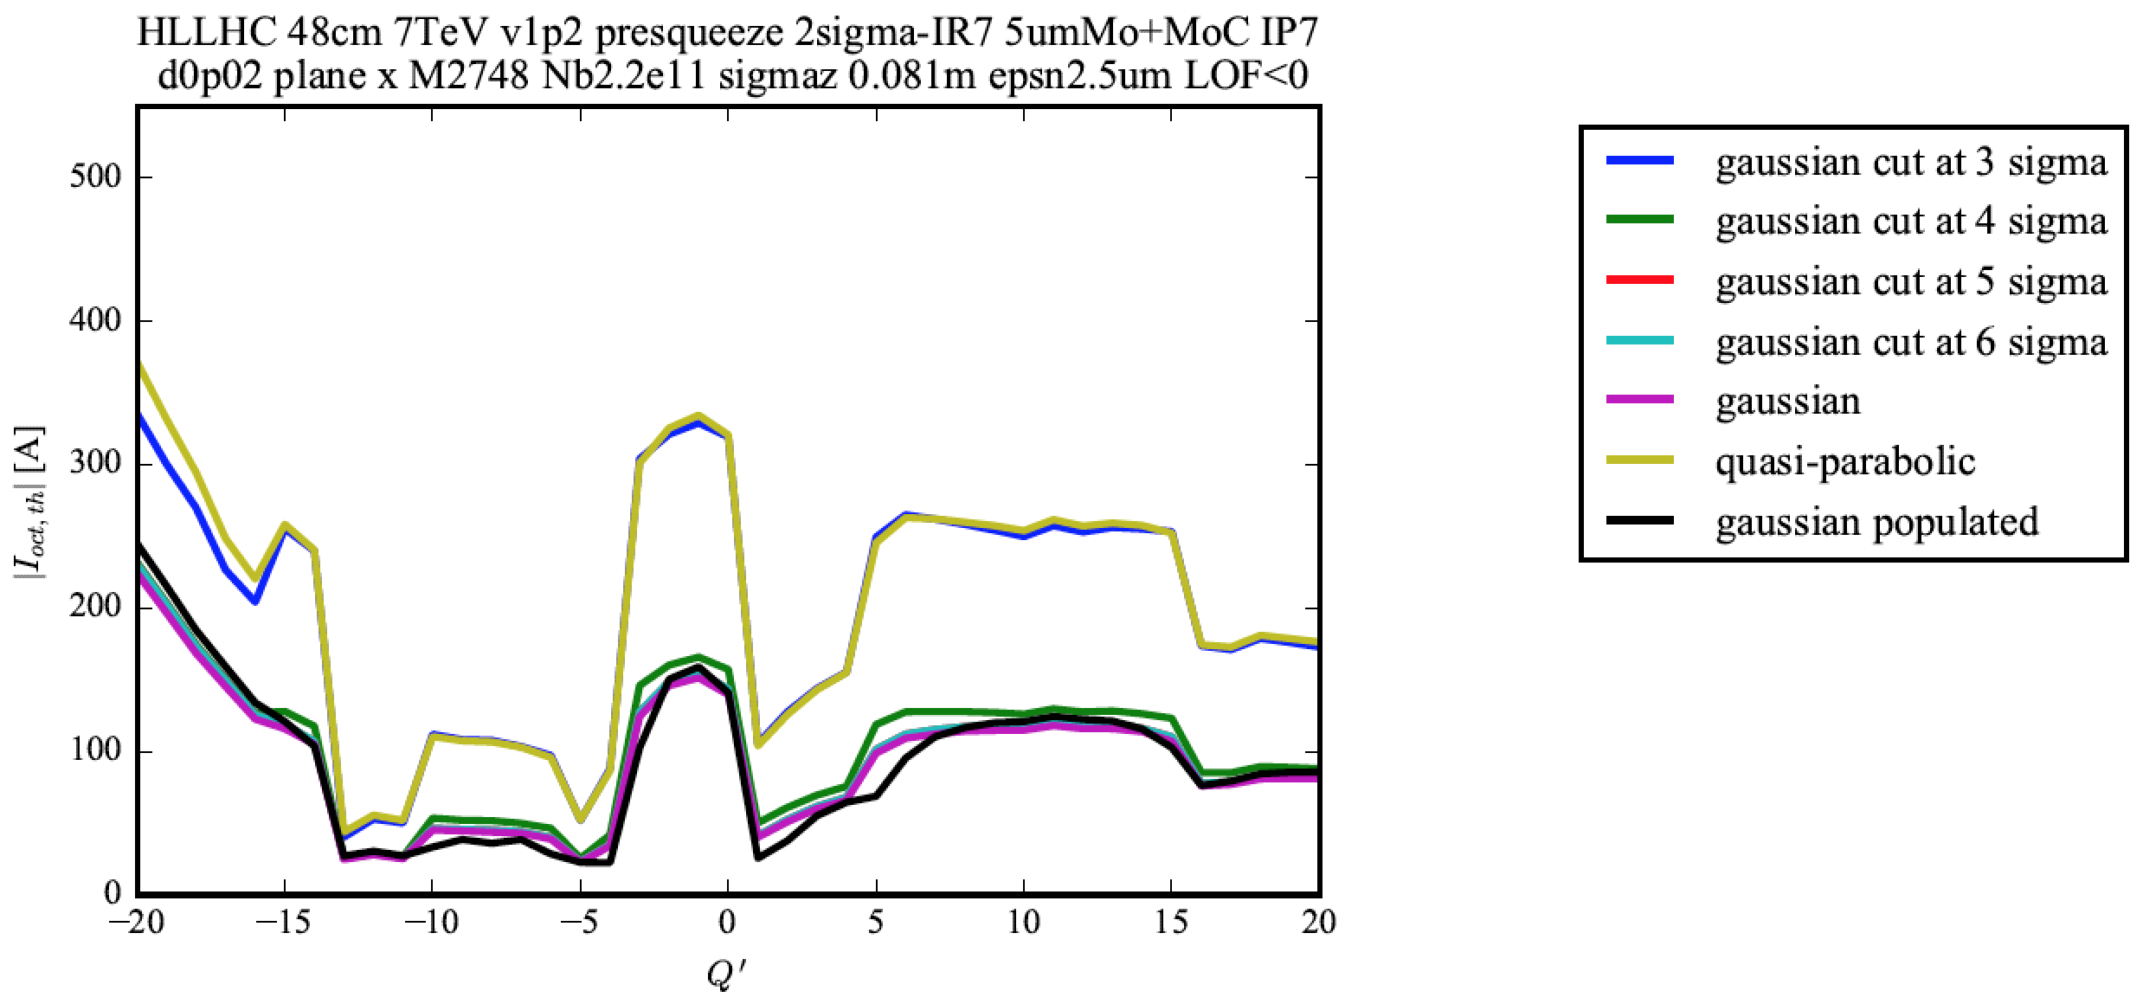
LOF < 0
Courtesy of N. Biancacci

Slide 22
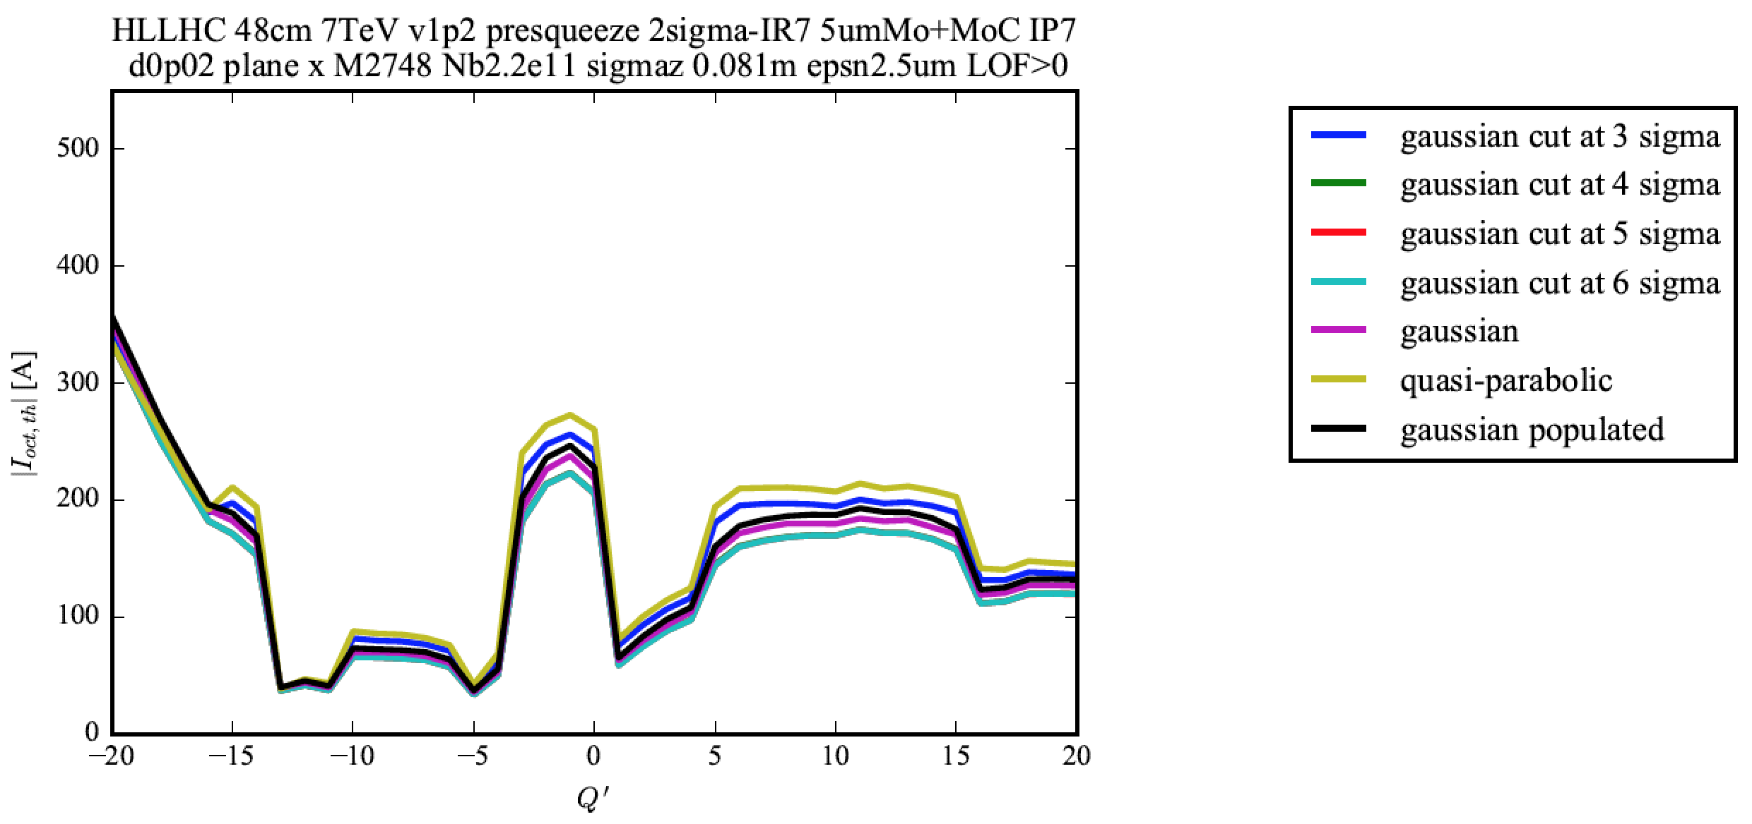
LOF < 0
Courtesy of N. Biancacci
LOF > 0

Slide 23
Highest bunch brightness reached so far

Slide 24
Highest bunch brightness reached so far
The HL-LHC bunch brightness has already been reached! => In 2016 at 6.5 TeV, bunches of ~ 1.4 times higher brightness than for HL-LHC were brought into collision with very good lifetime (burn-off dominated)

Slide 25
Highest bunch brightness reached so far
The HL-LHC bunch brightness has already been reached! => In 2016 at 6.5 TeV, bunches of ~ 1.4 times higher brightness than for HL-LHC were brought into collision with very good lifetime (burn-off dominated)
Parameter | LHC
Energy [TeV] | 7
Bunch population [10¹¹] | 1.15
Transv. emittance [μm] | 3.75
Brightness [10¹¹ / μm] | 0.31

Slide 26
Highest bunch brightness reached so far
The HL-LHC bunch brightness has already been reached! => In 2016 at 6.5 TeV, bunches of ~ 1.4 times higher brightness than for HL-LHC were brought into collision with very good lifetime (burn-off dominated)
Parameter | LHC | HL-LHC
Energy [TeV] | 7 | 7
Bunch population [10¹¹] | 1.15 | 2.2
Transv. emittance [μm] | 3.75 | 2.5
Brightness [10¹¹ / μm] | 0.31 | 0.88

Slide 27
Highest bunch brightness reached so far
The HL-LHC bunch brightness has already been reached! => In 2016 at 6.5 TeV, bunches of ~ 1.4 times higher brightness than for HL-LHC were brought into collision with very good lifetime (burn-off dominated)
Parameter | LHC | HL-LHC | LHC 2016
Energy [TeV] | 7 | 7 | 6.5
Bunch population [10¹¹] | 1.15 | 2.2 | 1.9
Transv. emittance [μm] | 3.75 | 2.5 | 1.5
Brightness [10¹¹ / μm] | 0.31 | 0.88 | 1.27
Factor 4.1!

Slide 28
Highest bunch brightness reached so far
The HL-LHC bunch brightness has already been reached! => In 2016 at 6.5 TeV, bunches of ~ 1.4 times higher brightness than for HL-LHC were brought into collision with very good lifetime (burn-off dominated)
Parameter | LHC | HL-LHC | LHC 2016 | Delta [%]
Energy [TeV] | 7 | 7 | 6.5 | - 7
Bunch population [10¹¹] | 1.15 | 2.2 | 1.9 | - 14
Transv. emittance [μm] | 3.75 | 2.5 | 1.5 | - 40
Brightness [10¹¹ / μm] | 0.31 | 0.88 | 1.27 | + 44
Factor 4.1!

Slide 29
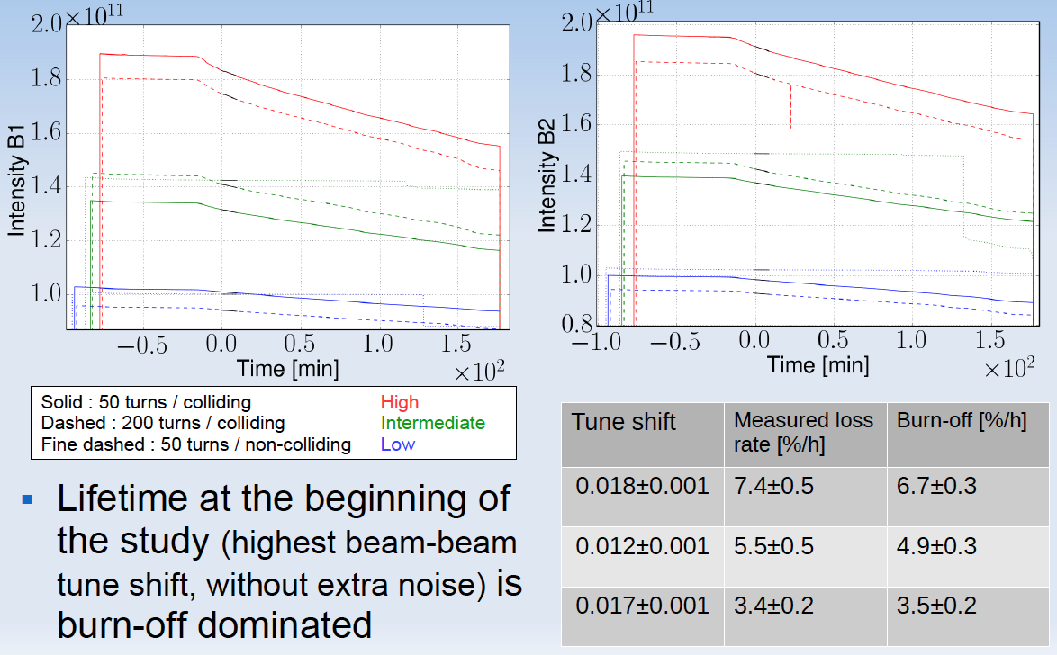

HIGHLIGHT!
Courtesy of X. Buffat

Slide 30
News on destabilising effect of linear coupling

Slide 31
News on destabilising effect of linear coupling
The worry from 2012 (i.e. without e-cloud) has been partly dissipated with the discovery of the effect of linear coupling: see talk at the last HiLumi meeting. Since then, 2 additional info going in the same direction

Slide 32
News on destabilising effect of linear coupling
The worry from 2012 (i.e. without e-cloud) has been partly dissipated with the discovery of the effect of linear coupling: see talk at the last HiLumi meeting. Since then, 2 additional info going in the same direction
  Instability in physics with 600 bunches disappeared after coupling correction => A coupling (closest tune approach) of ~ 0.005 is bad!

Slide 33
News on destabilising effect of linear coupling
The worry from 2012 (i.e. without e-cloud) has been partly dissipated with the discovery of the effect of linear coupling: see talk at the last HiLumi meeting. Since then, 2 additional info going in the same direction
  Instability in physics with 600 bunches disappeared after coupling correction => A coupling (closest tune approach) of ~ 0.005 is bad!
  A measurement from 2012 revealed an important coupling in October (~ 0.01)

Slide 34
Sunday 25/09/16, Fill #5332: Instability with 600 bunches

Slide 35
Sunday 25/09/16, Fill #5332: Instability with 600 bunches
LOF were at 470 A, Q’ ~ 15 units and nominal damper

Slide 36
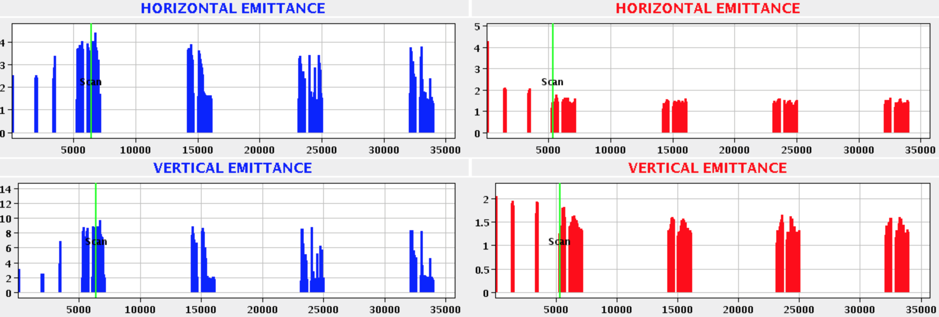
Sunday 25/09/16, Fill #5332: Instability with 600 bunches
LOF were at 470 A, Q’ ~ 15 units and nominal damper

Slide 37
β*

Slide 38
β*
B1H BBQ activity
B1V BBQ activity

Slide 39
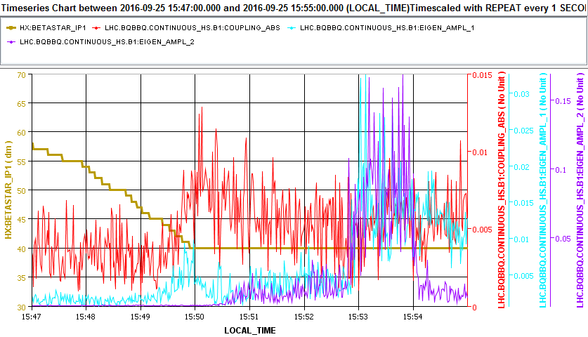
Bump
in |C⁻|
β*
B1H BBQ activity
B1V BBQ activity

Slide 40
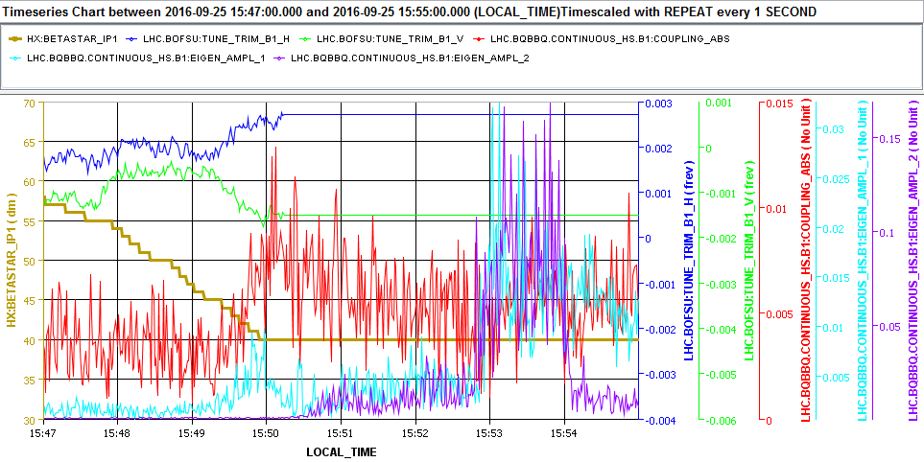
Q_{x} _FB_Trim
Bump
in |C⁻|
Q_{y} _FB_Trim
β*
B1H BBQ activity
B1V BBQ activity

Slide 41
Similar picture as during our dedicated study on linear coupling
Q_{x} _FB_Trim
Bump
in |C⁻|
Q_{y} _FB_Trim
β*
B1H BBQ activity
B1V BBQ activity

Slide 43
Linear coupling was then corrected

Slide 44
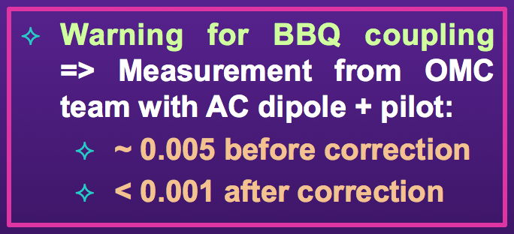
Linear coupling was then corrected

Slide 45
Could linear coupling have played an important role in the 2011-2012 End Of Squeeze Instability?

Slide 46
Could linear coupling have played an important role in the 2011-2012 End Of Squeeze Instability?
Info from RogelioT: In 2012, very few linear coupling measurements took place at 60 cm
  Commissioning in March => |C⁻| ≤ 0.002: OK

Slide 47
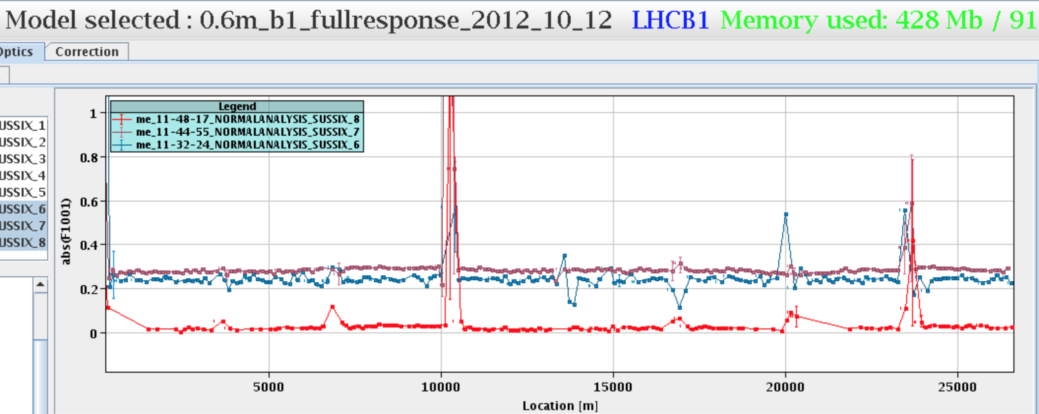
Could linear coupling have played an important role in the 2011-2012 End Of Squeeze Instability?
Info from RogelioT: In 2012, very few linear coupling measurements took place at 60 cm
  Commissioning in March => |C⁻| ≤ 0.002: OK
  Measurement during an MD on 12/10/2012: Huge coupling (~ 0.01)!
Courtesy of R. Tomas

Slide 48
Could linear coupling have played an important role in the 2011-2012 End Of Squeeze Instability?
Info from RogelioT: In 2012, very few linear coupling measurements took place at 60 cm
  Commissioning in March => |C⁻| ≤ 0.002: OK
  Measurement during an MD on 12/10/2012: Huge coupling (~ 0.01)!
Courtesy of R. Tomas
|C⁻| ≈ 0.01
(before correction)
α |C⁻|

Slide 49
Could linear coupling have played an important role in the 2011-2012 End Of Squeeze Instability?
Info from RogelioT: In 2012, very few linear coupling measurements took place at 60 cm
  Commissioning in March => |C⁻| ≤ 0.002: OK
  Measurement during an MD on 12/10/2012: Huge coupling (~ 0.01)! => Was corrected for the MD but was not put in the nominal cycle after the measurement…
Courtesy of R. Tomas
|C⁻| ≈ 0.01
(before correction)
α |C⁻|

Slide 50
Could linear coupling have played an important role in the 2011-2012 End Of Squeeze Instability?
Info from RogelioT: In 2012, very few linear coupling measurements took place at 60 cm
  Commissioning in March => |C⁻| ≤ 0.002: OK
  Measurement during an MD on 12/10/2012: Huge coupling (~ 0.01)! => Was corrected for the MD but was not put in the nominal cycle after the measurement…
Courtesy of R. Tomas
There was no request from our side at that time!
|C⁻| ≈ 0.01
(before correction)
α |C⁻|

Slide 51
Is leveling by transverse offset a viable option?

Slide 52
Is leveling by transverse offset a viable option?
The stability of the beams is reduced when colliding with an offset, BUT the model predicts sufficient margins with current machine and beam parameters

Slide 53
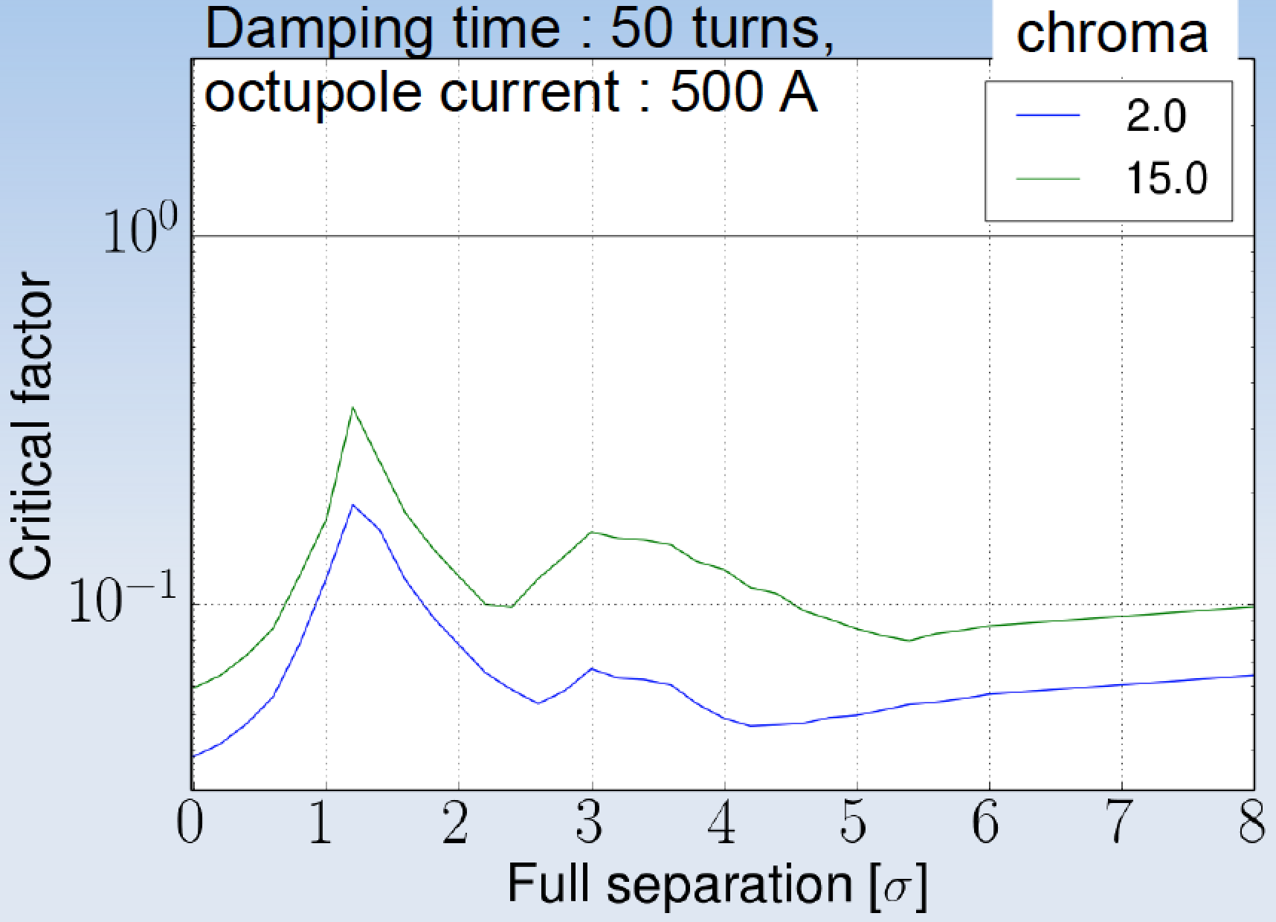
Is leveling by transverse offset a viable option?
The stability of the beams is reduced when colliding with an offset, BUT the model predicts sufficient margins with current machine and beam parameters
Courtesy of X. Buffat

Slide 54
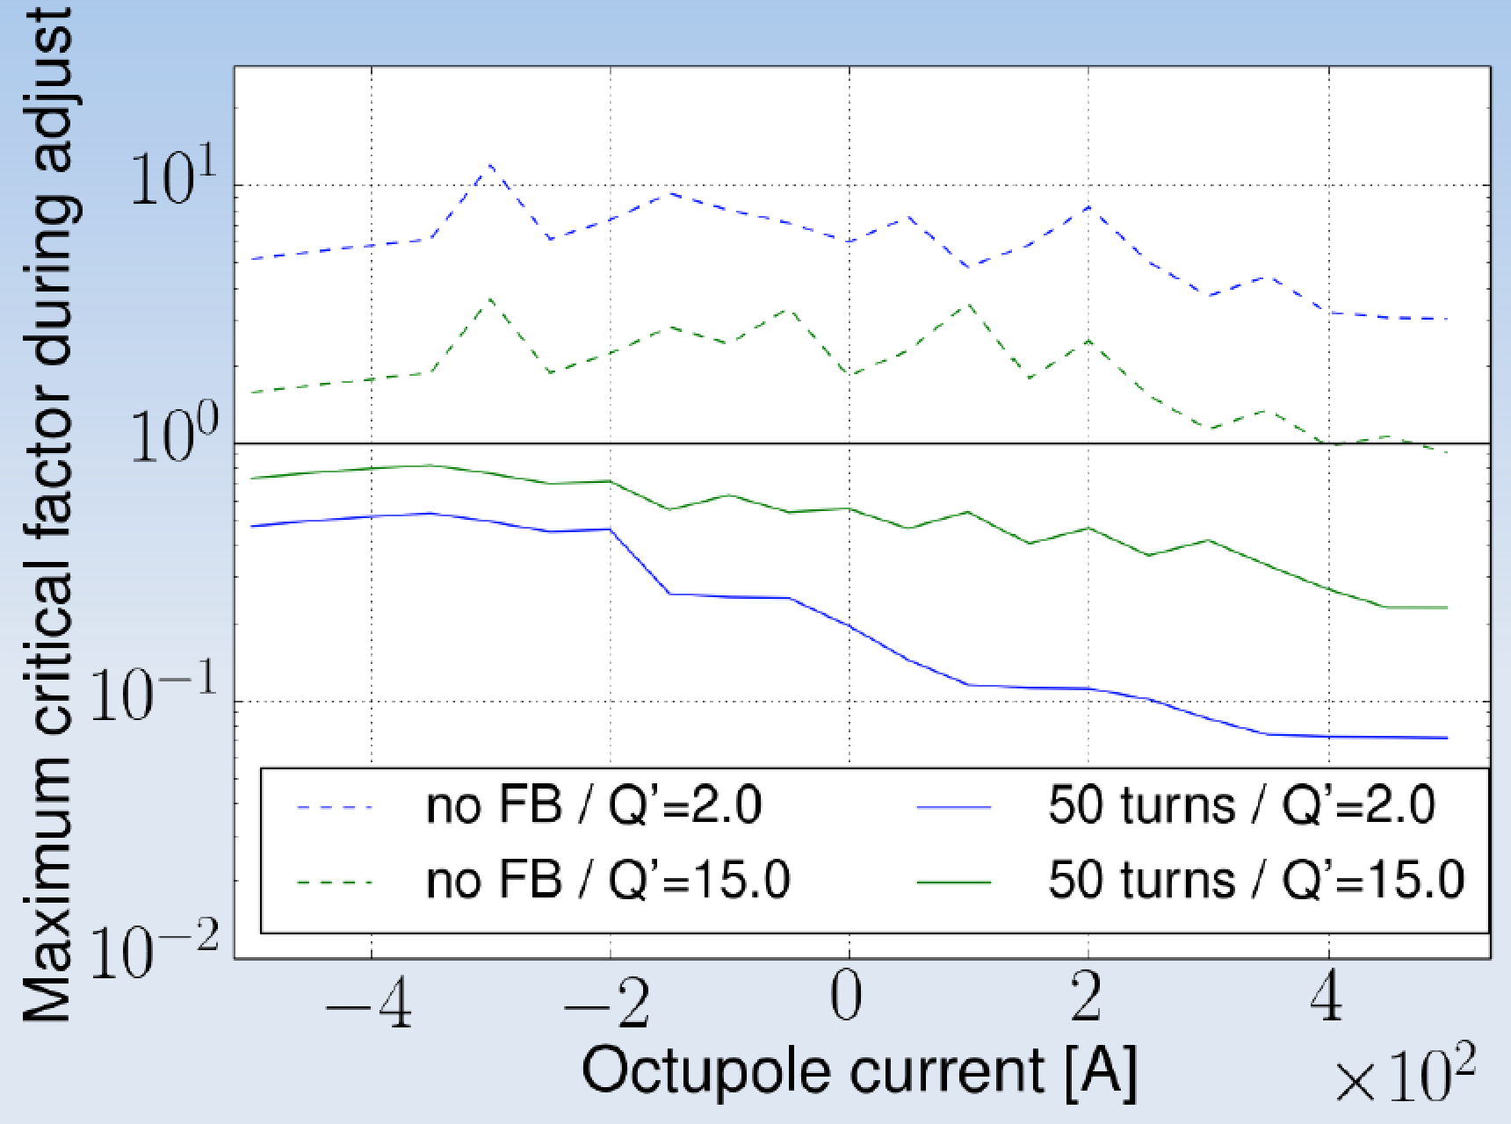
Is leveling by transverse offset a viable option?
The stability of the beams is reduced when colliding with an offset, BUT the model predicts sufficient margins with current machine and beam parameters
Courtesy of X. Buffat

Slide 55
Is leveling by transverse offset a viable option?
No instabilities were observed in dedicated tests with reduced octupole current and chromaticity

Slide 56
Is leveling by transverse offset a viable option?
No instabilities were observed in dedicated tests with reduced octupole current and chromaticity
A strong instability was observed when the damper was off (as predicted)

Slide 57
Is leveling by transverse offset a viable option?
No instabilities were observed in dedicated tests with reduced octupole current and chromaticity
A strong instability was observed when the damper was off (as predicted)
Some instabilities observed in ADJUST in the vertical plane of B1 during physics fill and some studies remain to be understood…

Slide 58
E-cloud induced instabilities
K. Li

Slide 59
E-cloud induced instabilities
INJECTION: In 2016, moving to BCMS beam (with smaller transverse emittances), the beam became unstable at injection => Could be stabilised by increasing the current in the Landau octupoles: LOF increased from 20 A (knob = - 1.5) to 40 A (knob = - 3)
K. Li

Slide 60
E-cloud induced instabilities
INJECTION: In 2016, moving to BCMS beam (with smaller transverse emittances), the beam became unstable at injection => Could be stabilised by increasing the current in the Landau octupoles: LOF increased from 20 A (knob = - 1.5) to 40 A (knob = - 3)
Courtesy of K. Li
K. Li

Slide 61
E-cloud induced instabilities
Can this be explained by simulations?
K. Li

Slide 62
E-cloud induced instabilities
Can this be explained by simulations?
Courtesy of K. Li
K. Li

Slide 63
E-cloud induced instabilities
Can this be explained by simulations?
Courtesy of K. Li
K. Li

Slide 64
E-cloud induced instabilities
Can this be explained by simulations?
Courtesy of K. Li
K. Li

Slide 65
E-cloud induced instabilities
Summary
K. Li

Slide 66
E-cloud induced instabilities
Summary
  E-cloud (from dipoles only) could explain the observations in V-plane
K. Li

Slide 67
E-cloud induced instabilities
Summary
  E-cloud (from dipoles only) could explain the observations in V-plane
  However, the H-plane should be stable => Simulations ongoing adding e-cloud in quadrupoles, etc.
K. Li

Slide 68
E-cloud induced instabilities
STABLE BEAM: In 2016, signs of e-cloud induced instability in stable beam with batches of 72 bunches for Q’ ~ 15

Slide 69
E-cloud induced instabilities
STABLE BEAM: In 2016, signs of e-cloud induced instability in stable beam with batches of 72 bunches for Q’ ~ 15
  Only vertical (B1&B2)
  At the end of trains of 72 bunches
  Emittance BU by a factor ~ 2
  No beam loss

Slide 70
E-cloud induced instabilities
STABLE BEAM: In 2016, signs of e-cloud induced instability in stable beam with batches of 72 bunches for Q’ ~ 15
  Only vertical (B1&B2)
  At the end of trains of 72 bunches
  Emittance BU by a factor ~ 2
  No beam loss

Slide 71
E-cloud induced instabilities
STABLE BEAM: In 2016, signs of e-cloud induced instability in stable beam with batches of 72 bunches for Q’ ~ 15
  Only vertical (B1&B2)
  At the end of trains of 72 bunches
  Emittance BU by a factor ~ 2
  No beam loss
  => Was cured by increasing the vertical chromaticity (+7) in stable beam (to ~ 22)

Slide 72
E-cloud induced instabilities
Possible mechanism?
K. Li

Slide 73
E-cloud induced instabilities
Possible mechanism?
K. Li

Slide 74
E-cloud induced instabilities
Possible mechanism?
  Huge simulation work which seems to confirm the predicted effect
Courtesy of G. Iadarola and A. Romano
K. Li

Slide 75
E-cloud induced instabilities
Possible mechanism?
  Huge simulation work which seems to confirm the predicted effect
  If confirmed, should not be a problem for HL-LHC
Courtesy of G. Iadarola and A. Romano
K. Li

Slide 76
Conclusion

Slide 77
Conclusion
Impedance induced instabilities

Slide 78
Conclusion
Impedance induced instabilities
  ~ As predicted (or even better)

Slide 79
Conclusion
Impedance induced instabilities
  ~ As predicted (or even better)
  A sufficient margin should exist

Slide 80
Conclusion
Impedance induced instabilities
  ~ As predicted (or even better)
  A sufficient margin should exist
2 mechanisms are critical for beam stability (from both simulations and measurements)

Slide 81
Conclusion
Impedance induced instabilities
  ~ As predicted (or even better)
  A sufficient margin should exist
2 mechanisms are critical for beam stability (from both simulations and measurements)
  Linear coupling between the transverse planes => OK when corrected (at the ~ 0.001 level)

Slide 82
Conclusion
Impedance induced instabilities
  ~ As predicted (or even better)
  A sufficient margin should exist
2 mechanisms are critical for beam stability (from both simulations and measurements)
  Linear coupling between the transverse planes => OK when corrected (at the ~ 0.001 level)
  E-cloud => From injection till stable beam!

Slide 83
Conclusion
In case of issues with transverse instabilities in the future, other remedies exist and are being studied

Slide 84
Conclusion
In case of issues with transverse instabilities in the future, other remedies exist and are being studied
  Q”

Slide 85
Conclusion
In case of issues with transverse instabilities in the future, other remedies exist and are being studied
  Q”
  RFQ

Slide 86
Conclusion
In case of issues with transverse instabilities in the future, other remedies exist and are being studied
  Q”
  RFQ
  Wide-band feedback system

Slide 87
Thank you for your attention!

