Slide 1

Crab Cavities Vacuum Interfaces for SPS Tests & HL-LHC
V. Baglin on behalf of WP12
6th HL-LHC Collaboration Meeting, Paris, 14-16th November 2016

Slide 2
Outline
Crab cavities in SPS
Crab cavities in HL-LHC
Conclusion

Slide 3
1. Crab Cavities in SPS

Slide 4
Crab Cavity Test Specifications
Location SPSBA6
  Half period QDA 61710
Schedule:
  New SPS sectorisation by EYETS 2016-2017
  Bypass installation during YETS 2017-2018
  Operates during LHC technical stops
Beams:
  Low intensity, single nominal bunch then multi-bunch (4 x 72b)
Vacuum level:
  ~ 10⁻¹⁰ mbar

Slide 5
Layout
A bypass is created in LSS6
Operating pressure ~ 10⁻¹⁰ mbar with beams
a-C coating is used to mitigate electron cloud
Cryomodule to be tested is conditioned at surface with valves V3 and V4 installed
Valves V2 and V5 allows to keep the bypass under vacuum during cryomodule exchange
VGHA + VGHB
V2
VGHA + VGHB
V4
VGHA + VGHB
VGHA + VGHB
V3
V5
V6
V1
VPIB
500 l/s
VPIB
500 l/s
VGHB
aC Coating
C. Pasquino, J. Hansen

Slide 6
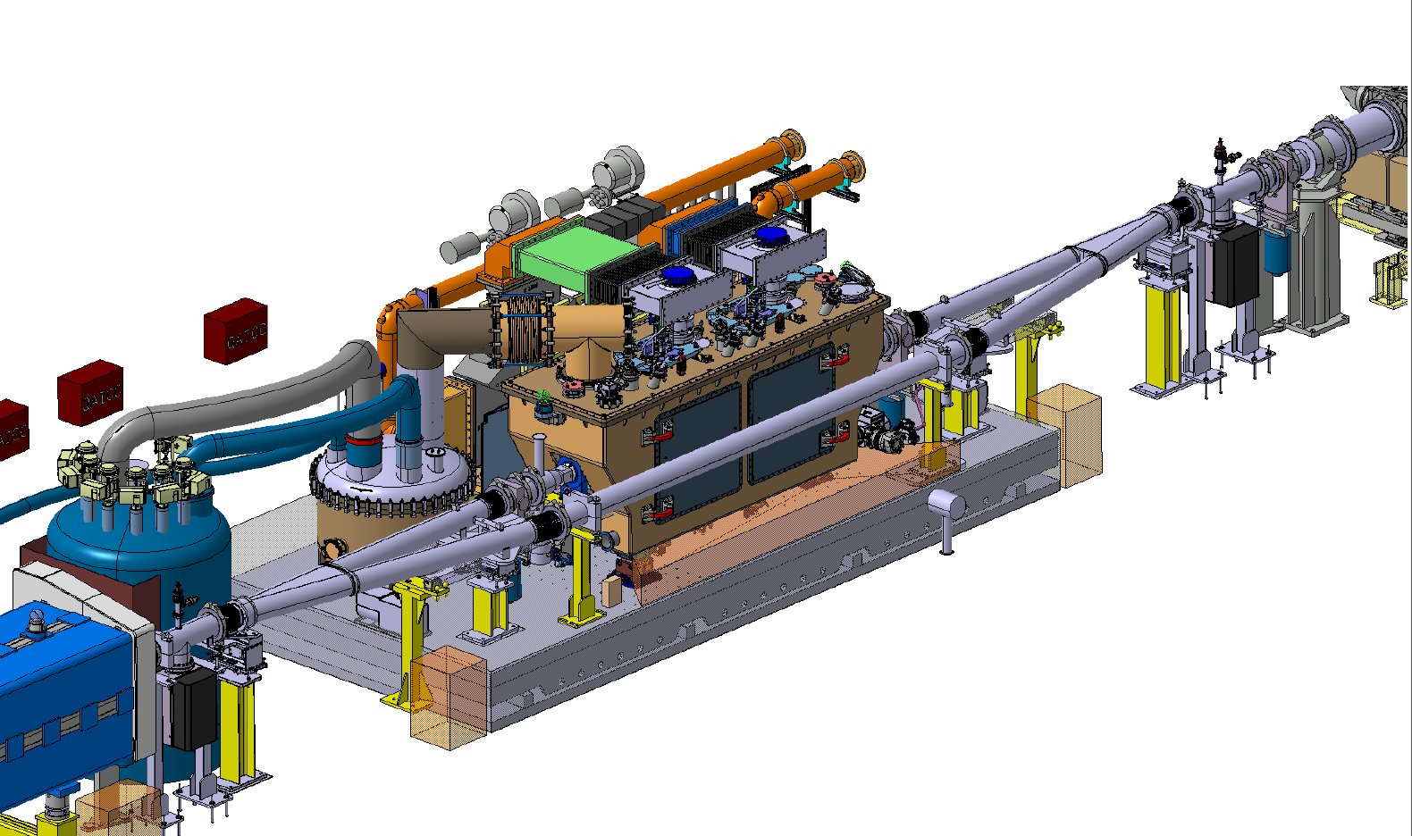
3D integration
Full installation is planned in 2 phases: EYETS 2016-17 + YETS 2017-18
S. Mehanneche

Slide 7
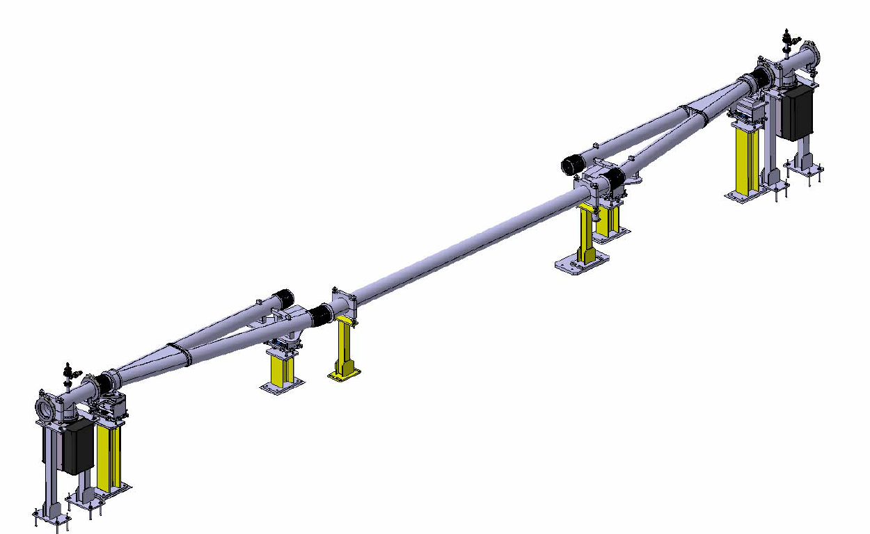
Y-Chamber & Bypass Supports
Design of Y chamber:
  Mechanical done
  Impedance under study (feedback expected from the IWG by Dec).
Production to start by Dec 2016
a-C coating October 2017
Supports and bypass design are well advanced (studied in collaboration with integration, alignment and the movable table teams).
Production to start by spring 2017
Delivery before YETS 2017-18
Y-chamber
Bypass assembly
J. Hansen, Q. Deliege

Slide 8
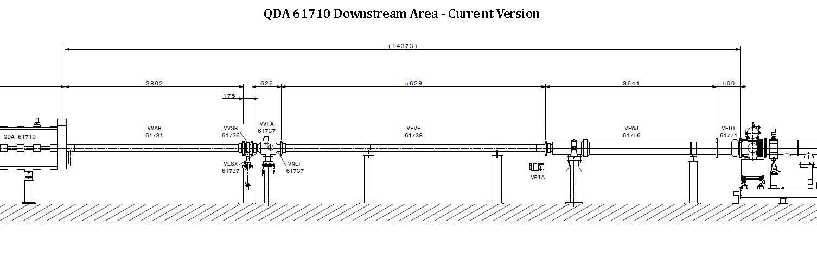
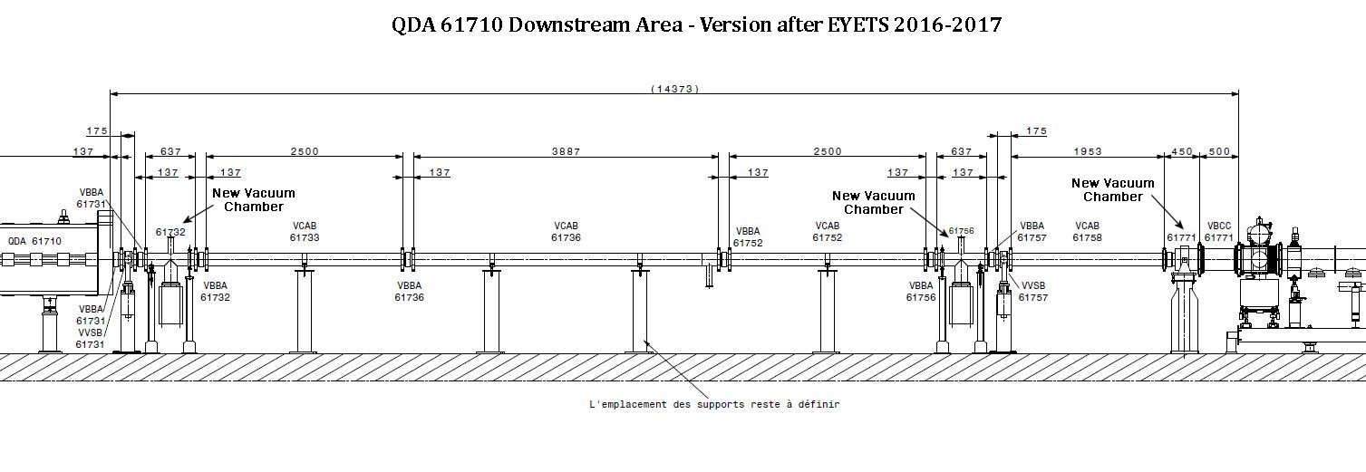
EYETS 2016-17
Implementation of the new sectorisation: Valves V1 and V6
~ 9.5 m are made available for the future installation of the bypass
ECR EDMS 1706946
Fast valve displaced upstream to the QDA 61710.
The intervention is planned to minimise the air exposure of the neighbouring sector with the aim to avoid the bakeout of the TPSG and MST.
  Venting the 2 adjacent sectors with N₂
  Immediate installation of the sector valves V1 & V6 to allow pump down of the adjacent vacuum sectors
TPSG - MST
VVSB, V1
VVSB, V6

Slide 9
YETS 2017-18
ECR to be finalised by March 2017
Components to be ordered / built & validated
Sequence:
    Venting and removal of SPS pipe
    Installation, alignment and closure of the CC bypass system (with a replacement chamber if CC not available)
    Pump down and leak detection
    Functional tests (moving table + instrumentation)
Installation, operating and maintenance procedures to be defined

Slide 10
2. Crab Cavities in HL-LHC

Slide 11
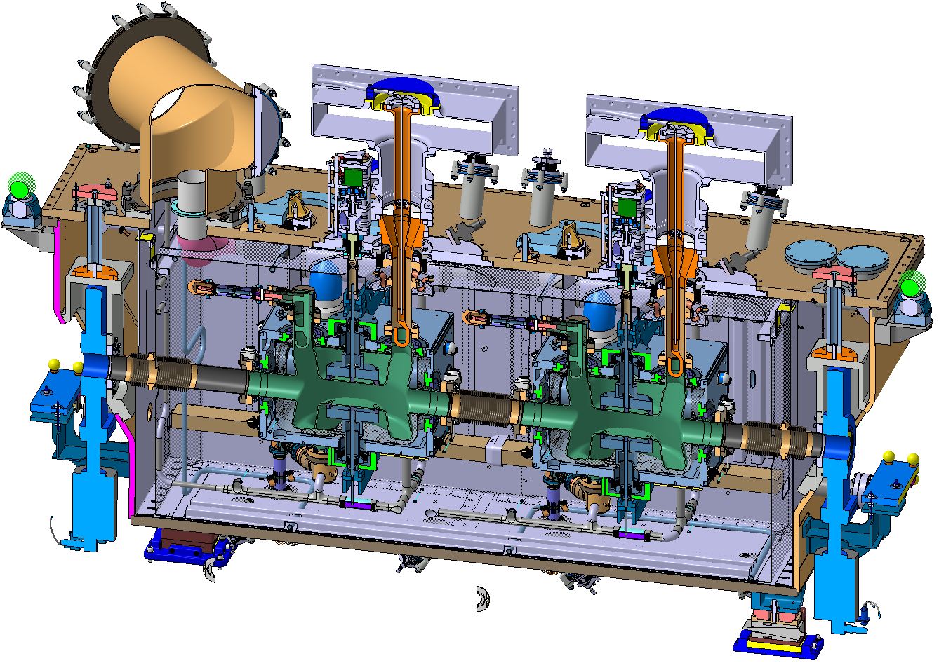
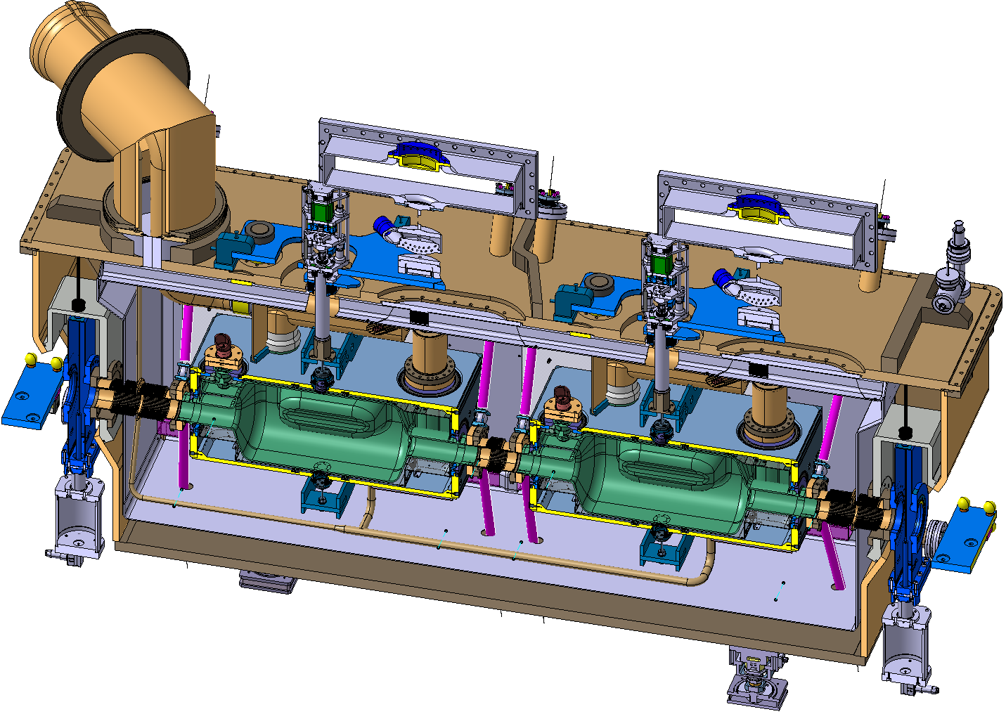
HL-LHC Crab Cavities
Operating pressure ~ 10⁻¹⁰ mbar with beams
2 designs with bulk Nb operating at 2 K
Vacuum instrumentation on the modules is under definition
Drawings and leak detection procedures need to be validated by VSC
Double Quarter Wave, Vertical Deflection (ATLAS)
RF Dipole,
Horizontal Deflection (CMS)
Illustration with SPS-type Cryomodules
R. Calaga, O. Capatina

Slide 12
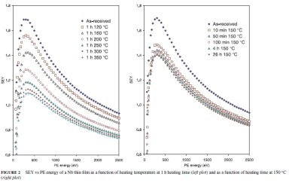
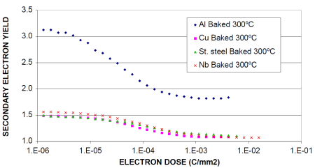
Electron Cloud
Impact of the electron cloud in the CC modules must be evaluated by WP2:
    Nb cavity itself
    Inter-cavity tube
    Module cold warm transition
Samples will be needed for qualification
1.1 < Nb film SEY < 1.7
Electron conditioning
N. Hilleret et al., Appl. Phys. A 79, 1085-1091 (2003)
N. Hilleret et al. EPAC 2000, Vienna, Austria

Slide 13
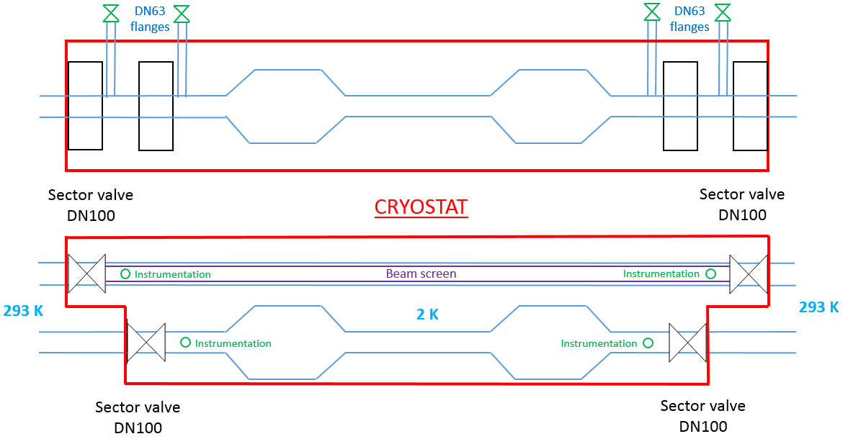
Conceptual Specifications
In order to guarantee vacuum stability, the non-crabbed vacuum chamber, operating at 2K, needs to be designed with a perforated beam screen-type system operating at 5-20K.
To separate room temperature from cold temperature pipes, 4 Sector valves DN100 in each crab module are required. They will allow conditioning of the cryomodules at the surface.
The 4 sector valves are interlocked to the beam
Two instrumentation ports per beam line are required to provide the vacuum instrumentation.
2 K
2 K
Instrumentation port
Side view
Top view
2 K
2 K
2 K
Sector valve

Slide 14
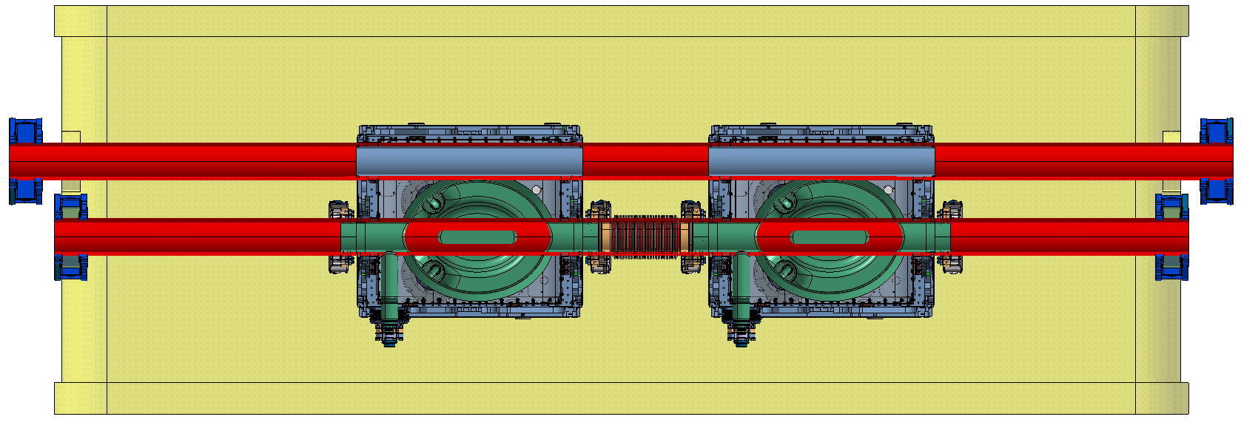
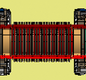
Non-Crabbed beam pipe
The 2nd beam pipe is held at 2 K and has its diameter limited by space
Cold warm transitions (CWT) have to be designed
In LHC, maximum length without beam screen is < 1 m (to be revised for HL-LHC)
Detailed studies are needed to comply with vacuum stability and pressure level (background to experiments)
CWT
CWT
A beam screen between
2 cryogenic pipes ?
A beam pipe with
Antechamber ?

Slide 15
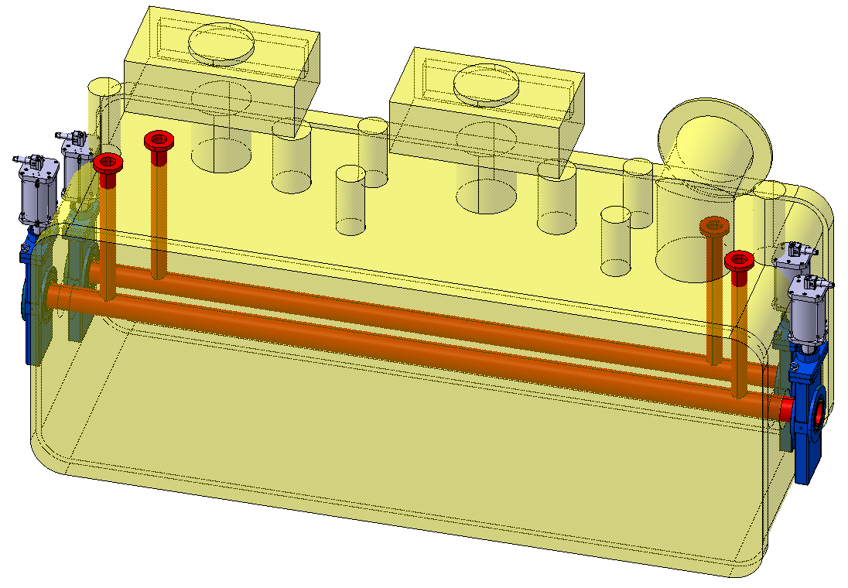
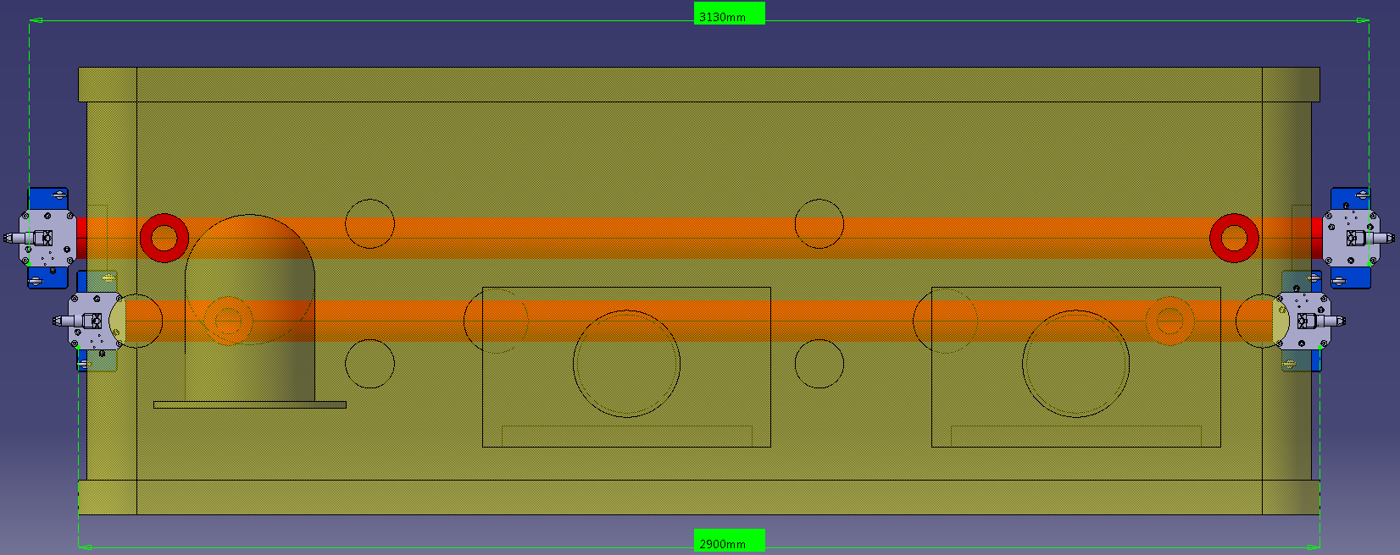
Instrumentation Integration
The cryomodule sector valves must be staggered due to the 194 mm beam separation and sector valve size. So, there are different cryomodule envelope length for crabbed and non-crabbed beams.
The estimated length are:
  3130 mm for the non-crabbed sector
  2900 mm for the crabbed sector
Detailed mechanical studies must be conducted in collaboration with and validated by WP4.
Instrumentation ports
Sector
valve
Mock-up ST0782198_01*
Courtesy of T. Capelli

Slide 16
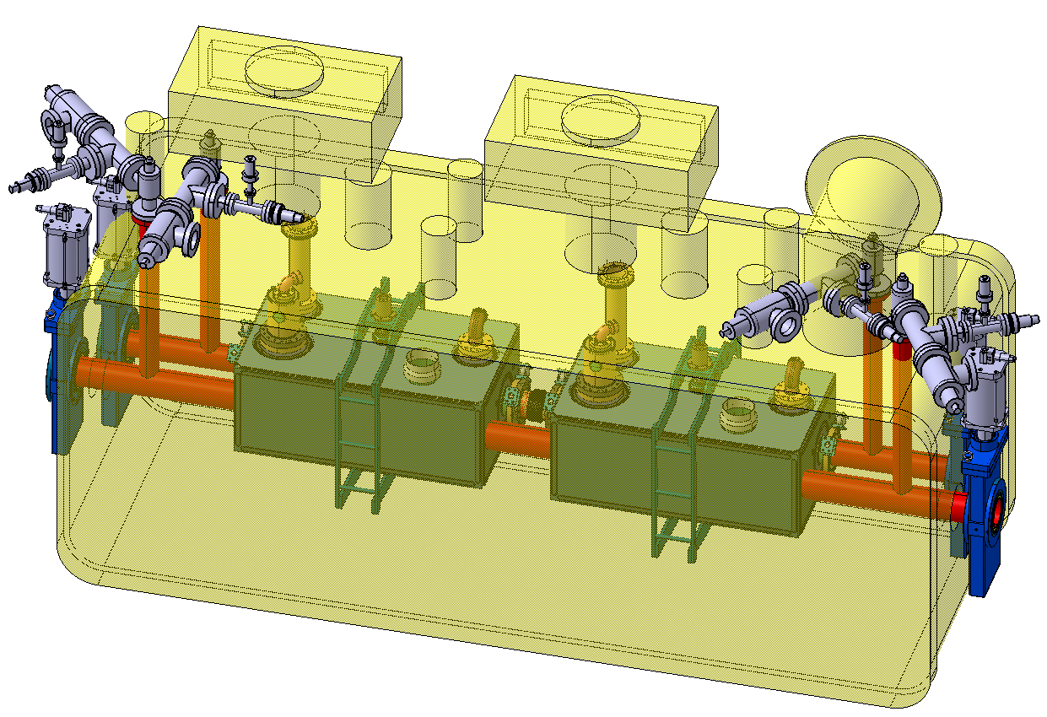
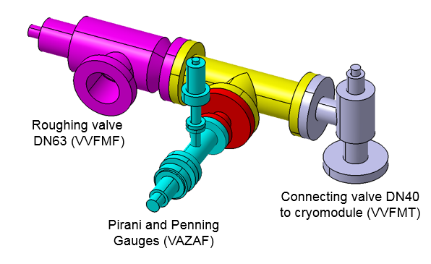
Preliminary Instrumentation Integration
The 4 instrumentation ports is equipped with vacuum gauges and roughing valves for monitoring and maintenance of the cryomodule
Detailled integration studied must be conducted and validated with WP4 and WP15.
P. Santos Diaz
Mock-up ST0782198_01*
Courtesy of T. Capelli

Slide 17
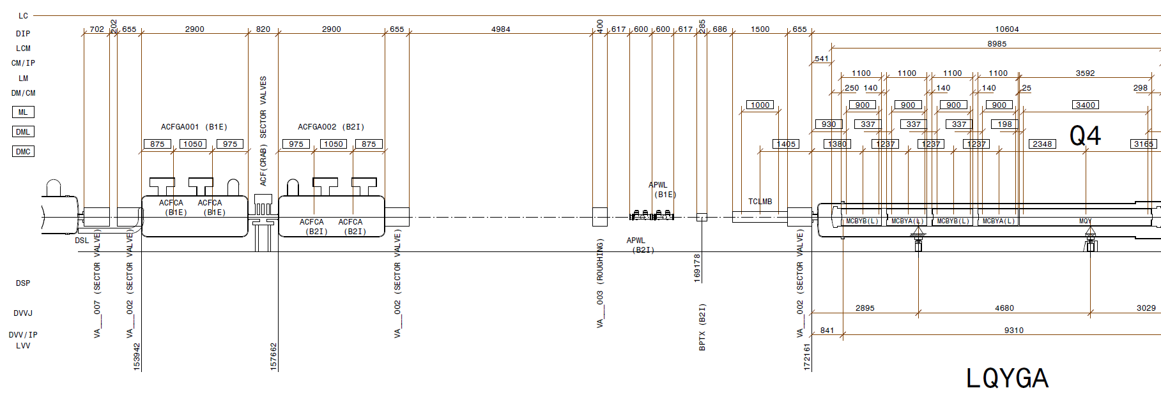
Layout –D2-Q4
Two cryomodules are installed close to D2
Room is made available for a possible later installation of two other cryomodules
The instrumentation / equipment outside the cryomodules is not yet up to date, it is expected that the next version will reflect the outcome of present studies
D2
Q4
LHCLSXH_0010 V1.3

Slide 18
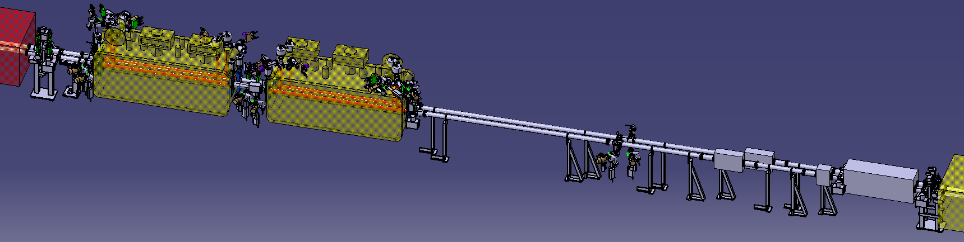
Preliminary Vacuum Layout
Three double room temperature sectors bakeable and NEG coated.
Two sectorized CC modules: unbaked and operating at cryogenic temperature (2K).
Three types of sector valves assemblies (VAB).
The mechanical aperture of the cryomodule is ID84.
The mechanical aperture of the vacuum chambers is ID 91 mm, flanges DN100.
APWL
CC
CC
BPTX
P. Santos Diaz
TCLMB

Slide 19
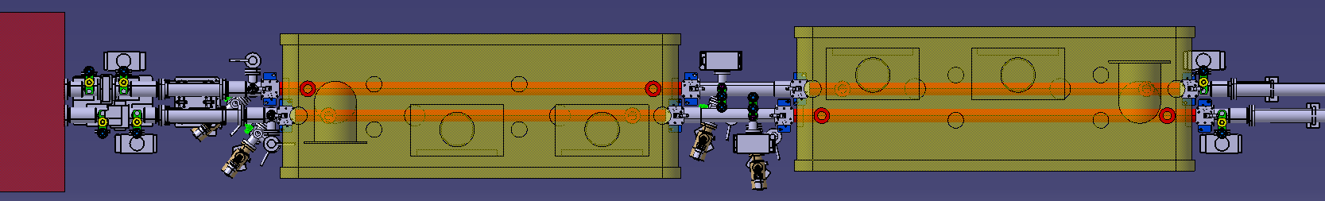
Mechanical Aperture
There are different mechanical apertures between D2 and Q4.
    → They must be studied in detail to define the positions of the ID transitions.
CWT to D2 BS
ID91
ID84
ID84?
ID84
ID91 until Q4
D2
CC
CC
P. Santos Diaz

Slide 20
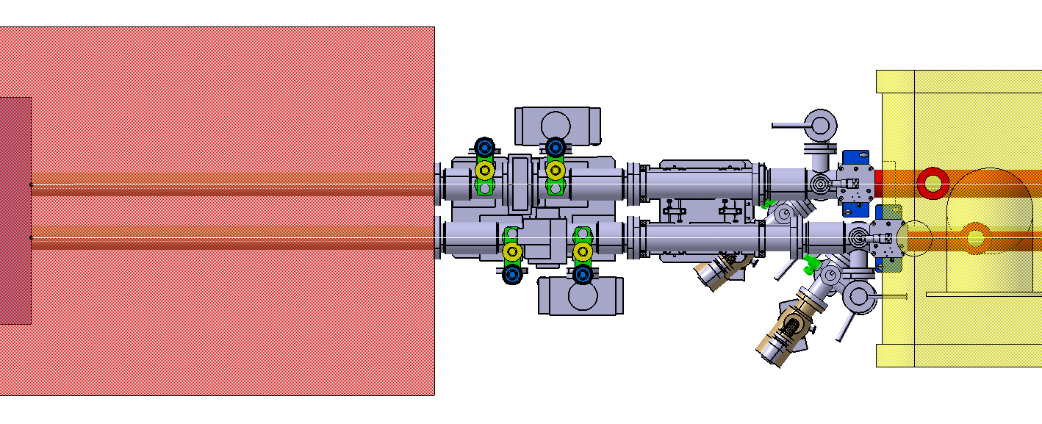
Merging Angle
Due to the difference between the beam separation in D2 (188 mm) and in the cryomodule (194 mm), there must be a mechanical merging angle between D2 flange and CC flange.
  → a special VAB configuration needs to be studied.
Merging angle: ~ 10 mrad
D2
CC
1559 mm
Beam separation: 188 mm
194 mm
tbc by WP3
P. Santos Diaz

Slide 21
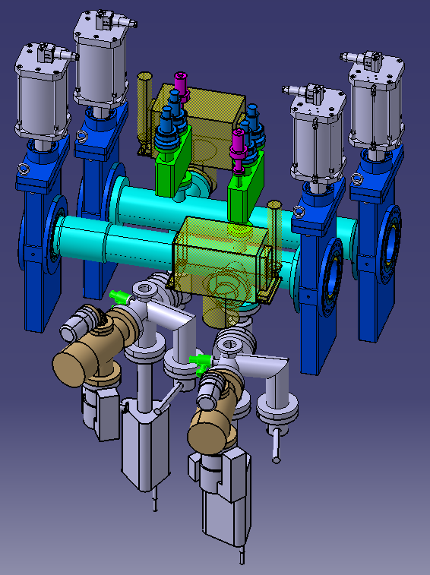
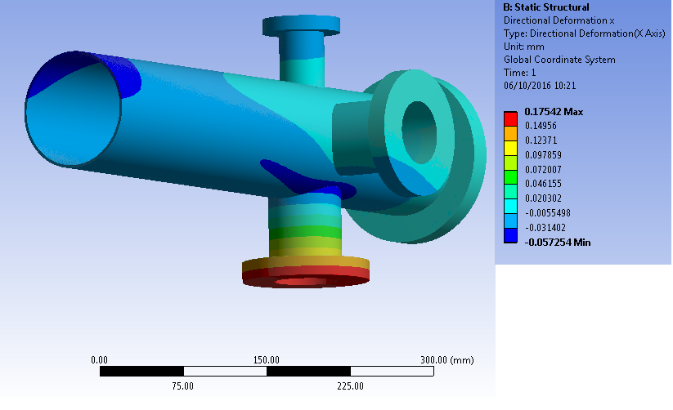
Cryomodule Interconnection
A specific vacuum module must be designed with the following specifications:
  Installed vacuum module length equal to 725 mm.
  Enough strength to support all the instrumentation required in a vacuum sector.
  The vacuum module must be bakeable up to 250 °C.
  Flanges DN100.
  NEG coated.
Detailled integration study is mandatory!
CC
CC
P. Santos Diaz
New vacuum module
stress analysis

Slide 22
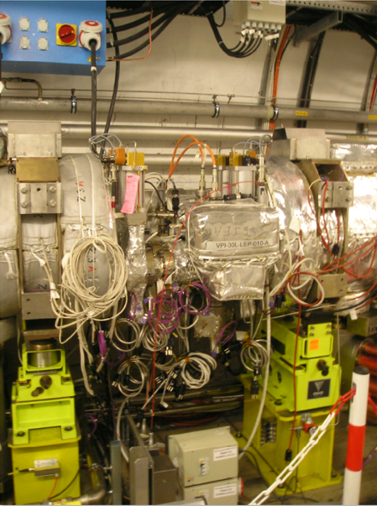
Example: MKI Interconnection
550 mm
The area is very busy …
Lessons learnt shall be implemented in the future HL-LHC crab-cavities cryomodule interconnection area
MKI
MKI

Slide 23
3. Conclusions

Slide 24
Conclusions
The design of the SPS bypass is progressing well
  The implementation is starting this EYETS!
  The system will be a-C coated
  The production of the Y- chamber will start soon!
A preliminary vacuum layout for the CC in HL-LHC has been shown:
  Cryomodule(s) envelope and position of ancillaries equipments must be studied in details (WP4, WP12, 15)
Dedicated studies are needed to:
  Understand the impact of electron cloud (WP2, WP4, WP12)
  Design the 2nd beam pipe of the cryomodule (WP4, WP12)

Slide 25
Thank you for your attention

Slide 26
Back-up slides

Slide 27
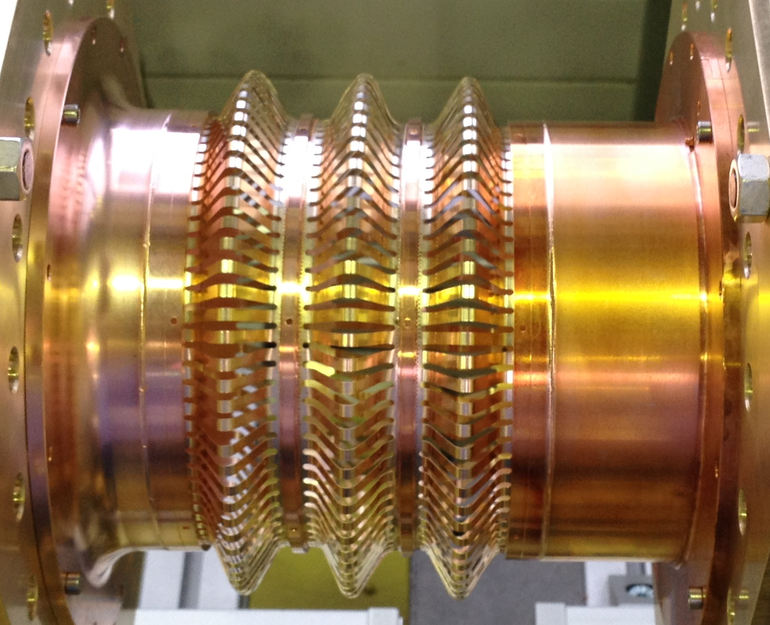
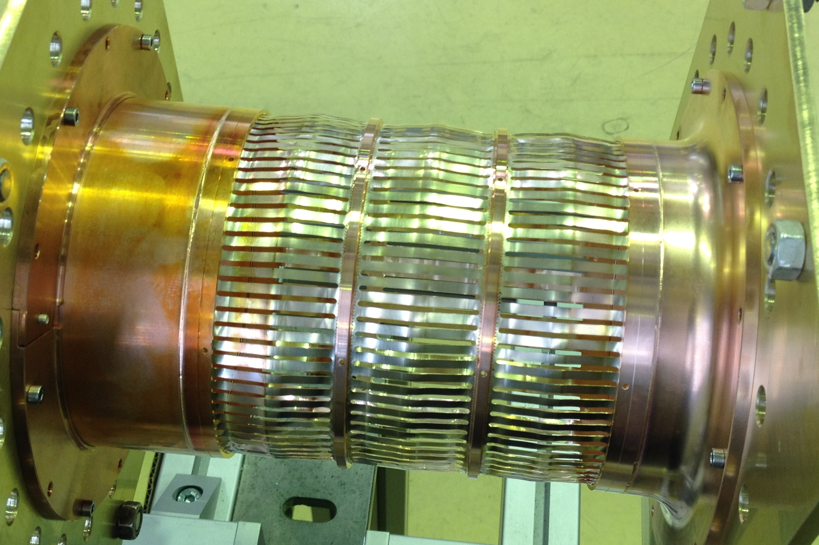
Impact of Transverse Movement
During operation, the cryomodule might move transversaly to compensate the beam movement of ~ 1 mm at the interaction point.
D2
AB
CD
Q4
IP offset:
  x,y: +-3.4 mm (Beam 1, CD),
  x,y: +-1mm (Beam 2, CD),
  avg. offset 1.2 mm, shear 2.2 mm
AB
CD
R. De Maria
New vacuum modules with deformable RF bridge could be designed if needed to accommodate a transverse movement of ~ 5 mm ➔ coordination is needed with WP2, WP4 and WP15
C. Garion

Slide 28
Schematic impact on the cavities
D2
AB
CD
Q4
Crossing angle:
  x,y: +-1.15 mm (Beam 1, AB)
  x,y: -+0.5 mm (Beam 2, AB)
  avg. offset 0.3 mm, shear 1.65 mm
AB
CD
D2
AB
CD
Q4
IP offset:
  x,y: +-3.4 mm (Beam 1, CD),
  x,y: +-1mm (Beam 2, CD),
  avg. offset 1.2 mm, shear 2.2 mm
AB
CD
Knobs can applies to both planes both signs.
Without re-aligning the machine one would need flexibility at the bellows for the two consecutive pipes (5-th axis type?).
Aperture of the crab free pipe (84 mm) still sufficient to accommodate the beam.
R. De Maria

