Slide 1

CERN – NTNU Screening Week
Marthe N. Dehli
Entrepreneurship Development Officer CERN Knowledge Transfer Group
@marthedehli

Slide 2
“The mission of CERN
Knowledge Transfer is to
maximise the impact of
CERN technology, research and know-how in society”

Slide 3
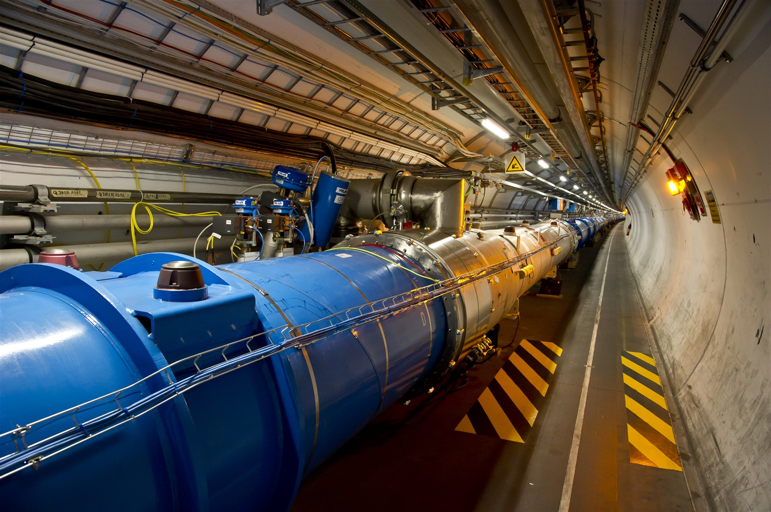
European Organization for Nuclear Research
1954
Joint Venture
22 member states

Slide 4
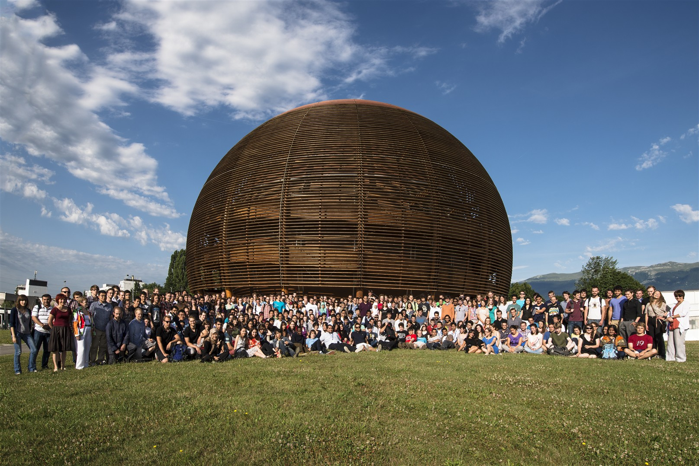


Students at CERN
2015: 157
2015:
518

Slide 5
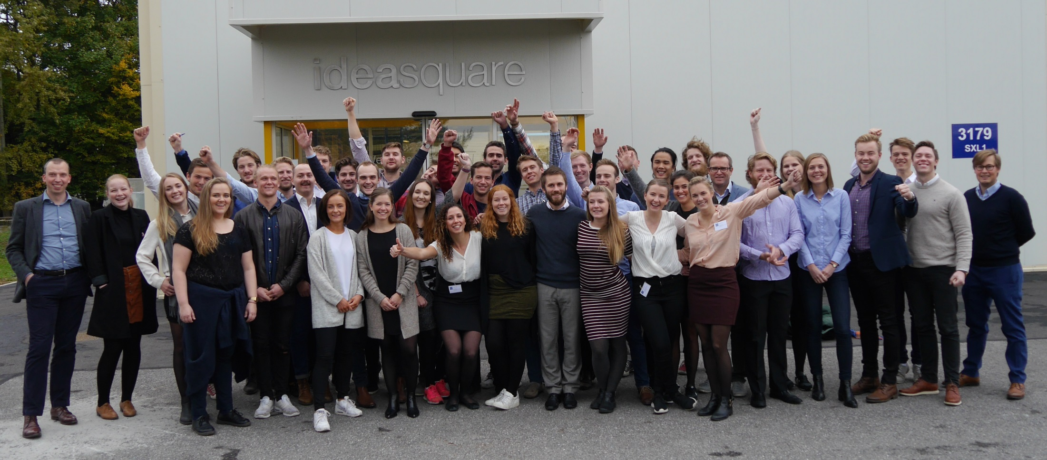
CERN – NTNU Screening Week

Slide 6
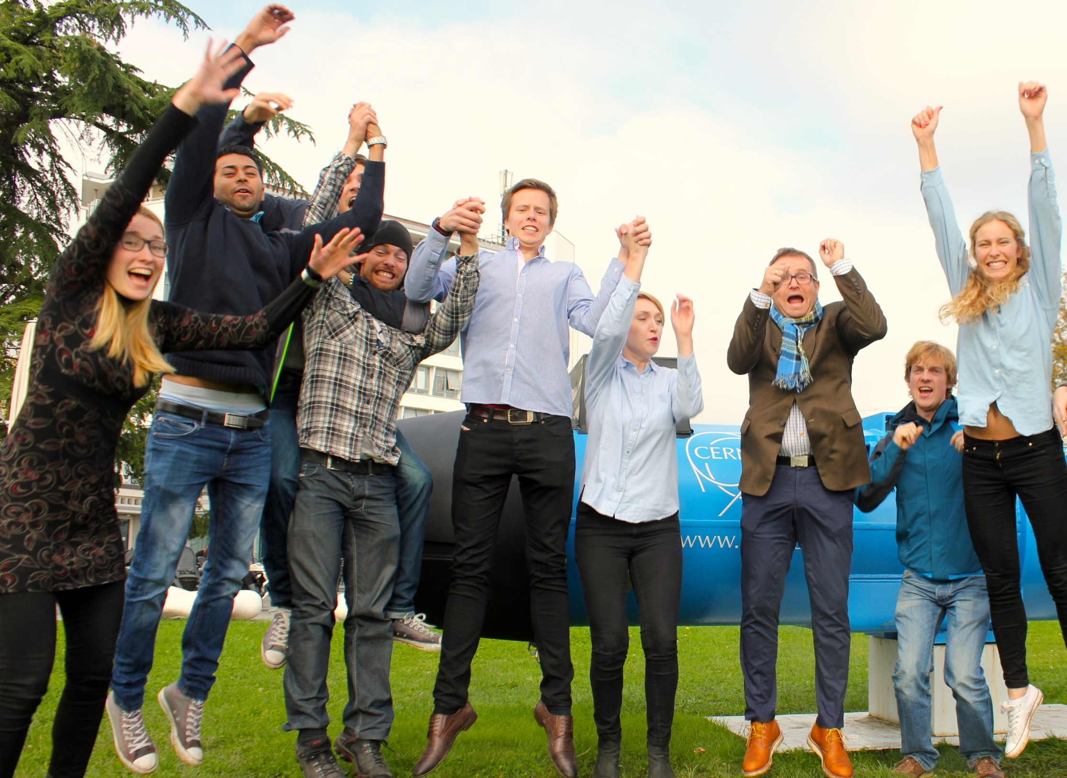
CERN – NTNU Screening Week
9th edition: Oct 2016
4 technologies
Support system
35 students

Slide 7
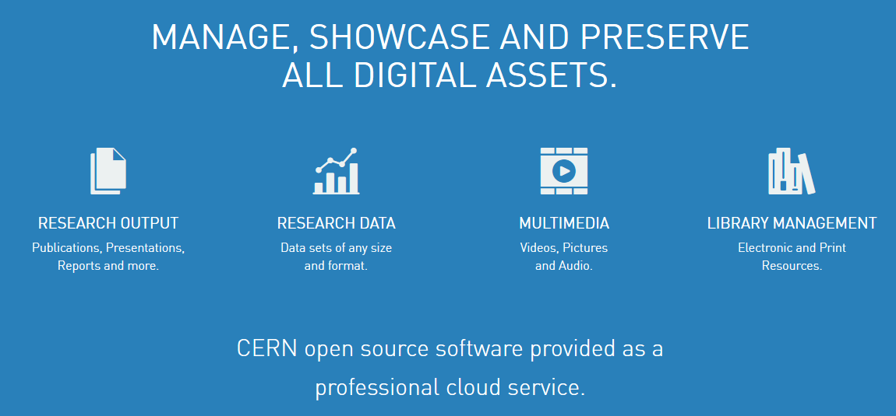
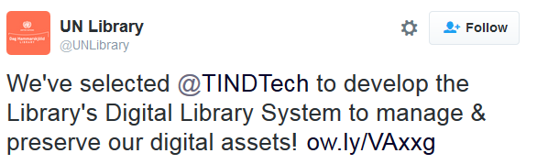


TIND Technologies

Slide 8
TBA
CESP CERN Entrepreneurship Student Program

Slide 9



How
Students
CERN tech
KTOs

Slide 10



How
Tech. experts
Trainings
Lectures

Slide 11



Financial need
40’000 CHF
10’000
CHF
7’500
CHF

Slide 12


