Slide 1


The HIE-ISOLDE Project
M. Pasini, CERN BE-RF and
Instituut voor Kern- en Stralingsfysica, K.U.Leuven

Slide 2
Overview
The ISOLDE Facility- status
HIE-ISOLDE project
Long term plan: towards the EURISOL facility
Summary
M. Pasini CLIC-RF-STRUCTURE meeting 08.04.2009

Slide 4
ISOLDE Community
M. Pasini CLIC-RF-STRUCTURE meeting 08.04.2009

Slide 5
Users trend
Picture from A. Herlert
M. Pasini CLIC-RF-STRUCTURE meeting 08.04.2009

Slide 6
The HIE-ISOLDE facility
M. Pasini CLIC-RF-STRUCTURE meeting 08.04.2009

Slide 7
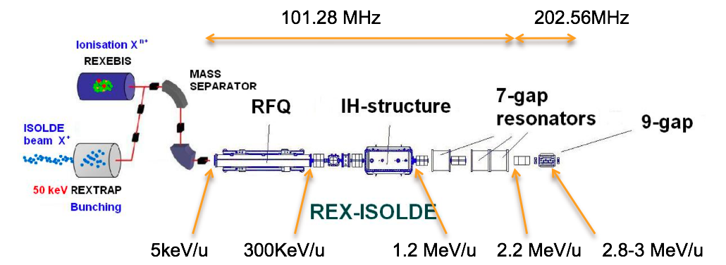
REX-ISOLDE Post accelerator
M. Pasini CLIC-RF-STRUCTURE meeting 08.04.2009

Slide 8
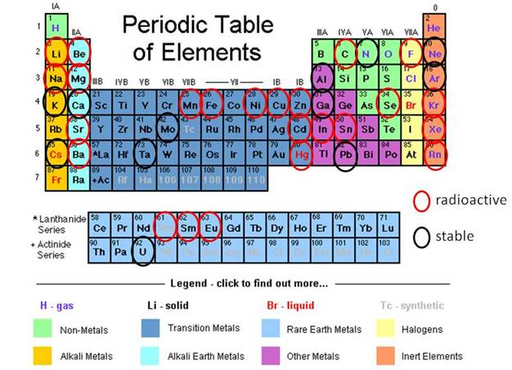
Accelerated elements (1/2)
M. Pasini CLIC-RF-STRUCTURE meeting 08.04.2009

Slide 9
Accelerated elements (2/2)
M. Pasini CLIC-RF-STRUCTURE meeting 08.04.2009

Slide 10
Users next requirements:
Higher energy for the post-accelerated beam
More beams (Intensity wise and different species)
Better beams (High purity beams, low emittances, more flexibility in the beam parameters)
M. Pasini CLIC-RF-STRUCTURE meeting 08.04.2009

Slide 11
HIE-ISOLDE activity
REX energy upgrade and increase of current capacity
Energy upgrade in 3 stages: 5.5 MeV and 8 MeV/u or higher and lower energy capacity
REX trap and charge breeder upgrade
ISOLDE proton driver beam intensity upgrade - strongly linked to PS Booster improvements including linac4
Faster cycling of the booster
New target stations for ISOLDE
New targets
New target handling system
ISOLDE radioactive ion beam quality – more than half already financed through the ISOLDE collaboration
Smaller longitudinal and transverse emittance
Higher charge state for selected users
Better mass resolution
Target and ion source development e.g. RILIS
M. Pasini CLIC-RF-STRUCTURE meeting 08.04.2009

Slide 12
HIE-ISOLDE 1 project
Energy upgrade up to 8 MeV/u with a superconducting linac and the design study of the intensity upgrade
R&D activity funded
HIE-ISOLDE 2 project
Higher Linac energies and Intensity upgrade: targets and charge breeder
M. Pasini CLIC-RF-STRUCTURE meeting 08.04.2009

Slide 13
HIE-ISOLDE SC-linac
SC-linac between 1.2 and 8 MeV/u (possibility to further extend to 10 MeV/u).
Energy fully variable; energy spread and bunch length are tunable. Average synchronous phase φ_{s}= -20 deg
2.5<A/q<4.5 limited by the room temperature cavity
16.02 m length (without matching section)
No ad-hoc longitudinal matching section (incorporated in the lattice)
M. Pasini CLIC-RF-STRUCTURE meeting 08.04.2009

Slide 14
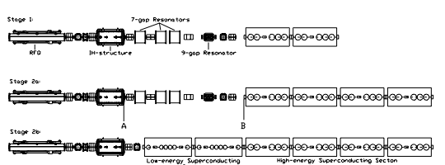
HIE-ISOLDE LINAC - layout
3 stages installation
1.2 MeV/u
3
MeV/u
5.5 MeV/u
8
MeV/u
10 MeV/u
M. Pasini CLIC-RF-STRUCTURE meeting 08.04.2009

Slide 15

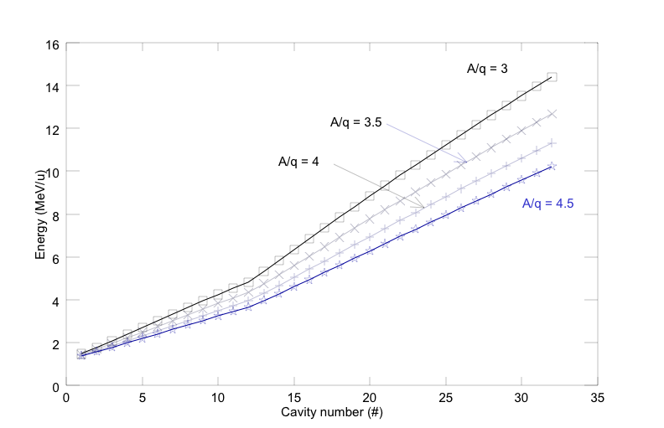
Final Beam Energies
M. Pasini CLIC-RF-STRUCTURE meeting 08.04.2009

Slide 16
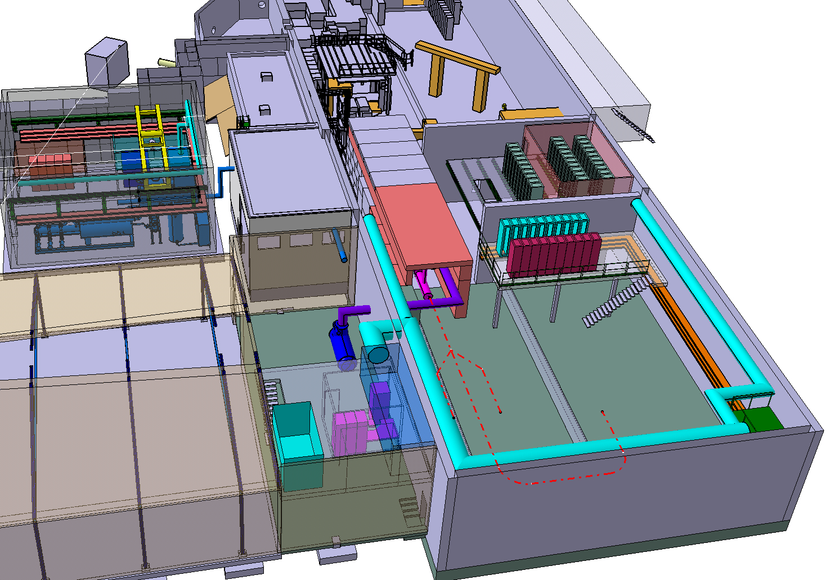
Buildings and infrastructures

Slide 17
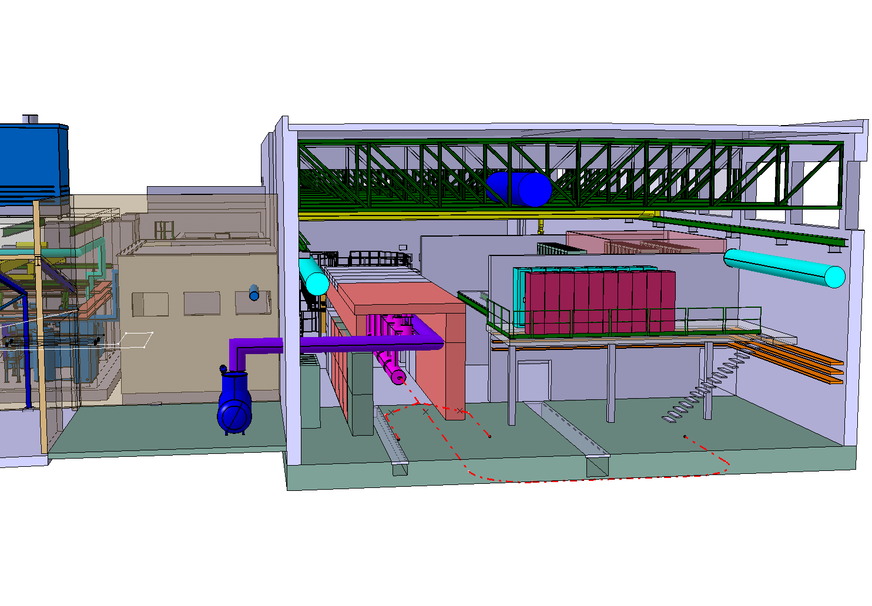

Slide 18
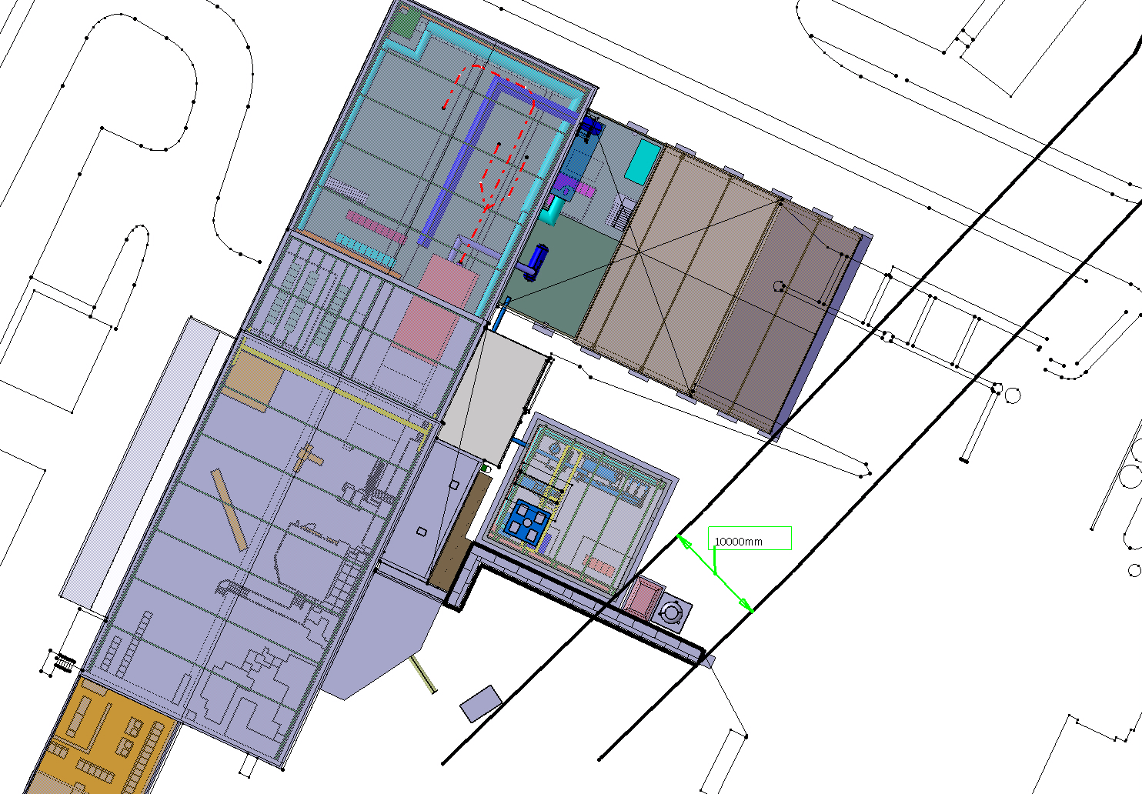

Slide 19
EURISOL at CERN
M. Pasini CLIC-RF-STRUCTURE meeting 08.04.2009

Slide 20
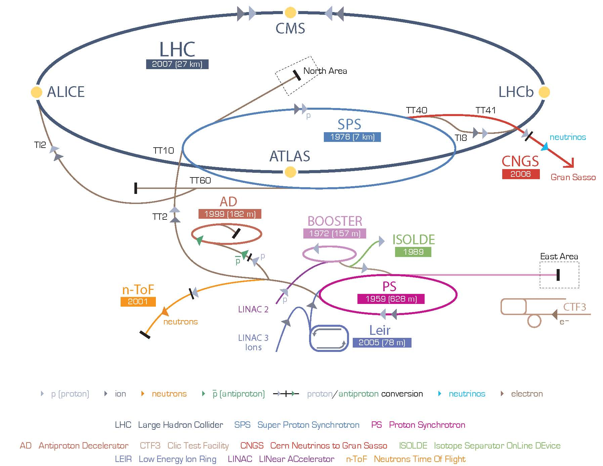
CERN accelerator complex
M. Pasini CLIC-RF-STRUCTURE meeting 08.04.2009

Slide 21
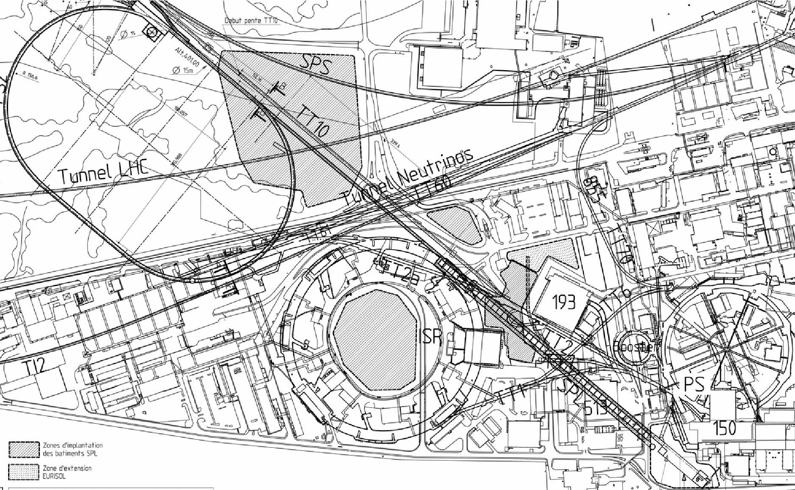
Overall layout of the new injectors (1/2)
SPS
PS2
ISOLDE
PS
SPL
Linac4
M. Pasini CLIC-RF-STRUCTURE meeting 08.04.2009

Slide 22
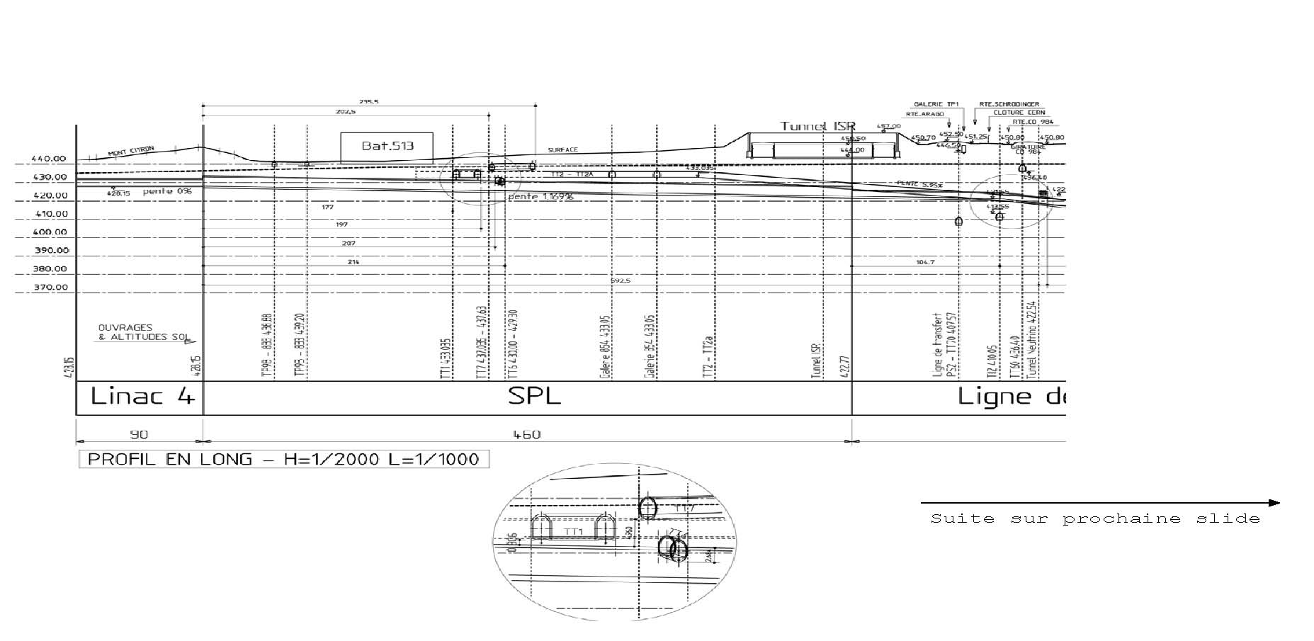
Overall layout of the new injectors (2/2)
M. Pasini CLIC-RF-STRUCTURE meeting 08.04.2009

Slide 23
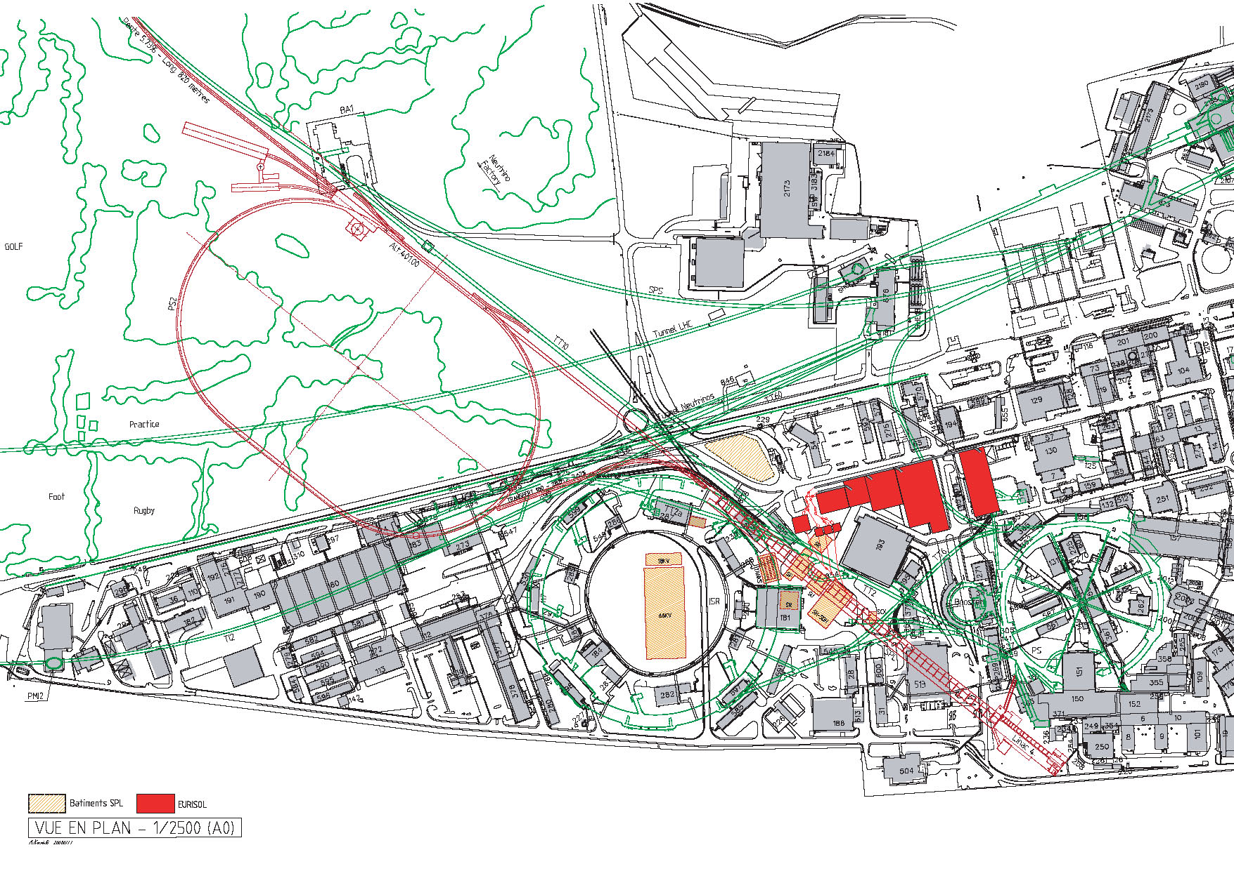
Connections to ISOLDE and EURISOL
TARGETS
RADIOACTIVE IONS LINAC
EURISOL EXPERIMENTAL HALLS
ISOLDE OR
EURISOL HIGH ENERGY EXPERIMENTAL HALL
TRANSFER LINES SPL to EURISOL
TRANSFER LINE SPL to ISOLDE
M. Pasini CLIC-RF-STRUCTURE meeting 08.04.2009

Slide 24
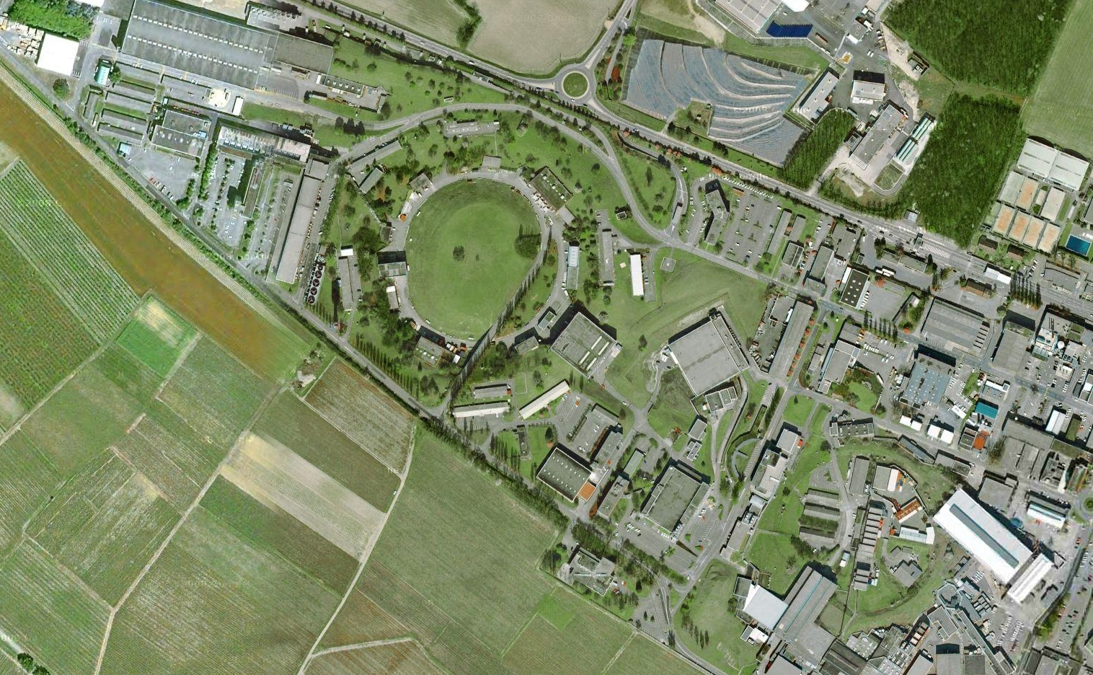

Slide 25
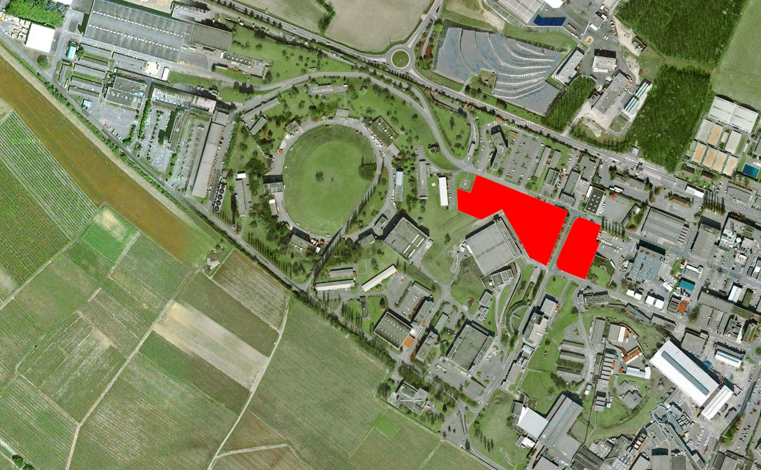

Slide 26
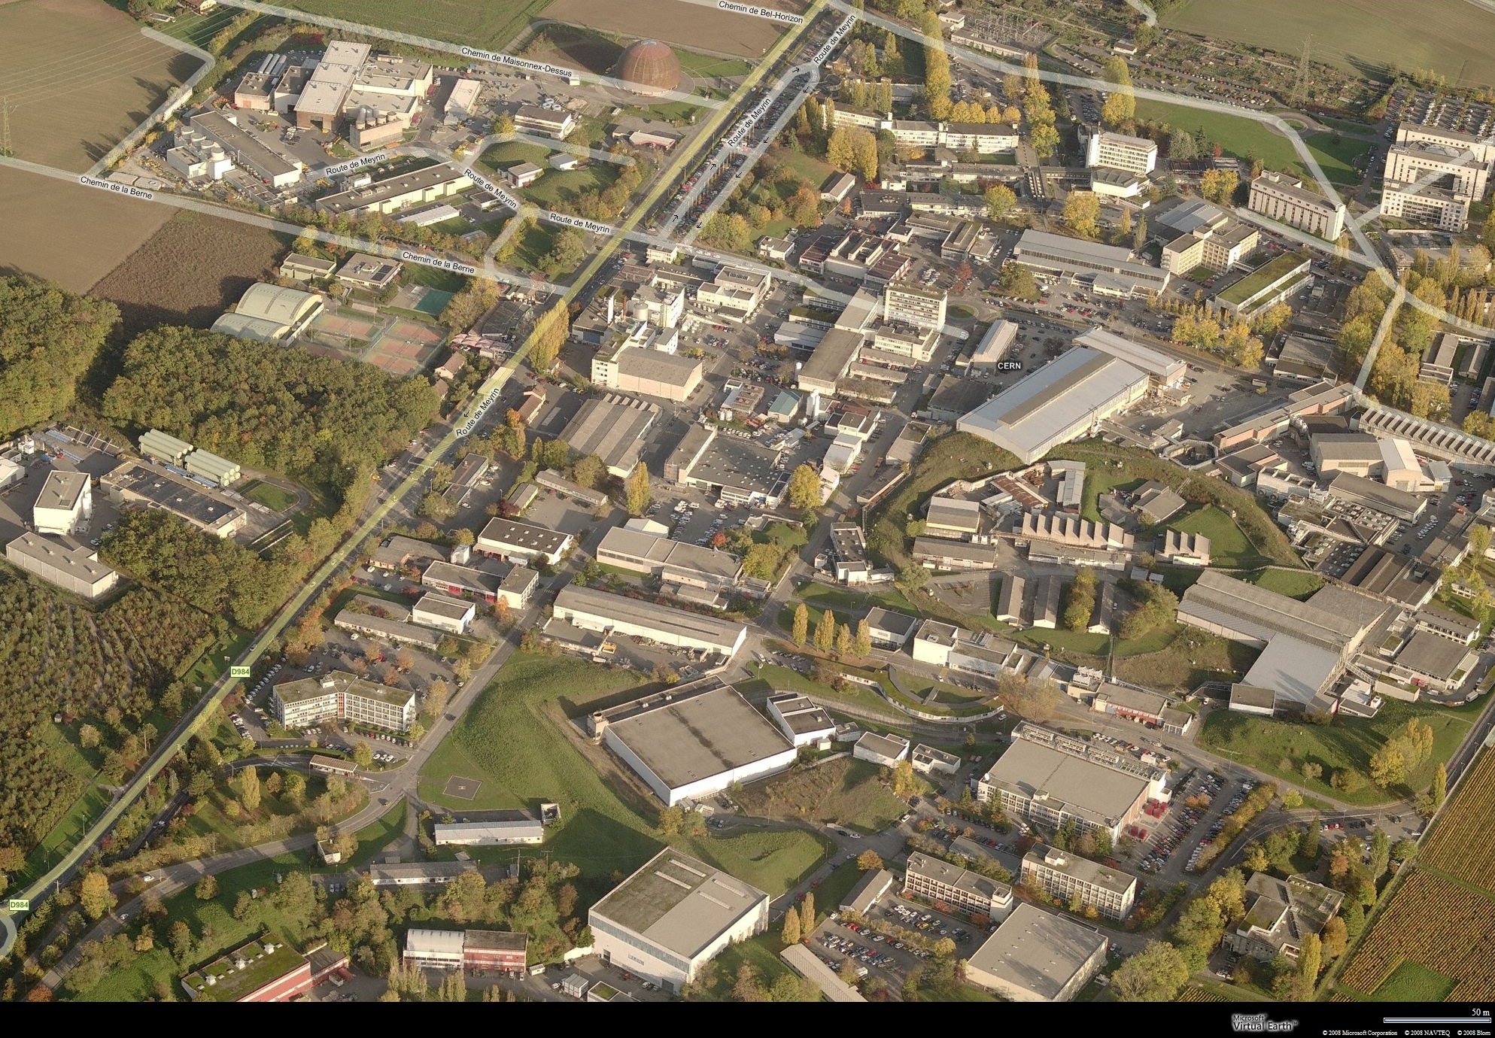

Slide 27
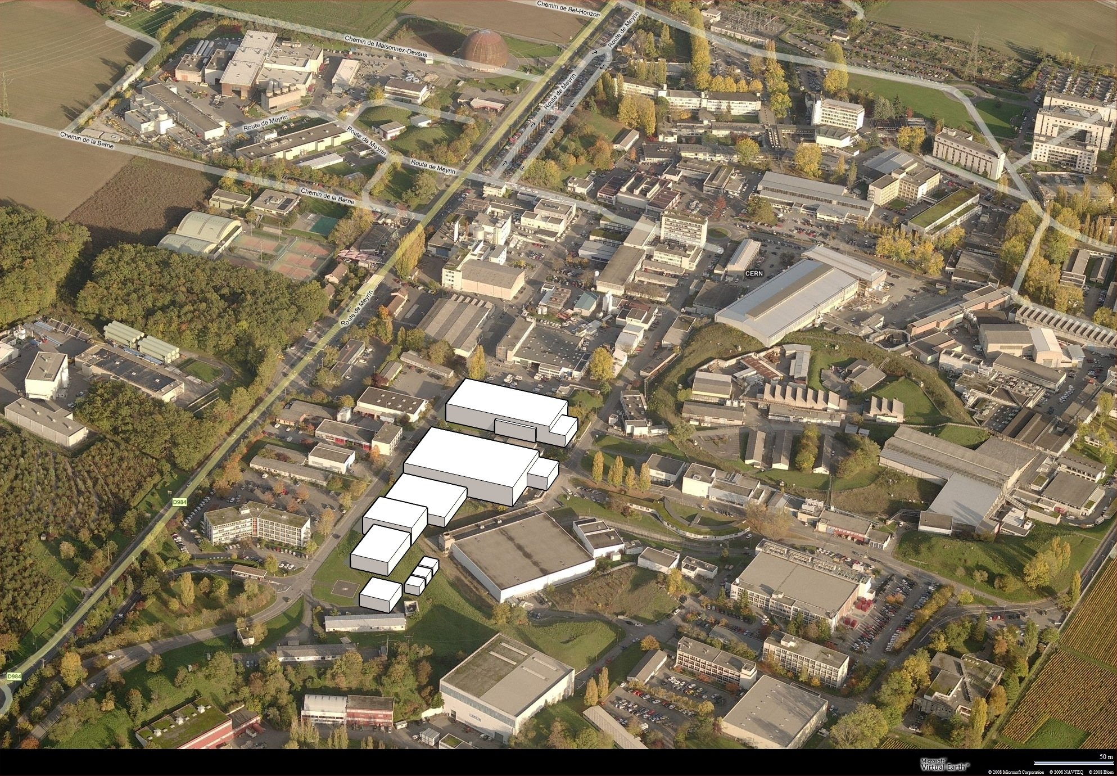

Slide 28
Summary
HIE ISOLDE R&D activity is in good health and ongoing
Test of the first cavity are expected in June/July
The real estate gradient is ~2.5 MV/m (including magnetic elements) which makes the linac very compact (for heavy ions CW machines).
EURISOL at CERN could be a interesting scenario
M. Pasini CLIC-RF-STRUCTURE meeting 08.04.2009

Slide 29
People
HIE-ISOLDE design group
ISOLDE physics and operation group
SPL design group
LNL-INFN and TRIUMF
Cockcroft Institute, Liverpool and Manchester University
KU Leuven
M. Pasini CLIC-RF-STRUCTURE meeting 08.04.2009

