Slide 1



“tune”
Frank Zimmermann
DITANET School, Royal Holloway,
2 April 2009

Slide 2
outline
introduction
tune, coherent & incoherent tune, detectors
integer betatron tune
fractional betatron tune
precision measurement, tune tracking, multiple bunches
modifications of tune signal
damping, filamentation, chromaticity, linear coupling
some “complications”
colliding beams, space charge, measuring incoherent tune
applications
tune shift with amplitude,high-order resonances,tune scans, β function measurement, nonlinear field errors
synchrotron tune
display of complex tune signals

Slide 3
introduction

Slide 4
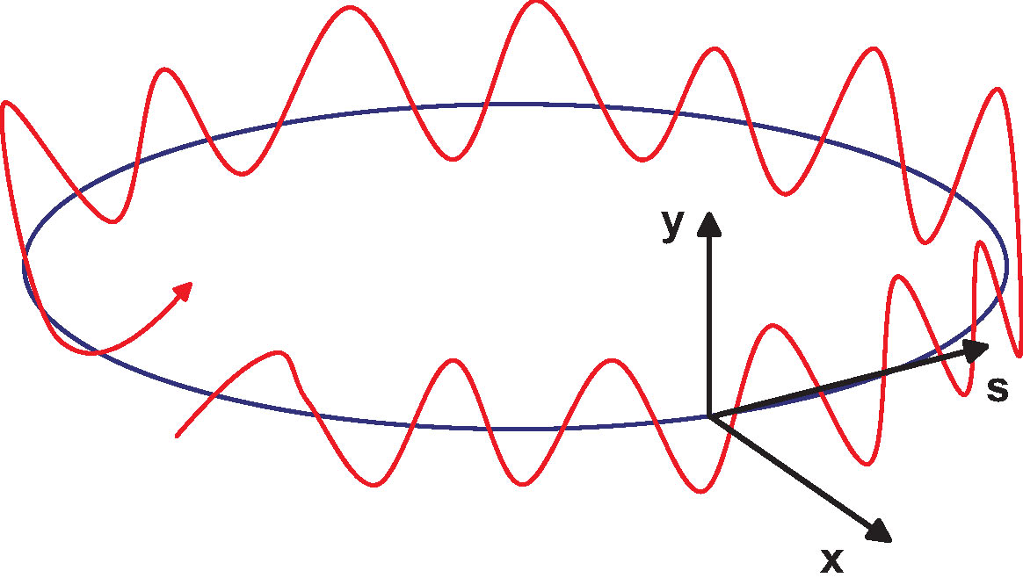
schematic of betatron oscillation around storage ring
tune Q_{x,y}= number of (x,y) oscillations per turn
quadrupole magnet
(many)
focusing elements:
quadrupole magnets

Slide 5
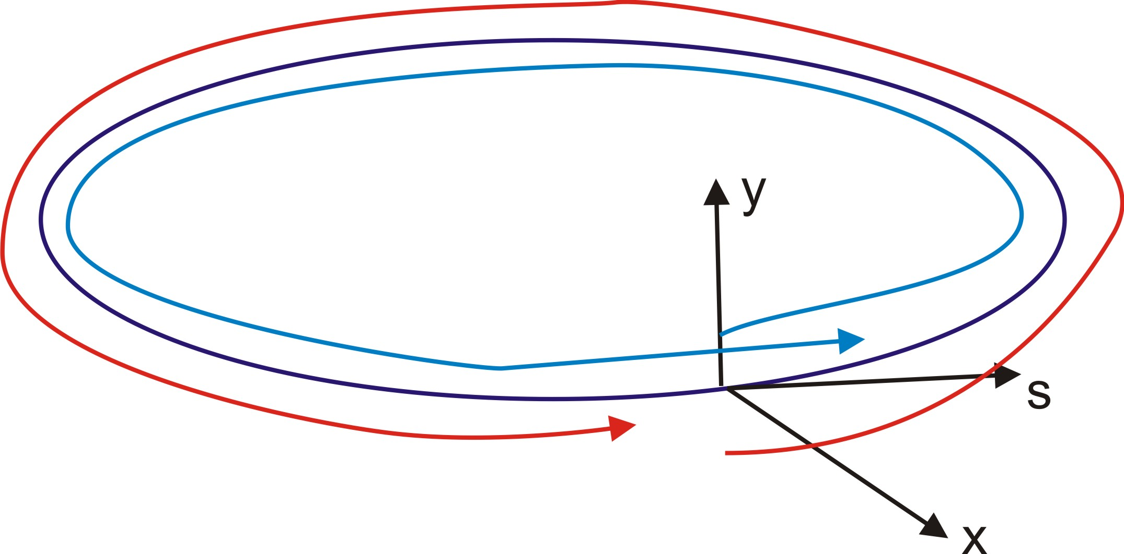
schematic of “longitudinal oscillation” around storage ring
tune Q_{s} = number of synchrotron oscillations per turn
RF cavity
focusing elements:
energy-dependent path length
rf cavities
synchrotron tune Q_{s} << 1, typically Q_{s} ~ 0.01-0.0001
betatron tune Q_{x,y} > 1, typically Q_{x,y} ~ 2 - 70

Slide 6
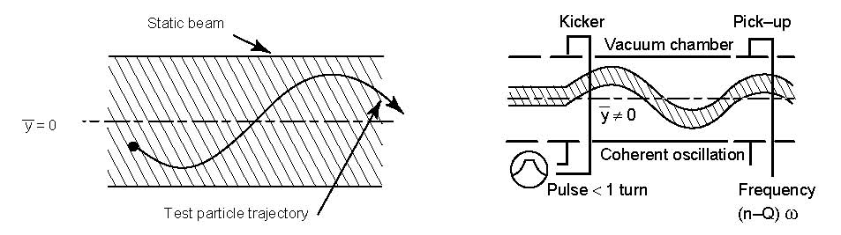
incoherent and coherent tune
K.H. Schindl
incoherent betatron motion of a particle
inside a static beam with its center of mass
at rest
amplitude and phase are distributed at
random over all particles
coherent motion of the whole beam after a transverse kick
the source of the direct space charge is now moving, individual particles still continue incoherent motion around the common coherent trajectory
at low beam intensity these two tunes should be about the same

Slide 7
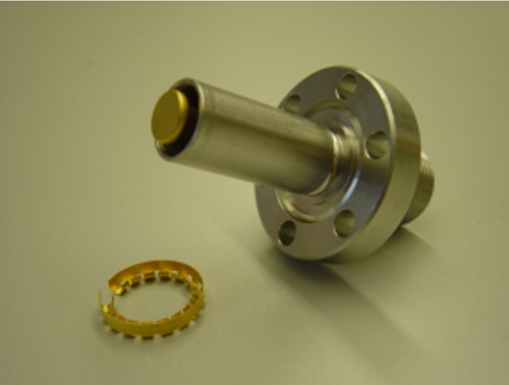
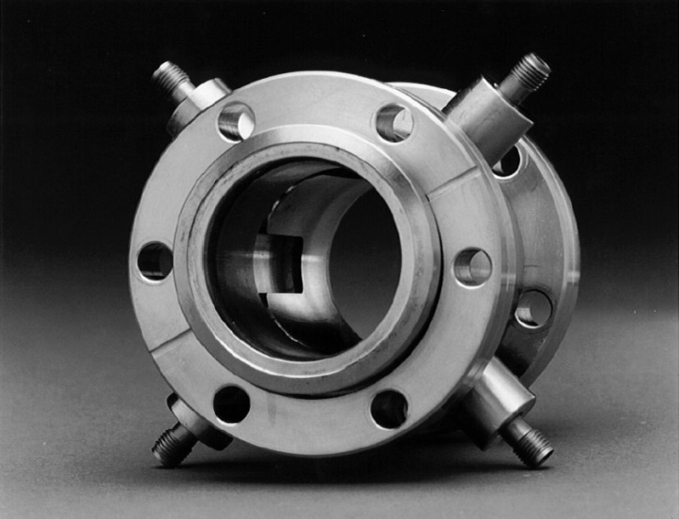
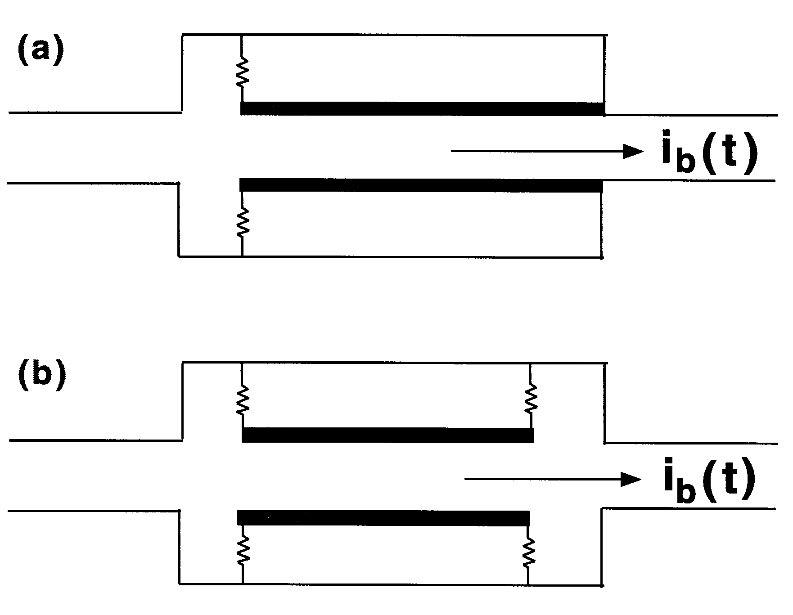
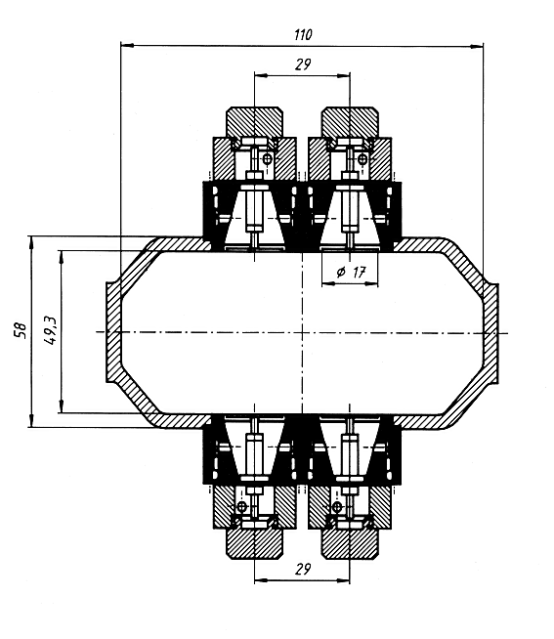
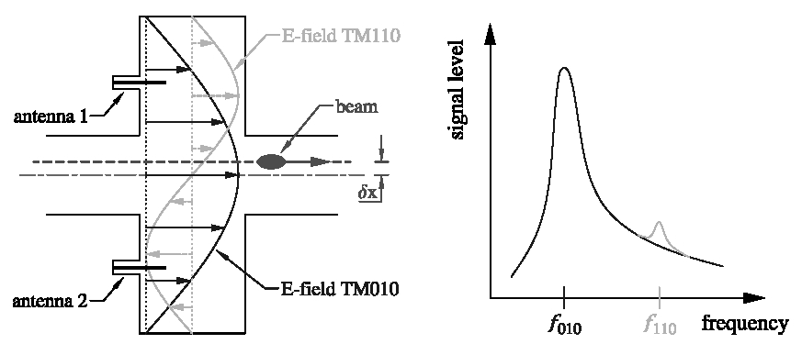
detectors to measure the coherent beam oscillations
button pick ups
strip line pick ups
unterminated transmission line
transmission line terminated (rhs)
to a matched impedance
the LEUTL at Argonne shorted S-band quarter-wave four-plate stripline BPM (courtesy R.M. Lill, 2003)
cavity BPMs
reference:
“Cavity BPMs”, R. Lorentz
(BIW, Stanford, 1998)
button electrode for use between the
undulators of the TTF II SASE FEL
(courtesy D. Noelle and M. Wendt, 2003)
TM₀₁₀, “common mode” (∝ I)
TM₁₁₀, dipole mode of interest

Slide 8
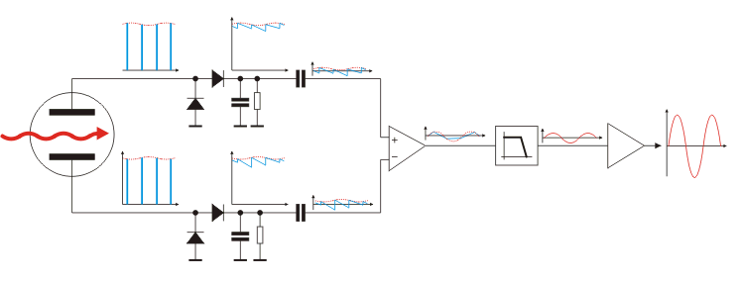
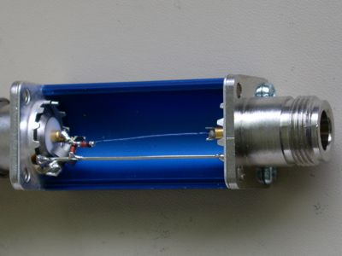
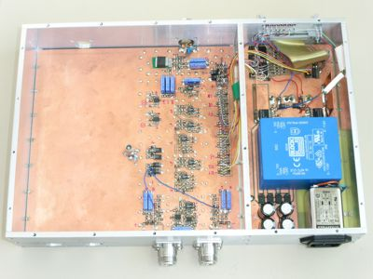
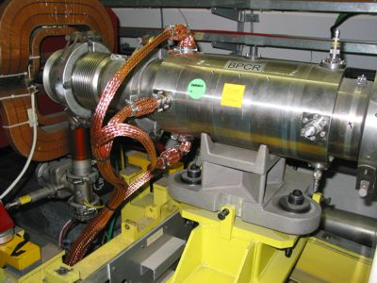
Direct Diode Detection Base-Band Q (3D-BBQ) Measurement in CERN Accelerators - Principle
Marek Gasior
diode
detectors
FE electronics:
amplifiers & filter
pick up
Apart from detectors, the filter is most important element of the system. It attenuates revolution frequency and its harmonics, as well as low frequencies.
detector
FE electronics
SPS installation

Slide 9
integer betatron tune

Slide 10
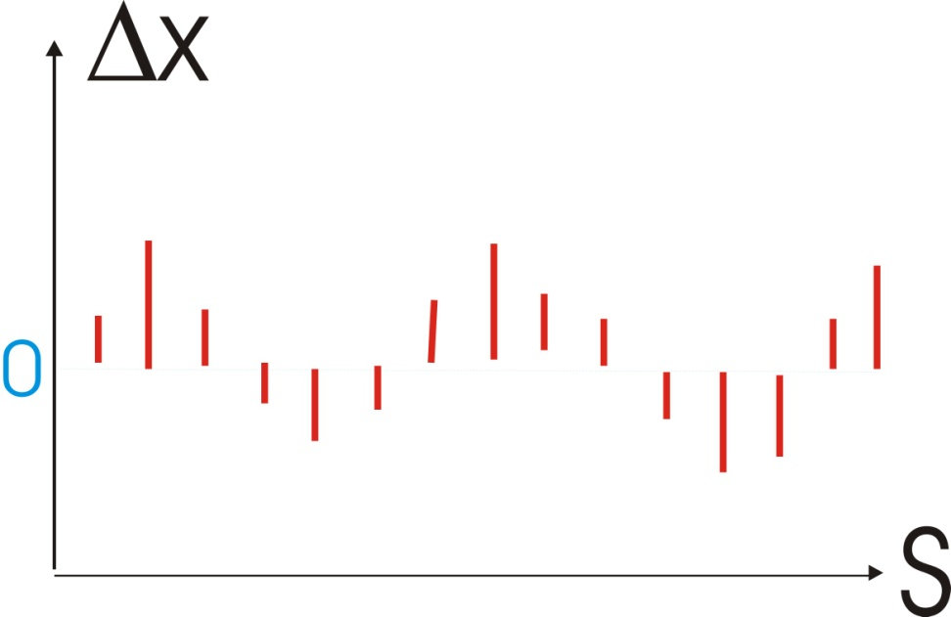
integer part of betatron tune
first turn injection oscillation
or difference orbit after exciting a single steering corrector
oscillation
count number of oscillations
(directly or via FFT)
integer value of tune Q
more intricate method: use multi-turn
BPM data to measure φ at each BPM;
then find Δφ between BPMs

Slide 11
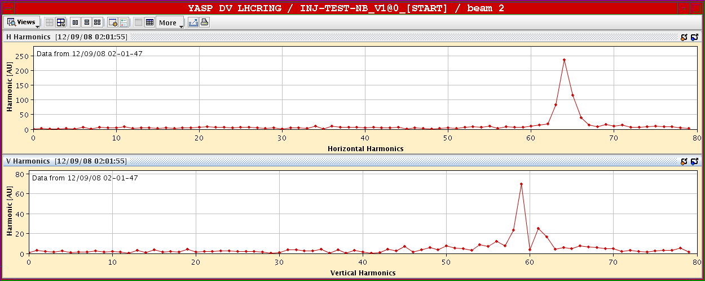
example - checking the integer tune
LHC beam commissioning 12 September 2008
J. Wenninger
integer tunes 64 and 59 equal to their design values!
(vertical FFT has second peak!?) – basic check of optics

Slide 12
fractional betatron tune
precision measurement
tune tracking
multiple bunches

Slide 13
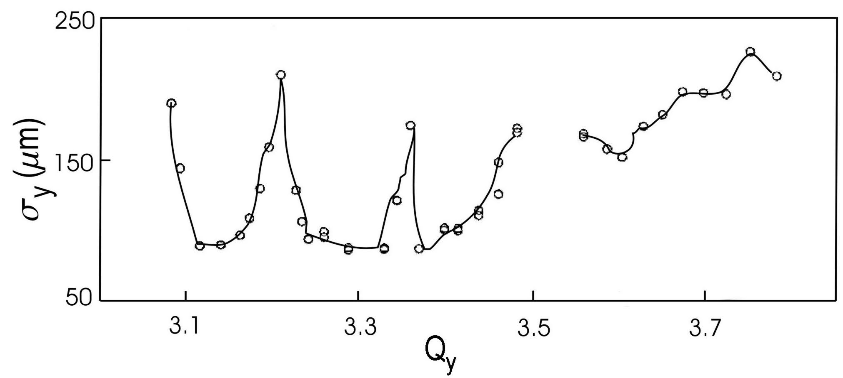
fractional part of the tune – why is it important?
one example
rms vertical beam size of the electron beam extracted from
the SLC damping ring as a function of the vertical betatron
tune, under unusually poor vacuum conditions.
all nonlinear and high-intensity effects are very sensitive to the
fractional tune - best performance requires optimum tune!

Slide 14
two categories:
precision tune measurements
tune tracking
to monitor & control fast changes
e.g. during acceleration

Slide 15
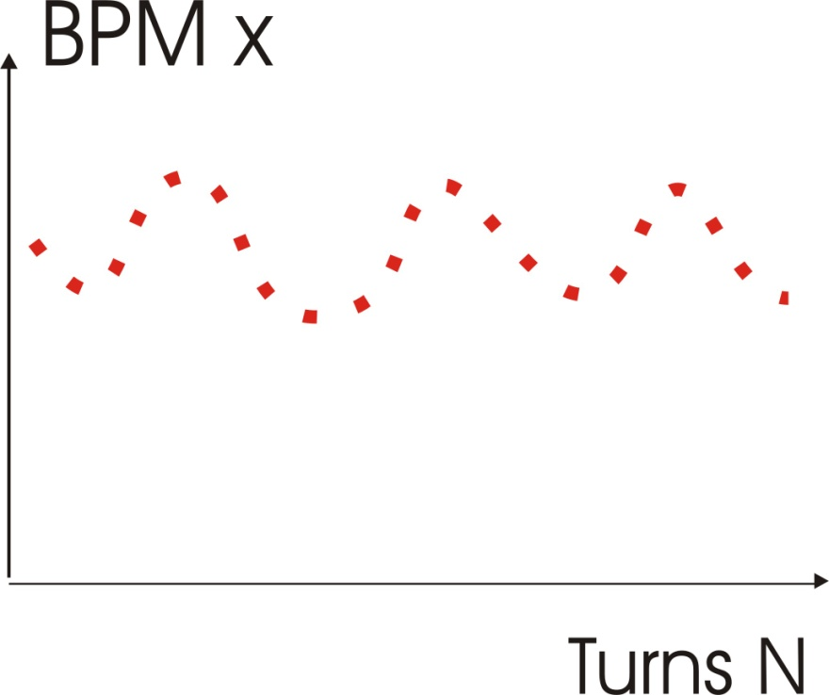
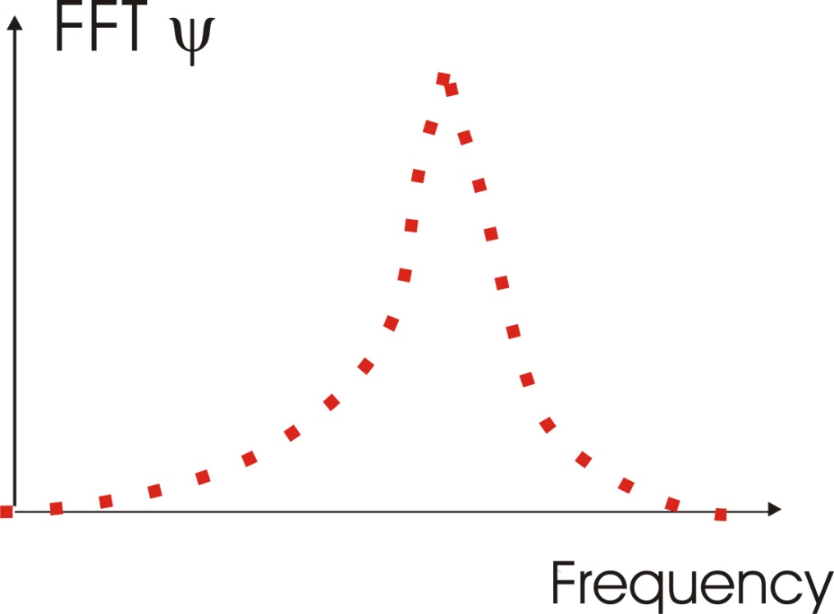
FFT (Fast Fourier Transform)
excite transverse beam motion + detect transverse
position on a pick up over N turns
(2) compute frequency spectrum of signal; identify
betatron tunes as highest peaks
step 1/N
between points

Slide 16
FFT signal = expansion coefficient
Q error of FFT:
due to discreteness of steps

Slide 17
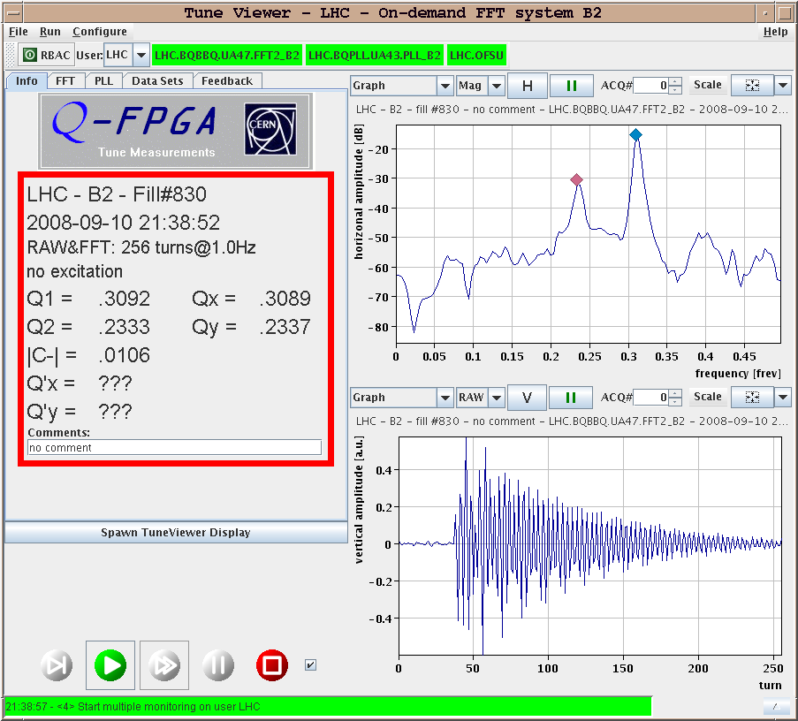
checking the fractional tune
LHC beam commissioning 10 September 2008
signal decay
(due to de-
bunching)

Slide 18
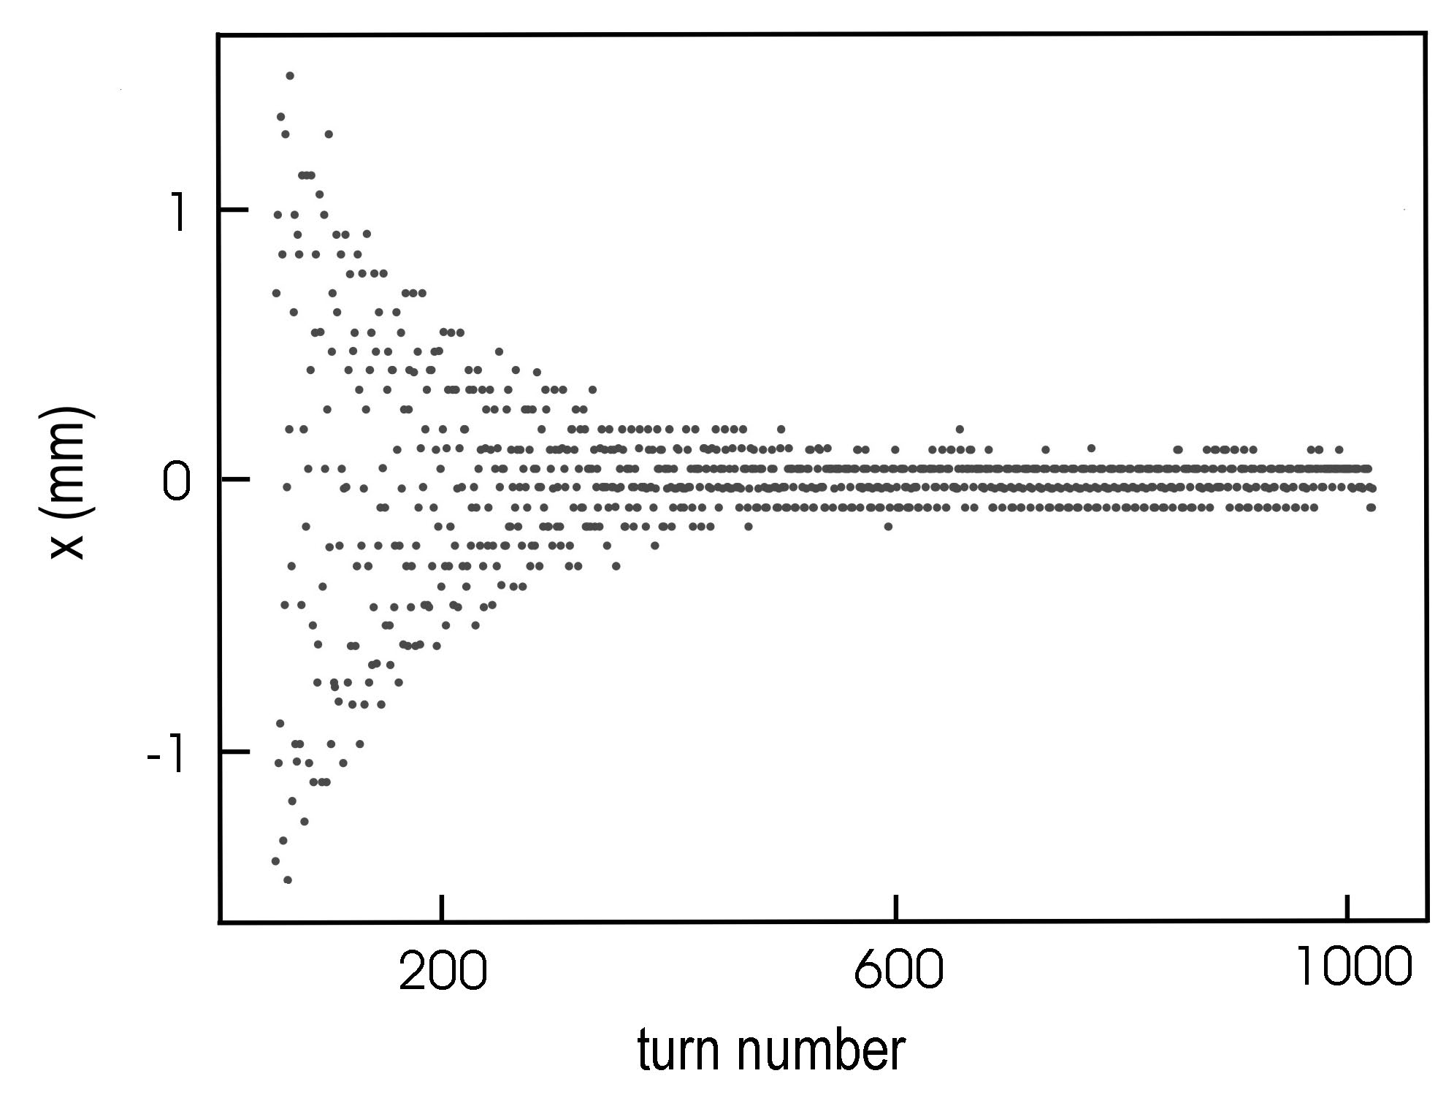
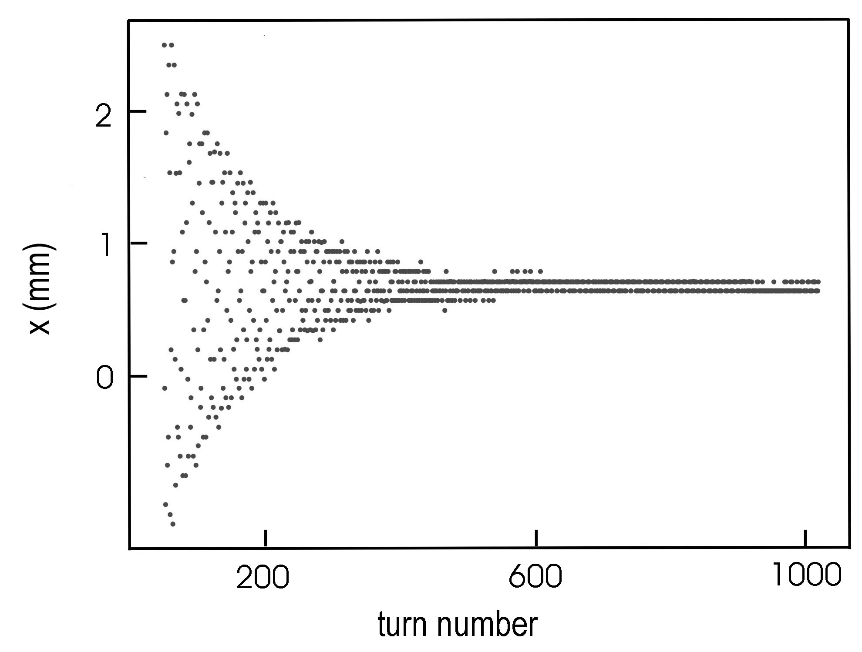
multi-turn orbit measurement for the motion of a single bunch in a 3-bunch train at LEP-1
signal decay (due to fast head-tail damping)
BPM in a dispersive
arc region (where
transverse position
varies with beam momentum)
BPM in a straight section
without dispersion

Slide 19
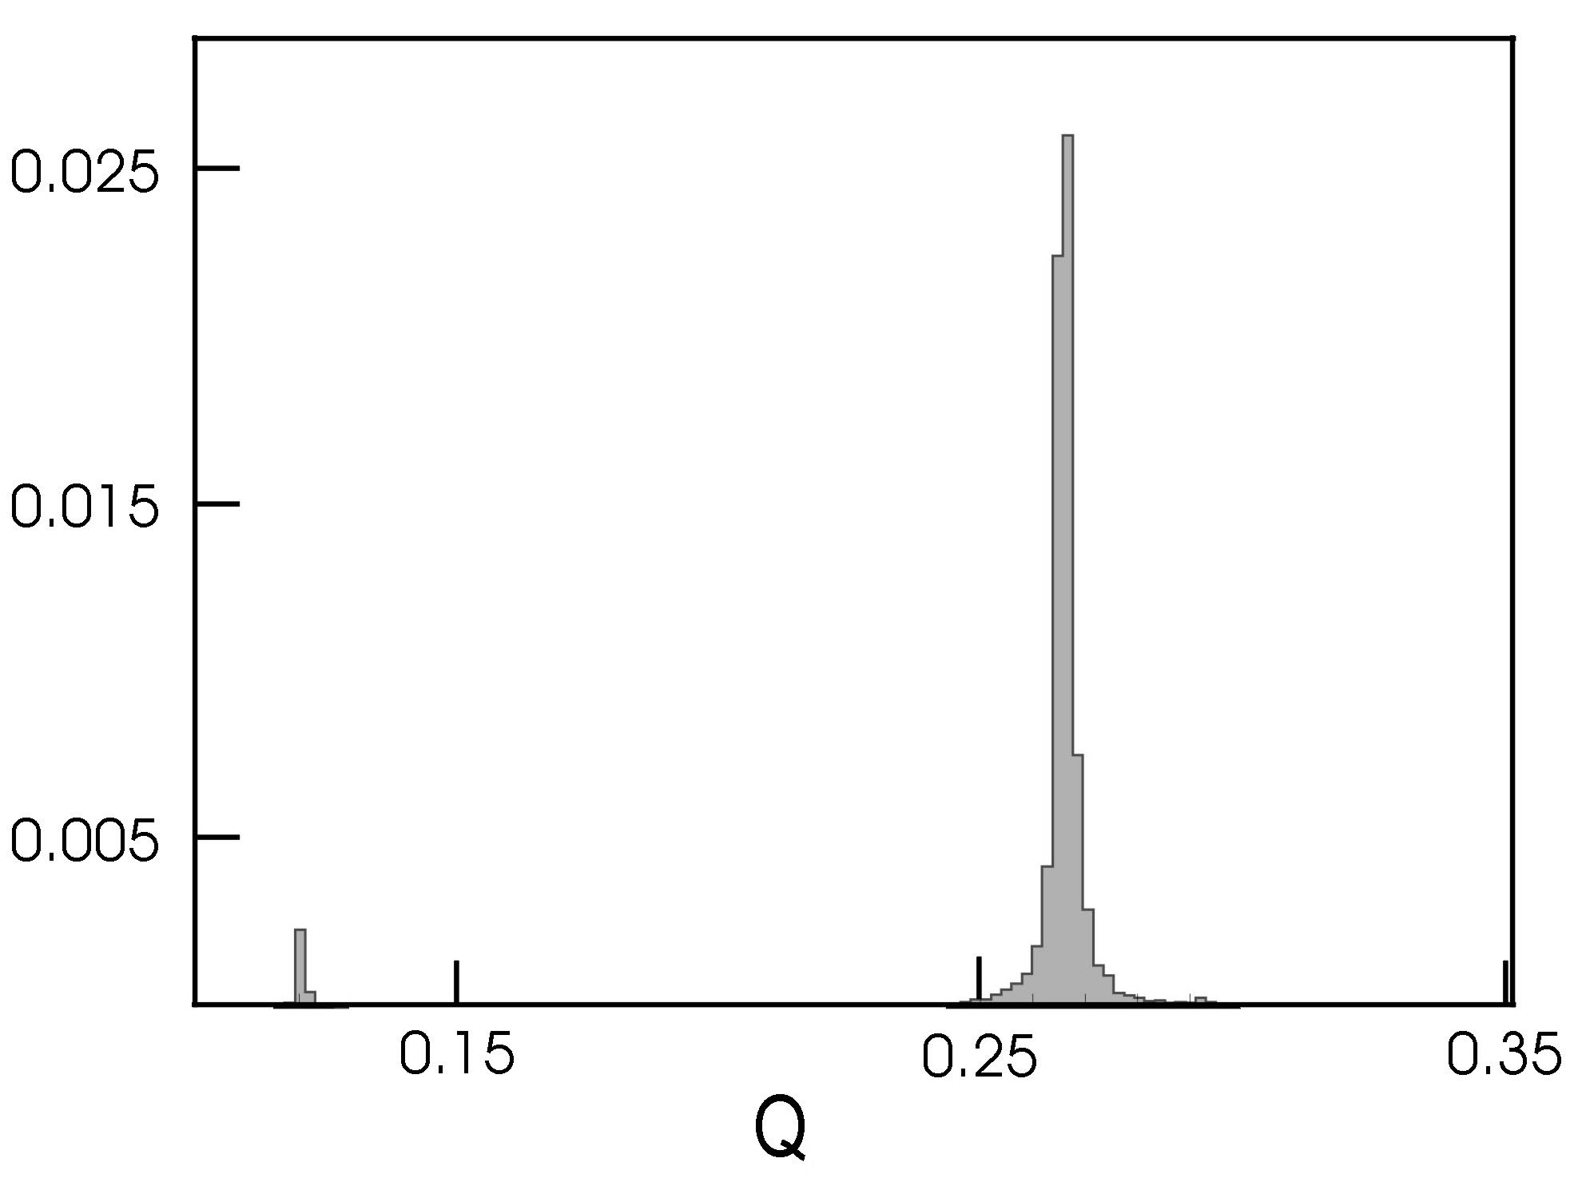
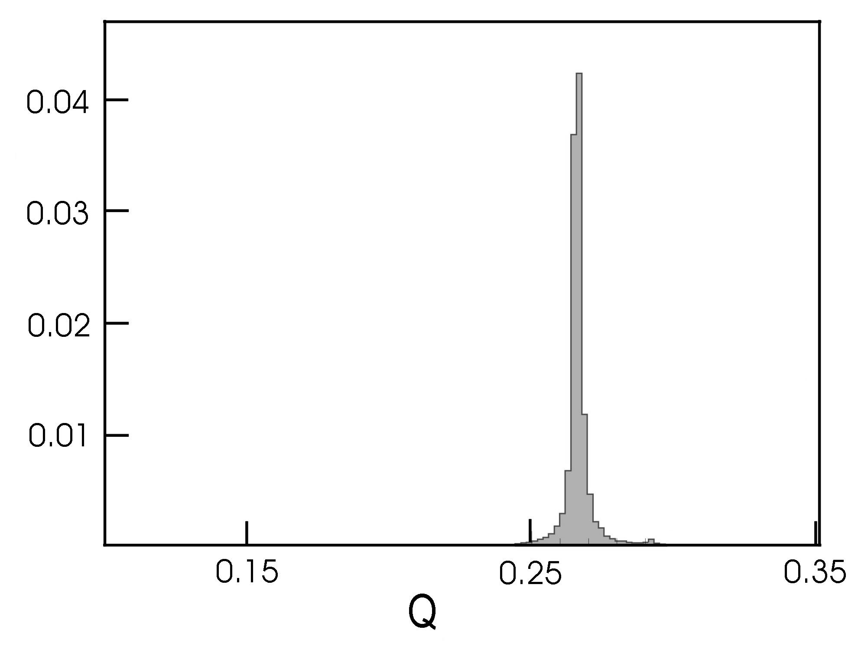
FFT power spectra for the two previous measurements
β tune
β tune
synchrotron
tune
BPM in a dispersive
arc region
BPM in a straight section
without dispersion

Slide 20
about 1000 turns are required for adequate tune
measurement with FFT, but
filamentation, damping,… (see later)
spurious results?!
further improvement in resolution, e.g. by
interpolating the shape of the Fourier spectrum around main peak

Slide 21
assumption: shape = pure sinusoidal oscillation
uses Q at peak and highest neighbor
error:

Slide 22
further improvement by interpolated FFT with data windowing
filter
e.g., Hanning filter of order l:
resolution:
however, with noise
as for the simple interpolation

Slide 23
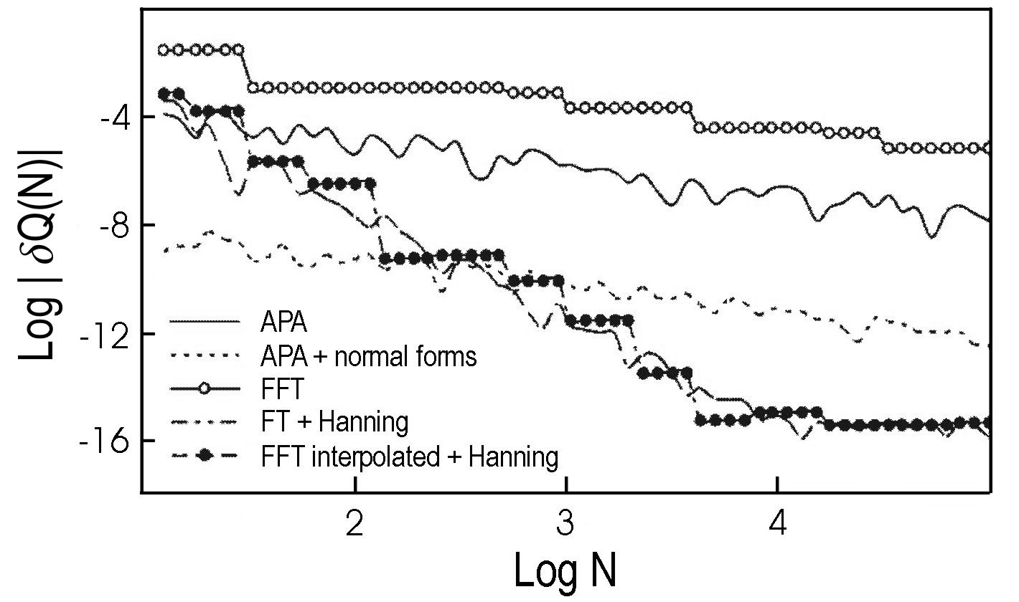
example: refined FFTs
(M. Giovannozzi et al.)

Slide 24
another approach to obtain higher accuracy than FFT
“Lomb normalized periodogram”
A.-S. Muller
no constraint on # data point or on time interval between points (replace Qn by ωτ_{n})
the constant n₀ is computed to eliminate the phase of the original
harmonic; since the phase dependence is removed, Lomb’s method
is more accurate than the FFT

Slide 25
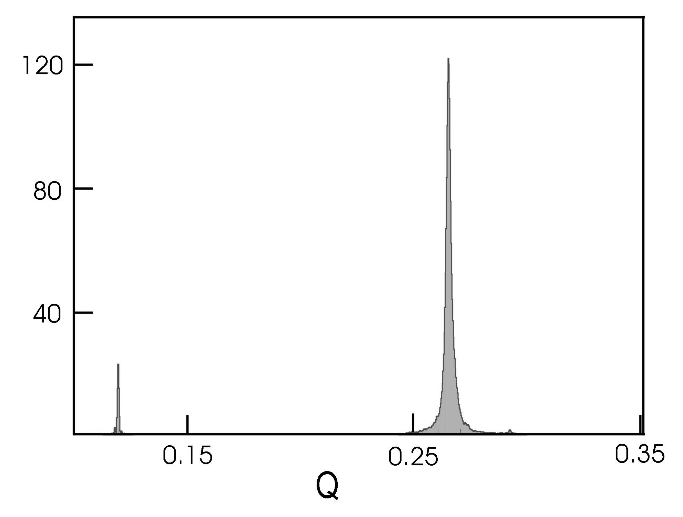
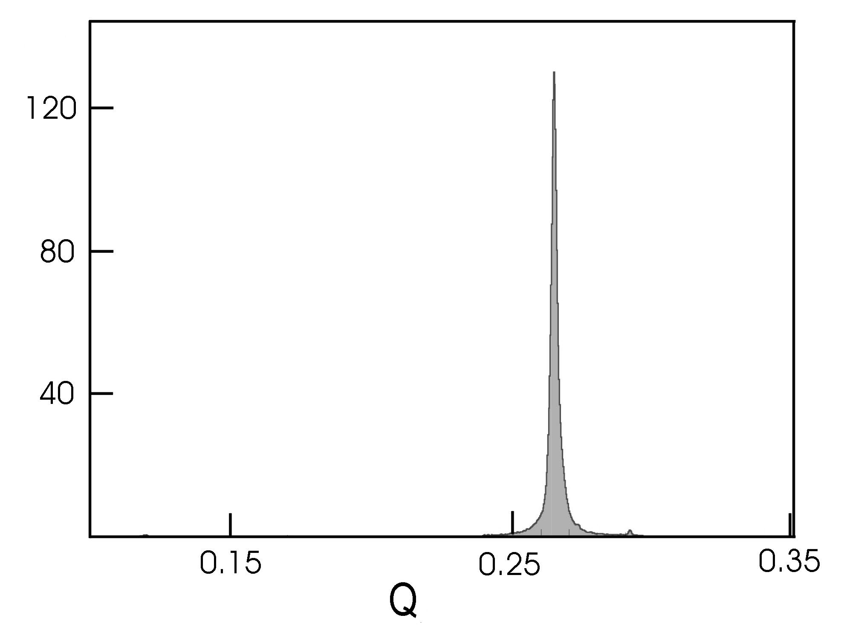
Lomb normalized periodogram for previous measurements
BPM in a dispersive
arc region
BPM in a straight section
without dispersion
(A.-S. Muller)

Slide 26
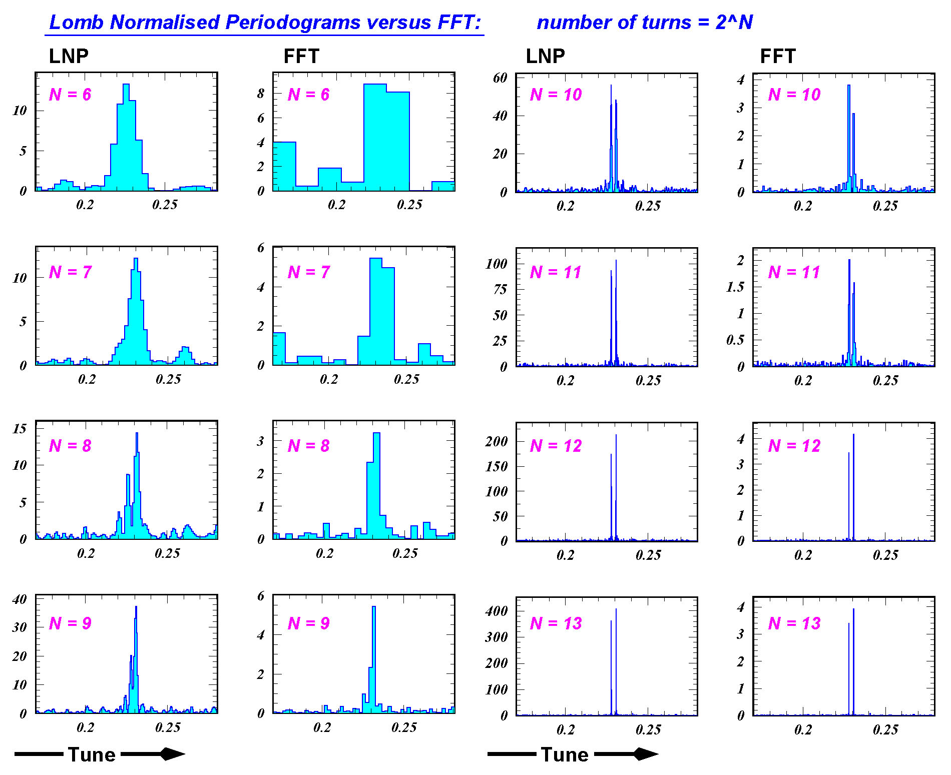
comparison Lomb-FFT for CERN PS simulation with two spectral lines [A.-S.Muller, ’04]]

Slide 27
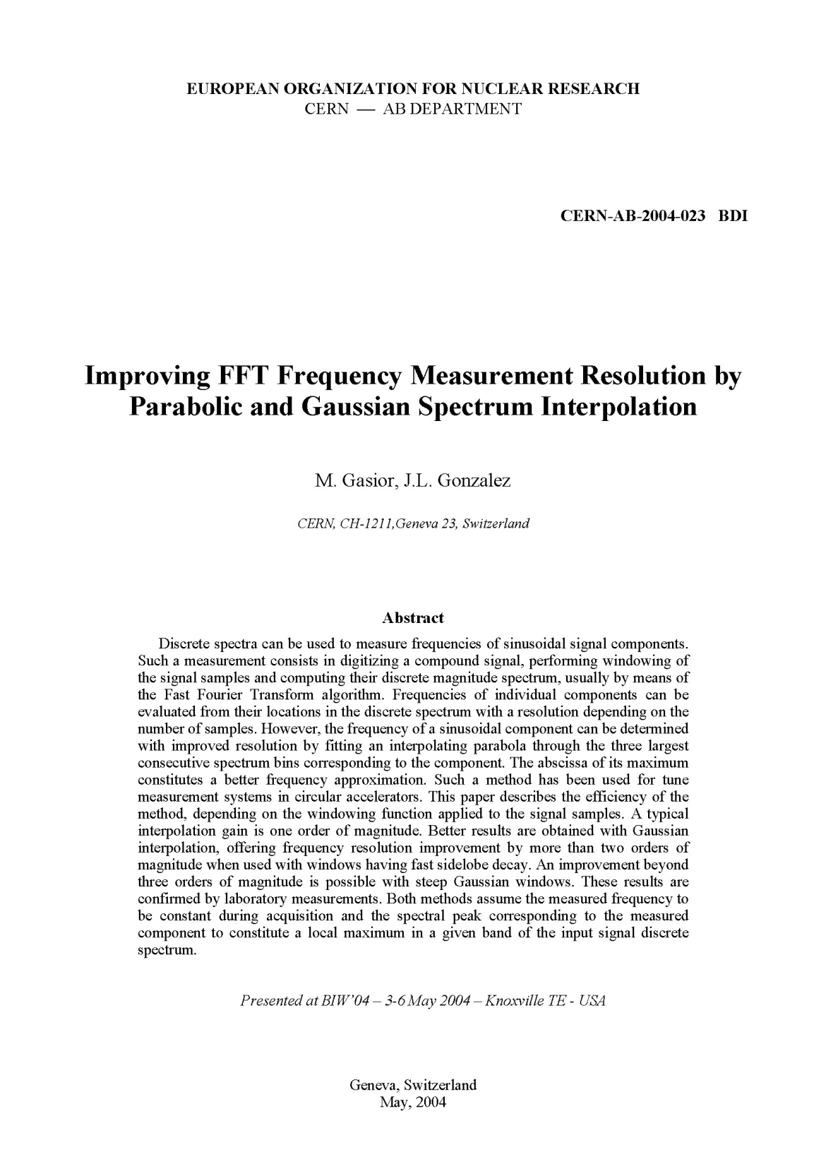
still an
active area
of research…
most of the above
“improvements”
rely on
harmonic motion

Slide 28
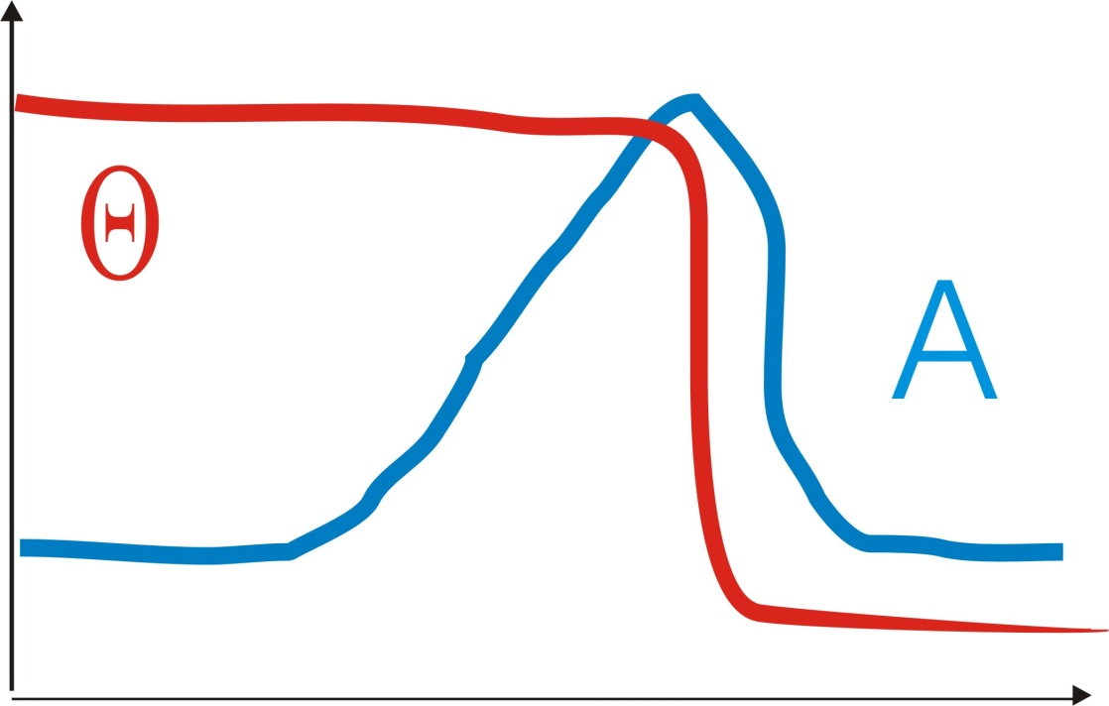
swept frequency excitation
excitation
measure response
vary ω in steps
amplitude
phase
180º
phase jump
“beam transfer
function”

Slide 29
beam transfer function
transverse impedance
radiation damping
at betatron tune:
A zero slope
θ maximum slope!
phase can be monitored by phase-locked loop
if beam is excited by VCO lock-in amplifier

Slide 30
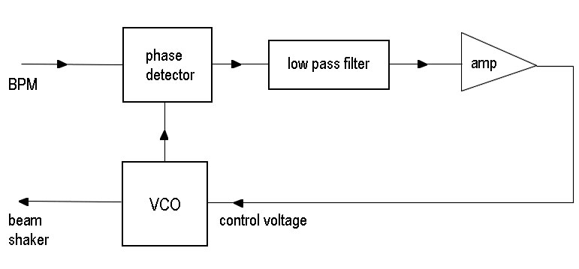
phase locked loop (for continuous tune control)
“locked”
in frequency
“lock-in
amplifier”
VCO frequency = betatron frequency

Slide 31
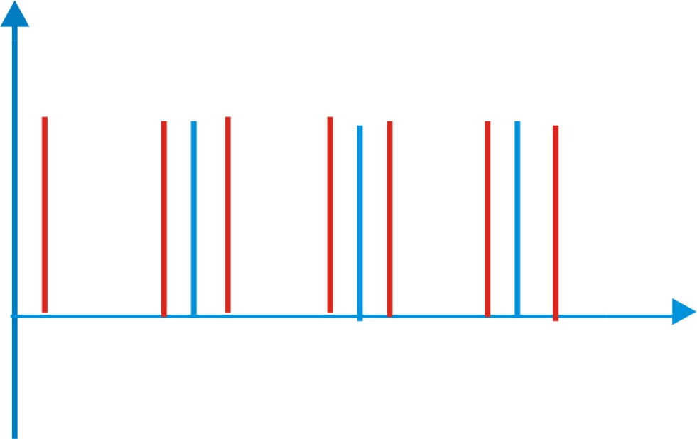
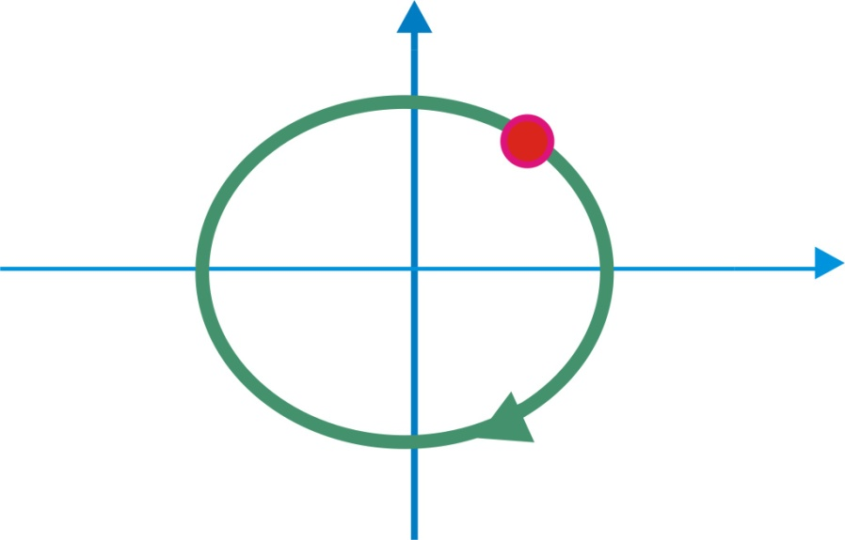
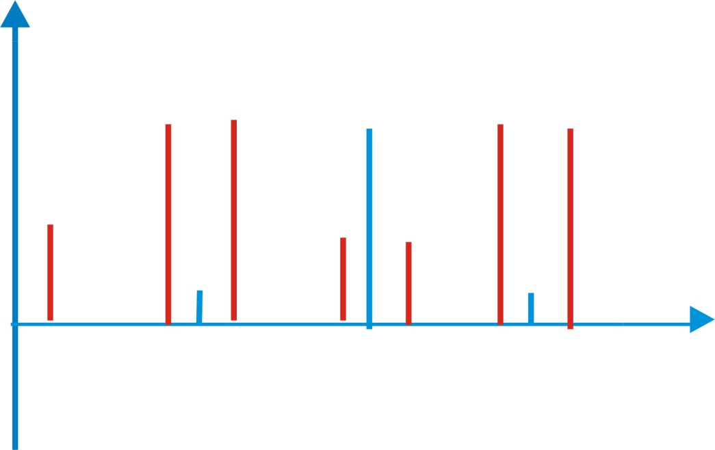
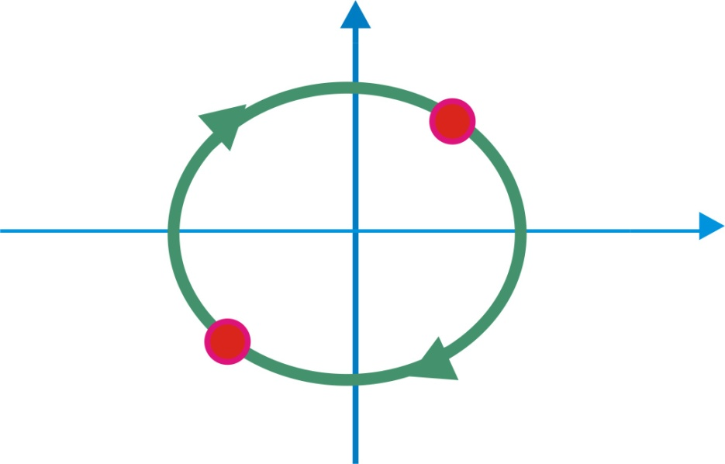
single bunch
multiple bunches
revolution
harmonics
f_{x}
f_{rev}-f_{x}
0
f_{rev}
2f_{rev}
3f_{rev}
2 bunches
phase space
f_{rev}/2
frequency spectrum
π mode
σ mode
0
2f_{rev}
at high current
fractional tune can
be different for
σ and π modes!
bumches in phase space
for π mode
2f_{rev}/2

Slide 32
at low current
φ=0: σ mode
φ=p: π mode
bunch 1
bunch 2
n_{b} bunches n_{b} multibunch modes
measuring spectrum from 0 to n_{b} frev/2
suffices!

Slide 33

the tune, or not the tune, that is the question

Slide 34
modifications of tune signal
damping
filamentation
chromaticity
linear coupling

Slide 35
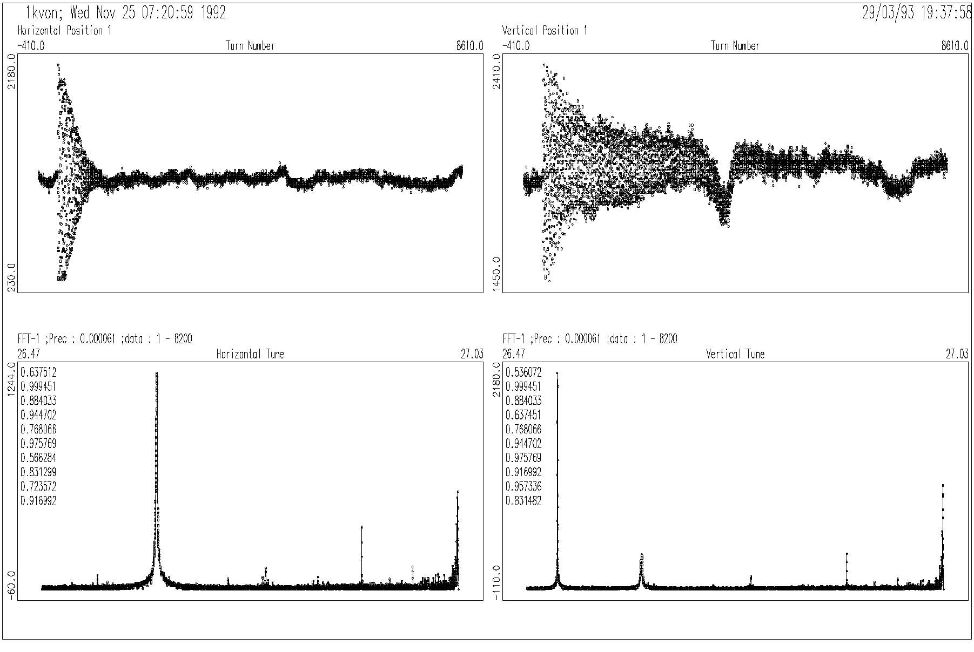
tune measurements for proton beams in the CERN-SPS
fast decay, ripple
& “noise”
many lines
W. Fischer and F. Schmidt, CERN SL/Note 93-64 (AP)

Slide 36
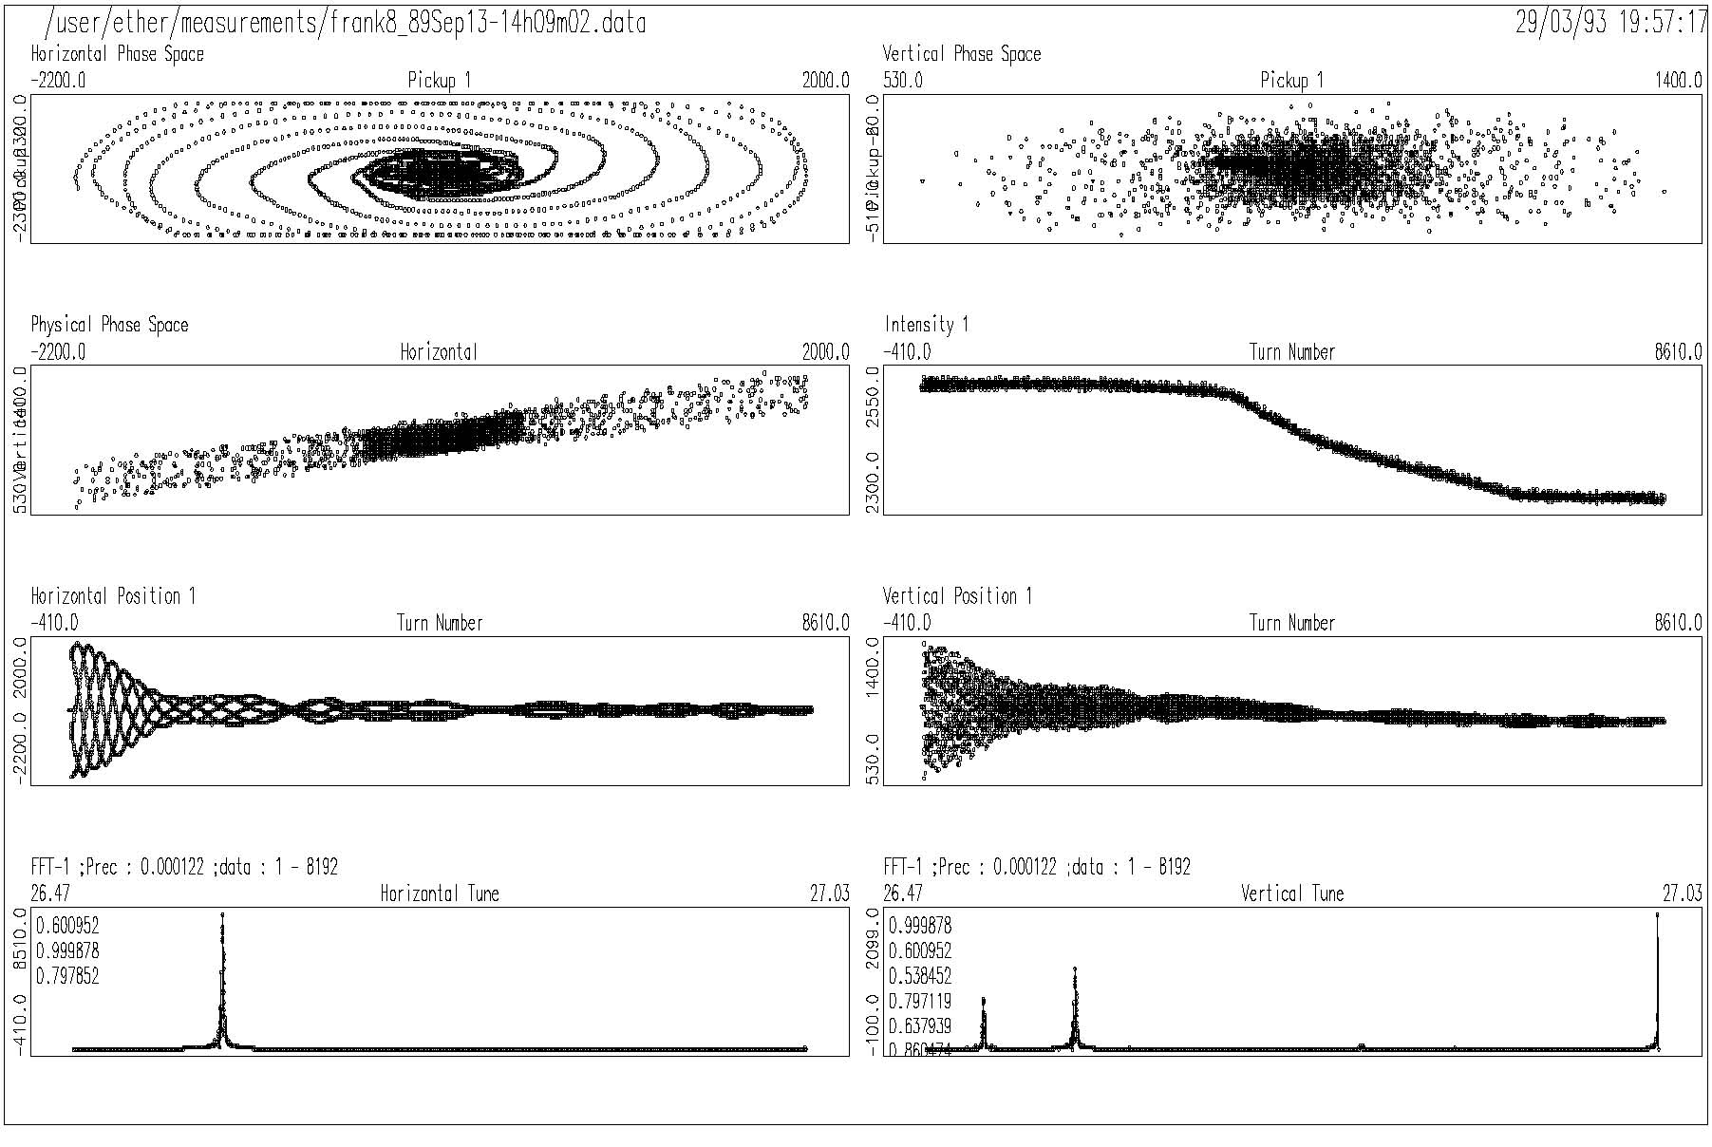
tune measurements for proton beams in the CERN-SPS
phase-space plot suggests filamentation
W. Fischer and F. Schmidt, CERN SL/Note 93-64 (AP)

Slide 37
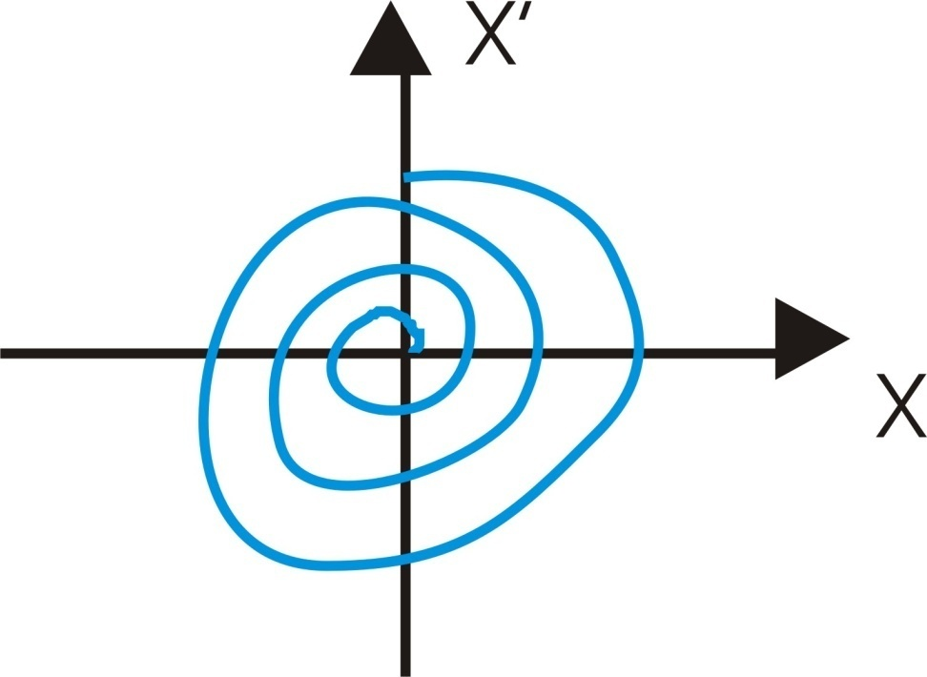
coherent oscillations, damping & filamentation
response to a kick: coherent damping
exp. decay
amplitude-dependent
oscillation frequency
bunch
population
chromaticity
head-tail damping
synchrotron-radiation damping

Slide 38
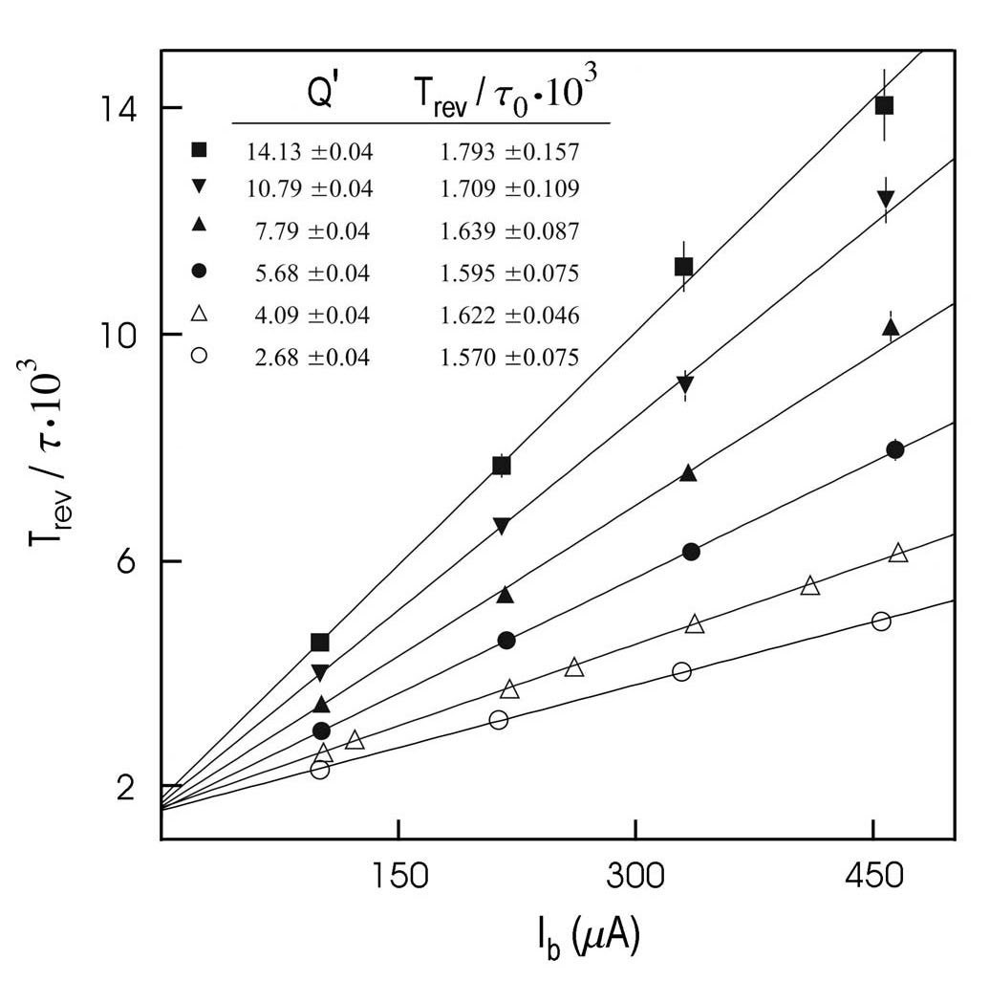
1/τ
LEP 45.63 GeV,
damping rate
1/τ vs. I_{bunch}
for different
chromaticities
[A.-S. Muller]
Q’=14
1/(100 turns)
horizontal
damping
partition number
Q’=2.7
1/τ_{SR}
I_{b}

Slide 39
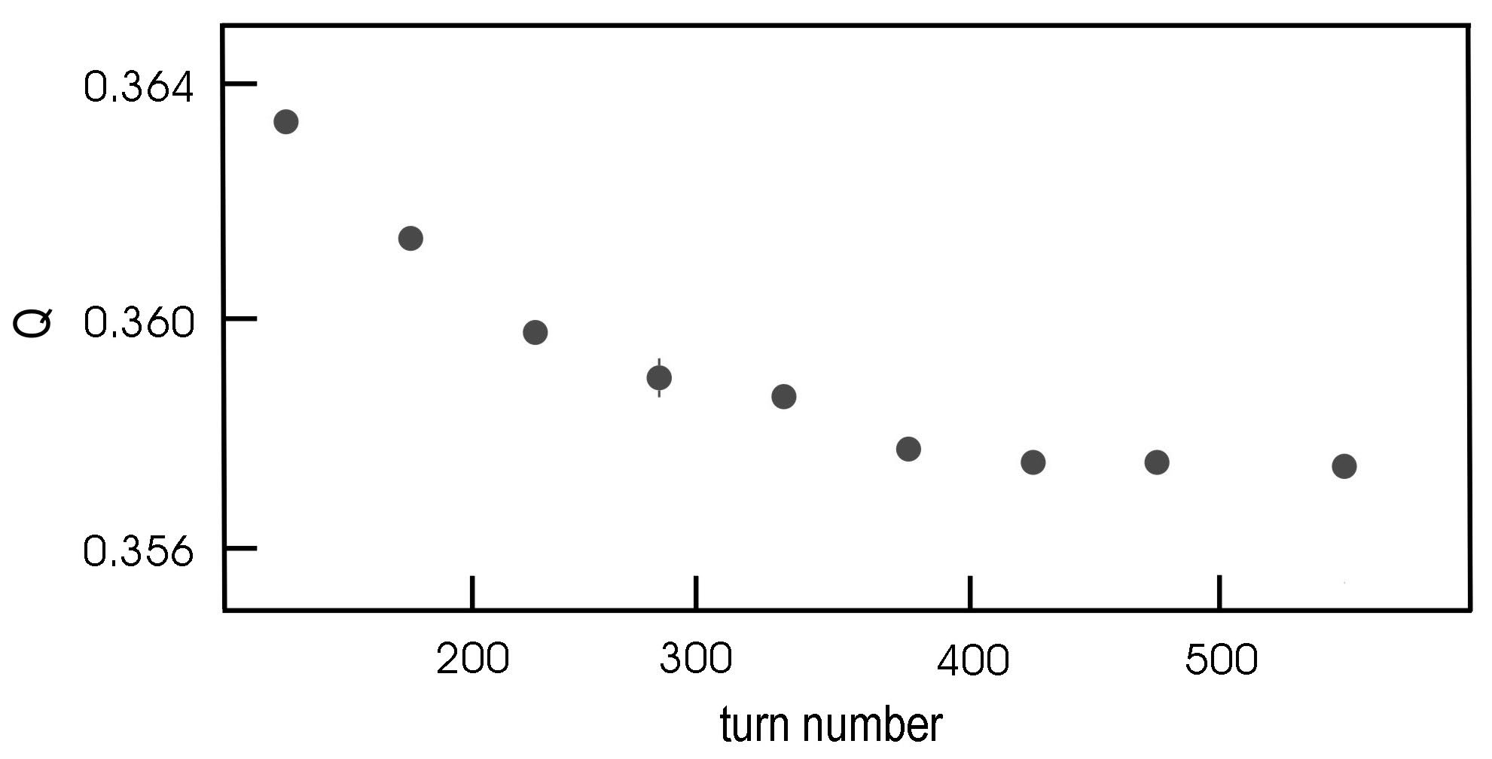
LEP: tune change during damping
Q
turns
[A.-S. Muller]

Slide 40
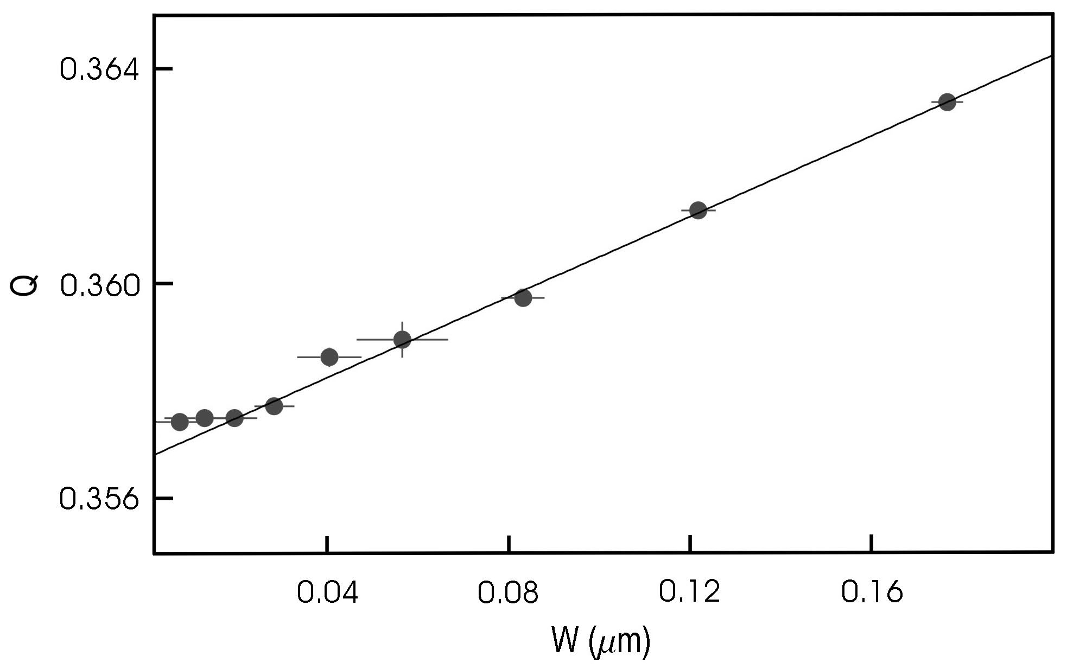
LEP: detuning with amplitude from single kick
Q
2 J
[A.-S. Muller]

Slide 41
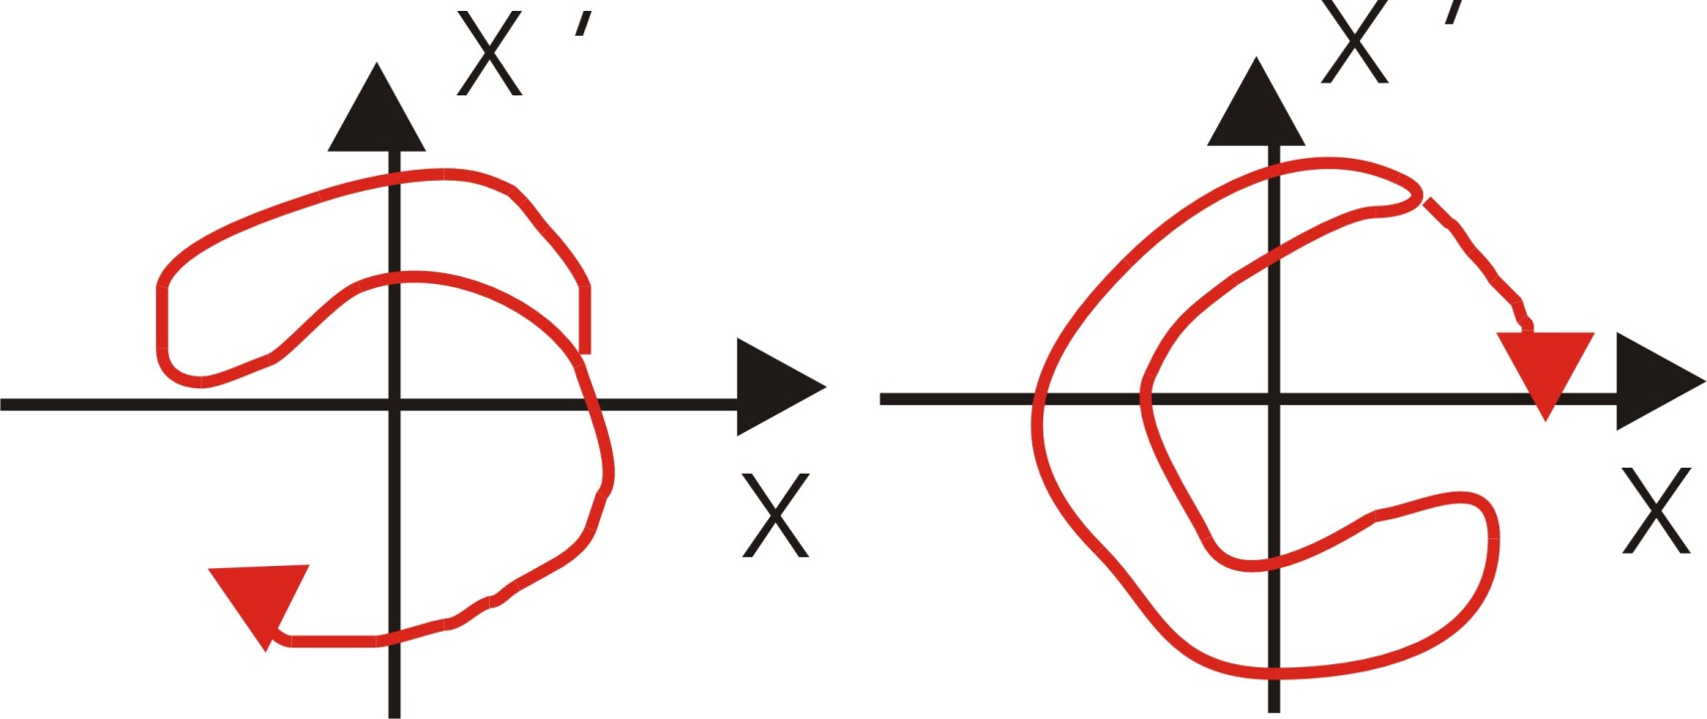
another response to a kick: filamentation
R. Meller et al.,
SSC-N -360, 1987
Z: kick in σ
α =(2μω₀)²
Q=Q₀-μa²
ex.:
both different from e^{-t/τ}
amplitude in σ

Slide 42
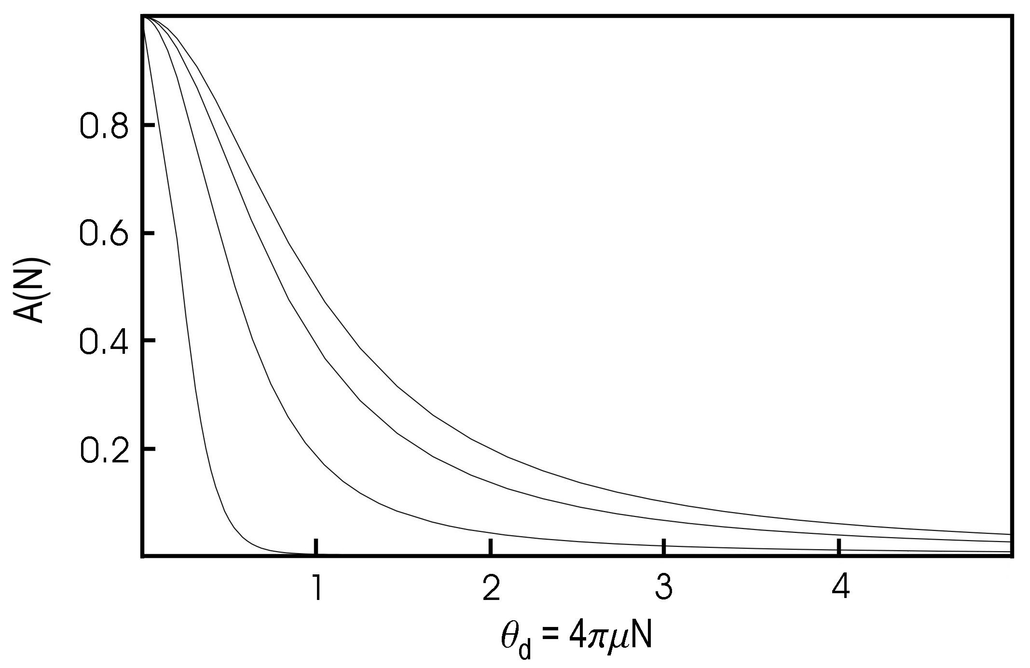
amplitude decoherence factor vs. turn number
oscillation
amplitude
1/5 σ kick
5σ kick

Slide 43
chromaticity
normalized
unnormalized
relation
chromaticity describes the change of focusing and tune
with particle energy
usually 2 or more families of sextupoles are used to compensate
and control the chromatcity
small chromaticity is desired to minimize tune spread and amount
of synchrobetatron coupling (maximize dynamic aperture)
but large positive chromaticity is often employed to damp
instabilities (ESRF, Tevatron, SPS,…)

Slide 44
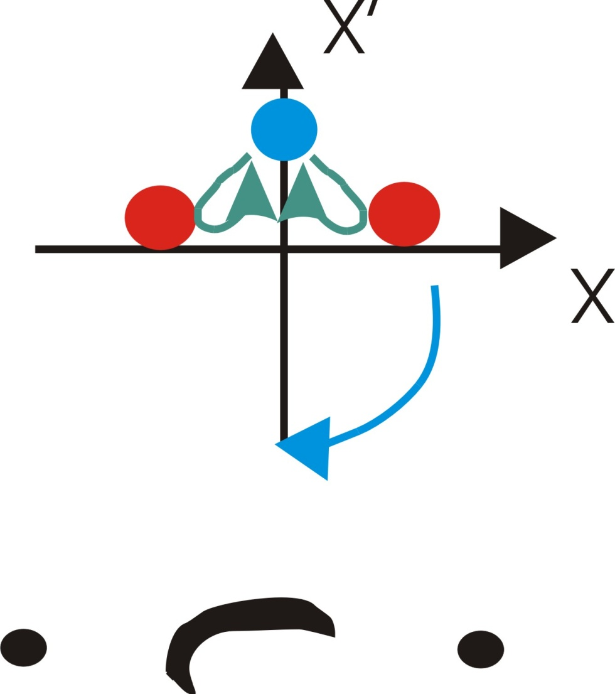
response to a kick: decoherence due to chromaticity
(Q’>0)
δ<0
δ>0
t=0
t=T_{s}/2
t=T_{s}

Slide 45
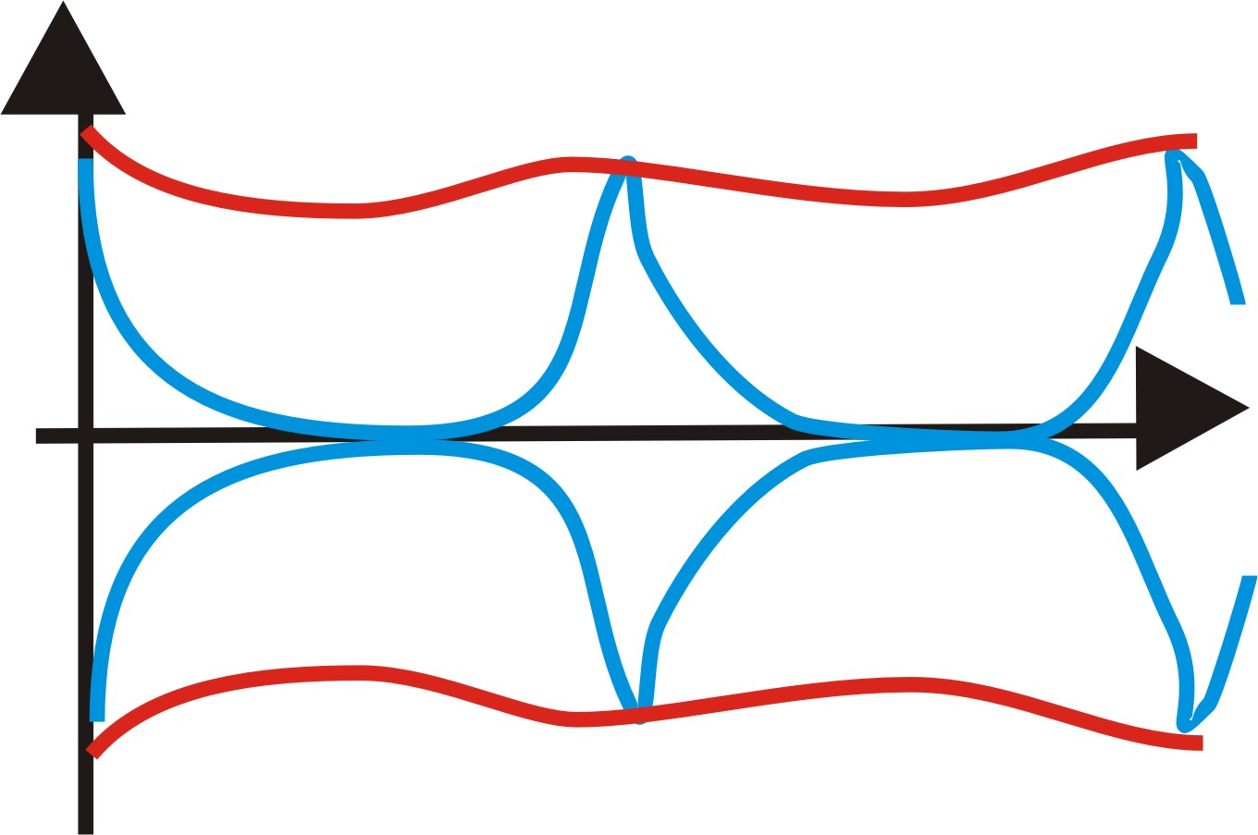
R. Meller et al.,
SSC-N -360, 1987
chromaticity
large ξ
time
small ξ
T_{s}
FFT over small number of turns → widening of tune peak
FFT over several synchrotron periods
→ synchotron sidebands around betatron tune

Slide 46
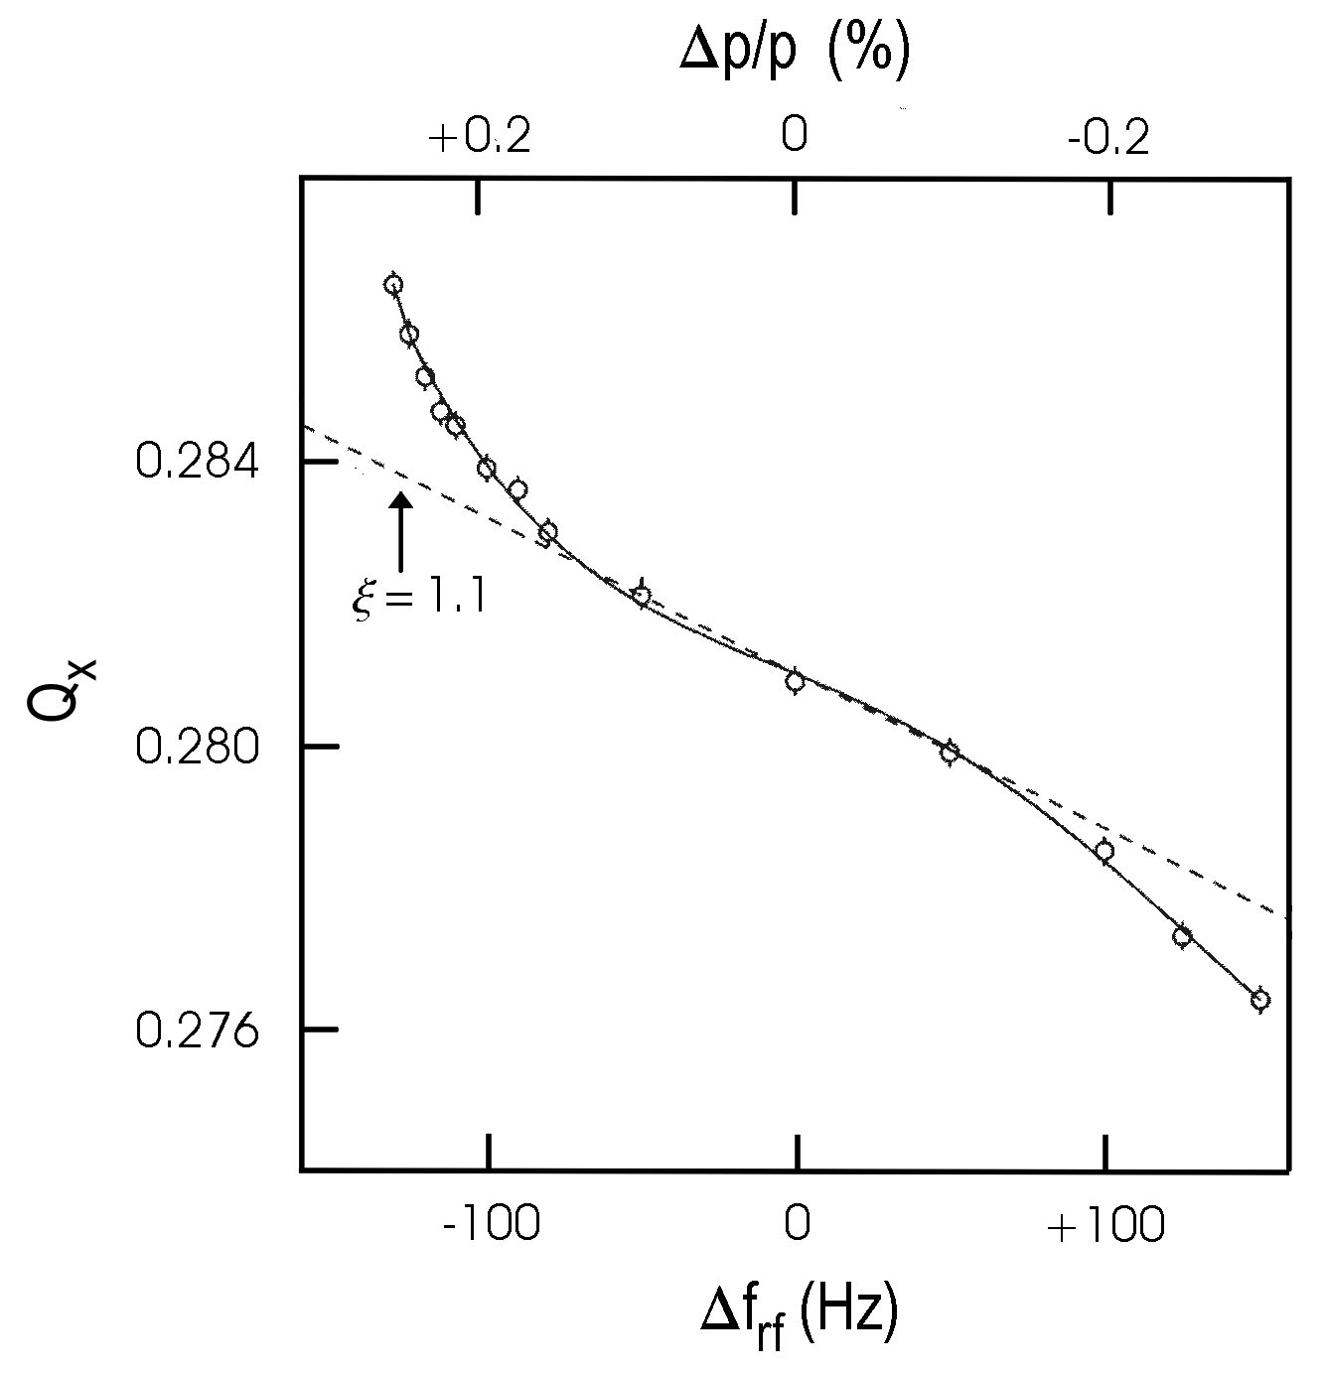
another method to determine total chromaticity
tune shift as a function of rf frequency
horizontal tune vs change
in rf frequency measured
at LEP;
the dashed line shows
the linear chromaticity
as determined by
measurements at
+/- 50 kHz

Slide 47
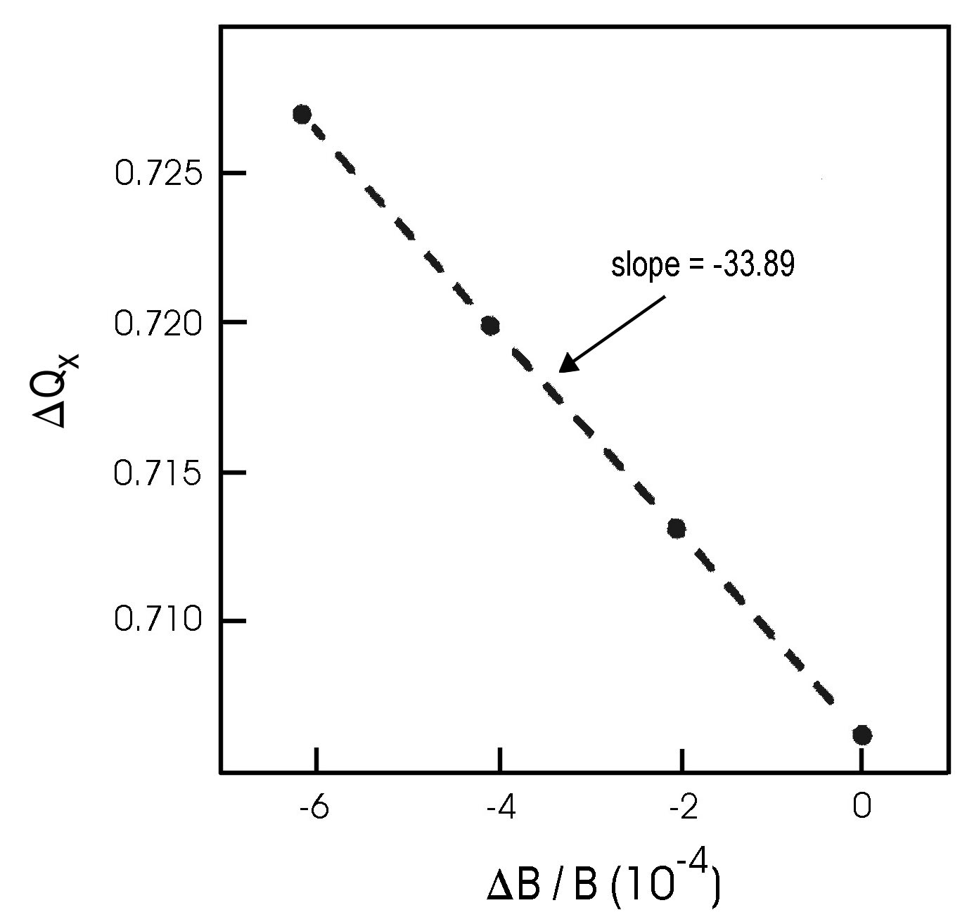
measuring the natural chromaticity (Q’ w/o sextupoles)
from tune shift vs. dipole field
electron
ring
natural chromaticity
measured at PEP-II HER
for e-, the orbit is unchanged
(determined by rf!)
for p, simultaneous
change in rf frequency
required to keep the
same orbit:

Slide 48
linear coupling: model of 2 coupled oscillators
κ: coupling strength
normal-mode coordinates:
decoupled equations
new
eigen-
frequencies
frequency split:
measure of strength of coupling

Slide 49
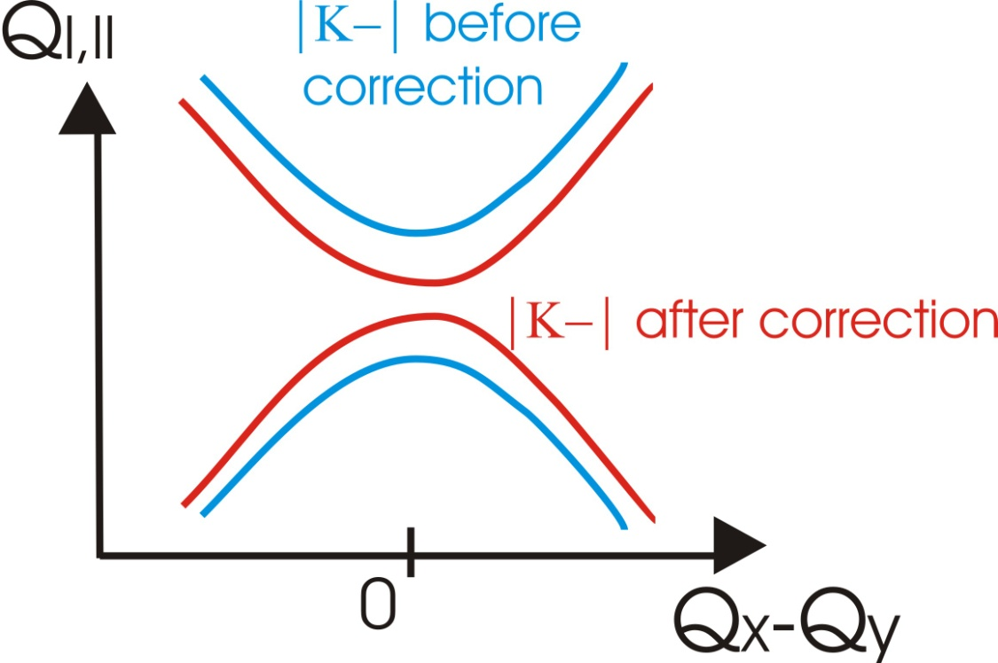
closest tune approach
near the difference resonance
the tunes of the two eigenmodes, in the vertical plane, are
uncoupled tunes
tunes can approach each other
only up to distance |κ_|
correction strategy;
use two skew quadrupoles
(ideally with Δ(φ_{x}-φ_{y})~π/2) to
minimize |κ_|, namely
the distance of closest tune approach

Slide 50
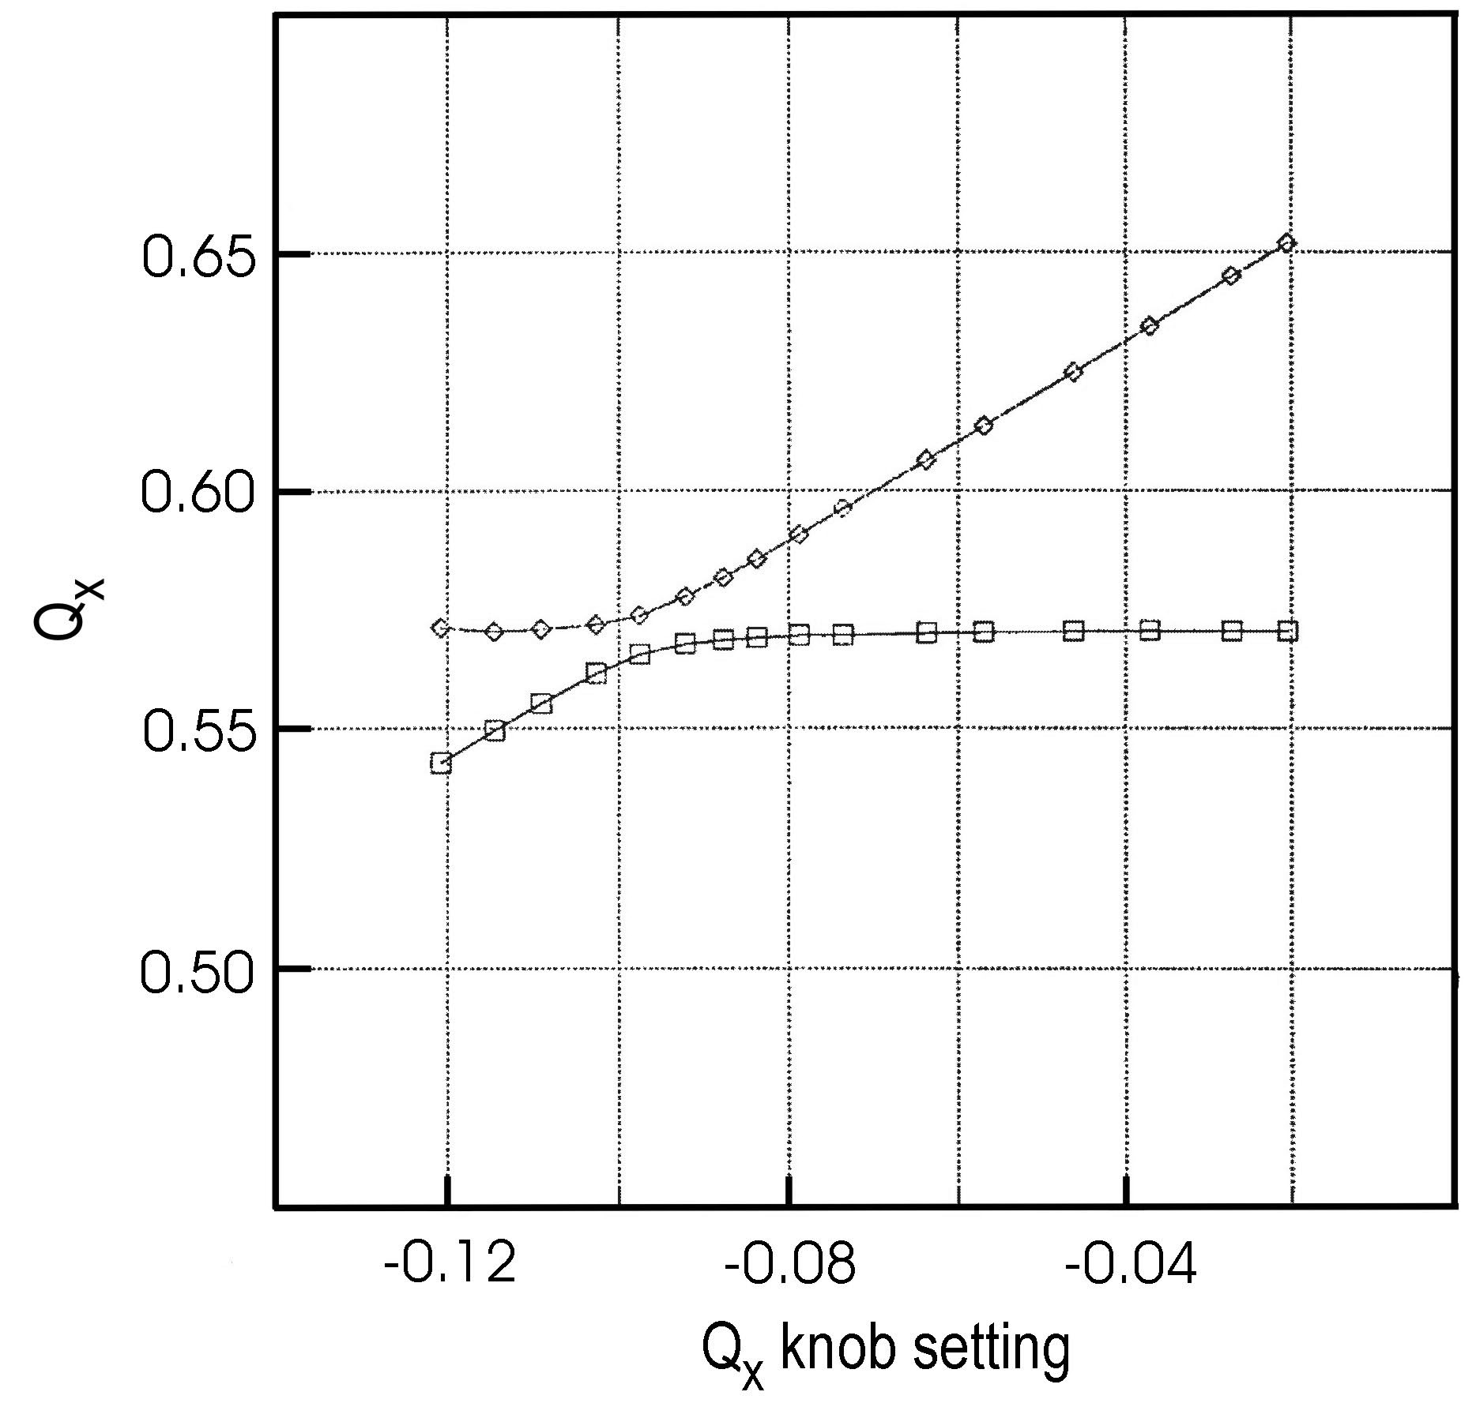
closest tune approach in the PEP-II HER before final correction; shown are the measured fractional tunes as a function of the horizontal tune knob; the minimum tune distance is equal to the driving term |κ_| of the difference resonance

Slide 51
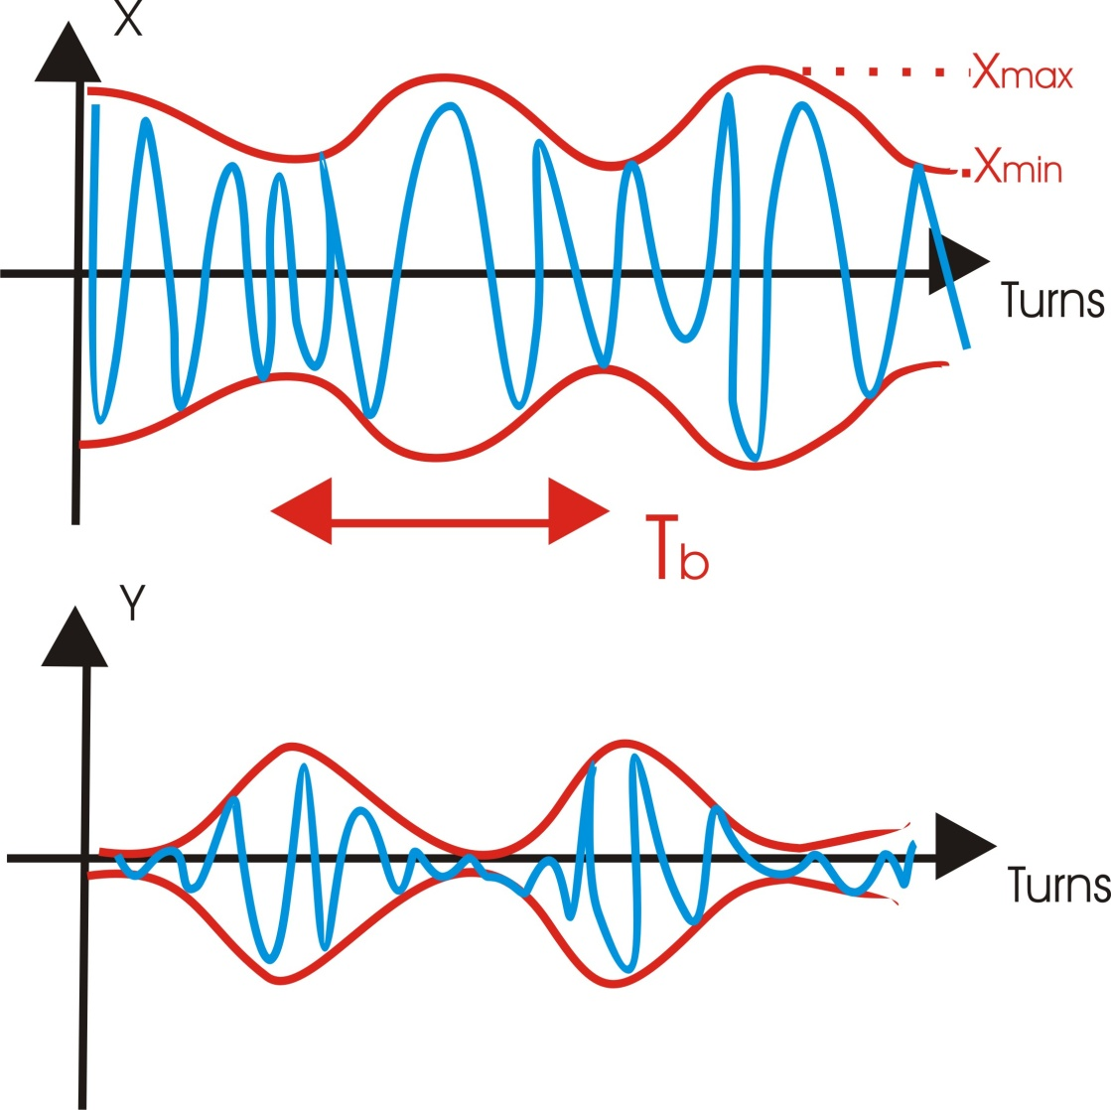
another way to measure |κ_|: kick response over many turns
define
envelopes of
horizontal and
vertical
oscillations
exhibit
beating
plane of kick
beating period
orthogonal
plane
!
one can show that
example
ATF

Slide 52
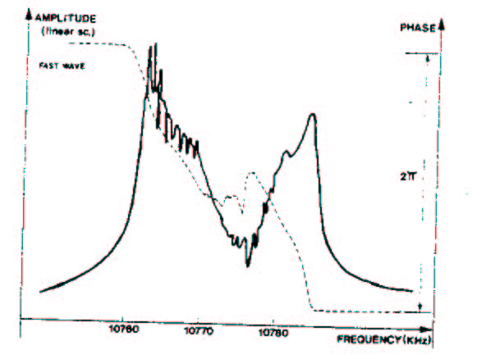
coupling transfer function
excite beam in x detect coherent y motion
used for continuous monitoring of coupling at the
CERN ISR in the 1970s;
is considered for LHC coupling control
amplitude and phase
of vertical response;
complex value of κ_
ISR
coupling
transfer
function
J.-P. Koutchouk,
1980

Slide 53
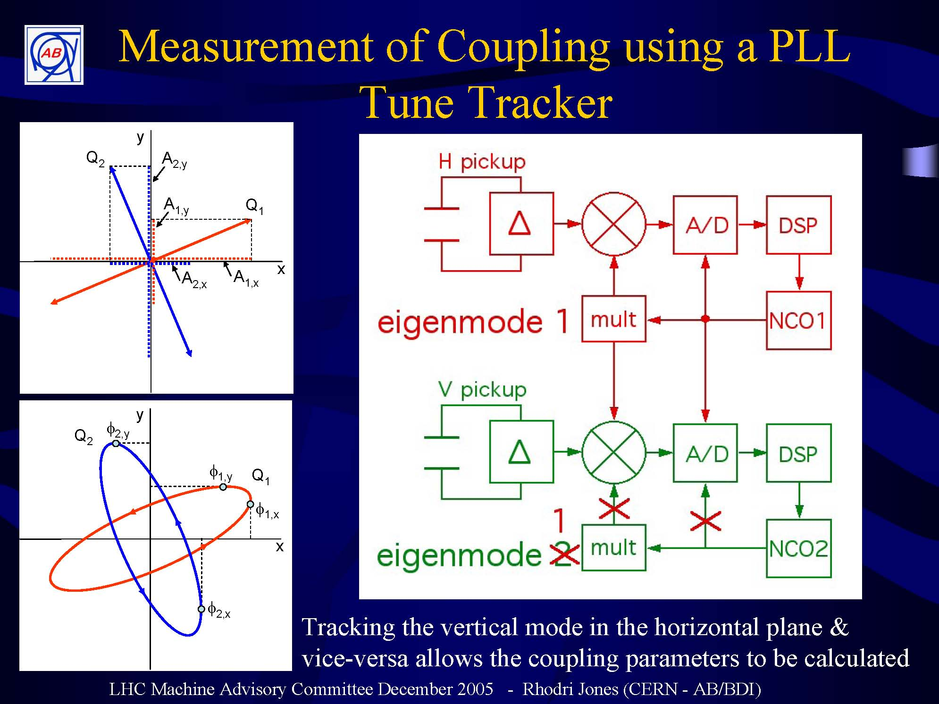
RHIC-Tevatron-LHC
2005

Slide 54

RHIC-Tevatron-LHC
2005

Slide 55

many other complications and challenges,
for example:
space charge
ionized gas molecules
electron cloud
beam-beam interaction
radiation damping
.. etc etc …
all these phenomena affect beam response to excitation
Courtesy B. Goddard

Slide 56
some “complications”:
colliding beam tune spectra
space charge tune spread
measuring the incoherent tune

Slide 57

transverse tune measurement (swept-frequency excitation)
with 2 colliding bunches at TRISTAN. Vertical axis: 10 dB/div.,
horizontal axis: 1 kHz/div [K. Hirata, T. Ieiri]
Hysteresis:
2 fixed points
due to nonlinear
beam-beam force

Slide 58

simulated tune spectrum for two colliding beams
π mode
σ mode
continuum
incoherent spectrum
equal intensity
intensity ratio 0.55
π mode not “Landau damped”
π mode “Landau damped”
M.P. Zorzano & F.Z., PRST-AB 3, 044401 (2000)
W. Herr, M.P. Zorzano, F. Jones, PRST-AB 4, 054402 (2002)
if the coherent tune lies outside the continuum “Landau damping” is lost
and the beam can be unstable; prediction for the LHC

Slide 59


evidence for coherent beam-beam modes@RHIC
RHIC BTF amplitude response at 250 GeV
without collisions with pp collisions
H & V signals for beam 1
H & V signals for beam 1
H & V signals for beam 2
H & V signals for beam 2
π mode?
σ mode?
continuum?
26. February 2009, Michiko Minty

Slide 60

space charge
example for space-charge
limited synchrotron:
betatron tune diagram and
areas covered by direct tune
spread at injection,
intermediate energy,
and extraction, for the
CERN Proton Synchrotron
Booster.
During acceleration,
acceleration gets weaker
and the “necktie” area
shrinks, enabling the external
machine tunes to move the
“necktie” to a region clear
of betatron resonances
(up to 4th order)
K.H. Schindl

Slide 61

how to measure the incoherent tune shift/spread?
K.H. Schindl

Slide 62


Schottky monitor
directly measures “incoherent” tune
(oscillation frequency of individual particles)
w/o centroid motion
incoherent signal
frequency bandwidth
emittance
#particles
“Schottky monitors”
stochastic cooling
FNAL
slotted
waveguide
1.7-GHz
Schottky
pickup
design
fabricated
FNAL
Schottky
pickup
design
R. Pasquinelli et al

Slide 63
applications

Slide 64
tune measurements are useful
to determine:
beta functions β, coupling strength |κ_|
chromaticity ξ, Q’
transverse impedance
nonlinear fields a_{n}, b_{n}
to improve:
dynamic aperture A
emittance ε
lifetime τ
instability thresholds I_{thr}

Slide 65
example applications
chromaticity
betatron coupling
damping & decoherence
tune shift with amplitude
high-order resonances
tune scans
β function measurement
measurement of nonlinear field errors

Slide 66
some applications of tune measurements
1. tune shift with amplitude
due to nonlinear fields
(octupoles, 12-poles,
sextupoles,…)
action-
angle-
coordinates
I, ψ
e.g., use FFT with data windowing
accurate tune evaluation over 32 turns

Slide 67


can measure entire curve Q(I) after single injection by calculating
Q&I for each time interval (making use of radiation damping)
Measurement of tune shift with amplitude in LEP at 20 GeV
using a high-precision FFT tune analysis

Slide 68
2. higher-order resonances
k,l,p integer
excited by nonlinear fields
distortion in phase space
chaos, dynamic aperture,
particles loss …

Slide 69

islands of 3rd
order resonance
3Q_{x}=p
separatrix
dynamic
aperture
linear
motion

Slide 70

tune vs. amplitude
resonance

Slide 71

phase-space distortion
additional lines in Fourier spectrum
line at Q_{x}
lines at Q_{x},
at 2Q_{x}, at 4 Q_{x}
resonance
no line at 3 Q_{x}!
in x signal
in y signal
reconstruct nonlinearities
from FFT SUSSIX

Slide 72

x [mm]
change in apparent closed
orbit after ‘kick’
turn
Dynamic aperture experiment in the CERN SPS (~1995).
Beam was kicked at about turn 100. Change in offset related
to (1,0) resonance or (0,0) line [Courtesy F. Schmidt, 2000].

Slide 73

FFT amplitude
many more lines in frequency spectrum!
fractional tune
FFT of beam position, evidencing nonlinear resonance lines
[Courtesy F. Schmidt, 2000]

Slide 74

Ph.D. thesis
R. Tomas,
2003
amplitude of (-2,0) line vs. longitudinal position for a hypothetical ring
with three sextupoles – the strength of the nonlinear line depends on s

Slide 75

Ph.D. thesis
R. Tomas,
2003
measurement compared with simulation for the SPS;
locations of 7 strong sextupoles are indicated

Slide 76

example - checking the coupling strength
LHC beam commissioning 11 September 2008
R. Tomas
beating confirms x-y tune split by 5 integers!

Slide 77
3. tune scans
beam lifetime
dynamic aperture
beam-beam interaction
sensitive to tunes!
measure
higher-order resonances appear as
stripes with reduced lifetime
tune diagram
identify (&compensate) harmful resonances
find optimum working point
compare with simulations

Slide 78

dynamic
aperture
simulation;
tune scan
around
24.709 (x),
23.634 (y)
measured
beam lifetime
around same
working
point
different slope attributed to
calibration error of tune knobs
PEP-II HER [Y. Cai, 1998]

Slide 79
4. measuring the β function with “K modulation”
vary quadrupole strength ΔK, detect tune change ΔQ,
obtain β at quadrupole
if
(tune not near integer or half integer)
and

Slide 80

quality of approximation

Slide 81

measurement
prediction
including “exact”
nonlinear
dependence
prediction of linear
approximation
Optics test in Fermilab Recycler Ring, March 2000.
Betatron tunes vs. strength of quadrupole QT601.

Slide 82


5. tune based reconstruction of local nonlinear field errors
Feed-down
Betatronic
motion
Deformed
closed orbit
Nonlinear
error
General tune response for sextupolar and octupolar
errors when deforming CO with steerers
The element of the nonlinear tune
response matrix are
G.Franchetti,A.Parfenova,I.Hofmann PRTAB 11, 094001 (2008)
G. Franchetti

Slide 83



Tune measurements in SIS
G. Franchetti
From the ``slopes’’ _{x}Q^{x}_{i} the
probing sextupolar errors
can be reconstructed
A. Parfenova, PhD Thesis 2008, Frankfurt University
A.Parenova, G.Franchetti,I.Hofmann
Proc. EPAC08, THPC066, p. 3137

Slide 84
synchrotron tune

Slide 85

LEP model
for synchrotron
tune
determined with 10⁻³
precision
from localization
of rf cavities
(computed)
voltage
calibration
energy loss
due to SR and
impedance
synchrotron tune
as a function of
total rf voltage
in LEP at 60.6 GeV;
the two curves are
fits to the 640 μA and
10 μA data;
tfe difference due to
current-dependent
parasitic modes is
clearly visible
(A.-S. Muller)

Slide 86

if the energy is known at one point, i.e., on a spin resonance,
the rf voltage can be calibrated from the Q_{s} vs V_{c} curve
fitted
beam
energy
energy
known from
resonant
depolarization
voltage calibration factor g
(A.-S. Muller)

Slide 87
display of complex tune signals

Slide 88




3D-“BBQ”-Measurement in CERN SPS WITHOUT ANY EXTERNAL EXCITATION
M. Gasior
fixed target beam
fixed target beam
SPS spectrum 1,
studies of the transverse damper influence on the tune path width
LHC beam
LHC beam

Slide 89




SPS continuous tune measurement example
M. Gasior
SPS spectrum 2
bizarre resonance occurred when one bunch LHC beam was going coast, measured during LHC collimator studies on 12/10/04
zoom on low frequency synchrotron sidebands of the revolution frequency

Slide 90

continuous BBQ tune diagnostics at the CERN SPS
M. Gasior

Slide 91
summary
introduction
tune, coherent & incoherent tune, detectors
integer betatron tune
fractional betatron tune
precision measurement, tune tracking, multiple bunches
modifications of tune signal
damping, filamentation, chromaticity, linear coupling
some “complications”
colliding beams, space charge, measuring incoherent tune
applications
tune shift with amplitude,high-order resonances,tune scans, β function measurement, nonlinear field errors
synchrotron tune
display of complex tune signals

Slide 92

further literature
CARE-HHH-ABI workshop on Schottky, Tune and
Chromaticity Diagnostics (with Real-Time Feedback),
Chamonix, France, 11-13 December 2007,
Proceedings CARE-Conf-08-003-HHH (editor Kay Wittenburg)
more examples and other
types of measurements
may be found in this book
Measurement and Control of Charged Particle Beams
M.G. Minty, F. Zimmermann,
Springer Verlag, Berlin, N.Y., Tokyo, 2003.

