Slide 1
Beam Instrumentation Workshop, June 2-3, 2009
CLIC Project breakdown structure: organization, documentation and cost estimate
G. Riddone 03.06.2009

Slide 2
Content
Introduction to CERN Product Lifecycle Management
CLIC Product Breakdown Structure
CLIC Beam Instrumentation documentation
Beam instrumentation cost estimate
Application and relevant EDMS features
Conclusions

Slide 3
Product Lifecycle Management
(PLM)
Intention to build an integrated Product Lifecycle Management (PLM) platform
Aim to link all the information related to one item/product to one common database
Whole lifecycle can be followed
PLM = EDMS at CERN
Integration
work under way
Design
Manufacturing
Installation
Maintenance
Dismantling
Commissioning
CERN
EDMS
Notes:
Therefore, there is an intention to build…
Aim to link all the information related to one item/product to one common database, so that the whole lifecycle of an item could be followed easily. (kuva:) Then it would be possible to follow all the lifecycle steps of a selected item and track what information is related to each of these phases.
This product lifecycle management system is supposed to be based on EDMS system at CERN.
At the moment they are doing this integration work, trying to build links between the different systems and databases.

Slide 4
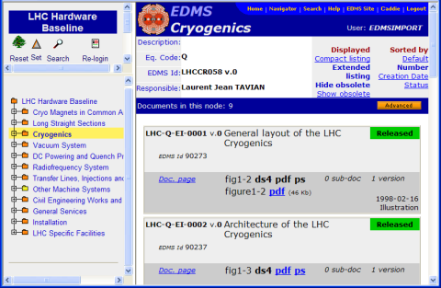
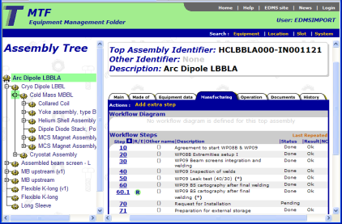
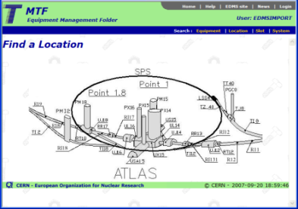
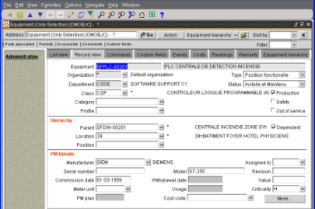
Overview of the CERN EDMS
Design data
management
Manufacturing follow-up
Installation follow-up
Maintenance
management
CERN Engineering & Equipment Data Management System
Agile PLM
Design data
Drawings & Documents
Infor EAM
Asset tracking
Work management
Other DBs
Layout databases
Production databases
D. Widegren

Slide 5
Introduction to EDMS
EDMS (Engineering and Equipment Data Management Service) provides engineering and equipment data management capabilities. This implies providing a set of advanced information systems but also the development and the formalization of methodologies and procedures for the engineering and equipment data management processes.
EDMS ensures that engineering and equipment data as well as documentation for projects and installations are safeguarded, organized, verified and remain retrievable on a long-term basis.
EDMS is used:
  for all technical data management and their associated work process
  for information flow among different teams, including external suppliers/collaborators

Slide 6
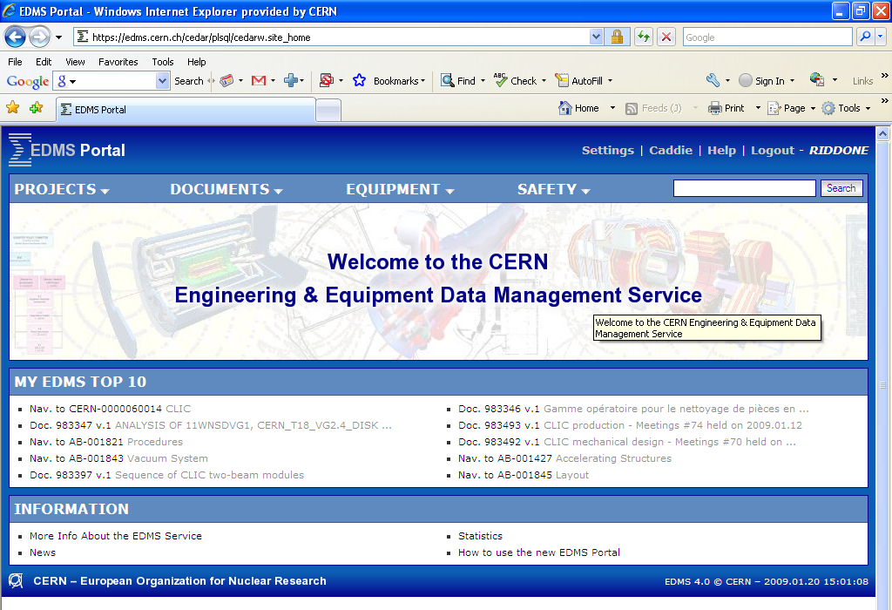
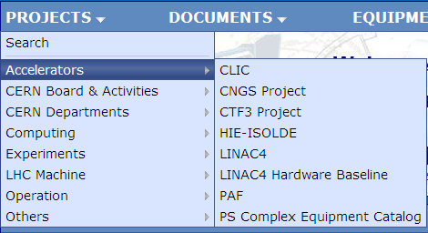
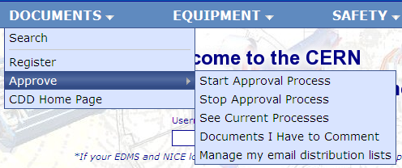
EDMS – Web Interface
https://edms.cern.ch/cedar/plsql/cedarw.site_home

Slide 7
Content
Introduction to CERN Product Lifecycle Management
CLIC Product Breakdown Structure
CLIC Beam Instrumentation documentation
Beam instrumentation cost estimate
Application and relevant EDMS features
Conclusions

Slide 8
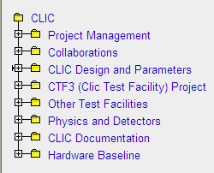
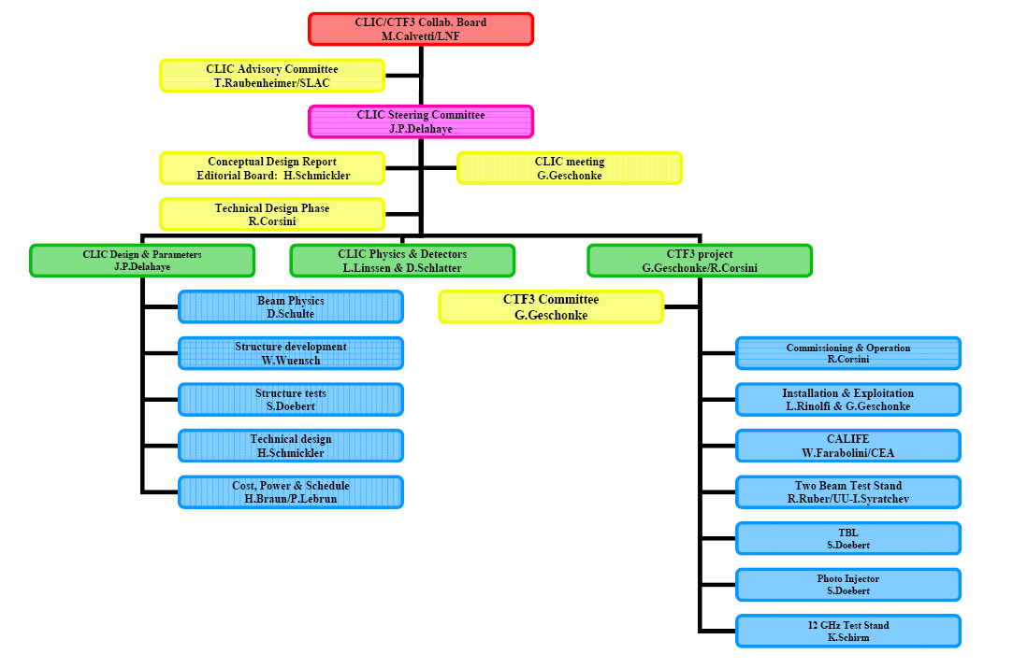
CLIC structure in EDMS -1
Based on the CLIC organization chart, a structure in EDMS has been implemented

Slide 9
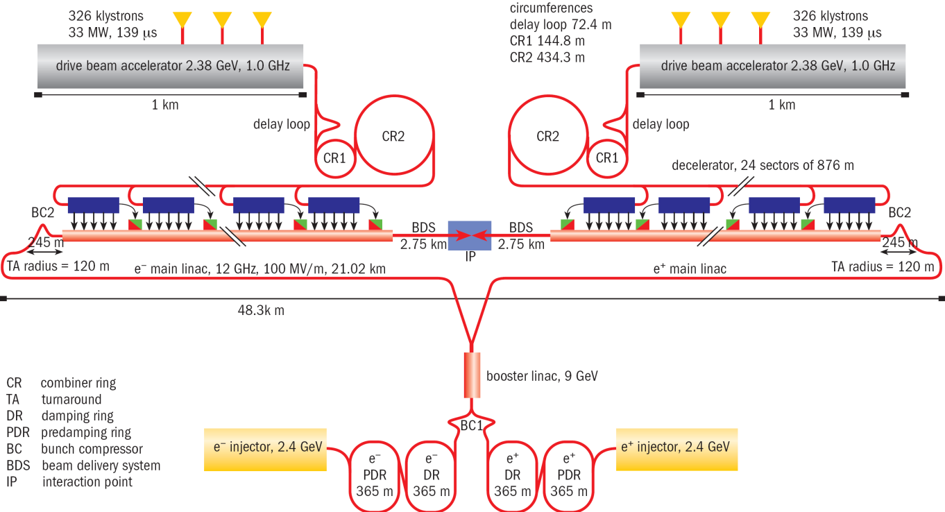
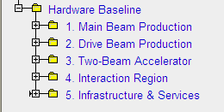
CLIC PBS (hardware baseline)
The hardware baseline is based on CLIC PBS, which has been defined according to the CLIC layout
Tree structure
The “hardware baseline” will contain all baseline documentation for the CLIC study :
Parameter Specifications, Functional Specifications, Engineering Specifications, Technical Specifications, Eng. Change Request, Eng. Change Order

Slide 10
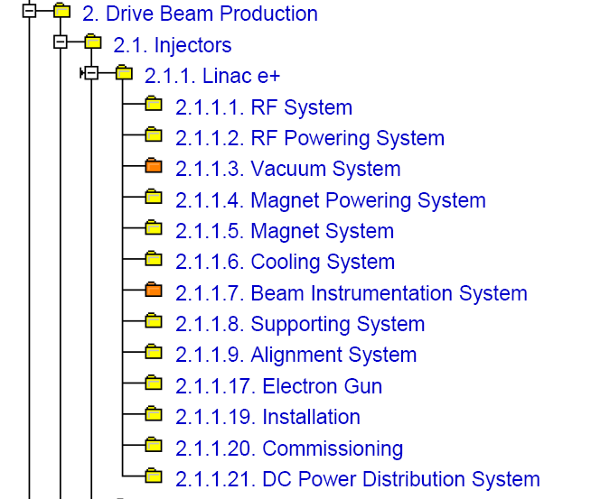
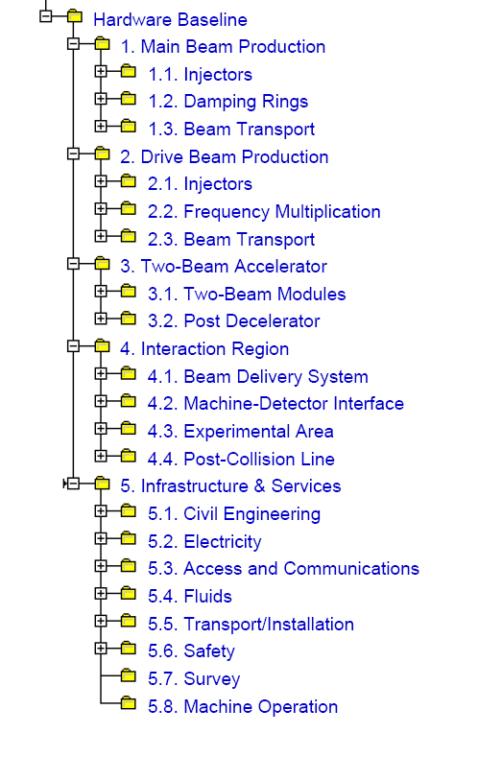
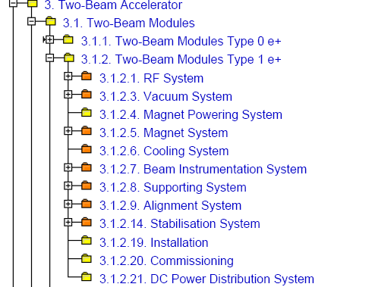
CLIC PBS (hardware baseline)
(level 3)
(level 1)
(level 2)
(level 4)

Slide 11
Content
Introduction to CERN Product Lifecycle Management
CLIC Product Breakdown Structure
CLIC Beam Instrumentation documentation
Beam instrumentation cost estimate
Application and relevant EDMS features
Conclusions

Slide 12
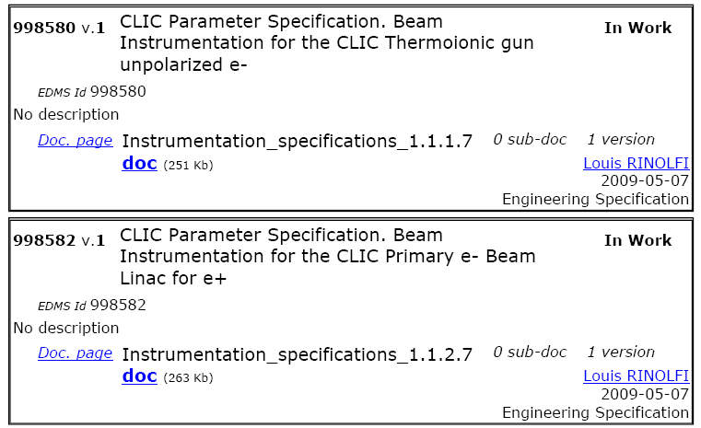
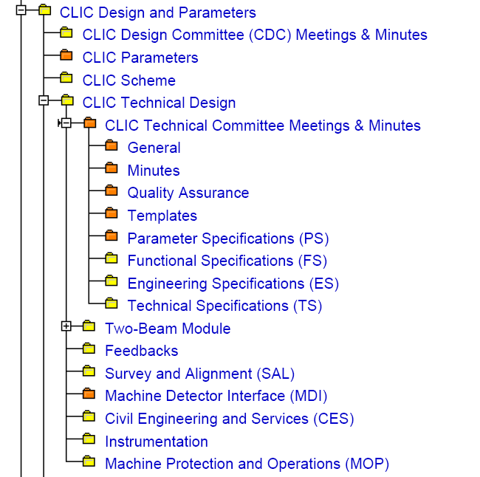
BI documentation -1
All CLIC specifications are collected in these nodes, and linked to the corresponding node in the HW baseline
Meetings
Workshops
Technical documents
Technical reports
Presentations
(Possibility to create links to Indico)

Slide 13
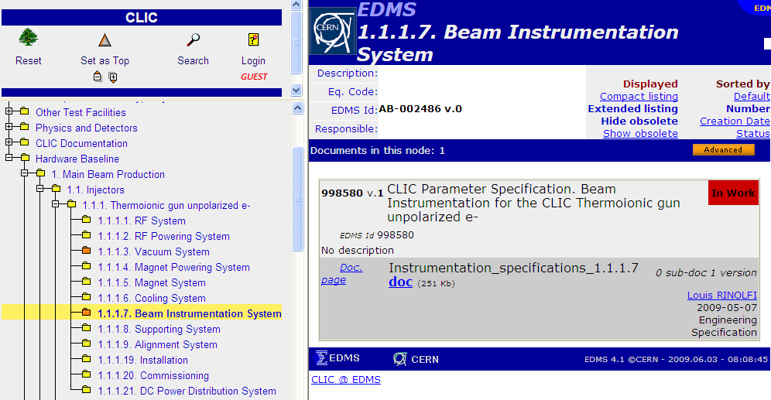
BI documentation -2
All technical documents are public
PS attached to the dedicated HW baseline node

Slide 14
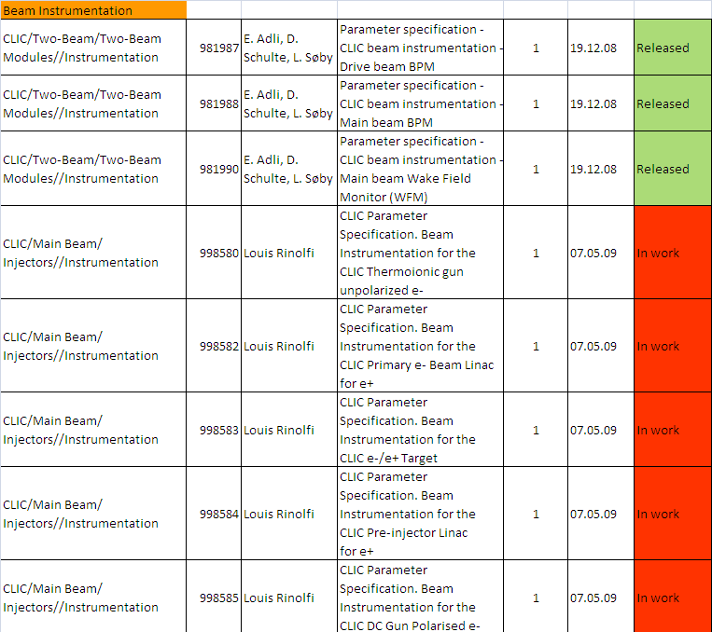
BI Par. Specifications
Complete list of PSs in EDMS:
927865

Slide 15
Content
Introduction to CERN Product Lifecycle Management
CLIC Product Breakdown Structure
CLIC Beam Instrumentation documentation
Beam instrumentation cost estimate
Application and relevant EDMS features
Conclusions

Slide 16
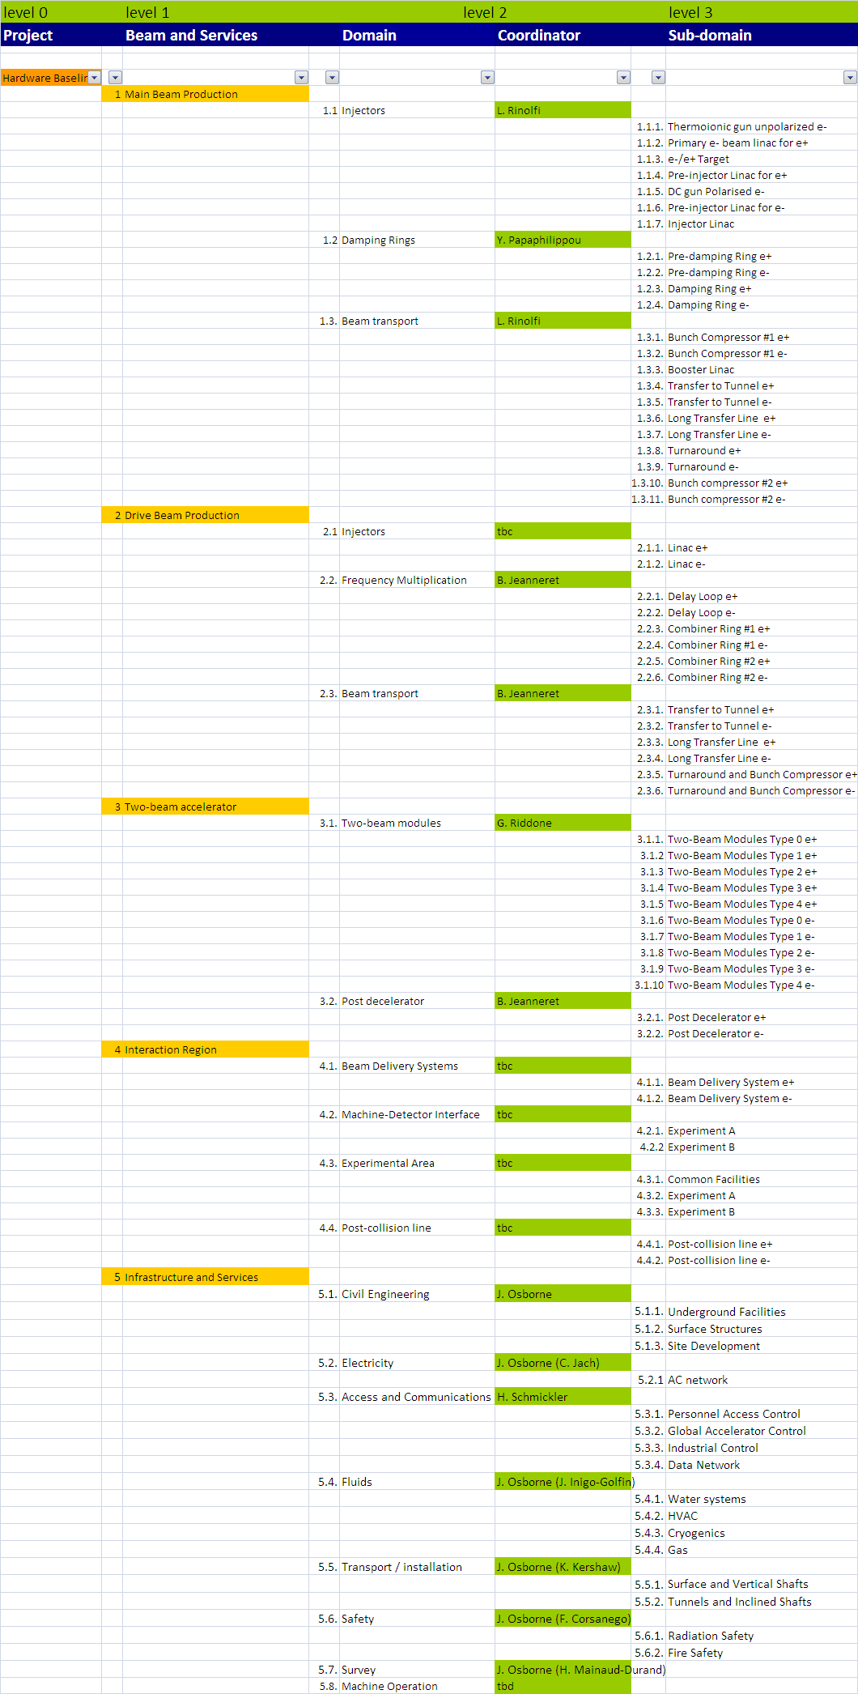
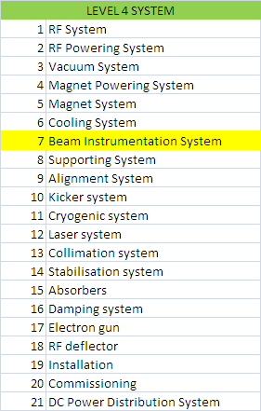
PBS-based cost estimate
Coordinators per
domain/subdomain

Slide 17
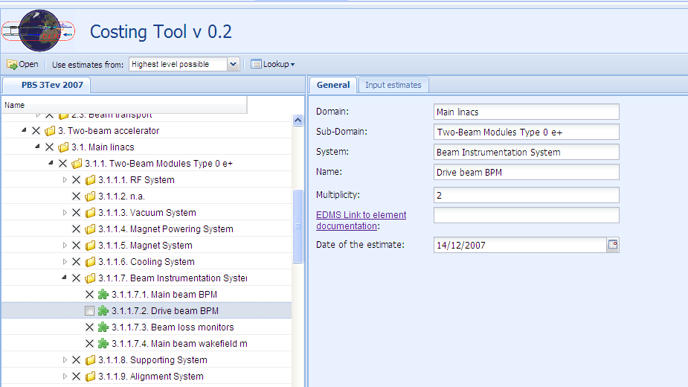
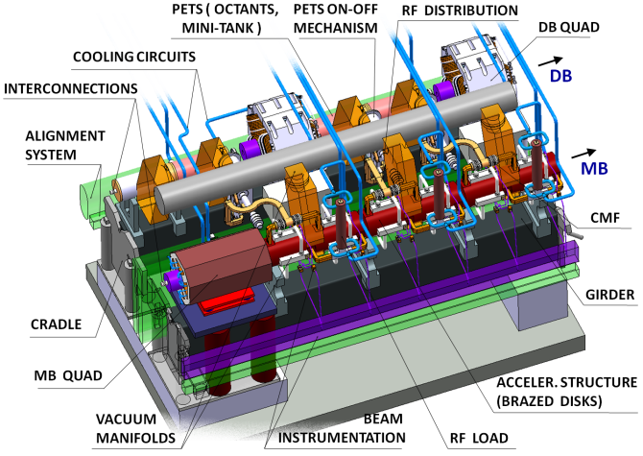
CLIC study costing tool -1
20924 modules
8374 type 0 e+ modules
DB BPMs per Type 0 e+ module

Slide 18
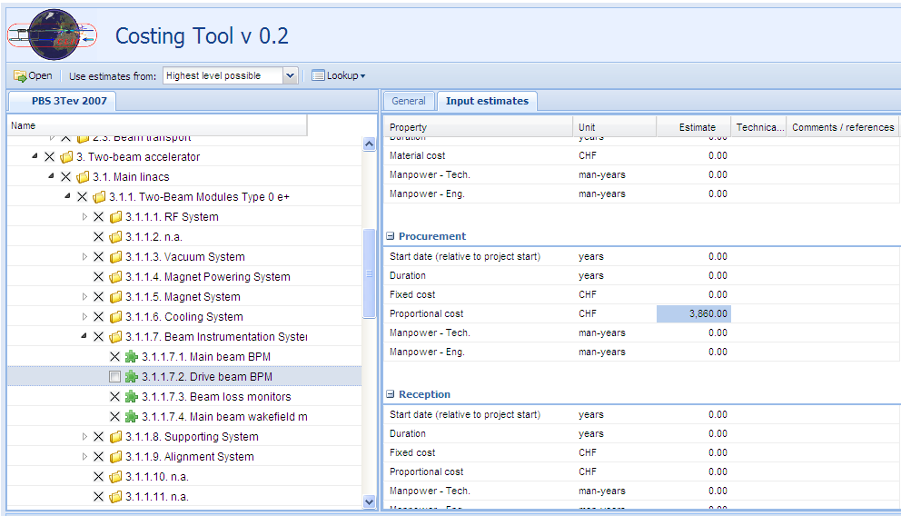
CLIC study costing tool -2

Slide 19
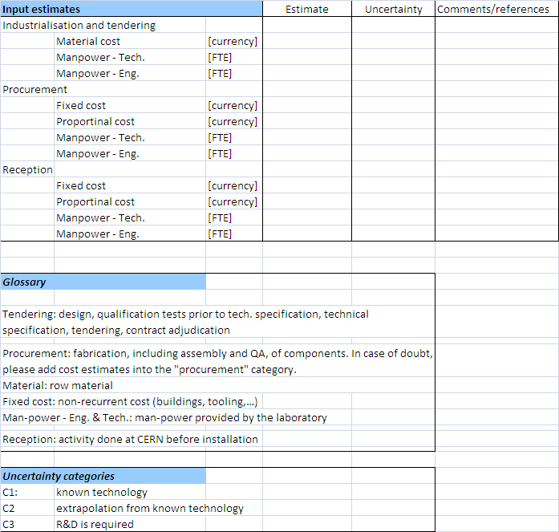
Input estimates
1. First round of updated cost estimate by end of 2009.
2. Input on schedule will be provided by T. Lefevre
3. T. Lefevre will collect all input for the BI cost estimate.
4. The domain/subdomain coordinators will put the values in the CLIC study costing tool

Slide 20
Content
Introduction to CERN Product Lifecycle Management
CLIC Product Breakdown Structure
CLIC Beam Instrumentation documentation
Beam instrumentation cost estimate
Application and relevant EDMS features
Conclusions

Slide 21
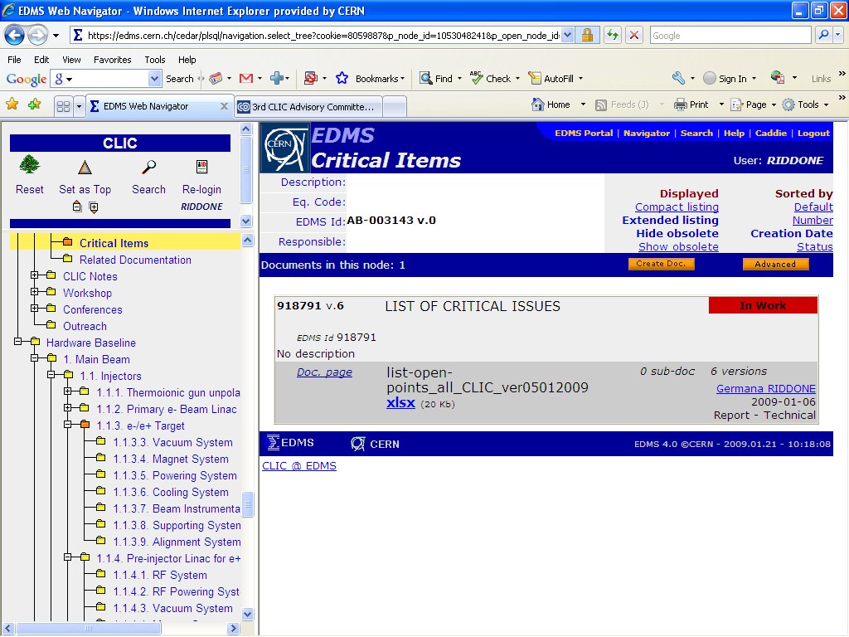
Example of a EDMS document -1

Slide 22
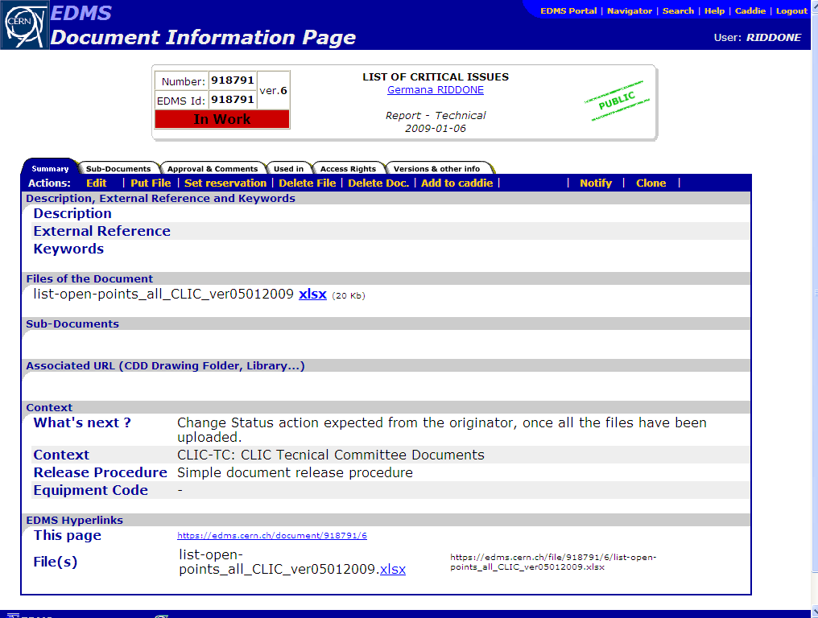
Example of a EDMS document -2
Several files can be uploaded in a EDMS document (max 100 Mb)

Slide 23
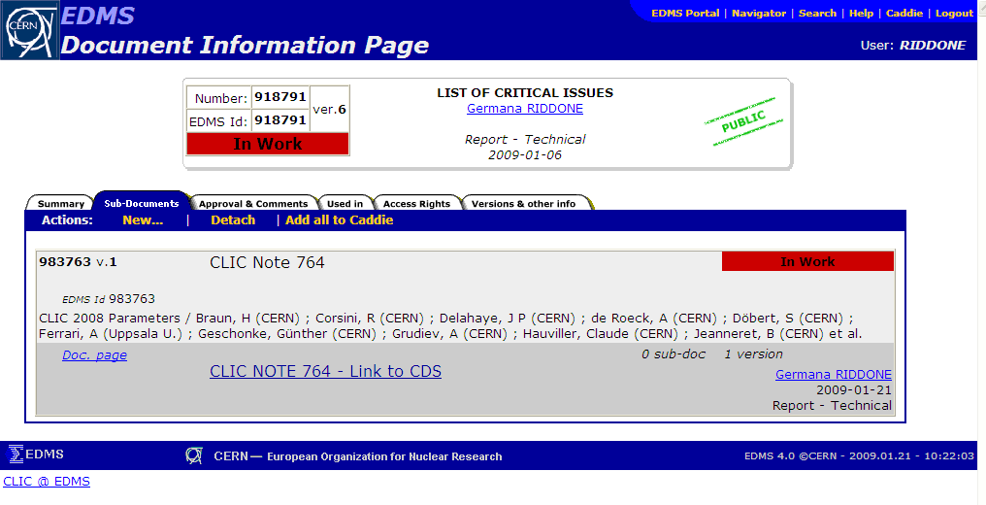
Example of a EDMS document -3
Possibility to attach EDMS documents as sub-documents

Slide 24
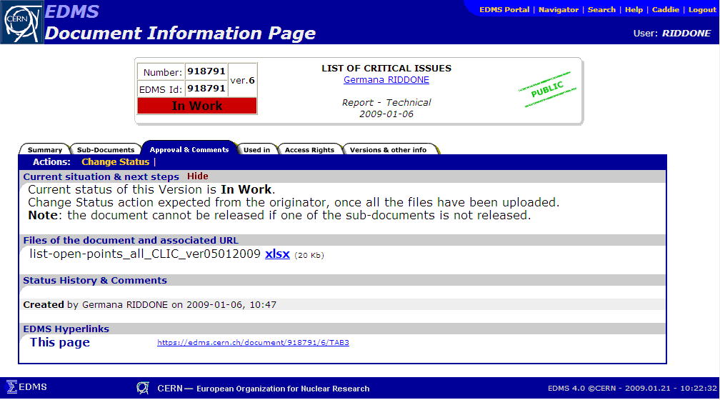
Example of a EDMS document -4
Documents have one life-cycle and depending on where they are in the life-cycle they have a corresponding status. The standard lifecycle for a document is
  In-Work
  Under-Approval
  Released and
  Obsolete
Once a document has been approved, it can be modified only via a versioning process
Other lifecycles can be programmed if required.

Slide 25
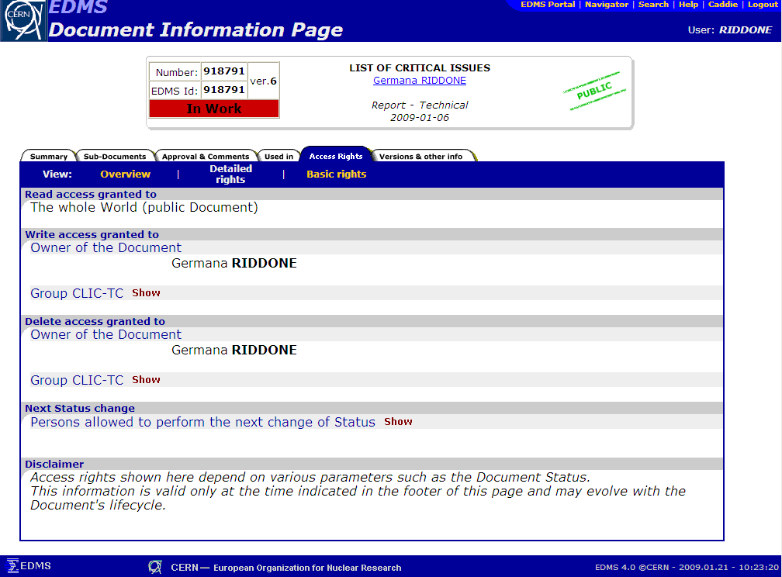
Example of a EDMS document -5
For all CLIC nodes (except nodes on cost and CSC)
WRITE: CLIC meeting members (can be adapted)
READ: public access
Nodes on cost and CSC: restricted read/write access

Slide 26
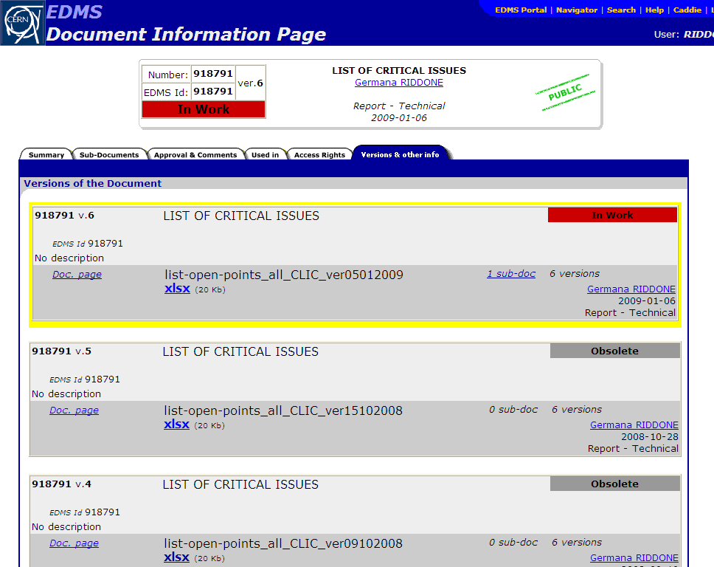
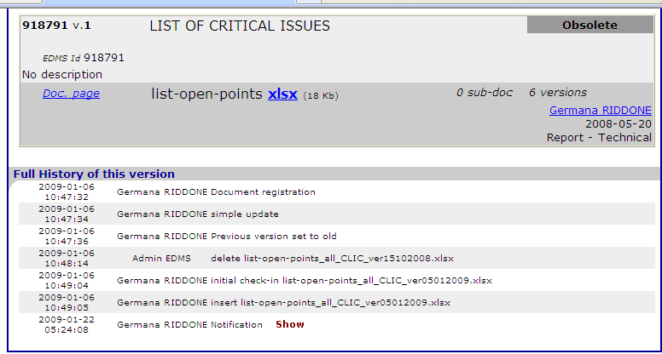
Example of a EDMS document -6
This tab shows the list of other existing versions of the document, and its full history, including notifications.

Slide 27
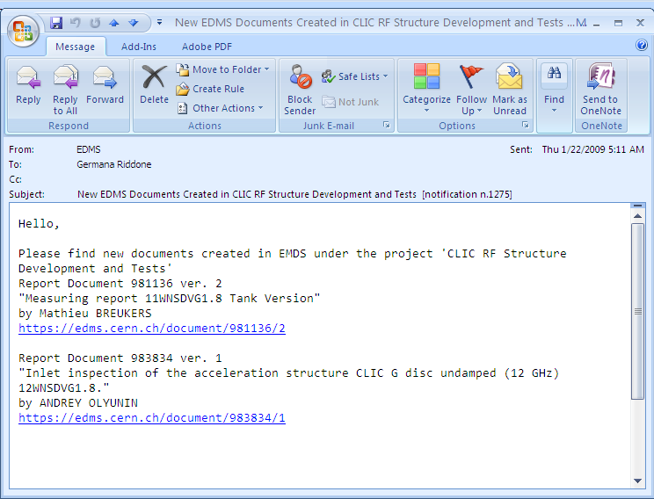
Notification e-mail list
Possibility to ask for e-mail daily notification list ➔ list of EDMS documents created the day before

Slide 28
Conclusions
We are getting organized towards a project-oriented structure
EDMS as unique source of information
Tree structure set-up for CLIC documentation in EDMS (can be used by CERN people and external collaborators)
All BI documentation will be available in EDMS: all PS have been archived and the approval circuit will be soon launched (collaborators will be largely involved)
Update cost estimate will be needed for CDR: first iteration by end of 2009 (still possibility to give feedback to technical systems)

