Slide 1
ADT firmware update after MD1
New features are implemented into the ADT signal processing modules
  New excitation mode implemented – “ADT AC dipole”
  Limitation on excitation length within a turn can be removed in an expert mode (cleaning/blow-up/tune kick) – protected by machine critical settings
  Further decoupling of the cleaning and excitation signal chains
  Preparation for the new gigabit link standards (new BeamPos modules)
  Many other small improvements (e.g. triggering, preparation for instability detection etc.)
The firmware in the machine has to be updated
A proper validation of the full transverse feedback system is necessary

Slide 2
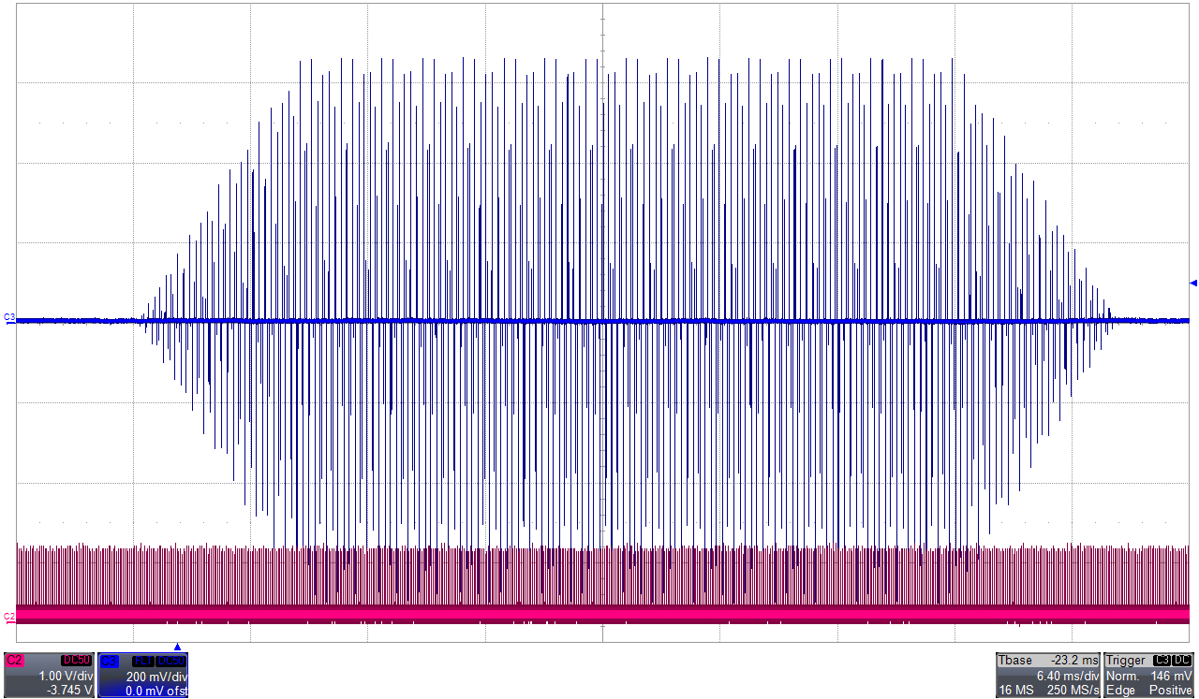
ADT as AC dipole (or tune kicker)
f

Slide 3
What needs to be validated?
The firmware had been recompiled – a full validation of the transverse feedback loop needs to be performed
  Open loop transfer function measurement (mainly to validate the 1-turn delay)
  A short train (12 b.) at injection, takes about 1 hour
Test and validation of the unrestricted excitation modes, including the controls via LSA, machine critical settings, RBAC roles, 1-2 hours
The ALLAbortGapClean class underwent a major modification, a full validation of the functionality at injection and during the intensity ramp-up, in a shadow of intensity ramp up

