Slide 1
PC Overview
Naples Meeting, 25-26/Oct./2016
M. Komatsu
1
1
1
1

Slide 2
PC meetings since March
PC meeting 12/5/2016
  https://indico.cern.ch/event/527558/
  Multiplicity Distributions in CC Interactions : Cagin
  Search for the neutrino disappearance in OPERA : Budimir
  nue analysis update : Svetlana
  Update on the lepton number measurement : Giuliana
  Short decay search : Mustafa
PC meeting 9/6/2016
  https://indico.cern.ch/event/538383/
  nue analysis summary : Svetlana
  Preliminary oscillation analysis : Matteo
  Electron energy measurement report : Frank
  Search for the neutrino disappearance in OPERA : Budimir
  Update on the lepton number measurement : Giuliana
  Update of hadron interaction analysis : Mizusawa
  Updates on annual modulation : Nicoletta, Andrea
  Outline of SPSC presentation : Giovanni

Slide 3
PC meetings since December
PC meeting 29/6/2016
  https://indico.cern.ch/event/545561/
  nue anlysis statistics and plots : Svetlana
  nue oscillation analysis result : Matteo
  numu disappearanc: Budimir
  Draft slides for Neutrino 2016 : Dominique
PC meeting 28/7/2016
  https://indico.cern.ch/event/558967/
  nue oscillation analysis result : Matteo
  Marginal event analysis : Giuliana
  Electron energy reconstruction : Frank
PC meeting 13/9/2016
  https://indico.cern.ch/event/567633/
  Electron neutrino update and prospect : Svetlana and Matteo
  Numu disappearance analysis update : Budimir
  Marginal event analysis update : Giuliana
  Update on electron energy measurement : Frank

Slide 4
Nue analysis
Svetlana and Matteo

Slide 5
Story on nue analysis
Very preliminary exclusion @ 9th June
  sin²(2θ) was 0.012 @ high dm² without energy cut.
Updated exclusion @ 29th June
  sin²(2θ) was about 0.1 @ high dm² with 20 GeV energy cut.
Due to the lack of confidence, we decided to drop exclusion from Neutrino 2016 presentation.
  We were short in time to get concrete result.
Sensitivity optimization @ 28th July
  Best energy cut was not 20 GeV.

Slide 6
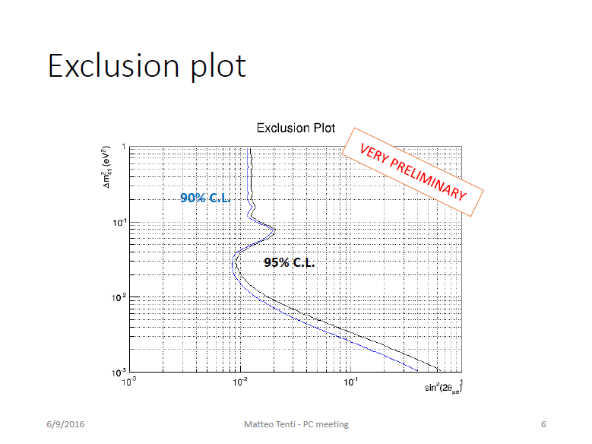
Matteo @ PC 9 June

Slide 7
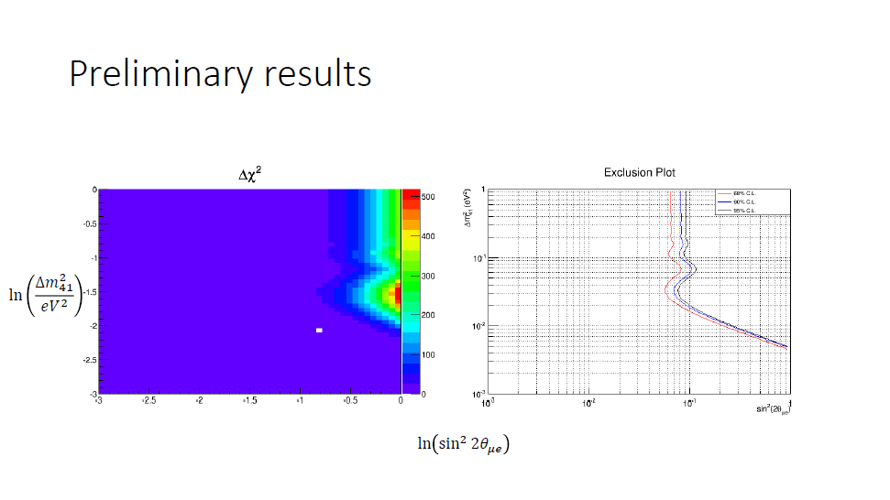
Matteo @ PC 29 June

Slide 8
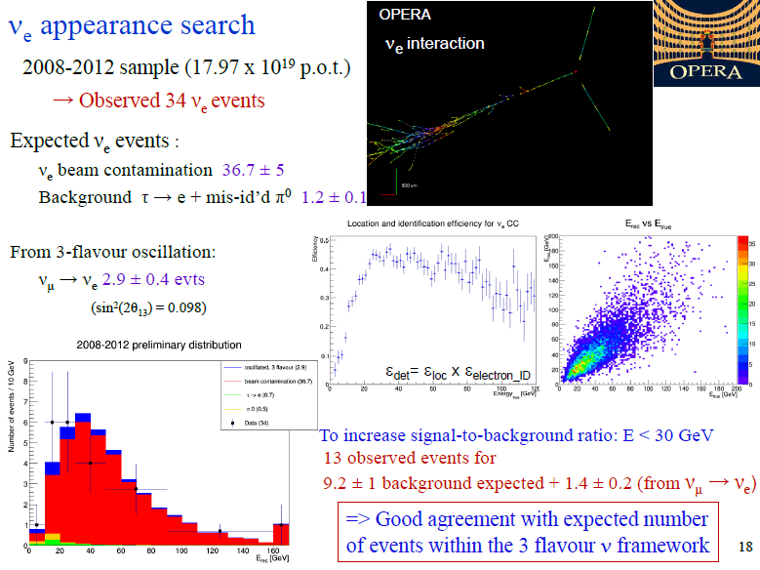
Slide in Neutrino 2016

Slide 9
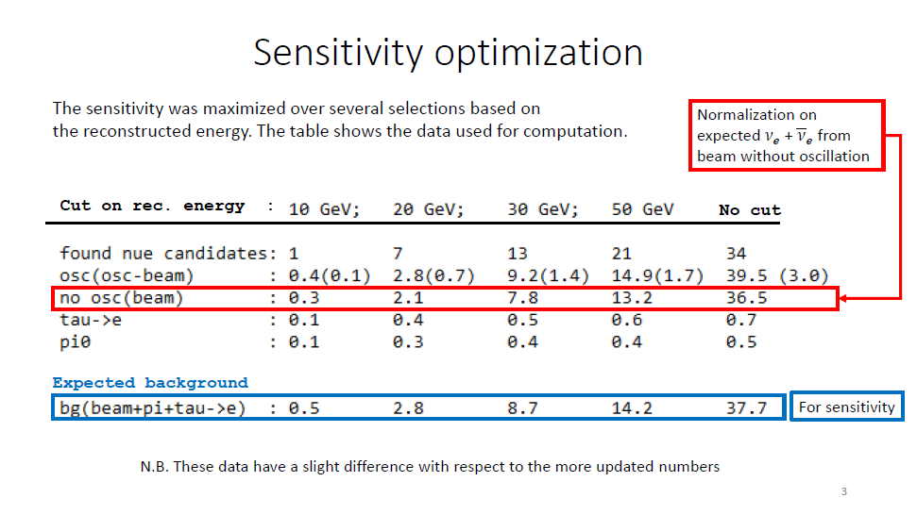
Matteo @ PC 28 July

Slide 10
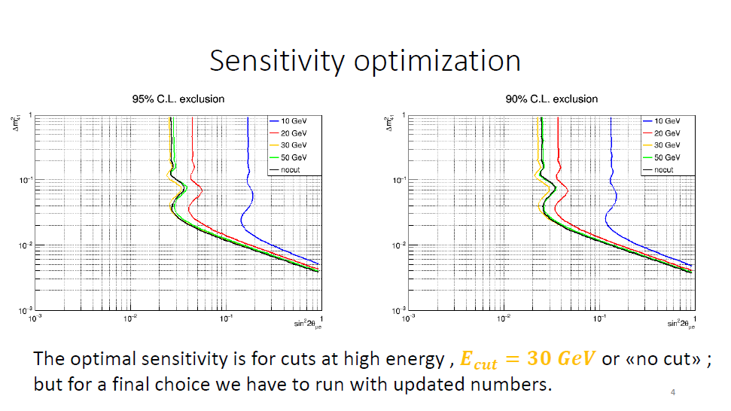
Matteo @ PC 28 July

Slide 11
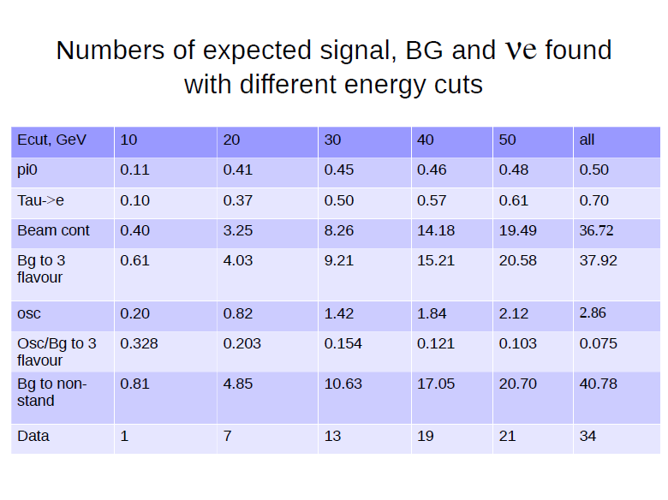
Svetlana @ PC 28 July

Slide 12
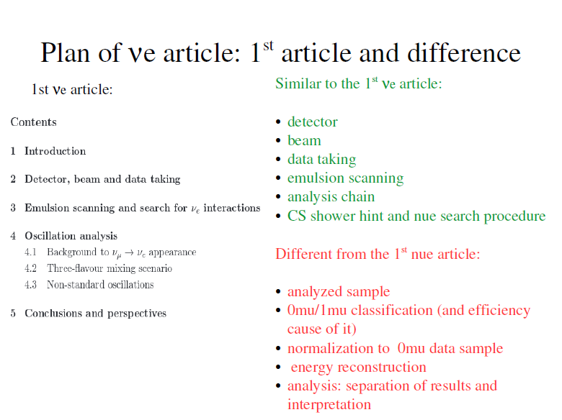
Svetlana @ PC 28 July

Slide 13
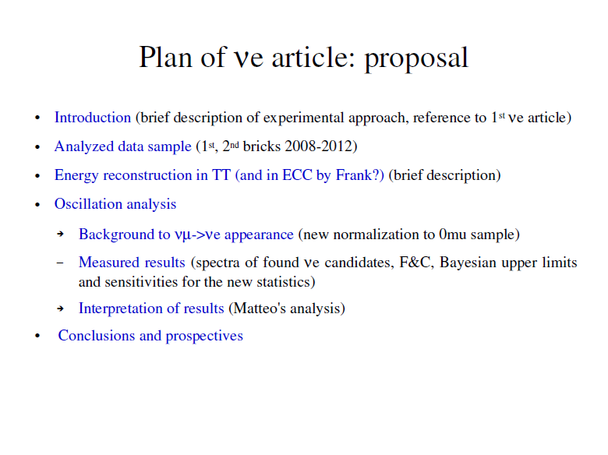
Svetlana @ PC 28 July

Slide 14
Numu disappearance
Budimir

Slide 15
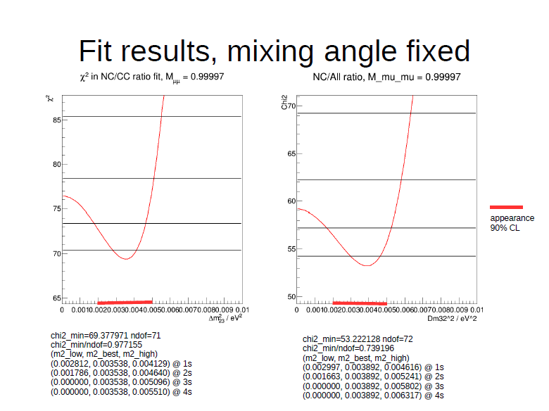
Budimir @ PC 29 June

Slide 16
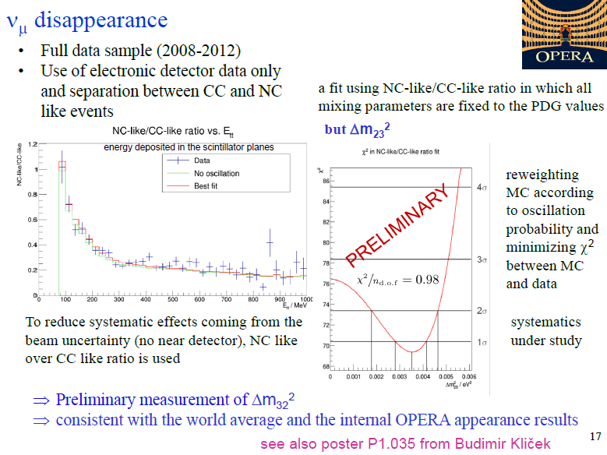
Slide in Neutrino 2016

Slide 17
Lepton number and marginal events
Giuliana

Slide 18
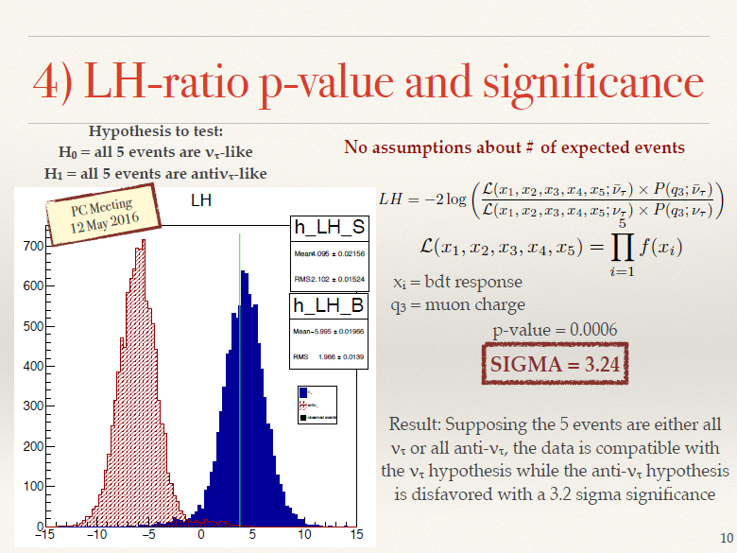
Giuliana @ PC 9 June

Slide 19
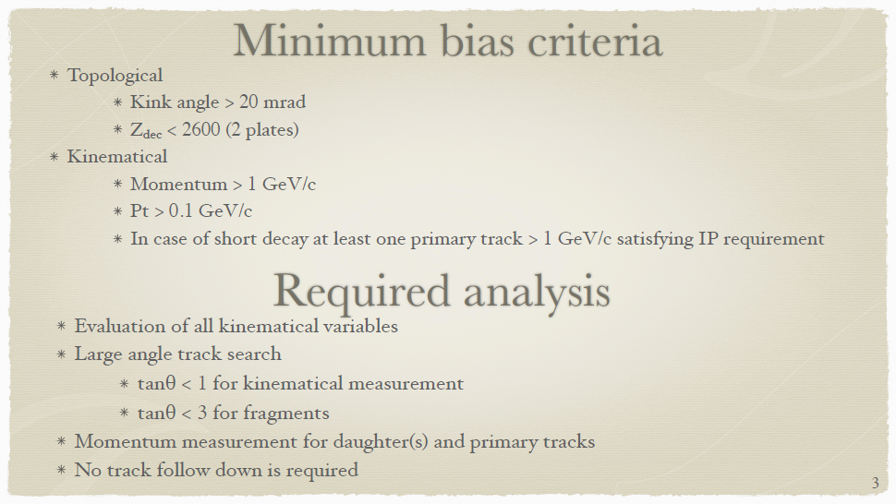
Giuliana @ PC 13 Sep.

Slide 20
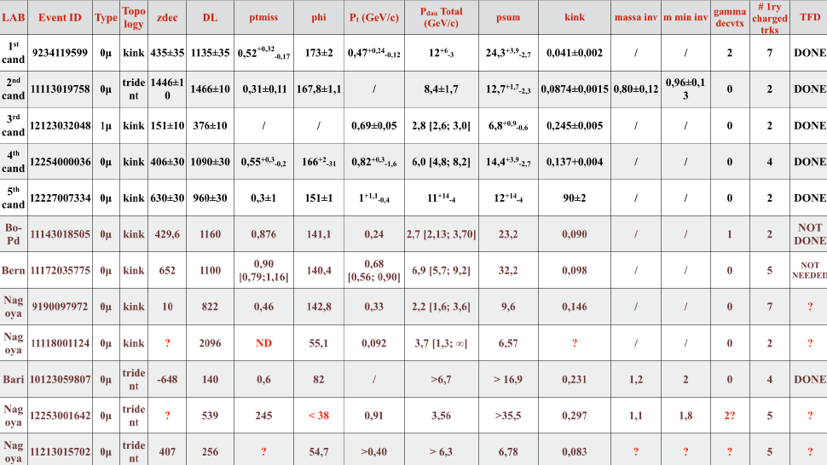
Giuliana @ PC 13 Sep.

Slide 21
Other activities
Multiplicity Distributions in CC Interactions : Cagin
Electron energy measurement report : Frank
Update of hadron interaction analysis : Mizusawa
Updates on annual modulation : Nicoletta, Andrea
Short decay search : Mustafa

Slide 22
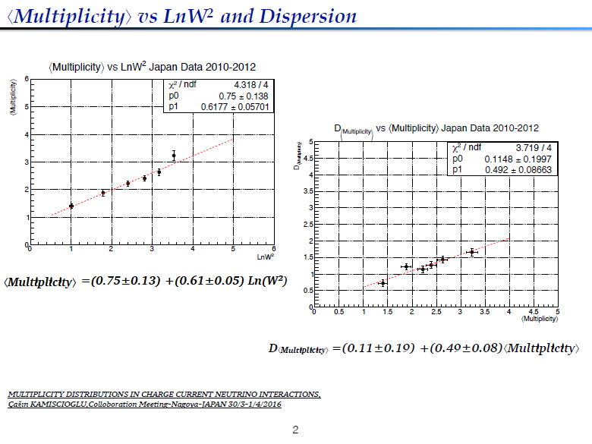
Cagin @ PC 12 May

Slide 23
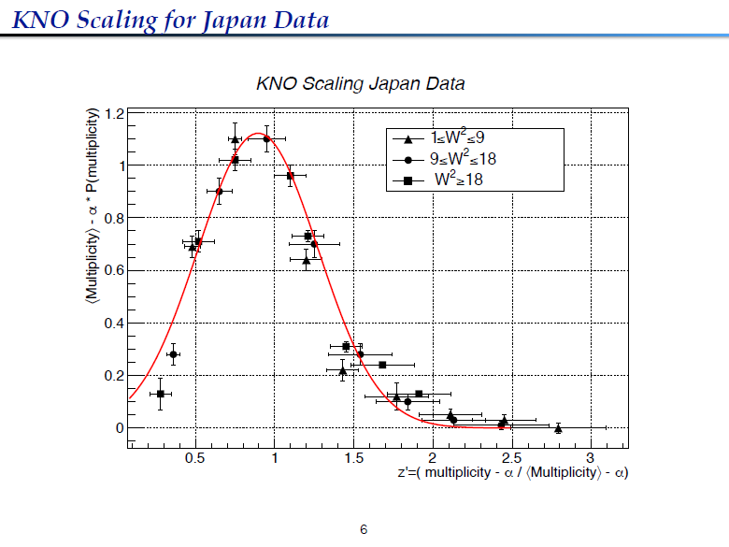
Cagin @ PC 12 May

Slide 24
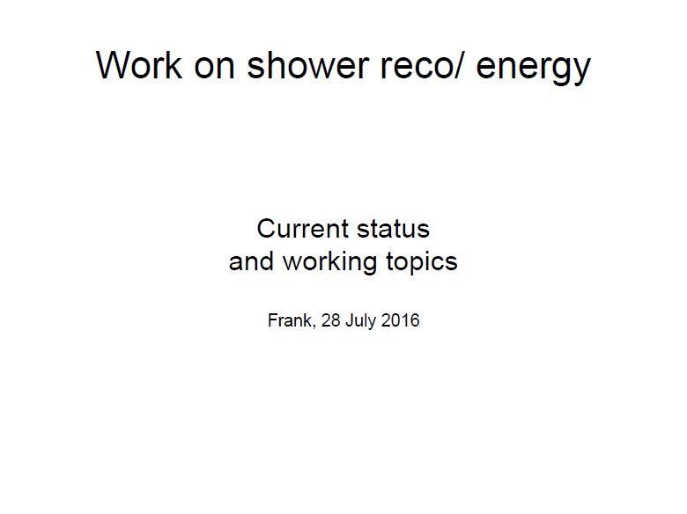
Frank @ PC 28 July
9 June and 13 Sep.

Slide 25
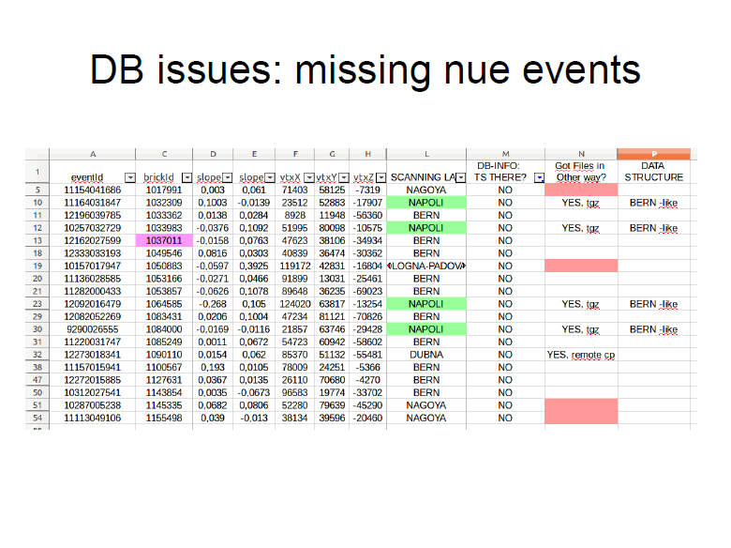
Frank @ PC 28 July
9 June and 13 Sep.

Slide 26
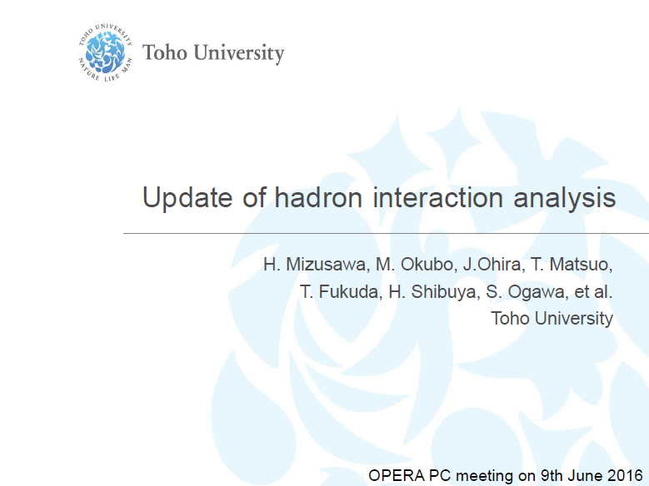
Mizusawa @ PC 9 June

Slide 27
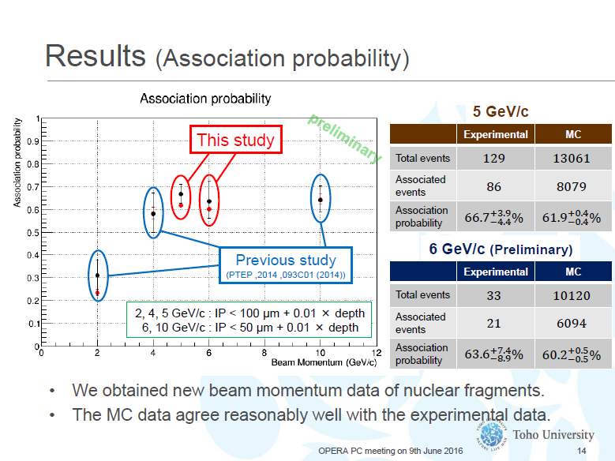
Mizusawa @ PC 9 June

Slide 28
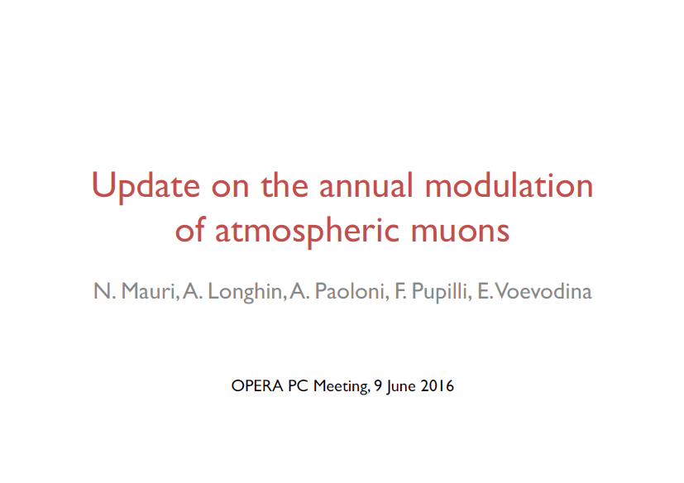
Nicoletta @ PC 9 June

Slide 29
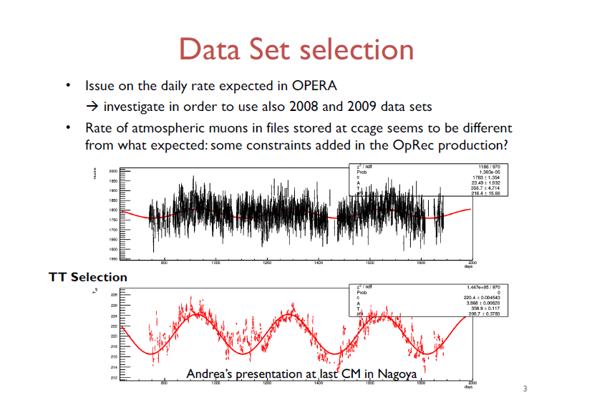
Nicoletta @ PC 9 June

Slide 30
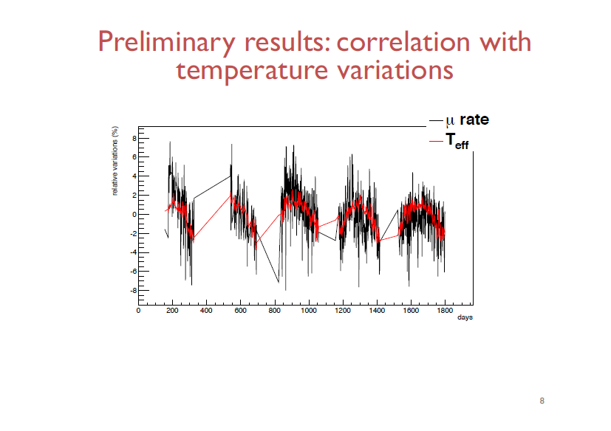
Nicoletta @ PC 9 June

Slide 31
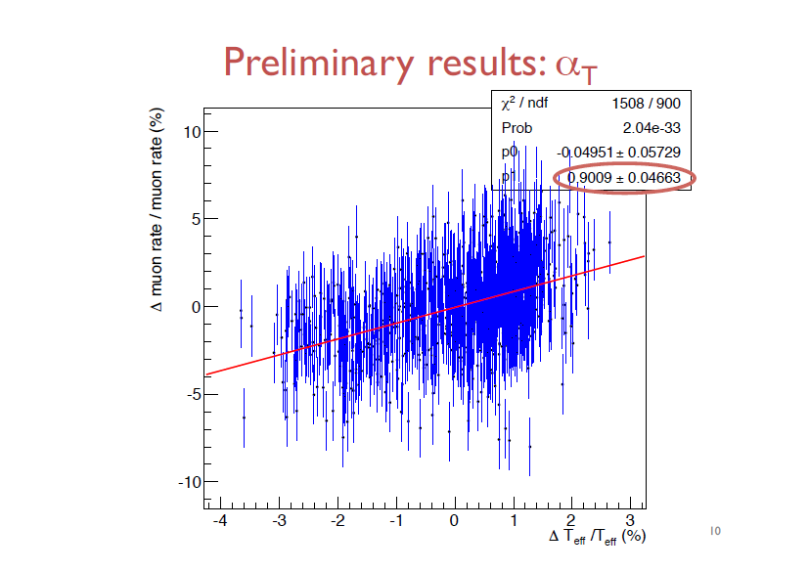
Nicoletta @ PC 9 June

Slide 32

Mustafa @ PC 12 May

Slide 33
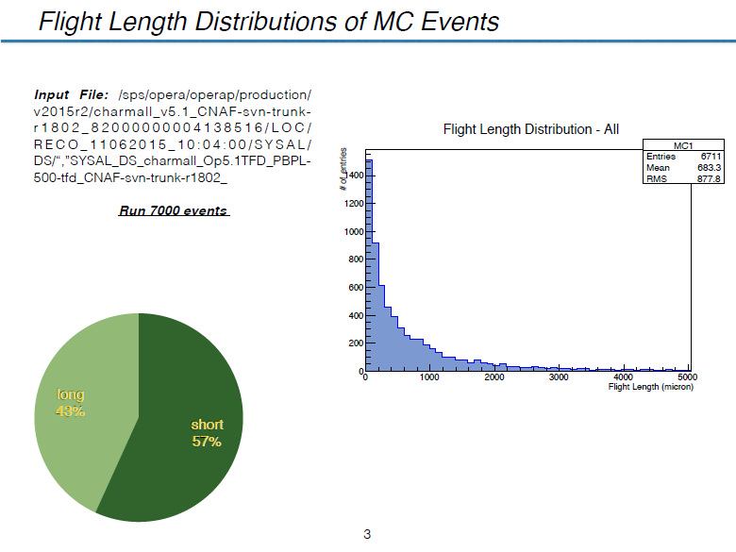
Mustafa @ PC 12 May

Slide 34
To do
Finalize statistics
  By the end of November
  We have to declare end of the scanning
All analysis should be done by April 2017.
  Regular (at least monthly) PC meeting will be called.
Several more papers are in the line
  Keep active until the end.
  Most of publication : by June 2017.

Slide 35
Agenda
nue oscillation analysis with 3+1 : Matteo
Cross check on the oscillation analysis : Alessandro
nue analysis summary and prospect for the paper : Svetlana
nue CC electron energy measurement : Frank
numu disappearance update : Budimir
Marginal event analysis : Giuliana
Analysis on neutrino interaction and prospect toward paper : Cagin
Short decay search : Mustafa
Electromagnetic shower reconstruction and possible improvements on event location : Andrey
Open data access: the experience of LHCb : Andrey

