Slide 1
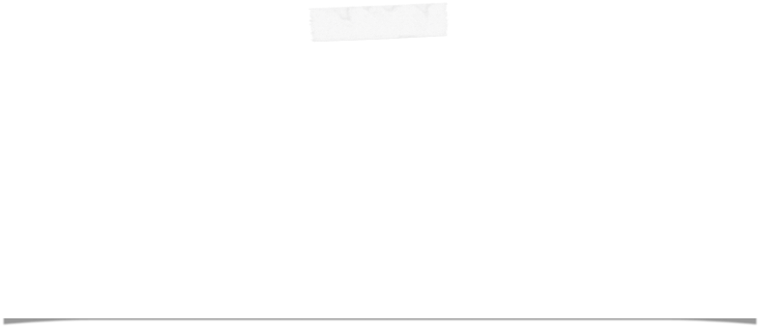

NEWS Collaboration Meeting
Naples, 27-28 October
Giovanni De Lellis
Università “Federico II” and INFN Napoli

Slide 2

NEWS short term plan @LNGS
Stefano Gazzana
September 7, 2016

Slide 3
Area Ex-BAM
Stefano Gazzana
On June 1, during the refurbishment of the Hall for NEWS R&D an incident occured, luckly no major damage inflicted the personnel and the infrastructure, only a ventilation unit was destroyed.
A deep analysis of the conditions and the facts started, in the meanwhile we open a discussion with LNGS insurance for to cover part of the costs.
A detailed plan how to recovery the hall (ex-Bam) is defined and ready.
At the moment we are still waiting the final green light from insurance (foreseen in this week).
From the moment we can restart the activities few weeks are necessary to be ready for the new works needed by NEWS.
The design of the rooms are almost defined. installation time of NEWS are in order of 8 weeks.
The costs must be covered
As back-up plan the NEWS R&D can use the existing facility in Hall B up to February 2017.

Slide 4
Detector
Stefano Gazzana
There are problem to use the DarkSide10 structure in the actual position, a backup plan must be discussed and approved.
We have to define needs of the Collaboration and a tentative schedule of the measurements taking in account the constrains and the working conditions in underground labs
A series of meetings will be organised by LNGS starting in the next days in order to finalise it before end of September.

Slide 5
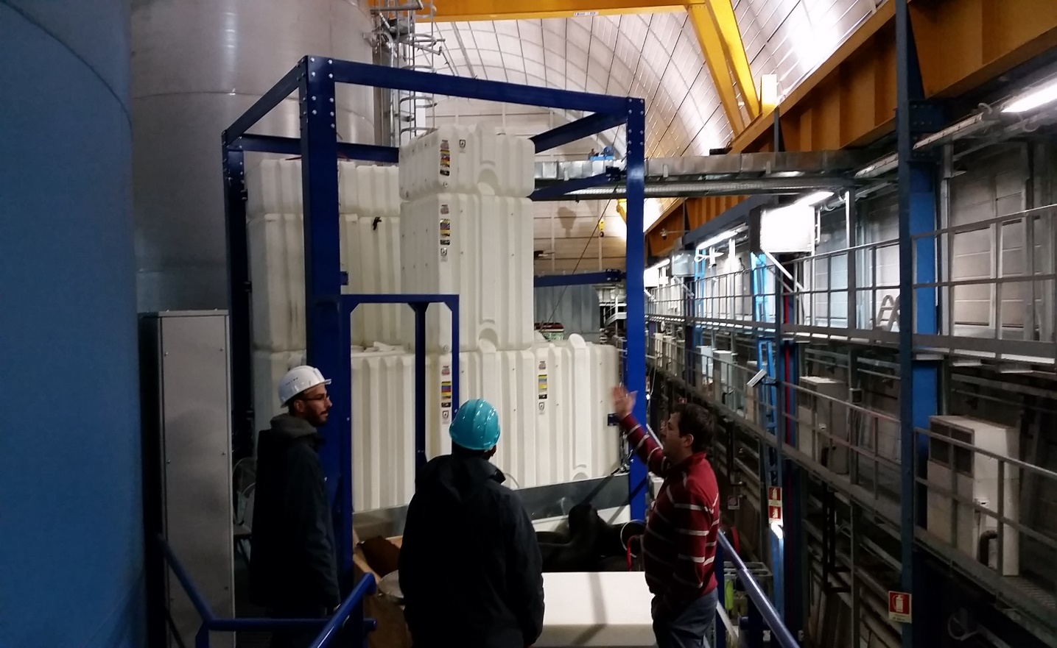
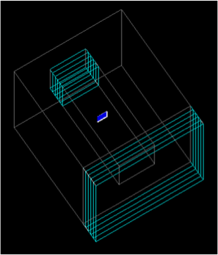
d) Measurement site with shielding at LNGS
About 1m of water-equivalent
~4π shielding
Interference with SABRE
NIT emulsions
Polysthyrene support
Water Tanks
Polyethilene Plates

Slide 6
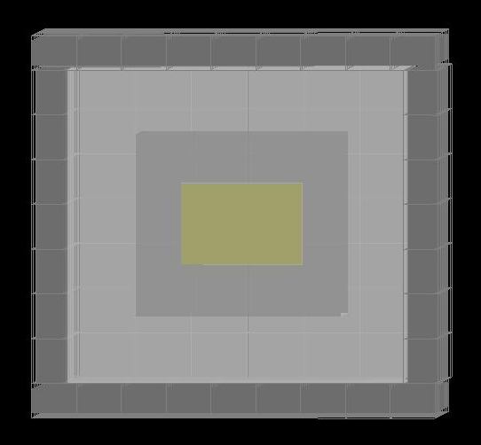
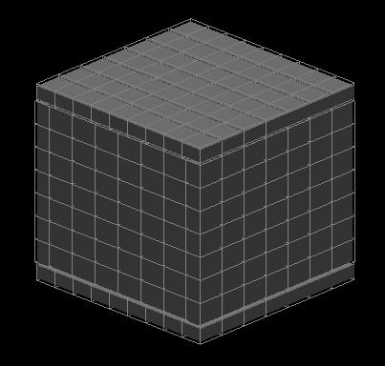
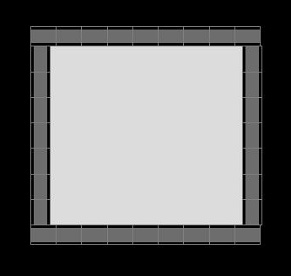
LEAD SHIELD OPTION
Valerio’s (old) simulation
AXONOMETRIC TOP VIEW
Lead
Empty space
Volume ∼ 1 m³
Surface ∼ 1 m²
Weight ∼ 3.5 ton ( 2.5 lead + 1 polyethylene)
(+ support)
5.6 cm
> 40 cm
NIT film
> 40 cm
15 cm
Polyethylene
NIT emulsion
Lead
Polyethilene
1)
2)
TOP VIEW
Polyethylene layer
* (Lead roof hidden)
No. of bricks ~ 308
3D VIEW

Slide 7
Present situation of the facility underground
After the fire accident on June 1st in the ex-BAM (now Hall F) tunnel, refurbishment works stopped for >3 months, restarted ~ 1 month ago
Use of the current OPERA facility granted until February 2017
The construction of the facility required some additional funds (35k€ received by INFN for that)
The movement to the new facility foreseen within February
Experimental area assigned: Hall B, behind Xenon
Dark-side-10 shield: large tanks not available but we may use the supporting structure and the polyethylene sheets
Use polyethylene plates, after reshaping some of them, and add a layer of lead all around, see Nicola and Valerio’s talks
Dark Side-10 pieces should be moved there ~November 15th

Slide 8
Toward the background test
Timeline: next few months
Design (finalise at this meeting) and construct the shield
Finalise the box containing the emulsions at this meeting (Nicola)
Start the first test (Valeri)
Goal of the test: measure the overall background and demonstrate < 1

Slide 9
Background budget
Neutrons from intrinsic radioactivity totally negligible
Neutron-induced background negligible
Electrons from ¹⁴C ~ 10⁸/kg/year, requires a rejection power for 10g and 1month exposure ~10⁵÷10⁶ at least
In perspective (~kg year) requires ~10⁸÷10⁹ and more
Dust after filtration, measure with un-sensitised films. Lever arm with polarisation analysis, but we need a conclusive estimation → measure
Fog (single grain from thermal excitation), sensitised but unexposed films: need a conclusive estimation

Slide 10
Analysis chain (see Andrey’s) machine learning can improve it
Threshold for fired pixels
Cluster reconstruction (2D gaussian fit)
Grain reconstruction (3D object)
Tracking at all angles (useful to identify “long” alpha tracks and discard their grains for further analysis)
Isolated grains → best cluster → parameter fit
Ellipticity cut
Polarisation analysis
Colour analysis
…

Slide 11
Activity in 2017
Movement from the old to the new facility
Continue the tests
Analyse the date
Prepare TDR for the experiment
  Clear evaluation of background
  Design equatorial telescope
  Establish the film production line (clean room)
  Prepare a scheme to minimise the time without shield: from sensitization to exposure, from exposure to development
Proceed with R&D in parallel

Slide 12
Facility at Lab 1
~300 OPERA films/batch → ~1kg/batch

Slide 13
NEWS name
A message from Gilles Gerbier (NEWS = New Experiment With Sphere), October 17th
Dear Giovanni,
From what I Giomataris said to me from your discussion in July , you would tackle the point of identical names of two experiments at a board meeting of your collaboration. Did you come to some conclusion ? We should go ahead and solve this question I think.
As of question of first appearance of this acronym in public for us, it was at WINDOWS conference in Vietnam august 2013 and TAUP september 2013 and in paper in arXiv:1401.7902.
Let me know where you are up to.
Best,
Gilles
My recommendation would be to modify slightly the name without loosing the original spirit

Slide 14





The NEWS Collaboration
Italy
Bari
GSSI
LNGS
Naples
Rome
Japan
Chiba
Nagoya
Korea
Jinju
Russia
LPI RAS Moscow
JINR Dubna
SINP MSU Moscow
INR Moscow
Turkey
METU Ankara
Welcome to INR!
http://news-dm.lngs.infn.it

Slide 15
Next meetings and Committees
Gran Sasso Scientific Committee, Oct 18th
Written report required, no oral presentation
Meeting with referees

