Slide 1
Analysis chain in Japan
In NEWS meeting @Napoli 27-28/Oct./2016
T. Katsuragawa

Slide 2
topic
Analysis chain
Scan -> Ellipse fit -> Dust removal
Scanning results about LNGS sample

Slide 3
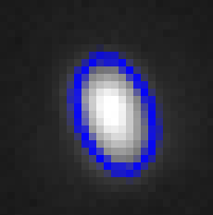
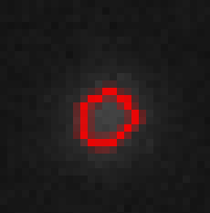
Flow of analysis by Ellipse fitting
Katsuragawa’s slide in NEWS meeting 28/11/2014
■PTS_Scanning
・Stop & Go ・.bmp (8bit_1ch *4Mpixel = 4Mbyte/1picture)
■Ellipse fitting
・High pass filter ・Binarization ・Labeling (clustering of pixels)
・Contour retrieval ・Ellipse fit
■Best focus selection
・Event sort (brightness) ・Clustering (use distance)
・Best focus selection(use brightness)
■Noise rejection
・Surface & bottom cut ・Dust rejection x2
Major
Minor
Ellipse fit
Mean brightness 58.6

Slide 4
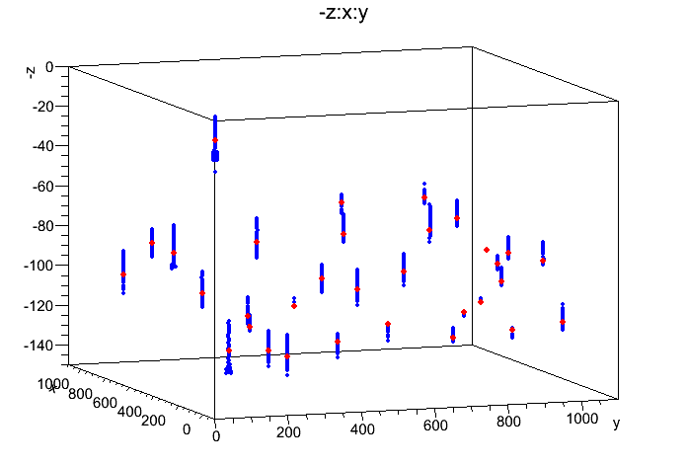

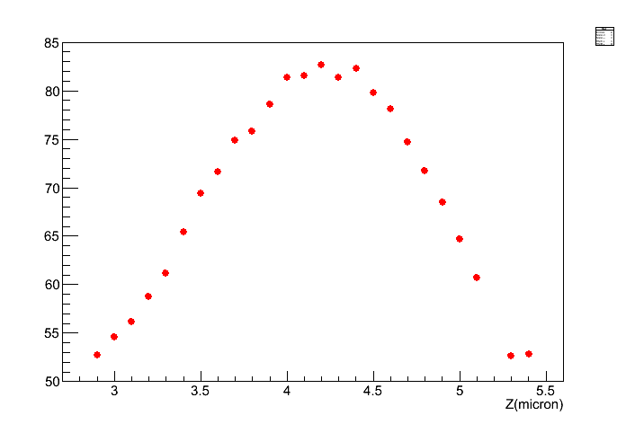
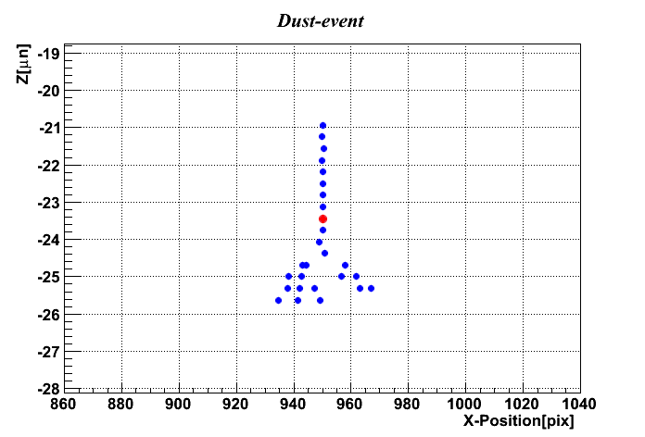



Red : beat focus layer
Blue: de-focus layer
3D_map about hit position
Katsuragawa’s slide in NEWS meeting 28/11/2014 + α
Focus direction
clustering
Detail of
best focus selection
DOF
Focus direction
clustering
Z [um]
Mean of brightness
Definition of best focus
$$h$$
Focus direction,
About 1 event
$$θ$$
Z [um]

Slide 5
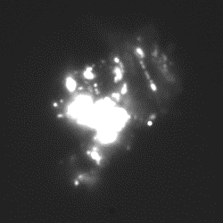
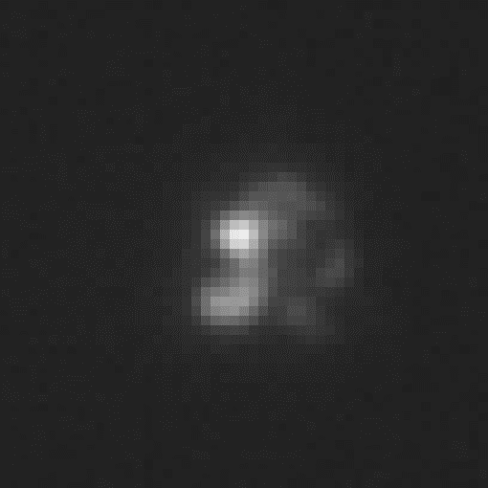
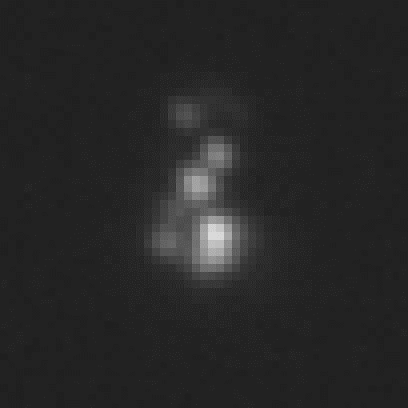
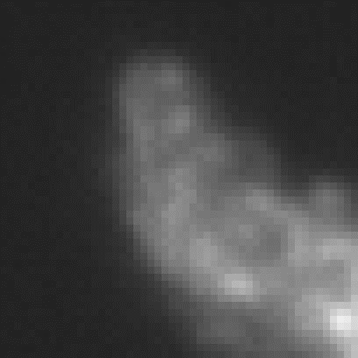
Dust(Noise) rejection in 1st scan
Raw data (without any cuts) of 1st scanning has many multiple-hits induced by large or middle size dust (> 10 um).
=> its should be removed.
RAW data
Large dust (very high brightness)
Removing surface & bottom layer
R
(already talked)
13.7 um
Rejecting large dust and shadow hits
by brightness information and fiducial cut
Z
Large dust
(already talked)
Fiducial volume cut
R<75 pix, Z:all
Constructing and reject to cluster-type dust (middle size dust)
(new, I will talk in “background from dust”)
Cluster-type dust
1st scanning result
Constructing by space
and reject
2.8 um

Slide 6
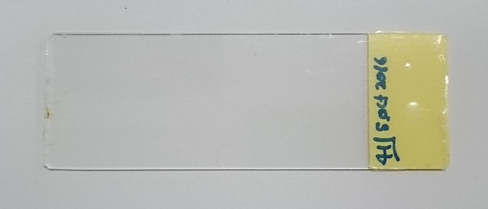
Sample list scanned in Nagoya
Scanning about LNGS sample
Batch ID of NIT; FAN079f ( f = filtered )
□ Nagoya sample (before LNGS) x3
- Only fix
- MAA dev. + fix
- Filtered gelatin about FAN079f
□ LNGS Sample x3 (+1)
- 0 week (ID 42)
- 1 week (ID 65)
- 0 week PMMA (ID 26)
(- beta, ID 41)
Talked by Asada
(or Valerio)

Slide 7
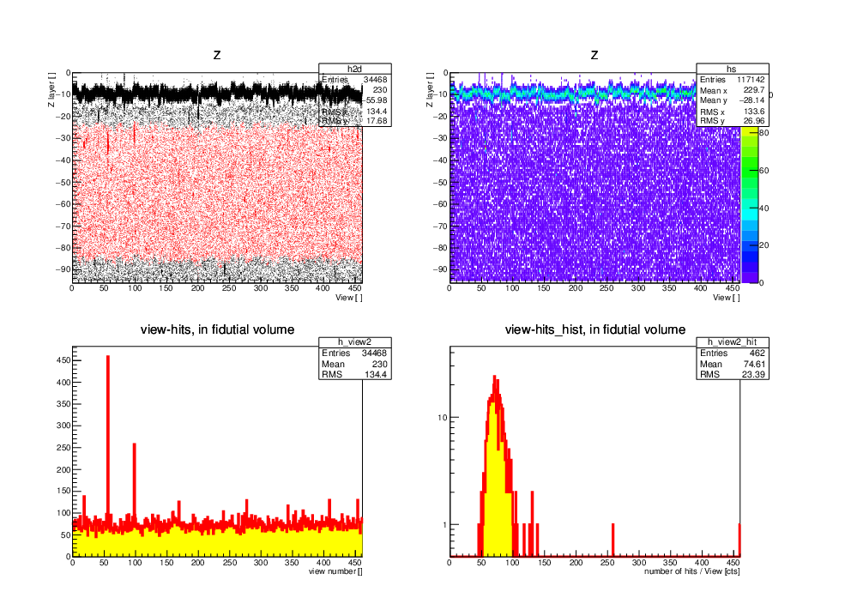
Raw data about “Sample_42“
Ag coating layer
Z layer
Z layer
35.0 um
Color map ver.
View id
View id
# of Hits vs. view_id
Hits distribution (# of hits/ view)
too large dust > 10 um
View id
# of hits / view

Slide 8
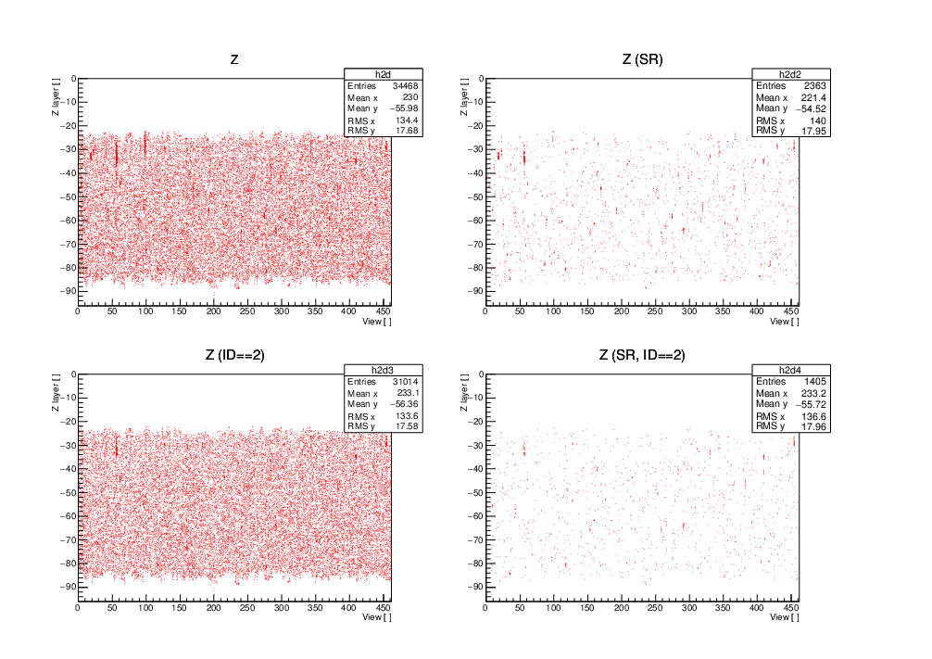
To remove large type dust
Z layer
RAW data
Z layer
Fiducial volume cut
35.0 um
too large dust > 10 um
View id
View id
To remove “large dust and shadow hits”
(by fiducial cut and brightness information)
Z layer
Z layer
Ellipse cut
middle size dust ~10 um
several dust remain
View id
We should use these data.
View id

Slide 9
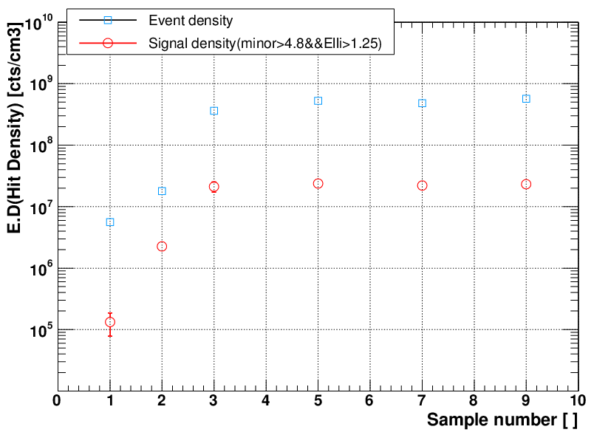
Summary of FAN079f
*before shrinkage correction
and w/o cluster-dust rejection
onlyfix
MAA+fix
MAA+fix
MAA+fix
MAA+fix
Filtered gelatin
Before LNGS
(made in Nagoya,
Slide glass)
Sample_42
(slide glass, 0 week)
Sample_65
(slide glass, 1 week)
Sample_6
(PMMA, 0 week)
Made in Nagoya
Made in LNGS
(LNGS sample)

Slide 10
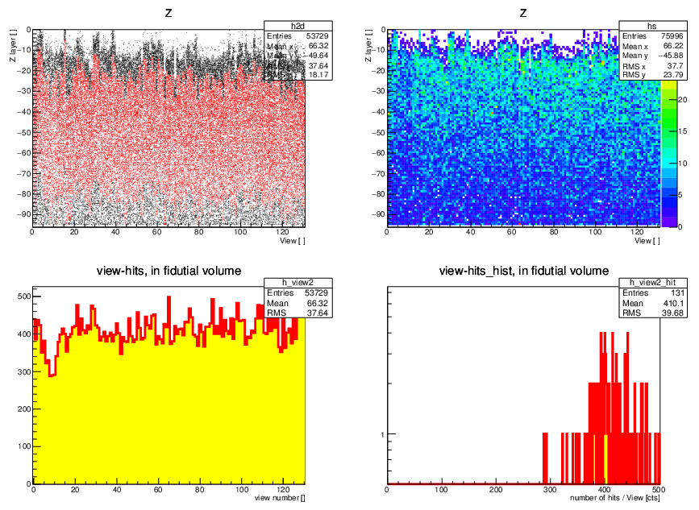
Raw data of “Sample_41”(β-ray sample) **w/o Ag coating
Event density depend on irradiation direction

Slide 11
points
LNGS sample and Nagoya sample(same NIT) looks like same quality.
PMMA(=acrylic base) has also same results.
Beta sample has strong dependence of irradiation direction
=> Surface recognition and fiducial volume cut are very important for comparison between Japan and Italy
**especially, surface recognition for each view is essential.

