Slide 1
Electron and fog background
~ next approach~
Tatsuhiro Naka
Nagoya University

Slide 2
Intrinsic radioactive background
Radioactivity [mBq/kg]
U-238 | Th-232 | K-40 | Ag-110m | C-14
27 | 6 | 69020 | (~400) preliminary | 24000
~27 | ~6 | 35 | (~400) | 24000
1-10 | ~ 1 | < 35 | (~400) | < 100
・normal gelatin
・AgBr production from KBr
Ra-226 ~ 1/10
Ra-228 < 1/30
~1/2000
・de-ionized gelatin
・AgBr production from NaBr
Present device
・gelatin → synthetic polymer
T_{1/2}~ 250 days
⇒ should we use old Ag?

Slide 3
Electron rejection power

Slide 4
Sensitivity control toward low-background device
Q.E. control of AgBr crystal due to structure inside of crystal
Formation efficiency control of latent image specks on the surface of crystal
e.g., Tz compound
Development sensitivity control
⇒ output the difference of activation energy for latent image specks
Temperature
⇒output the energy-loss mechanism, especially low velocity atom and β-ray

Slide 5
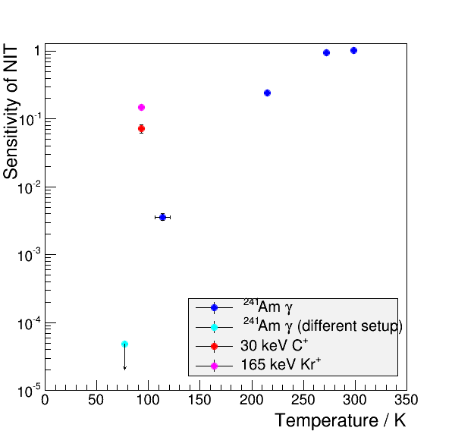
Temperature dependence on the sensitivity for current NIT device
Kr
S/N (NR /electrons) is increase in lower temperature.
⇒ Dependence of energy loss mechanism
Nuclear recoil : thermal spike in the AgBr crystal due to nuclear stopping power and high electron stopping power
Electrons: only ionization and low dE/dx
C
Preliminary
Cryogenic condition is critical for electron background rejection .
In addition, stability for emulsion device should be improved.
90% C.L.
M. Kimura et al., NIMA (VCI2016) 2016

Slide 6
Background rejection expectation
Usual temp.
-20 ℃
-50 ℃
Electron background rejection power using only elliptical analysis
≒
-100℃
100 g・month
Temperature control
-150 ℃
Leakage rate
∝(crystal sensitivity )²
Standard sensitized treatment
Crystal sensitivity control (e.g., chemical, doping )

Slide 7
Summary of Sensitivity relationship between ion and γ-rays (Am-241)
Very preliminary result for NIT sensitivity using Tz compound
Relationship between ion and γ-ray sensitivity
-20 ℃
-50 ℃
-100 ℃
-150 ℃
Tz concentration
(5-8 mmol/Agmol)

Slide 8
Obtain the information of nano-structure
C 60 keV
Generation of filament
⇒ unique information of latent image specks (i.e., by particle, not dust)
Filament structure
⇒ nuclear recoil is very complicated structure, but electron should be very simple.
1 μm
These information should be reflected in the localized surface plasmon resonance, especially reflection spectrum and reaction due to polarization of light.
not have image yet

Slide 9
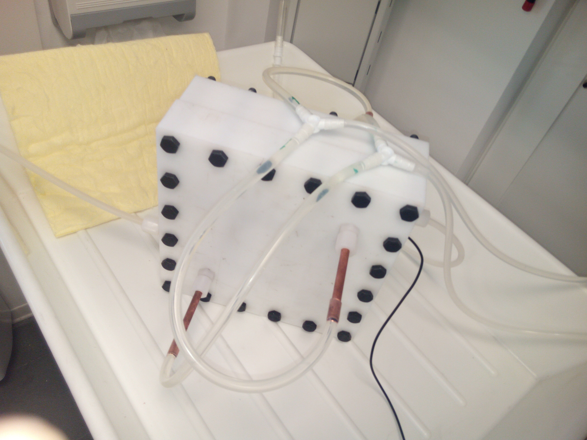
How do we check that?
current achievement is around -15 ℃
⇒ Can we keep lower temperature?
How do we check the sensitivity of low-temperature device?
⇒ high intensity radiation if expose from
outside of system
⇒ natural radiation source if set inside the system
N2 gas
N2 gas
Refrigerant
Refrigerant
Thermo-sensor
Ex.) K-40 (N.A. 0.0117 %)
γ-ray effect should be small from decay rate and cross section, but β-ray may be useful to check that
β-decay : Q-value 1.311 MeV (89 % D.P.)
γ-decay ：1.461 MeV (10.7 % D.P.)
By very rough estimation, β-day will be accumulated about 1-10 /(10µm)³ for 10 days exposure.
⇒ Simulation is needed taking into account β-spectrum
KBr powder of 10 g ⇒ ~ 10⁷ decay/day
KBr powder
NIT

Slide 10
Fog

Slide 11
Development sensitivity tuning
Current (usual) development treatment
Ideal situation
Developer
Reduction process
Activation energy (ORP)
Fog
Activation energy (ORP)
oxidation
Fog
Developer
Signal
Reduction
Signal
Kinetical process
Equilibrium process
Developed intensity
Ag⁺ + e- (decomposition)
Signal
Fog
Fog
e-
Signal
Ag⁺
Time

Slide 12
Current study (task within November)
We need to know redox potential of latent image specks using Redox
buffer ⇒ now on going
Tuning of redox potential for developer ⇒ it’s easy
Easy method (idea from Prof. Tani)
Diluted developer
Usual developer
Size difference of specks between fog and signal should be enhanced.
Ratio of Signal size and contrast to fog will be enhanced.

Slide 13
Conclusions
Lower temperature should be critical to achieve high electron rejection power
Combination both low-temperature and chemical sensitivity control is very promising because those processes reveal essentially difference process.
Development treatment is not optimized yet, and there are room for improvement.
Redox potential control is under studying, and go to study for improvement of developer to reduce the background

