Slide 1
ICHEP 2016 Chicago
All the numbers shown here are NOT final
Young-Kee Kim
The University of Chicago
August 7, 2016

Slide 2
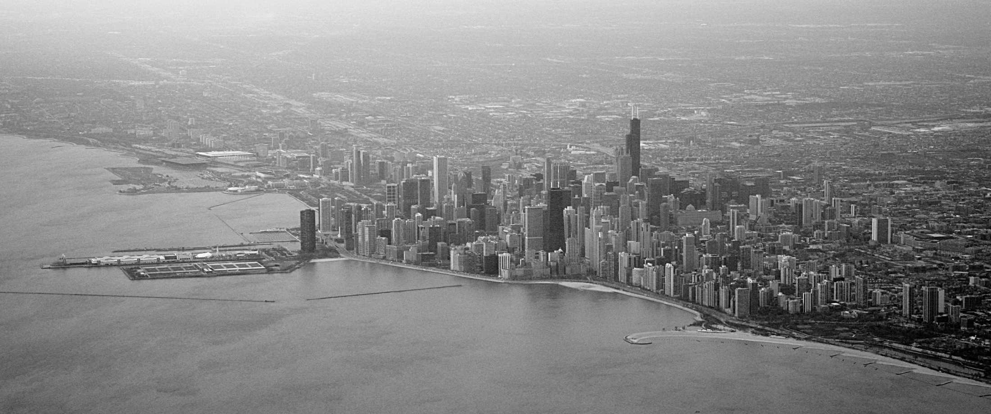
Conference Location: Sheraton Hotel
The Chicago shoreline of Lake Michigan
Sheraton Hotel
walking distance
Museum campus
Parks
Concert halls
Beach
Sailing

Slide 3
Timeline
Date | Task
July 2015 | Finalize the ICHEP 2016 logo
October 2015 | Form International Advisory Committee Finalize the list of parallel sessions
November 23, 2015 | Open submission of abstracts
December 15, 2015 | Visa information available on web Finalize conveners of parallel sessions Finalize the program of plenary sessions
February 7, 2016 | Deadline for abstract submission (oral and poster presentations)
February 8, 2016 | Registration opens Grant application website opens Accommodation website for preferential rates opens
March 25, 2016 | Publication of accepted abstracts for oral and poster presentations
April 30, 2016 | Deadline for grant application
May 31, 2016 | Deadline for early registration
June 30, 2016 | Deadline for regular registration Deadline for accommodation at preferential rates

Slide 4
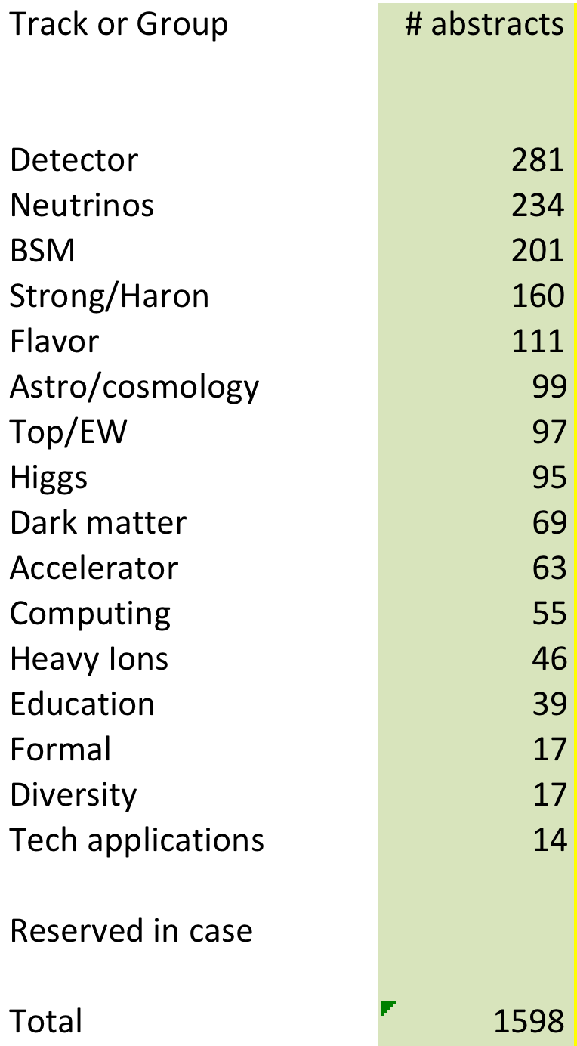
16 parallel groups, and abstracts ~1,600
Many multiple tracks.
This table assumes 1 primary track for each abstract
~1,600 abstracts
  ~600 talks
    many merged
    some declined
  ~500 posters
    ~250 on Sat with a reception
    ~250 on Mon with a reception

Slide 5
Conveners & Plenary talks
Total | 64 conveners
Female | Female (50%) Male (50%)
Total | 36 talks
Region | Europe (31%) Americas (39%) Asia (25%) Africa ( 6%)
Gender | Female (36%) Male (64%)

Slide 6
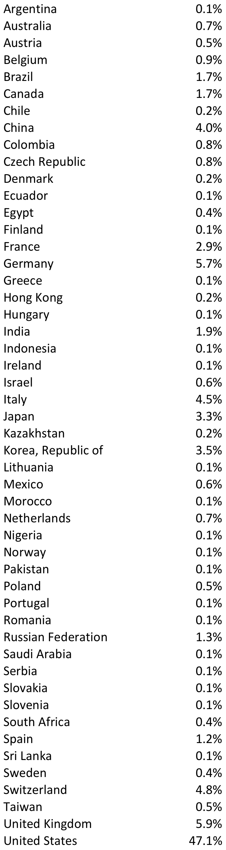
Attendees
Total | 1,430 from 51 countries
Students | Students (20%) Postdocs (21%) Seniors (59%)
Gender | Female (20%) Male (80%)
Region | Americas: North + South (52%) Europe (32%) Asia + Pacific (15%) Africa ( 1%)

Slide 7
Overall Program
Registration began on Wed.
Parallel sessions (Thursday – Saturday)
  Outreach training, Lunch & Learn at the Sheraton
  1’ Elevator speech training at the Sheraton
  Library visit program (30 libraries in Chicago by 60 volunteers)
  Poster session #1
Free day (Sunday)
  Poster presenters networking with industry participants (career discussions)
  Many satellite meetings
Plenary sessions (Monday – Wednesday)
  Communication training

Slide 8
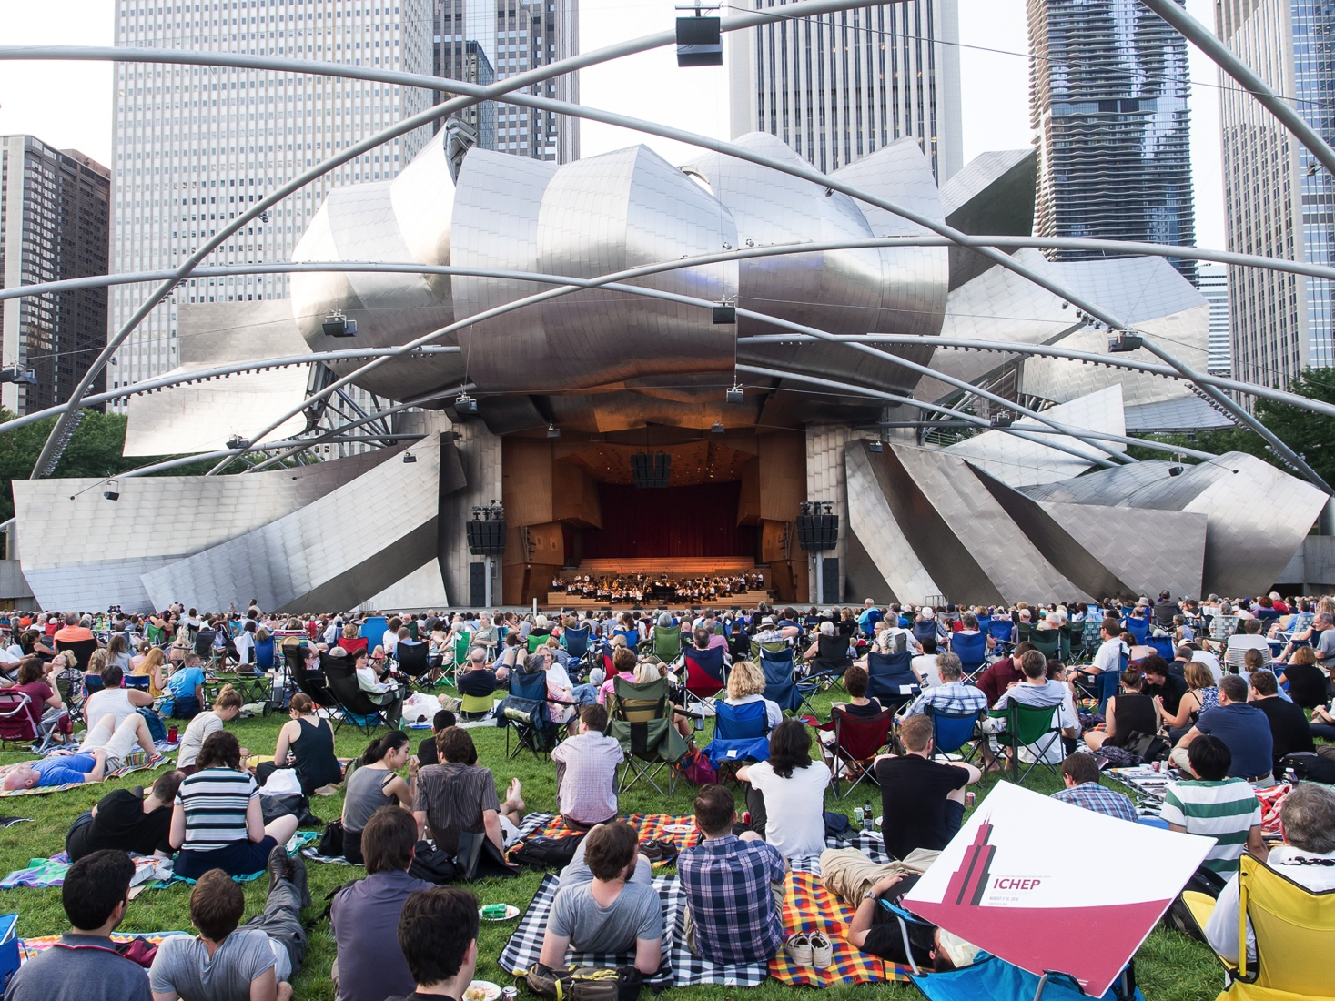
Wednesday, August 3, 2016: Grant Park Outdoor Concert

Slide 9
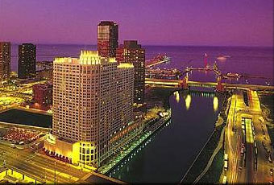
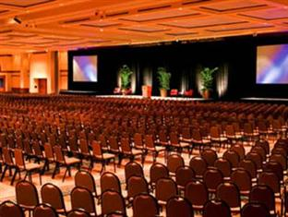
Conference rooms / guest rooms
Chicago River
Plenary sessions (~1,350 seats)
9 Parallel sessions at a given time (80 – 250 seats)
a few small meeting rooms (~30 seats)
500 hotel guest rooms at the Sheraton
100 guest rooms at 2 Club Quarters
(including ~300 rooms for share)

Slide 10
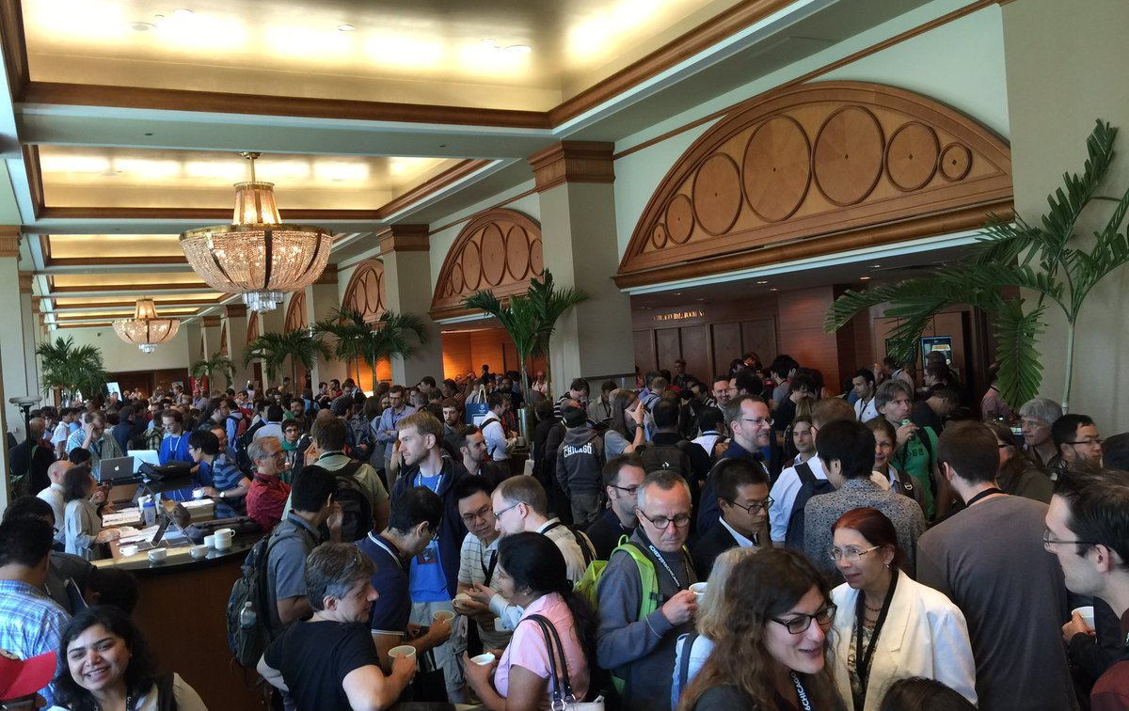
Discussions during coffee break

Slide 11
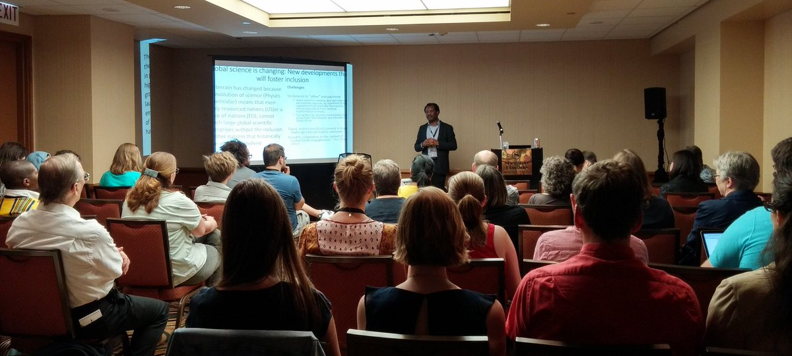
Diversity and Inclusion Session
New to this conference: very important, well attended

Slide 12
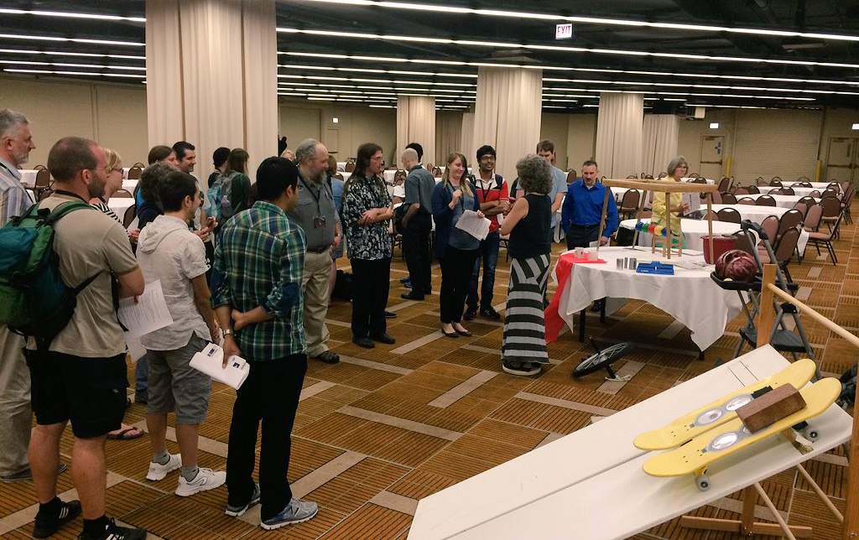
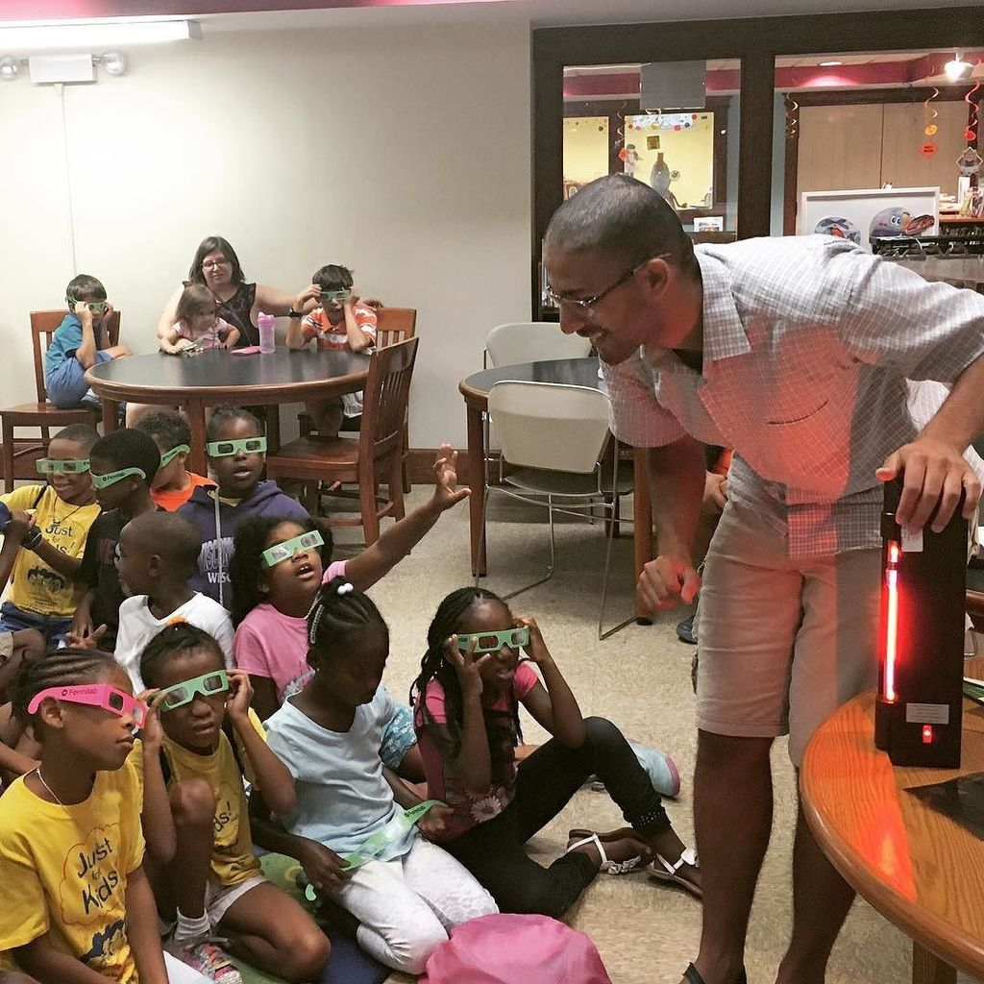
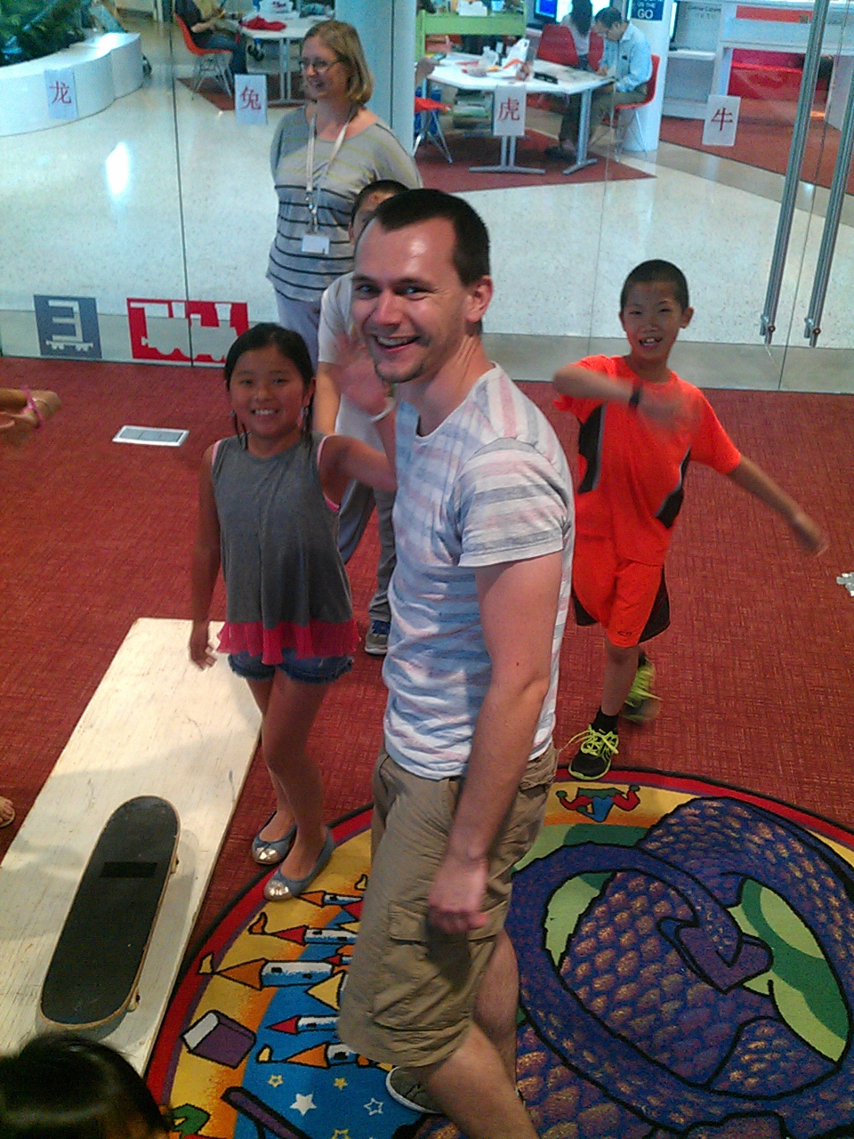
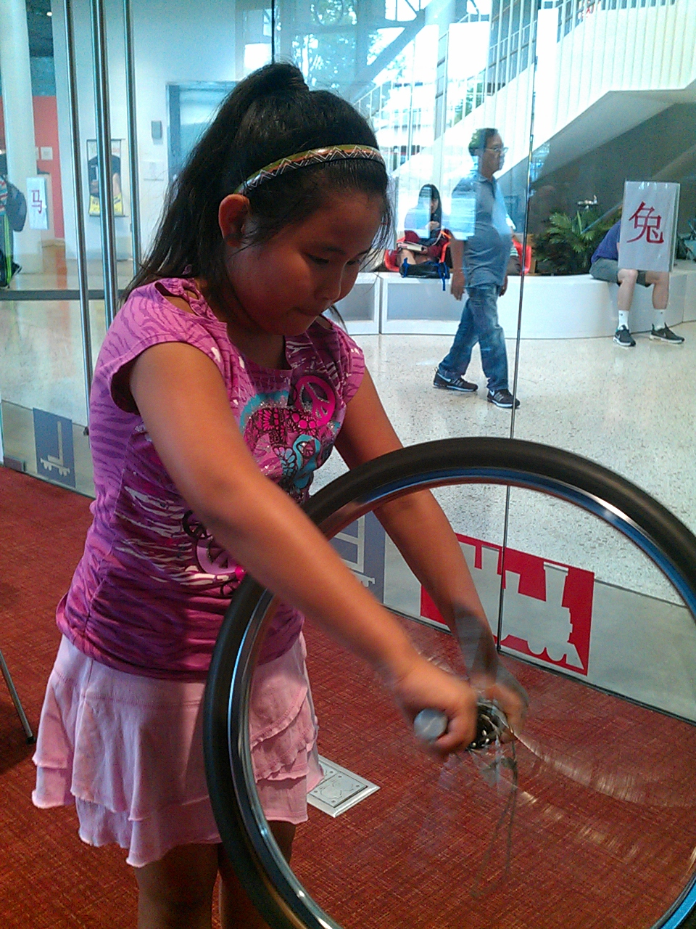
Public outreach at Chicago public libraries
(30 libraries by 60 volunteers)

Slide 13
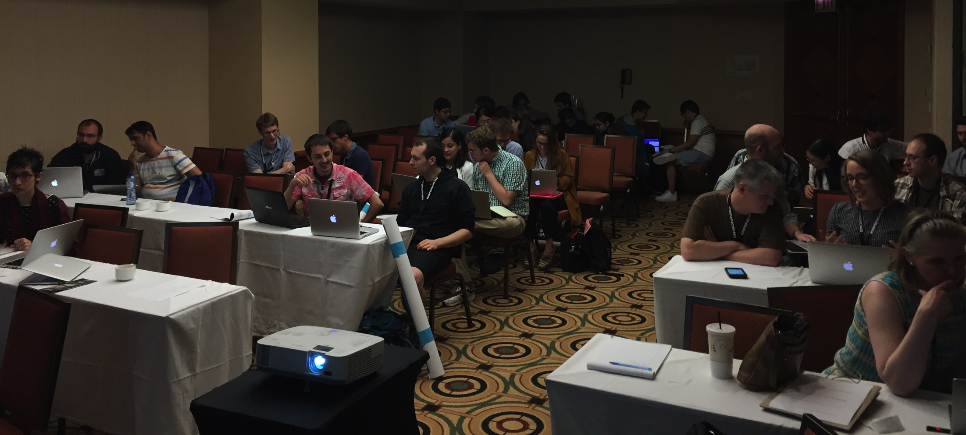
1’ Elevator speeches
More than 100 people volunteered in a day
40 chosen (to be presented during plenary sessions)
Training session on Saturday

Slide 14
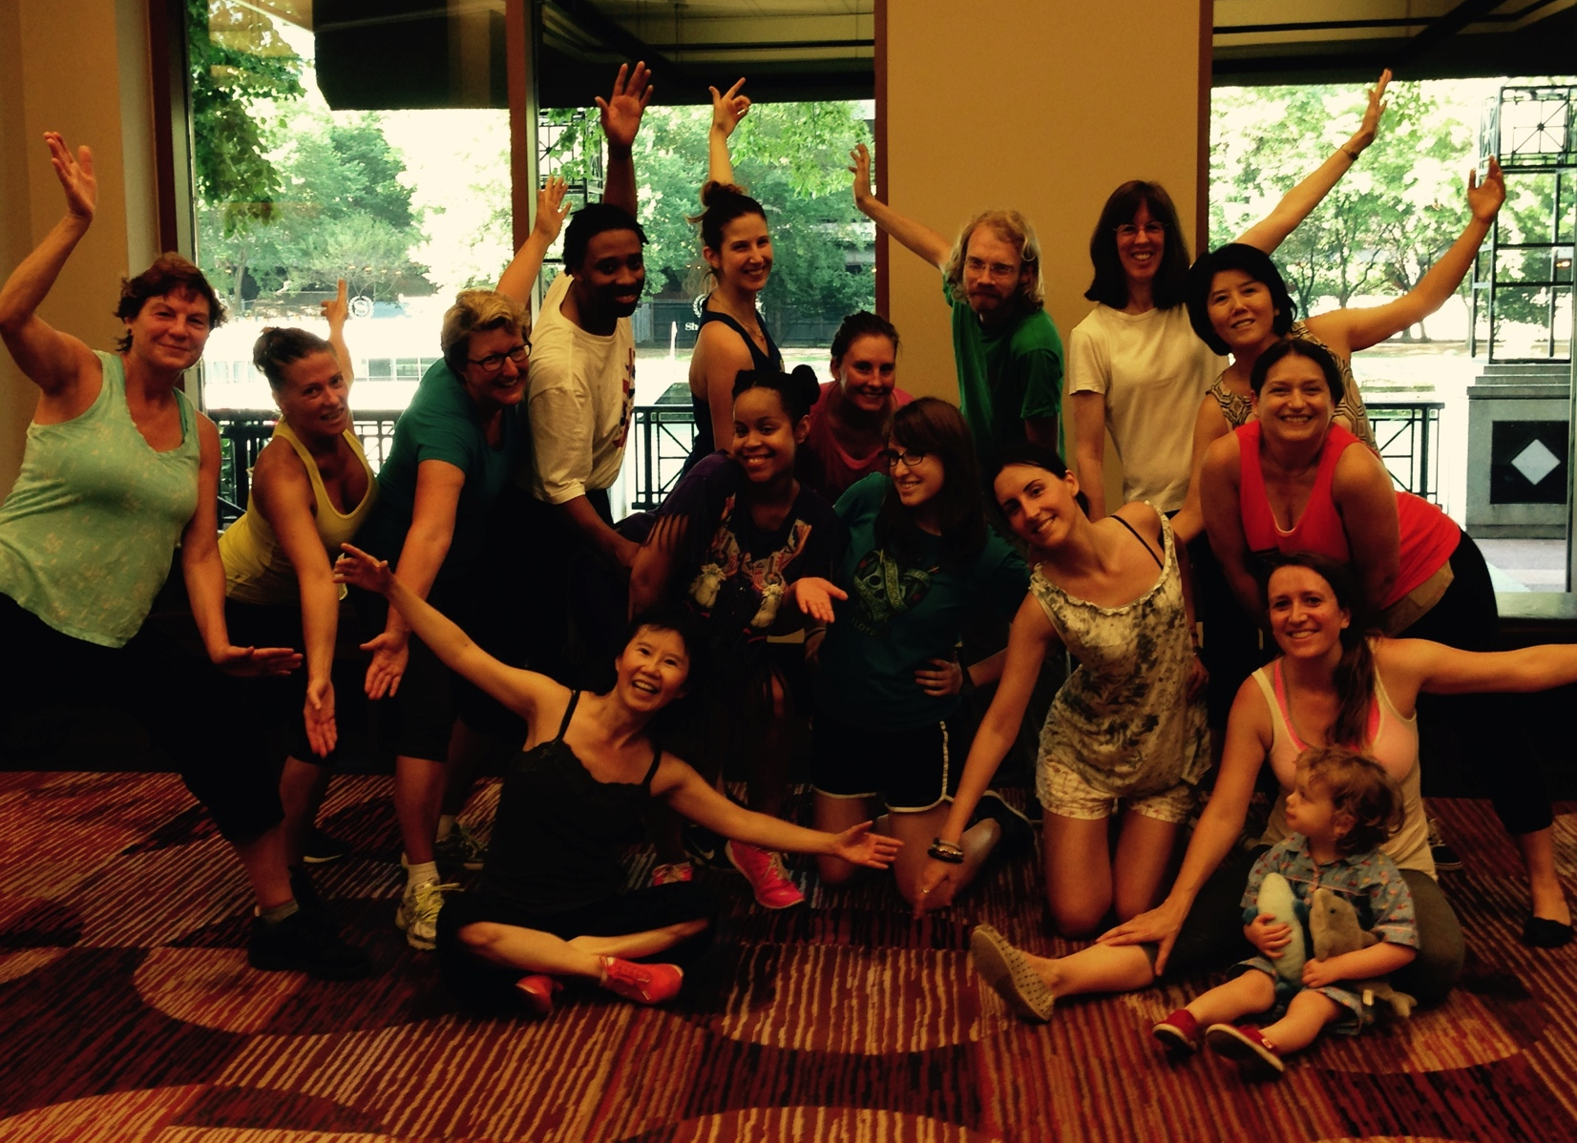
Daily Zumba (7 – 8 am)

Slide 15
Registration fees
Early registration until May 31, 2016
  Standard US$ 590; Student US$ 390
Late registration: June 1, 2016 - July 1, 2016
  Standard fee US$ 690; Student US$ 490
One day pass:
  ~60% of the regular fee

Slide 16
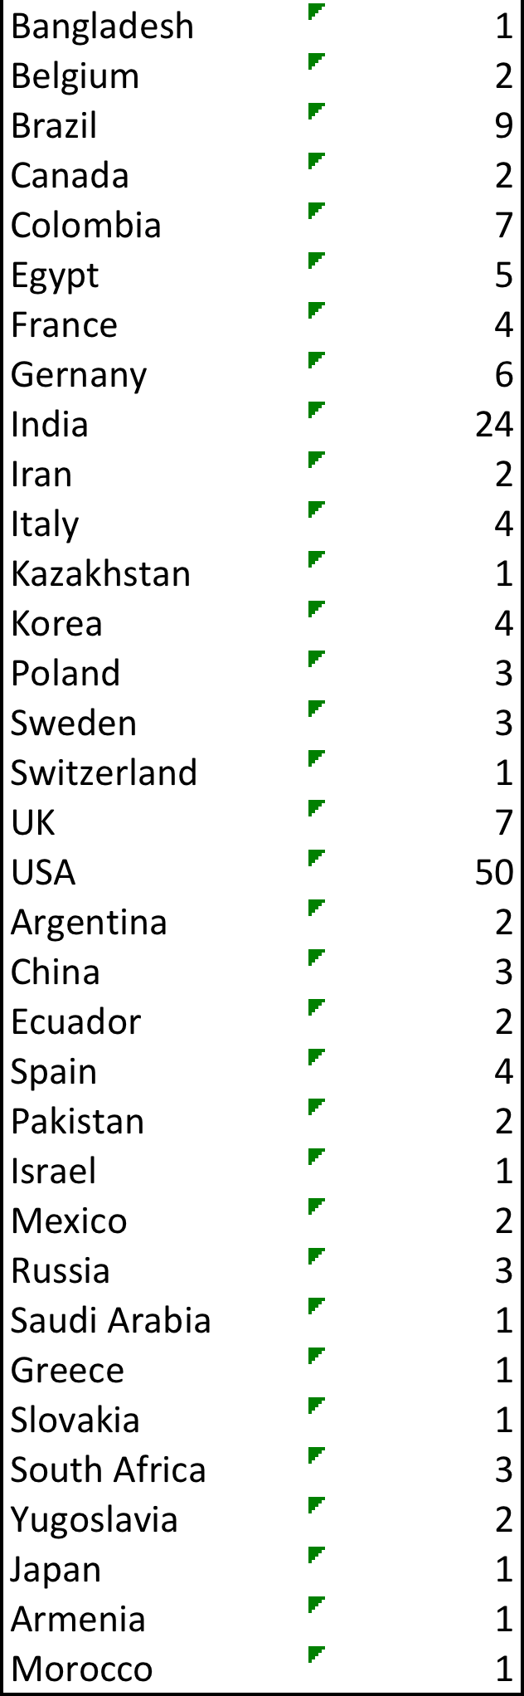
Travel grants
Offers | Total = 175
Type | Lodging (29%) Registration (41%) Lodging + Registration (28%) Lodging + Registration + Airfare (3%)
Position | Students (52%) Postdocs (18%) Senior scientist (30%)
Gender | Female (40%) Male (60%)
Region | Americas: North + South (43%) Europe (25%) Asia + Pacific (27%) Africa ( 5%)

Slide 17
Budget: Income and Expenses (preliminary)
Total Income | $1,060,000
Registration | $720,000
Industry | $60,000
Local and International institutions | $280,000
DRAFT
Total Expenses | $1,033,000
Food / drinks | $652,000
Audio / video / staging / wifi | $170,000
Posters / booths | $20,000
Program books, others | $33,000
Registration system merchant fees / staff | $39,000
Travel grants excluding registration fees | $118,000

Slide 18
Visa issues: to be analyzed
China (late application / approval ???)
  Yijian Du, China
  Feifei Huang, Chinese citizen in US
  Kun Liu, Chinese citizen in France
  Muhammad Ahman, China
India, Bangladesh, Pakistan
  Genius Walla, India
  Shekhar Banerjee, Bangladesh
  Fakhra Ghafoor, Pakistan
Yasaman Farzan, Iran
Masroor Bukhari, Saudi Arabia
Chris Bouchard, Scotland
  (just moved there and had issue)
DRAFT

Slide 19
Remote participation
There were a number of requests for remove presentations and participations
ICHEP 2016 policy
  No remote presentations, nor remote participations except “webcast” and a special diversity and inclusion session with students in Africa
Future directions on this?

