Slide 1
XXIII International Baldin Seminar
Relativistic Nuclear Physics and
Quantum Chromodynamics devoted to the 90th anniversary of Academician A.M. Baldin http://relnp.jinr.ru/ishepp/
Dubna, September 19 – 24, 2016

Slide 2
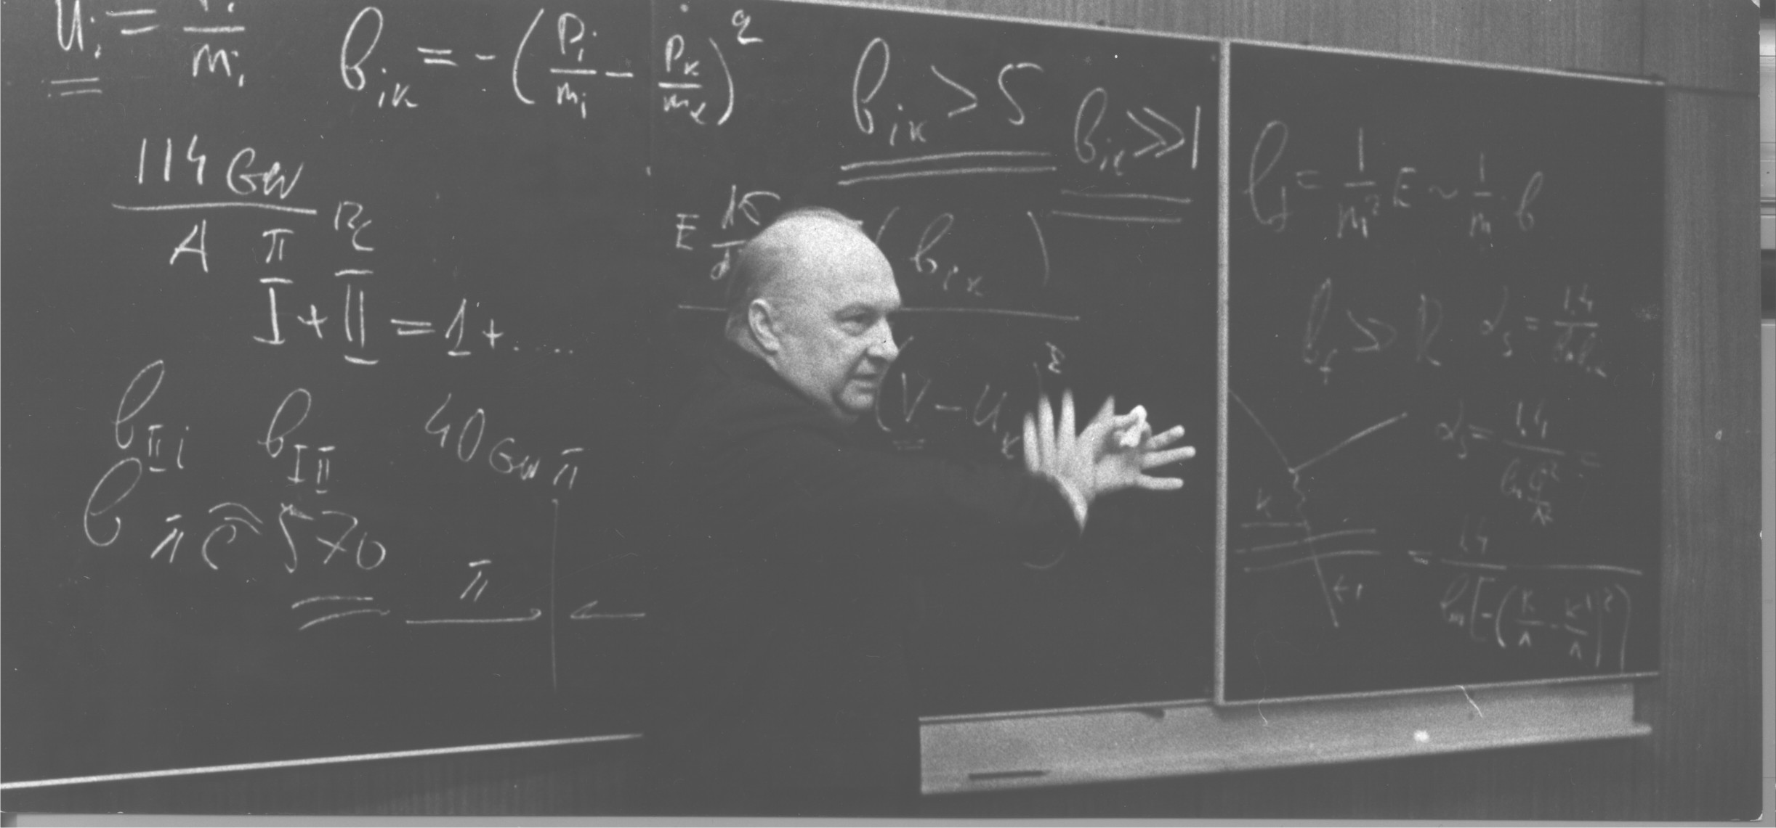
Alexander Mikhailovich Baldin
February 26, 1926 - April 29, 2001

Slide 3
The first 1969 Dubna Seminar
The first 1969 Dubna Seminar of this series
was devoted to study of vector mesons
and has included a considerable number of reports
on development of gauge field theory
Among the participants there were
N.N. Bogoliubov, J. Bjorken, B. Zumino,
V.F. Markov, S. Ting, L.D. Faddeev
and others who made an essential contribution to this field

Slide 4
Dubna Seminars 1969 – 2016 biennial
the subsequent seminars of this series were devoted to
the physics of strong interactions,
multiparticle production, relativistic nuclear physics, quantum chromodynamics, cumulative meson production, structure functions, …
theoretical studies and ideas discussed at the Seminar
in the early seventies later on became the main trends
in the experimental program
at the Synchrophasotron and Nuclotron at JINR.

Slide 5
Dubna Seminars 1969 - 2014
Typical scale of the Seminars
around two hundred participants from ~ 20 countries, and more than 120 reports
The Proceedings of the ISHEPP VI - XXII comprise
reports on hot problems of relativistic nuclear physics, perspectives and statuses of experiments which
are aimed to investigate relativistic nuclear collisions
including polarization phenomena

Slide 6
XXII International Baldin Seminar
Statistics:
  217 participants from 17 countries (young scientists ~ 22%)
    40 women
  160 speakers from Scientific Centers (CERN, GSI, JLAB, BNL, JINR, COSY, FNAL, JPARC,…)
    31 women
Proceedings:
  http://pos.sissa.it/cgi-bin/reader/conf.cgi?confid=225
    115 talks

Slide 7
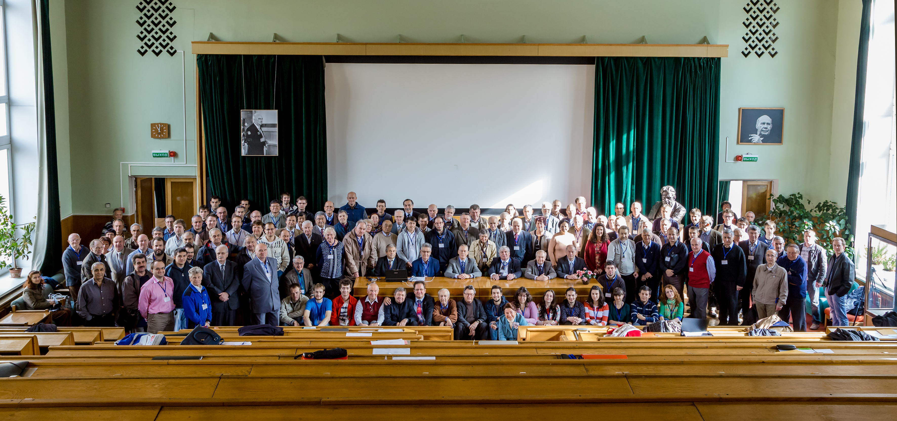
XXII International Baldin Seminar

Slide 8
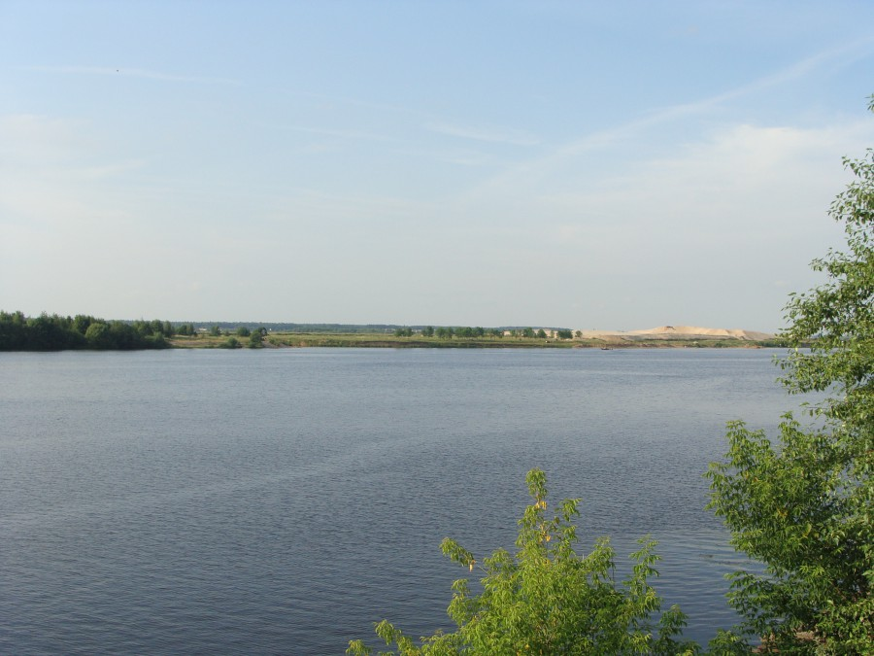
XXIII International Baldin Seminar
Dubna, September 19 – 24, 2016
http://relnp.jinr.ru/ishepp/

Slide 9
International Advisory Committee
Local Organizing Committee
A. Andrianov (Russia)
A. Antonov (Bulgaria)
Ts. Baatar (Mongolia)
J. Carbonell (France)
C. Ciofi degli Atti (Italy)
T. Donnelly (USA)
S. Dubnichka (Slovak Republic)
M. Gazdzicki (Poland/Germany)
P. Giubellino (CERN)
H. Gutbrod (Germany)
P. W-Y. Hwang (Taiwan)
V. Kekelidze (JINR)
A. Kurepin (Russia)
H. Machner (Germany)
L. Majlling (Czech Republic)
V. Matveev (JINR)
Y. Musakhanov (Uzbekistan)
Sh. Nagamiya (Japan)
V. Novozhilov (Russia)
Ch. Perdrisat (USA)
W. Plessas (Austria)
L. Pondrom (USA)
G. Roepke (Germany)
G. Salme (Italy)
V. Savrin (Russia)
L. Schroeder (USA)
P. Senger (Germany)
A. Shebeko (Ukraine)
A. Slavnov (Russia)
B. Slowinski (Poland)
H. Stocker (Germany)
A. Thomas (USA)
H. Toki (Japan)
E. Tomasi-Gustafsson (France)
I. Tserruya (Israel)
V. Voronov (JINR)
Nu Xu (USA)
G. Zinovjev (Ukraine)
Seminar topics:
Quantum chromodynamics at large distances
Relativistic heavy ion collisions
Hadron spectroscopy, multiquarks
Cumulative processes (short range correlations)
Structure functions of nucleons and nuclei
Multiparticle dynamics
Polarization phenomena, spin physics
Studies of exotic nuclei in relativistic beams
Development of accelerator facilities
Project NICA at JINR
New experimental results from JINR, CERN, BNL, JLAB, GSI, …
Applied researches in relativistic beams
Burov V.V. (co-Chairmen)
Malakhov A.I. (co-Chairmen)
Bondarenko S.G. (Deputy-Chairmen)
Rogochaya E.P. (Scientific Secretary)
Rusakovich E.N. (Secretary)
Anisimov Yu.S., Baldin A.A., Boguslavsky I.V.,
Gerasimov S.B., Kovalenko A.D., Lukianov V.K.,
Migulina I.I., Pakulyak S.Z., Panebratsev Yu.A.,
Piskunov N.M., Plekhanov E.B., Starchenko B.M.,
Teryaev O.V., Toneev V.D., Vodopianov A.S.,
Zarubina I.G., Zarubin P.I.

Slide 10
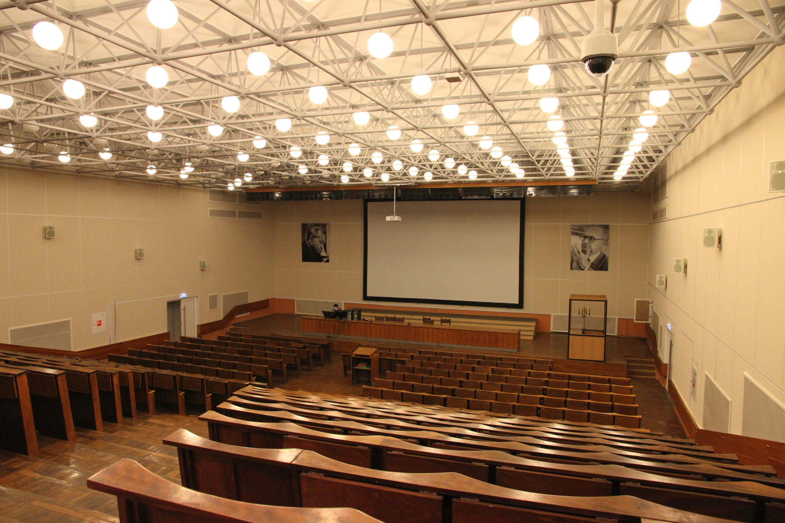
Venue

Slide 11
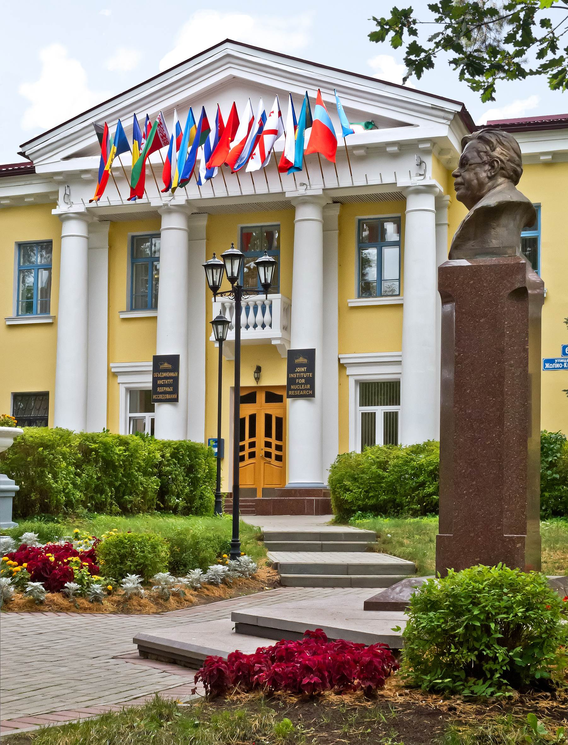
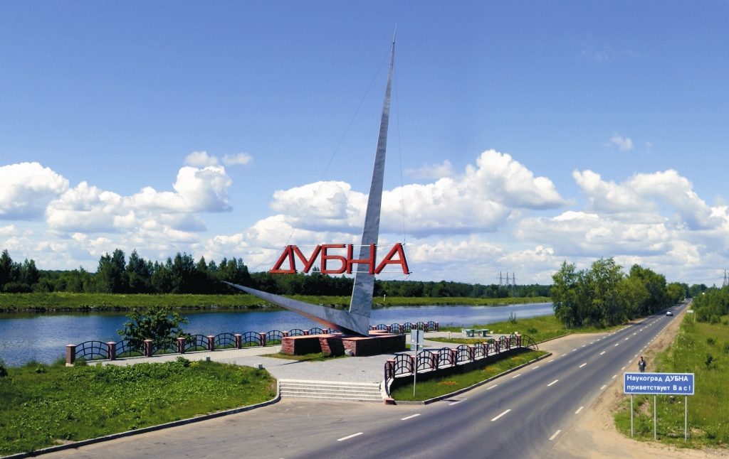
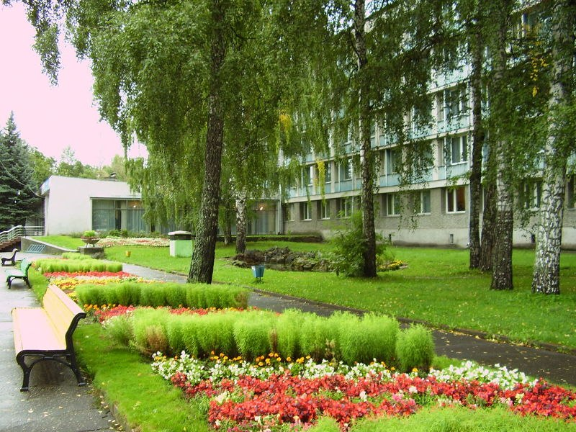
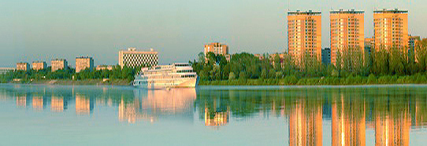
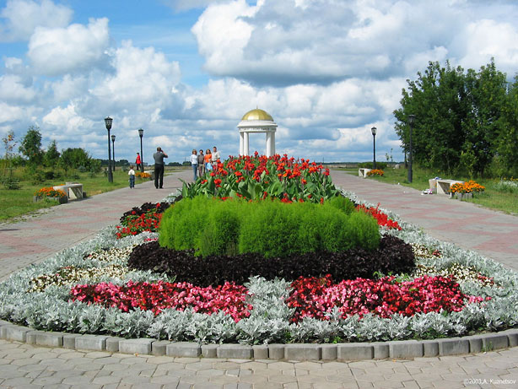
Venue

Slide 12
XXIII International Baldin Seminar
Dubna, September 19 – 24, 2016
~250 participants are expected
registered more then 130 participants now;
dead line for registration: 31 August 2016
~150 reports are supposed already accepted > 110
conference fee - 350 Euro
it covers transfer from airports to Dubna and back,
social program, refreshments during the breaks,
the welcome party, banquet
and publishing of the Proceedings
limited support for young scientists
- free accommodation

Slide 13
XXIII International Baldin Seminar
The Organizing Committee:
appreciates IUPAP for the conference support;
requests financial support for C-class conferences, which can help to attract young scientists, especially from developing countries;
expresses confidence that it will increase interests
to the C-class conferences in the world.

Slide 14
Thank you for the attention

