Slide 1
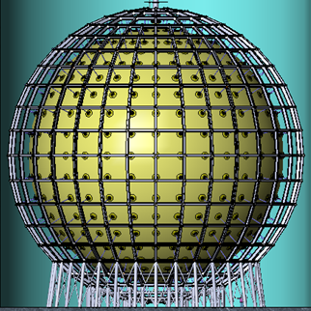
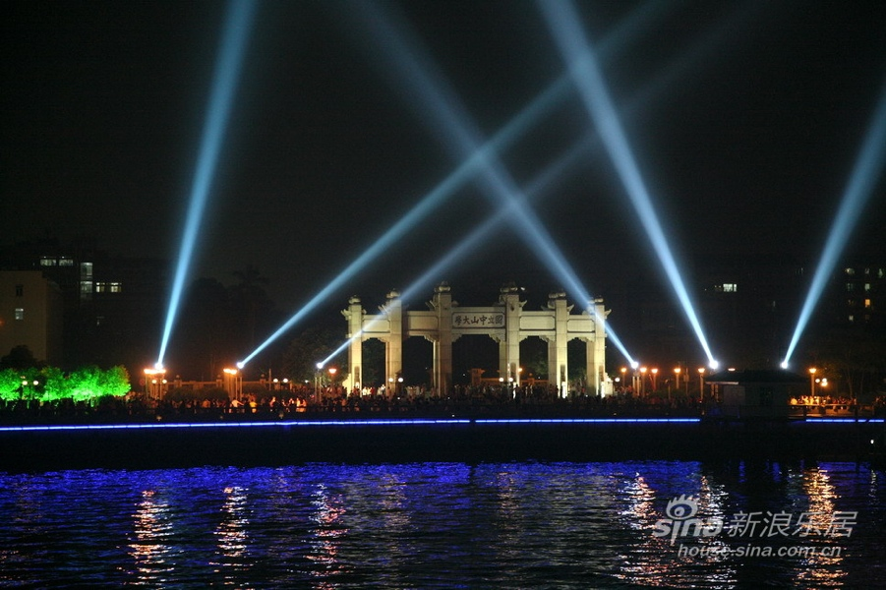
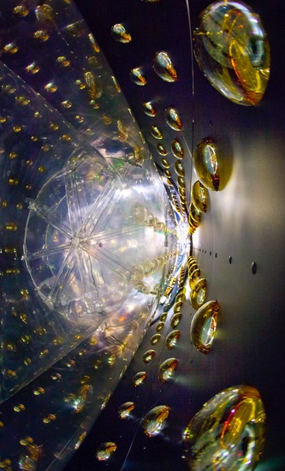
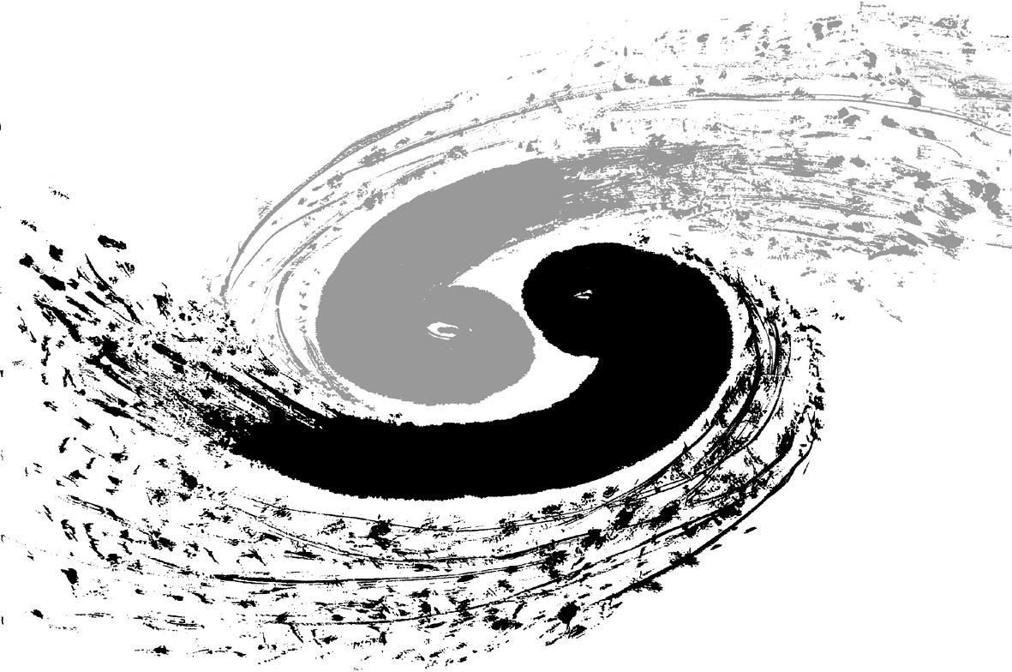

LP2017 at SYSU in Guangzhou, China
Wei Wang（王为）, SYSU

Slide 2
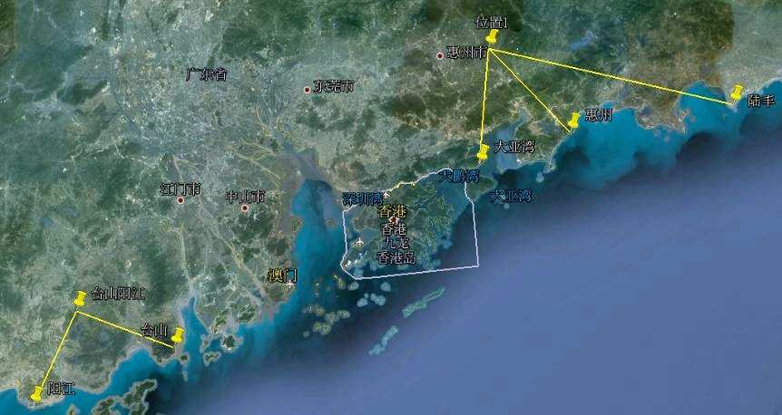

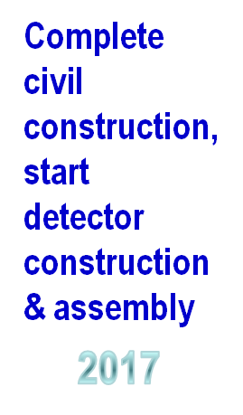


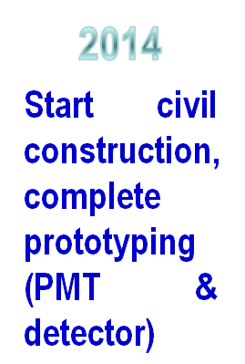
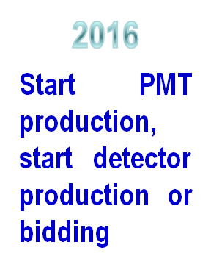
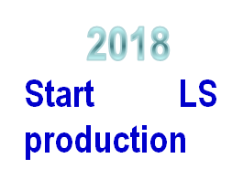
Where is Guangzhou?
Chinese SNS
Sun Yat-Sen University
School of Physics
Daya Bay
Airport choices:
Guangzhou(CAN)
  America -> Beijing -> Guanghou
Hong Kong (2 hours away)
  Suitable to European colleagues
Macau (2 hours away)
Hong
Kong
JUNO
Macau
Taishan
Yangjiang
Wei Wang

Slide 3
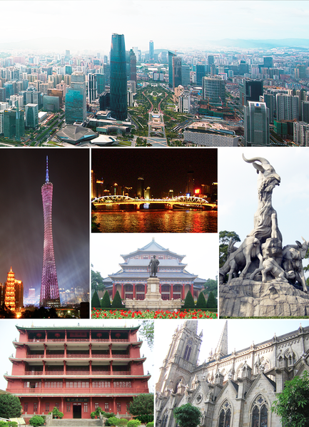
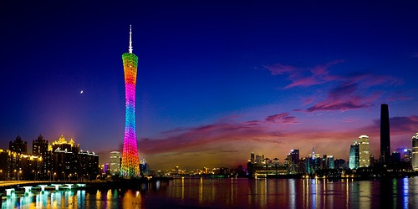
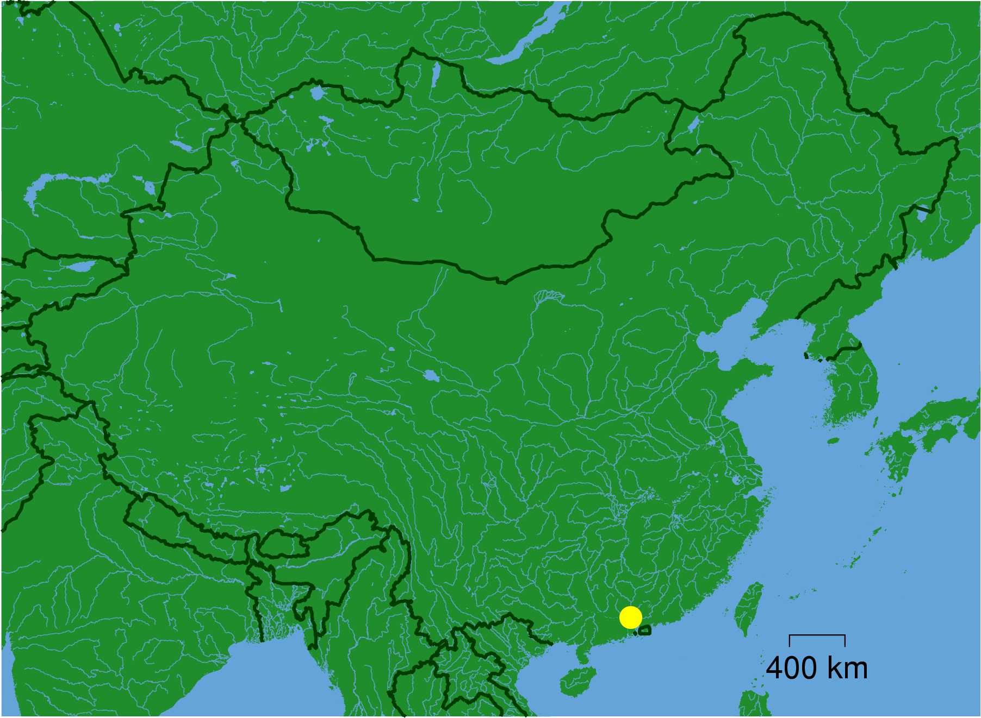
A Few Words about Guangzhou and Zhujiang Delta
The capital city of Guangdong Province (Canton), one of the so-called 4 Tier 1 cities.
The oldest open port in South China. Has rich history and is also highly international.
Famous for Chinese and fusion food, where dim-sum was invented. :)
One of the most popular tourist destinations; Fantastic for biking and walking.
Wei Wang

Slide 4
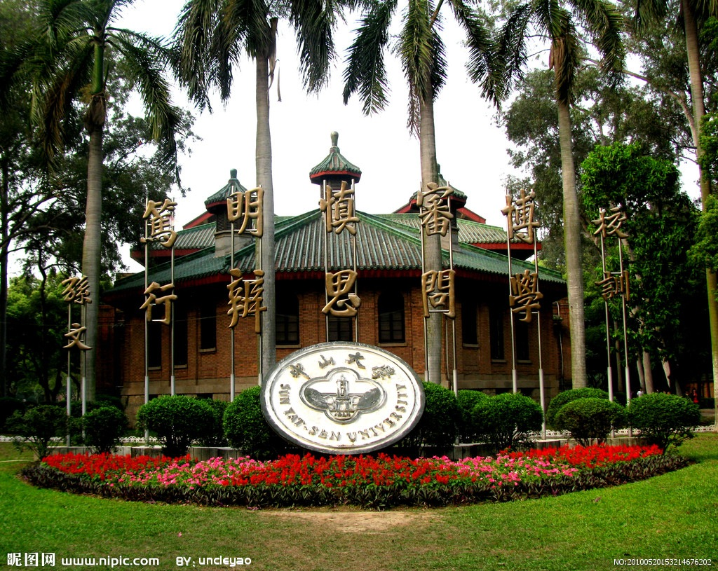
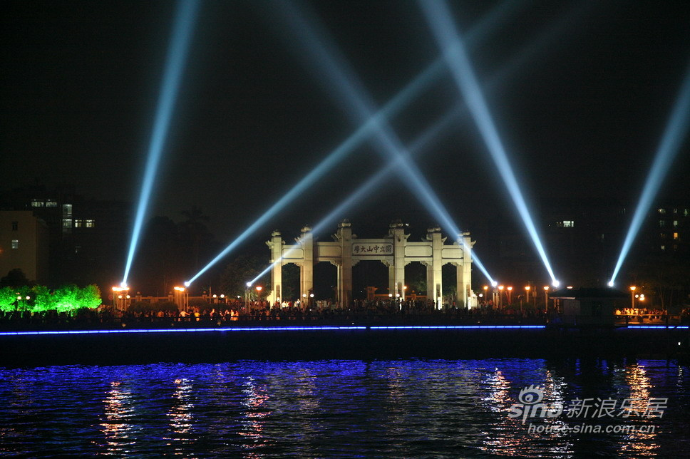
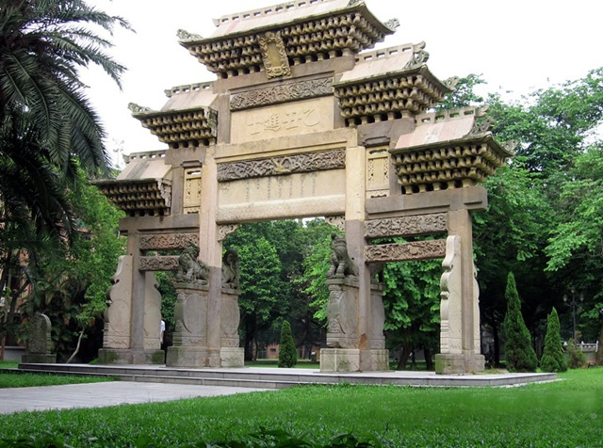
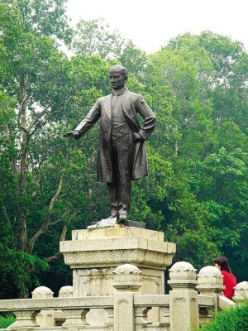
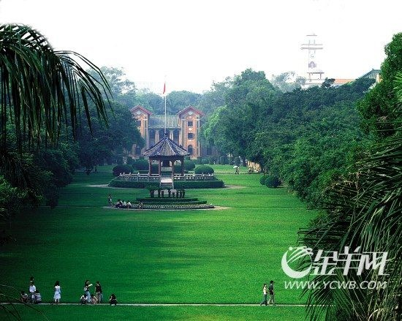
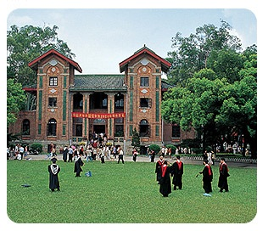
A Brief List of (Important) Facts of SYSU
SYSU: Sun Yat-Sen University, Guangzhou, China
  Funded by Dr. Sun Yat-Sen, the founder of the Republic of China in 1924
  Undergraduate students ~32,000; graduate students ~20,000
  Faculty members (associate professors and up) ~4,000
  The best university in South China; One of the top 10 physics programs in China;
  One of the most beautiful campuses in China
Wei Wang

Slide 5
Main Venue
Poster Venue
Main Venue
Wei Wang

Slide 6
Poster Venue
Wei Wang

Slide 7
Resources On- and Off-campus
OPEN NOW!
Wei Wang

Slide 8
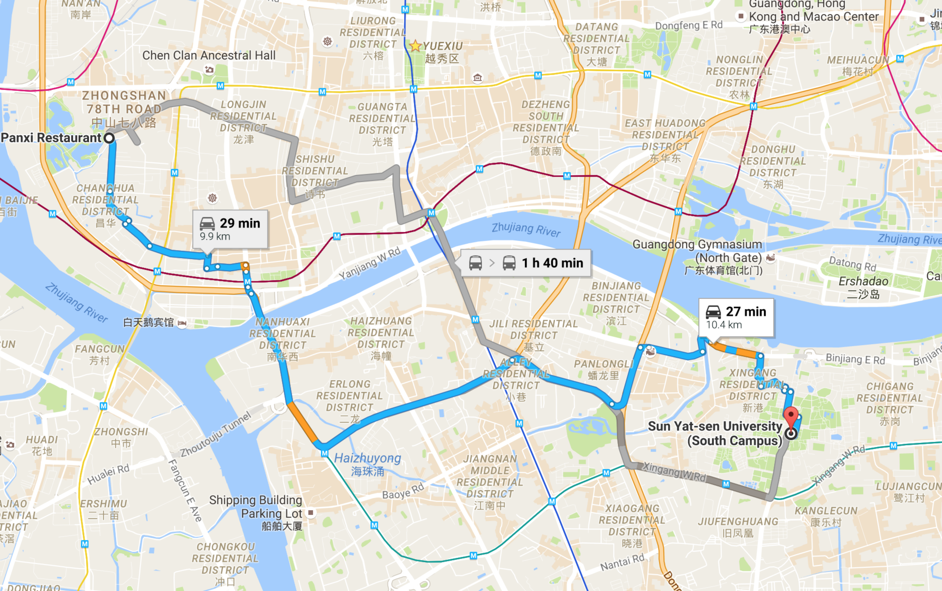
Banquet: Panxi Restaurant
Wei Wang

Slide 9
Summary
The City: A Fantastic Tourist Destination
Guangzhou is well connected by air, by land and by water. Fantastic public transportation system --- bus&metro.
Neighboring to Hong Kong and Macau, ~2 hours by car or by train. Direct ferries to HK Airport are also available.
Both affordable and upper-scale hotels within walking distance readily available, on/off campus, some with river views
The Science: Big Science Facilities Nearby
The Daya experiment is probably completing (waiving bye-bye)
JUNO will be taking data. First results on certain topics possible.
ADS; Chinese Spallation Neutron Source; …...
The Team: SYSU and IHEP are co-hosting

