Slide 1
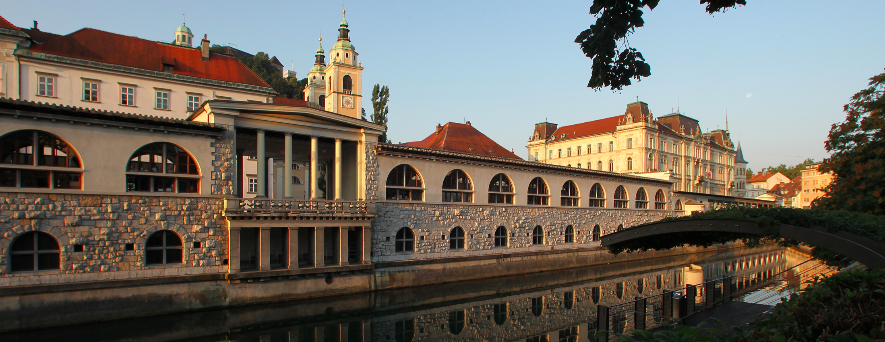
Lepton Photon 2015
Ljubljana, Slovenia, August 17-22, 2015
Status Report

Slide 2
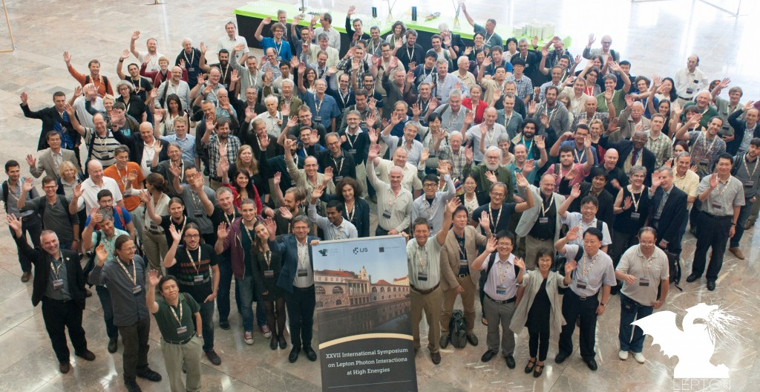
XXVII International Symposium on Lepton Photon Interactions at High Energies lp2015.ijs.si

Slide 3
Attendance: ~220
Attendance
by country

Slide 4
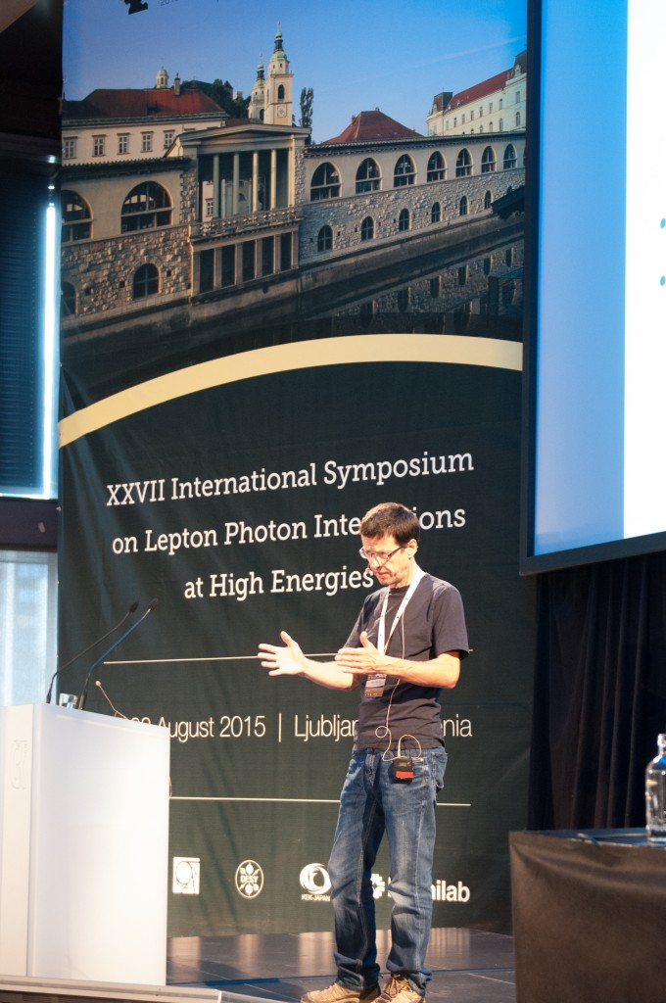
Talks
61 talks in 4 ½ days
Organized in 15 sessions:
– Highlights of LHC Run 2
– BEH Boson
– Beyond SM
– EW Physics
– Neutrinos
– QCD
– Top Quark
– Flavour Physics
– Heavy Ions
– Dark Matter
– Inflation, CMB and Dark Energy
– Astroparticle Physics
– Future Facilities

Slide 5
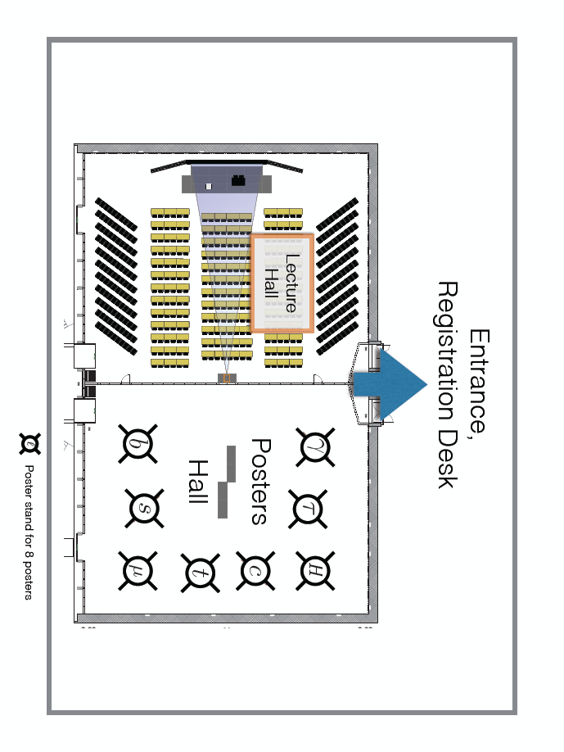
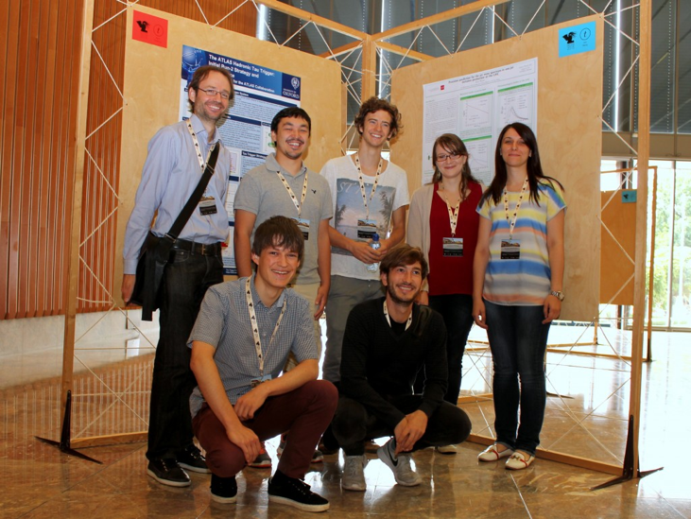
Posters
57 posters
Organized in 3 groups
On display during entire conference
One of the groups staffed at coffee break
  each group presented twice
6 posters upgraded to short oral

Slide 6
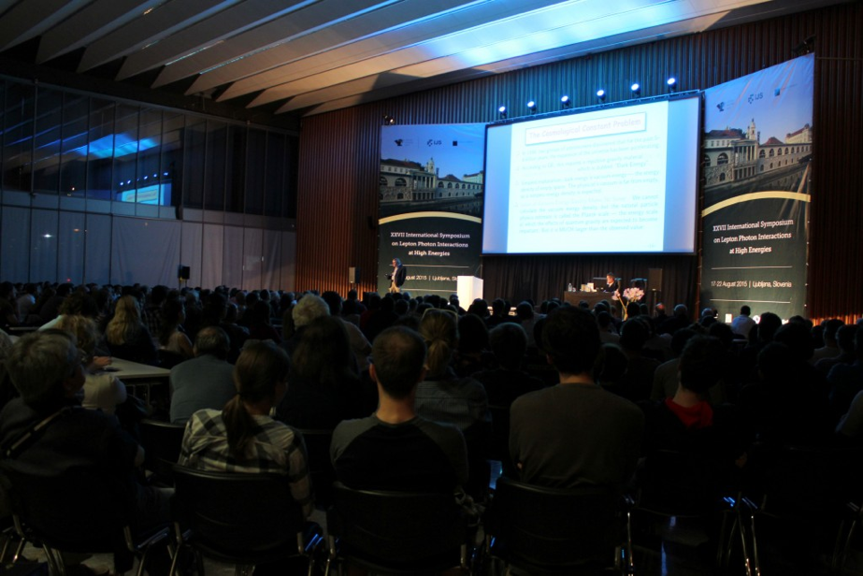
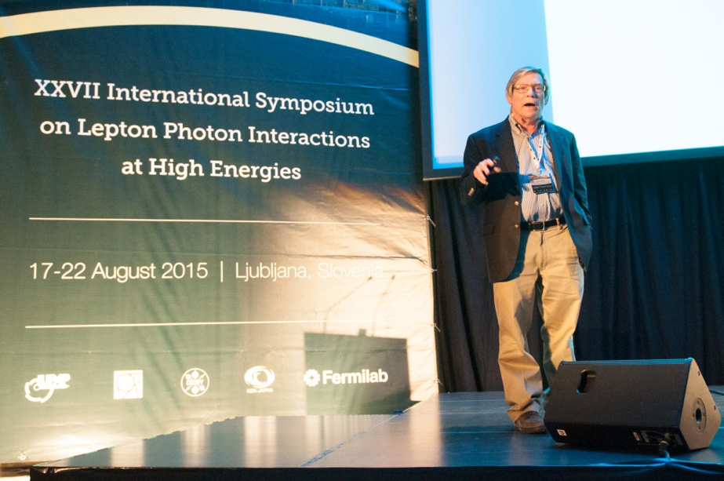
Public Lecture
Inflationary Cosmology: Is Our Universe Part of a Multiverse?
  delivered by Alan Guth
Attended by ~1300 people
Advertised on Social Media
Live webcast via CERN
  as all the conference talks
Recorded on Videolectures
  http://videolectures.net/single_guth_multiverse/

Slide 7

Sponsors
Organizing institutions
IUPAP
Major HEP labs
  CERN, DESY
  Fermilab, KEK
City of Ljubljana
~22 kEUR collected
Big thanks to all !

Slide 8
Support
Partial waiver of conference fee
Mainly to students and postdocs
  Contribution required
Some speakers not attending all time
All expense of public lecture speaker
Reduction | Persons
20% | 7
25% | 3
50% | 13
75% | 4
100% | 2
Total | 29

Slide 9
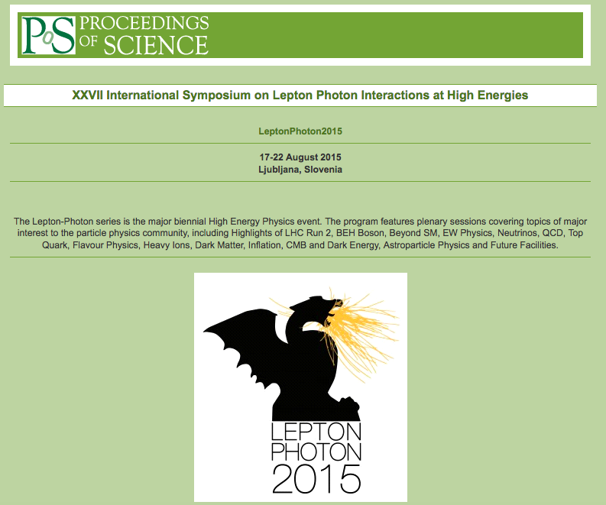
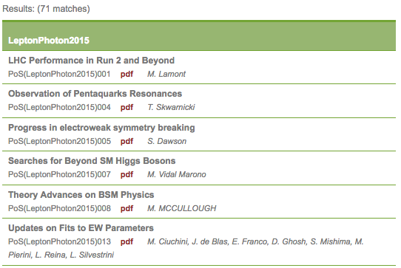
Proceedings
Web based, no paper copy
Proceedings of Science
Editorial Team:
  B. Golob
  J. F. Kamenik
  A. Zupanc
71/112 contributions on PoS server
Expect to be published asap

Slide 10
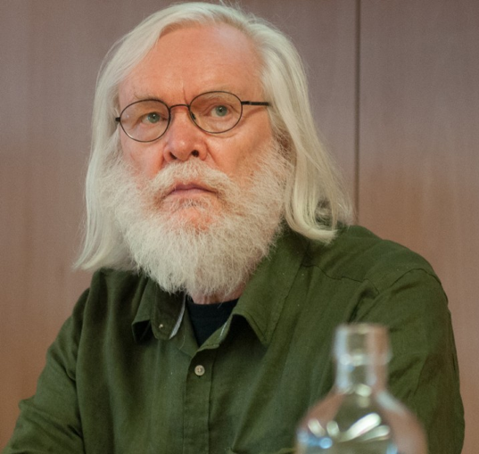
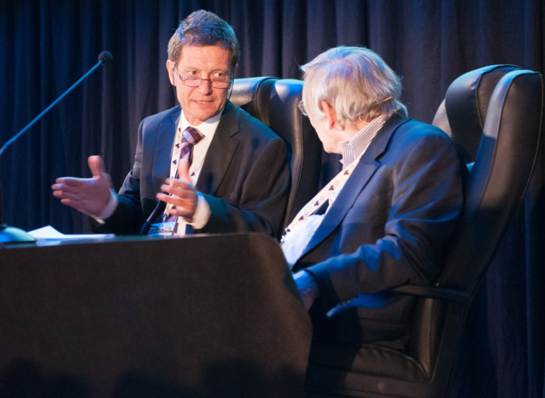
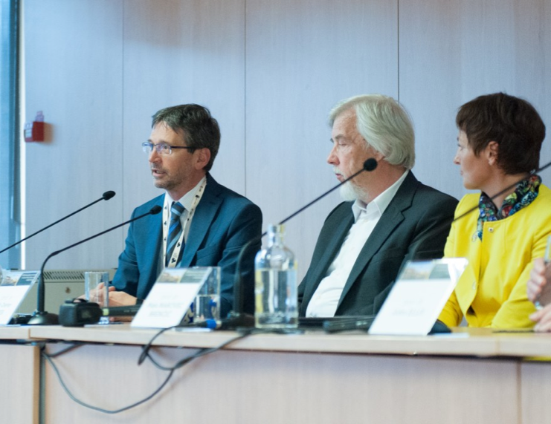
Impact
Extremely well covered by media
  daily press clips
  many interviews with participants
Opened by Science Minister
Public lecture attended by the
  President of National Assembly
Press conference of the Minister with CERN DG
  relaunching of Slovenia’s adherence to CERN

Slide 11
Budget
Income | kEUR
Conference fees | 96
Sponsorships | 22
Total income | 118
Expenses | kEUR
Fixed cost (venue) | 63
Variable (catering, excursions) | 52
Proceedings | 2
Public lecturer | 3
Total expenses | 120

