Slide 1
Measurements of VAT valve/
Status Report
Christine Vollinger,
Thomas Kaltenbacher
Impedance Working Group, 15-Jul-2016

Slide 2
SPS vacuum sector valves
Request to IWG for the installation of 11 additional SPS vacuum sector valves for improved vacuum sectorisation;
Details can be found here:
( https://edms.cern.ch/document/1543081/1.0 );
RF measurements with probes carried out on the valve/ status;
Wire measurement in standard configuration/ status;
Simulations for longitudinal impedance/ status.

Slide 3
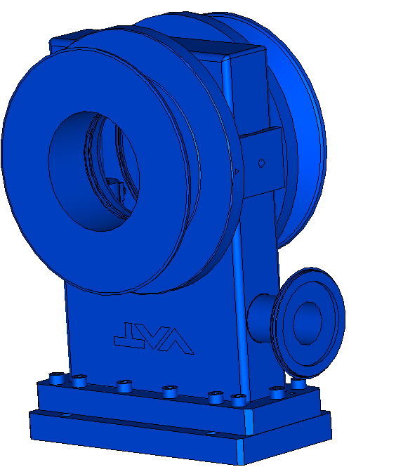
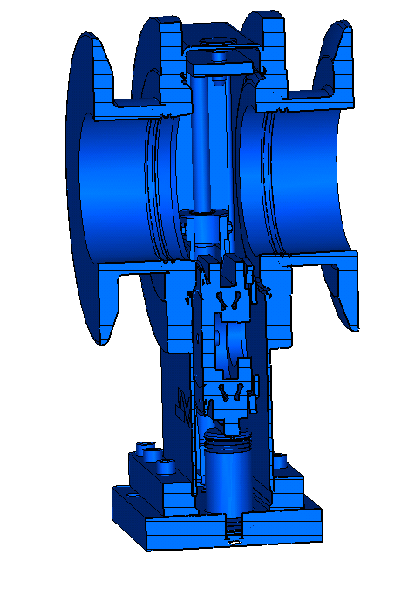
SPS vacuum sector valves
For these valves, no full CATIA model, but only stp-files exist;
Valve was RF-measured and simulations in both eigenmode and wakefields were carried out (partially still ongoing).

Slide 4
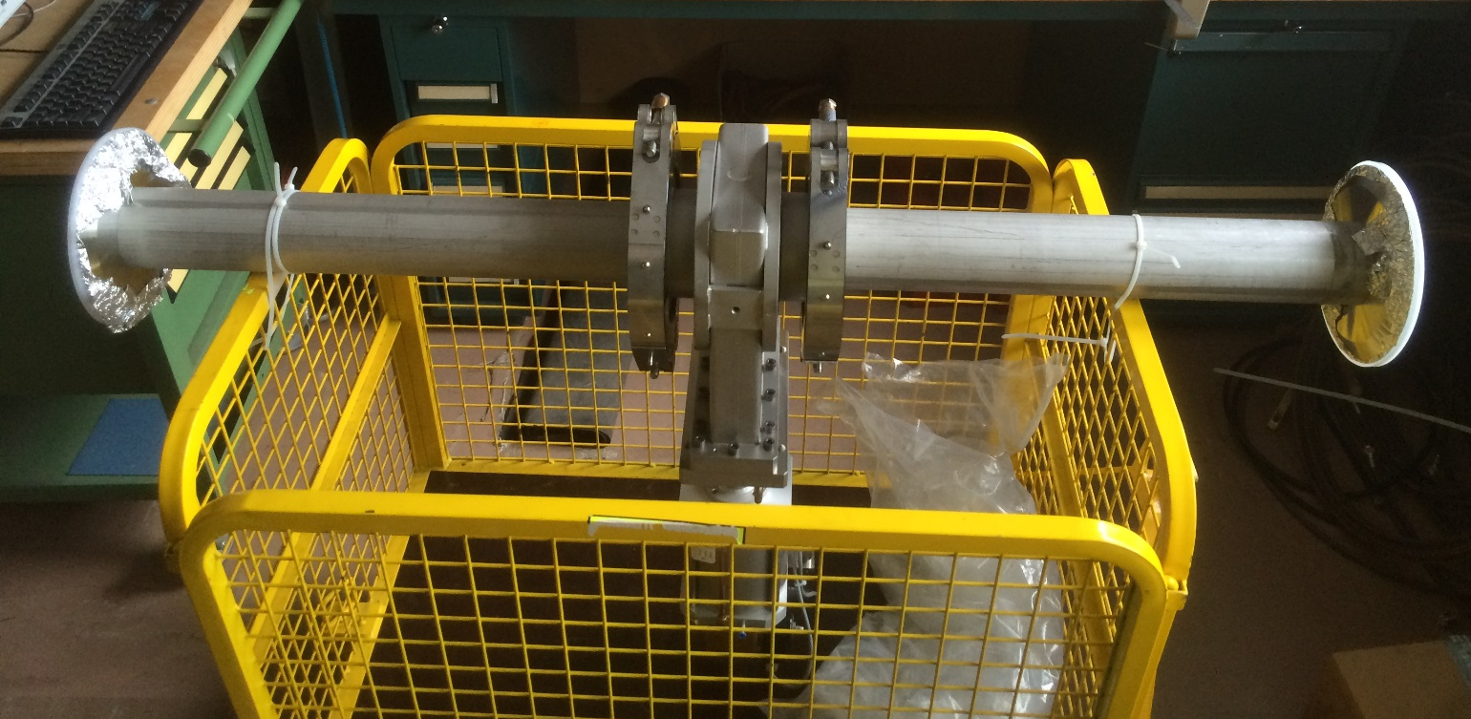
RF-Measurements with Probes (1/3)
Probe-measurements
Valve

Slide 5
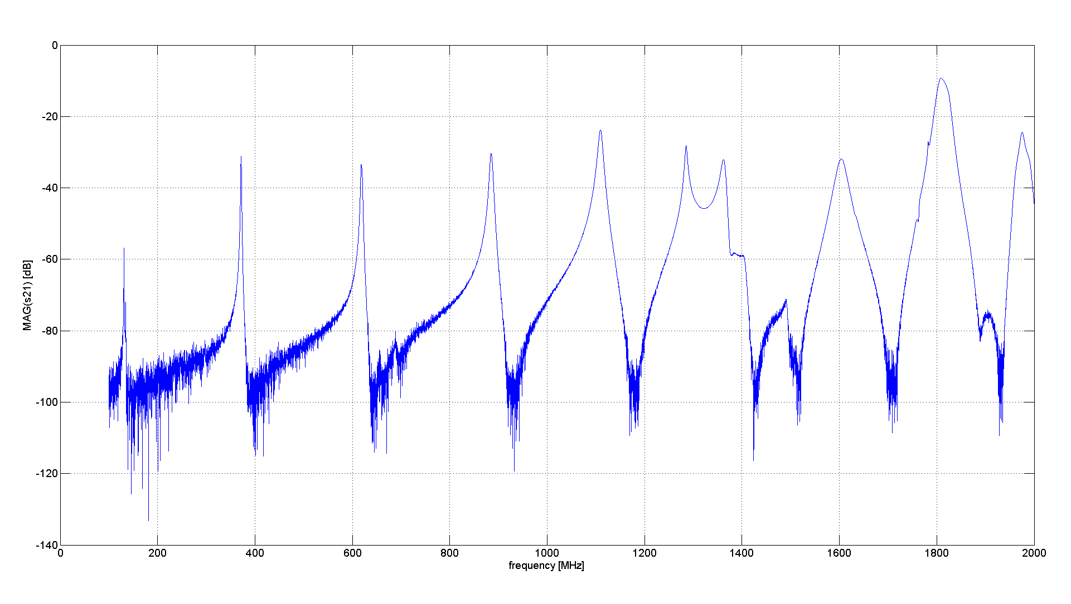
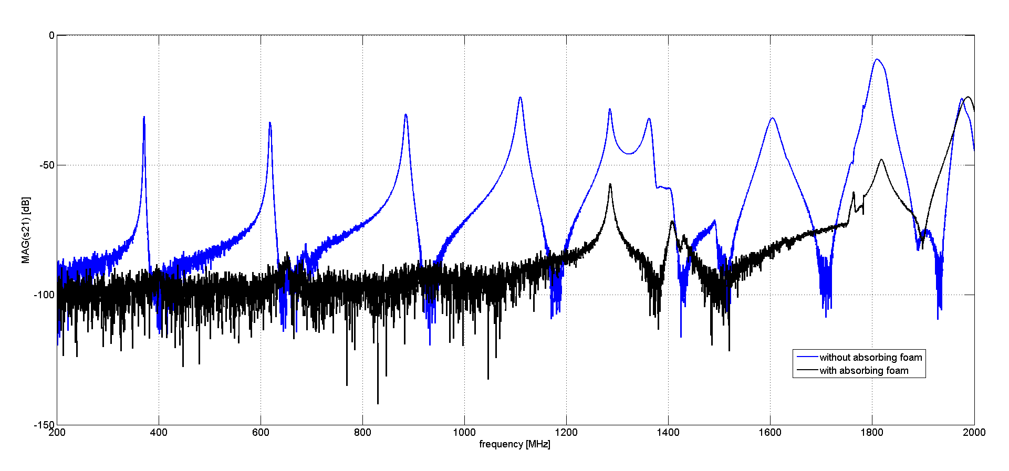
RF-Measurements with Probes (2/3)
Probe measurement with multiple reflections on shorted ends.
Expected resonances from measurements.
Added trace:
Probe measurement with absorber to suppress multiple reflections on shorted ends.

Slide 6
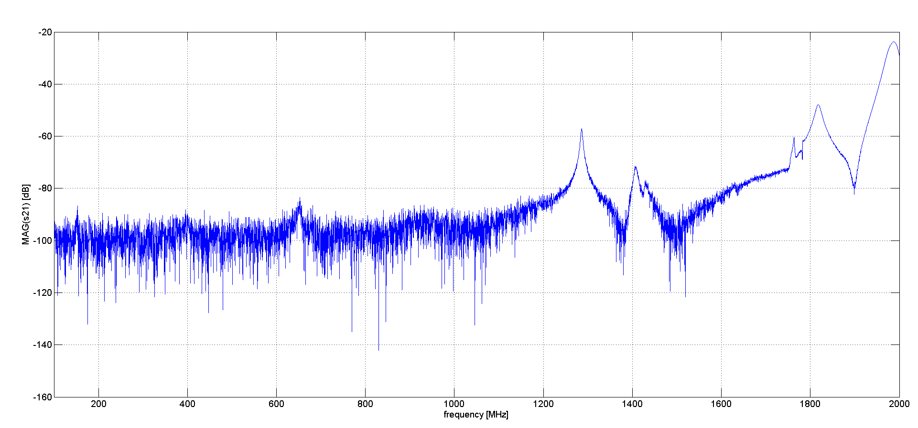
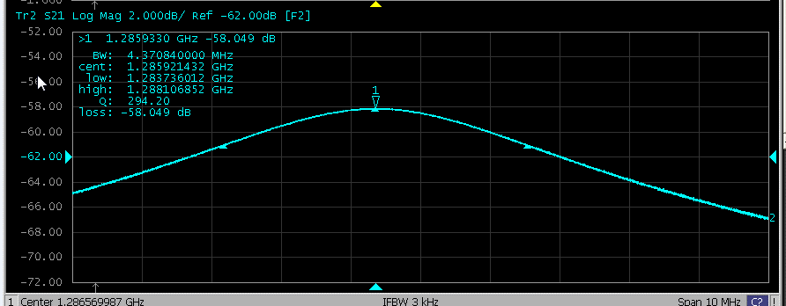
RF-Measurements with Probes (3/3)
These peaks could not be evaluated from probe measurement.
Meas. | Sim.
1.29 GHz | 1.27 GHz
Q=294 | Q=600
 | R/Q ~ 13

Slide 7
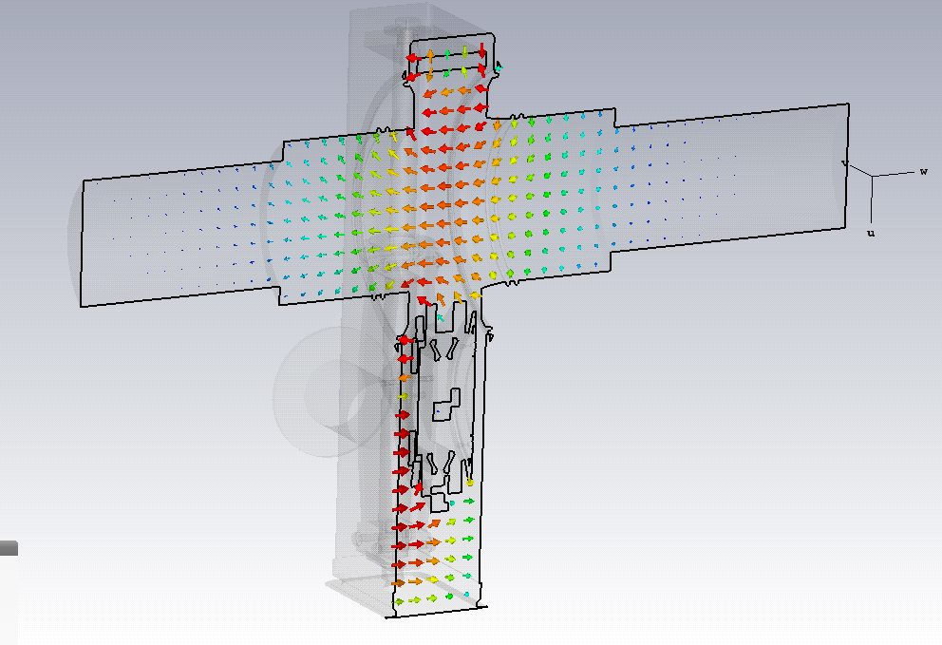
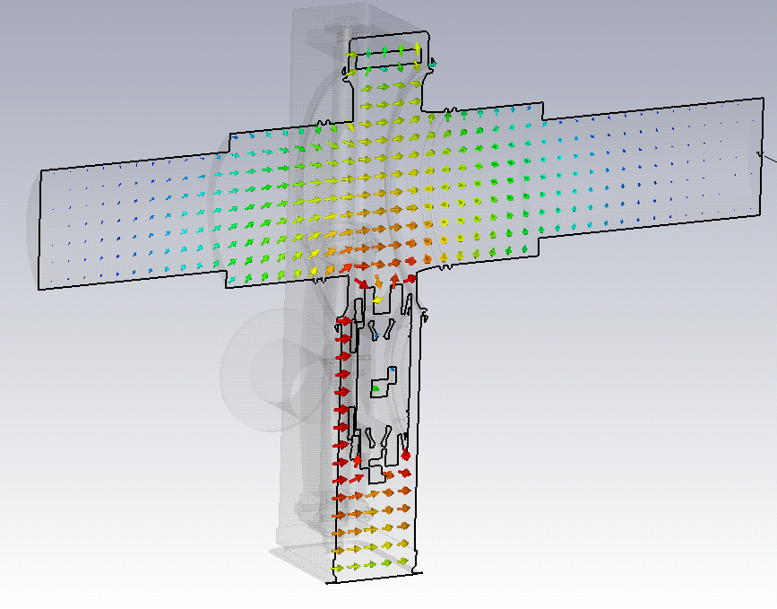
Field patterns in the Valve Confirm Measurements
Rather weak signal at ~600 MHz is too noisy to evaluate;
1.29 GHz peak is ok for Q-determination.
One split peak is to be re-measured.

Slide 8
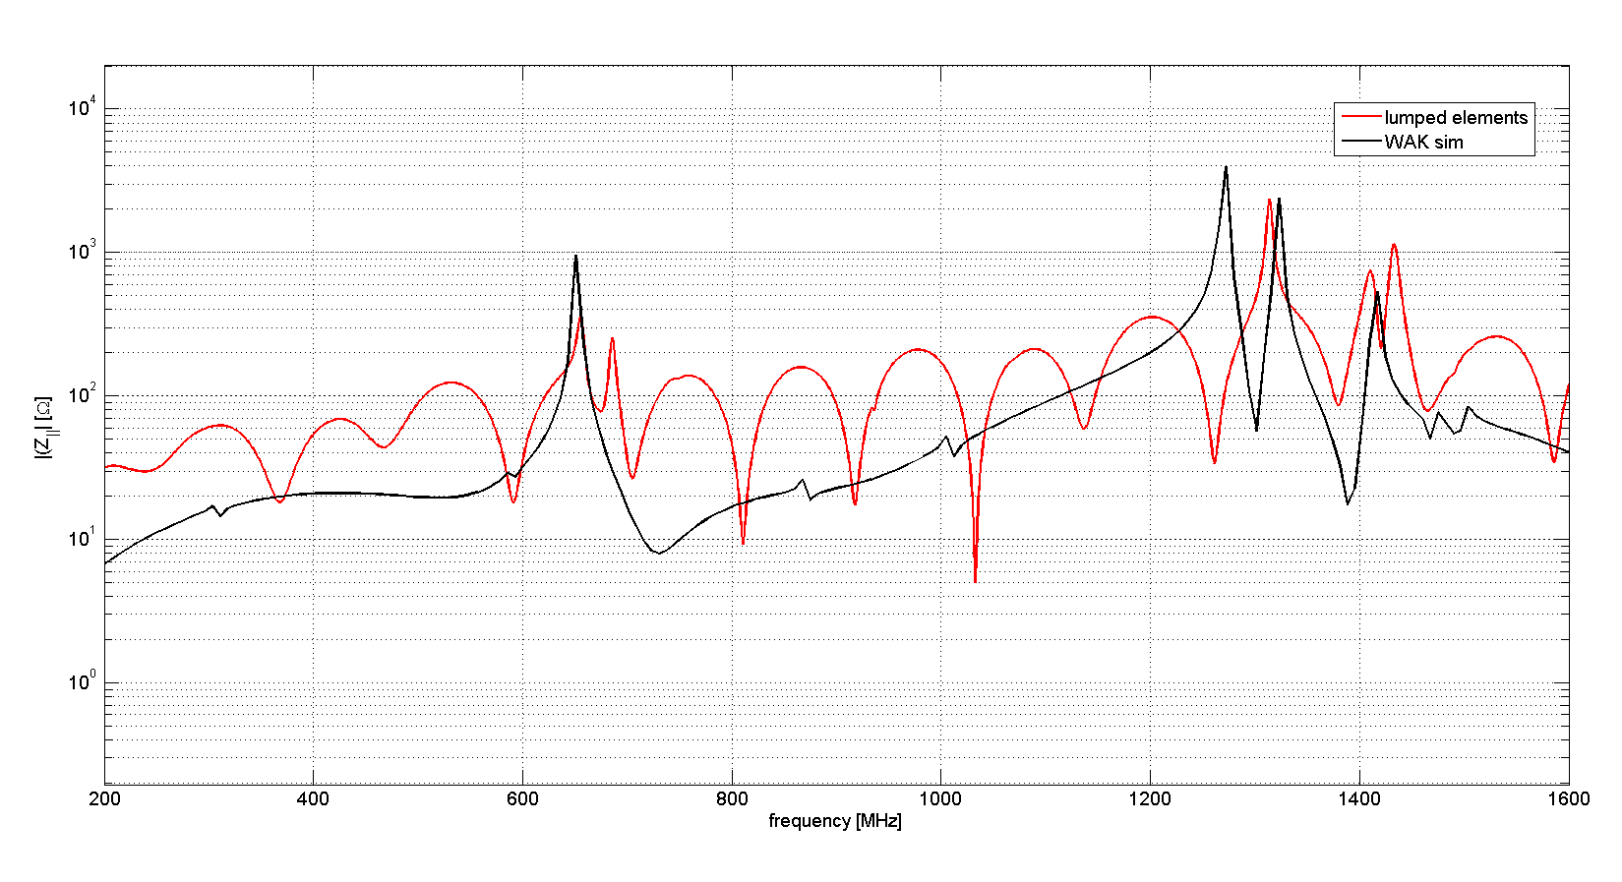
RF-Measurements with Wire and WAK Simulation
Wire measurements were carried out for the evaluation of the peaks at about 600 MHz and at about 1.6 GHz. Data is evaluated with lumped element formulae to be compared to WAK simulations.
We see a very good agreement. Evaluation of higher frequencies is still ongoing (not shown yet).
Split peak is still a problem.

Slide 9
Conclusions
We carried out probe and wire measurements on the sector valve, as well as eigenvalue and wakefield simulations for longitudinal impedances;
Multiple reflexions from probe measurements could be suppressed with absorbers; still some peaks were difficult to evaluate;
Wire measurements gave additional information on some resonances;
Higher frequency resonances were observed as well but still need detailed evaluation;
Simulations and measurements show a very good agreement, but analysis is not yet finished due to the advancement of the original deadline (sorry, we do what we can, but deadline was advanced for EYETS installation!)
More analysis to come soon….

Slide 10
Thank you!
Many thanks also to:
Adewale Alao, Fotios Avgidis, Fritz Caspers, and Patrick Krämer
(all from the RF-group)
for precious help with these measurements!

