Slide 1

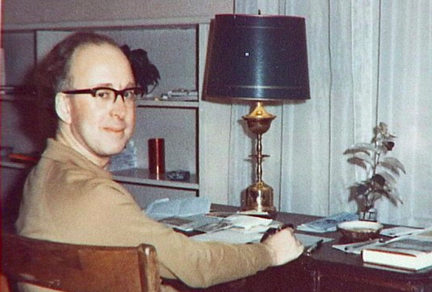

Introduction to Higgs & Beyond
The Standard Model
The Higgs boson
What may lie above and beyond it?
John Ellis

Slide 2
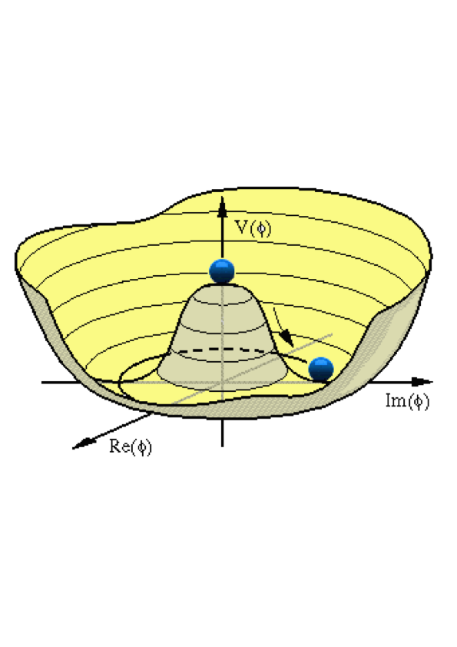







The Brout-Englert- Higgs Mechanism
Postulated effective potential:
Minimum energy at non-zero value:
Components of Higgs field:
π m = 0, σ massive: Higgs boson
After gauging: Massive gauge boson
Couple to fermions: non-zero masses:

Slide 3
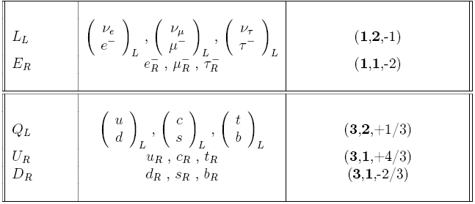
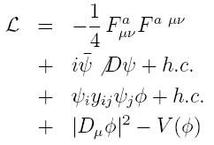
Summary of the Standard Model
Particles and SU(3) × SU(2) × U(1) quantum numbers:
Lagrangian: gauge interactions
matter fermions
Yukawa interactions
Higgs potential
Untested
before 2012

Slide 4
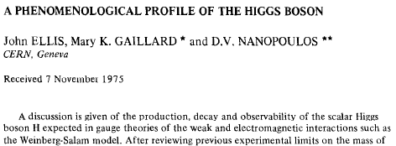
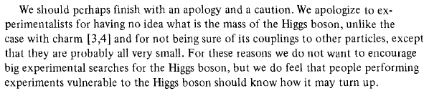
A Phenomenological Profile of the Higgs Boson
1975
First attempt at systematic survey

Slide 5
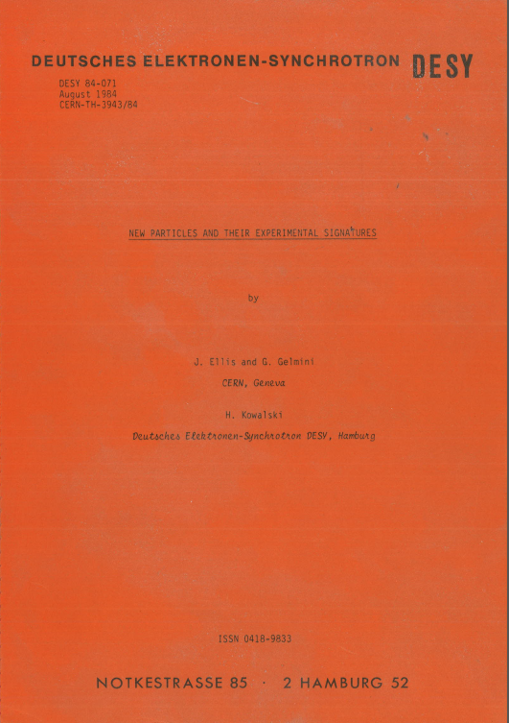
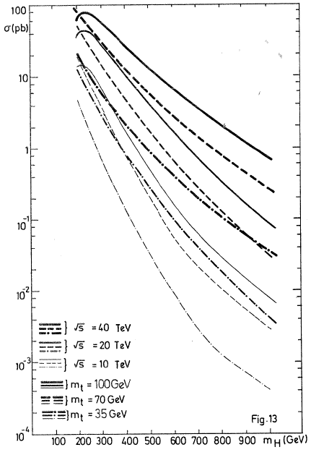
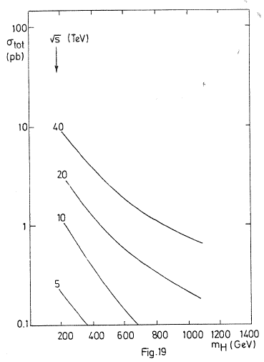
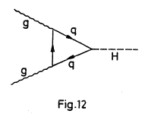
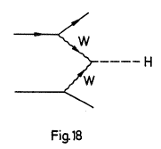
A Preview of the Higgs Boson @ LHC
1984
Prepared for LHC Lausanne workshop 1984
JE, Gelmini & Kowalski, 1984

Slide 6



Constraints on Higgs Mass
2011
Electroweak observables sensitive via quantum loop corrections:
Sensitivity to top, Higgs masses:
Preferred Higgs mass: m_{H} ~ 100 ± 30 GeV
Compare with lower limit from direct search at LEP:
m_{H} > 114 GeV
and exclusion around (160, 170 GeV) at TeVatron

Slide 7
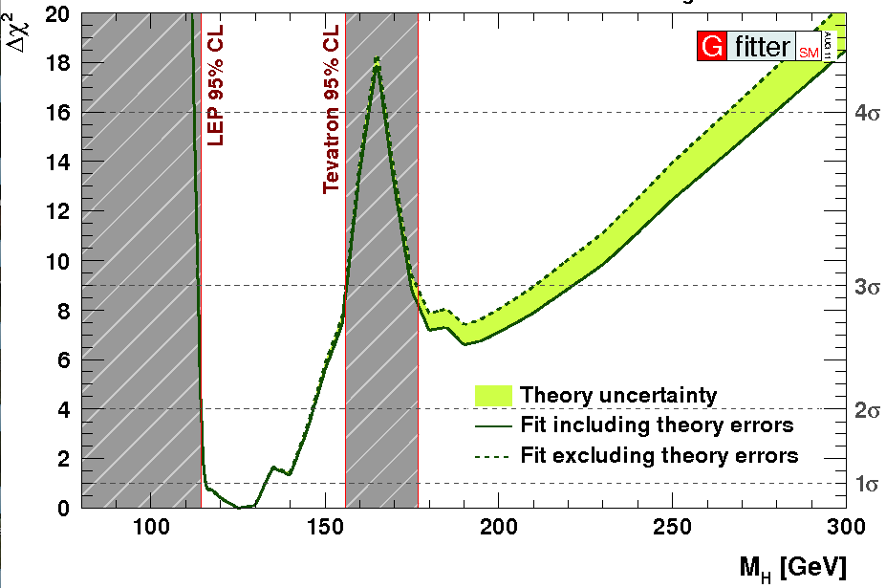
2011: Combining Information from Previous Direct Searches and Indirect Data
m_{H} = 125 ± 10 GeV
Gfitter collaboration

Slide 8
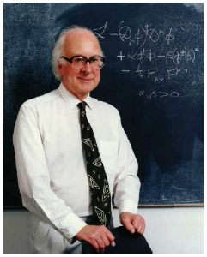
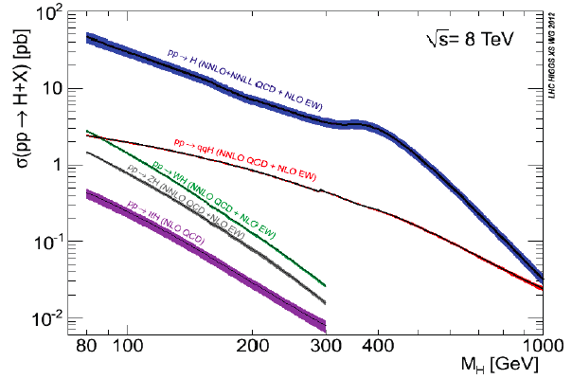
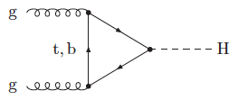
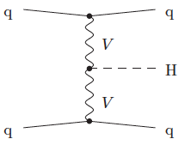
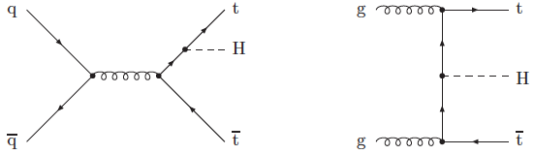
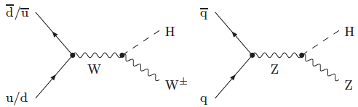
Higgs Production at the LHC
A la recherche du
Higgs perdu …
Many production modes measurable if M_{h} ~ 125 GeV

Slide 9
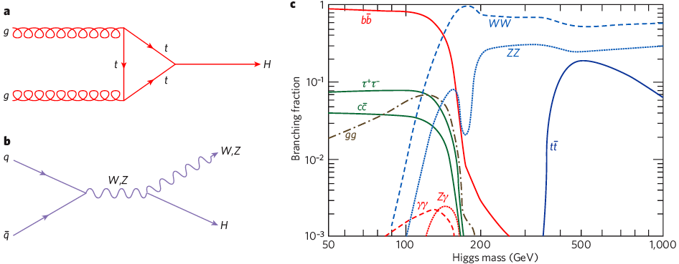
Higgs Decay Branching Ratios
Couplings proportional to masses (?)
Important couplings through loops:
  gluon + gluon → Higgs → γγ
Many decay modes measurable if M_{h} ~ 125 GeV

Slide 10
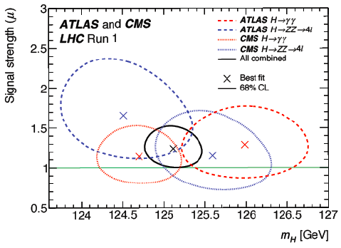
Higgs Mass Measurements
ATLAS + CMS ZZ* and γγ final states
Statistical uncertainties dominate
Allows precision tests
Crucial for stability of electroweak vacuum

Slide 11

The Particle Higgsaw Puzzle
Did LHC find the missing piece?
Is it the right shape?
Is it the right size?

Slide 12
What is it ?
Does it have spin 0 or 2?
Is it scalar or pseudoscalar?
Is it elementary or composite?
Does it couple to particle masses?
Quantum (loop) corrections?
What are its self-couplings?

Slide 13
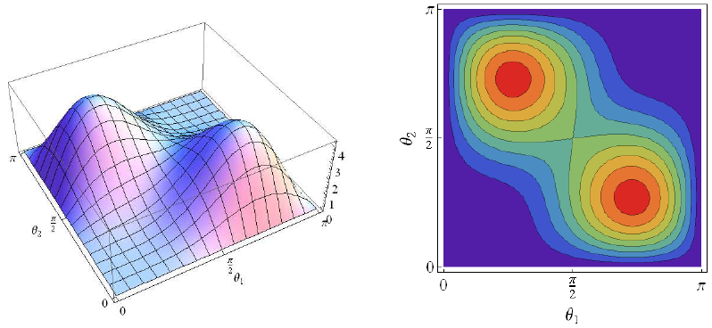
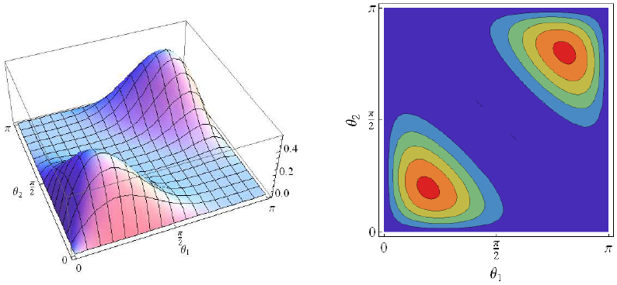
Does the ‘Higgs’ have Spin Zero ?
Polar angle distribution for X₂ ➔W⁺W⁻
Polar angle distribution for X₀ ➔W⁺W⁻
  (for φ = π)
JE, Hwang: arXiv:1202.6660

Slide 14
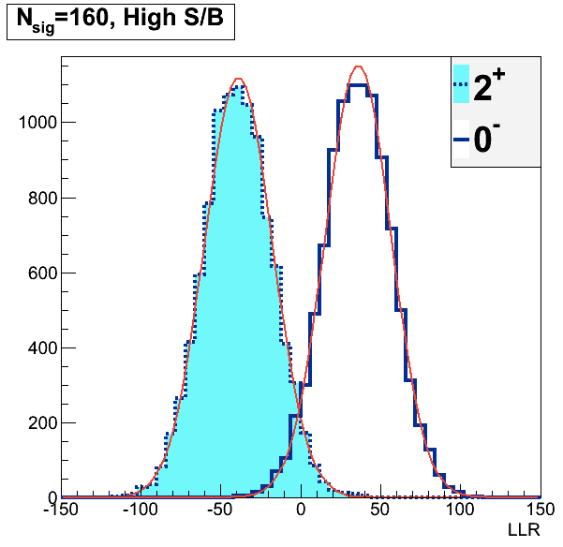
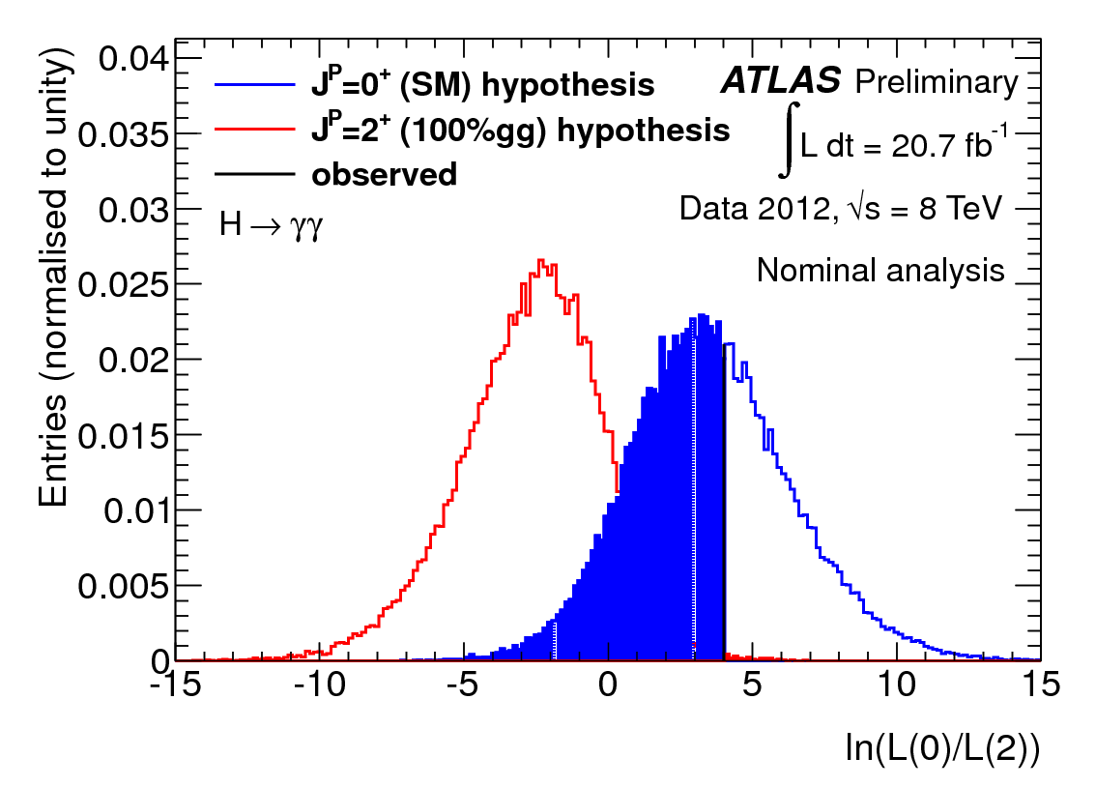
Does the ‘Higgs’ have Spin Two ?
Discriminate spin 2 vs spin 0 via angular distribution of decays into γγ
JE & Hwang: arXiv:1202.6660
Monte Carlo
simulations
2⁺ disfavoured @ 99%
JE, Fok, Hwang, Sanz & You: arXiv:1210.5229

Slide 15
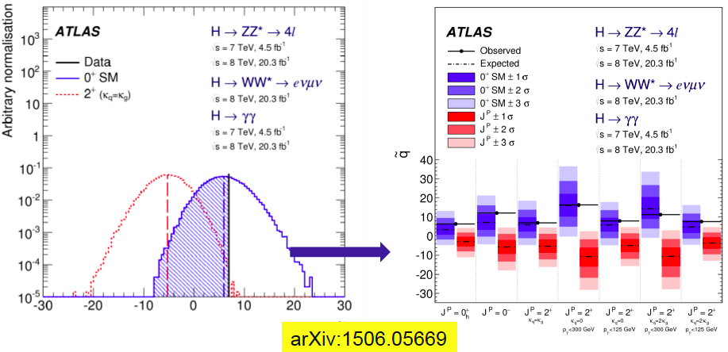
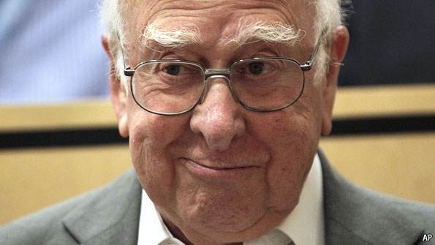
H Spin-Parity Tests: 0⁺ AOK
Alternative spin-parities disfavoured > 99.9%

Slide 16
What is it ?
Does it have spin 0 or 2?
  Spin 2 strongly disfavoured
Is it scalar or pseudoscalar?
  Pseudoscalar strongly disfavoured
Is it elementary or composite?
Does it couple to particle masses?
Quantum (loop) corrections?
What are its self-couplings?

Slide 17
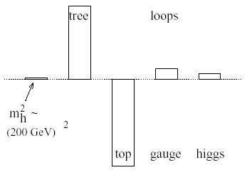
Elementary Higgs or Composite?
Higgs field:
<0|H|0> ≠ 0
Quantum loop problems
Fermion-antifermion condensate
Just like QCD, BCS superconductivity
Top-antitop condensate? needed m_{t} > 200 GeV
Cutoff
Λ = 10 TeV
New technicolour force?
Heavy scalar resonance?
Inconsistent with
precision electroweak data?
Cut-off Λ ~ 1 TeV with
Supersymmetry?

Slide 18
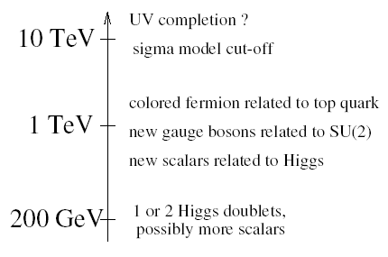
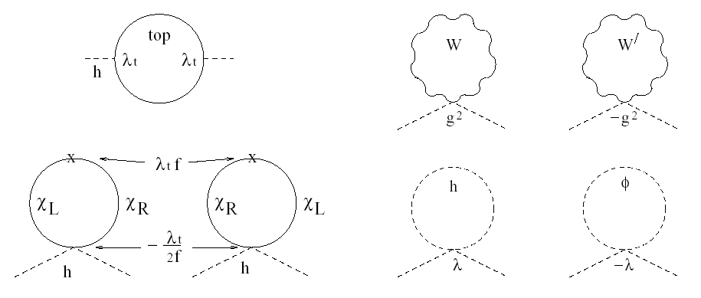
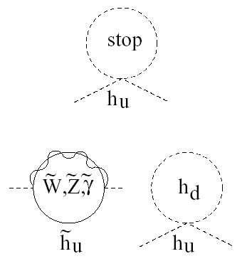
Higgs as a Pseudo-Goldstone Boson
‘Little Higgs’ models
(breakdown of larger symmetry)
Loop cancellation mechanism
Little Higgs
Supersymmetry

Slide 19
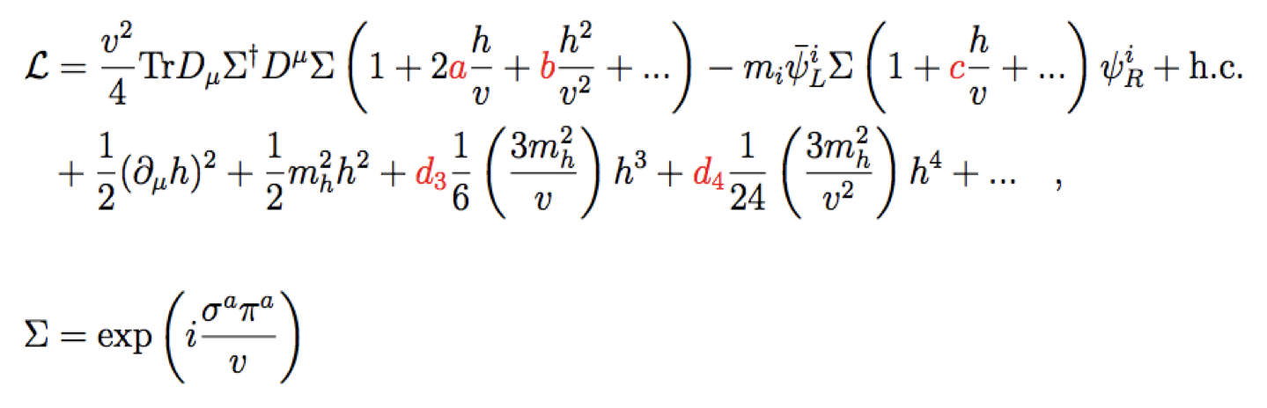

Phenomenological Framework
Assume custodial symmetry:
Parameterize gauge bosons by 2 × 2 matrix Σ:
Coefficients a = c = 1 in Standard Model
Notes:
Coefficients chosen to reproduce SM in limit of unit coefficients a, c, b etc. To follow this talk all you really need to remember is that a parametrizes the gauge couplings of the scalar and c parametrizes its fermionic couplings.

Slide 20
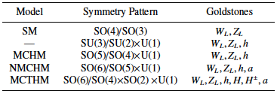
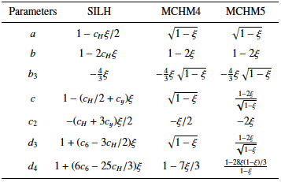
Examples of Higgs as
Pseudo-Goldstone Boson
Sample models:
Dependences of couplings on model parameters:
To be measured!
Translation to experimental parameters:
a = κ_{V}, c = κ_{F}

Slide 21
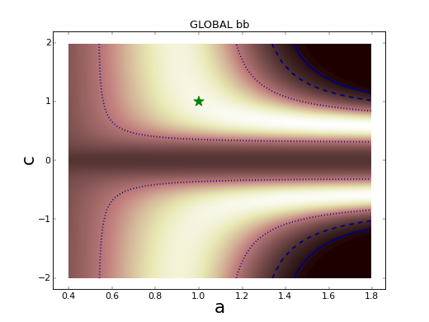
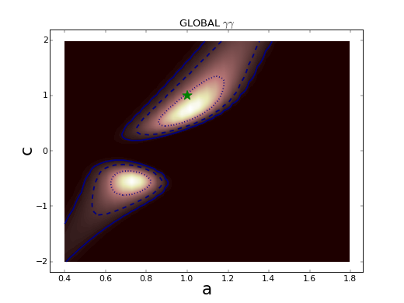
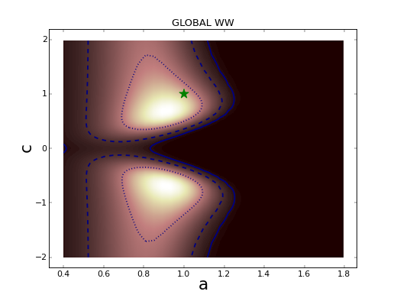
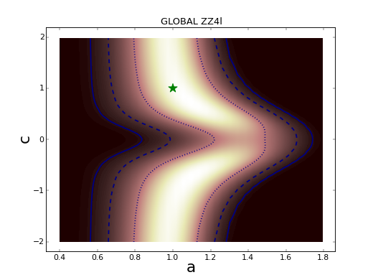
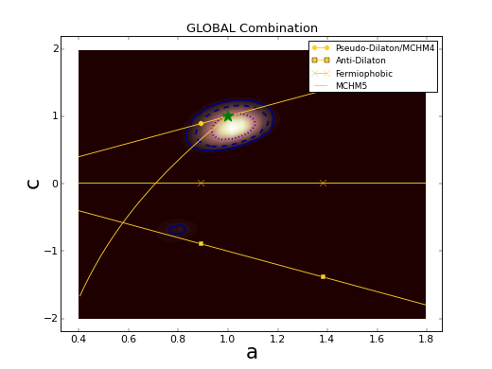
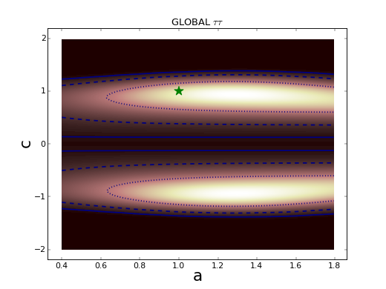
Global Analysis of Higgs-like Models
Rescale couplings: to bosons by a, to fermions by c
Standard Model: a = c = 1
No evidence for
deviation from SM
W W
Global
b bbar
τ τ
γ γ
Z Z
JE & Tevong You, arXiv:1303.3879

Slide 22
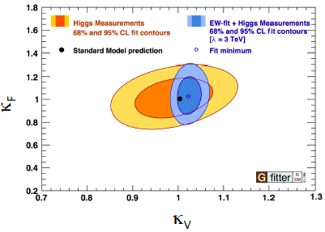
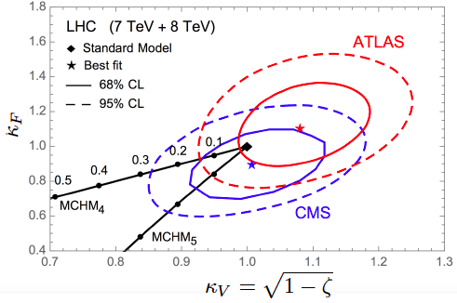
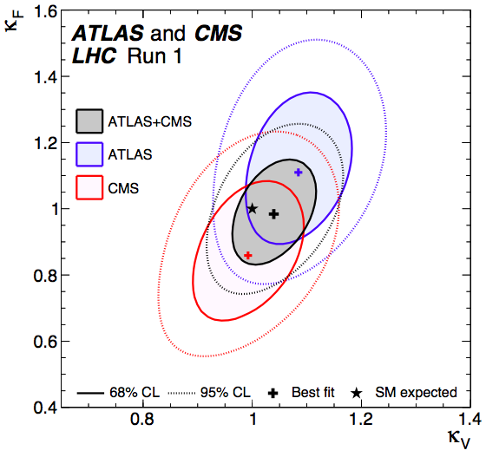
Global Analysis of Higgs-like Models
Rescale couplings: to bosons by κ_{V}, to fermions by κ_{f}
Standard Model: κ_{V} = κ_{f} = 1
Consistency between Higgs and EW measurements
Must tune composite models to look like SM

Slide 23
What is it ?
Does it have spin 0 or 2?
  Spin 2 strongly disfavoured
Is it scalar or pseudoscalar?
  Pseudoscalar strongly disfavoured
Is it elementary or composite?
  No significant deviations from Standard Model
Does it couple to particle masses?
Quantum (loop) corrections?
What are its self-couplings?

Slide 24
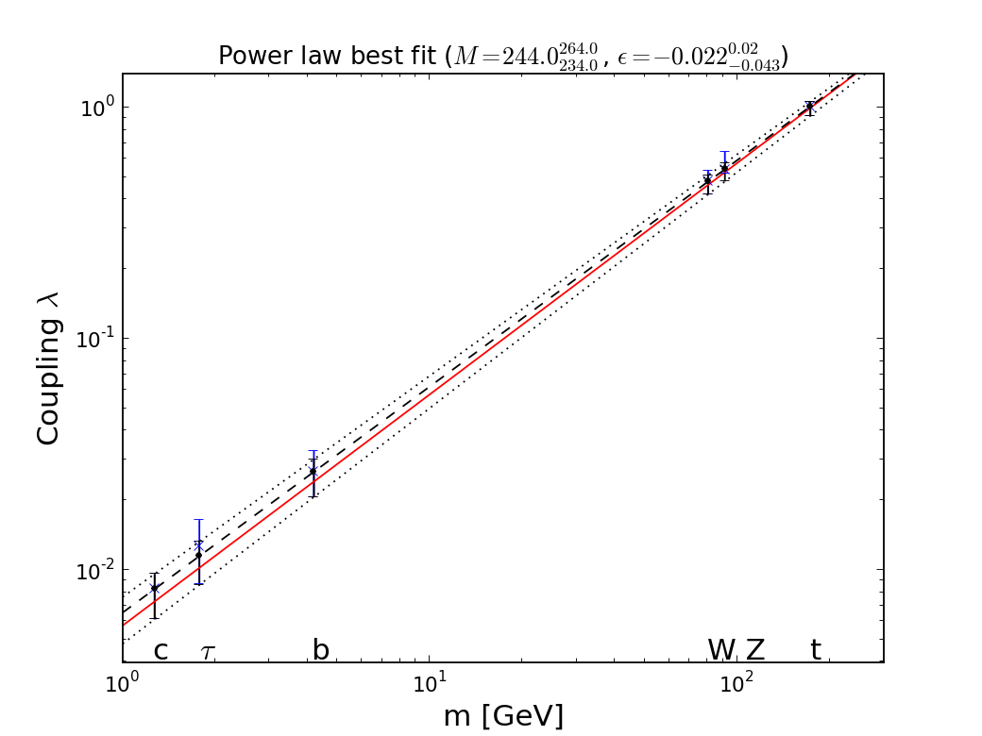
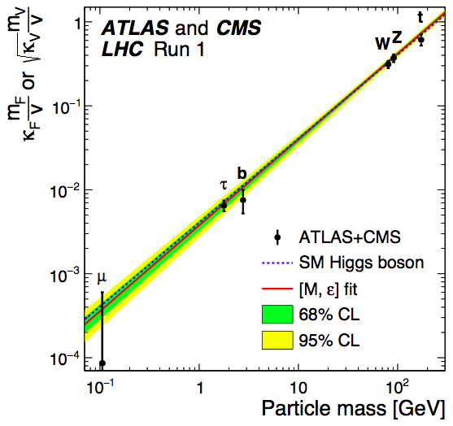


It Walks and Quacks like a Higgs
Do couplings scale ~ mass? With scale = v?
Red line = SM, dashed line = best fit
Global
fit
JE & Tevong You
Blue dashed line = Standard Model

Slide 25
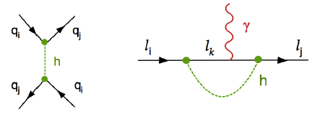
Flavour-Changing Couplings?
Upper limits from FCNC, EDMs, …
Quark FCNC bounds exclude observability of quark-flavour-violating h decays
Lepton-flavour-violating h decays could be large:
BR(τμ) or BR(τe) could be O(10)%
B BR(μe) must be < 2 ✕ 10⁻⁵
Blankenburg, JE, Isidori: arXiv:1202.5704

Slide 26
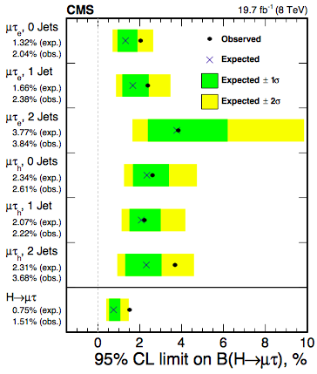
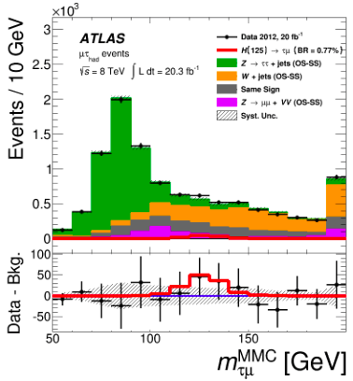
Flavour-Changing Higgs Coupling?
Also: BR(eτ) < 0.69%, BR(eμ) < 0.036%

Slide 27
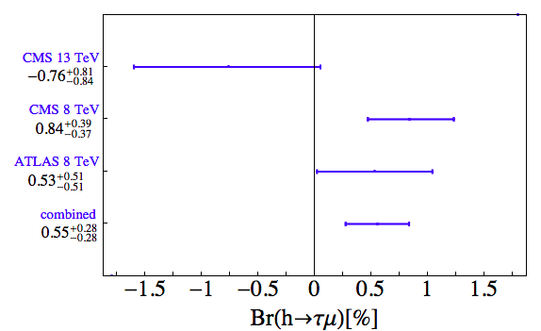
Flavour-Changing Higgs Coupling?
Update from 2015 data

Slide 28
What is it ?
Does it have spin 0 or 2?
  Spin 2 strongly disfavoured
Is it scalar or pseudoscalar?
  Pseudoscalar strongly disfavoured
Is it elementary or composite?
  No significant deviations from Standard Model
Does it couple to particle masses?
  Prima facie evidence that it does
Quantum (loop) corrections?
What are its self-couplings?

Slide 29
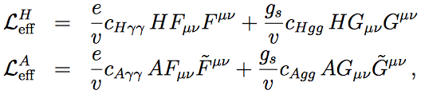
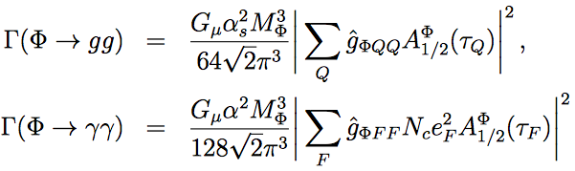

Triangle Diagrams for gg ➔Spin-0 ➔γγ
Effective vertices:
Decay rates:
Vertex
form factors:
Vanish for fermion mass << spin-0 mass

Slide 30

Triangle Diagrams for gg ➔Spin-0 ➔γγ
Form factors for triangle diagrams
Vanish for fermion mass << spin-0 mass

Slide 31

Loop Corrections ?
Combination of data on γγ, gluon-gluon couplings
Loop diagrams ~ Standard Model?
JE & Tevong You, arXiv:1303.3879

Slide 32

What is it ?
Does it have spin 0 or 2?
  Spin 2 strongly disfavoured
Is it scalar or pseudoscalar?
  Pseudoscalar disfavoured
Is it elementary or composite?
  No significant deviations from Standard Model
Does it couple to particle masses?
  Prima facie evidence that it does
Quantum (loop) corrections?
  γγ, gg couplings ~ Standard Model
What are its self-couplings?

Slide 33

Dixit Swedish Academy
Today we believe that “Beyond any reasonable doubt, it is a Higgs boson.” [1]
http://www.nobelprize.org/nobel_prizes/physics/laureates/2013/advanced-physicsprize2013.pdf
[1] = JE & Tevong You, arXiv:1303.3879

Slide 34


Standard Model Effective Field Theory
Assuming H(125) is SM-like: Model-independent search for new physics
Higher-dimensional operators as relics of higher-energy physics, e.g., dimension 6:
Operators constrained by SU(2) × U(1) symmetry:
Constrain with precision EW, Higgs data, TGCs ...

Slide 35

Electroweak Precision Data
Operators affecting oblique parameters
Also other electroweak tests
Constraints from LEP et al. data
Leptonic
observables
+ hadronic
observables
Fits to individual dimension-6 operators
Global fit to dimension-6 operators
JE, Sanz & Tevong You, arXiv:1410.7703

Slide 36

Fits including Higgs Production
Using signal strengths & VH kinematics in global fit
Single-parameter fits
JE, Sanz & Tevong You, arXiv:1404.3667

Slide 37


Global Fits including
LHC TGCs
Associated production
LHC Triple-gauge couplings
Global combination
Individual operators
JE, Sanz & Tevong You, arXiv:1410.7703

Slide 38



Introduction
Standard Model Particles:
Years from Proposal to Discovery
Lovers of physics
Beyond the SM:
be patient!
Notes:
All the particles of the standard model, from conception to discovery, with the higgs the last missing piece. History will remember the higgs discovery of this year as closing the chapter on an amazing century of unraveling the subatomic world and building the SM. End with “given the particle content of the SM and their quantum numbers…”
(Alternatively): The picture of fundamental physics at the start of the last century was a classical one in which all that was left was to measure to increasing precision, with a few anomalies here and there like blackbody radiation or the precession of mercury…

Slide 39



Run 2
SUSY
« Empty » space is unstable
Dark matter
Origin of matter
Masses of neutrinos
Hierarchy problem
Inflation
Quantum gravity
…
Run 2
SUSY
Run 2
SUSY
Run 2
SUSY
SUSY
SUSY
^{The} Standard Model
Notes:
39

Slide 40
What lies beyond the Standard Model?
Supersymmetry
New motivations
From LHC Run 1
Stabilize electroweak vacuum
Successful prediction for Higgs mass
  Should be < 130 GeV in simple models
Successful predictions for couplings
  Should be within few % of SM values
Naturalness, GUTs, string, …, dark matter

Slide 41



Theoretical Constraints on Higgs Mass
Large M_{h} → large self-coupling → blow up at low-energy scale Λ due to
renormalization
Small: renormalization
due to t quark drives
quartic coupling < 0
at some scale Λ
→ vacuum unstable
Vacuum could be stabilized by Supersymmetry
Instability @
10^{11.1±1.3} GeV
Degrassi, Di Vita, Elias-Miro, Giudice, Isodori & Strumia, arXiv:1205.6497

Slide 42



Vacuum Instability in the Standard Model
Very sensitive to m_{t} as well as M_{H}
Instability scale:
m_{t} = 173.3 ± 1.0 GeV ➔ log₁₀(Λ/GeV) = 11.1 ± 1.3
New D0
World
average
New ATLAS
New CMS
Bednyakov, Kniehl, Pikelner and Veretin: arXiv:1507.08833
Buttazzo, Degrassi, Giardino, Giudice, Sala, Salvio & Strumia, arXiv:1307.3536

Slide 43

Hard QCD: the Top Mass
Basic parameter of SM; stability of EW vacuum?
World average:
m_{t} = 173.34 ± 0.76 GeV
Running➔pole mass OK?
Monte Carlo mass ✓?
New measurements:
ATLAS: 172.99±0.91 GeV
CMS: 172.38±0.65, D0: 174.98±0.58±0.49 GeV

Slide 44


Instability during Inflation?
Hook, Kearns, Shakya & Zurek: arXiv:1404.5953
Do inflation fluctuations drive us over the hill?
Then Fokker-Planck evolution
Do AdS regions eat us?
  Disaster if so
  If not, OK if more inflation
Stabilize vacuum with some physics beyond the SM?

Slide 45




How to Stabilize a Light Higgs Boson?
Top quark destabilizes potential: introduce introduce stop-like scalar:
Can delay collapse of potential:
But new coupling must be
fine-tuned to avoid blow-up:
Stabilize with new fermions:
  just like Higgsinos
Very like Supersymmetry!
JE + D. Ross

Slide 46


Craig@LHCP

Slide 47




Loop Corrections to Higgs Mass²
Consider generic fermion and boson loops:
Each is quadratically divergent: ∫^{Λ}d⁴k/k²
Leading divergence cancelled if
Supersymmetry!
2
x 2

Slide 48

Unification of Gauge Couplings
Impressive!
Over-ambitious? Hubristic?

Slide 49


Minimal Supersymmetric Extension of Standard Model (MSSM)
Double up the known particles:
Two Higgs doublets
- 5 physical Higgs bosons:
- 3 neutral, 2 charged
Lightest neutral supersymmetric Higgs looks like the single Higgs in the Standard Model

Slide 50


Higgs Bosons in Supersymmetry
Need 2 complex Higgs doublets
  (cancel anomalies, form of SUSY couplings)
8 – 3 = 5 physical Higgs bosons
  Scalars h, H; pseudoscalar A; charged H±
Lightest Higgs < MZ at tree level:
Important radiative corrections to mass:
ΔM_{H}|_{TH} ~ 1.5 GeV

Slide 51

MSSM Higgs Masses & Couplings
Lightest Higgs mass
up to ~ 130 GeV
Heavy Higgs masses
quite close
750?
Consistent
With LHC

Slide 52
Lightest Supersymmetric Particle
Stable in many models because of conservation of R parity:
R = (-1) ^{2S –L + 3B}
where S = spin, L = lepton #, B = baryon #
Particles have R = +1, sparticles R = -1:
Sparticles produced in pairs
Heavier sparticles → lighter sparticles
Lightest supersymmetric particle (LSP) stable

Slide 53
Lightest Sparticle as Dark Matter?
No strong or electromagnetic interactions
Otherwise would bind to matter
Detectable as anomalous heavy nucleus
Possible weakly-interacting scandidates
Sneutrino
(Excluded by LEP, direct searches)
Lightest neutralino χ (partner of Z, H, γ)
Gravitino
(nightmare for detection)

Slide 54

Classic Dark Matter Signature
Missing transverse energy
carried away by dark matter particles

Slide 55

Searches with ~ 20/fb @ 8 TeV
Notes:
55

Slide 56


Craig@LHCP

Slide 57
(Non-)Universal Scalar Masses?
Different sfermions with same quantum #s?
e.g., d, s squarks?
disfavoured by upper limits on flavour- changing neutral interactions
Squarks with different #s, squarks and sleptons?
disfavoured in various GUT models
e.g., d_{R} = e_{L}, d_{L} = u_{L} = u_{R} = e_{R} in SU(5), all in SO(10)
Non-universal susy-breaking masses for Higgses?
No reason why not! NUHM

Slide 58
Sample Supersymmetric Models
Universal soft supersymmetry breaking at input GUT scale?
  For gauginos and all scalars: CMSSM
  Non-universal Higgs masses: NUHM1,2
Strong pressure from LHC (p ~ 0.1)
Treat soft supersymmetry-breaking masses as phenomenological inputs at EW scale
  pMSSMn (n parameters)
  With universality motivated by upper limits on flavour-changing neutral interactions: pMSSM10
Less strongly constrained by LHC (p ~ 0.3)

Slide 59

E. Bagnaschi, M. Borsato, O. Buchmueller, R. Cavanaugh, V. Chobanova, M. Citron, J. Costa, A. De Roeck, M.J. Dolan, J.E., H. Flacher, S. Heinemeyer, G. Isidori, M. Lucio, D. Martinez Santos, K.A. Olive, A. Richards, K. Sakurai, G. Weiglein

Slide 60

Data
Electroweak precision observables
Flavour physics observables
g_{μ} - 2
Higgs mass
Dark matter
LHC
Deviation from Standard Model:
Supersymmetry at low scale, or …?
M_{H} = 125.09 ± 0.21 ± 0.11 GeV
MasterCode: O.Buchmueller, JE et al.

Slide 61


Fit to Constrained MSSM (CMSSM)
2012
20/fb
Allowed
region
extends
to large
m₀
Buchmueller, JE et al: arXiv:1312.5250
m₀
p-value of simple models ~ 10% (also SM)

Slide 62

Constrained MSSM (CMSSM)
Buchmueller, JE et al: arXiv:1312.5250
LHC
MET
searches
2012
20/fb
Contributions
to global χ²
from
different
observables
g_{μ} - 2
Flavour

Slide 63


Dark Matter Density Mechanisms
2012
20/fb
Buchmueller, JE et al: arXiv:1312.5250
Estimated reach with
Run 2 of the LHC
Current LHC reach

Slide 64

Probing the CMSSM with the LHC
2012
20/fb
Buchmueller, JE et al: arXiv:1312.5250
Buchmueller, JE et al: arXiv:1505.04702

Slide 65
Measuring the CMSSM with the LHC
3000/fb
300/fb
LHC
Combined
Combined
LHC
Buchmueller, JE et al: arXiv:1505.04702

Slide 66

Dark Matter in CMSSM, NUHM1/2, pMSSM10
Current LHC reach
Estimated future
LHC reach
Bagnaschi, JE et al: arXiv:1508.01173

Slide 67


Phenomenological
MSSM (pMSSM10)
2012
LHC
MET
searches
De Vries, JE et al: arXiv:1504.03260
g_{μ} - 2
Contributions
to global χ²
from
different
observables
Flavour

Slide 68



Possible Dark Matter Particle Mass
2012
20/fb
1
5
Neutralino mass
⬆
⬆
De Vries, JE et al: arXiv:1504.03260
pMSSM10 favours smaller masses than in models with GUT-scale unification

Slide 69
Anomalous Magnetic Moment of Muon
2012
20/fb
1
5
g_{μ} – 2 anomaly
Cannot be explained
by models with
GUT-scale unification
Can be explained
in pMSSM10
⬆
De Vries, JE et al: arXiv:1504.03260
pMSSM10 can explain experimental measurements of g_{μ} - 2

Slide 70

Long-Lived Stau in CMSSM, NUHM?
Possible if m_{stau} – m_{LSP} < m_{τ}
Generic possibility in CMSSM, NUHM1, NUHM2
(stau coannihilation region)
Bagnaschi, JE et al: arXiv:1508. 01173
CMSSM
NUHM1
NUHM2
pMSSM10
τ_{stau} > 10³ s gives problems with nucleosynthesis
τ_{stau} > 10⁻⁷ s gives separated vertex signature

Slide 71

Long-Lived Stau in CMSSM, NUHM?
Possible if m_{stau} – m_{LSP} < m_{τ}
Generic possibility in CMSSM, NUHM
(stau coannihilation region)
2012
CMSSM
NUHM1
Estimated future
LHC reach
Current LHC reach
τ_{stau} > 10³ s gives problems with nucleosynthesis
τ_{stau} > 10⁻⁷ s gives separated vertex signature for τ-like decays
Bagnaschi, JE et al: arXiv:1508. 01173

Slide 72
Fits to Supersymmetric Models
2012
20/fb
1
5
Gluino mass
Reach of LHC at
High luminosity
⬆
De Vries, JE et al: arXiv:1504.03260
Favoured values of gluino mass also significantly
above pre-LHC, > 1.2 TeV

Slide 73
Fits to Supersymmetric Models
2012
20/fb
1
5
Squark mass
Reach of LHC at
High luminosity
⬆
De Vries, JE et al: arXiv:1504.03260
Favoured values of squark mass significantly
above pre-LHC, ~ 1.5 TeV or more

Slide 74
Fits to Supersymmetric Models
2012
20/fb
1
5
Stop mass
Compressed
stop region
⬆
De Vries, JE et al: arXiv:1504.03260
Remaining possibility of a light “natural” stop
weighing ~ 400 GeV

Slide 75


Exploring Light Stops @ Run 2
2012
20/fb
1
5
Reach of
chargino + b
searches
pMSSM10
Reach of
LSP + top
searches
De Vries, JE et al: arXiv:1504.03260
Part of region of light “natural” stop weighing
~ 400 GeV can be covered

Slide 76

Fits to Supersymmetric Models
2012
20/fb
1
5
Buchmueller, JE et al: arXiv:1312.5250
Gluino and squark masses
⬆
Stau
coannihilation
H/A
funnel
Favoured values of gluino and squark masses significantly above pre-LHC, ~ 2 TeV or more

Slide 77

Direct Dark Matter Searches
Compilation of present and future sensitivities
Neutrino
“floor”

Slide 78

Direct Dark Matter Search
2012
20/fb
1
5
CMSSM
Bagnaschi, JE et al: arXiv:1508. 01173
NUHM1
Spin-independent
dark matter
scattering
Estimated reach with
LUX-Zepelin
pMSSM10
NUHM2
May also be below
Neutrino ‘floor’
Direct scattering cross-section may be very close to LUX upper limit, accessible to LZ experiment

Slide 79

Prospects for SUSY Searches
Different models, various dark matter mechanisms
No guarantees, but good prospects
Bagnaschi, JE et al: arXiv:1508. 01173

