Slide 1
madgraph + pythia
ISR/FSR MI

Slide 2
Jets
PFOs
status 3 quarks
status 2 quarks
N jets (all jets consiered)
N PFOs in the two leading jets
Theta
DR
pT
pp -> bb
pT(b)=50GeV
NO OPAL - ppHad
Why pT peak so broad?
Delta pT

Slide 3
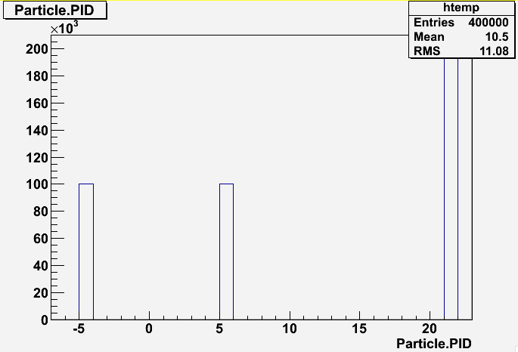
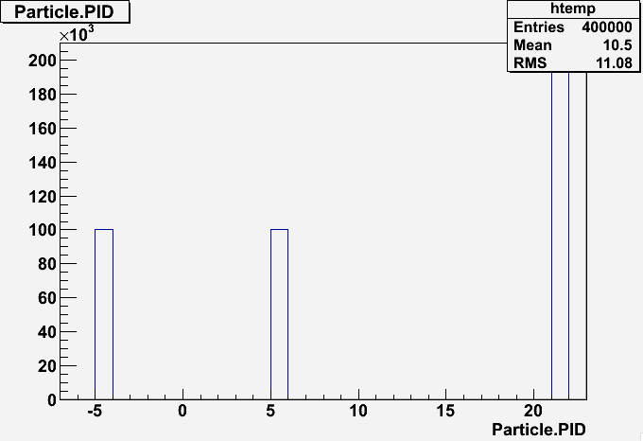
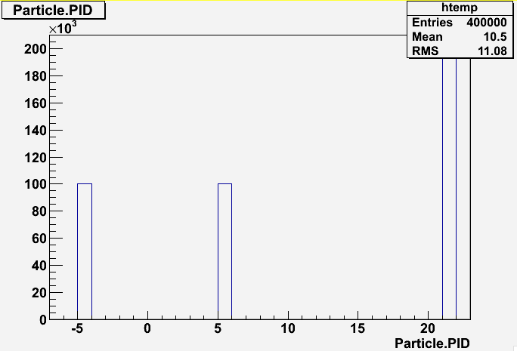
Andrea’s files (my input files)
gluon
b+
Only contain two gluons and two b quarks
gluon
b-
Pythia is doing the rest of the event (ISR, FSR, multiple interactions) and that’s why the status 3 b’s have such a wide peak.
Try removing them step by step:

Slide 4
with: FSR, ISR, MI
pp -> bb
pT(b)=50GeV
ppHad MSTP81=1
MSTP61=2
old model
status 3 and
status 2 quarks
ud
92
gluon d gluon gluon …. gluon
p
u
gluon
92
gluon
gluon
b
b
92
gluon
gluon
b
b
92
p
d
gluon
92
gluon gluon …gluon
uu
92
gluon
92
gluon
92
gluon
92
gluon
92

Slide 5
with: FSR, ISR
pp -> bb
pT(b)=50GeV
ppHad MSTP81=0
MSTP61=2
OLD model
u
92
gluon c c u gluon …. gluon
p
p
gluon gluon …. gluon
u
gluon
b
b
92
gluon
gluon
b
b
92
p
d
gluon gluon …. gluon
gluon gluon… gluon
uu
92

Slide 6
with: FSR
pp -> bb
pT(b)=50GeV
ppHad MSTP81=0
MSTP61=0
MSTP17=1
OLD model
uu
92
p
d
92
gluon gluon gluon gluon
gluon
gluon
b
b
92
gluon
gluon
b
b
92
p
d
92
gluon gluon
uu
92

Slide 7
ee colisions at sqrt(s)=91GeV
they all have status 2
but choose as equivalent to pp status 3 and status 2
b+
b+
b+
e+
e+
b+
b+
b+
gluon
gluon
gluon
gluon
94
92
b-
b-
e-
b-
b-
b-
e-
gluon
gluon
equivalent to ee collisions used

Slide 8
pp -> bb
pT(b)=50GeV
NO OPAL - ppHad
with: FSR, ISR, MI

Slide 9
pp -> bb
pT(b)=50GeV
ppHad MSTP81=20
MSTP61=2
with: FSR, ISR

Slide 10
pp -> bb
pT(b)=50GeV
ppHad MSTP81=20
MSTP61=0
MSTP71=1
with: FSR
original partons 50+/-2.5 GeV

Slide 11
ee-> bb
sqrt(s)=91GeV
with: FSR
(shifted in energy)

Slide 12
pt spectrum has very large impact on flav tagging performance:

Slide 13
Next steps
Compare flav tagging performance:
  ee sqrt(s)=91GeV ; 35<jet pt<45 ; CDR
    Nilou
  pp pT(q)=50 GeV; no ISR, MI ; 45<jet pt<55 ; CDR
    Nilou-like
  pp pT(q)=50 GeV; no ISR, MI ; jet pt> 40 ; CDR
    effect of using inclusive pt spectrum
  pp pT(q)=50 GeV; with ISR, MI (new model); jet pt> 40 ; CDR
    realistic pp collisions with CDR layout
  pp pT(q)=50 GeV; with ISR, MI (new model); jet pt> 40 ; FCC
  pp pT(q)=500 GeV; with ISR, MI (new model); jet pt> 40 ; FCC
  pp pT(q)=5000 GeV; with ISR, MI (new model); jet pt> 40 ; FCC
    realistic pp collisions with FCC layout (optimized tracking strategies)

Slide 14
missing pT

Slide 15
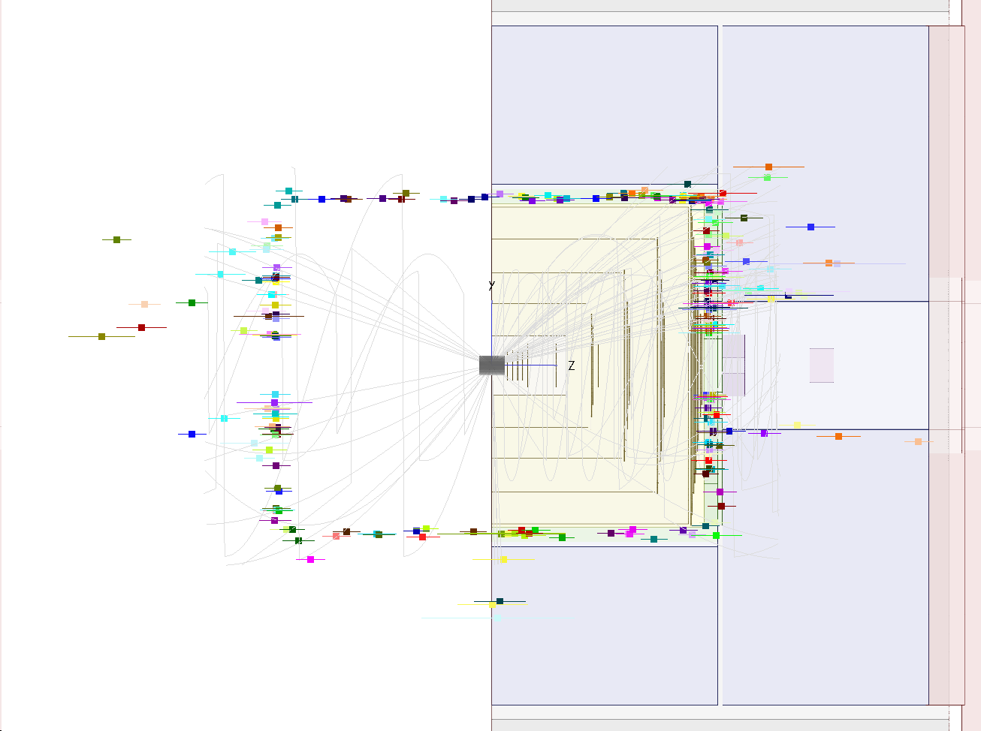
How does this event view work?
it projects particles to the corresponding side (it is not missing particles)
error bar size proportional to energy
Are my pp events unbalanced?
→ sum the 4-momentum of all particles, check the transverse component (- missing-pT)

Slide 16
pp -> bb
pT(b)=50GeV
Take MC paricles from the MCSkimmed container, use only the generator status 1
→ WT****?
Take PFOs from PandoraPFOCollection (no timing cuts)
Take PFOs in all the jets
Take PFOs in the two leading jets

Slide 17
ee->Z(bb)nn
(real MET – but neutrinos have status 1 …)
ee->bb
whizard_bb_91gev_90deg
ee->bbbbbb

Slide 18
Backup

Slide 19
pp -> bb
pT(b)=50GeV
ppHad MSTP81=20
MSTP61=0
with:

Slide 20
event with ISR & without MI
pp -> bb
pT(b)=50GeV
ppHad MSTP81=20
MSTP61=2
new model
u
92
u
92
ud
92
gluon u c c gluon gluon …. gluon
p
gluon gluon …. gluon
u
gluon
b
b
92
d
gluon
b
b
91
p
gluon gluon …. gluon
u d u gluon gluon
uu
uu
92

Slide 21
event without ISR & MI
pp -> bb
pT(b)=50GeV
ppHad MSTP81=20
MSTP61=0
new model
ud
92
p
u
92
gluon
gluon
b
b
92
gluon
gluon
b
b
92
p
u
92
ud
92
shall I use new or old model?

Slide 22
Underlying Event
p
p
Multiple Interactions
Beam Remnants
(color connections)
p
p
Hard Scattering
ISR
p
p
Pile Up

Slide 23
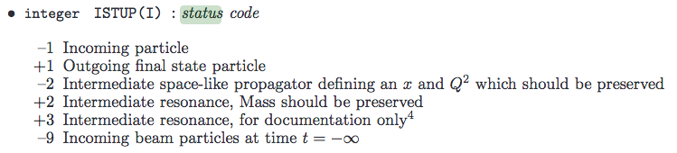
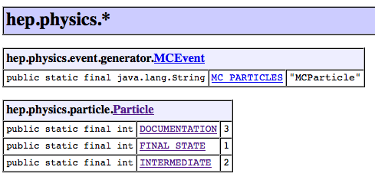
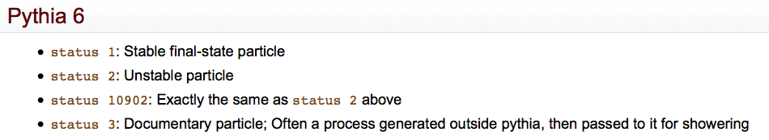
b (status 2)
PDGID=92
proton
gluon
b (status 2)
b (status 3)
PDGID=92
gluon
gluon
gluon
gluon
& matched in DR to the jet

Slide 24
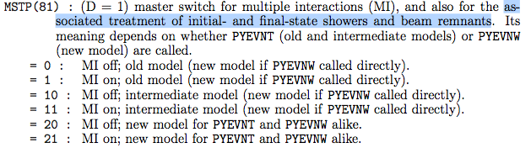

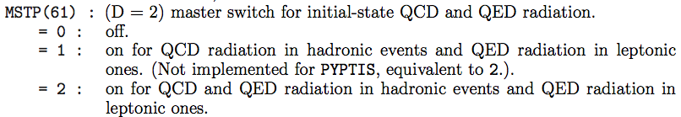

Slide 25
Pythia parameters (from Andrea)
MSTU(11) changed from 6 to 6
All output is directed to unit MSTU(11), by default 6, and it is up to you to set this unit open for write
MDCY(C15,1) changed from 1 to 0
MSEL changed from 1 to 0
Here 102, 123 and 124 are the three main Higgs production graphs gg → h, ZZ → h, and WW → h, and MSUB(ISUB) = 1 is the command to switch on process ISUB. Full freedom to combine subprocesses ‘a` la carte’ is ensured by MSEL = 0; ready-made ‘menus’ can be ordered with other MSEL numbers.
Reading pythia input card
mstp(61)=1 mstp(61) changed from 2 to 1
MSTP(61) : (D = 2) (C) master switch for initial-state QCD and QED radiation.
=0: off.
=1: on.
=1: on for QCD radiation in hadronic events and QED radiation in leptonic ones.
=2: on for QCD and QED radiation in hadronic events and QED radiation in leptonic ones.
mstp(71)=1 mstp(71) changed from 1 to 1
MSTP(71) : (D = 1) (C) master switch for final-state QCD and QED radiation.
=0: off. =1: on. Note: additional switches (e.g. for conventional/coherent showers) are available in MSTJ(38) - MSTJ(50) and PARJ(80) - PARJ(90), see section 10.4.
mstj(1)=1 mstj(1) changed from 1 to 1
MSTJ(1) : (D = 1) choice of fragmentation scheme. = 0 : no jet fragmentation at all. = 1 : string fragmentation according to the Lund model. = 2 : independent fragmentation, according to specification in MSTJ(2) and
MSTJ(3).
mstp(81)=20 mstp(81) changed from 1 to 20
MSTP(81) : (D = 1) master switch for multiple interactions.
=0: off.
=1: on.
mstu(21)=1 mstu(21) changed from 2 to 1
MSTU(21) : (D = 2) check on possible errors during program execution. Obviously no guarantee is given that all errors will be caught, but some of the most trivial user-caused errors may be found.
=0 :errors do not cause any immediate action, rather the program will try to cope, which may mean e.g. that it runs into an infinite loop.
= 1 :parton/particle configurations are checked for possible errors. In case of problem, an exit is made from the misbehaving subprogram, but the gener- ation of the event is continued from there on. For the first MSTU(22) errors a message is printed; after that no messages appear.
= 2 :parton/particle configurations are checked for possible errors. In case of problem, an exit is made from the misbehaving subprogram, and subse- quently from PYEXEC. You may then choose to correct the error, and continue the execution by another PYEXEC call. For the first MSTU(22) errors a message is printed, after that the last event is printed and execution is stopped.
lhaid= 10041

Slide 26
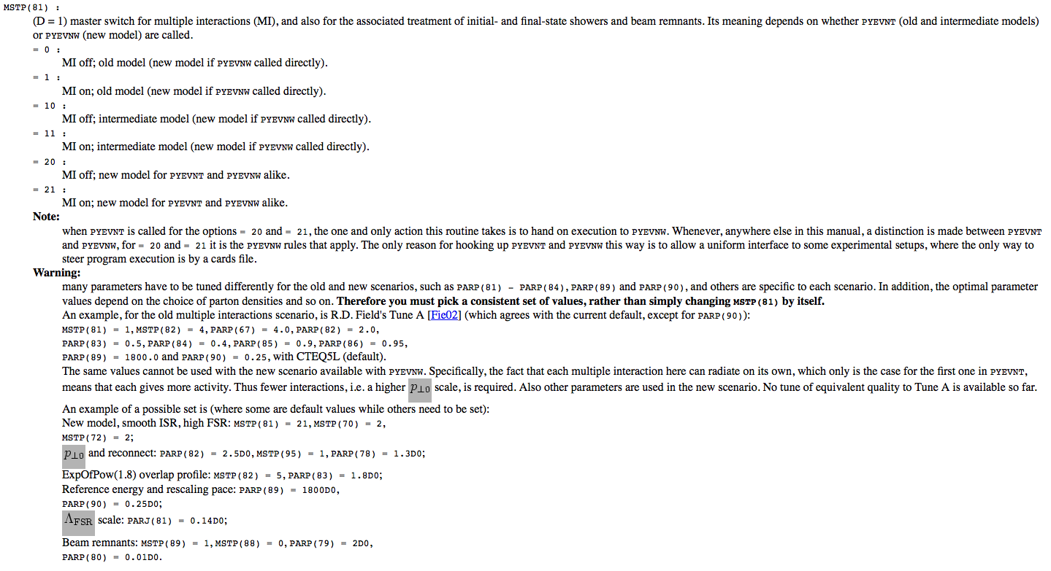
http://home.fnal.gov/~mrenna/lutp0613man2/node190.html

Slide 27
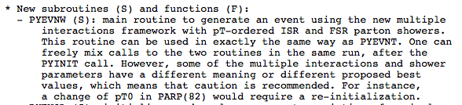

Slide 28
MSTP(161) changed from 0 to 88
MSTP(162) changed from 0 to 88

Slide 29
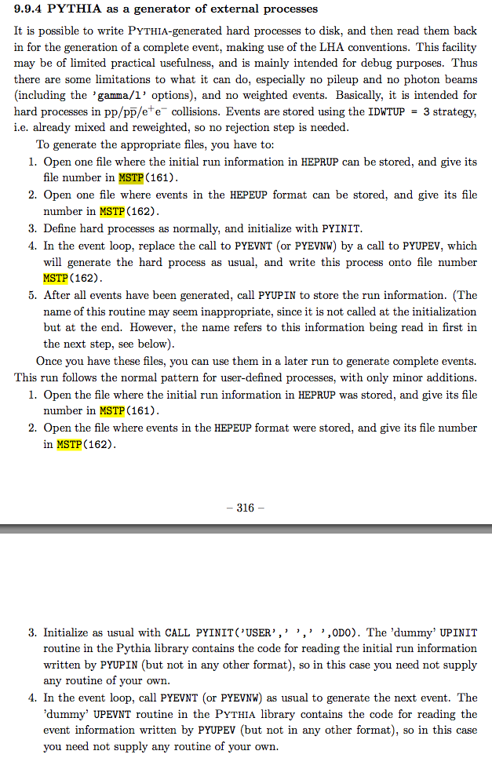

Slide 30
pp -> bb
pT(b)=50GeV
OPAL

Slide 31
pp -> bb
pT(b)=50GeV
ppHad MSTP81=0

Slide 32
pp -> bb
pT(b)=50GeV
ppHad MSTP81=20

Slide 33
pp -> bb
pT(b)=500GeV
ppHad MSTP81=20

Slide 34
pp -> bb
pT(b)=5000GeV
ppHad MSTP81=20

