Slide 1
Tier-1 Strategy - Progress
Andrew Sansum
1st September 2016

Slide 2
What I’m Going to Talk about
GridPP5 Staffing Challenge at the Tier-1
What we promised to STFC
New communities engagement update
Continuing to seek efficiecy savings
Costing model for a UK-T0

Slide 3
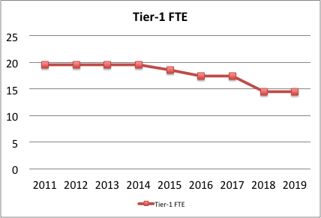
GridPP Funded Tier-1 Effort
GridPP4
GridPP4+
GridPP5

Slide 4

Tier-1 Strategy in GridPP5 (recap)
Increase relevance to other communities
Share costs (additional income)
Reduce cost for PP Community

Slide 5

But also Deliver LHC Computing
the Tier-1
PPAN
LHC

Slide 6
Working With PPAN Communities
  DiRAC Storage at Tier-1 (Brian’s talk) moving towards full production
    But need to ensure clear understanding of GridPP commitment
    Resolve cost of providing tape capacity (not in GridPP5 proposal)
  SKA – AENEAS proposal funded by Horizon 2020. Modest funding to SCD/Tier-1 (2PM per year). Joint funding with existing GridPP posts for:
    Technology foresight and modeling for European regional computing.
    Data transfer interoperation
  Joint AAAI project between GridPP (Jens), DiRAC and Archer (3PMs). Bridge authentication into GridPP x509
  EUCLID – established on classic UI, LOFAR – no news.

Slide 7
Making Further Efficiency Savings
Historically the Tier-1 has been operated by a team solely focused (dedicated) on LHC computing.
  Separate group (RIG) runs JASMIN and STFC infrastructure)
Large effort by Tier-1 during GridPP4 to gain efficiency through improved processes and deployed technology:
  Virtualisation
  Configuration management
  Automation and standard operational processes
Similar activity within RIG. Further savings can only be achieved by merging SCD teams delivering systems infrastructure.
  Single group (Nick Hill) running all SCD network, hardware and infrastructure management, Tier-1 operations.
  Ian Collier’s group focusing on e-Infrastructure projects and middleware
  Alison Packer’s group (Data Services) running storage systems and DB

Slide 8
Systems Division Re-organisation
ALC/UKT0

Slide 9
Building a Sustainable costing model for A UK-T0
Simple Example to illustrate the challenge. Non GridPP VOs
Experiment | Needs
Alpha | 25% extra CPU and will use the GridCE and needs to make an availability commitment + pledge resource
Beta | 25% extra CPU, 25% extra disk, 50% extra tape but don’t want any Grid services but have own special systems that need to be operated
Gamma | Only wants 25% extra disk but needs us to develop an API, will use FTS. Needs excellent data retention
Delta | 50% extra CPU and wants to submit jobs by logging in and using classic qsub.
Hardware cost? Extra Tier-1 staff effort? What share of existing T1 staff for grant proposal?

Slide 10
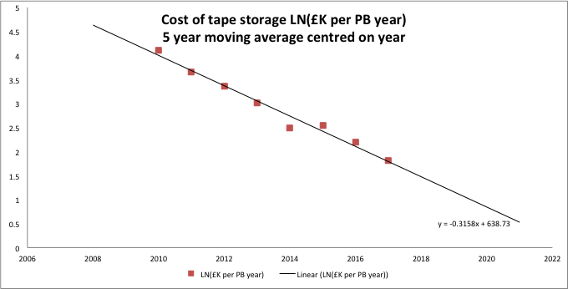
Hardware cost model
GridPP micro-models annual hardware cycle. Knows what hardware generations exist and projects HW phase-out. Projects hw price, annual purchase plan and grant request.
  Difficult to extend model to new communities. Must avoid single “one off” hardware purchases. Annual procurement cycle works well for GridPP need to be able to integrate new communities funded through different grant mechanisms.
Instead calculate annual hardware “rental” cost. In 2016:
Tape: £8.2K per PByr
Disk: £24K per PByr
CPU: £2.4K per kSH06yr

Slide 11
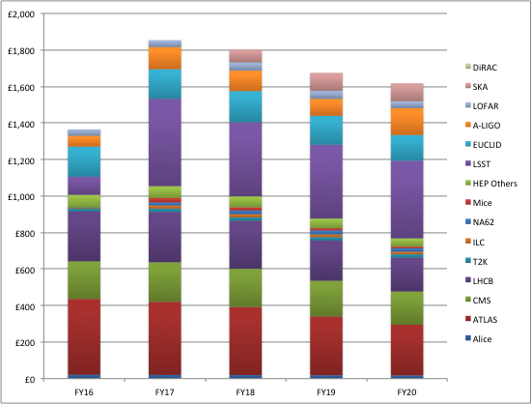
Annual HW Costs for a UK-T0
£K
GridPP

Slide 12
Modeling the Effort Requirement
How much extra does it take to run extra hardware.
  Eg if just 1 extra VO wants 100% extra kit, 4 Vos 25% extra each.
Build model of Tier-1 staff effort. Several components from GridPP5 proposal:
  Core underpinning infrastructure (5.7)
  Scaling capacity component: disk, tape, CPU (6.1 FTE)
  Shared Services (eg Grid services) 2.1 FTE
  Private services (eg ATLAS frontier) 0.85
  Development effort – currently CEPH, Cloud, Mesos, IPV6 (3.1)
Calculate marginal-extra new staff VO must contribute for
  Extra capacity (try SQRT of capacity increase!). Eg double=40% extra capacity component. 4VOs*25% increase=4*12%=50% extra=3 FTE
  New private services – bespoke estimate per service
Estimate what share of existing staff VO must request

Slide 13
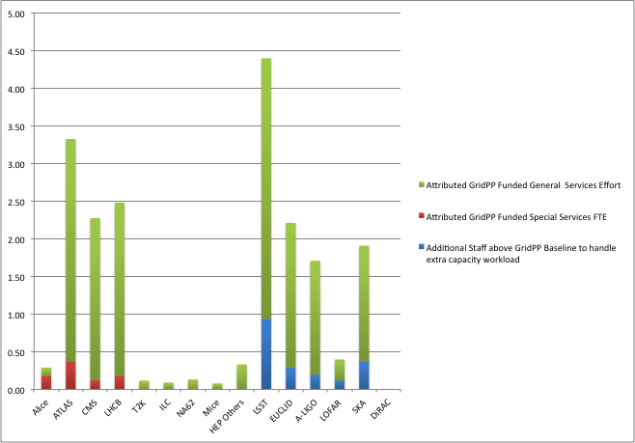
2019 Effort Attribution
PPAN=10.63FTE
GridPP=9.13FTE

Slide 14
Many Opportunities
Considerable activity within the Tier-1 to engage with external parties.
Huge change compared to 3 years ago. Team used to be effectively completely dedicated to LHC computing.
Need to adequately sustain our LHC computing delivery while generating new opportunities and exploring synergies.
Very exciting time but still hard to be clear what the future holds.

