Slide 1


FCC Week 2017
Berlin, 29 May – 2 June 2017
16 T magnet R&D - CDR plan and status
Davide Tommasini

Slide 2
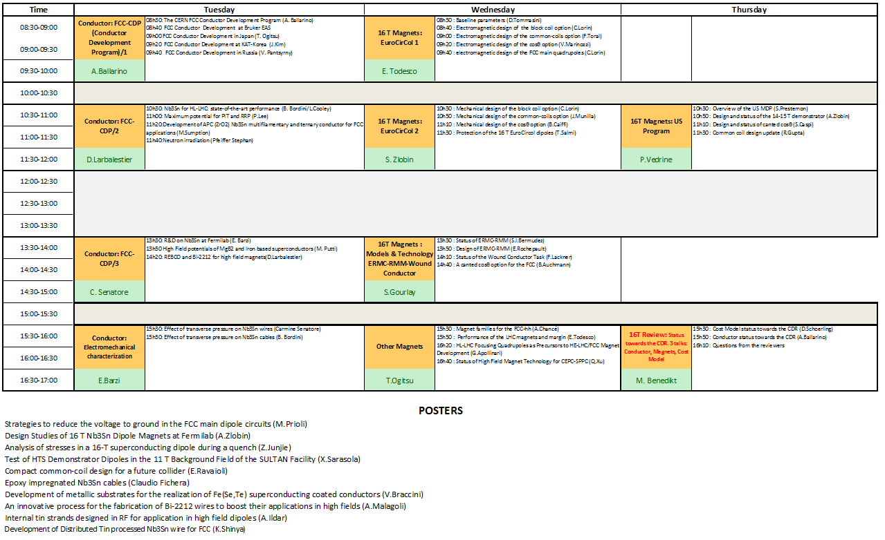
16 T dipoles: an intensive program
US MDP
Conductor
Magnets
16 T Review
Posters

Slide 3
16 T dipoles: Targets for the CDR
by the end of 2018 we shall provide:
a reference design for the 16 T dipoles, including integration in cryostat;
a concept for the magnet and circuit protection;
an estimate of the cost for the series production;
The content of the CDR shall be CREDIBLE

Slide 4
Being credible is not obvious …
Many unknowns:
conductor cost
achievable conductor performance, no enhancements expected within 2018
electromechanical performance of conductor and cable not yet fully characterized
achievable magnet performance (required margin) has a major impact on cost
no one Nb3Sn magnet operating in a particle accelerator by the time of the CDR
still I believe we can manage, by making best use of the available time and experience

Slide 5
What we will have available to be credible
16 T already achieved as maximum field in a no-gap dipole configuration both in US and at CERN
a comprehensive review of the past experience on Nb₃Sn accelerator magnets*
some preliminary results of conductor development worldwide
new information about the electromechanical characterization for the conductor and cable
the indication that 12 T industrial accelerator magnets are feasible (HILUMI)
hopefully a good performance of Fresca II (hitting 14 T in a laboratory magnet)
hopefully the demonstration that 16 T can be achieved with margin, though in a no-gap dipole configuration (test of ERMC in 2018), even with the conductor presently available. Perhaps first test of RMM (50 mm gap).
ideally a good performance of the US-MDP 14-15 T model (with real physical aperture)
It is useless to say that a good performance of the US-MDP model would certainly contribute to the scientific credibility of a proposal for 16 T for the FCC. No other “accelerator like” model >14 T can be developed and tested within the same timeline (within end 2018).
* Being Edited by D.Schoerling and A.Zlobin

Slide 6



Overview
      FCC 16 T Magnets Technologies (until 2023) Tuesday/Wednesday
        conductor development & procurement (about 1 ton/year)
        winding characterization
        R&D magnets : ERMC/RMM, start winding in 2017
        model magnets at CERN, CEA, CIEMAT, INFN, PSI, start winding in 2019
      EuroCirCol WP5 (until 2019) Wednesday
        7 institutes
        feed the FCC CDR with baseline design and cost model of 16 T magnets
      US Magnet Development Program Thursday
        initially focused to a 14-15 T cosine-theta demonstrator (2017-2018);
        also exploring a canted cosine-theta option, in a first step possibly as an insert to the outer layers of the 14-15 T demonstrator above;
        a slotted cosine-theta option in combination with the optimized inner layers of the 14-15 T demonstrator (see poster “Design Studies of 16 T Nb₃Sn dipole at Fermilab” on Tuesday May 30).

Slide 7
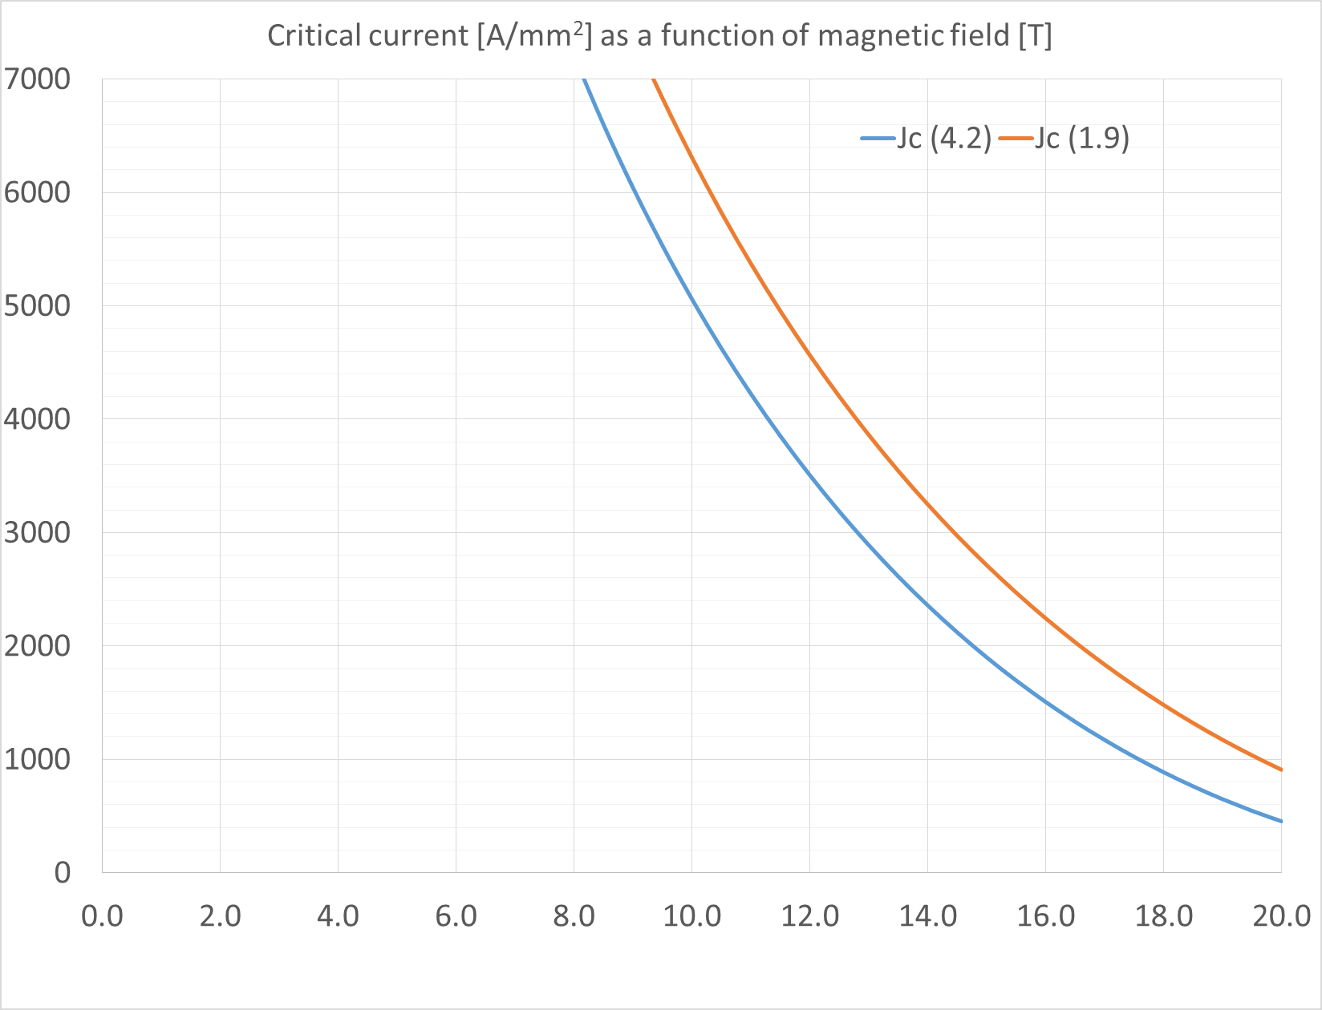
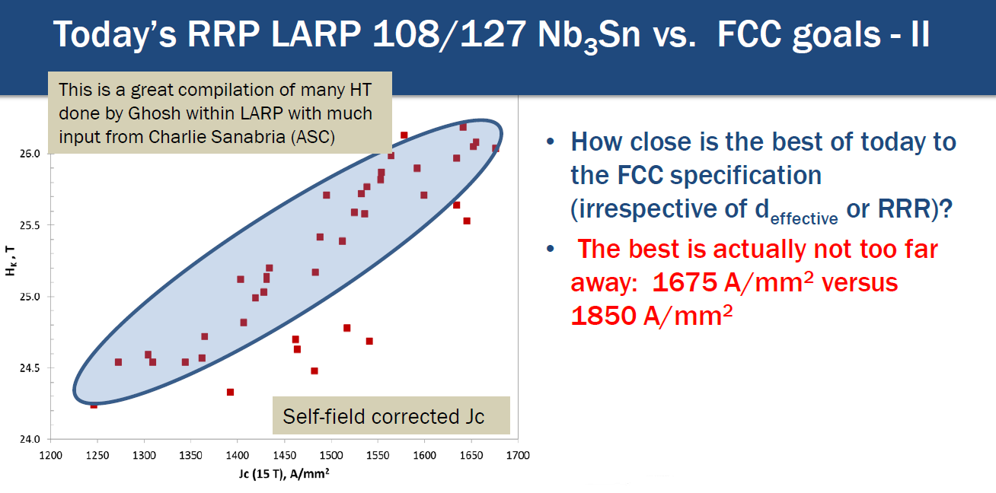
Conductor (Tuesday)
RRR=100
Cable compaction c=1-h/2d < 0.14
h= thin edge thickness, d= strand diameter
Degradation to cabling 3%
Maximum strand diameter 1.2 mm
Cost 5 Euro/kAm
D.Larbalestier

Slide 8
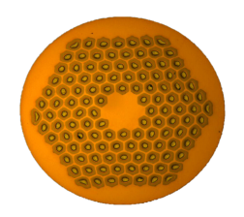
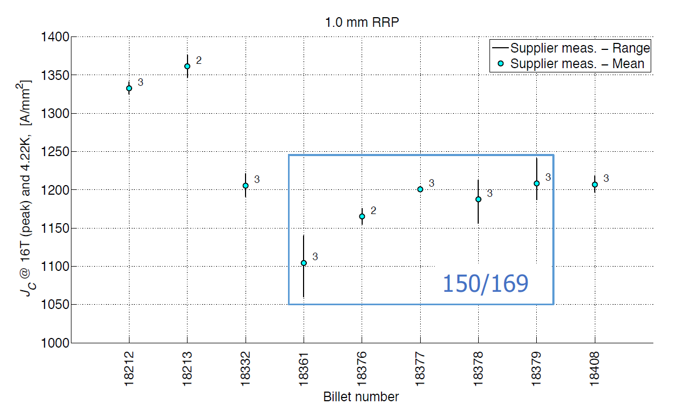
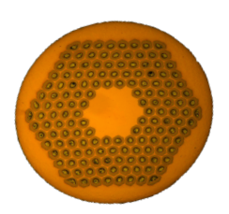
Conductor for initial ERMC-RMM coils (2017-2018)
53 km of 1.0 mm, RRP wire delivered in 2016 (from OST)
4 billets 120/127
sub element size 64 μm
Cu/nonCu 1.05-1.10:1
RRR > 120 with exception of billet 18213 (RRR 90-100)
5 billets 150/169
sub element size 55 μm
Cu/nonCu 1.05-1.10:1

Slide 9
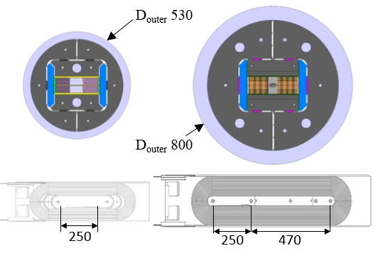
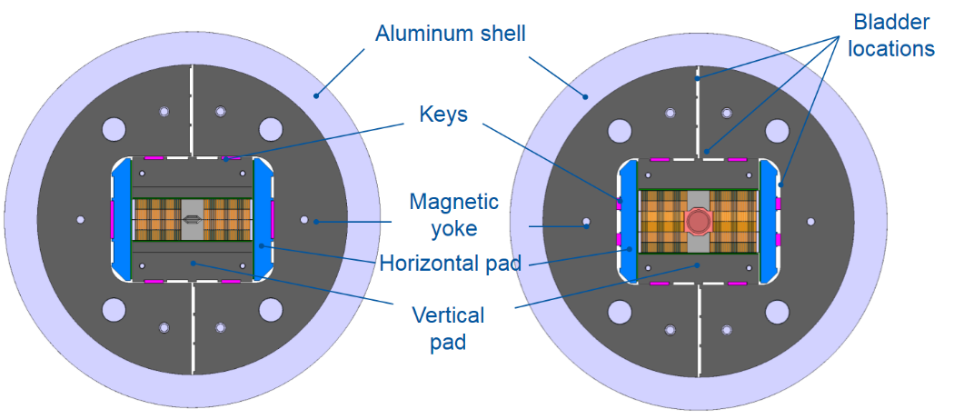
R&D Magnets : ERMC/RMM (Wednesday)
Two model types: ERMC and RMM, non-graded and graded versions
530
800
a real straight section
a structure for fields up to 18-19 T, key & bladders for ease of multiple assembly
ERMC coils compatible with use in the RMM
RMM equipped with harmonic field probes
RMC
ERMC/RMM
demonstrate that the field level can be achieved with margin and limited/no training
measure and characterize field quality static and dynamic with different conductors
management of transitions (layer jump, ends …)
study/optimize coil manufacture (including interface conditions coil/pole, coil-coil …)
explore different loading configurations/strategies (transversal & longitudinal)
splice studies in real magnet configuration

Slide 10
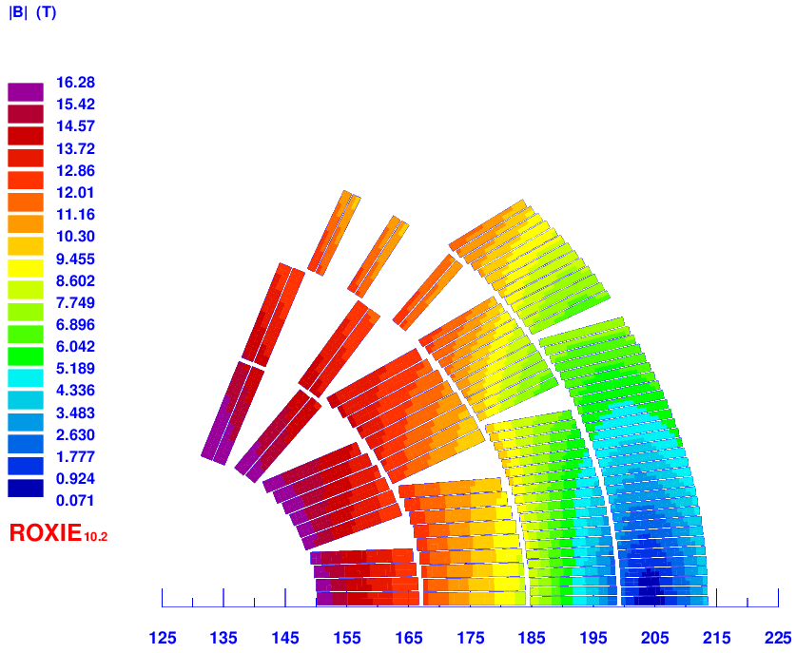
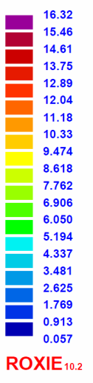
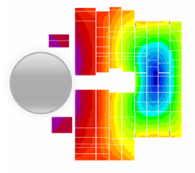
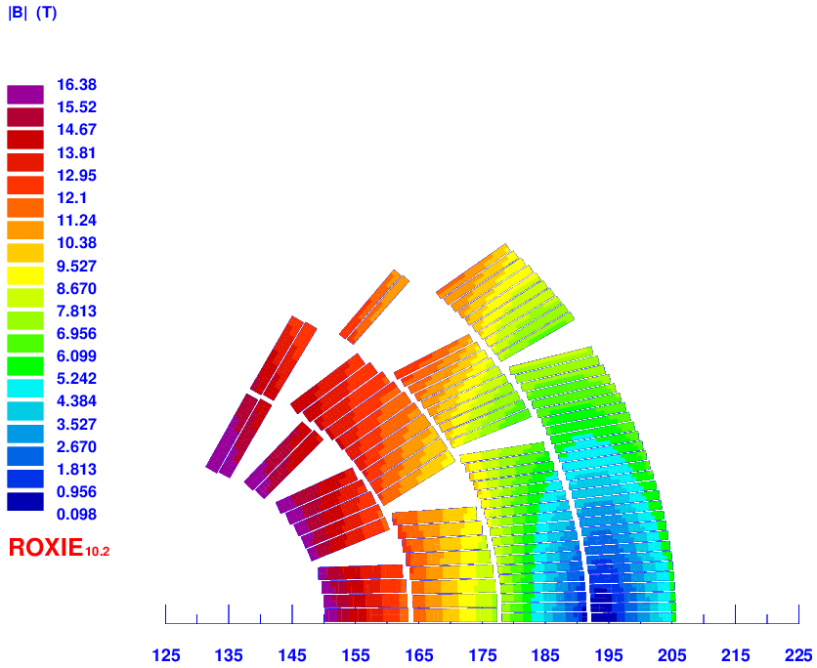
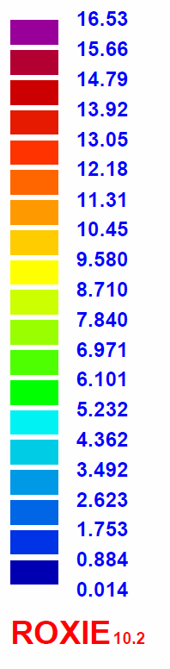
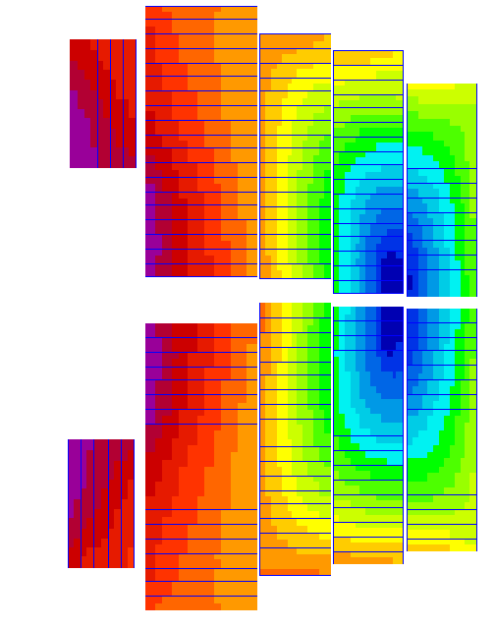
EuroCirCol WP5 : Design Options (Wednesday)
A specific feature of this program is that different design options are being considered with the same specification and analysis tools so that they can be compared relatively to each other.
scale / 2
CEA
INFN
CIEMAT
… to which we also add a canted cosine theta design (PSI) thanks to a Swiss contribution to the FCC
The reference parameter space has been finalized considering recommendations from the 1st WP5 EuroCirCol Review (11-13 May 2016, http://indico.cern.ch/event/516049)

Slide 11
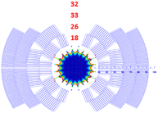
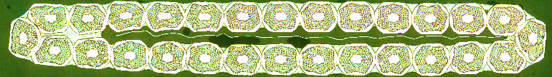
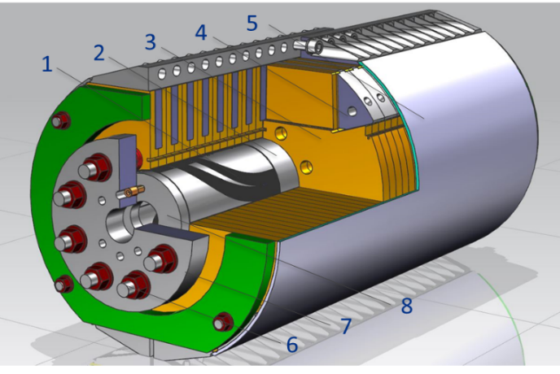
US-MDP Cosinetheta Model (Thursday)
Coil:
  60-mm aperture
  4-layer graded coil
  W_{sc} = 68 kg/m/aperture
Cable:
  L1-L2: 28 strands, 1 mm RRP150/169
  L3-L4: 40 strands, 0.7 mm RRP108/127
  Insulation: E-glass tape
Mechanical structure:
  2-mm StSt coil-yoke spacer
  Vertically split iron laminations
  Aluminum I-clamps
  12-mm thick StSt skin
  thick end plates and StSt rods
  Cold mass OD<610 mm
Fabrication status:
  In progress
Planned magnet test: February-March 2018

Slide 12
EuroCirCol WP5 : Cost Model (Thursday)
The development of a cost model has accompanied the project since its beginning, in particular for strategic choices of the parameter space (magnet margin, operating temperature, physical aperture …).
The conductor represents about 50% of the entire magnet cost.
Target conductor cost is:
5 EUR/kA.m at 16 T and 4.2 K (3.5 EUR/kA.m at 16 T and 1.9 K)
corresponding to 450 EUR/kg for a Cu/Non-Cu ratio of 1/1 and target performance of J_{c}= 1500 A/mm² at 16 T and 4.2 K (J_{c}= 2300 A/mm² at 16 T and 1.9 K)
The identification of the other cost drivers and both an analytical and extrapolated cost model are on good track.

Slide 13
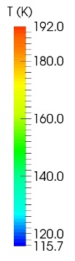
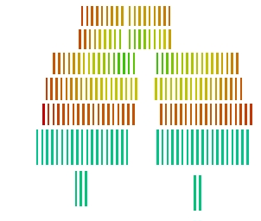


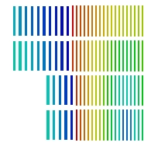
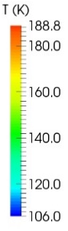
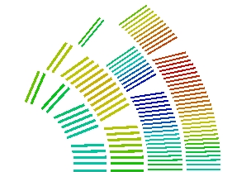
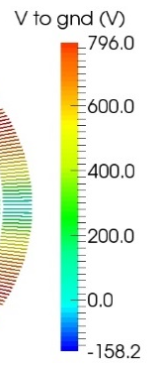
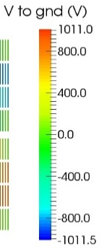
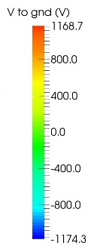

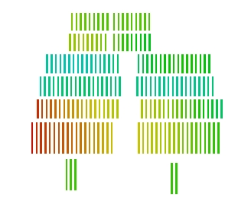
EuroCirCol WP5 : Magnet & Circuit Protection
Quench protection was integrated into the magnet design since an early stage
In the accelerator the dipole must absorb its stored energy after a quench
A 40 ms time margin¹ to 350 K was set as a design criterion
  Assume 20 ms for detection + 20 ms for the protection system to effectively quench the entire coil → Hotspot temperature must be < 350 K
A limit for single magnet voltage after a quench set to 1.2 kV
Talk T. Salmi, poster M. Prioli, poster J. Zhao
  Temperatures and voltages with 40 ms protection delay
356 K
346 K
353 K
800 V
-1000 V
1200 V
Cosθ:
22b-37-optd6f6
Block: V20ar
Common-coil:
V1h2
¹ E. Todesco, Proc. WAMSDO 2013

Slide 14
In summary
The EuroCirCol WP5 will provide most of the material for the 16T FCC CDR
The credibility of this material will be supported by the information coming from past experience and by results of on-going experimental activity worldwide.

Slide 15
Thank you for your attention

Slide 16
Salient common assumptions
Magnet length 14.3 m
Free physical aperture 50 mm
Field amplitude 16 T
Margin on the load-line @ 1.9K 14 %
Total time delay 40 ms
Critical current density @ 1.9 K, 16T (total) 2300 A/mm²
Conductor fit (Jc/B) Bernardo’s fit
Degradation due to cabling 3%
Minimum Cu/nonCu 0.8 also check 0.9-1.0
Maximum strand diameter 1.2 mm also check 1.1 mm
Maximum (any) stress on conductor 200 MPa
Maximum hot spot temperature (@ 105% I_{nom}) 350 K
Maximum number of strands in a cable 40 check up to 60
Maximum voltage to ground (magnet contribution) 1.2 kV set as tentative value
Maximum TOTAL voltage to ground 2.5 kV
Conductor cost (performance based) 5 Euro/kAm

