Slide 1

FCC-hh Layout and Parameters
Daniel Schulte for the FCC-hh team
Berlin, May 2017

Slide 2
Note: FCC-hh CDR
Will consist of two parts for the accelerator:
FCC-hh Design Overview
A concise description of the goals, main concepts, key issues and solutions
Should allow to understand the expected performance
FCC-hh Accelerator Design
Documents the studies performed
A resource to support the baseline concept
The basis for the next phase, highlights remaining R&D, alternatives, …

Slide 3
Tentative FCC-hh Design Overview
1) Design goals and basic choices
2) Parameter optimisation
3) Key design challenges and solutions
4) Optics design and beam dynamics
5) Machine performance and operation aspects
6) Enabling technologies
7) Site integration
8) Injectors
9) Additional options
- Ion operation
- lepton-hadron operation
- special purpose experiments
10) Detectors and experiments
11) Schedule and cost
12) Detailed Parameter Table

Slide 4
Tentative FCC-hh Accelerator Design
Descriptions of the collider areas
Performance evaluation
Options
Technical components, e.g.
Experimental insertion region concept
Collimation concept
Injection and extraction concept
RF insertion concept
Arc concept
Integrated optics design
Single beam current limitations
Beam-beam effects
Collimation system performance
Operation cycle (incl. machine protection concept)
Ion operation concept
FCC-he concept
Magnets
Beamscreen
…

Slide 5
FCC-hh Layout
Layout has changed according to site requirements
Two high-luminosity experiments (A and G)
Two other experiments combined with injection (L and B)
Two collimation insertions
  Betatron cleaning (J)
  Momentum cleaning (E)
Extraction insertion (D)
Clean insertion with RF (H)
Circumference 97.75km
Can be integrated into the area
Can use LHC or SPS as injector

Slide 6
Beam Parameters
Baseline: 1.25ab⁻¹ per 5 year cycle
considering shutdowns, stops, MDs, …
= 2fb⁻² per day
Ultimate: 5ab⁻¹ per 5 year cycle
= 8fb⁻² per day
Total 17.5ab⁻¹
 | FCC-hh Baseline | FCC-hh Ultimate
Luminosity L [10³⁴cm⁻²s⁻¹] | 5 | 20-30
Background events/bx | 170 (34) | <1020 (204)
Bunch distance Δt [ns] | 25 (5)
Bunch charge N [10¹¹] | 1 (0.2)
Fract. of ring filled η_{fill} [%] | 80
Norm. emitt. [μm] | 2.2(0.44)
Max ξ for 2 IPs | 0.01 (0.02) | 0.03
IP beta-function β [m] | 1.1 | 0.3
IP beam size σ [μm] | 6.8 (3) | 3.5 (1.6)
RMS bunch length σ_{z} [cm] | 8
Crossing angle [σ’] | 12 | Crab. Cav.
Turn-around time [h] | 5 | 4
Focus on ultimate parameters
Injection energy 3.3TeV

Slide 7
Luminosity Drivers
Maximise the beam current
Risks:
High stored energy and losses
Impedance and electron cloud
Aperture should be minimised for dipole cost
High synchrotron radiation load due to high beam energy
Squeeze the beam as much as possible
Harder than in HL-LHC (scaling with energy)
More collision debris due to higher luminosity and energy
Limited by emittance growth and particle losses
Somewhat more difficult than HL-LHC due to longer L*
For integrated luminosity:
Fast turn-around critical for luminosity
Minimise time for stops etc.
High availability with more components than LHC
Maximising current also maximises time between new fills

Slide 8
Power and Choice of Temperature
Can only use some temperatures in order to maintain good vacuum
<20, 40K-60K, 100K-120K, >190K
Ph. Lebrun, L. Tavian,
V. Baglin et al.
300MW
200MW
100MW
2K is cheapest for dipole magnets
Choose 50K
Need 20x5MW=100MW for cooling
Proton beams emit about 5MW of synchrotron radiation

Slide 9
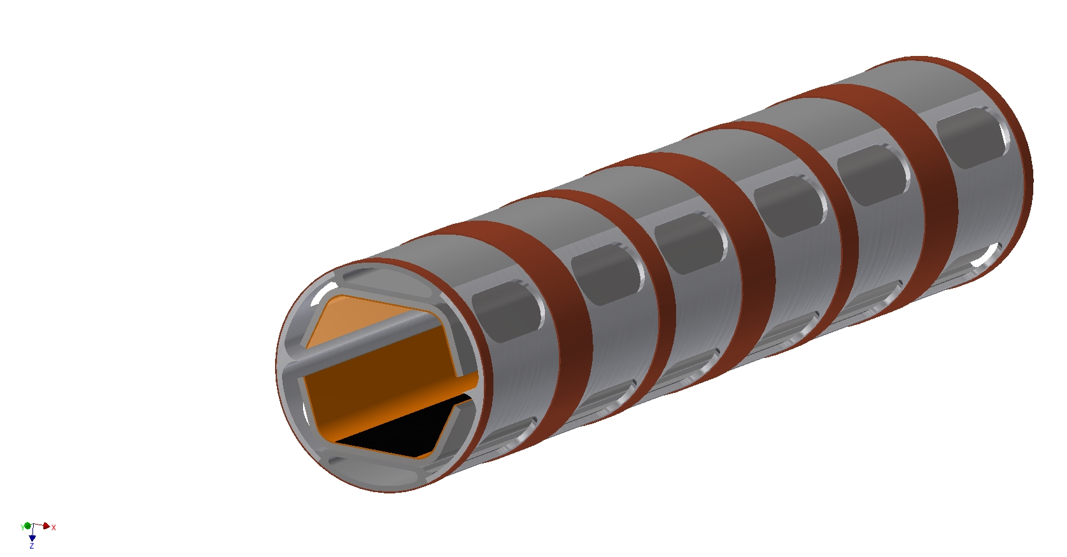
Beam Screen Concept
Magnet aperture is now 50mm
Laser treatment to mitigate electron cloud
Magnet cold bore
T=2K
0.3mm copper layer to reduce impedance
Cooling channels
T=50K for efficiency
26mm aperture to reduce impedance
Pumping holes
Hidden from beam
Prevents prohibitive impedance
Deflector minimises photons in main chamber
Ribs:
Mechanical strength
Photon stopper
Seems to be tight but OK
Impedance more important than in LHC

Slide 10
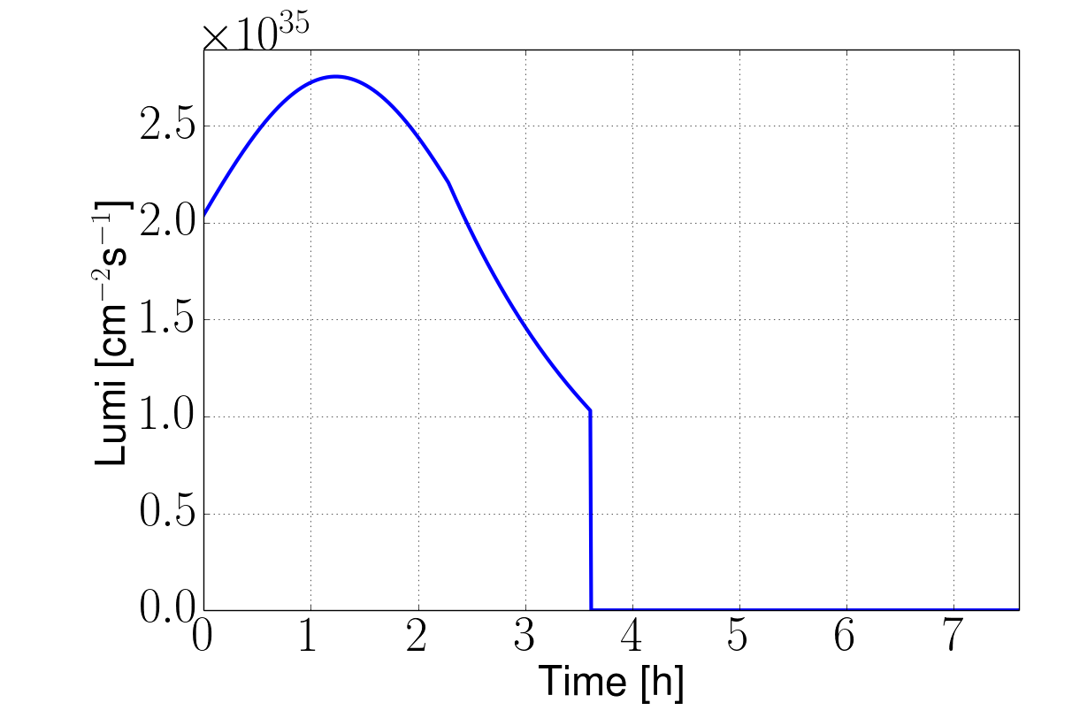
Parameter Optimisation
With our beam current can reach luminosity goal
Not much to be gained
  pushing beam-beam parameter increases risk and requires less noise
  reducing beta-function reduces triplet shielding or tightens collimation (impedance, higher risk)
Will reconsider for 5ns spacing
Important for integrated luminosity are
Turn-around time
Availability
Operational schedule
Example options to be considered
Electron lens
Wires
Pushing collision point beta-functions smaller during run

Slide 11
Parameter Optimisation
Physics looks for reduction of background
Do not have a clear target, so will explore range of options
Possibilities are a combination of
  Longer bunches
  Smaller bunch spacing and charge
  Luminosity leveling
Will put emphasis on 5ns and 12.5ns bunch spacing parameters
  Makes use of octupoles even harder, will have to use different scheme
  Instrumentation already specified for 5ns spacing
  Have to compensate or accept luminosity reduction
    Main compensation is to use smaller beta-function
    Still a relative loss remains
  More sensitive to noise
Luminosity leveling costs limited amount of integrated luminosity
  E.g. limit to 10³⁵cm⁻²s⁻¹ leads to 30%-40% reduction

Slide 12
Conclusion
FCC-hh parameters have been derived systematically
The key design challenges have been identified
Should be able to cope with them
There are interesting alternatives that will be considered to become baseline
In case they are still too premature they will remain alternatives for now

Slide 13
Reserve

Slide 14
Parameter Optimisation
Choice of bunch spacing
Put together a set of parameters for the 5ns (or 12.5ns) bunch spacing
Choice of working point
Use LHC working point as starting point
Would like to have a scan of the working point for impedance, dynamic aperture and beam-beam
Round vs. flat optics
Need to see how far we progress with the flat optics
Default will be round
Injection energy
Waiting for the field errors at injection, so no calculation for dynamic aperture
Collimation will be tight for lower injection energy, would require lower emittance

Slide 15
Parameter Optimisation
Operation of additional experiments under the different conditions
Close interaction with the experiments is required
Operation with moving collimators
Move collimators in as the beam burns off (constant impedance effect)
Allows to reduce IP betafunction

Slide 16
Parameter Optimisation
Choice of collective effects stabilisation methods
Main problem is transition into collision
Switch off feedback before collision and only use octupoles?
  Total octupoles need to be 20 times stronger than in HL-LHC for the same tuneshift
  Tune shift is expected about up to 3 times higher
  Further increase due to emittance damping (faster than burn-off)
  Would need more than 60 times the LHC octupoles strength
  Potentially further increase by factor 5 for 5ns spacing
Can we use a feedback in spite of beta-beating?
  Requires very low noise
  E.g. proportional gain of 0.01 and resolution of 0.1μm (0.5% of beam size)

