Slide 1



3.3 TeV beam injection into combined experimental and injection FCC machine insertions
M. Hofer, M.I. Besana, F. Burkart, F. Cerutti, R. Martin, D. Schulte, R. Tomas

Slide 2
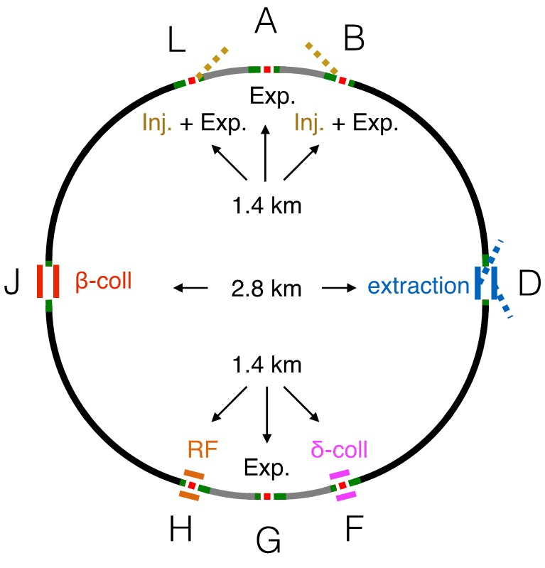
Motivation
Since the last FCC week in Rome 2016 the overall
layout of the FCC-hh has changed
The new layout has a reduced circumference of
97.75 km compared to 99.97 km for the
previous baseline layout
Low luminosity experiments moved from Points F & H
to B & L and are now combined with the injection
The length of these insertion remains at 1400 m
See Talk by Daniel Schulte

Slide 3
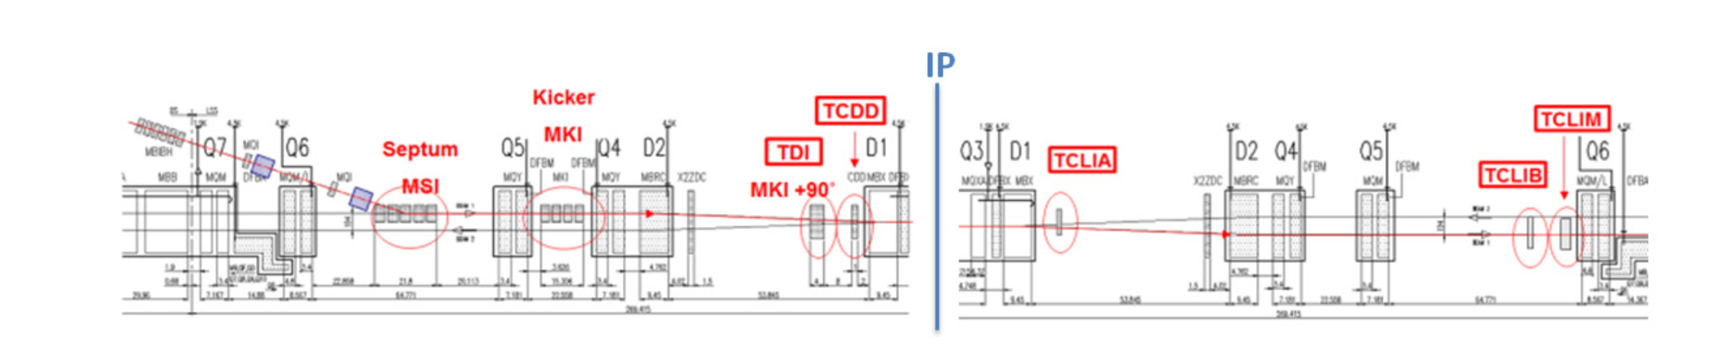
Combined injection and experimental insertion in (HL-)LHC
Example for a combined insertion in the (HL-)LHC
Insertion layout for ALICE
Symmetric design and injection protection close to the experiments
High-Luminosity Large Hadron Collider (HL-LHC) Preliminary Design Report
https://cds.cern.ch/record/2116337/files/CERN-2015-005.pdf

Slide 4
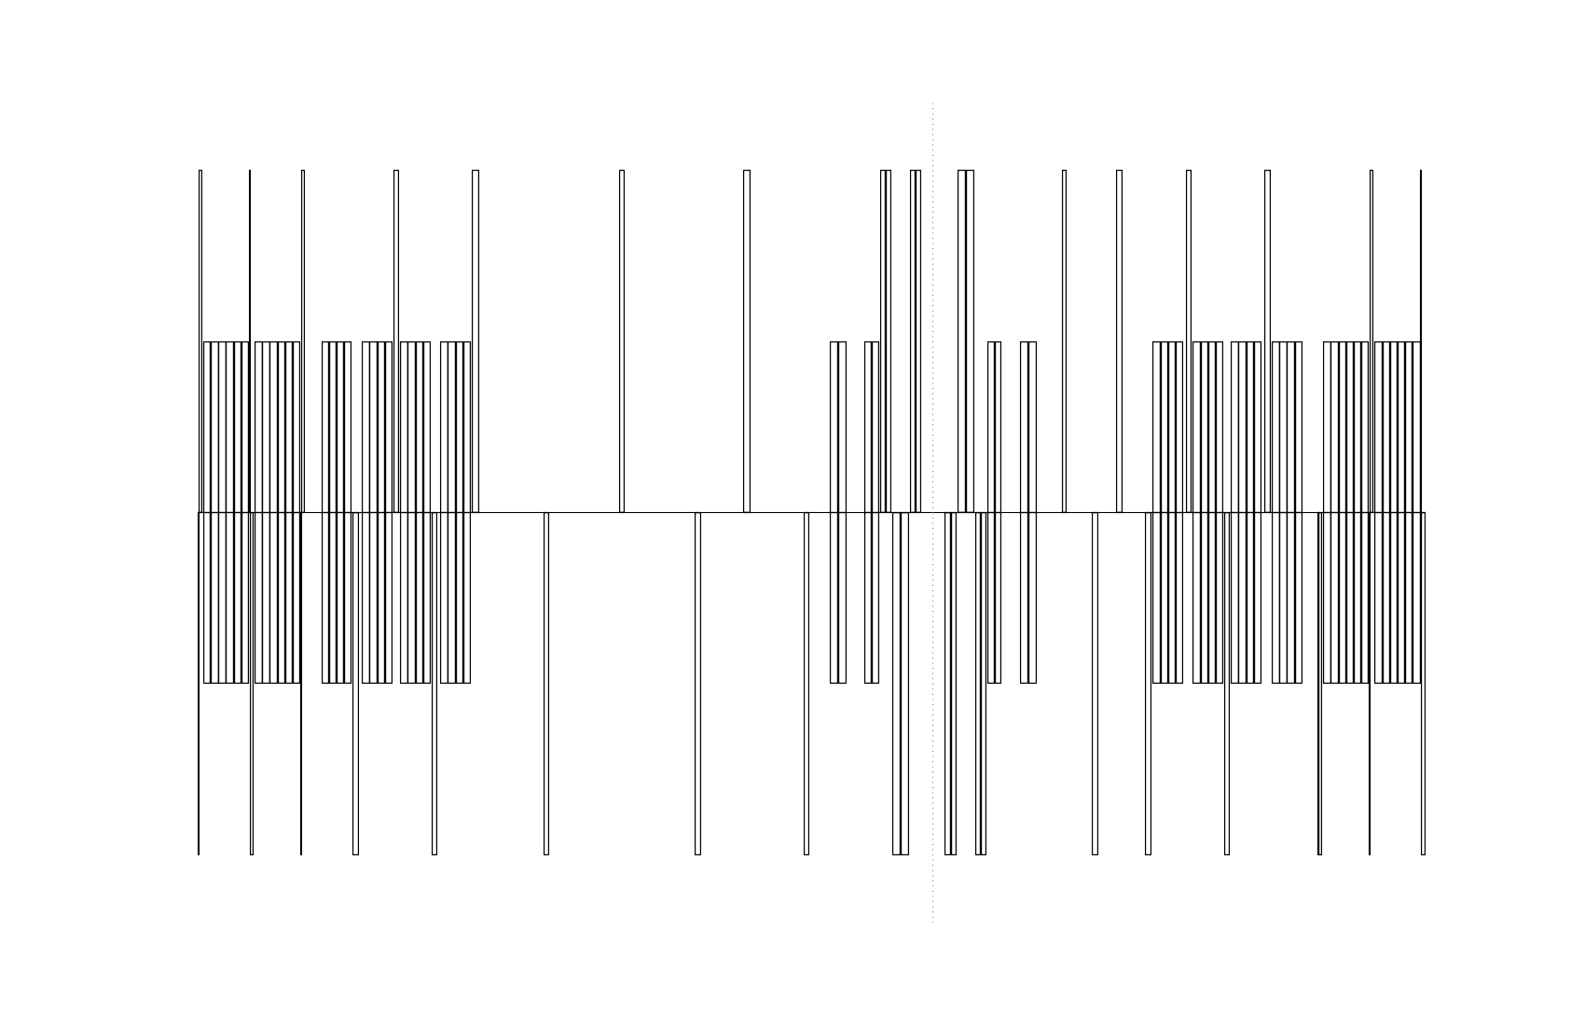
Strategy
For these insertion a rather conservative approach was chosen separating Injection and Experiments as best possible
Chosen as it seems preferable from a machine protection point of view
Not as deeply interwoven as LHC
Same layout is used for both IPB and IPL
Injection
Experiment

Slide 5
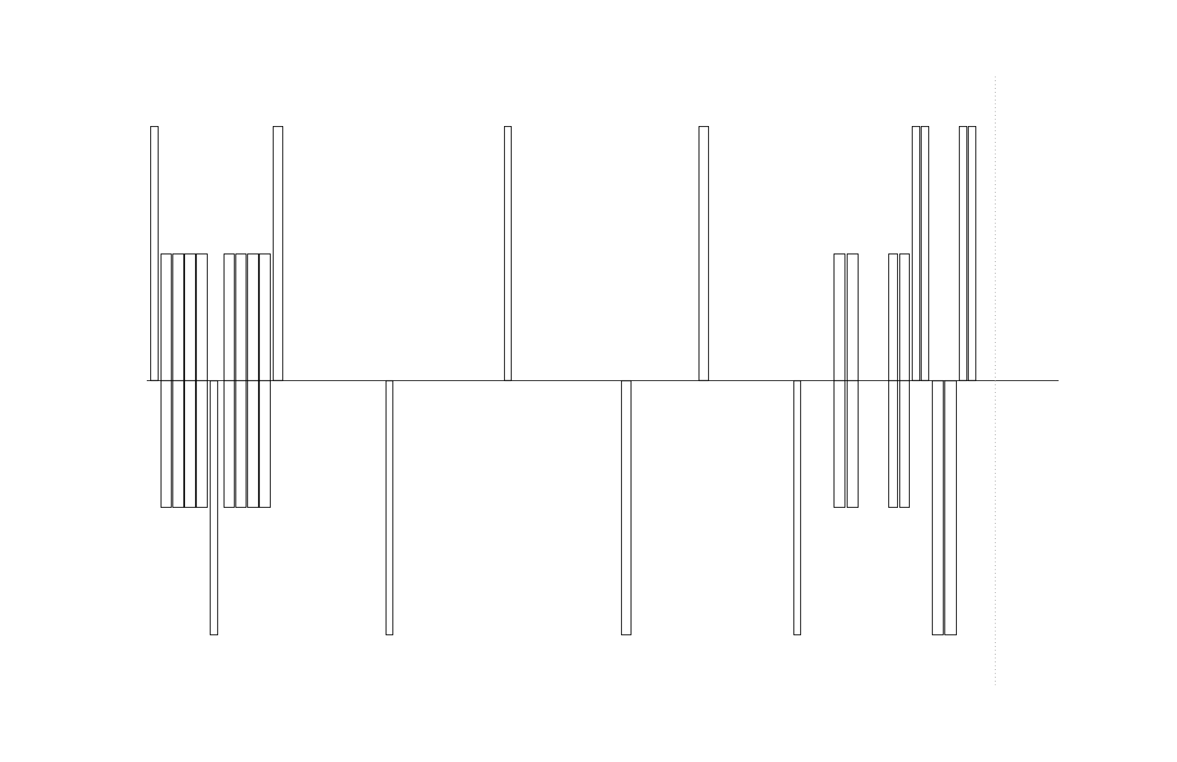
Injection Layout
Half cell length for injection devices is 150 m
Septum is located right next to the Dispersion Suppressor
Protection elements far away from the experiment
MSI
IPB
TDI
MKI
150 m
Possible additional injection protection elements

Slide 6
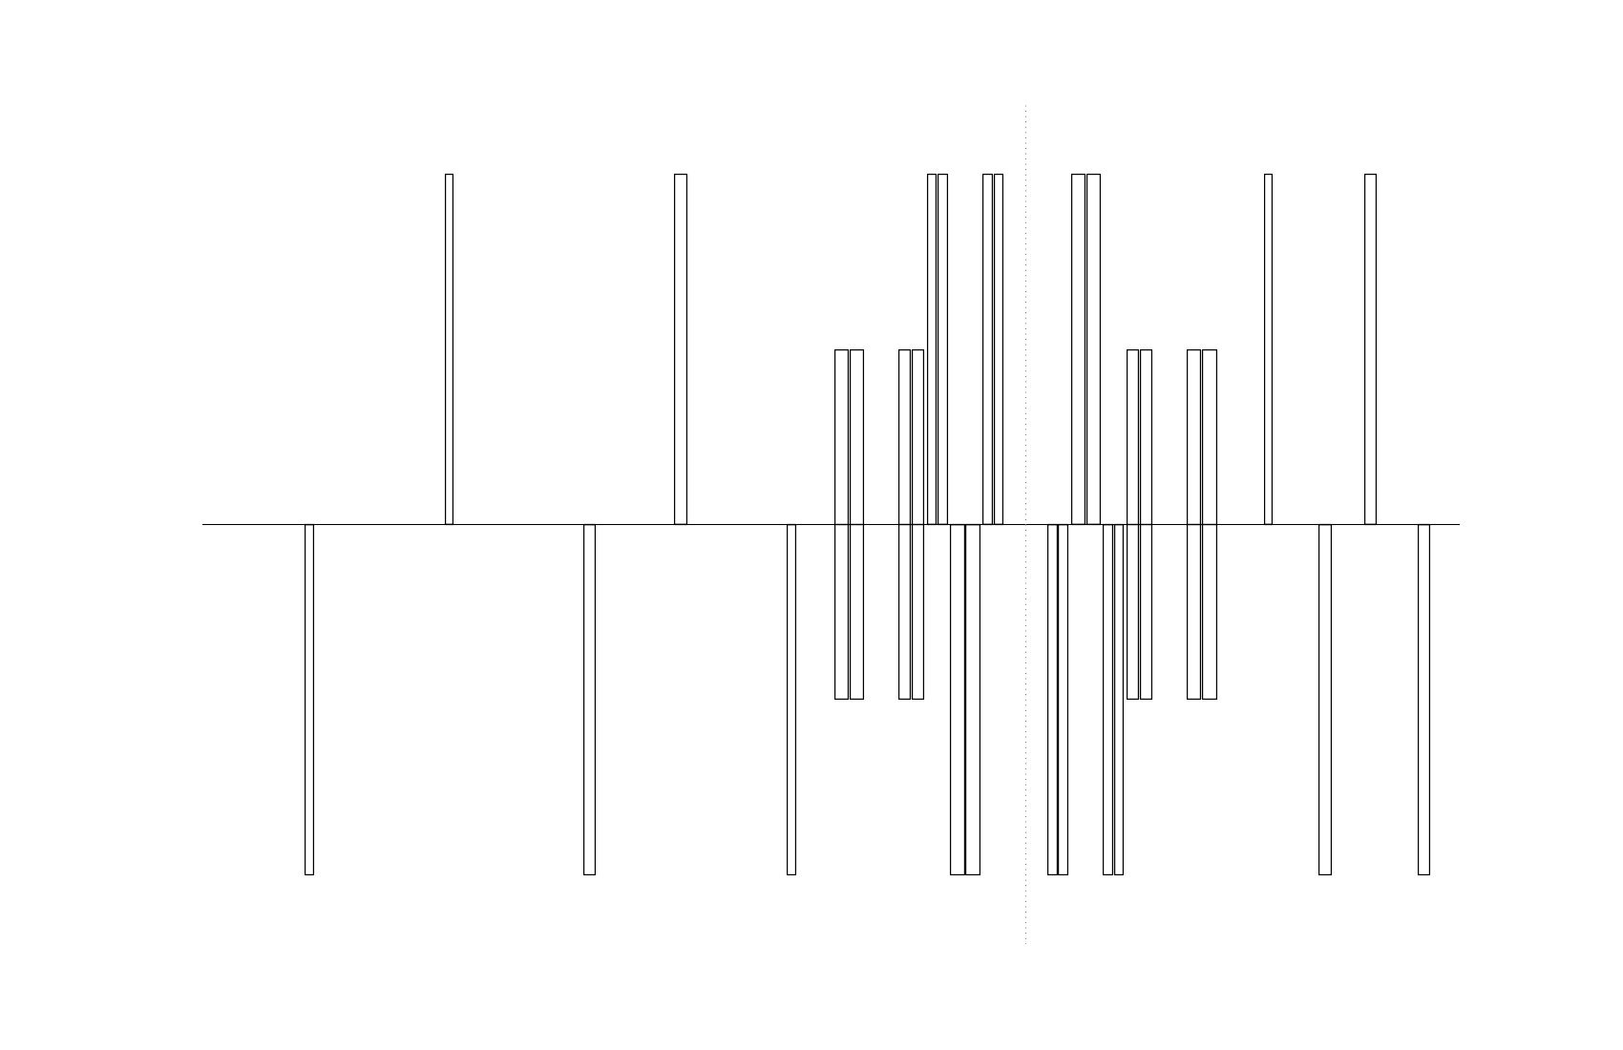

Experiment layout
These Experiments were designed with no specific scenario in mind (e.g. Ions, FCC-he)
For the low luminosity experiments an $L^{∗}$ of 25 m was suggested by the detector design group
Keep separation section length as short as possible
IPB
TDI
MKI
L* = 25 m

Slide 7
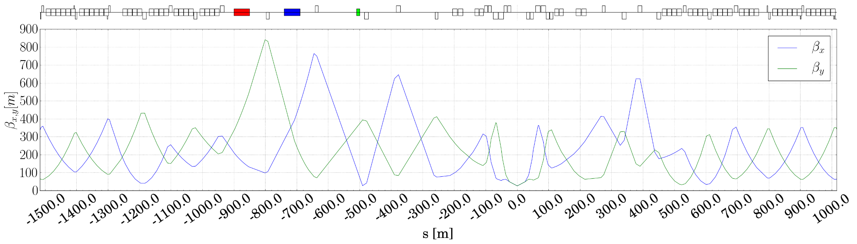
Injection Optics
Predetermined injection cell length adds space constraints
Injection optics requires special matching constraint to ensure optimum protection:
  90° phase advance constraint between the Kickers and the absorber TDI
  vanishing dispersion to mitigate the effect of injection oscillation

Slide 8
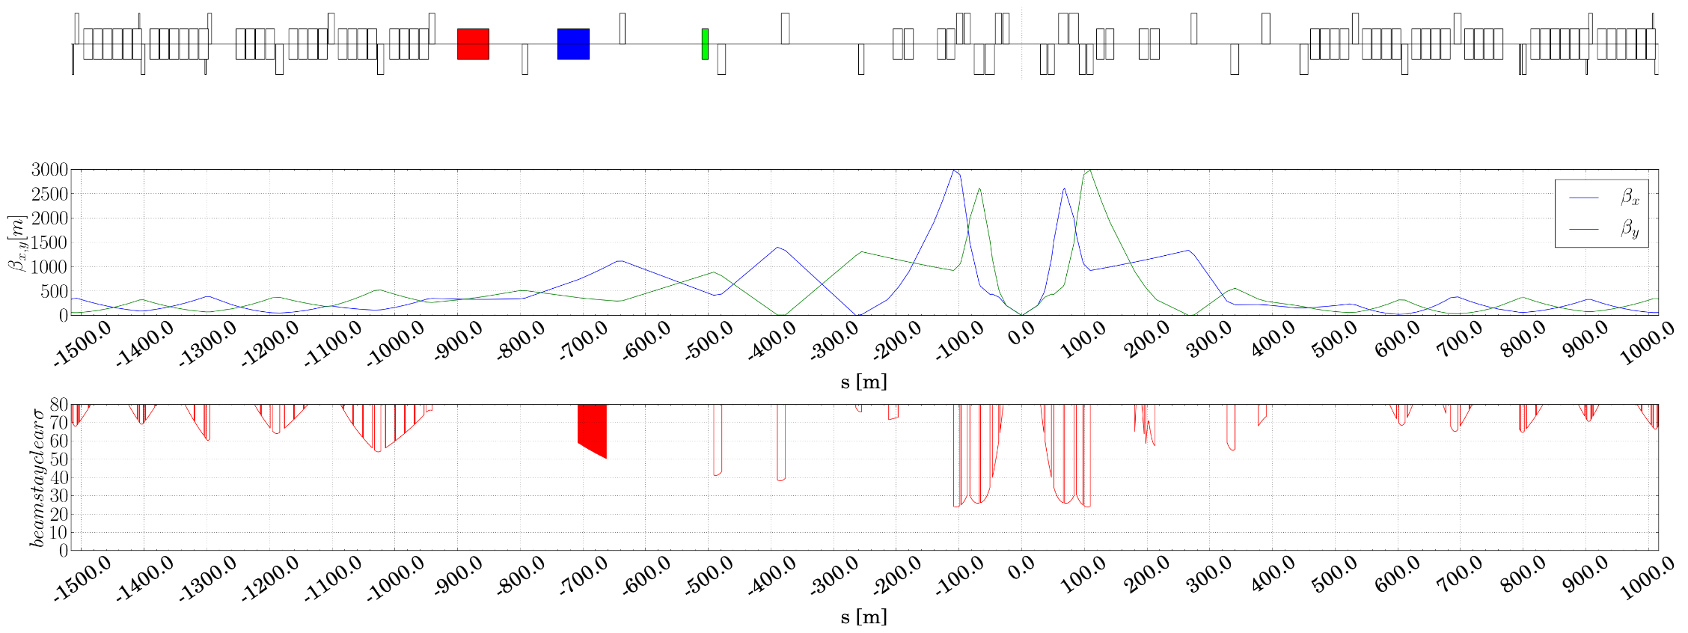

Collision Optics
During collision no special constraints need to be applied
With this layout a minimum round $β^{∗}$ of 3 m has been matched
Crossing angle has been scaled from Main Experiments with the reduced distance IP to D1 which yields$θ=39 µrad$

Slide 9
Energy depositions studies
Energy deposition in the magnets is one of the key factors that defines luminosity reach
The maximum instantaneous luminosity is determined by the quench limit of the superconductivity magnets
The cumulated dose sets the achievable integrated luminosity

Slide 10
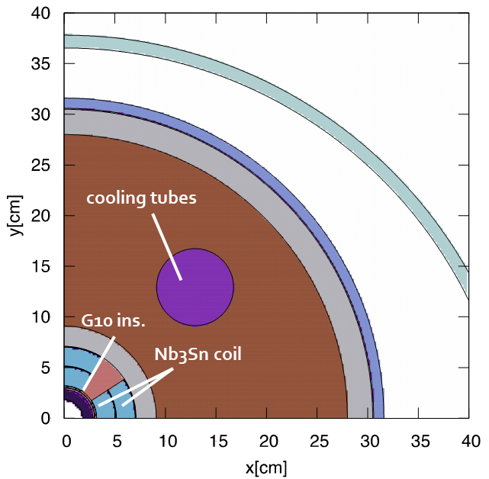
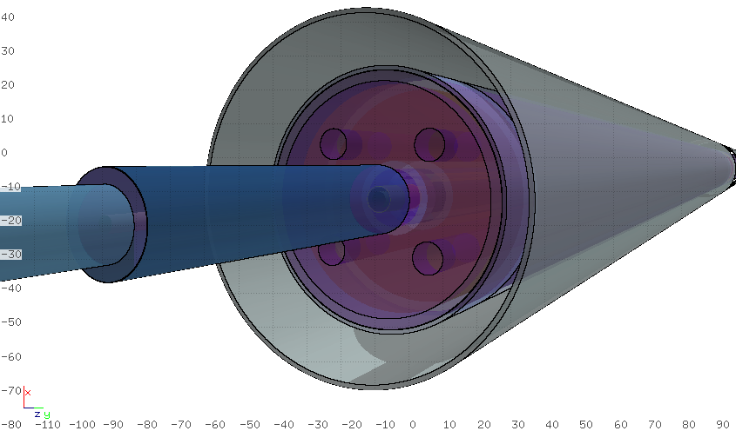
Magnet Models
Unlike in the main experiments, the triplet quadrupoles
in these insertions are shorter and
require a higher gradient and a significantly smaller aperture
Same magnet model for all triplet quadrupoles
and a constant 10 mm tungsten (INERMET180) shielding
An 80 cm long tungsten mask is placed
in front of the quadrupole closest to the IP
Tungsten mask
Q1A

Slide 11
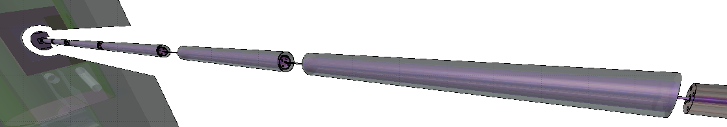
Magnet Models
Triplet quadrupoles also needed to be split and housed in separate cryostats
70 cm shielding gaps were assumed in the interconnects
For the separation section after the triplet a design using superconducting dipoles was chosen to keep the section as short as possible which will also needed to be considered for energy deposition studies
Q2B
Q3A
Q3B
C2

Slide 12
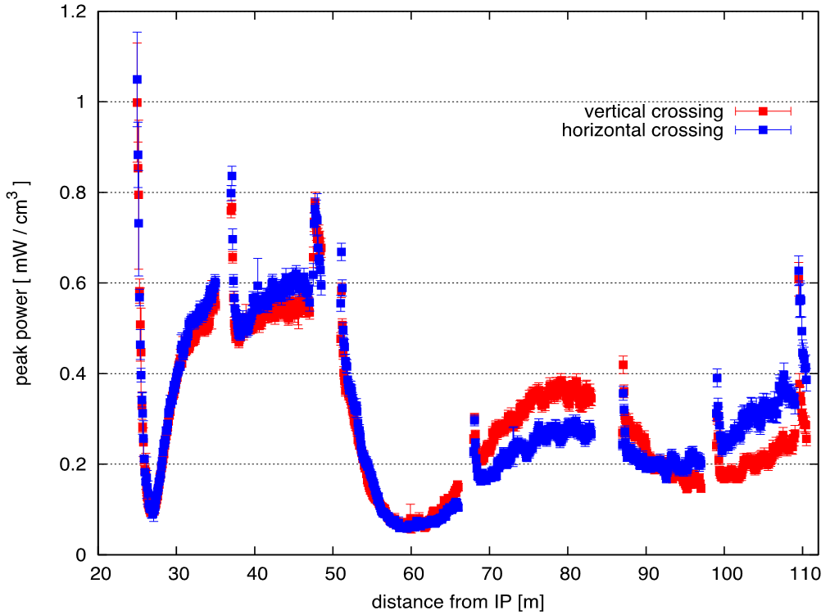

Energy deposition
For an instantaneous luminosity of $5∙{10}^{33} {cm}^{−2}s^{−1}$
the peak power density in the triplet is
well below the current design limit
of Nb₃Sn of $5 mW{cm}^{−3}$
C1
C2
Effect of 70 cm shielding gaps in the interconnects
from splitting the triplet quadrupoles clearly visible
Q1
Q2
Q3
$$\text{Peak} \text{power} \text{density} \text{for} 5∙{10}^{33} {cm}^{−2}s^{−1}$$

Slide 13

Energy deposition
Total Power for $5∙{10}^{33} {cm}^{−2}s^{−1}$ : 4.3 kW per side
  1.7 kW deposited in the triplet
  2.6 kW going downstream
maximum power per meter on Q1A
for both crossing schemes: ~14.4 W/m
power on the mask in front of Q1A: ~280 W
Further simulations needed to understand where
these particles will impact
  Single diffractive protons (50 TeV) lost
  further downstream (DS, collimation section)
  Lower energy protons (~25 TeV) and pions expected
  to be lost in D1, D2, TAN or MS
  Neutral particles lost in TAN or further downstream
Particle Spectra at the exit of Q3B per collision

Slide 14
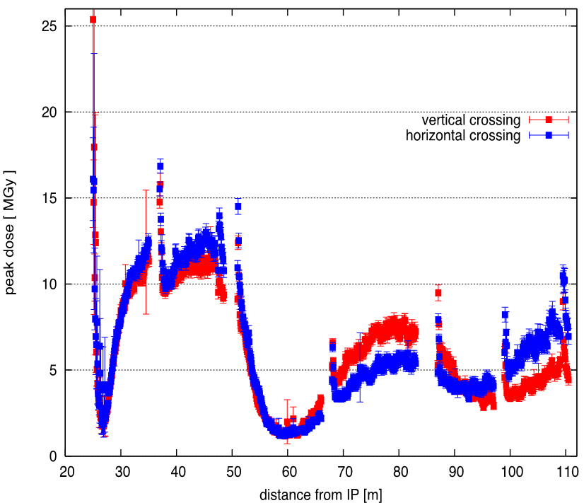


Energy deposition
With the current baseline radiation limits
$500 {fb}^{−1}$ seems feasible
In order to survive longer, options like
thicker shielding with a higher $β^{∗}$,
switching the crossing plane or
swapping the triplet quadrupoles in a LS
could be explored
Current FCC-hh target radiation limits
Baseline | 30 MGy
Ultimate (R&D Goal) | 250 MGy
Q1
Q2
Q3
$$\text{Peak} \text{dose} \text{for} 500 {fb}^{−1}$$

Slide 15

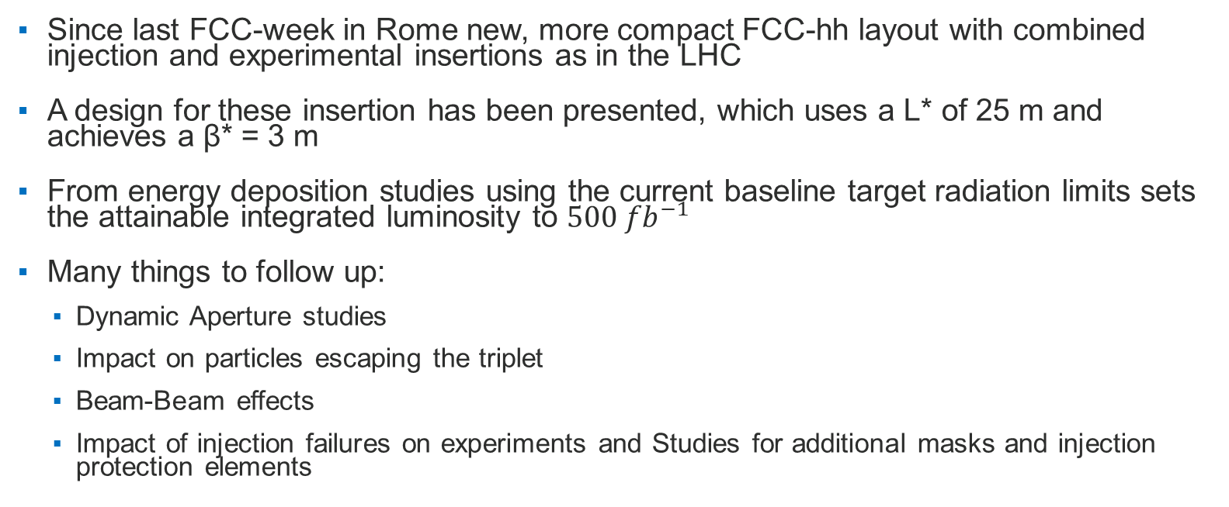
Conclusions and Outlook
Since last FCC-week in Rome new, more compact FCC-hh layout with combined injection and experimental insertions as in the LHC
A design for these insertion has been presented, which uses a L* of 25 m and achieves a β* = 3 m
From energy deposition studies using the current baseline target radiation limits sets the attainable integrated luminosity to $500 {fb}^{−1}$
Many things to follow up:
  Dynamic Aperture studies
  Impact on particles escaping the triplet
  Beam-Beam effects
  Impact of injection failures on experiments and Studies for additional masks and injection protection elements

Slide 16
Thank you for your attention!

Slide 17
Reserve

Slide 18
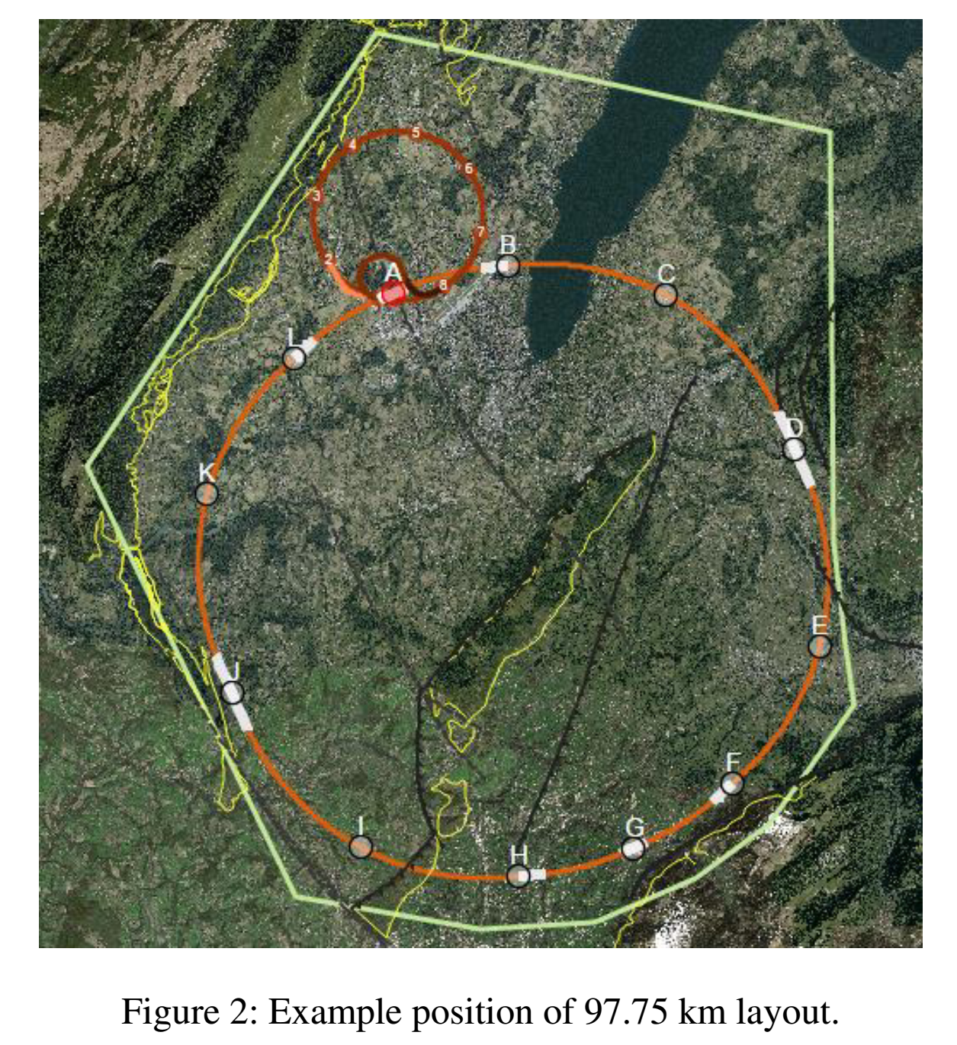
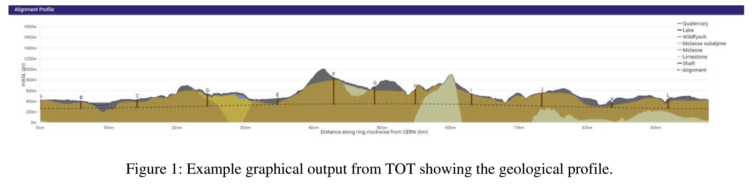
Geology
“The favoured layouts avoid the Jura and Pre-Alps limestone whilst
also avoiding exceptionally deep shafts in Points H, G and F, however
it has proved difficult to simultaneously fulfil these criteria.”
See J. Stanyard, V. Mertens, J. Osborne, Y. Loo, C. Sturzaker, M. Sykes
“Optimisation of the design of the future circular collider
from a civil engineering perspective”,
in Proc.IPAC2017, Copenhagen, Denmark

Slide 19
Total Power deposited in triplet
Magnet | Power [W] vertical crossing |  |  | Power [W] horizontal crossing
 | Total | Shielding | Cold Mass | Total | Shielding | Cold Mass
Q1A | 248.8 | 100.9 | 147.9 | 251.3 | 101.9 | 149.4
Q1B | 267.9 | 182.7 | 85.2 | 269.0 | 183.7 | 85.3
C1 | 27.1 | 18.9 | 8.2 | 27.7 | 19.3 | 8.4
Q2A | 118.1 | 82.3 | 35.8 | 119.3 | 83.3 | 36.0
Q2B | 204.4 | 147.1 | 57.3 | 190.9 | 137.3 | 53.6
Q3A | 111.1 | 76.7 | 34.4 | 112.9 | 80.3 | 32.6
Q3B | 112.6 | 81.2 | 31.4 | 132.1 | 95.2 | 36.9
C2 | 14.7 | 10.7 | 4.0 | 17.5 | 12.8 | 4.7
Total on Magnets | 1104.6 | 700.6 | 404.1 | 1120.7 | 713.9 | 406.8
  maximum power per meter on Q1A for both crossing schemes: ~14.4 W/m
  power on the mask in front of Q1A: ~280 W

Slide 20
Peak dose: Angular Position
Q1
Q2
Q3

Slide 21
Magnets
Type | Gradient [T/m] | Field [T] | Aperture [mm] | Length [m] | Units per IP
Triplet Q1 | 270 | - | 64 | 10 | 4
Triplet Q2 | 270 | - | 64 | 15 | 4
Triplet Q3 | 270 | - | 64 | 10 | 4
Separation Dipole D1 | - | 12 | 100 | 12.5 | 4
Recombination Dipole D2 | - | 10 | 60 | 15 | 4
Matching Quadrupole Short Type MQM | 200 | - | 70 | 9.1 | 4
Matching Quadrupole Long Type MQML | 300 | - | 50 | 12.8 | 6
Orbit Corrector | - | 3 | 64 | 1 | 6

Slide 22
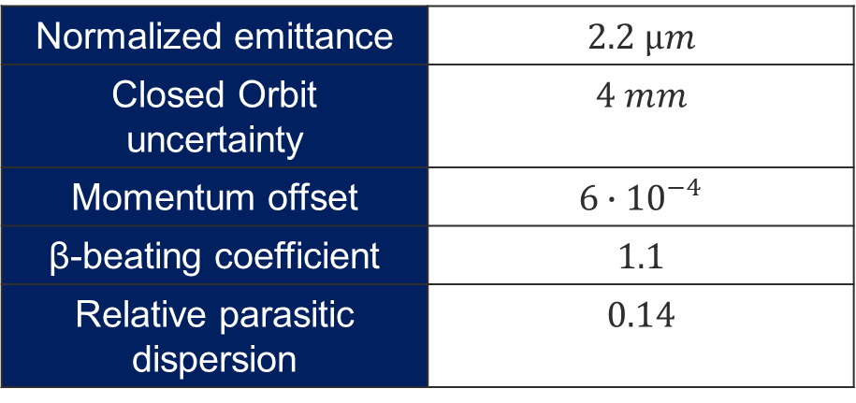
Parameters
β* during collision | 3 m
β* during injection | 27 m
Full crossing angle | 39 µrad
Separation during injection | 1.5 mm
Normalized emittance | $$2.2 µm$$
Closed Orbit uncertainty | $$4 mm$$
Momentum offset | $$6∙{10}^{−4}$$
β-beating coefficient | $$1.1$$
Relative parasitic dispersion | $$0.14$$

