Slide 1


















European XFEL Status
Hans Weise & Winni Decking, DESY
On behalf of the European XFEL Accelerator Consortium
work supported by the respective funding agencies of the contributing institutes; for details please see http://www.xfel.eu
TTC Meeting 02/2017
Notes:
How to edit the title slide
Upper area: Title of your talk, max. 2 rows of the defined size (55 pt)
Lower area (subtitle): Conference/meeting/workshop, location, date,
your name and affiliation,
max. 4 rows of the defined size (32 pt)
Change the partner logos or add others in the last row.

Slide 2
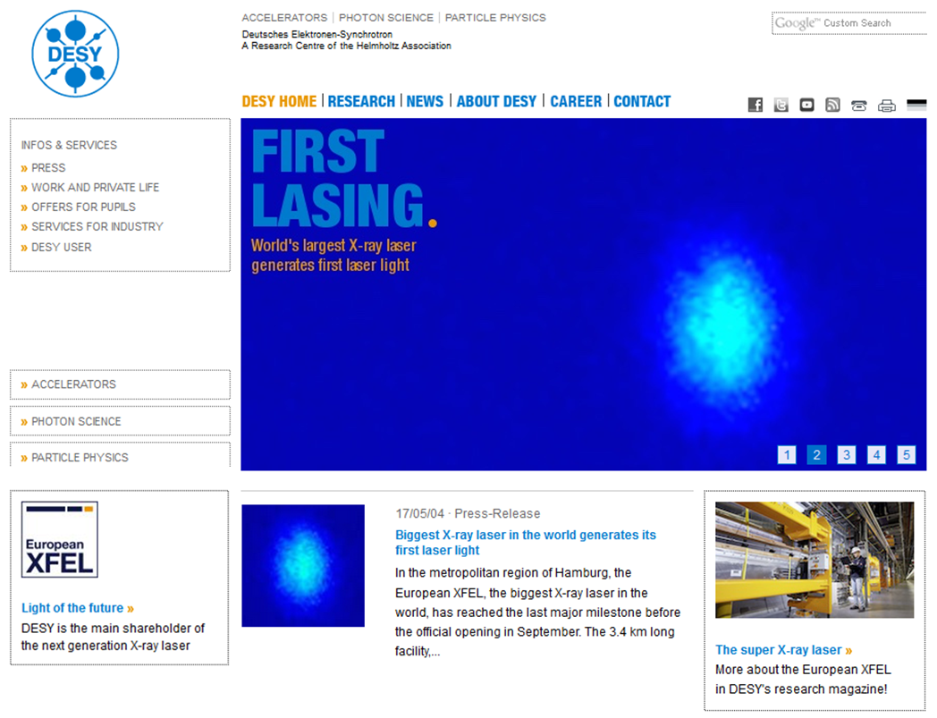
First Lasing.

Slide 3
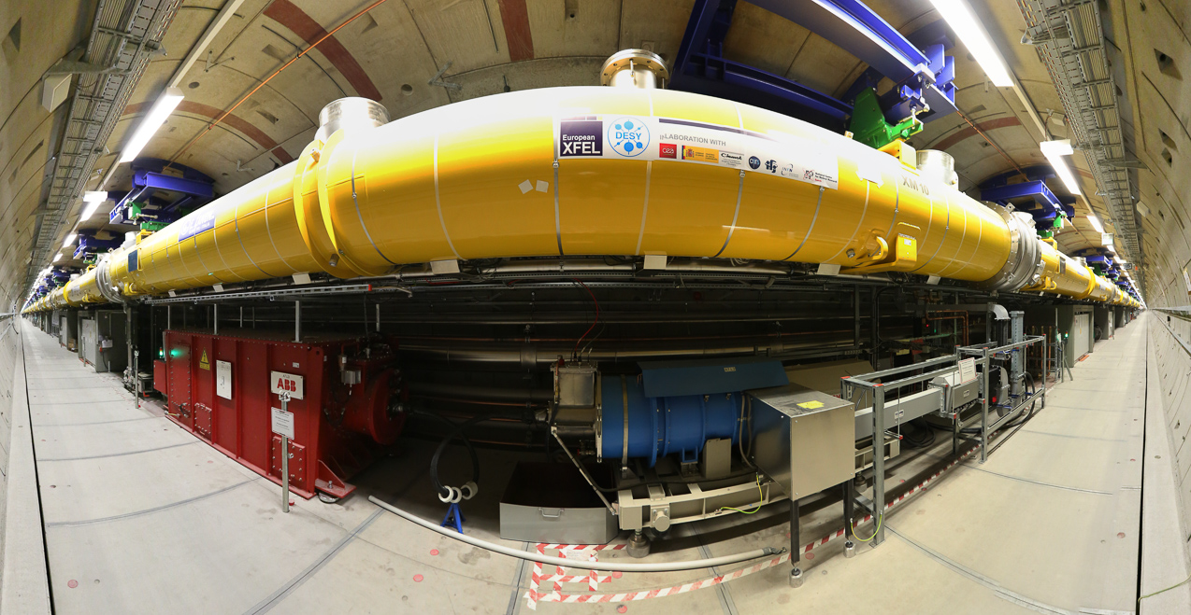
One Kilometer of Cold Linac

Slide 4
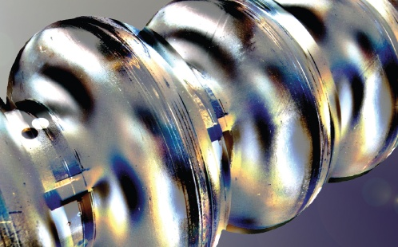
With almost 800 Superconducting Cavities

Slide 5
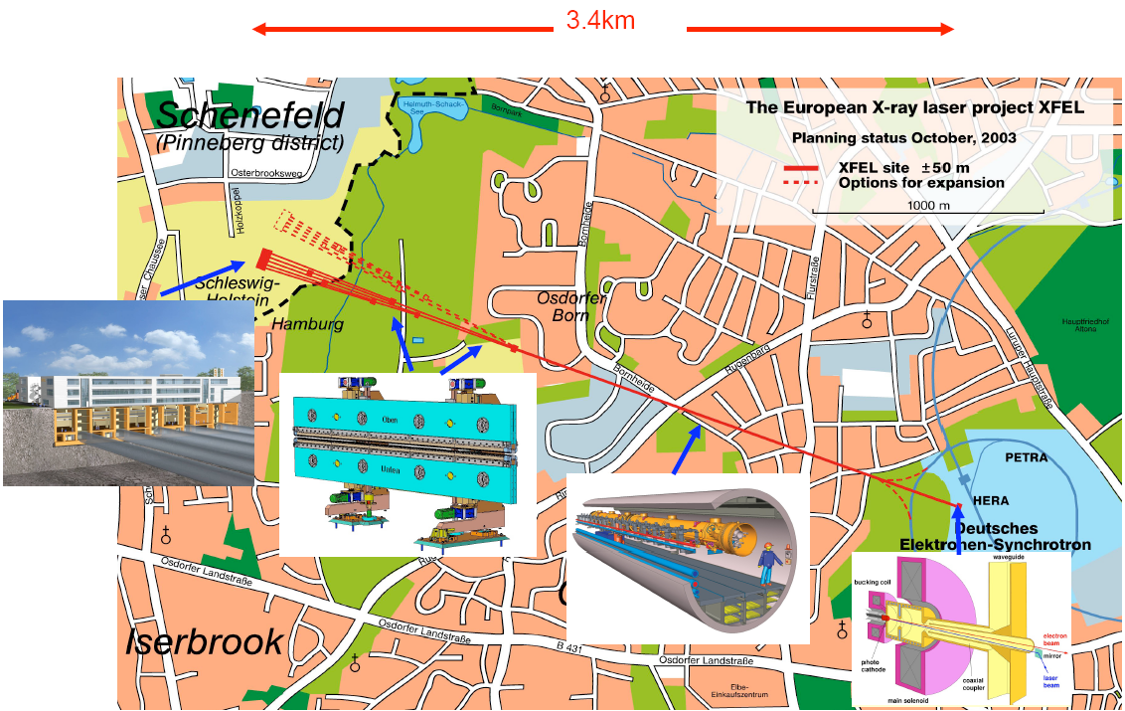
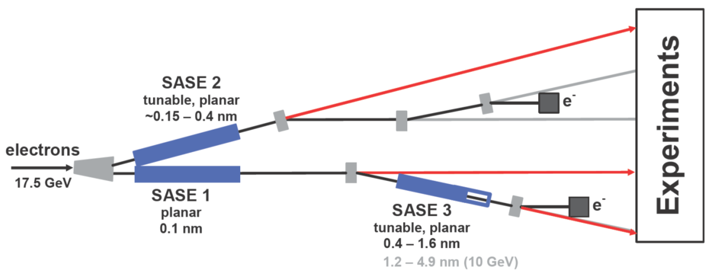
The European XFEL
Built by Research Institutes from 12 European Nations
Some specifications
Photon energy 0.3 - 24 keV
Pulse duration ~ 10 - 100 fs
Pulse energy few mJ
Superconducting linac 17.5 GeV
10 Hz (27 000 b/s)
5 beam lines / 10 instruments
  Start version with 3 beam lines and 6 instruments
Several extensions possible:
  More undulators
  More instruments
  …….
  Variable polarization
  Self-Seeding
  CW operation
SASE2
(= SASE1)
17.5 GeV
SASE1, λ_{u}= 40 mm
0.2 – 0.05 nm
SASE3, λ_{u}= 68 mm
1.7 – 0.4 nm

Slide 6
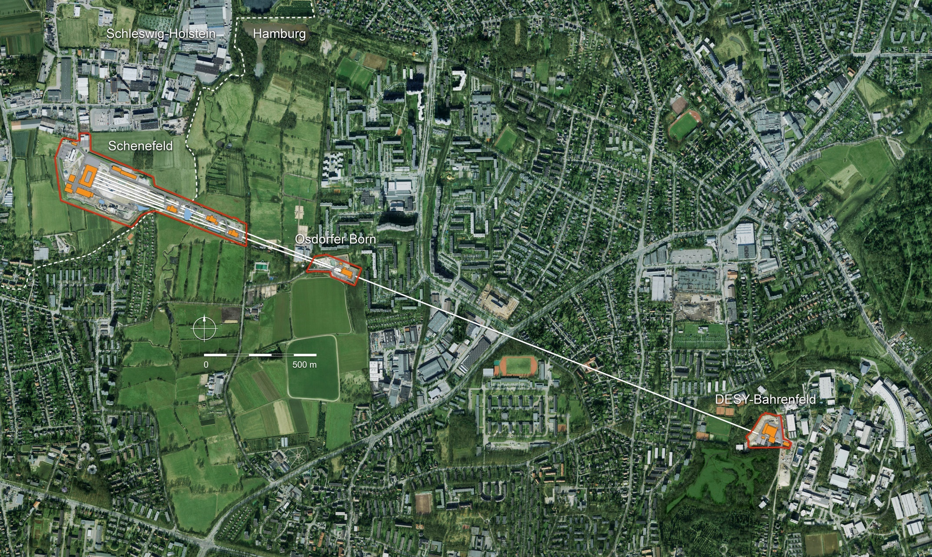
European XFEL Layout
Undulator/Photon Tunnels
Injector at DESY campus
Experiment Hall
in Schenefeld
Linear Accelerator
1.9 km - 17.5 GeV

Slide 7
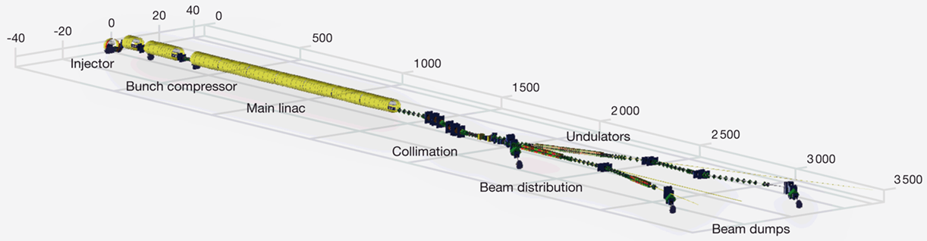
Accelerator Complex with Challenging Parameter Set
electron beam energy | 8/12.5/14/17.5 GeV
macro pulse repetition rate | 10 Hz
RF pulse length (flat top) | 600 μs
# of bunches/second | 27,000
bunch charge | 0.02 – 1 nC
electron bunch length after compression (FWHM) | 2 – 180 fs
normalized slice emittance* | 0.4 - 1.0 mm mrad
beam power | 500 kW
simultaneously operated SASE undulators | 3
* normalized emittance: $ε_{n}=γε=γ\sqrt{\left\langle x^{2}\right\rangle \left\langle p_{}^{2}\right\rangle +{\left\langle xp_{x}^{}\right\rangle }^{2}}$

Slide 8
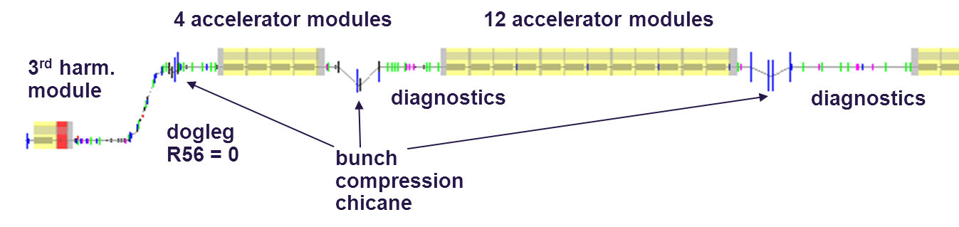
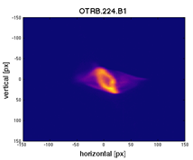
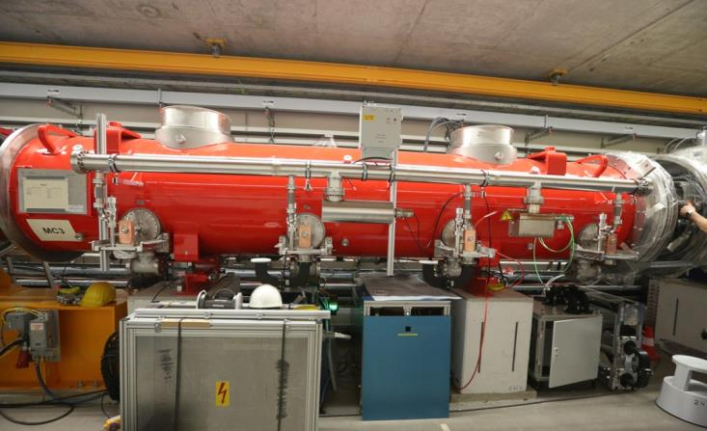
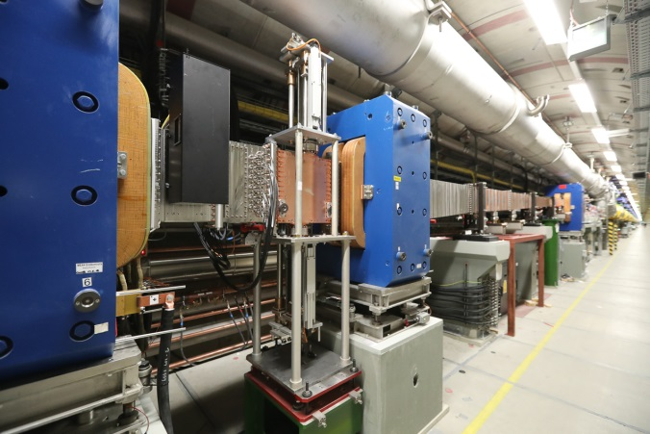
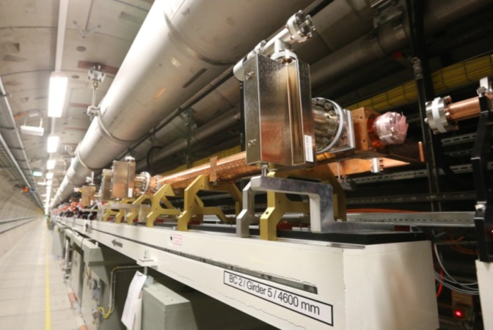
State of the Art 3 Stage Bunch Compression
3 stage bunch compression: flexible and less sensitive to noise from RF system
R56=60-120mm
R56=
60-120mm
R56=30-100mm
= 40 mm
σ_{σ} = 2 mm
I_{peak}= 50 A
σ_{Ε} = 0 %
E = 130 MeV
σ_{σ} = 1 mm
I_{peak}= 100 A
σ_{Ε} = 1.5 %
E = 130 MeV
σ_{σ} = 0.1 mm
I_{peak}= 1 kA
σ_{Ε} = 1 %
E = 600 MeV
σ_{σ} = 0.02 mm
I_{peak}= 5 kA
σ_{Ε} = 0.3 %
E = 2400 MeV
harmonic system
bunch compressor
beam diagnostics

Slide 9
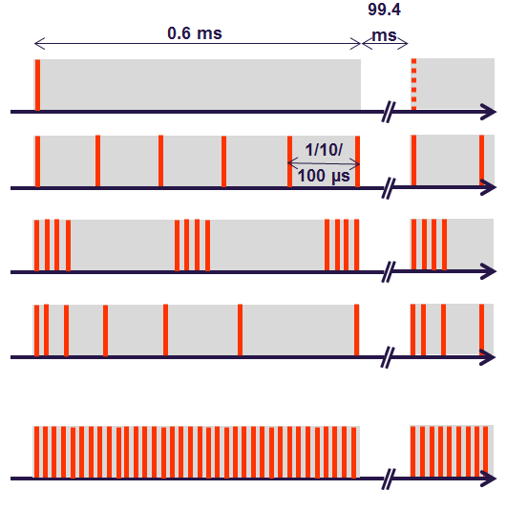
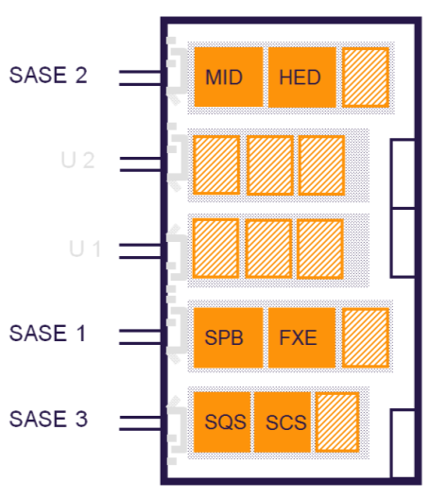
X-ray Beamlines for Different Wavelengths with Different Time Structures
experiments
electron tunnel
electron switch
HED
photon tunnel
electron bend
MID
undulator
electron dump
SASE 2
3 – 24 keV
~
~
~
FXE
SPB
LINAC
17.5 / 14 / 10.5 GeV
SASE 1
3 – 24 keV
SASE 3
0.26 – 3 keV
SQS
SCS
2 hard x-ray undulators and beam transport with 4 instruments
1 soft x-ray undulator and beam transport with 2 instruments
all undulators planar and tunable

Slide 10
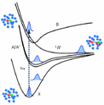
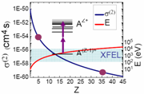

The Suite of Instruments
FXE Femtosecond
X-ray
Experiments
SASE 2
MID
HED
U 2
HED High Energy
Density Science
SPB Single Particle &
Biomolecules
U 1
MID Materials Imaging &
Dynamics
SASE 1
SPB
FXE
SQS Small Quantum
Systems
SASE 3
SQS
SCS
SCS Spectroscopy &
Coherent Scattering
More about experiments: http://www.xfel.eu

Slide 11















Project History
2000: First lasing at 109 nm at the Tesla Test Facility (TTF), now FLASH
2001: TESLA Linear Collider TDR with XFEL appendix
2002: TESLA TDR supplement with stand-alone XFEL
2006: European XFEL TDR
2009: Foundation of the European XFEL GmbH
Start of underground construction
2010: Formation of the Accelerator Consortium
16 accelerator institutes under the coordination of DESY
2012: End of tunnel construction
Start of underground installation
2016: Finish of accelerator installation
Start of commissioning

Slide 12
Commissioning Plan
(include as many systems as early as possible)
12/16 Linac Cooldown
01/17 Injector at 130 MeV (3 RF stations)
01/17 L1 commissioning (+1 RF station)
02/17 L2 commissioning (+3 RF stations)
02 - 04/17 L3 commissioning (+15 RF stations)
05/17 Beam through SASE1 & SASE3 undulator sections
end 05/17 Milestone “First Lasing Possible”
06 - 08/17 Commission SASE1 photon beamline and experiment Consolidate FEL operation at 8-10 keV photon energy
09/17 First user experiments (total 800 hours)
2018 Continue facility commissioning + 2000 user hours
2019 Routine operation with 6 experiments + 4000 user hours

Slide 13
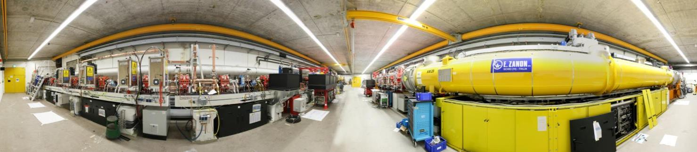
Injector in Operation 2015 / 2016
Spectrometer Diagnostic Section Laser Heater 3.9 GHz Module 1.3 GHz Module Gun
Dump Transverse Deflecting Structure
Photoinjector conditioned and characterized at PITZ, DESY-Zeuthen
Injector cool-down 12 / 2015
First Beam on Dec 18th 2015 - commissioning till Q2/2016
Full bunch train length (27,000 bunches/s) reached for 20pC - 1000pC bunch charges
  Photocathode laser with excellent up-time
  (Yb:YAG laser from Max-Born Institute Berlin; 257 nm ≤ 4 μJ; 3 ps)
3.9 GHz system operational from day 2
Laser heater commissioned

Slide 14
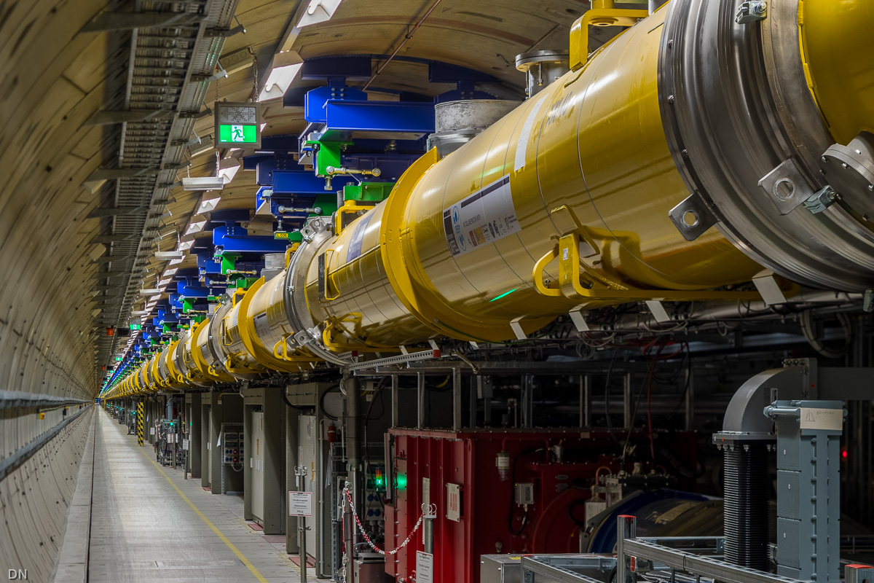
View along L3 accelerator section

Slide 15
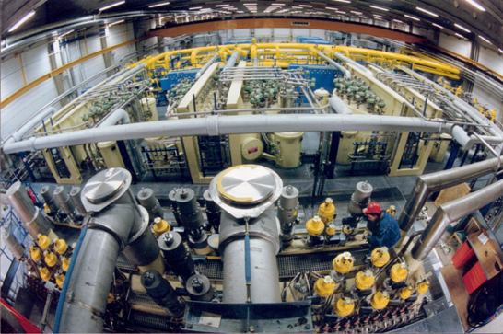
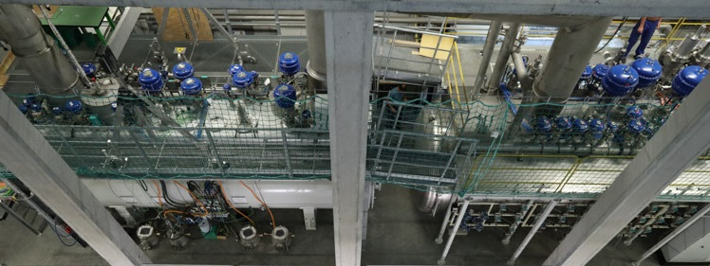

Overview of XFEL Cryogenic Equipment
Cryo Plant
Cryo plant with cold compressors and extended distribution system
Cooling capacity:
2K : >1.9 kW
5/8K : 4 kW
40/80K : 24 kW
Linac is one 1.5 km long cryo-string
Cold Compressors He Distribution
Linac

Slide 16
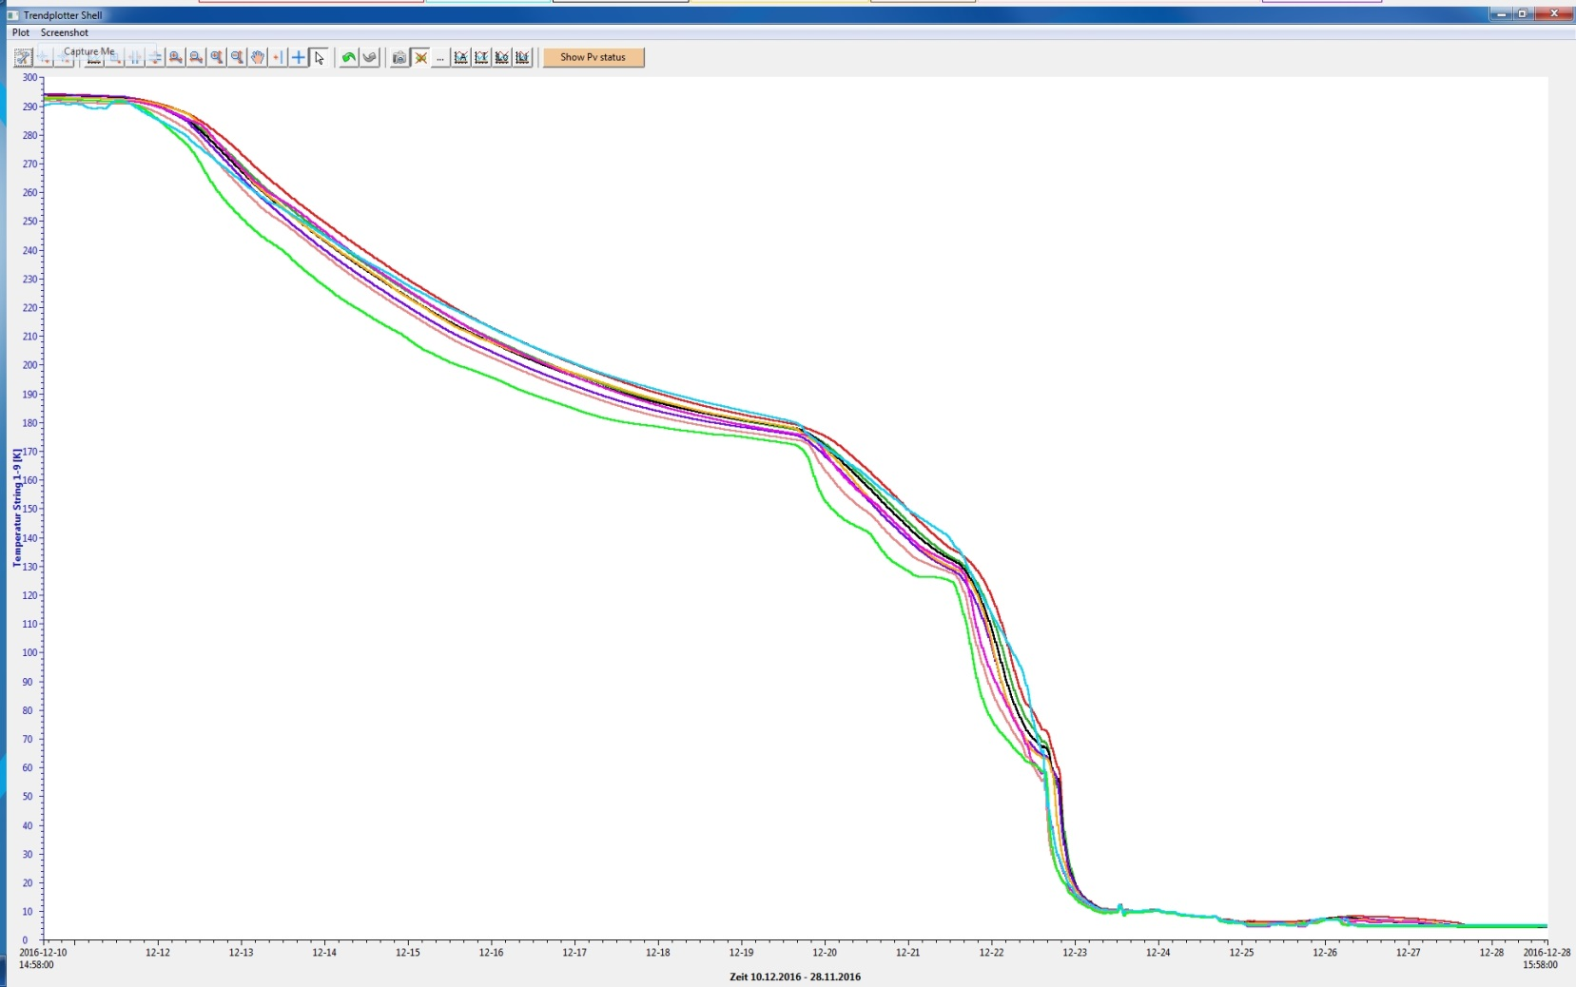

First Cooldown of XFEL Linac during Dec 2016
Start asymmetrical operation of two cold boxes to speed up cooldown
Fast cooldown at temperatures below liquid nitrogen (no more thermal stress)
Entry of cold return flows in cold boxes to enhance cryogenic capacity
10.12.2016
24.12.2016
No Cold Leaks!!!

Slide 17
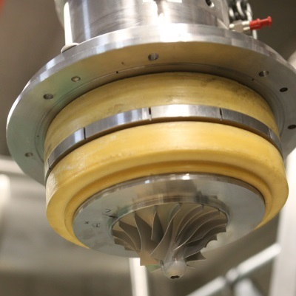
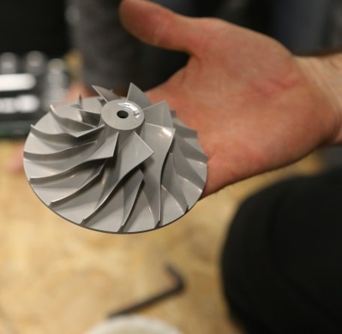
Cryogenics is very challenging
Complexity of cryogenic system asked for sufficient commissioning time; experts had to establish / optimize operation and to gain experience with new machines, especially the used cold compressors.
How to deal with…
  671 control valves
  >3,800 sensors (temperature, pressure, flow, level)
  433 regulation loops
  >22,000 records and >220,000 properties
  and last but not least … >300 tons of material to be cooled down
Required 2K pressure stability of 2% peak from LLRF requirements (cavity detuning)
Tedious adjustment of regulation loops
Inner-system heaters to counteract dynamic processes

Slide 18



We cooled down all 96 accelerator modules
CS1
L001
A2.1.L1
L002
A2.2.L1
L003
A2.3.L1
L004
A2.4.L1
CS2
L005
A3.1.L2
L006
A3.2.L2
L007
A3.3.L2
L008
A3.4.L2
L1
BC1
L2
XM 5
XM 1
XM 2
XM -1
DEMACO Cryo-connection
XM 62
XM 61
XM 71
XM 76
P
A2
P
P
A3
CS2
L009
A4.1.L2
L010
A4.2.L2
L011
A4.3.L2
L012
A4.4.L2
L013
A5.1.L2
L014
A5.2.L2
L015
A5.3.L2
L016
A5.4.L2
L2
BC2
50
XM 73
XM 57
XM59
XM 72
XM44
XM 43
XM47
XM42
DEMACO Cryo-connection
CS3
A4
32
A5
P
L017
A6.1.L3
L018
A6.2.L3
L019
A6.3.L3
L020
A6.4.L3
L021
A7.1.L3
L022
A7.2.L3
L023
A7.3.L3
L024
A7.4.L3
L025
A8.1.L3
L026
A8.2.L3
L027
A8.3.L3
L028
A8.4.L3
L3
XM 7
XM 6
XM11
XM 3
XM 13
XM 9
XM 10
XM 19
XM 27
XM 18
XM 30
XM 20
SCB 1
51
52
53
A6
54
55
56
57
A7
58
59
60
61
A8
P
62
63
L029
A9.1.L3
L030
A9.2.L3
L031
A9.3.L3
P
UV XTL-2AV
L033
A10.1.L3
P
CS4
L032
A9.4.L3
L034
A10.2.L3
L035
A10.3.L3
L036
A10.4.L3
L037
A11.1.L3
L038
A11.2.L3
L039
A11.3.L3
L040
A11.4.L3
L3
XM 31
XM 28
XM 34
XM 14
XM 39
XM 37
XM 40
XM 41
XM 26
XM 38
XM 36
XM 35
SCB 2
64
65
66
A9
67
68
69
70
A10
P
72
73
74
A11
P
75
76
CS5
L041
A12.1.L3
L042
A12.2.L3
L043
A12.3.L3
P
L044
A12.4.L3
L045
A13.1.L3
L046
A13.2.L3
L047
A13.3.L3
L048
A13.4.L3
L049
A14.1.L3
L050
A14.2.L3
L051
A14.3.L3
L052
A14.4.L3
L3
XM 56
XM 32
XM 25
XM 53
XM 17
XM 51
XM 15
XM 52
XM 45
XM 16
XM 33
XM 49
SCB 3
77
78
79
A12
80
81
82
83
A13
P
84
85
86
87
A14
88
89
CS6
L053
A15.1.L3
L054
A15.2.L3
L055
A15.3.L3
P
L056
A15.4.L3
L057
A16.1.L3
L058
A16.2.L3
L059
A16.3.L3
L060
A16.4.L3
L061
A17.1.L3
L062
A17.2.L3
L063
A17.3.L3
P
L064
A17.4.L3
L3
XM 64
XM 68
XM 70
XM 21
XM 69
XM 60
XM 63
XM 66
XM 12
XM 23
XM 58
XM 48
SCB 4
A15
A16
A17
CS7
L065
A18.1.L3
L066
A18.2.L3
L067
A18.3.L3
L068
A18.4.L3
L069
A19.1.L3
L070
A19.2.L3
L071
A19.3.L3
L072
A19.4.L3
L073
A20.1.L3
L074
A20.2.L3
L075
A20.3.L3
L076
A20.4.L3
L3
XM 77
XM 74
XM -2
XM 79
XM 4
XM 67
XM55
XM65
SCB 5
CS8
L077
A21.1.L3
L078
A21.2.L3
L079
A21.3.L3
L080
A21.4.L3
L081
A22.1.L3
L082
A22.2.L3
L083
A22.3.L3
L084
A22.4.L3
L085
A23.1.L3
L086
A23.2.L3
L087
A23.3.L3
L088
A23.4.L3
L3
CS9
L089
A24.1.L3
L090
A24.2.L3
L091
A24.3.L3
L092
A24.4.L3
L093
A25.1.L3
L094
A25.2.L3
L095
A25.3.L3
L096
A25.4.L3
L097
A26.1.L3
L098
A26.2.L3
L099
A26.3.L3
L100
A26.4.L3
1.508 m
L3

Slide 19
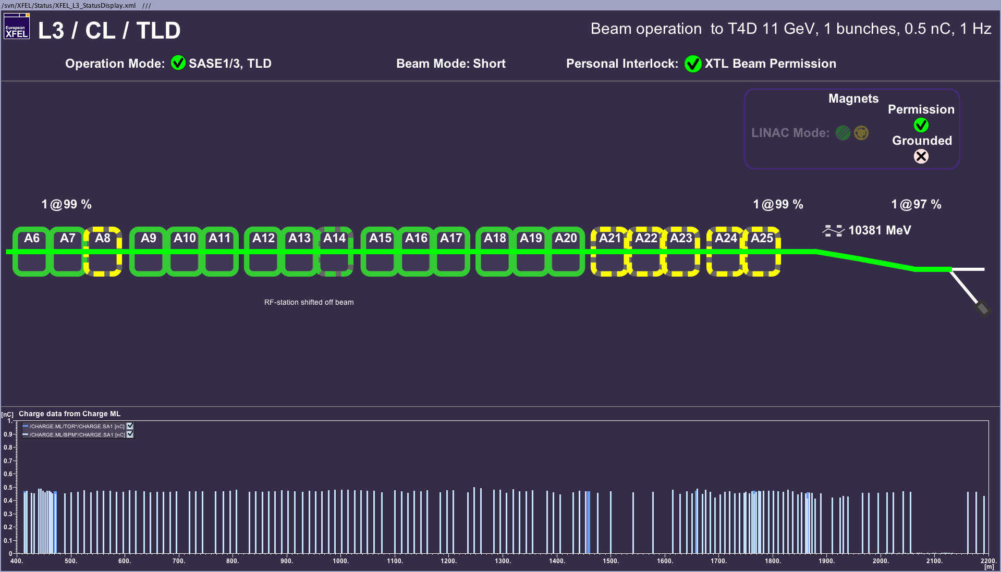
L3 RF Stations on the Status Pannel
in operation
dito. but shifted off beam
off
All RF stations including CS7 are commissioned at moderate gradients.
Detailed measurements will show the path towards higher beam energies.
CS8 is meanwhile ready for LLRF commissioning; thanks to maintenance days.
The last two stations (CS9) require still longer tunnel access.

Slide 20
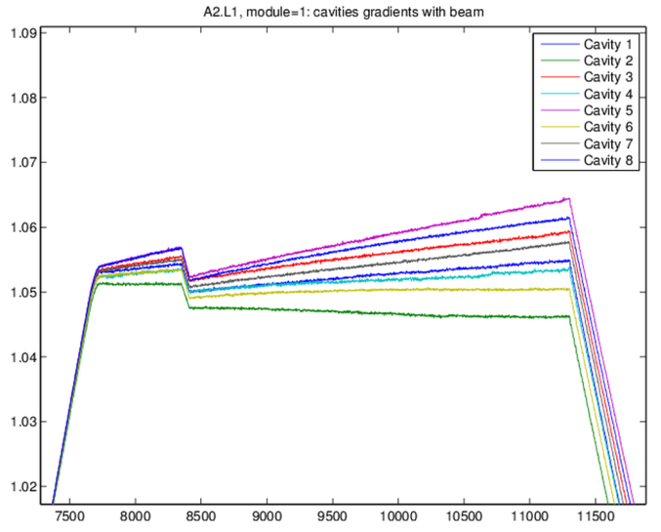
LLRF Commissioning includes…
Commissioning milestones
  Initial checks (LLRF system ready for commissioning)
  Cold coupler conditioning (optional)
  Cavity Forward and Reflected RF signal integrity (cabling issues? signal saturation?)
  Frequency tuning (from parking position)
  Cavity Probe RF signal integrity (cabling issues? signal saturation?)
  Coupler tuning (target QL)
  Power-based gradient calibration (coarse)
  Cavity phasing (using waveguide phase shifters)
  Closed-loop operation (feedback, learning feedforward)
  Beam-based gradient calibration (fine)
Reached goals by now
  Handed over to operations and controlled via FSM
  Inner loop RF stability <0.01 deg, < 0.01%
  Preliminary measurements of beam energy jitter ≈ 10⁻⁴
Beam loading transient
Example: beam induced transient during cavity phasing
Notes:
Before you start editing the slides of your talk change to the Master Slide view:
Menu button “View”, Master, Slide Master:
Edit the following 2 items in the 1st slide:
1) 1st row in the violet header:
Delete the existent text and write the title of your talk into this text field
2) The 2 rows in the footer area: Delete the text and write the information
regarding your talk (same as on the Title Slide) into this text field.
If you want to use more partner logos position them left
beside the DESY logo in the footer area
Close Master View

Slide 21
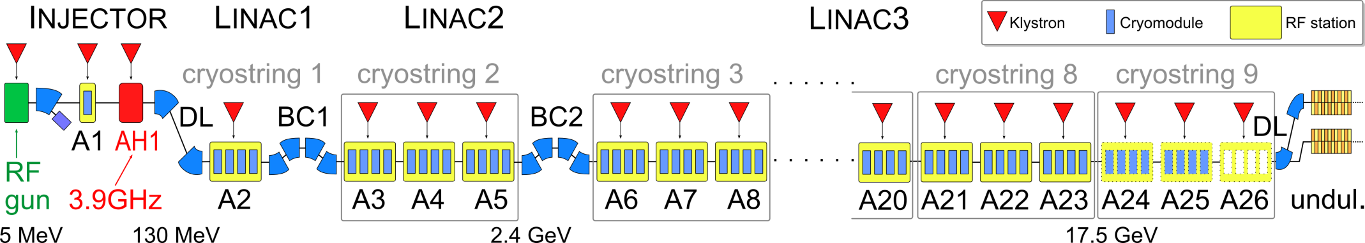
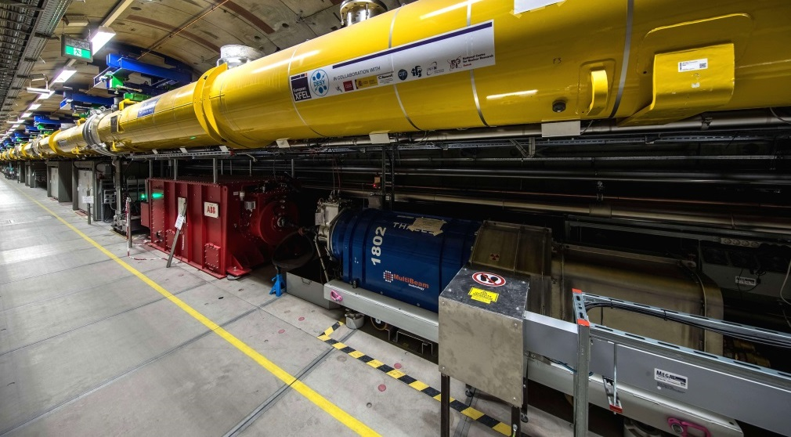
XFEL RF System
CM1 (8 cav.)
CM2 (8 cav.)
CM3 (8 cav.)
CM4 (8cav.)
KLYSTRON
HV Modulators in surface hall
Connected to pulse transformer via up to 2km long pulse cables
Klystron and modulator
below module

Slide 22
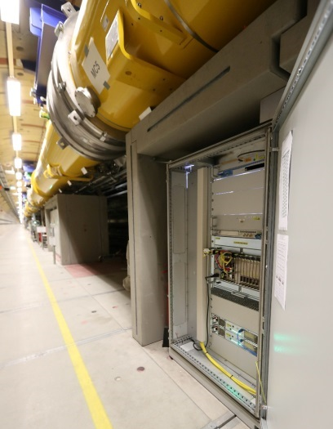
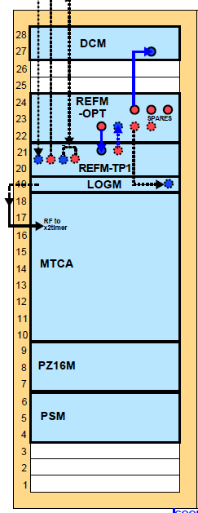
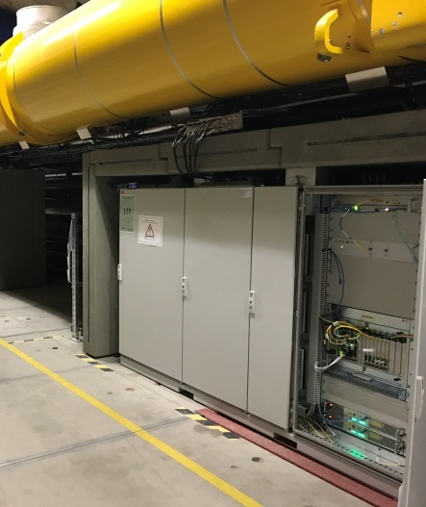
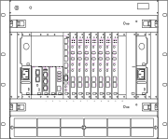
XFEL LLRF System
CM1 (8 cav.)
CM2 (8 cav.)
CM3 (8 cav.)
CM4 (8cav.)
KLYSTRON
LLRF master
LLRF slave
Drift compensation
Reference synchr. + distr.
Clocks + local oscillator
Main controller crate (MicroTCA)
LLRF master
Piezo*
LLRF slave
Power supplies
* not installed yet

Slide 23
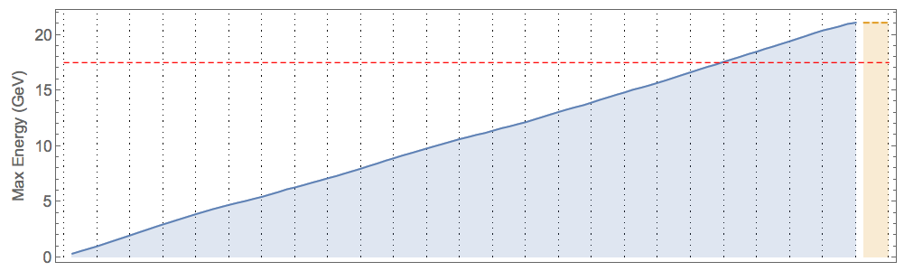

Energy Reach of European XFEL Modules
Design: 17.5 GeV
maximum energy reach
  according to accelerator module test
  after tunnel installation
  ignoring bunch compressor set-points
L1
L2
L3
Average accelerating gradient after pre-installation module test and waveguide tailoring
  26 MV/m, (design 23.5 MV/m)
Some additional gradient reduction due to tunnel waveguide distribution
Excess energy reach will enhance operation reliability

Slide 24
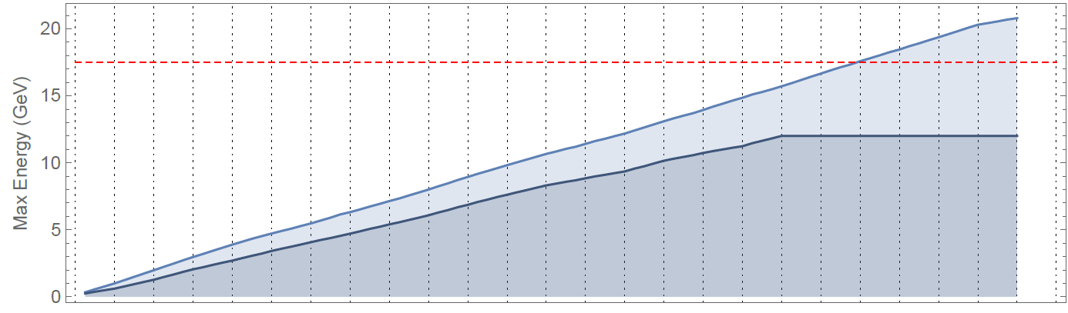
Operating Gradients used so far
Design: 17.5 GeV
maximum energy reach
  according to accelerator module test
  after tunnel installation
  ignoring bunch compressor set-points
12 GeV
exp. status of 10.04.17
L1
L2
L3
After initial commissioning design gradient almost reached
Operation of RF stations “off beam” allows final commissioning of single stations parallel to XFEL lasing operation
Quite some RF cavities needed short multipactor processing around 16 to 20 MV/m.
So far 4 couplers were disconnected due to temperature rise at warm window; RF conditioning was not easily possible.

Slide 25
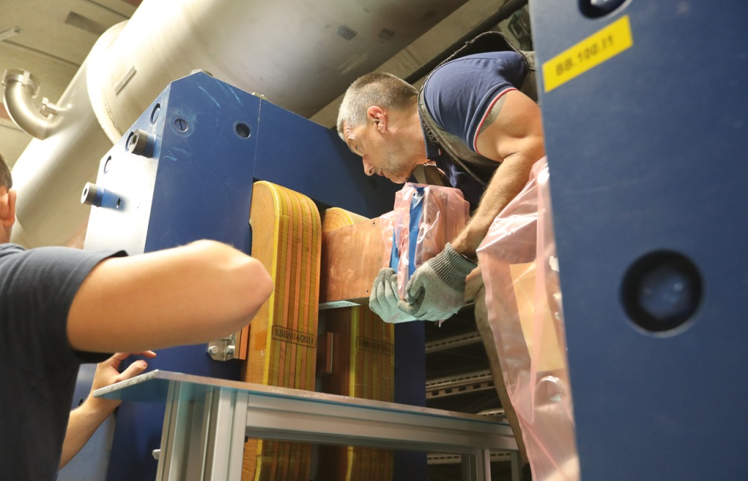
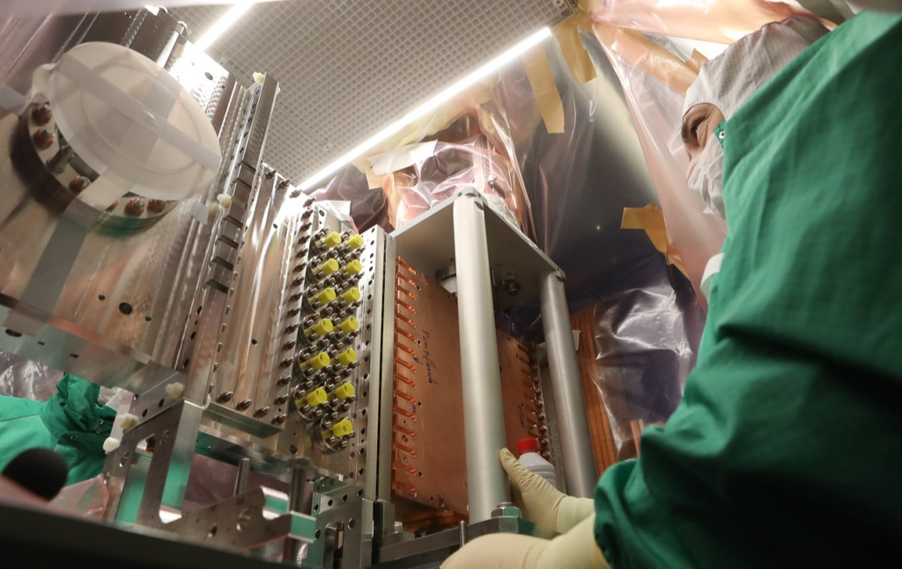
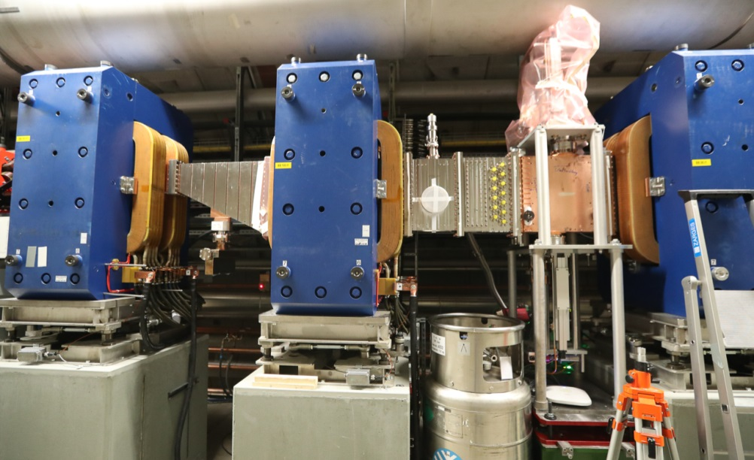
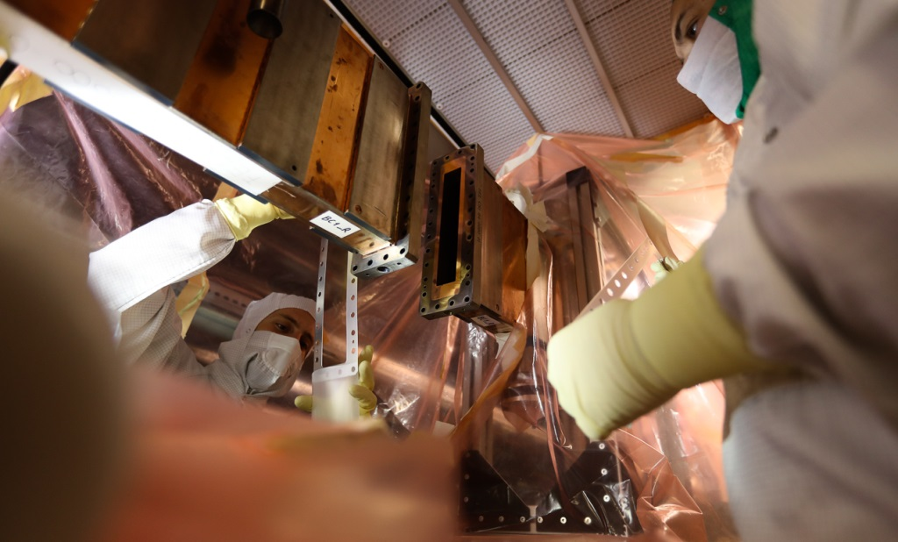

Warm Beam Line Sections
Bunch Compressor Sections – Challenging Installation

Slide 26


Bunch Compressor BC1

Slide 27
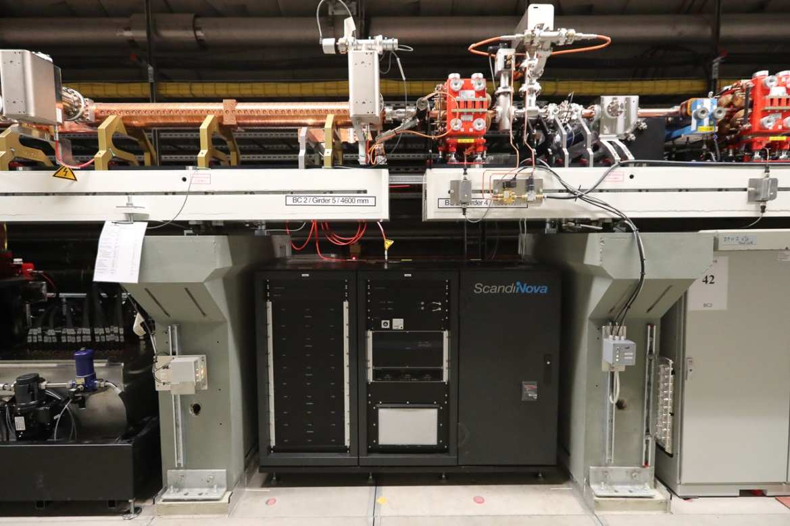
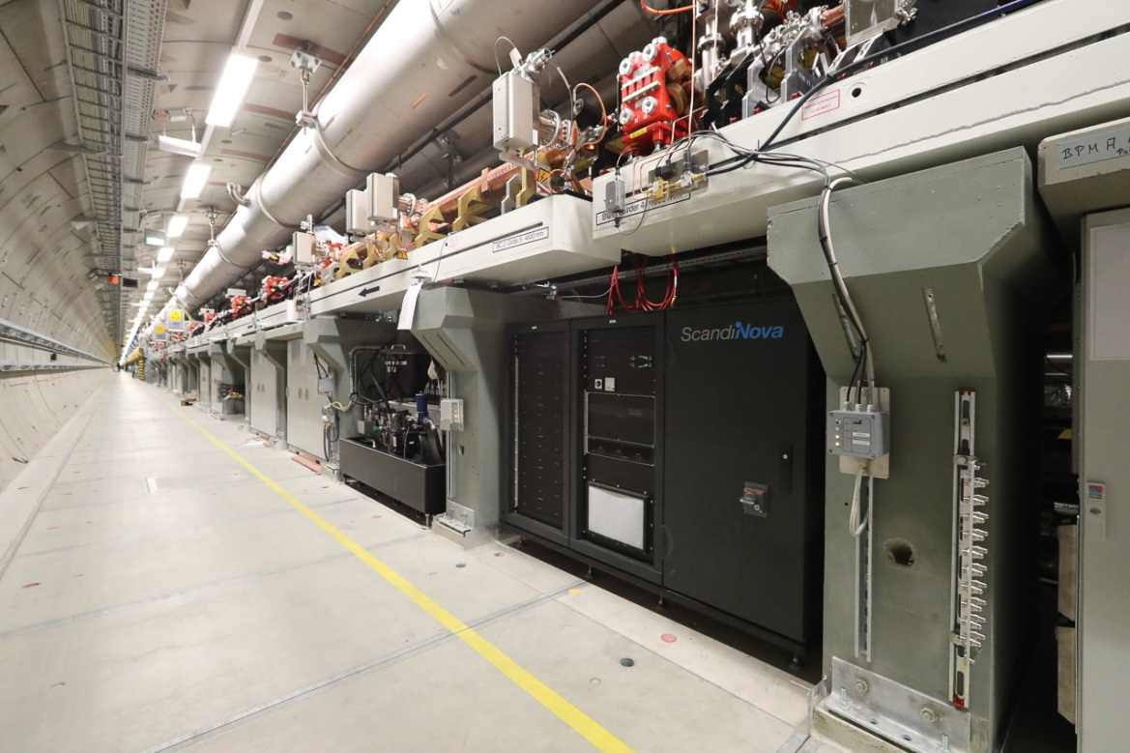

Transverse Deflection System in Bunch Compressor BC2
The BC2 TDS system is one important system to be used to verify short bunch lengths during linac setup.

Slide 28
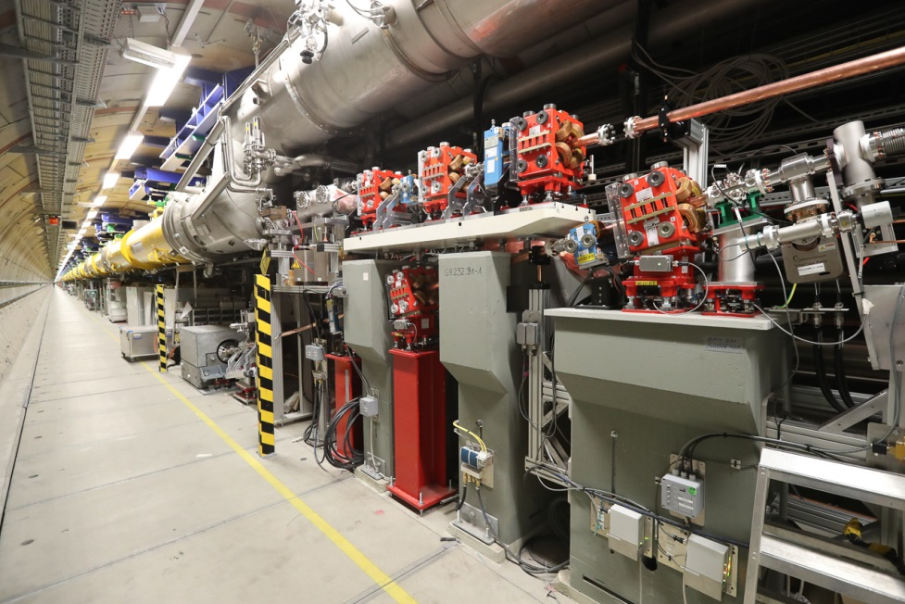
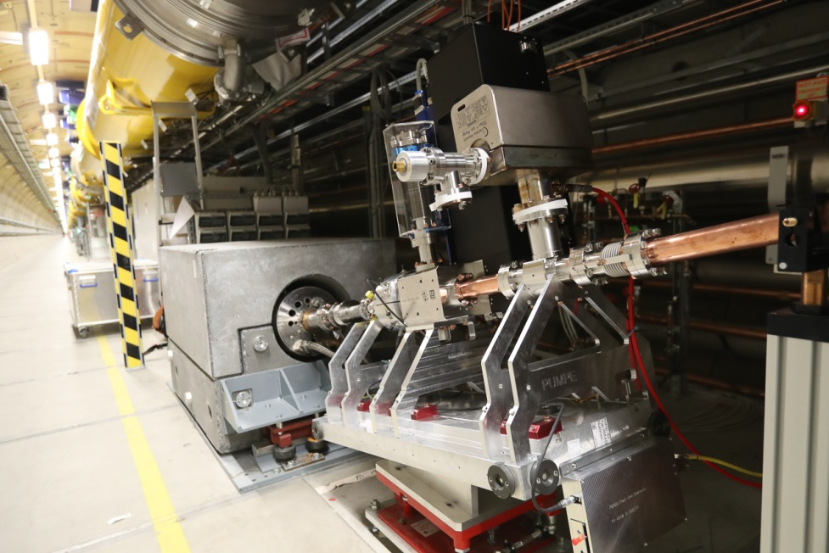
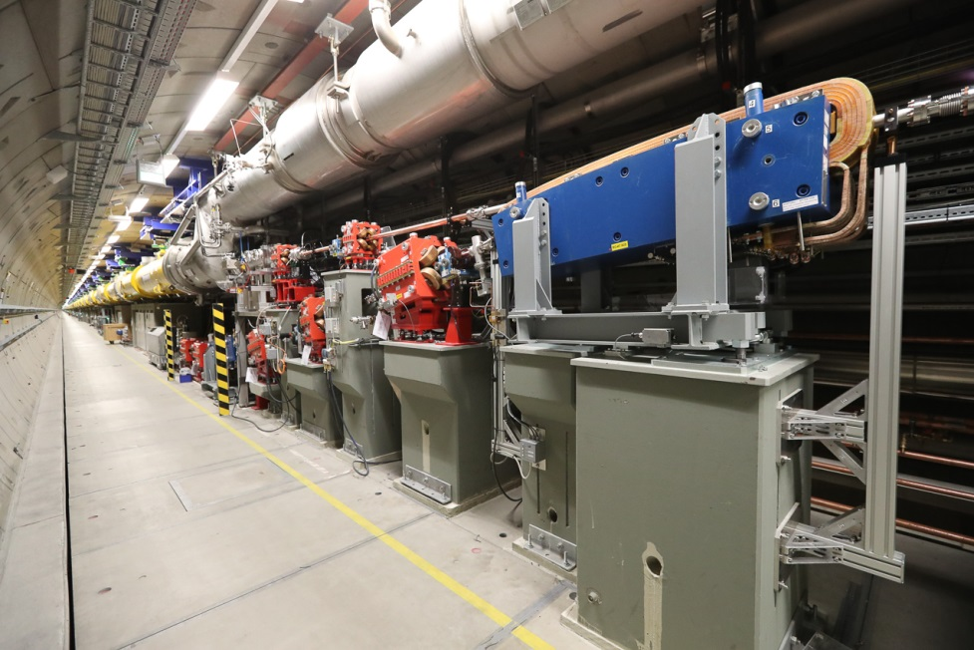
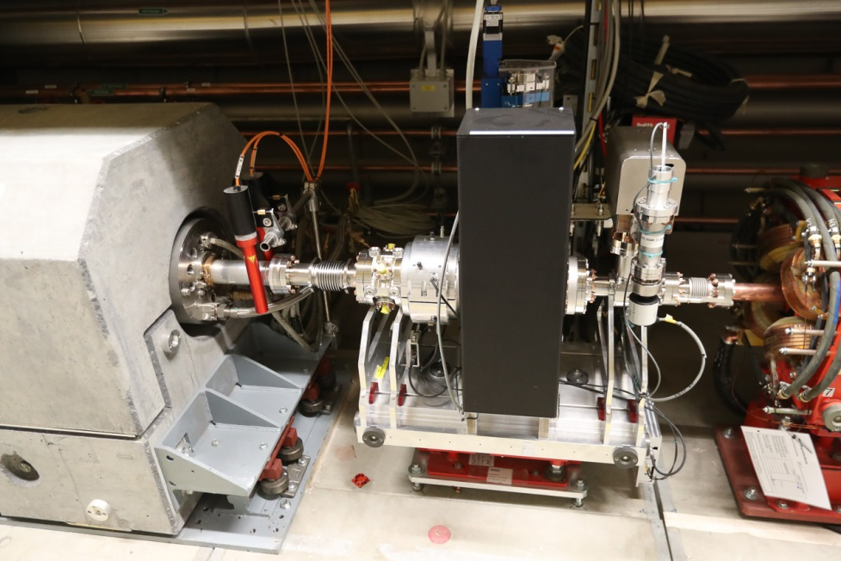
Both Bunch Compressors BC1 / BC2 include Commissioning Beam Dumps

Slide 29
Linear Accelerator

Slide 30
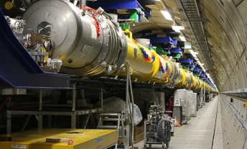
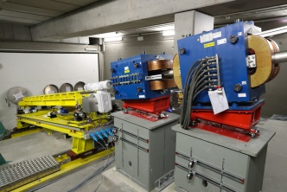
Post Linac Beam Lines upstream of XS1
1.508m
200 m transport line (eq. to 4 + 12 modules)
200 m collimation
XTL
1.520m
1.530m
1.540m
1.550m
1.560m
1.570m
1.580m
1.590m
1.600m
1.610m
1.620m
DACHS
door
143
144
1.620m
1.630m
1.640m
1.650m
1.660m
1.670m
1.680m
1.690m
1.700m
1.710m
1.720m
1.730m
1.740m
<<< Cabling >>>
145
146
147
148
1.740m
1.750m
1.760m
1.770m
1.780m
1.790m
1.800m
1.810m
1.820m
1.830m
1.840m
1.850m
1.860m
Container for condensed water
450 ltr.
<<< Cabeling >>>
149
150
151
1.860m
1.870m
1.880m
1.890m
1.900m
1.910m
1.920m
1.930m
1.940m
1.950m
1.960m
1.970m
1.980m
<<< Cabling >>>
<<< Cabling >>>
152
153
154
155
156
157
158
159
160
161
162
163
164
1.980m
1.990m
2.000m
2.010m
2.020m
2.030m
2.040m
2.050m
2.060m
2.070m
2.080m
2.090m
2.100m
166
167
168
169
170
Wall
2.100m
2.110m
XS1
2.120m
2.130m
200 m beam distribution
100 m XS1 dump line
DUMP

Slide 31
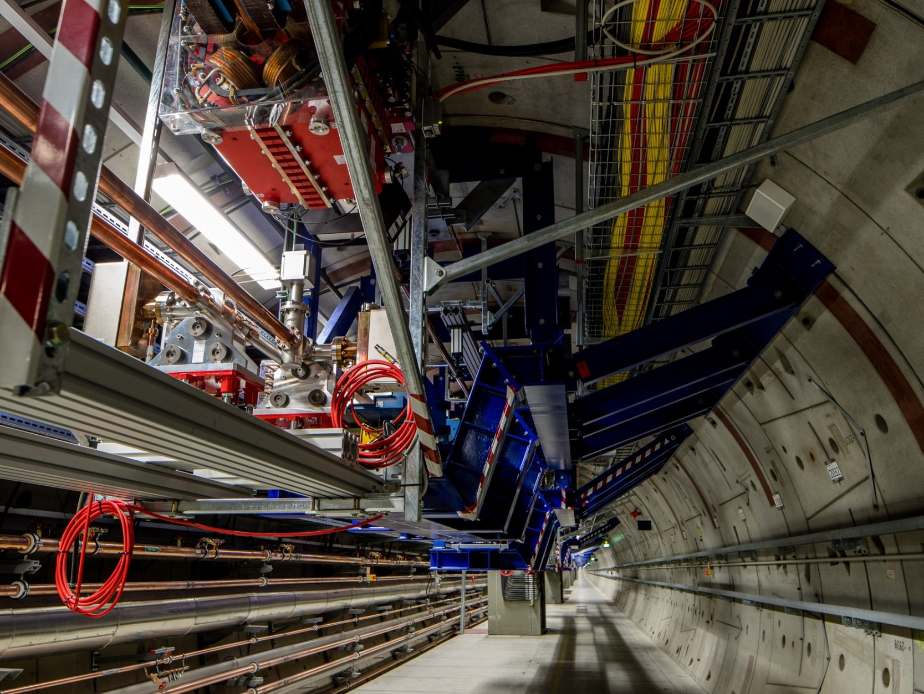

Transfer Lines at the End of the Main Linac Tunnel (XTL)
XDU2
XDU2
All beam lines are suspended from the ceiling
Engineering of ‘hanging’ system needed some effort but result is very satisfying
XS1
XDU2

Slide 32
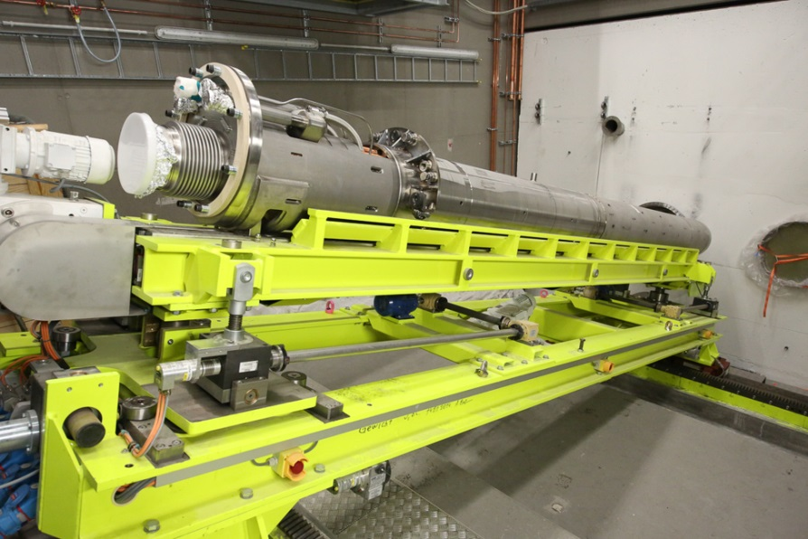
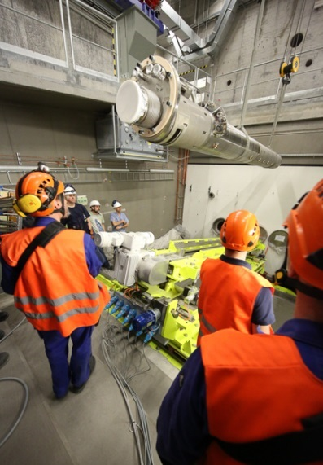
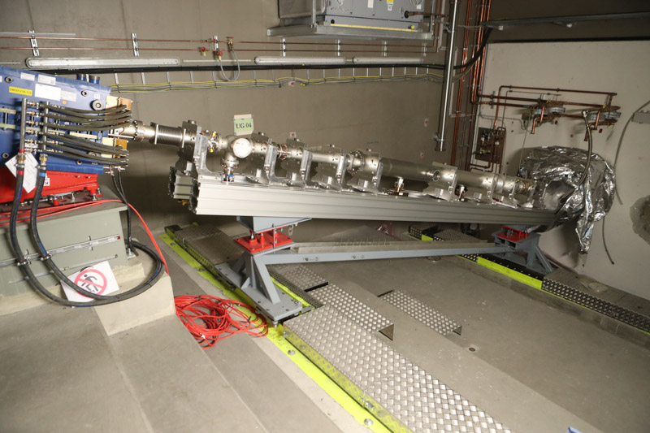
Warm Beam Line Sections
Transport Line to XS1 Beam Dump
XDU2
XDU2
XS1
XDU2
Three 300 kW main beam dumps
Special vehicles to exchange activated dumps

Slide 33
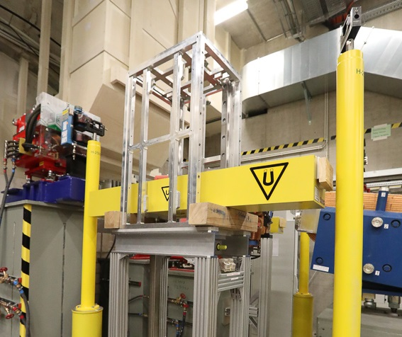


Installation on Top of XS1 Dump Cave
XS1 installation includes transport towards XTDs

Slide 34




Final Installation Activities
SASE2 Undulator Section
Mechanical vacuum work in the southern branch almost finished.
Technical commissioning in Q3/2017.

Slide 35

SASE Undulator Sections with special air conditioning hutch
courtesy of XFEL.EU

Slide 36



Installation of Photon Beamlines
courtesy of XFEL.EU
1st and 2nd offset mirrors in XTD2
Fast valves and 500 m pipes in XTD9
Differential pump + XGM in XTD9

Slide 37







Photon Beam Diagnostics Status SASE1 – XTD2
courtesy of XFEL.EU
Gas supply
K-mono
XGM
Pop-in Monitor
Filter Ch. & IMGTR
IMGSR
MCP-detector

Slide 38





Photon Beam Diagnostics Status SASE1 – XTD9
courtesy of XFEL.EU
crystal
chamber
grating
chamber
XGM@XTD9
HIREX diagnostic
spectrometer system
XGM@XTD9
HIREX crystal chamber
Pop-in Monitors Type I and II-45

Slide 39



XHEXP – SASE1 science instruments
courtesy of XFEL.EU

Slide 40


SASE1 - Femtosecond X-ray Experiment (FXE)
courtesy of XFEL.EU

Slide 41



Beamline Commissioning Progress
L1
L2
L3
0m 30m 230m 480m 1430m 2100m 3100m
13/01*
15/01 @ 130 MeV
19/01 @ 600 MeV
* Beam permission on 13/01
02/02 @ 600 MeV
22/02 @ 2.5 GeV
27/04 Beam spot before dump
25/02 @ 2.5 GeV
19/03 @ 6 GeV
08/04 @ 12 GeV
27/04*
* Beam permission on 26/04
keen on lasing…

Slide 42



First signal from FEL radiation
02.05.17 - 03.05.17
low energy 6.4 GeV working point for beam based alignment
no undulator beam based alignment yet, no laser heater
some tweaking of compression and trajectory
E = 6.4 GeV
K = 3.5
9 Å

Slide 43

Systematic approach towards short wavelengths
After first lasing a systematic approach (BBA and commissioning of undulator ctrl) was chosen.
Photon beam diagnostics was commissioned. Well prepared for lasing at short wavelength…
300µm
x
y
SASE1
500pC
charge

Slide 44



Lasing at 2 Angstroem
orbit & compression feedback in operation
transport to SASE1 exp area is next
photon beam at the end of XTD9

Slide 45


















General Assembly of the European XFEL Accelerator Consortium
04.05.2017
Guest Scientists during commissioning
THANK YOU TO ALL CONTRIBUTORS TO THE
EUROPEAN XFEL

