Slide 1
Alternative and Flat Beam Triplet
Léon van Riesen-Haupt, Jose Abelleira-Fernandez, Andrei Seryi, Emilia Cruz-Alaniz
Thanks to Roman Martin and Rogelio Tomás
30th May 2017

Slide 2
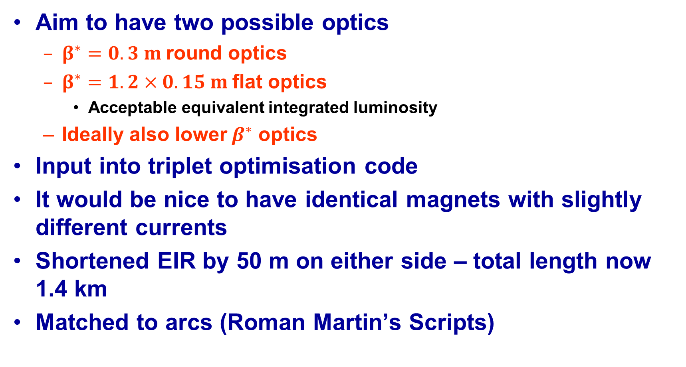
Attempt
Aim to have two possible optics
  $β^{∗}=0.3 m$round optics
  $β^{∗}=1.2×0.15 m$flat optics
    Acceptable equivalent integrated luminosity
  Ideally also lower$β^{∗}$ optics
Input into triplet optimisation code
It would be nice to have identical magnets with slightly different currents
Shortened EIR by 50 m on either side – total length now 1.4 km
Matched to arcs (Roman Martin’s Scripts)

Slide 3
Triplet Optimisation
Optimisation code
  Scans through parameter space
    Using thin lenses first
    Then MADX aperture module
  Finds shortest triplet with sufficient beam stay clear
  See poster
Optics design and radiation studies worked closely together
  Radiation studies done on triplet
  Shielding adjusted if needed
  Run optimisation again

Slide 4
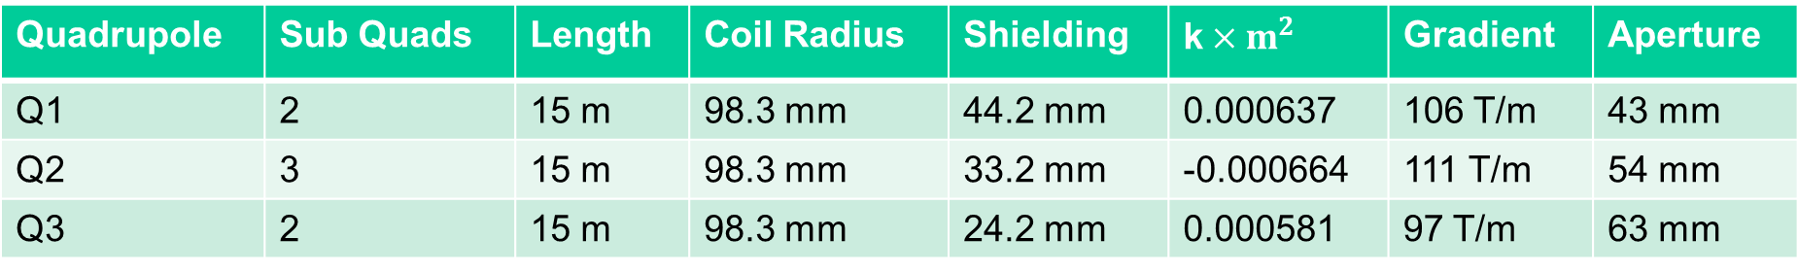
Quads
Triplet made of 2-3-2 pattern of identical magnets
2 m spacing between sub-magnets
7 m between groups – fit kickers and instruments
Quadrupole | Sub Quads | Length | Coil Radius | Shielding | k$×m^{2}$ | Gradient | Aperture
Q1 | 2 | 15 m | 98.3 mm | 44.2 mm | 0.000637 | 106 T/m | 43 mm
Q2 | 3 | 15 m | 98.3 mm | 33.2 mm | -0.000664 | 111 T/m | 54 mm
Q3 | 2 | 15 m | 98.3 mm | 24.2 mm | 0.000581 | 97 T/m | 63 mm
15 m
2 m
7 m
Q1A
Q1B
Q2A
Q2B
Q2C
Q3A
Q3B
45 m
Q1
Q2
Q3

Slide 5
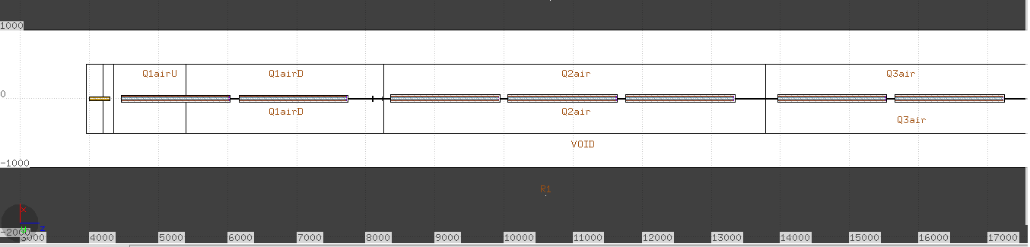
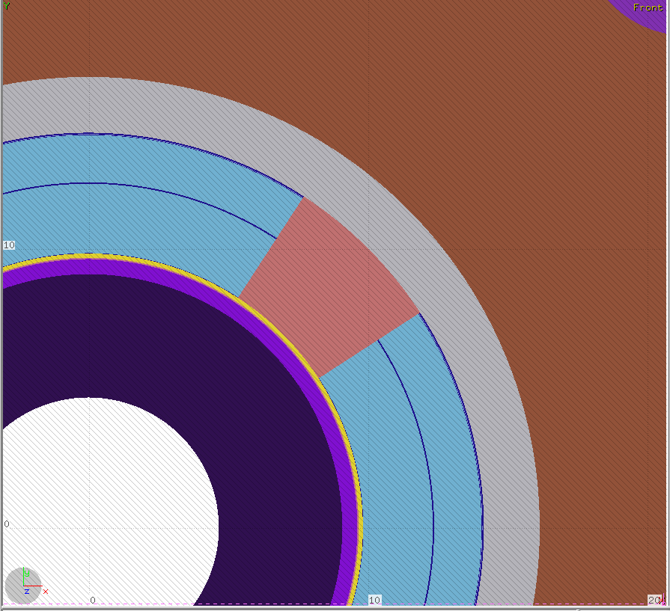
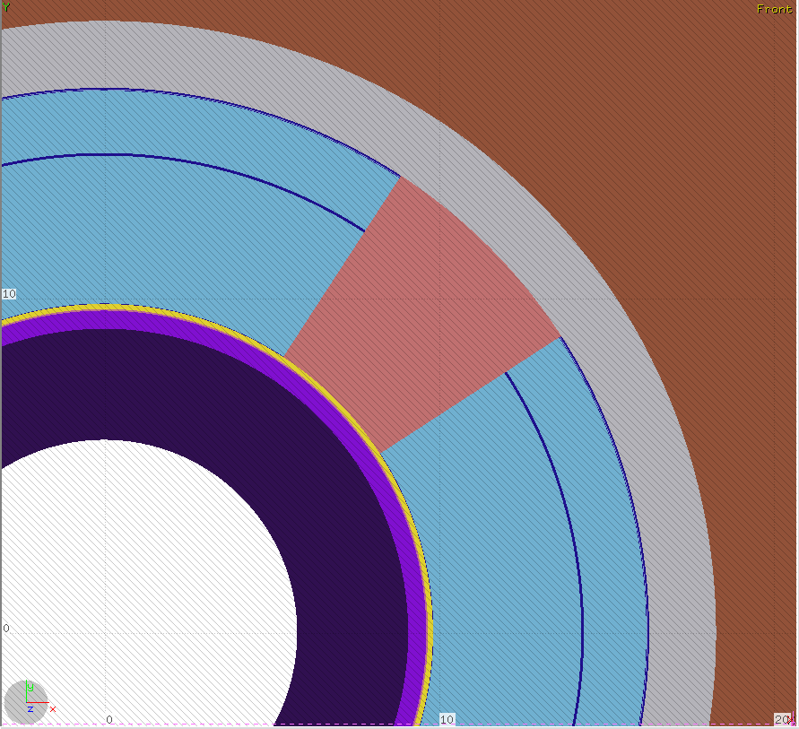
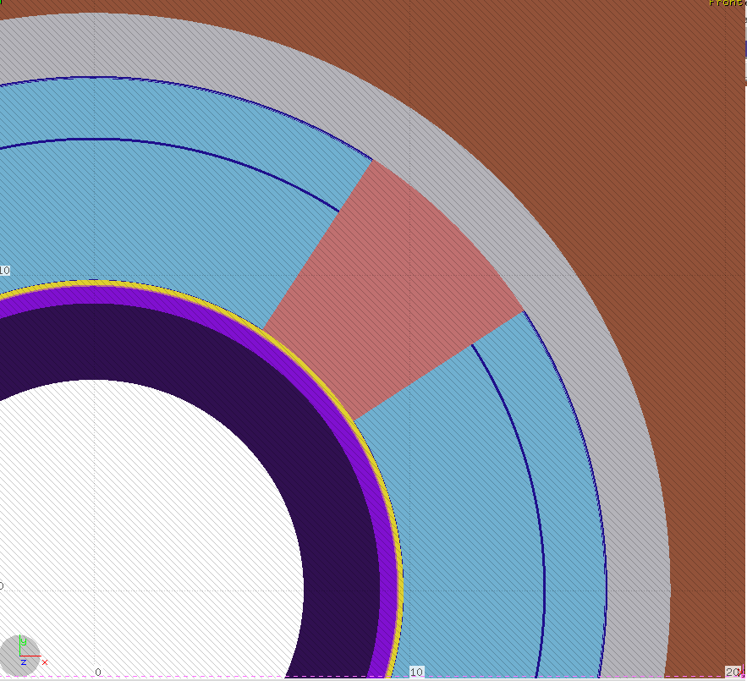
Model
Q1
106 T/m
Q2
111 T/m
Q3
97 T/m
Abs:4.4 cm
Abs:3.3 cm
Abs: 2.4cm

Slide 6
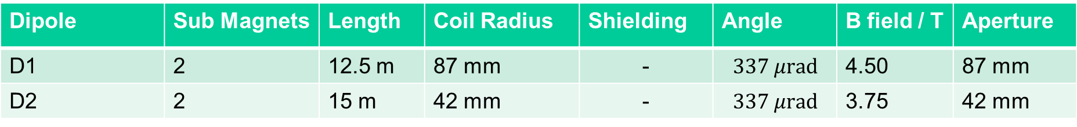
Separation Dipoles
Moved D1 close to triplet (consistent 7 m)
Moved D2 and entire matching section 50 m closer to triplet
  Conserves space for crab cavities
  EIR now 1.4 km
Re-matched matching section
Dipole | Sub Magnets | Length | Coil Radius | Shielding | Angle | B field / T | Aperture
D1 | 2 | 12.5 m | 87 mm | - | $$337 μrad$$ | 4.50 | 87 mm
D2 | 2 | 15 m | 42 mm | - | $$337 μrad$$ | 3.75 | 42 mm

Slide 7
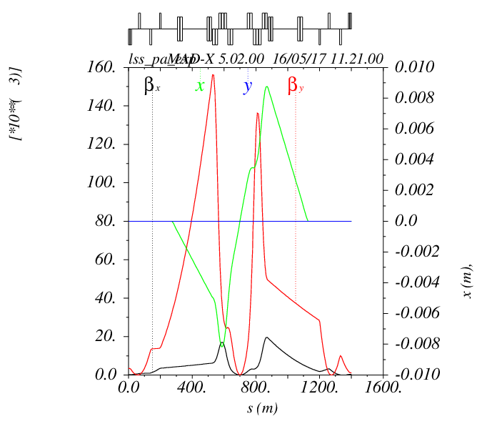
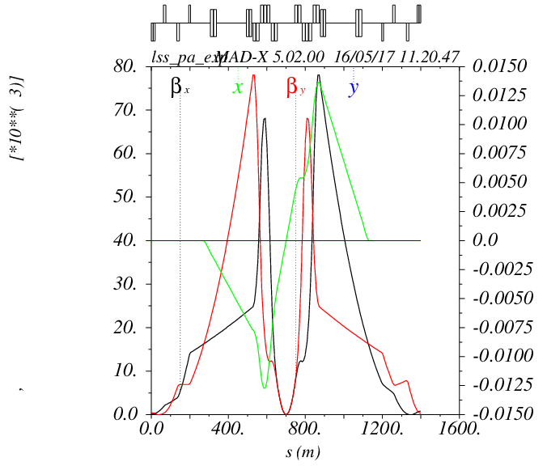


Optics
Round$β^{∗}=0.3 m$
Flat${ β}^{∗}=1.2×0.15 m$

Slide 8
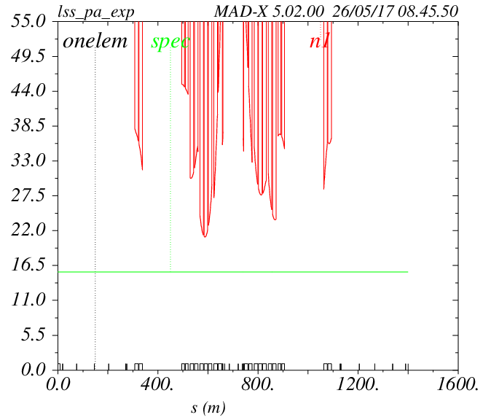
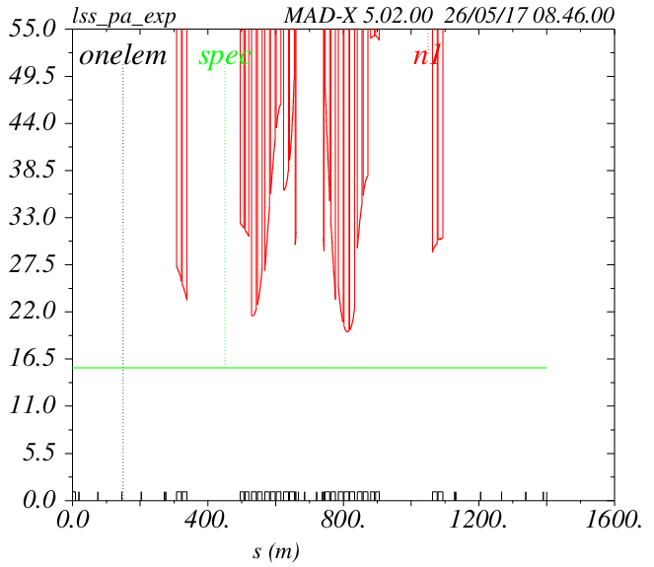



Beam Stay Clear
Round${ β}^{∗}=0.3 m$
Flat${ β}^{∗}=1.2×0.15 m$
$$21σ$$
$$19.6σ$$

Slide 9
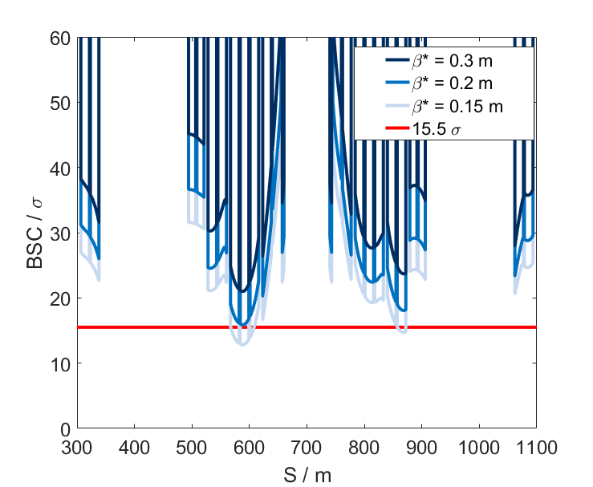
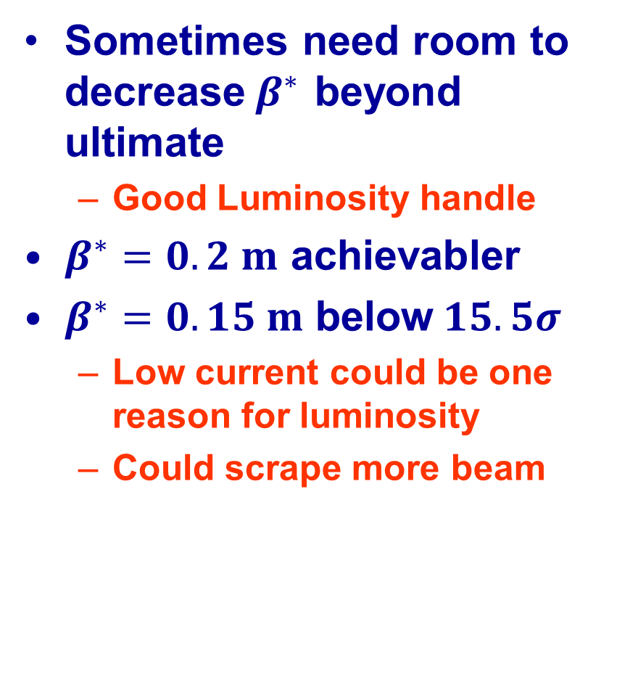
$β^{∗}$ Reach
Sometimes need room to decrease$β^{∗}$ beyond ultimate
  Good Luminosity handle
$β^{∗}=0.2 m$ achievabler
$β^{∗}=0.15 m$ below$15.5σ$
  Low current could be one reason for luminosity
  Could scrape more beam

Slide 10
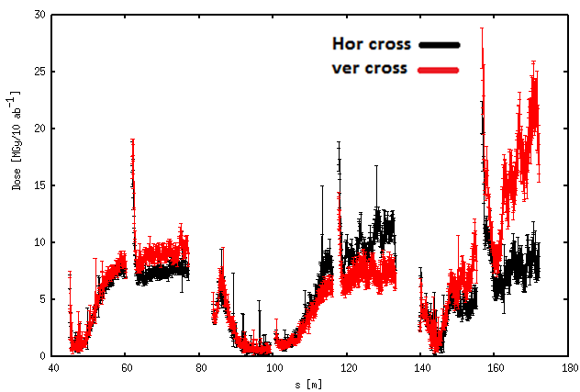
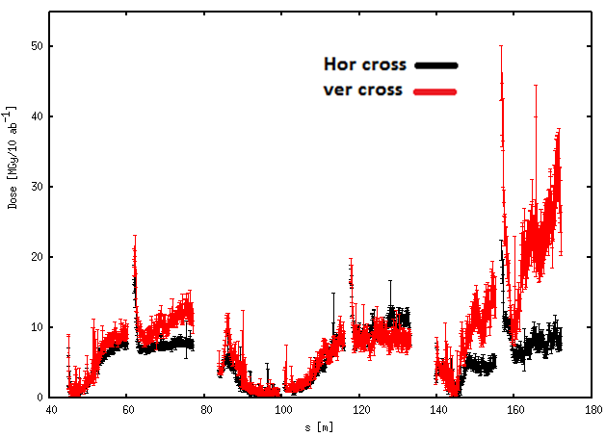
Radiation
Round${ β}^{∗}=0.3 m$
Flat${ β}^{∗}=1.2×0.15 m$

Slide 11
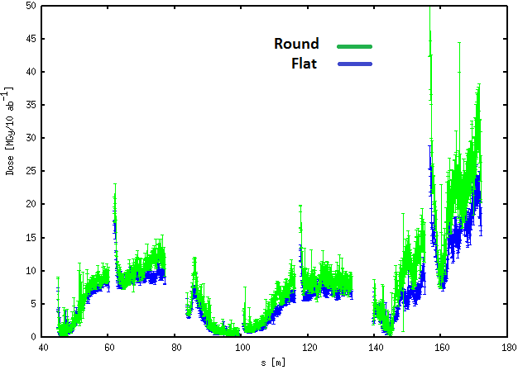
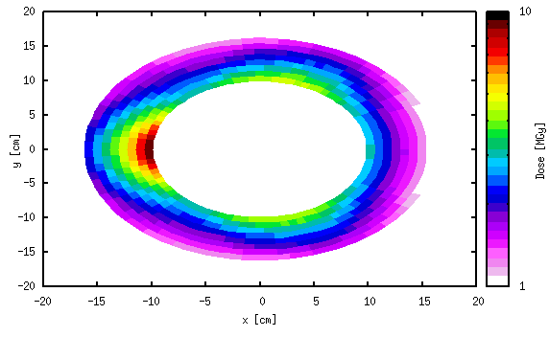
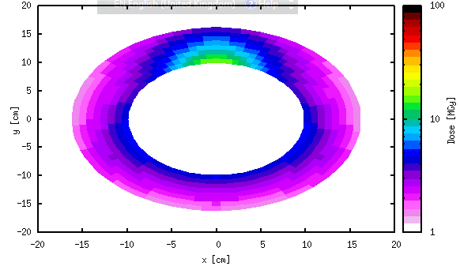
Changing Crossing Planes
Peak dose (50 % hor, 50% vertical cross.)
Q1-Q2 below 15 MGy (45MGy for 30 ab-1).
Q3 still high. Can be potentially reduced by increasing shielding – still some margin.

Slide 12
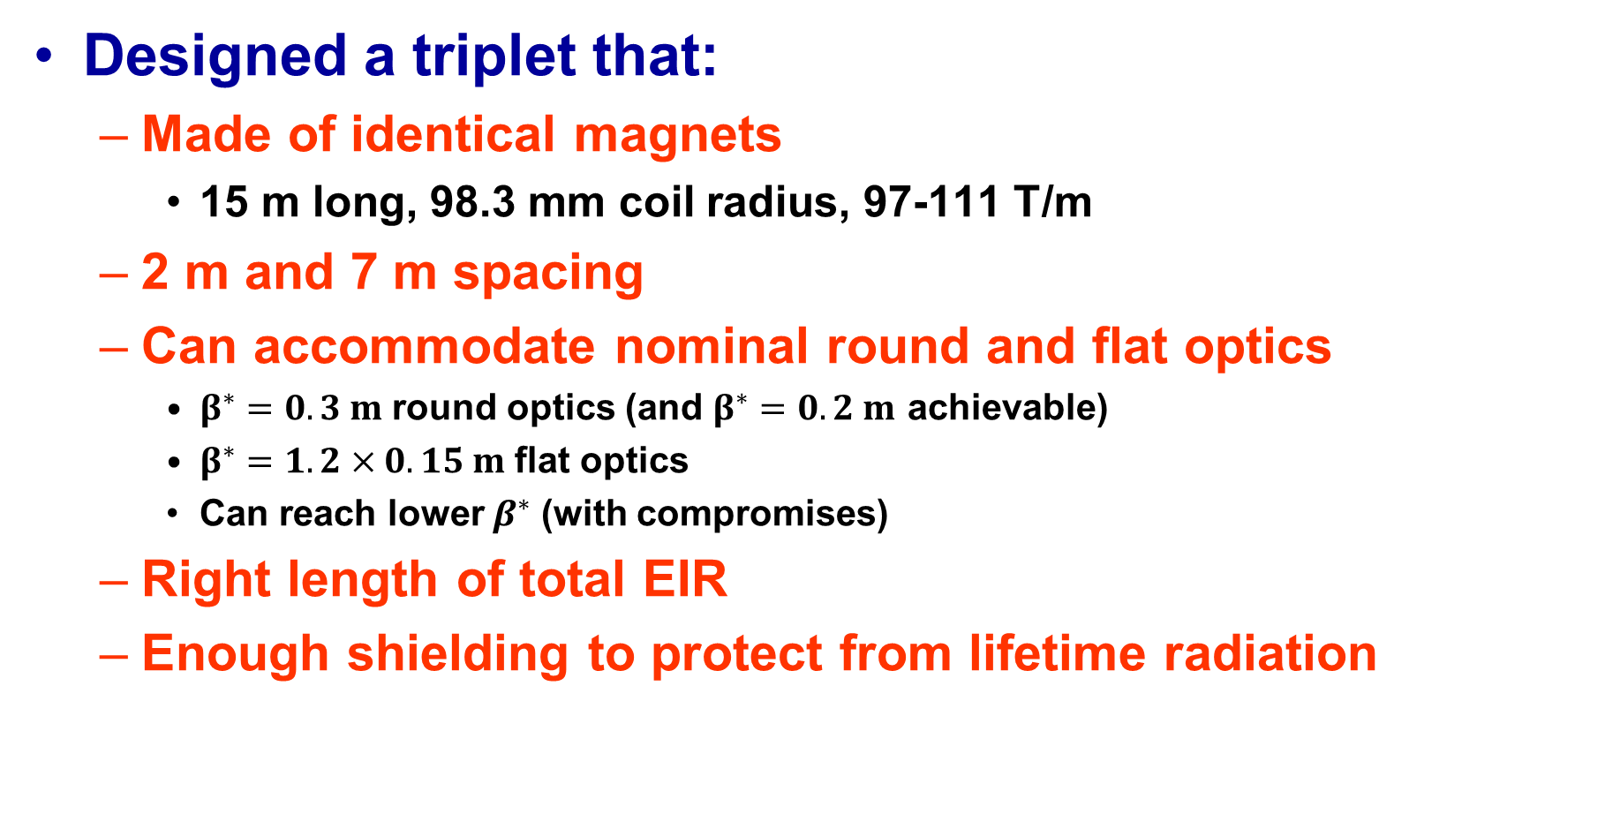
Conclusion
Designed a triplet that:
  Made of identical magnets
    15 m long, 98.3 mm coil radius, 97-111 T/m
  2 m and 7 m spacing
  Can accommodate nominal round and flat optics
    $β^{∗}=0.3 m$round optics (and $β^{∗}=0.2 m$ achievable)
    $β^{∗}=1.2×0.15 m$flat optics
    Can reach lower$β^{∗}$ (with compromises)
  Right length of total EIR
  Enough shielding to protect from lifetime radiation

