Slide 1
Accelerating and injecting polarized beams into FCC-ee
I. Koop, BINP, Novosibirsk
FCC-week, Berlin, 01 June 2017

Slide 2
Outline
Introduction to a concept.
Polarizing damping rings.
Acceleration of polarized beams in the booster synchrotrons.
Evaluation of the depolarization rates.
Free spin precession approach proposed for fast determination of the average beam energy.
Conclusion.

Slide 3
Introduction
FCC-ee demands 50 keV beam energy resolution at Z and 100 keV at W, separately in e⁺ and e⁻ rings.
Only the resonant depolarization (RD) can provide such extreme absolute accuracy: ΔE/E ˂ 1 · 10 ⁻⁶ !
Two 1 - 1.5 GeV damping rings with high field bends can provide fast self-polarization of both beams.
Every 10-20 s one or few polarized bunches will be extracted from the damping ring and will be accelerated in a 5-6 GeV linac and then in the cascade of synchrotrons (6-20, 20-45… 175 GeV).
Preservation of the polarization will be provided by the use of the solenoid type spin rotators (Siberian Snakes ) installed in 2 or 4 straight sections of each synchrotron.

Slide 4
Acceleration scheme for FCC-ee: proposal
Acceleration scheme for FCC-ee: options #1, #2
Polarizing
Damping Rings
1 GeV
Collider rings
45 – 175 GeV
e⁻ linac
1 GeV
e⁺ linac
1 GeV
Booster
20 - 175 GeV
linac
5 GeV
Pre-booster
6 - 20 GeV
e⁺
e⁻
Polarizing
Damping Rings
1 GeV
Collider rings
45 – 175 GeV
e⁻ linac
1 GeV
e⁺ linac
1 GeV
Booster
15 - 175 GeV
linac
14 GeV
e⁺
e⁻

Slide 5
Pro and contra of two acceleration scheme options
No degradation of the polarization in a linac is expected.
Repetition frequency of a linac is high.
But synchrotrons are cheaper compared to linacs!?
Still the use of many fast ramping solenoids in spin rotators presents a certain challenge:
1) Heat released in coils due to eddy currents – a first problem.
2) High ramp voltage dictates use of many solenoid sections,
powered by the independent power-converters.
So, it is preferable to eliminate extra synchrotrons except of the last one, which will share a tunnel with the collider and will be not too fast ramping (~10 seconds).

Slide 6
Polarizing damping ring optimization
Optimal energy is about 1 GeV. It is large enough to suppress IBS and small enough not radiate too much SR power.
SLAC was operating very successfully 1.2 GeV damping rings!
From polarization point of view it is preferable to use the high field bends instead of asymmetric field wigglers. Currently we propose to use of B=5.5 T short dipole magnets (24 identical dipoles, 15⁰ each).
But SC wigglers are better developed, could also be considered as an option.

Slide 7
Polarizing ring parameters
Energy, E | 1 | GeV
Circumference, C | 22 | m
Average radius, R | 3.5 | m
Bending radius, ρ | 0.6 | m
Bending field, B | 5.5 | T
Energy loss / turn, U₀ | 145 | keV
Momentum spread, σ_{p} | 0.00155
Number of e± per bunch, N | 10¹⁰
Number of bunches, N_{b} | 16
Total beam current, I | 350 | mA
SR powrer | 50 | kW
Sokolov-Ternov polarization time , τ_{ST} | 127 | s
Polarization degree | 70 | %
Injection/Ejection time periodicity, T₀ | 10 | s
Here we assume that every bunch spends in a ring T₀ ·N_{b=}=160 s before extraction.
So, the polarization degree is high enough, in the order of 70%!
Every 10 s one bunch is assumed to be extracted for the energy calibration purposes .
Use of high bending field is energetically beneficial to obtain the required polarization degree.

Slide 8
High energy booster synchrotron demands
Fast acceleration from 15-20 GeV up to 175 GeV of train of unpolarized e± bunches to keep the collider luminosity constant within 10% or better.
Preserve during acceleration the polarization of one or few polarized bunches, which are extracted from the polarizing damping ring and be added to the train of unpolarized bunches.
The Resonant Depolarization technique can work only below 80-100 GeV (extrapolation from LEP studies). So, there is no much sense to build spin rotators for operation at higher energy.
Energy measurement above 80-100 GeV shall be provided by the magnetic spectrometers, which will be calibrated by RD below that threshold.

Slide 9
Closed spin orbit in a ring with 4 snakes
In 70-th such approach was considered by A.Kondratenko,
for FCC-ee discussed by S.R. Mane:
arXiv:1406.0561v1, physics.acc-ph 3 Jun 2014.
Snake 3
φ2=(1+δ)π/2
φ3=(1-δ)π/2
We propose δ=0.002
Then ν=0.363 at 80 GeV
Instead of being ν₀ = γa =181.5
Snake 4
Snake 2
φ4=(1-δ)π/2
φ1=(1+δ)π/2
Snake 1
The equilibrium spin direction is upright or down in arcs. Snakes rotate spin by 180⁰ around the longitudinal direction. The spin precession frequency will be zero in case of equally spaced snakes. To make the spin motion stable , a small asymmetry of “positive” and “negative“ arcs has to be foreseen: φ=(1±δ)π/2. Then the spin tune became reduced to ν= δ ·ν₀. Here ν₀=γa is the unperturbed spin tune, with the anomalous magnetic moment: a=0.001159652187….

Slide 10
Booster ring for FCC-ee top up injection
Four snakes spaced by the azimuthal angle π/2 ± φ from each other will reduce the spin precession tune by the factor 2φ/π.
φ=0.003
FCC-ee collider rings
FCC-ee collider arcs
Solenoid type
Siberian Snakes
With φ=0.003, one gets
ν=0.36 at E=80 GeV,
instead of being ν₀=181.5 w/o snakes.
Non-skewed quads!
Solenoids
~ 200 m

Slide 11
Depolarization in presence of snakes
Derbenev-Kondratenko formula:

Slide 12
Tolerances on the orbit distortions

Slide 13
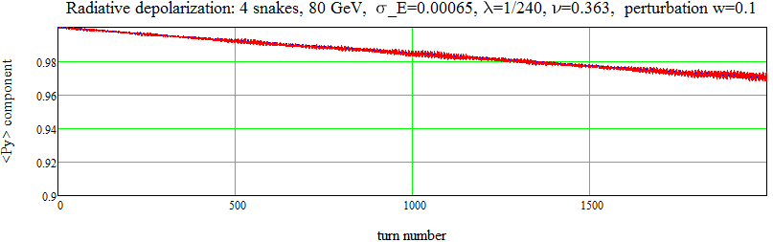
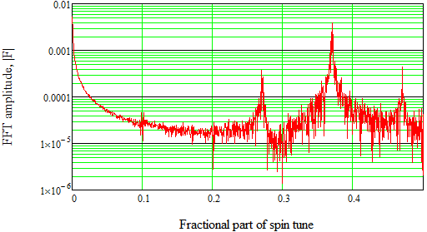
Spin tracking of the depolarization process
Spin tracking of 1000 particles in a ring with the spin perturbation w=0.1.
The depolarization time 18 s is sufficient for acceleration to 80 GeV in 10 s.
Due to perturbation the spin precession frequency became shifted to 0.3702 from the ideal 0.3631 value.
Spectrum of the transversal polarization component.
Side bands are spaced by synchrotron tune ν_{s}=0.1

Slide 14
How to utilize polarized bunches in FCC-ee
The accelerated to Z or W thresholds polarized bunches can be used for energy calibration in FCC-ee in two ways:
1) They simply can be resonantly depolarized, being injected into collider with vertical direction of spin.
2) Alternatively, they can be injected with spins directed in the horizontal plane. And using the laser polarimeter one can observe the modulation of Compton backscattering cross-section by the coherent precession of bunch spins ensemble.
The last option can provide much faster and robust method of the spin precession frequency determination. Still it works if the synchrotron tune is large enough, only!
Few examples of spin tracking results are presented in next slides.

Slide 15
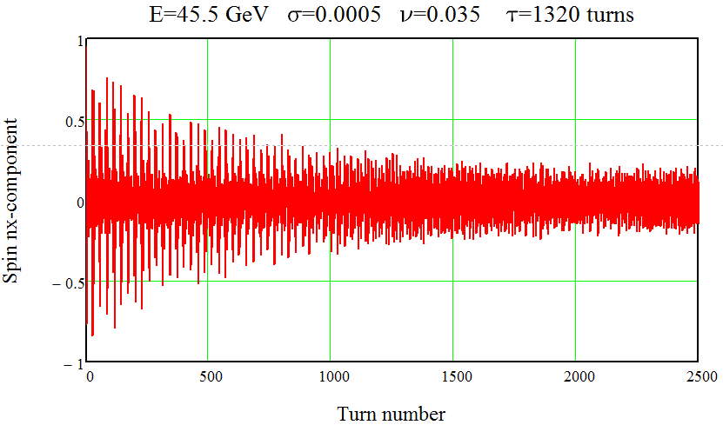
Spin tracking oscillogram. 125 test-particles.
E=45.5 GeV, σ_{δ}=0.0005, ν_{s} =0.035, τ_{s} =1320 turns

Slide 16
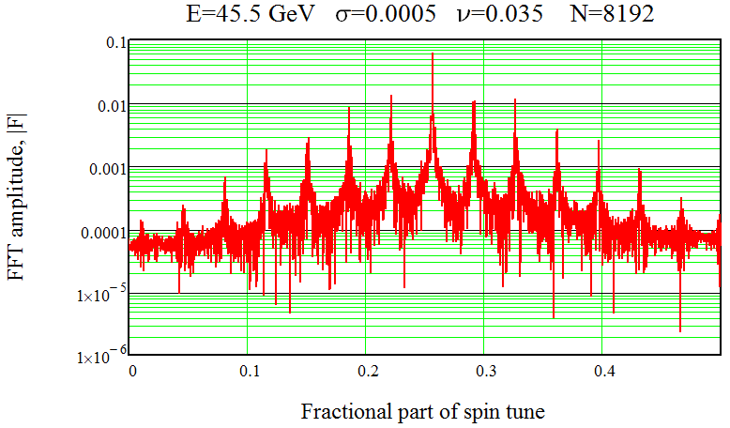
Spin precession spectrum. Number of turns 8192.
E=45.5 GeV, ν₀=103.25, σ_{δ}=0.0005, ν_{s} =0.035, χ=1.48
We want: χ < 1.7. With χ > 1.7 peaks in spectrum disappear!

Slide 17
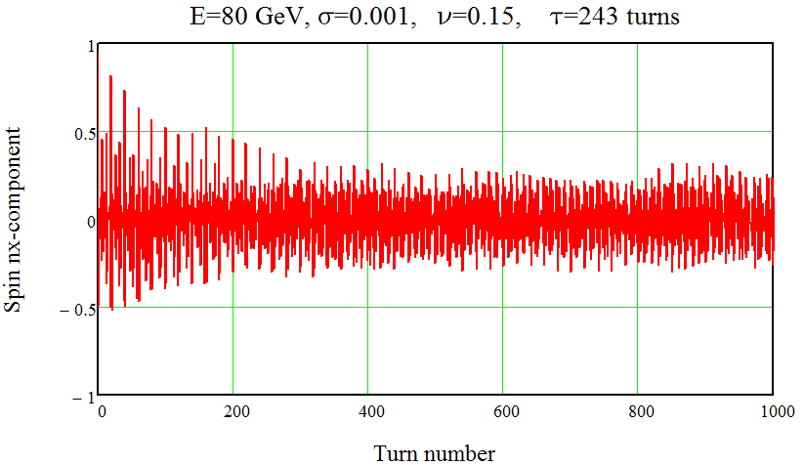
Spin tracking oscillogram. 125 test-particles.
E=80 GeV, σ_{δ}=0.001, ν_{s} =0.15, τ_{s} =243 turns

Slide 18
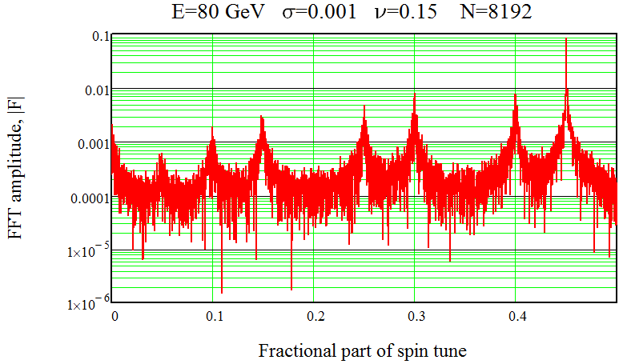
Spin precession spectrum. Number of turns 8192.
E=80 GeV, ν₀=181.55, σ_{δ}=0.001, ν_{s} =0.15, χ=1.21

Slide 19
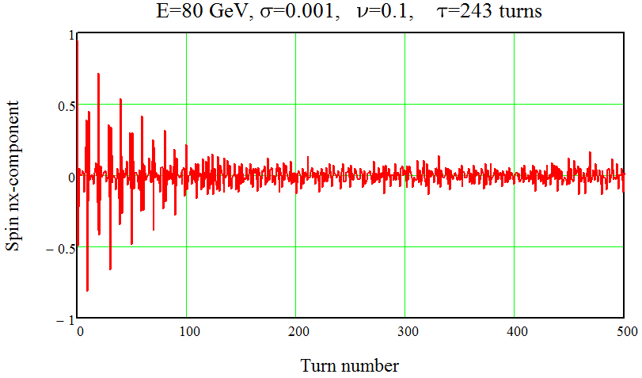
Spin tracking oscillogram. 125 test-particles.
E=80 GeV, σ_{δ}=0.001, ν_{s} =0.10, τ_{s} =243 turns
Fast de-phasing due to too slow synchrotron motion!

Slide 20
Conclusion
Four Siberian snakes installed in the main booster at proper locations provide preservation of the polarization during acceleration up to E=80 – 100 GeV beam energy.
Free precession approach can be applied for fast determination of the spin tune after injection of single polarized bunch into the collider.
Important: the synchrotron modulation index should be small: χ < 1.8 (χ= ν₀σ_{δ}/ν_{s} ), otherwise it will happen fast decoherence of the spin precession. This leds to operation of the collider with high value of the synchrotron tune: ν_{s} > 0.10 at E=80 GeV.
The Sokolov-Ternov self-polarization mechanism requires also small value of the synchrotron modulation index: χ < 1. Seems, unrealistic above 80 GeV?
A set of energy monitors (well controlled magnetic spectrometers?) shall be used for the local beam energy measurements in the full energy range of FCC-ee.

