Slide 1


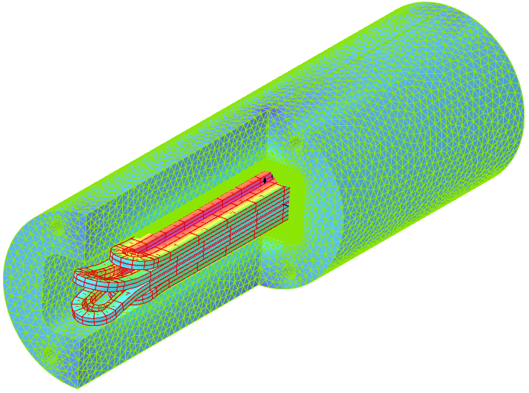
EuroCirCol
Block emag
FCC week 2017
Clement Lorin, Maria Durante
CEA
Acknowledgements :
Chhon Pes, Helene Felice, Arnaud Madur, Susana Izquierdo-Bermudez, Etienne Rochepault
all WP5 ECC members!
Berlin, 31 May 2017

Slide 2
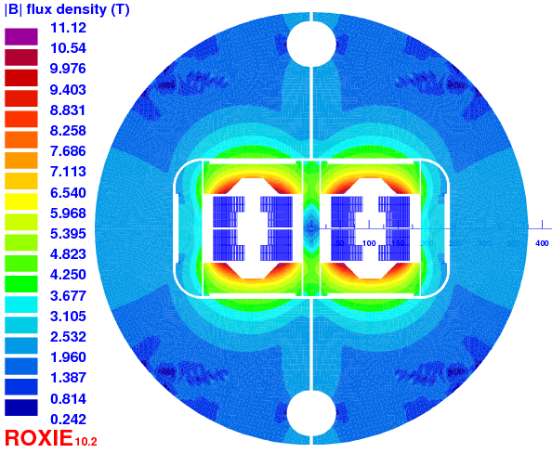
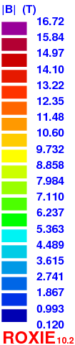
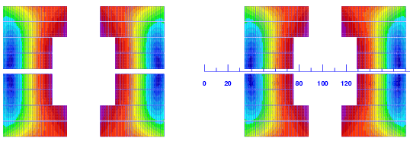
2D overview of a 16 T central field 2-in-1 block magnet
Yoke/pads
Coils
Global remarks:
Heat Exchanger: Ф = 80 mm?
-> study?
No tie rods
Trapezoid: b3 low current

Slide 3

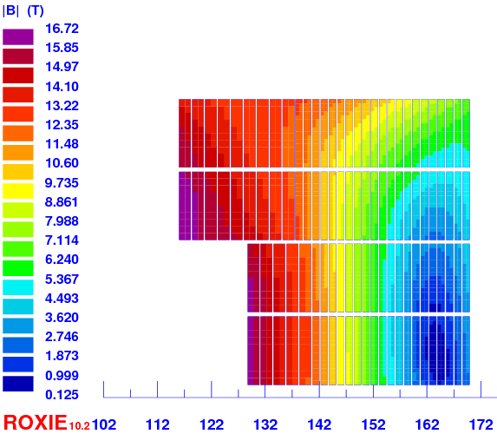
Design evolution
Quantity | ASC2016 | v20ar | v1ari204 | Unit
strand diameter | 1.1 – 0.7 | 1.155 – 0.705 | 1.15 – 0.70 | mm
nb of strands | 24 – 39 | 21 – 35 | 20 – 34 | N/A
Cable width | 14.25 | 13.05 | 12.6 | mm
Cable thickness | 2.0 – 1.25 | 2.1 – 1.25 | 2.1 – 1.25 | mm
Cu/nonCu | 0.8 – 1.6 | 0.8– 2.3 | 0.8– 2.0 | N/A
I_{nom} | 10930 | 10990 | 10480 | A
B_{peak} | 16.81 | 16.74 | 16.72 | T
LL margin (1.9 K) | 13.95 | 14.01 | 13.93 | %
Inductance diff. (2 ap) | 48.06 | 39.80 | 44.2 | mH/m
Stored energy (2 ap) | 3016 | 2518 | 2542 | kJ/m
Nb of turns | 114 = 3+3+9+9 +22+22+23+23 | 104 = 5+5+10+10 +18+18+19+19 | 108 = 5+5+9+9 +19+19+21+21 | -
Fx & Fy (per ½-coil) | 8473 & -3572 | 8042 & -3347 | 8042 & -3329 | kN/m
Hotspot | 348 | 349 | 351 | K
Bore thickness | 6.3 | 1.75 | 1.6 | mm
Midplane shim | 1.45 | 1.75 | 2.25 | mm
LdxI (1 aperture) | 263 | 218 | 232 | HA/m
I/Ic HF-LF | - | 0.47 – 0.61 | 0.47 – 0.61 | -
Conductor area (2 ap) | 151.9 | 133.7 | 130.3 | cm²
4578 x 14.3 x 8.7 weight | 8652 | 7614 | 7420 | tons
= v20ar
v1ari204
Cable insulation thickness = 0.15 mm
bore tip th. decrease
interbeam decrease (250mm -> 204 mm)

Slide 4
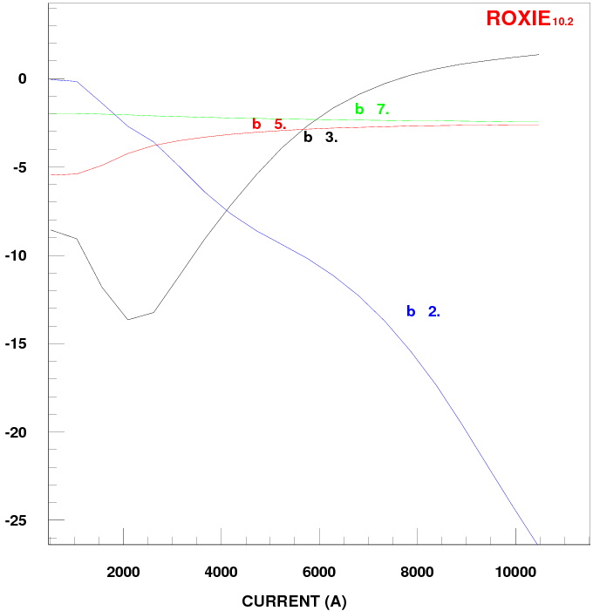


Harmonic contents
V1ari204 harmonic content: within the specs.
1 T
3.3 T
16 T
at nominal 16 T:
inter beam [mm] | 194 | 204 | 250
b2 [units] at nominal | 31 | 27 | 12
D. Schulte remark on b₃ :

Slide 5
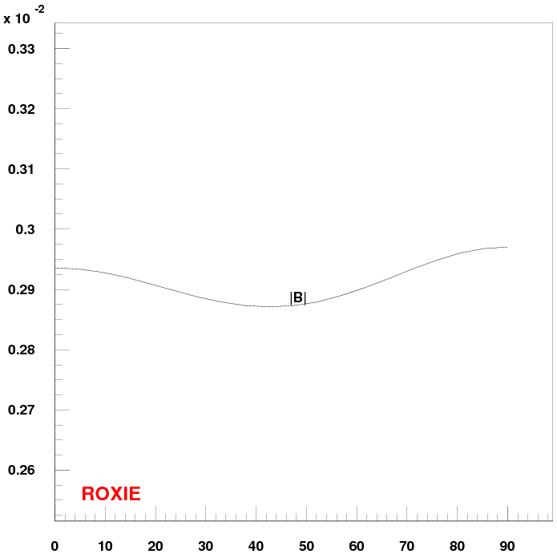
Fringe field
R = 1 meter -> lBl ~ 3 mT << 100 mT
90°
R = 1 m
0°
Yoke diameter: 750 mm

Slide 6
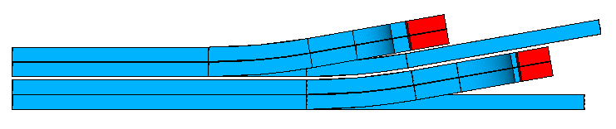
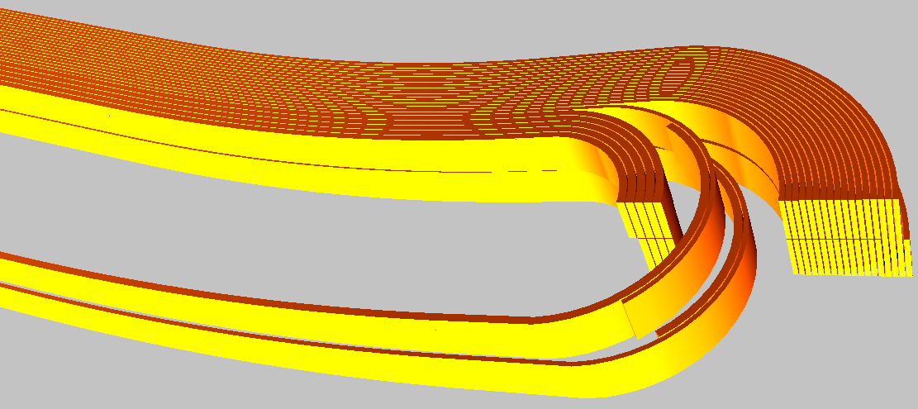
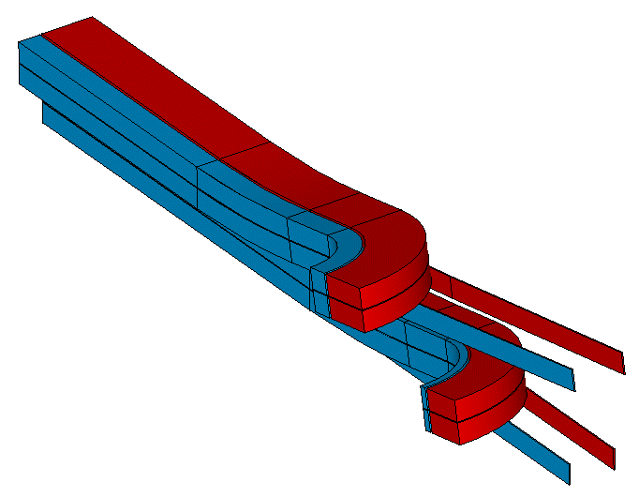


Graded: how?
Two present options:
External connections vs Internal connections
Courtesy from Etienne Rochepault
CERN
Development program CERN, CEA, PSI
Pros&Cons:
-Coil fabrication: leads supported in wedges
-Gap between top and bottom coils
-Additional connection box
-Splice in low field area
-Connection length
Pros&Cons:
-Length of the splice (not long enough < Tp)
-Gap between HF & LF turns
-Splice in high field area
-Magnet assembly easier
-End parts simpler
No consensus on pros&cons so far!
Both concepts to be proven! Consensus on that!

Slide 7
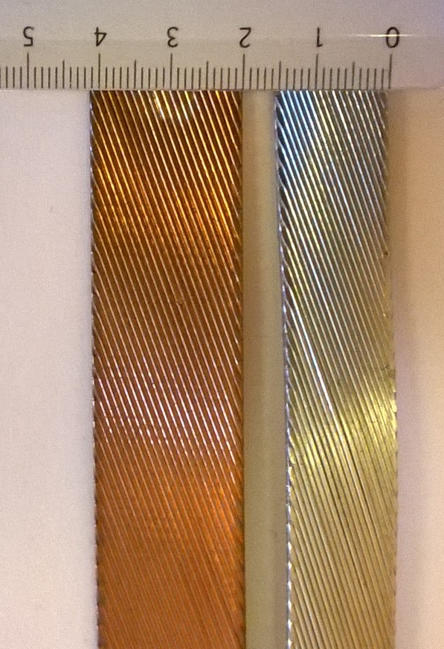
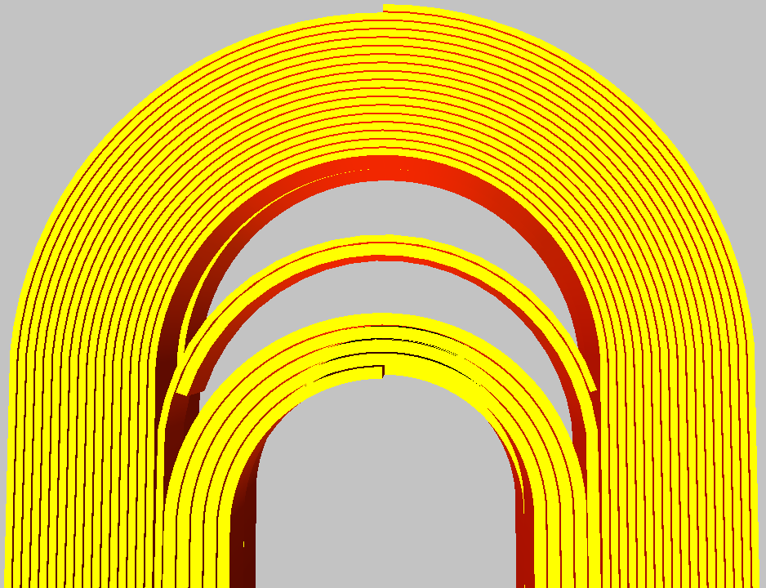
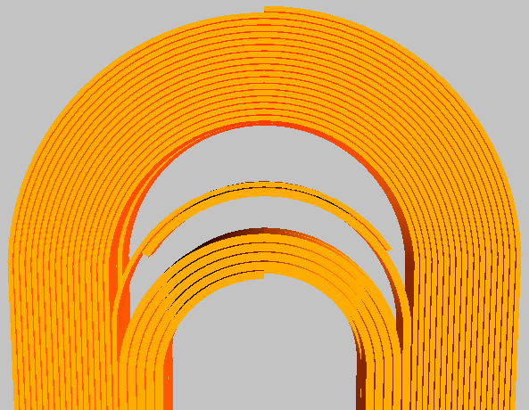
Room for splices ?
V20ar version but still true
Tp HF cable ~ 98 mm
Tp LF cable ~ 97 mm
99 mm arc splice length -> 163°arc angle
L1L2 pancake
163°
R= 38.75 mm
-> 99 mm splice
145°
R= 38.75 mm
-> 74 mm splice
Room in-between the two coils? How much?

Slide 8
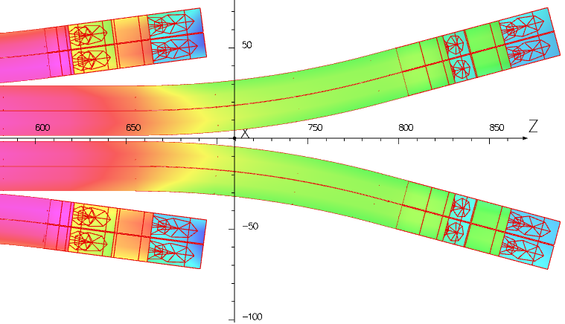
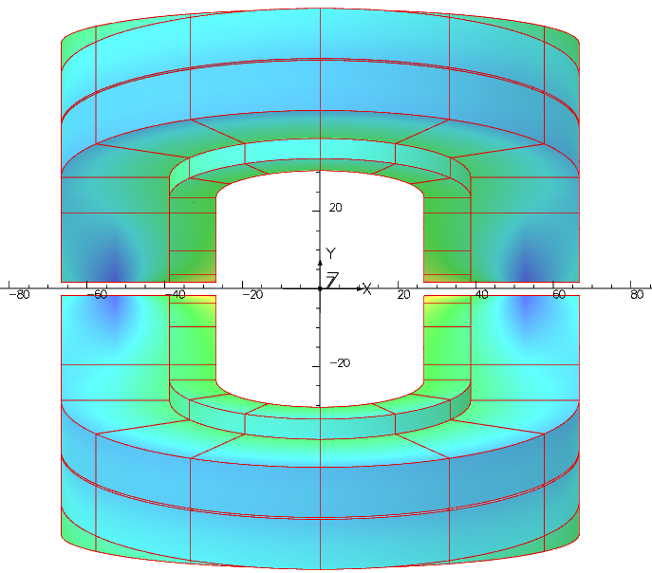
3D ends – Opera
Assumptions
  Preliminary study:
    return ends – only conductor - no yoke – single ap.
  Internal splice: 20 mm gap between LF-HF cables
    No gap between layer
  Fz pile-up through spacers (black pieces) ?
  Both layers of each double pancake are aligned
  Hardway bending: R_{hmin} = 450 mm w = 12.6 mm Layer 4
Fresca2 : w ~ 21 mm
R ~ 700 mm
LHC MB : w ~ 16 mm
Layer 4
Layer 3
Layer 2
20 mm
5 mm for support
Layer 1
aperture

Slide 9
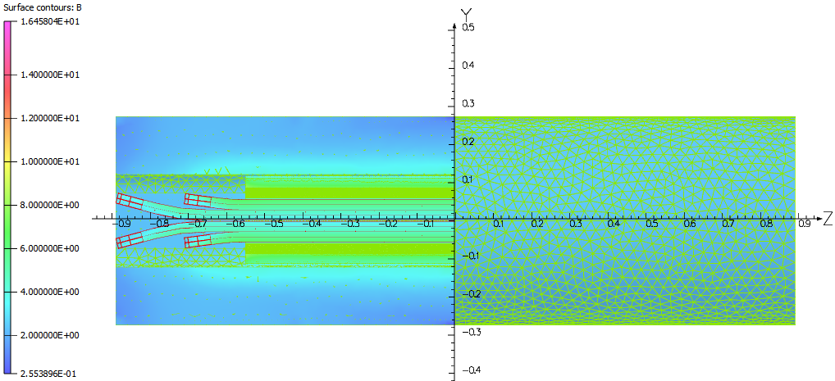
3D peak field
Magnetic length versus physical length
  Role of yoke and pad length
Lyoke [mm] | Lpad [mm] | Bp_{ends} –Bpeak_{SS} [T] | Lmag (16T) [mm] | version
1400 | 1200 | -0.08 | 1479.1 | v017
1600 | 1160 | -0.12 | 1483.2 | v018
1780 | 1160 | -0.10 | 1486.4 | v019
1780 | 1060 | -0.42 | 1482.7 | v020
3 mm of magnetic length x 5000 magnets = 15 meter = 1 magnet
Coil straight section arbitrarily set to 1120 mm

Slide 10
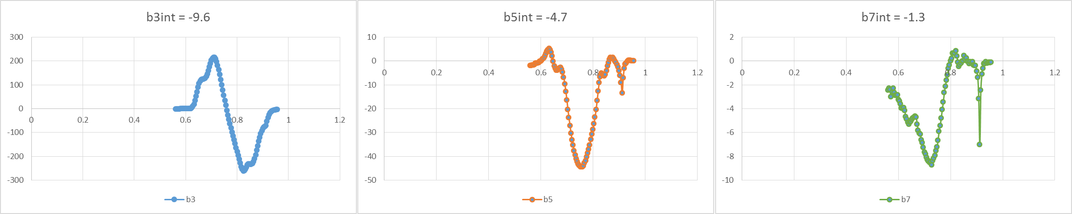
Emag 3D
Opera model:
Lyoke = Lcoil = 1780 mm
141 mm
Lmag = 1498 mm
Bp_{ss}-Bp_{ends} = 0.4 T
Straight section arbitrarily set to 2 x 560 mm
340 mm
Lpads = 1100 mm
Harmonics from 560 mm to 960 mm (orange box)
b3 can be easily tuned
but costly in terms of Lcoil/Lmag.

Slide 11
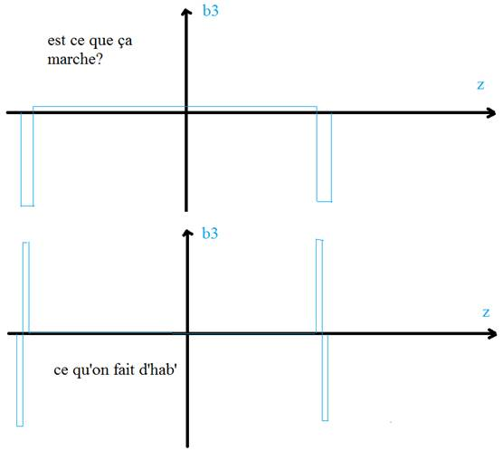
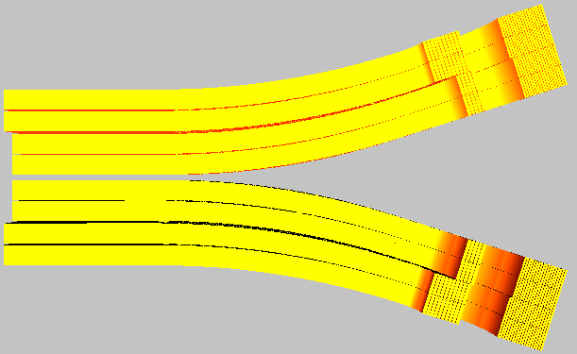
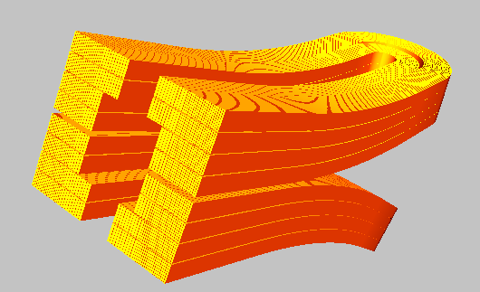

Emag 3D - Optics
Question asked to beam guys (WP2, A. Chance, B. Dalena):
What we usually do:
No straight section length effect
Is that feasible?
Optimization depends on the SS length
14 m with b3 = 6 units
2x0.15 m with b3 = -300 units
To get more compact ends for block design*
*Valid for cosine-theta too (V. Marinozzi)

Slide 12
Conclusion: 204 mm interbeam
Quantity | v1ari204 | Unit
strand diameter | 1.15 – 0.70 | mm
nb of strands | 20 – 34 | N/A
Cable width | 12.6 | mm
Cable thickness | 2.1 – 1.25 | mm
Cu/nonCu | 0.8– 2.0 | N/A
I_{nom} | 10480 | A
B_{peak} | 16.72 | T
LL margin (1.9 K) | 13.93 | %
Inductance diff. (2 ap) | 44.2 | mH/m
Stored energy (2 ap) | 2542 | kJ/m
Nb of turns | 108 = 5+5+9+9 +19+19+21+21 | -
Fx & Fy (per ½-coil) | 8042 & -3329 | kN/m
Hotspot | 351 | K
Bore thickness | 1.6 | mm
Midplane shim | 2.25 | mm
LdxI (1 aperture) | 232 | HA/m
I/Ic HF-LF | 0.47 – 0.61 | -
Conductor area (2 ap) | 130.3 | cm²
4578 x 14.3 x 8.7 weight | 7420 | tons
Emag design:
  4 layer design
  Low current cable ~ 10 kA
  Hotspot temp ~ 350 K
  Voltage to ground < 1.2 kV
  Straight section field quality: ok
  Peak field reduction in the ends: -0.4 T
  3D end harmonic content: ok
  No-internal-splice design looks feasible

Slide 13
Next steps:
Quantity | v1ari204 | Unit
strand diameter | 1.15 – 0.70 | mm
nb of strands | 20 – 34 | N/A
Cable width | 12.6 | mm
Cable thickness | 2.1 – 1.25 | mm
Cu/nonCu | 0.8– 2.0 | N/A
I_{nom} | 10480 | A
B_{peak} | 16.72 | T
LL margin (1.9 K) | 13.93 | %
Inductance diff. (2 ap) | 44.2 | mH/m
Stored energy (2 ap) | 2542 | kJ/m
Nb of turns | 108 = 5+5+9+9 +19+19+21+21 | -
Fx & Fy (per ½-coil) | 8042 & -3329 | kN/m
Hotspot | 351 | K
Bore thickness | 1.6 | mm
Midplane shim | 2.25 | mm
LdxI (1 aperture) | 232 | HA/m
I/Ic HF-LF | 0.47 – 0.61 | -
Conductor area (2 ap) | 130.3 | cm²
4578 x 14.3 x 8.7 weight | 7420 | tons
Emag design:
  194 mm interbeam distance?
  Strand dimension & performance - after reaction
  Bore tip & tie rod iteration – more conductor
  Splice baseline for engineering design
In June (2017☺):
  CEA-CERN agreement beyond ECC for building a FCC dipole model.

Slide 14
Extra slides

Slide 15
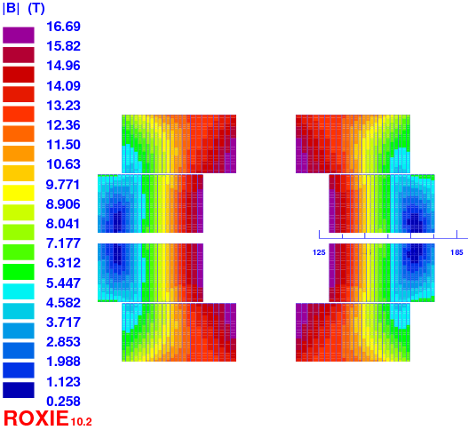
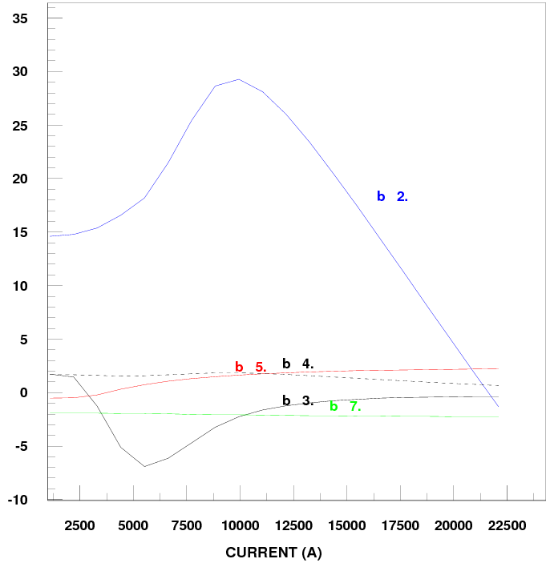

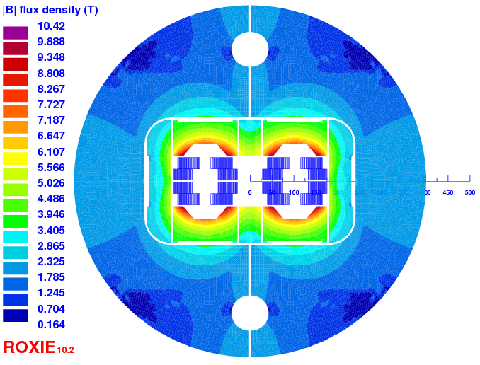
Do we discard it?
Quantity | v8ari204
strand diameter | 1.2 – 0.8
nb of strands | 40 – 60
width | 25.2
thickness | 2.2 – 1.45
Cu/nonCu | 0.8 – 1.6
I_{nom} | 22100
B_{peak} | 16.7
LL margin (1.9 K) | 14.1
Inductance diff. (2 ap) | 9.58
Stored energy (2 ap) | 2457
Nb of turns | 114 = 3+3+9+9 +22+22+23+23
Fx & Fy (per ½-coil) | 7942 & -3242
Hotspot | 340
Bore thickness | 2.35 (-0.5 of insulation)
Midplane shim | 2.25
LdxI (1 aperture) | 105
I/Ic HF-LF | 0.45 – 0.59
Conductor area (2 ap) | 133.9
4578 x 14.3 x 8.7 weight | 7626
F_{Lorentz}/width = 178 MPa
F_{Lorentz}/width = 127 MPa
Voltage
Splices
1 DP
Current
Cable

Slide 16
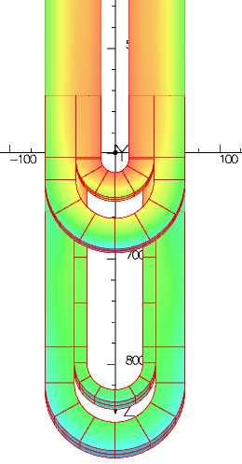
3D ends – Extra
Field quality in the ends (v014):
Fz pile-up cought here

Slide 17
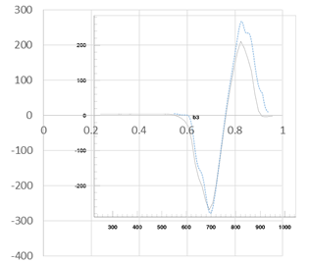
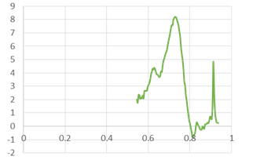
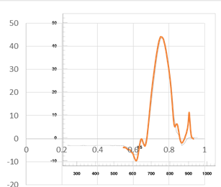
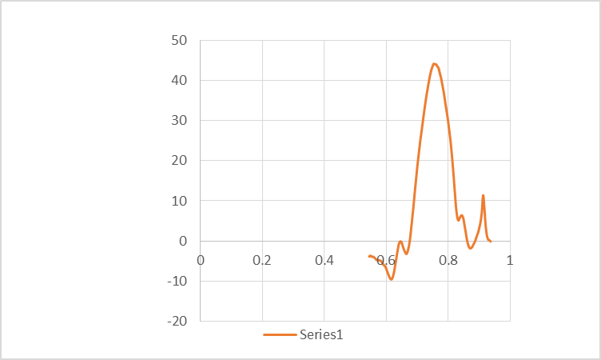
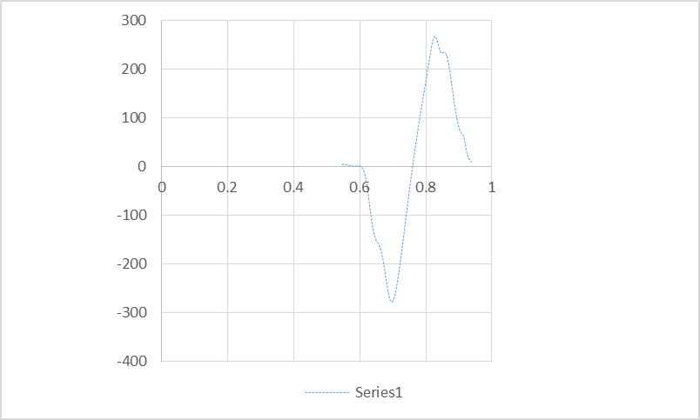
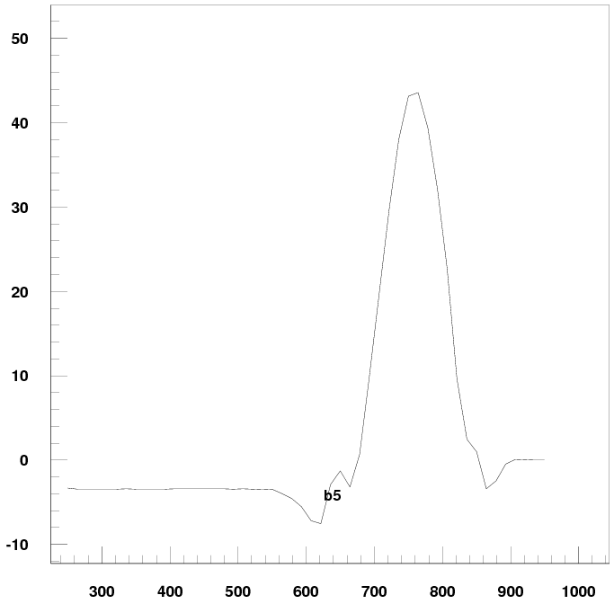
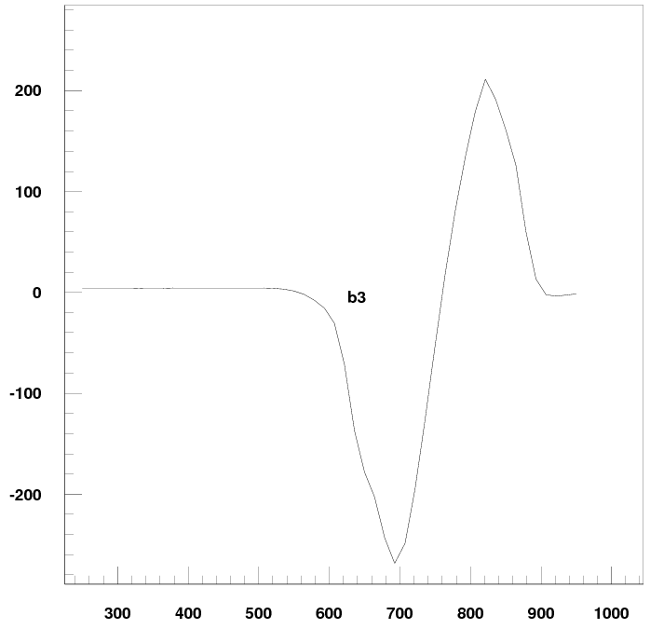
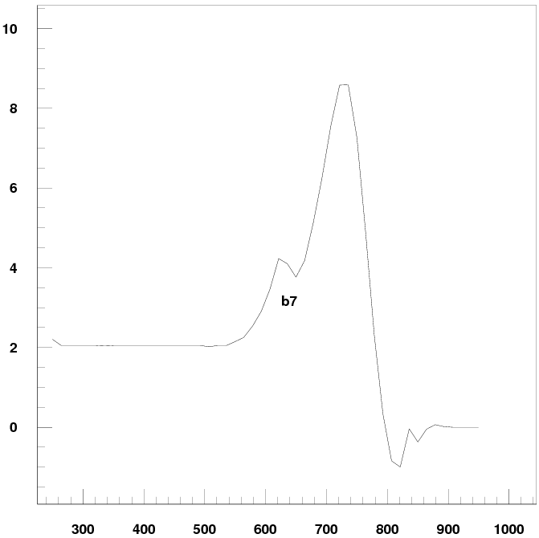
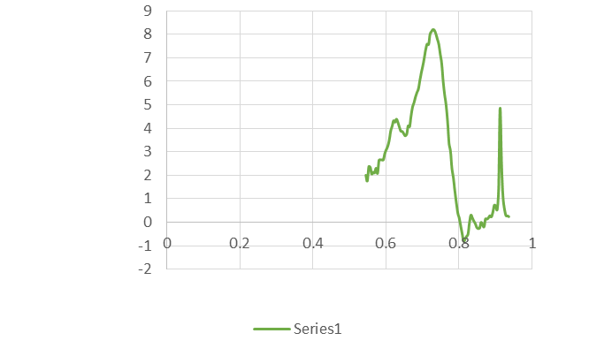
3D ends: Roxie/Opera
Good agreement between Roxie and Opera for 3D end harmonics

Slide 18
Critical surface Nb₃Sn
Jc (1.9 K, 16 T) = 2245 A/mm²
no cabling degr.
C0 = 267845 AT/mm²
where t = T/T_{c0} and b = B/B_{c2}(t) with B the magnetic flux density on the conductors. T_{c0} = 16 K, B_{c20} = 29.38 T, α = 0.96, are fitting parameters computed from the analysis of measurements on the conductor.
Similarly:
  Jc (1.9 K, 16 T) = 2312 A/mm²
  3% cabling degr.
  C0 = 275880 AT/mm²

Slide 19
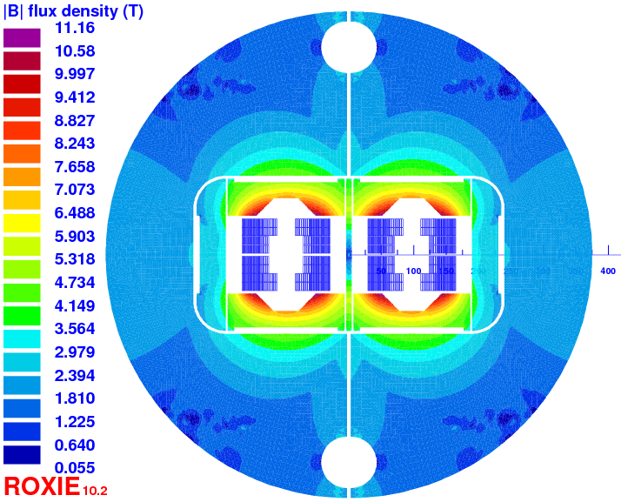
194 mm interbeam
Emag looks ok. Mechanics?

