Slide 1











STATUS OF THE WOUND CONDUCTOR TASK
D. Pulikowski, P. Ebermann, F. Wolf, J. Fleiter, S. Luzieux, S. Triquet, F. Meuter,
D. Tommasini, C. Scheuerlein, D. Schoerling, T. Koettig, F. Lackner
TE-department - MSC-LMF, MSC-MNC, MSC-SCD, MSC-MDT, CRG-CI
FCC Week 2017, Berlin
31th, May 2017

Slide 2

Characterization of Nb₃Sn wound conductor
Mechanical coil characterization by measurement and simulation
What can we measure directly in the Nb₃Sn coils or a magnet assembly
Winding tension during the winding process
Coil geometry after impregnation (no ext. stress)
Stress condition on shell assembly, axial stress reaction on end support plates, rods
Strain conditions on supporting structures (collar nose in case of 11T)
Pressure sensitive foils can provide information on pole and midplane stress and the related distribution
What we currently can not measure
Conductor stress-strain state during coil fabrication, magnet assembly, cooling & operation
What do we currently estimate from simulations
Stress-distribution in the coil cross-section (mainly in 2D) to develop knowledge on required pre-stress at ambient temperature, achieved precision is strongly depending on input parameters
Shimming of coils to achieve and keep pre-stress during different operation conditions (cooling – operation) is presently based on the measured coil geometry and stress estimation from FEA simulations using the stiffness measurements from 10-stack sample (stacked cables comparable to coil cross-section)

Slide 3
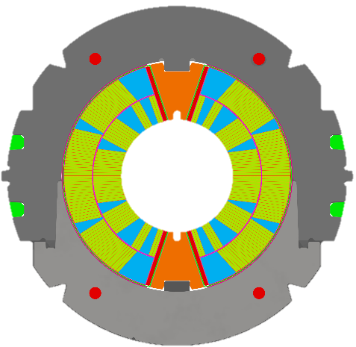
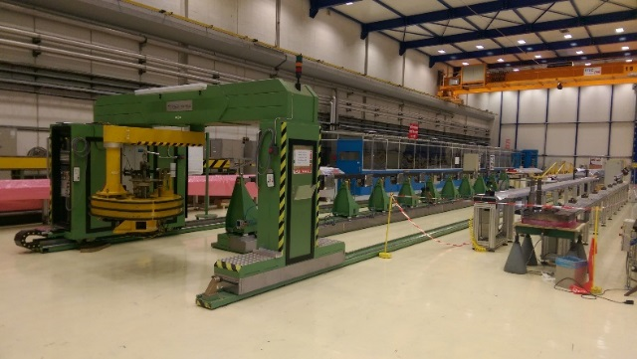
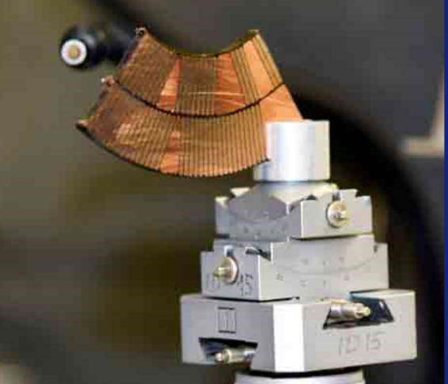
Characterization of Nb₃Sn wound conductor
Windability
Material characterization
Development of winding test setup to define a “windability factor” allowing comparison between different Rutherford cables
Irreversible degradation
Quantify irreversible degradation of the conductor during the magnet assembly at RT
Develop knowledge about stress distribution on Rutherford cable stack under the transversal load
Improving knowledge of magnet material parameters for refinement of FE modelling
Improved FE meshing using tomographic coil characterization
Development of adequate scanning method to quantify strand displacements during the winding process
Lateral shim
Coil size top
Arc length
Coil size bottom
Collar nose shim
Collar-Yoke shim

Slide 4
I_{c} degradation after transversal pressure at RT
The dominating load case in accelerator magnets is transverse compressive
Coils are loaded during the assembly, cooling, powering, quenching & thermal cycles
Experimental results about the room temperature (RT) stress limits of Nb₃Sn wires, cables and coils at which irreversible conductor degradation occurs are lacking
The ongoing experiment aims to determine the critical RT transverse compressive stress limits of cured, reacted and impregnated Nb₃Sn coil components
The degradation is quantified in terms of critical current and n-value

Slide 5
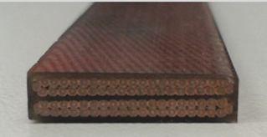
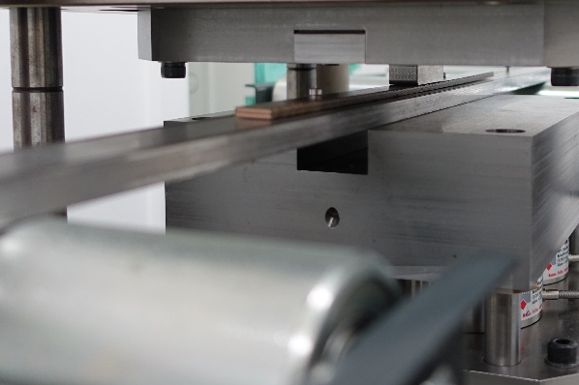
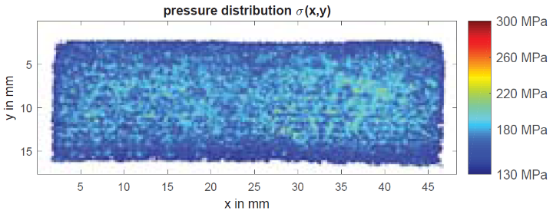
TESTING SEQUENCE
  The Ic of a reacted and impregnated two stack cable sample is measured in FRESCA
  Sample is taken out from FRESCA and compressed in a controlled manner at ambient temperature
  The sample is re-measured in FRESCA to check if, and by how much the compression has modified the I_{C}
FRESCA sample, RRP – Nb₃Sn 11T cable stack
Cable compression on hydraulic press
The test setup has been optimized in order ensure a known pressure distribution during the load step
Improved knowledge on stress-distribution

Slide 6
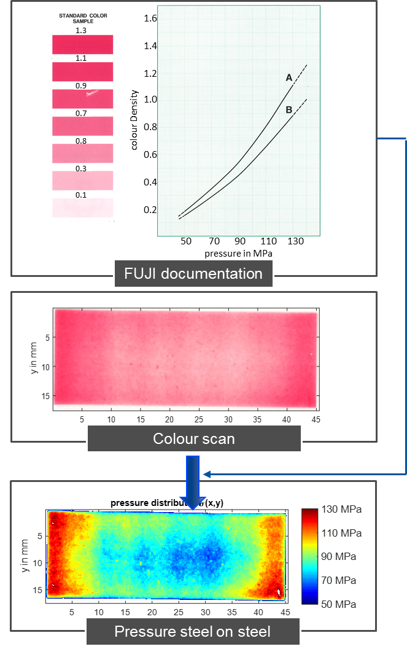
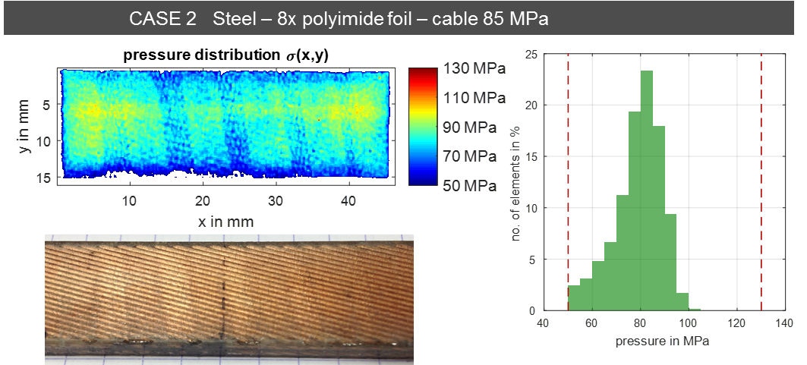
The Press
OPTIMIZATION OF THE LOADING STEP
Pressure measurement films from FujiFilm are used to measure the pressure distribution during the loading cycle
We optimized the pressing tool to provide a reasonable uniform pressure on the sample
Courtesy of P. Ebermann & F. Wolf
Notes:
Superconductive coil characterization for next dipoles and quadrupoles generation
Malathe Khalil
05/08/2016 CERN

Slide 7
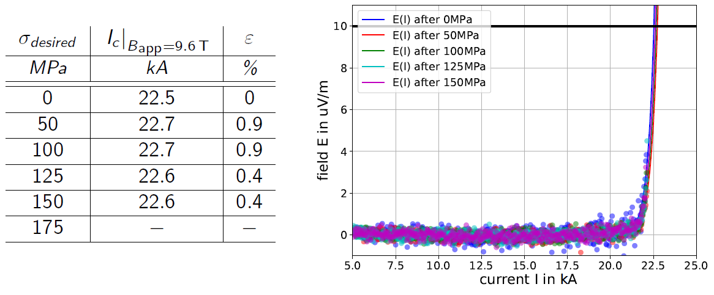
RESULTS
Comparison of fitted voltage-current-curves at Bapp = 9.6 T at T = 4.2 K
No degradation observed up to 150 MPa
*
* Measurements are ongoing on 31st of May.
First results at 4.2 K show relative degradation Ɛ in the order of 2 – 3 %

Slide 8
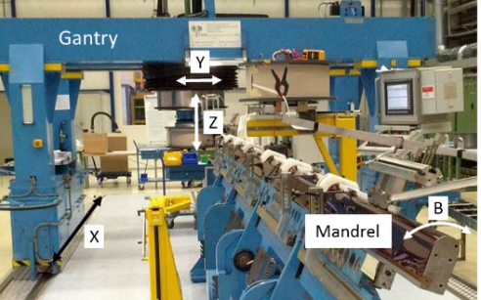
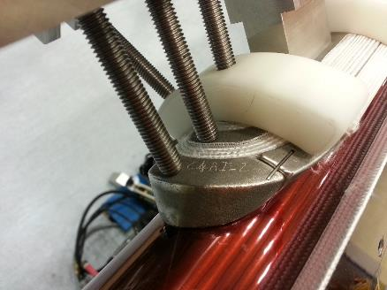
WINDABILITY
Measure and model the geometrical evolution of cables during winding.
Identification of the parameters dominating this process to possibly provide feedback for cabling & winding.
Set-up a standard to quantify a “windability factor” or similar.
CERN-LMF, 11T dipole winding machine
CERN-LMF, 11T dipole pole end
Courtesy of D. Pulikowski
Notes:
New slide from Davide.
Showing that conductor development is launched at international level, Russia, Japan, (Korea and Europe in preparation)
Underline importance of that development as main cost driver for the hadron collider machine.

Slide 9
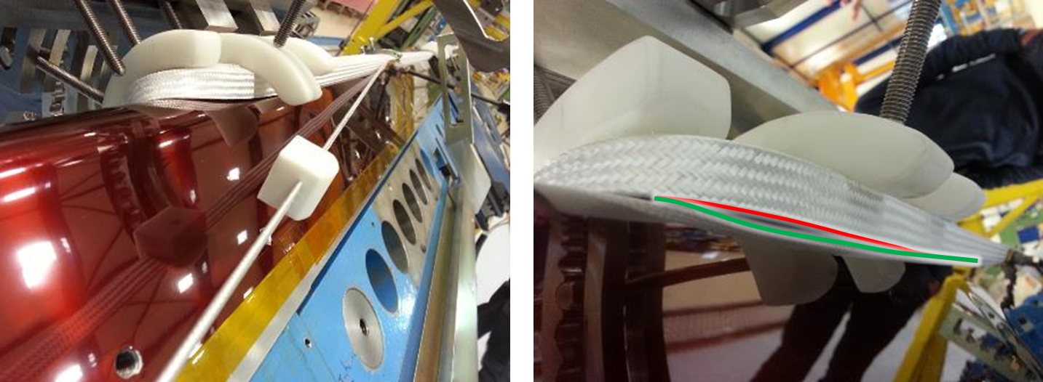
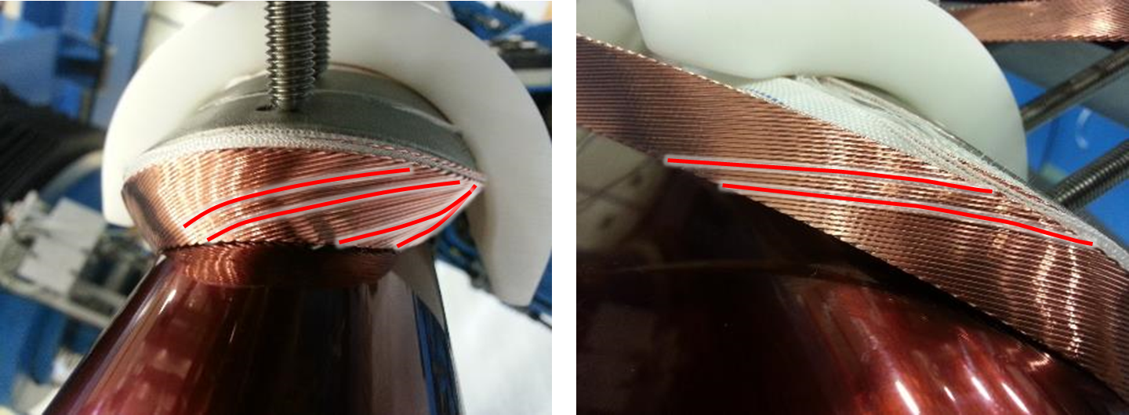
WINDABILITY
Typical findings during the winding of Nb₃Sn coils
Protrusion from the mandrel surface
Strand pop-out
Quantify geometrical displacements due to observed instabilities
Proposal and definition of a “windability factor” allowing to compare results of different cable geometries

Slide 10
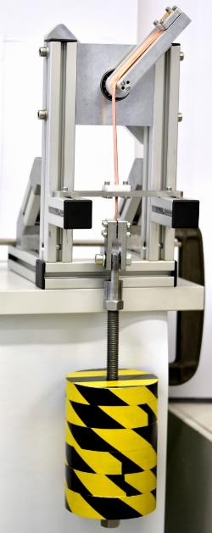
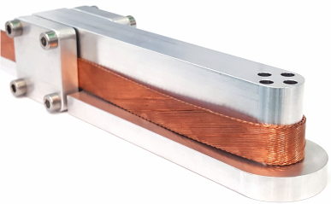
1 DOF WINDING MOCKUP
1DOF
Allows to wind specimens with the Rutherford type cables in 1 DOF
Provides repeatable conditions;
Allows to adjust several winding parameters:
  Winding tension, Bending radius, Cable guide position and angle & winding direction.
Cable guide
Path
Envelope
Pop-out
Winding tension (mass)
Protrusion
Sample holder for winding tests

Slide 11
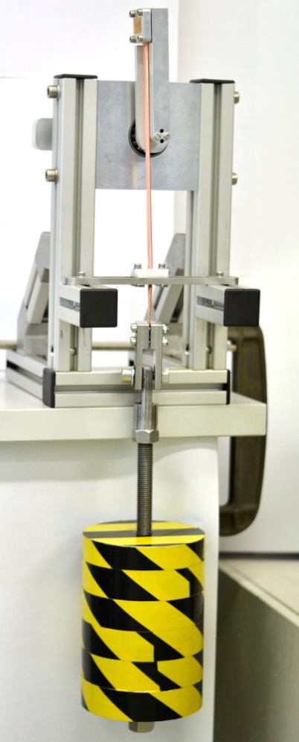
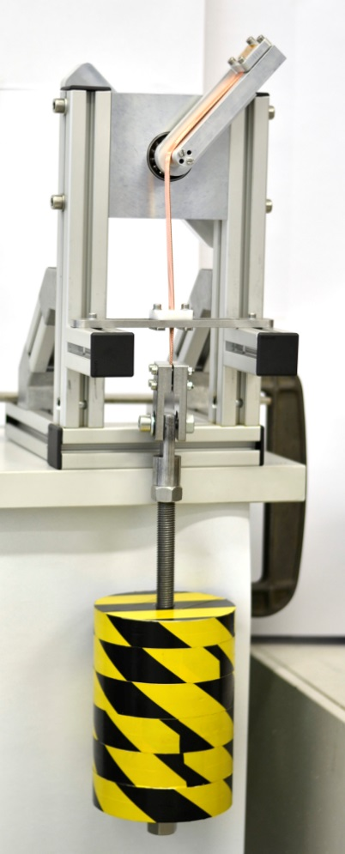
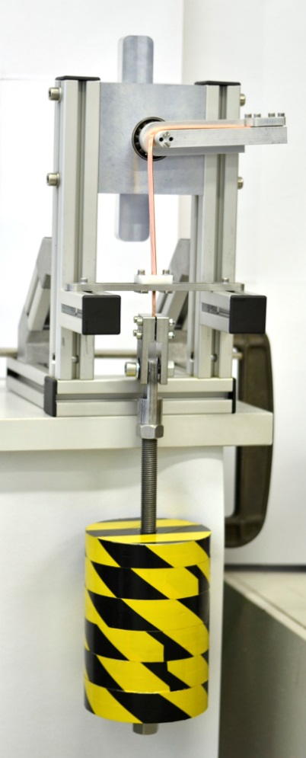
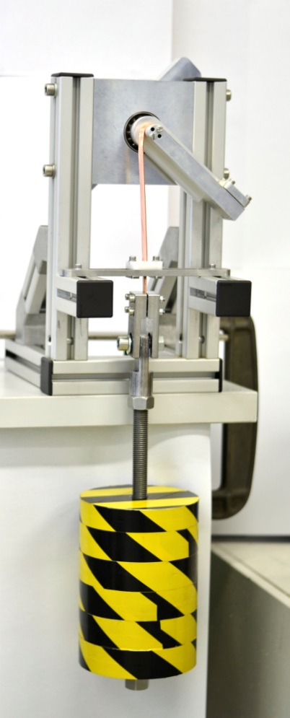
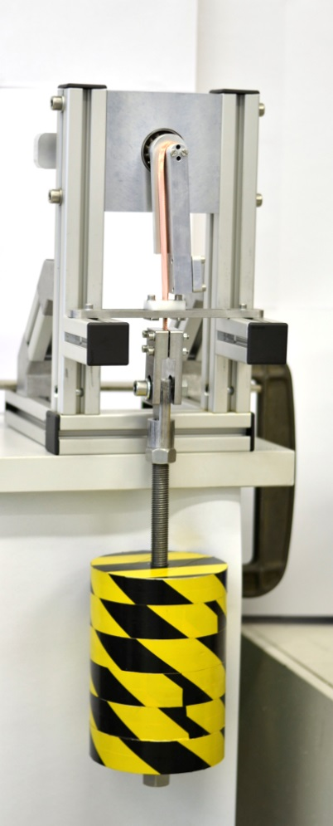





1 DOF WINDING MOCKUP
0$°$
45$°$
90$°$
135$°$
180$°$

Slide 12
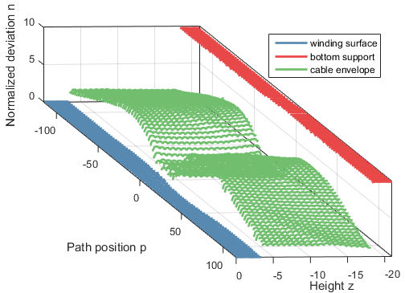
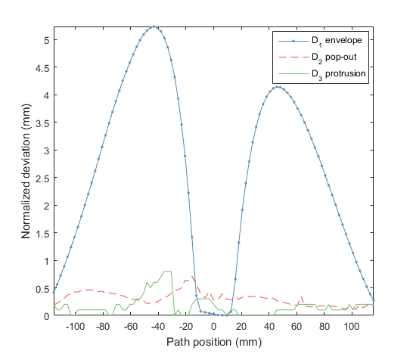
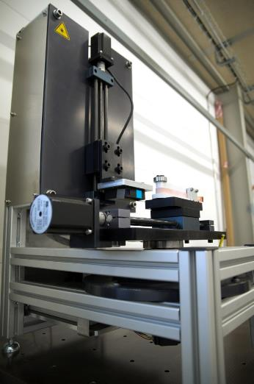
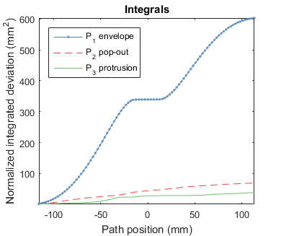
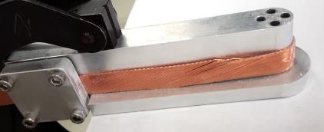
1 DOF WINDING SCANNER
Z
Y
A

Slide 13
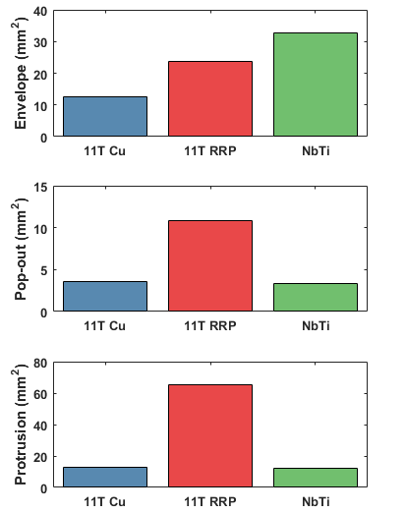
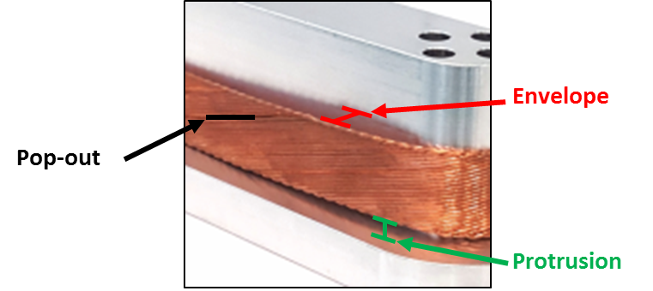
WINDING STABILITY OF Cu, Nb-Ti AND RRP Nb₃Sn CABLES
Stability of the winding is the average standard deviation ($1σ$) of three specimens for each winding tension and direction.
It describes the performance spread for one parameter set.
Nb-Ti shows the worse envelope instability.
11T RRP shows multiple times larger winding instability of pop-out and protrusion.

Slide 14
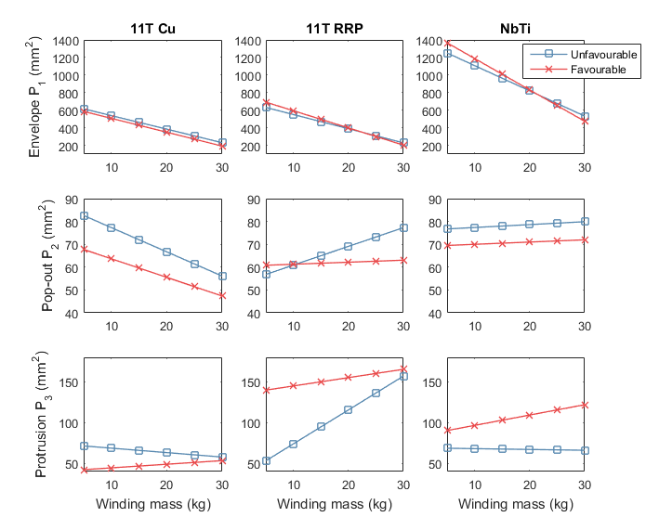
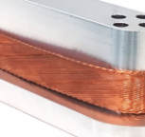
WINDING STABILITY OF Cu, Nb-Ti AND RRP Nb₃Sn CABLES
Preliminary results on first samples:
Envelope trends are declining, the smallest deformation is achieved by 11T Cu cable.
Pop-out: Nb-Ti shows least dependence on the winding tension.
Larger protrusion deformation in favourable direction for 11T RRP and Nb-Ti.
Envelope
Pop-out
Protrusion

Slide 15
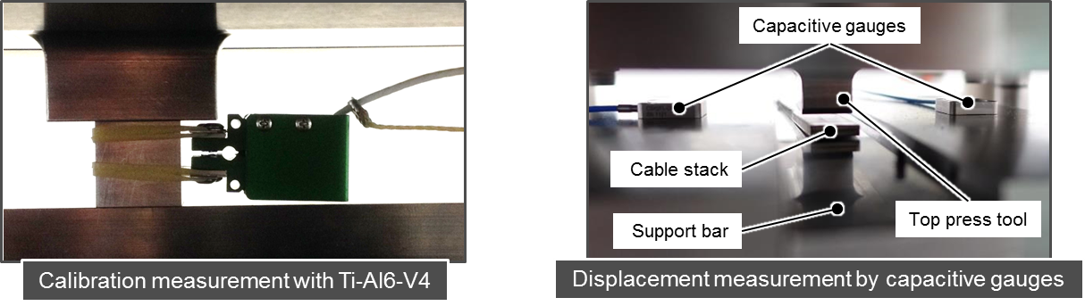
MECHANICAL PROPERTIES OF A CABLE STACKS
Impact of insulation and impregnation conditions on the coil stiffness
Variables:
  The insulation (e.g. impact of Mica foil)
  The impregnation (variation of compaction level of the cable stack)
  The sample length (15 mm, 30 mm, 100 mm)
Measurements:
  Force measurement by calibrated load cells in the force line of a hydraulic test setup
  Displacement measurement direct at the sample with an extensometer
  Displacement measurement of the press tools by capacitive gauges
Courtesy of F. Wolf

Slide 16
FURTHER ACTIVITIES
Thermomechanical properties of a Nb₃Sn coil (11 T) and tooling constituents in collaboration with Federal Laboratory for Materials Research and Testing (BAM), Berlin.
Young’s moduli, shear moduli, Poisson ratio and thermal expansion coefficients vs temp (-150°C to 700 °C).
To be completed by September 2017.
Friction coefficients between 11 T dipole materials pairs in collaboration with Federal Laboratory for Materials Research and Testing (BAM), Berlin. Friction measurements are performed at RT and in LHe. Materials pairs are TiAlV on 316L shim, TiAlV on Polyimide, steel on Polyimide, and the effect of MoS2 coatings on friction is studied (at RT and in LHe). To be completed by September 2017.
Nb₃Sn strain state distribution in a 11 T dipole coil, in collaboration with ID15A beamline of European Synchrotron (ESRF) and StressSpec beamline at Heinz Maier-Leibnitz Zentrum (MLZ), Munich.
Nb₃Sn strain state distribution at RT and at 10 K without externally applied stress
Nb₃Sn strain state distribution at RT with external stress applied through steel collars
Tomographic studies of the Nb3Sn conductor in 11 T dipole coils in collaboration with Federal Laboratory for Materials Research and Testing (BAM), Berlin, ANTARES beamline at Heinz Maier-Leibnitz Zentrum (MLZ), Munich, and Fraunhofer Institute for Industrial Mathematics (ITWM), Kaiserslautern. Determination of the 3D shape of Rutherford cables in coils. To be completed by September 2017.

Slide 17
CONCLUSIONS
The results coming from the characterization of the irreversible cable degradation at RT, though very preliminary seem encouraging and support the choices performed within the EuroCirCol study
The winding setup may allow to define a windability factor useful for future cable development and winding process (robust and repeatable quality, production time)
The study of the stiffness of cable stacks depending on their manufacturing procedure has been started
A number of studies are under way to refine input parameters and meshes for FE analysis, and to characterize the internal stress distribution in Nb₃Sn coils

