Slide 1



Study of the socio-economic impact of CERN HL-LHC and FCC-hh
Workshop on
“The economic impact of CERN colliders:
technological spillovers, from LHC to HL-LHC and beyond”
May 31st, 13:30 – 15:30
Intercontinental Hotel, BERLIN
The economic impact of technological procurement
for large-scale research infrastructures:
evidence from the Large Hadron Collider at CERN
Massimo Florio
(University of Milan)
with Castelnovo, P. (University of Milan), Forte, S. (TIF Lab, Department of Physics, University of Milan and INFN), Rossi, L. (CERN and University of Milan) and Sirtori, E. (CSIL).

Slide 2


BACKGROUND:
Study of the socio-economic impact of CERN HL-LHC and FCC-hh
2/16
2016 - 2019
It builds on the results of a previous study (2013-2015) titled Cost-Benefit Analysis in the RDI sector (http://www.eiburs.unimi.it/) during which the net social benefits generated by the Large Hadron Collider were estimated.
It is a Cost-Benefit-Analysis study of the High-Luminosity Large Hadron Collider (HL-LHC) and a scenario for a larger and more powerful particle collider - Future Circular Collider.
STAKEHOLDERS INVOLVED

Slide 3
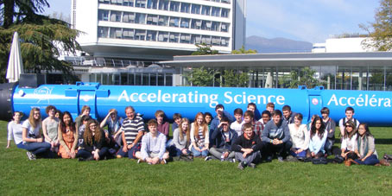
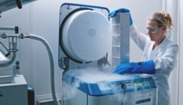
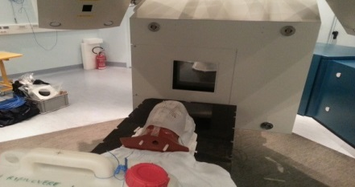






FOCUS OF THE STUDY
3/16
FIRMS
EMPLOYEES
Human Capital Formation
$$\text{Use}$$
$$\text{Benefits}$$
Technologcal externalities
USERS
arXiv
Social benefits to consumers
of services
Knowledge output
Cultural effects
TAXPAYERS
$$\text{Non} \text{Use}$$
$$\text{B}\text{enefits}$$
Quasi option value
Existence value

Slide 4
LHC: CBA results
●
4/16
TOTAL MEASURED BENEFITS
LHC: summary of costs and benefits (Billion, EUR)
COSTS: | 13.5 ± 0.4
USE BENEFITS:
Knowledge Formation | 0.3 ± 0.1
Human Capital | 5.5 ± 0.3
Technological Spillovers | 5.3 ±1.7
Cultural | 2.1 ± 0.5
NON-USE BENEFITS:
Existence Value | 3.2 ± 1.0
Human capital, technological spillovers, cultural + existence value each give about 33% of benefits (publications are negligible)
Uncertainty largest on technological spillovers
More than 90% chance of positive NPV
Florio, M., Forte, S. and Sirtori, E., 2016. Forecasting the socio-economic impact of the Large Hadron Collider: A cost–benefit analysis to 2025 and beyond. Technological Forecasting and Social Change, 112, pp.38-53.
Notes:
Colori torta corrispondenti alla tabella

Slide 5
Estimating the effect of LHC procurement
We followed three alternative approaches to evaluate the impact of CERN procurement on its supply chain
Accounting data
(from the Orbis Database)
Survey Data
(own data from online survey
February-May 2017)
Econometric Analysis:
Before/after approach, focus on realized outcome. This presentation.
2. Econometric Analysis: Program evaluation approach → reliance on a counterfactual;
focus on potential outcome. Presentation by A. Bastianin
3. Bayesian Network Analysis
Presentation by E. Sirtori

Slide 6
Introduction
Aim:
To assess the existence of a positive long-term “learning-effect” on LHC suppliers' revenues and profitability, beyond the initial order.
Distinguishing features of the study
The effects on the value chain and the suppliers of large RI have never been quantitatively evaluated by any econometric study: we are the first to perform an empirical analysis based on firms’ balance-sheet data, differently from previous studies based on survey data only.

Slide 7
Data
CERN-LHC Procurement Database 1995-2008:
Includes around 12,000 orders >10,000 CHF commissioned to almost 1,300 LHC suppliers belonging to 35 different States.
Volume of orders per country (CHF)

Slide 8
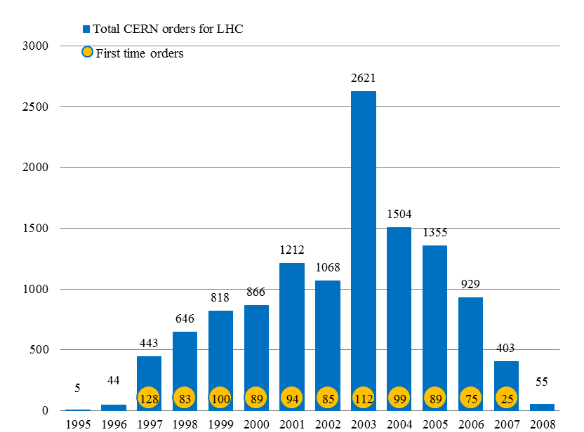
Distribution by year of LHC procurement orders and of first-time orders to a supplier
Number of orders
8/16

Slide 9
Firms and First orders
Exploiting the Orbis Database, we were able to build a sample of more than 350 LHC suppliers for which financial data are available over the years 1991-2014, for a total of >5800 observations
Yearly distribution of LHC procurement orders, first-time orders to a supplier and new suppliers in our sample

Slide 10
Orders by activity code
10/16
Magnets
Building Work
Specialised Techniques
Storage and Transport
Low-Temperature Materials
Distribution of activity codes by volume of orders

Slide 11
Technological intensity
We classified as “high-tech” the suppliers that received at least one order with activity codes having avg tech. intensity ≥ 3. According to this criteria, 63% of the companies in our sample are “high-tech” suppliers.
Act. Code | Technological Intensity | 1 | 2 | 3 | 4 | 5 | Avg. Tech intensity
11 | BUILDING WORK | 1 |  |  |  |  | 1
12 | ROADWORKS | 1 |  |  |  |  | 1
13 | INSTALLATION AND SUPPLY OF PIPES | 1 |  |  |  |  | 1
21 | SWITCH GEAR AND SWITCHBOARDS | 1 | 1 | 1 |  |  | 2
22 | POWER TRANSFORMERS |  | 1 | 1 |  |  | 2.5
23 | POWER CABLES AND CONDUCTORS |  | 1 | 1 |  |  | 2.5
27 | MEASUREMENT AND REGULATION |  | 1 | 1 | 1 |  | 3
33 | ELECTRONIC MEASURING INSTRUMENTS |  | 1 | 1 | 1 |  | 3
71 | FILMS AND EMULSIONS |  |  | 1 | 1 | 1 | 4
72 | SCINTILLATION COUNTER COMPONENTS |  |  | 1 | 1 | 1 | 4
… | …
We sampled 300 orders that were then evaluated in detail by CERN experts and classified into a 5-point scale according to the technological intensity embedded: Class 1: Most likely "off-the-shelf" orders with low technological intensity; Class 2: Off-the-shelf orders with an average technological intensity; Class 3: Mostly off-the-shelf, but usually high-tech and requiring some careful specification; Class 4: High-tech orders with moderate to high intensity of the specification activity to customize products for LHC; Class 5: Products at the frontiers of technology with intensive customization and co-design involving CERN staff.

Slide 12
Methods
Empirical approach: compare the before/after event values of the outcome variable for each firm
We take advantage of the fact that we a have a time-variant sequence of events and two different groups: high-tech and non-high tech firms.
This approach is similar to a difference-in-difference panel because we do not have just 1 before/after time, but 12 such different times, each involving different firms.

Slide 13

Empirical Model: fixed effects regression
Dependent variables:
yearly change of EBIT
yearly change of revenues,
yearly change of EBIT margin
of firm i, located in country c, at time t
Variable of interest:
CERN effect (dummy variable)
Control variables:
$1−$year lagged value of the dependent variable
yearly % change of GDP
yearly % change of CPI
yearly variation of total assets
country fixed effects
time fixed effects
random error term

Slide 14
 | FULL SAMPLE |  | HIGH-TECH |  | NON HIGH-TECH
 | ∆OR | ∆EBITm | ∆OR | ∆EBITm | ∆OR | ∆EBITm
CERN_effect | 26345.9*** | 0.893*** | 31486.3*** | 0.848*** | 11753.8 | 1.010
 | (7929.1) | (0.210) | (7756.6) | (0.236) | (9808.9) | (0.629)
∆EBIT_lag1
∆OR_lag1 | 0.108*** |  | 0.0931*** |  | 0.216
 | (0.0205) |  | (0.0183) |  | (0.164)
∆EBITm_lag1 |  | -0.367*** |  | -0.355*** |  | -0.388***
 |  | (0.0273) |  | (0.0419) |  | (0.0277)
∆TA | 350274.0*** | -0.0449 | 342103.8*** | -0.0836 | 770950.0** | 0.770
 | (17469.6) | (0.248) | (17534.8) | (0.259) | (345518.6) | (1.268)
GDP_growth | 4541.0 | 0.171 | 1246.1 | 0.236 | 10660.7 | 0.0560
 | (3718.7) | (0.196) | (1169.3) | (0.197) | (12029.4) | (0.450)
CPI | 75.03*** | 0.0233*** | 60.11*** | 0.0236*** | 476.5 | -0.107
 | (24.33) | (0.00111) | (11.26) | (0.000881) | (2326.2) | (0.310)
Country FE | yes | Yes | yes | yes | yes | yes
Time FE | yes | Yes | yes | yes | yes | yes
Cons | -35401.0** | -3.923*** | -7238.6* | 0.985 | -26604.0 | 3.847**
 | (15820.6) | (0.836) | (3903.6) | (1.489) | (33551.2) | (1.584)
N | 5293 | 5295 | 3380 | 3382 | 1913 | 1913

Slide 15
Conclusions
We found evidence of a statistically significant correlation over time between LHC procurement and supplier revenues (pvalue<0.01), profits (pvalue<0.10) and profit margins (pvalue<0.01), after controlling for trends, firm-level, country-level and year fixed effects.
These results hold for high-tech companies only, while the effect for non-high-tech suppliers is mostly statistically insignificant.

Slide 16
Conclusions
The clear-cut finding that the CERN effect was important for high-tech firms, but not for the others, suggests that a learning process leading to product and process innovation ultimately boosted the performance of high-tech firms.
On the other hand, a generic effect in increasing market opportunities or claiming higher prices seems not to play a significant role.

