Slide 1
Update on the impedance of stripline BPMs in the
HL-LHC triplet region
N. Biancacci, R. De Maria, B.Salvant
Acknowledgement: T.Lefevre, D.Draskovic

Slide 2
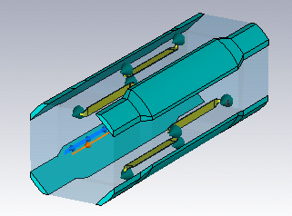
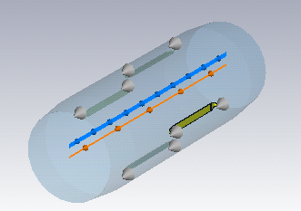
Studied models
Octagonal- with tungsten
Circular – no tungsten
Strip to strip = 112mm
Strip to strip = 123mm
PS: No inermet anymore.

Slide 3
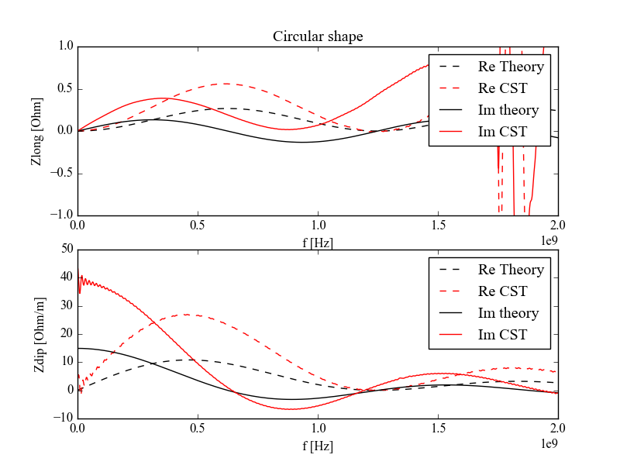
Simulations: circular shape
Discrepancy between theory and simulation….
Still investigating it.

Slide 4
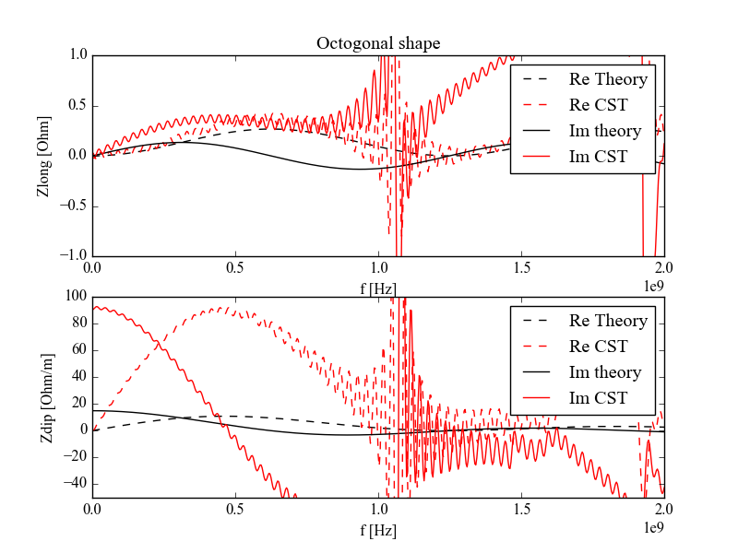
Simulations: octogonal shape
Discrepancy between theory and simulation….
Still investigating it.

Slide 5
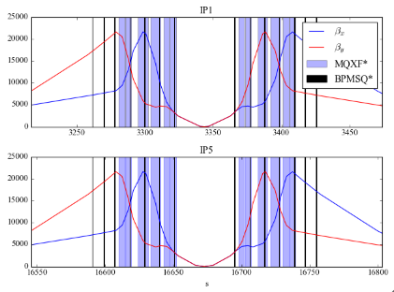
BPMSQ optics at 15cm beta*

Slide 6
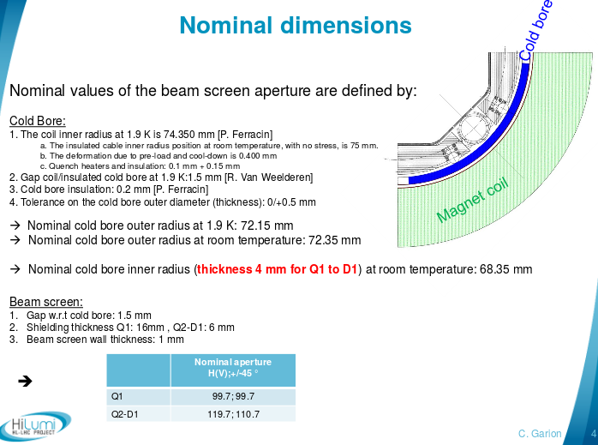
Beam screen dimensions
C.Garion, 7th HL-LHC TCC http://indico.cern.ch/event/515629/contributions/2145081/

Slide 7
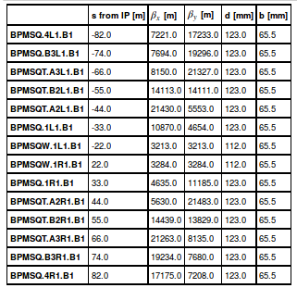
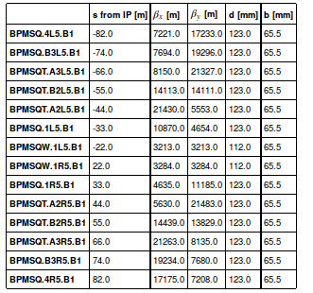
All BPMS

Slide 8
Effective impedance
Accounting for all the BPMs with analytical formulas, the effective impedance is:
BPM total impedance
Zx= 4.8 kOhm/m,
Zy= 4.6 kOhm/m
Z/n= 11.1 mOhm
HL-LHC (15cm)
Zx=20.8MOhm/m,
Zy=17.8MOhm/m
Z/n=92.890 mOhm
If we account for only inductive impedance at max beta we get Zt_eff in the order of 500kOhm
The longitudinal impedance is ~10%

Slide 9
Conclusions and outlook
The triplet stripline BPMs impedance look negligible in both configurations, octogonal and circular, wr.t. the full HLLHC impedance model.
The longitudinal impedance is in the order of 10%
CST simulations are being investigated w.r.t. analytical formulas for both shapes as in the past we got good agreements (even myself…)
The device radius should be updated to the new beam screen specs and new simulations should be performed

Slide 10
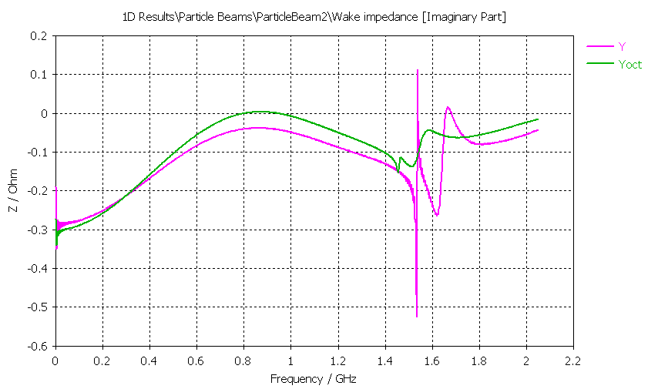
Appendix
Comparisons from Benoit

Slide 11
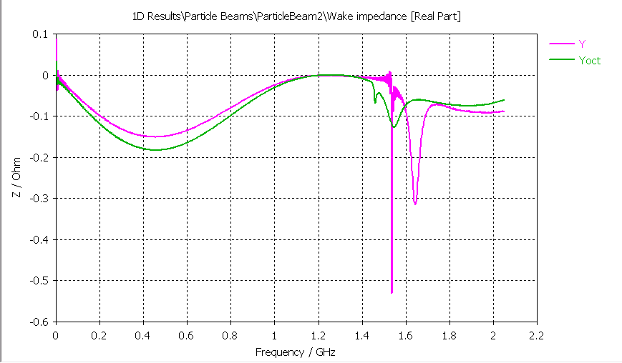

Slide 12
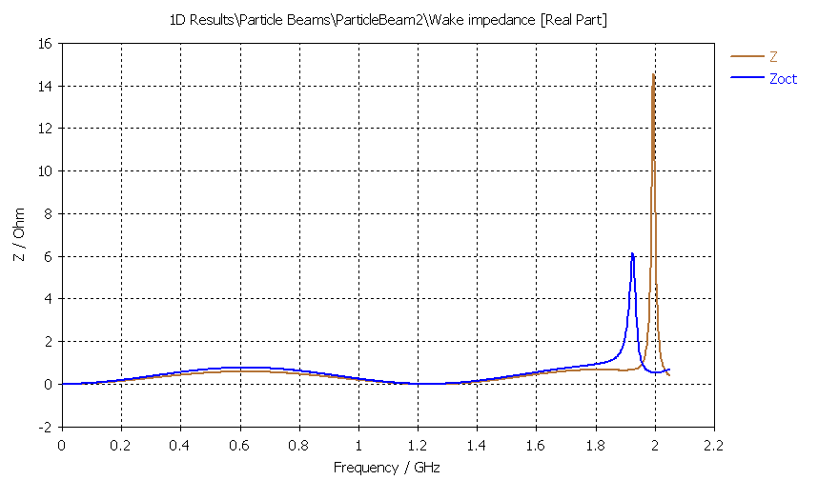

Slide 13
