Slide 1
T24_vg1.8_disk 11WNSDVG1.8 CLIC_G un-damped @ 11.424 GHz measurements versus simulations (preliminary)
Grudiev
17.06.2009

Slide 2
Acknowledgements
CERN:
M. Gerbaux
R. Zennaro
A. Olyunin
W. Wuensch
SLAC:
Z. Li

Slide 3
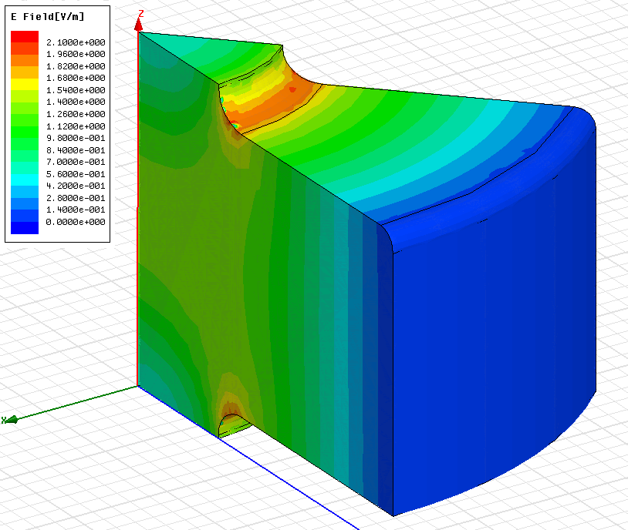
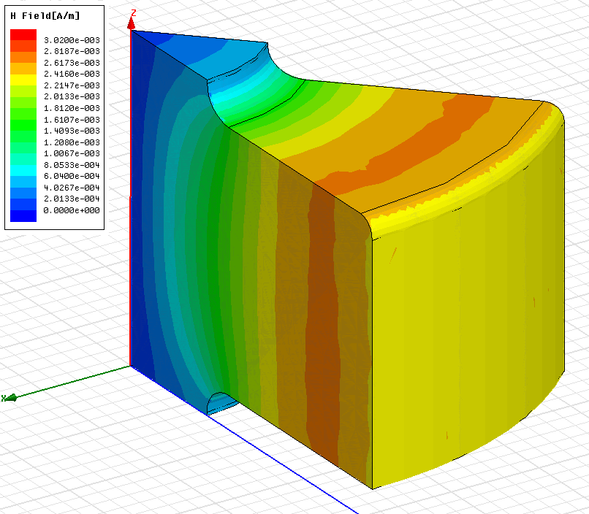
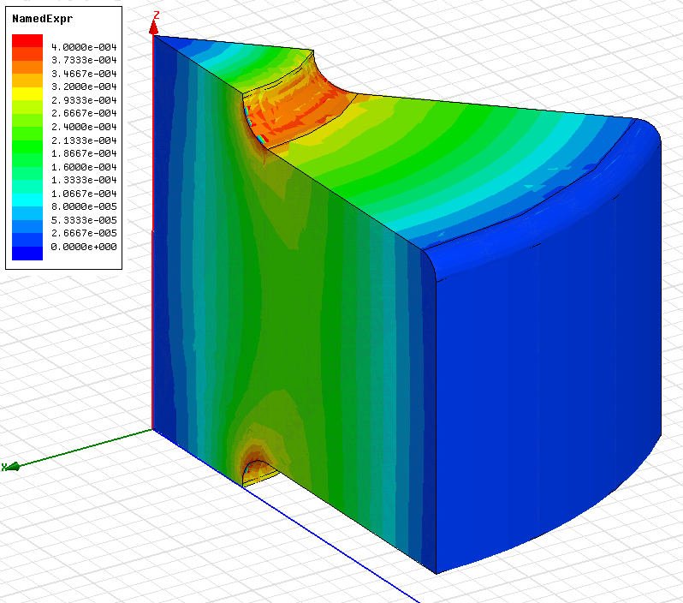
First cell
E_{s}/E_{a}
H_{s}/E_{a}
S_{c}/E_{a}²
a [mm] | 3.307
d [mm] | 1.753
e | 1.16
f [GHz] | 11.433
Q(Cu) | 6814
vg/c [%] | 1.83
r’/Q [LinacΩ/m] | 15198
Es/Ea | 1.95
Hs/Ea [mA/V] | 2.6
Sc/Ea² [mA/V] | 0.37

Slide 4
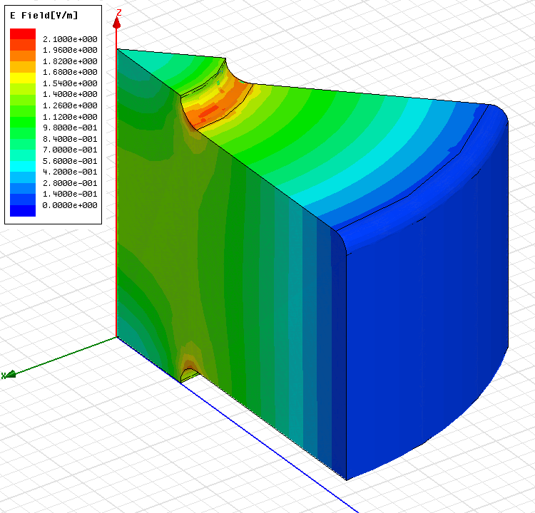
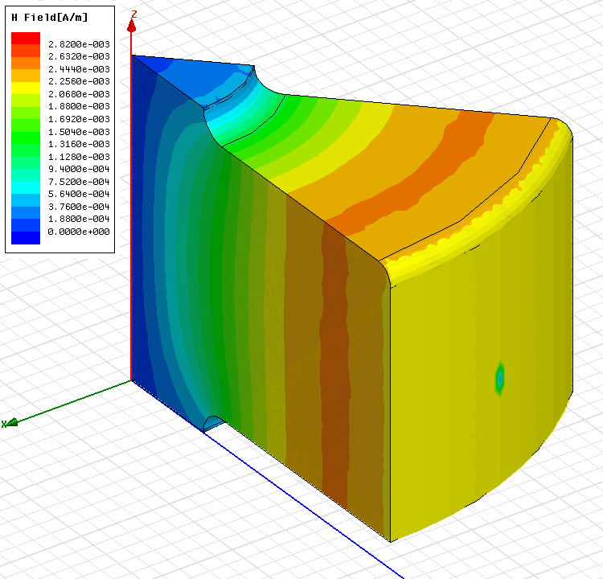
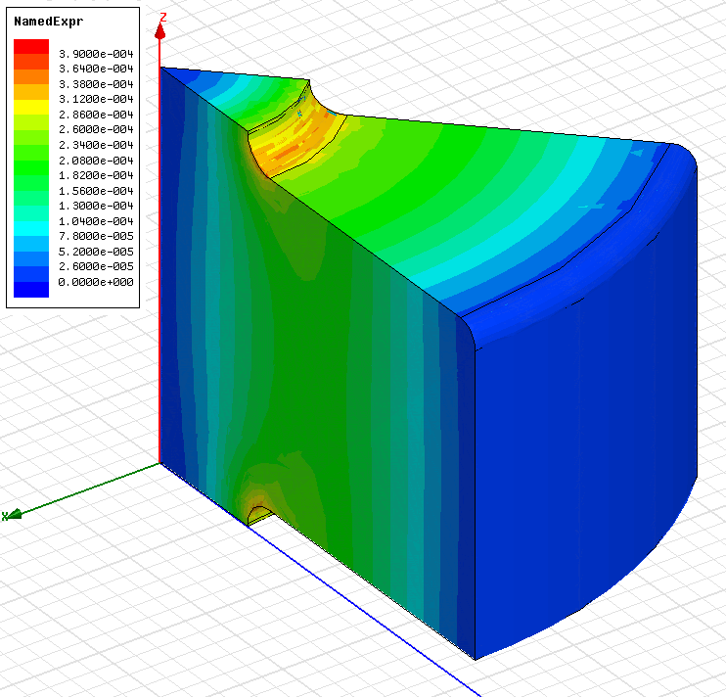
Middle cell
E_{s}/E_{a}
H_{s}/E_{a}
S_{c}/E_{a}²
a [mm] | 2.887
d [mm] | 1.402
e | 1.15
f [GHz] | 11.432
Q(Cu) | 6980
vg/c [%] | 1.33
r’/Q [LinacΩ/m] | 16960
Es/Ea | 1.95
Hs/Ea [mA/V] | 2.45
Sc/Ea² [mA/V] | 0.34

Slide 5
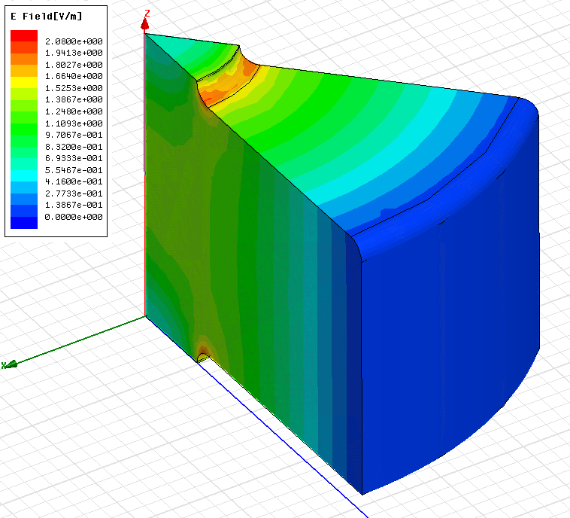
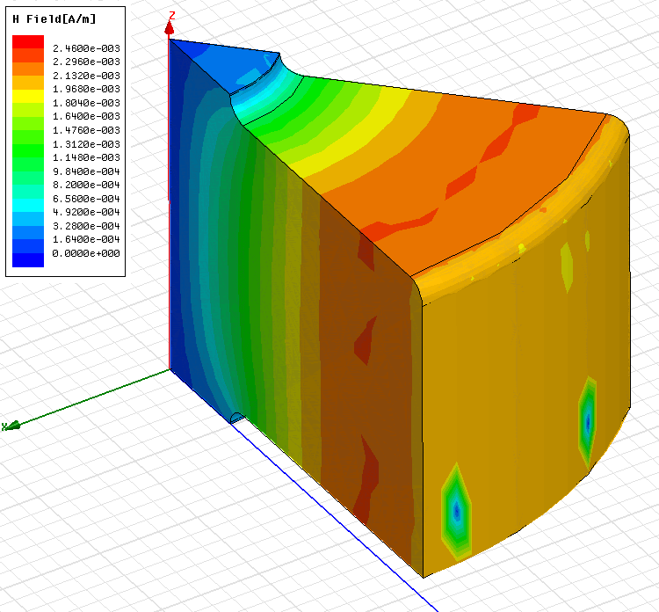
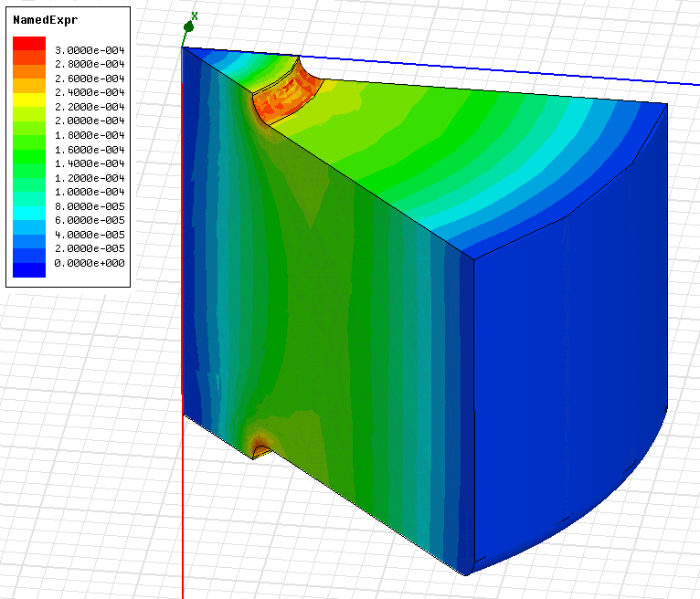
Last cell
E_{s}/E_{a}
H_{s}/E_{a}
S_{c}/E_{a}²
a [mm] | 2.467
d [mm] | 1.05
e | 1.13
f [GHz] | 11.426
Q(Cu) | 7157
vg/c [%] | 0.92
r’/Q [LinacΩ/m] | 18713
Es/Ea | 1.9
Hs/Ea [mA/V] | 2.3
Sc/Ea² [mA/V] | 0.28

Slide 6
Gradient in 24 regular cells
Average unloaded of 100 MV/m
Average loaded of 100 MV/m
Number of regular cells: Nc | 24
Bunch population: N | 3.72x10⁹
Number of bunches: Nb | 312
Bunch separation: Ncycl | 6 rf cycles

Slide 7
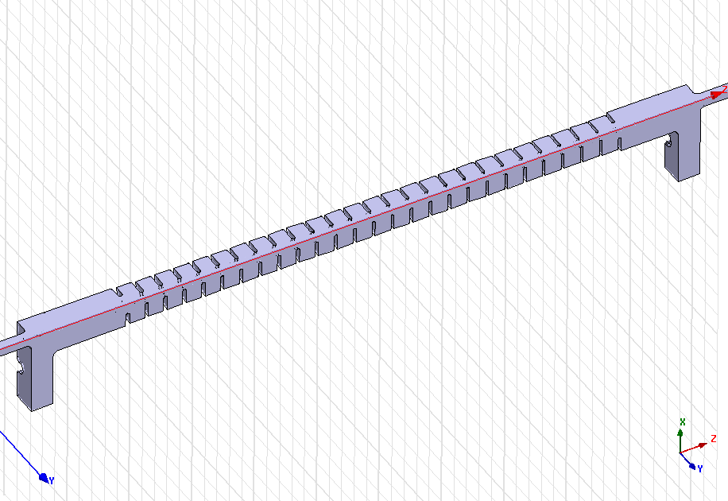
Simulation setup 1 & 2
HFSS-quad
HFSS simulation of ¼ of the structure:
Surface conductivity (Cu): 58e6 S/m
Surface approximation: ds=5 μm,
Total number of tetrahedra: Ntetr = 1024991
Mesh density: ~ 35000 tetr / ¼ cell
HFSS v11.1
S3P-quad
S3P simulation of ¼ of the structure made by Zenghai Li at SLAC-ACD
Surface conductivity (Cu): 57e6 S/m different

Slide 8
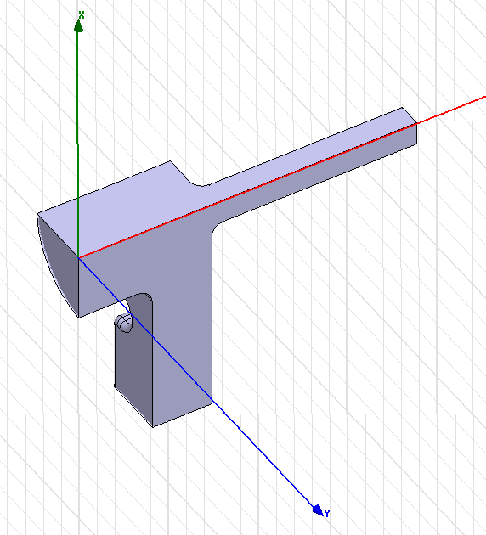
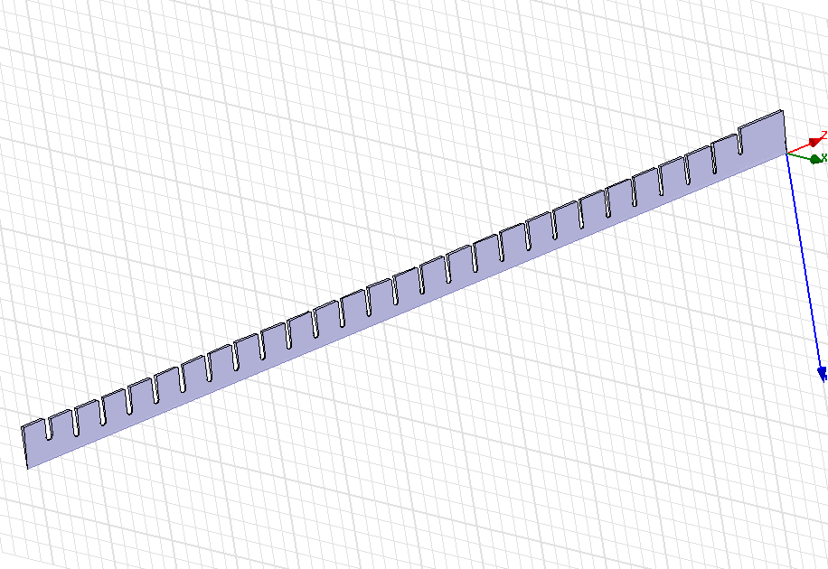
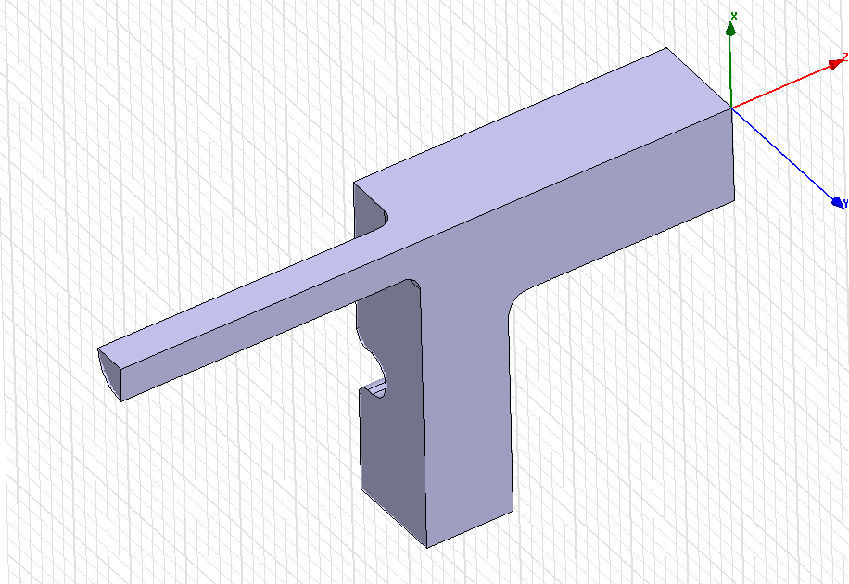
Simulation setup 3
HFSS-cells + couplers
HFSS simulation of ¼ of input coupler + segment of 5 deg. of the cells + ¼ of output coupler :
Surface conductivity (Cu): 58e6 S/m
Surface approximation: ds=1 μm,
Total number of tetrahedra for cells: Ntetr = 506075
Mesh density: ~ 350000 tetr / ¼ cell
(10 times higher than in HFSS-quad setup)
HFSS v11.1

Slide 9
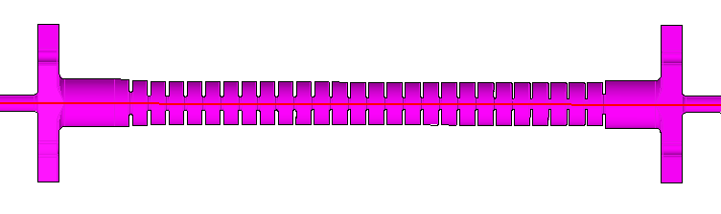
Measurement setup 1 (reflections)
VNA
port1
Perfect
load
1
4
2
3
Reflection = S11+S12
Perfect
load
VNA
port2
Frequency correction due to air (ε = 1.00059)
Frequency in vacuum: f’ = f*sqrt(1.00059)

Slide 10
Reflection: comparison
There is a shift up in frequency of ~3.5 MHz due to air correction in the measurements
The HFSS simulation results are about 4 MHz higher than air corrected measurements
The S3P simulation results are about 4-5 MHz lower than air corrected measurements
There is very small (~1MHz) or no difference between S3P simulations and the air corrected measurements

Slide 11
Measurement setup 2 (transmission)
VNA port1
Perfect load
1
4
2
3
Perfect load
VNA port2
Transmission = S13+S23
Perfect load
Perfect load
1
4
2
3
VNA port1
VNA port2

Slide 12
Transmission: comparison
There is a shift up in frequency of ~3.5 MHz due to air correction in the measurements
The HFSS simulation results are about 4 MHz higher than air corrected measurements
The HFSS simulation results shows more transmission by about 0.3 dB at 11.424 GHz
The S3P simulation results shows less transmission than HFSS by about 0.15 dB at 11.424 GHz

Slide 13
Some useful equations
On the other hand
Finally

Slide 14
Transmission: comparing group delay
There is a shift up in frequency of ~3.5 MHz due to air correction in the measurements
The HFSS simulation results are about 4 MHz higher than air corrected measurements
There is no difference between S3P simulations and the air corrected measurements

Slide 15
Transmission: comparing Q-factor
There is no difference in Q-factor (~7000) between HFSS and S3P simulations.
The measured Q-factor of about 6600 is lower than the simulated value by about 6 %.

Slide 16
Measurement setup 3 (bead pull)
VNA
port1
Perfect
load
1
4
2
3
E² ~ S11-<S11>
Perfect
load
VNA
port2

Slide 17
Bead pull in complex plane
Measurements: S11-<S11>
HFSS-cells: E

Slide 18
Bead pull: field magnitude
Measurements: |sqrt(S11-<S11>)|
HFSS-cells: |E|

Slide 19
Field distribution at 120º phase advance per cell
The best frequency fit for 120 deg average phase advance per cell is the same for S3P simulations and air corrected measurements: 11.424 GHz and is different for HFSS: 11.428 GHz
S3P simulation results
courtesy of Zenghai Li

Slide 20
Field distribution at the best match
The best match frequency is 3-4 MHz lower than the 120 deg phase advance frequency both in HFSS simulation and measurement
The average phase advance per cell is about 3 deg/cell different at the best match frequency both for HFSS simulation and measurement
There is still residual standing wave even in the case of HFSS simulations where the match is about -40 dB
Power for <Eacc> = 100 MV/m

Slide 21
Summary table for T24_vg1.8_disk parameters at 11.424 GHz if not stated otherwise
 | S12 | Pout/Pin | τ=0.5ln (Pout/Pin) | tf=dφ/dω [ns] | tf=W0/Pin [ns] | Q=ωtf/2τ | Q=ωW /Ploss | Pin100 24 cells [MW]
Measurements | 0.7077 | 0.5008 | 0.3457 | 63.11 | - | 6600 | -
HFSS ¼ | 0.741 | 0.549 | 0.2998 | 58.67 | 58.65 | 7025 | 7006
HFSS InCoup OutCoup Cells 24+2 | 0.7412 0.99875 0.99889 0.743 | 0.5494 0.9975 0.9978 0.552 | 0.2994 0.0013 0.0011 0.297 |  | 58.59 0.460 0.362 57.77 | 7020 12700 11800 6980 | 7005 13200 12300 7001 | 42.1 @ 11.428 GHz
3-cells model |  | 0.569- 0.533 | 0.282- 0.315 | - | 54.8- 59.37 | 6974- 6764 | 6980 | 41.1
S3P (SLAC) | 0.730 | 0.533 | 0.315 | 60.8 |  | 6927(σ=57e6) 6988(σ=58e6) |  | 42.4

Slide 22
Conclusions
There is no difference between HFSS simulations of ¼ of the structure and HFSS simulation of couplers + cells despite a factor 10 difference in the mesh density. This demonstrates that numerical convergence has been reached
All 3 different ways of calculating Q-factor: S3P, HFSS-S-parameter solver and HFSS-eigenmode solver give very close values of 6990, 7020 and 6980, respectively
The measurements of the T24_vg1.8_disk structure made at CERN show 6 % lower Q-factor of 6600
The difference in the simulated transmission between HFSS-S-parameter and S3P comes from the “geometrical” type of error which is equivalent to a difference of 4 MHz in the frequency for the 120 deg phase advance per cell
S3P simulations show 120 deg phase advance frequency of 11.424 GHZ. This is the frequency used in design of the cells using HFSS-eigenmode solver meaning that HFSS-eigenmode solver and S3P agrees and that the systematic error of 4 MHz in the case of T24_vg1.8_disk geometry comes from the HFSS-S-parameter solver
The 120 deg phase advance frequency in the air corrected measurement is 11.424 GHz which is the same as design frequency with the accuracy of ± 0.5 MHz. This demonstrates extremely high (sub-micron) precision of machining. For example, it is equivalent to ± 0.6 μm tolerance on the outer wall radius

Slide 23
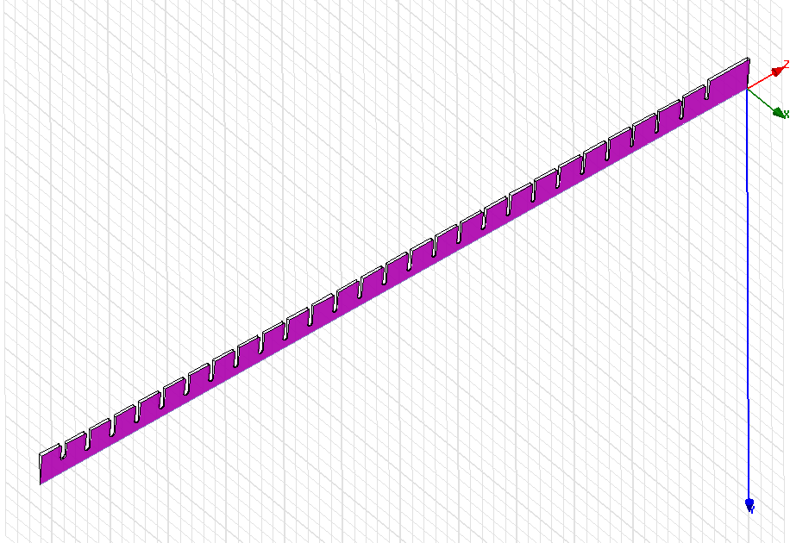
Simulation setup 4
HFSS-cells + couplers
HFSS simulation of ¼ of input coupler
+ segment of the cells made in HFSS by 5 deg. Sweep (3D geometry created in HFSS)
+ ¼ of output coupler :
Surface conductivity (Cu): 58e6 S/m
Surface approximation: ds=1 μm,
HFSS v11.1
versus
HFSS v10.1

Slide 24
Reflection
HFSS v11.1
HFSS v10.1

Slide 25
Transmission
HFSS v11.1
HFSS v10.1

Slide 26
Group delay
HFSS v11.1
HFSS v10.1

Slide 27
Q-factor
HFSS v11.1
HFSS v10.1

Slide 28
Phase advance per cell
HFSS v11.1
HFSS v10.1

Slide 29
Phase advance per cell
S3P simulation results
courtesy of Zenghai Li
HFSS v10.1

Slide 30
Outlook
To cross-check above conclusions S-parameter frequency sweep calculated with S3P would be very useful
Similar study of the other structures (T18, TD18, TD24, …) would also help to understand the limitations of structure manufacturing as well as the structure design using HFSS-S-parameter solver
Recipes for structure matching
Use HFSS-S-parameter solver VERSION 10
Use S3P
…

