Slide 1
Concept design of a high power Cyclotron for transmutation of radioactive waste.
A proposal for call in
EU2020
Future Emerging Technology
M.Losasso, CERN
July 2016

Slide 2
Meeting agenda
Welcome and introduction by Project Coordinator
Brief Presentation of the Participants and Organizations involved
FET – Background – Status of the play
HPCYC proposal – WP sharing
Points to elaborate
Road Map to Proposal Preparation

Slide 3
Status of the play
After the stop on last year, CERN management has agreed to let CERN coordinate a FET call on high-power cyclotron for radioactive waste transmutation.
….Au vu de l’intérêt du projet, des technologies (même si le CERN n’a plus de cyclotron en opération), de la faible implication du CERN pour la préparation de l’offre (la contribution de Marcello Losasso) et de l’absence de fonds de contrepartie (financement de EU à 100% en cas de succès), nous sommes d’accord que le CERN joue le rôle de coordinateur pour cette proposition FET….
F.Bordry email on 24.06.2016

Slide 4
FET mission
Future and Emerging Technologies activities help to create in Europe a fertile ground for responsible and dynamic multi-disciplinary collaborations on future and emerging technologies and for kick-starting new European research and innovation eco-systems around them. These will be the seeds for future industrial leadership and for tackling society's grand challenges in new ways.
FET focuses on research beyond what is known, accepted or widely adopted and supports novel and visionary thinking to open promising paths towards radically new technological possibilities. In particular, FET funds interdisciplinary collaborations that seek genuine cross-fertilisation and deep synergies between the broadest range of advanced sciences (including the life sciences, social sciences and humanities) and cutting-edge engineering disciplines.

Slide 5
FET program
The FET programme has three complementary lines of action to address different methodologies and scales, from new ideas to long-term challenges:
• FET Open supports the early-stages of the science and technology research and innovation around new ideas towards radically new future technologies. It also funds coordination and support activities for such high-risk forward looking research to prosper in Europe.
• FET Proactive addresses promising directions for research on future technologies in order to build up a European critical mass of knowledge and excellence around them.
• FET Flagships are science-driven, large-scale, multidisciplinary research initiatives oriented towards a unifying goal, aiming at transformational impacts with substantial benefits for European competitiveness and for society.
.

Slide 6
Call - FET-Open – Novel ideas for radically new technologies - H2020-FETOPEN-2016-2017
This call aims to support the early stages of joint science and technology research for radically new future technological possibilities. The call is entirely non-prescriptive with regards to the nature or purpose of the technologies that are envisaged and thus targets mainly the unexpected. A bottom-up selection process will build up a diverse portfolio of projects. In order to identify and seize opportunities of long-term benefit for citizens, the economy and society, the early detection of promising new areas, developments and trends, wherever they come from, will be essential.
.

Slide 7
HORIZON 2020 - Work Programme 2016 -2017
Future and Emerging Technologies
http://ec.europa.eu/research/participants/data/ref/h2020/wp/2016_2017/main/h2020-wp1617-fet_en.pdf

Slide 8
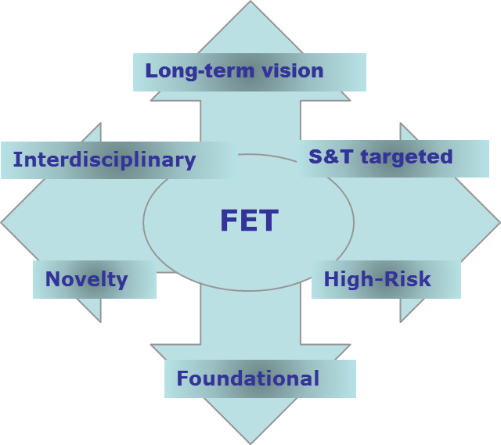

Slide 9
FET-Open
https://ec.europa.eu/programmes/horizon2020/en/h2020-section/fet-open
FET Open calls for collaborative research and innovation actions that satisfy 6 'gatekeepers', which define the kind of research that FET is looking at:
    Long-term vision
    Interdisciplinary
    Novelty
    Foundational
    S&T targeted
    High-Risk
Bottom-up, but targeted - not blue sky research
Collaborative research
All technologies, no thematic restriction

Slide 10
Long-term vision: the research proposed must address a new, original or radical long-term vision of technology-enabled possibilities that are far beyond the state of the art and currently not anticipated by technology roadmaps.
Breakthrough S&T target: research must target scientifically ambitious and technologically concrete breakthroughs that are arguably crucial steps towards achieving the long-term vision and that are plausibly attainable within the life-time of the proposed project.
Foundational: the breakthroughs that are envisaged must be foundational in the sense that they can establish a basis for a new line of technology not currently anticipated.
Novelty: the research proposed must find its plausibility in new ideas and concepts, rather than in the application or incremental refinement of existing ones.
High-risk: the potential of a new technological direction depends on a whole range of factors that cannot be apprehended from a single disciplinary viewpoint. This inherent high-risk has to be countered by a strongly interdisciplinary research approach, where needed expanding well beyond the strictly technological realm.
Interdisciplinary: the proposed collaborations must be interdisciplinary in the sense that they go beyond current mainstream collaboration configurations in joint science- and technology research, and that they aim to advance different scientific and technological disciplines together and in synergy towards a breakthrough.

Slide 11
The Commission considers that proposals requesting a contribution from the EU of up to EUR 4 million would allow to address appropriately the scope.
Nonetheless, this does not preclude submission and selection of proposals requesting other amounts.
Expected Impact:
  • Initiating or consolidating a baseline of feasibility or a radically new line of technology and its future uses by establishing the essential proofs-of-principle and their foundational scientific underpinnings.
  • Strengthening European leadership in the early exploration of visionary, new and emerging technologies, beyond academic excellence and with global recognition. This impact can be reinforced by involving also new high-potential actors such as young, both female and male, researchers and high-tech SMEs that may become the European scientific and technological leaders and innovators of the future.
  • Impact is also sought in terms of the take up of new research and innovation practices for making leading-edge science and technology research more open, collaborative, creative and closer to society.

Slide 12
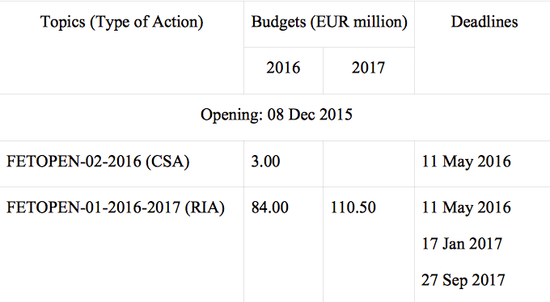
TIMELINE of CALL-OFF

Slide 13
Our proposed project:
Concept design of a compact Cyclotron for transmutation of radioactive waste.

Slide 14
scope
Starting from the current status of the technology and the market outlook, we want to define the requirements for a high-power, compact, cost effective and easy to operate, cyclotron for transmutation of nuclear waste.
The objective is to deliver a conceptual design that is in principle adoptable by the market.
We plan to demonstrate the main conceptual aspect of our design with prototypes and PoC demonstrators that are aimed to bridge the gap to industrialization.
We plan to get a full understanding of the cost drivers that have made unacceptable this technology so far

Slide 15
how
By combining novel accelerator technologies, compact reactor concept, the use of MgB2 superconductors and innovative design features that foresee a single stage accelerator and multiple sources for the injection, our objective is to produce a machine design that is highly reliable, and easily maintained and operated.
We plan to use as much as possible the results of FP5 projects Europart and Eurotrans dealing with ADS design for transmutation, on all the issues already addressed of safety, radiation protection, transport, secondary waste, cost, scheduling.
The long term vision of our project: higher reliability and simpler operation will make the unprecedented design ready for adoption in the frame of a larger program aimed to build an industrial machine crucial for the decarbonization of EU in the next decades.

Slide 16
Evaluation criteria
EXCELLENCE
Compliance with the FET-gatekeepers as described in the call:
Clarity and novelty of long-term vision, and ambition and concreteness of the targeted breakthrough towards that vision.
Novelty, non-incrementality and plausibility of the proposed research for achieving the targeted breakthrough and its foundational character.
Appropriateness of the research methodology and its suitability to address high scientific and technological risks.
Range and added value from interdisciplinarity, including measures for exchange, cross-fertilisation and synergy.
Threshold: 4/5, Weight: 60%

Slide 17
Evaluation criteria
IMPACT
Contributions to the impacts listed under this topic in the workprograme:
  Importance of the new technological outcome with regards to its transformational impact on technology and/or society.
  Impact on future European scientific and industrial leadership, notably from involvement of new and high potential actors.
  Quality of methods and measures for achieving impact beyond the research world and for establishing European though leadership, as perceived by industry and society.
  Threshold: 3.5/5, Weight: 20%

Slide 18
Evaluation criteria
IMPLEMENTATION
The following aspects are taken into account:
  Soundness of the workplan and clarity of intermediate targets.
  Relevance of expertise in the consortium.
  Appropriate allocation and justification of resources (person-months, equipment).
  Threshold: 3/5, Weight: 20%
  A guide to evaluation of proposal is here:
  http://ec.europa.eu/research/participants/data/ref/h2020/grants_manual/pse/h2020-guide-pse_en.pdf

Slide 19
Project fits the scope of the call because:
It will help Europe to grasp leadership into the area of management of radioactive waste, a sector where thousands ton of toxic materials are produced per year, without any yet accepted and adopted solution of definitive disposing [from IAEA data Waste Counter: 29,620,000 m³ in ~366 Facilities, Not including some countries]
It will bring closer science and society by finding a concrete technical solution for a grand society challenge
The interdisciplinary action of superconductivity, accelerator technologies, new materials, environmental and nuclear sciences is expected to foster cross fertilization in many different areas, one example are accelerators playing a role in environmental conservation through their use in processing water and flue gases
It will open a new line of market into the cyclotron business, with expected new jobs in Europe, addressing as well the challenges of next-generation reactors that burn non-fissile fuel, such as thorium, that can be burned with the use of particle beams. Both or either of these approaches could lead to an increase in power generation through greenhouse gas emission-free nuclear energy and could provide a long-term strategy for the energy supply.

Slide 20
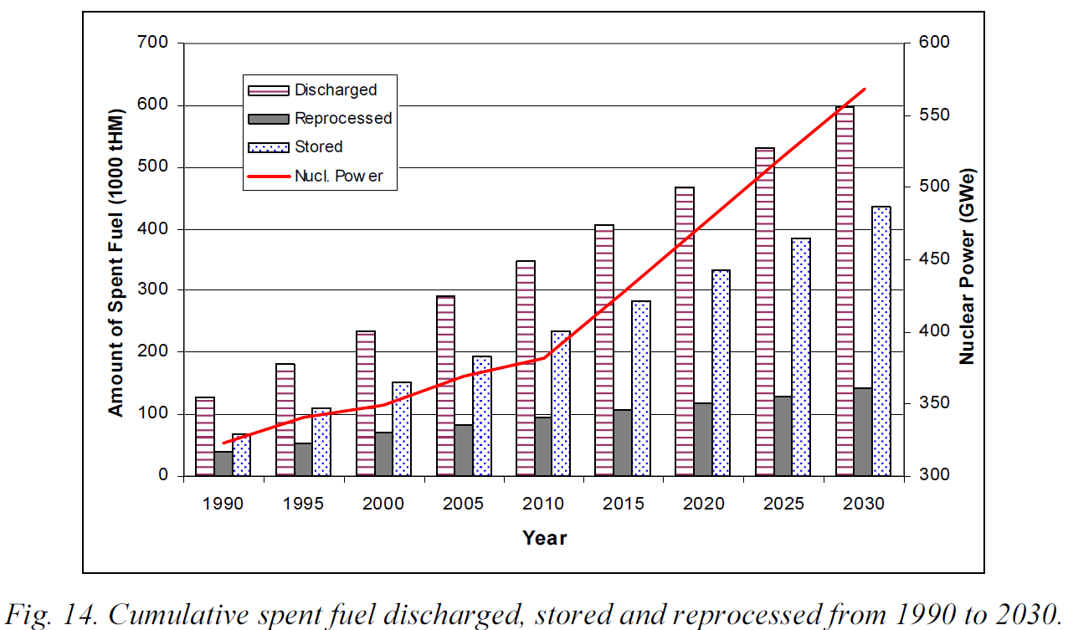
Data IAEA-TECDOC-1613, April 2009 spent nuclear fuel from nuclear plant worldwide
Even if nuclear would be phased-out tomorrow, the world still would need to address the safe, economic and definitive management of all the waste produced in the last 60 years.

Slide 21
The project is innovative because:
A key challenge facing the nuclear fuel cycle is reducing the radiotoxicity and lifetime of spent nuclear fuel. Partitioning or sorting of nuclear waste isotopes and accelerator-based transmutation combined with geological disposal can lead to an acceptable societal solution to the problem of managing spent nuclear fuel.
The original idea of ADS has never been crossing the “death valley”
Of the integration into the design of the machine of concepts never explored before in this context (High temperature superconductors, new design of cavity, SOC, for example) that will increase the reliability, reduce the cost, improve the simplicity of the operation.

Slide 22
value chain and their actors:
Technology designers → AIMA, ASG
Design Integrators → CERN, iThEC, PSI
Application Testing → AIMA, ASG, PSI
System integrators → Hydromine Nuclear Energy
Nuclear-21

Slide 23
Proposed consortia is appropriate because:
Each partner brings added value. In fact:
AIMA is EU leader in cyclotron design
ASG is EU leader into magnet manufacturing
PSI is the world leader of the cyclotron operation
CERN is the leader into particle physics and the site of the world largest accelerator, with consolidated experience of integration of research, researchers and technologies.
Hydromine Nuclear Energy (represented by Ing. Cinotti), holds a large number of patents and invention in many field of nuclear applications
Nuclear-21 is a Belgian based company specialized in nuclear science & technology services to governments, investors, utilities, industry, R&D-organizations and waste management agencies worldwide.
ITHEC is a Geneva not-for profit based organization whose mission is to promote innovation into the field of Th, ADS and waste transmutation.

Slide 24
The proposed work package distribution
WP0 (CERN) → coordination Management, integration, dissemination.
WP1 (iThEC, all) → Identification, definition and integration of machine parameters
WP2 (AIMA, CERN, PSI, ASG) → Novel Cyclotron Design
WP3 (Hydromine Nuclear Energy, iThEC) → Spallation Target design & Beam transport
WP4 (iThEC, CERN, PSI) → Trasmutation analysis
WP5 (nuclear-21, all) → Life Cycle Analysis
WP6 (ASG, AIMA) PoC prototypes

Slide 25
WP0 (CERN): coordination Management, integration, dissemination, tech and financial monitoring, coordination of governance committees
WP1 (iThEC):
identification of requirements
definition of machine parameters
integration
WP4 (iThEC):
transmutation analysis
WP2 (AIMA): design of novel cyclotron
Magnetic design
Mechanical design
Cryogenic design
WP5 (nuclear-21): life cycle analysis
cost/benefit balance for transmutation
Socio-political sustainability vs. technical-economic challenges
larger economic benefit of this transmutation, e.g. radioisotopes production and separation
WP3 (Hydromine Nuclear Energy): spallation target design & beam transport
Interface cyclotron/reactor
Adaptation of innovative reactor designs to ADS
WP6 (ASG):
Proof of Concept
Prototypes

Slide 26
proposed way to go:
July 2016 : Agreement on the consortia composition and work packages distribution
August 2016 : consolidate partners information ( mail to the project coordinator):
  Preliminary description of work packages: overall scope, tasks distribution in WPs.
  General info, administrative data
  Contacts
  Draft budget per WPs.
September. .2016 : VC is arranged with all partners. -→ fix the date already now: Monday September 12 is ok? In alternative 22 or 23 September?
October 2016 : in person meeting. The coordinator edits a first draft for circulation to the partners; internal review with CERN EU experts to address issues in the call preparation
→ fix the date already now: October 10, Monday, is ok? In alternative all that week is fine with me.
November 2016: second draft preparation and approval of the partners
December 2016: in person meeting, proposal submission. Resolution of issues. Discussion and draft of consortium agreement.

Slide 27
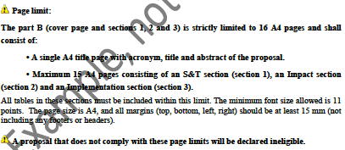
We have to prepare a 16 A4 page document, plus adm info

Slide 28
FET open
We have to prepare a 16 A4 pages document, plus adm info
Success rates* for the 1st cut-off date of FET Open call
RIA: 24 / 643 (3.7%) CSA: 4 / 31 (12.9%) Of note, number of proposals below threshold(s): 385 (RIA) and 10 (CSA) (*) Number of proposals retained for Grant Agreement preparation / Number of submitted proposals
To increase our chances:
we have to clearly set the appropriate TRL and the ambitions we have for concrete technology transfers
we have to highlight value chain concepts and cross sectorial impact

Slide 29
COVER PAGE
Title of the Proposal:
Acronym: HPCYC
List of Participants
Partticipant No
Participant organisation name Country
1 (Coord) European Organization for Nuclear Research - CERN International European Interest Organisation
2
3
…
Abstract:
The HPCYC will tackle a societal issue by delivering a novel technical solution to the radioactive waste management. The present solutions for the radioactive waste storage and disposal are not considered satisfactory, and even in the 100% phased out nuclear scenario on a planet scale, the waste is estimated to increase in the next decades to unacceptable levels. The proposed technology will combine status-of the art particle accelerator know-how with new material developments and simulation advances to allow the transmutation of nuclear waste and the reduction of its volume. By delivering PoC prototypes the project will demonstrate the technical and economical viability of the concept, and it will dramatically open the way to new applications for a carbon-free economy and also for HEP.

Slide 30
WP Objectives, Deliverables, Milestones….
WP Description of work.

Slide 31
discussion

