Slide 1






HL-LHC
Magnet components and assemblies
E. Todesco, F. Savary, on behalf of WP3 and WP11
See also the presentation from F. Savary in 2015
https://indico.cern.ch/event/387162
31st October 2016 – Instituto Superior Técnico, Lisbon

Slide 2
FOREWORD
HL LHC magnets are within WP3 and WP11
  Different timeline (as shown by L. Rossi)
    WP11: to be installed in 2019-20
    WP3: to be installed in 2024-25
  Together, they represent ¼ of the HL-LHC budget
  About one third of magnets comes from in kind contributions or collaborations agreements
    So this fraction is not steered directly by CERN
  7 types of new magnets, all built in industry
    Except 11 T (CERN with industry personnel), Q1/Q3 (US labs)
  7 labs participating (LBNL, BNL, FNAL, KEK, CEA, INFN, CIEMAT)
Cryostats discussed by D. Duarte Ramos

Slide 3
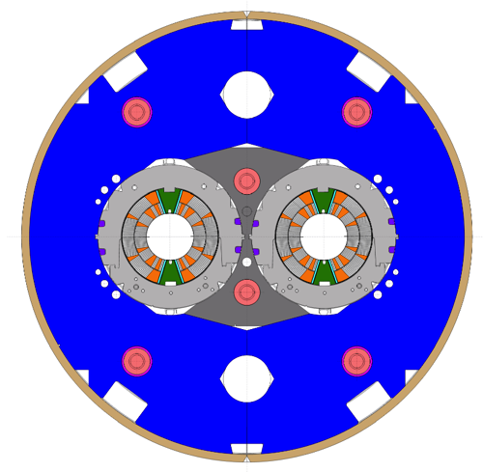
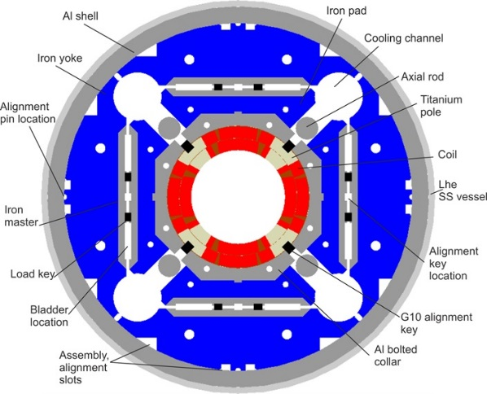
Nb₃Sn MAGNETS
Two types of Nb₃Sn magnets: 11 T and the triplet
  Both with wind and react technique
  Both with peak field of 11.5 T
  Lengths and quantities
    4.2 m (Q1/Q3) – 20 units from US (90 coils)
    5.5 m (11 T) – 6 units (30 coils)
    7.15 m (Q2a Q2b) – 10 units (50 coils)
  Apertures
    60 mm for 11 T (LHC arc)
    150 mm for triplet (IR region)
D1 cross-section
[M. Karpinnen F. Savary et al.]
QXF cross-section [P. Ferracin, G. Ambrosio et al.]

Slide 4
Nb₃Sn MAGNETS
Coil manufacturing is the dominant part (time, budget)
  Same technology: winding, reaction at 650 C, impregnation, instrumentation
Mechanical structure is different
  11 T: stainless steel collars, loading with collaring press
  Triplet: Al shell loaded with bladder and key
Production strategy:
  11 T: at CERN with manpower from industry
  Triplet: prototypes at CERN, we are exploring the option of manufacturing of series in industry

Slide 5
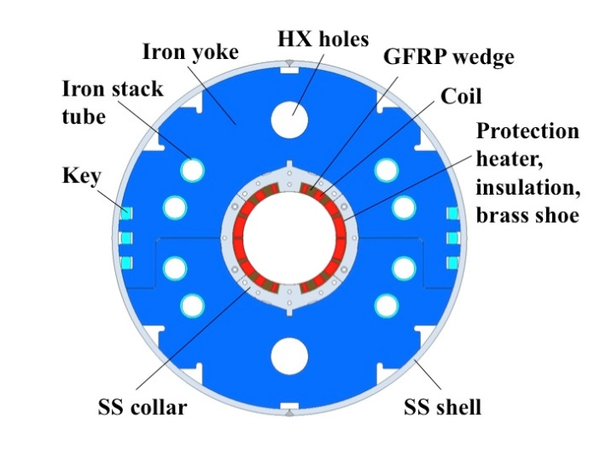
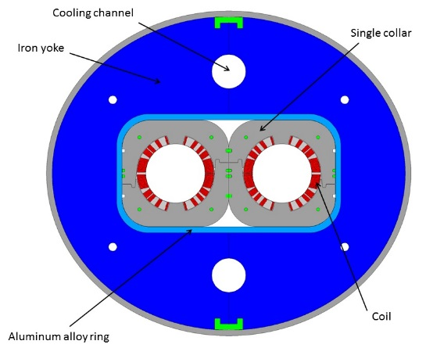
NB-Ti MAGNETS
Two main magnets: D1 and D2
  Both with Nb-Ti classical technology
    Rutherford cable
  Bore field of 4.5 T to 5.6 T
  Lengths and quantities
    6.2 m (D1) – 6 units from Japan
    7.8 m (D2) – 6 units (prototype from INFN)
  Apertures: 150 mm for D1 - 105 mm for D2
  Mechanical structure
    Iron yoke (D1)
    Self standing collars (D2)
D1 cross-section [T. Nakamoto, M. Sugano et al.]
D2 cross-section [P. Fabbricatore, S. Farinon]

Slide 6
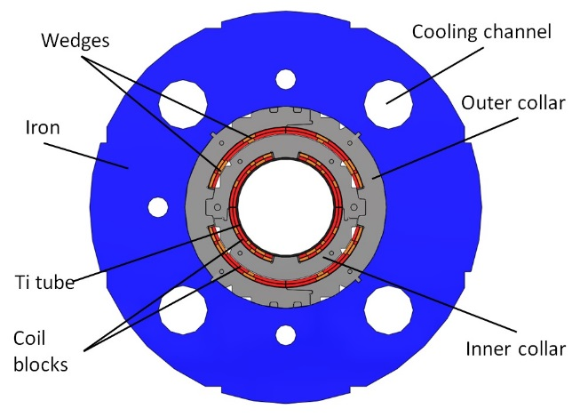
CORRECTOR MAGNETS: NESTED
Nb-Ti technology, sector coil Rutherford cable
  Nested correctors: bore field of 2.1 T in each plane Lengths and quantities
    1.2 m (short) – 6 units (prototype from CIEMAT)
    2.1 m (long) – 12 units
  150 mm aperture
  Mechanical structure
    Self standing collars, double collaring
MCBXF cross-section
[F. Toral, J. Garcia Matos et al.]

Slide 7
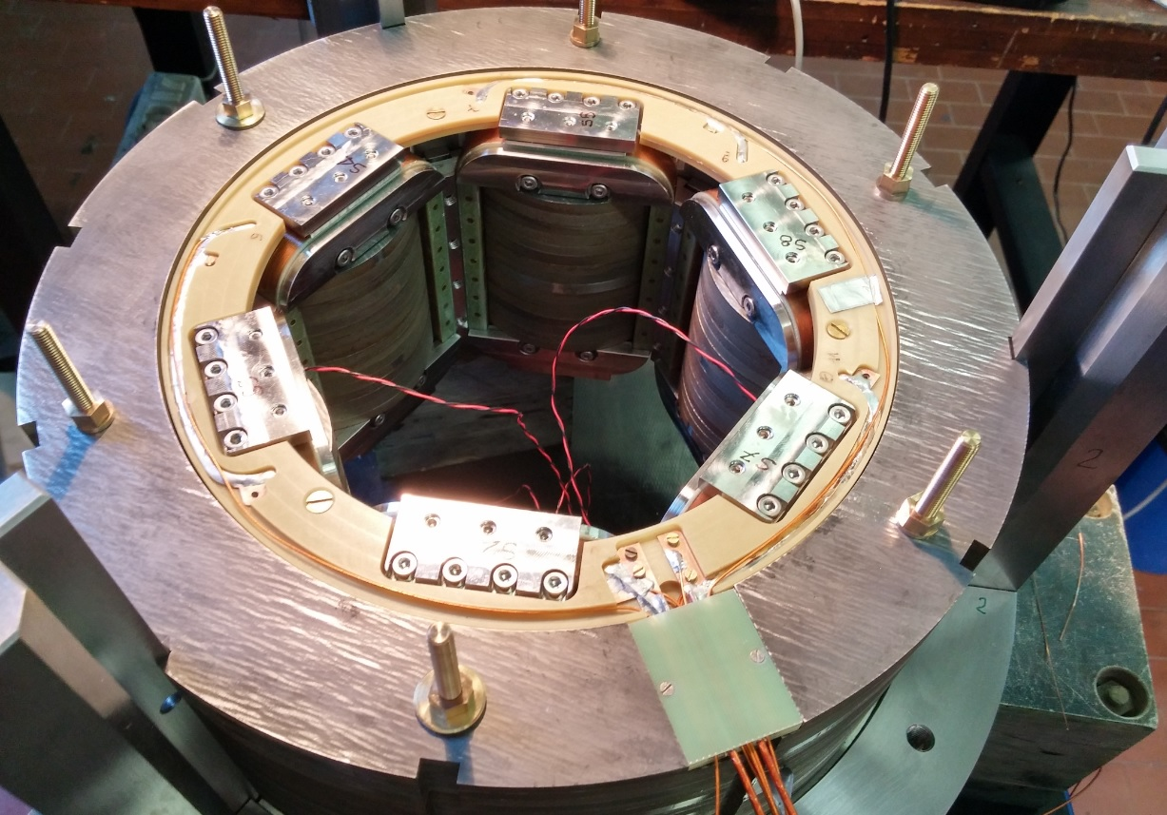
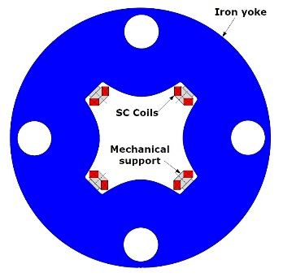
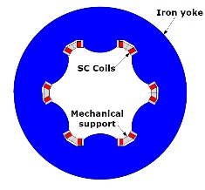
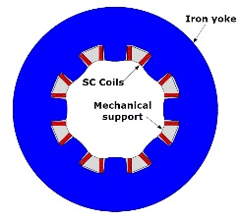
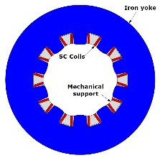
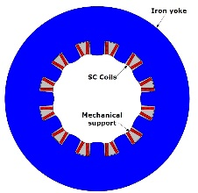
CORRECTOR MAGNETS: HIGH ORDER
Nb-Ti technology, superferric design
  High order correctors: peak field of 2-3 T (prototypes by INFN)
  Lengths and quantities
    About 1 m (quadrupole) – 6 units
    About 0.5 m (dodecapole) – 6 units
    About 0.1 m (sextupole, octupole, decapole) – 6*7 units
  150 mm aperture
High Order correctors cross-section [G. Volpini, M. Statera, et al.]

Slide 8
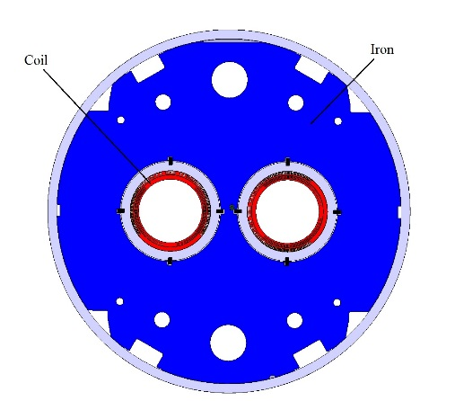
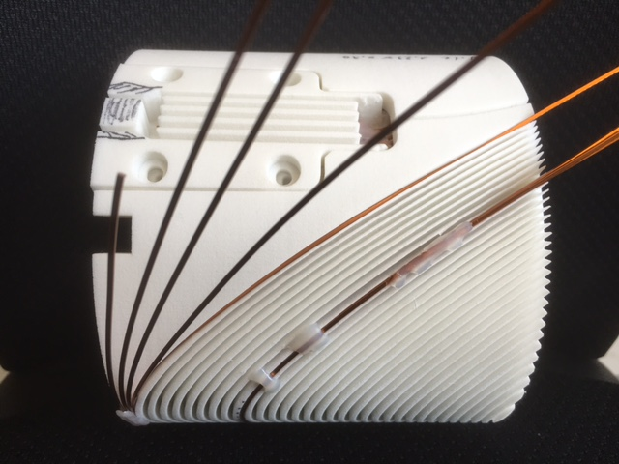
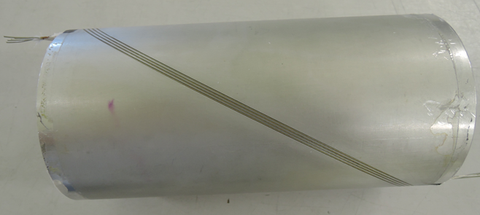
CORRECTOR MAGNETS: CANTED
Nb-Ti technology, canted design
  High order correctors: peak field of 2-3 T (prototypes by INFN)
  2 m long, 12 units
  105 mm aperture
MBCRD cross-section
[G. Kirby, J. Rysti]
Winding tests of the canted model [G. Kirby, J. Rysti, J. Mazet, et al.]

Slide 9
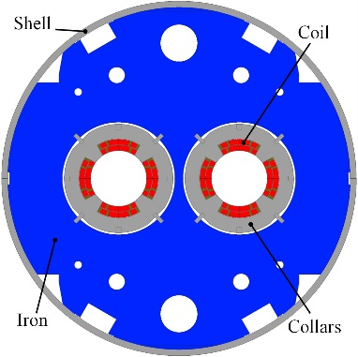
LARGE APERTURE Q4 DEVELOPMENT
A large aperture Q4 (90 mm) was in the initial baseline (called MQYY)
  Series removed in June 2016 to cope with budget reduction
  Activities going on:
    Short model development from CEA
    Construction of two prototypes within
    QUACO EU initiative
MQYY [J. M. Rifflet, M. Segreti, et al.]

Slide 10
COMPONENTS
Superconducting strand
  Nb₃Sn: Procured by CERN and US collaboration, two producers
  Nb-Ti: D1 and D2 reuse LHC cable, nested reuses SLHC cable, superferric and canted use existing strands
For 11 T and triplet, CERN (and US) procure all main components
For Nb-Ti main magnets and correctors, industry will be probably in charge of component procurement
CERN will provide raw material (both magnetic and non magnetic steel) to guarantee magnetic performance and to minimize costs

Slide 11
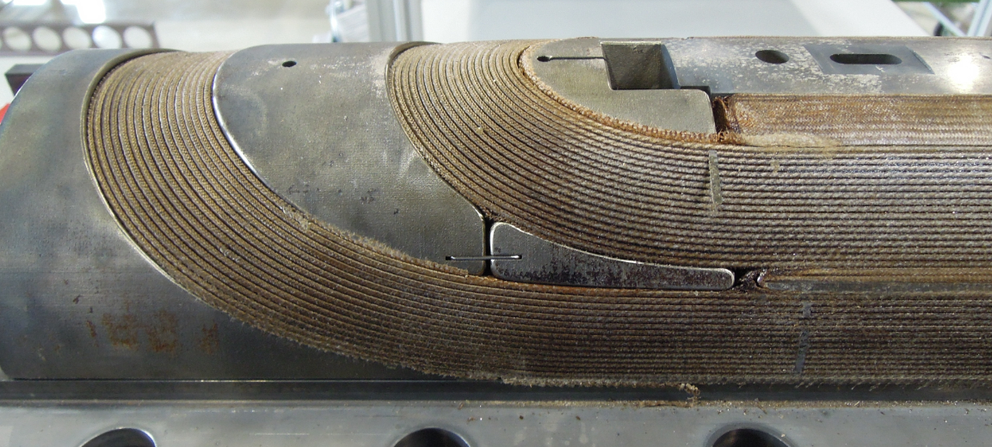
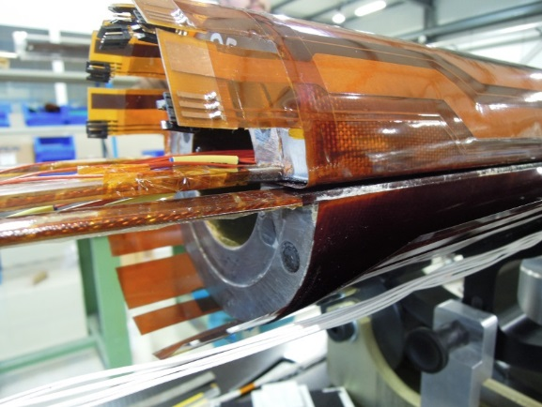
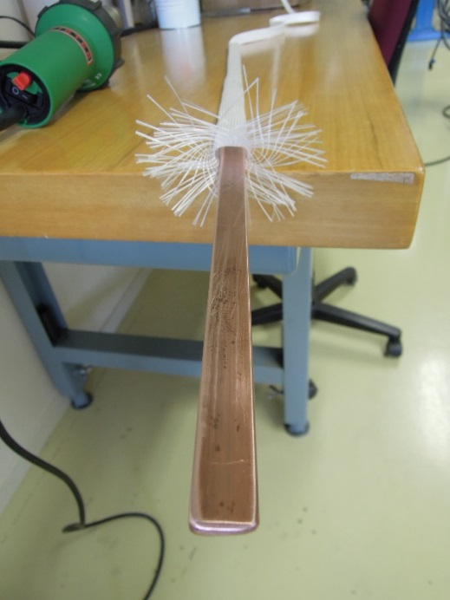
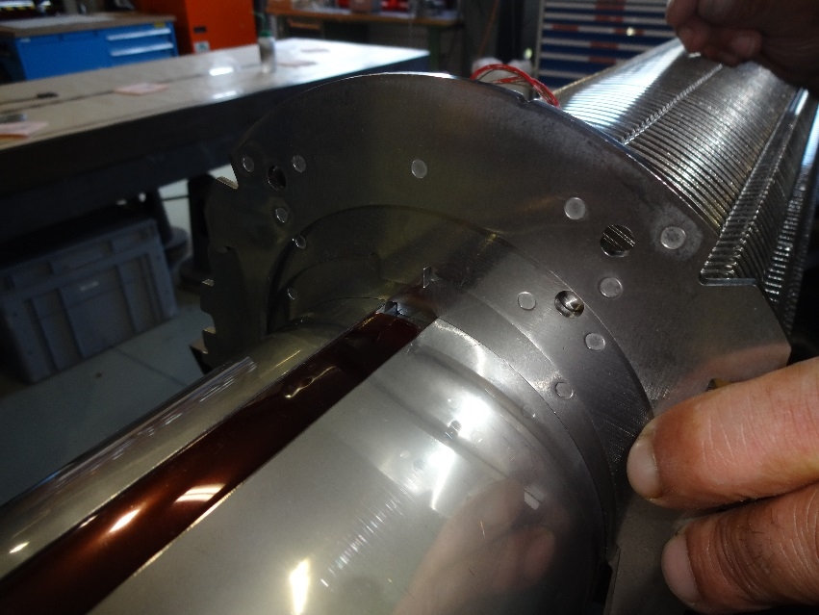
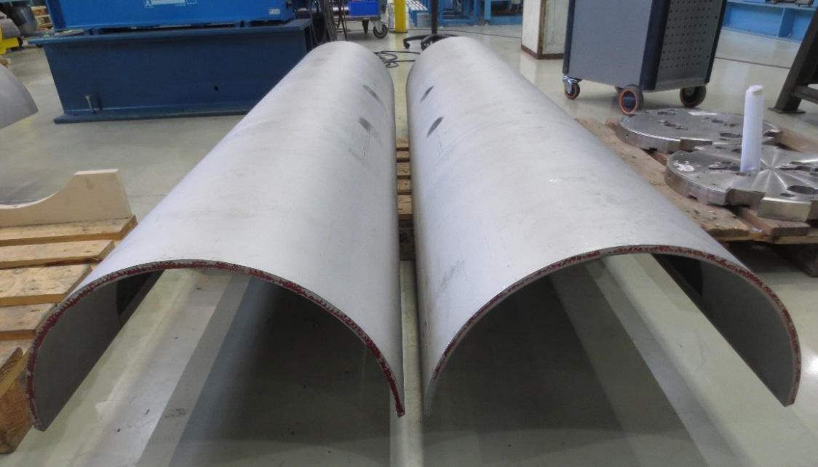
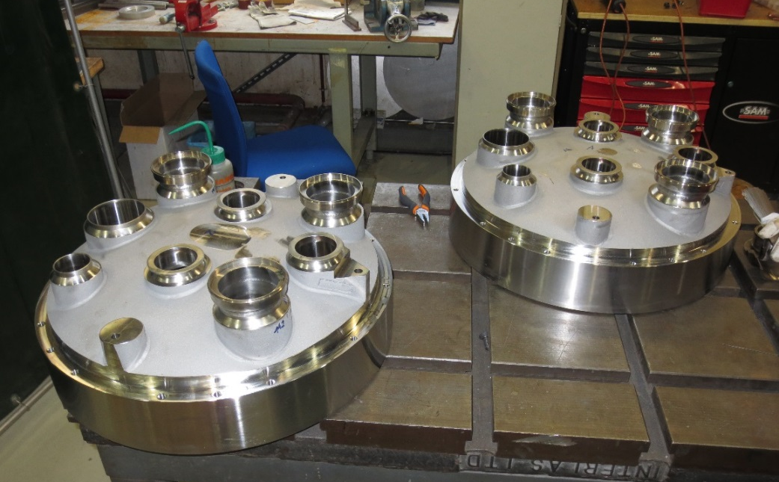
COMPONENTS
Non exhaustive list of components
  Coil:
    Cable insulation
    Impregnation resin
    Winding poles
    End spacers
    Wedges
    Quench heaters
  Magnet:
    Collars
    Yoke laminations
  Cold mass:
    End domes
    SS half shells

Slide 12
CONCLUSION
We have a challenging project requiring substantial involvement of the industry
  Effective partnership is crucial for the success
  Several challenges
    Some new tecnologies to be applied for the first time in high energy accelerator magnets (Nb₃Sn, plus canted magnet)
    More critical aspects
      Relatively small series, little time to react
      Many different magnets
      Timeline of procurement
      Many collaborations, interfaces management
      Exchange of information (see www.cern.ch/hilumi/wp3 www.cern.ch/hilumi/wp11 https://project-hl-lhc-industry.web.cern.ch )

Slide 13
A summary from F. Savary about status in 2015
Legend:
We are covered
We need more suppliers
We desperately need suppliers
Item # | Description | Raw material | 2018 | Later | What is challenging
1 | Coil keys | AISI 316 L – DIN 1.4435 |  |  | Machining (accuracy & elasticity)
2 | End spacers | SLS – AISI 316 L – DIN 1.4435 |  |  | 3D-metrology, electrical insulation is needed
3 | Saddles | Impregnated glass fiber as per IEC/EN 61212-3-1 EP-GC22 |  |  | 5-axes machining, GC22, accuracy
4 | Removable pole | TA6V annealed (Ti6Al4V; 3.7165) |  |  | Accuracy & material
5 | Wedges – precision profiles | Aluminum oxide dispersion strengthened copper (ODS) |  |  | Accuracy, material ODS
6 | Quench heaters | Polyimide – St.Steel – Copper |  |  | Flexible Printed Circuits
7 | Collars | YUS-130S (High Mn Steel) |  |  | Fine blanking, accuracy
8 | Collaring keys | AISI 316 L – DIN 1.4435 |  |  | Accuracy
9 | Yoke laminations & inserts | Low carbon steel |  |  | Fine blanking, accuracy
10 | Heat exchanger tube | Oxygen Free Cu – UNS C10200 |  |  | Cu quality
11 | Bus bars – hollow bars | Oxygen Free Cu – UNS C10200 |  |  | Length, Cu quality
12 | Lyras | Oxygen Free Cu – UNS C10200 |  |  | Cu quality
13 | Shells | AISI 316 LN – DIN 1.4429 |  |  | Raw material, thickness, accuracy
14 | End covers | AISI 316 LN – DIN 1.4429 |  |  | Raw material, accuracy

