Slide 1
LIU-PSB Baseline 7 Status (2016)
Gian Piero Di Giovanni

Slide 2
Summary Table (I)
LIU-PSB WP | 2016 Baseline 6 (kCHF) | 2016 Baseline 7 (kCHF) | Comment
1.0: Management | 100 | 10 | Spending allocated for BTP supports moved in 2017
3.0: Magnets | 947 | 408 | Contracts committed in 2016 and paid in 2017
3.0: Magnetic Measurements | 100 | 30 | Matched Year-by-year
4.1: RF Cavities | 340 | 675 | Orders for PS and amplifiers in 2016. 10% of the payment done in 2016. The rest in 2017
4.2: LLRF | 63 | 39 | Fine tuning for this year
4.3: PSB TF | 85 | 93 | Fine tuning for this year
5.1: LIU-L2B, PSB Injection | 3050 | 3050 | 2016 spending confirmed
5.2: 2GeV Upgrade | 6377 | 1099 | 5218 kCHF were mostly moved to 2018 because of POPS-B planning change.

Slide 3
Summary Table (II)
LIU-PSB WP | 2016 Baseline 6 (kCHF) | 2017 Baseline 7 (kCHF) | Comment
6.0: BI | 1426 | 1735 | Cabling + 50 kCHF more for CtC for BTMS
7.0: BID (EN-STI) | 133 | 50 | Fine tuning for 2016
8.0: Vacuum | 721 | 566 | Fine tuning for 2016
9.2: ABT Injection | 3686 | 2927 | CtC reduced by 363 kCHF
10.2: ABT Extraction | 1547 | XXXX | Missing Info
11.0: Control | 130 | 130 | WP to be completed end 2016
12.0: EN-EL (LV/HV) | 1034 | 1014 | Fine tuning for 2016
13.0: CV | 352 | 20 | Commitment paid in 2017
14.0: Transport | 128 | 95 | Fine tuning for 2016
15.0: Civil Engineering | CtC: 3405 | Actual CtC: 2270
17.0: Interlock | 43 | 13 | Fine tuning for 2016
Notes:
14780 (new) 66890950

Slide 4
Status In Details

Slide 5
LIU-PSB 1.0: Management
Cost-to-completion unchanged.
Perfect matching year-by-year.
Budget reduced from 100 kCHF to 10 kCHF. Money to be allocated for BTP support moved in 2017.

Slide 6
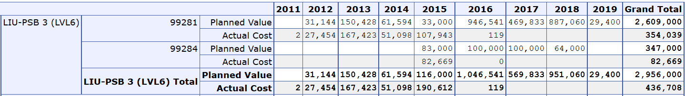
LIU-PSB 3.0: Magnets
before
after
Cost-to-completion unchanged
Fine tuning for the magnetic measurements (from 100 kCHF to 30 kCHF)
Re-adjustement of the spendings in 2016 for main WUs (A. Newborough): from 946 kCHF to 408 kCHF

Slide 7
LIU-PSB 4.1: RF Power And Cavities
before
after
Year-by-year mismatch, but the sum matches nicely for all years before 2016.
The discrepancy is only 13 kCHF on a budget of ~12 MCHF…
Increased budget from 340 kCHF to 675 kCHF:
  Commitment for power supplies and power amplifiers to be done in 2016.
  Full payment expected in 2017, but 10% of the payment will be done in 2016.

Slide 8
LIU-PSB 4.2: LLRF
before
after
Mismatch year-by-year, but the sum of money planned and spent up to the end of 2015 matches!
Fine tuning for the spending of 2016: From 63 kCHF to 39 kCHF.

Slide 9
LIU-PSB 4.3: PSB Transverse Feedback
before
after
Good matching year-by-year.
Budget profile nearly unchanged.

Slide 10
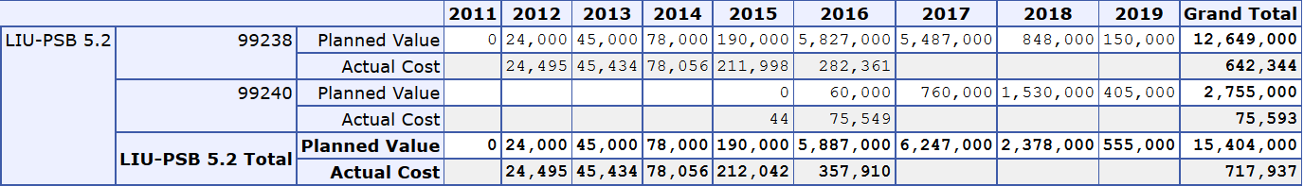
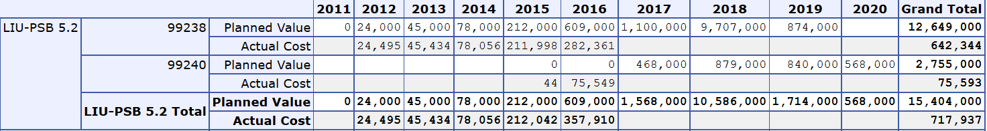
LIU-PSB 5.2: 2 GeV Upgrade (I)
before
after
Major change of planning for POPS-B project:
  Drastic reduction of costs in 2016.
  Most of the spending is expected in 2018.

Slide 11
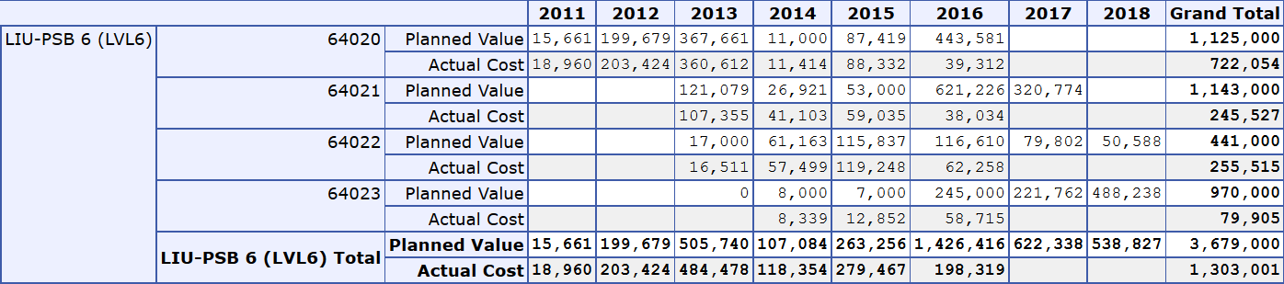
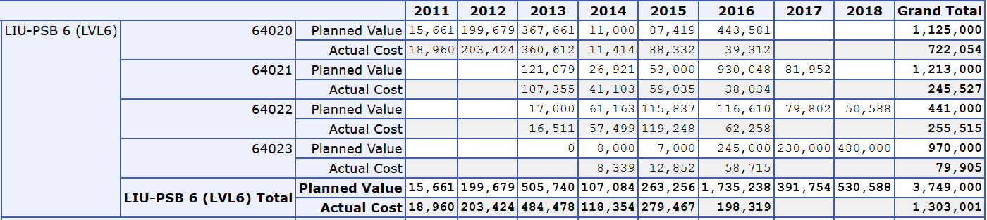
LIU-PSB 6: Beam Instrumentation
before
after
The budget increase from 1426 kCHF to 1735 kCHF (2016) including all budget for cabling, previously
assumed in 2017.
Increase of the CtC by 50 kCHF because of BTMS additional material request.

Slide 12
LIU-PSB 7: Beam Intercepting Devices
before
after
Cost-to-completion unchanged.
Reduced budget for 2016: From 133 kCHF to 50 kCHF.

Slide 13
LIU-PSB 8: Vacuum System
before
after
Cost-to-completion unchanged.
Few minor mismatch year-by-year but the sum up to 2015 is matching for the planned and spent
money.
Reduction of the budget in 2016: From the estimated 721 kCHF to 566 kCHF.

Slide 14
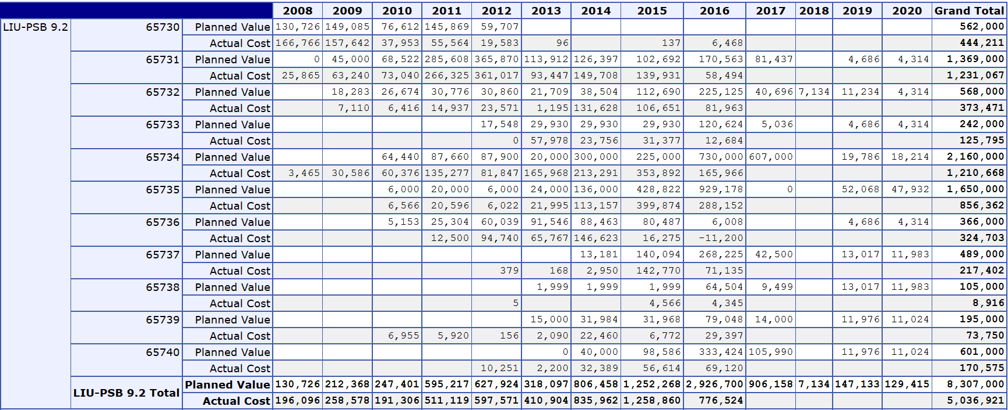
LIU-PSB 9: ABT Injection
Cost-to-completion reduced by 363 kCHF (was 8670 kCHF)
Mismatches year-by-year, but the sum of planned and spent money matches for years < 2016 is:
  Planned value = 4260 kCHF.
  Actual cost = 4190 kCHF.

Slide 15
LIU-PSB 10: ABT Extraction

Slide 16
LIU-PSB 12: EN-EL, LV/HV Parts
before
after
Cost-to-completion unchanged and good matching year-by-year.
Fine tuning of the spending in 2016: Reduced budget by 20 kCHF.

Slide 17
LIU-PSB 13: CV
before
after
Cost-to-completion unchanged and good matching year-by-year.
Moved the committed money to be paid only in 2017 from the current budget:
  Reduction from 352 kCHF to 20 kCHF.

Slide 18
LIU-PSB 14: Transport
before
after
Cost-to-completion unchanged, and cleaned up the previous mismatches.

Slide 19
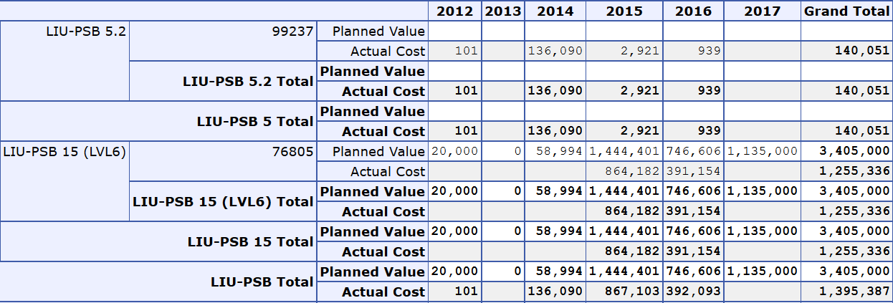
LIU-PSB 15: Civil Engineering
Cost-to-completion unchanged, but bad matching.
Complicated WU as before it was belonging to EPC (LIU-PSB 5.1), then moved to its own WP, but part of
the money were payed on the BC99237.
To end in 2016, so it was agreed to leave it as it was.
On the other hand the WP saved 1135 kCHF out of the original spending:
  Some money have been already re-allocated for civil engineering work for PSB injection transformers

Slide 20
LIU-PSB 17: Interlock System
before
after
Cost-to-completion unchanged.
Mismatch year-by-year, but the sum of the expenses up to 2015 (included) now matches
the actual cost of ~130 kCHF.

