Slide 1
Digital Calorimetry for Future Colliders
Tony Price
University of Birmingham
03/08/2016

Slide 2
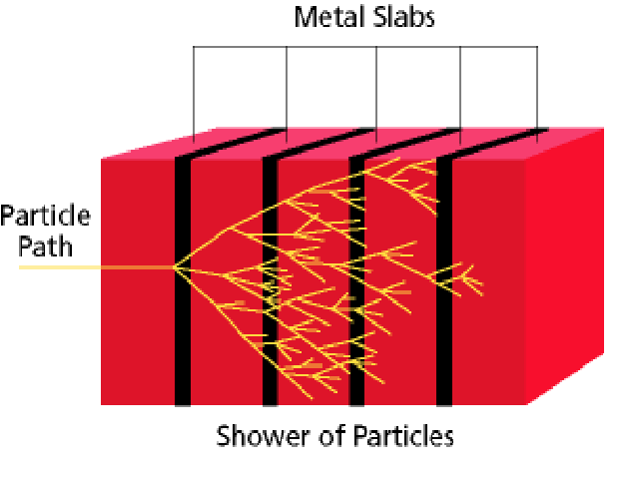
Sampling Calorimetry
Incident particle interacts with a dense material and a shower develops
The shower particles then deposit energy in the sensitive regions
  Si sensors, scintillators, lAr etc…
The sum the energy deposits and scale to the energy of incident particle

Slide 3
Sources of Uncertainty
Average number of particles in the shower is proportional to incident energy
  fluctuations on this number
Energy deposited in sensitive layer is proportional to number of particles
  Fluctuations in angle
  Particle velocity
  Landau energy deposition

Slide 4
Sources of Uncertainty
Average number of particles in the shower is proportional to incident energy
  fluctuations on this number
Energy deposited in sensitive layer is proportional to number of particles
  Fluctuations in angle
  Particle velocity
  Landau energy deposition
Remove this uncertainty by just counting number of particles

Slide 5
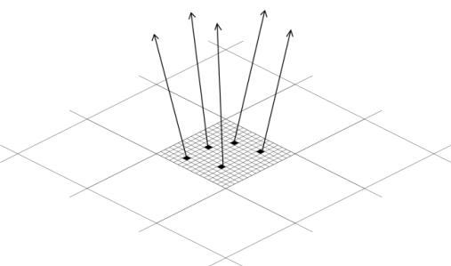
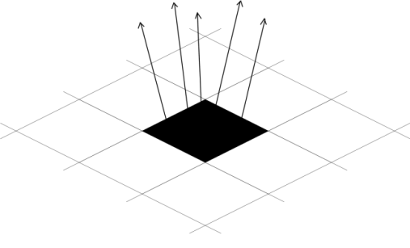
Digital Calorimetry: The Concept
Dates back to c.2005 work within CALICE
Make a pixelated calorimeter to count the number of particles in each sampling layer
Ensure that the particles are small enough to avoid multiple particles passing through a single pixel to avoid undercounting and non-linear response in high particle density environments
Digital variant of ILD ECAL would require 10¹² channels
Essential to keep dead area and power consumption per channel to a minimum
Analogue: 5mm pitch
Digital: 50um pitch

Slide 6
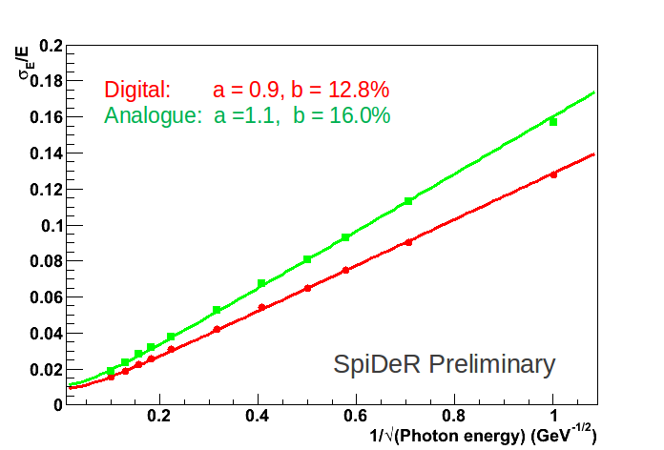
ILD (D)ECAL Simulated Energy Resolution
Full Mokka G4 simulation with 20 layers 0.6 & 10 layers 1.2

Slide 7
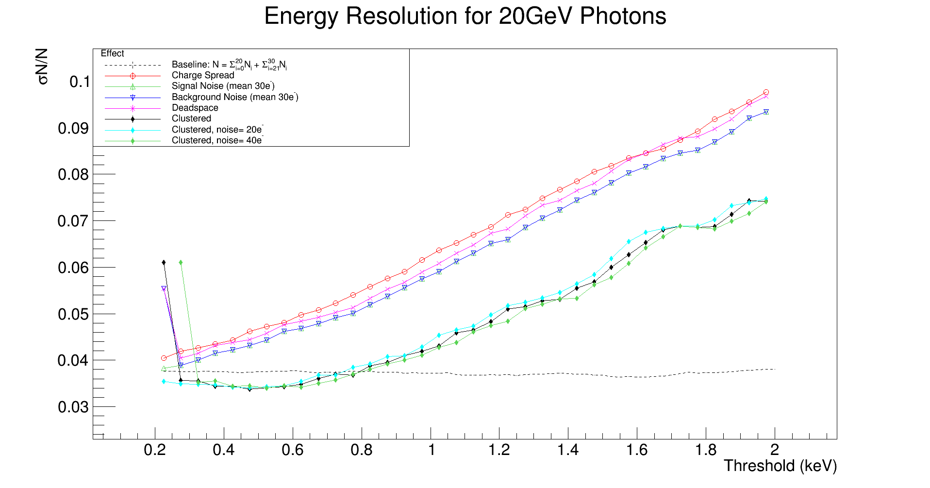
DECAL Simulations with added realism
Original work by Anne-Marie Magnan (now on CMS) and resurrected by current PhD student Alasdair Winter

Slide 8
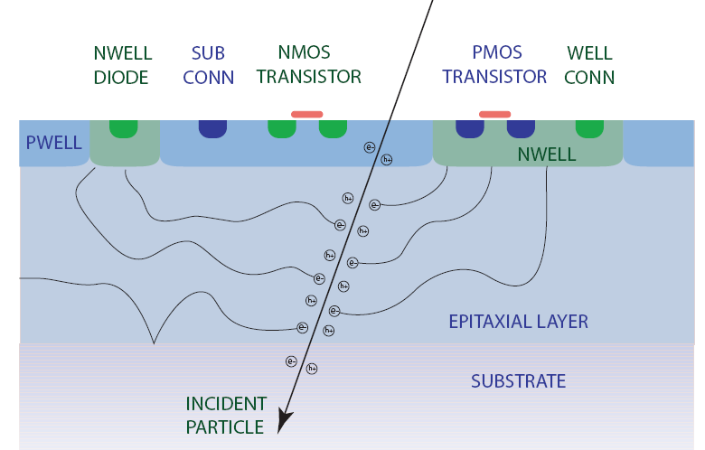
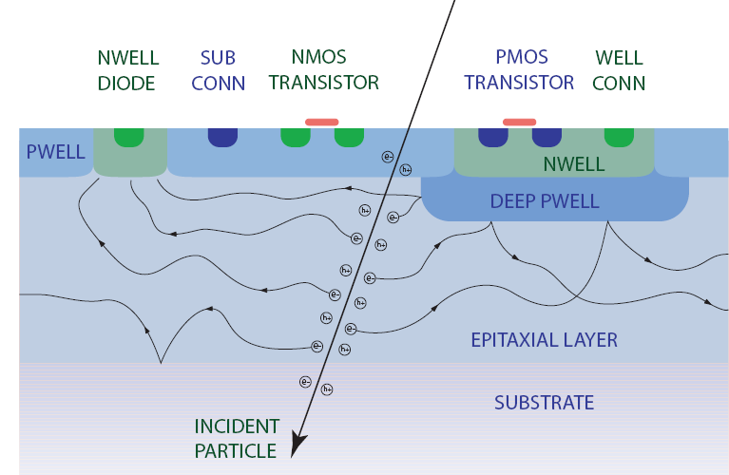
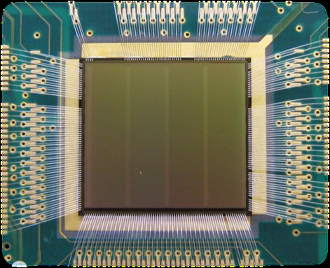
TPAC Sensor
CMOS MAPS
168x168 pixel grid
50x50 um pitch
12-18 um epi layer
Digital readout
Low noise
Utilise the INMAPS process
Collect charge by diffusion to signal diodes
Sampled every 400 ns (timestamp)
Readout every 8192 timestamps (bunch train)

Slide 9


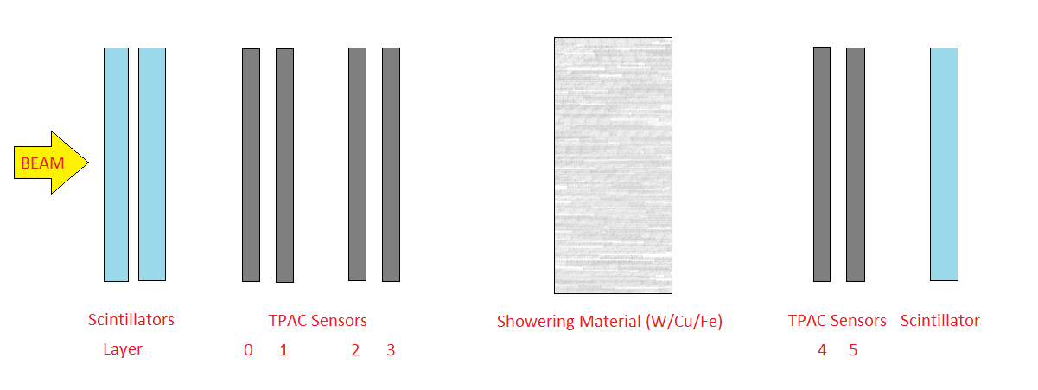
Experimental Validation of DECAL Concept
Showering Mode
1-5 GeV e+ at DESY in Feb/March 2010
Triggered with PMTs either side of the sensors
Tracks found in the first four sensors
Projected through material and properties of shower measured downstream

Slide 10
Shower Multiplicities: DESY Testbeam
Demonstrates DECAL concept to be valid
Further results can be found http://etheses.bham.ac.uk/4515/1/Price13Phd1.pdf

Slide 11

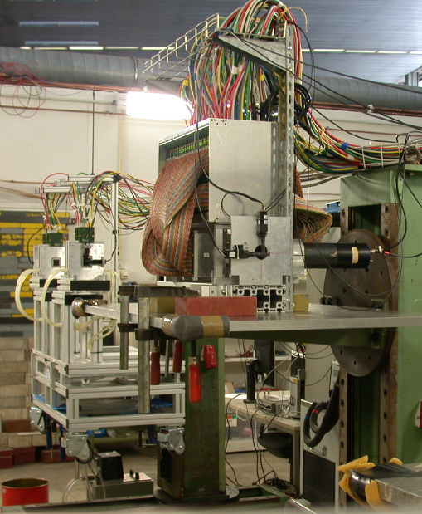
ALICE FoCal: SPS and DESY test beams
ALICE Forward Calorimeter (FoCal) require highly granular to separate showers
Mixture of MAPS and pad sensors proposed
Protoype used 24 layers of MAPS interweaved with 1.5mm W
Tested at DESY and SPS in 2012
Results here are from Martijn Reicher’s thesis

Slide 12
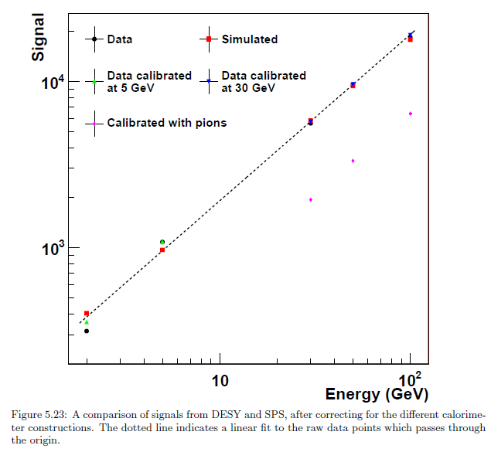
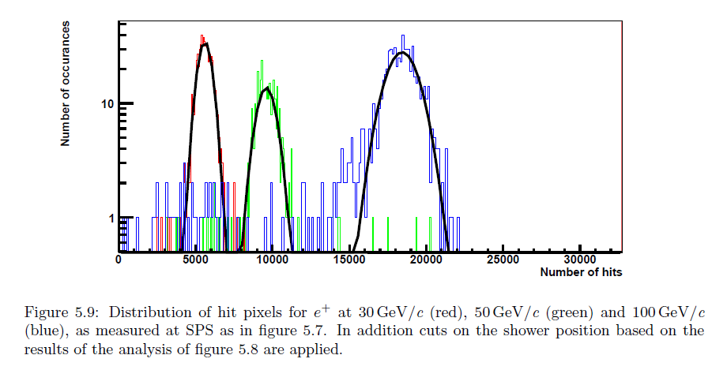
ALICE FoCAL: Results
Results in Martijn’s thesis further demonstrate the validity of a DECAL

Slide 13


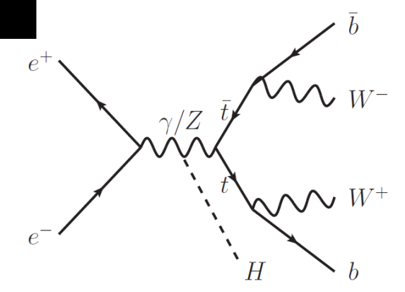
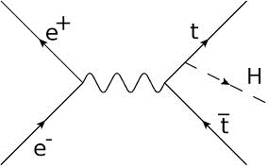
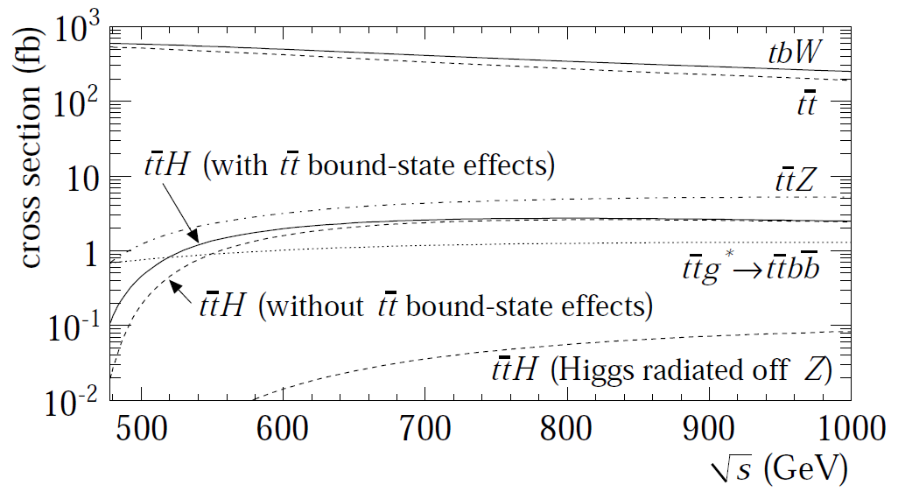
Top Higgs Yukawa Coupling: ILC @ 1 TeV
Samples created for the ILC TDR in 2012
Studied the semi-leptonic final state
  ttH->lvbbjjbb
Main backgrounds considered
TMVA analysis led to measurement on coupling uncertainty of 4.3%
Changed the ILD SiW ECAL for a DECAL with MAPS to evaluate impact on this

Slide 14
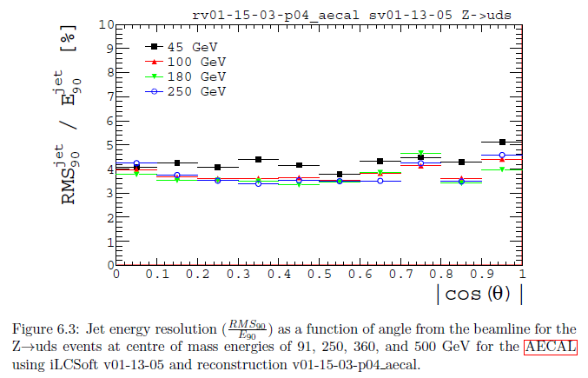
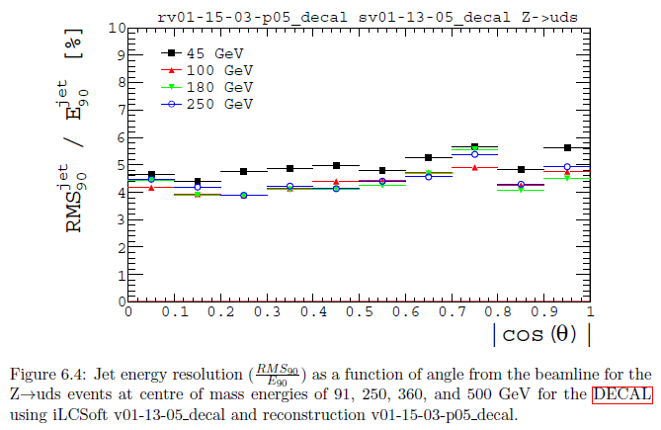
Impact on Jet energy resolution
Conventional ECAL
DECAL
ECAL calibrated with Z->uds dijet events.
Resolution marginally degraded with DECAL BUT the geometry not optimised for DECAL. Just changed sensitive region

Slide 15
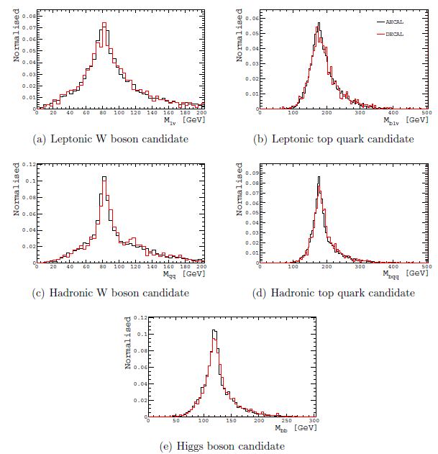
Impact on reconstructed mass
Reconstructed mass of W, t and H candidates unchanged between (D)ECALs
All other variables in the MVA also largely uneffected
Introduction of DECAL at ILD does not impact on the measurements of top Yukawa coupling

Slide 16
DECAL at the FCC-hh?
New funding started July 2016 to investigate reconfigurable, radiation hard, HR-CMOS MAPS for tracking and DECAL purposes for future HEP experiments and Medical Physics
The University of Birmingham
  P. Allport (PI), P. Newman, N. Watson, L. Gonella, K, Nikolopoulos, T. Price, A, Winter
Rutherford Appleton Laboratory
  F. Wilson, R. Turchetta, D. Das, S. Worm, S. McMahon, Z. Zhang, P. Phillips
The University of Sussex
  F. Salvatore

Slide 17
PRD WP1: Physics and performance simulations, specifications and requirements
“The physics goals of the FCC-hh programme set the most demanding requirements and the international programme to develop detailed experiment concepts…”
“..the current status of FCC-hh planning still allows an excellent opportunity for the UK to establish a strong international role and to help shape planning for international developments to follow the HL-LHC programme..”
“…This work-package will involve Geant4 [25], [26] simulation of shower shapes at very high energies in a Si-W calorimeter coupled with use of DELPHES package [27] to provide parametric representation of detector response for physics studies…”
“A number of the key channels expected to motivate the FCC science case which depend critically in electromagnetic calorimeter performance will be looked at to confirm the proposed Si-W solution will deliver the required capability.”

Slide 18
Geant4 Modelling
We currently have a stand alone Geant4 model and a setup in Mokka for the ILD detector to evaluate shower properties and influence design choices of our sensor
We believe that an (analogue) SiW geometry has been / will be implemented within FCCSW(?) If so, rather than studying a DECAL with non optimal geometry could be nice to create at this relatively early stage an optimised DECAL.
  With effort from us (me) potentially
Use of DELPHES to study impact on physics of the DECAL
  Note: single particle resolution will always be worse for DECAL than LAr so would need to implement PFA within DELPHES

Slide 19
Physics Studies
The HEP group at UoB were involved in the Higgs and EWSB Physics Report for FCC workshop (arXiv:1606.09408)
Continue with physics studies of very rare Higgs boson decays probing the light quark Yukawa couplings
  UoB leading contribution in pioneering papers on probing the couplings of Higgs boson to light quarks with ATLAS (arXiv:1607.03400, arXiv:1501.03276)
  Two MSc student that will study this in the context of FCC starting in September
In order to understand the origin of EWSB we would also like to study Vector Boson Scattering

Slide 20
Other Considerations
Radiation Hardness
  Forward region of FCC-hh detectors Si not an option
  Barrel region of 10¹⁴ n_{eq}/cm² makes Si and MAPS feasible
  Depleted CMOS currently under development (HV/HR) with results up to 10¹⁵ n_{eq}/cm² presented recently by other groups
Cost
  Cost of MAPS needs to decrease to make affordable but over 20 years this is expected to fall dramatically.
  A cost of 30 cents / cm² would mean an ECAL of ~$10M.
Pile Up
  Need to evaluate shower properties, widths, multiplicity etc.
  average occupancy and particle density at entrance
Deployment
  Complimentary technology to as a pre-shower / tracker
  seamless transition from tracker to ECAL possible with same technology in second detector?

Slide 21
In Conclusion
Hopefully I have convinced you that a DECAL is feasible at a future collider
We are developing a new sensor aimed at digital electromagnetic calorimetry with readout structures to match HL-LHC / FCC-hh
We want to perform physics studies in the context of FCC-hh and compare with conventional methods
Still lots to do and think about
But also a lot of time before FCC-hh detector design choices are made so makes sense to look at all options.

Slide 22
In Conclusion
Hopefully I have convinced you that a DECAL is feasible at a future collider
We are developing a new sensor aimed at digital electromagnetic calorimetry with readout structures to match HL-LHC / FCC-hh
We want to perform physics studies in the context of FCC-hh and compare with conventional methods
Still lots to do and think about
But also a lot of time before FCC-hh detector design choices are made so makes sense to look at all options.
We want to work in collaboration with you!!!
Any questions?*
*only nice easy ones allowed

