Slide 1
Digital Calorimetry within FCCSW
Tony Price
University of Birmingham
31/08/2016

Slide 2
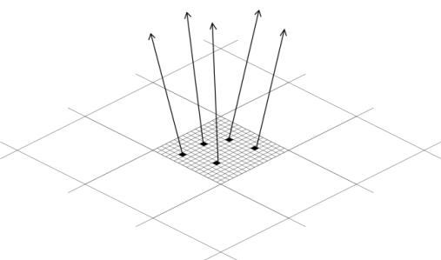
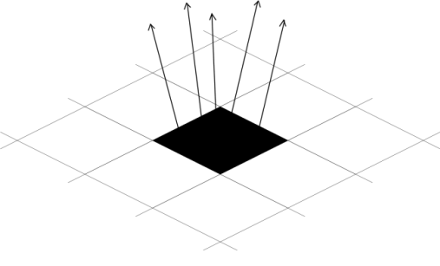
Digital Calorimetry: The Concept
Dates back to c.2005 work within CALICE
Make a pixelated calorimeter to count the number of particles in each sampling layer
Ensure that the particles are small enough to avoid multiple particles passing through a single pixel to avoid undercounting and non-linear response in high particle density environments
Digital variant of ILD ECAL would require 10¹² channels
Essential to keep dead area and power consumption per channel to a minimum
Analogue: 5mm pitch
Digital: 50um pitch

Slide 3
DetFCChhECalDigital Geometry
Started from DetFCChhECalSimple
Modified ECAL barrel inner radius to 1700 mm (as discussed at the last meeting)
Removed cryostat as not required for SiW calorimeter
Modified geometry such that there are four repeated volumes per module
  epitaxial (sensitive)
  Silicon substrate
  Tungsten
  Air gap
Ability to change materials and thicknesses of these layers from xml file
Ability to change the number of modules from xml file

Slide 4
DetFCChhECalDigital Readout
Started from SimpleCalorimeterSD
Sum all the energy deposited in a cell (aka AggregateCalorimeterSD)
Added an “EndOfEvent” function to SD class so can apply a threshold to the hits
Currently score
  Number of pixels above threshold
  Number of particle per pixel (for pile-up non linearity studies)
  Energy deposited (to allow threshold studies to be applied)
Need to pass this to the proper readout chain (next job to do)

Slide 5
First linearity checks
15um Si epitaxial layer
450um Si substrate
3.5 mm W as absorber
0mm air gap (all sqashed together for now)
No B field
Electrons |eta| < 0.1
Segmentation XYZ used at 50x50x50um grid
Not correct but best option available this far in FCCSW
Anna is working on a better solution ☺
Non linearity ~6% at 1TeV
Currently debugging strange behaviour in energy resolution

Slide 6
Acknowledgements
Martin Aleksa and his group for meeting with me and helping me understand some of the requirements for FCC-hh calorimeters
Jana Faltova for sitting and introducing me to FCCSW, and for providing her code as a base
Anna Zaborowska for helping me with segmentation issues and working on improved implementation
Joschka Lingemann and Valentin Volkl for replying to mailing list and technical questions promptly and clearly (and offering to meet for coffee to discuss more technical issues)

Slide 7
Conclusions
Lots of work still to do but good progress has been made.
  Basic Geometry and readout implemented
  Need to pass my output to ROOT files
Investigating strange behaviour regarding the energy resolution and “reflections” in Geant4 (observed in MOKKA, standalone, and FCCSW)
Currently we get 6% deviation from linearity at 1TeV but expect this to improve with better segmentation
30 layer DECAL with 50x50um pixels, starting at 1700 mm leads to 2.12e12 channels in the barrel
Thank you again to all who have helped me!

