Slide 1
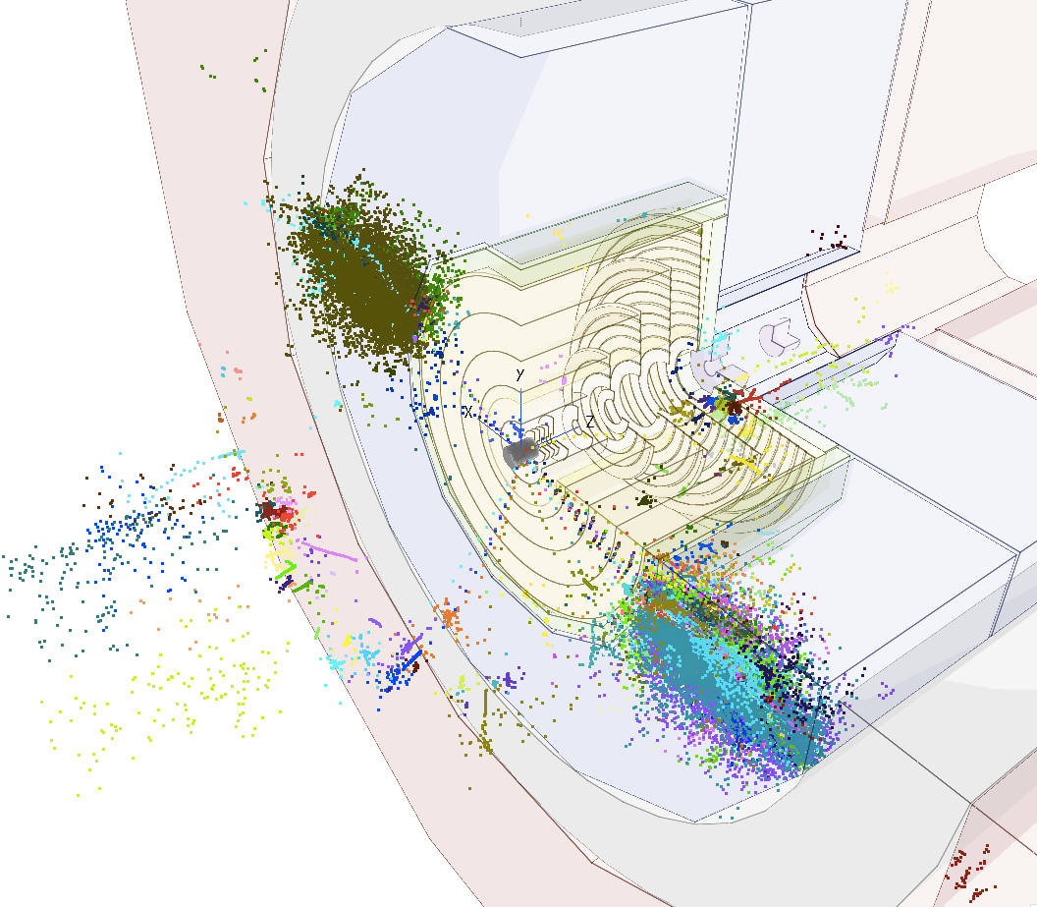
FCC-hh vertex detector optimization status
Andrea Coccaro (UniGe), Dominik Dannheim (CERN),
Estel Perez (CERN), Philipp Roloff (CERN), Rosa Simoniello (CERN)
FCChh meeting , 29th September 2016

Slide 2
Introduction
Use LiC Detector Toy (fast simulation) to identify starting point for geometry and variations
Find optimal FCC-hh Vertex detector geometry based on flavor tagging performance → Need full simulation
Use linear collider (LC) software chain
Challenges:
  Need to reconstruct and tag jets over a large range of p_{T}: from O(50 GeV) to O(10 TeV)
  Flavor tagging in the forward region (crucial for processes like double Higgs production)
  Pile up O(200 events/bunch crossing) →Not addressed yet

Slide 3
Outline
Fast Simulation studies:
  Cross-check TrkLayout results (by Zbynek) using LiC Detector Toy.
  Variations on single point resolution and layout
Full simulation studies:
  Performance of flavor tagging on pp events – using CLIC detector model
  Reconstruction of 5TeV b-jets - using FCChh (old) vertex detector geometry

Slide 4
Fast Simulation Status
Using LiC Detector Toy
  Includes multiple scattering (uses Kalman filter)
  Models single planes: cylinders or disks (no module structure)
Step 1: Cross-check TrkLayout results by Zbynek → done
Step 2: Variations on geometry and resolution → ongoing
Step 3: Occupancy studies → next step

Slide 5
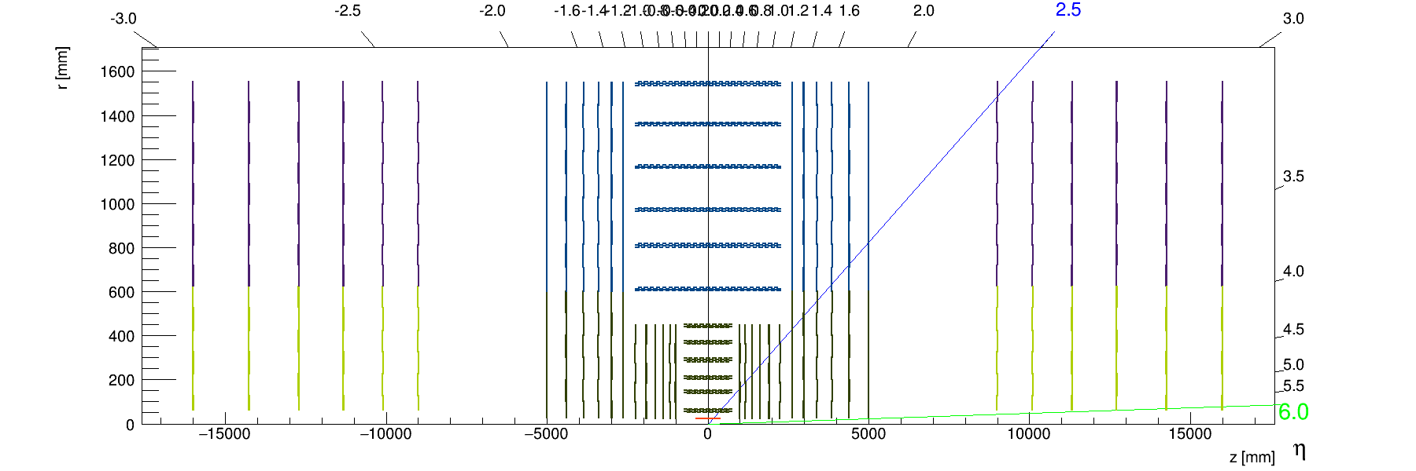
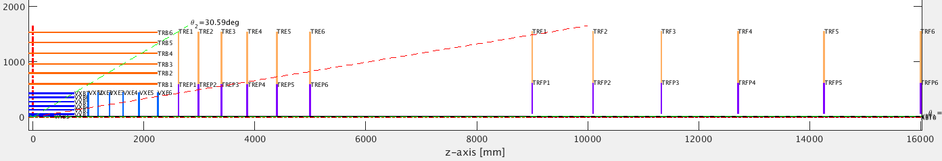
Geometry description
Baseline tracker as presented by Zbynek in the last FCChh meeting
https://indico.cern.ch/event/557687/
Implemented in LiC Detector Toy

Slide 6
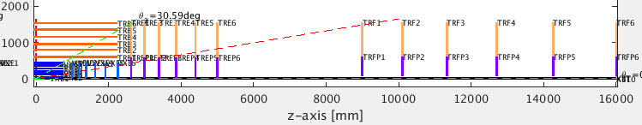
Detector parameters
Taken from:http://fcc-tklayout.web.cern.ch/fcc-tklayout/FCChh-Option3/index.html
  Used as baseline throughout this presentation
Single-point resolution:
5x25µm
10x25µm
10x25µm
Material budget [X/X₀]:
0.015
0.015
0.03
0.00286
Pixels
Pixels
Strips
Beampipe

Slide 7
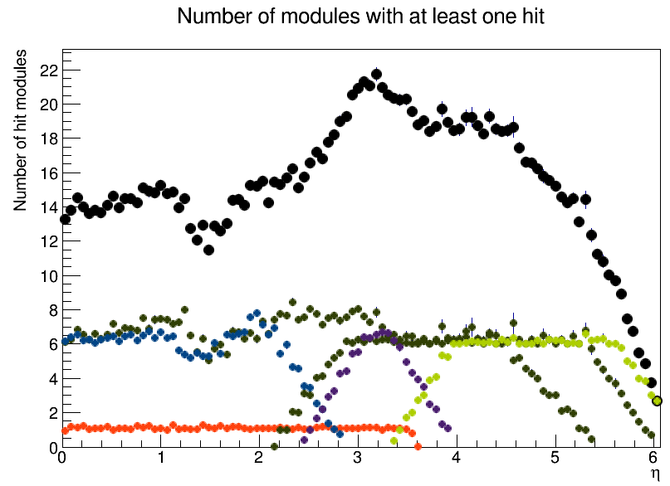
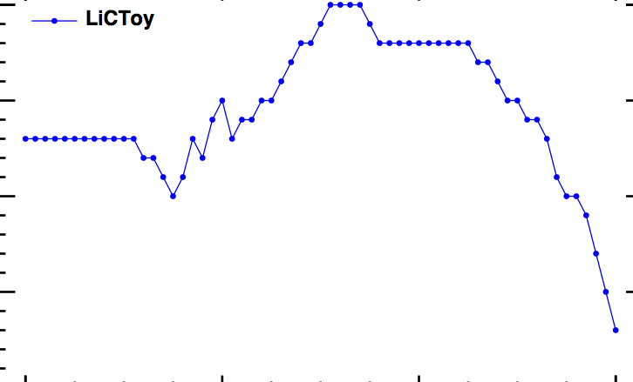
Number of hits vs eta
TrkLayout
LiC Toy
Structure well reproduced
Small differences due to TrkLayout allowing several hits per layer

Slide 8
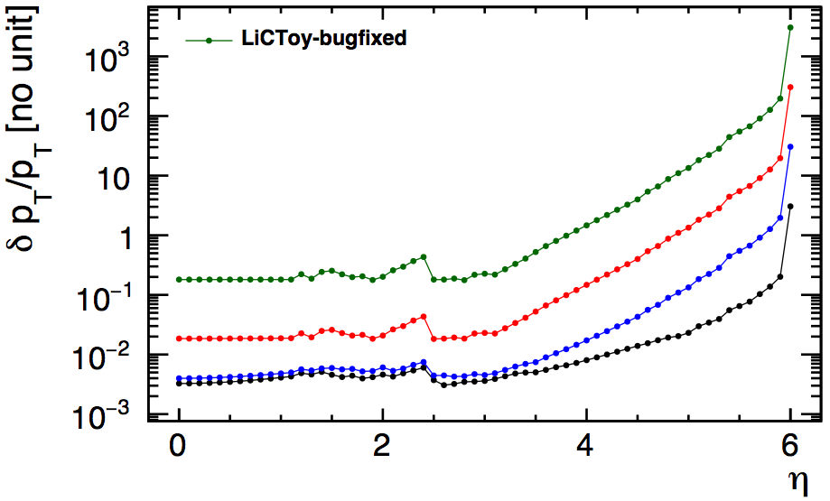
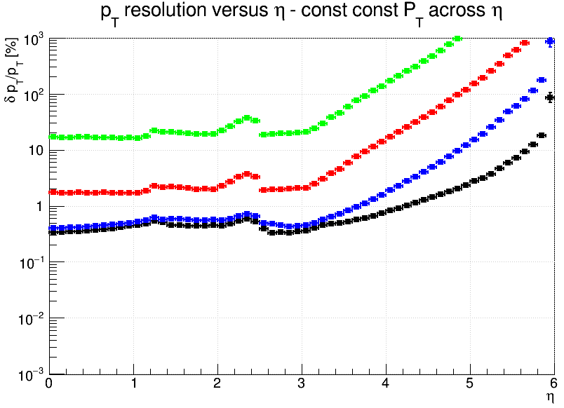
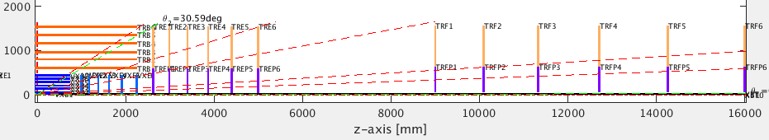
pT Resolution
Slide updated after the presentation
Track pT
TrkLayout
10 GeV
100 GeV
1000 GeV
10000 GeV
Very good agreement in the pT resolution
Resolution reflects the layout structure:
η=1.2
last outer barrel layer
η=1.9
last outer layer
η=2.4
first fwd layer
η=3.5
first barrel layer
η=4
all pixel layers

Slide 9
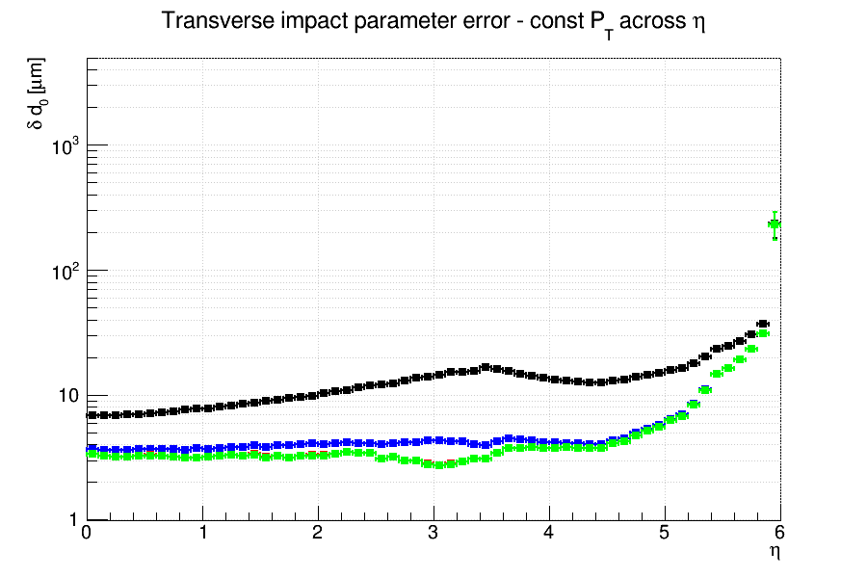
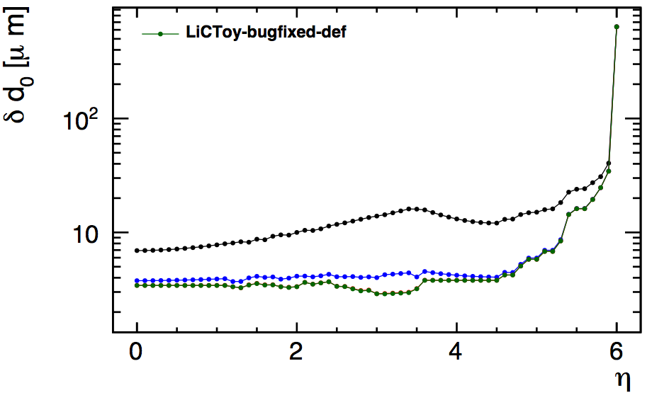
Transverse impact parameter resolution
Slide updated after the presentation
Track pT
10 GeV
100 GeV
1000 GeV
10000 GeV
TrkLayout
Excellent agreement in d0 resolution

Slide 10
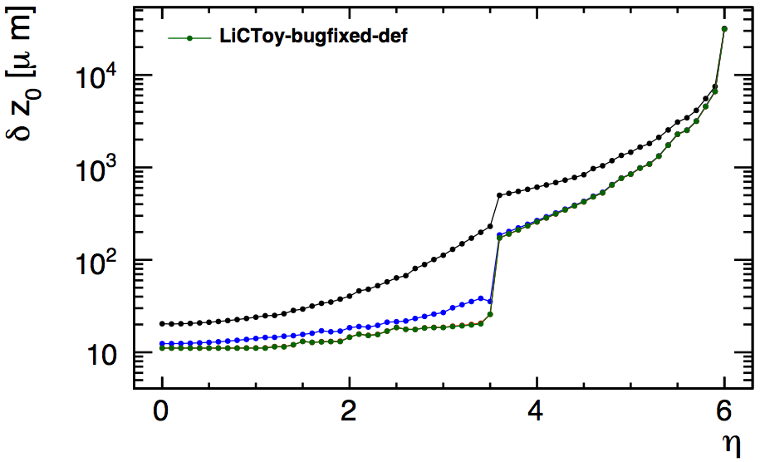
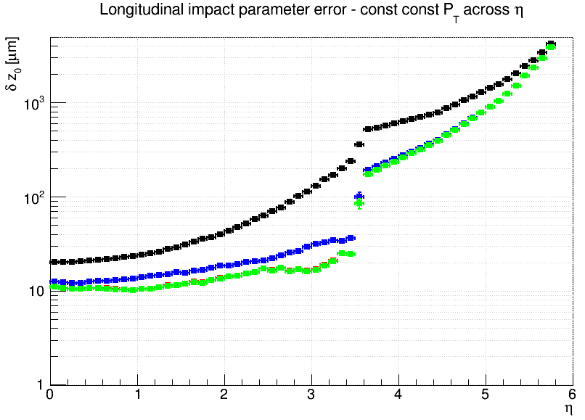
Longitudinal impact parameter resolution
Track pT
10 GeV
100 GeV
1000 GeV
10000 GeV
TrkLayout
Very good agreement in z0 resolution

Slide 11
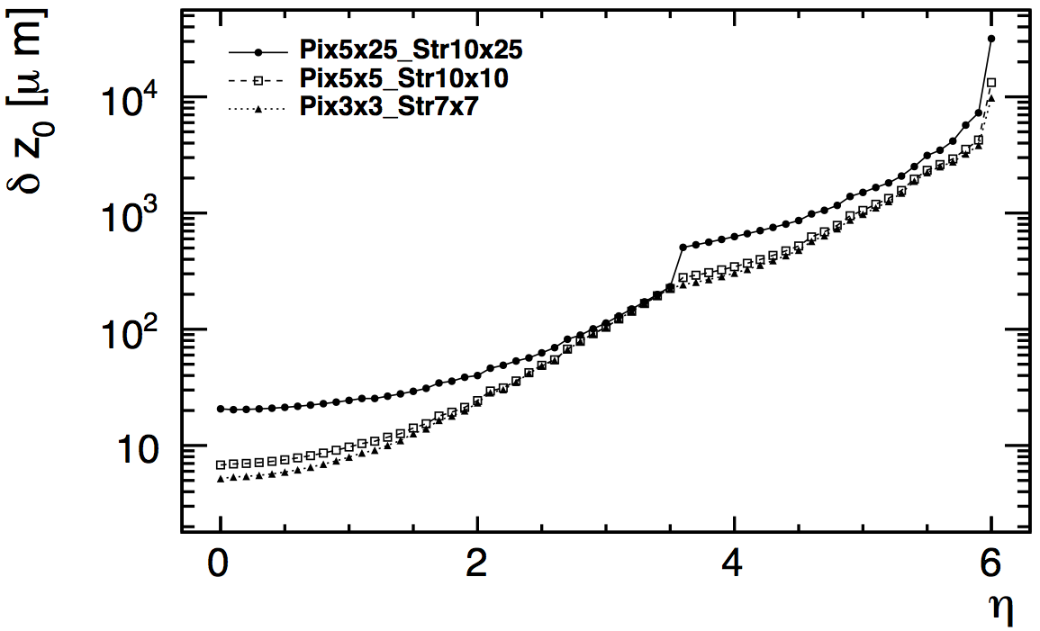
Variation (I): single point resolution
Single-point resolution:
baseline
squared
“CLIC”
Pixels
Pixels
Strips
5x25µm
10x25µm
10x25µm
5x5µm
10x10µm
10x10µm
3x3µm
7x7µm
7x7µm
How does z0 resolution improve with the single point resolution
Baseline (FCChh-Opt3)
Square-shaped pixels and strips → z₀ res improves by factor of 3 at eta=0
Under consideration for CLIC →z₀ res improves by 30% at eta=0
Track pT
10 GeV

Slide 12
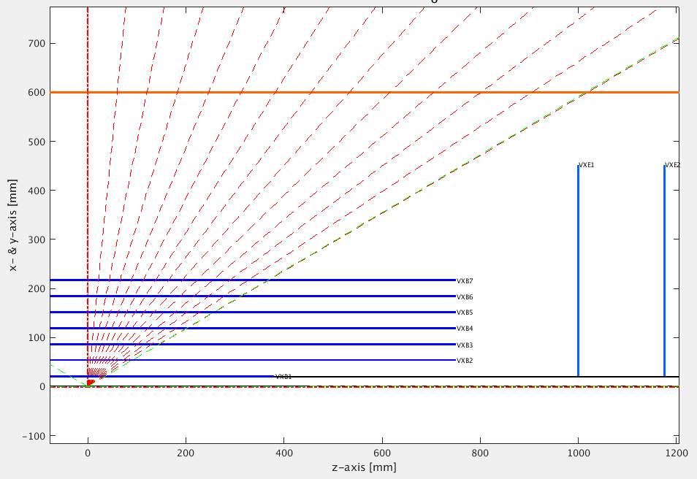
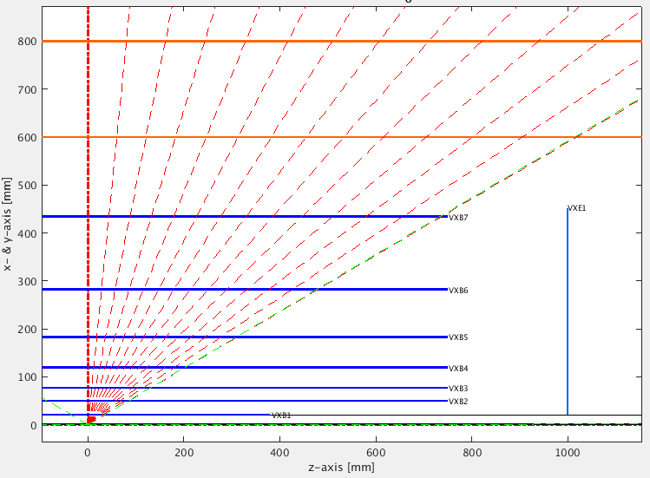
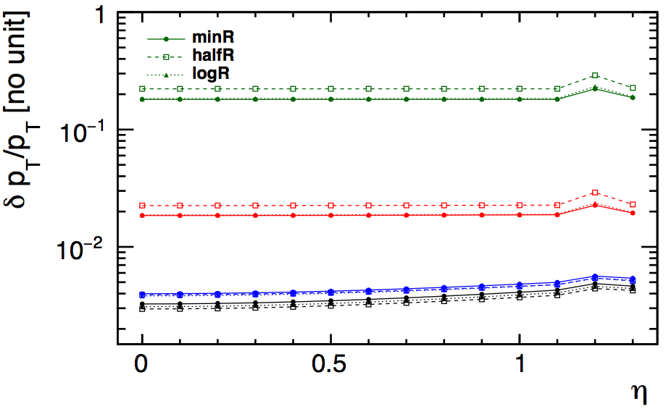
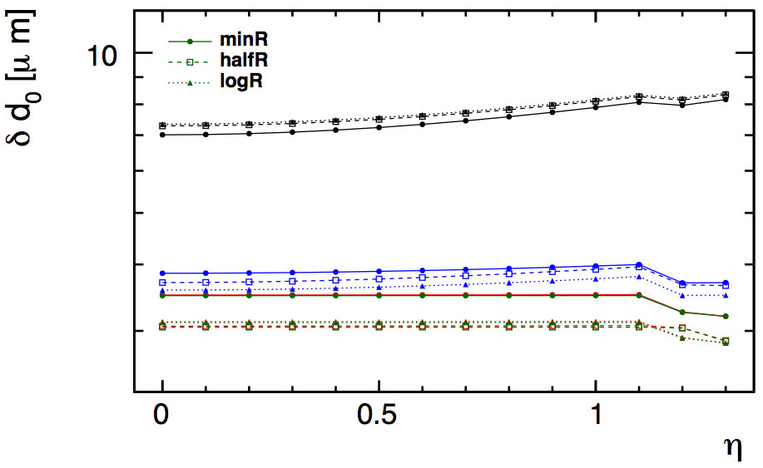
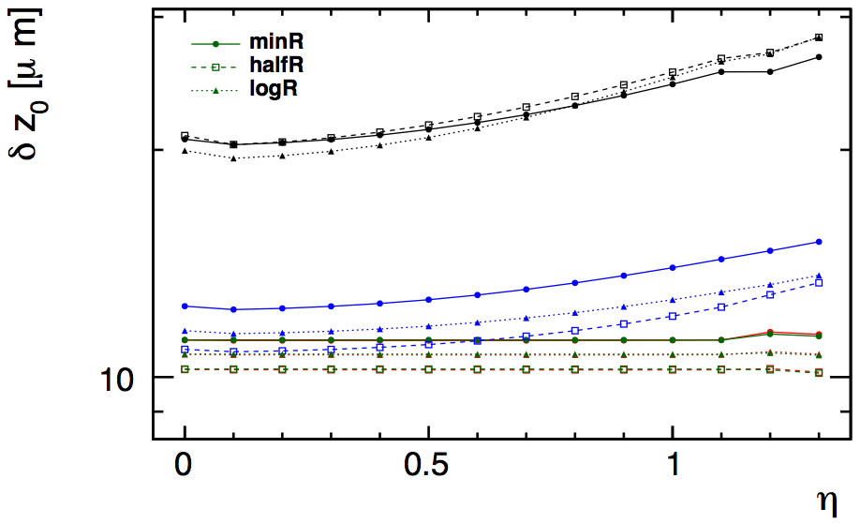
Variation (II) vertex layers radius
half the Radius
logarithmic
*kept at least 3cm between layers: R1=21mm R2=50mm in all cases
Small differences in the resolution (single particle). Will become relevant when we take into account occupancy
Equidistant option is the best in terms of pT resolution at high pT
Track pT
10 GeV
100 GeV
1000 GeV
10000 GeV
half R and log. R options perform similarly in d0 resolution
half R is the best at z0 resolution for high pT tracks

Slide 13
Next steps
More variations, for instance:
Barrel length: find trade off between resolution in the barrel and the amount of material (cables) in the transition region
Pixel size: check constraints from occupancy
Gap between endcap and forward: check effect of occupancy on extrapolation (how background affects pattern recognition)

Slide 14
Full simulation status
Check flavour tagging performance on pp events → done for CLIC detector
Implement FCChh vertex geometry → done for “Rome” baseline
Reconstruct very high p_{T} b-jets in FCChh vertex detector → optimization ongoing
Check Flavour tagging performance at high pT → next step

Slide 15
Linear Collider Full Simulation
Compared flavor tagging performance on pp events against ee events
  In the CLIC detector geometry
  No underlying event (nor pile-up)
    Flavor tagging package not adapted for underlying event and pileup
    We are anyway only interested in geometry effects
Dijet samples:
ee→jj
Wizard+pythia6
√s=91 GeV
Beam spot constrain in PV fit
pp→jj
Madgraph+pythia6
p_{T}(jet)> 40 , central
No pileup, No underlying event
No beam spot constrain.

Slide 16
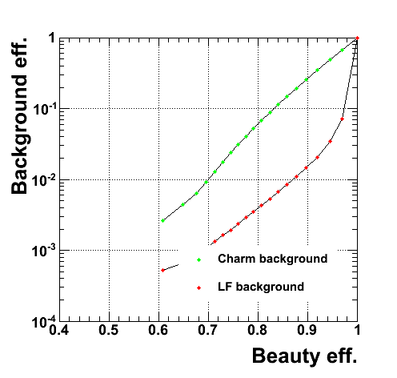
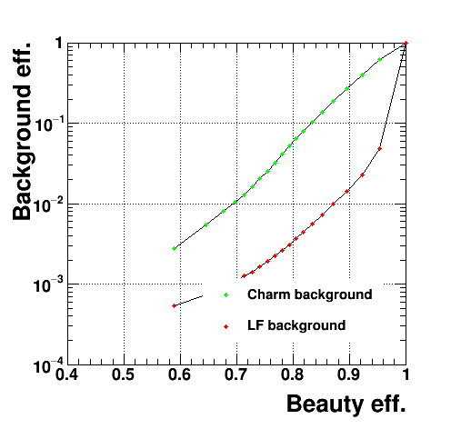
b-tagging performance
ee→jj ; √s=91 GeV
pp→jj ; p_{T}(jet)> 40; no UE
* lines to guide your eye
Very similar performance is obtained when UE is removed

Slide 17
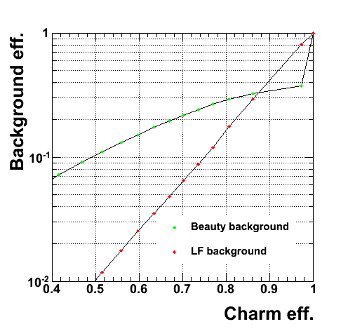
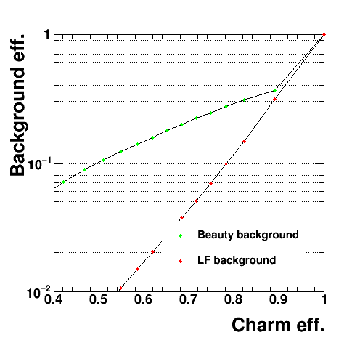
c-tagging performance
ee→jj ; √s=91 GeV
pp→jj ; p_{T}(jet)> 40; no UE
Also for c-tagging, very similar performance.
Better Light Flavour rejection due to the slightly higher p_{T} jets

Slide 18
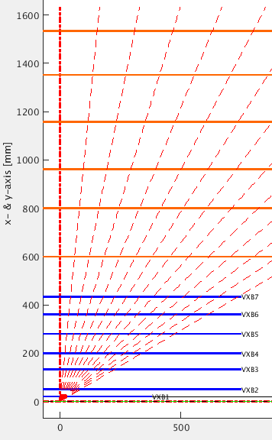
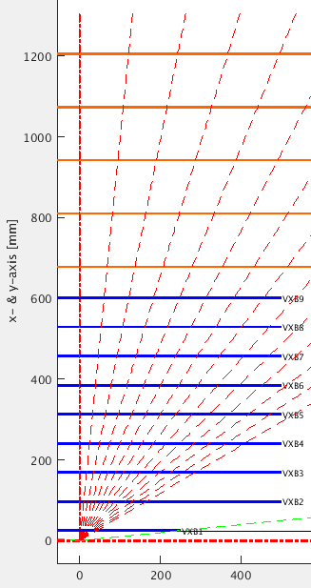
Using “Rome” FCChh vertex geometry
Geometry of FCC vertex (as in Rome FCC week) + squeezed CLIC tracker (to fit inside the CLIC detector)
  Considering barrel region to start with
  (see my slides in Rome: https://indico.cern.ch/event/438866/contributions/1085046/attachments/1257030/1856499/EstelPerez_FCCWeek_2016_04_11_v4.pdf )
Baseline used in fast simulation
“Rome” vertex + CLIC tracker
Vertex detector size not so far from the baseline geometry

Slide 19
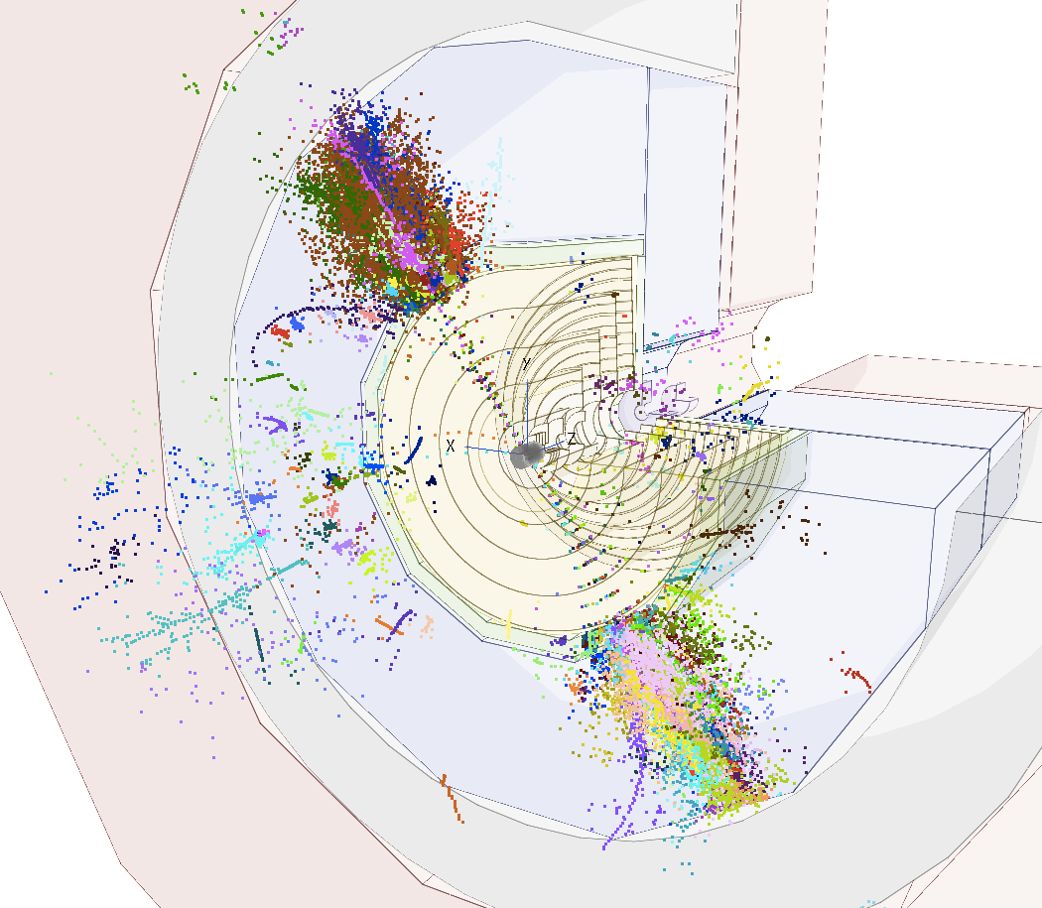
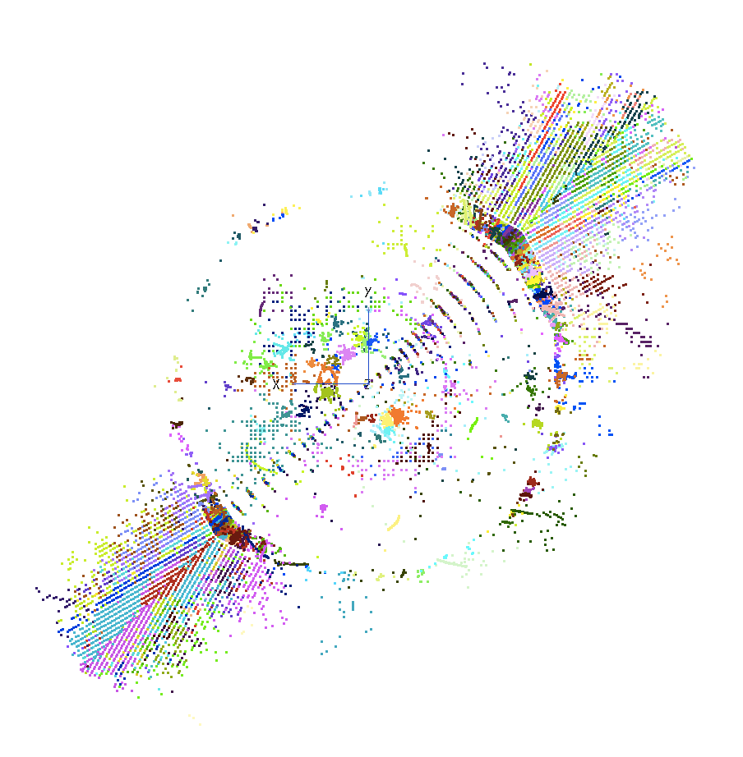
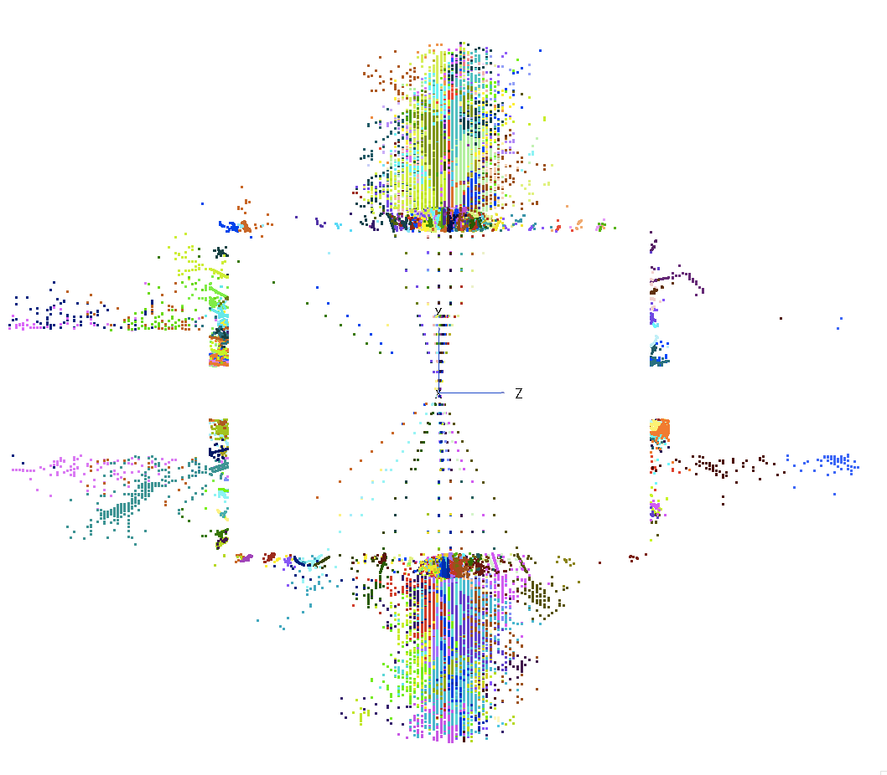
Jet reconstruction
Event display of two central pT=5 TeV b-jets
Checked that the Particle flow algorithm correctly accounts for Energy leakage beyond the calorimeters

Slide 20
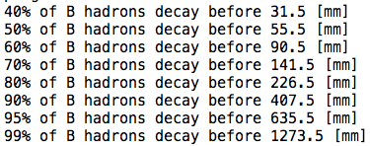
Tracking for high pT b-jets
A large fraction of high-pT b-jets have very displaced secondary vertices
Very displaced tracks not reconstructed with the standard tracking
Challenge: modify track finding strategy
→ ongoing
pT=10 TeV b-jets
Need to be efficient up to R(x,y)~=600 mm?

Slide 21
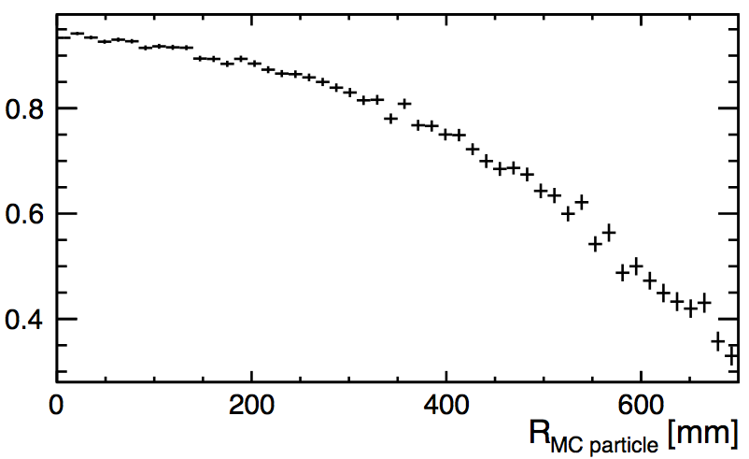
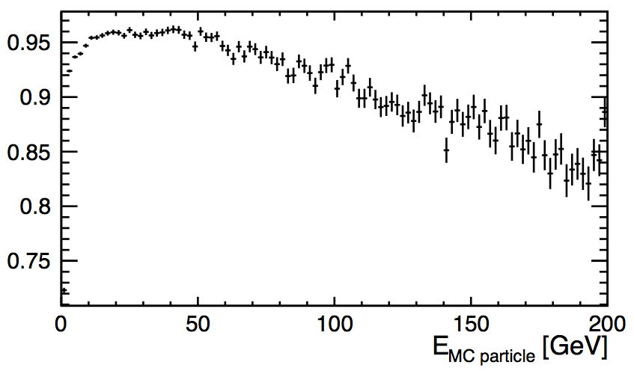

Tracking efficiency vs position of the production vertex
Reconstruct 5 TeV b-jet events
Efficiency to find a track associated with a charged MC particle, vs transverse position of the production vertex:
WORK IN PROGRESS…
Efficiency vs pT
# matched tracks / # MC particles
PT_{MC particle}
5TeV jets
R(x,y) of production vertex

Slide 22
Next steps
Finish tracking strategy optimization
Implement the new baseline (when it is fixed)
  Analyze flavor tagging performance as function of the jet energy (50 GeV to 10 TeV)
  Comparing different barrel layouts and sensor parameters (based on input from fast simulation)
  Tackle the forward region

Slide 23
Backup

Slide 24
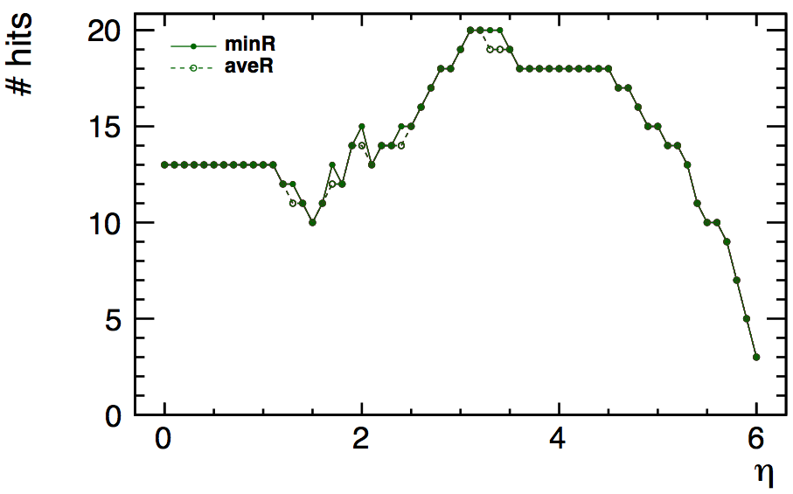
minimum R vs average R

Slide 25
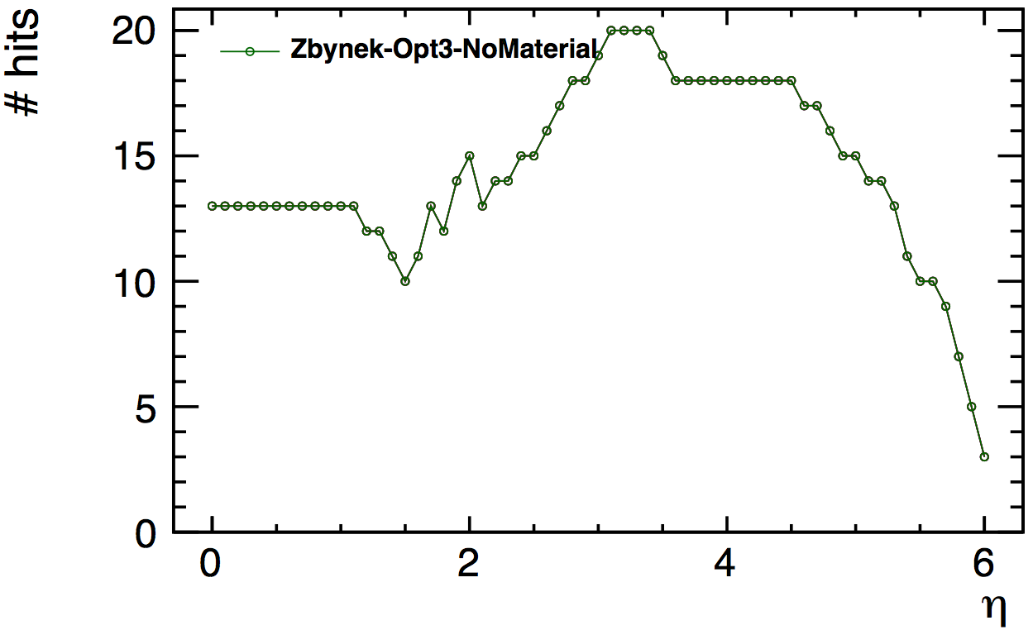
Number of hits vs eta

Slide 26
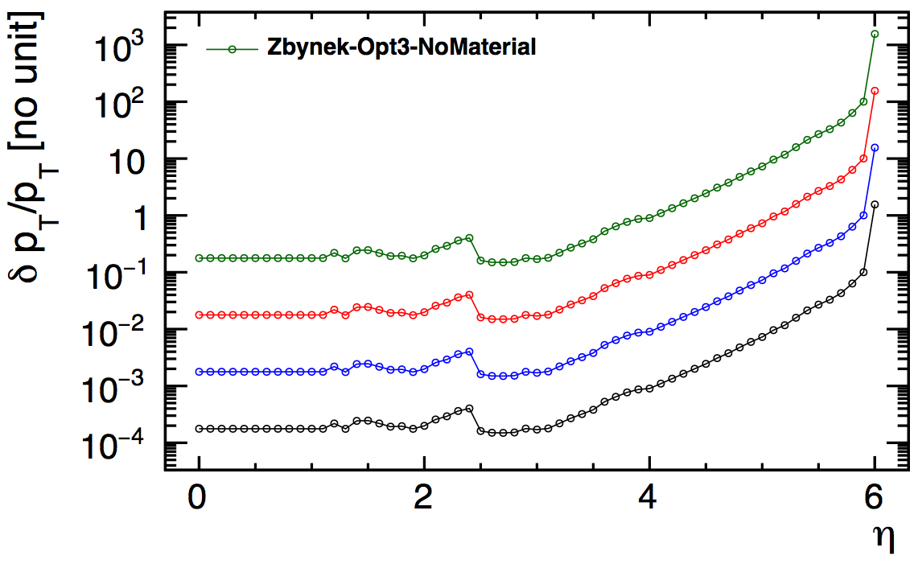
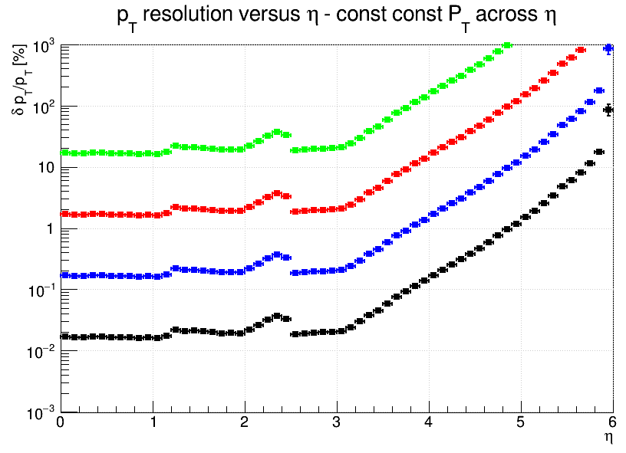
pT Resolution, no MS
very good agreement

Slide 27
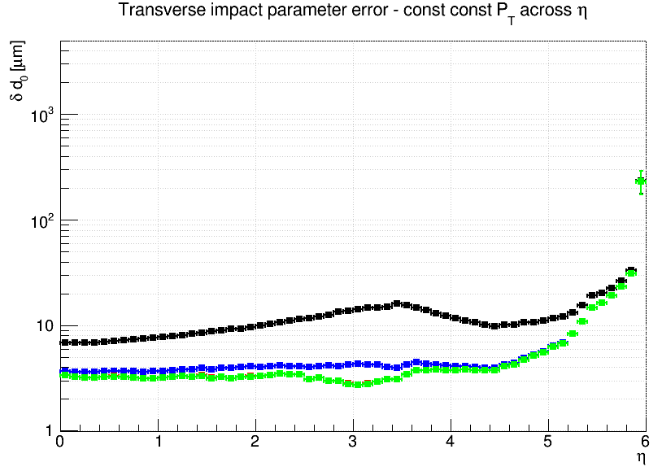
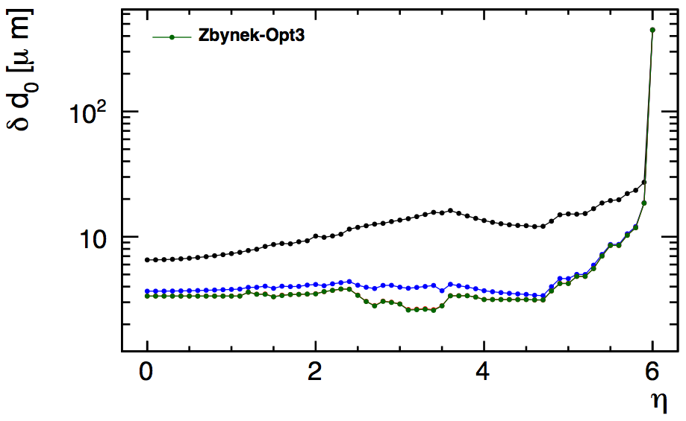
Transverse impact parameter resolution
Track pT
10 GeV
100 GeV
1000 GeV
10000 GeV
LiC Toy
TrkLayout
Well-reproduced results:
Forward resolution slightly better for LiC Toy at high pT ,
slightly worse at low pT

Slide 28
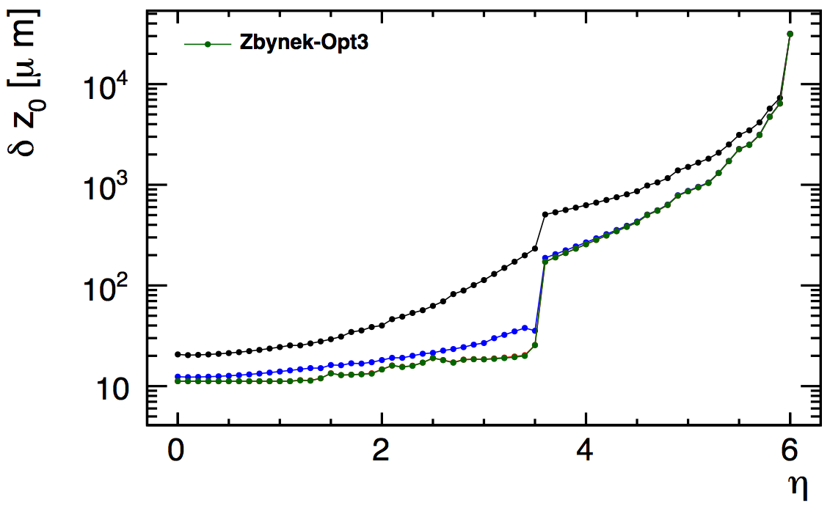
Longitudinal impact parameter resolution
Track pT
10 GeV
100 GeV
1000 GeV
10000 GeV
LiC Toy
TrkLayout
Perfect agreement

Slide 29
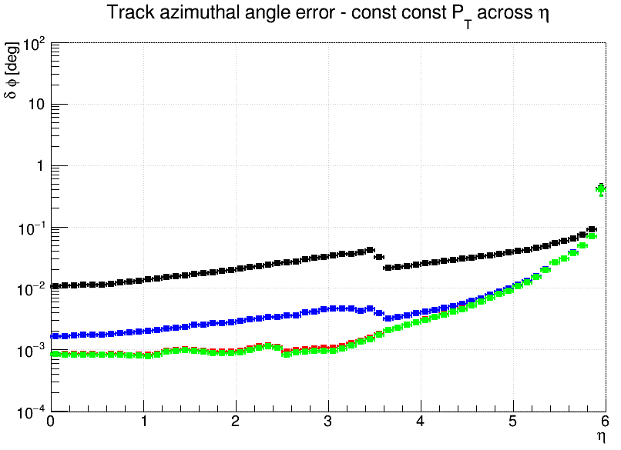
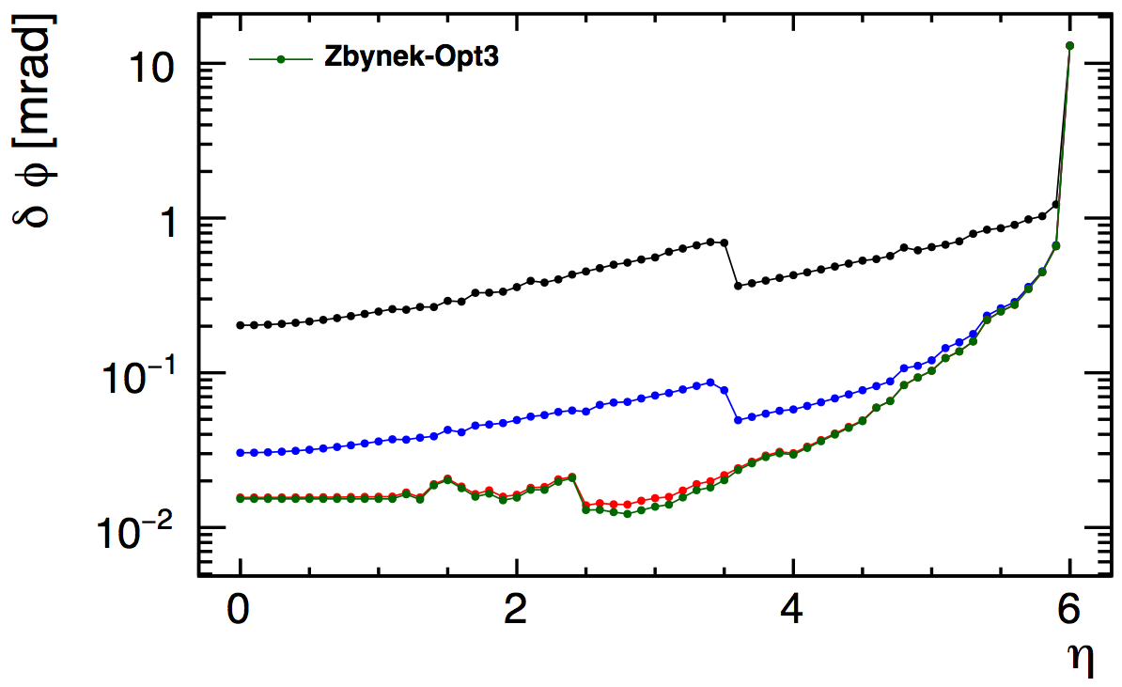
Phi Resolution

Slide 30
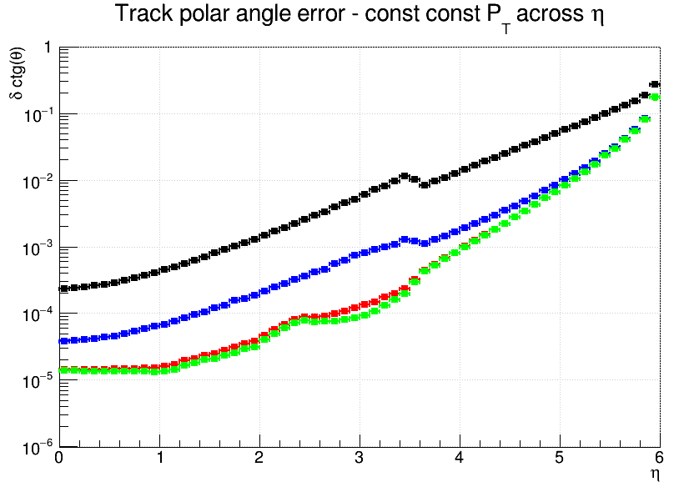
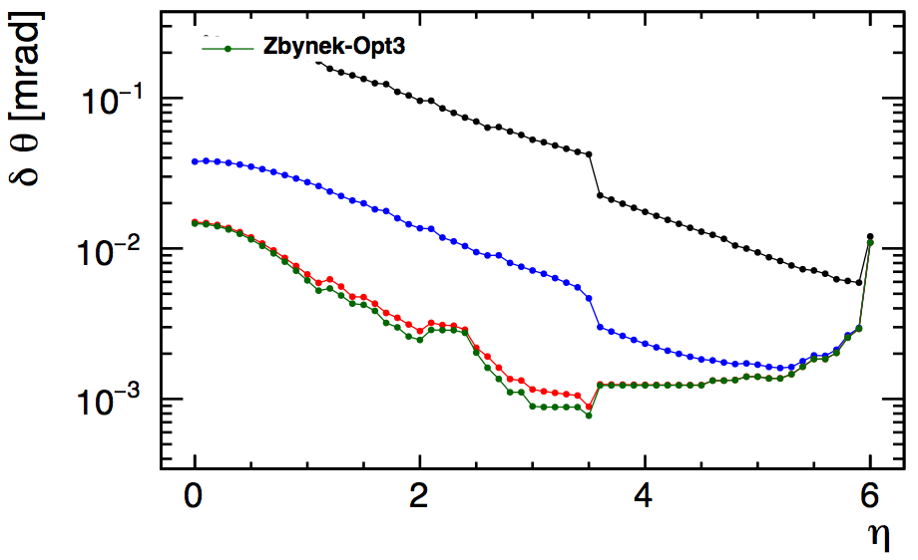
Theta (ctg theta) Resolution
theta
ctg(theta)

Slide 31
Linear Collider Full Simulation
ee->jj
sqrt(s)=91 GeV
No ISR
FSR included
No Overlay
Beamspot constrain in PV fit
pp->jj
sqrt(s)=100TeV
pT(q)=50 GeV
eta(q)=0 +/- 0.05
No pileup
No underlying event
Includes ISR, FSR
pT(jet)> 40
No timing cuts or beamspot constrain.
Pythia parameters
MSTP(81)=20
MSTP(61)=1
MSTP(71)=1

Slide 32
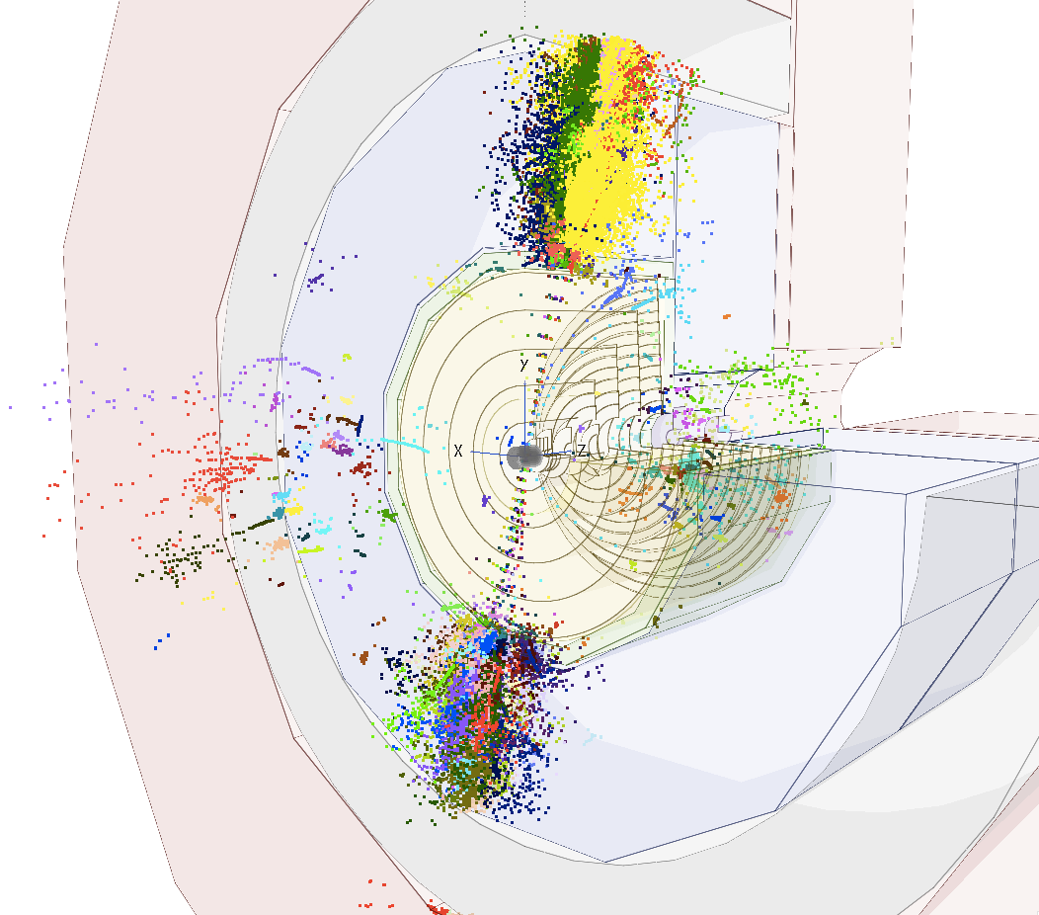

Slide 34
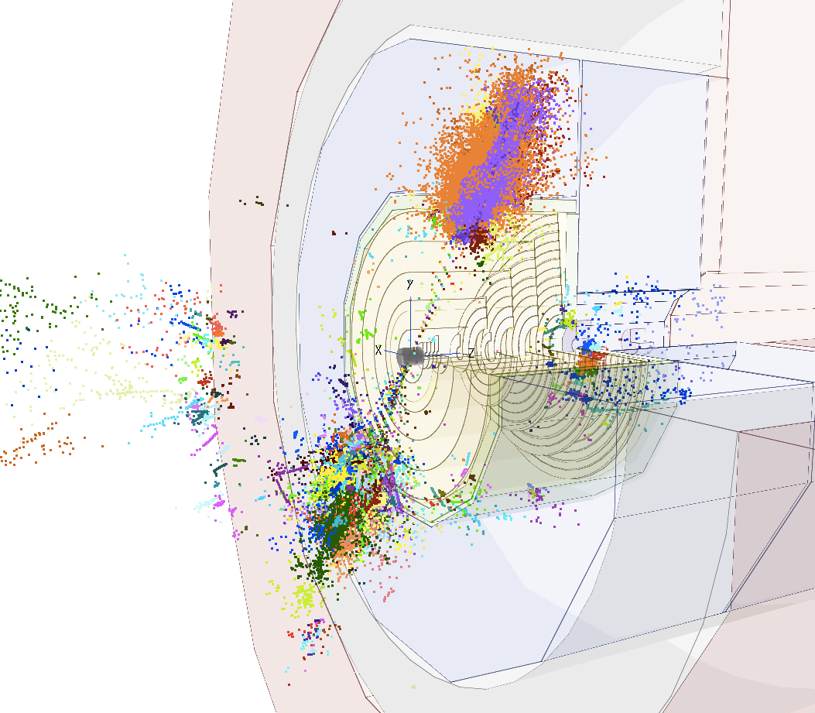

Slide 35
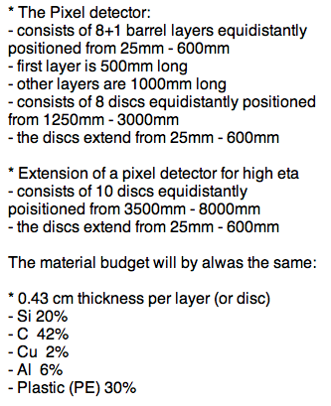
FCC Vertex Detector geometry
Start with the barrel region
  Increase inner radius of CLIC_SiD tracker to make space for the FCC vertex detector
    Avoid modifying the calorimeters by now, to be able to use the same calibrations
  Add Vertex Layers (1+8)
  Modify Pixel modules material composition
Kept 3μm single point resolution (as for CLIC)
Keep CLIC magnetic field of 5T

Slide 36
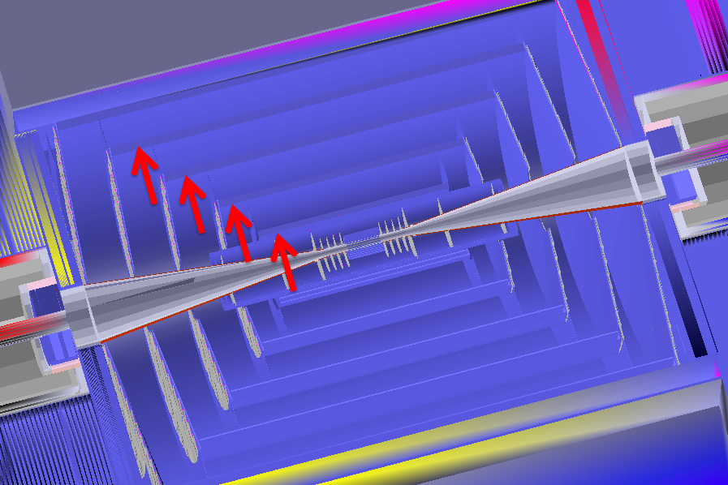
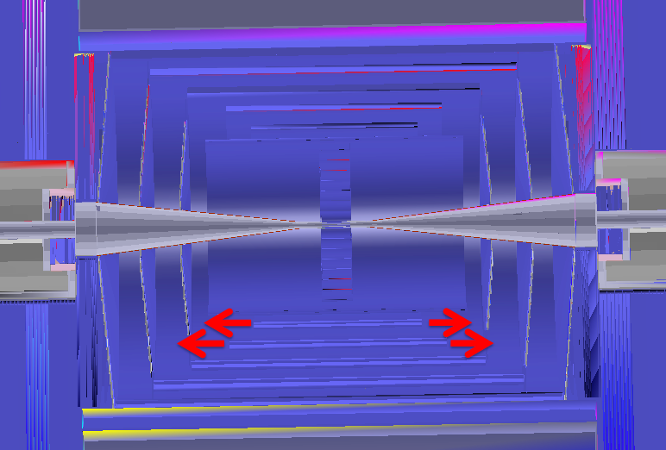
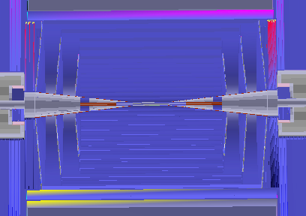
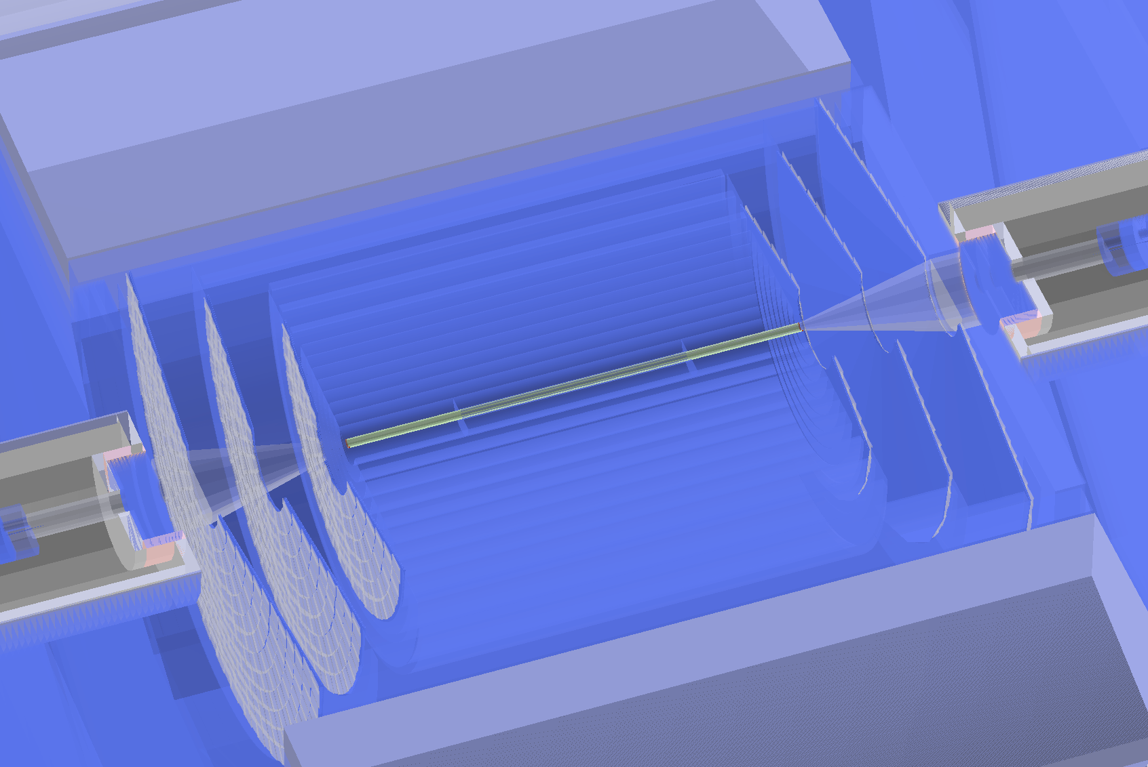
Vertex Detector geometry
Starting point
FCC vertex detector inside CLIC_SiD

Slide 37
CLIC_SiD
CLIC_FCCvtx_barrel
figures on the same scale
r1=27mm
r2=38mm
r3=51mm
r4=64mm
r5=77mm
r1=25mm
r2=97mm
r3=169mm
r4=241mm
r5=313mm
r6=385mm
r7=457mm
r8=529mm
r9=601mm

Slide 38
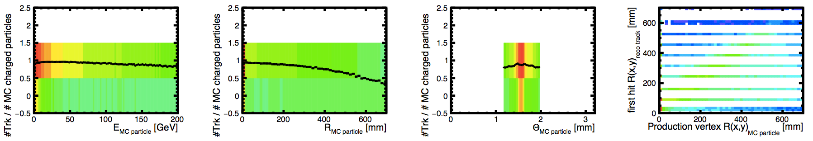
Tracking optimization
5 TeV b-jets

Slide 39


Flavor tagging
B-tagging performance in CLIC comparable to LHC
LF misid. eff. vs B-tagging eff. in CLIC
LF rejection vs B-tagging eff. in ATLAS
CLICdp
E^{jet}=100GeV
e+e- events
(uses LCFIPlus package)
https://cds.cern.ch/record/1742993
http://arxiv.org/pdf/1512.01094v2.pdf

Slide 40

Flavor tagging
In addition LC flavor tagging can provide very good c-tagging performance as well
LF misid. eff. vs C-tagging eff. in CLIC
c-tagging important for FCC-hh physics?
CLICdp
E^{jet}=100GeV
e+e- events

Slide 41
MC Samples for barrel studies
Generated using Madgraph5 + Pythia6, writing stdhep files compatible with LC framework.
Central (|η|<0.05) dijet samples (pp⟶bb̅/cc̅/uu̅) √s=100 TeV
  inclusive: p_{T}(q) > 50 GeV
  mono-energetic:
    p_{T}(q) = 50 GeV (between 47.5 GeV and 52.5 GeV)
    p_{T}(q) = 200 GeV
    p_{T}(q) = 500 GeV
    p_{T}(q) = 1 TeV
    p_{T}(q) = 5 TeV GeV
    p_{T}(q) = 10 TeV GeV
  angular separation: ΔR(q,q)>0.4

Slide 42


