Slide 1
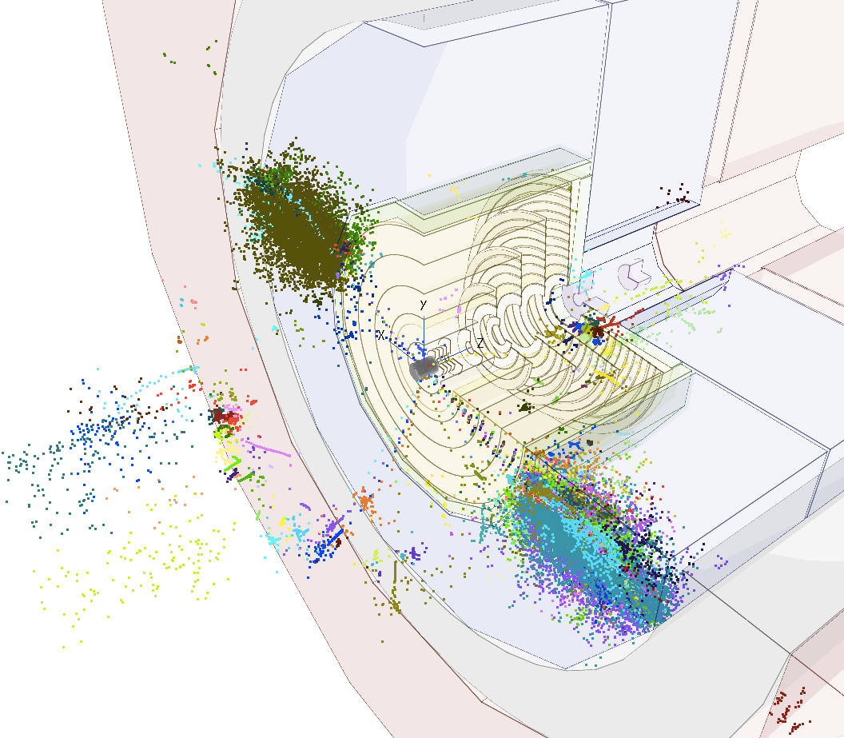
FCC-hh vertex detector optimization status of fast simulation studies
Andrea Coccaro (UniGe), Dominik Dannheim (CERN),
Estel Perez (CERN), Philipp Roloff (CERN), Rosa Simoniello (CERN)
FCChh meeting , 19th October 2016

Slide 2
Fast Simulation Status
Using LiC Detector Toy
  Includes multiple scattering (uses Kalman filter)
  Models single planes: cylinders or disks (no module structure)
Step 1: Cross-check TrkLayout results by Zbynek → shown at last FCChh meeting 28/09 (slides updated)
Step 2: Variations on geometry and resolution → today
Step 3: Occupancy studies → ongoing

Slide 3
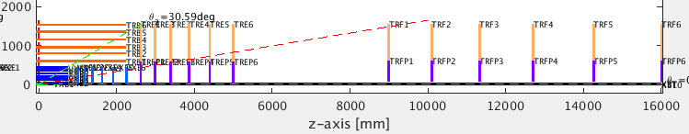
Baseline Detector parameters
Taken from:http://fcc-tklayout.web.cern.ch/fcc-tklayout/FCChh-Option3/index.html
  Used as baseline throughout this presentation
Single-point resolution:
5x25µm
10x25µm
10x25µm
Material budget [X/X₀]:
0.015
0.015
0.03
0.00286
Pixels
Pixels
Strips
Beampipe

Slide 4
Plan
Reproduce some of the studies done for CLIC:
    https://cds.cern.ch/record/1443503/files/LCD-2011-031.pdf
Start with geometry & material variations
  vertex layers radius -> shown last FCChh meeting
  single point resolution -> shown last FCChh meeting
  beampipe radius -> today
  beampipe & layers material -> today
Calculate occupancies -> ongoing
  Variation of the distance between endcap and fwd disks -> today
  Variation of single point resolution -> today
Implement Cables & supports (?)
  Variation on barrel layers length (and therefore on material –cables- between the barrel and the endcap)

Slide 5
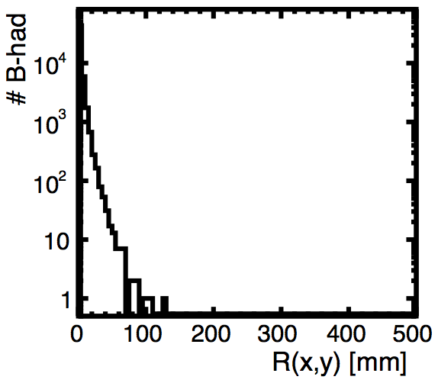
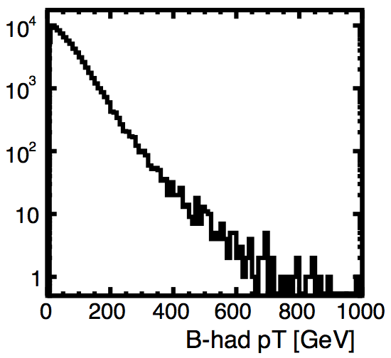
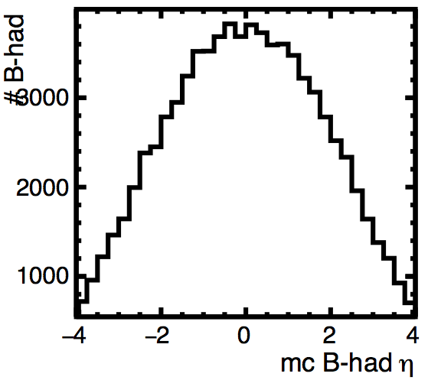
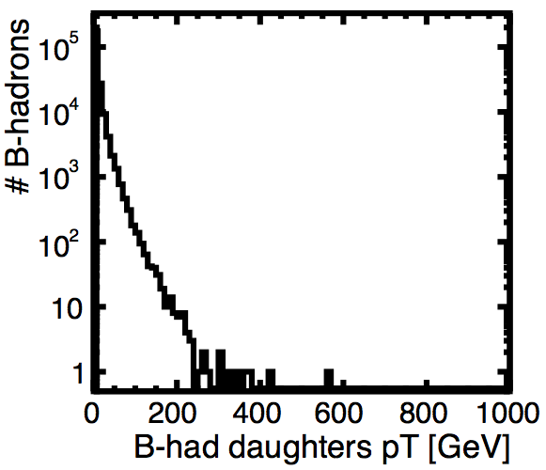
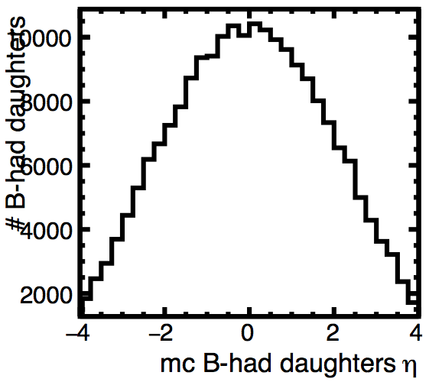
Benchmark kinematic ranges
Use double higgs production with H->bb @100 TeV
  (from https://test-fcc.web.cern.ch/test-FCC/LHEevents.php )
Kinematics of long-lived B-hadrons and their charged daughters
radius of production vertex
pT
B-hadrons
Eta
B-hadrons’ daughters
pT
Eta

Slide 6

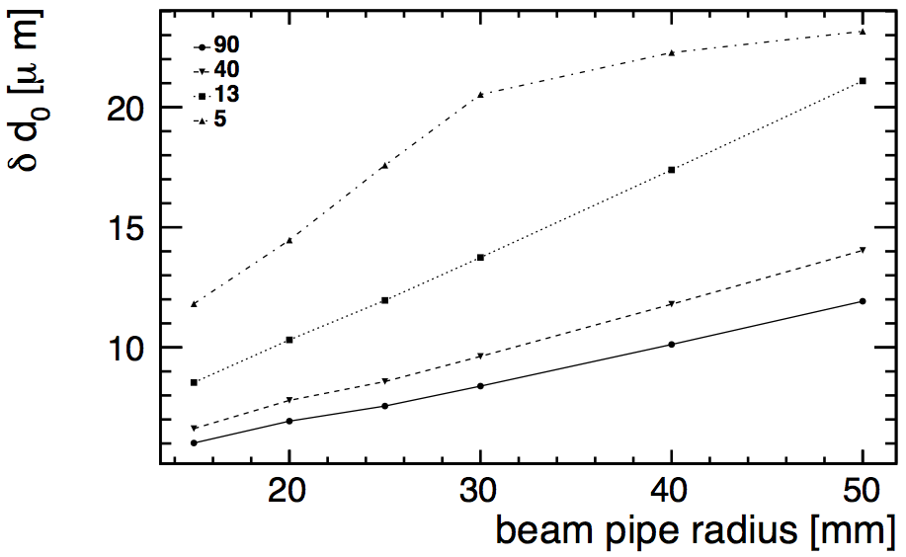
d0 resolution dependence on the beampipe radius
90 deg
40 deg
13 deg
5 deg
Baseline value: 20 mm
Scan on beampipe radius, move the vertex layers accordingly:
1st layer always at 1mm from the beampipe
2nd layer always at 29mm from the 1st layer
last layer always at the same position (434mm)
Layers in between: equi-spaced
pT= 10 GeV
Theta [deg]
Preliminary
Linearly correlated in the central region.
For very forward tracks, at large radius barrel hits are lost
Notes:
----- Meeting Notes (6/10/16 14:49) -----
add other energies
on linear scale

Slide 7
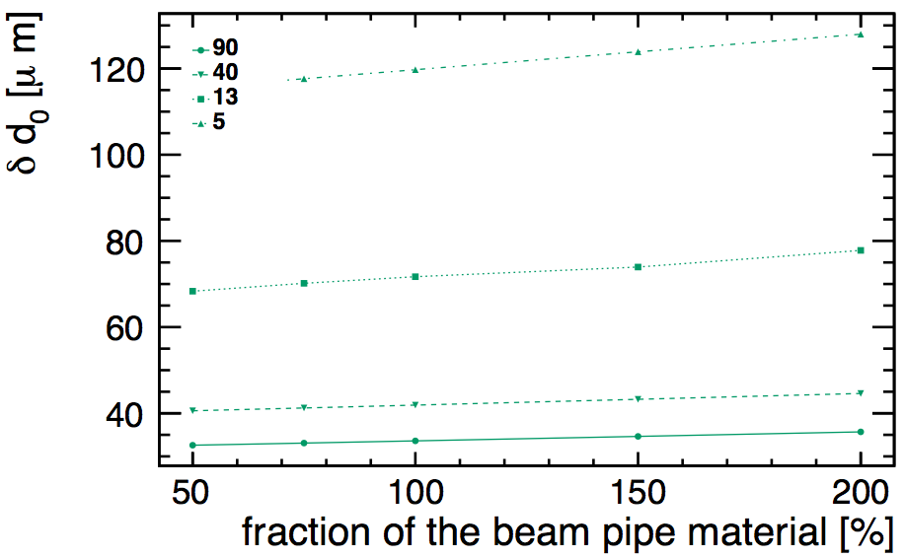
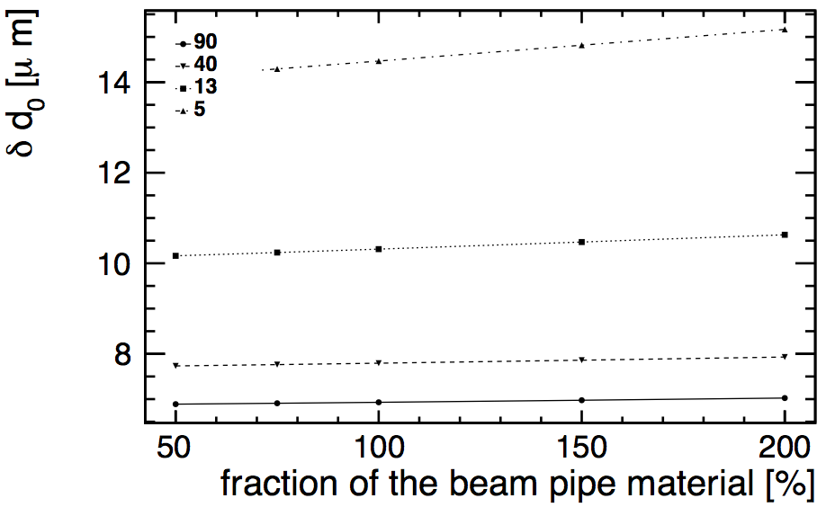
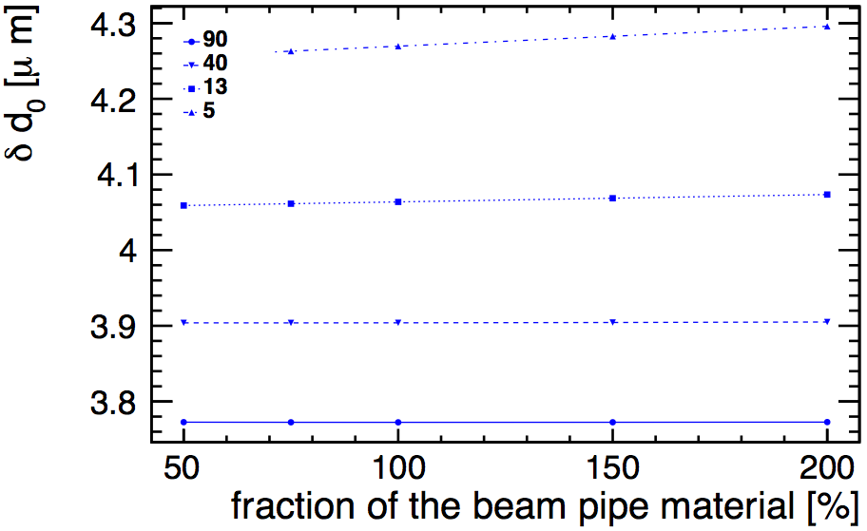
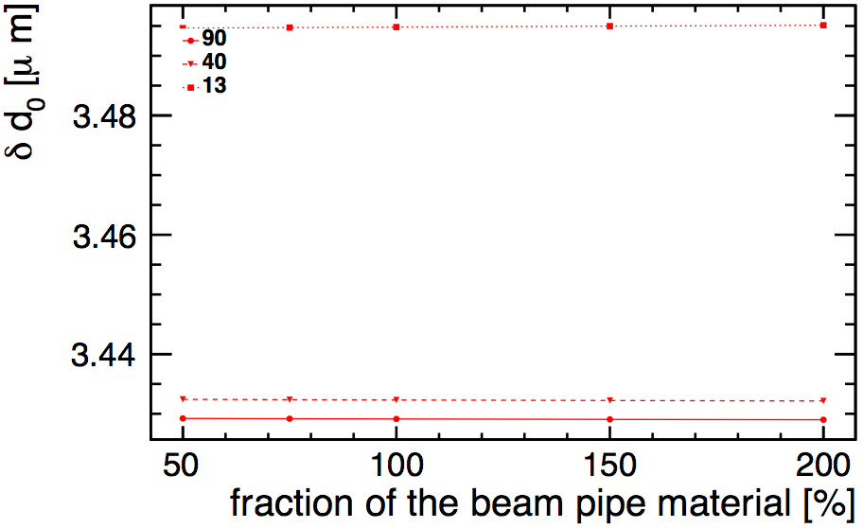
d0 resolution dependence on the beampipe material
Baseline: beampipe X/X₀=0.00286.
Reduce/increase the beampipe material by: 50%, 75%, . , 150%, 200%
pT= 1 GeV
pT= 10 GeV
significant dependence only for low pT forward tracks
pT= 100 GeV
pT= 1000 GeV

Slide 8
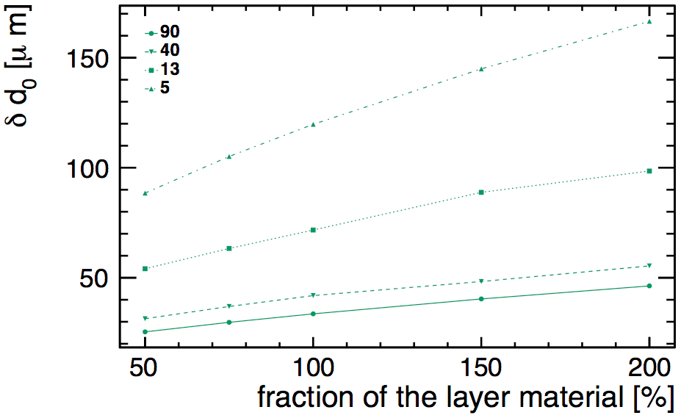
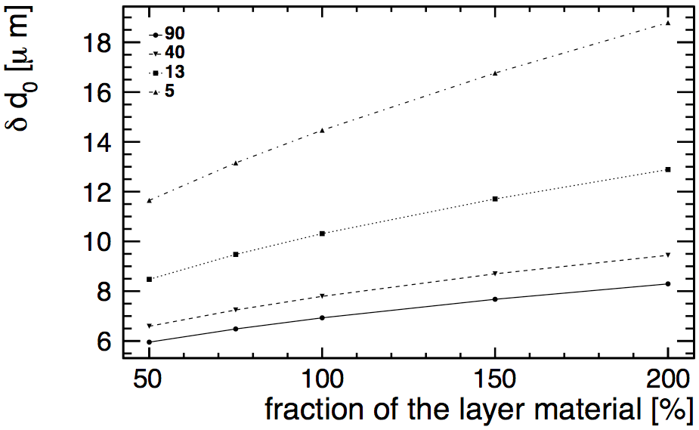
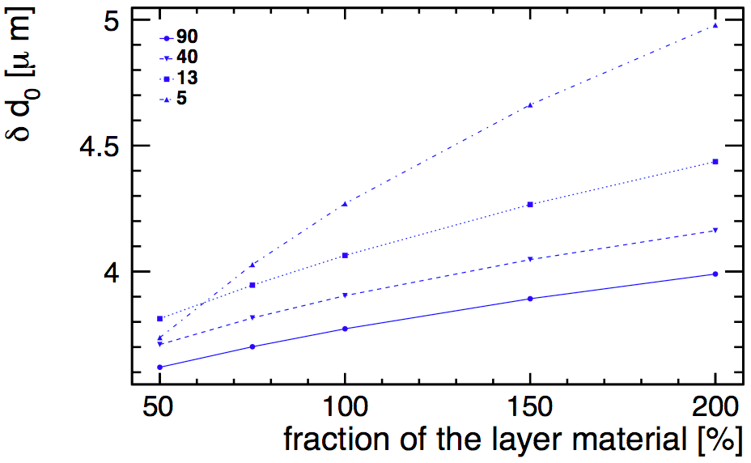
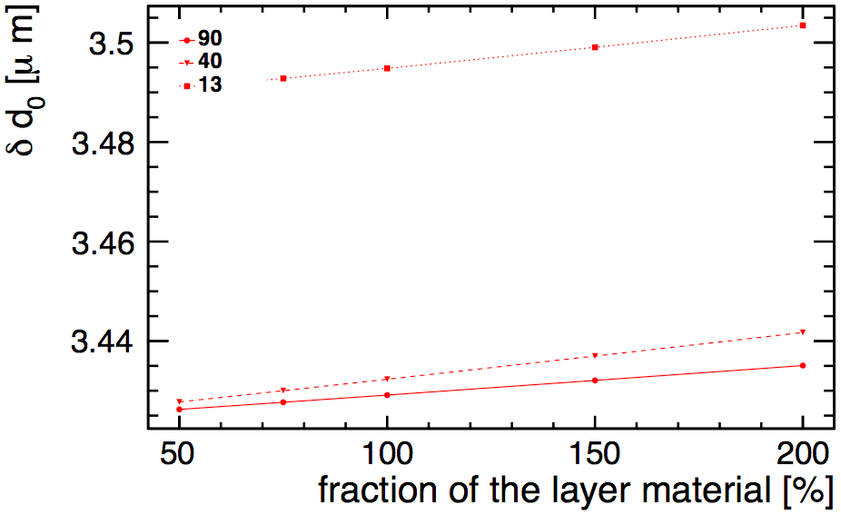
d0 resolution dependence on the layers material
Reduce/increase all layers material by: 50%, 75%, . , 150%, 200%
pT= 1 GeV
pT= 10 GeV
pT= 100 GeV
pT= 1000 GeV
Reducing the material budget by 50% would improve the d0 resolution by 15%(4%) at pT=10GeV(100GeV)
Notes:
----- Meeting Notes (6/10/16 14:49) -----
1 geV, 2 5 10
pt distr of particles from ilaria
get track diraction within the layer. pattern in a single layer
dependence of the flav tagging on this

Slide 9
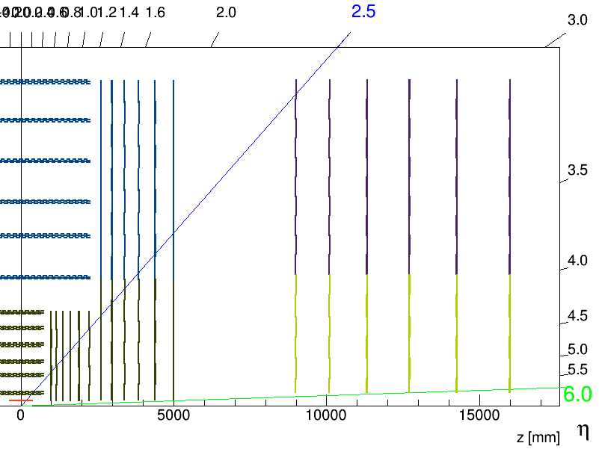
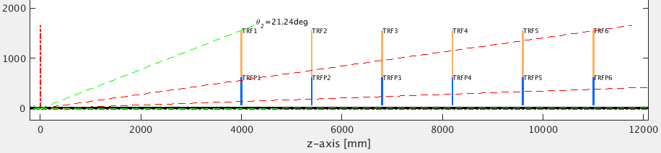
Occupancy in track extrapolation area: procedure
LiC Toy uses outside-in tracking.
To study the occupancy in the last endcap disk, project there the track’s covariance matrix
Calculate area of the error ellipse:
  A= ¼ * π * res(Rphi) * res(z) * tan(theta)
For a very forward track: 1.2 deg (goes through all pixel layers only), study:
Area as a function of the gap distance (endcap – forward)
Area as a function of the single-point resolution of the forward layers
Use Fluka simulations to convert this area into occupancy
Endcap
Forward
Gap
2 deg

Slide 10
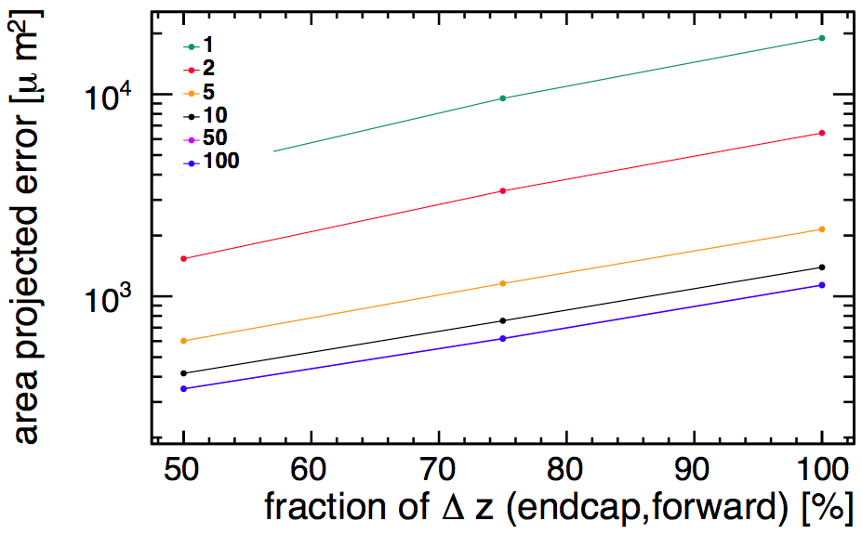
Area as a function of distance between endcap and forward disks
  Test fraction of the distance: ½, ¾ , 1 (move first forward layer, keep last fwd layer fixed, others equi-spaced)
pT [GeV]
theta = 1.2 deg
Preliminary
Error ellipse area increases with gap distance:
if gap reduced to half, area (proportional to occupancy) reduced by ~80%

Slide 11
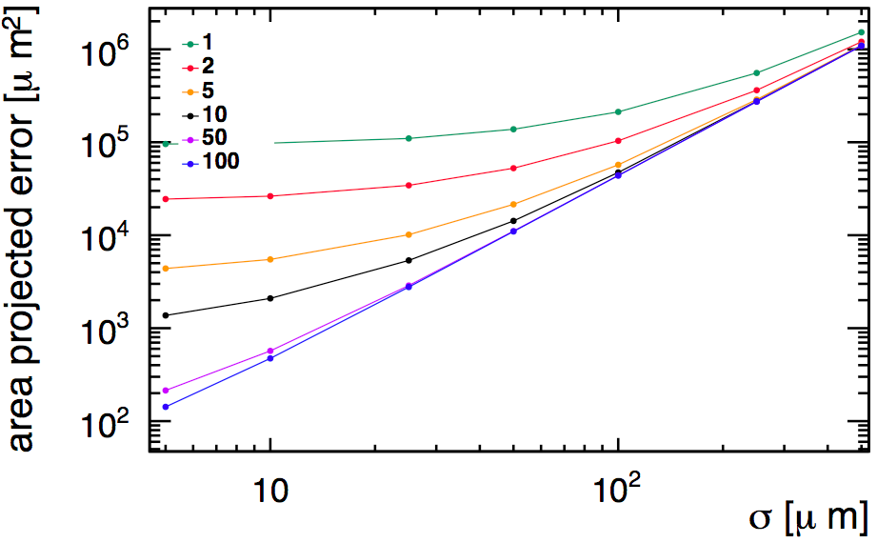
Area as a function of single point resolution of forward disks
Use very forward track (theta=3 deg). Assume squared pixels
Plot error ellipse area as a function of the single point resolution (σ) of the forward pixel layer
  Variations: σ= 5x5, 10x10, 25x25, 50x50, 100x100, 250x250 μm
pT [GeV]
theta = 3 deg
Slide updated after the presentation
Preliminary
Next: Scale area to the occupancy to extract required granularity

Slide 12
Next steps on fast simulation studies
Finish occupancy studies
  Extract required granularity
Include cables (& supports) (?)
  Optimize barrel length

Slide 13
Backup

Slide 14
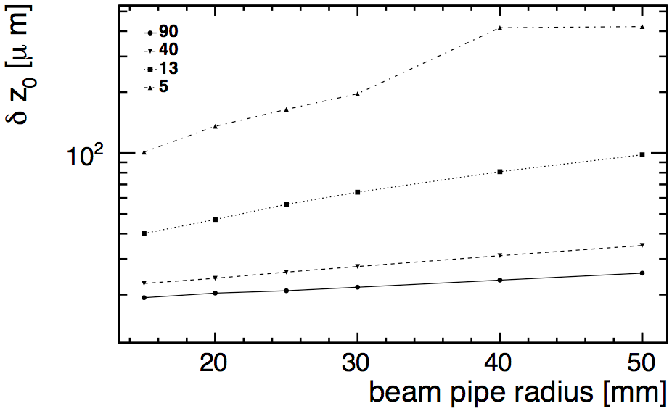
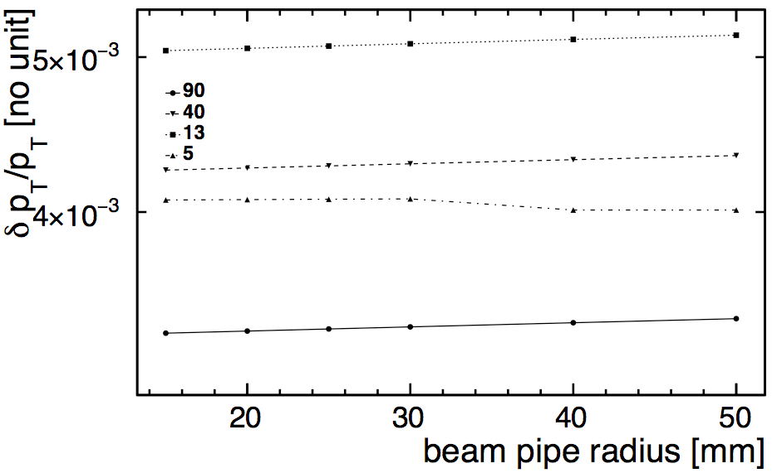
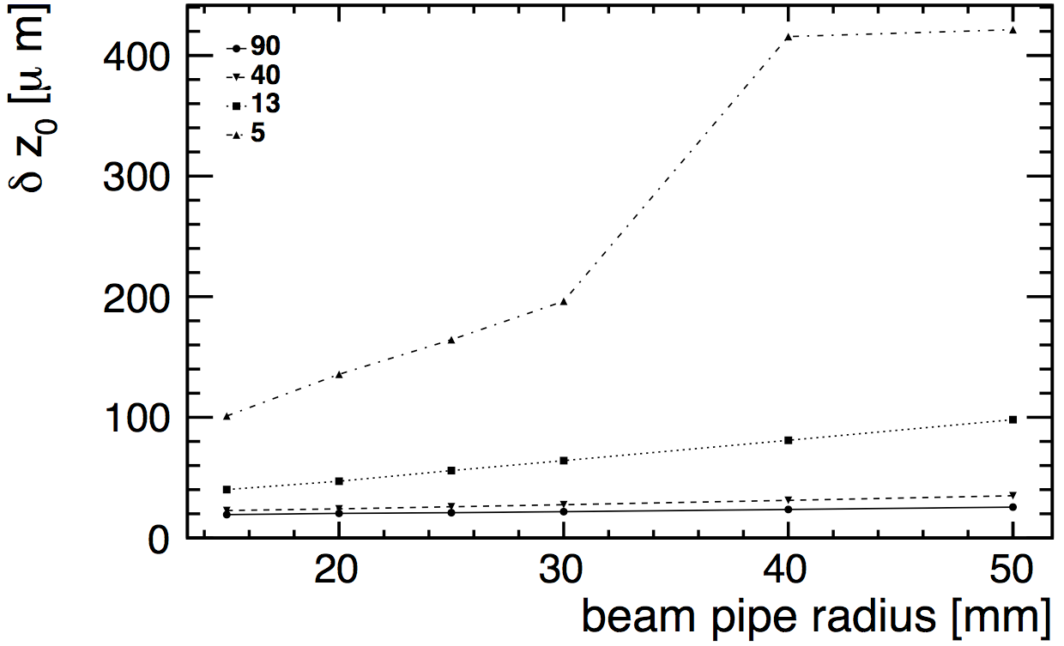
d0 and z0 resolution dependence on the beampipe radius
90 deg
40 deg
13 deg
5 deg
10 GeV
Theta [deg]
z0 res. lin scale
Slide updated after the presentation
Notes:
----- Meeting Notes (6/10/16 14:49) -----
add other energies
on linear scale

Slide 15
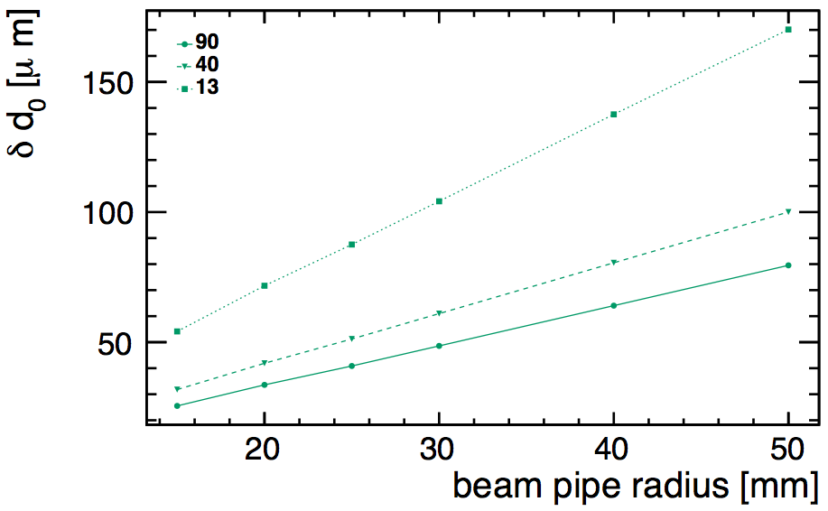
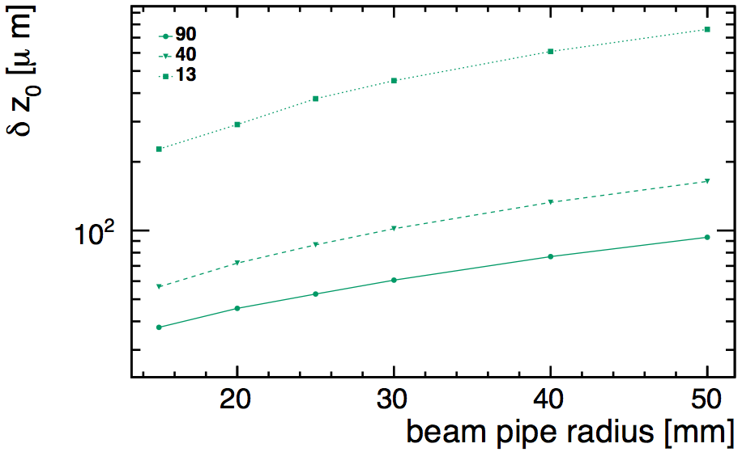
d0 & z0 res vs beampipe radius
1GeV

Slide 16
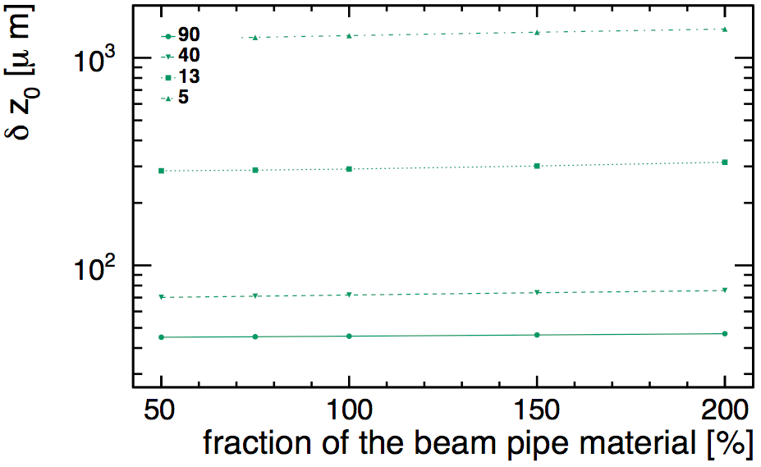
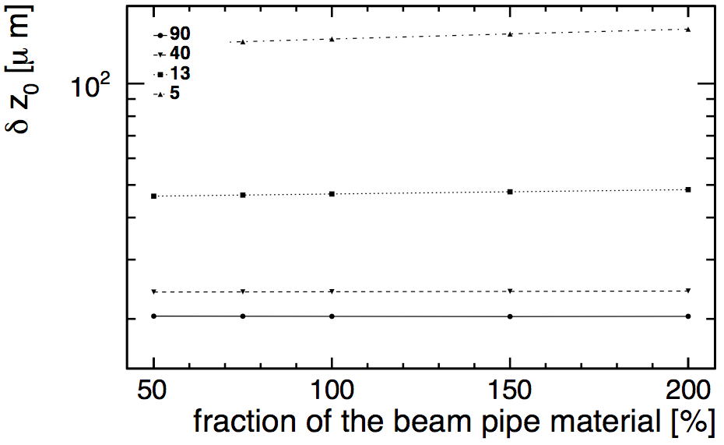
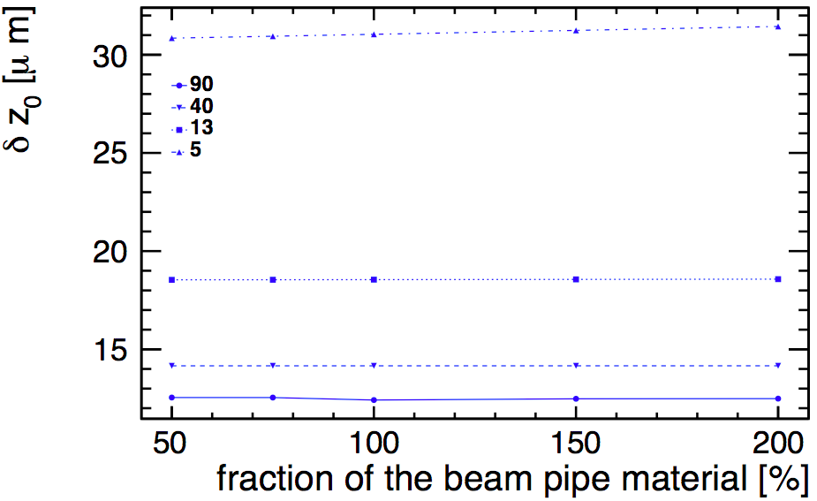
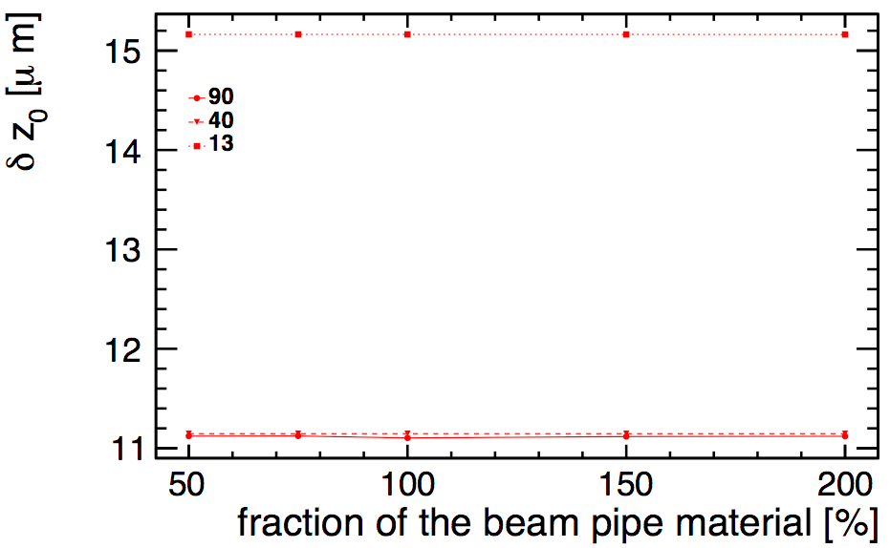
z0 resolution dependence on the beampipe material
Slide updated after the presentation
Baseline: beampipe X/X₀=0.00286.
Reduce/increase the beampipe material by: 50%, 75%, . , 150%, 200%
pT= 1 GeV
pT= 10 GeV
tiny dependence only for low pT forward tracks:
half the material improves z0 resolution by <4% @5deg pT=10GeV
pT= 100 GeV
pT= 1000 GeV

Slide 17
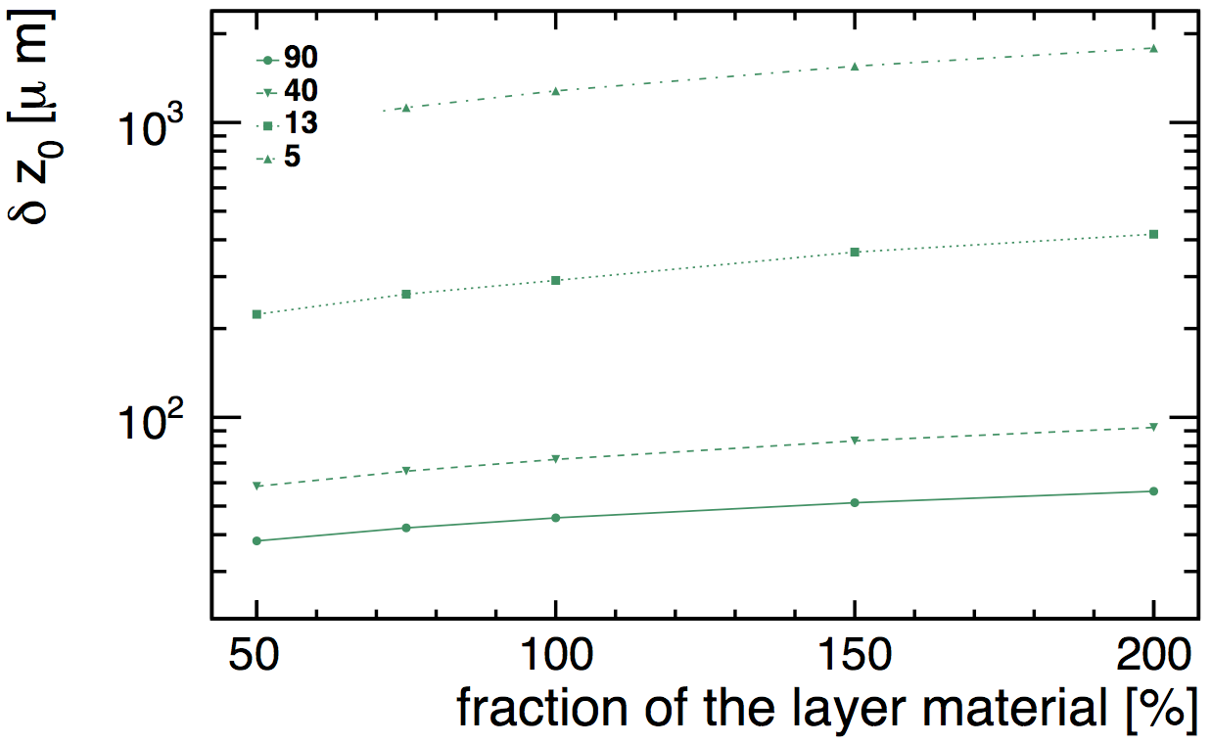
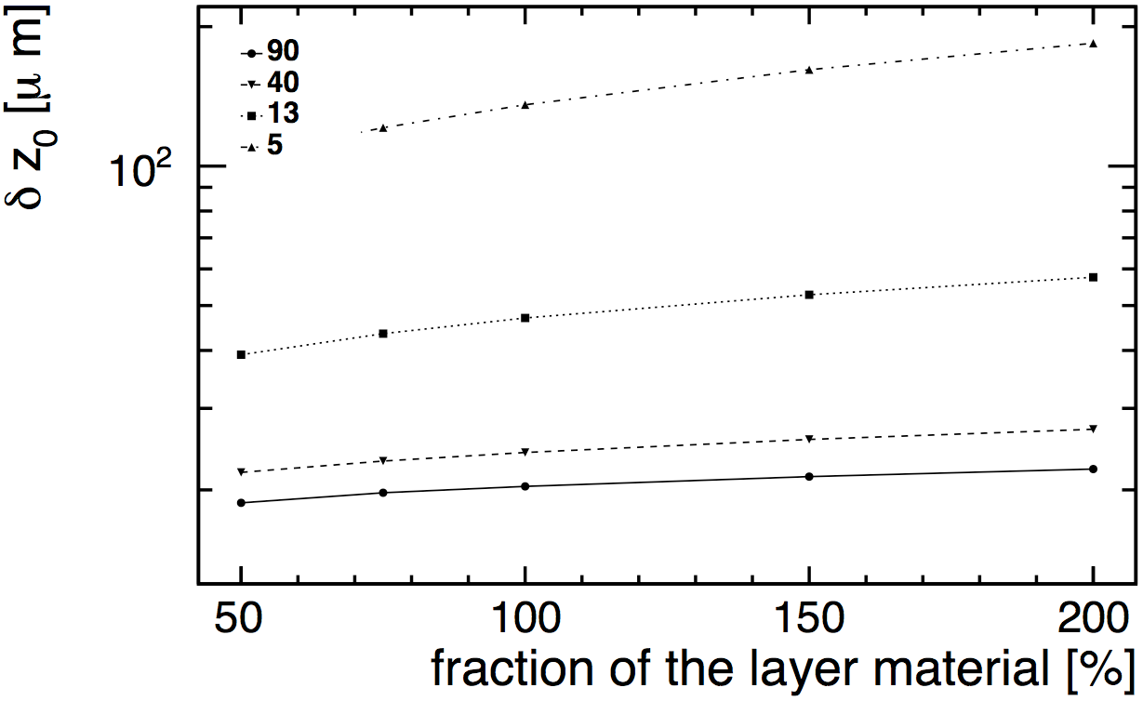
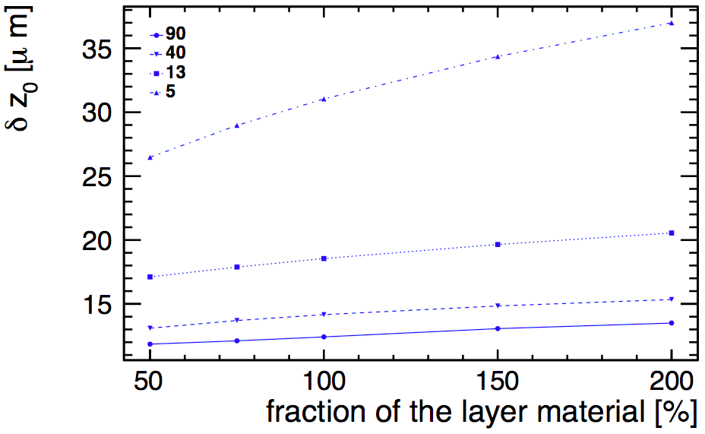
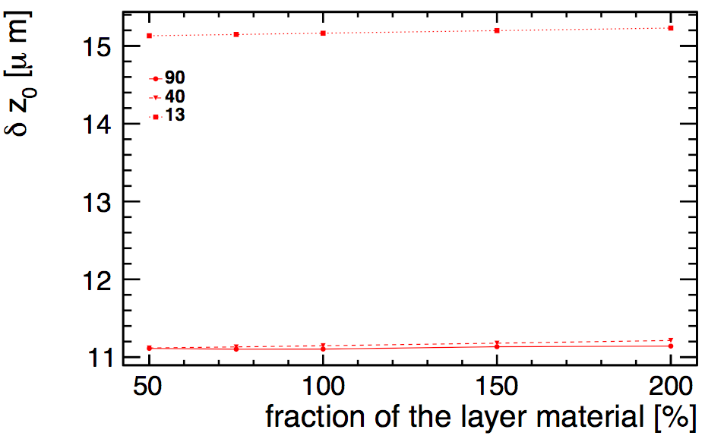
z0 resolution dependence on the layers material
Reduce/increase all layers material by: 50%, 75%, . , 150%, 200%
pT= 1 GeV
pT= 10 GeV
pT= 1000 GeV
Slide updated after the presentation
pT= 100 GeV
Reducing the material budget by 50% would improve the z0 resolution by 23%(16%) at pT=10GeV(100GeV) @5deg
Notes:
----- Meeting Notes (6/10/16 14:49) -----
1 geV, 2 5 10
pt distr of particles from ilaria
get track diraction within the layer. pattern in a single layer
dependence of the flav tagging on this

