Slide 1
Energy Resolution of DECAL in the FCC-hh
Tony Price
University of Birmingham
19/10/2016

Slide 2
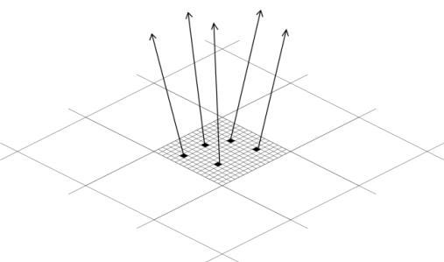
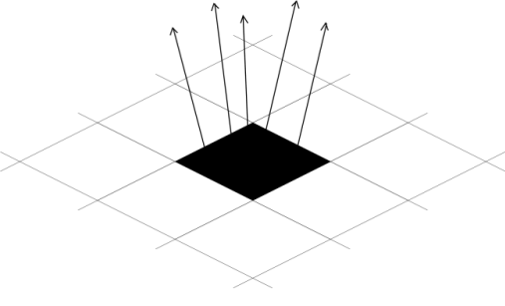
Digital Calorimetry: The Concept
Dates back to c.2005 work within CALICE
Make a pixelated calorimeter to count the number of particles in each sampling layer
Ensure that the particles are small enough to avoid multiple particles passing through a single pixel to avoid undercounting and non-linear response in high particle density environments
Digital variant of ILD ECAL would require 10¹² channels, FCC-hh ECAL is similar
Analogue: 5mm pitch
Digital: 50um pitch

Slide 3
DetFCChhECalDigital Geometry
Modified ECAL barrel inner radius to 1700 mm
Removed cryostat as not required for SiW calorimeter
Access gap of 100mm so inner R = 18000 mm
Modified geometry such that there are four repeated volumes per module
  25 um epitaxial (sensitive)
  Silicon substrate
  Tungsten
  Air gap
All configurable from xml files
Currently ECAL is just 130mm deep (excluding envelope)

Slide 4
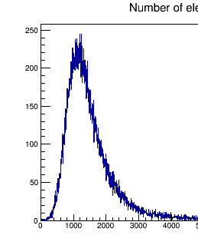
DetFCChhECalDigital Readout
Signal for 18um epi in e-
Sum all the energy deposited in a cell
Apply a threshold of 480 e- (6*noise of designed CMOS)
Currently score
  Number of pixels above threshold
  Number of particle per pixel (for pile-up non linearity studies)
Since the last meeting the hits remaining in the collection are stored in EDM format
Thanks to Jana (and others on the SW team) I have replicated my simple python analysis to use EDM readout objects

Slide 5
Samples
Single electron samples of energy 10-1000 GeV
Barrel restricted to +/- 1m in Z due to limitations in number of cellIDs (need to optimise what I am doing)
Uniform in theta
Restricted to eta < 0.1
All ECAL has 30 radiation lengths of W. Assuming for now the Si does not contribute

Slide 6
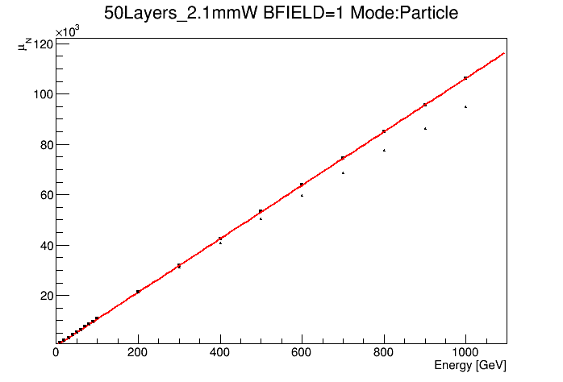
Linearity
Red line is truth particle response
Points are pixel count

Slide 7
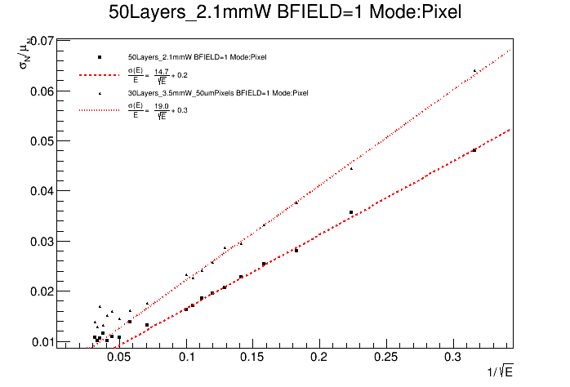
Impact of Sampling Fraction

Slide 8
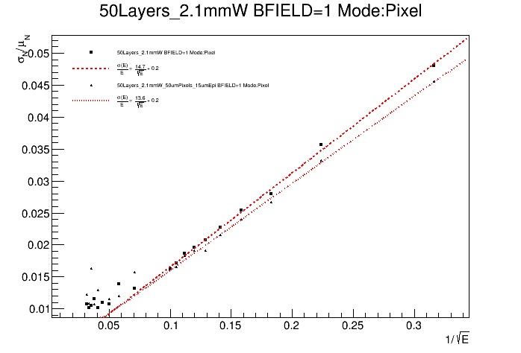
Impact of Epitaxial thickness

Slide 9
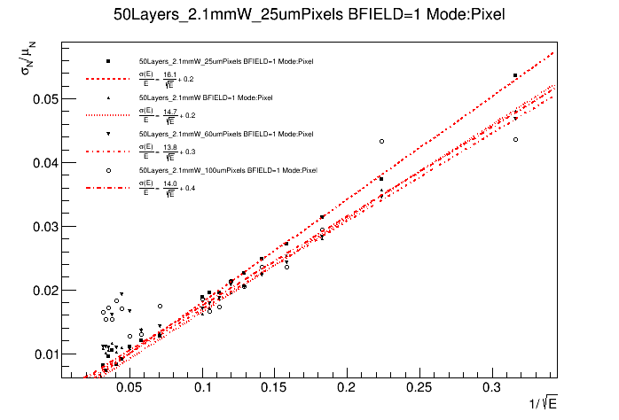
Impact of Pixel Pitch
Pixel pitch determined by energy range
Implication is that there is an optimal aspect ratio of the pixel. Alasdair Winter at UoB investigating

Slide 10
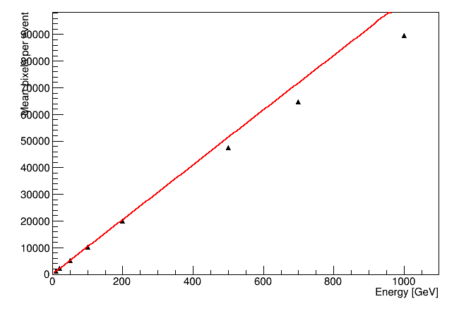
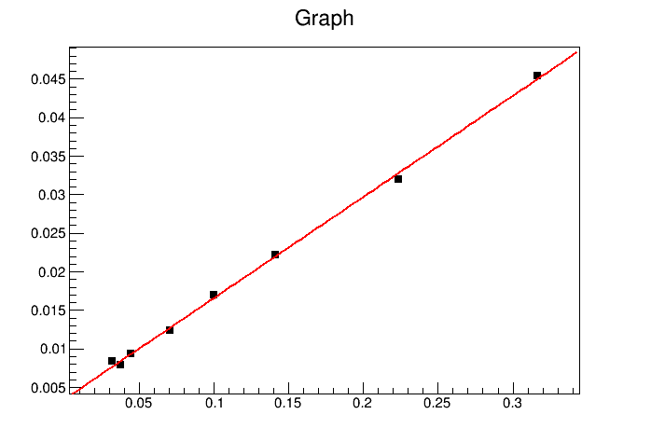
EDM Analysis
Up to now all plots have been made by just printing number of pixels to terminal and analysing log files with python
Now, I have readout using EDM which I can analyse
This will allow us to look into other properties of the shower to investigate whether we can improve performance at higher energies
Linearity follows the same pattern
Require more stats but resolution ~14% same as my python analysis
Resolution ~ 14%/√E

Slide 11
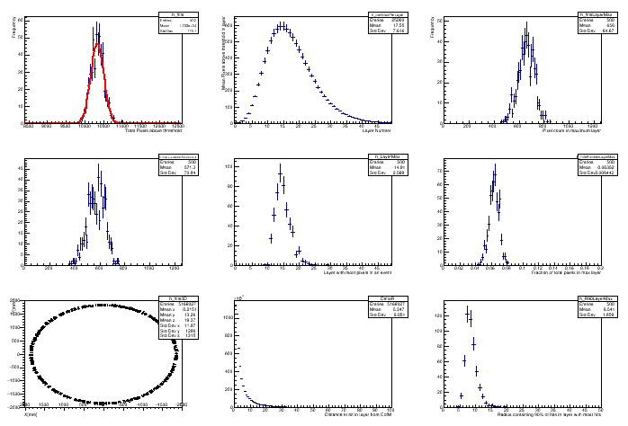
Parameters under investigation
100 GeV
Pixels in event
Longitudinal profiles
Pixels in max layer
Pixels in layer relative to max
Position of max layer
Fraction of counts in layers
Hit position in ECAL XY
Radial shower profiles within layers
Moliere Radius

Slide 12
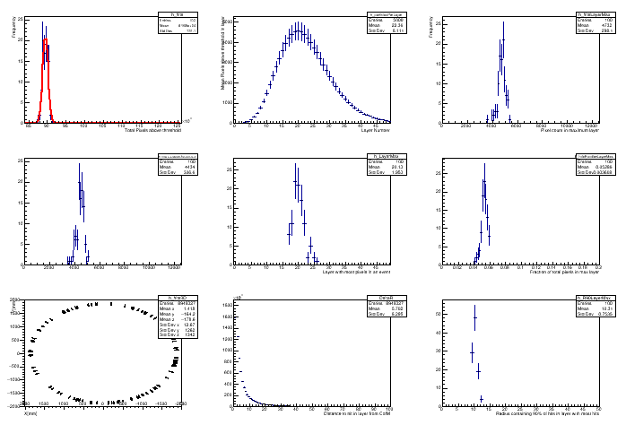
Parameters under investigation
1000 GeV
Pixels in event
Longitudinal profiles
Pixels in max layer
Pixels in layer relative to max
Position of max layer
Fraction of counts in layers
Hit position in ECAL XY
Radial shower profiles within layers
Moliere Radius

Slide 13
Prototype Sensor
As part of current grant we are also developing a reconfigurable CMOS MAPS for use in DECAL
Counting will happen by column then row readout
Lends itself to a readout mode with column readout as a strip
  Could be used in the outer tracking layers?
Results from these simulations are influencing design choices

Slide 14
Conclusions
Simulation still underdevelopment but progressing well
Single particle resolution ~14% achievable for 50 layers (2.1mm W), 19% for 30 layers (3.5mm W)
An ECAL of just 130mm would allow smaller detector overall
Aspect ratio of pixel will have an impact so investigating
Readout and analysis with EDM now possible and simulation more flexible
Investigating ways to improve performance at higher energy
Possibility of SiW pre-shower (before cryostat) with LAr ECAL?
Evaluating the impact of pile-up under discussion with Joshcka and Valentin
Results from FCCSW used to impact design choices of prototype sensor

