Slide 1
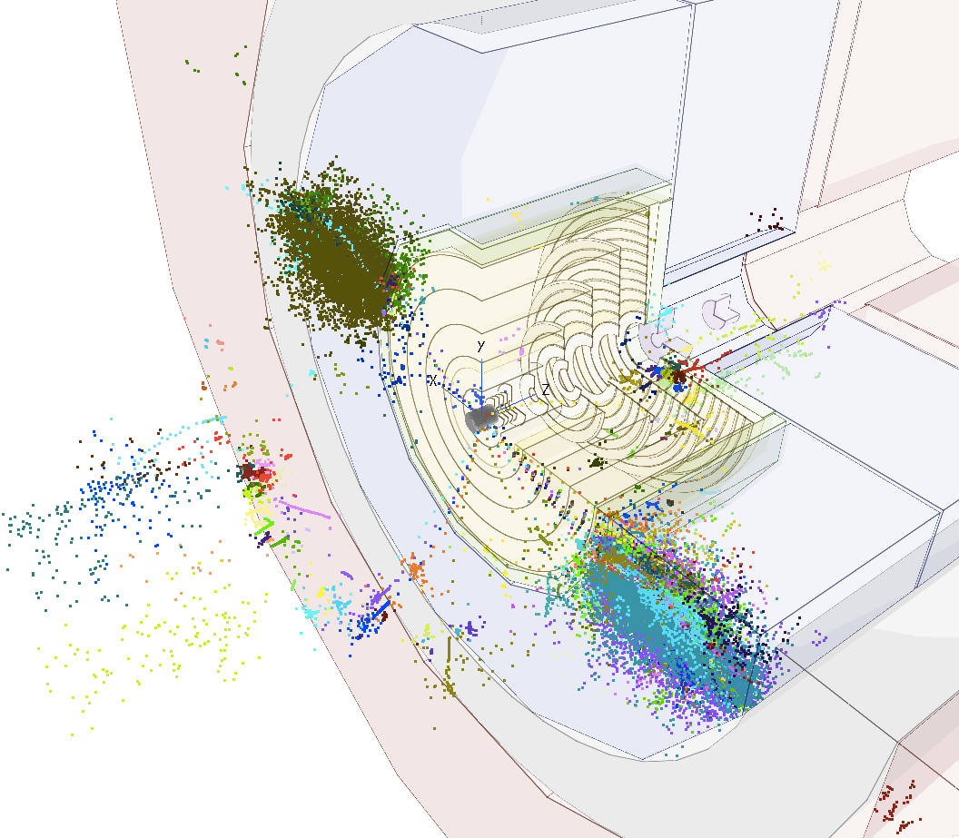
FCC-hh vertex detector optimization status of fast simulation studies
Dominik Dannheim (CERN),
Estel Perez (CERN), Philipp Roloff (CERN), Rosa Simoniello (CERN)
Special thanks to Zbynek Drasal (CERN)
FCChh meeting , 16th November 2016

Slide 2
Outline
Constraints of the background occupancy on:
Detector’s granularity (pixel size)
Pattern recognition
  Trade-off between number of layers and single point resolution

Slide 3
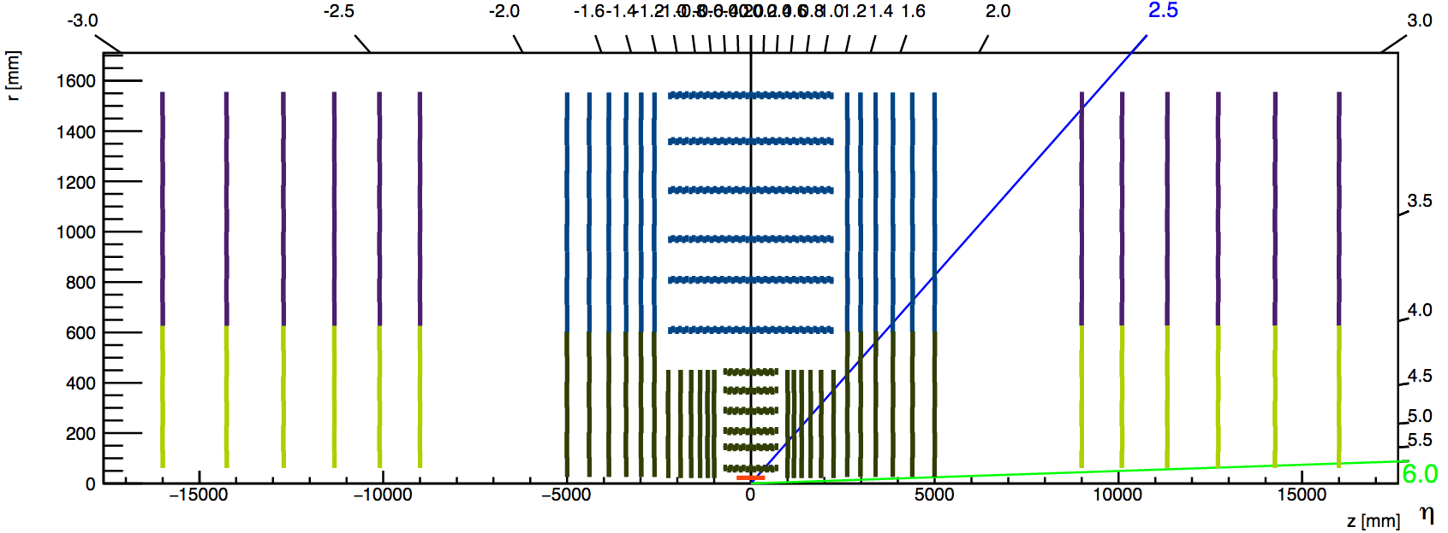
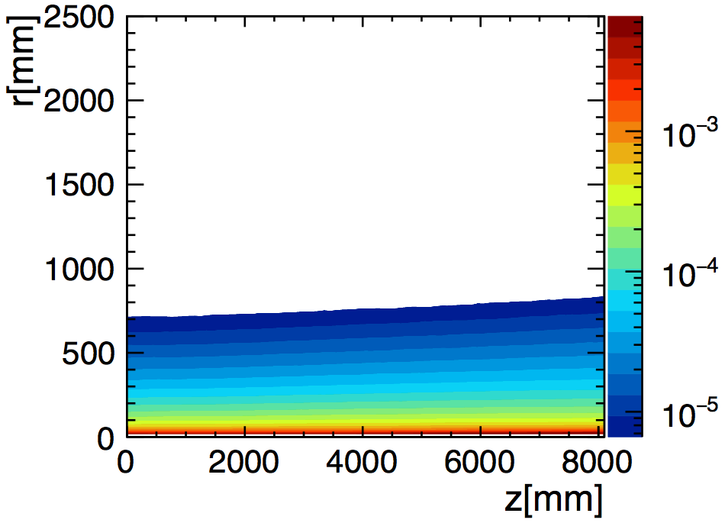
Fluence map
Provided by M. Ilaria Besana
Number of particles per pp collision per unit area
For B field = 4 T
  (scaled from the 6T map used by Zbynek in his past studies)
  Does not include tracker material (small effect)
  Includes EM calorimeter (acts as source of back scattered particles)
  Assumes HAD calorimeter absorbs all particles
Up to z=8m
  Fluence in forward region not available: depends on the layout which is not yet fixed
Irradiation map available
Zoomed-in area in the next slide

Slide 4
1) Constraints from fluence on detector granularity
Given the fluence map, what is the minimum granularity needed in each part of the detector, to make sure there will be only one particle firing a pixel?
Assume we need the occupancy <=0.01 (for consistency with prev. results, to be reviewed)
Assume # Pile up interactions per bunch crossing =1100
Assume no diffusion (cluster size for a perpendicular track = 1)
if we Assume squared pixels and no charge sharing, can express the area in terms of σ:
For a given single point resolution, how close to the beampipe can we go?
maximum Fluence= 0.01/1100 /(σ * √12)²
→ Draw constant fluence curves in the R vs Z plane
# particles per unit area, per pp collision
Occupancy = Fluence * Pile up * PixelArea
per Bunch Crossing
# of pp collisions per Bunch Crossing (BC)
PixelArea = (PixelPitch)² = (single point resolution * √12 )²

Slide 5
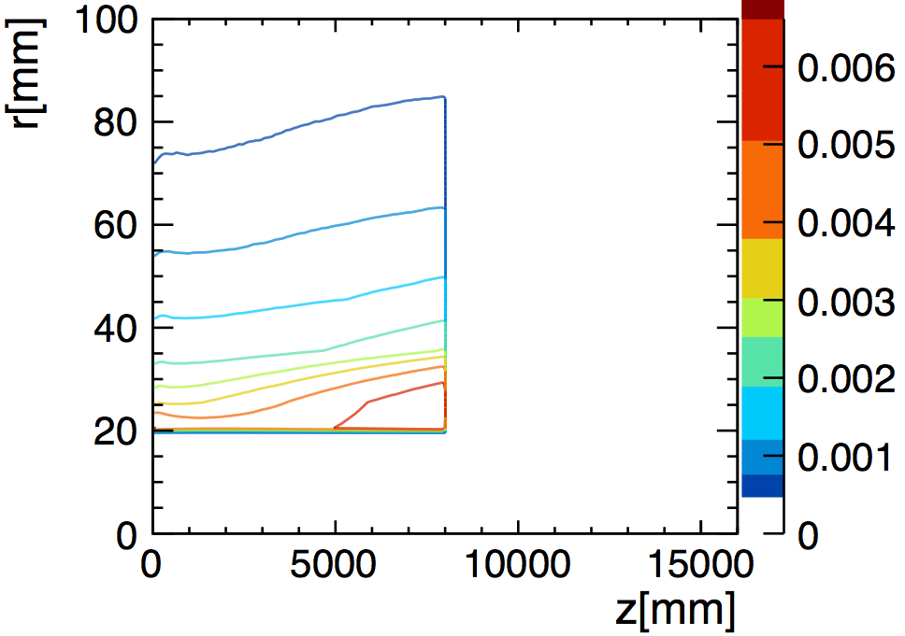
1) Constraints from occupancy on detector granularity
Which single point resolution is needed in each part of the tracker?
Inner
Outer
Endcap
Forward
eta=5.7
40x40
# particles in a pixel <=0.01
σ = Pitch/√12
#PU =1100 int. per BC
10x100
eta=6
25x25
single point res σ [μm] | pitch* [μm] | pixel area [μm^2] | max Fluence [mm^-2]
5x5 | 17.3 | 300 | 0.03030
10x10 | 34.6 | 1200 | 0.00758
10x15 | 42.4 | 1800 | 0.00505
10x20 | 49.0 | 2400 | 0.00379
10x25 | 54.8 | 3000 | 0.00303
10x30 | 60.0 | 3600 | 0.00253
20x20 | 69.3 | 4800 | 0.00189
25x25 | 86.6 | 7500 | 0.00121
10X100 | 109.5 | 12000 | 0.00076
40x40 | 138.6 | 19200 | 0.00047
20x20
10x30->PixelArea=3600
10x25
10x20
10x15->PixelArea=1800
For layers and rings with R<35mm, pixel area should go down to 1800μm² -> single point resolution =10x15 μm (for first inner barrel layer and innermost ring of all endcap disks)
* pitch = sqrt(pixel area), even for non-squared pixels

Slide 6
Current baseline
σ
10x15
10x30
10x100

Slide 7
Proposal 1 (from occupancy point of view)
σ
10x15
10x30
10x100
Need to review also where the transition to σ=10x100 should happen (consider also z0 and d0 resolution)

Slide 8
1) Constraints from occupancy on detector granularity - requests
Do we have a baseline estimate of max occupancy and cluster size, for FCChh envisaged technologies?
  Assuming 1% occupancy is probably not realistic:
  HL-LHC already requires to go down to 0.2%
    RD53 aims at 50x50μm pixel pitch coping with 3 GHz/cm²
      Sensors of area= 50x50μm = 2500 μm²
      3 GHz/cm² = 75 KHz/pixel -> in 25 ns: 0.0019 particles
  Propose to use occupancy 0.2% as benchmark for the future
    Factor of 5 in the max occupancy -> factor of 2.2 in the single point resolution
    Go down to 7x5 μm single point resolution for the innermost layers and disks
Would need an estimation of the fluence values up to z=16000mm to realistically assess the minimum granularity in the forward part of the detector.

Slide 9
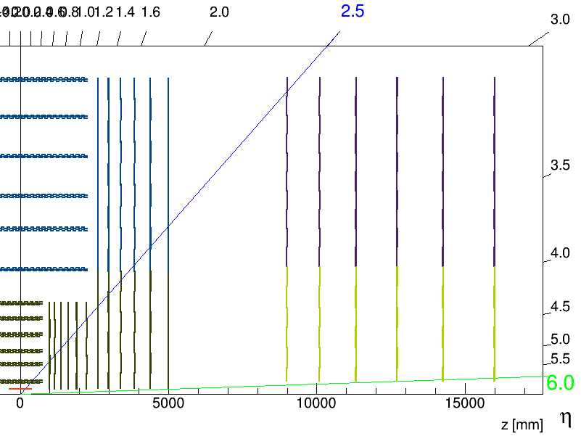
2) Pattern recognition
How does the single point resolution of the forward disks and the gap distance affect pattern recognition
Outer Endcap
Forward disks
Steps:
Project track covariance matrix on the last encap disk
Calculate fluence at such position
If there is another particle in the error ellipse area, it will cause confusion in the tracking algorithms
gap
LiC Toy uses outside-in tracking

Slide 10
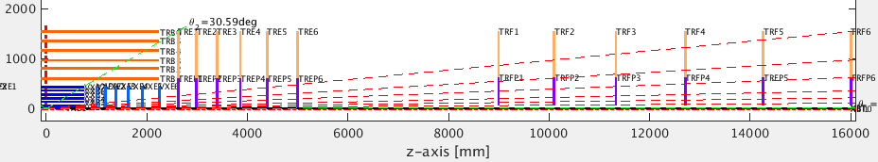
# of background particles in the error ellipse ?
Area of the error ellipse projected at the last endcap disk:
Multiply by fluence at the last endcap disk
EllipseArea = ¼ π σ_{Rφ} σ_{z} tanθ
# bkg particles in error ellipse = Fluence * Pile up * EllipseArea
Study, for forward tracks: (going through all fwd layers)
Area as a function of the single-point resolution of the forward layers
Area as a function of the gap distance (endcap – forward)
R
θ
z
Rφ
A=1/4 π σ_{Rφ}σ_{R}
σ_{R}=σ_{z} tanθ
Endcap
Gap
Forward
θ=5.49 deg;
η=3
θ=0.39 deg;
η=5.7
Note: In this study the upper and lower part of the disks have the same material budget and resolution

Slide 11
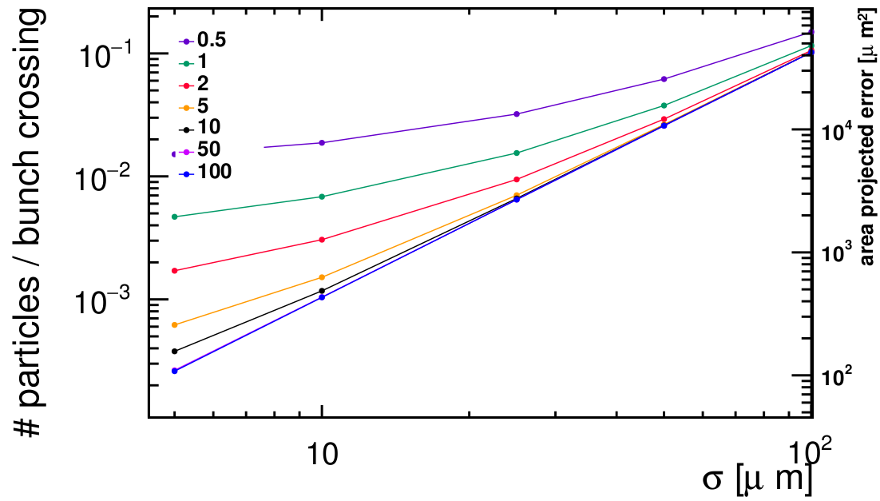
Bkg in error area vs single-point resolution
Assume we need the # bkg particles in the error ellipse to be <=0.01, which single point resolution is required for the forward layers?
Assume # Pile up interactions per bunch crossing =1100
Assume squared pixels (single point resolution: 5x5, 10x10, 25x25, 50x50 100x100 μm)
Show results for the forward-most angle that hits all layers (theta = 0.39 deg; eta=5.7)
# bkg particles in error ellipse = Fluence * Pile up * EllipseArea
pT [GeV]
θ=0.39 deg; η=5.7
In order to have less than 0.01 particles per bunch crossing in the error ellipse area, would need σ=10x10μm.
Not possible to go below pT=0.5 GeV with this layout

Slide 12
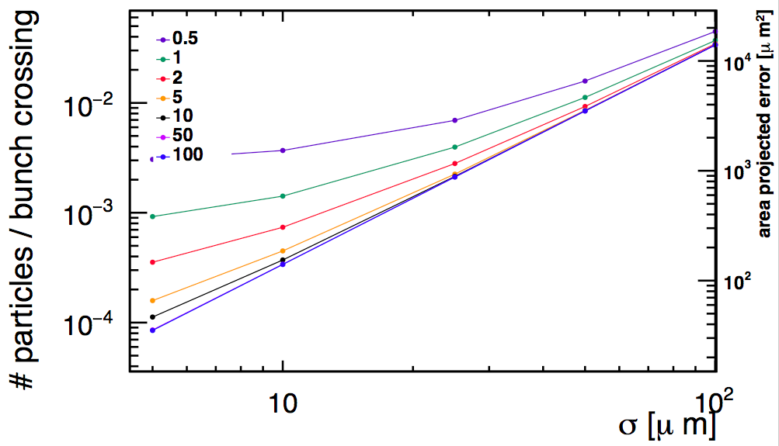
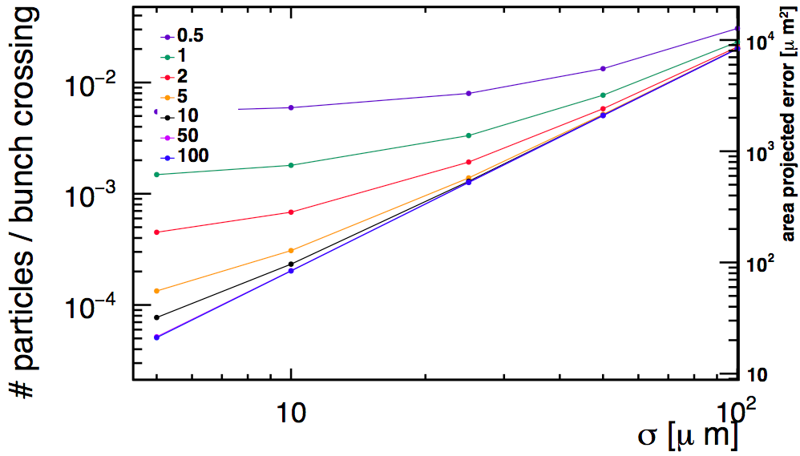
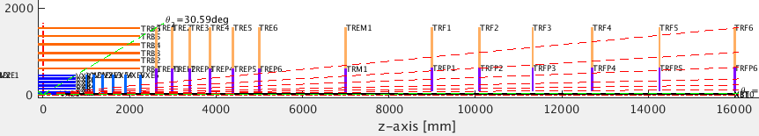
Adding an extra disk in the middle of the gap
Baseline
extra disk in the middle of the gap
pair of extra disks in the middle of the gap
(5cm apart)
pT [GeV]
pT [GeV]
pT [GeV]
θ=0.39 deg; η=5.7
Line at max # particles in the error ellipse area per BC = 0.01
Assume #PU/BC = 1100
→ factor of 5 less background
→ extra material is counter-productive for low pT tracks
If we add one(two) extra layer(s) in the middle of the gap, we can go down to σ=25x25 μm single point resolution for the forward disks and down to pT=0.5 GeV tracks.
Endcap
extra disk
Forward

Slide 13
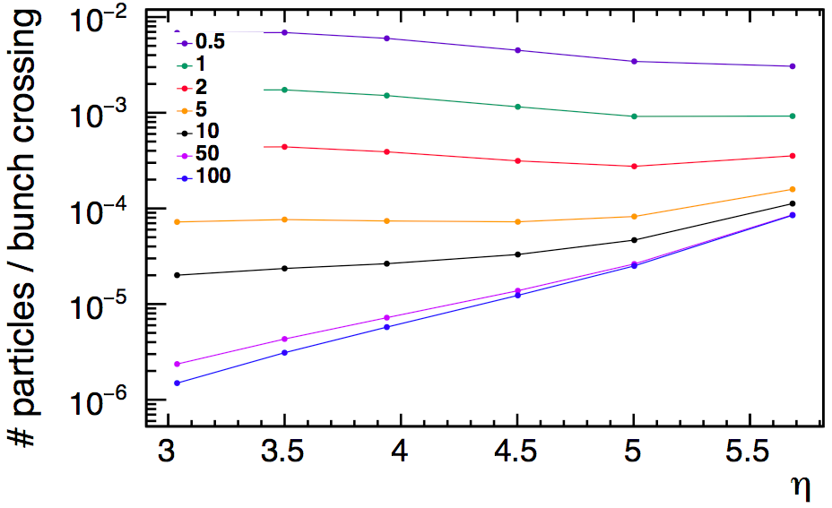
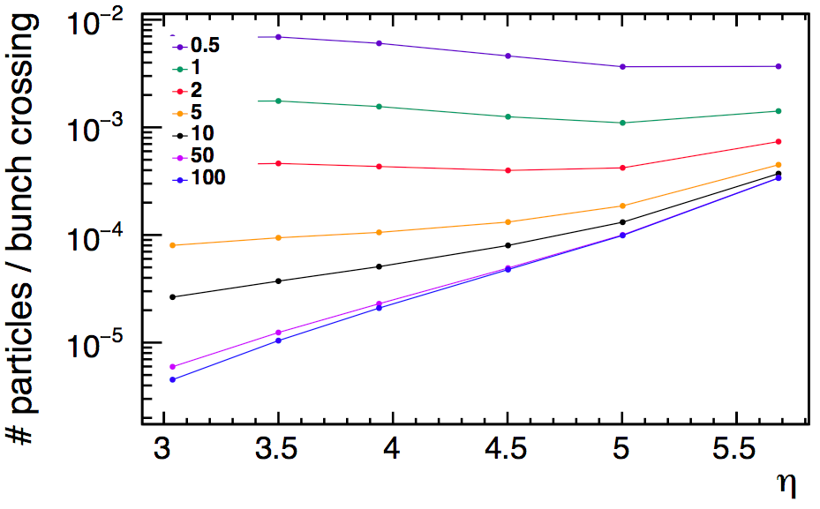
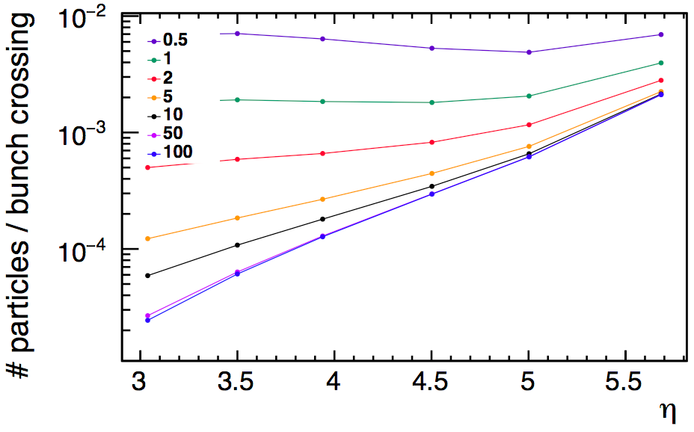
Dependance on track η
Would σ=25x25μm work for every η?
Show # particles per BC vs η for different single point resolutions (σ) of the forward disks.
pT [GeV]
Line at max # particles in the error ellipse area per BC = 0.01
Assume #PU/BC = 1100
1 extra disk in the middle of the gap
σ=5x5μm
Yes, even if highest η does not always mean highest #particles
pT [GeV]
pT [GeV]
σ=10x10μm
σ=25x25μm

Slide 14
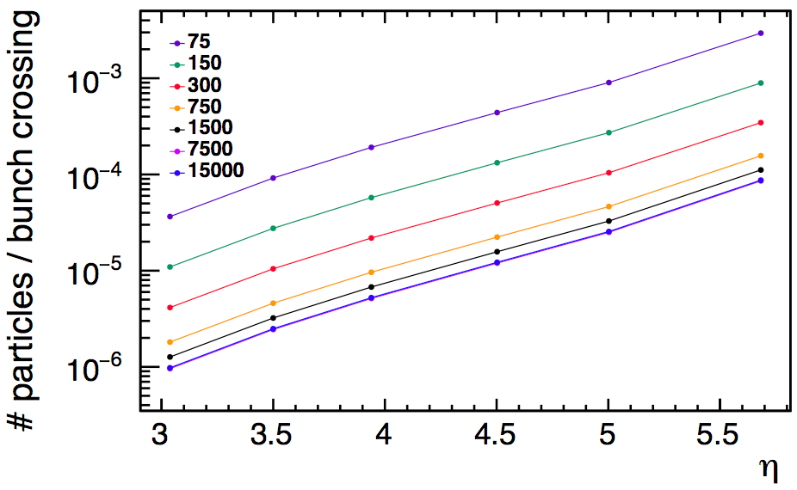
Dependance on track η
σ=5x5μm
1 extra disk in the middle of the gap
Assume #PU/BC = 1100
pT
p
pT [GeV]
p [GeV]
equivalent for η=5.7
At high η the higher fluence is compensated by smaller ellipse area (less multiple scattering: at constant pT, higher η means much higher p)

Slide 15
Conclusions
Detector granularity close to the beampipe driven by fluence, while at larger R the limitations of the pattern recognition will start to play a role
Need finer granularity in the area close to the beampipe
  For layers and rings with R<35mm, single point resolution should be about 10x15 (7x5) μm for occupancy<1% (0.2%)
Need at least one extra disk between the endcap and the forward disks
  Decreases background in the error ellipse by a factor of 5

Slide 16
Next steps
Plan to also check pattern recognition constrains between
  inner and outer barrel
  inner and outer endcap
Note:
Having time resolution of the order of 0.1 ns would allow to decrease background for pattern recognition.

Slide 17
Backup

Slide 18
Proposal 1b (from occupancy point of view)
10x15
10x30
10x100
In terms of occupancy , one could use lowest resolution down to R<200mm. To be checked: pattern recognition and d0,z0 resolution

Slide 19
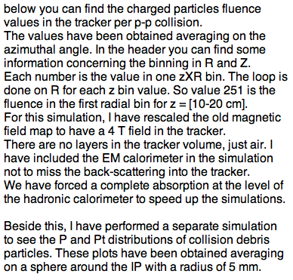
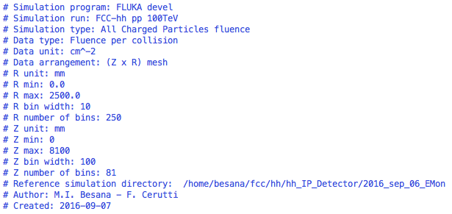
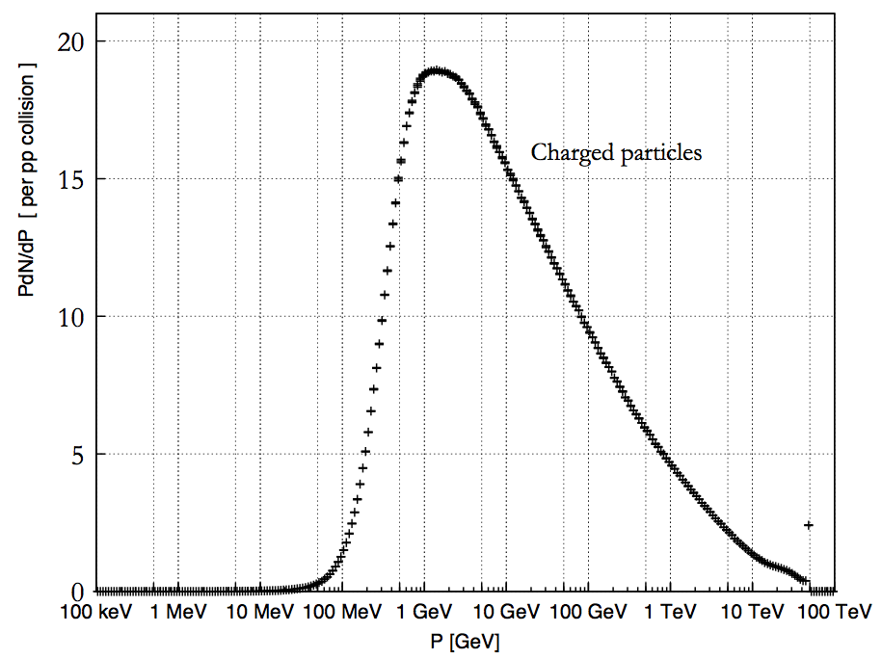
Occupancy
Occupancy map from Ilaria
Notes:
----- Meeting Notes (27/10/16 14:59) -----
disk projection
ask which prjection ilaria used
check if integrated over time
16 Nov next FCChh meeting

Slide 20
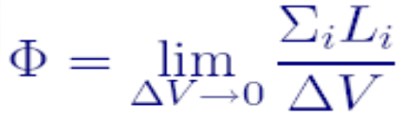
  Independent of the orientation of the surface
  http://www.fluka.org/content/course/NEA/lectures/Scoring.pdf
  Original map interpolated to obtain more precise values
Irradiation map provided

Slide 21
1) Constraints from fluence on detector granularity
Given the fluence map, what is the minimum granularity needed in each part of the detector, to make sure there will be only one particle firing a pixel?
Assume we need the occupancy <=0.01 (to be reviewed)
Assume cluster size due to difussion = 1
Assume # Pile up interactions per bunch crossing =1100
# particles per unit area, per pp collision
# hit pixels per perpendicular particle
Occupancy = Fluence * Pile up * PixelArea * ClusterSize(Diffusion)
per Bunch Crossing
# of pp collisions per Bunch Crossing (BC)
Cluster size has 2 components:
geometric:
diffusion:
included in the fluence calculation
assumed to have no diffusion (size=1)

Slide 22
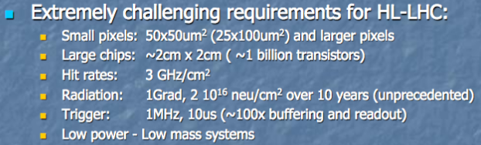
RD53
https://indico.cern.ch/event/527359/contributions/2158545/attachments/1278486/1898346/LHCC_status_report_2016_v5.pdf

Slide 23
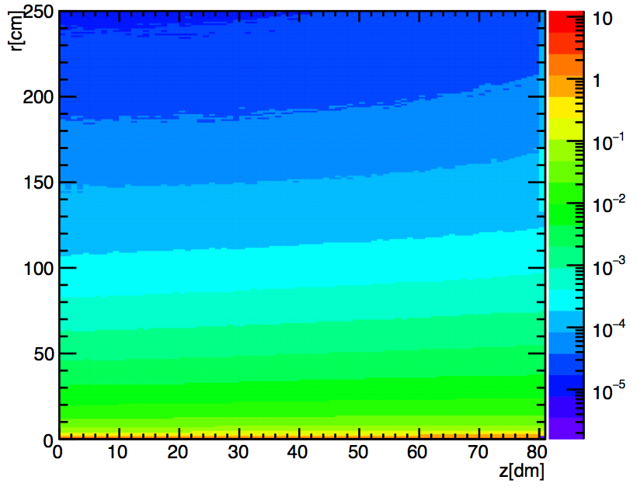
Irradiation Map [cm^-2] (original)

Slide 24
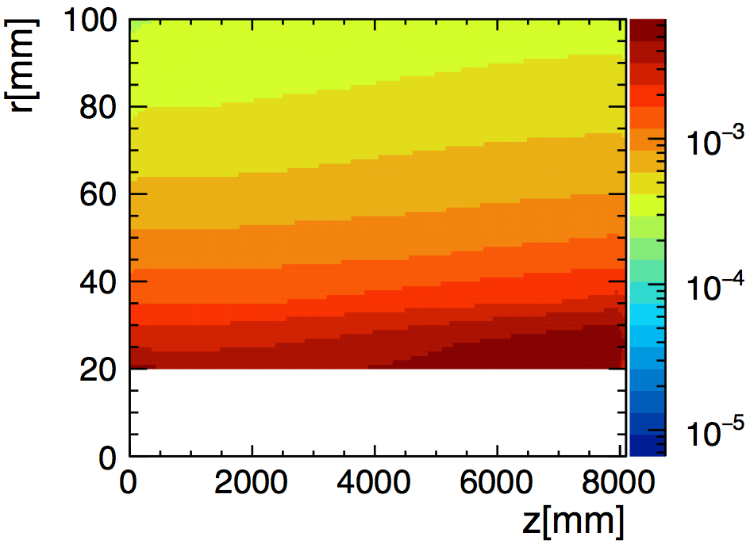
Interpolated Irradiation Map [mm^-2] (zoom in low R, full Z, removed beampipe area)
increases with z

Slide 25
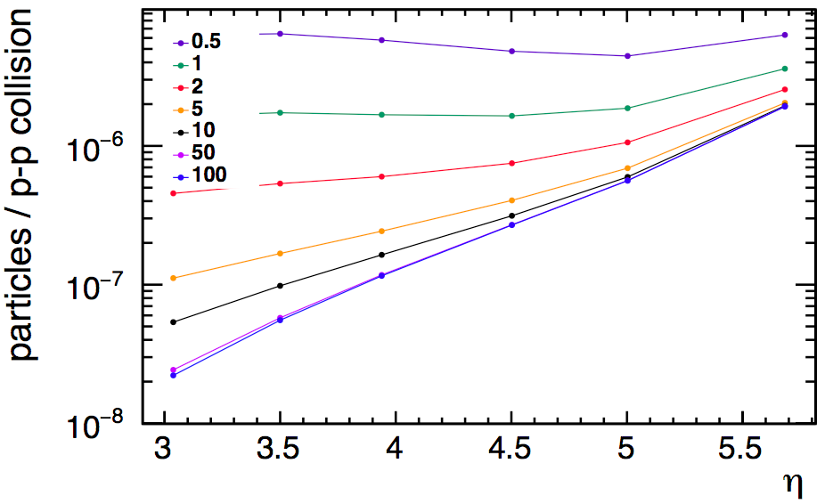
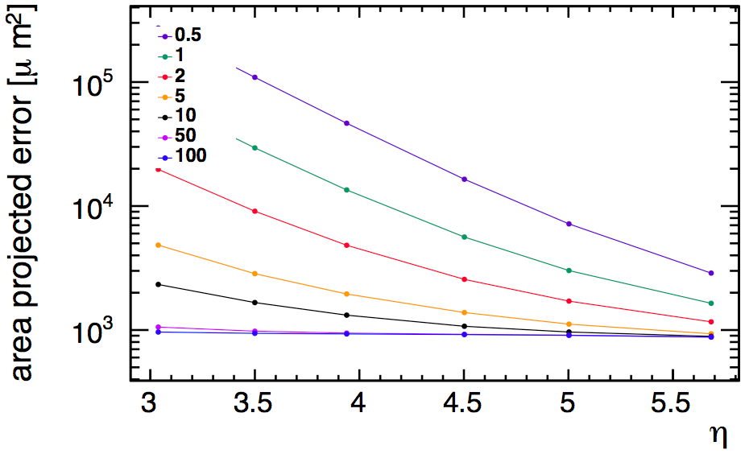
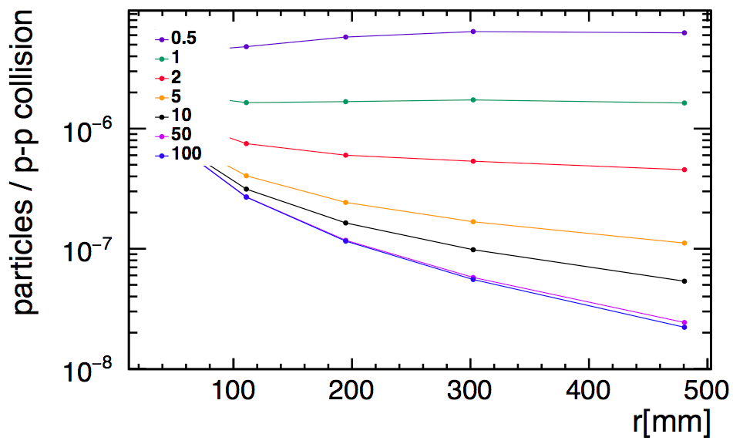
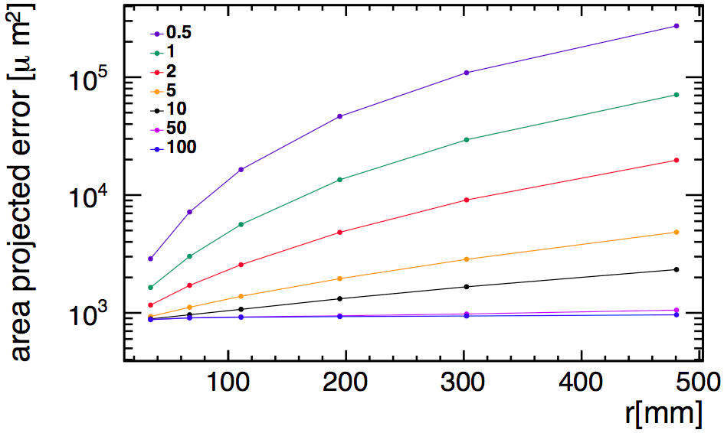
σ(fwd layers)=25x25
1 middle layer
versus eta
pile up=1100
EllispeArea
“Occupancy”
versus radius at last encap layer
pile up=1100
EllispeArea
“Occupancy”
PRELIMINARY

Slide 26
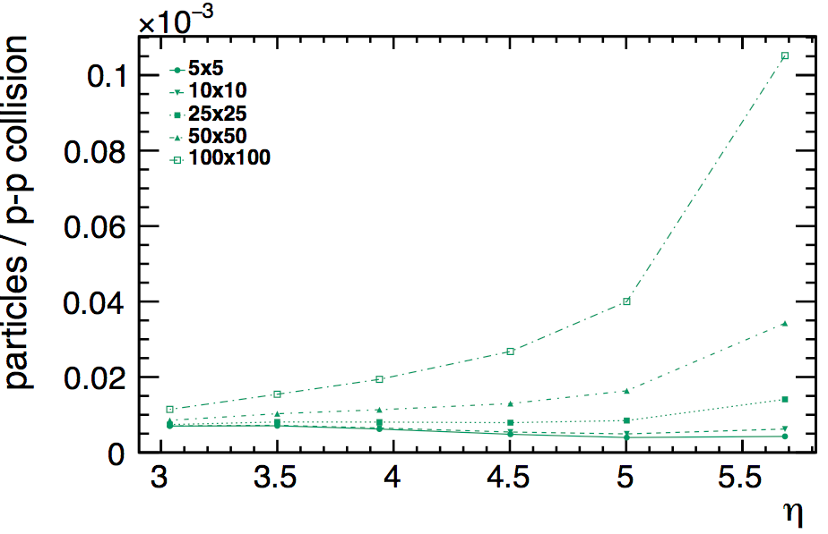
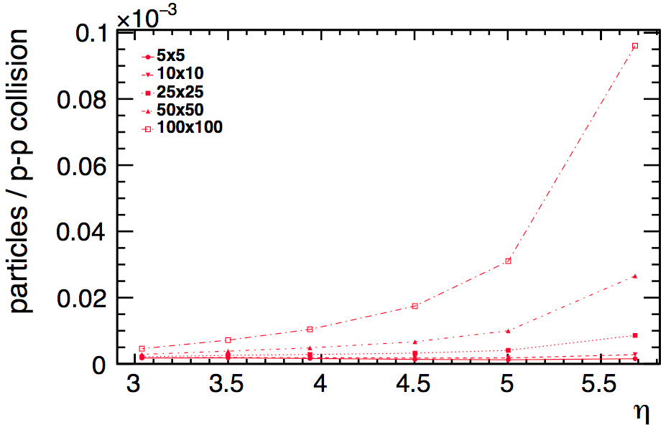
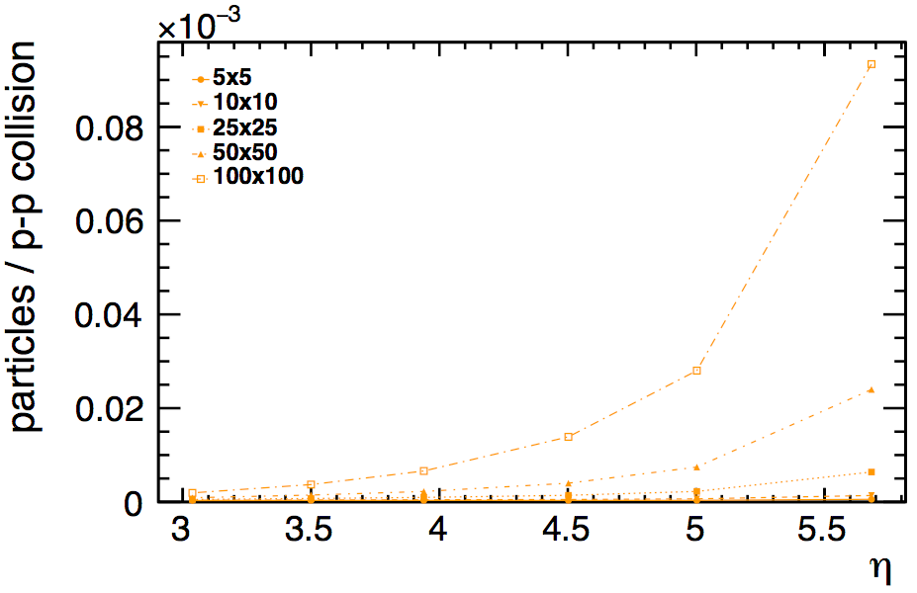
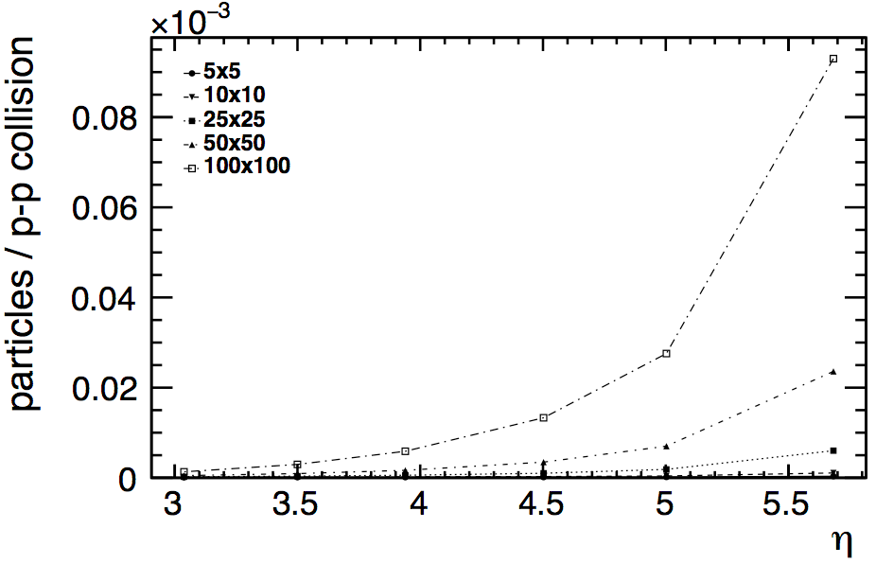
occupancy dependence with the angle
Occupancy
pT
Single point resolution
Eta
Gap distance
pT=1 GeV
pT=2 GeV
pT=5 GeV
pT=10 GeV
pile up=200
pile up=1100

Slide 27
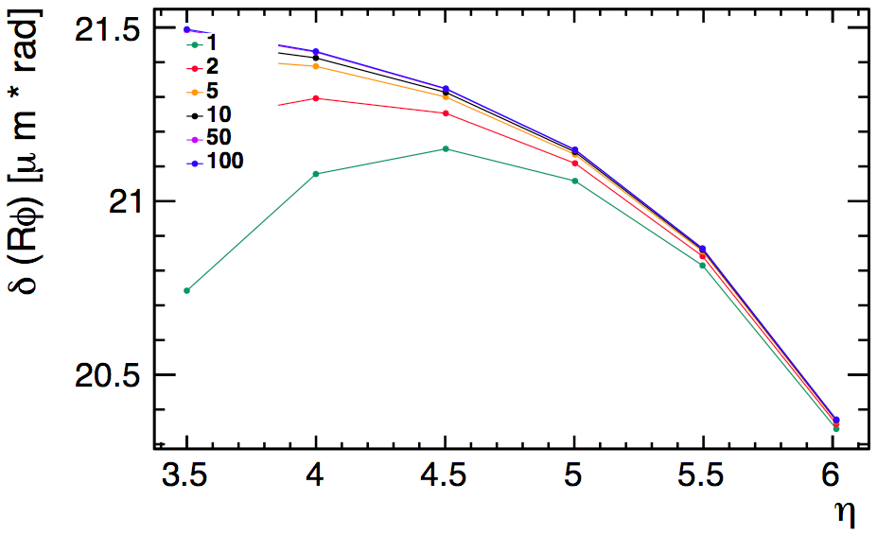
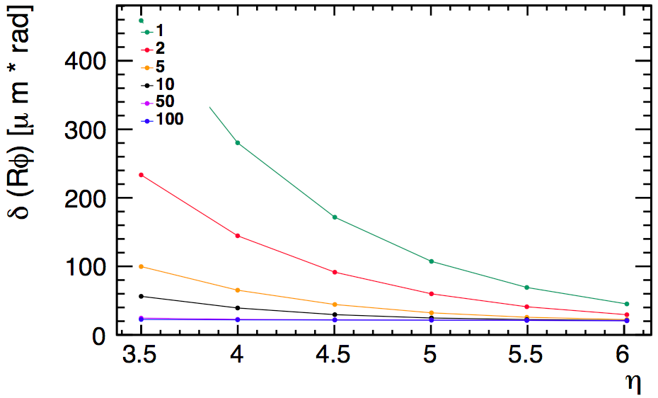
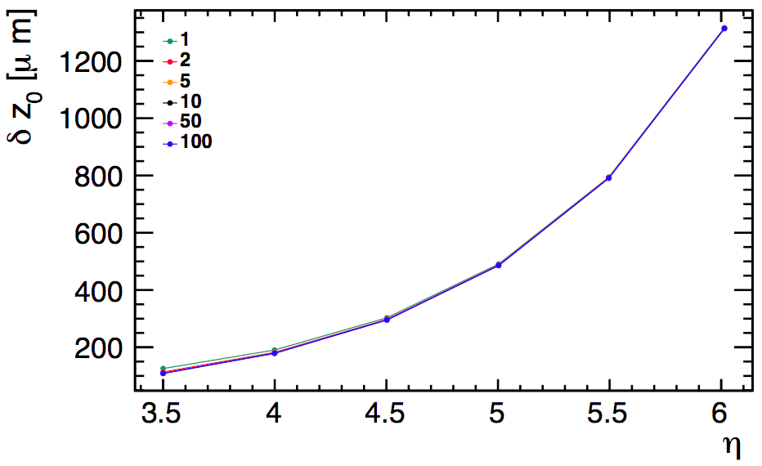
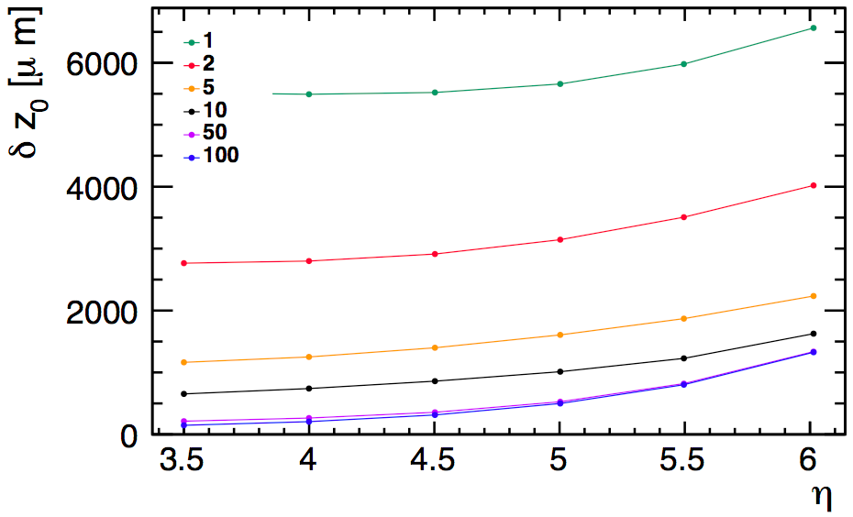
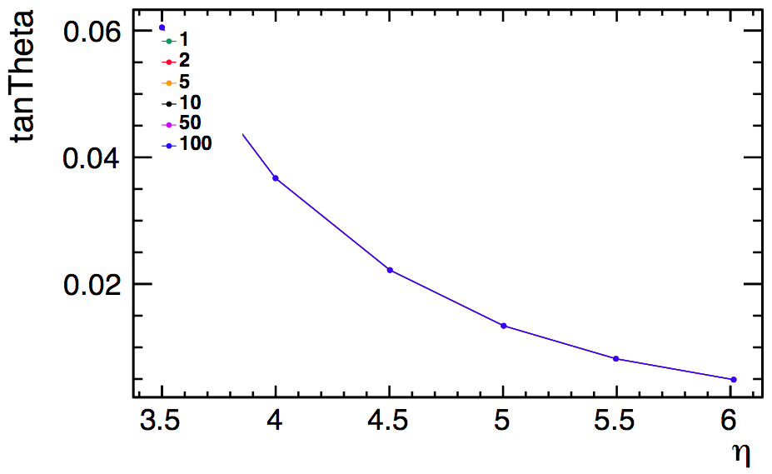
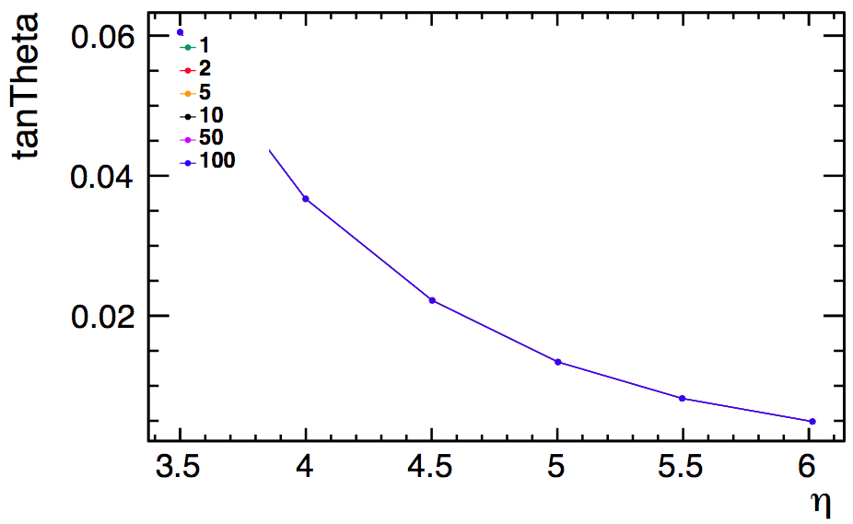
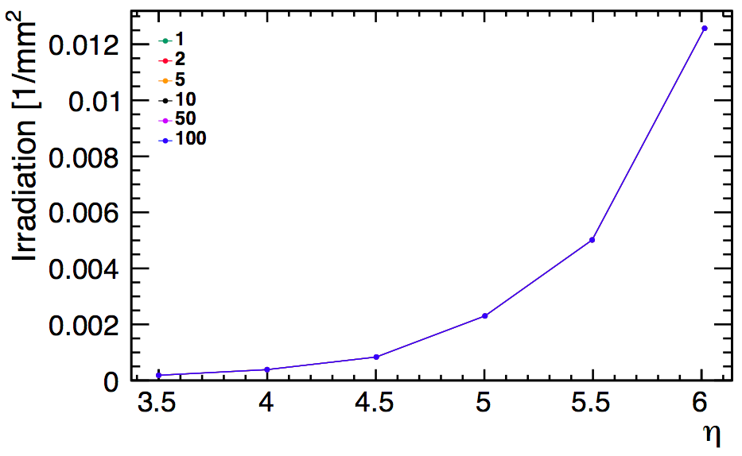
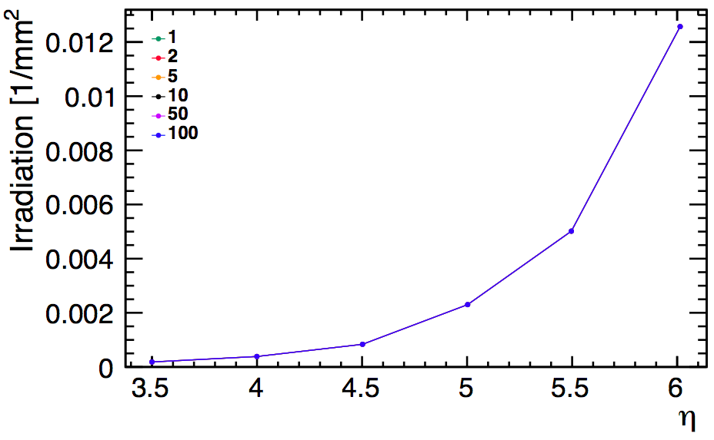
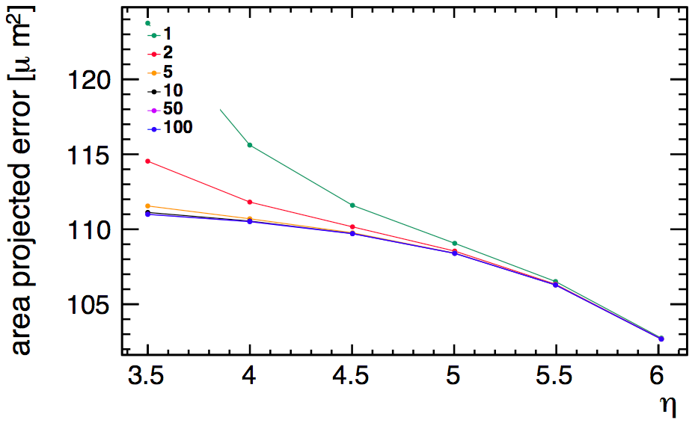
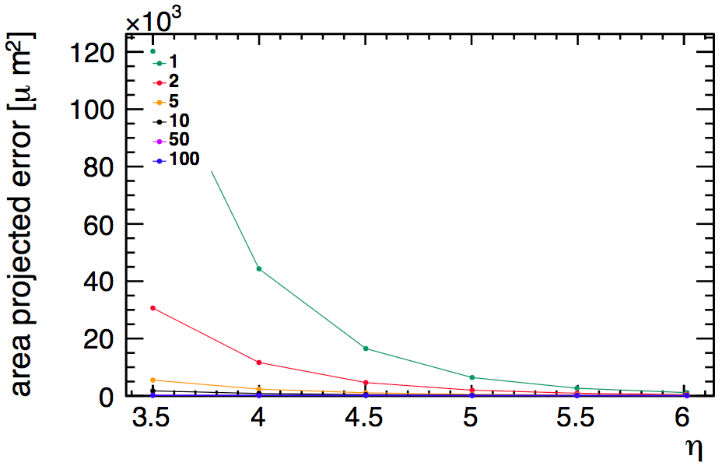
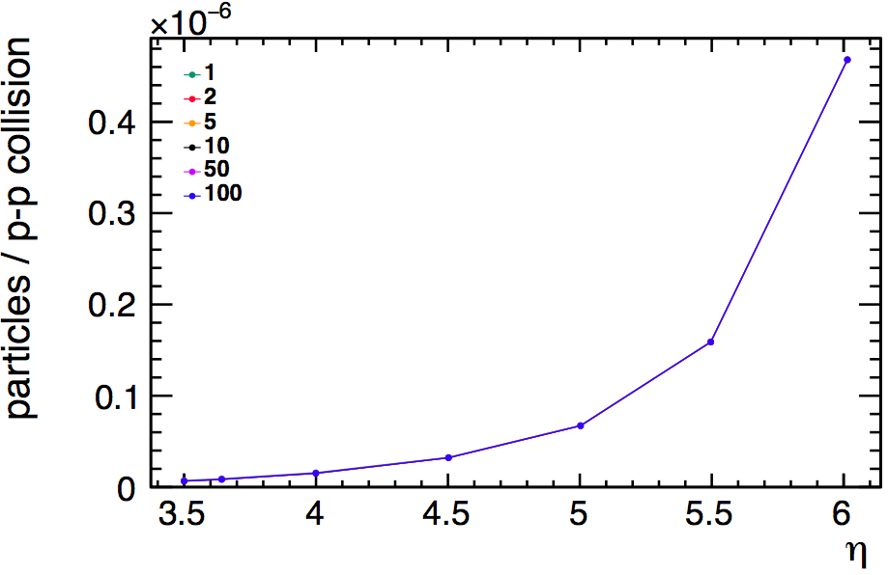
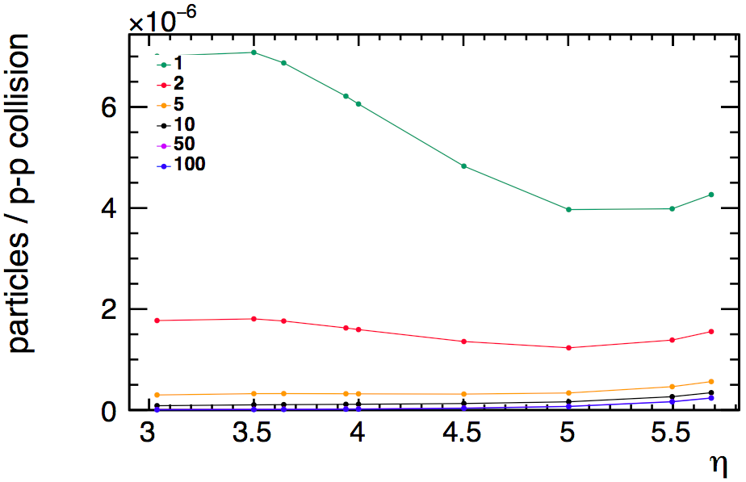
NO MultipleScattering
MultipleScattering
Cross-checking area and occupancy calculations
pT [GeV]
pT [GeV]
δ RPhi
  A= ¼ * π * res(Rphi) * res(z) * tan(theta)
δ z0
Occupancy = Irradiation[mm^-2] *
10^-6 [mm^2 / um^2] * Area [um^-2]
NO MultipleScattering
MultipleScattering
tan Theta
Irradiation
Ellipse area
Occupancy

Slide 28
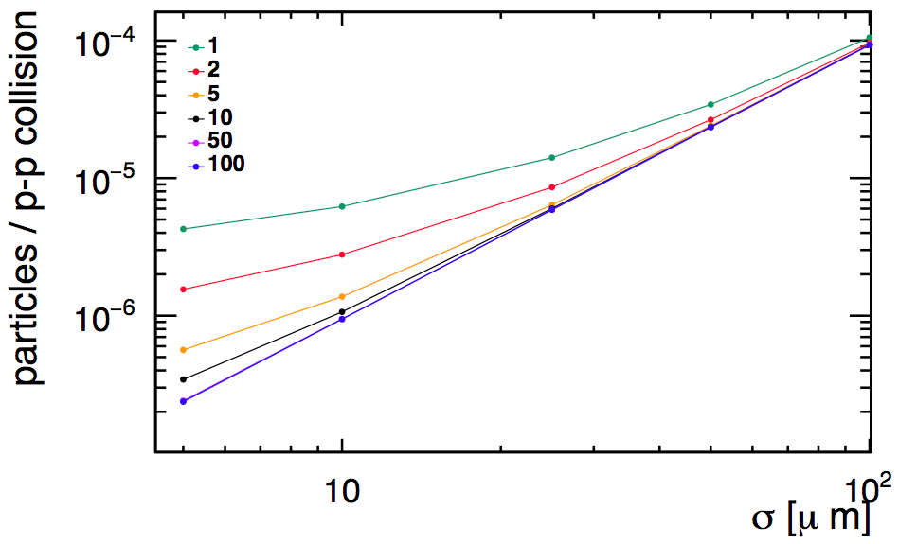
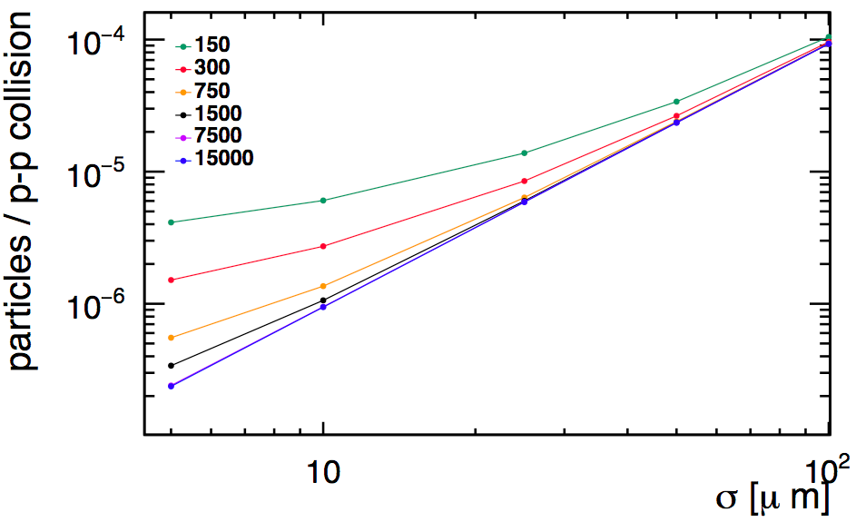
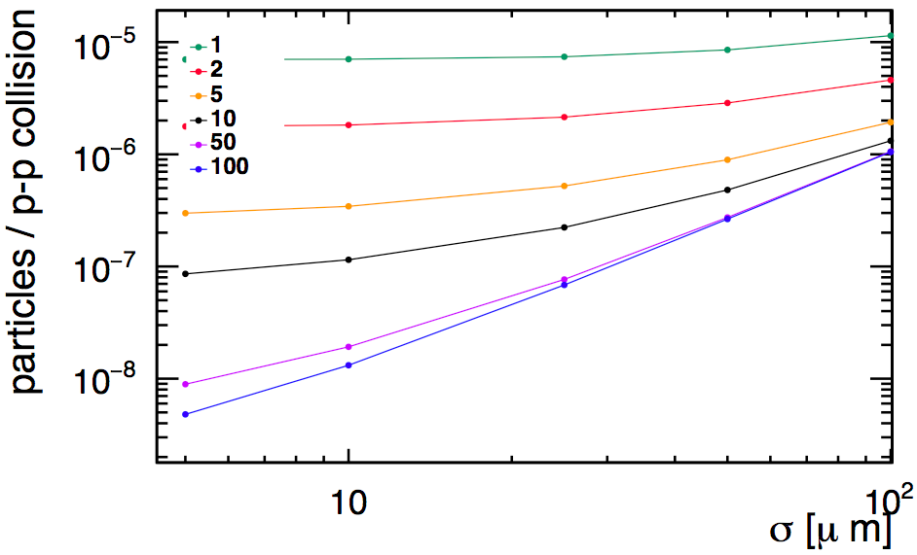
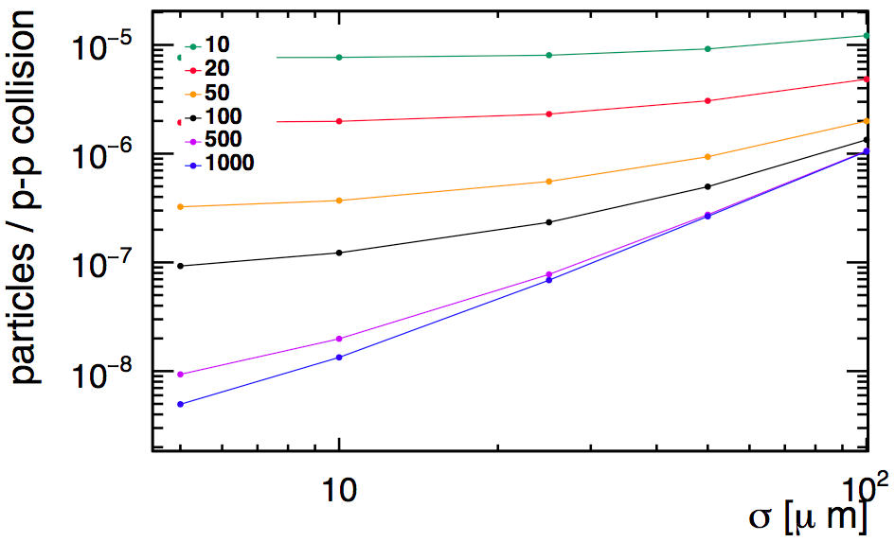
Cross-checking area and occupancy calculations
eta=-ln[tan(theta/2)] ; p=pT*cosh(eta)
pT
theta=0.39 deg ; eta=5.683
pT=1 GeV → p=146.9 GeV
p
pT
theta=5.49 deg ; eta=3.04
pT=1 GeV → p=10.45 GeV
p

Slide 29
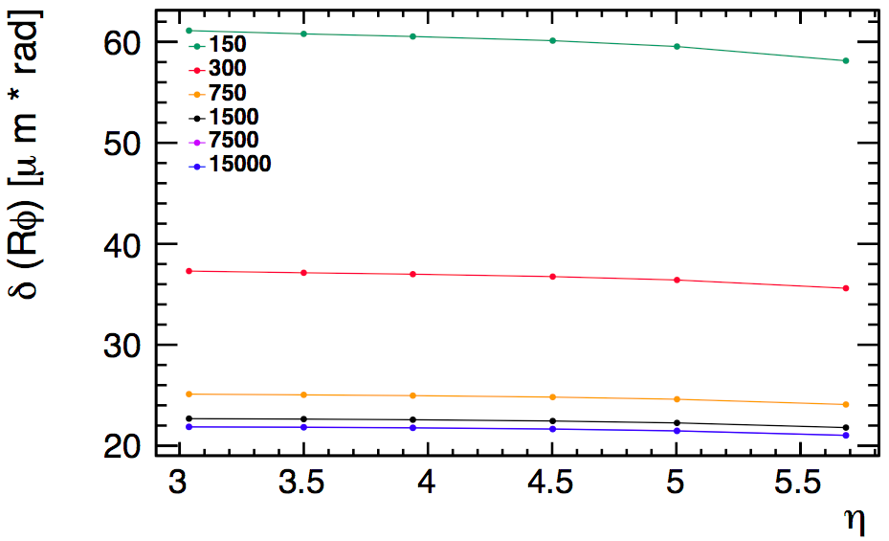
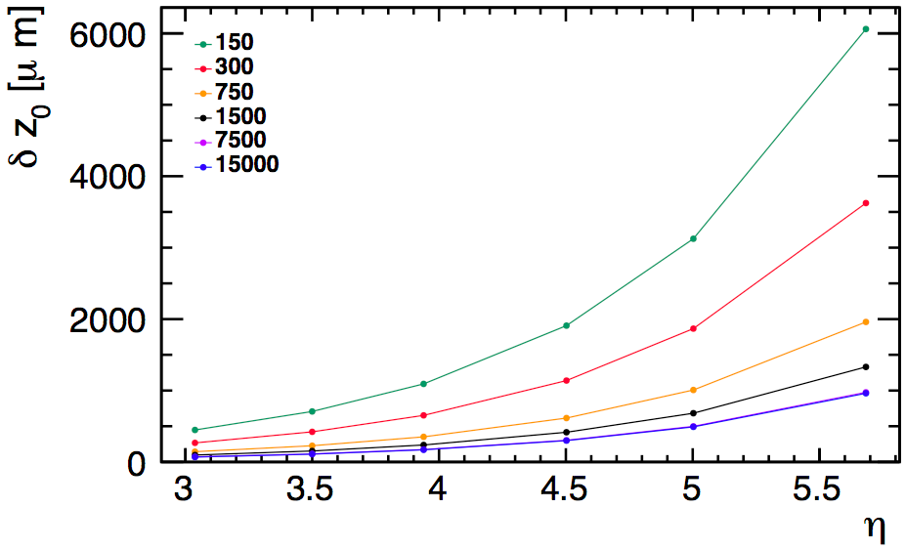
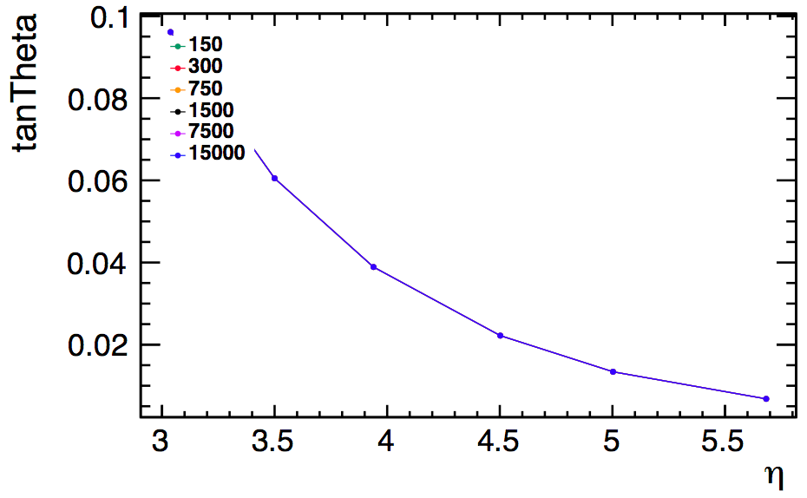
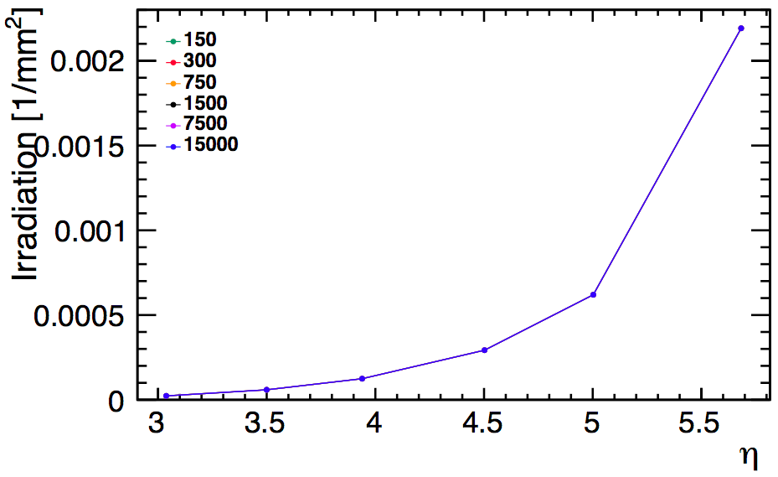
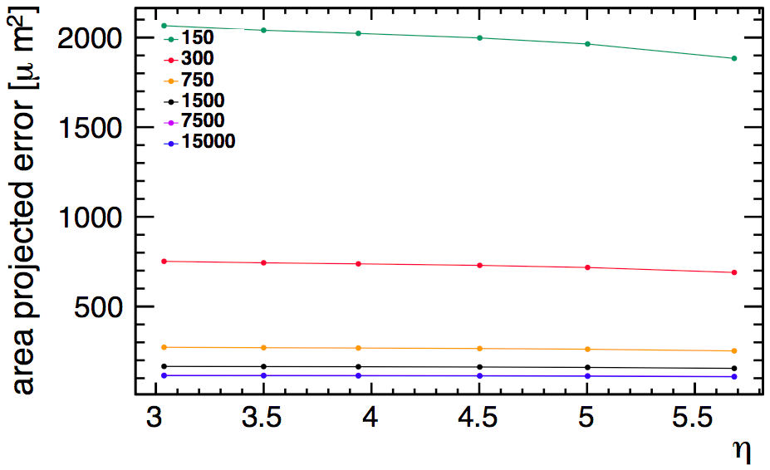

equivalent for eta=5.7
p
pT
Cross-checking area and occupancy calculations
p [GeV]
pT [GeV]
δ RPhi
  A= ¼ * π * res(Rphi) * res(z) * tan(theta)
δ z0
Occupancy = Irradiation[mm^-2] *
10^-6 [mm^2 / um^2] * Area [um^-2]
p
pT
tan Theta
Irradiation
Ellipse area
Occupancy

Slide 30



New baseline geometry from Zbynek: http://fcc-tklayout.web.cern.ch/fcc-tklayout/FCChh_Option3.v01
longer inner barrel layer,
lighter 1st and 2nd barrel (X/X0=0.5%, others 1.5%)
worse single point resolution assumed
Notes:
----- Meeting Notes (27/10/16 14:59) -----
check why worse resolution

