Slide 1
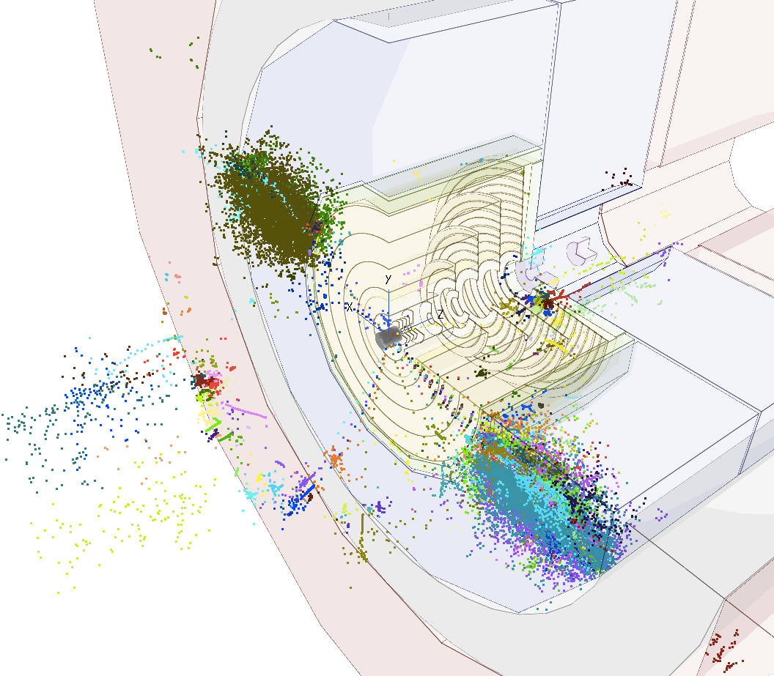
Tracking detector resolution and boosted objects
Dominik Dannheim (CERN),
Estel Perez (CERN), Philipp Roloff (CERN), Rosa Simoniello (CERN)
Special thanks to Zbynek Drasal (CERN), Valentin Volkl, Andre Sailer(CERN)
FCChh meeting , 14th December 2016

Slide 2
Introduction
Q: What is the requirement on the detector granularity given by our need to resolve close-by hits from decays of very boosted particles?
Check in the simulation, what is the distance between the two closest hits
  We studied the benchmark signature of very boosted taus

Slide 3
Procedure
Generate di-tau events
  Very boosted: E_{tau}=10 TeV
  Central: 80 <θ_{tau}< 100 deg ( |η|<0.2 )
  Select events with at least one tau decaying to 3-prongs (at least 3 charged pions in the event)
Use TkLayout geometry (from Zbynek) compact file + install DD4Hep drivers from Valentin to CLIC New SW chain (NEW!)
Simulate events using CLIC new SW
Calculate minimal distance between two hits
  Require the two hits to be in the same layer, produced by two different charged pions

Slide 4
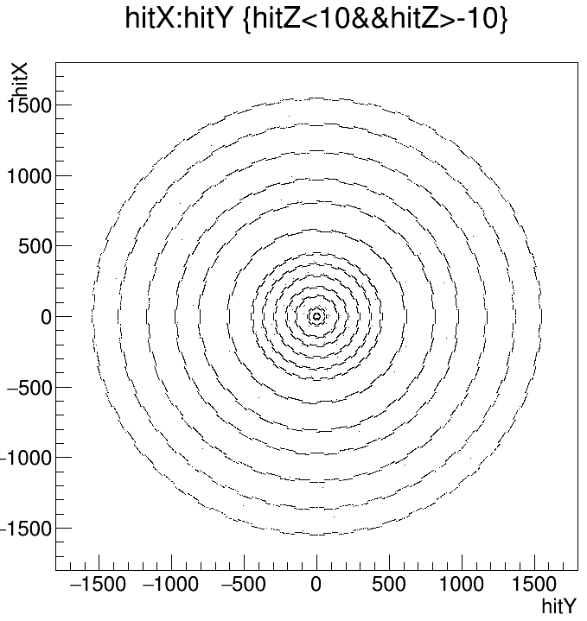
Geometry used
Position of all the hits in all events
140k events
Does not correspond to the latest version of the geometry, but differences are not very relevant for this particular study.
(only the position R(x,y) of the layers matters (and the material), but not its resolution

Slide 5
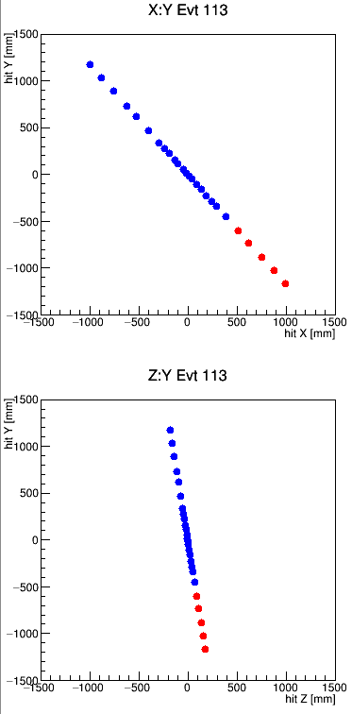
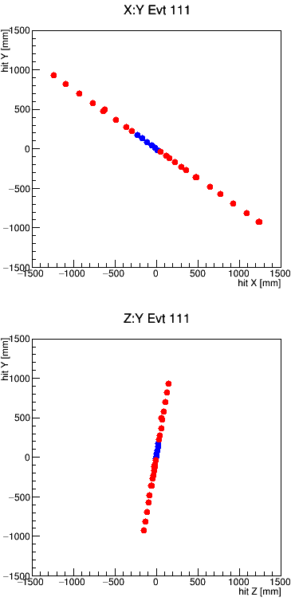
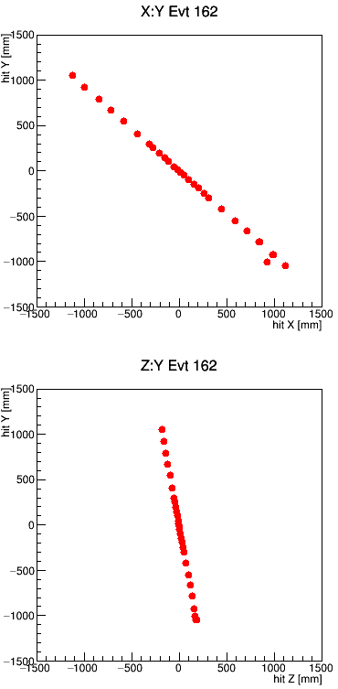
Event Displays
hits from a tau
hits from a charged pion
They look like single points but some of these are actually 3 very close-by hits
Sometimes the tau decay is very displaced→ effect of vertex displacement will be convoluted with effect of opening angle of the decay products, when calculating the distance between hits

Slide 6
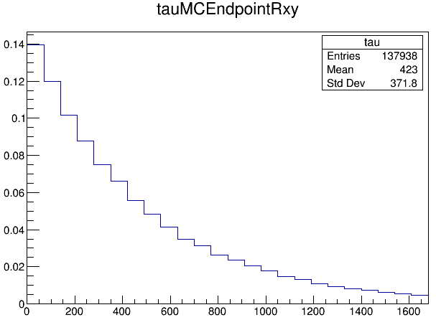
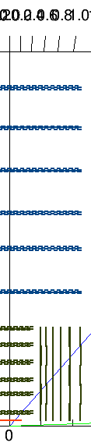
Tau displacement
Less than 14% of the taus decay before the 2nd vertex layer
fraction of the taus
-> To study only the effect of the opening angle, require that the tau decays before the first layer
Tracker
(6 layers)
Vertex
(7 layers)
tau endpoint position R(x,y) [mm]

Slide 7
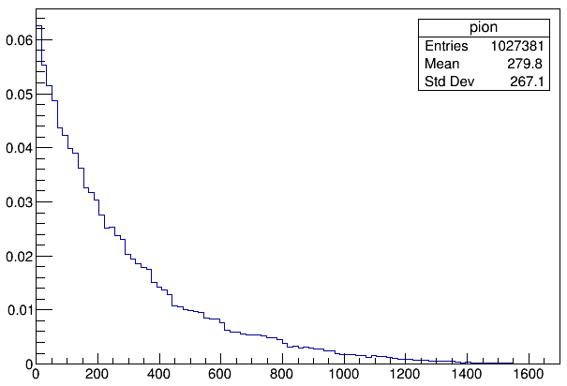
Selection
Origin of the pions hitting any of the layers
Hits from charged pions
  pdg=+/- 211
  status==1
Consider pairs of hits in the same layer (study layer by layer)
From different MCParticle
To disentangle the effects of the tau displacement, Require that the pion originates before the beam pipe (R(x,y)<20mm)
Calculate 3D distance between two hits (for eache layer)
  Since in the same module -> distance on the module plane
  Any direction (not projecting to Rphi-Z coordinates). (Next Step)
Compare this distance to the pixel pitch
require the tau to decay inside the beampipe => 4% of cases
(one entry per hit, area normalized to unity)
pion origin point position R(x,y) [mm]

Slide 8
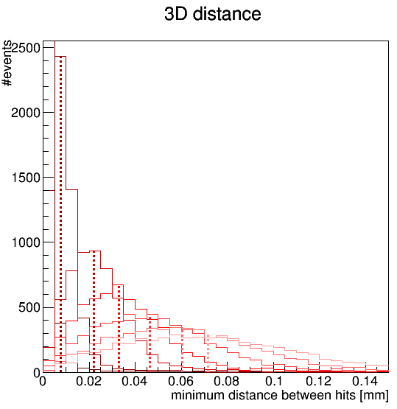
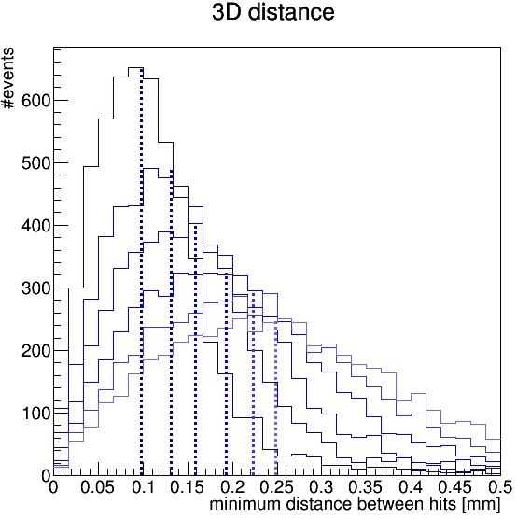
minimum 3D-distance between hits
The peak of the distance distribution shifts with the radius of the layer
Vertex layers
Tracker layers
layer1
layer2
layer3
layer4
layer5
layer6
layer7
layer1
layer2
layer3
layer4
layer5
layer6
vertical lines for visual help only
layer3 (layer4) peak at about 22um (33um)
layer1 (layer3) peak at about 100um (160um)
requirements from occupancy studies:
10x15 um single point resolution
= 52x34 um pixel pitch (area=1800um²)
5000x10 um single point resolution
=17320x34 um pixel pitch (area=0.6mm²)
The two closest hits would end up in the same pixel in some of the layers
Notes:
----- Meeting Notes (8/12/16 14:39) -----
worst case barrel,
disentangle flight distance and angle
try endcap
fraction of aus that can be resolved as function of decay length

Slide 9
Considerations
Being able to resolve all 3 charged pions from the decay of a 10TeV tau would require higher granularity in most of the layers
  Not only need to have the particles in different pixels, but also in different clusters
  Need to project to Rphi-Z coordinates (next step), to know the actual requirements
To be able to reconstruct the pion’s tracks, no need to resolve the hits in ALL layers
  minimum number of layers will depend on your tracking algorithm
  On the other hand, for the very displaced taus requirements will be tighter.
To be able to identify the tau, no need to always resolve the 3 prongs
  At the analysis level one would look also at other observables
We cannot make final conclusions on the required resolution only based on this study, but we can provide important information based on full simulation.

Slide 10
Summary & outlook
Calculated distance between 2 closest hits in each layer
  disentangled opening angle from decay length effects
New workflow used
  TkLayout geom -> dd4hep -> CLIC SW
  Thanks to Zbynek, Valentin, Andre, Rosa
  Can benefit from some of the full sim tools already existing in CLIC SW
  Once we add “helper surfaces” (next step) we’ll be able to project distances in Rphi-Z coordinates and run “truth” tracking
Other benchmark processes suggested by Michele:
  W jets, top jets, b jets, light jets uds, gluon jets
  need to consider flavour tagging algorithm

Slide 11
Backup

Slide 12
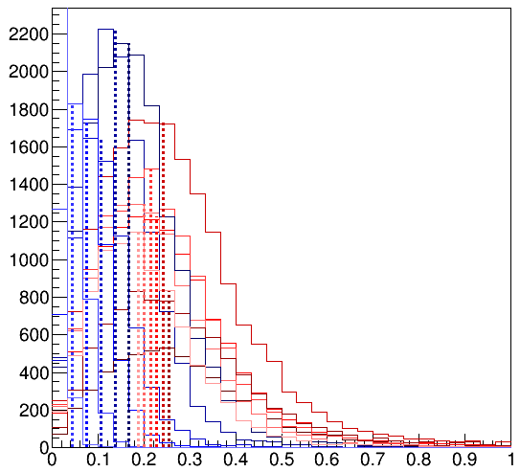
Distance at last layer vs tau decay length
vertex
tracker
distance between two closest hits in the last tracker layer
for tau decay happening:
before layer 1
between layer 1 and layer 2
etc…
layer1
layer2
layer3
layer4
layer5
layer6
layer7
layer1
layer2
layer3
layer4
layer5
layer6
If tau decays before the tracker, we could resolve the 3 prongs on the last layer with pixel pitch < 160um
PRELIMINARY
minimum distance between hits [mm]

Slide 13
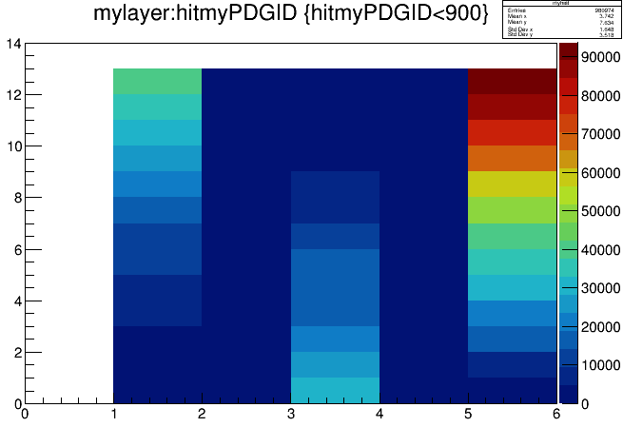
Number of hits in a layer vs particle creating the hit
layer
Tracker
(readout3)
Vertex
(readout2)
Innermost Vertex (readout1)
electron
muon
tau
photon
charged pion
Many taus decay after the first few layers → not so many pions in the first layer

Slide 14
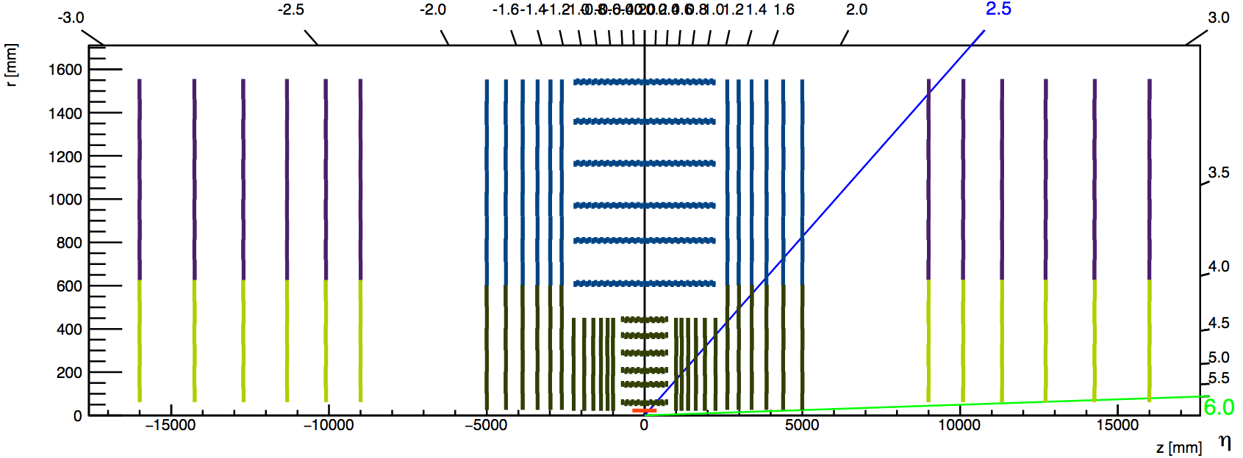
Proposal 1 (from occupancy point of view)
σ
7X5
15x10
5000x10
Need to review also where the transition to σ=10x100 should happen (consider also z0 and d0 resolution)

Slide 15
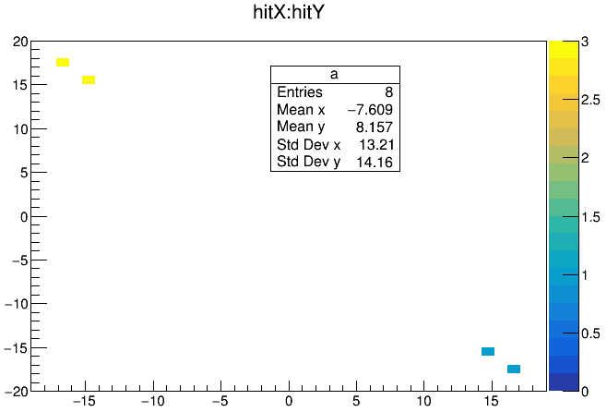
3-prong tau
(hitting 2 different modules)
1-prong tau
(hitting 2 different modules)

Slide 16
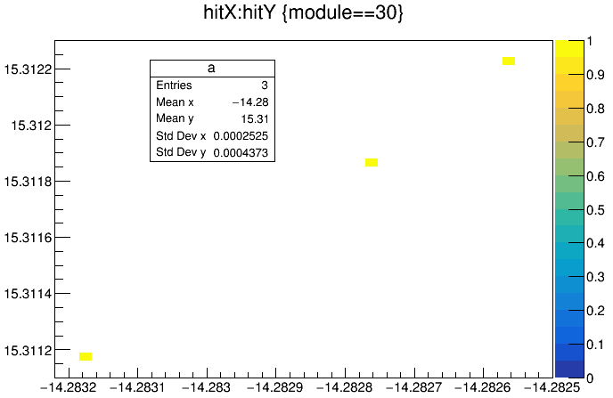
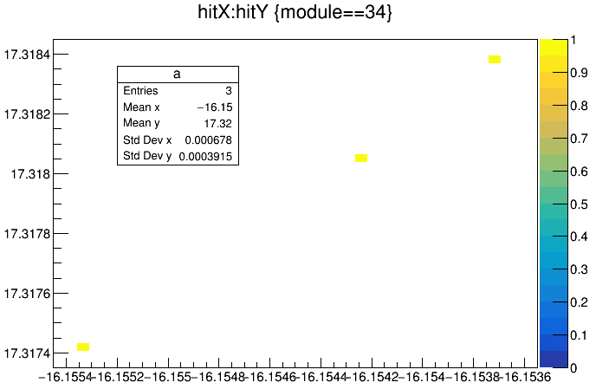
3-prongs of a tau
distance of the order of 10⁻⁵ mm

