Slide 1
Update on DECAL and some questions

Slide 2
Eta Dependency
For these studies I used the following in the barrel region
  50 Layers
  2.1mm W per later
  18um epitaxial thickness (sensitive region)
  1mm Air Gap
  XYZ segmentation of 50x50x50 um
  FCCSW 0.8pre
Varied the eta to 0, 0.5, 1.0, 1.5

Slide 3
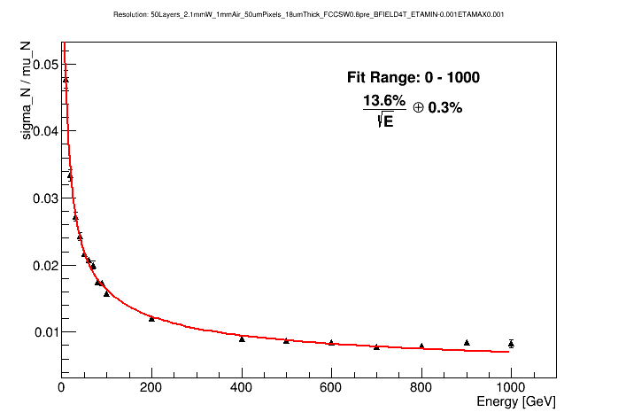
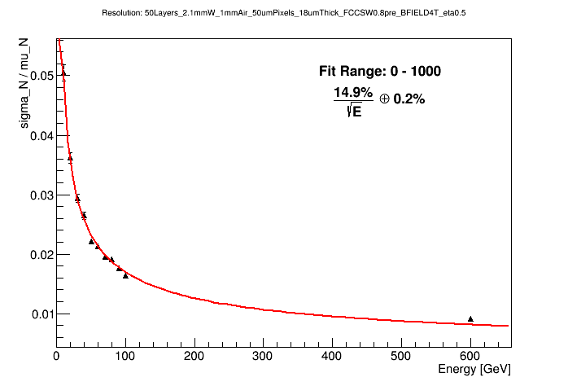
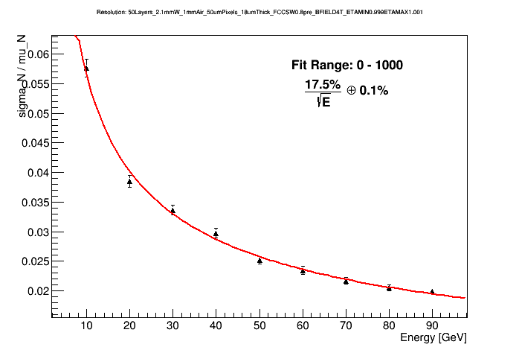
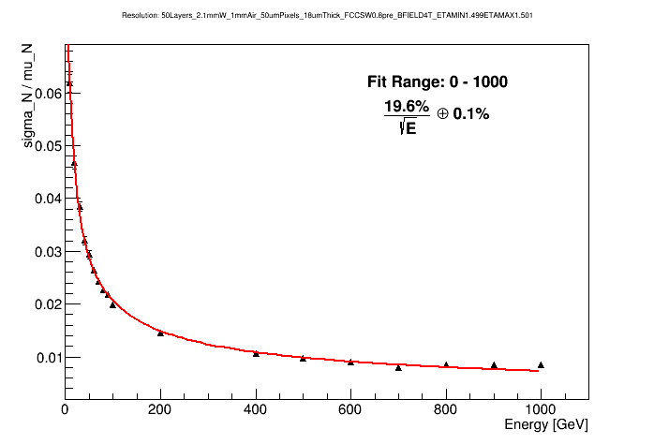
Eta Dependency
Eta = 0.0
13.6%/√E
Eta = 0.5
14.9%/√E
Eta = 1.0
17.5%/√E
Eta = 1.5
19.6%/√E

Slide 4
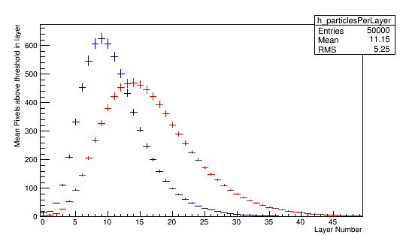
Eta Dependency
Eta == 0.0 Eta == 1.0
The additional material traversed by particles at larger eta changes the shower profile and affects resolution.
Need to compensate for this (added to the “to do list”)

Slide 5
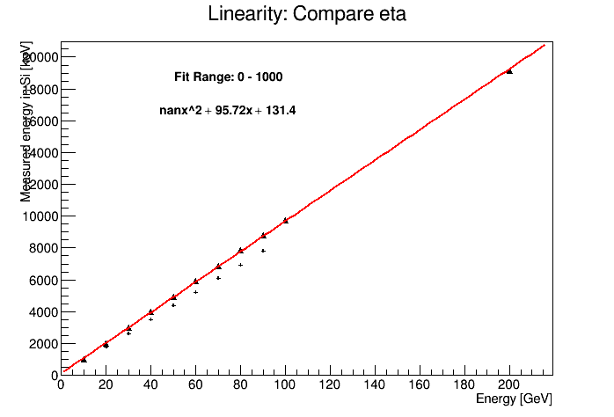
Eta Dependency
Triangles = 0
Crosses = 1.0

Slide 6
Reconfigurableness
Mentioned at previous meetings that we are also designing a DECAL sensor with 50x50um2 pixels which will be read out as a 5x5mm2 pad
The value returned from the pad is the number of pixels fired in that pad
Thus far in FCCSW I have written the code to do this as part of the DigitalCalorimeterSD class
As this is specific to only us (and some people at some time may want to run a DECAL) I am now working on removing this from the SD and doing it afterwards
With thanks to Anna I can now
  Simulate the DECAL with 50x50um2 pixels
  Read in off line and resegment the detector
  Store the number of hits in a pad (not the sum of energy)
Results are in agreement with the SD method

Slide 7
Options for detector other than FCChhBaseline
SiW DECAL be approx. 30cm deep (allowing for air gaps etc) 50cm allowing for volumes around it.
This could allow some alternative designs for the detector
  Fixed outer tracker radius, smaller ECAL outer radius, smaller detector as a whole, much reduced costs
  Fixed outer radius of ECAL, larger tracker, same size detector
The resolution of a pure pixel counting ECAL has been shown to be degraded relative to LArPb (as expected)
However, to harness the full power of the DECAL the detector would need to use PFA
Larger tracker could help to facilitate this.

Slide 8
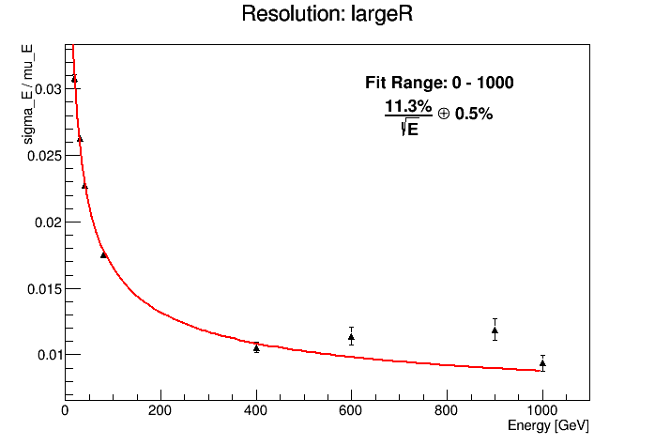
Effect of larger inner Radius of ECAL
Area to cover for the ECAL in MAPS increases due to radius
So does the number of channels
However, preliminary results show that the energy resolution of a DECAL is not degraded
Note: 0mm air used in this simulation, the resolution has not improved from previous slides
Question 1: What would the impact be on the tracker to extend its outer radius to 2.4m?

Slide 9
Particle Flow Algorithms
Current layout of the FCC-hh detector would not allow PFAs
Work in CLIC has demonstrated that above ~400 GeV jets, a conventional detector has better performance compared to PFA
I hope to talk to some PandoraPFA developers at AIDA-2020 this week for an update on this as study I found was from 2013.
Question 2: Are there and CLIC/PFA experts that could update this number for me?
Question 3: If the limit of PFA is 400 GeV then how often do we get jets with energies higher than this at FCC-hh from important physics channels?
PFA (for good reason is not implemented within FCCSW so we cannot directly study the impact for the DECAL
However, our resolutions are very similar to those achieved within iLCSoft for pixel counting DECAL. We will study the effect of PFA on both the DECAL and analogue SiW calorimeter in iLCSoft as feasibility study

