Slide 1
FCC-hh experiment
Integration procedure

Slide 2
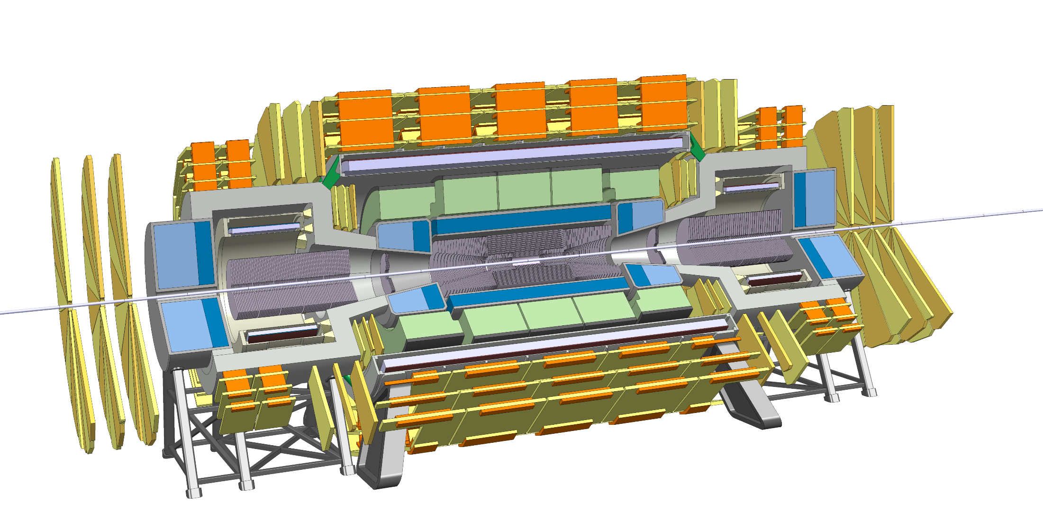
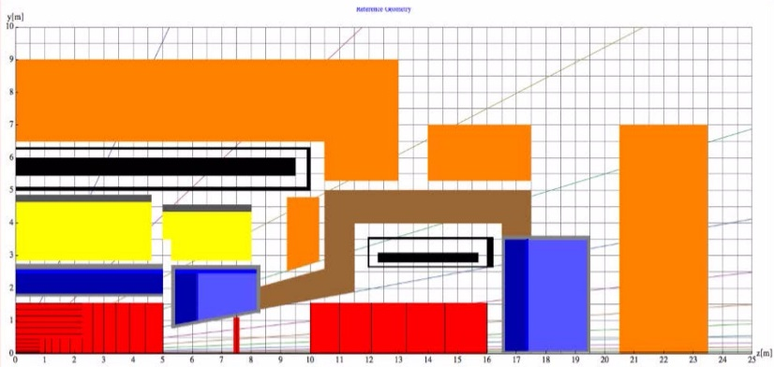
Detector overview
Changes:
  Inner tracker and forward tracker
  Inner and forward E-cal
  Force transfer between forward and main solenoids

Slide 3

Experiment integration

Slide 4
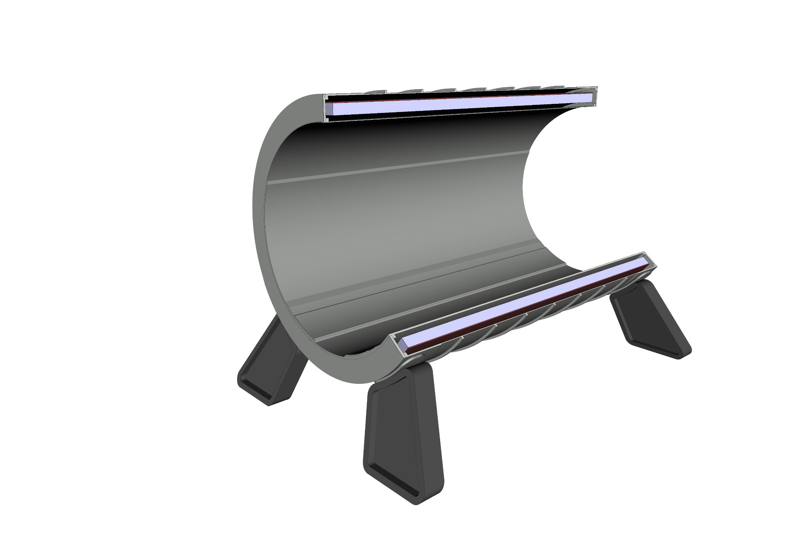
Experiment integration
1 - Install Central Solenoid

Slide 5
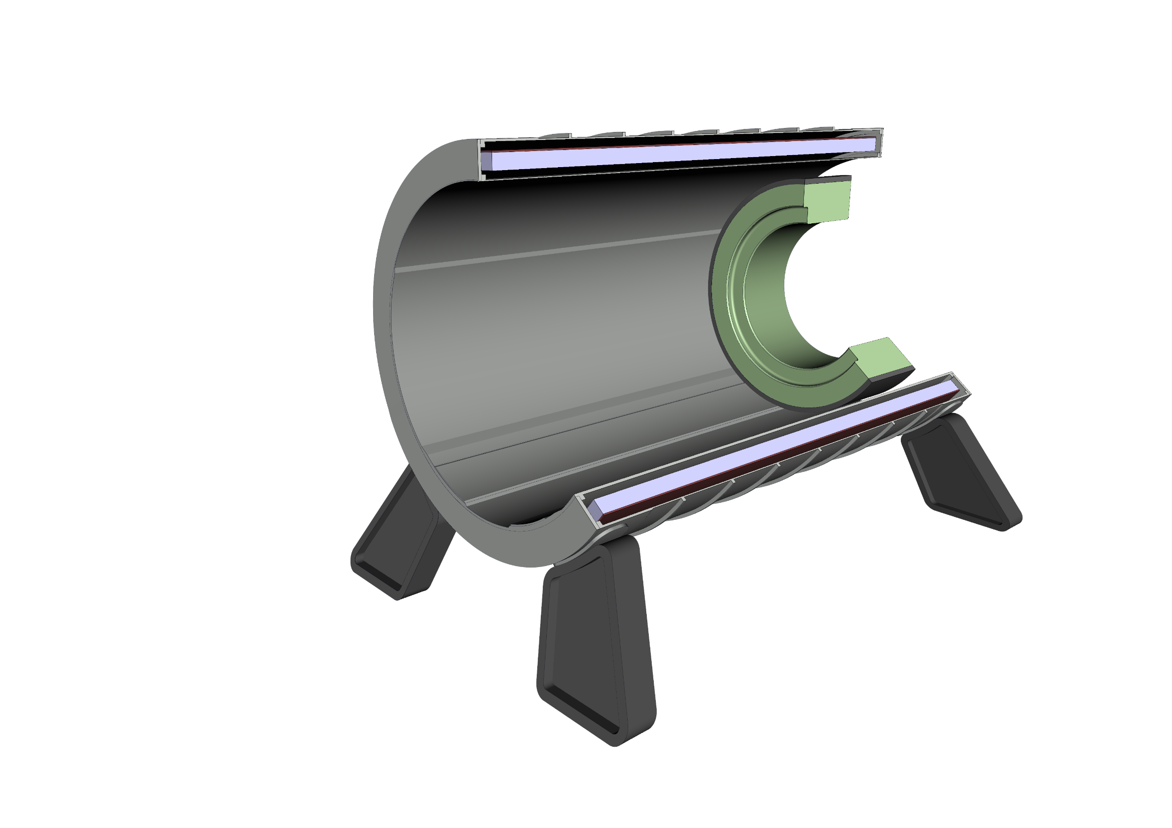
Experiment integration
2 - Install 1st HCal module

Slide 6
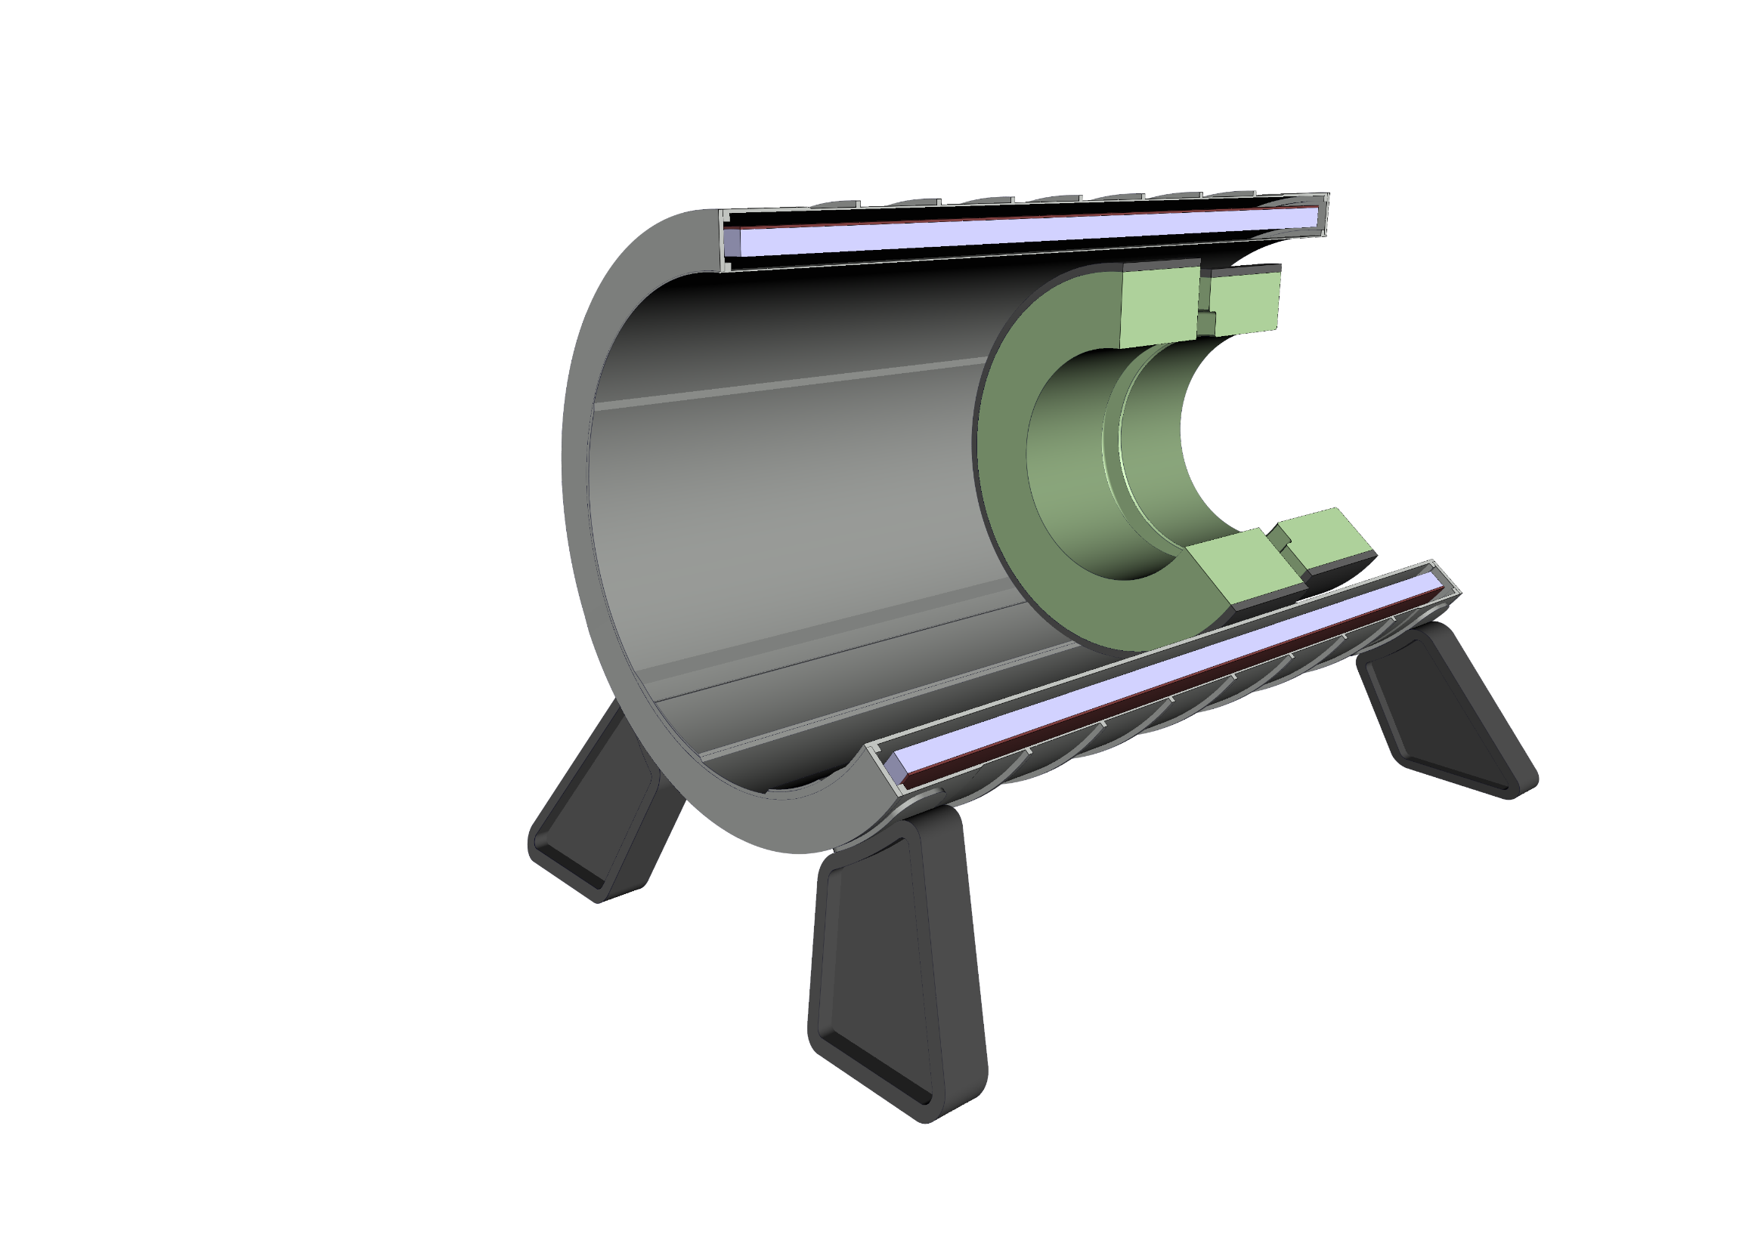
Experiment integration
3 - Install 2nd HCal module

Slide 7
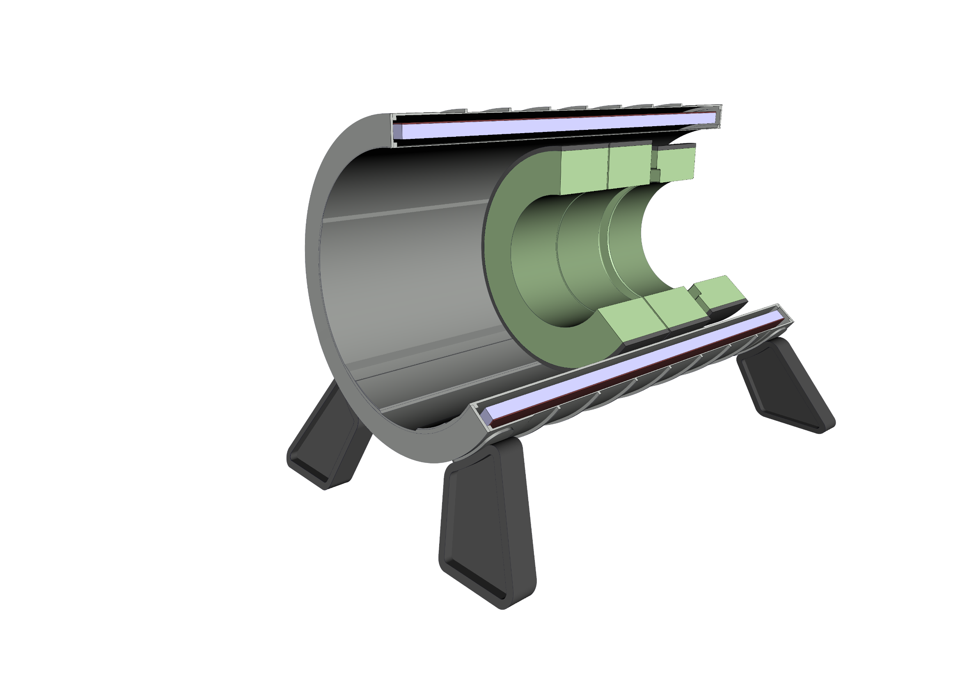
Experiment integration
4 - Install 3rd HCal module

Slide 8
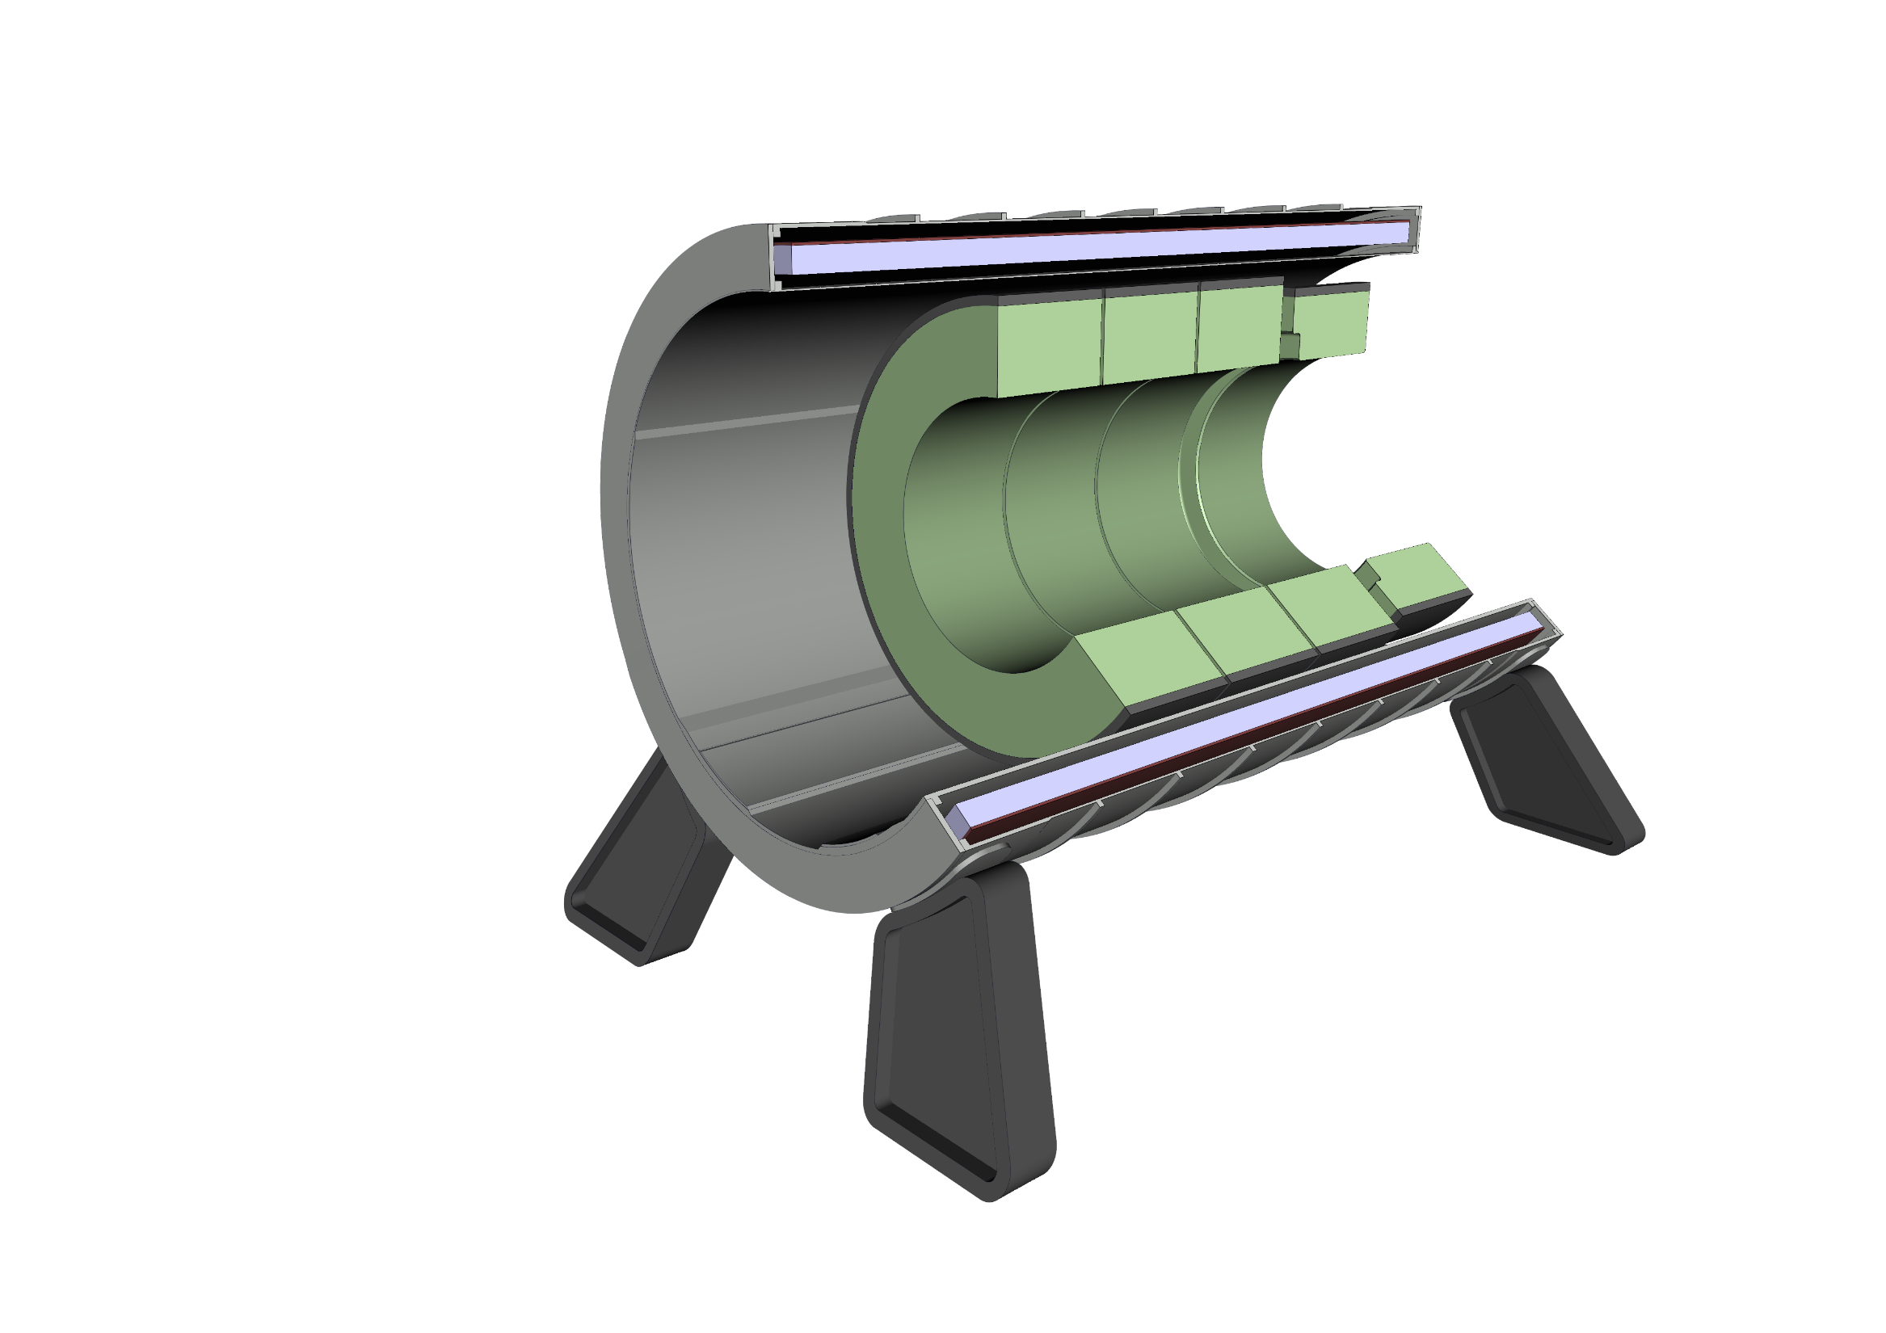
Experiment integration
5 - Install 4th HCal module

Slide 9

Experiment integration
6 - Install 5th HCal module

Slide 10

Experiment integration
7 - Install 1st ECal module

Slide 11
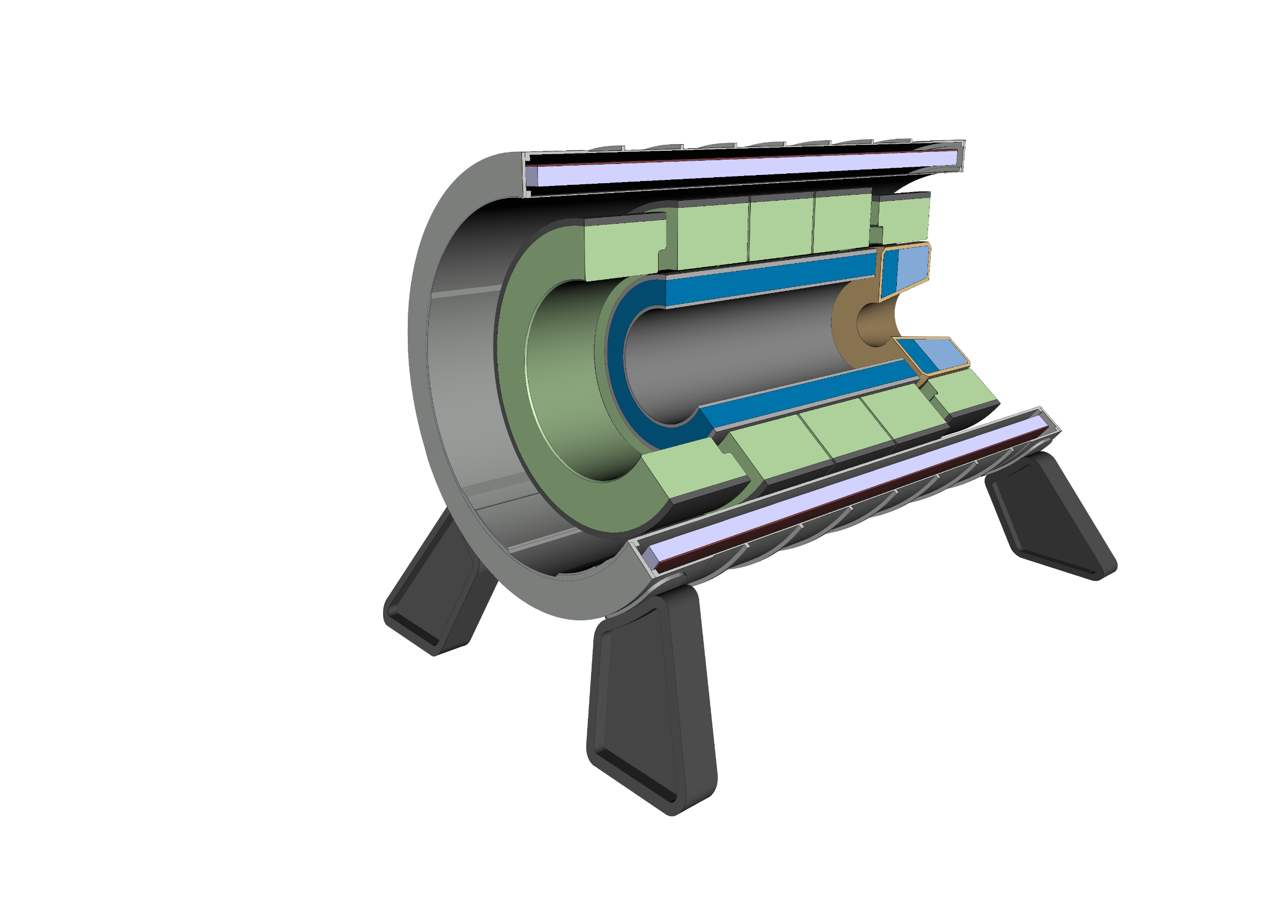
Experiment integration
8 - Install 2nd ECal module

Slide 12
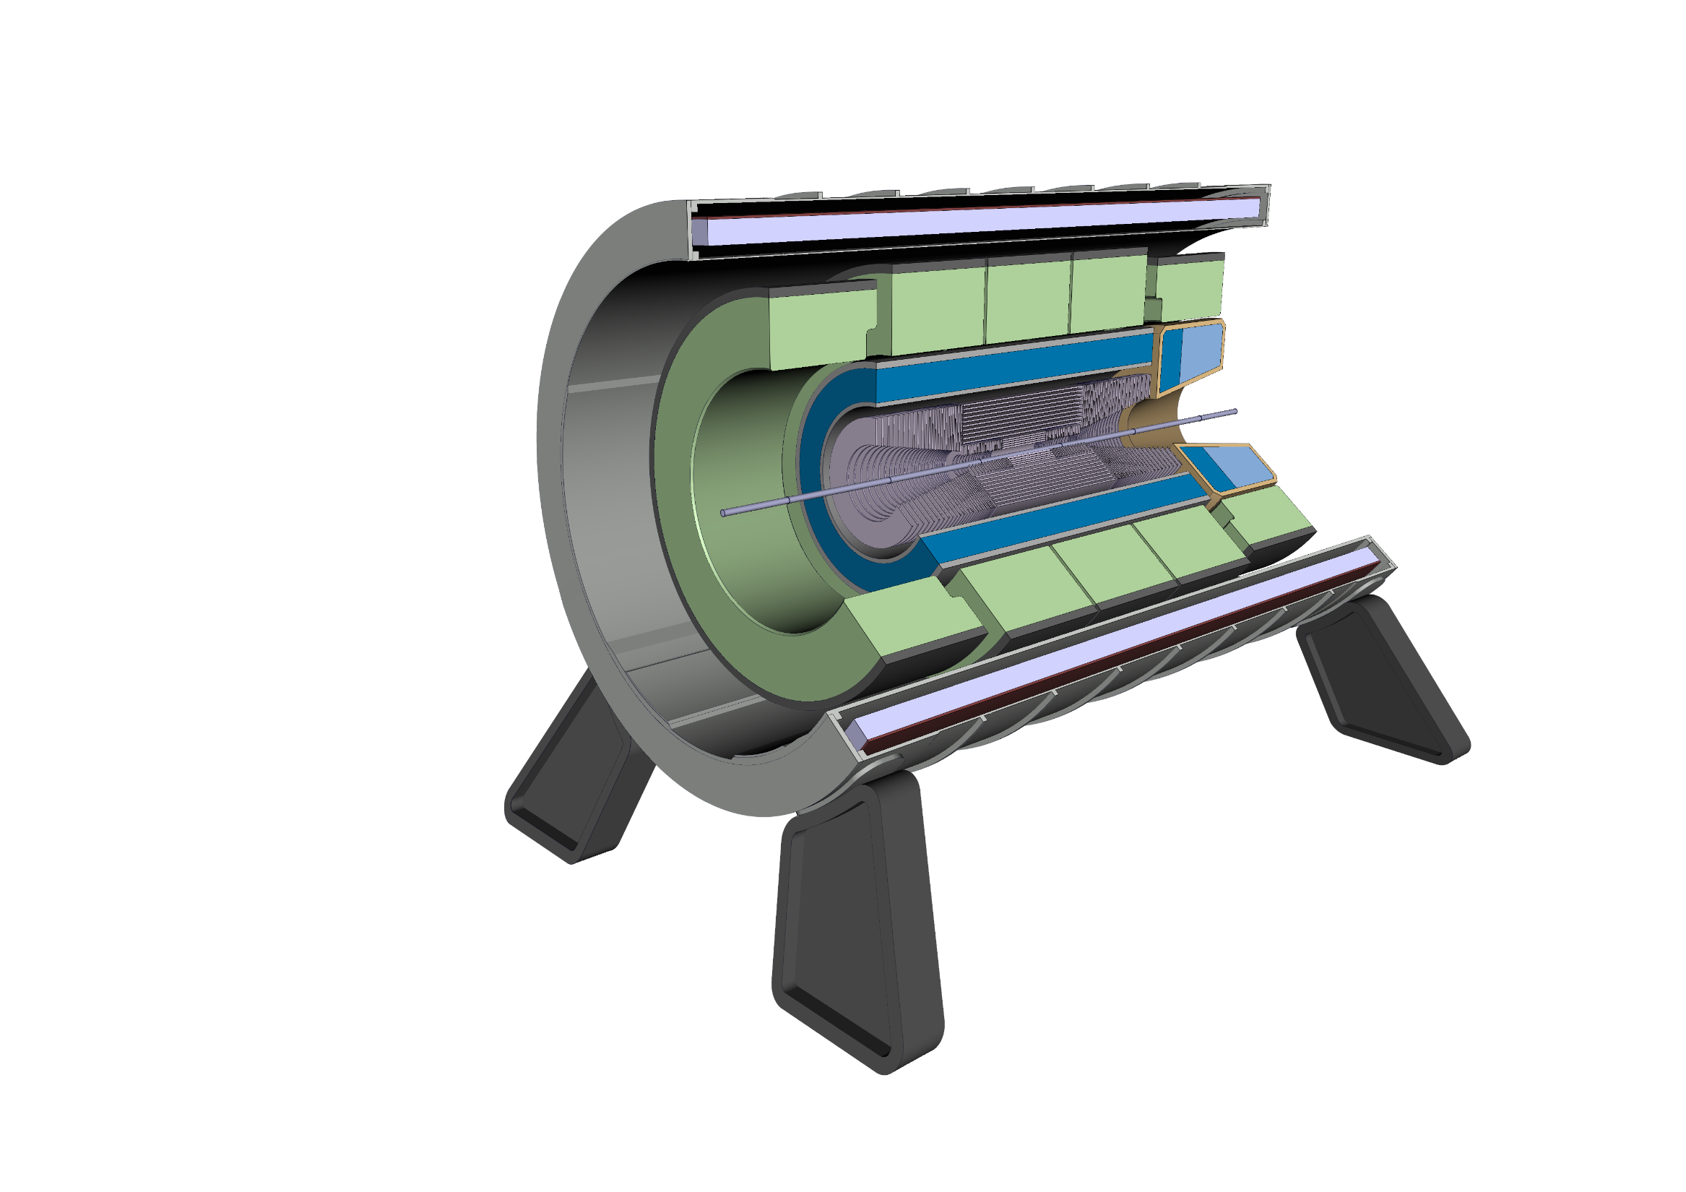
Experiment integration
9 - Install Inner Tracker

Slide 13
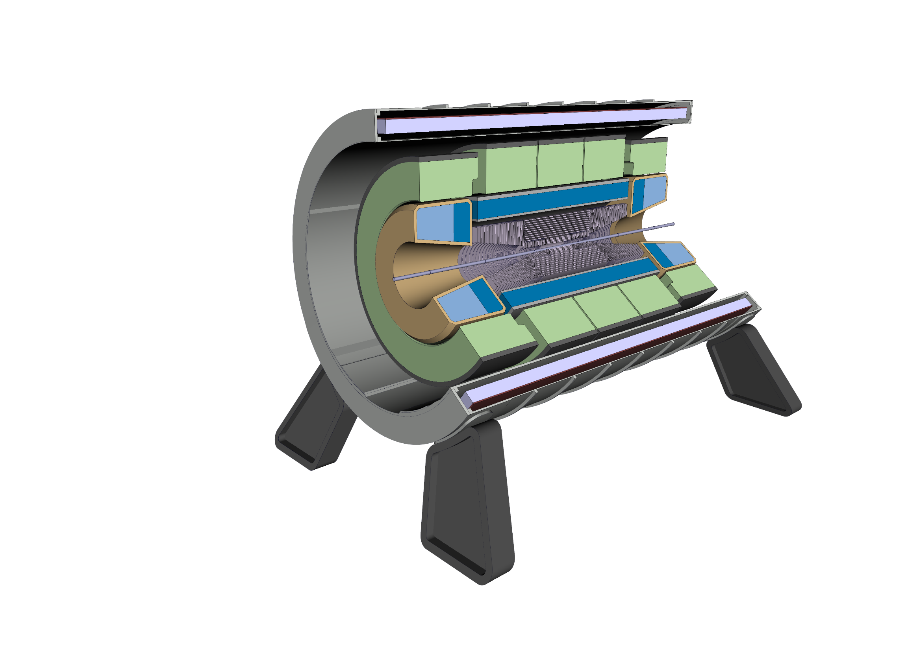
Experiment integration
10 - Install 3rd ECal module

Slide 14
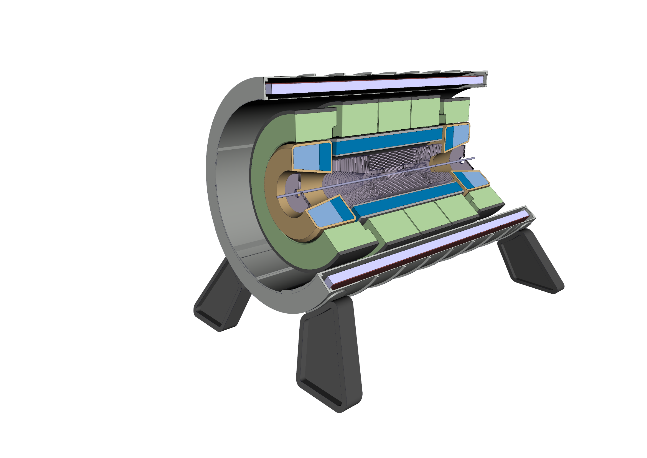
Experiment integration
11 - Install 1st Forward Tracker module

Slide 15
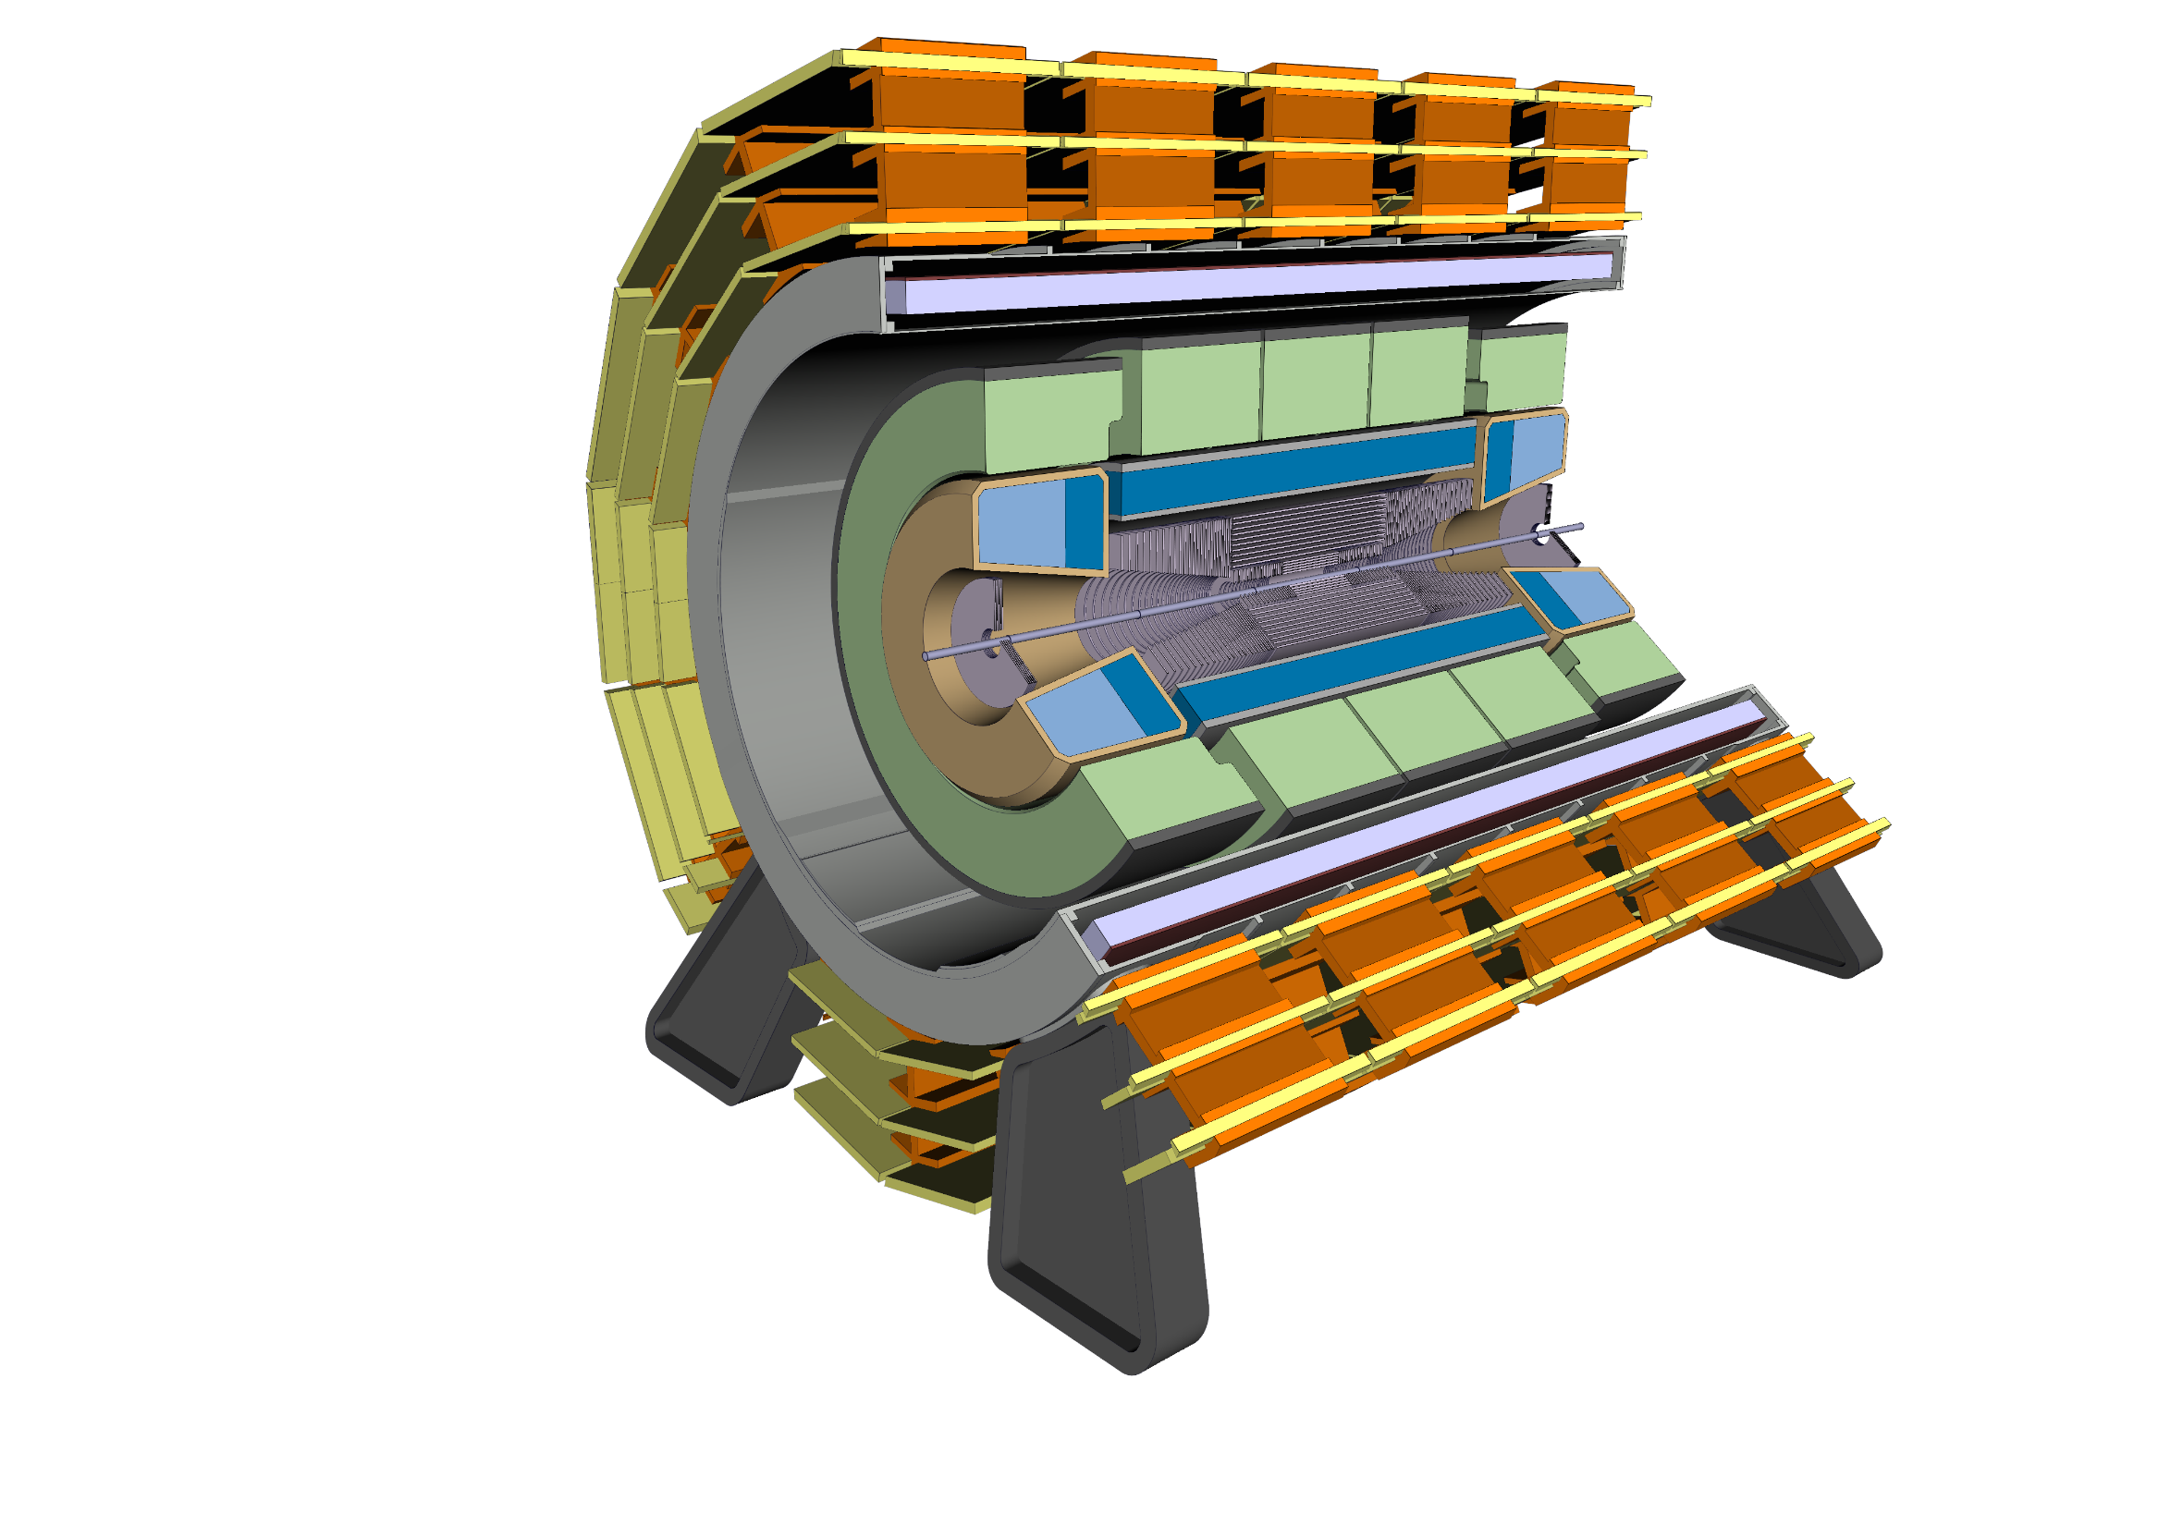
Experiment integration
12 - Install Muon Chambers onto the solenoid

Slide 16
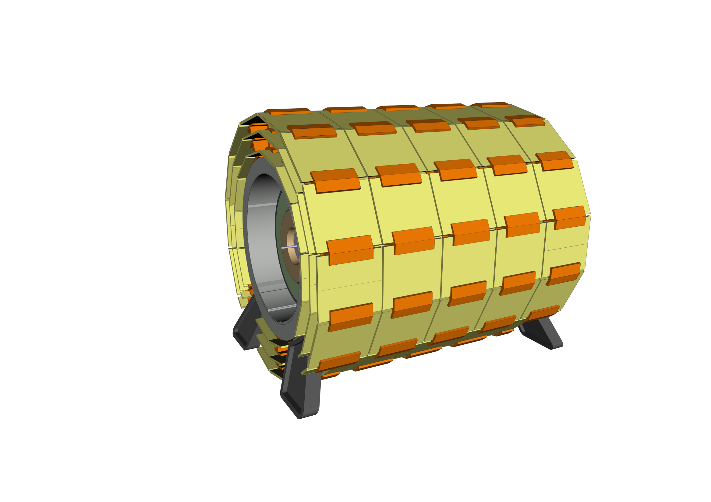
Experiment integration
12 - Install Muon Chambers onto the solenoid

Slide 17
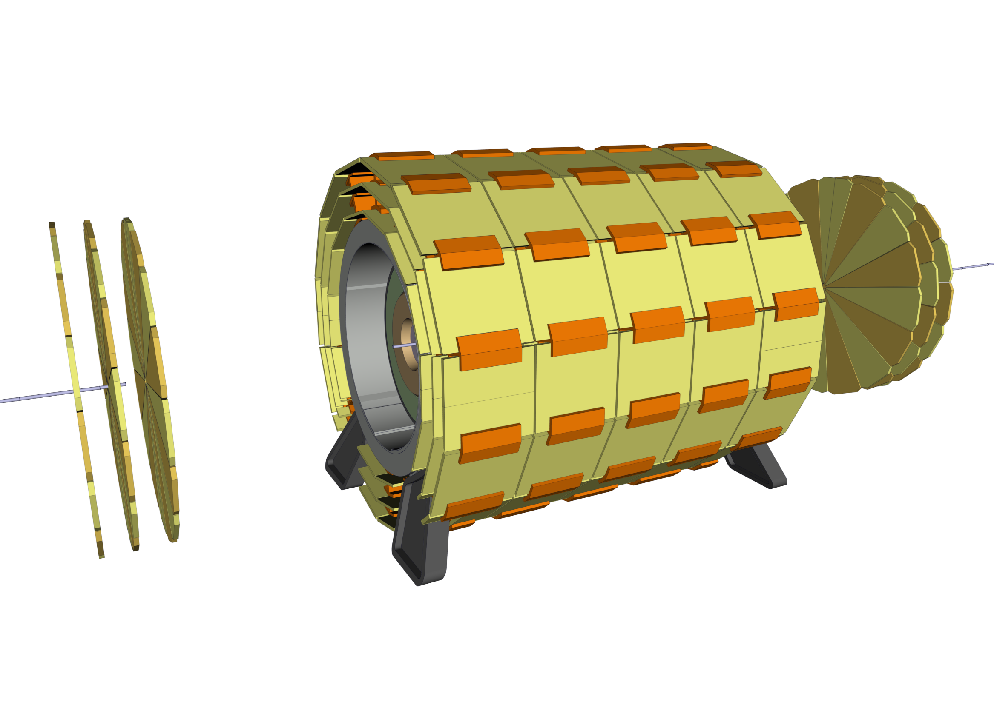
Experiment integration
13 – Install Forward Muon Chambers

Slide 18
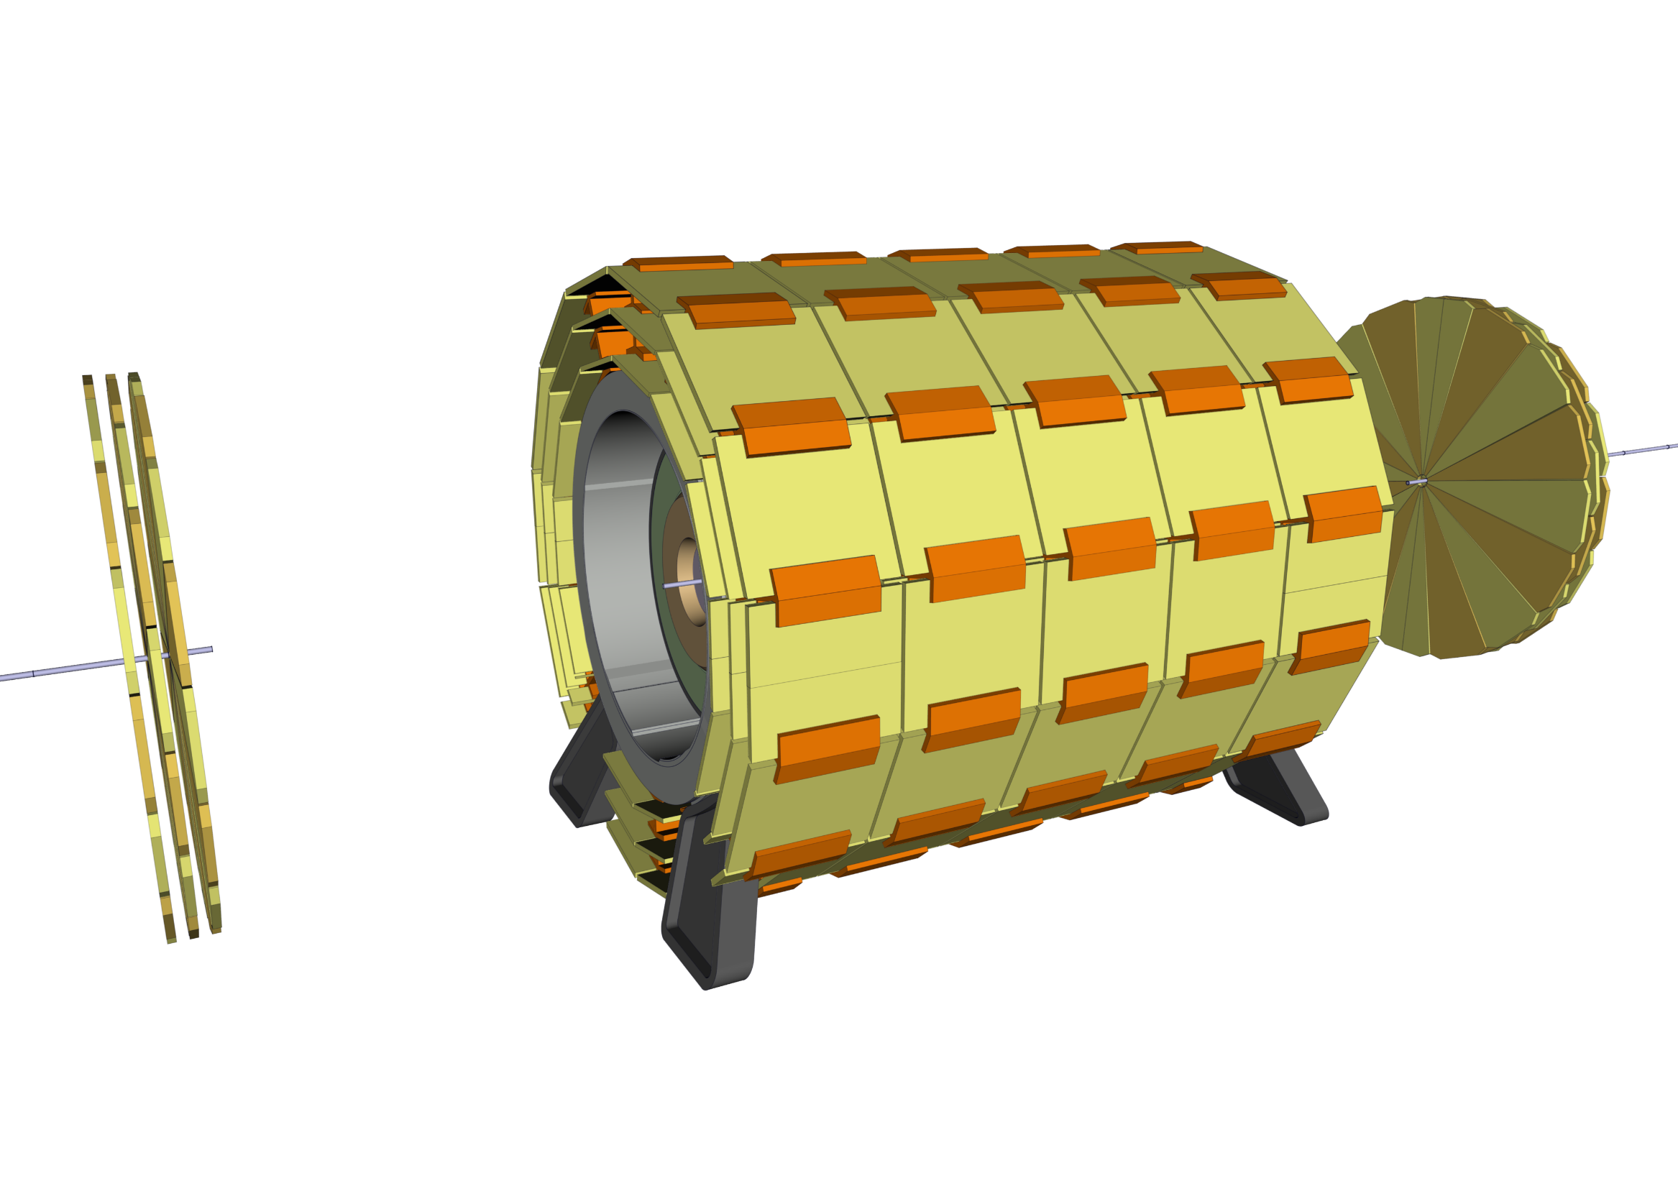
Experiment integration
14 – Compact the Forward Muon Chambers

Slide 19
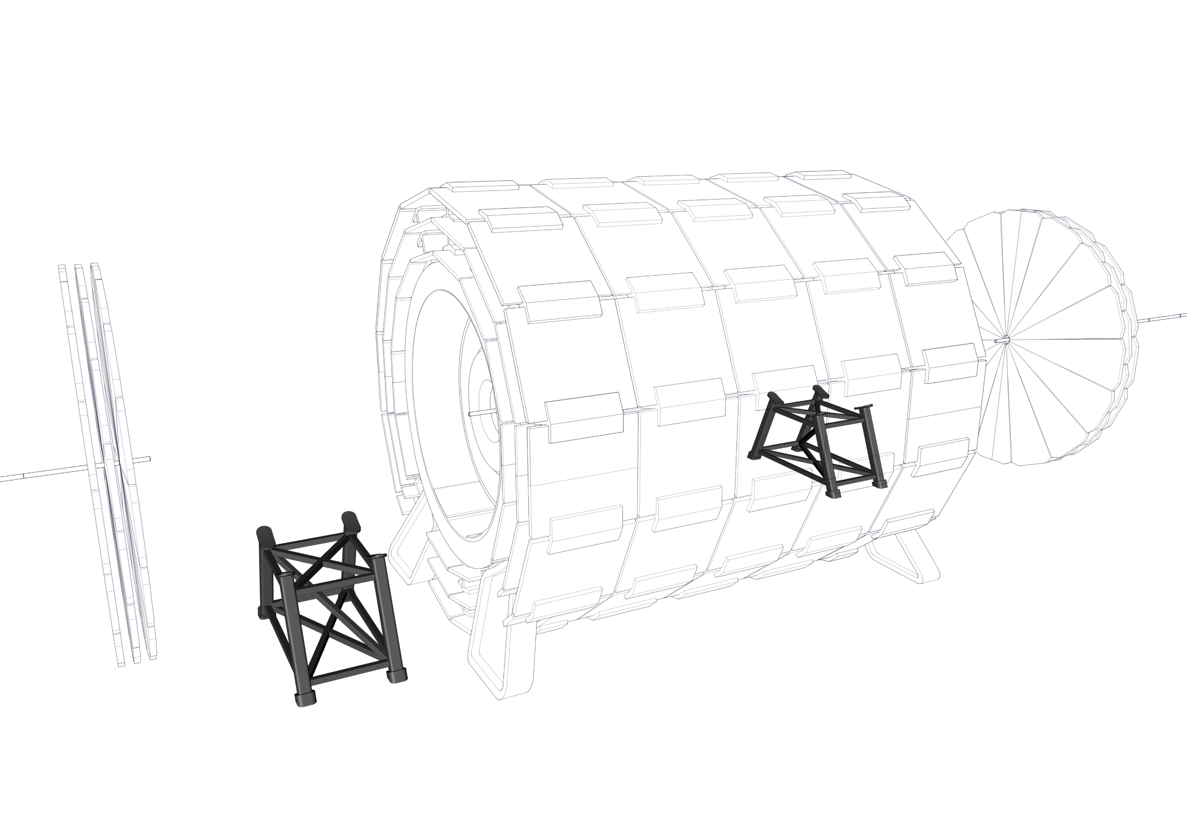
Experiment integration
15 – Install the Forward Solenoid support structure

Slide 20
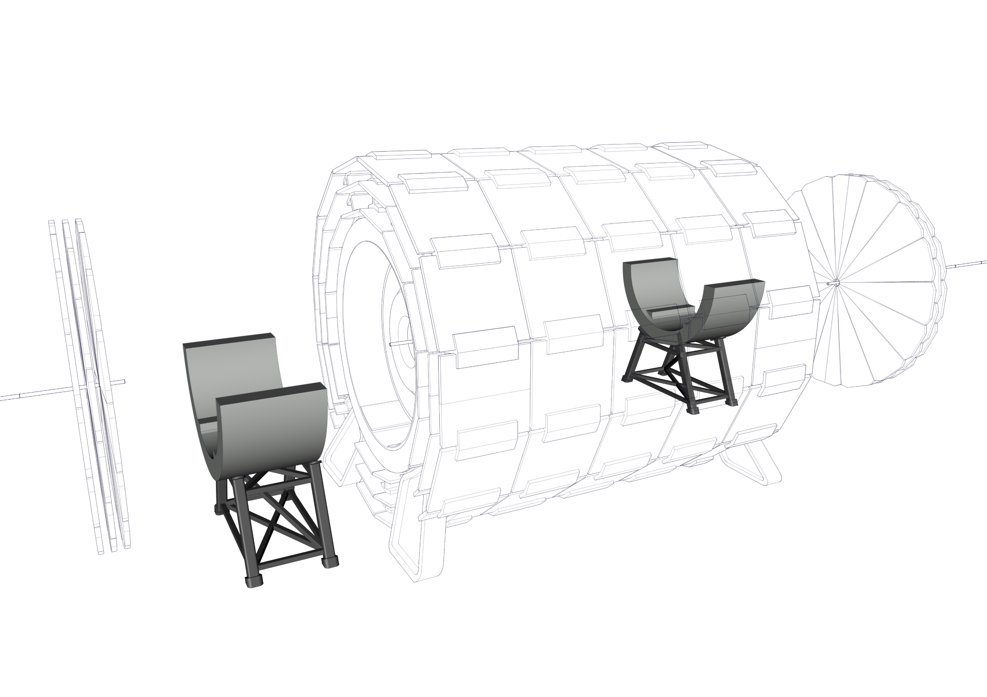
Experiment integration
16 – Install bottom half of the Radiation Shield

Slide 21
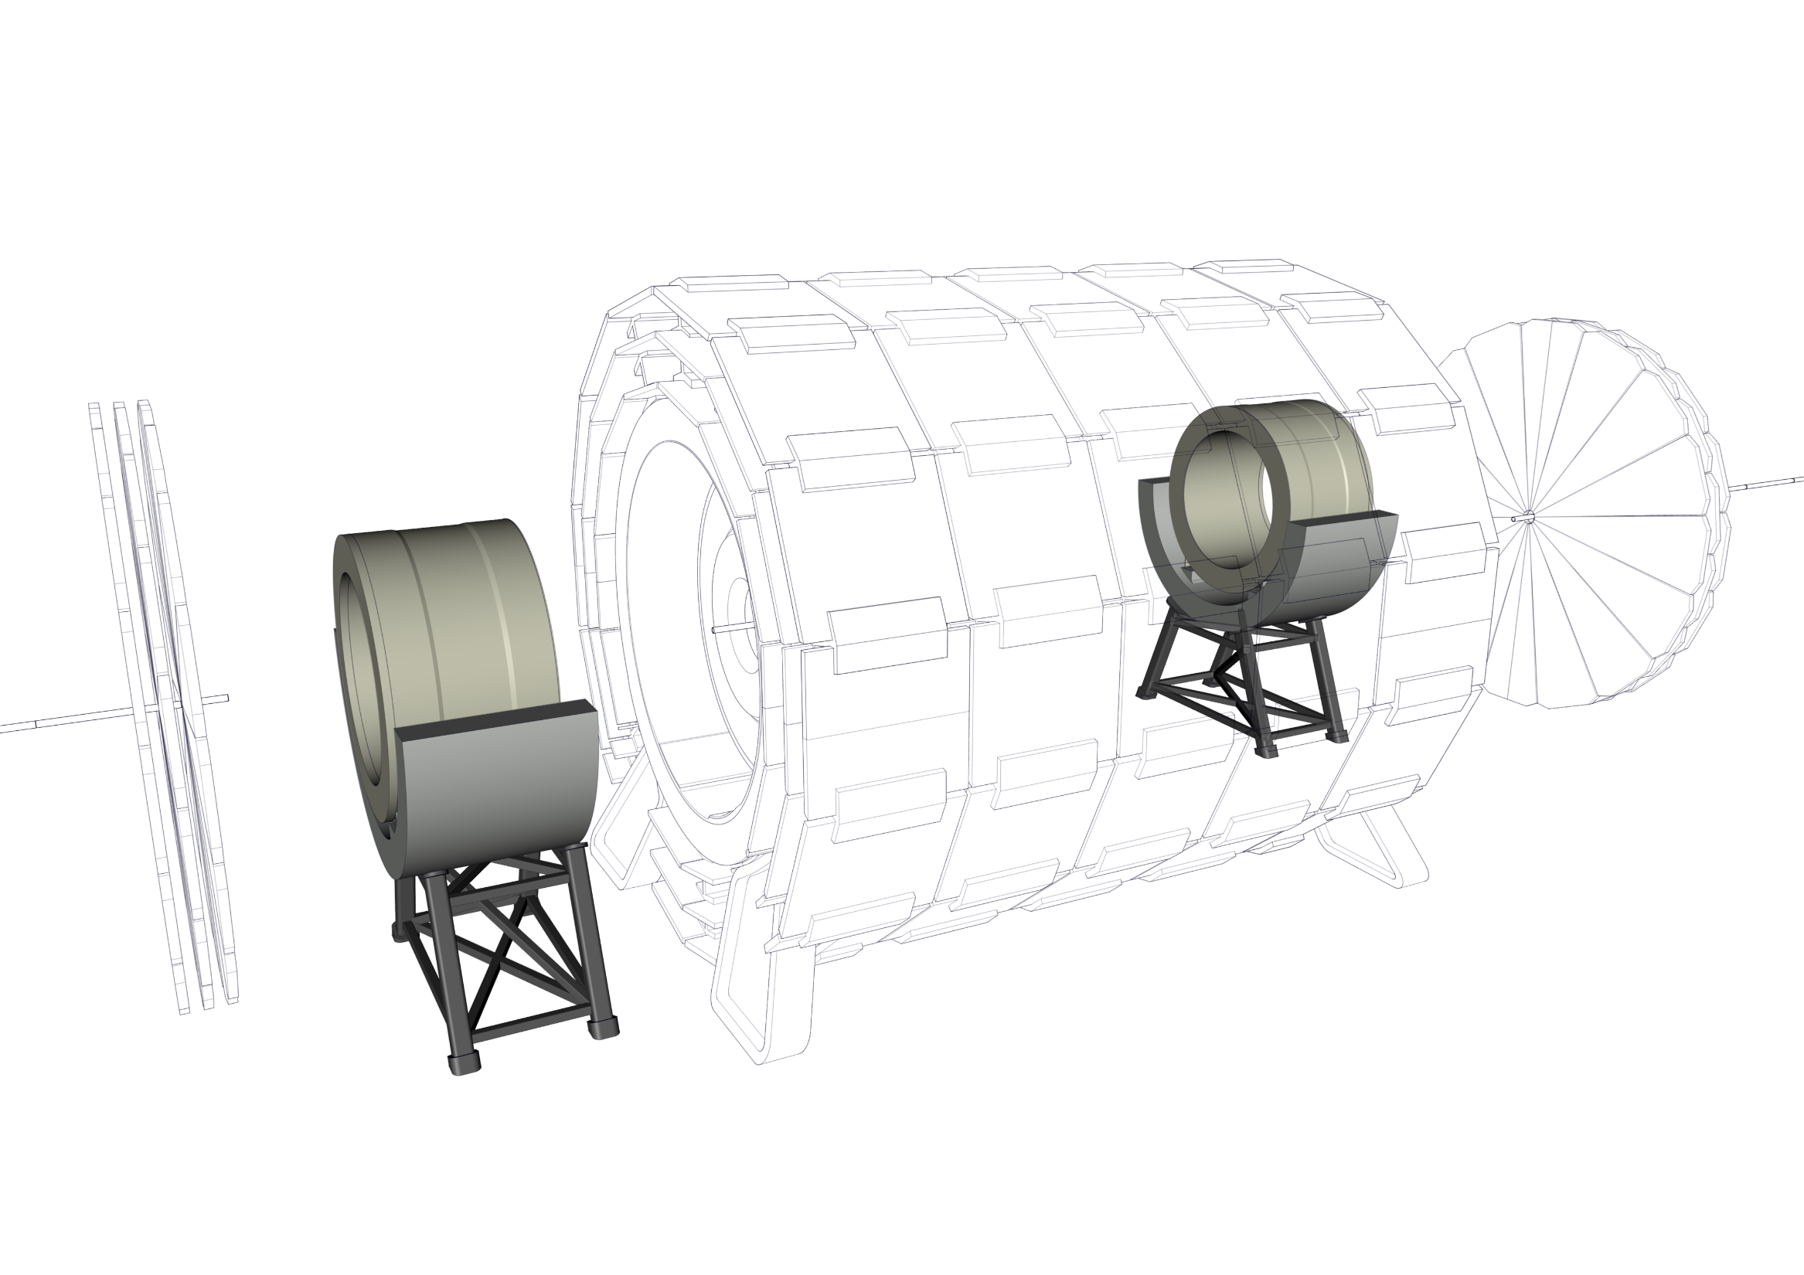
Experiment integration
17 – Install Forward Solenoids

Slide 22
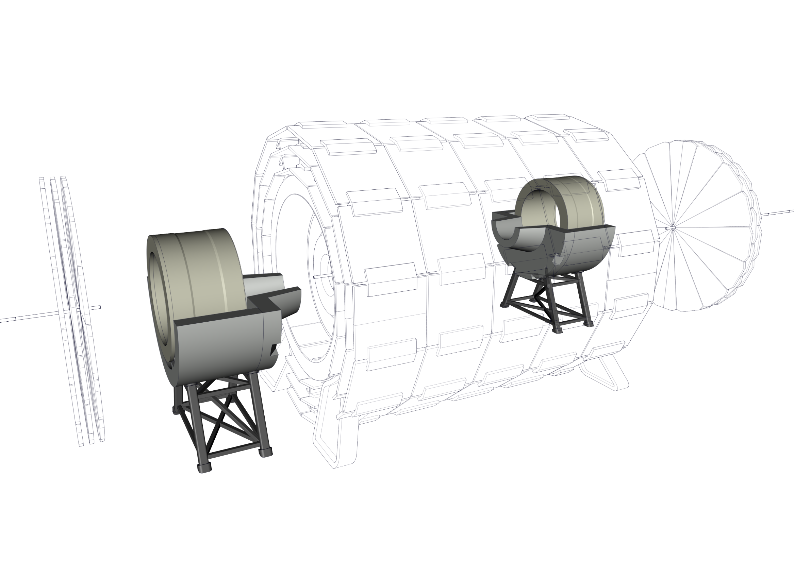
Experiment integration
18 – Install bottom half of the radiation shield nose

Slide 23
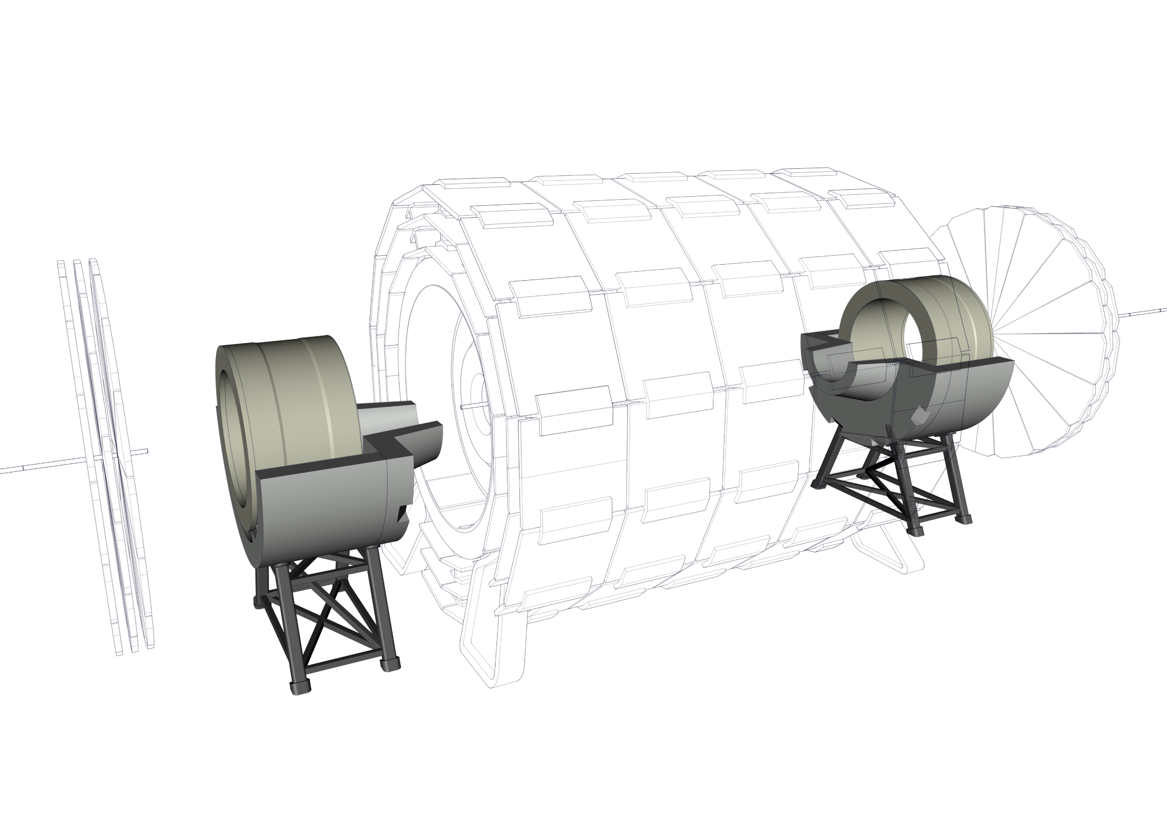
Experiment integration
19 – Align the off centered solenoid with the experiment

Slide 24

Experiment integration
20 – Install another portion of the beam pipe

Slide 25
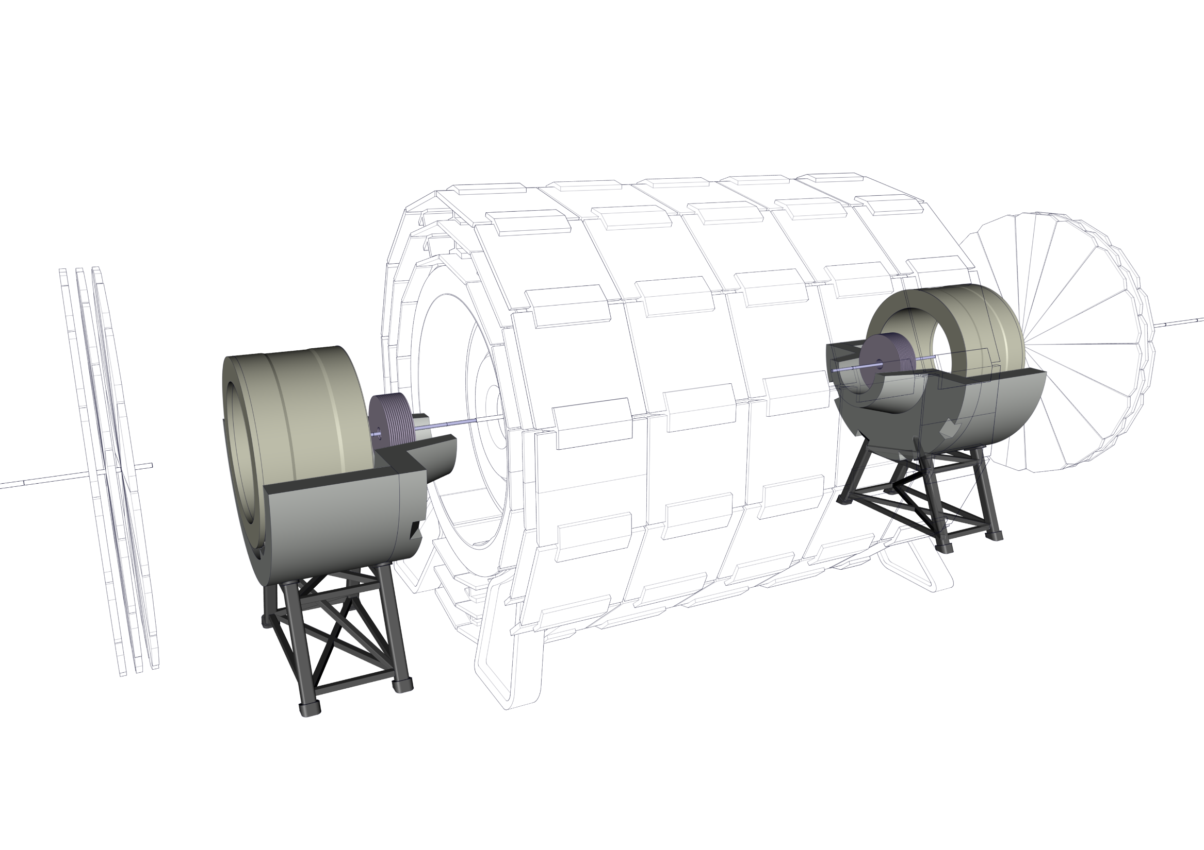
Experiment integration
20 – Install Forward Trackers

Slide 26
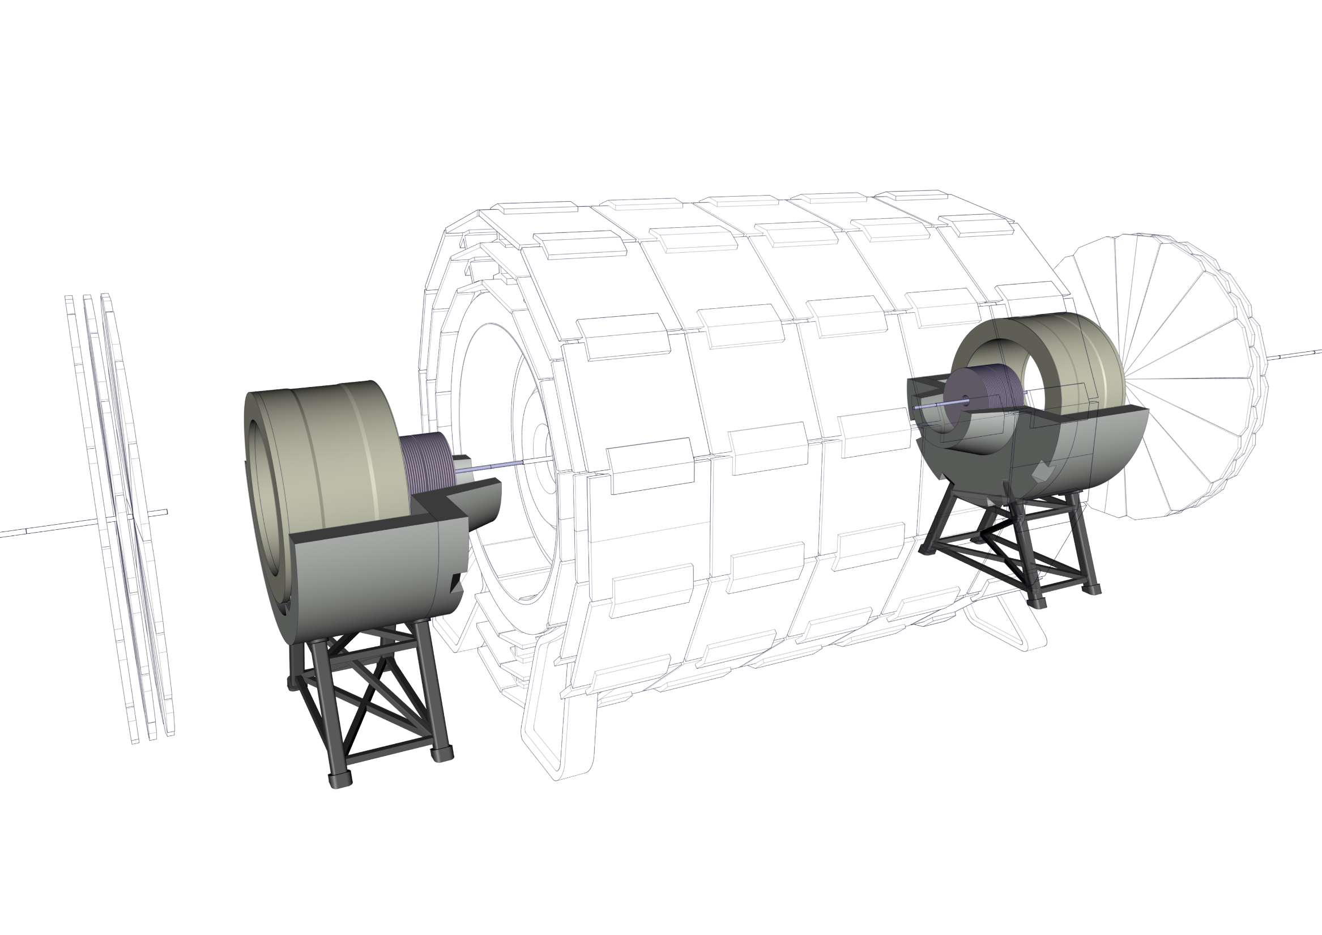
Experiment integration
20 – Install Forward Trackers

Slide 27
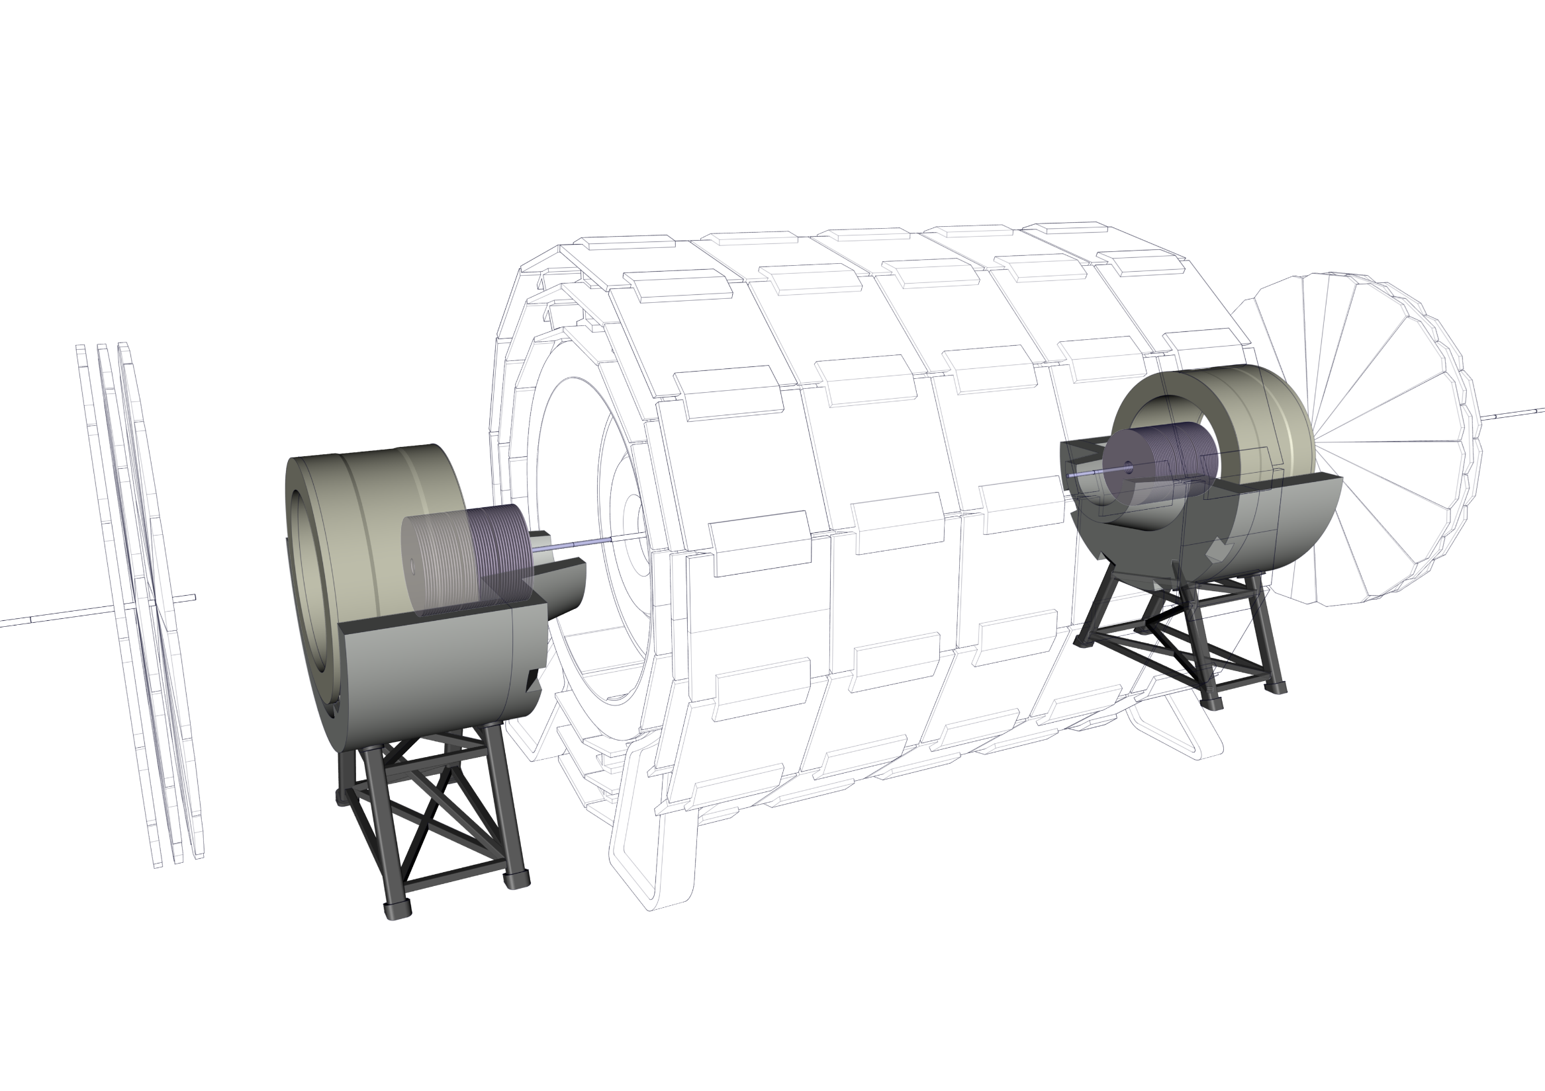
Experiment integration
20 – Install Forward Trackers

Slide 28
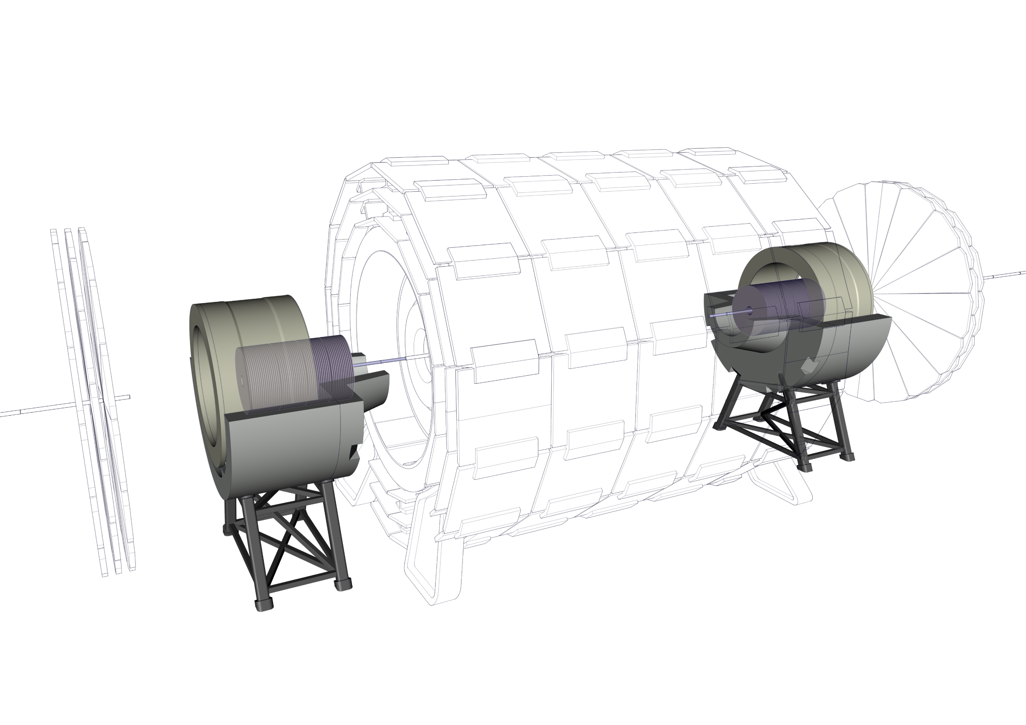
Experiment integration
20 – Install Forward Trackers

Slide 29

Experiment integration
20 – Install Forward Trackers

Slide 30
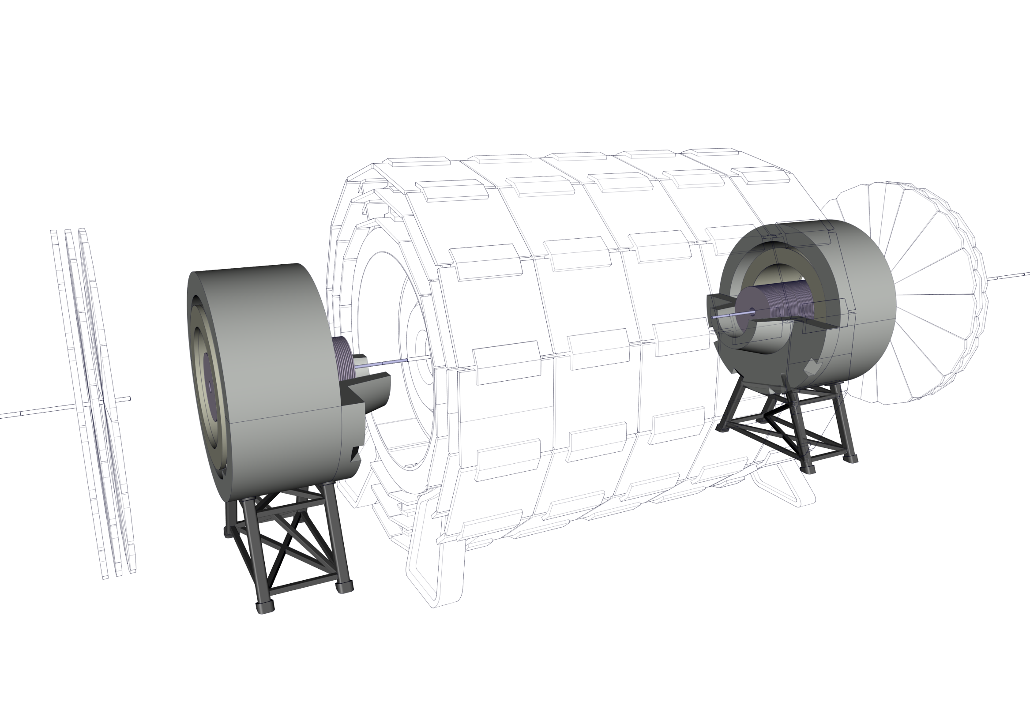
Experiment integration
21 – Install top half of the Radiation Shield

Slide 31
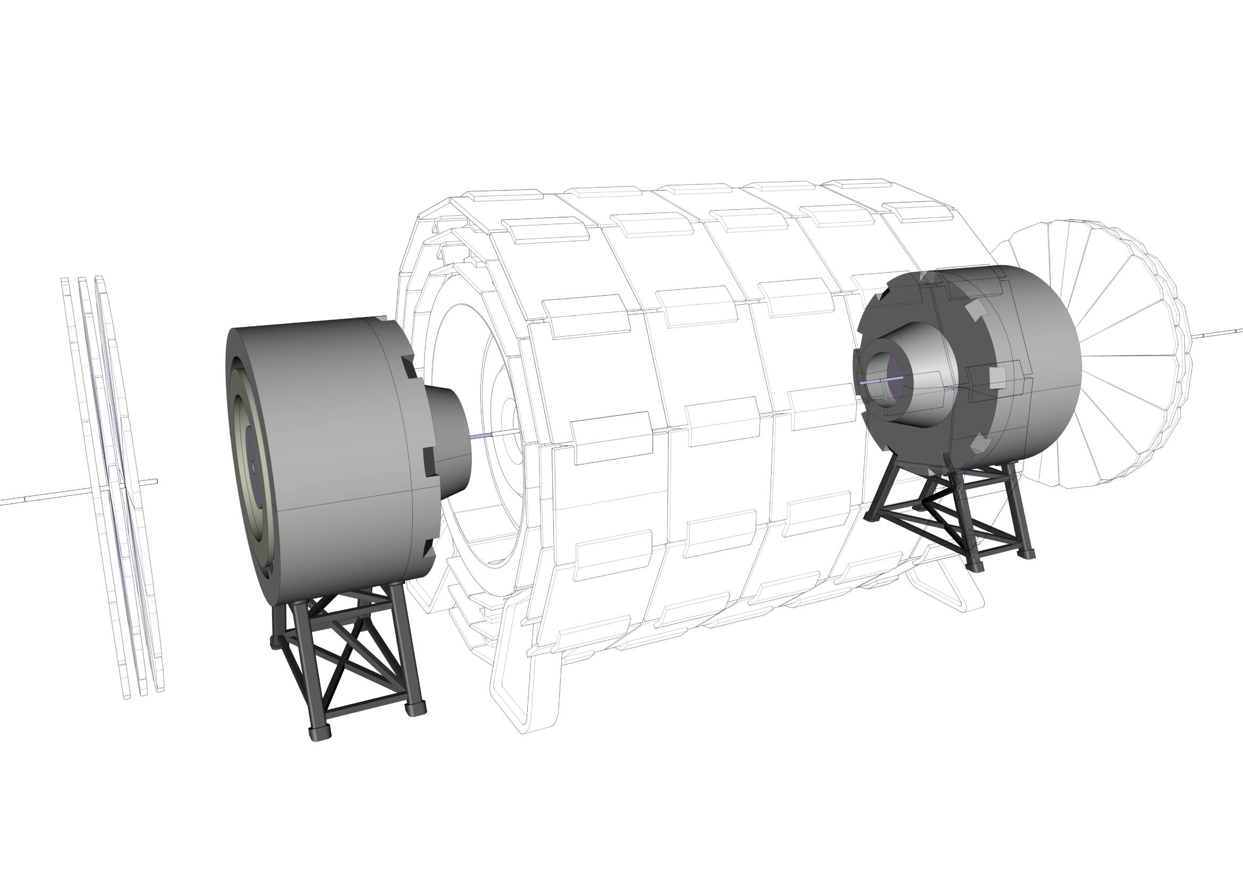
Experiment integration
22 – Install top half of the Radiation Shield nose

Slide 32
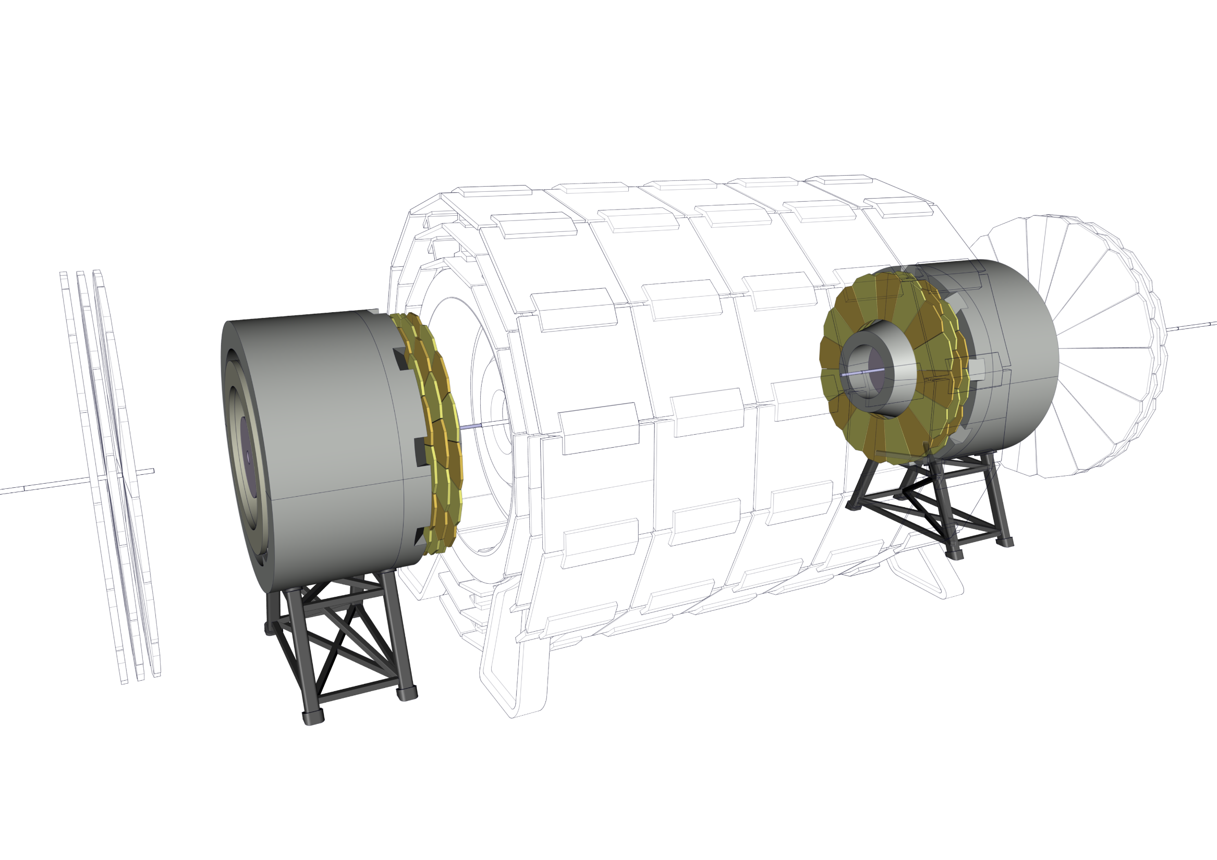
Experiment integration
23 – Install Muon Chambers

Slide 33
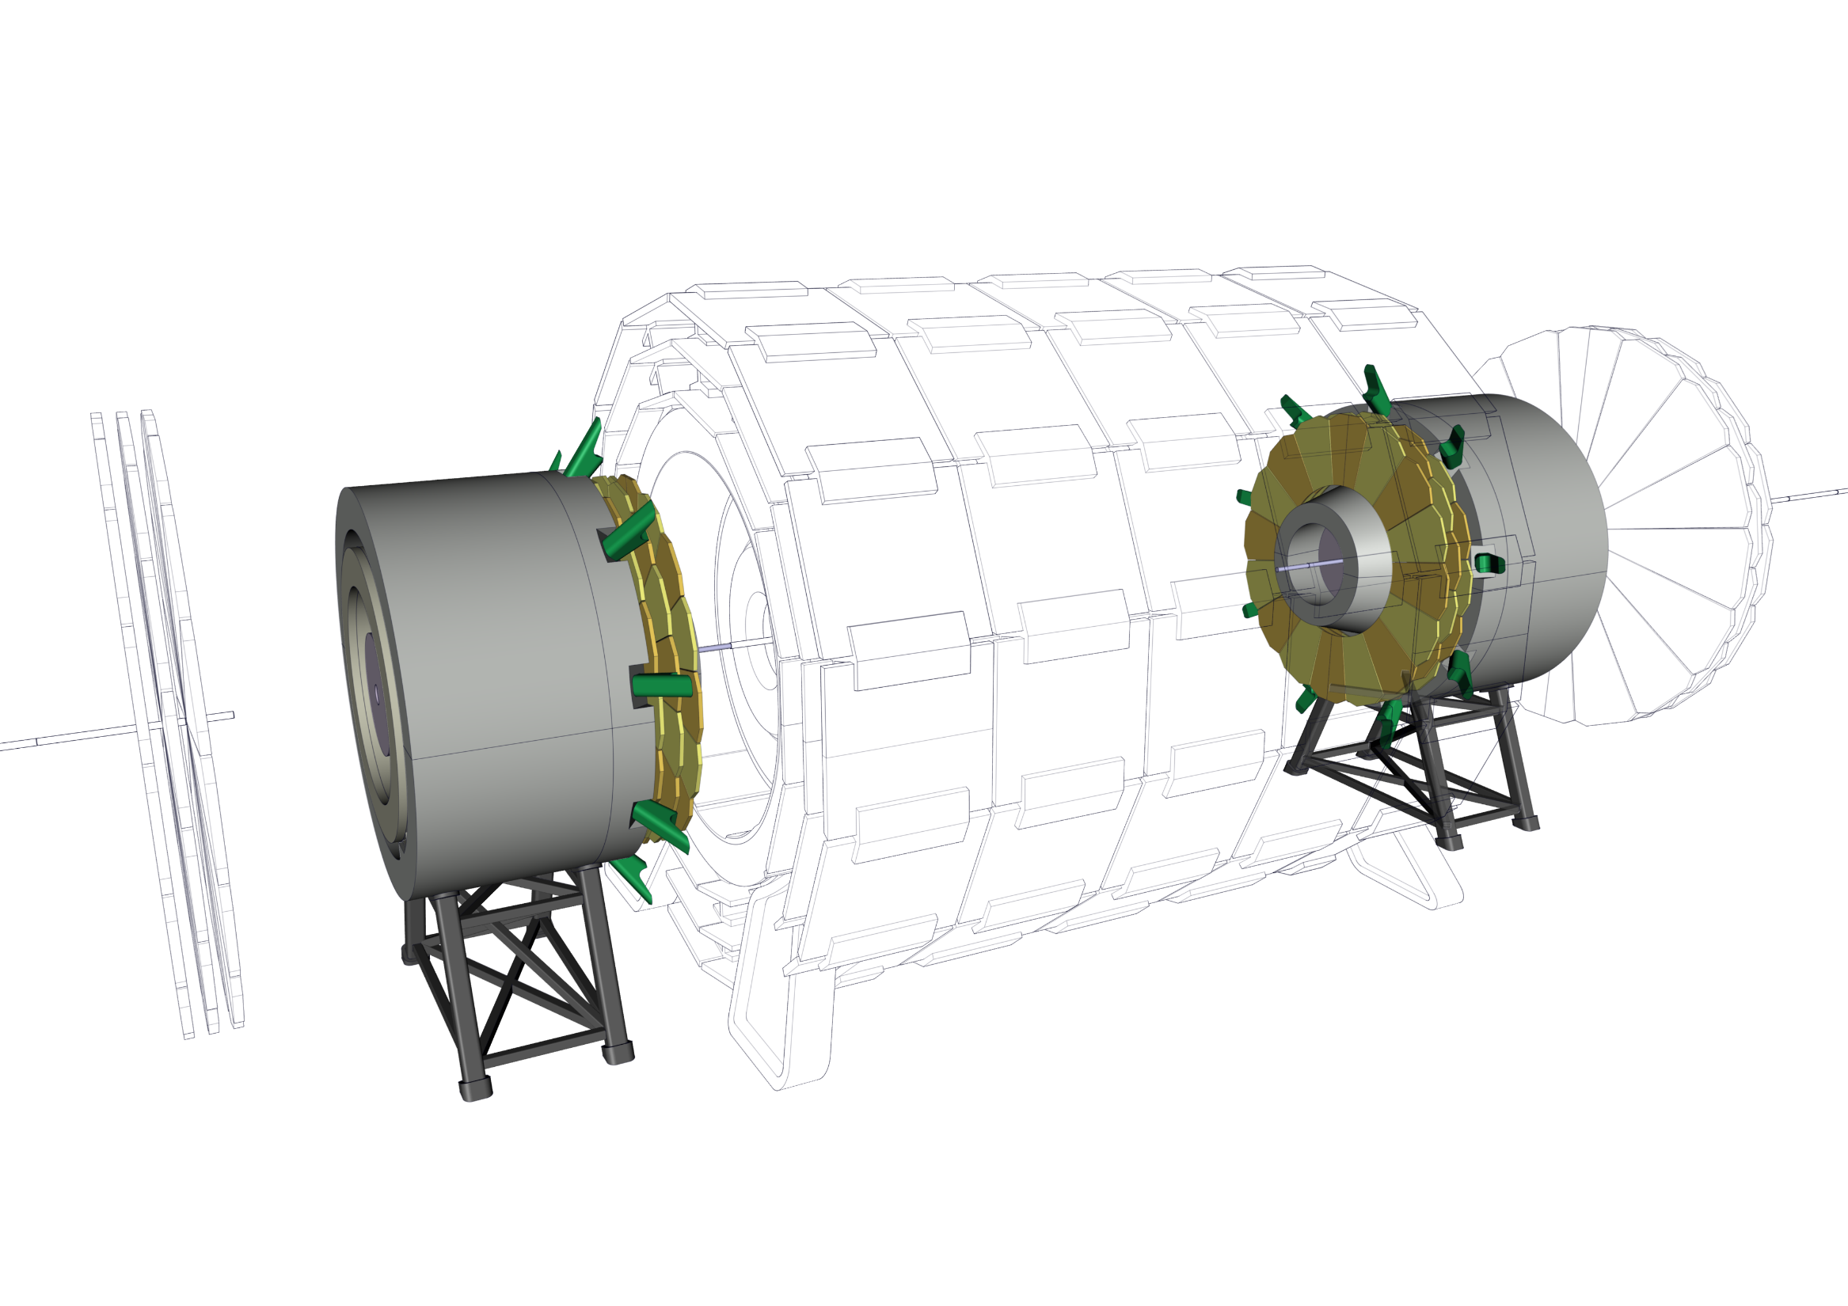
Experiment integration
24 – Install Spokes

Slide 34
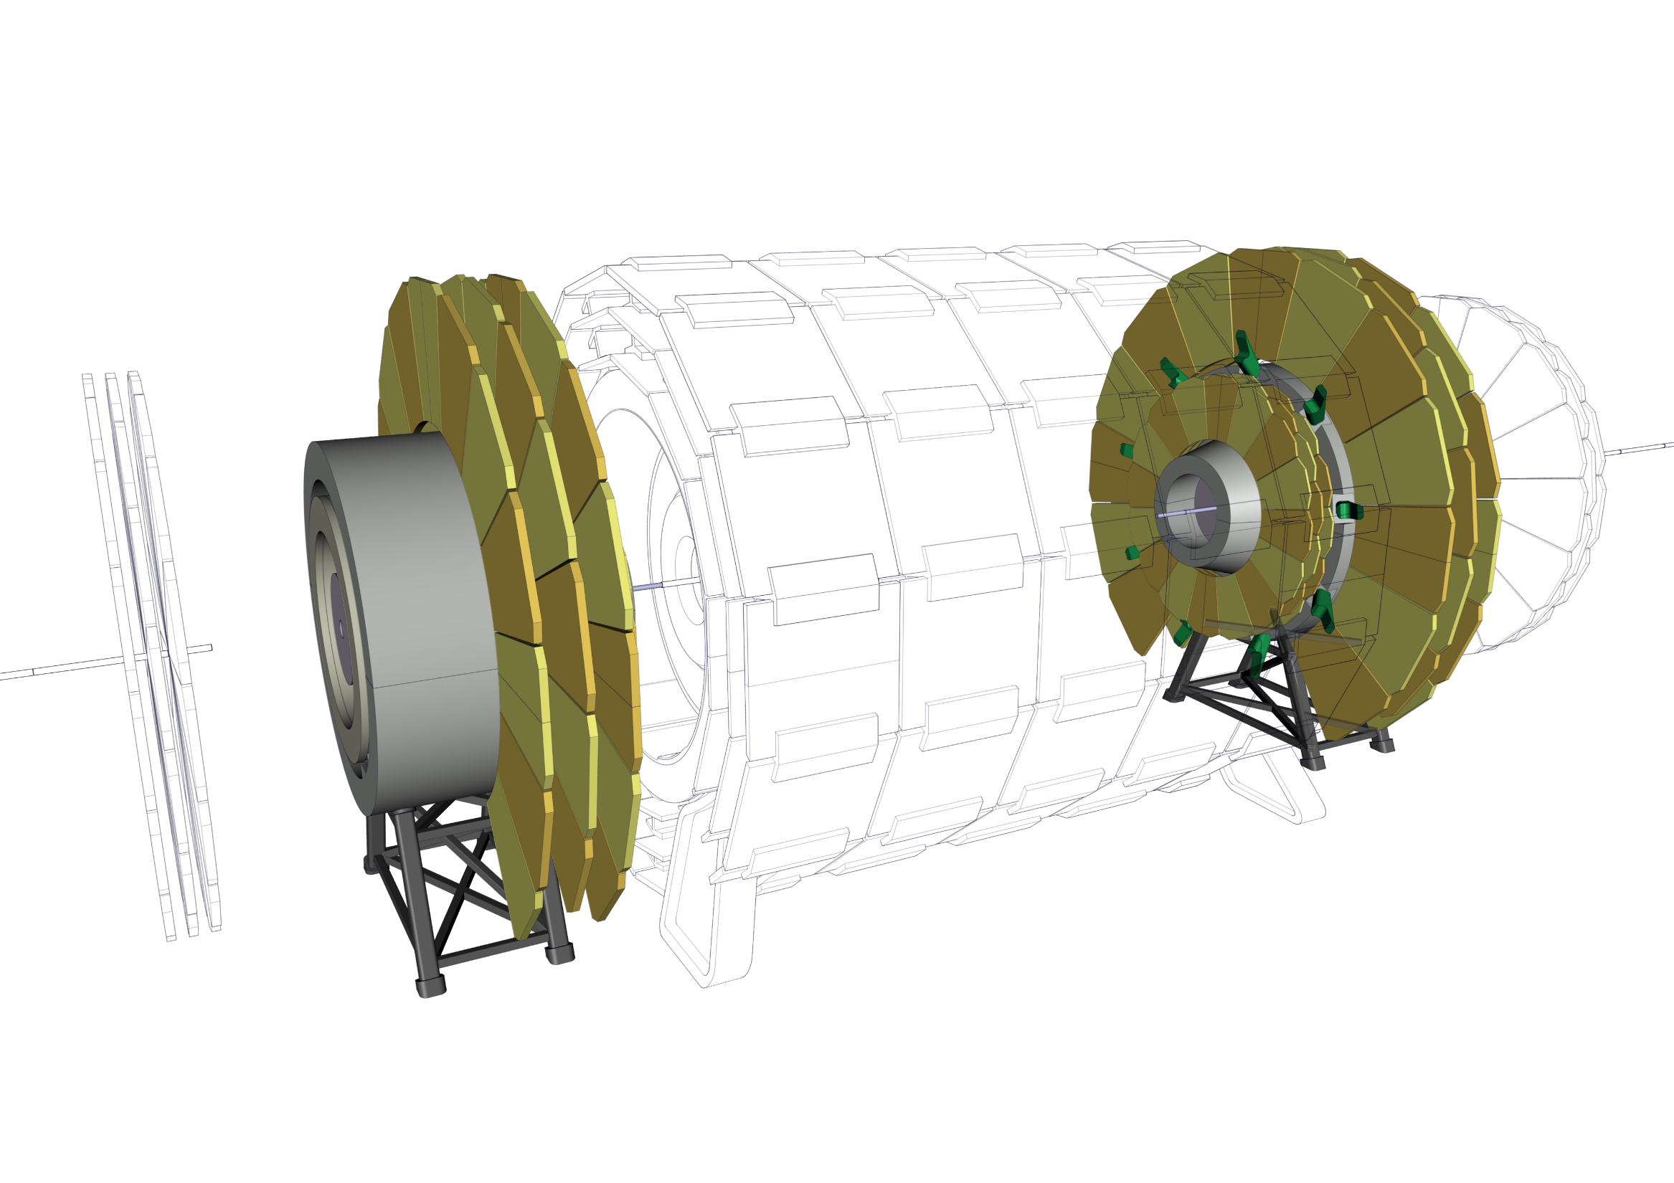
Experiment integration
25 – Install Muon Chambers

Slide 35
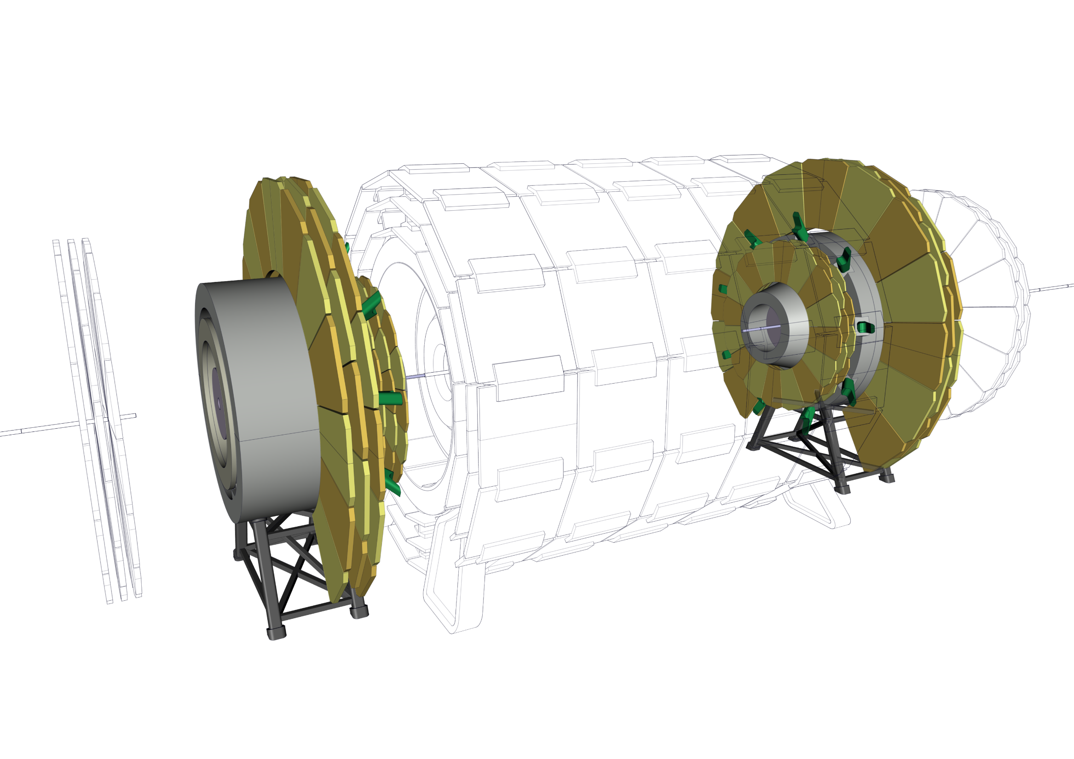
Experiment integration
26 – Compact Muon Chambers

Slide 36
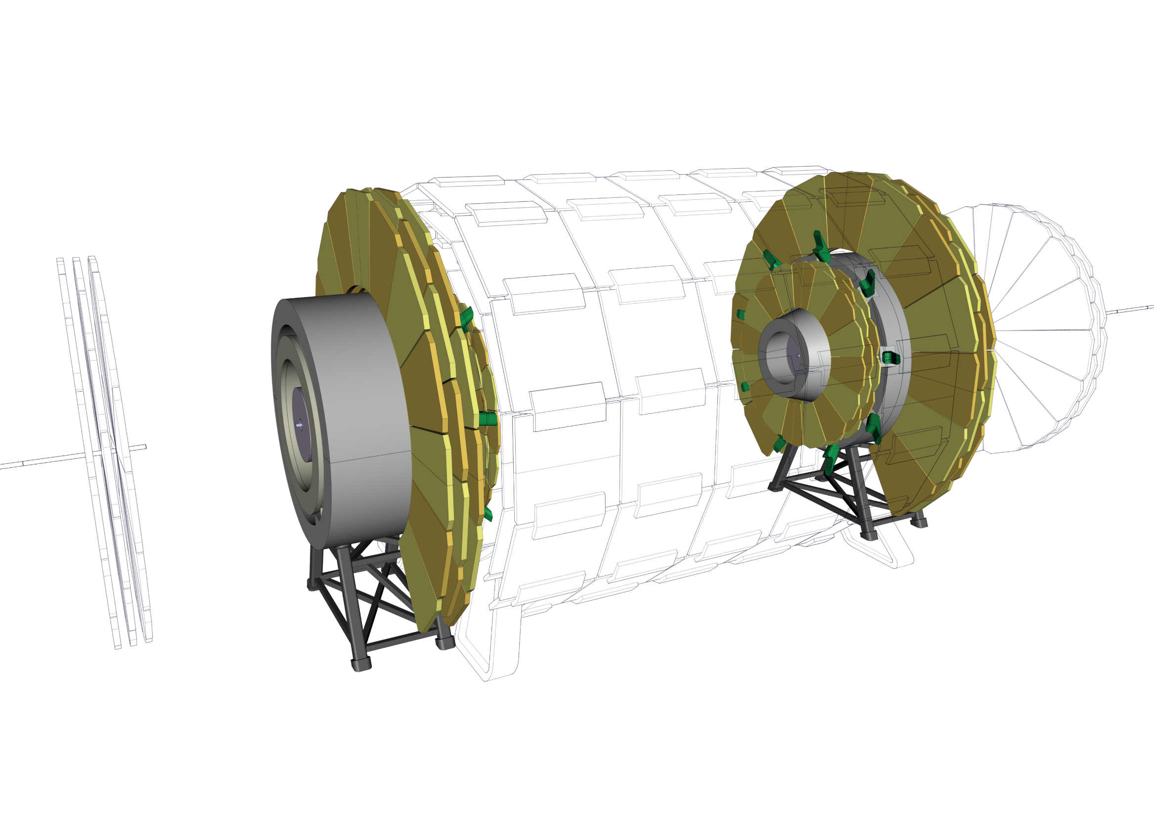
Experiment integration
27 – Connect Spokes to main cryostat

Slide 37
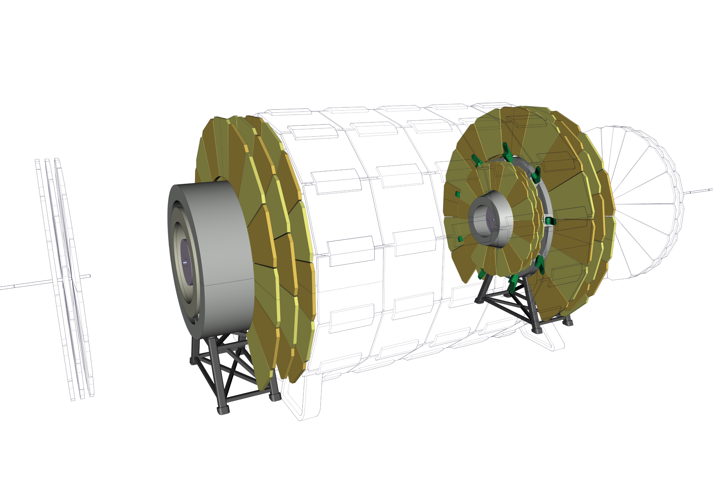
Experiment integration
28 – Bring Muon Chambers to their final position

Slide 38
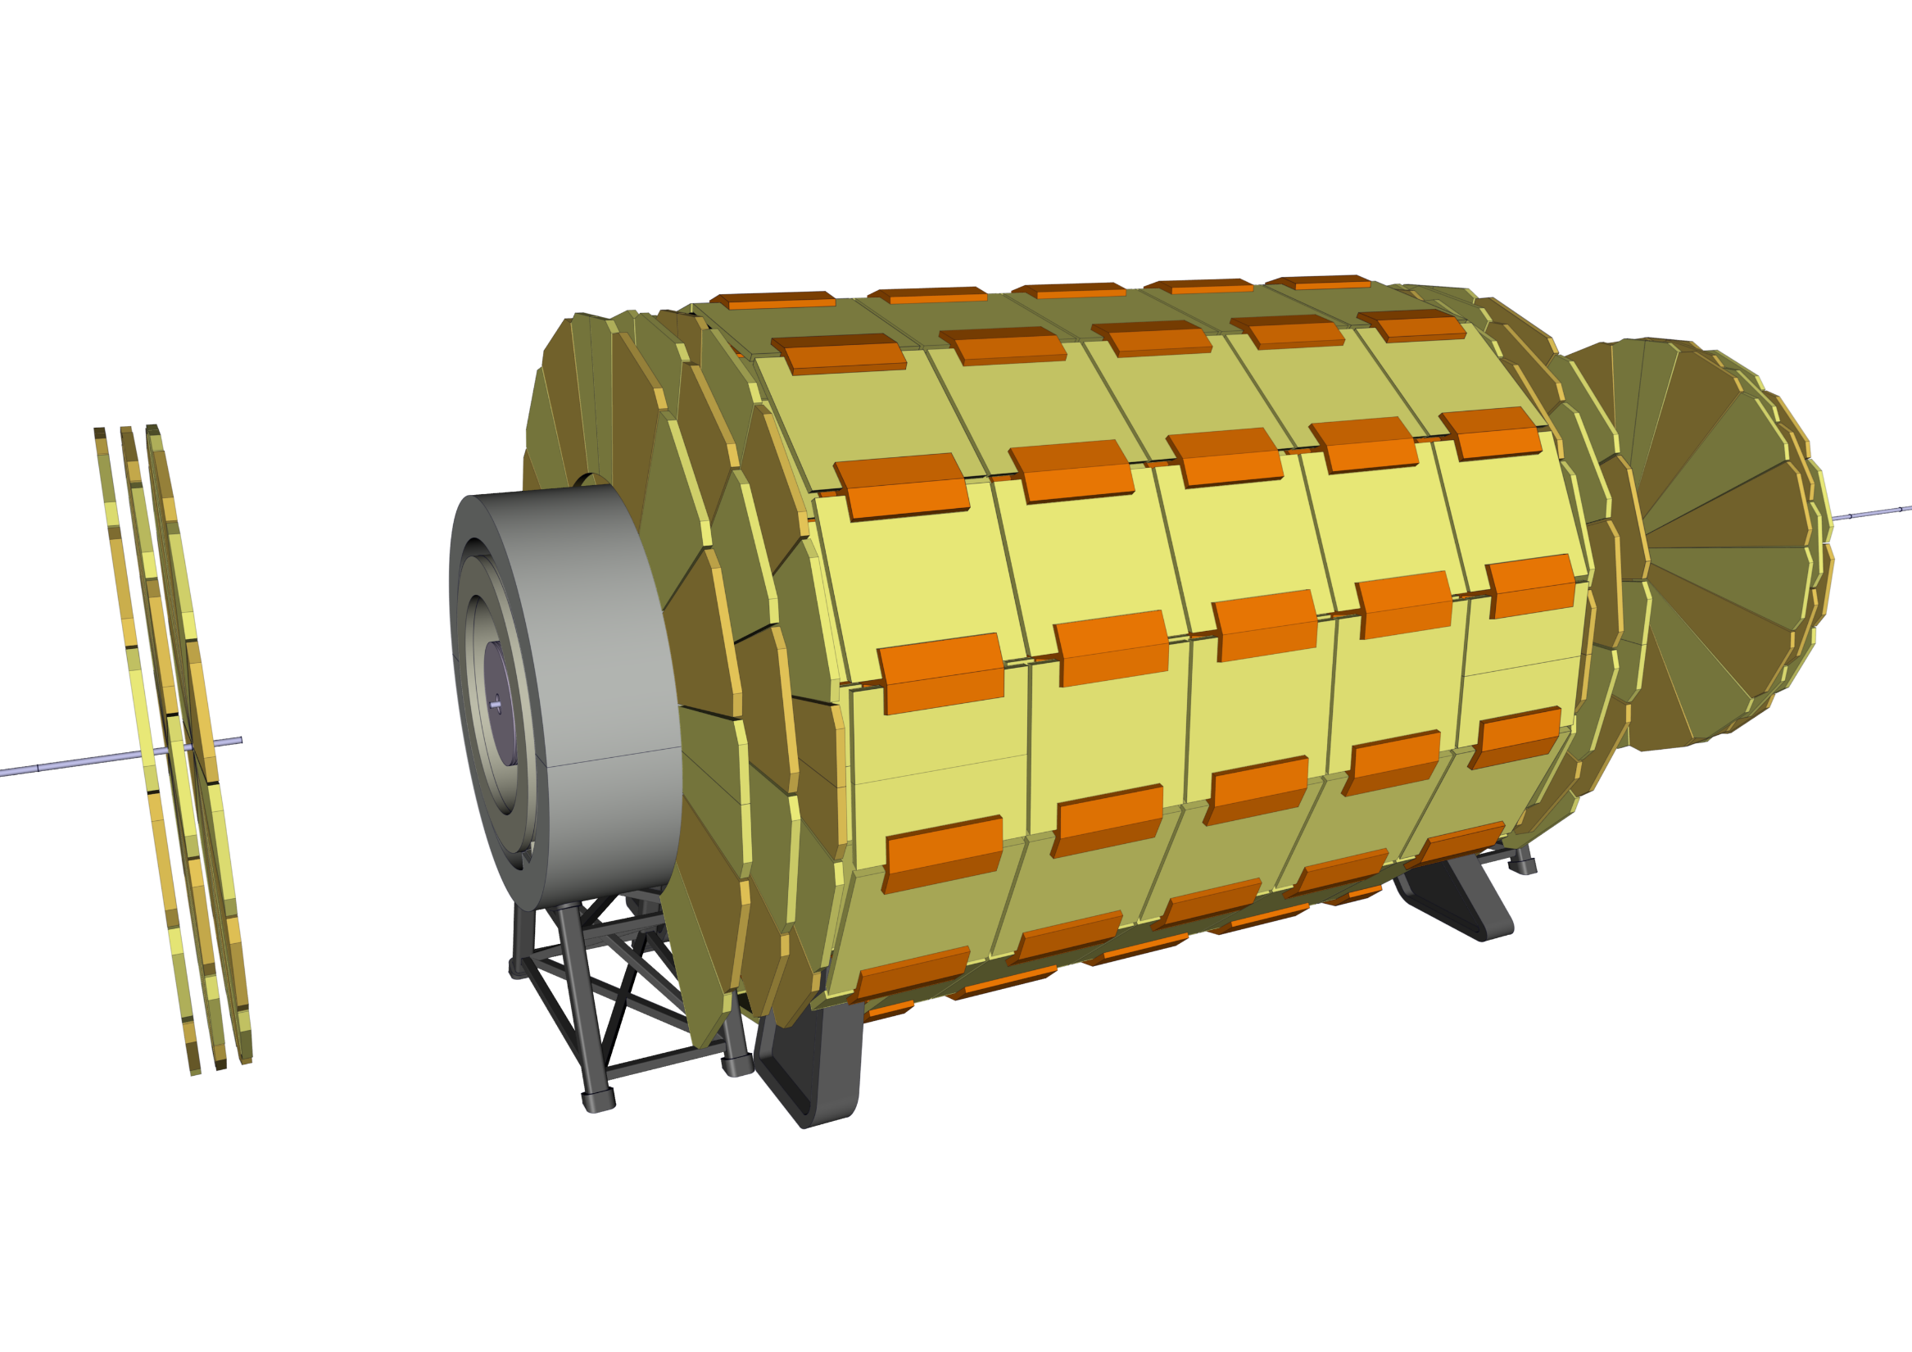
Experiment integration
28 – Bring Muon Chambers to their final position

Slide 39
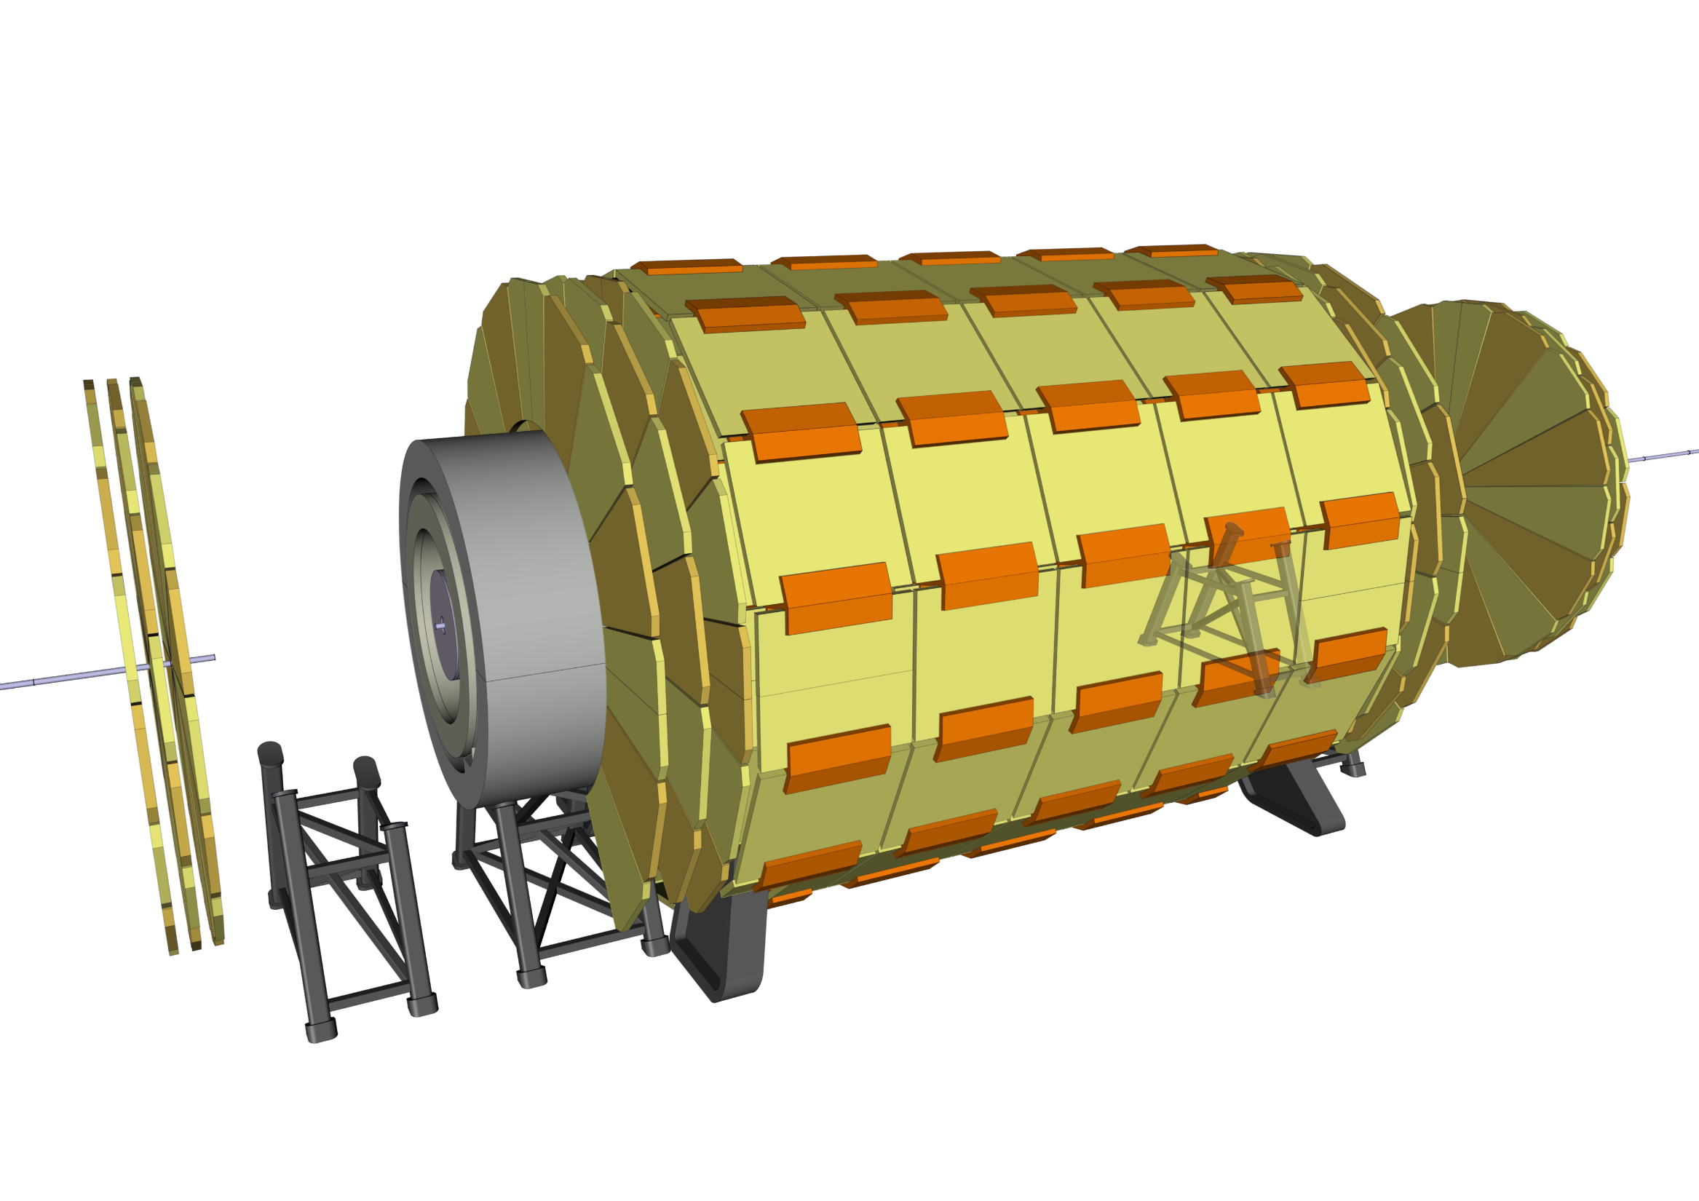
Experiment integration
29 - Install Forward ECal support structure

Slide 40
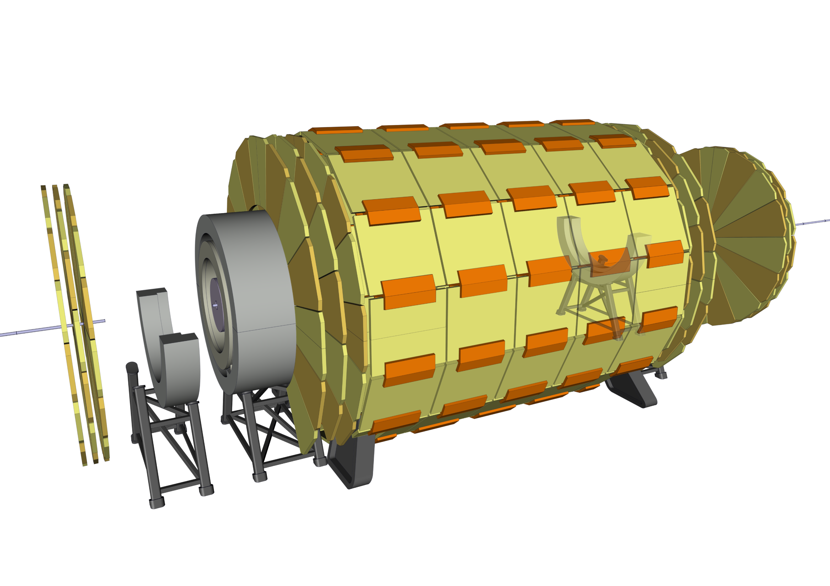
Experiment integration
30 - Install bottom half of the Ecal Radiation Shield

Slide 41
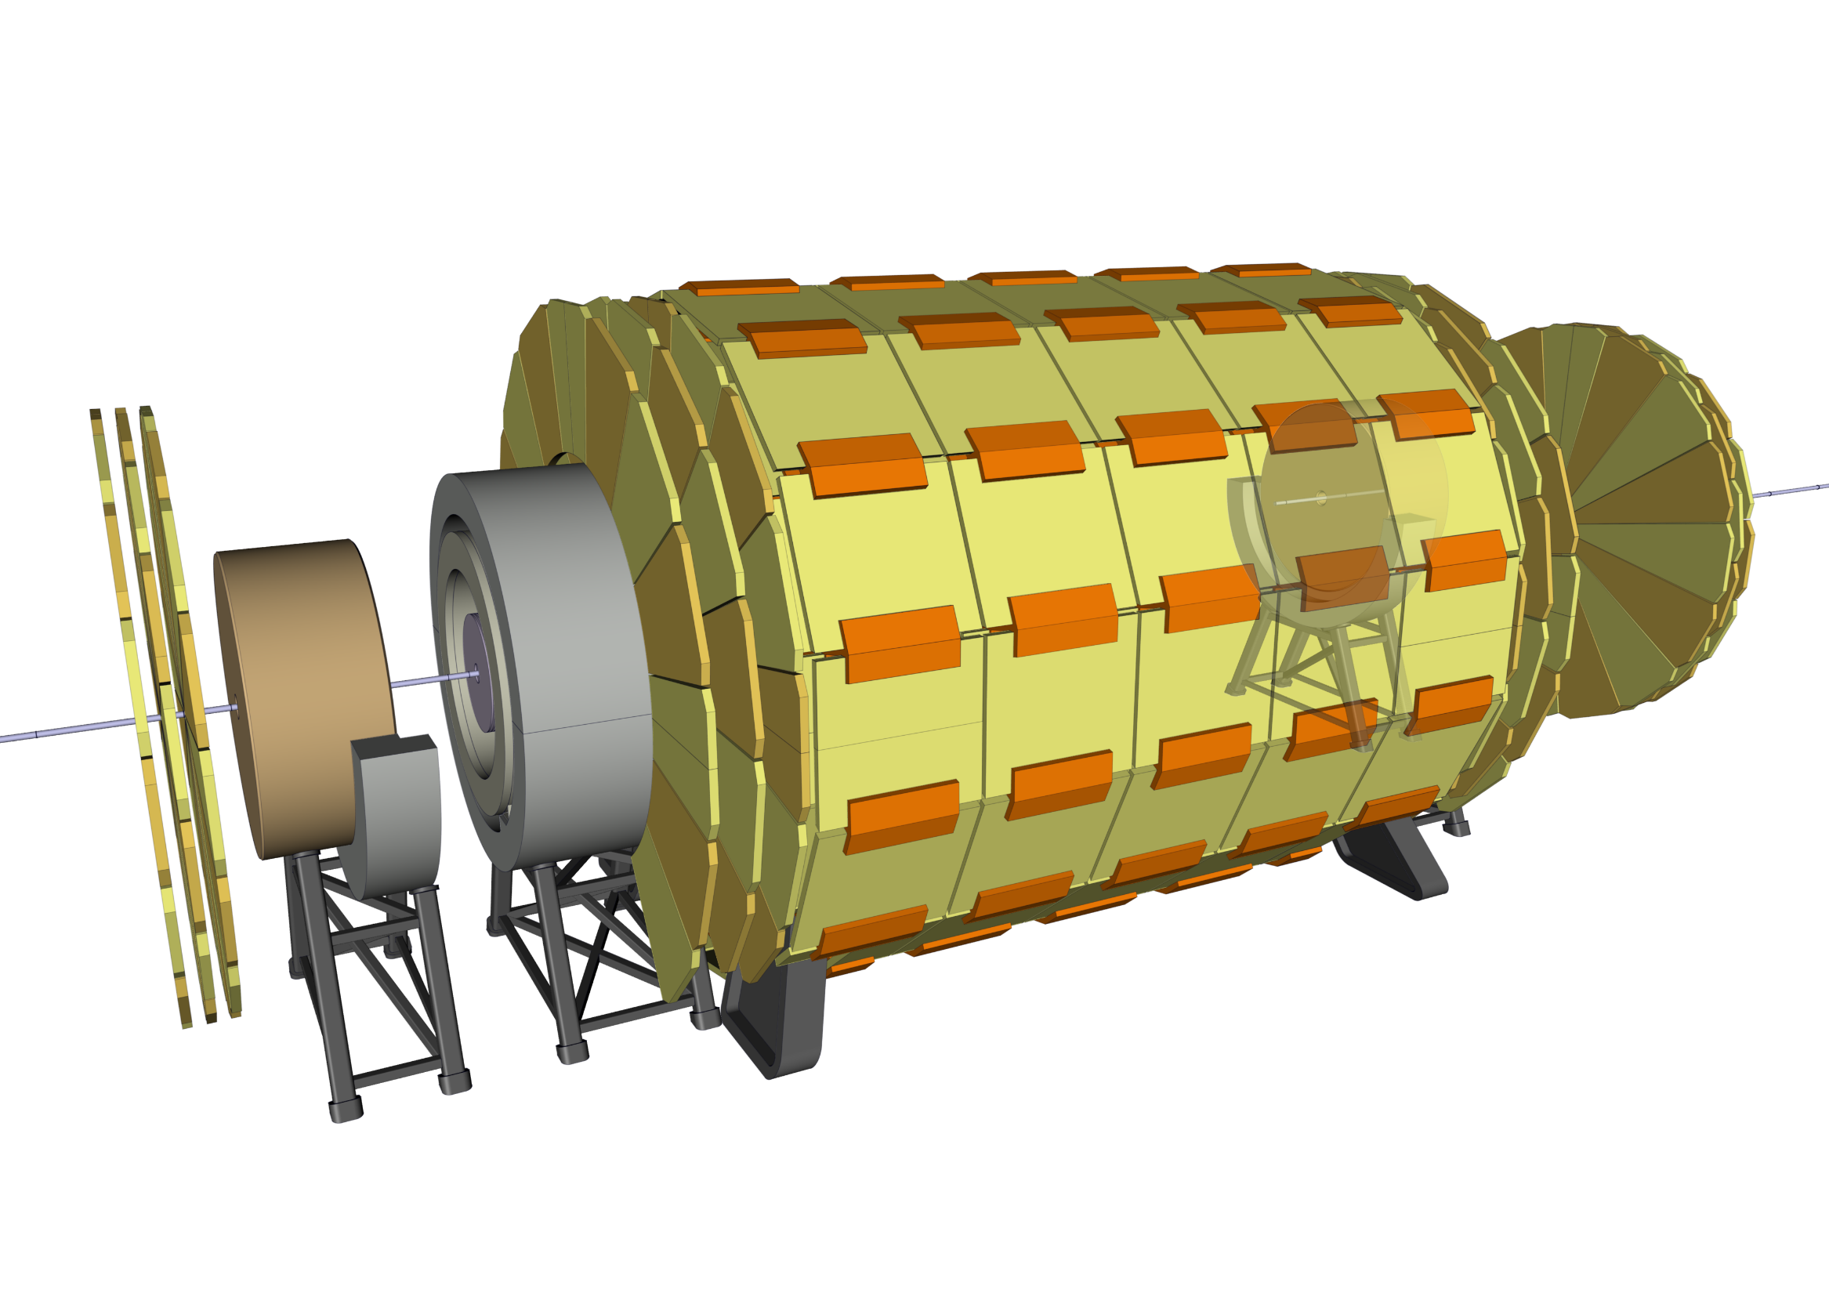
Experiment integration
31 - Install Forward Ecal

Slide 42

Experiment integration
32 – Align the off-centered Ecal with the experiment and close Beam Pipe

Slide 43

Experiment integration
33 - Install top half of the Ecal Radiation Shield

Slide 44
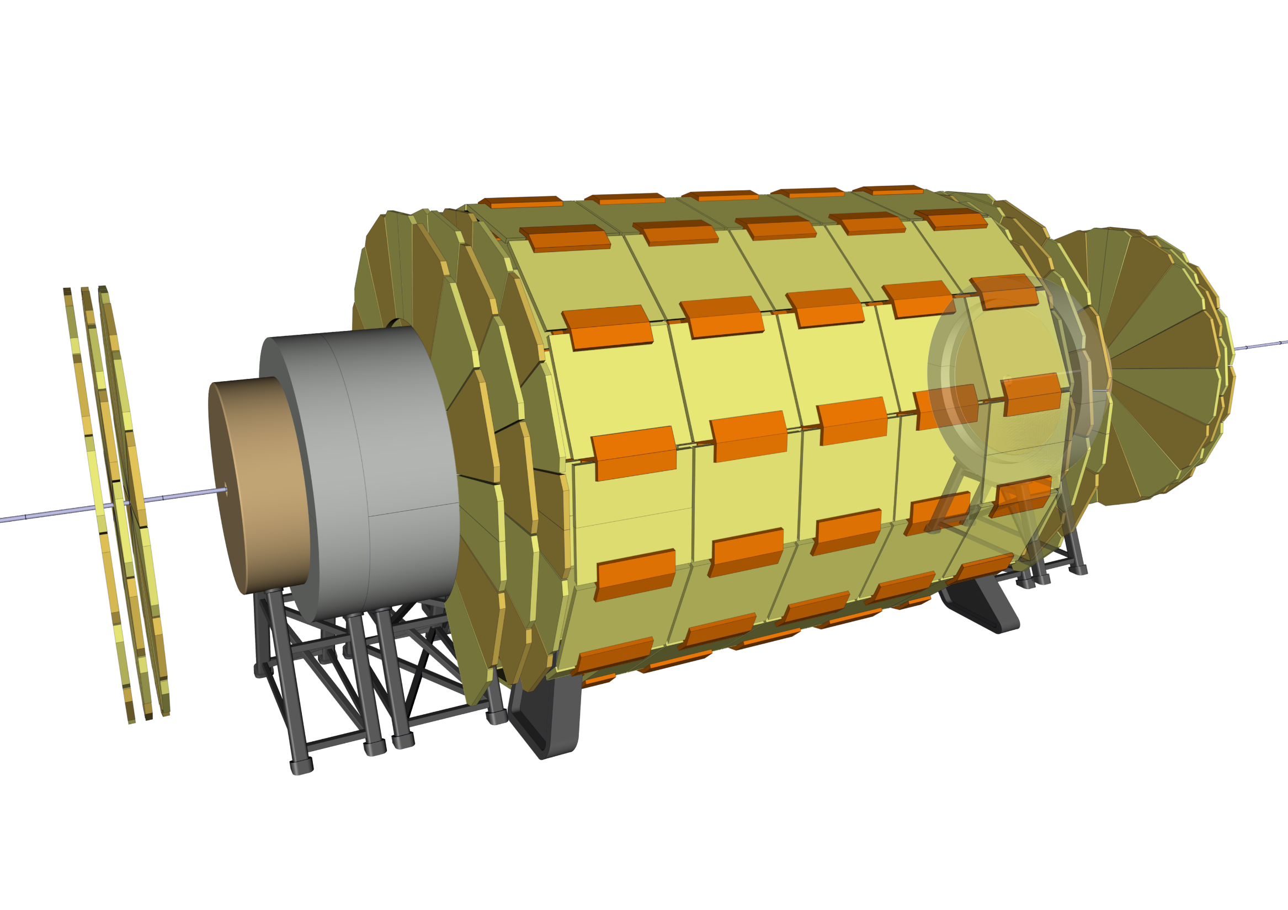
Experiment integration
34 – Move Forward Ecal to its final position

Slide 45
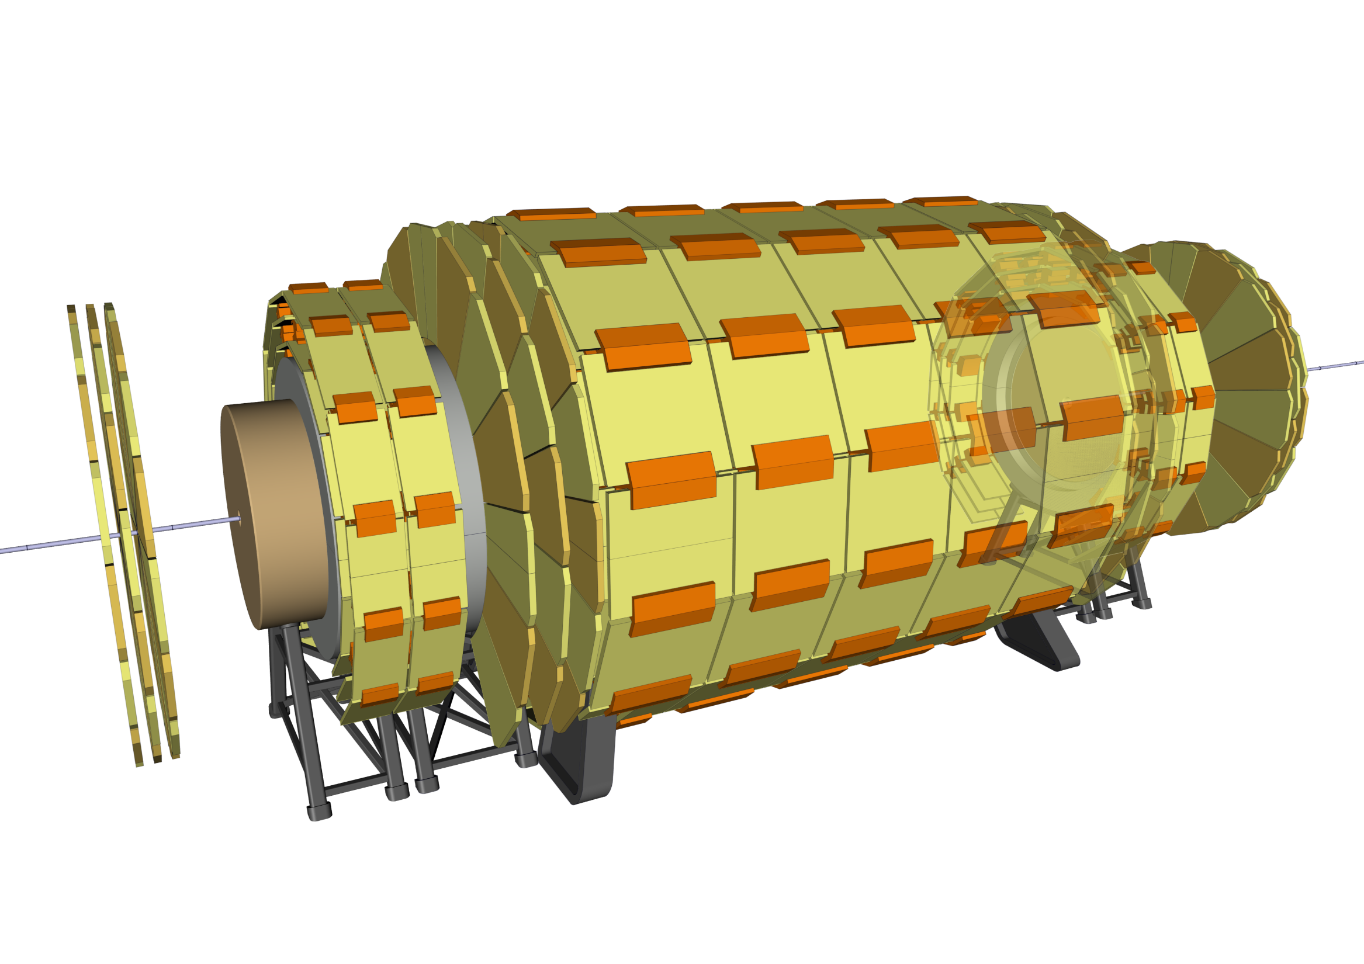
Experiment integration
35 - Install remaining Muon Chambers

Slide 46
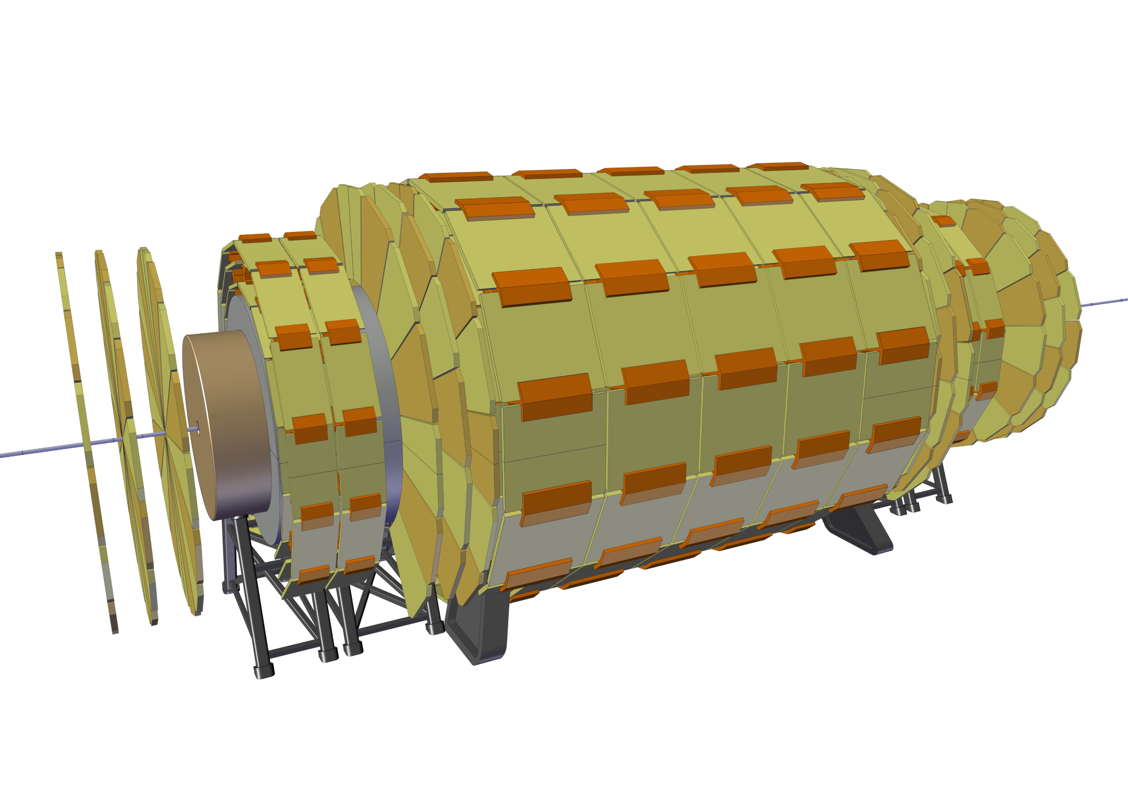
Experiment integration
36 – Move Forward Muon Wheels to their final position

Slide 47
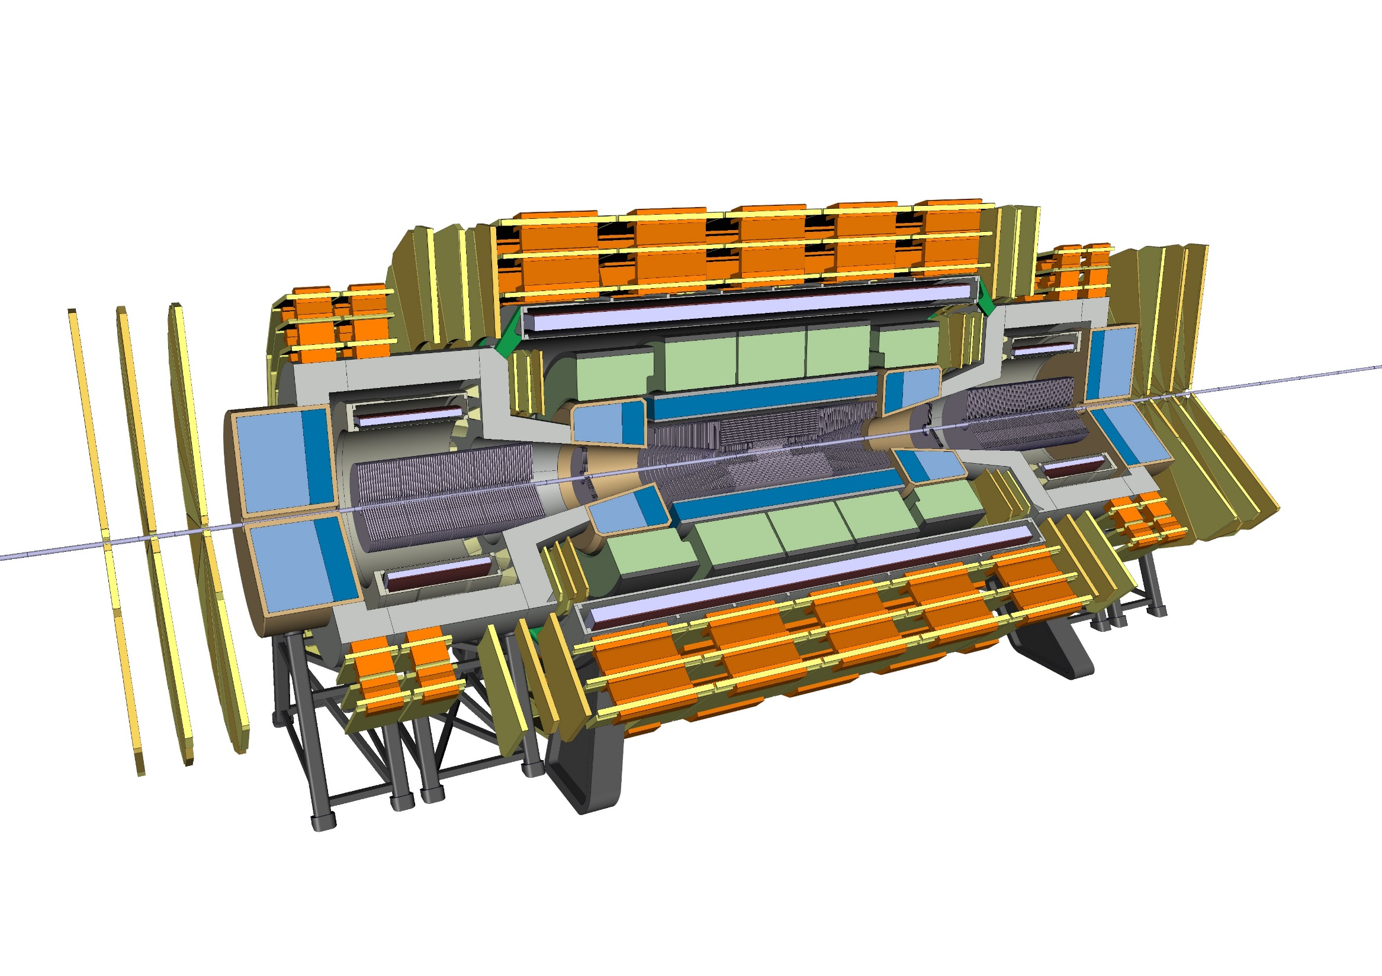
Experiment integration
COMPLETE ASSEMBLY

Slide 48
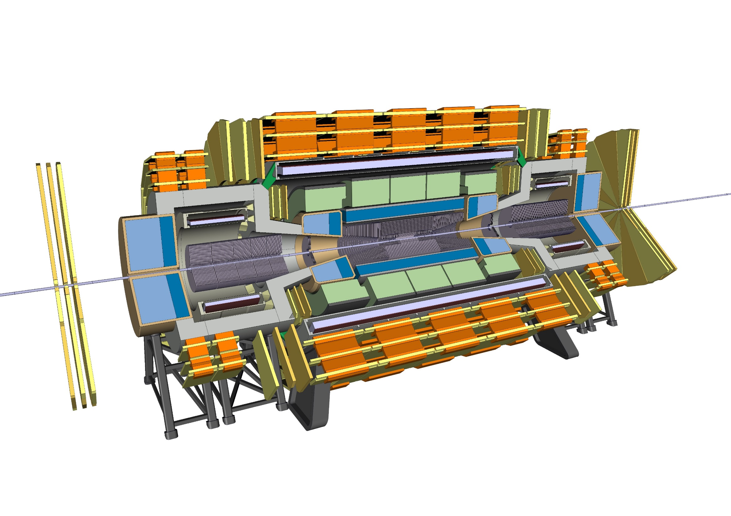
Short opening scenario
1 – Compact forward Muon Wheels

Slide 49
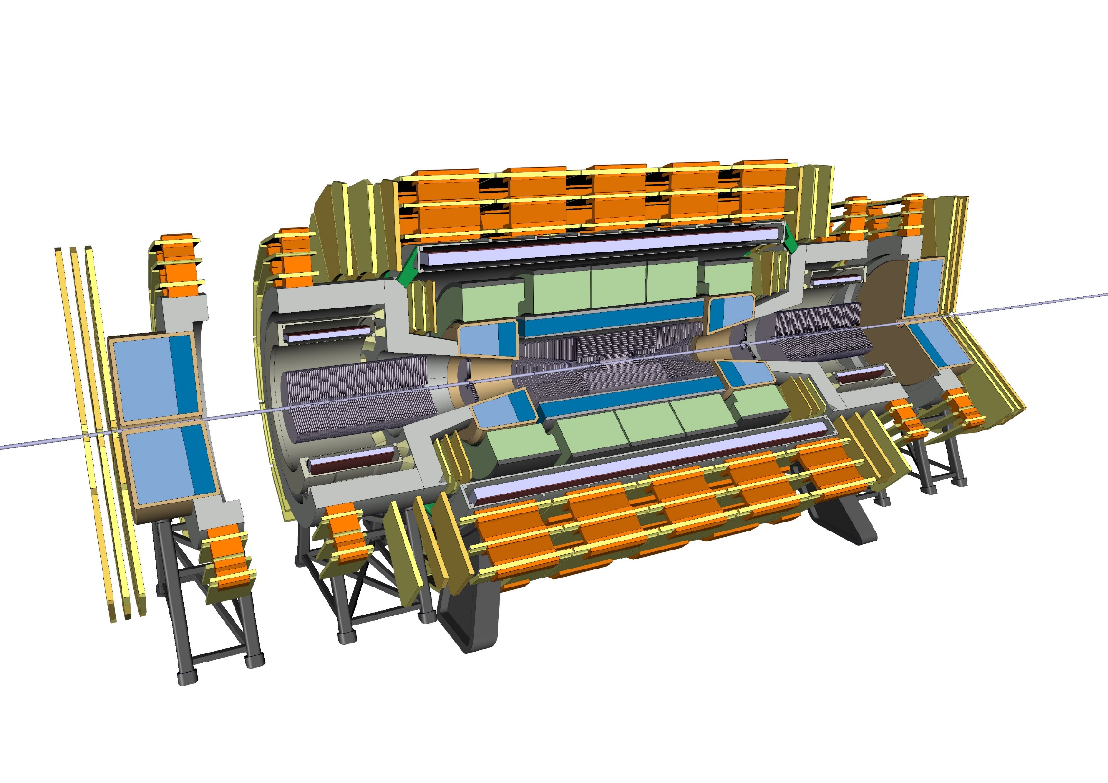
Short opening scenario
2 – Open Radiation Shield

Slide 50

Short opening scenario
3 – Compact Muon Chambers and disconnect Spokes

Slide 51

Short opening scenario
4 – Slide trackers module inside Radiation Shield

Slide 52
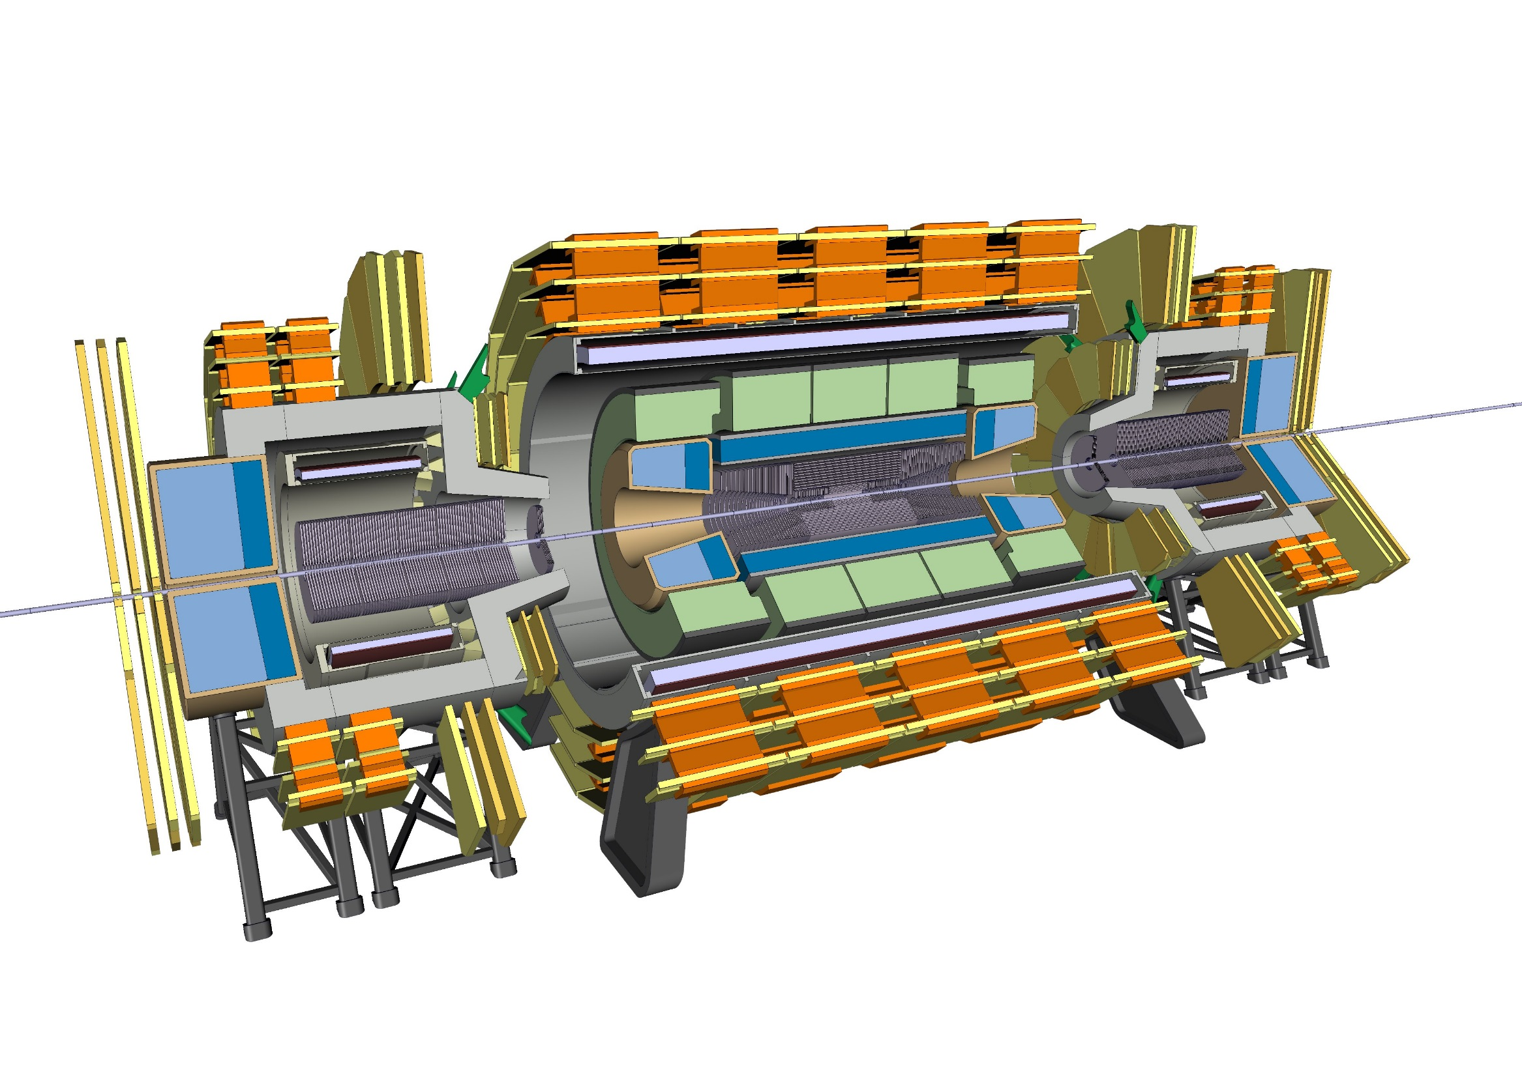
Short opening scenario
5 – Slide the Forward Solenoid structure

Slide 53

Long shutdown scenario
1 – 3rd step of the short opening on one side, and the final step on the other end

Slide 54
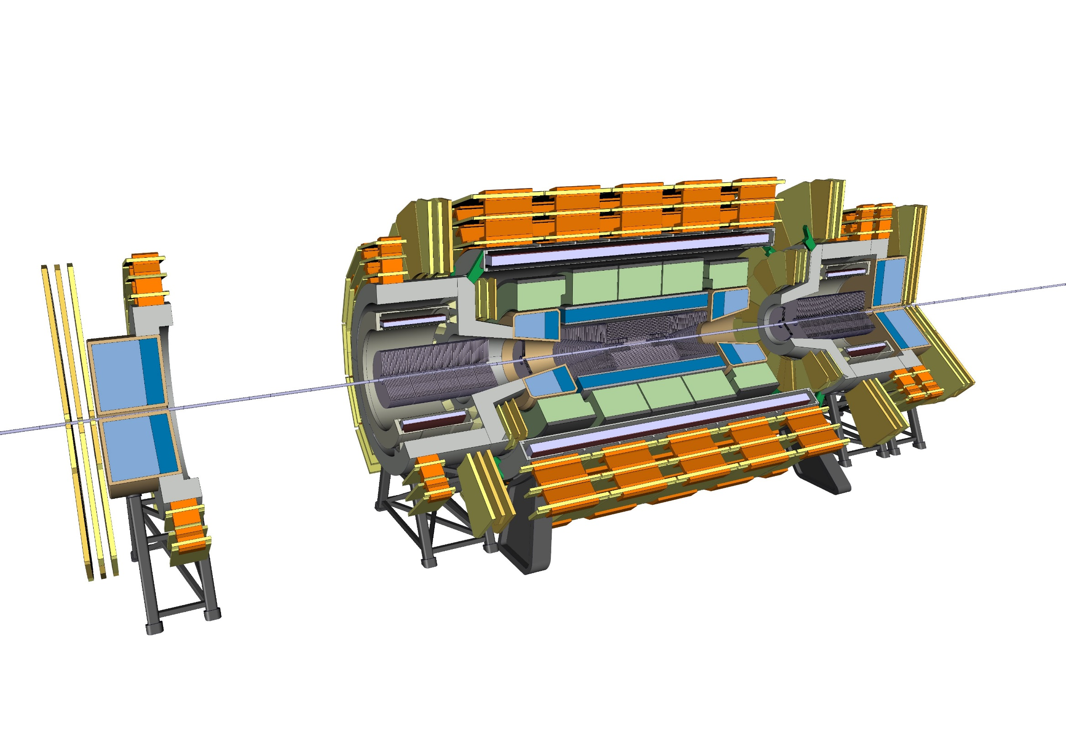
Long shutdown scenario
2 – Slide the Ecal 10.2m from the Forward Solenoid

Slide 55

Long shutdown scenario
3 – Remove part of the Beam Pipe

Slide 56
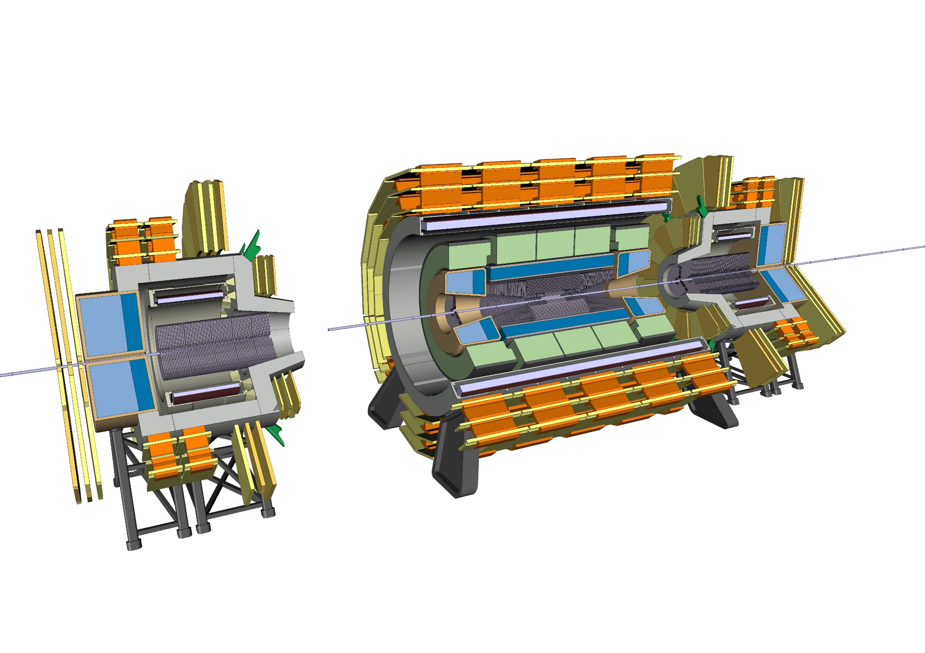
Long shutdown scenario
4 – Slide the Forward Solenoid structure

Slide 57

Long shutdown scenario
5 – Remove another portion of the beam pipe

Slide 58
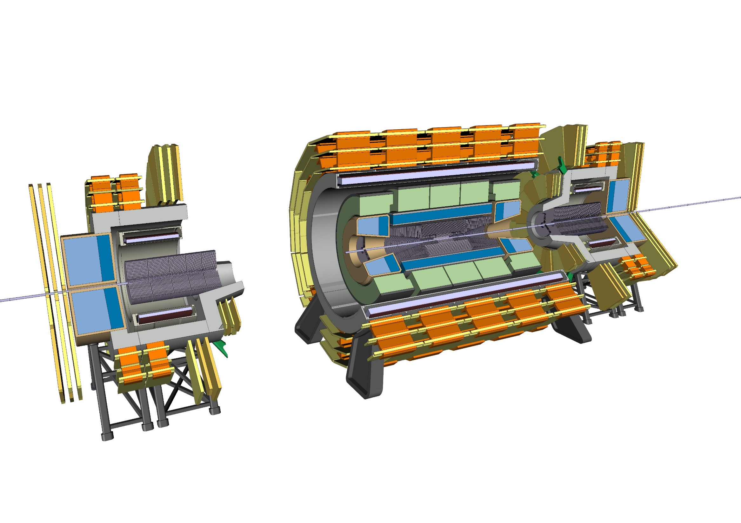
Long shutdown scenario
6 – Remove the top part of the Radiation Shield nose and its Muon Chambers

Slide 59

Long shutdown scenario
7 – Remove two modules of the Forward Trackers

Slide 60
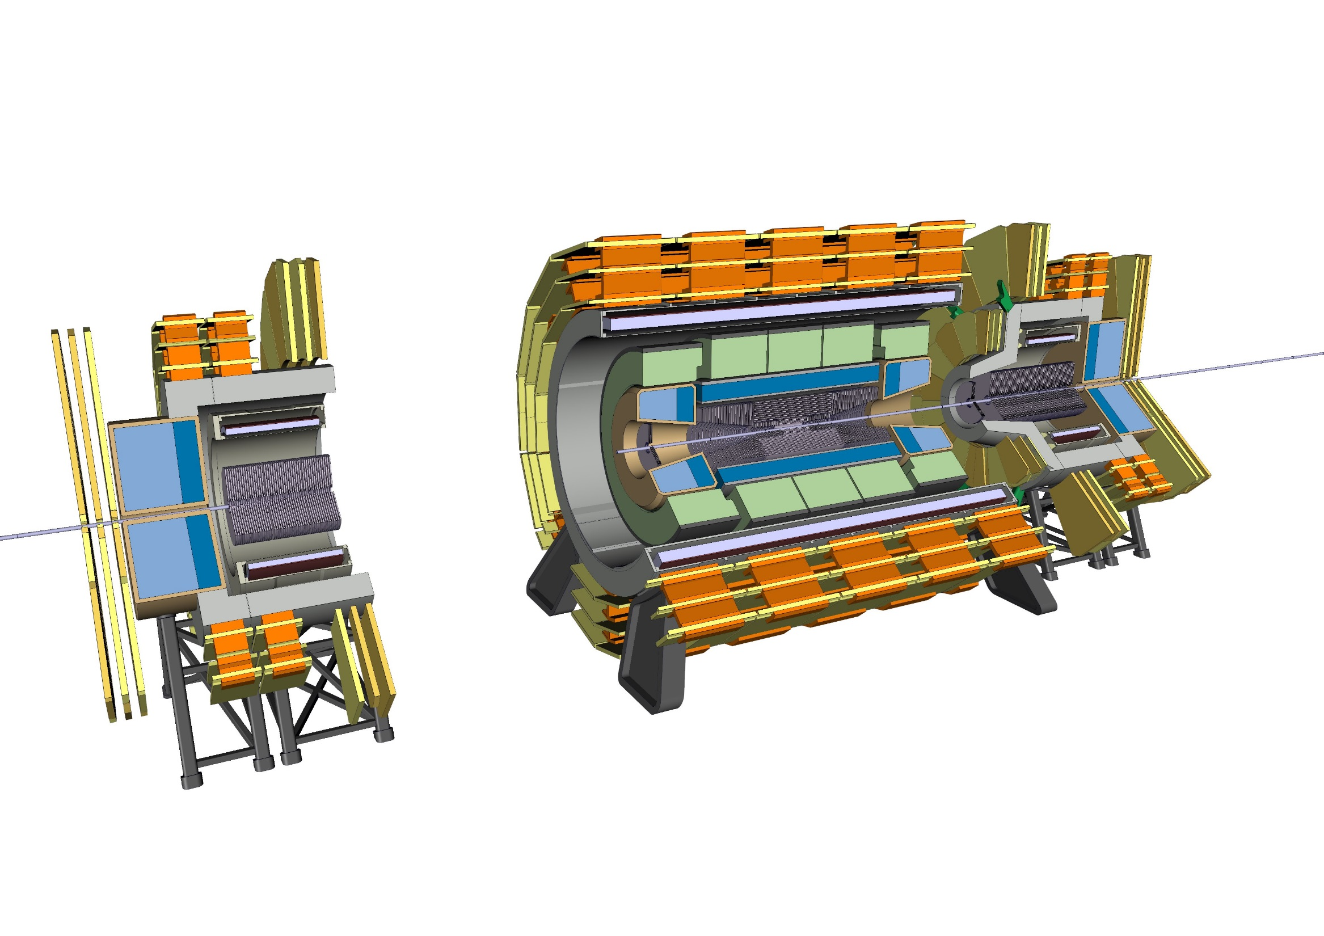
Long shutdown scenario
8 – Remove the bottom part of the Radiation Shield nose and its Muon Chambers

Slide 61
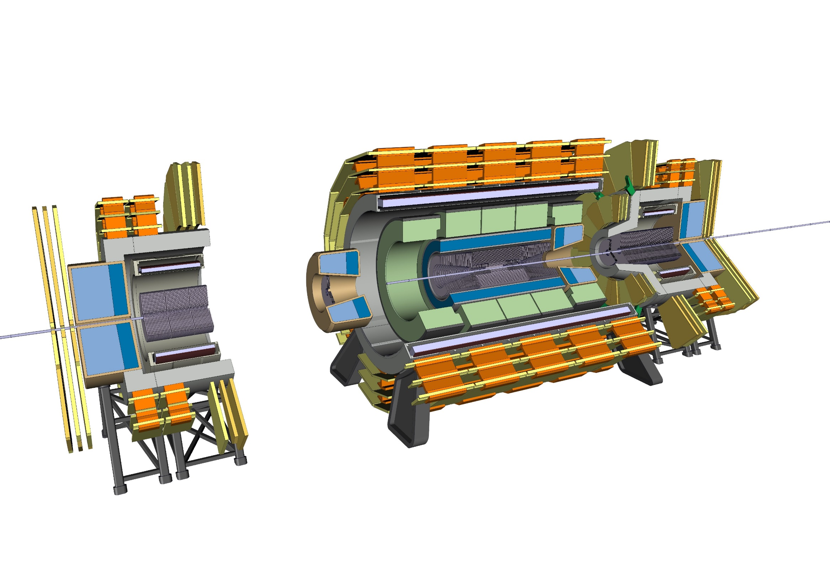
Long shutdown scenario
9 – Remove the Ecal Module and the Tracker module inside

Slide 62
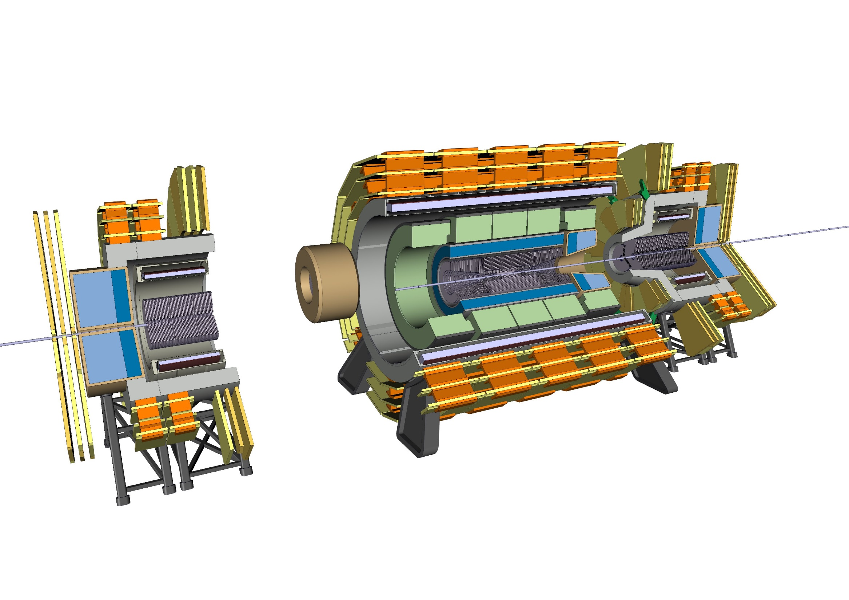
Long shutdown scenario
10 – Move the Ecal Module and the Tracker module sideways

Slide 63

Long shutdown scenario
11 – Remove another portion of the Beam Pipe (on both ends of the tracker)

Slide 64
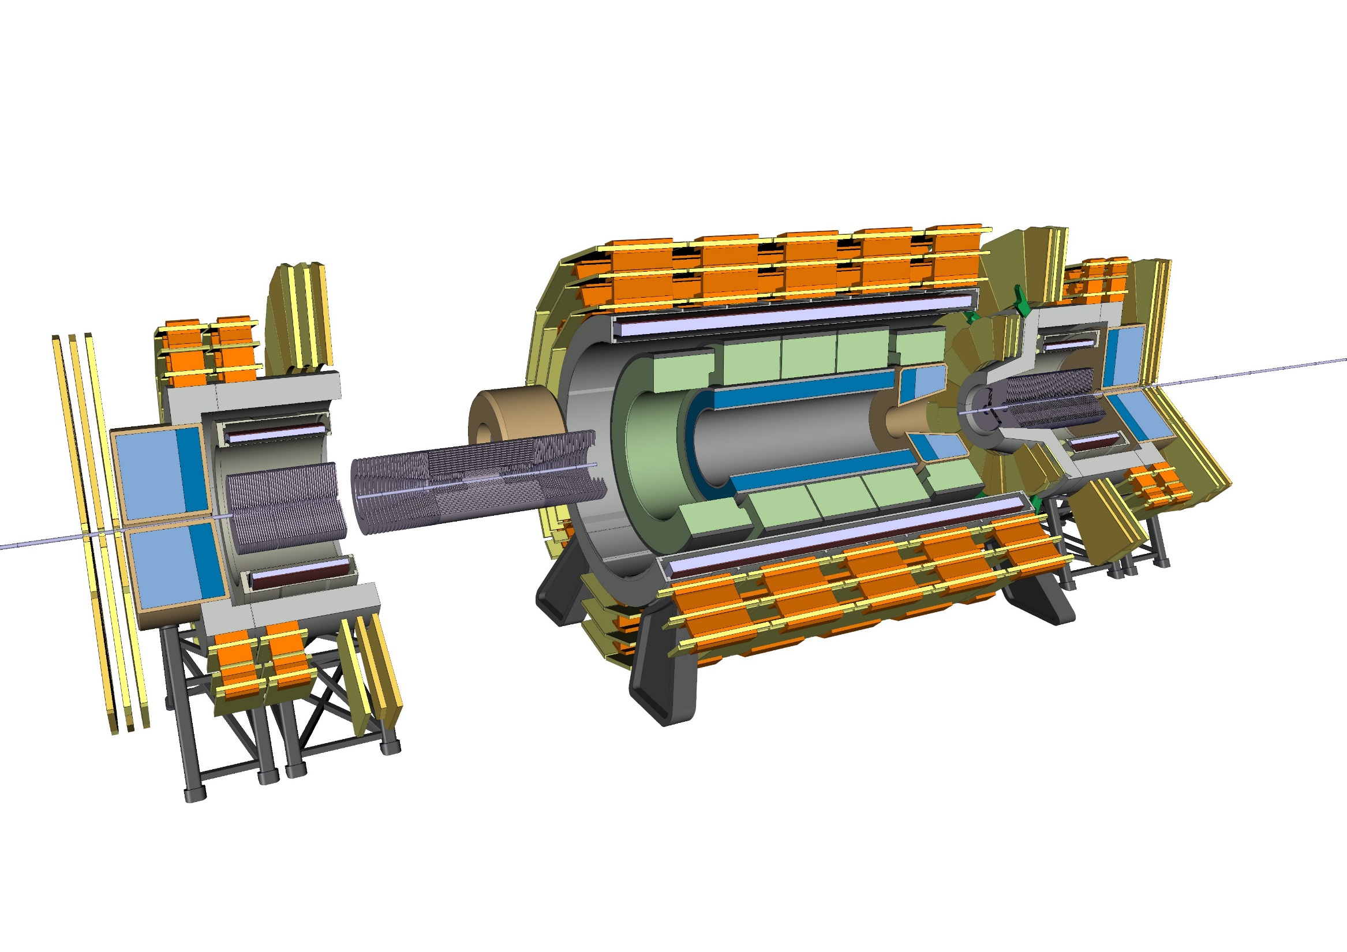
Long shutdown scenario
12 – Slide the Trackers Outside

Slide 65

Cavern
Detector envelope (L x W x H) [m³] | 54 x 18 x 18.5
Cavern Size (L x W x H) [m³] | 65 x 28 x 28
Main Shaft diameter [m] | 12
Secondary shaft diameter [m] | 10
Main shaft crane requirement [kt] | 2 or 3 (depends on Hcal modularity)
Secondary shaft crane requirement [kt] | 0.6

