Slide 1
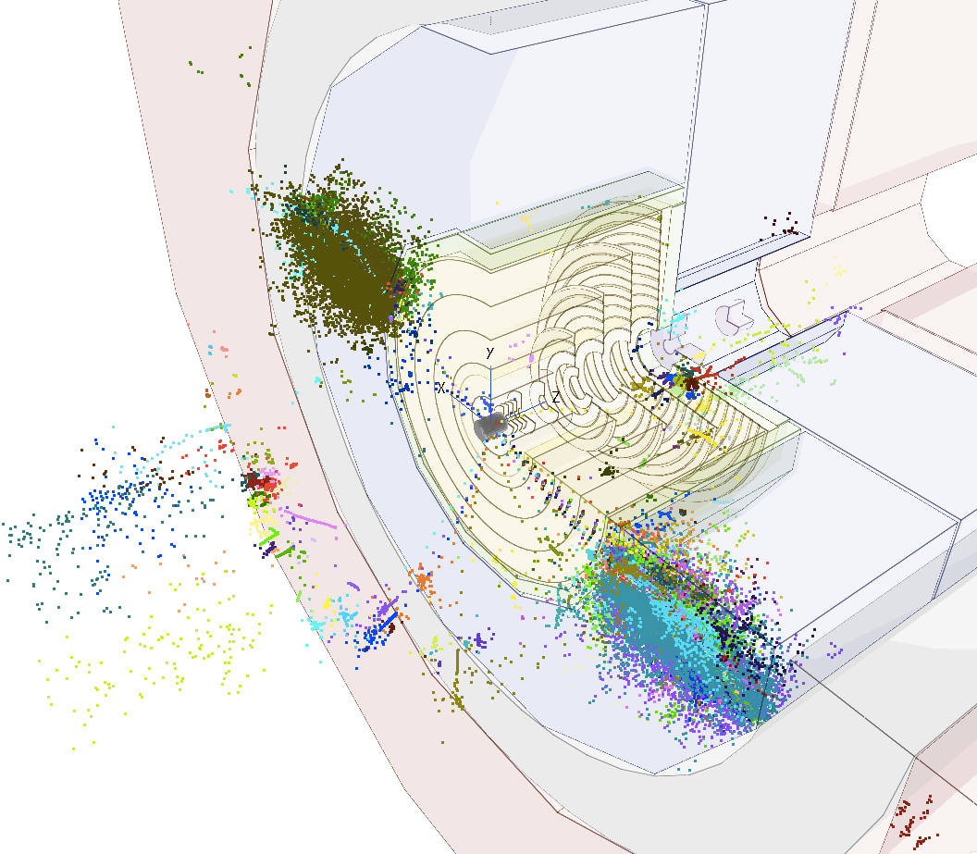
Tracker resolution and boosted objects
Dominik Dannheim (CERN), Daniel Hynds (CERN)
Estel Perez (CERN), Philipp Roloff (CERN), Rosa Simoniello (CERN)
Special thanks to Zbynek Drasal (CERN), Valentin Volkl, Andre Sailer(CERN)
FCChh detector meeting , 8th Feb 2017

Slide 2
Introduction
Q: What is the requirement on the detector granularity given by our need to resolve close-by hits from decays of very boosted particles?
Our Benchmark: high energy taus decaying to 3 prongs (worst case scenario)
  tkLayout geom + drivers, new CLIC SW full simulation
Notice 2 effects are convoluted:
  small opening angle between the prongs
  very displaced decay vertex
Efficiency of resolving the 3 prongs
  vs tau flight distance
  vs tau energy
  vs detector granularity
NEW: Similar study using B-jets

Slide 3
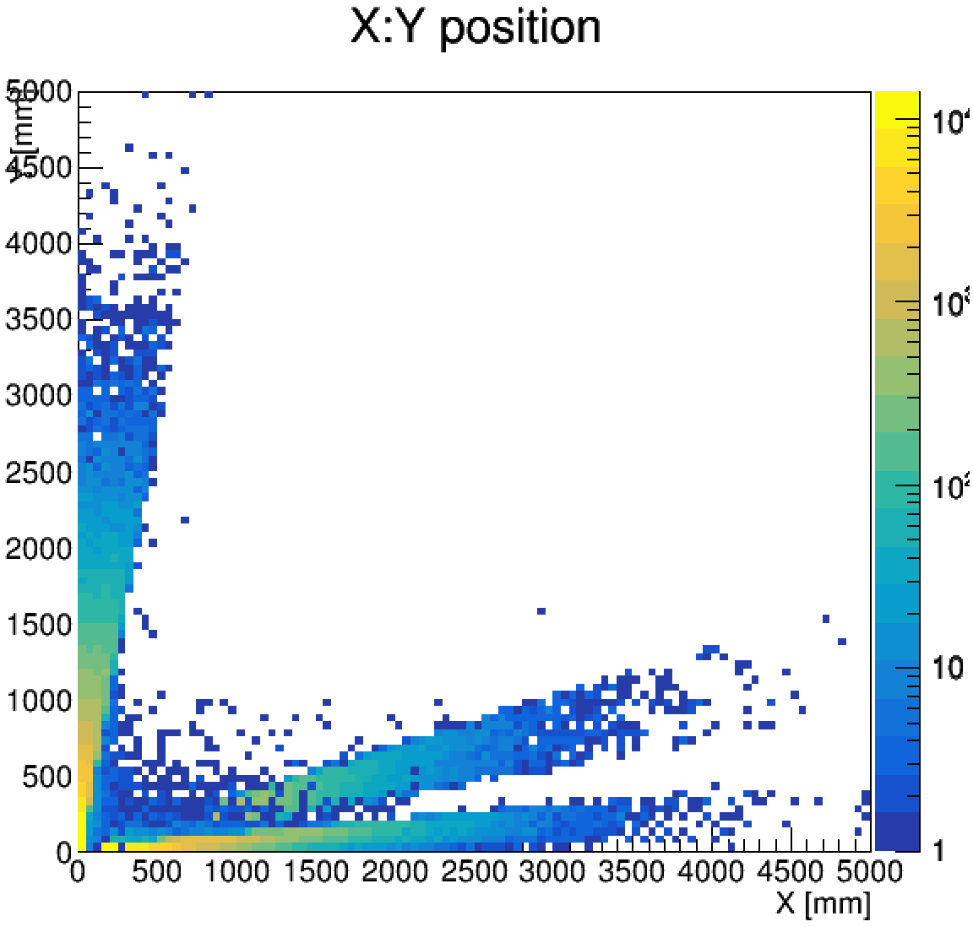
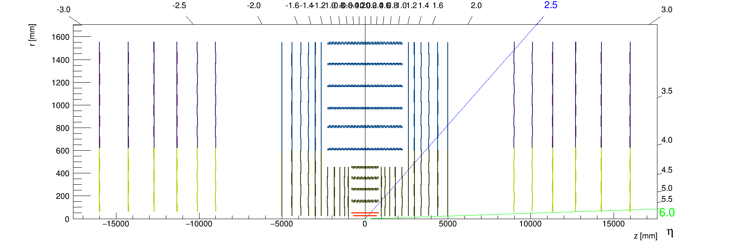
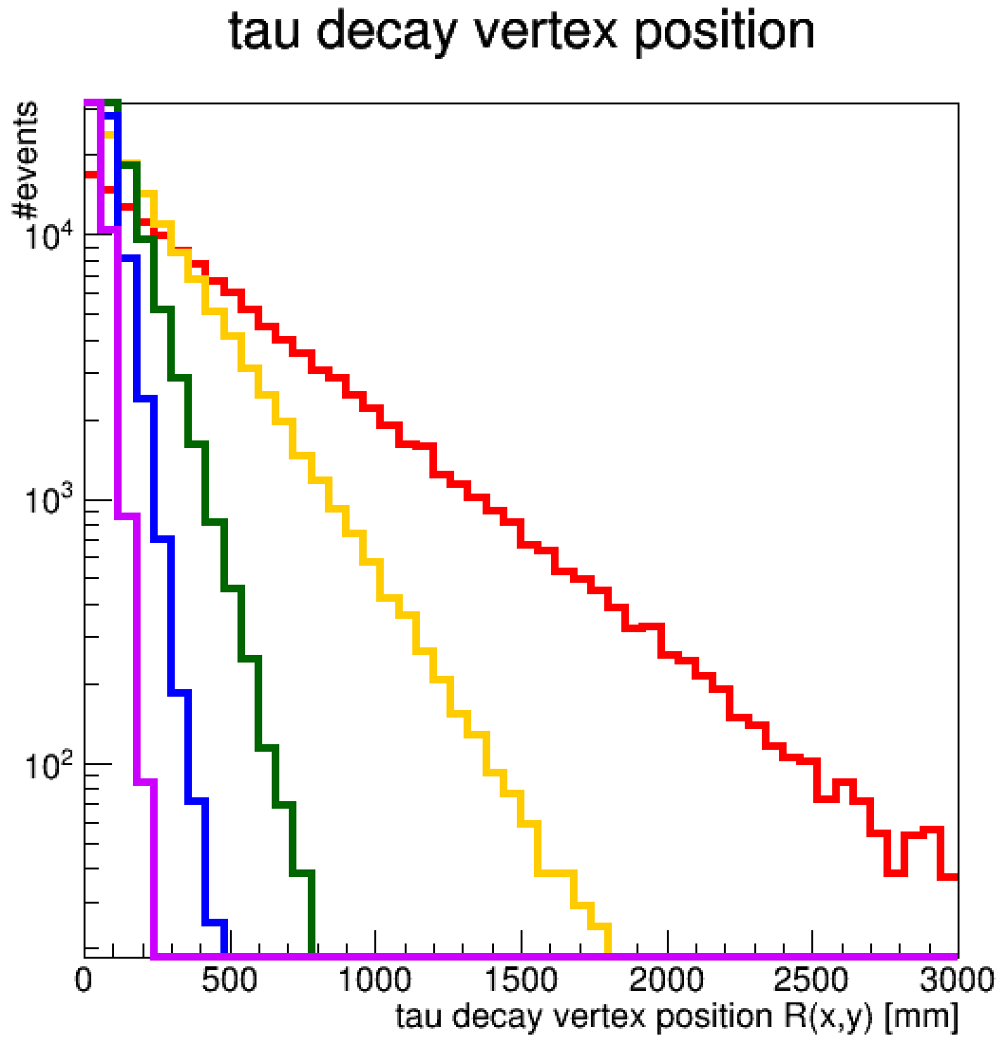
Tau samples used
tau decay vertex position (R:Z plane)
Z’-> tau tau events (no ISR, taus back-to-back) with at least one 3-prong tau
Eτ=10TeV
central
Fraction of central taus decaying
inside the beampipe
(within R(x,y)<20mm )
Etau=10 TeV : 0.045
Etau=5 TeV : 0.088
Etau=2 TeV : 0.201
Etau=1 TeV : 0.357
Etau=0.5 TeV : 0.586
Etau=0.2 TeV : 0.888
Etau=0.1 TeV : 0.987
transition
forward
Z[mm]
Central
Etau=10 TeV
Etau=5 TeV
Etau=2 TeV
Etau=1 TeV
Etau=500 GeV
While 99% of central 100 GeV taus decay within the beampipe, only 4% of 10TeV central taus do.

Slide 4
Efficiency definition (I)
Resolve all prongs → reconstruct all tracks → have enough hits per track
Assume: we need at least 3+1(backup) non-shared hits per track
Assume: outside-in tracking
→ the hits from different prongs must be resolved in the 4th-to-last layer of the tracker
tau decay vertex position
«Acceptance»:
Fraction of central taus decaying before the 4th-to-last barrel layer
Etau=10 TeV : 0.857
Etau=5 TeV : 0.978
Etau=2 TeV : 0.9999
Etau=1 TeV : 1
Etau=10 TeV
Fraction of forward taus decaying before the 4th-to-last barrel layer
Etau=10 TeV : 0.9992
Start by studying the barrel…
Z[mm]

Slide 5
Efficiency definition (II)
π^{+/-}
π^{+/-}
π^{+/-}
Consider the closest pair of hits in the 4th-to-last layer
v
Assume: single-hit clusters
→ To resolve the two prongs, the distance between their hits > 2*pixel pitch
(In either the RPhi(u) or Z(v) direction )
2*pixel pitch
u
τ^{+/-}
Efficiency = ΔRPhi (ΔZ) distance between closest hits > 2*RPhi (Z) pixel pitch / closest pair of pion hits in the 4th-to-last layer
[effectively factoring out taus that decay after the 4th-to-last layer – out of acceptance]

Slide 6
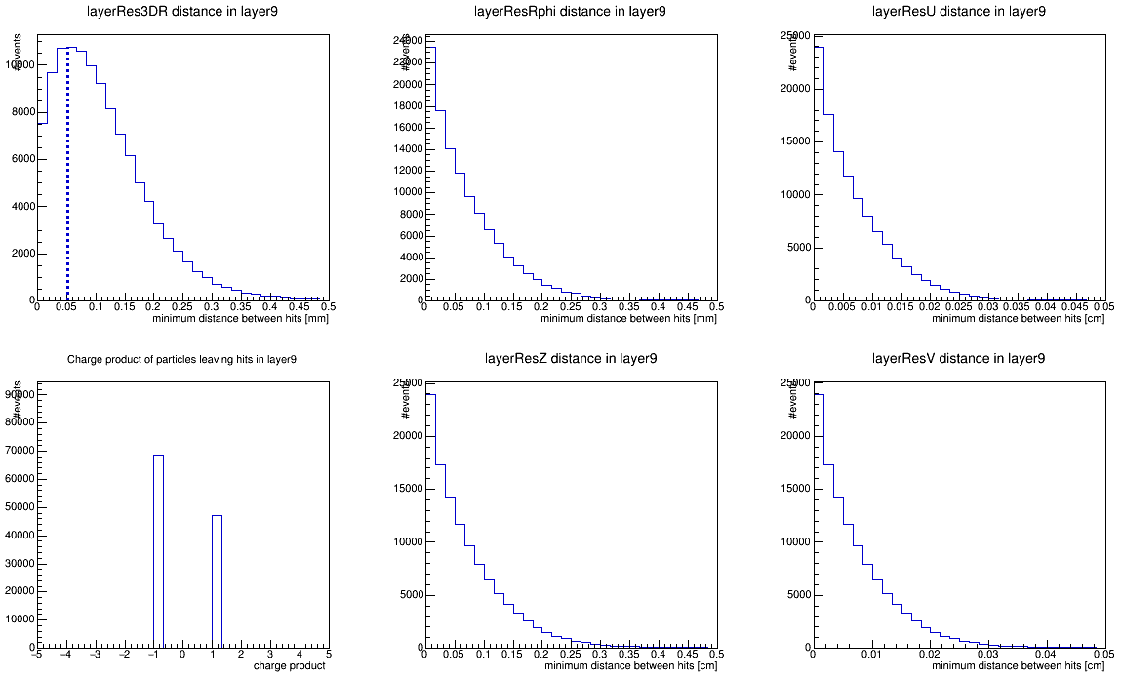
Efficiency definition (III)
Assume: 10x100 [μm] single point resolution in the 4th-to-last layer
Assume: pixel pitch = single point resolution * √12
→ if ( ΔRPhi > 2 * 10 μm * √12 ); pass
Central tau of E=10 TeV decaying before 9th barrel layer (86% acceptance)
Distance between the closest pion hits in the 9th barrel layer
41% efficiency
(acceptance not included)
Same separation in RPhi and Z, no privileged direction
Efficiency driven by cut in RPhi since pitch is 10 times smaller
3D distance
distance in RPhi
distance in u
pass
charge product
distance in Z
distance in v
(module local coordinates)

Slide 7
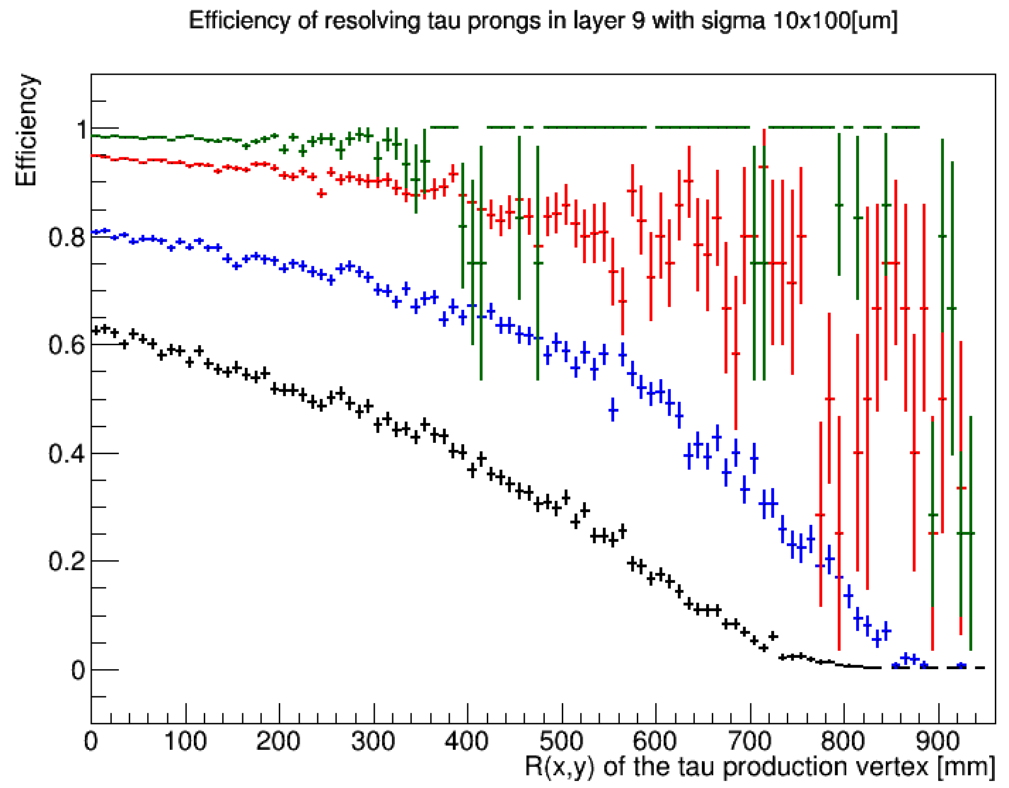
Efficiency vs tau decay vertex position
For various tau energies
For 10 TeV taus decaying before the beampipe: ~60% efficiency only due to the small opening angle between decay products
  Could be improved by using higher detector granularity
Efficiency drops in R due to tau displaced decay
  Could one use the tau track in the vertex detector as an extra handle for identification?
No significant inneficiency for taus of E < 1 TeV
Central taus
Etau = 1 TeV
Etau = 2 TeV
Etau = 5 TeV
Etau = 10 TeV
decay

Slide 8
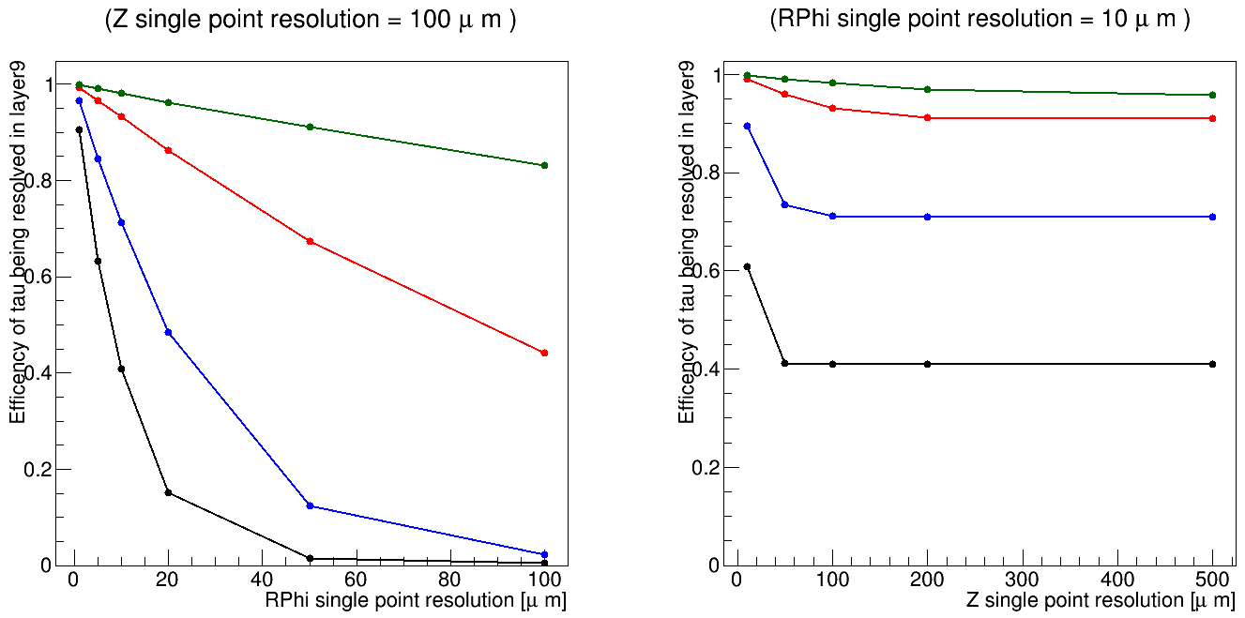
Efficiency vs detector single point resolution
Assuming: pixel pitch = single point resolution * √12
Vertical line shows the default 10x100 [μm]
Etau = 1 TeV
Etau = 2 TeV
Etau = 5 TeV
Etau = 10 TeV
Etau = 1 TeV
Etau = 2 TeV
Etau = 5 TeV
Etau = 10 TeV
Rapid change with pixel pitch (single point resolution), specially for highest energy taus
In the current design, efficiency driven by RPhi. Not much gain by improving Z resolution unless comparable to RPhi.

Slide 9
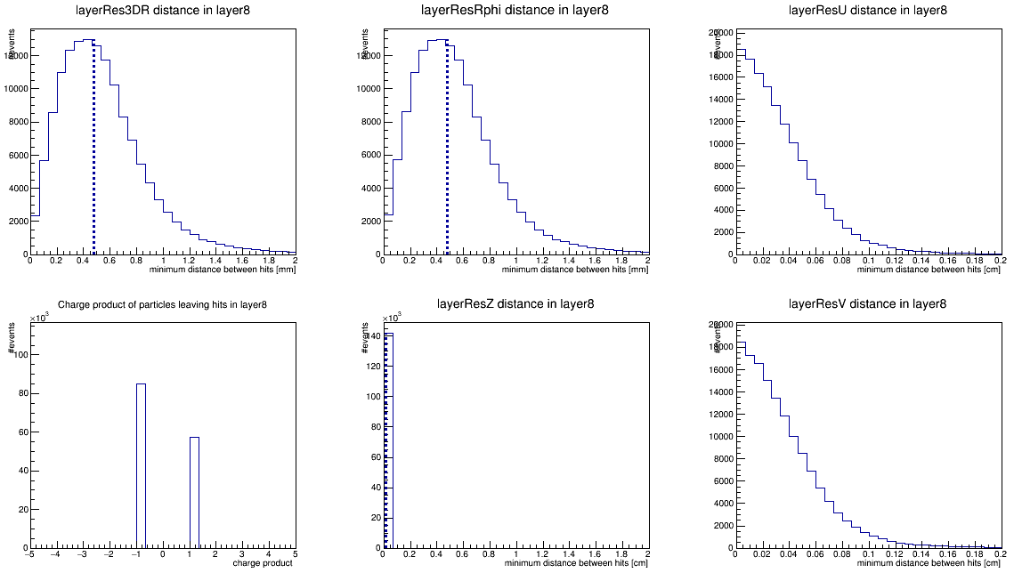
Endcap region
Assume: 10x100 [μm] single point resolution
Assume: pixel pitch = single point resolution * √12
→ if ΔRPhi(u) > 2 * 10 μm * √12 or ΔR(v) > 2 * 100 μm * √12 ; pass
3D distance
distance in RPhi
distance in u
pass
Forward tau of E=10 TeV decaying before 8th endcap disk (99.9% acceptance)
  4th-to last layer is more than 3 times further out
efficiency > 85% (acceptance not included)
→ Endcaps much less problematic due to longer lever arm
charge product
distance in v
(module local coordinates)

Slide 10
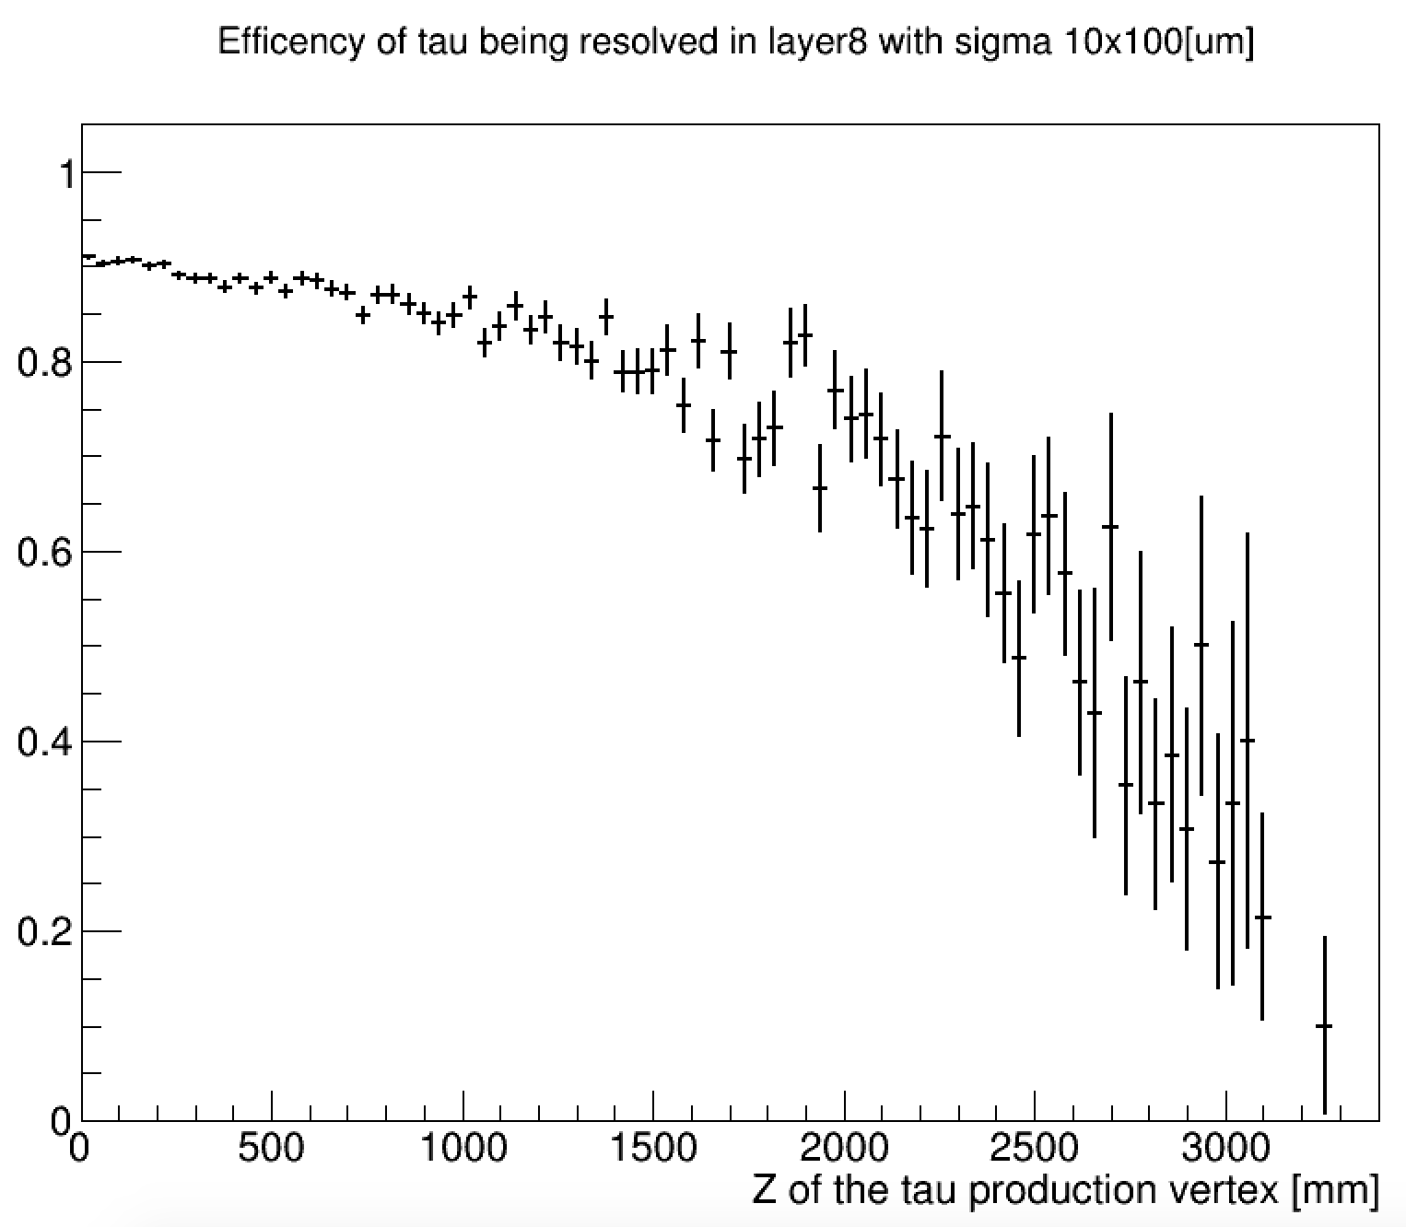
Efficiency vs tau decay vertex position
Etau=10TeV
For taus decaying in the beampipe,
efficiency close to 90%

Slide 11
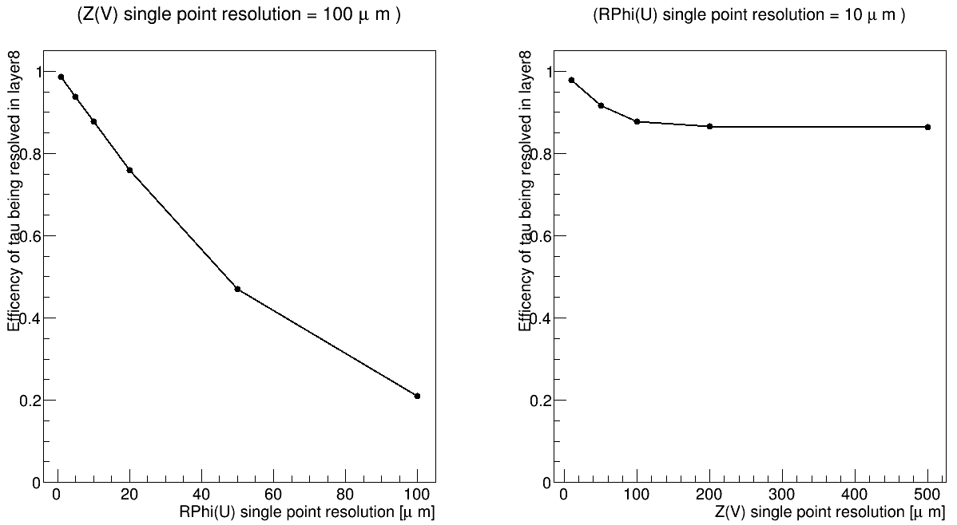
Efficiency vs detector single point resolution
R
R
An improve in granularity would not be so helpful for the endcap

Slide 12
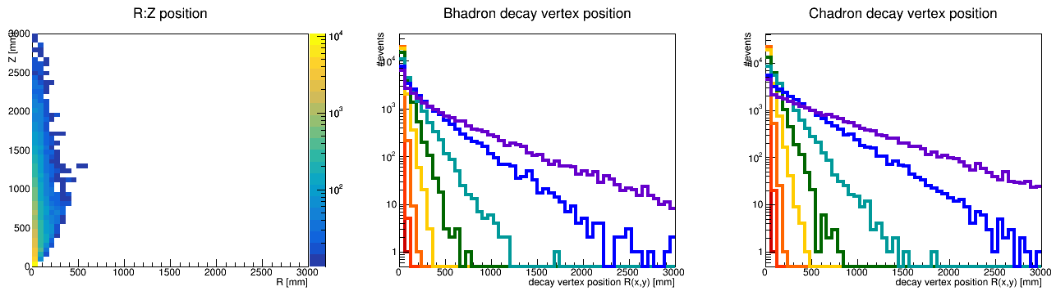
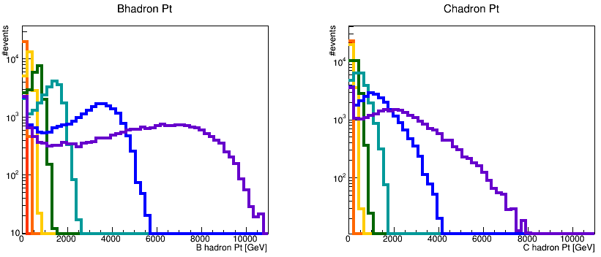
B-jets
pT(Bjet)=10 TeV
pT(Bjet)=5 TeV
pT(Bjet)=2 TeV
pT(Bjet)=1 TeV
pT(Bjet)=500 GeV
pT(Bjet)=200 GeV
pT(Bjet)=100 GeV
pT(Bjet)=50 GeV
Similarly, study the long-lived hadrons in a B-jet
Select B-hadrons as well as their C-hadron daughters
For different b-jet energies, use bb dijet events in the barrel
R[mm]
central bb dijet events
Z[mm]
Hadrons not mono-energetic → flight distance distribution deviates from straight line.
B-hadron Pt
C-hadron Pt

Slide 13
Efficiency definition (II)
C-hadron
Consider only the hits produced by the daughters of the long-lived B and C-hadrons
  Require generator status==1
Assume: we need to separate the closest pair of daughters
→ Consider the closest pair of hits in the 4th-to-last layer
B-hadron

Slide 14
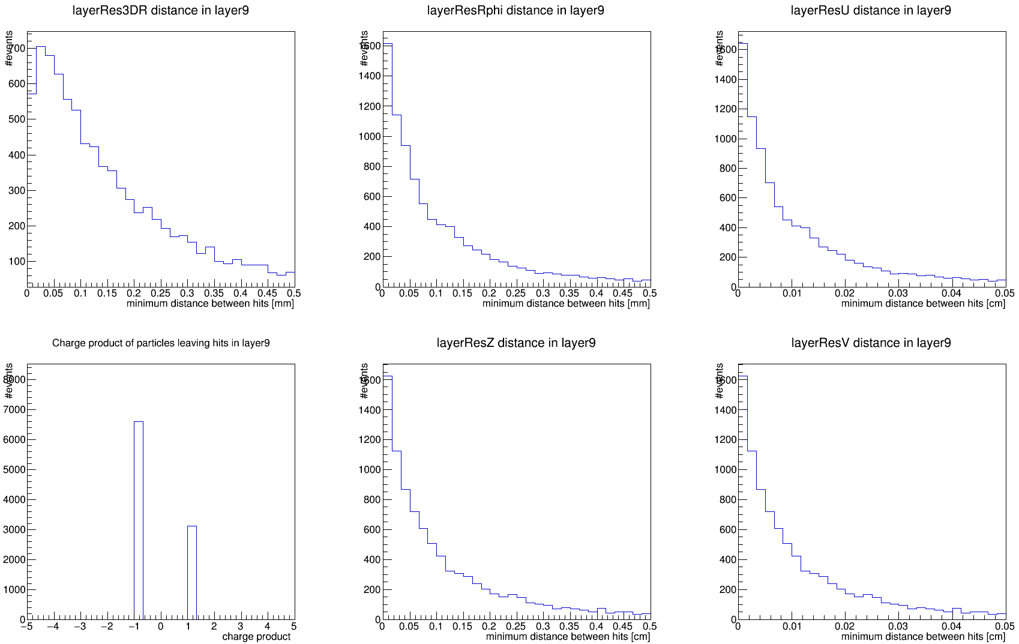
Efficiency definition (III)
Assume: 10x100 [μm] single point resolution
B-jet of pT=10 TeV
Distance between the closest daughters hits in the 9th barrel layer
(88% acceptance)
Quite similar to 10 TeV taus :
54% efficiency (acceptance not included)
(efficiency higher since actual B/C-hadron energy is lower)
3D distance
distance in RPhi
distance in u
pass
charge product
distance in Z
distance in v
(module local coordinates)

Slide 15
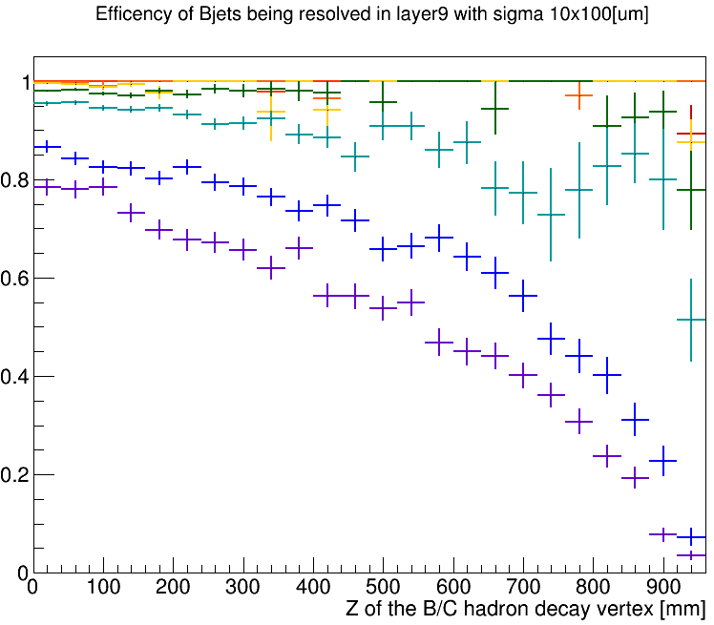
Efficiency vs decay vertex position
For various B-jet energies
Central B-jets
pT(Bjet)=10 TeV
pT(Bjet)=5 TeV
pT(Bjet)=2 TeV
pT(Bjet)=1 TeV
pT(Bjet)=500 GeV
pT(Bjet)=200 GeV
pT(Bjet)=100 GeV
pT(Bjet)=50 GeV
For 10 TeV B-jets, with B or C-hadrons decaying before the beampipe: ~80% efficiency only due to the small opening angle between decay products
No significant inneficiency for B-jets of Pt < 1 TeV

Slide 16
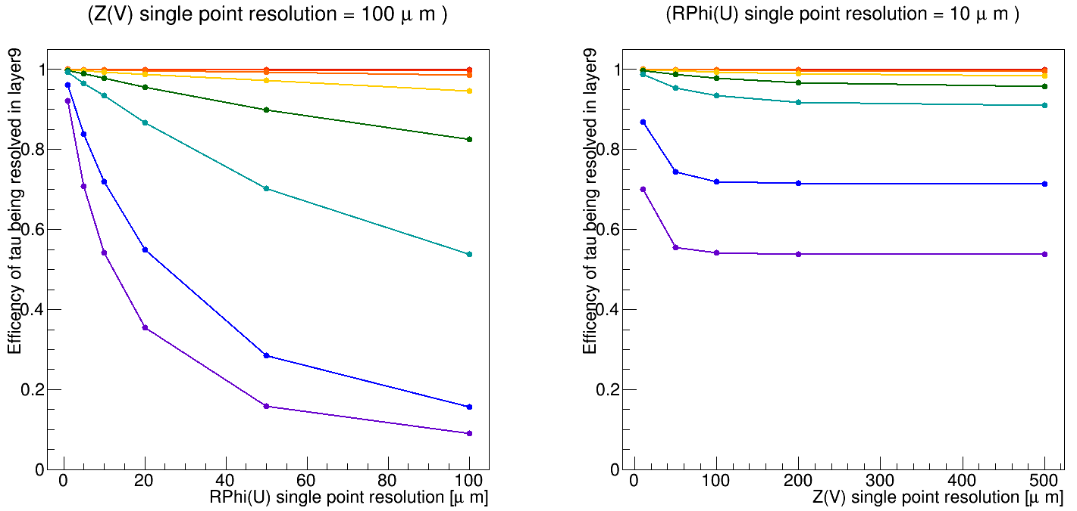
Efficiency vs detector single point resolution
Vertical line shows the default 10x100 [μm]
pT(Bjet)=10 TeV
pT(Bjet)=5 TeV
pT(Bjet)=2 TeV
pT(Bjet)=1 TeV
pT(Bjet)=500 GeV
pT(Bjet)=200 GeV
pT(Bjet)=100 GeV
pT(Bjet)=50 GeV
Improving resolution in RPhi by a factor of 2 would mean efficiency 55%→70% for 10 TeV b-jets

Slide 17
Conclusions
The current granularity is suitable for E=1TeV 3-prong taus and for Pt=1 TeV b-jets
The efficiency of reconstructing all the charged daughters of a central:
  3-prong tau (E tau = 10 GeV) is about 40%
  B-hadron (from a Pt=10 TeV b-jet) is about 55%
If we want to increase this efficiency, we could improve the RPhi granularity of the strips in the barrel
This problem is less important in the endcaps (efficiency > 85%) since we have a larger lever arm

Slide 18
Backup

Slide 19
B jets acceptance
B hadrons
E(Bjet)=50 GeV ,B Fraction up to R=20 [mm]: 0.996848
E(Bjet)=100 GeV ,B Fraction up to R=20 [mm]: 0.959081
E(Bjet)=200 GeV ,B Fraction up to R=20 [mm]: 0.829957
E(Bjet)=500 GeV ,B Fraction up to R=20 [mm]: 0.583421
E(Bjet)=1000 GeV ,B Fraction up to R=20 [mm]: 0.398114
E(Bjet)=2000 GeV ,B Fraction up to R=20 [mm]: 0.275022
E(Bjet)=5000 GeV ,B Fraction up to R=20 [mm]: 0.192235
E(Bjet)=10000 GeV ,B Fraction up to R=20 [mm]: 0.161509
E(Bjet)=1000 GeV ,B Fraction up to R=925 [mm]: 1
E(Bjet)=2000 GeV ,B Fraction up to R=925 [mm]: 0.999217
E(Bjet)=5000 GeV ,B Fraction up to R=925 [mm]: 0.965865
E(Bjet)=10000 GeV ,B Fraction up to R=925 [mm]: 0.875244

Slide 20
B jets acceptance
C hadrons
E(Bjet)=50 GeV ,C Fraction up to R=20 [mm]: 0.991606
E(Bjet)=100 GeV ,C Fraction up to R=20 [mm]: 0.92315
E(Bjet)=200 GeV ,C Fraction up to R=20 [mm]: 0.719064
E(Bjet)=500 GeV ,C Fraction up to R=20 [mm]: 0.407441
E(Bjet)=1000 GeV ,C Fraction up to R=20 [mm]: 0.233609
E(Bjet)=2000 GeV ,C Fraction up to R=20 [mm]: 0.147122
E(Bjet)=5000 GeV ,C Fraction up to R=20 [mm]: 0.113189
E(Bjet)=10000 GeV ,C Fraction up to R=20 [mm]: 0.102258
E(Bjet)=1000 GeV ,C Fraction up to R=925 [mm]: 1
E(Bjet)=2000 GeV ,C Fraction up to R=925 [mm]: 0.997447
E(Bjet)=5000 GeV ,C Fraction up to R=925 [mm]: 0.934408
E(Bjet)=10000 GeV ,C Fraction up to R=925 [mm]: 0.793054

Slide 21
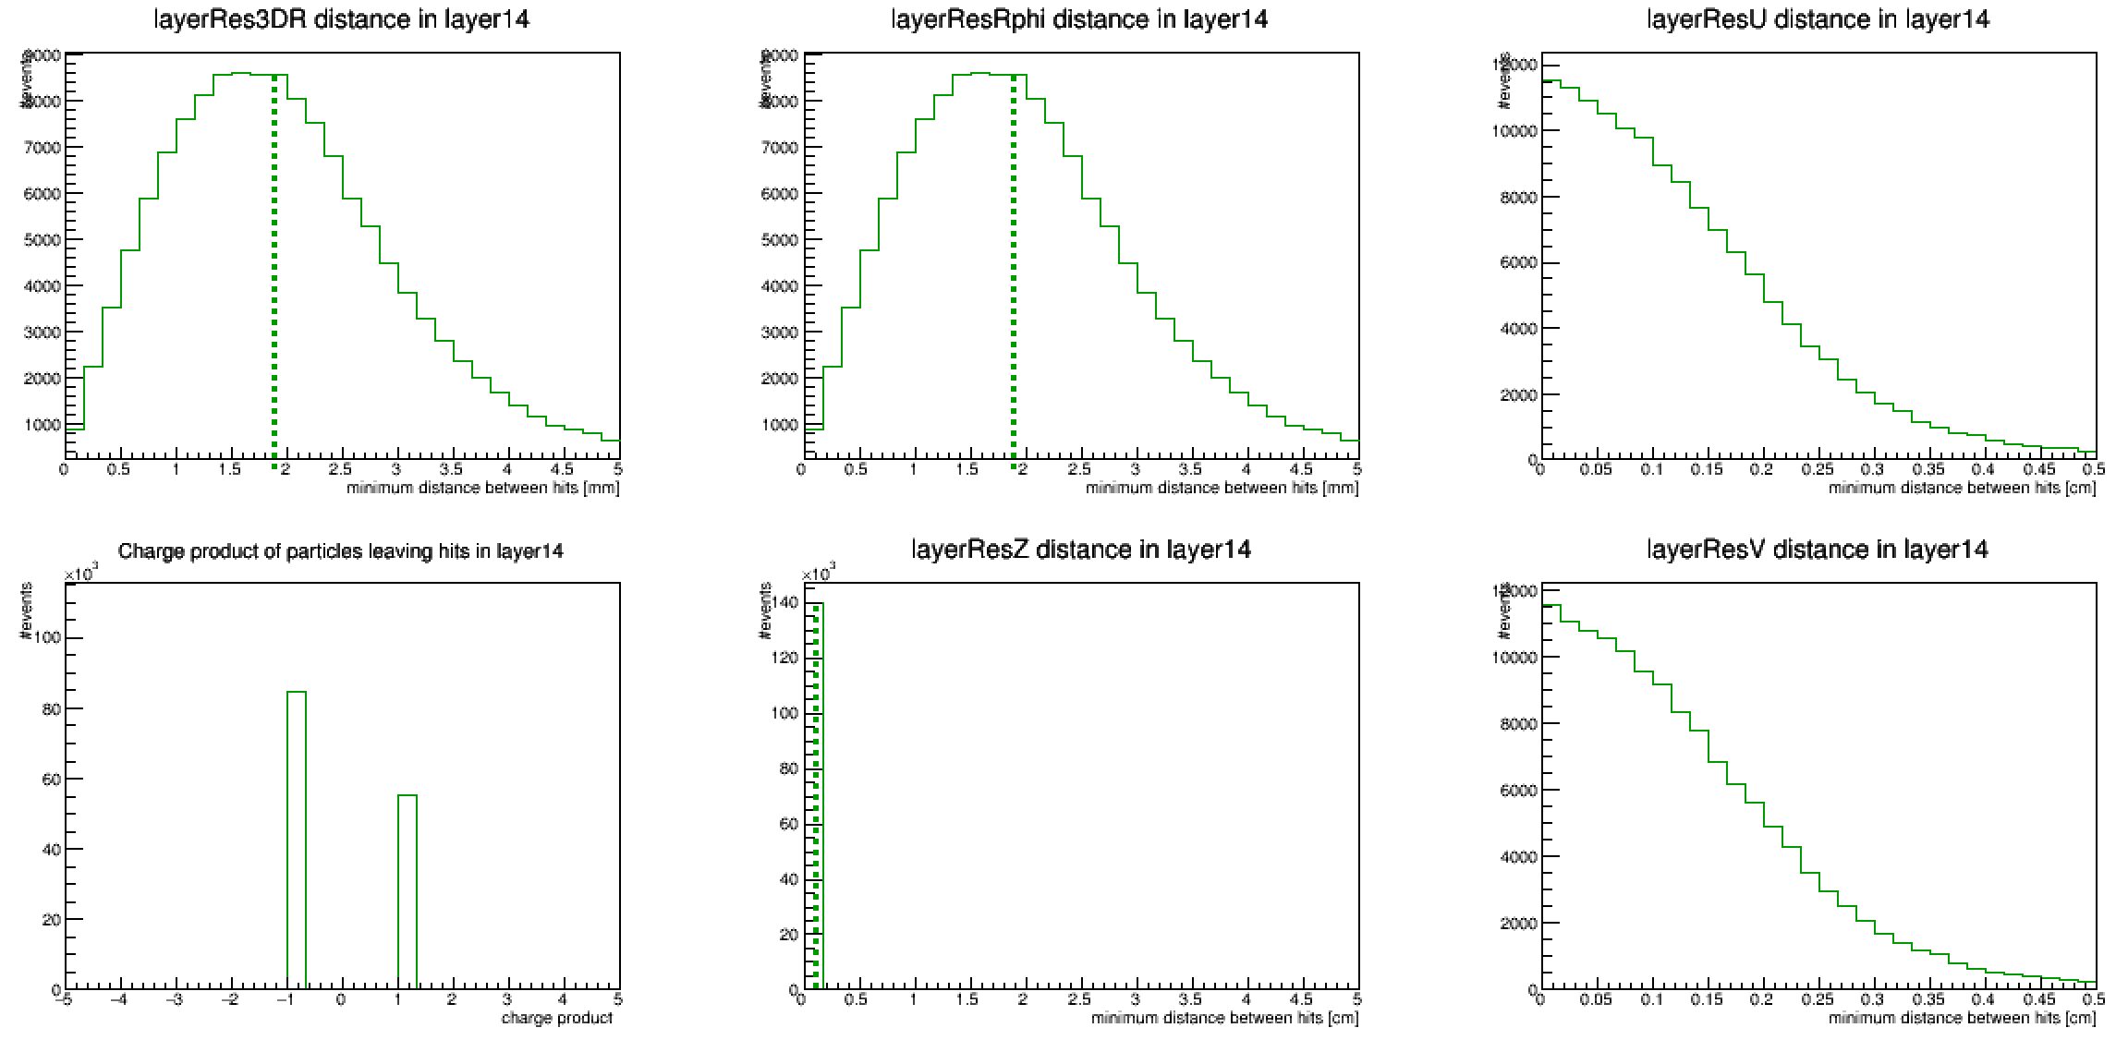
Forward region
tau decay vertex position (Y:X plane)
fraction of E=10TeV taus decaying before this layer = 1
Eτ=10TeV
forward

Slide 22
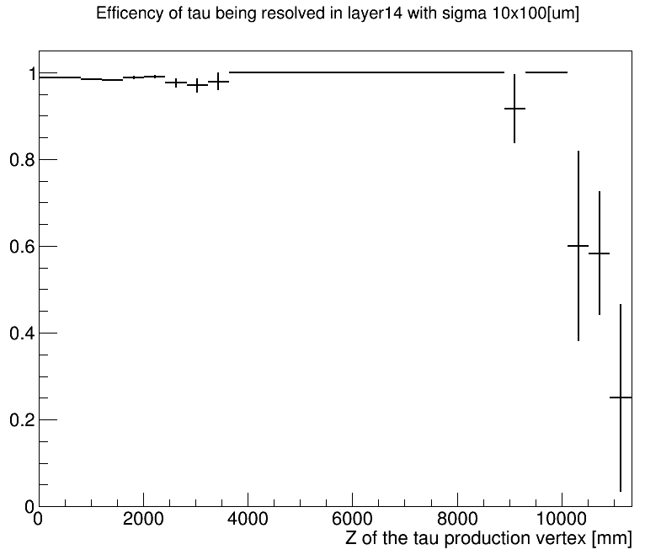
Efficiency vs tau decay vertex position

Slide 23
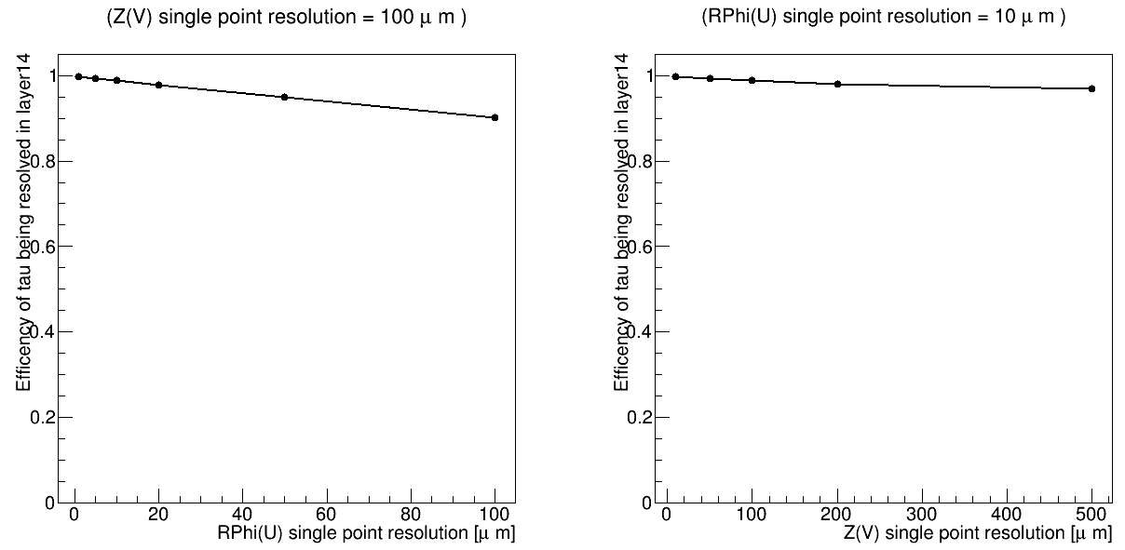
Efficiency vs detector single point resolution

