Slide 1
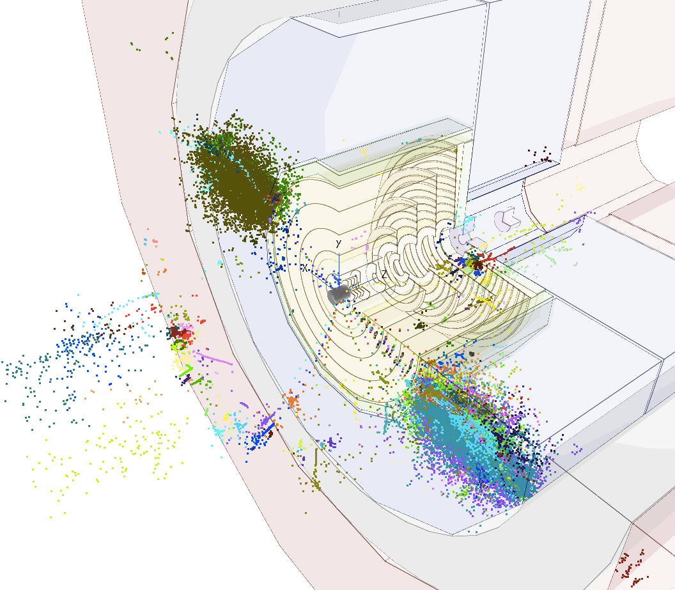
Status of Vertex Detector Optimization with full simulation flavor tagging performance
Dominik Dannheim (CERN),
Estel Perez (CERN), Philipp Roloff (CERN), Daniel Hynds (CERN),
Special thanks to Zbynek Drasal (CERN), Andrea Coccaro (UniGe)
FCChh detector meeting , 3rd May 2017

Slide 2
Introduction
Goal: optimize the Vertex detector taking into account the flavor tagging performance
Tools: evaluate performance using CLIC_SiD software chain
Steps:
Updating geometry to current baseline → done
Variations
  resolution → preliminary
  layout/material → ongoing
  tracking strategies → ongoing
Scan over jet energies
  obtain preliminary parameterization

Slide 3
Software chain: Summary
Generation: MG5 central dijets, restricted quark pT. *
Hadronization: Pythia6. Multiple interactions: off, ISR/FSR: on. *
Detector Model: CLIC_SiD with FCC vertex and squeezed FCC tracker (Option3_v02). Barrel only. *
Simulation: FCC material budget (services included in the module)
Digitization: FCC pixel sizes. Smear sim. hit position by Gaussian of σ=p/√12. *
Tracking: Nhits>=6, chi2<10, d0<10 [mm] (under study) *
Particle flow: Pandora
Vertexing: LCFIPlus. PFOs in 2 kT jets R=0.5. (to be revised)
Flavour Tagging: LCFIPlus (to be revised) *
(*)=some details in the next slides

Slide 4
Event Generation
Event generation in MadGraph5: (By Andrea Coccaro)
  pp->bb / cc / ll (udsg) at √s=100TeV
  restricted quark pT: Ex: 47.5 < pT(b) < 52.5 GeV
  Central eta: |η(b)|<0.05
  DR(bb)>0.4
Samples:
  Quark pT in GeV: 50, 100, 200, 500, 1000, 2000, 5000, 10000
  20k events per sample
  1M events for 50 & 500 GeV samples
Hadronization in Pythia6:
    Multiple Interaction: OFF
    FSR: ON
    ISR: ON

Slide 5
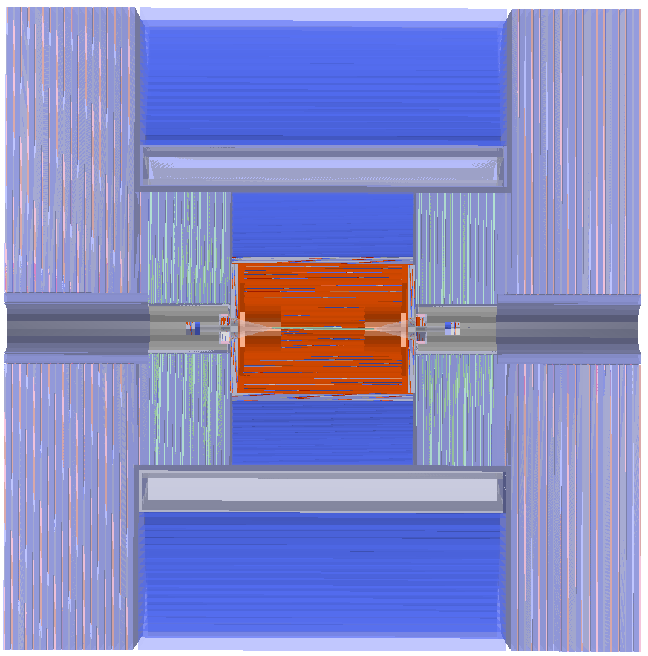
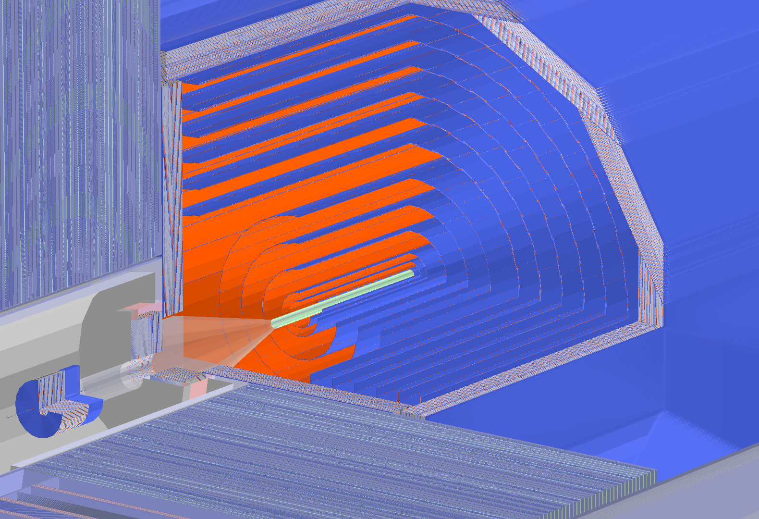
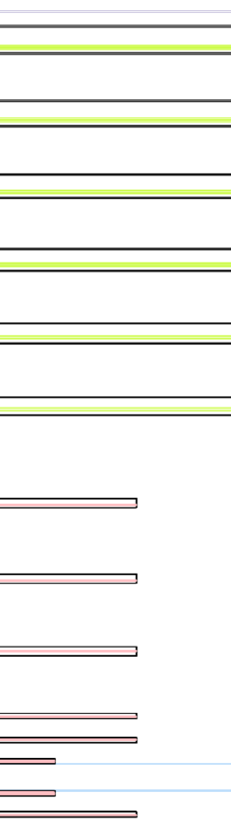
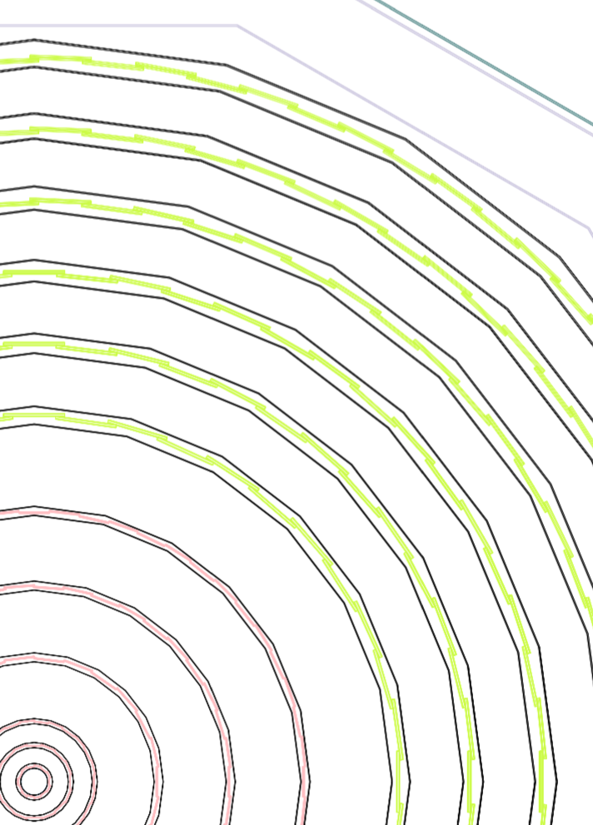
Detector Model
CLIC_SiD with FCC vertex and squeezed FCC tracker.
  Version Option3_v02 from Zbynek
  Barrel only. Vertex and tracker endcaps removed (do not fit inside CLIC_SiD).
    Tracker max z = 1536 mm instead of 2250mm (FCC), to avoid clashes with the CLIC endcap calorimeter
  Tracker outer layer R reduced from 1541mm (FCC) to 1206mm (CLIC)
  No explicit cables or supports. Material budget included in the modules material.
Digitisation:
  Both vertex and tracker detectors are digitized as long pixels.
  We used a simplified digitizer, smearing the simulated hit position with a Gaussian of σ=pitch/√12 , which provides with a direct relationship between pitch and single point resolution (as done for Fast Sim).
  → Factor out detector technology

Slide 6
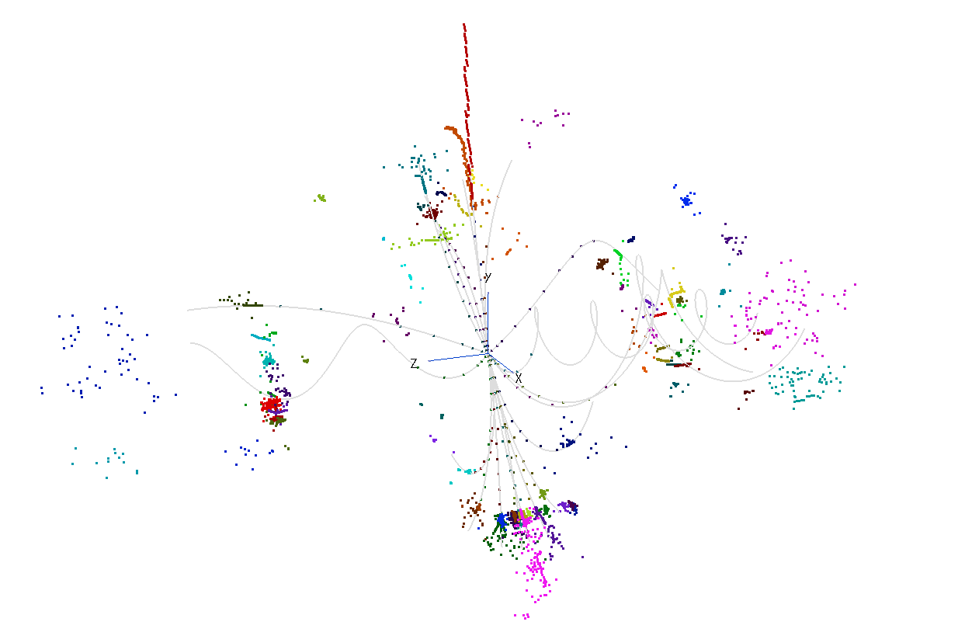
Event display
dijet (bb)
pT(b)=50GeV

Slide 7
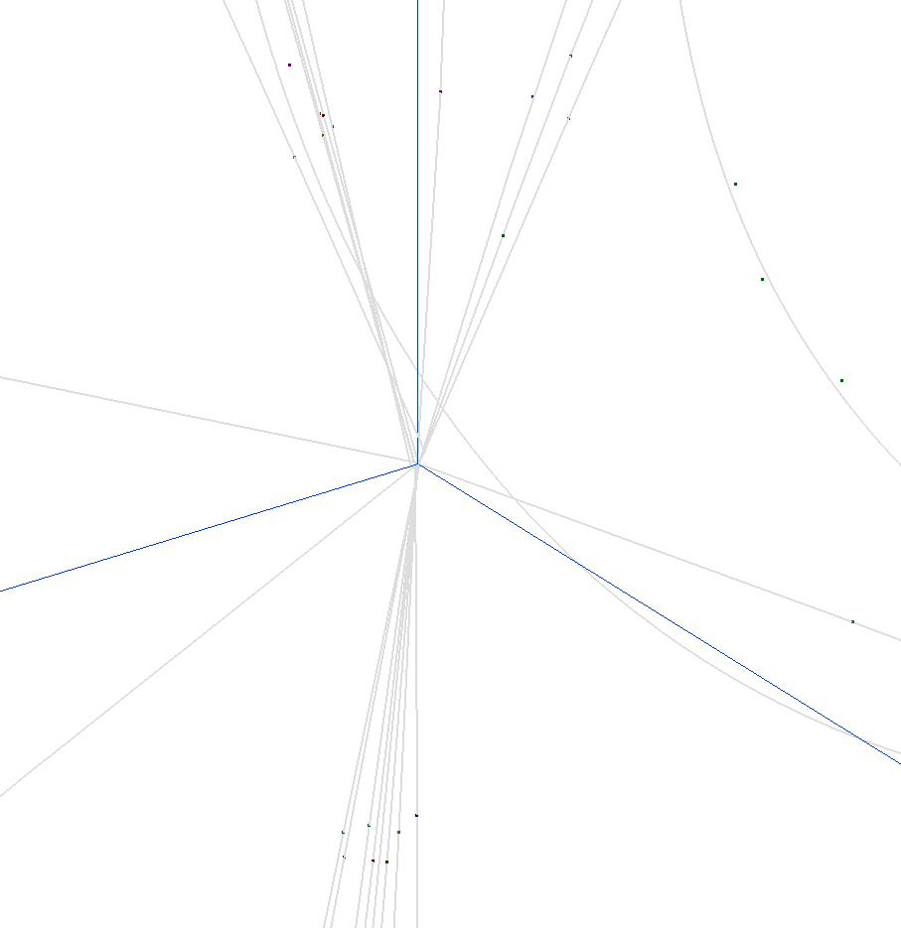
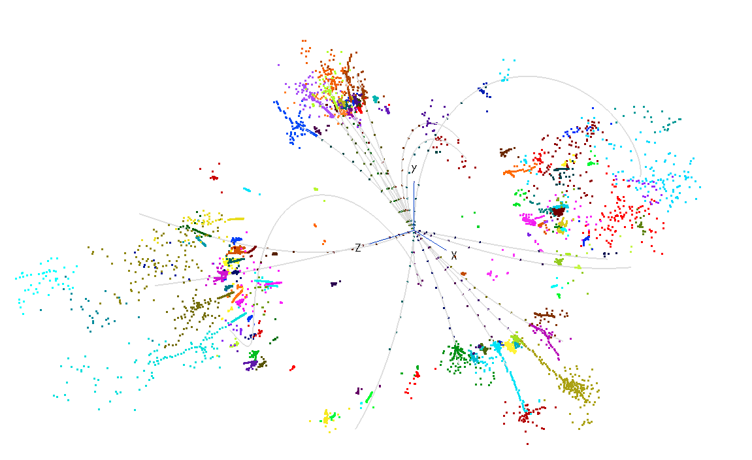
Event display
dijet (bb)
pT(b)=50GeV
can tell displaced vertices from direction of reconstructed tracks

Slide 8
Tracking
Tracking parameters used
MinPT= 0.2 GeV
MinHits= 6
MaxD0= 10.0 mm
MaxZ0= 10.0 mm
MaxChisq= 10.0
We have 6+6 layers, but we want to be able to reconstruct tracks only in the vertex or only in the tracker (to target very displaced decays)
Tracking strategies trained with displaced single muon tracks (to account for missing inner hits)
Under review & optimization
Preliminary track resolution comparison
*Full Sim
E=100GeV prompt muon
|η|<0.175 (θ=80-100 degrees)
resolution | Full Sim* | Fast Sim**
δpT/pT | 0.75% | 0.48 %
δd0[μm] | 6.1 | 5.02
δz0[μm] | 13.1 | 10.59
good enough approximation for our purposes
**Fast Sim
pT=100GeV prompt muon
0.001<|η|<1.5
(remember: we have squeezed the tracker,
and fast sim averages over a larger eta range)

Slide 9
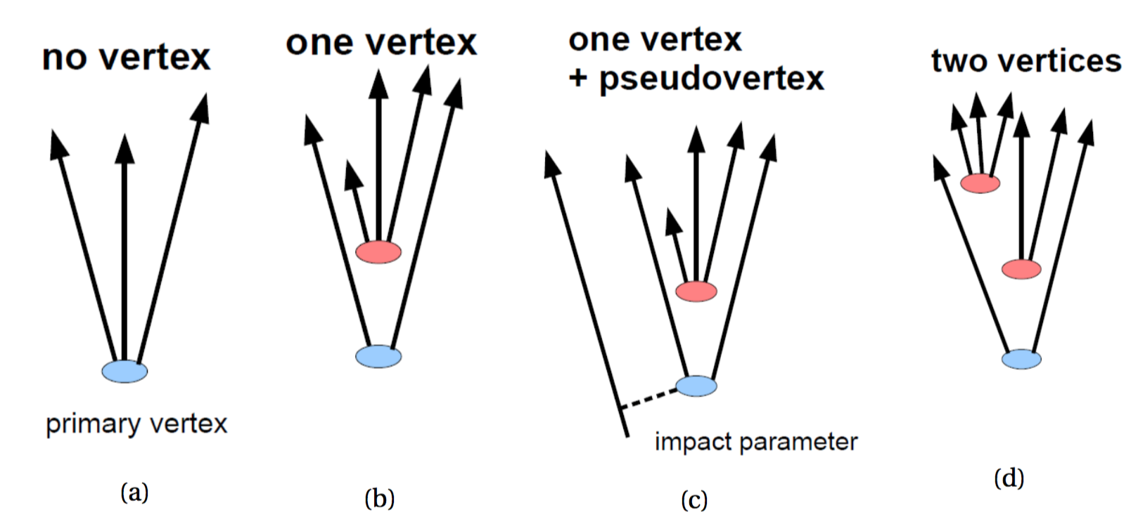
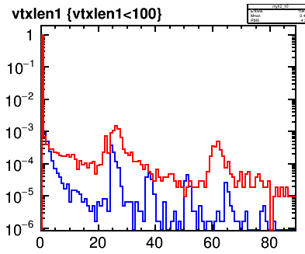
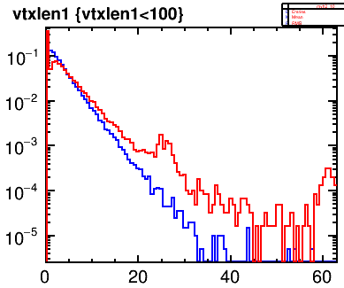
Flavor Tagging
Jets are classified in 4 categories according to the number of secondary vertices
  BDTs are trained using variables related to: [ref] (see backup)
  track d0/z0/momentum
  vertex mass/momentum/angle/decay length
decay length of the vertex in a light-flavour dijet sample
In the light flavor sample, vertices due mainly to interaction with the material
FCC
CLIC SiD (ee)
norm. to unity
decay length of the vertex in a bb dijet sample
FCC
CLIC SiD
norm. to unity
small differences due to energy spectrum
[mm]

Slide 10
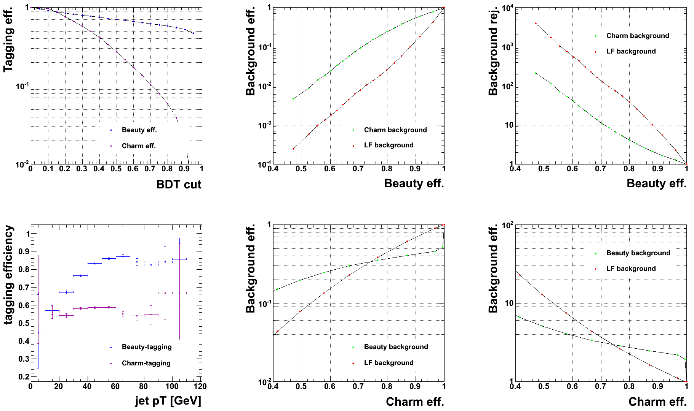
FCC Flavor tagging performance
central dijets , pT(quark)=50GeV (before hadronization)
FCC B-tagging
B eff. = 80% | FCC
LF bkg eff. | 2.6 x 10^-2
C bkg eff. | 2.4 x 10^-1
for BDT cut = 0.3 (B eff = 80%)
FCC C-tagging
C eff. = 70% | FCC
B bkg eff. | 3.2x 10^-1
C bkg eff. | 2.8 x 10^-1
tagging efficiency relatively flat in jet pT above 40 GeV
Reasonable performance
(comparisons in next slides)

Slide 11
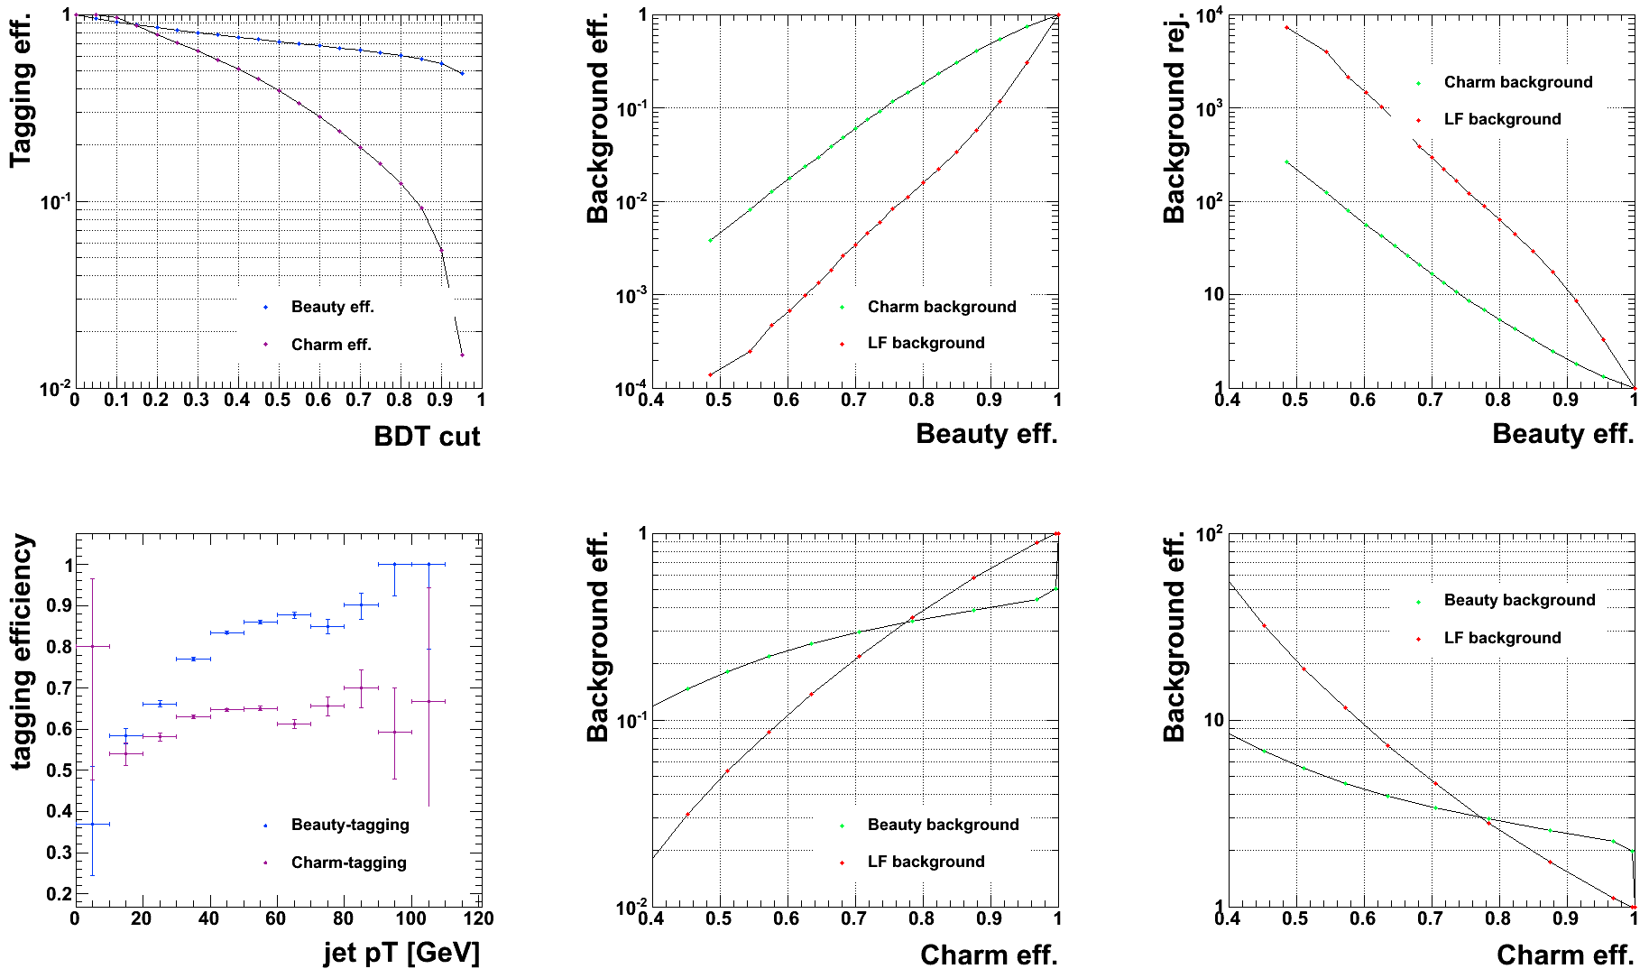
Flavor tagging – pitch variation
central dijets pT(quark)=50GeV
FCC default
FCC with 20um pitch in the 3 innermost layers
By using 20x20um pitch instead of 25x50um pitch in the 3 innermost layers (3umx3um single point resolution, as CLIC_SiD, instead of 7.5x15um),
light flavor rejection improves by 50%
B eff. = 80% | FCC - 20um | FCC
LF bkg eff. | 1.6 x 10^-2 | 2.6 x 10^-2
C bkg eff. | 1.8 x 10^-1 | 2.4 x 10^-1
→ factor of ~ 1.6
→ factor of ~ 1.3

Slide 12
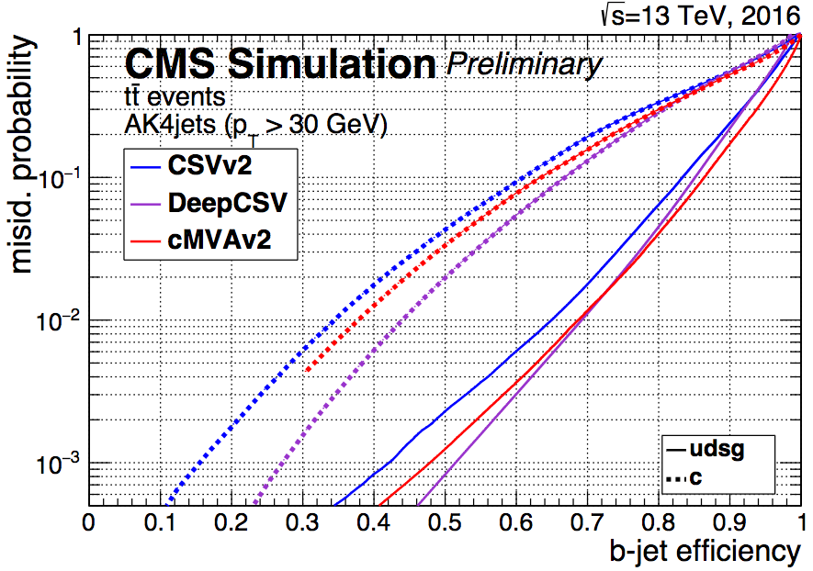
Comparison to CMS run 2
https://twiki.cern.ch/twiki/bin/view/CMSPublic/BTV13TeVDPDeepCSV
Similar performance as CMS run 2.
FCC factor of ~1.5 better at LF-rejection

Slide 13
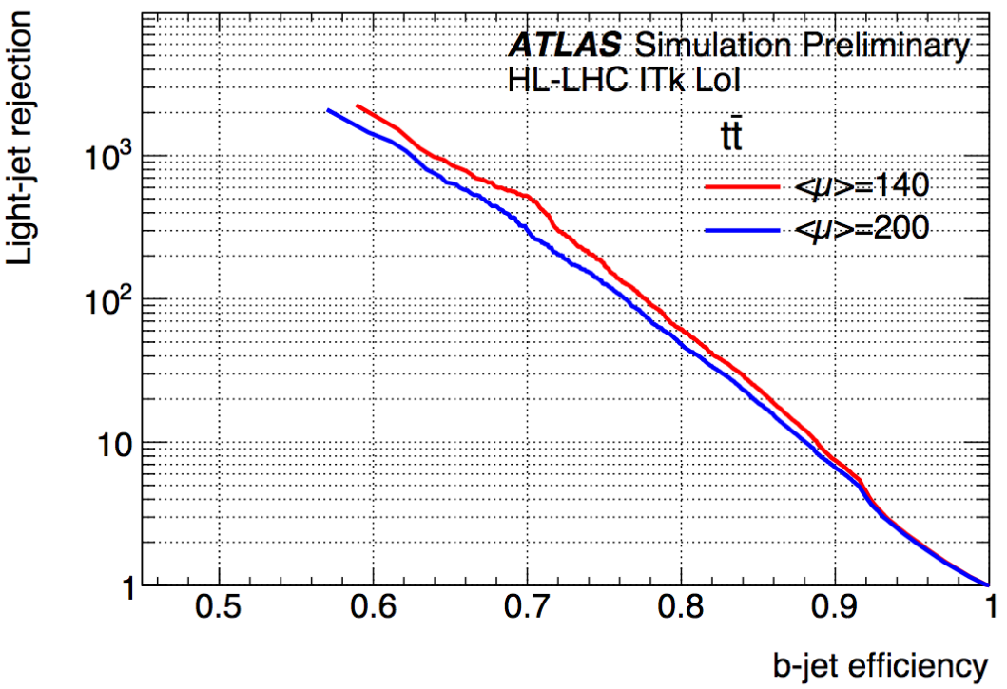
Comparison to HL-LHC
pT(jet)>20GeV
|eta(jet)|<2.7
https://atlas.web.cern.ch/Atlas/GROUPS/PHYSICS/PUBNOTES/ATL-PHYS-PUB-2016-026/
Similar performance as ATLAS HL-LHC
FCC factor of 1.5 worse at LF-rejection (for pile up mu=140)

Slide 14
Conclusions
Validated setup to optimize the Vertex detector taking into account the flavor tagging performance , using CLIC_SiD software chain
Tracking performance validated against Fast Simulation
Reasonable flavor tagging performance, compared to LHC experiments & CLIC
In place to perform variations on the detector geometry and layout
  Example: If single point resolution for the 3 innermost layers improved to 3x3um, LF jet rejection would improve by 50%

Slide 15
Next steps
Main upcoming points:
Optimize tracking strategies for high pT b-jets
Perform variations in the layout (add 4th inner layer)
Study flavor tagging performance for high pT jets

Slide 16
BACKUP

Slide 17
comparisons

Slide 18
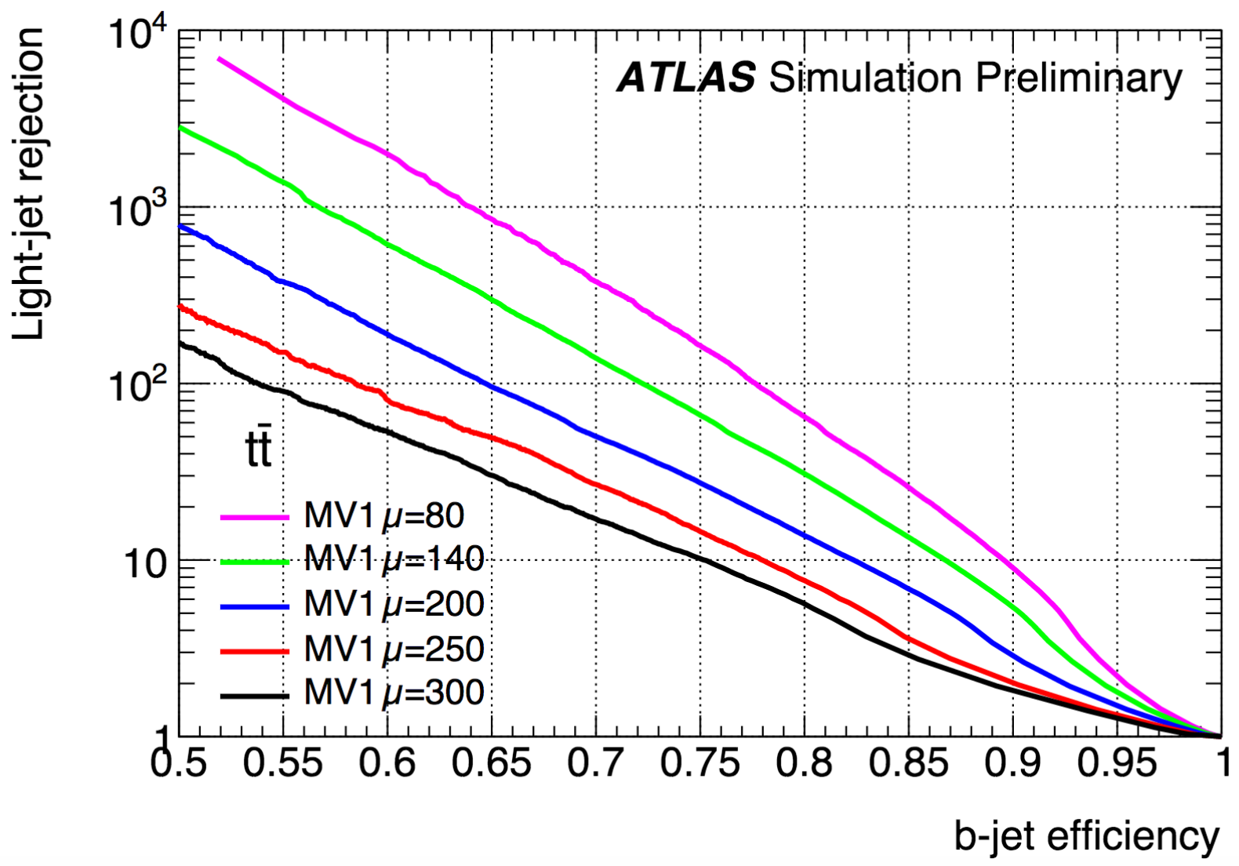
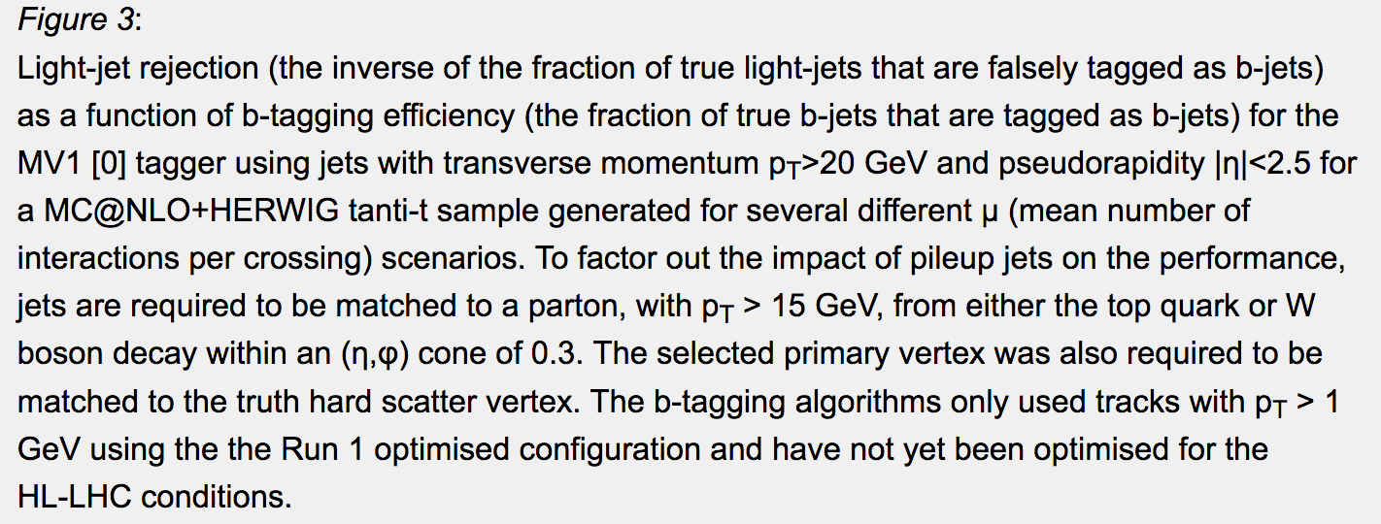
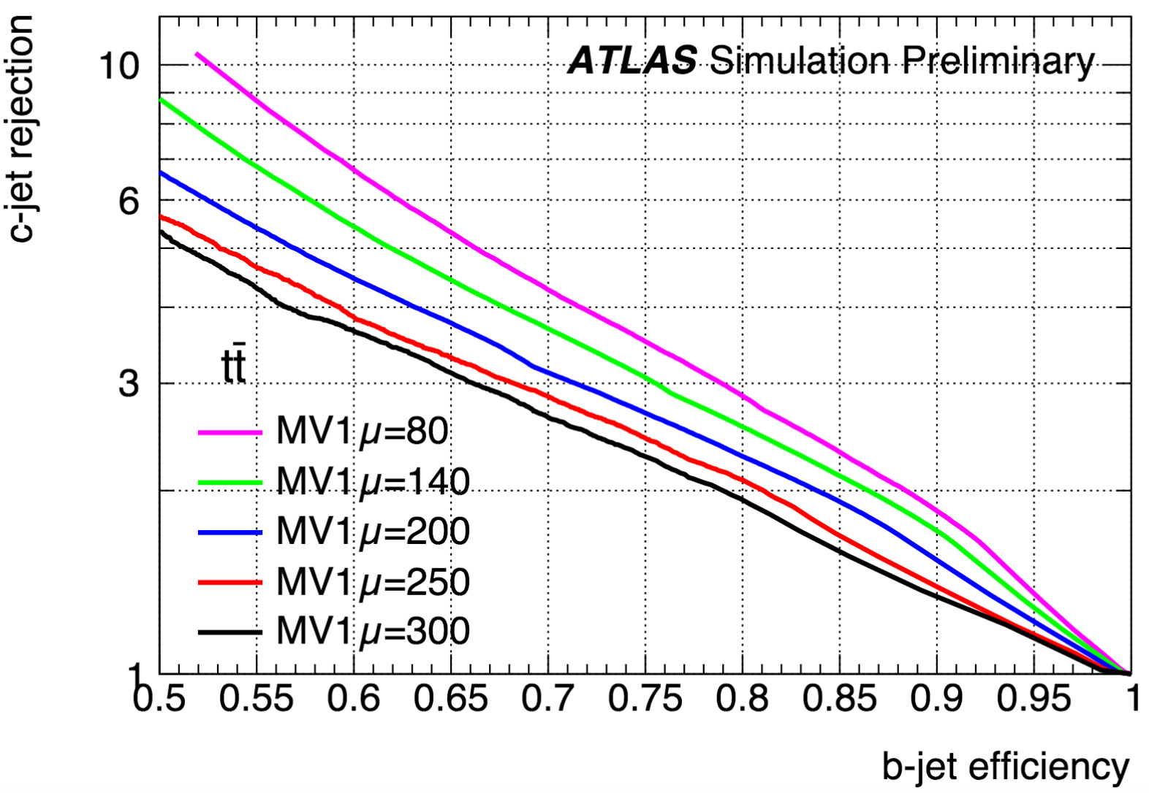
Comparison to HL-LHC
pT(jet)>20GeV
|eta(jet)|<2.5
b-tagging: Run 1 config:
pT(track)>1GeV
Similar performance as ATLAS HL-LHC
FCC factor of 2 “better” at c-rejection, factor of 1.5 “worse” at l-rejection (for pile up mu=80)
http://atlas.web.cern.ch/Atlas/GROUPS/PHYSICS/UPGRADE/PLOT-UPGRADE-2014-003/

Slide 19
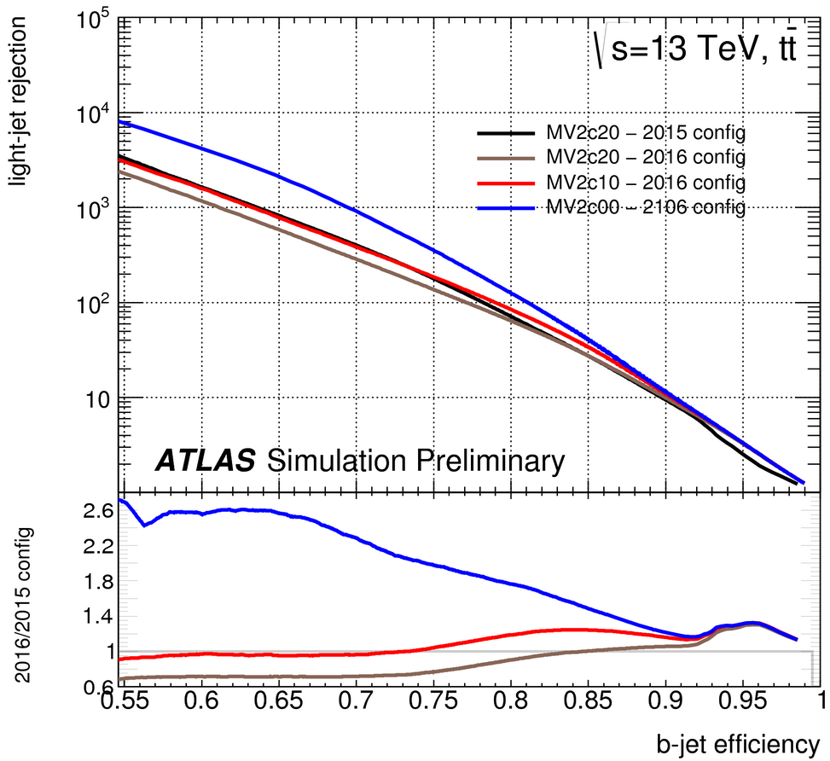
Comparison to ATLAS run2
Similar performance as ATLAS run 2
FCC factor of ~3 “worse” at l-rejection
https://atlas.web.cern.ch/Atlas/GROUPS/PHYSICS/PUBNOTES/ATL-PHYS-PUB-2016-012/

Slide 20
Flavor tagging performance
FCC default (min 6 hits)
for central dijet samples with pT(quark)=50GeV (before hadronization)
Compared to CLIC SiD (e+e-) with √s= 90 GeV
B eff. = 80% | FCC | CLIC SiD
LF bkg eff. | 26 x 10^-3 | 4 x 10^-3
C bkg eff. | 24 x 10^-2 | 5 x 10^-2
→ factor of ~ 6
→ factor of ~ 5
strong dependence in jet pT
for BDT cut = 0.3 (B eff = 80%)
C eff. = 70% | FCC | CLIC SiD
B bkg eff. | 3.2x 10^-1 | 2 x 10^-1
C bkg eff. | 28 x 10^-2 | 6 x 10^-2
→ factor of ~ 1.5
→ factor of ~ 4.5
Differences expected, due to:
single point resolution
material budget
layout

Slide 21
Flavor tagging performance
FCC with 20um pitch in the 3 innermost layers (min 7 hits)
for central dijet samples with pT(quark)=50GeV (before hadronization)
Compared to CLIC SiD (e+e-) with √s= 90 GeV
B eff. = 80% | FCC - 20um | CLIC SiD
LF bkg eff. | 16 x 10^-3 | 4 x 10^-3
C bkg eff. | 18 x 10^-2 | 5 x 10^-2
→ factor of ~ 4
→ factor of ~ 3.5
By using 3umx3um single point resolution (as CLIC SiD) in the 3 innermost layers, rejection improves by 50%
Next step: check impact of reducing material budget

Slide 22
50GeV
FCC default (min 6 hits)
inverted values in Y axis, for comparison with LHC
for BDT cut = 0.3

Slide 23
50GeV
FCC with 20um pitch in the 3 innermost layers (min 7 hits)
inverted values in Y axis, for comparison with LHC
for BDT cut = 0.3
better single point resolution, significantly improves performance

Slide 24
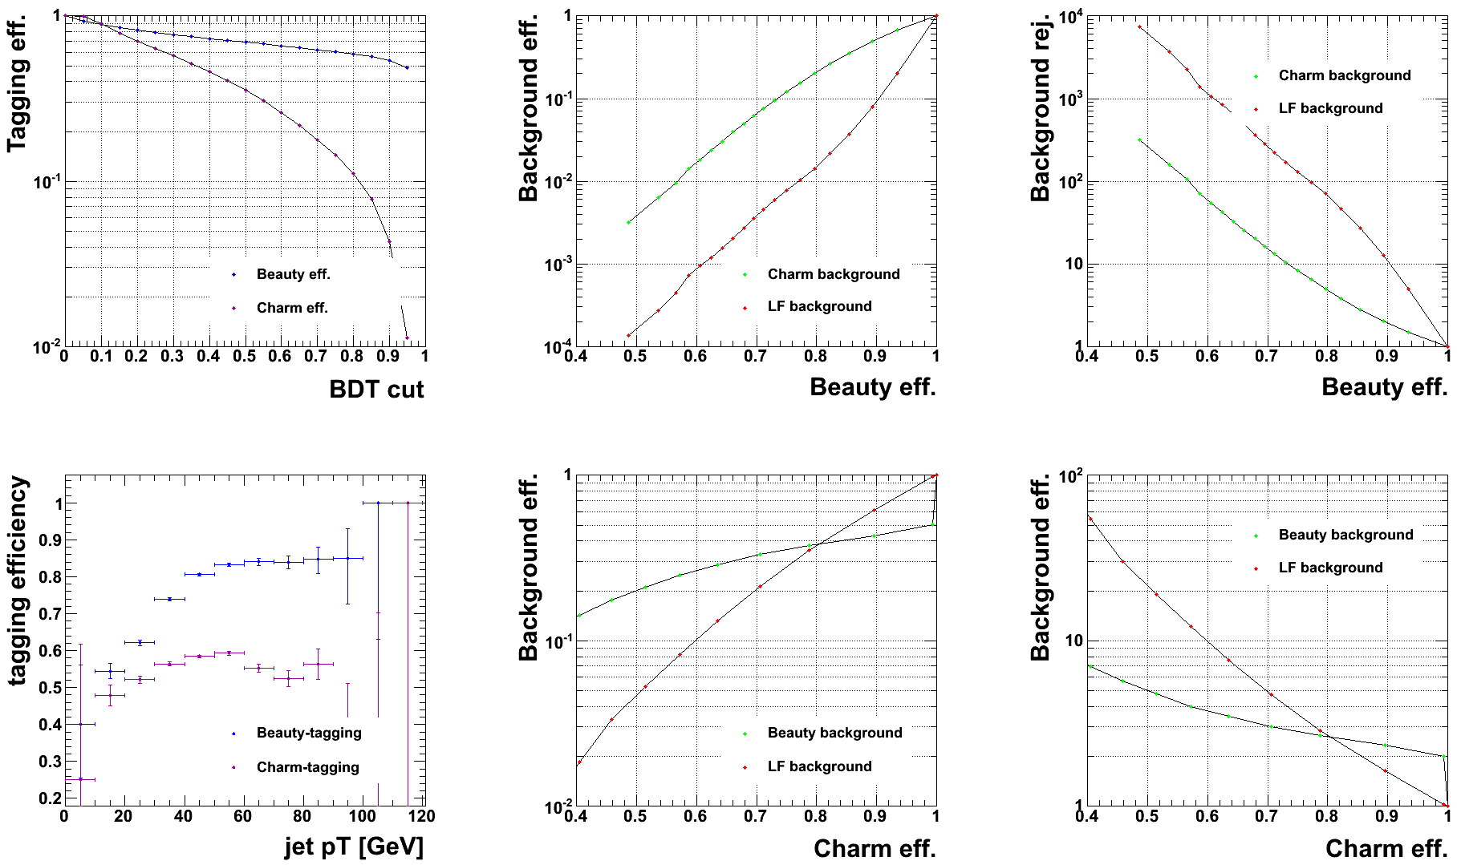
50GeV
FCC with HALF of the material budget (min 6 hits)
inverted values in Y axis, for comparison with LHC
for BDT cut = 0.3
better single point resolution, significantly improves performance

Slide 25
flavour tagging variables

Slide 26
Flavour tagging
Top discriminating variables for the different categories [full definition] (“_jete” = normalized to the jet energy)
vtxsig12_jete: distance between the 1st and 2nd vertices
vtxmom_jete: vertex momentum (sum of its tracks momentum)
vtxdirang12_jete: angle between the displacement and the momentum vectors between the two vertices
vtxmassall: vertex mass all tracks forming secondary vertices
vtxlen1_jete : Decay length of the first vertex in the jet
vtxmom1_jete: vector sum of the momenta of all tracks in the first vertex
vtxmasspc: Mass of the vertex with minimum pT correction allowed by the error matrices of the primary and secondary vertices.
d0qprob: Product of light-flavour-quark probabilities of d0 values for all tracks
z0qprob: Product of light-flavour-quark probabilities of z0 values for all tracks
trkmass: Mass of all tracks exceeding 5 sigma significance in d0/z0 values

Slide 27
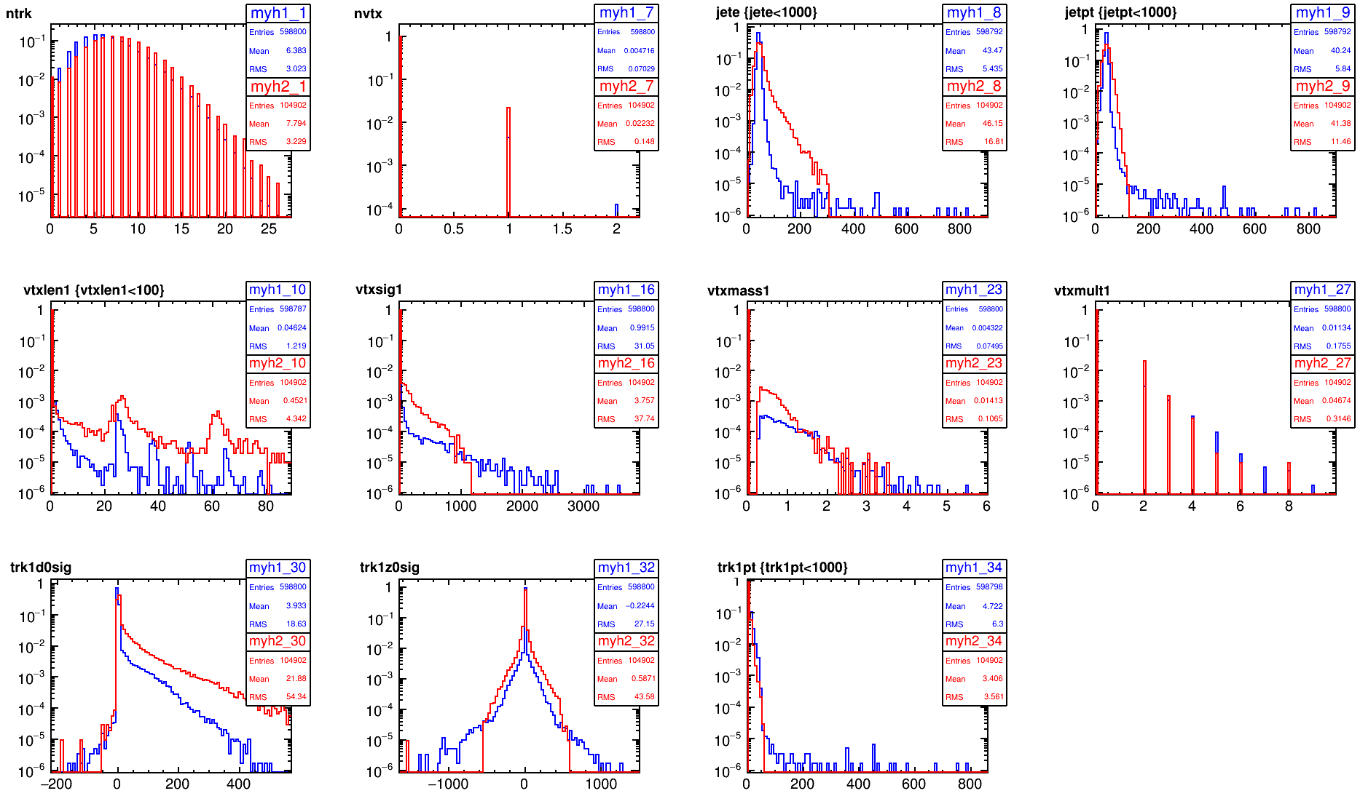
Opt3v02 vs CDR
ll dijet sample
less SV from interaction with material

Slide 28
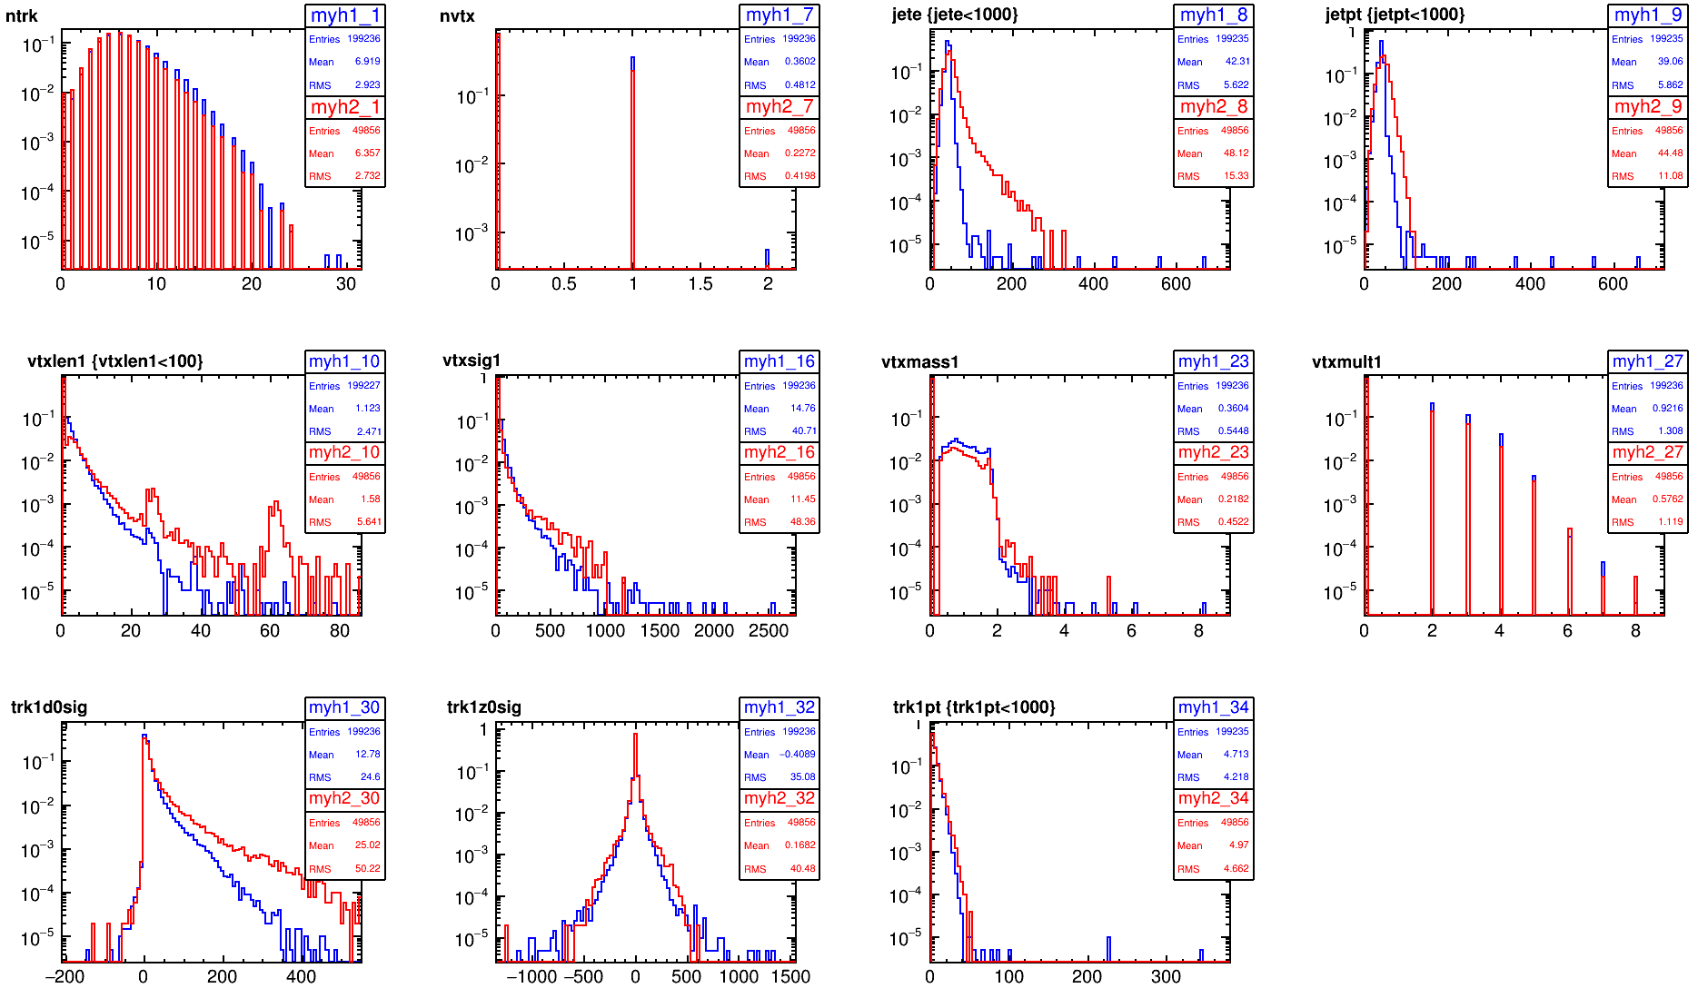
Opt3v02 vs CDR
cc dijet sample
less SV from interaction with material

Slide 29
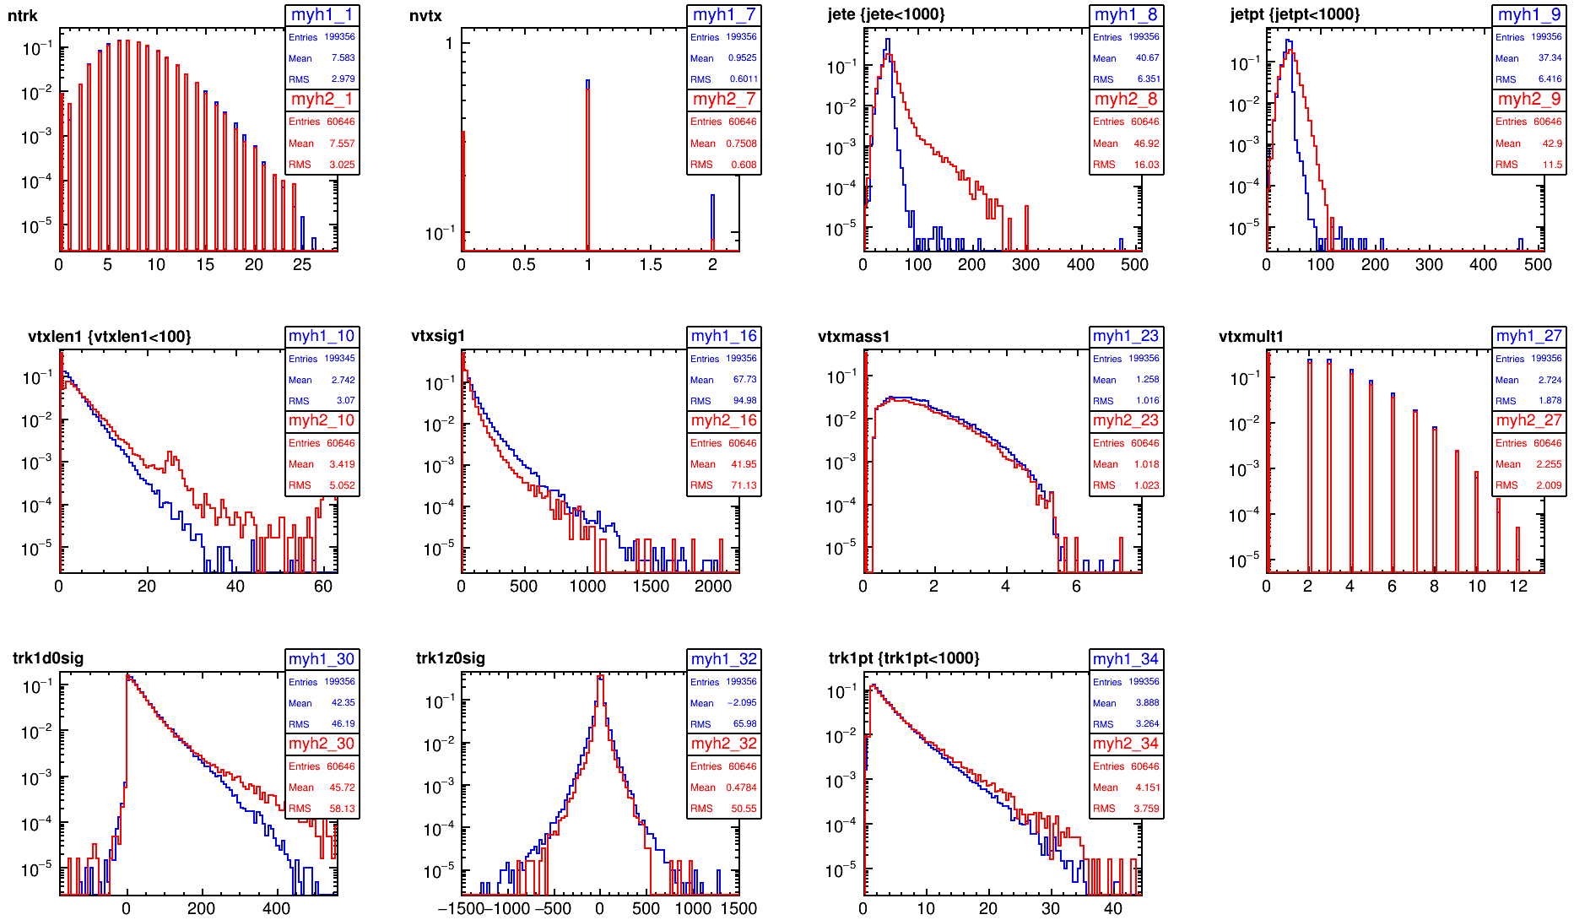
Opt3v02 vs CDR
cc dijet sample
less SV from interaction with material

Slide 30
more details of SW chain

Slide 31
Simulation
LCSim
  use FCC thickness and material budget, which include services&supports
    Tracker: X/X₀= 3% [200um active Si]
    Outer vertex: X/X₀= 1.5% [100um active Si]
    Inner vertex: X/X₀= 1% [100um active Si]

Slide 32
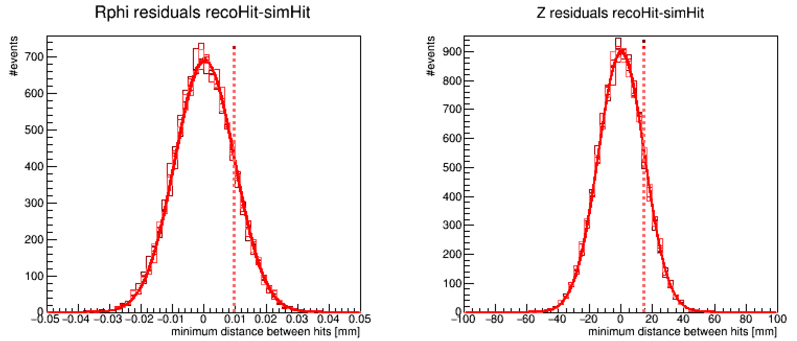

Digitisation
Both vertex and tracker detectors are digitized as long pixels.
We used a simplified digitizer, smearing the simulated hit position with a Gaussian of σ=pitch/√12 , which provides with a direct relationship between pitch and single point resolution (as done for Fast Sim).
  This factors out the detector technology
SimHit-RecoHit residuals in the tracker layers
σ_{RPhi}=9.5um
σ_{Z}=14700mm
SimHit-RecoHit residuals[mm]
SimHit-RecoHit residuals[mm]

Slide 33
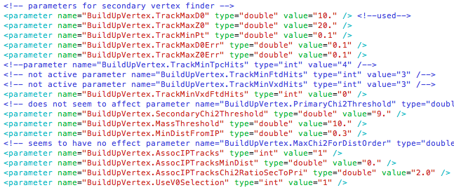
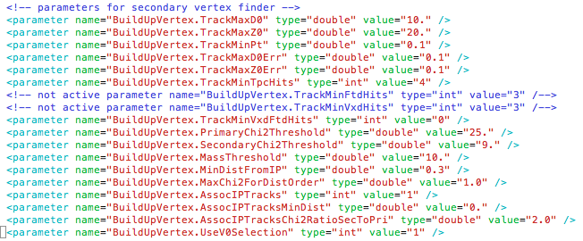
Vertexing
LCFIPlus. Default
  Consider only PFOs in 2 kT jets of R=0.5.
    Avoid including particles in the “beam jets” (fwd particles close to the beam)
    (Vertexing will rerun its own jet algorithm)
To do: review how these cuts are actually applied
(ongoing)

Slide 34
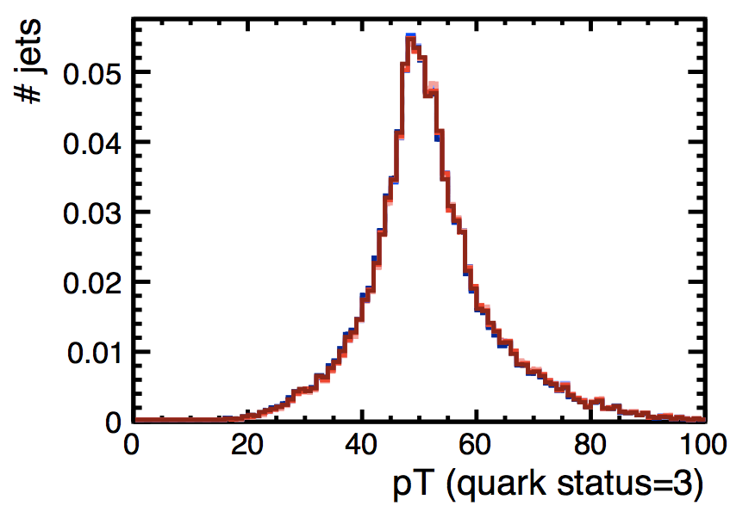
Hadronization
Pythia6:
            MSTP(81)=20 Multiple Interaction: OFF
            MSTP(61)=1 FSR: ON
            MSTP(71)=1 ISR: ON
b quark pT spectrum
arbitrary units

Slide 35
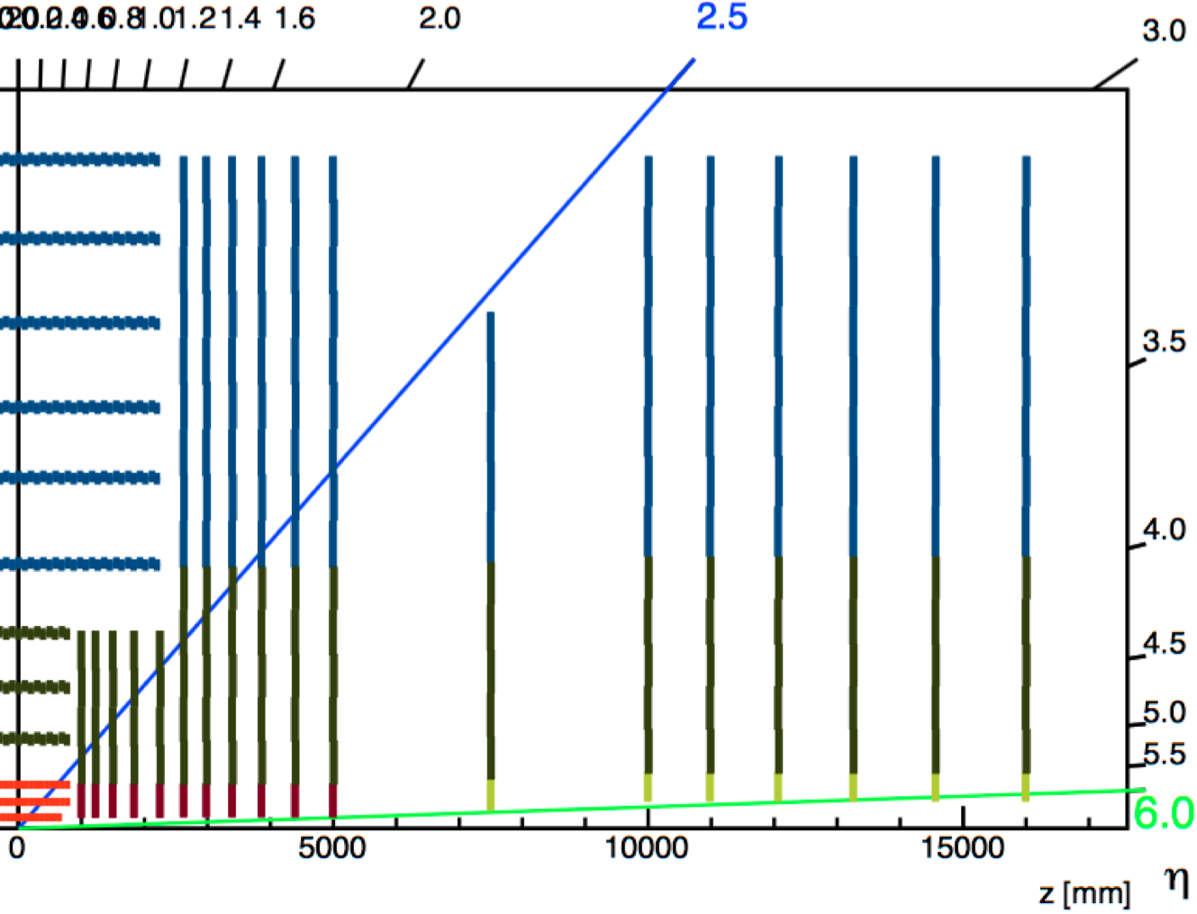
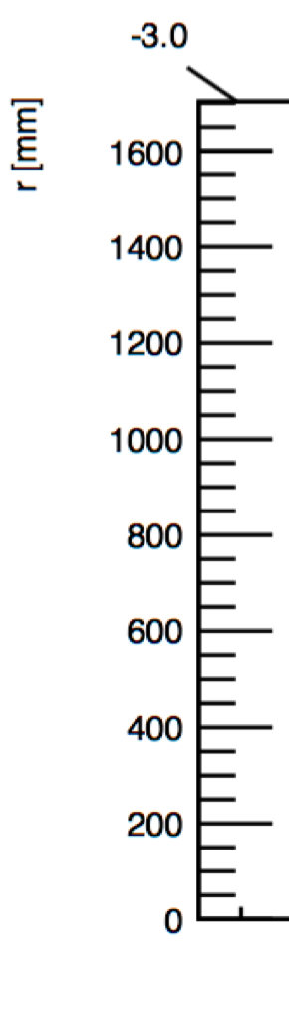
Current baseline geometry
http://fcc-tklayout.web.cern.ch/fcc-tklayout/FCChh_Option3.v02/index.html

Slide 36
Current baseline geometry – Vertex Detector
(version v03 will have 4 innermost layers and tilted modules)

