Slide 1
FCC-hh experiment
Integration procedure

Slide 2
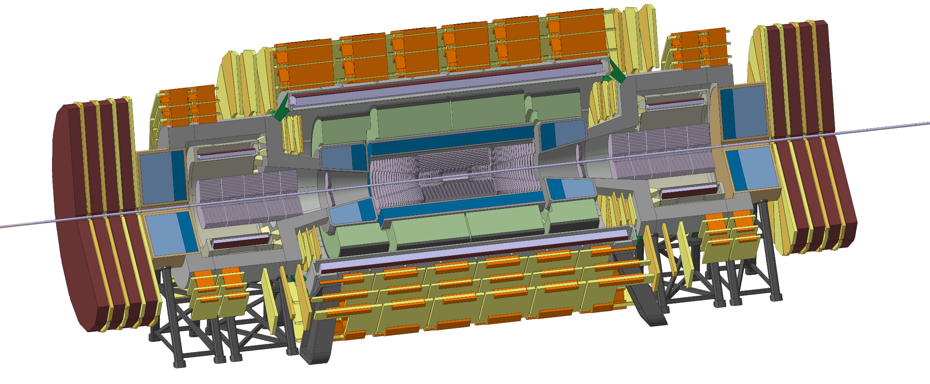
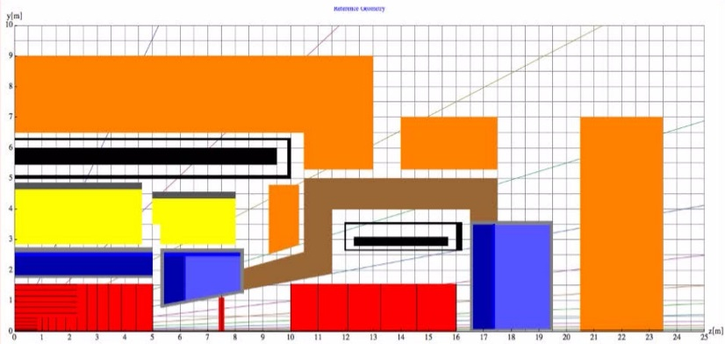
Detector overview
Base Line Design
  Exception was made in the forward Muon Chambers
  The use of iron in between the muon chambers is a possibility

Slide 3
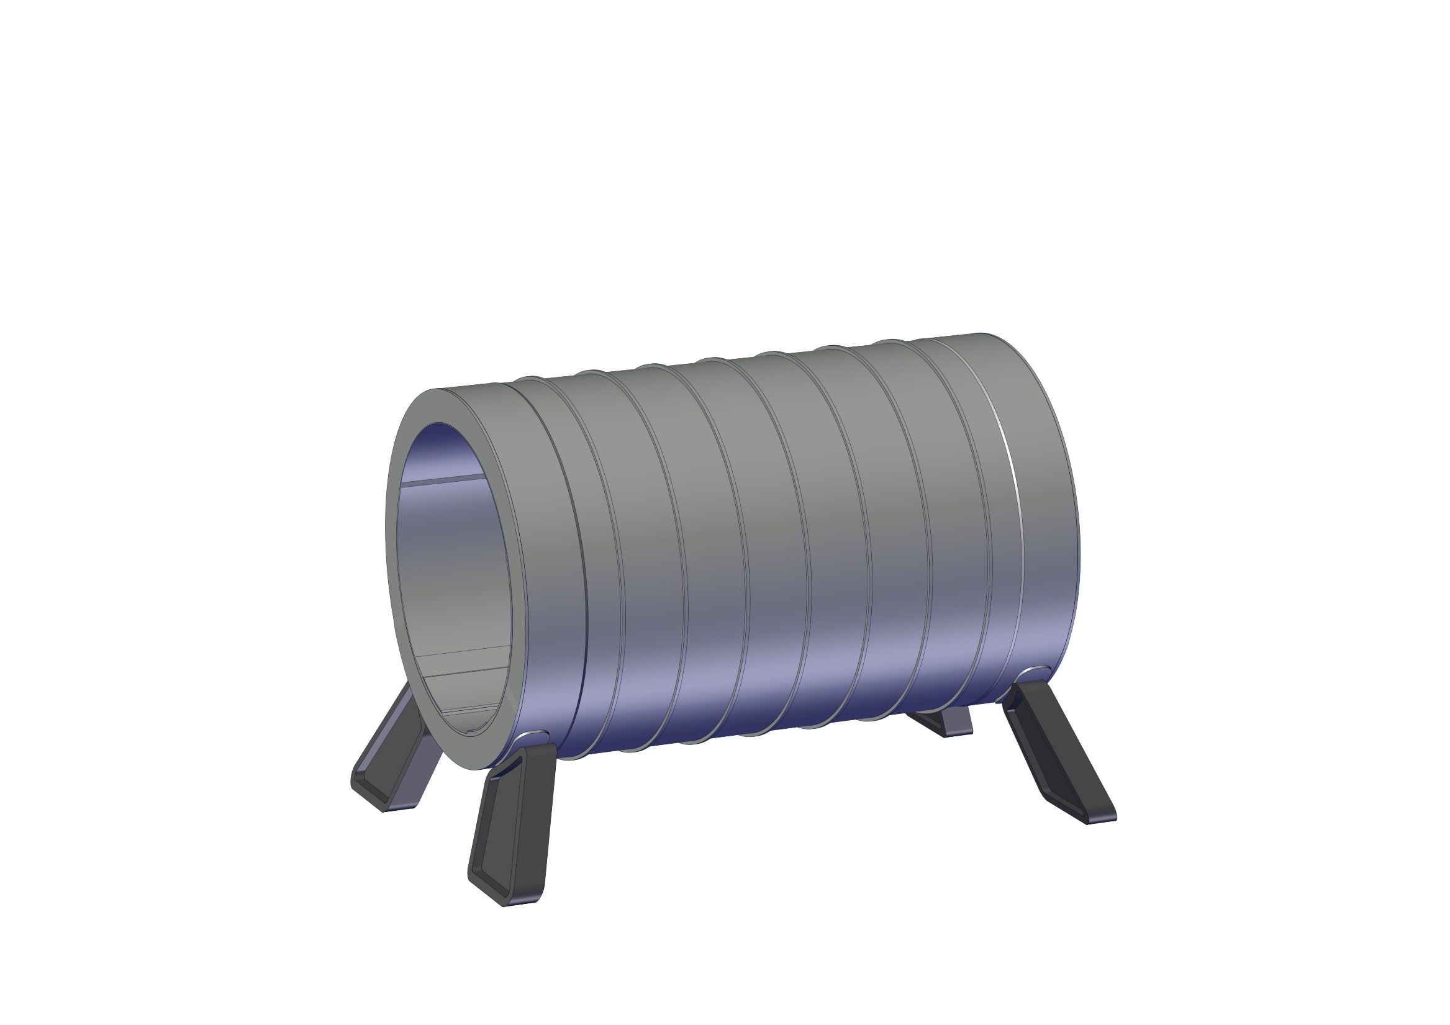
Experiment integration
1 - Install Central Solenoid

Slide 4
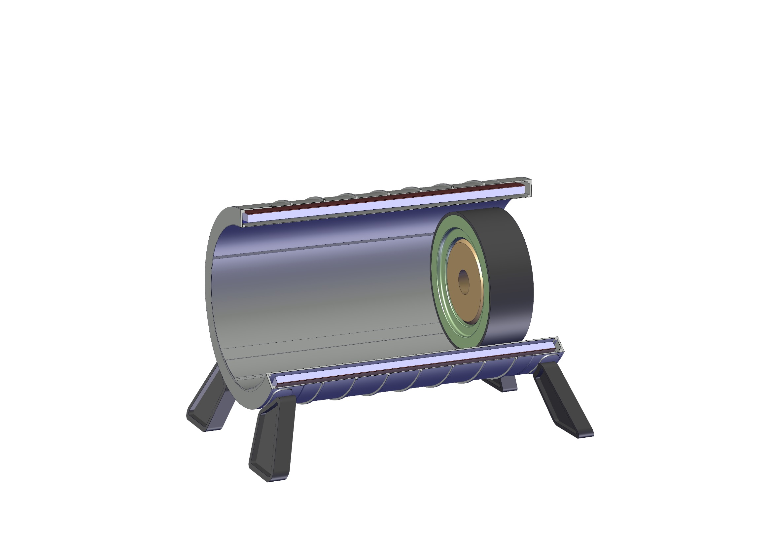
Experiment integration
2 - Install 1st HCal module with 1st Ecal Module

Slide 5
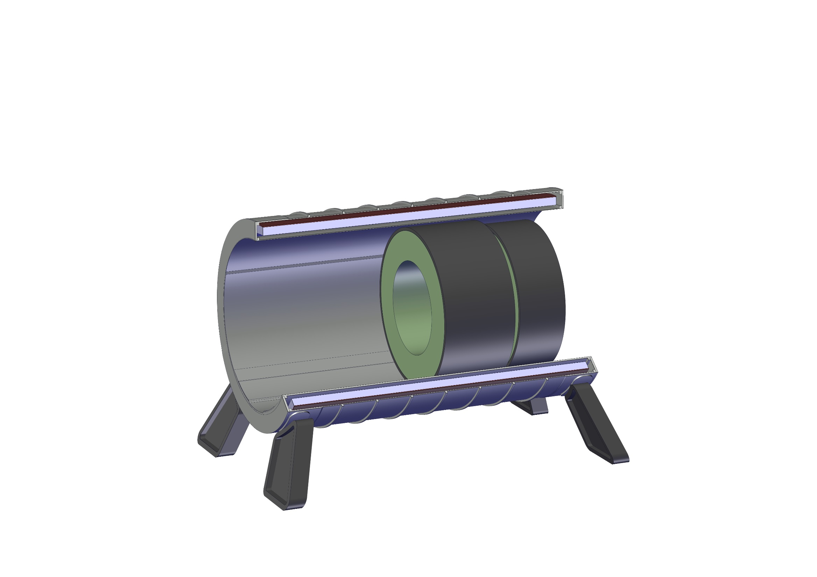
Experiment integration
3 - Install 2nd HCal module

Slide 6
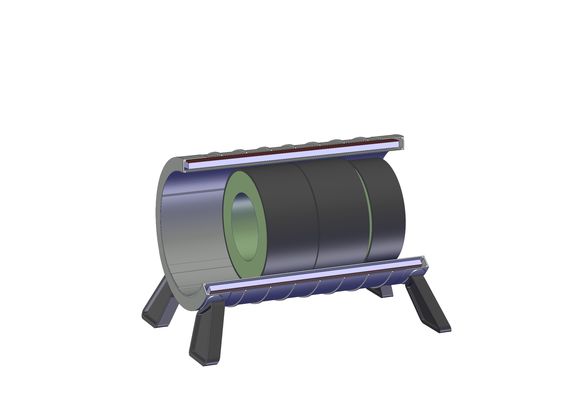
Experiment integration
4 - Install 3rd HCal module

Slide 7
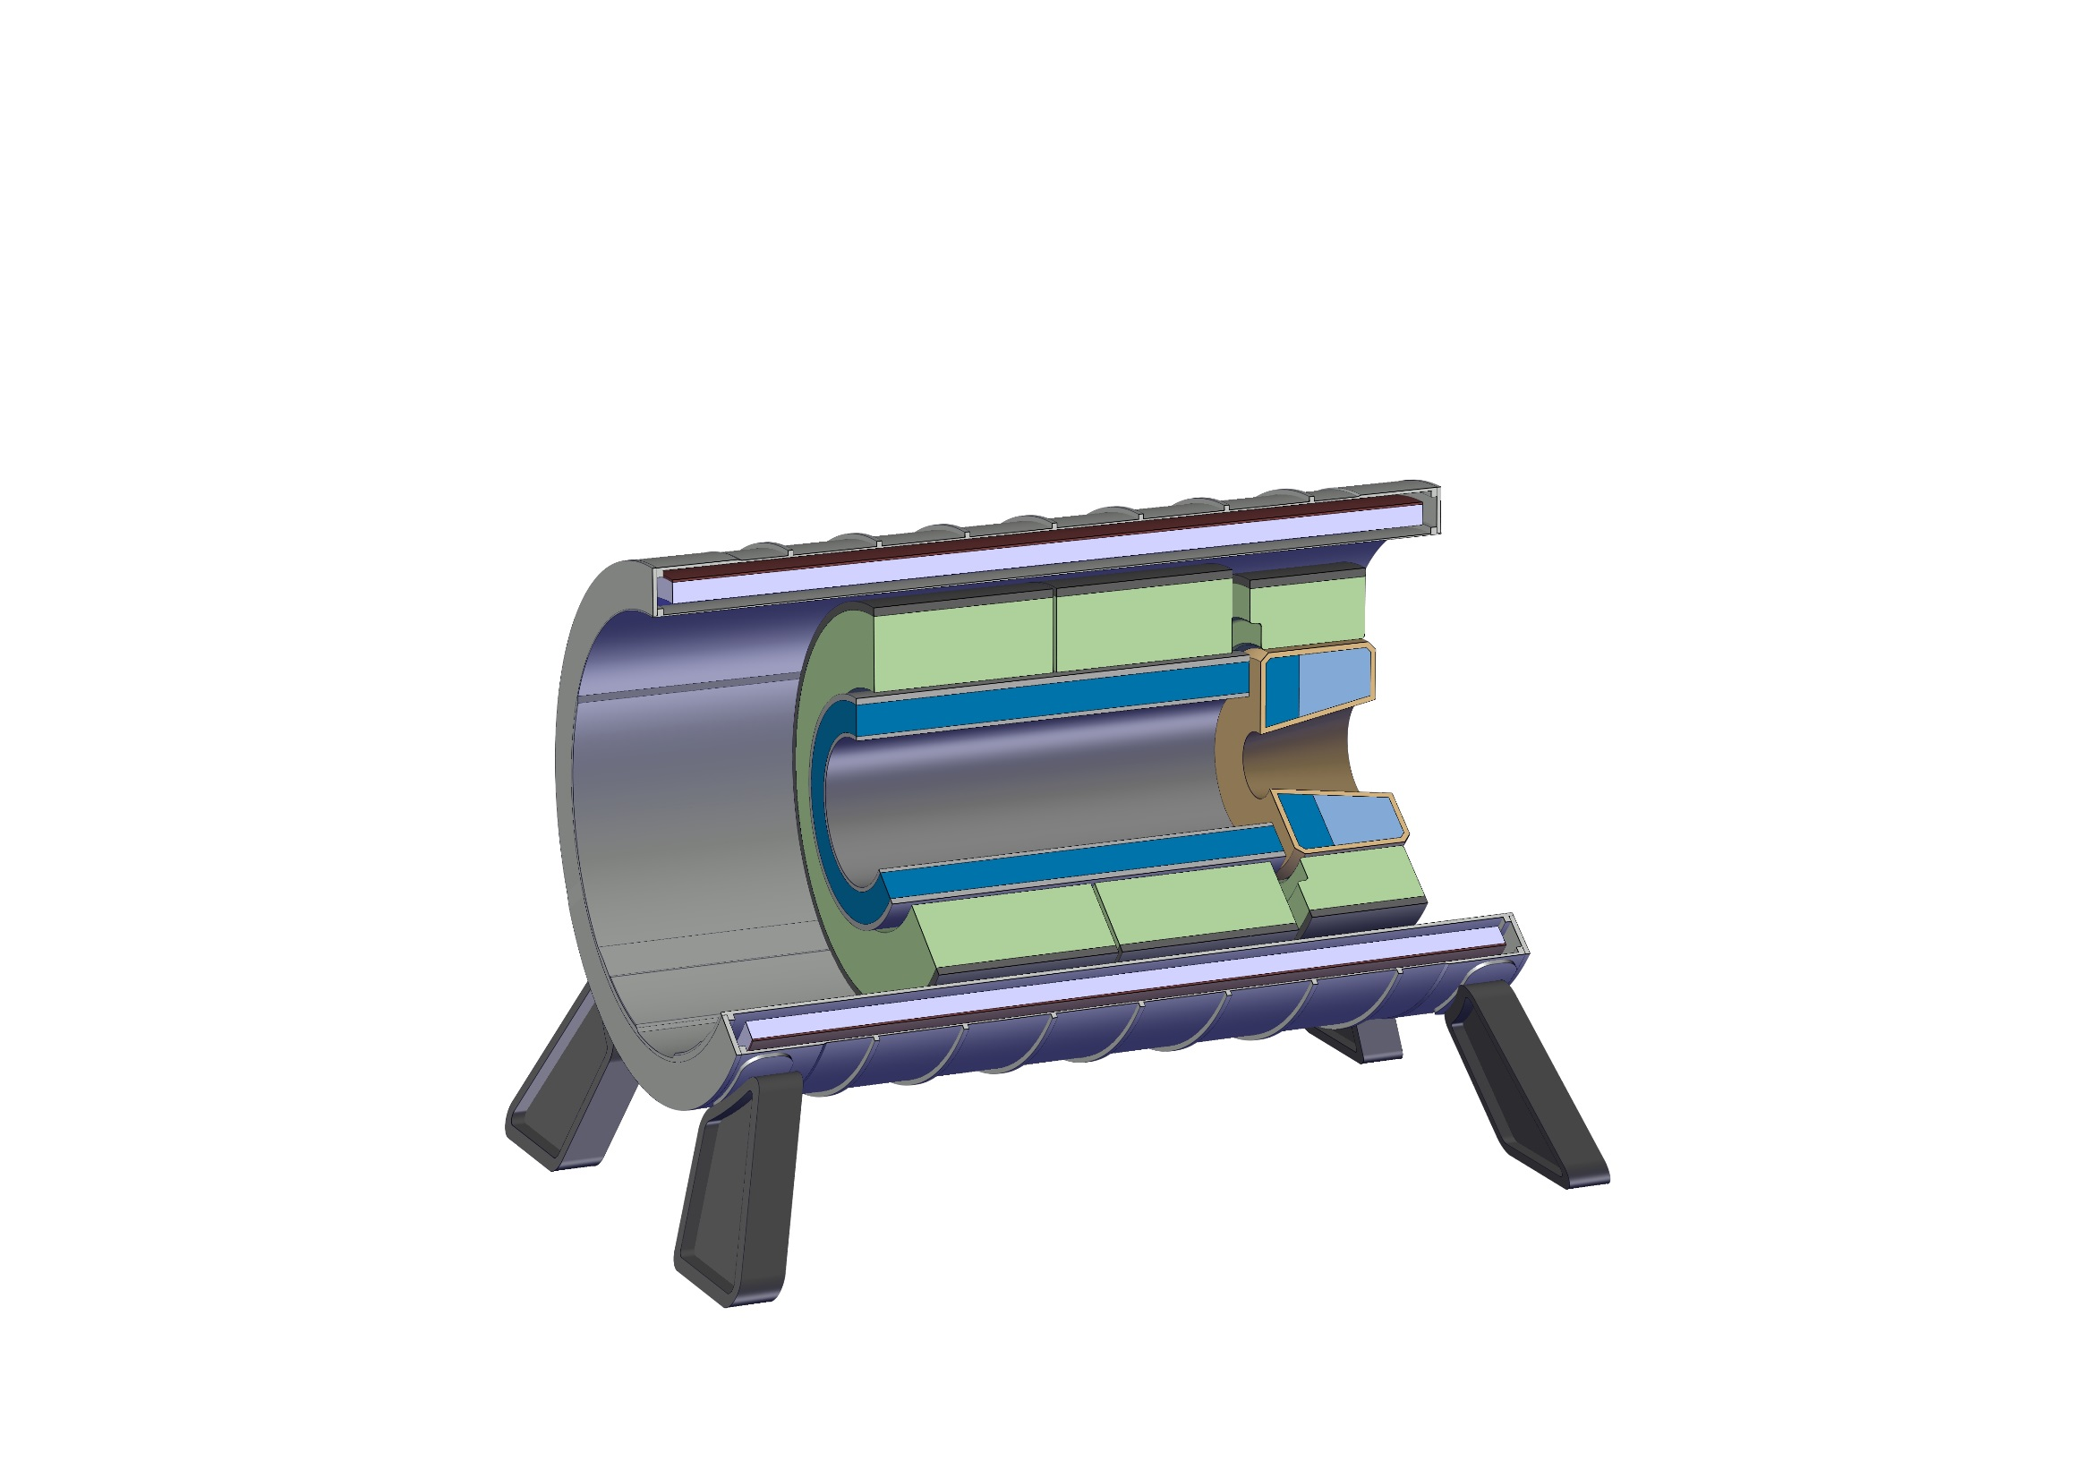
Experiment integration
5 - Install 2nd ECal module

Slide 8

Experiment integration
6 - Install Inner Tracker

Slide 9
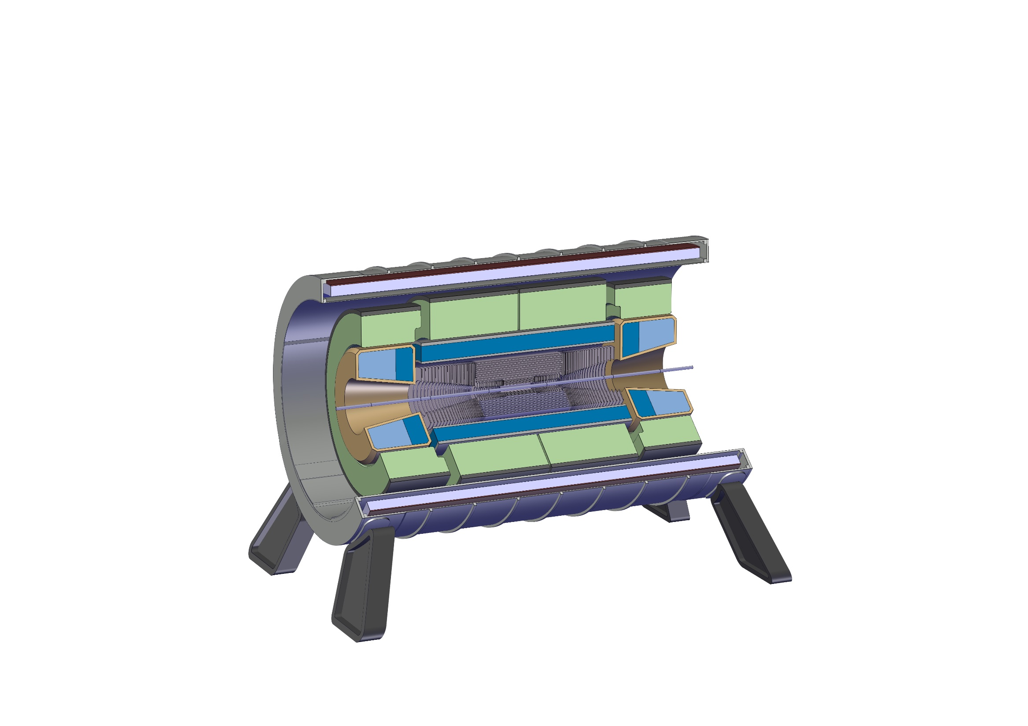
Experiment integration
7 - Install the last Ecal and HCal module

Slide 10

Experiment integration
8 - Install Forward Tracker module

Slide 11
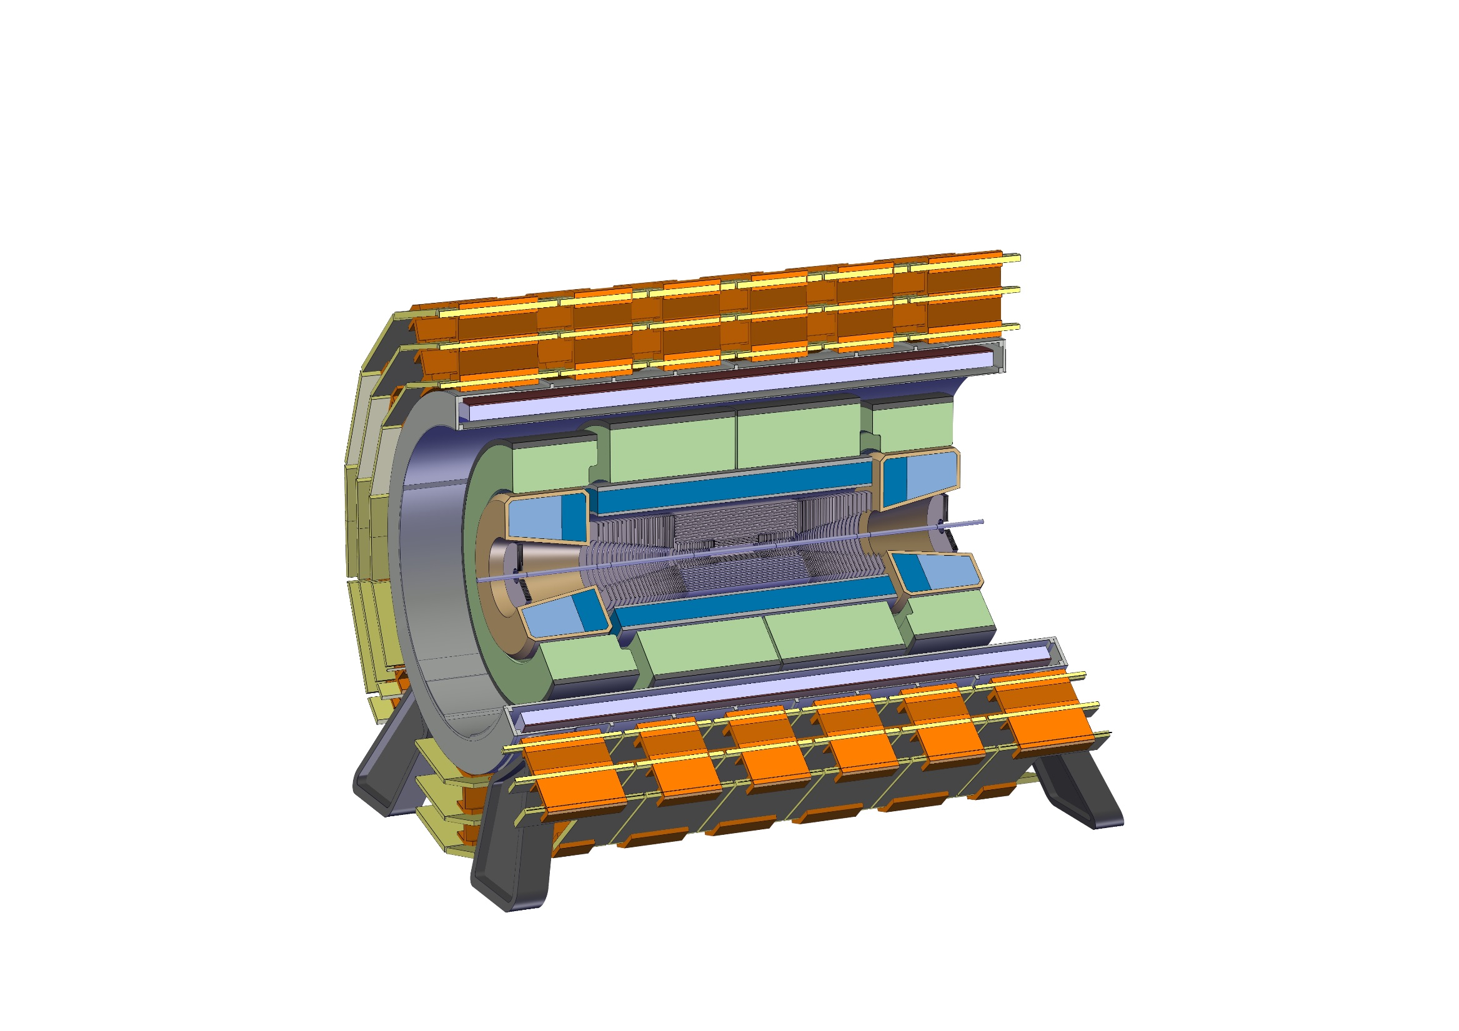
Experiment integration
9 - Install Muon Chambers onto the solenoid

Slide 12
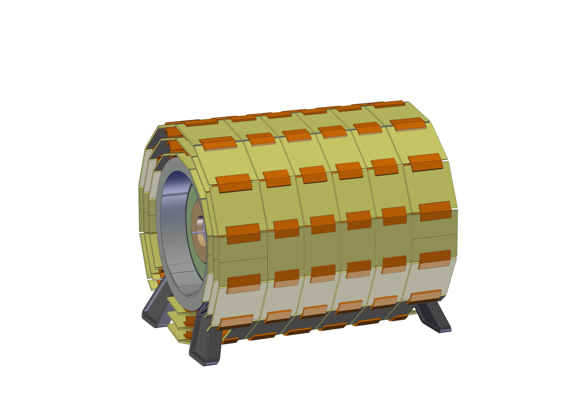
Experiment integration
9 - Install Muon Chambers onto the solenoid

Slide 13
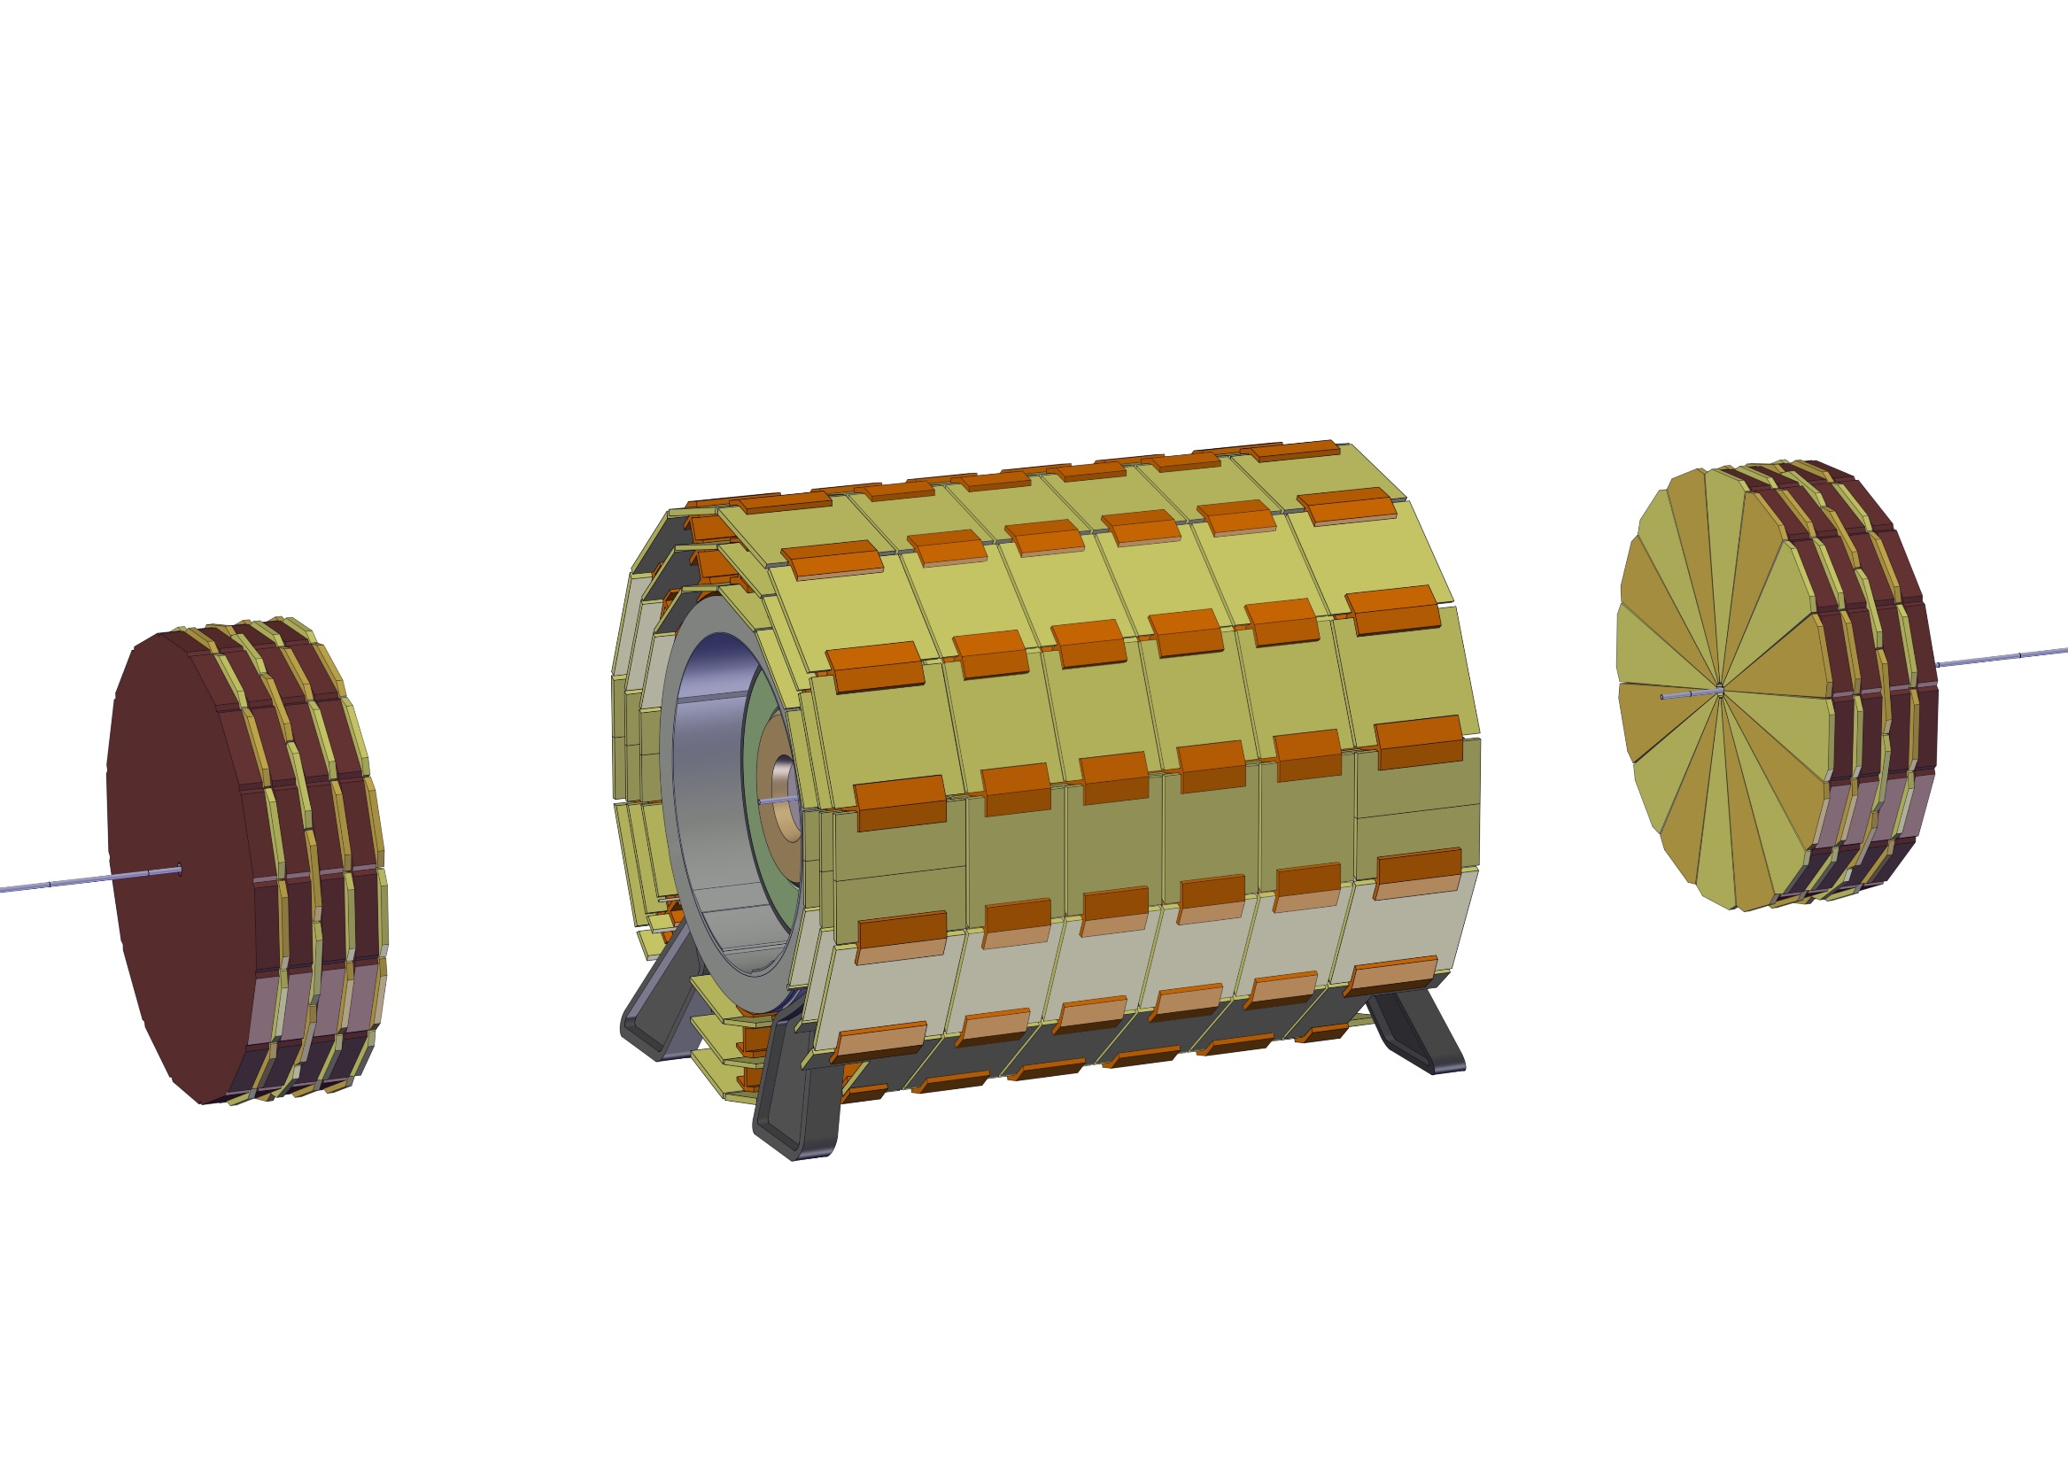
Experiment integration
10 – Install Forward Muon Chambers

Slide 14
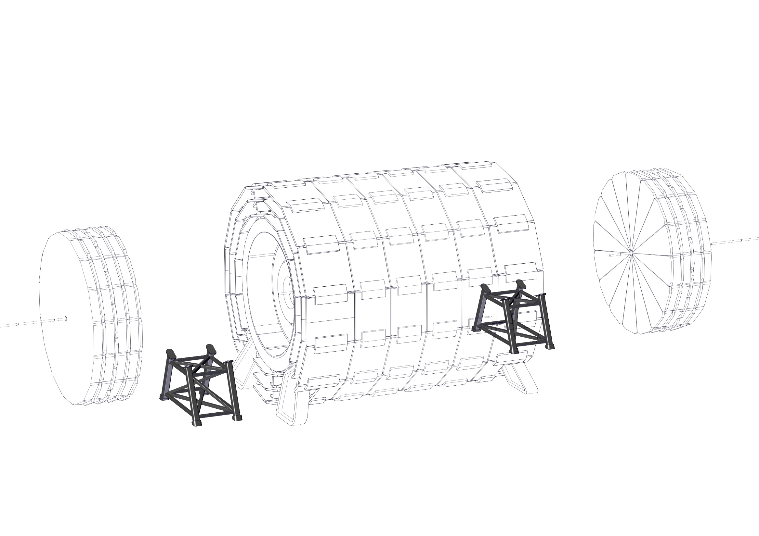
Experiment integration
11 – Install the Forward Solenoid support structure

Slide 15
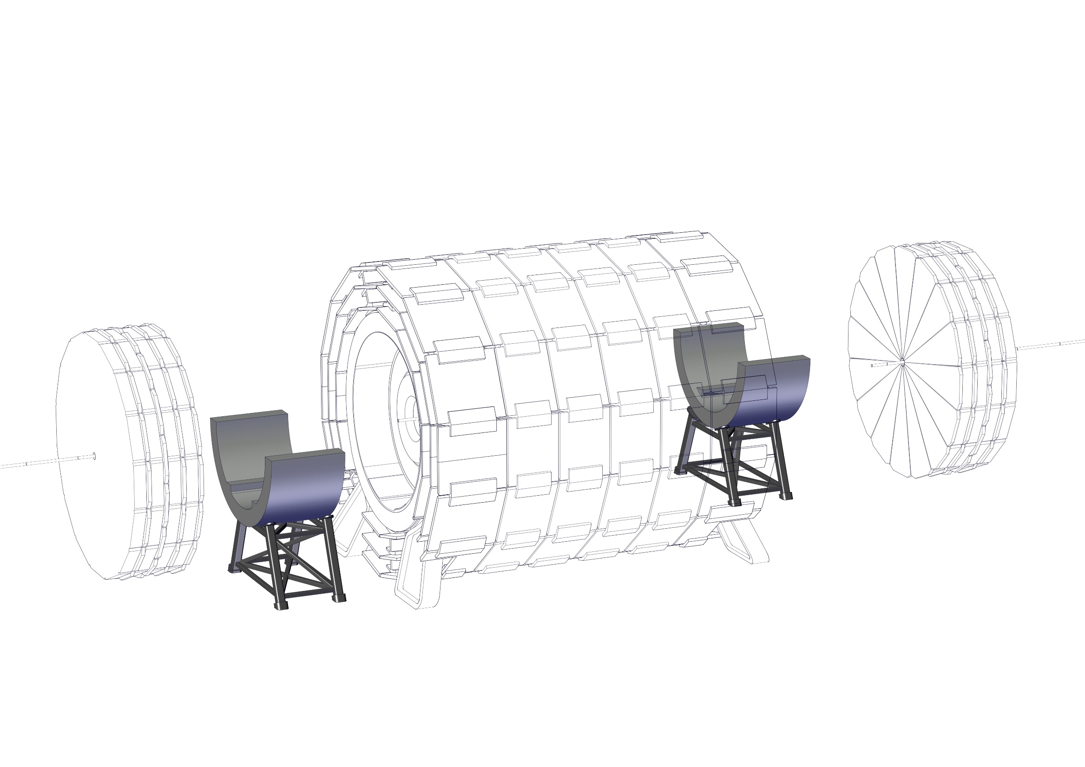
Experiment integration
12 – Install bottom half of the Radiation Shield

Slide 16
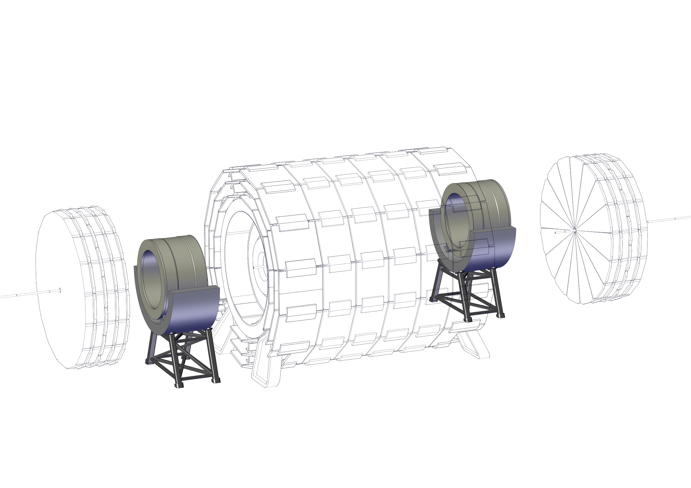
Experiment integration
13 – Install Forward Solenoids

Slide 17
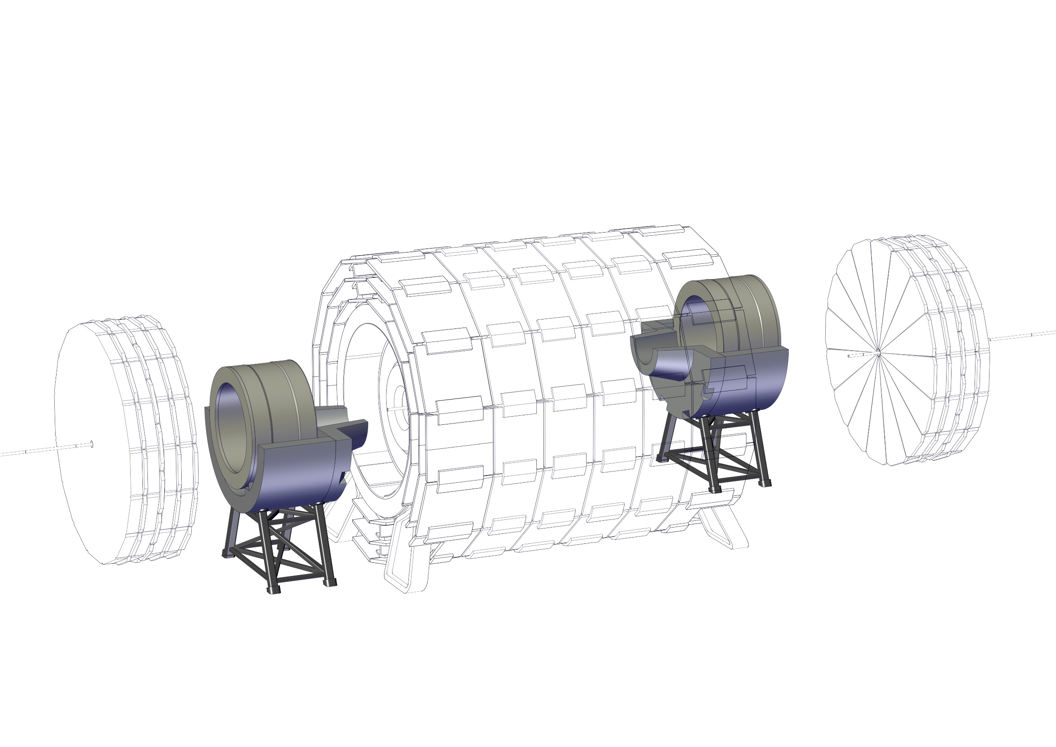
Experiment integration
14 – Install bottom half of the radiation shield nose

Slide 18
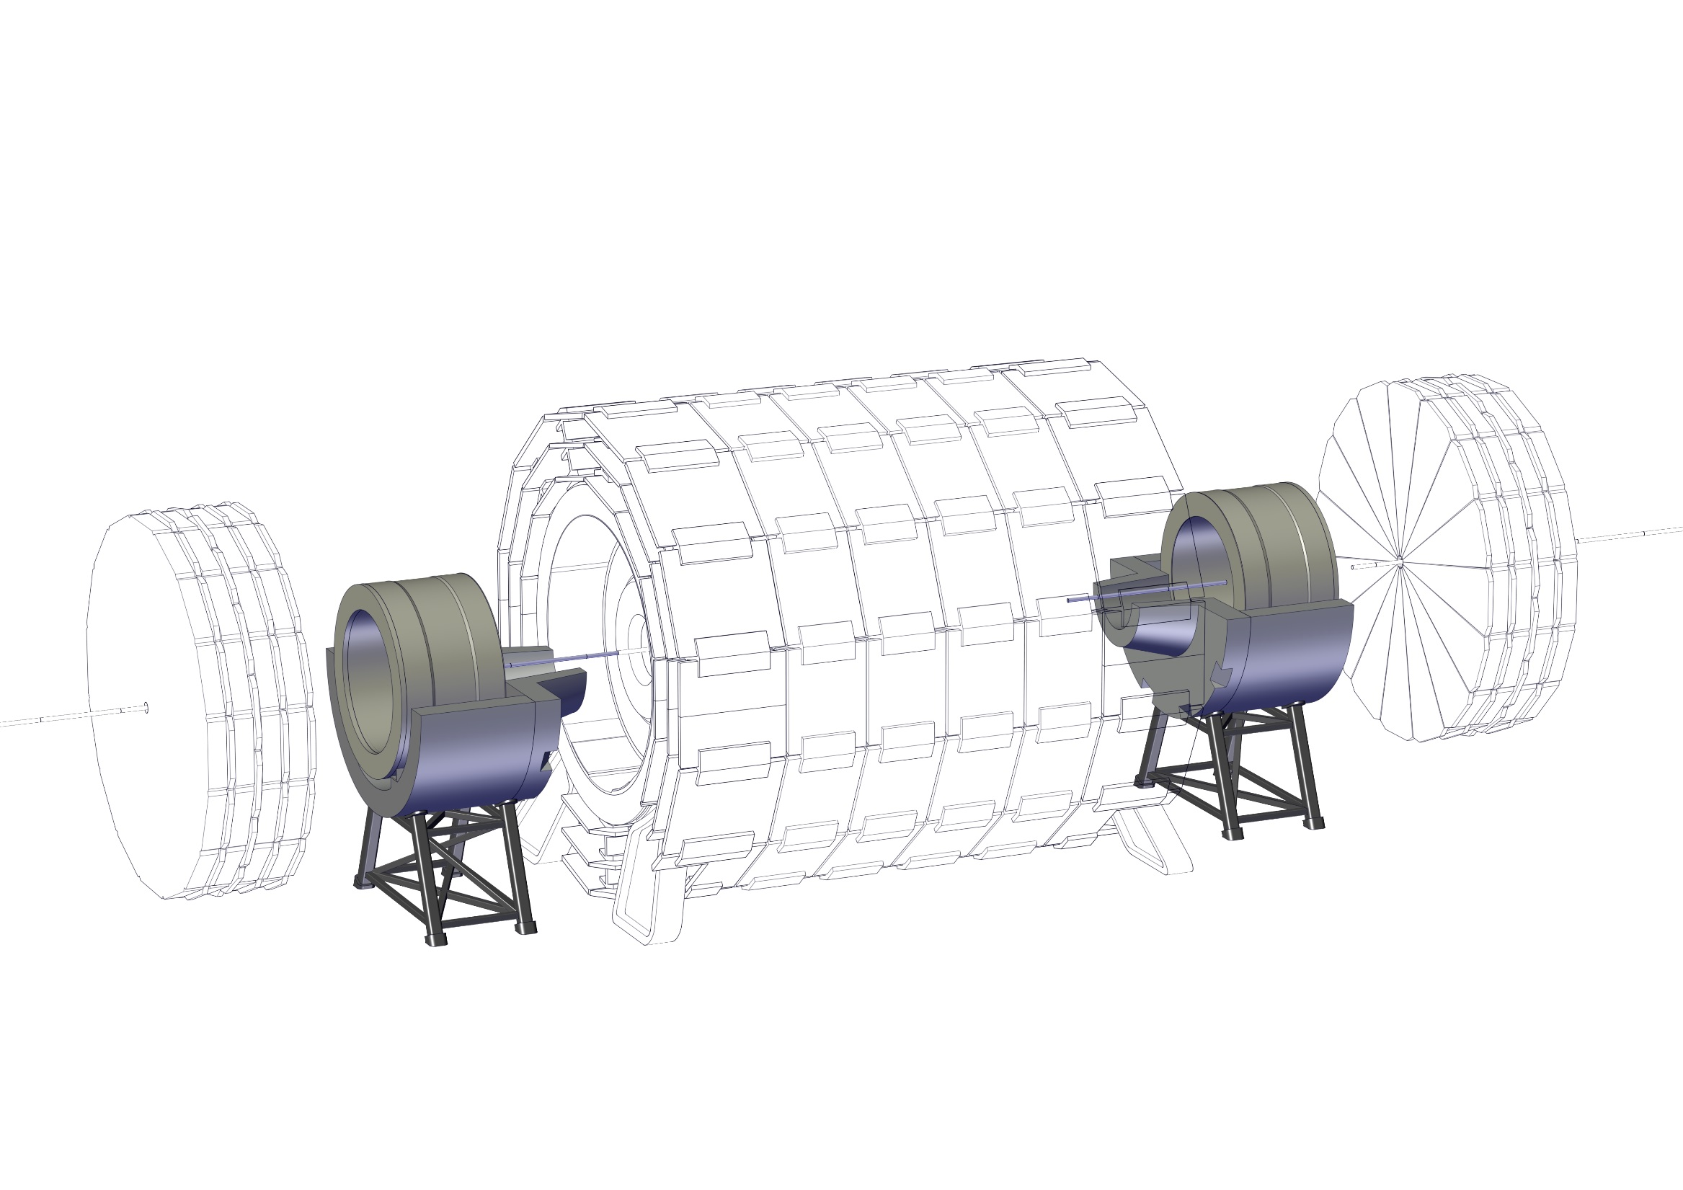
Experiment integration
15 – Align forward solenoid with the experiment and install part of the beam pipe

Slide 19
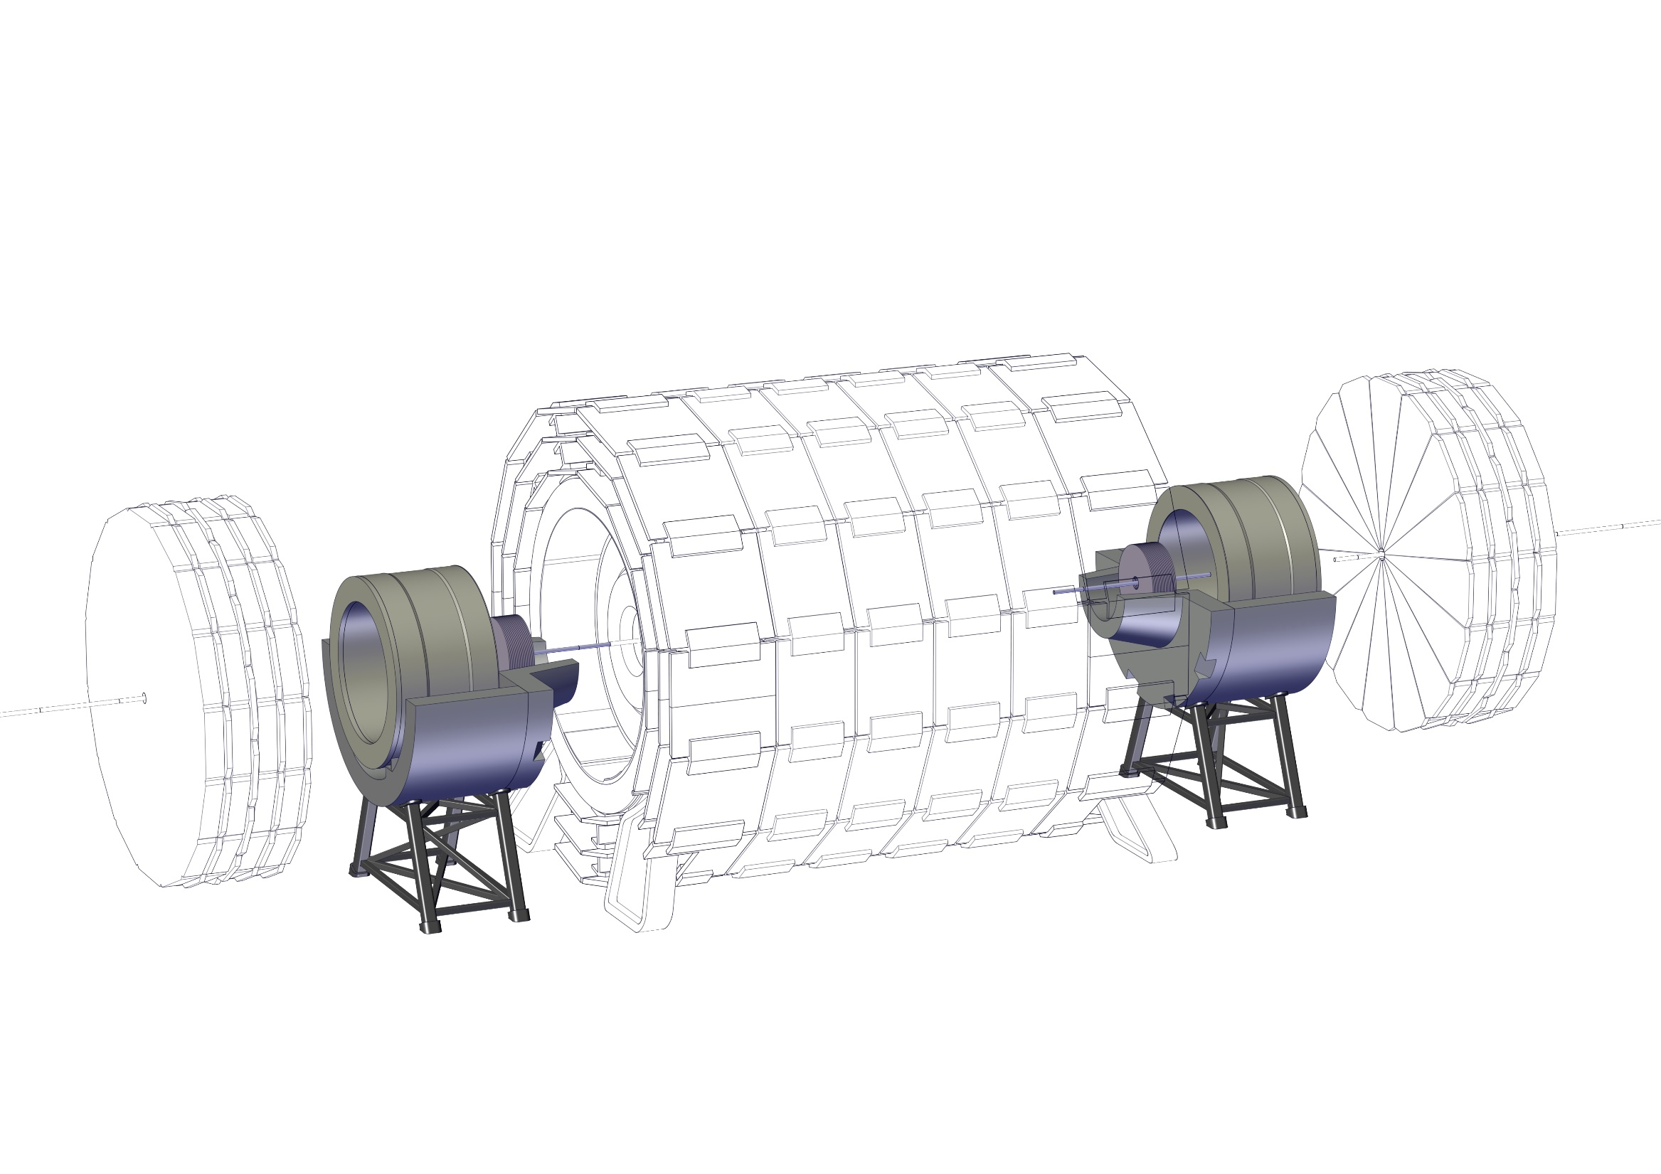
Experiment integration
16 – Install Forward Trackers

Slide 20
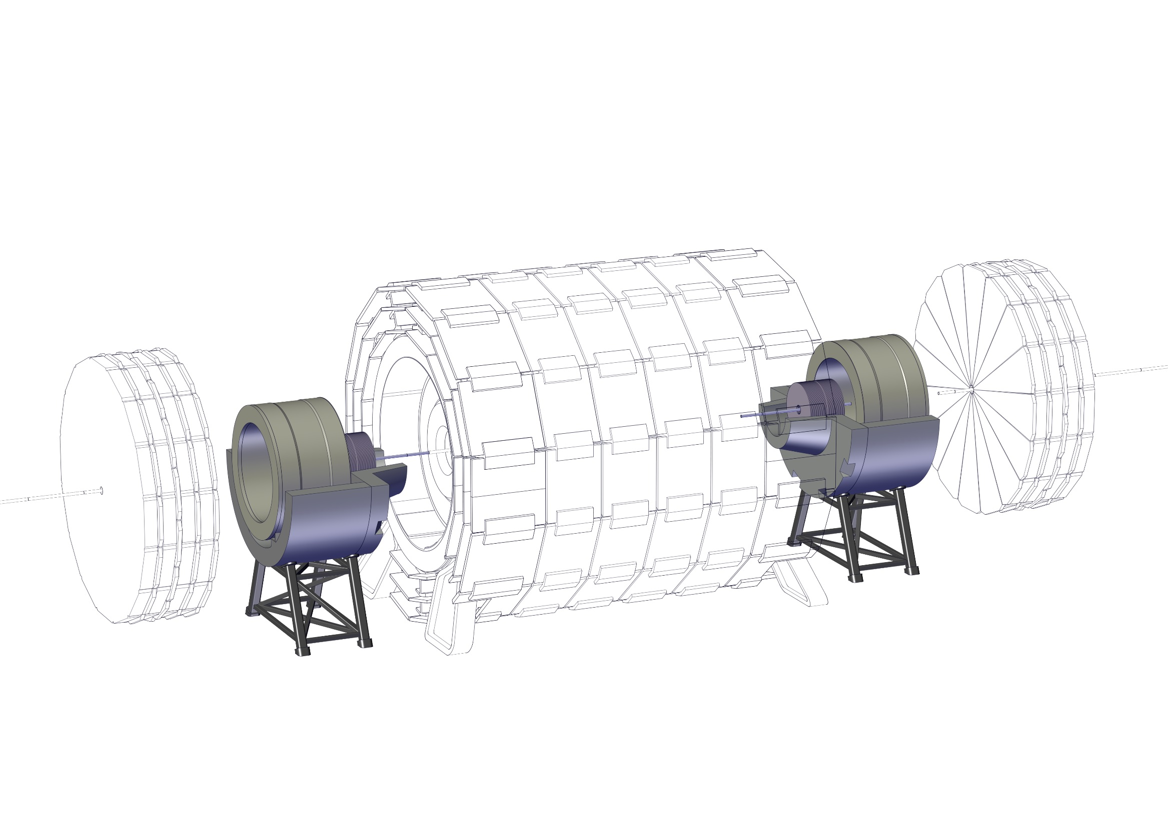
Experiment integration
16 – Install Forward Trackers

Slide 21
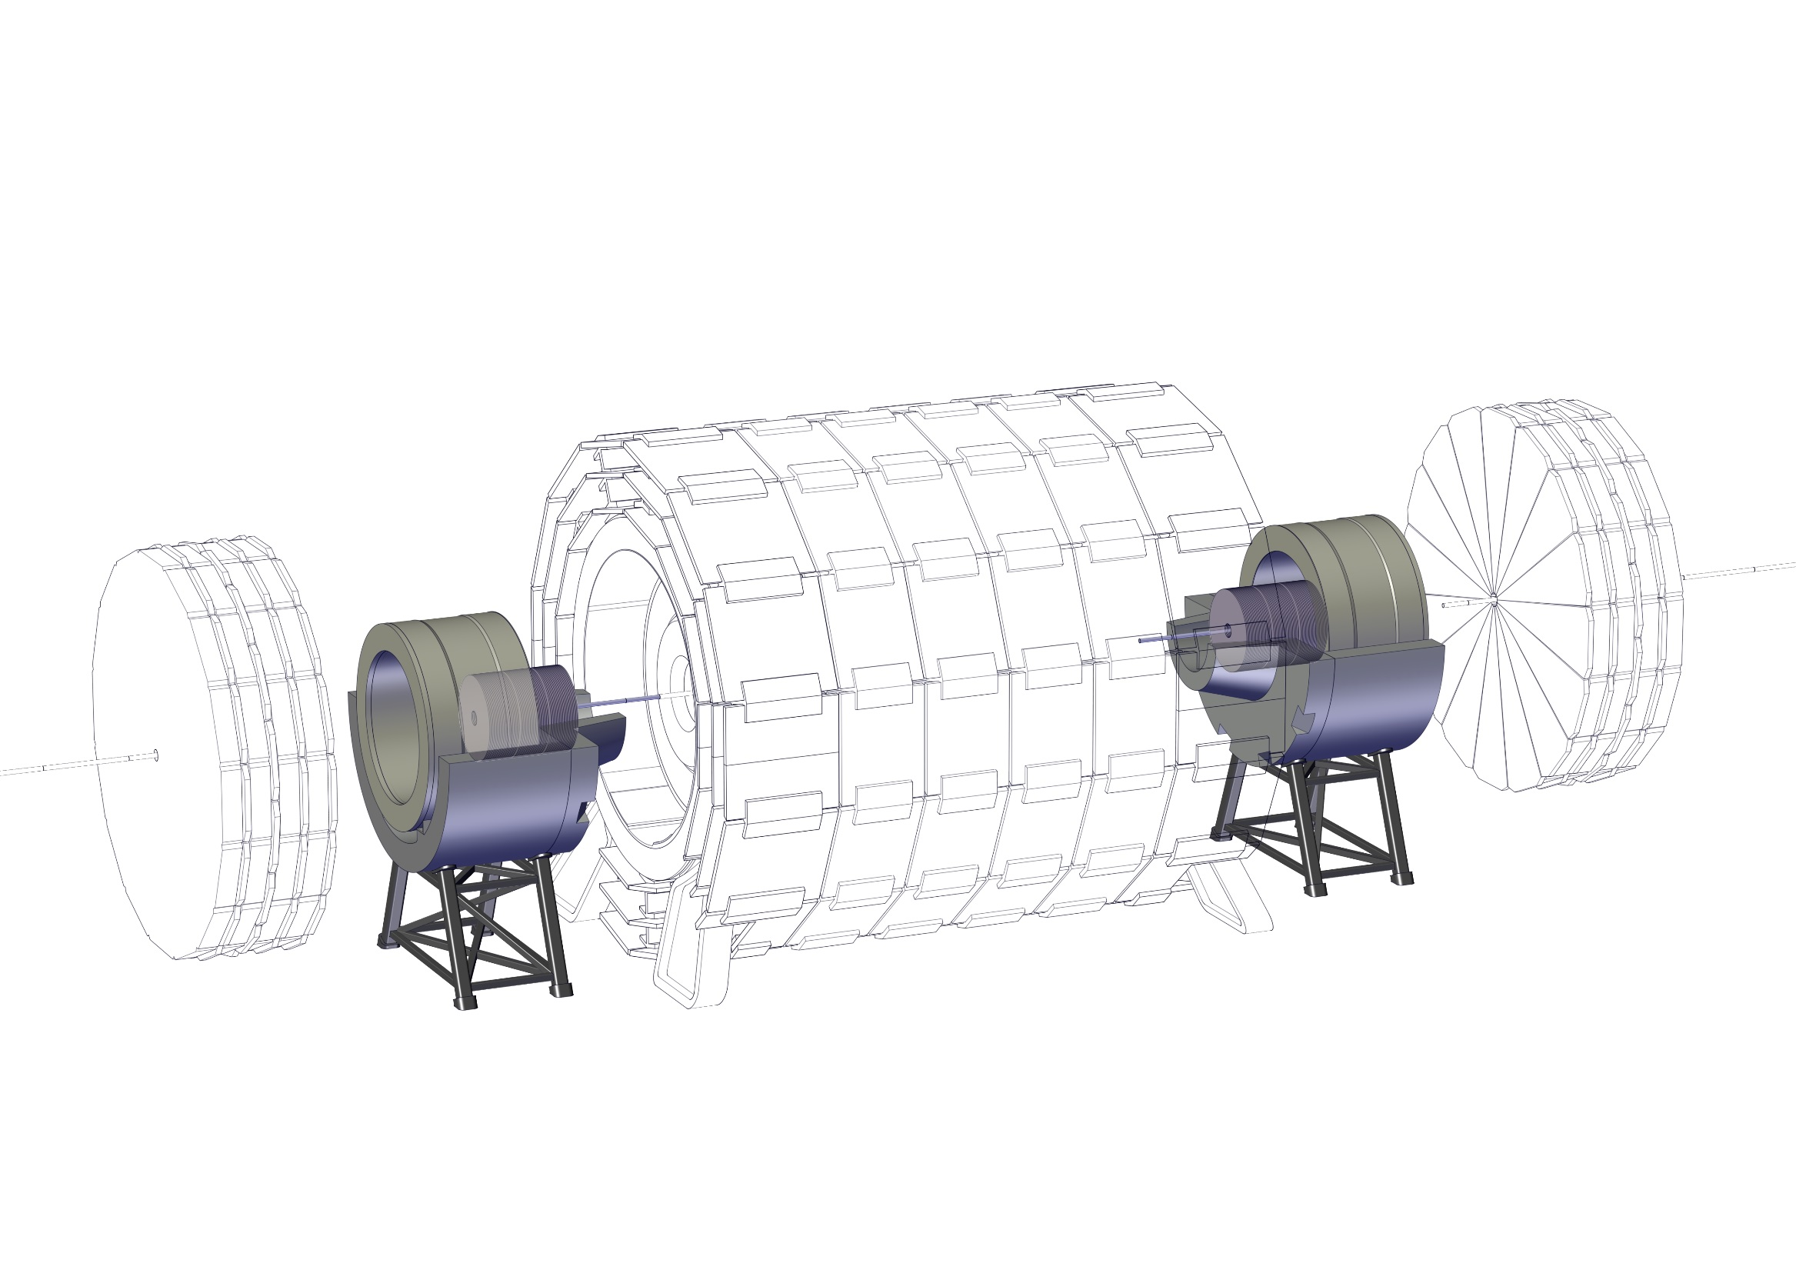
Experiment integration
16 – Install Forward Trackers

Slide 22
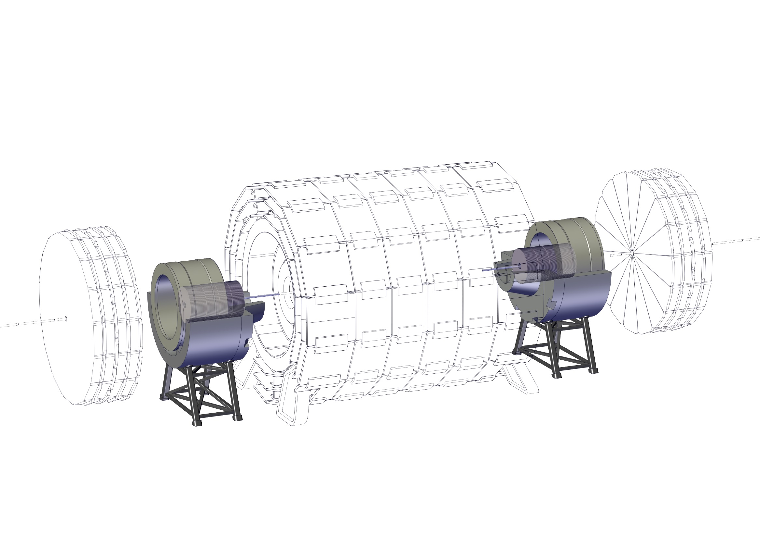
Experiment integration
16 – Install Forward Trackers

Slide 23
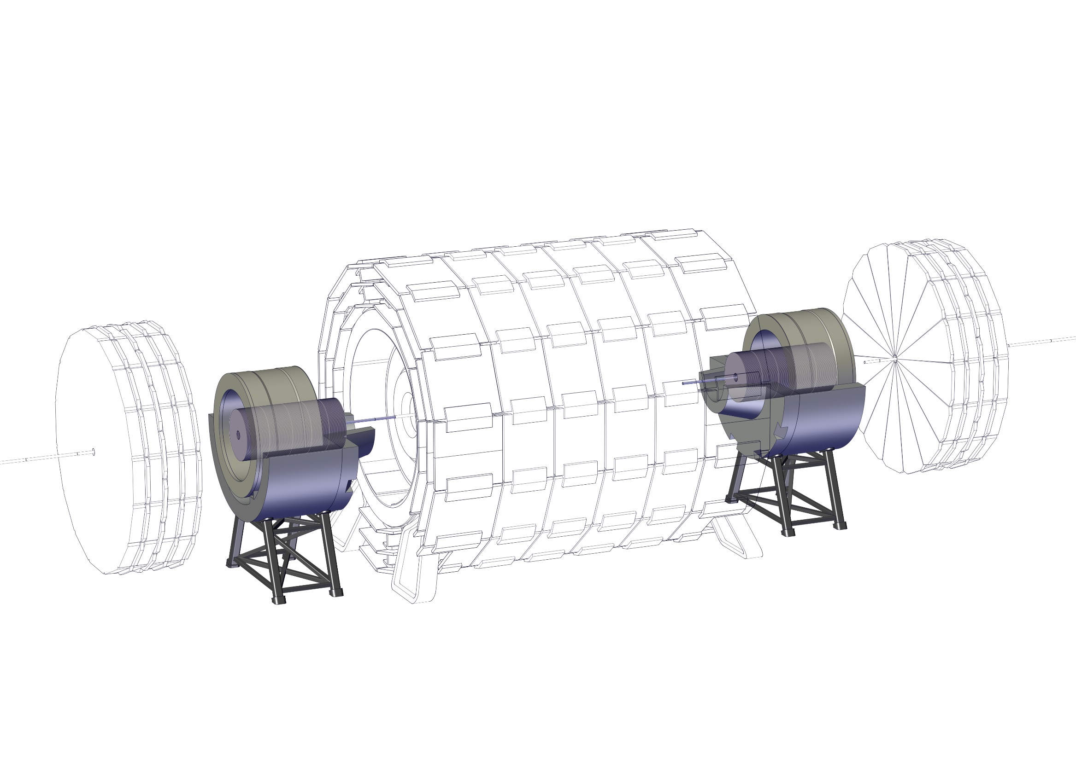
Experiment integration
16 – Install Forward Trackers

Slide 24
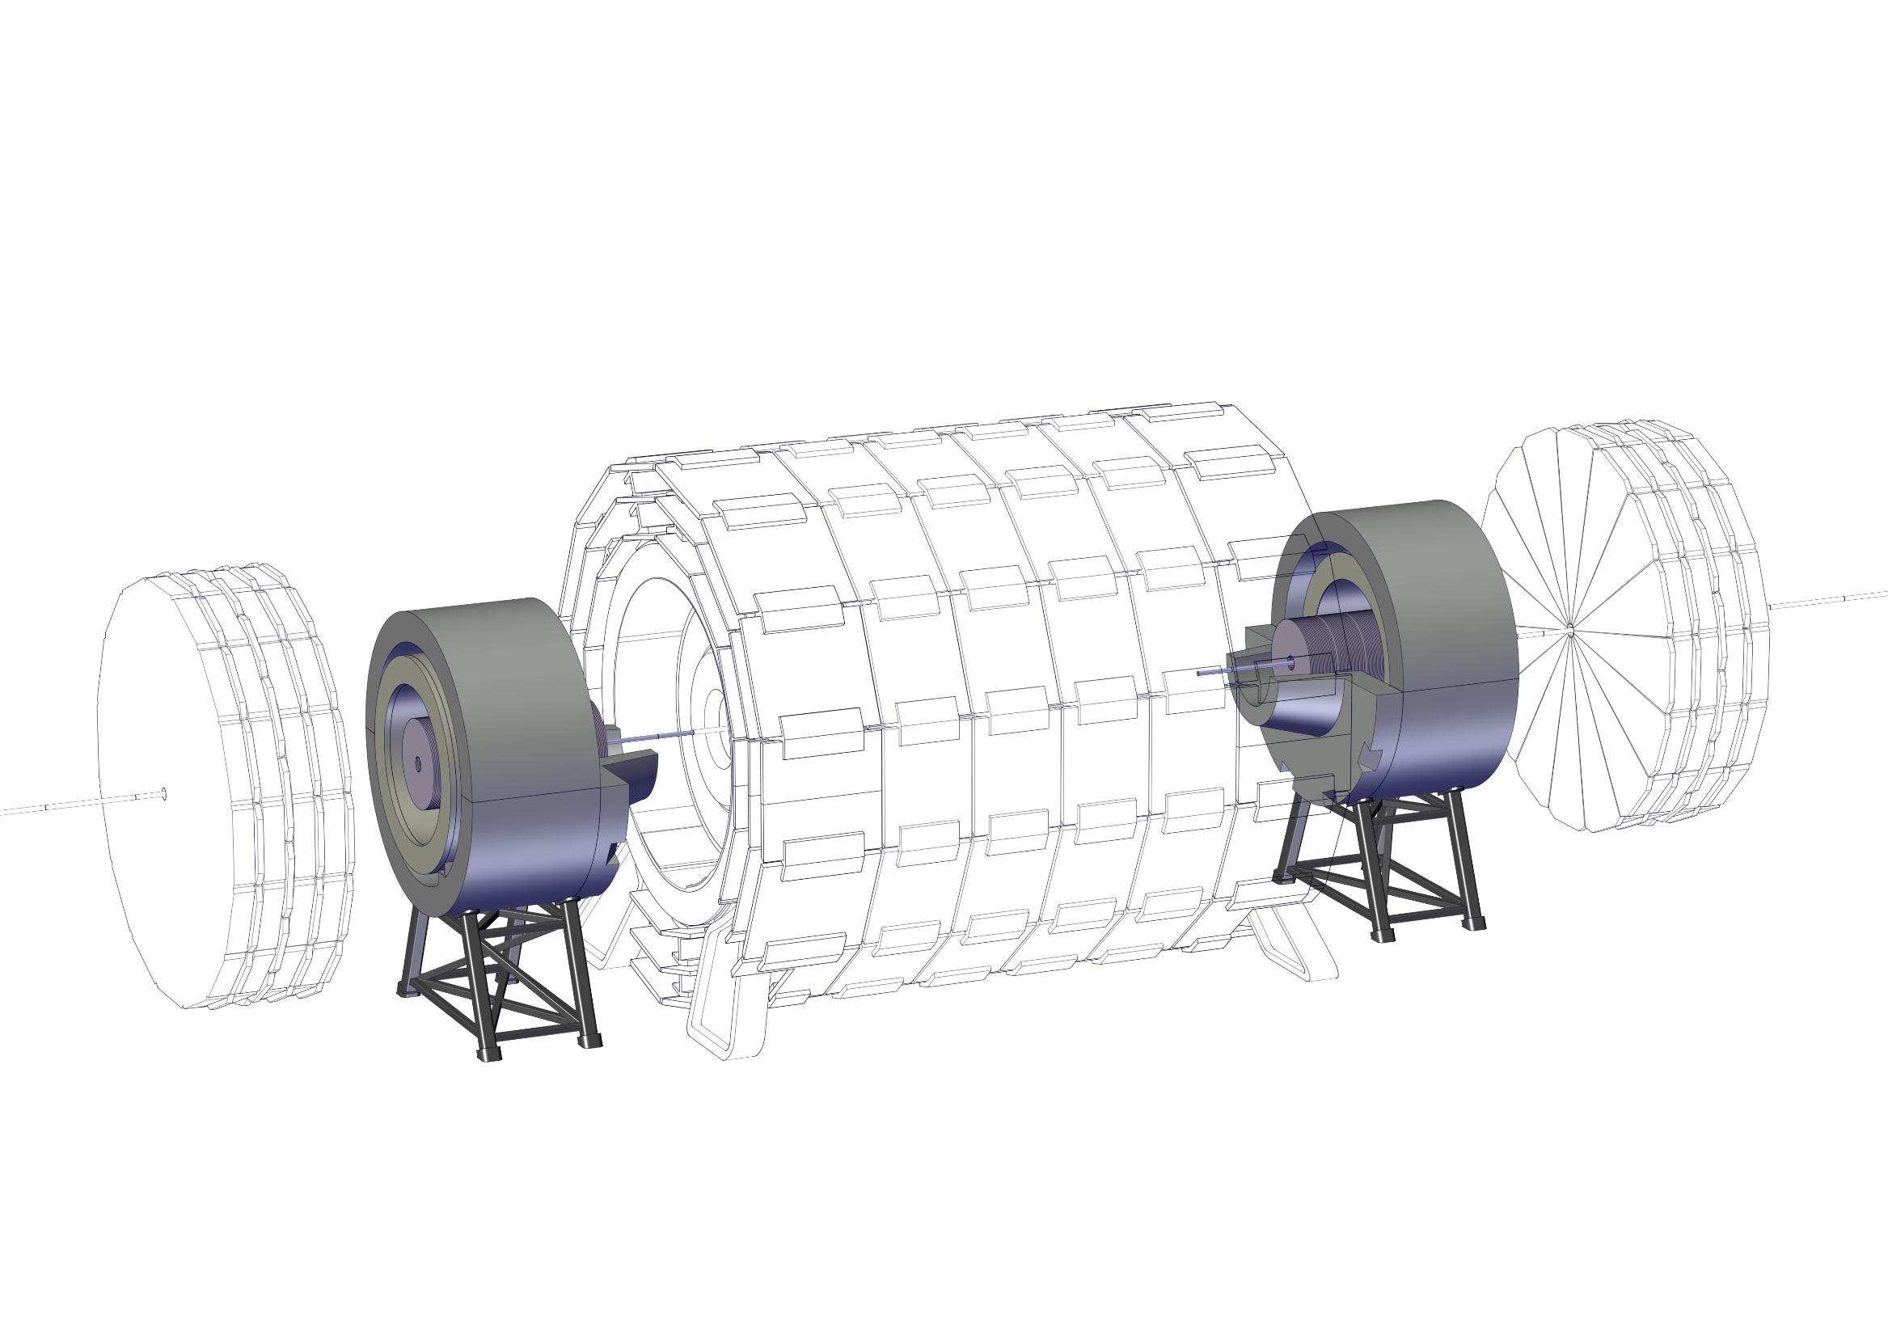
Experiment integration
17 – Install top half of the Radiation Shield

Slide 25
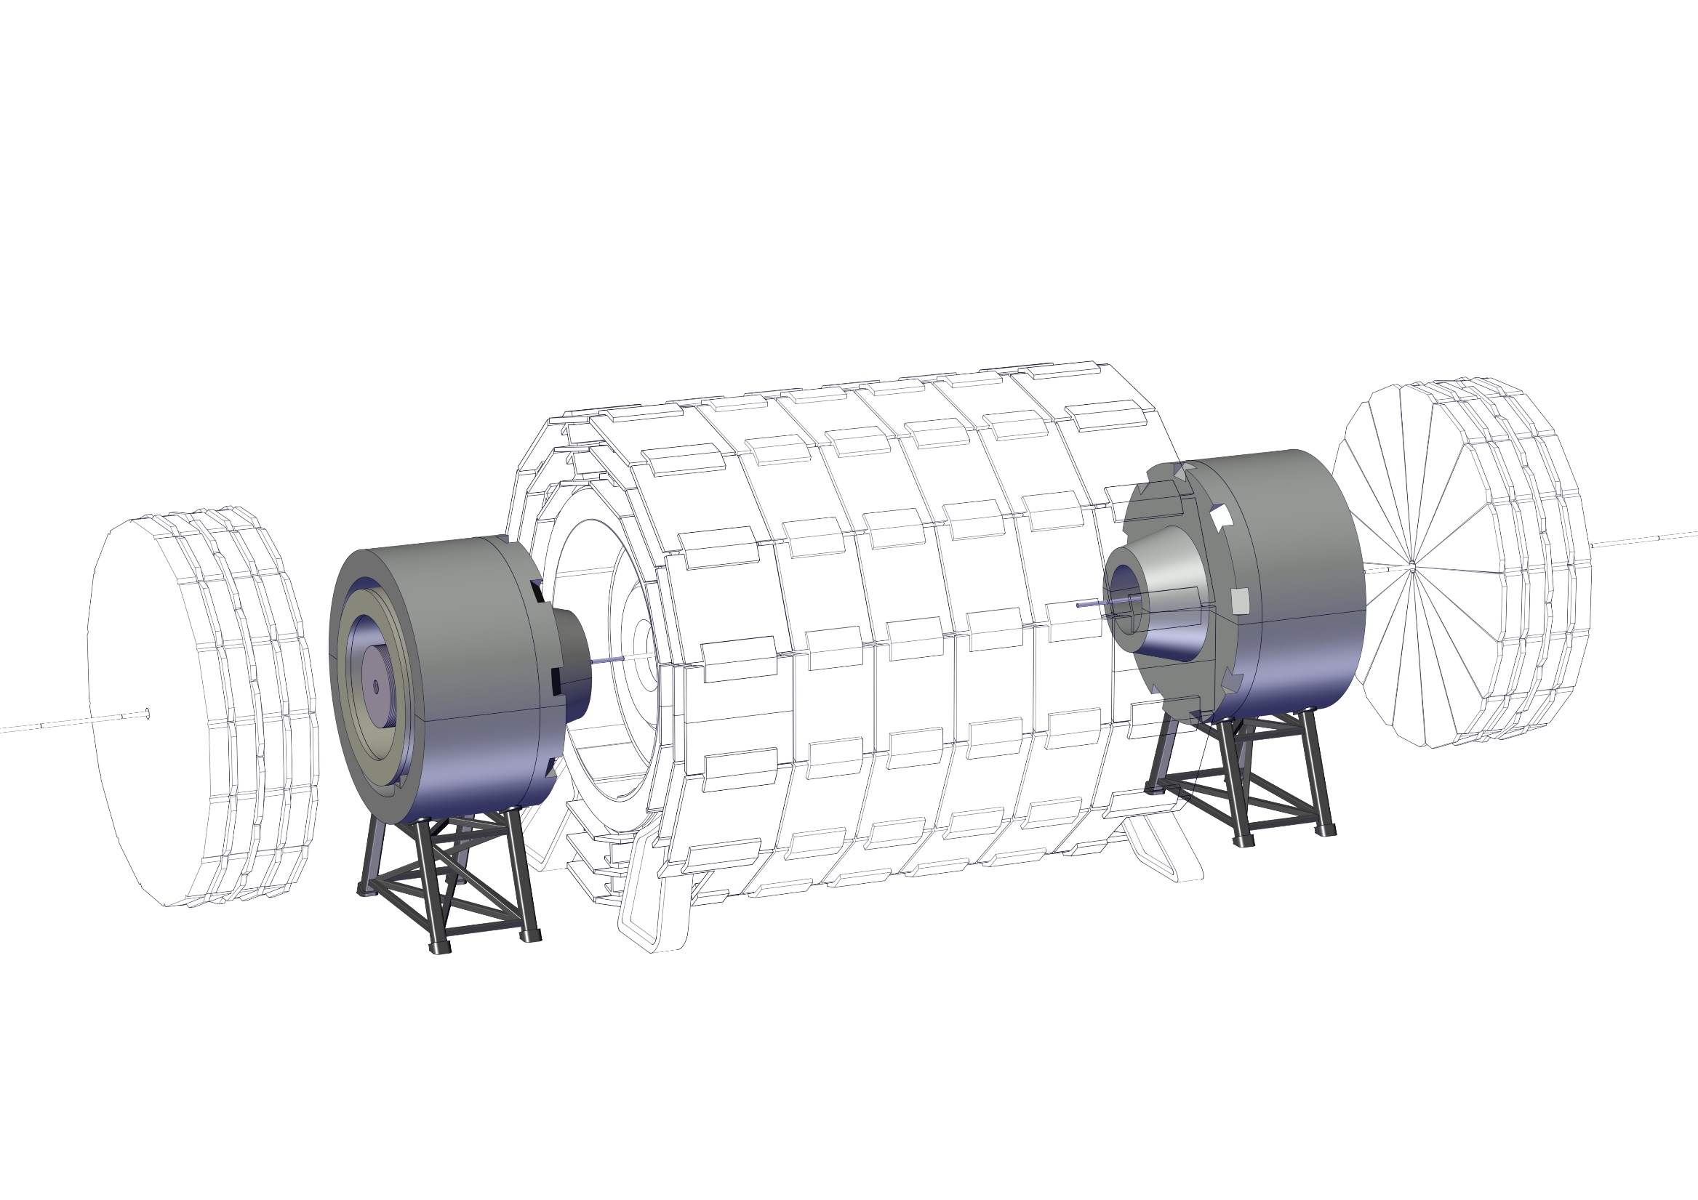
Experiment integration
18 – Install top half of the Radiation Shield nose

Slide 26
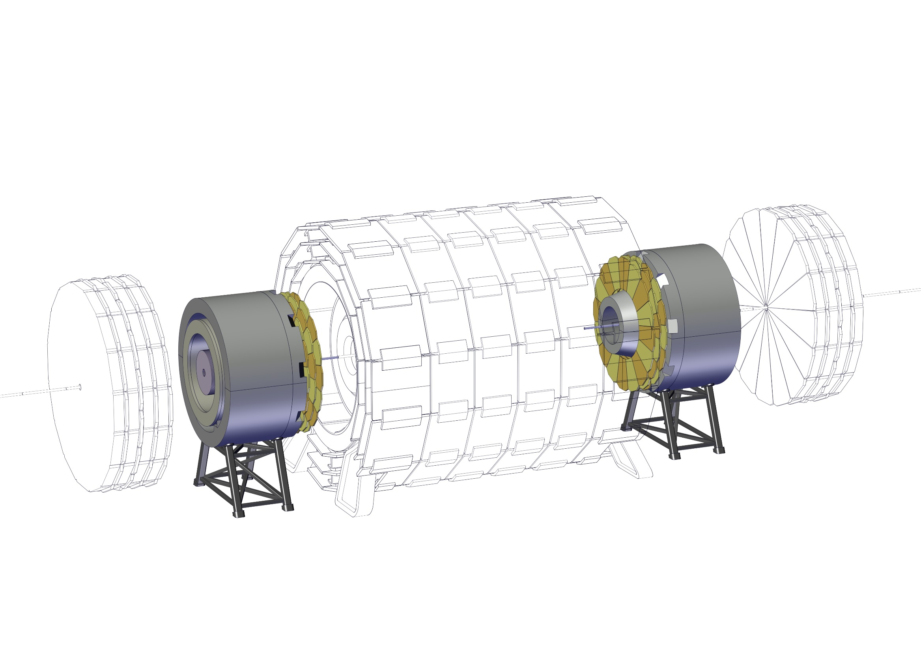
Experiment integration
19 – Install Muon Chambers

Slide 27
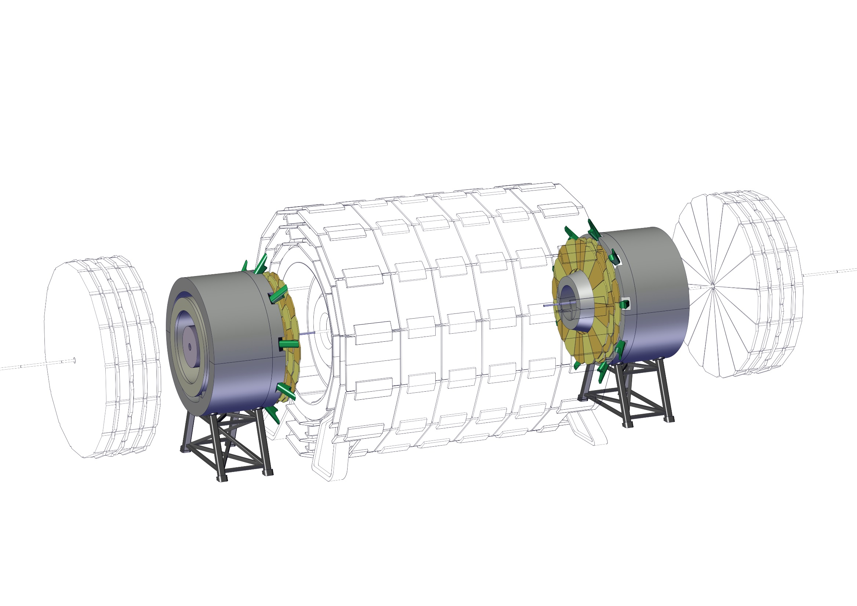
Experiment integration
20 – Install Spokes

Slide 28
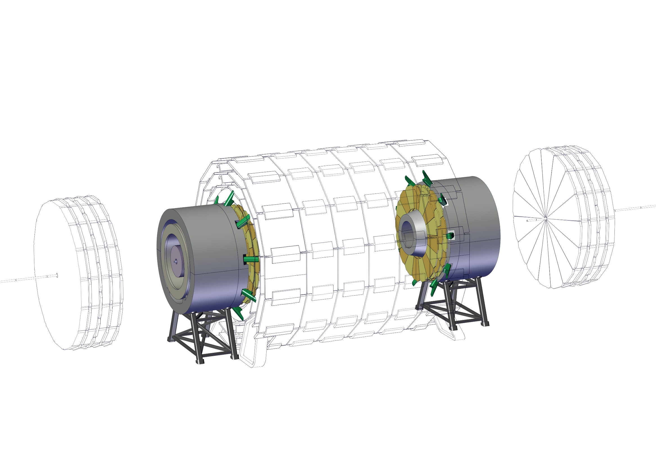
Experiment integration
21 – Connect Spokes to main cryostat

Slide 29
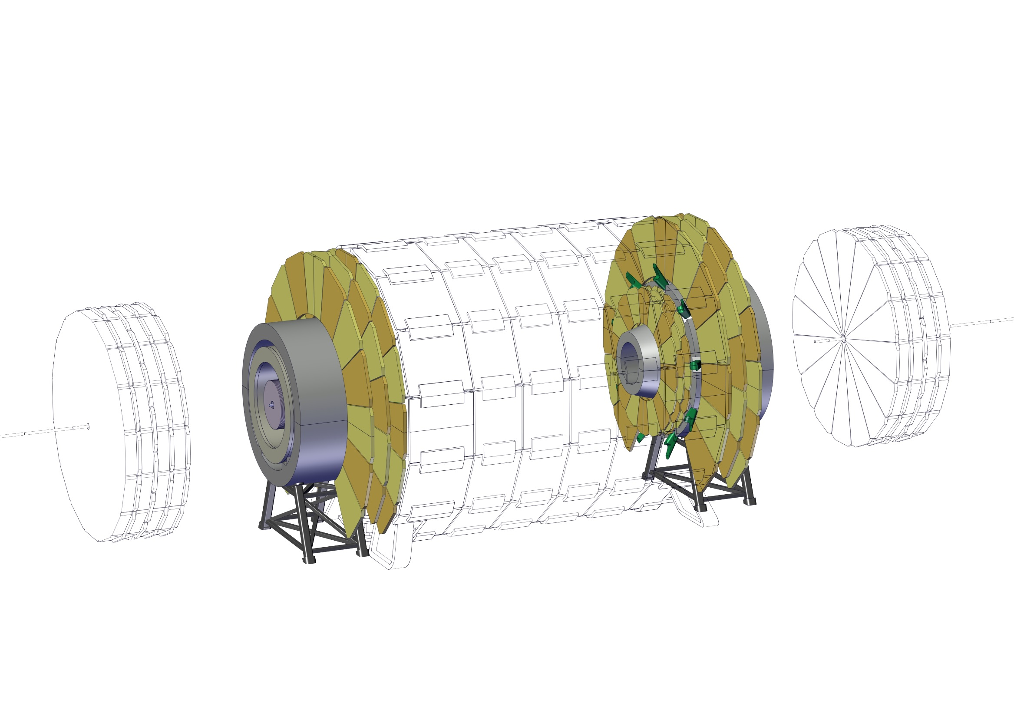
Experiment integration
22 – Install Muon Chambers

Slide 30
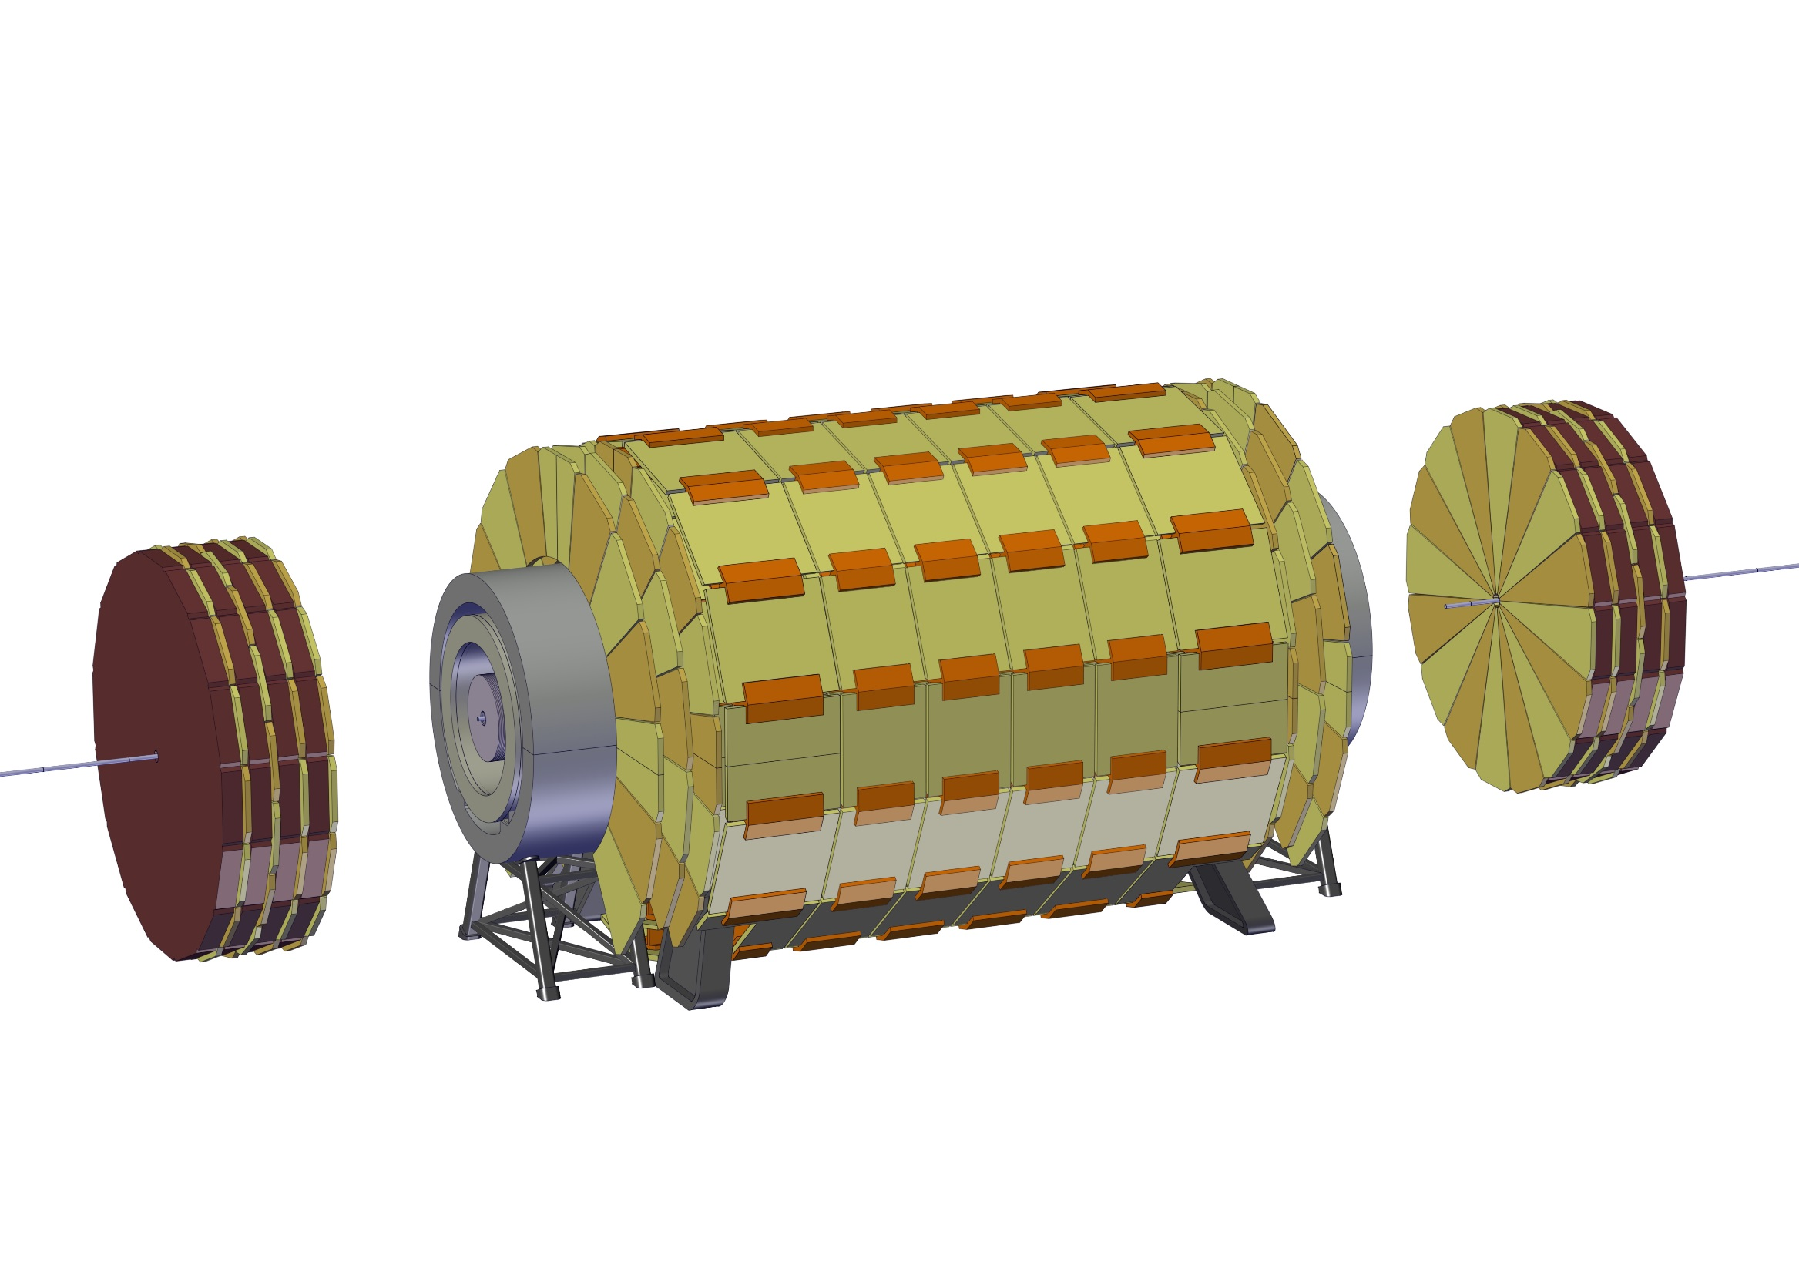
Experiment integration
22 – Install Muon Chambers

Slide 31
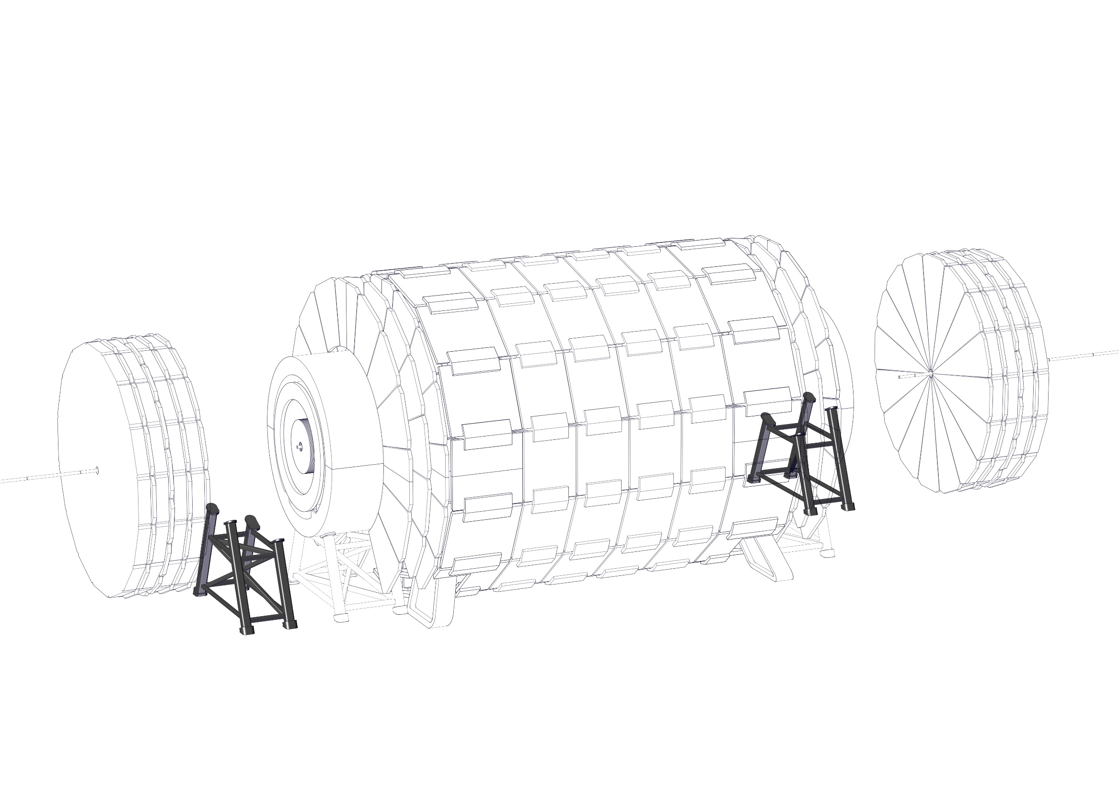
Experiment integration
23 - Install Forward ECal support structure

Slide 32
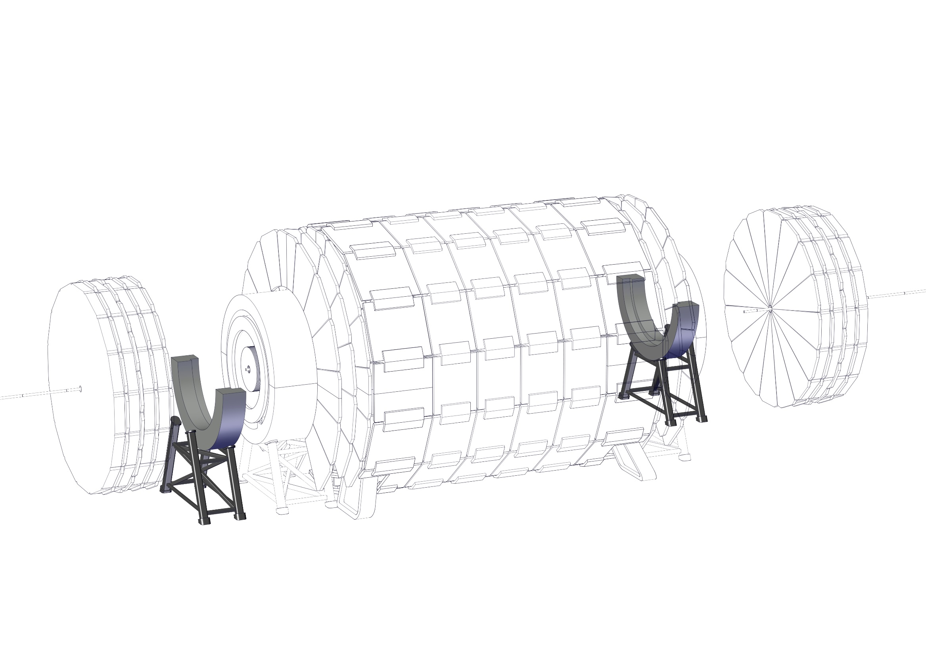
Experiment integration
24 - Install bottom half of the ECal Radiation Shield

Slide 33
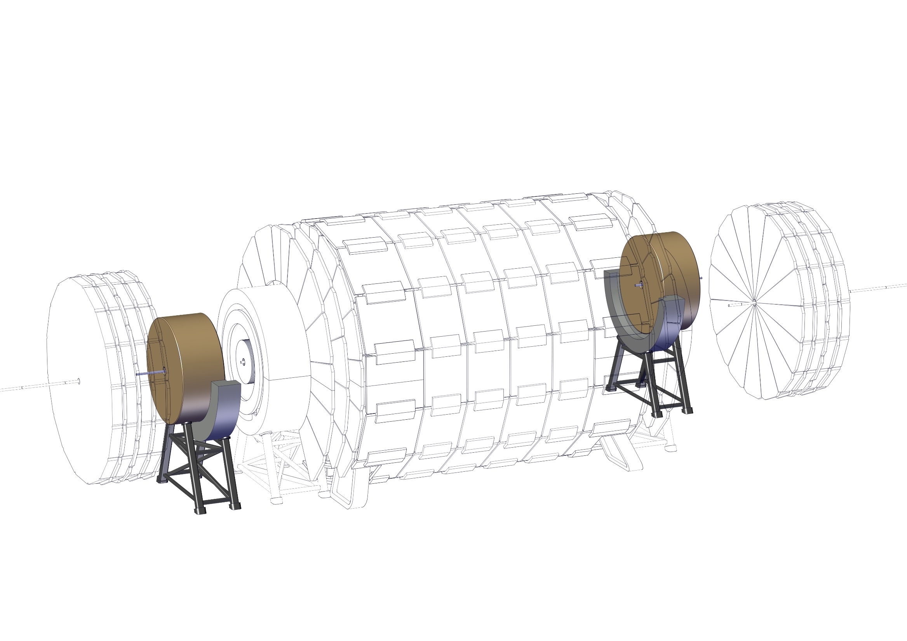
Experiment integration
25 - Install Forward ECal

Slide 34
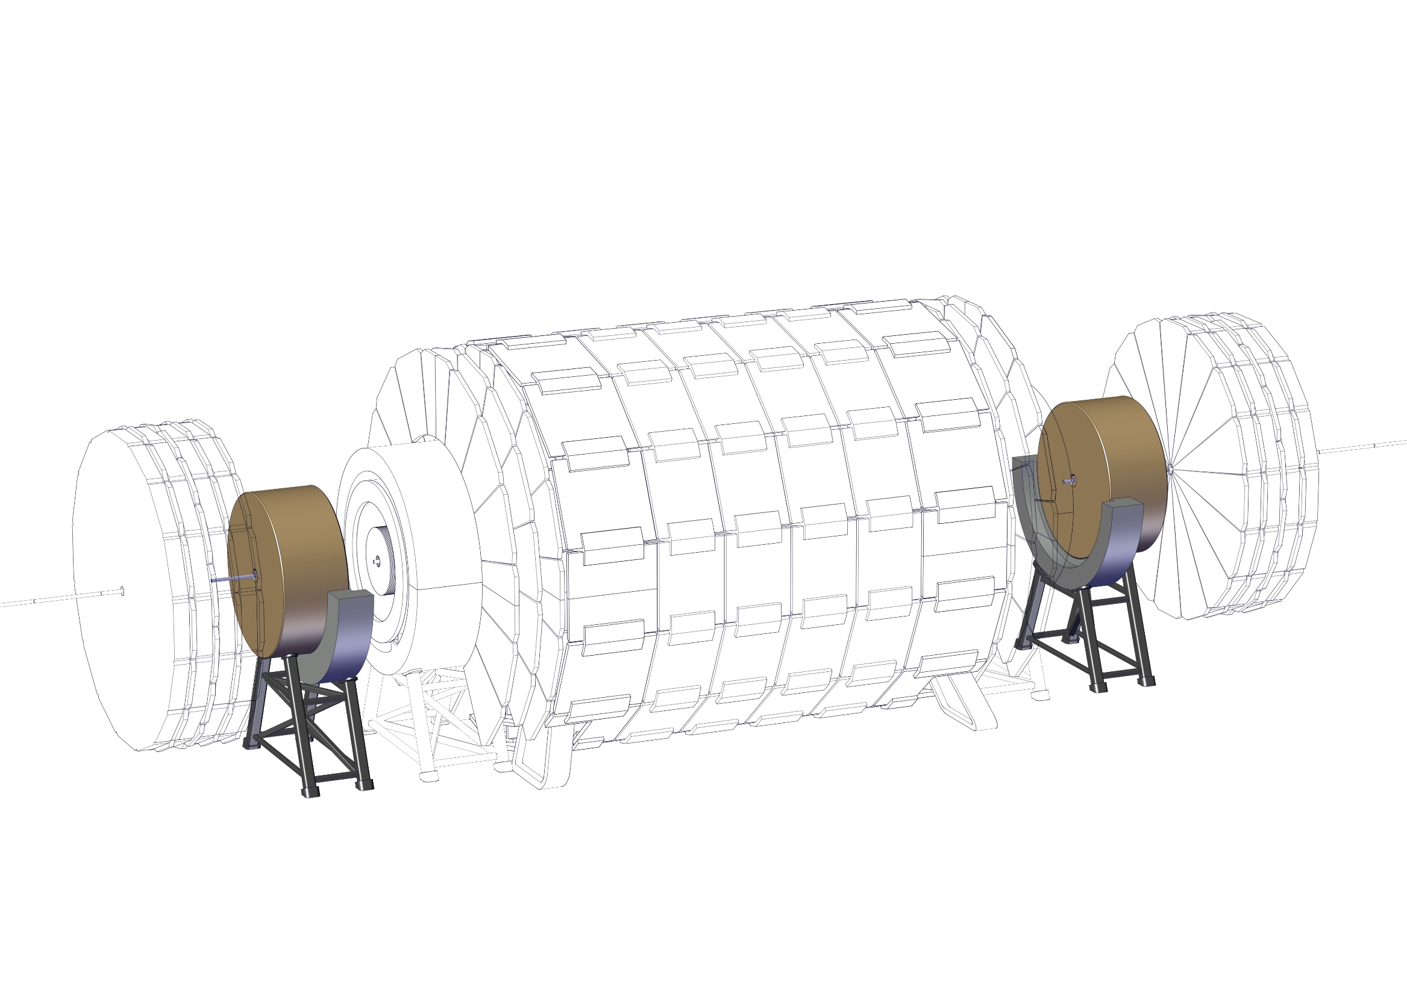
Experiment integration
26 – Align the off-centered ECal with the experiment and close Beam Pipe

Slide 35
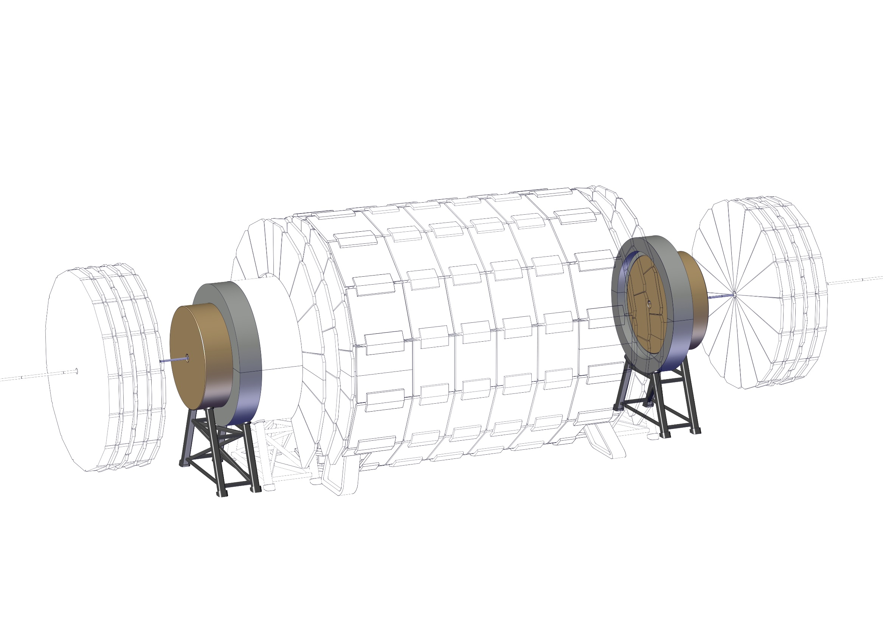
Experiment integration
27 – Install the top half and close the radiation shield

Slide 36
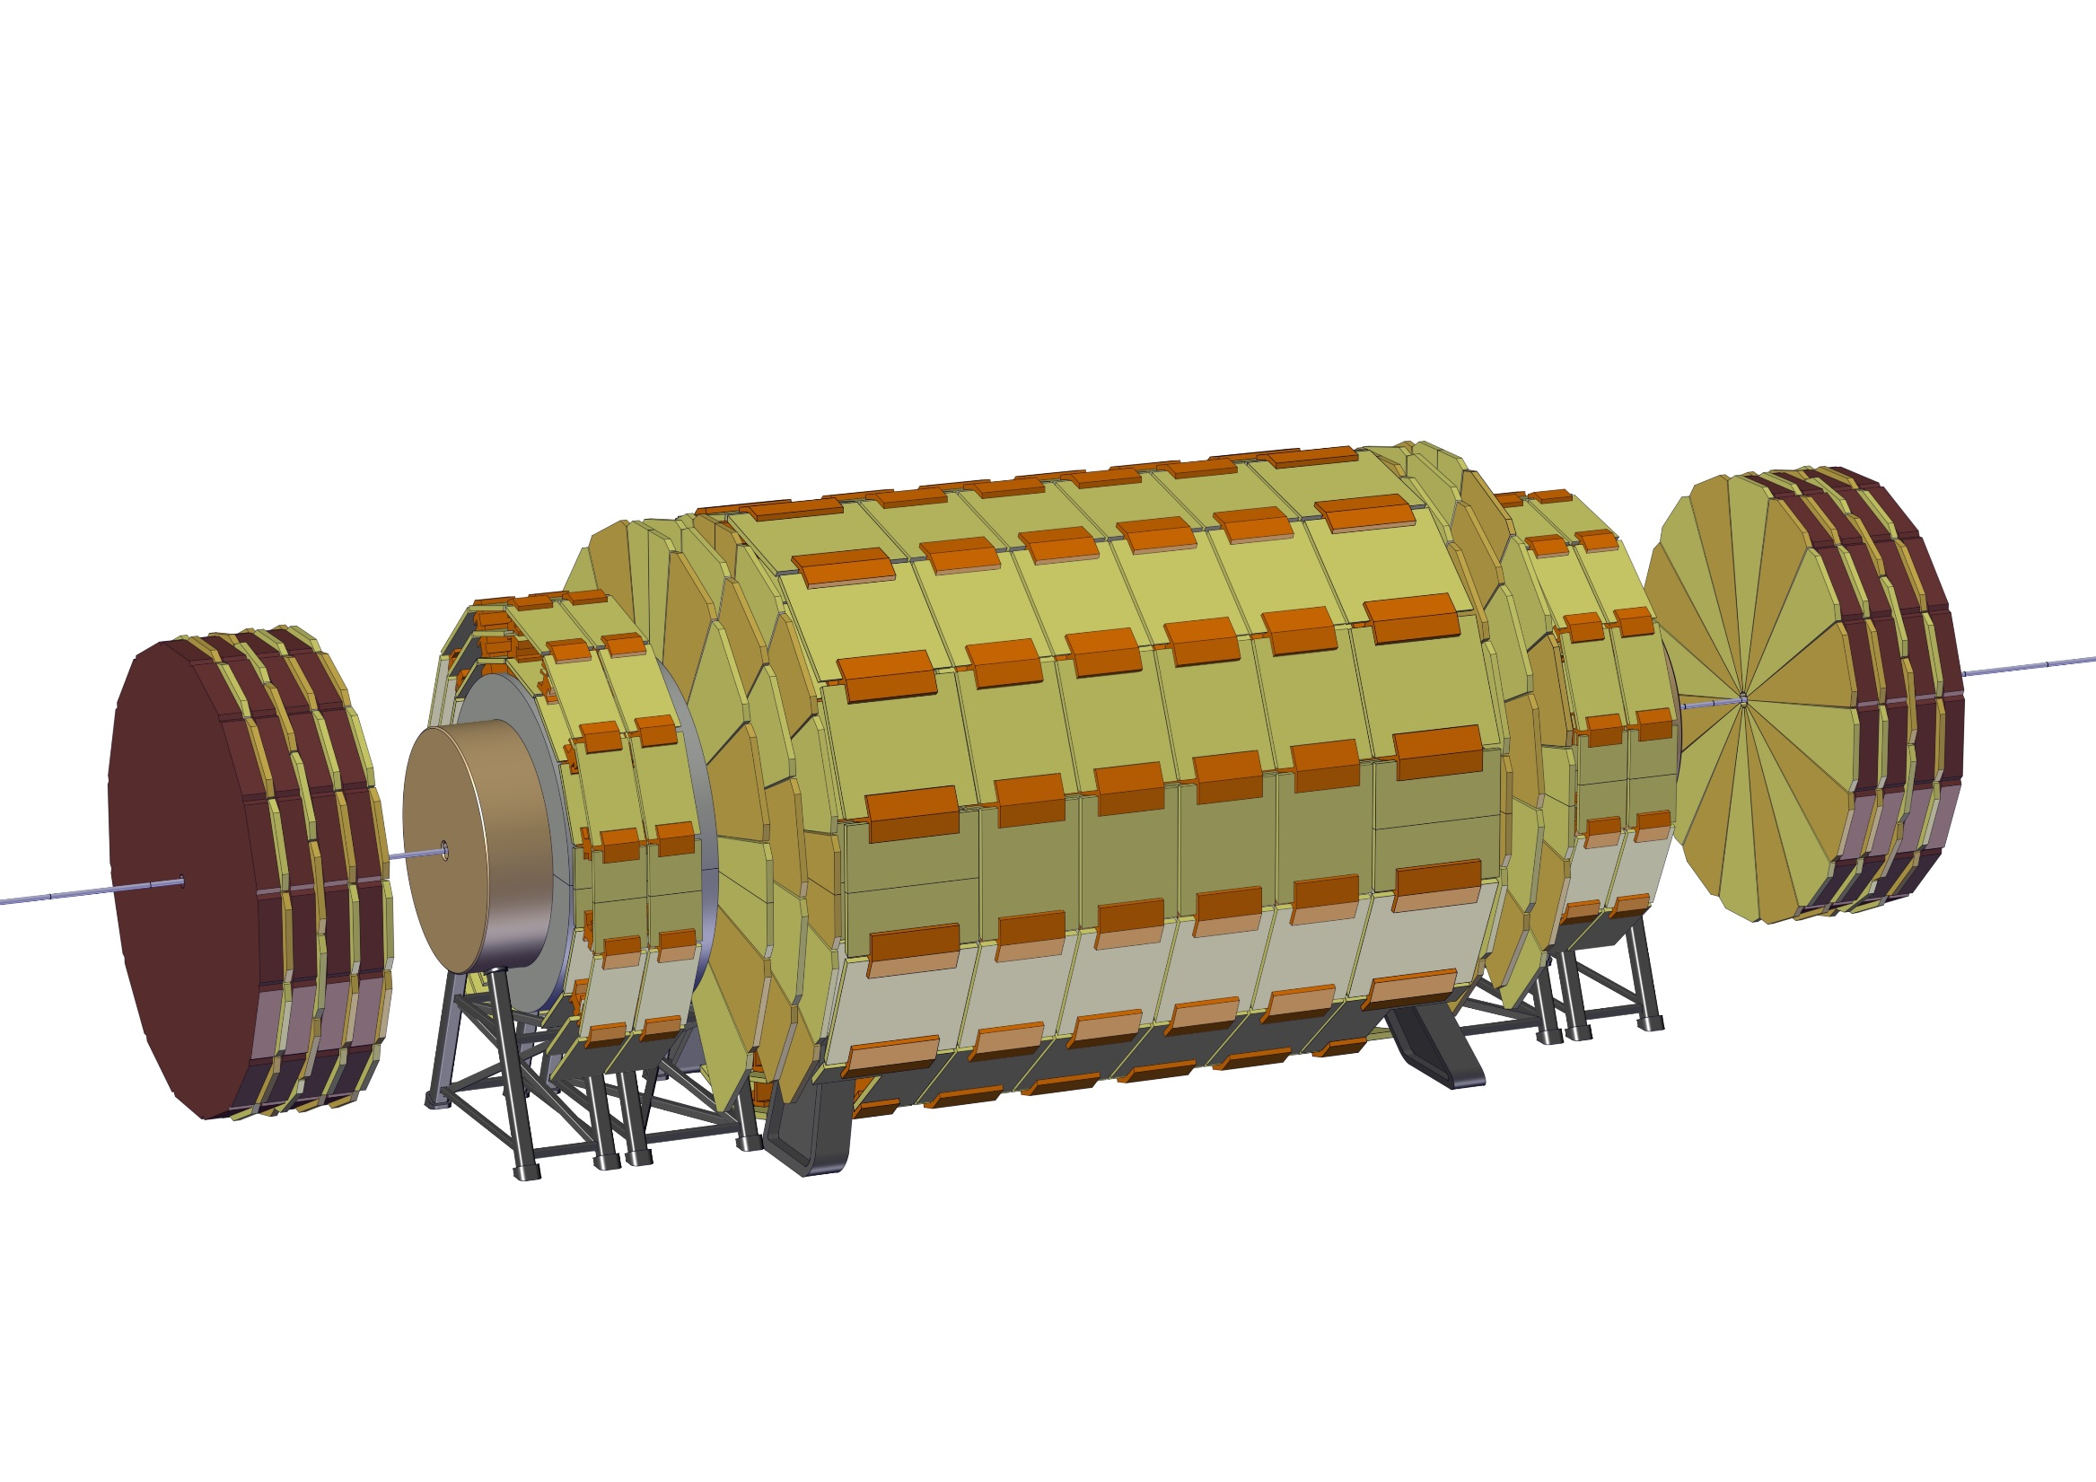
Experiment integration
28 – Install remaining Muon Chambers

Slide 37
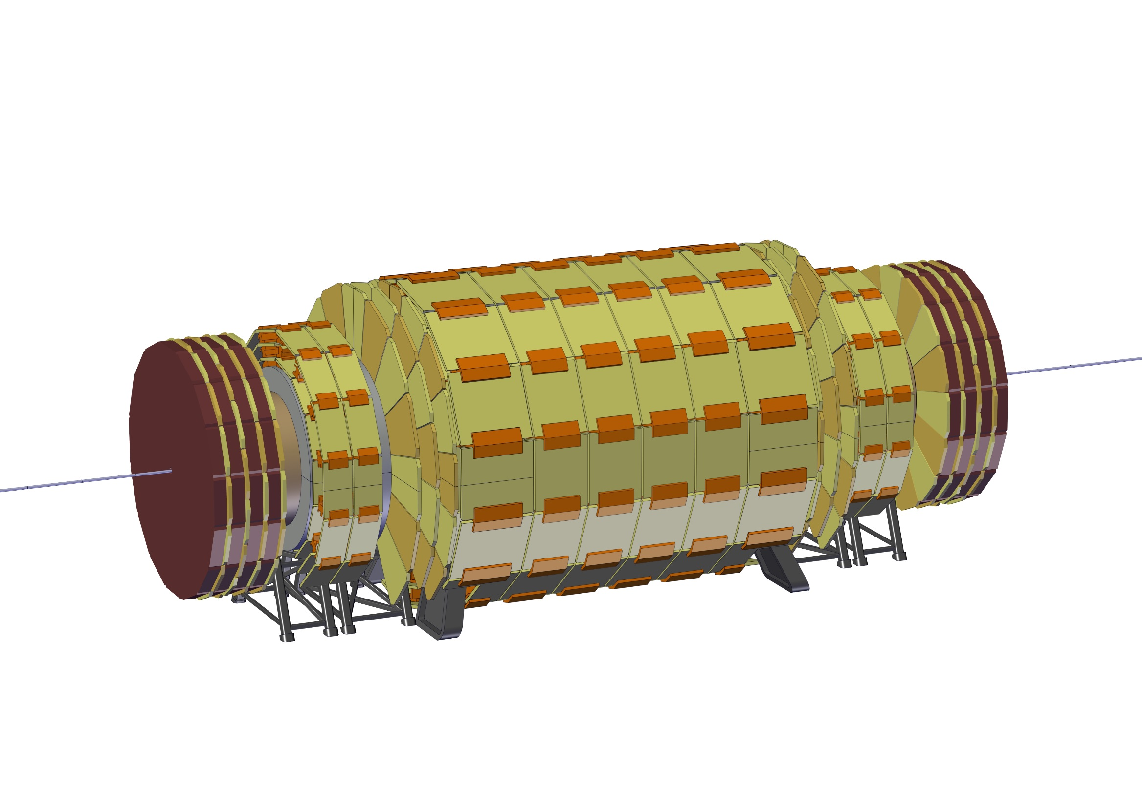
Experiment integration
29 – Move Forward Muon Wheels to their final position

Slide 38
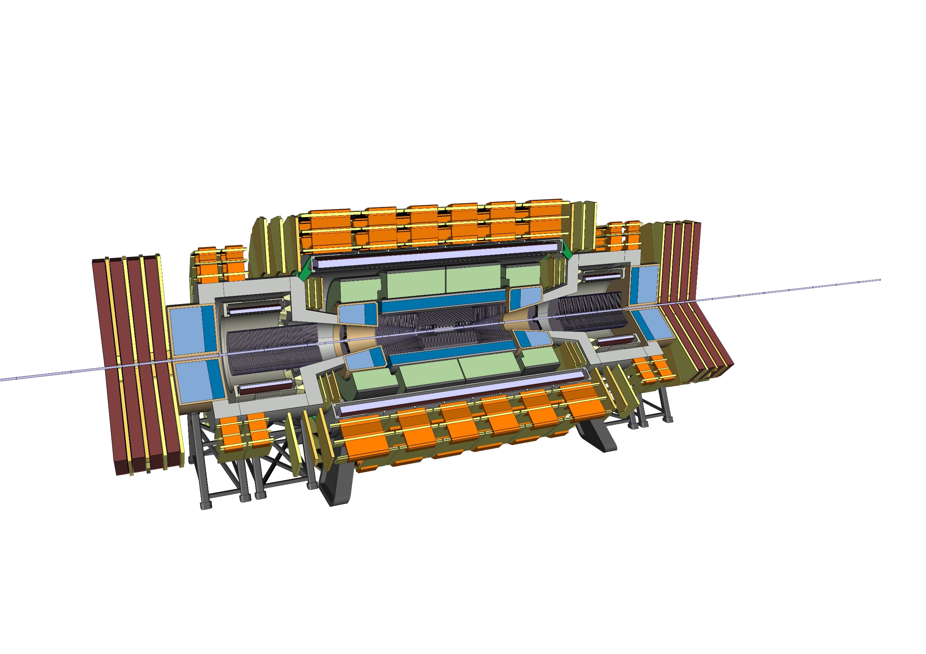
Experiment integration
COMPLETE ASSEMBLY

Slide 39
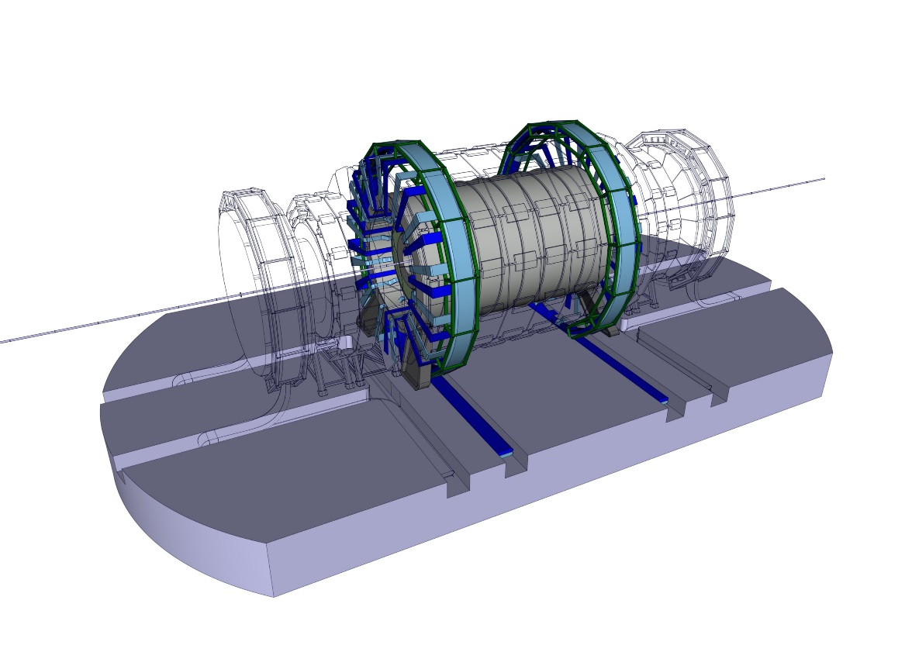
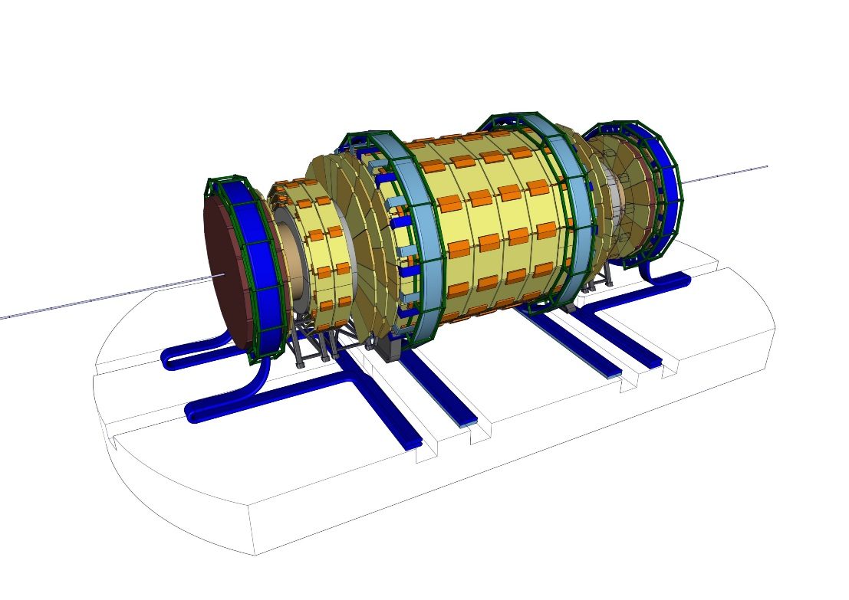
Services Routing
Inner detectors cables and services are routed to the exterior of the detector and then to a side cavern.
Forward detectors will make use of flexible chains that will be placed on trenches allowing only for longitudinal movements.
For simplicity, only the services routing of the muon chambers in the forward direction are shown in the pictures above.

Slide 40
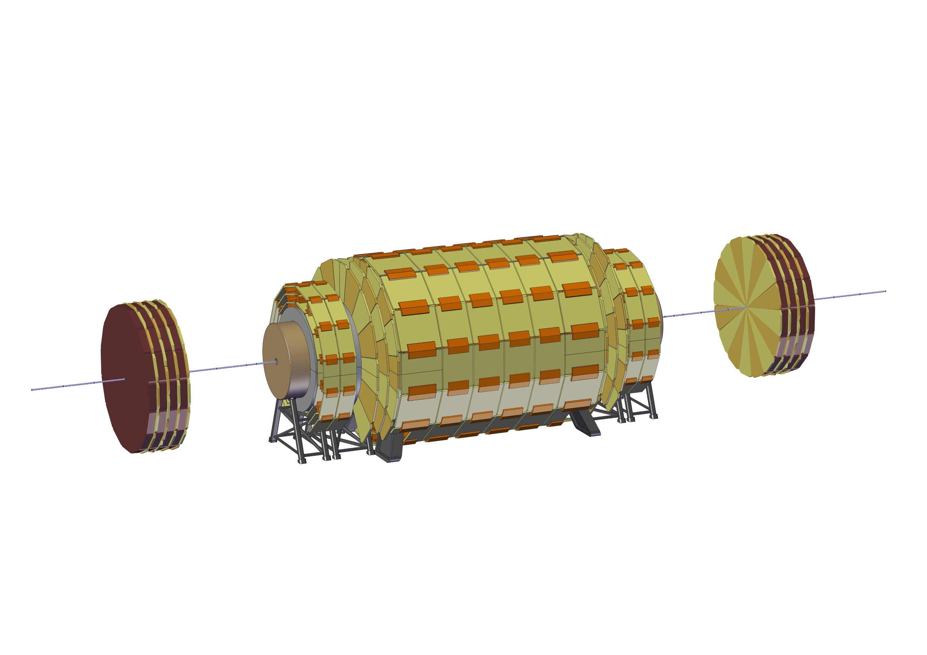
Short opening scenario
1 – Slide the Forward Muon Chambers away from the experiment

Slide 41
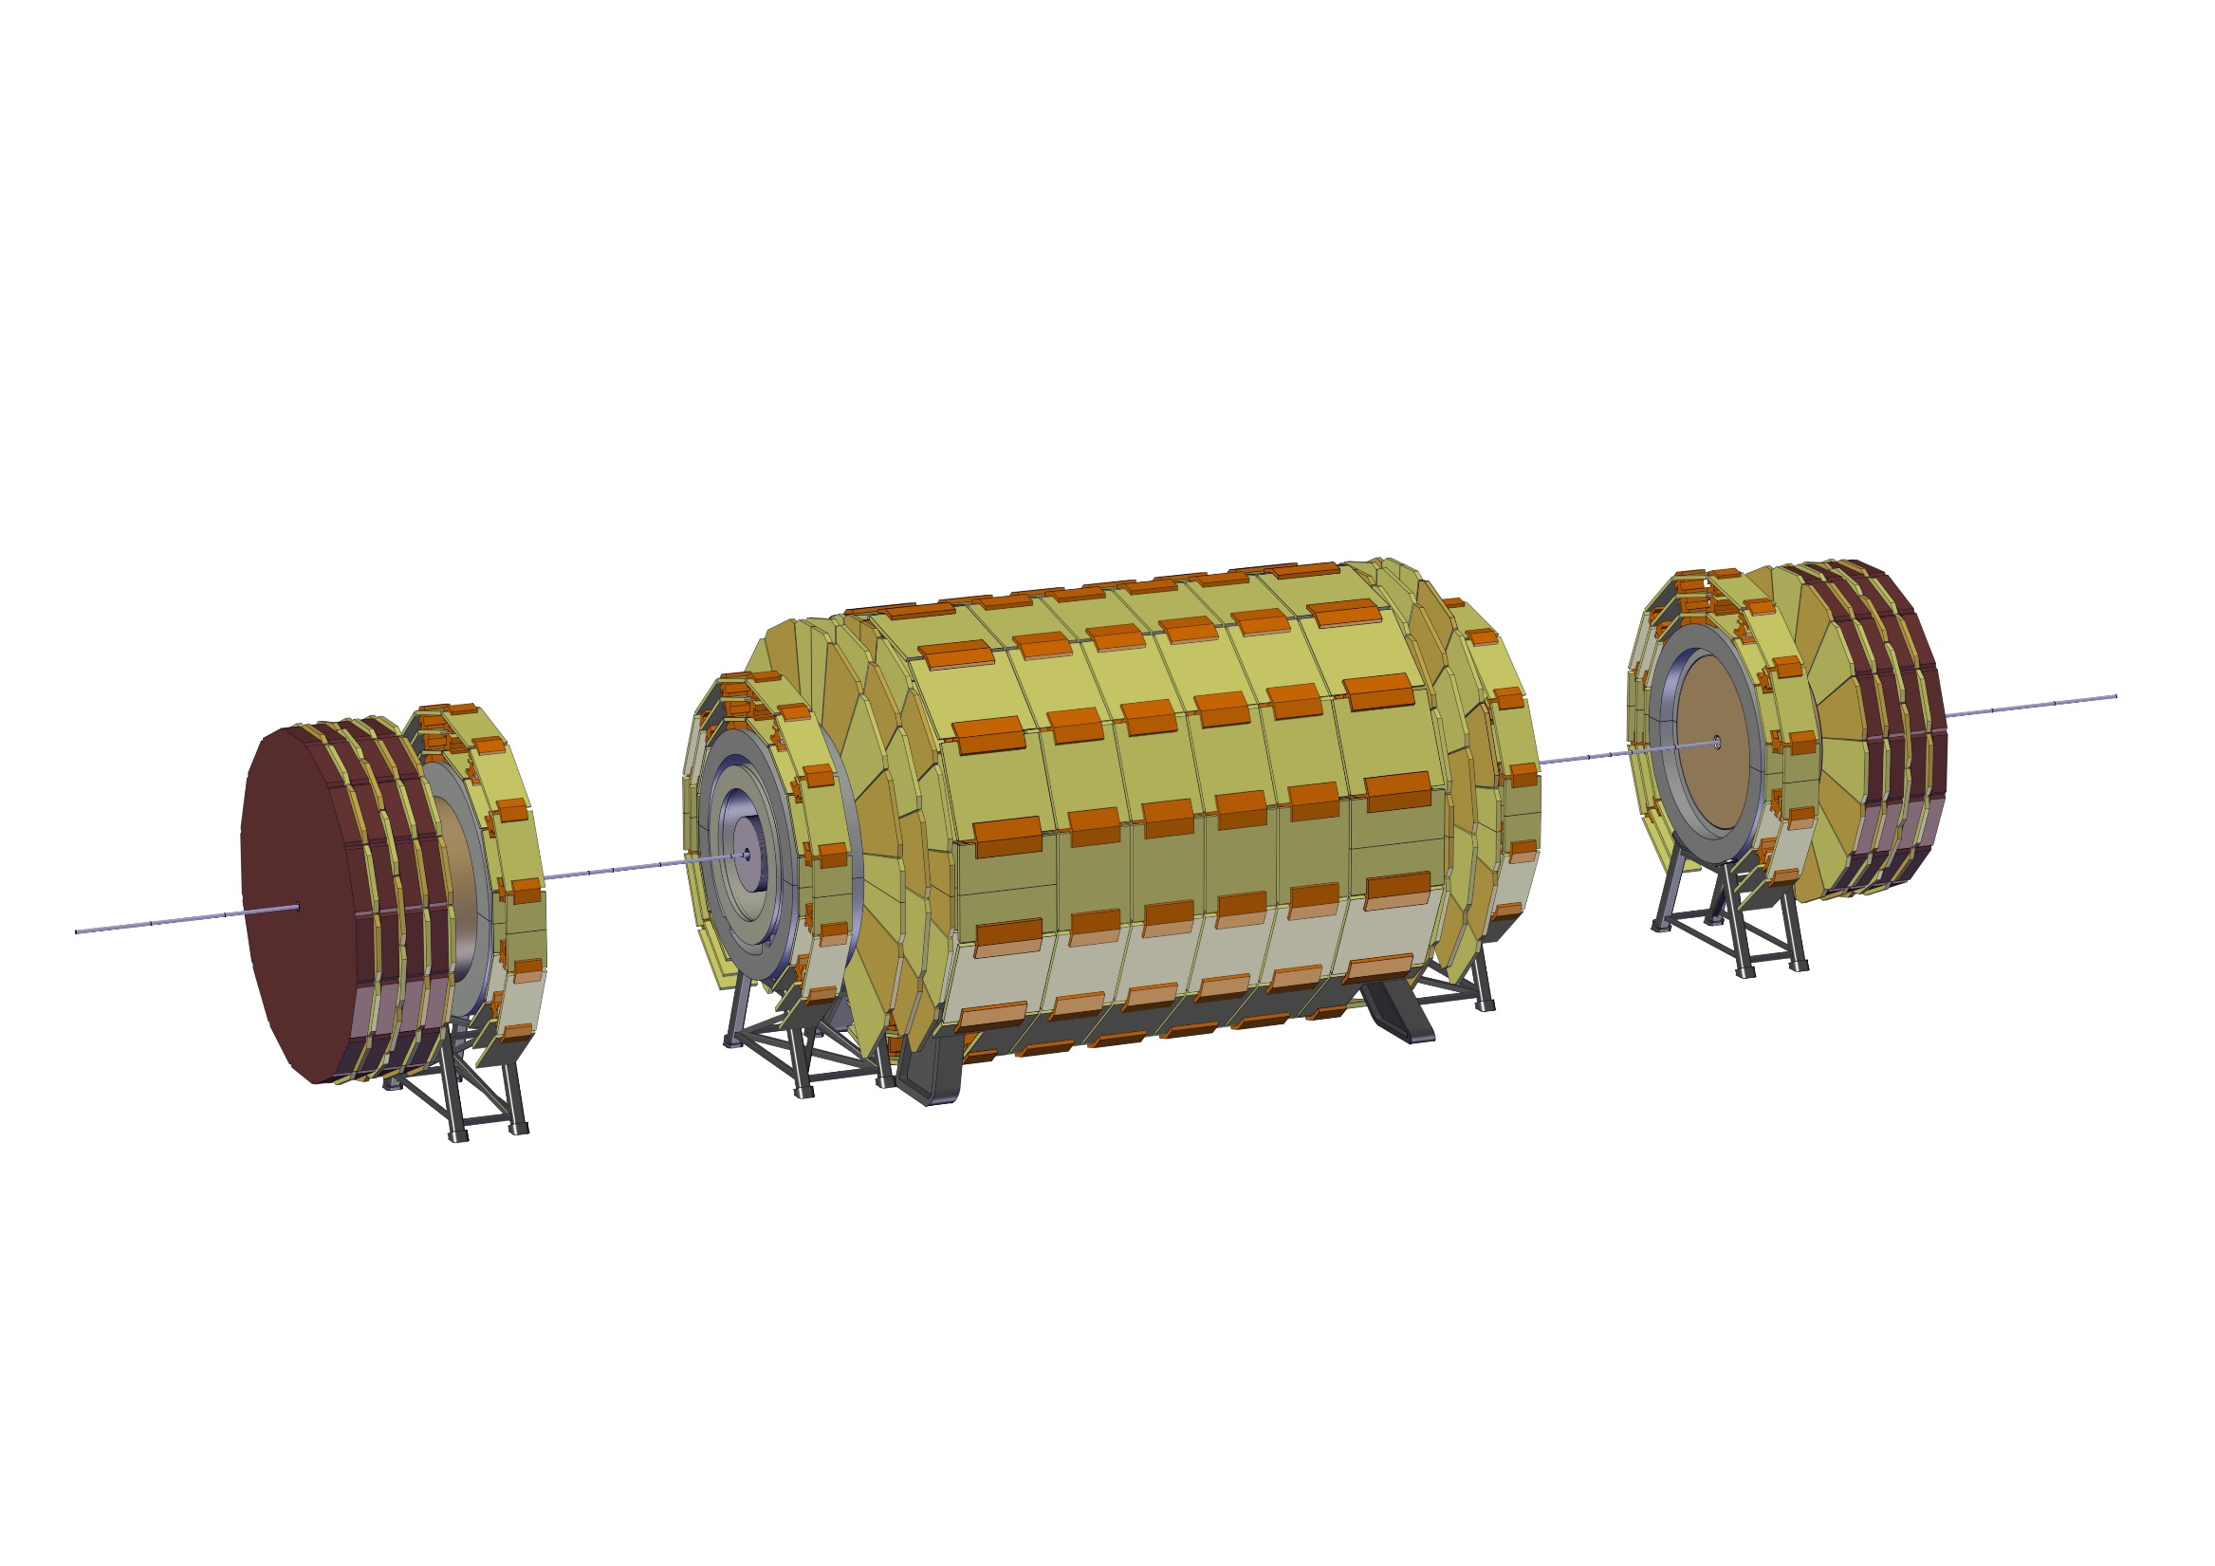
Short opening scenario
2 – Open Radiation Shield

Slide 42

Short opening scenario
3 – Compact Muon Chambers and disconnect Spokes

Slide 43

Short opening scenario
4 – Move Forward Solenoid close to Forward ECal

Slide 44

Short opening scenario
5 – Install support for HCal

Slide 45
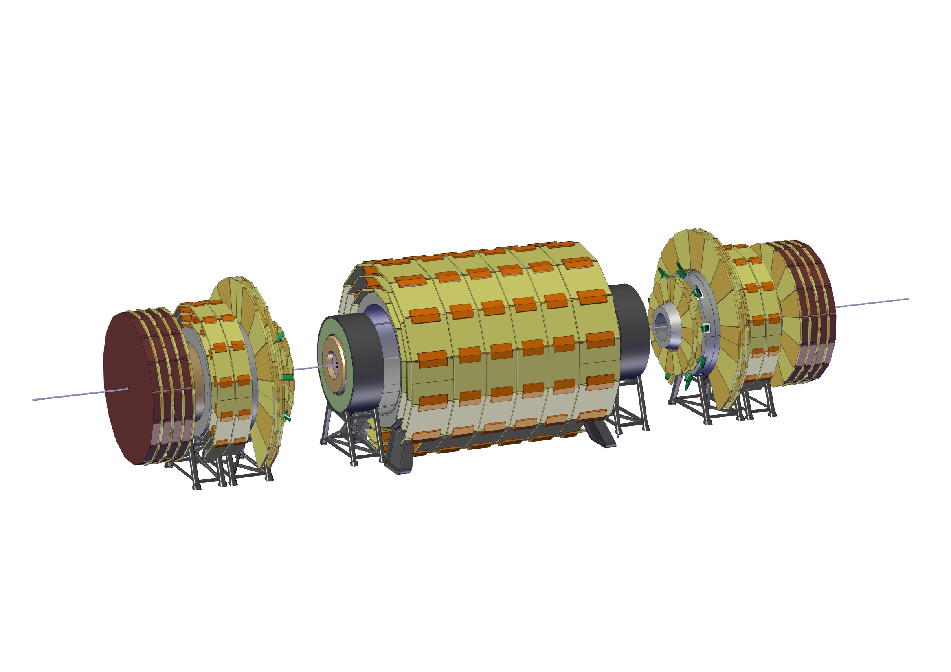
Short opening scenario
6 – Slide HCal outwards

Slide 46
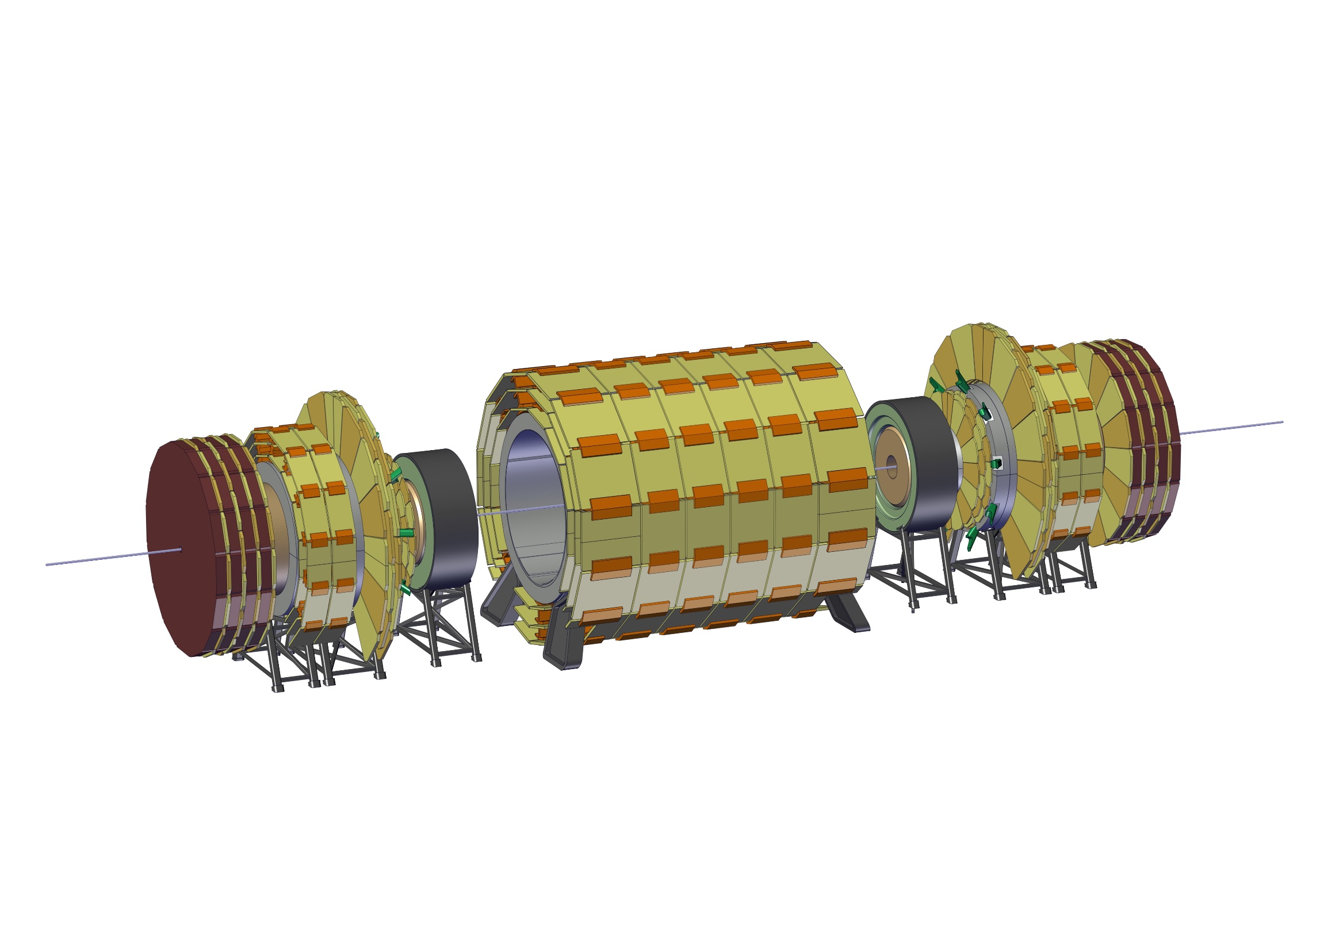
Short opening scenario
6 – Slide HCal outwards

Slide 47
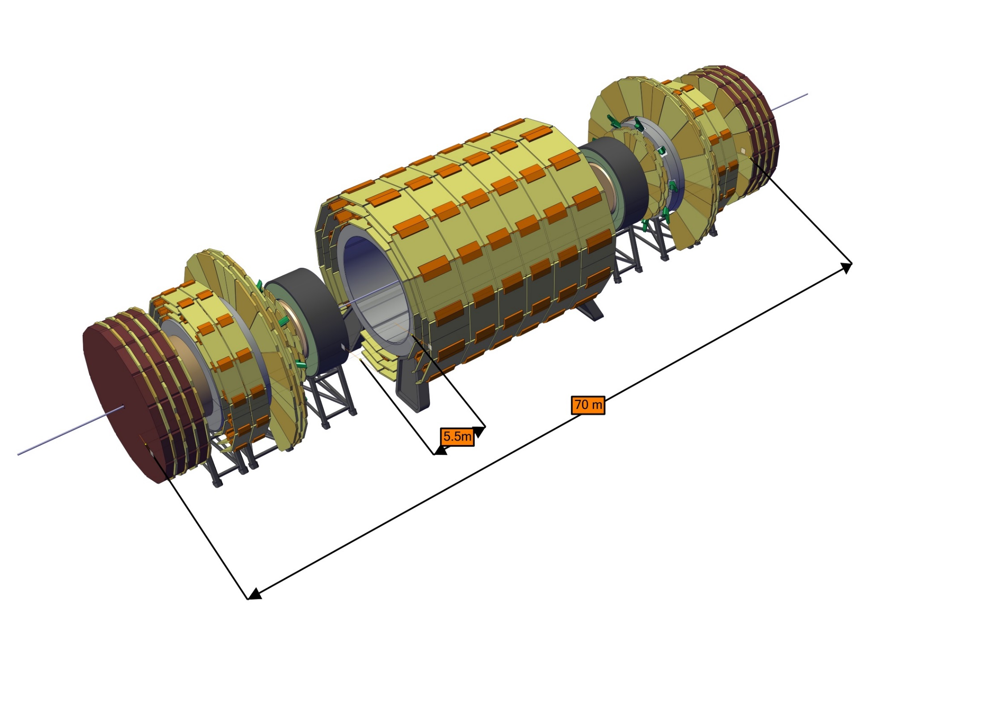
Short opening scenario
Short Opening final layout

Slide 48
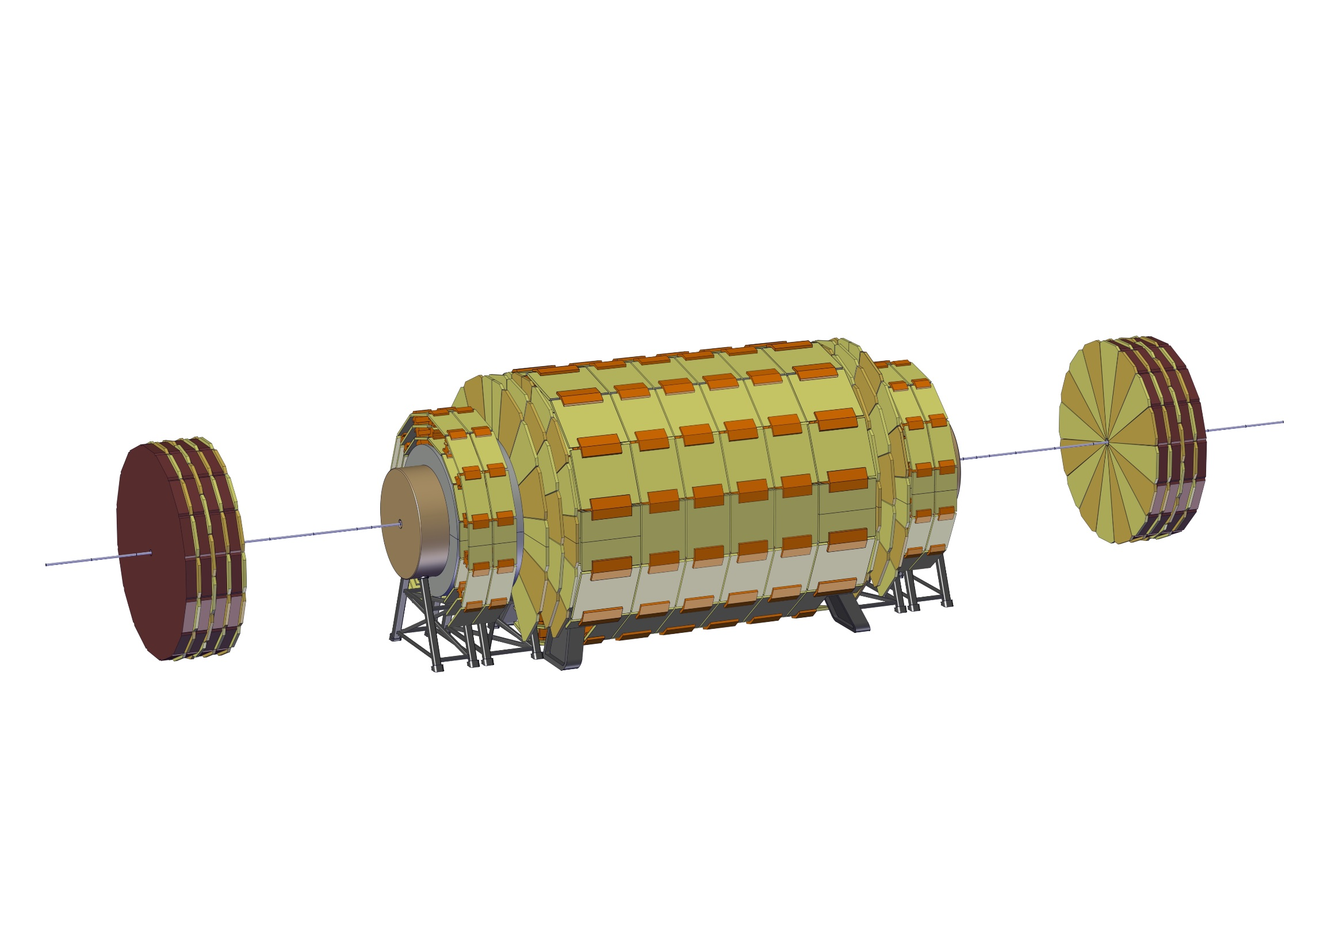
Long shutdown scenario
1 – Slide the Forward Muon Chambers 13.5 m away from the Forward ECal

Slide 49

Long shutdown scenario
2 – Remove part of the Beam Pipe

Slide 50
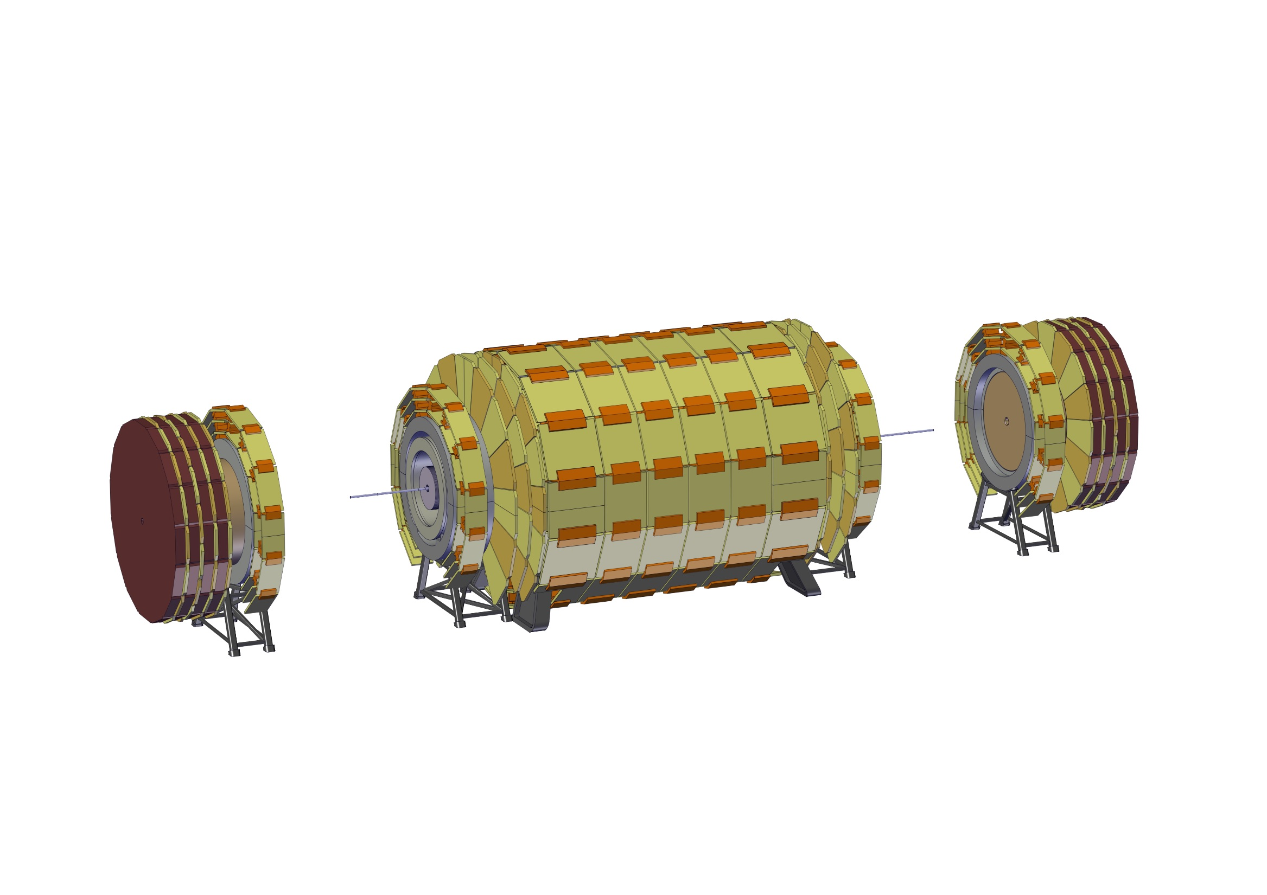
Long shutdown scenario
3 – Slide the Forward ECal Structure

Slide 51

Long shutdown scenario
4 – Remove another portion of the beam pipe

Slide 52
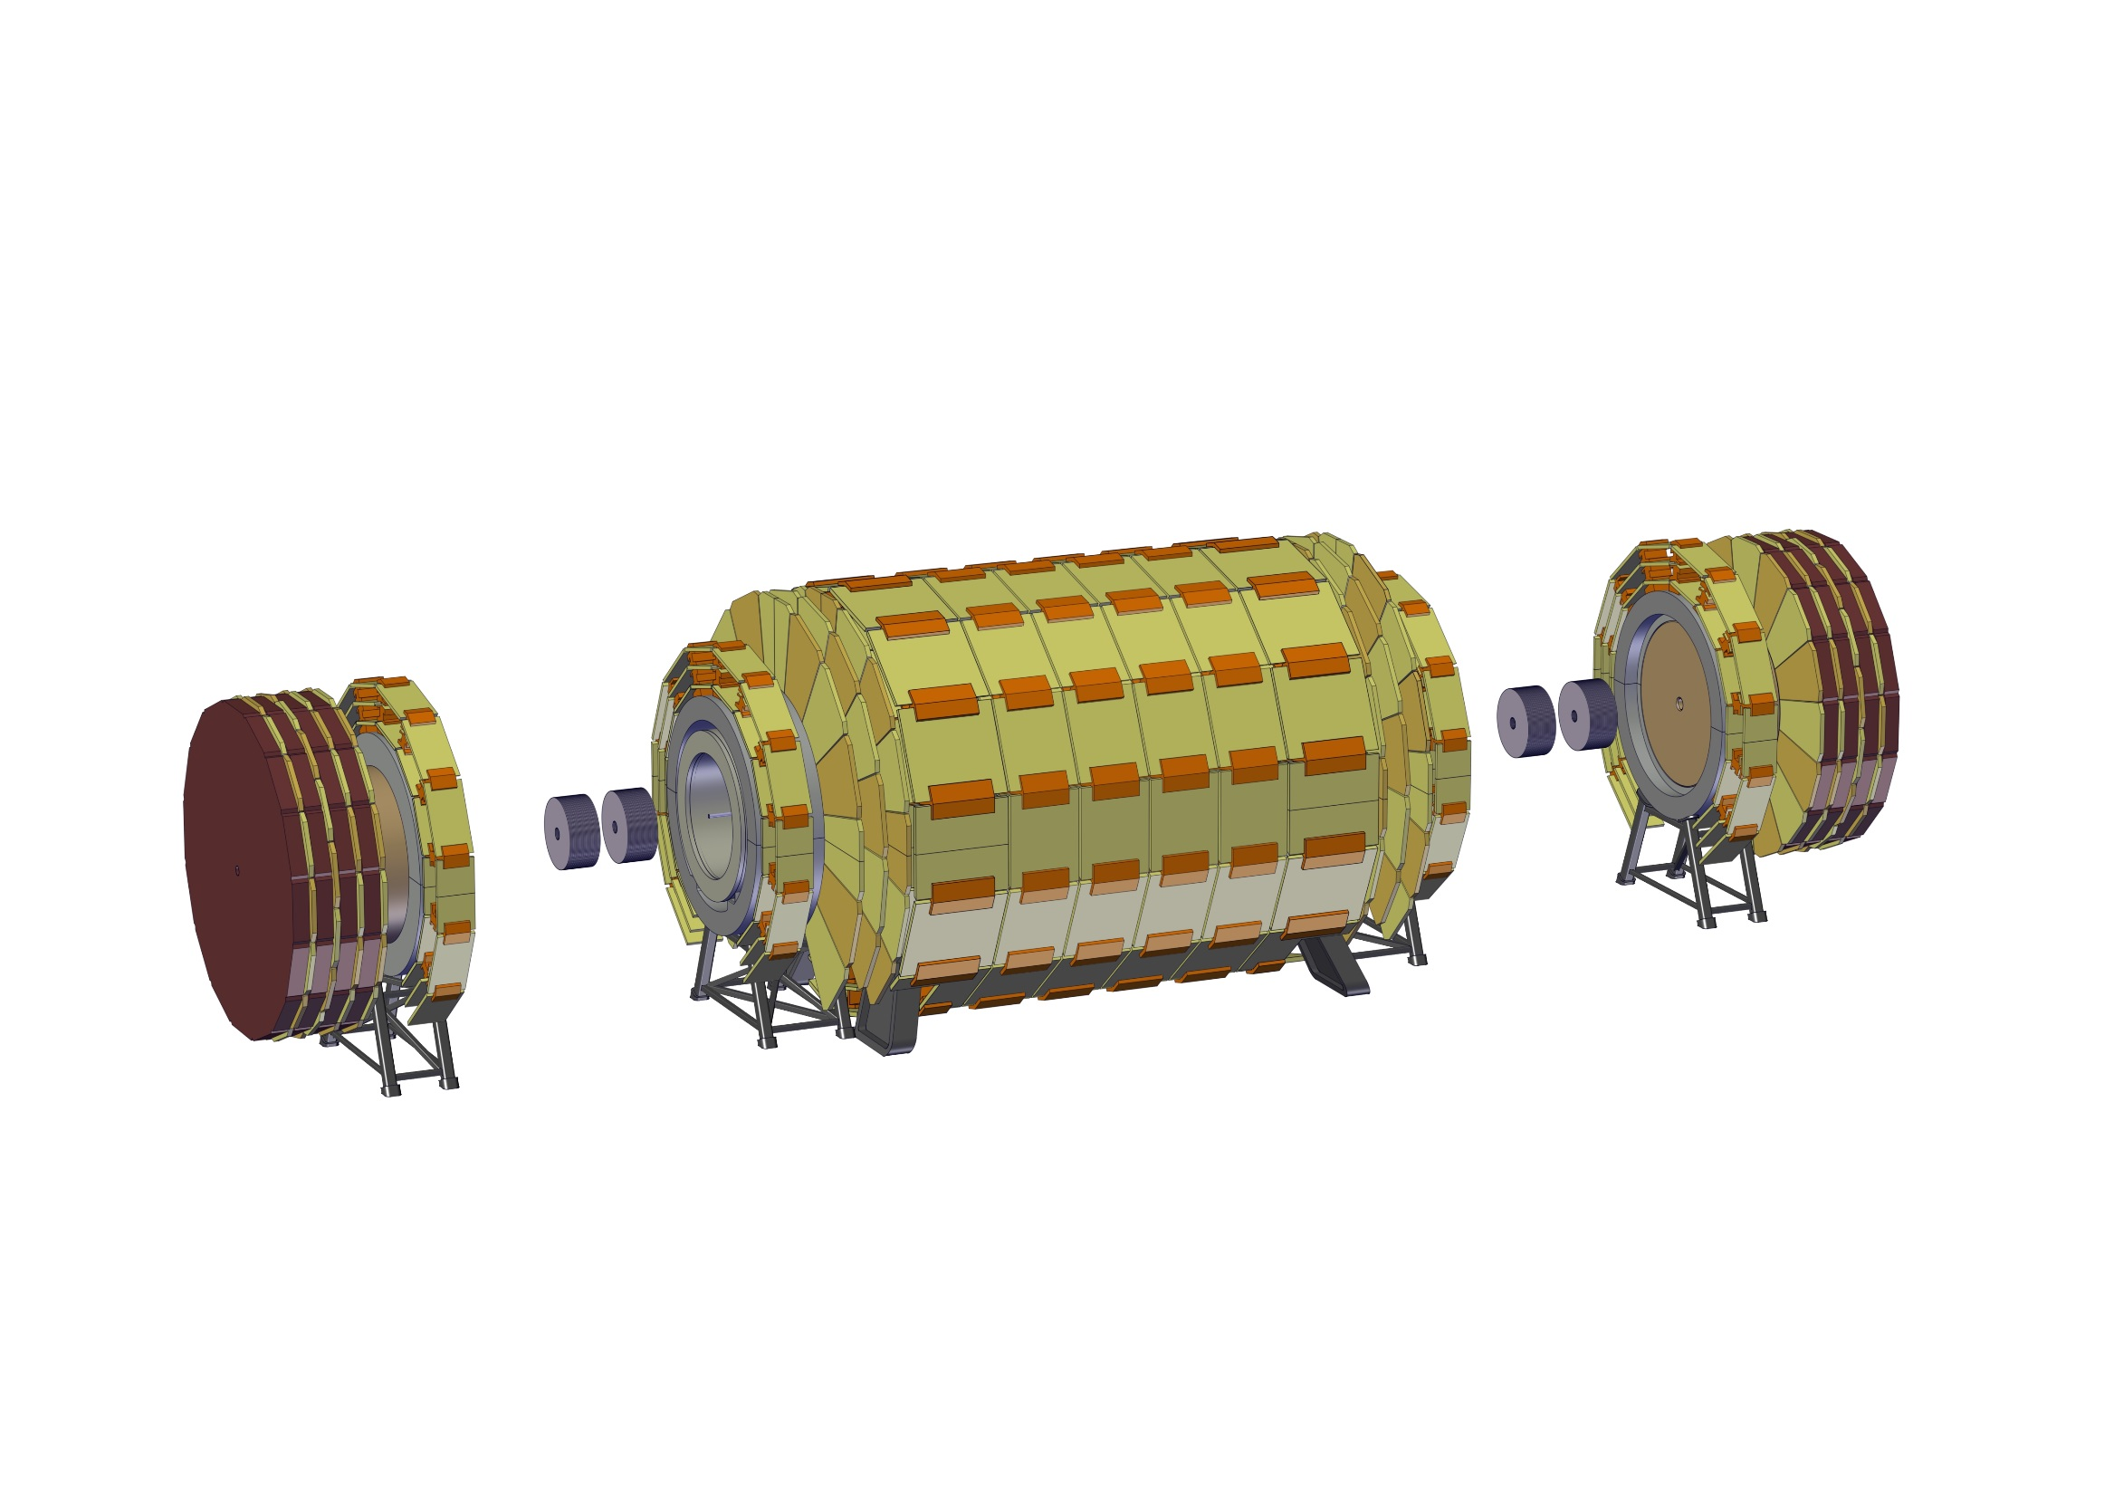
Long shutdown scenario
5 – Remove forward trackers if necessary

Slide 53

Long shutdown scenario
5 – Remove forward trackers if necessary

Slide 54
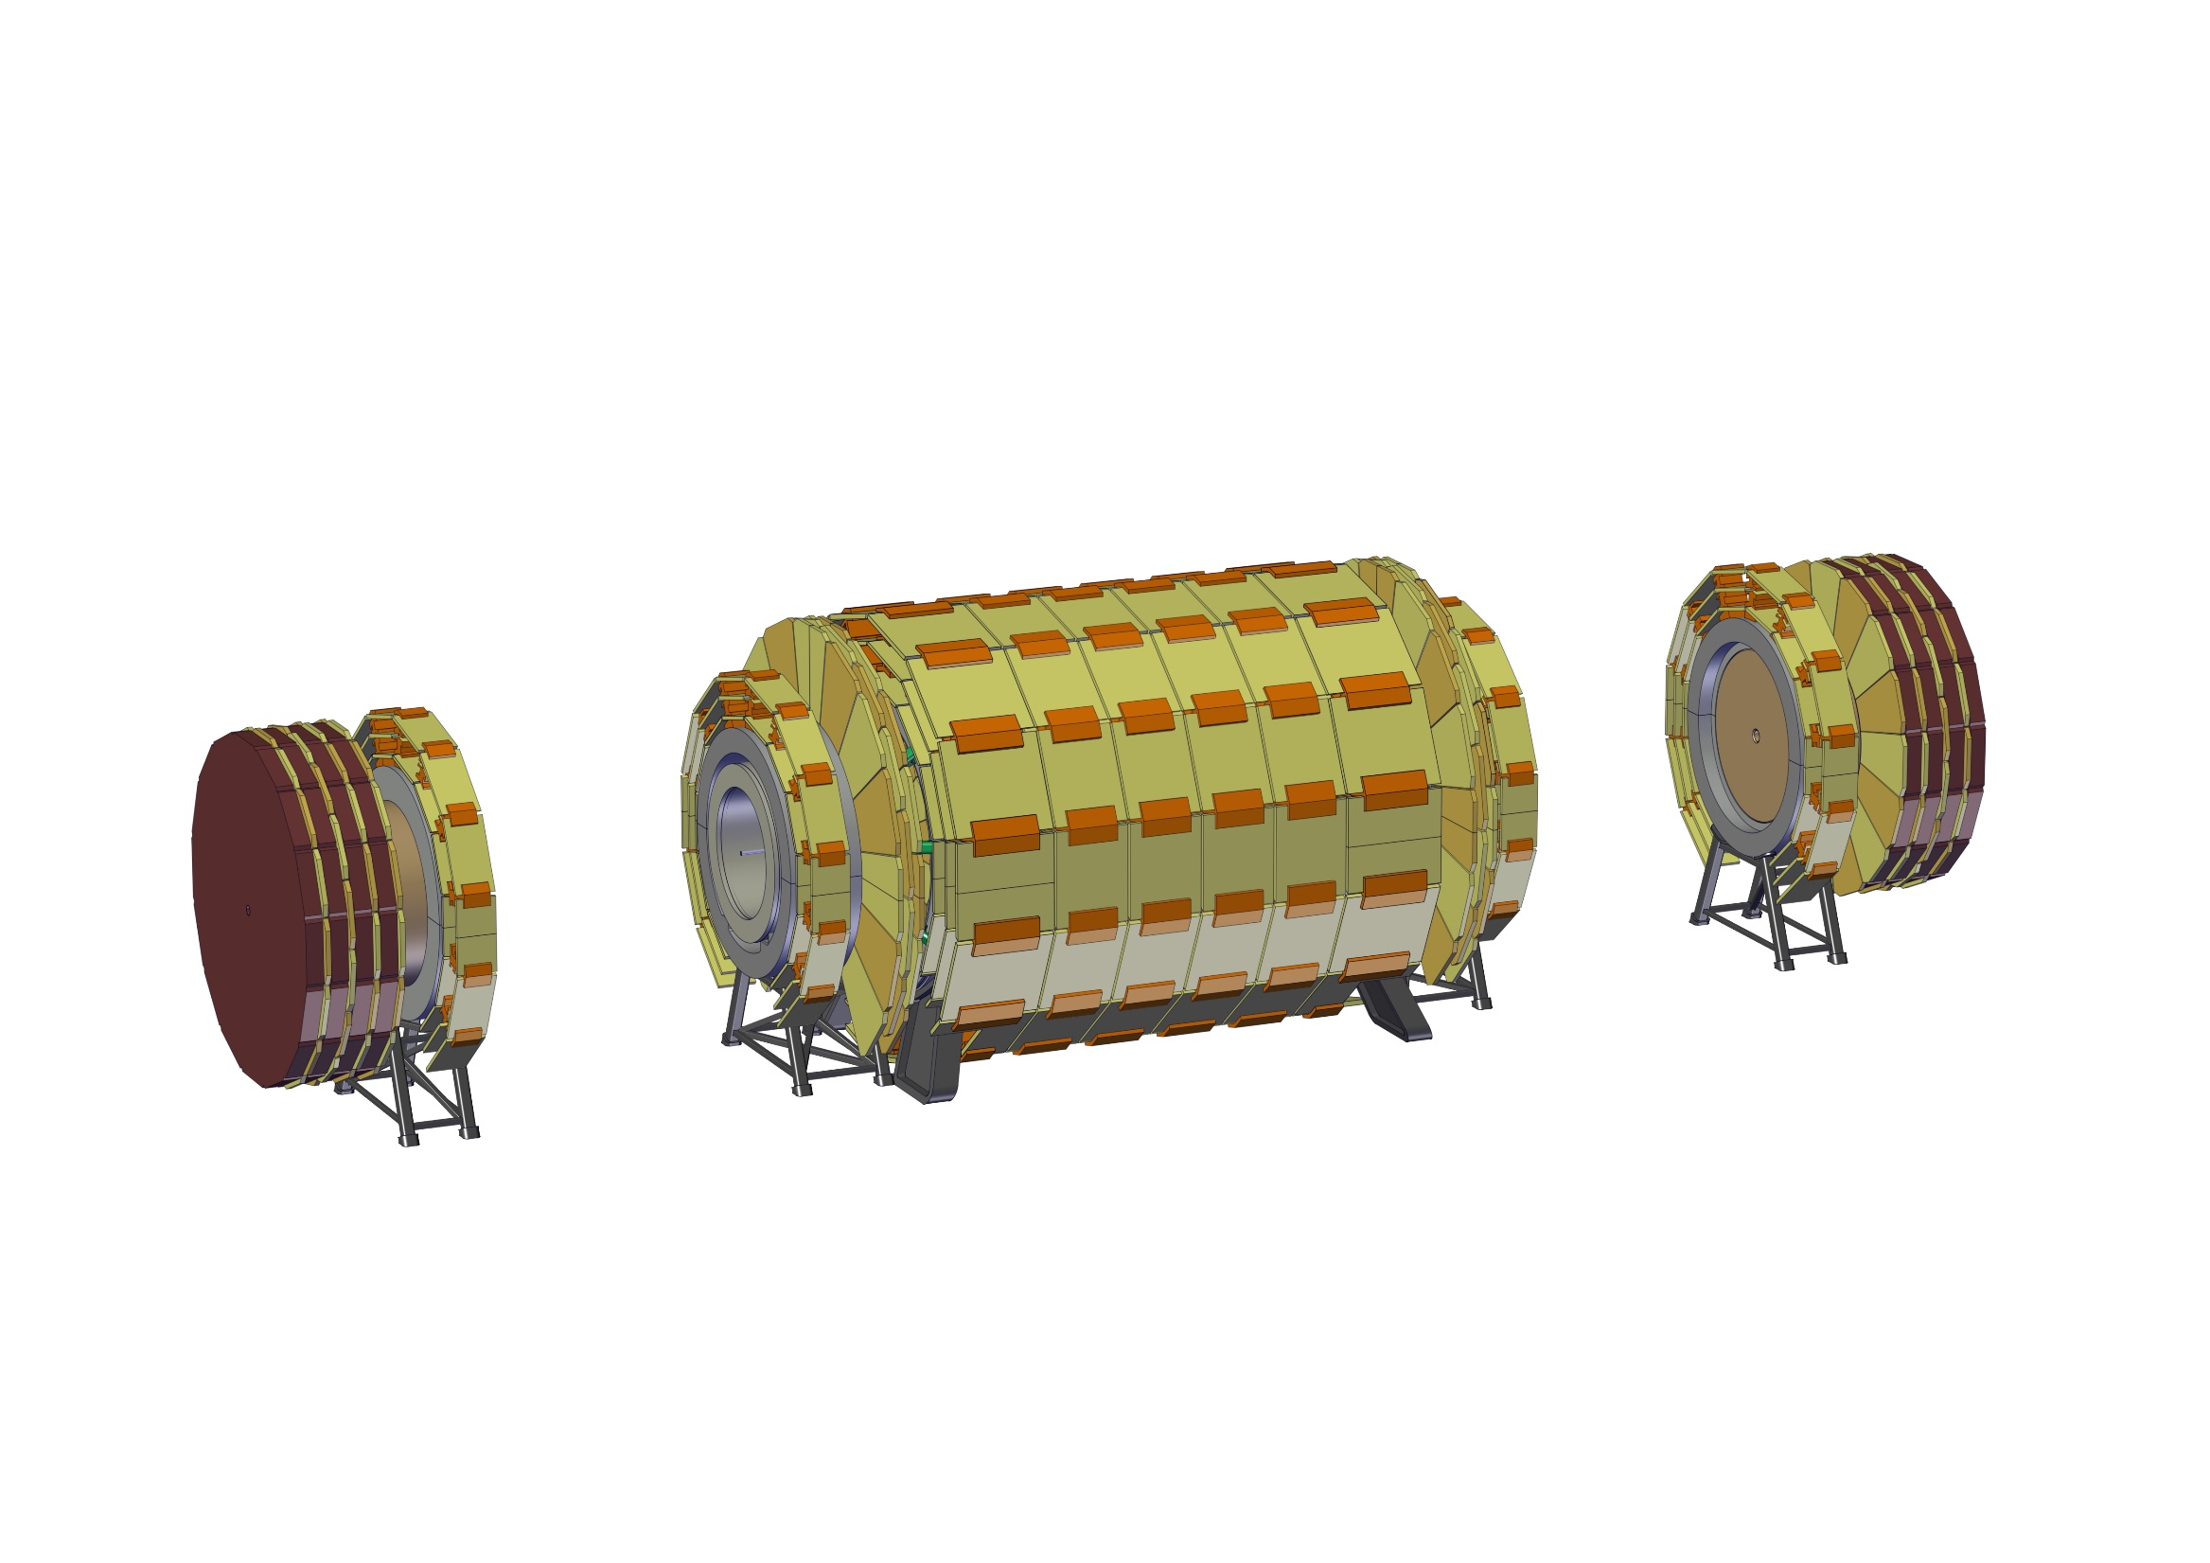
Long shutdown scenario
6 – Compact Muon Chambers and disconnect the spokes

Slide 55
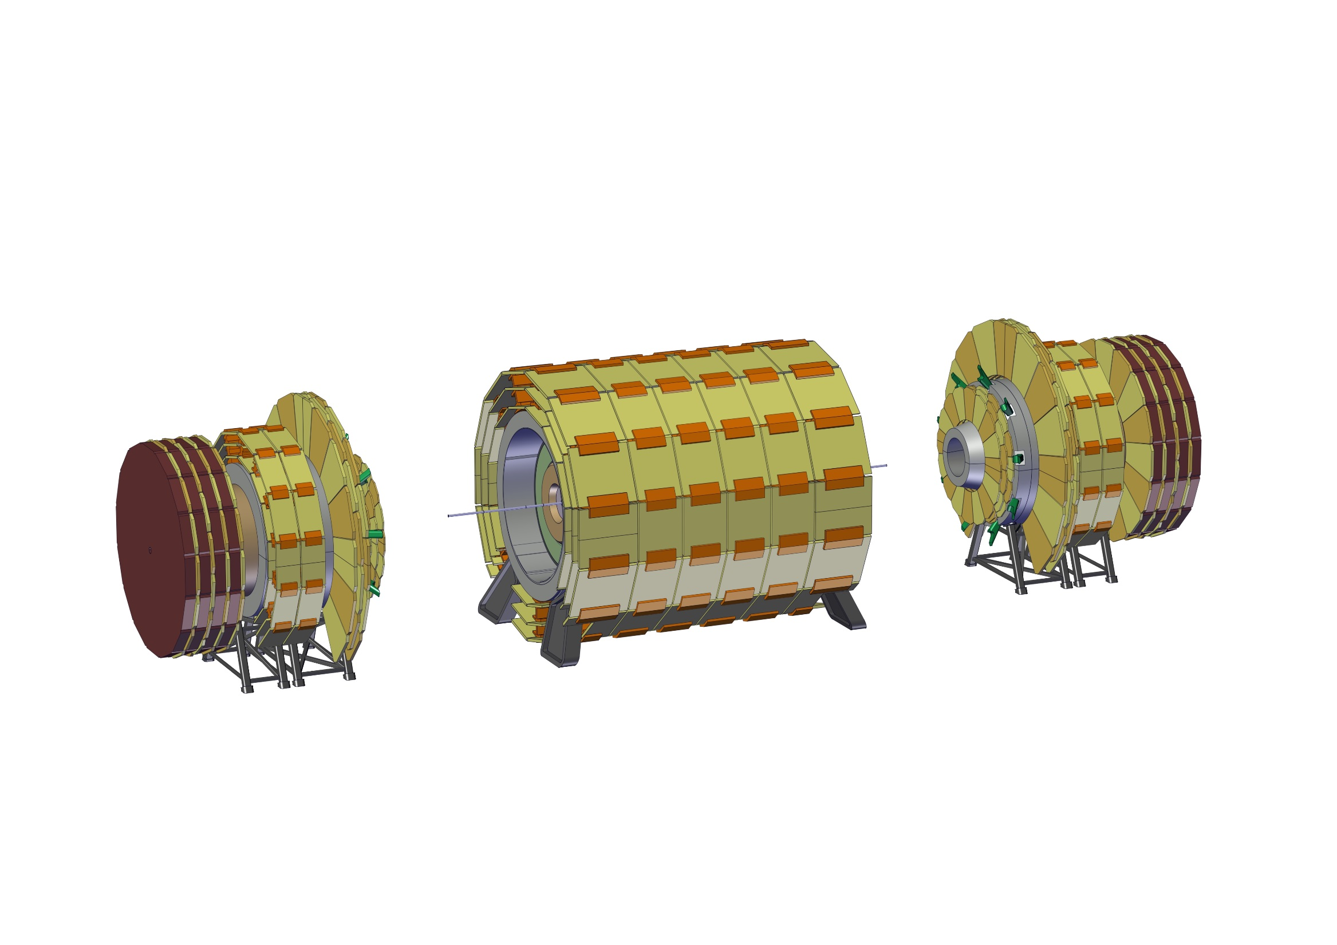
Long shutdown scenario
7 – Move Forward Solenoid towards the forward ECal

Slide 56

Long shutdown scenario
8 – Remove another portion of the beam pipe

Slide 57
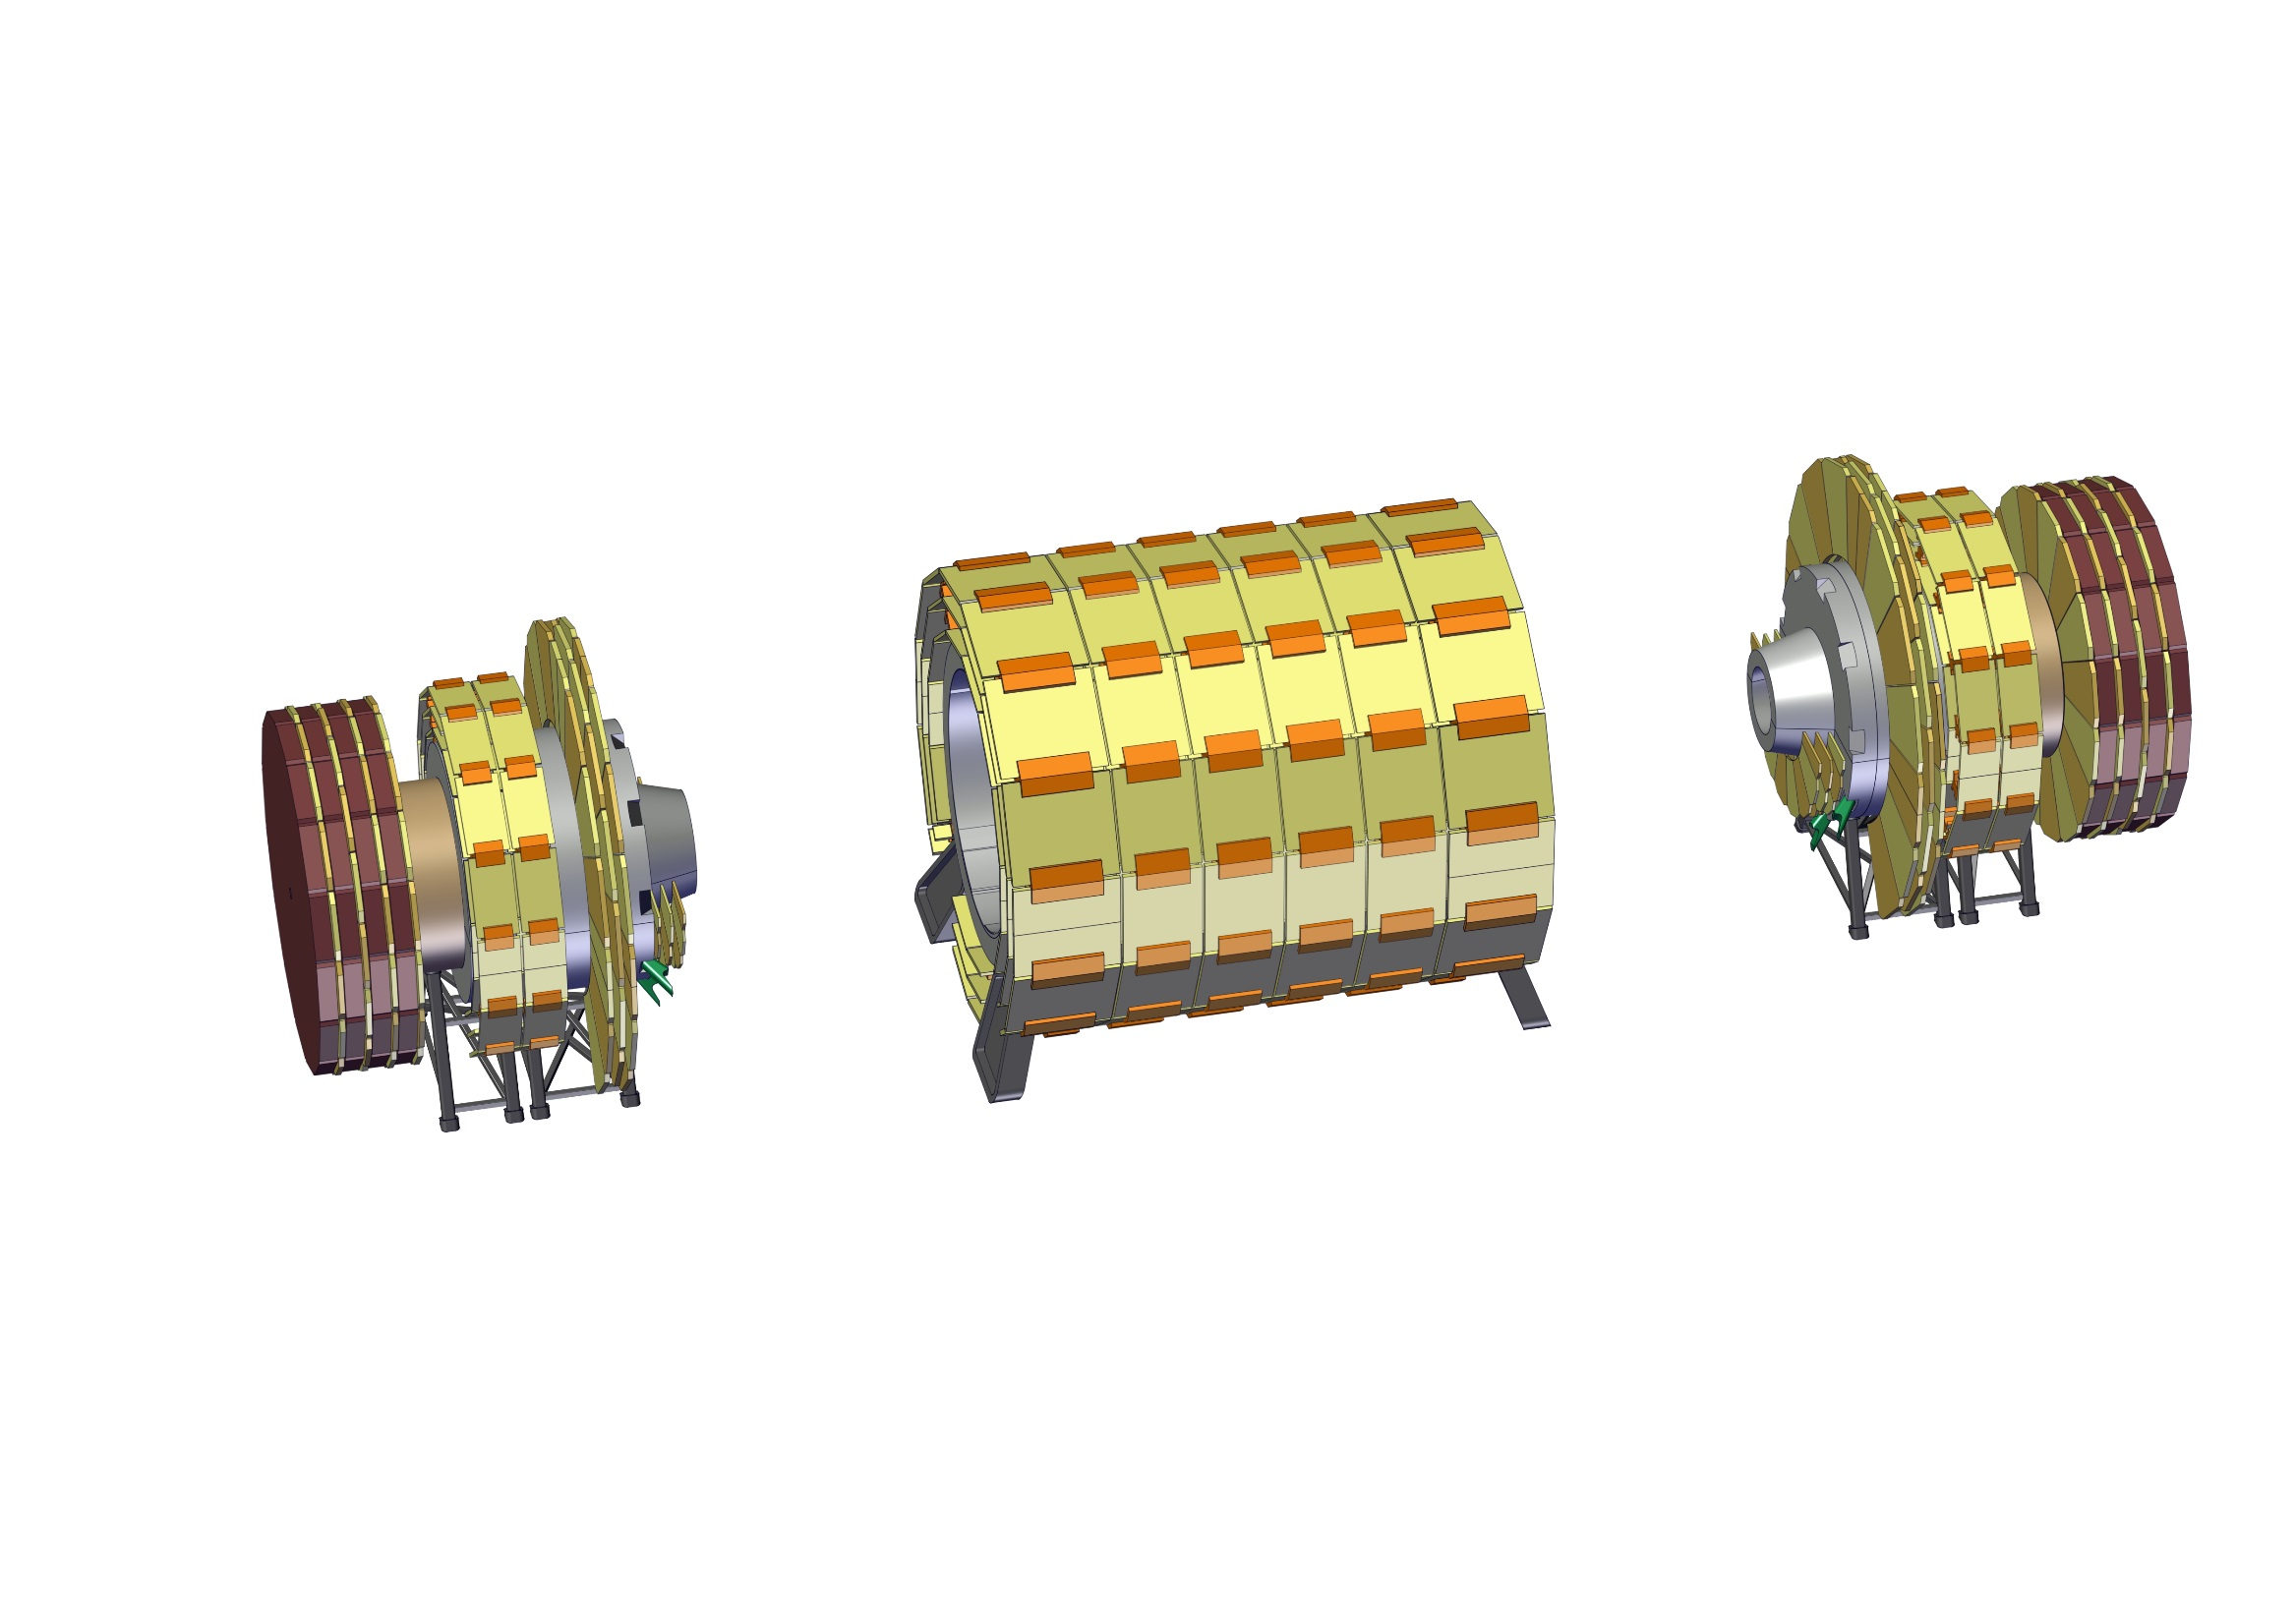
Long shutdown scenario
9 – Remove top Muon chambers on the radiation shield nose

Slide 58
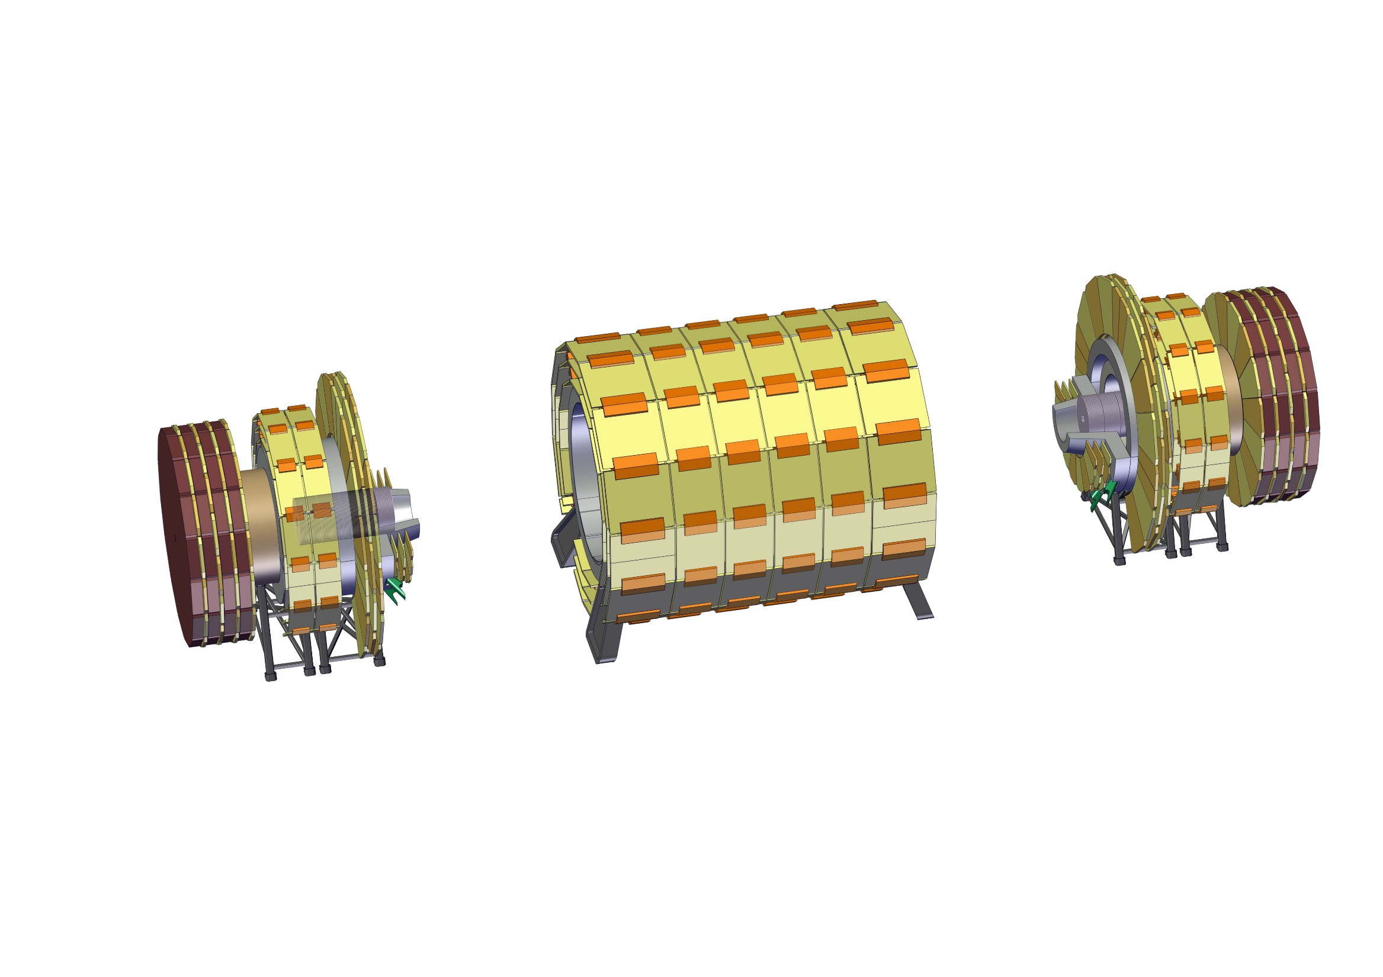
Long shutdown scenario
10 – Remove top part of radiation shield nose

Slide 59

Long shutdown scenario
11– Remove two tracker modules in the forward direction

Slide 60

Long shutdown scenario
12 – Remove bottom Muon Chambers on the radiation shield nose

Slide 61

Long shutdown scenario
13 – Install temporary support for HCal and ECal Modules

Slide 62

Long shutdown scenario
14 – Remove HCal and ECal module

Slide 63

Long shutdown scenario
15 – Move HCal and ECal module next to the forward solenoid

Slide 64

Long shutdown scenario
15 – Move HCal and ECal module next to the Forward Solenoid

Slide 65

Long shutdown scenario
16 – Remove another portion of the beam pipe

Slide 66

Long shutdown scenario
17 – Extract inner trackers

Slide 67

Cavern
Maximum length experiment | *75m
Cavern Size (L x W x H) [m³] | 75 x 30 x 35
Main Shaft diameter [m] | 20
Main Shaft usable space [m²] | 18x15
Secondary shaft diameter [m] | 15
Secondary shaft usable space [m²] | 9x5
Main shaft crane requirement [kt] | 2 or 3 (depends on Hcal modularity)
Secondary shaft crane requirement [kt] | 0.6
* Depending on the compromises made, the open experiment length may vary from 70 m to 80m.

Slide 68

Cavern
Experiment cavern has two shafts
Secondary shaft is off-center
Service cavern is perpendicular to the experiment
Service cavern dimensions are 15 x 20 x100 m³ (HxWxL)
1mT line is at half length of the service cavern
Most sensitive electronics can be placed further from the magnet system

