Slide 1
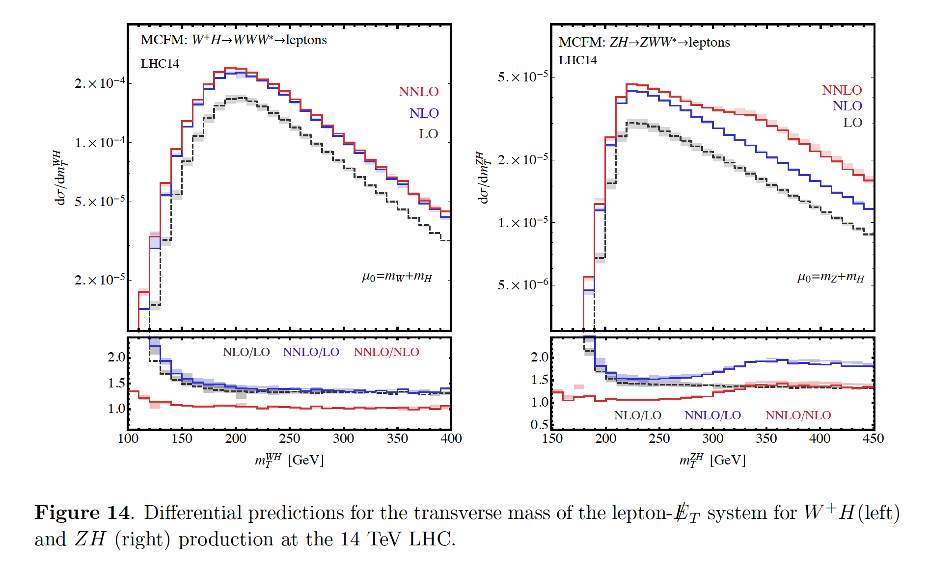
Do we even need NNLO for LHC analysis
Beyond LO calculations on HPC
Walter Giele
Sep 22, 2016
Fermilab
Campbell, Ellis, Williams, arXiv:1601.00658

Slide 2
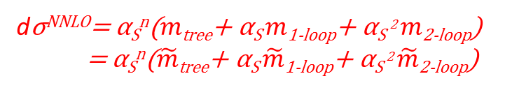



Intro NNLO (=Next-to-Next-to Leading order)
Goal:
  Increased accuracy (expansion in small coupling constant)
Issues:
  Analytic complexity
  Numerical computing time for phase space integrations
dσ^{NNLO}= α_{S}^{n}($m$_{tree}+ α_{S} $m$_{1-loop}+ α_{S} ² $m$_{2-loop})
= α_{S}^{n}($\tilde{m}$_{tree}+ α_{S} $\tilde{m}$_{1-loop}+ α_{S} ² $\tilde{m}$_{2-loop})
Two-Loop
One-Loop
Tree-Level
LO ($O$(α_{S}^{n}))
NLO (adds $O$(α_{S}^{n+1}))
NNLO (adds $O$(α_{S}^{n+2}))

Slide 3
pQCD Calculations in Support of Experiments
Calculations in pQCD for hadron colliders go back a long time.
They are mainly driven by colliders experiments UA1/UA2, CDF/D0, ATLAS/CMS.
Leading Order:
  Goes back to the early 1970’s.
  Came to maturity around 1988-1990 (VECBOS, NJETS,…) as there was a need to understand high multiplicity jet configurations in order to discover the top quark.
  Led to slew of new techniques:
    Helicity formalism (breaking up the calculation in smaller parts).
    Color ordering (breaking up the calculation in smaller parts).
    Recursion relations (algorithmic generation of Feynman diagrams).
    MC integration over Phase Space.
  Eventually lead to fully automated parton level MC’s (MADGRAPH, COMIX,…).

Slide 4
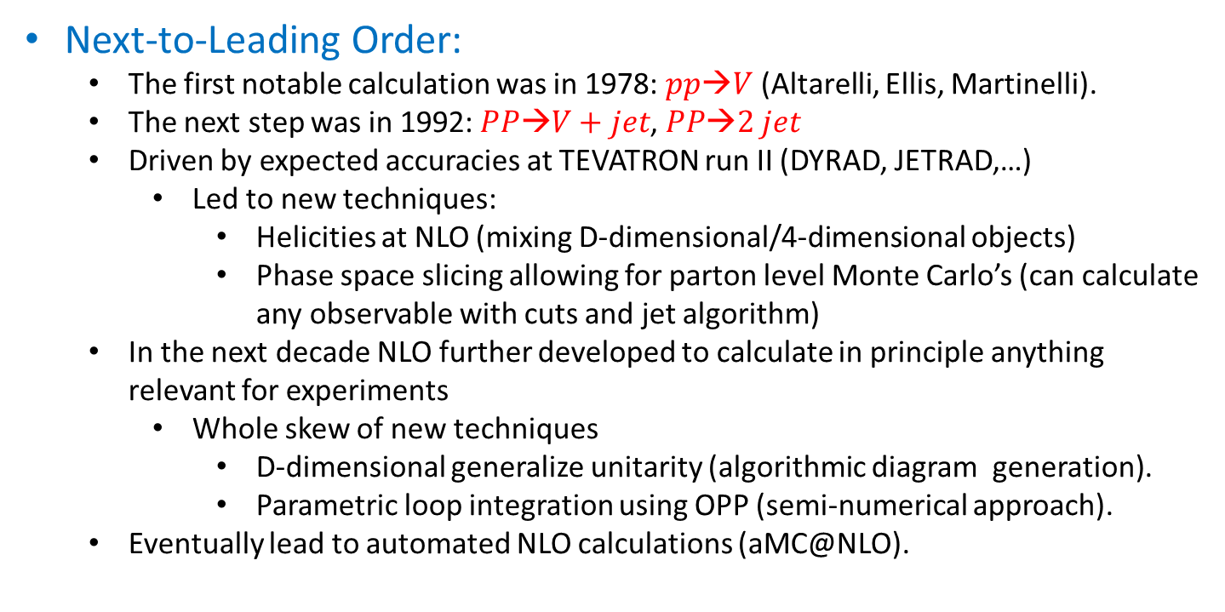
Next-to-Leading Order:
  The first notable calculation was in 1978: $pp→V$ (Altarelli, Ellis, Martinelli).
  The next step was in 1992: $PP→V+jet$, $PP→2 jet$
  Driven by expected accuracies at TEVATRON run II (DYRAD, JETRAD,…)
    Led to new techniques:
      Helicities at NLO (mixing D-dimensional/4-dimensional objects)
      Phase space slicing allowing for parton level Monte Carlo’s (can calculate any observable with cuts and jet algorithm)
  In the next decade NLO further developed to calculate in principle anything relevant for experiments
    Whole skew of new techniques
      D-dimensional generalize unitarity (algorithmic diagram generation).
      Parametric loop integration using OPP (semi-numerical approach).
  Eventually lead to automated NLO calculations (aMC@NLO).

Slide 5


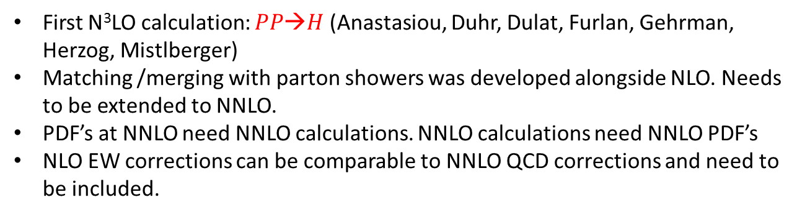

Next-to-Next-to Leading Order:
  First NNLO calculation in 1990: $PP→V$ (van Neerven, Matsuura, Hamberg)
  2012-2016: $PP→2 jets$, $PP→ttbar$, $PP→V/H+1 jet$,… at NNLO
    Moving more and more towards HPC (parallelism):
      multi-threading
      gpu’s
LO
NLO
NNLO
N³LO
$$PP→V,H$$
1970 (?) | 1978 | 1990 | 2015
1979 (?) | 1992 | 2016 | 2030 (?)
$$PP→V+1 jet$$
  First N³LO calculation: $PP→H$ (Anastasiou, Duhr, Dulat, Furlan, Gehrman, Herzog, Mistlberger)
Matching /merging with parton showers was developed alongside NLO. Needs to be extended to NNLO.
PDF’s at NNLO need NNLO calculations. NNLO calculations need NNLO PDF’s
NLO EW corrections can be comparable to NNLO QCD corrections and need to be included.

Slide 6
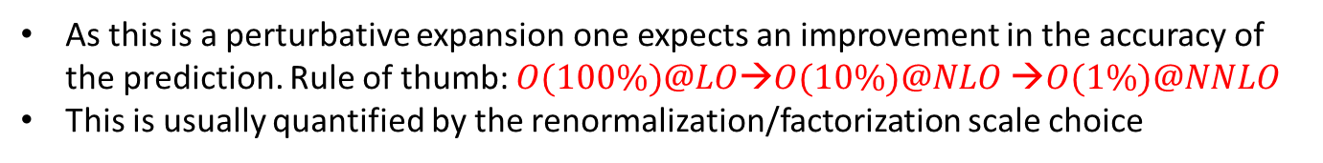
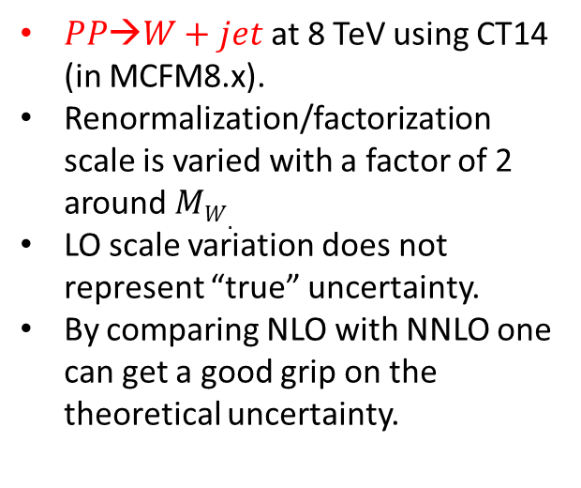
NNLO Improvements: Normalization
As this is a perturbative expansion one expects an improvement in the accuracy of the prediction. Rule of thumb: $O(100\%)@LO→O(10\%)@NLO →O(1\%)@NNLO$
This is usually quantified by the renormalization/factorization scale choice
$PP→W+jet$at 8 TeV using CT14 (in MCFM8.x).
Renormalization/factorization scale is varied with a factor of 2 around $MW.$
LO scale variation does not represent “true” uncertainty.
By comparing NLO with NNLO one can get a good grip on the theoretical uncertainty.
Boughezal, Focke, Liu, Petriello, arXiv:1504.02131

Slide 7
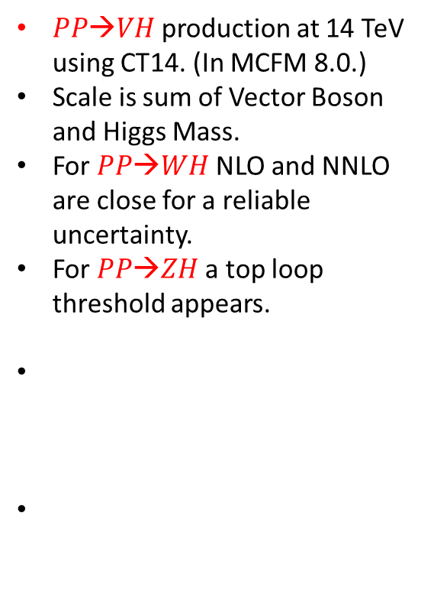
NNLO Improvements: new channels
$PP→VH$production at 14 TeV using CT14. (In MCFM 8.0.)
Scale is sum of Vector Boson and Higgs Mass.
For $PP→WH$NLO and NNLO are close for a reliable uncertainty.
For $PP→ZH$a top loop threshold appears.
Ellis, Campbell, Williams, arXiv:1601.00658

Slide 8
NNLO Monte Carlo’s
More and more NNLO Monte Carlo’s are being implemented:
  PP→V: Catani, Cieri, Ferrera, Florian, Grazzini (2009) →DYNNLO, MATRIX
  Li, Petriello (2012) →FEWZ
  Boughezal, Campbell, Ellis, Focke, Giele, Liu, Petriello, Williams (2016)
  → MCFM v8.0
  PP→ H: Catani, Grazzini, Sargsyan (2007, 2008, 2013)→HNNLO, MATRIX
  Anastasiou, Duhr, Dulat, Herzog, Mistlberger (2015)→up to N³LO
  Boughezal, Campbell, Ellis, Focke, Giele, Liu, Petriello, Williams (2016)
  → MCFM v8.0
  PP→WH: Ferrera, Grazzini, Tramontana (2014)→MATRIX
  Campbell, Ellis, Williams (2016) → MCFM v8.0
  PP→ZH: Ferrera, Grazzini, Tramontana (2015) →MATRIX
  Campbell, Ellis, Williams (2016) → MCFM v8.0
  PP→di-photon: Catani, Cieri, de Florian, Ferrera, Grazzini (2012)→MATRIX
  Campbell, Ellis, Li, Williams (2016) → MCFM v8.0

Slide 9
  PP→H + jet: Chen, Gehrmann, Glover, Jaquier (2015,2016) →NNLOjet
  Boughezal, Caola, Melnikov, Petriello (2015)
  Boughezal, Focke, Giele, Liu, Petriello (2015)→ MCFM v8.x
  PP→W+jet: Boughezal, Focke, Liu, Petriello (2015) → MCFM v8.x
  PP→Z+jet: Gehrmann-de Ridder, Gehrmann, Glover, Huss, Morgan (2015)
  →NNLOjet
  Boughezal, Campbell, Ellis, Focke, Giele, Liu, Petriello (2015)
  → MCFM v8.x
  PP->H (WBF): Cacciari, Dreyer, Karlberg, Salam, Zanderighi (2015)
  H→bb: Anastasiou, Herzog, Lazopoulos (2012)
  Del Duca, Duhr, Somogyi, Tramontano, Troscanyi (2015)
  PP→ZZ: Cascioli, Gehrmann, Grazzini, Kallweit, Maierhofer, von Manteuffel,
  Pozzorini, Rathlev, Trancredi, Weihs (2014) →MATRIX
  Caola, Melnikov, Rontsch, Trancredi (2015)

Slide 10
PP→WW: Gehrmann, Grazzini, Kallweit, Maierhofer, von Manteuffel,
Pozzorini, Rathlev, Tracredi (2014) →MATRIX
Caola, Melnikov, Rontsch, Trancredi (2015)
PP→V+photon: Grazzini, Kallweit, Rathlev (2016) →MATRIX
PP→tt: Czakon, Fiedler, Heymez, Mitov (2016)
Abelof, Gehrmann-de Ridder, Majer (2015)
PP→single top: Brucherseifer, Caola, Melnikov (2014)
Top decay: Brucherseifer, Caola, Melnikov (2013)
PP→Di-Jets: Currie, Gehrmann-de Ridder, Gehrmann, Glover, Pires, Wells
(2014)→NNLOjet

Slide 11
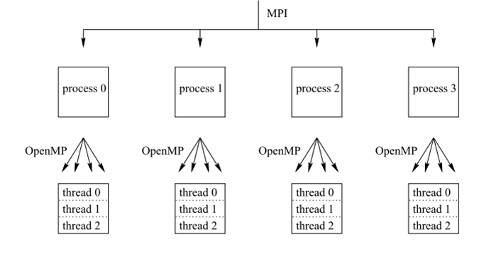
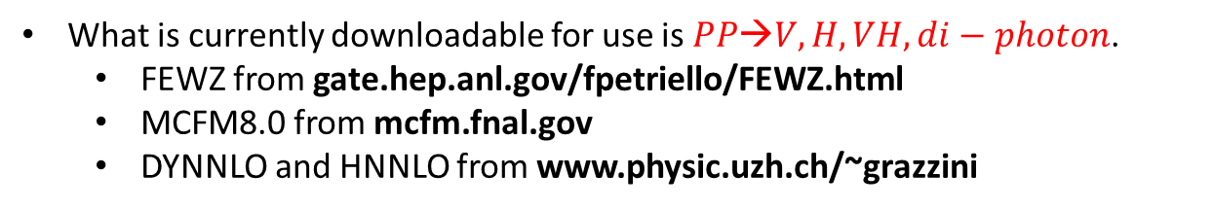
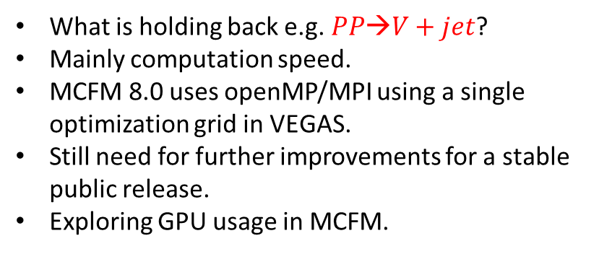
What is currently downloadable for use is $PP→V, H, VH, di−photon$.
  FEWZ from gate.hep.anl.gov/fpetriello/FEWZ.html
  MCFM8.0 from mcfm.fnal.gov
  DYNNLO and HNNLO from www.physic.uzh.ch/~grazzini
What is holding back e.g. $PP→V+jet$?
Mainly computation speed.
MCFM 8.0 uses openMP/MPI using a single optimization grid in VEGAS.
Still need for further improvements for a stable public release.
Exploring GPU usage in MCFM.
NNLO
6 threads/MPI node

Slide 12
NNLO: Current analysis
Using NNLO is required to be sure:
  The expected theoretical uncertainty is a few percent for most observables.
  Understanding of the uncertainty by comparing to NLO in case the observable has a bad perturbative behavior (comparing NLO to LO usually fails to understand the uncertainty).
  Probing possible new thresholds such as top quark loops.
Current issues are availability and high computer demands (solvable over time).

Slide 13
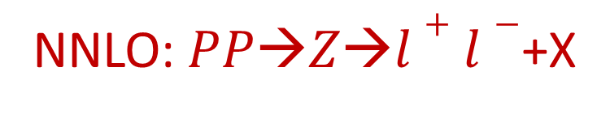
NNLO: $PP→Z→l+l−$+X
Truly a standard candle for PP collisions.
Important for PDF fits, shower MC generator tunes, detector calibrations.
We see excellent agreement with NNLO
If systematic and especially luminosity uncertainty further reduced N³LO required
Alternatively, if one could use N³LO might give a better luminosity measurement.

Slide 14
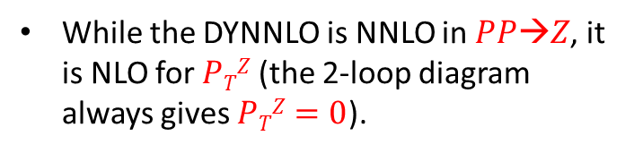
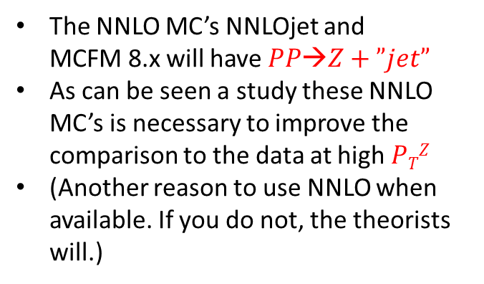
Gehrmann-De Ridder, Gehrmann, Glover, Huss, Morgan (arXiv:1605:04295) → NNLOjet
While the DYNNLO is NNLO in $PP→Z$, it is NLO for $PTZ$ (the 2-loop diagram always gives $PTZ=0$).
The NNLO MC’s NNLOjet and
MCFM 8.x will have $PP→Z+”jet”$
As can be seen a study these NNLO MC’s is necessary to improve the comparison to the data at high $PTZ$
(Another reason to use NNLO when available. If you do not, the theorists will.)

Slide 15
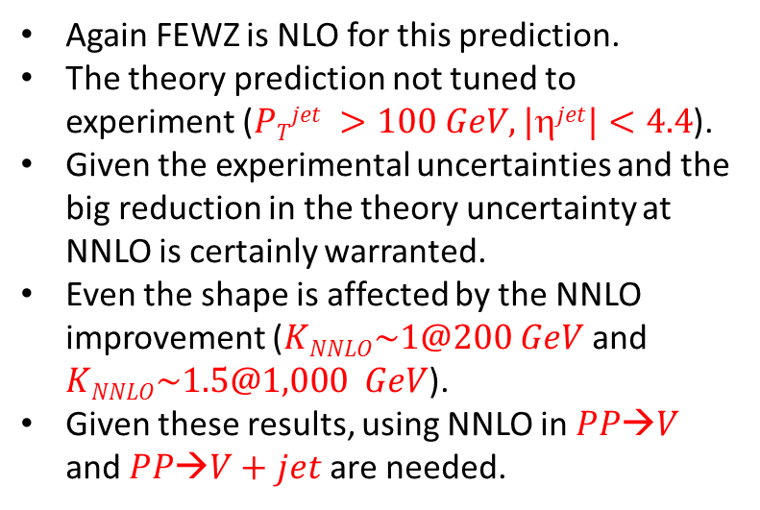
Boughezal, Lui, Petriello (arXiv:1602.08140)
→ MCFM 8.x
Again FEWZ is NLO for this prediction.
The theory prediction not tuned to experiment ($PTjet >100 GeV, |jet|<4.4$).
Given the experimental uncertainties and the big reduction in the theory uncertainty at NNLO is certainly warranted.
Even the shape is affected by the NNLO improvement ($KNNLO\sim 1@200 GeV$and $KNNLO\sim 1.5@1,000 GeV$).
Given these results, using NNLO in $PP→V$ and $PP→V+jet$ are needed.

Slide 16
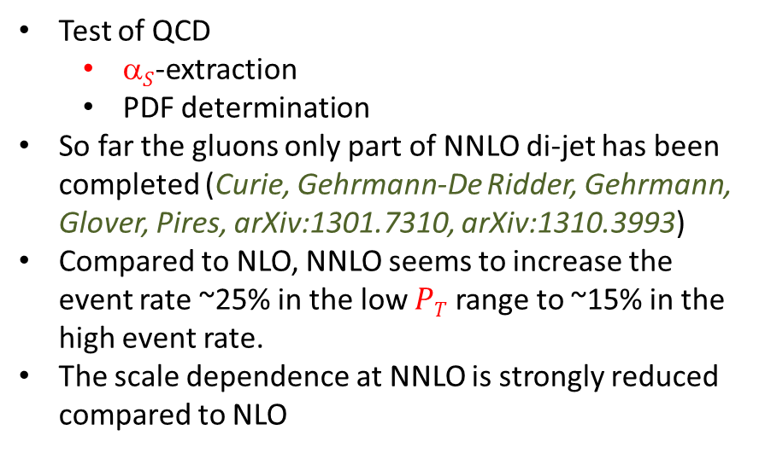

NNLO: $PP→Di−Jet$
Test of QCD
  $S$-extraction
  PDF determination
So far the gluons only part of NNLO di-jet has been completed (Curie, Gehrmann-De Ridder, Gehrmann, Glover, Pires, arXiv:1301.7310, arXiv:1310.3993)
Compared to NLO, NNLO seems to increase the event rate ~25% in the low $PT$ range to ~15% in the high event rate.
The scale dependence at NNLO is strongly reduced compared to NLO

Slide 17
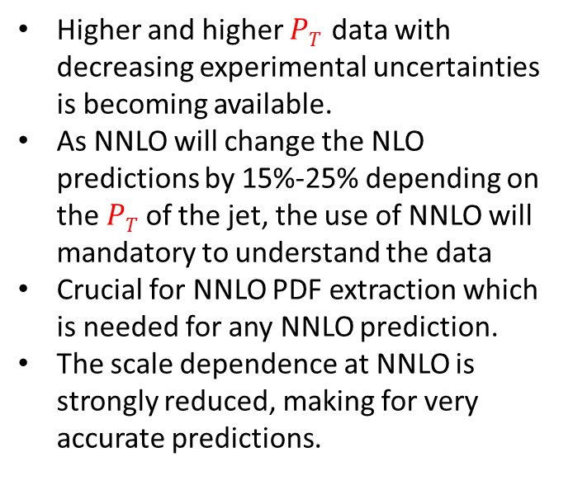
Higher and higher $PT$ data with decreasing experimental uncertainties is becoming available.
As NNLO will change the NLO predictions by 15%-25% depending on the $PT$ of the jet, the use of NNLO will mandatory to understand the data
Crucial for NNLO PDF extraction which is needed for any NNLO prediction.
The scale dependence at NNLO is strongly reduced, making for very accurate predictions.

Slide 18
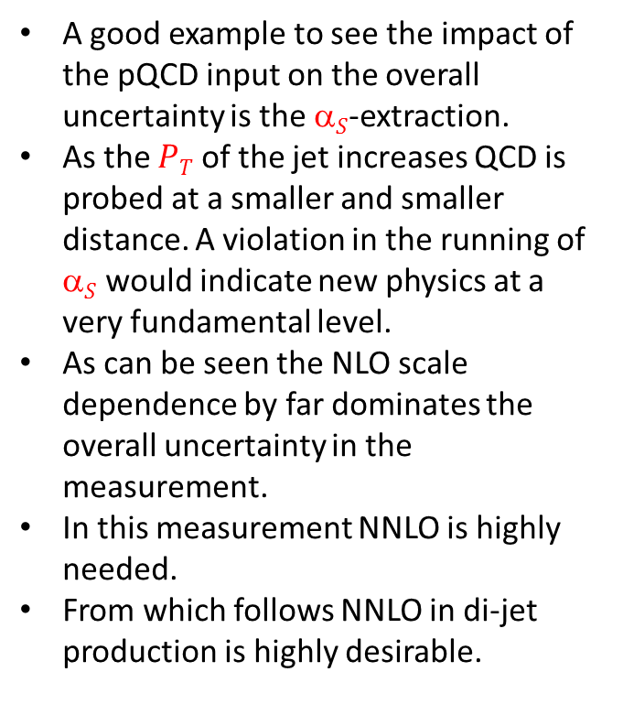
  A good example to see the impact of the pQCD input on the overall uncertainty is the $S$-extraction.
  As the $PT$ of the jet increases QCD is probed at a smaller and smaller distance. A violation in the running of $S$ would indicate new physics at a very fundamental level.
  As can be seen the NLO scale dependence by far dominates the overall uncertainty in the measurement.
  In this measurement NNLO is highly needed.
  From which follows NNLO in di-jet production is highly desirable.

Slide 19

NNLO: $PP→di−photon$
Two NNLO calculations exist of this process
  Catani, Cieri, de Florian, Ferrera, Grazzini (2012)→MATRIX
  Campbell, Ellis, Li, Williams (2016)
  → MCFM v8.0
As in all other cases when multiple calculations exist they are compared.
In this case a discrepancy exist at NNLO which needs to be resolved.
Note that the higher order corrections are substantial.
Furthermore, the scale dependence is not reduced at all at NNLO.
This is typical for PP→V₁V₂ processes, making NNLO (and even N³LO). indispensable for understanding these important processes.
NNLO describes shapes well. How about about a more detailed comparison?

Slide 20
Looking at the event rate prediction compared to date is illuminating.
The CMS measured di-photon cross section at 7 TeV is given by:
For the prediction MCFM8.0 was used emulating the CMS cuts as lose as possible:
To find
NNLO is needed as NLO completely fails.
Note
  LO and NLO are not even close to the data
  NNLO corrections are large
  Seems N³LO is needed

Slide 21
NNLO: PP→V₁V₂ (V_{i}=(γ*, W, Z))
Similar physics as the di-photon production.
Higher order corrections are therefore large as well.
  PP→ZZ:
    Cascioli, Gehrmann, Grazzini, Kallweit, Maierhofer, von Manteuffel, Pozzorini, Rathlev, Trancredi, Weihs (2014) →MATRIX
    Caola, Melnikov, Rontsch, Trancredi (2015)
  PP→W⁺W⁻:
    Gehrmann, Grazzini, Kallweit, Maierhofer, von Manteuffel, Pozzorini, Rathlev, Tracredi (2014) →MATRIX
    Caola, Melnikov, Rontsch, Trancredi (2015)
Normalized

Slide 22

NNLO: $PP→top−quark pair$
PP→tt:
  Czakon, Mitov (2012)
  Abelof, Gehrmann-de Ridder, Majer (2015)
  Czakon, Fiedler, Heymez, Mitov (2016)
We see NNLO is required to match the experimental uncertainties.
In the future the NNLO prediction might even be insufficient to describe the data.

Slide 23

NNLO: $PP→H$
The inclusive Higgs cross section is known up to N³LO (Anastasiou, Duhr, Dulat, Herzog, Mistlberger, 2015).
While the experimental uncertainties are still large compared to NNLO theory we see NNLO and N³LO are in good agreement indicating a stable prediction.
The 13 TeV prediction (Herzog, ICHEP2016):
(gg-fusion channel)

Slide 24
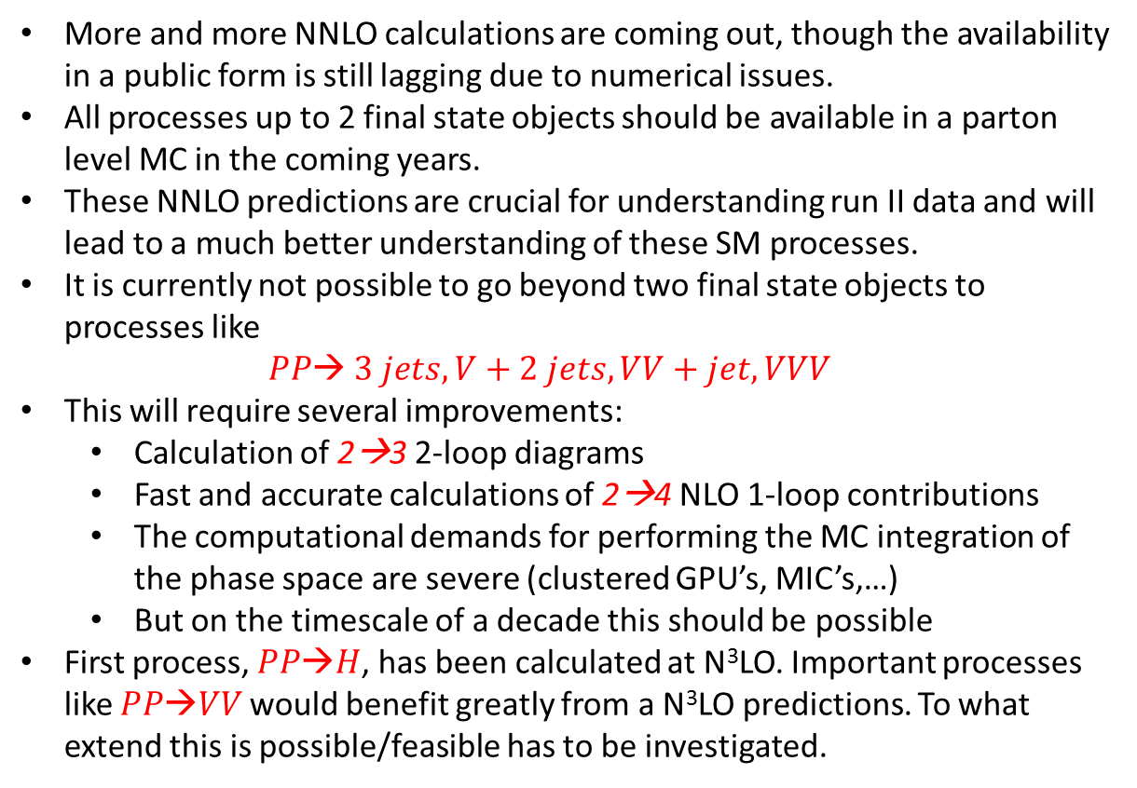
NNLO: Conclusions
More and more NNLO calculations are coming out, though the availability in a public form is still lagging due to numerical issues.
All processes up to 2 final state objects should be available in a parton level MC in the coming years.
These NNLO predictions are crucial for understanding run II data and will lead to a much better understanding of these SM processes.
It is currently not possible to go beyond two final state objects to processes like
$PP→ 3 jets, V+2 jets, VV+jet, VVV$
This will require several improvements:
  Calculation of 2→3 2-loop diagrams
  Fast and accurate calculations of 2→4 NLO 1-loop contributions
  The computational demands for performing the MC integration of the phase space are severe (clustered GPU’s, MIC’s,…)
  But on the timescale of a decade this should be possible
First process, $PP→H$, has been calculated at N³LO. Important processes like $PP→VV$would benefit greatly from a N³LO predictions. To what extend this is possible/feasible has to be investigated.

