Slide 1





JESD204B
High Speed ADC Interface Standard
Matthew Jones
Purdue University
8th INFIERI Workshop – Fermilab 2016

Slide 2
Introduction
Applications:
  Medical imaging: ultrasound
  Digital oscilloscopes: PMT waveform digitization
  Software defined radio
  Synthetic aperture radar
Wide range of applications benefit from high speed (> 200 MSPS) analog-to-digital converters
  Commercially available components
  Commercially available modules
Application development benefits from well-defined standards followed by multiple vendors

Slide 3
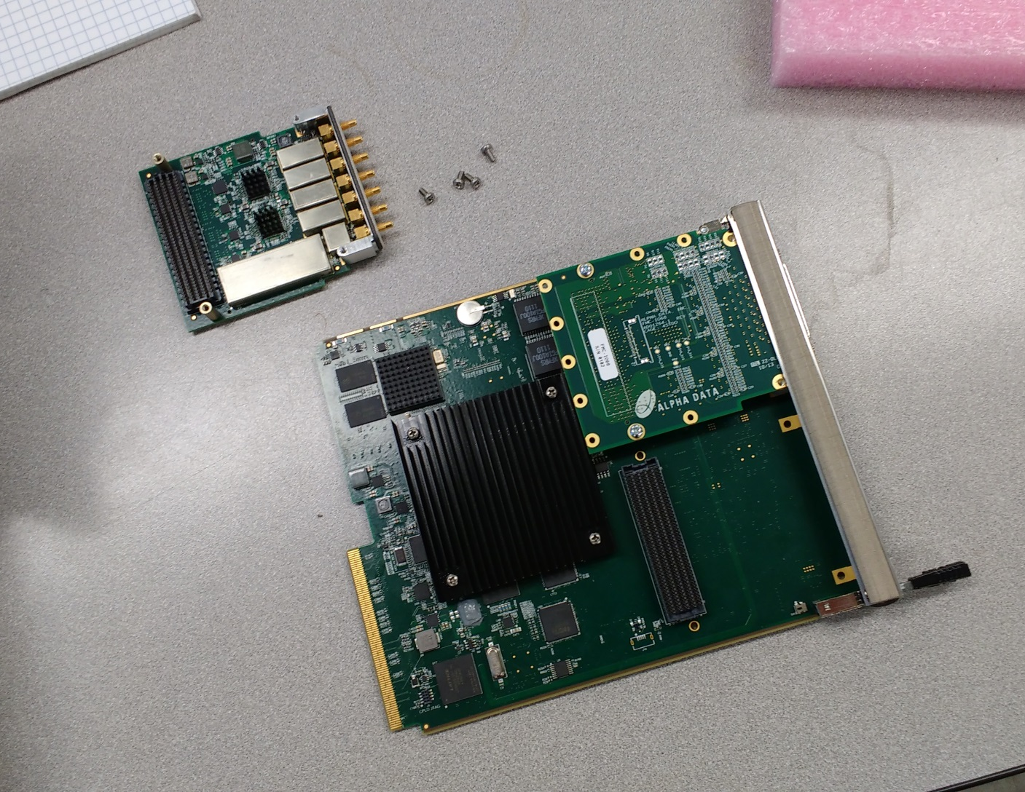
Introduction
Vadatech
FMC228
AMC502

Slide 4
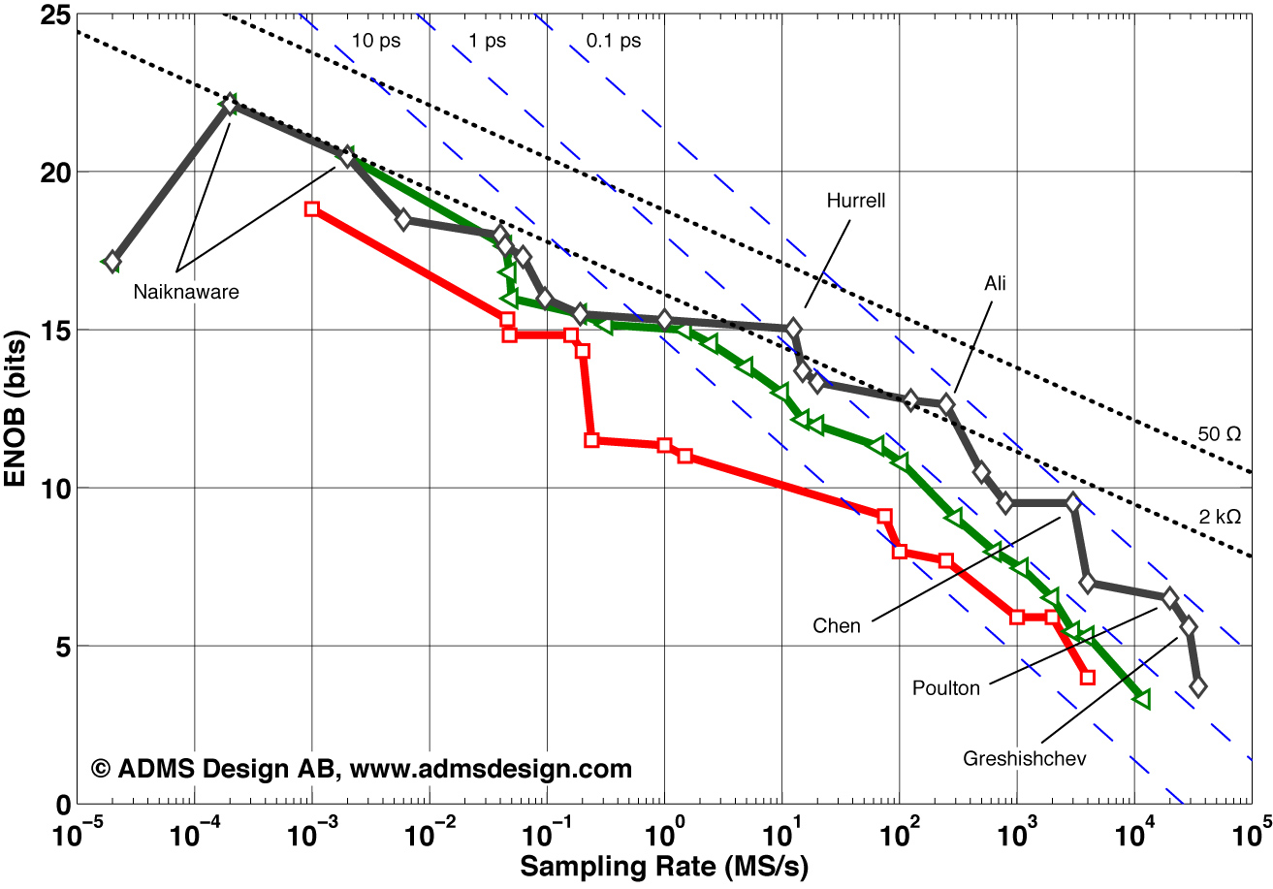
Analog to Digital Conversion

Slide 5
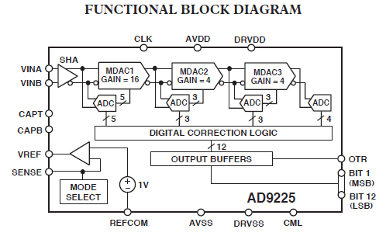
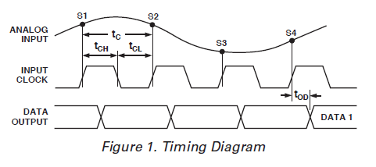
Data Interfaces
Example: AD9225 (circa 1998)
  One channel, 12-bits, 25 MSPS, 5V CMOS
Parallel interfaces become challenging above 100 MSPS due to noise, signal skew.

Slide 6
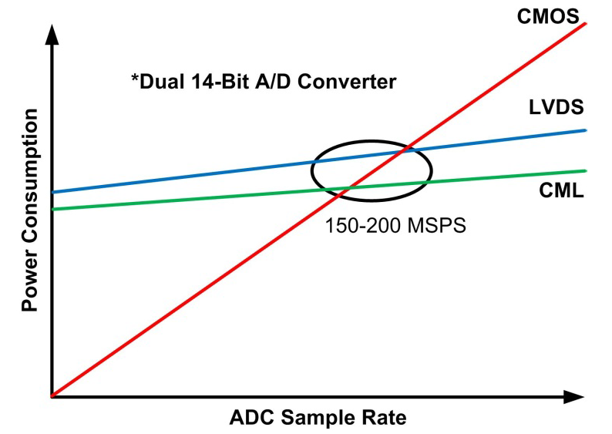
Data Interfaces
Power dissipation is also a factor:

Slide 7
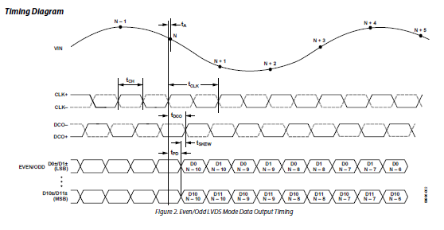
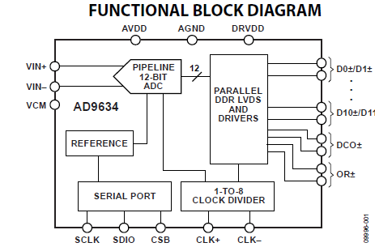
Data Interfaces
Example: AD9634 (circa 2011)
  One channel, 12-bits, 250 MSPS, 1.8V CMOS
Lower voltage, differential signals, forwarded clock output but signal skew still a potential problem.

Slide 8
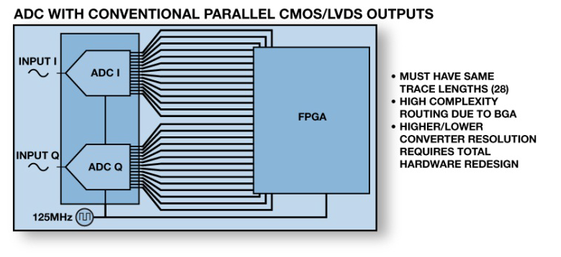
Data Interfaces
PCB design complications:
Most of these problems can be mitigated by means of a high-speed, reconfigurable serial interface (JESD204)

Slide 9
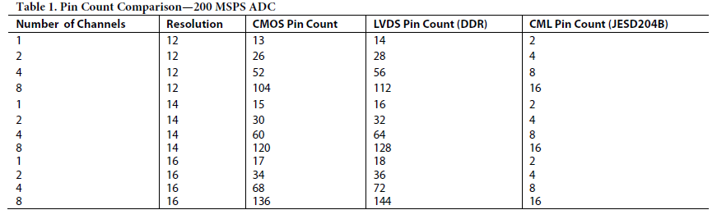
Data Interfaces
Complexity of the interface is moved from PCB routing into FPGA logic.

Slide 10
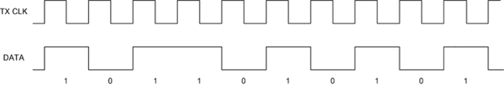
Serial Data Communications
Differential signals (LVDS or CML)
Clock recovery:
8b10b encoding: replace 8 bits with 10 bit code
Ensures DC balance and a sufficient number of transitions for clock recovery.

Slide 11
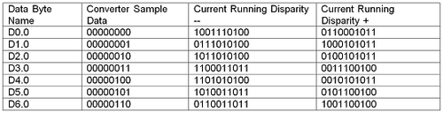
8b10b Encoding
256 data bytes encoded using 512 10-bit words, selected to maintain DC balance.
Not all the remaining 512 words are useful
  Too many long sequences of 1’s or 0’s
The ones that are useful are control characters

Slide 12
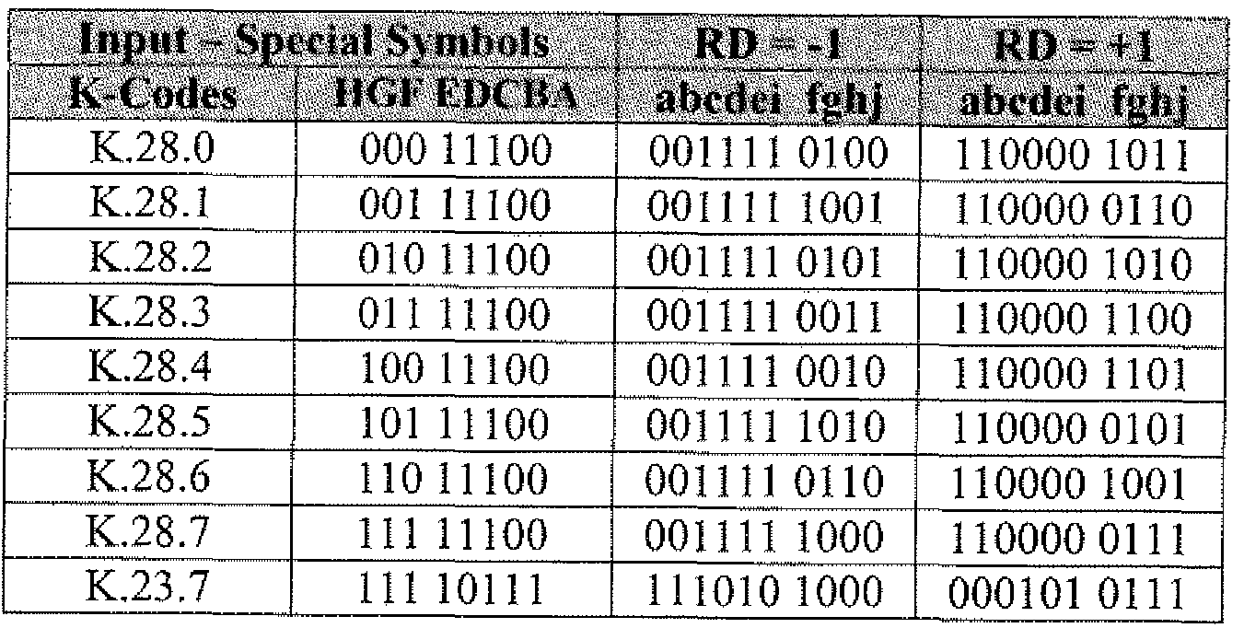
8b10b Control Codes
JESD204B Control characters
/R/
/A/
/Q/
/K/
/F/
Used to transmit “non-data” status and control information on the serial link
Decoded data provided as 8-bits plus one bit to indicate D- or K-code.

Slide 13
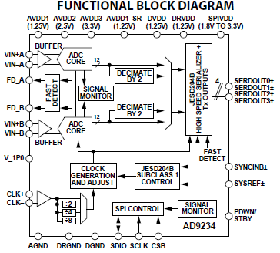
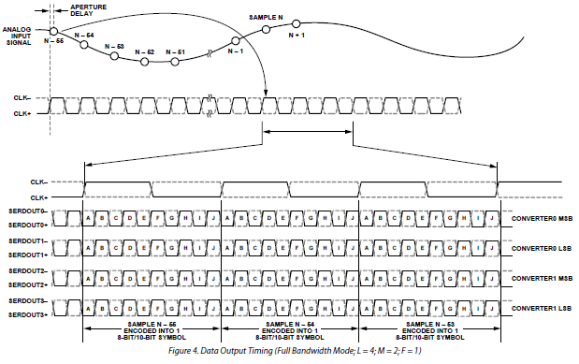
Multi-Lane Data Interface
Clock recovery determines relative phase of data bits.
Additional information is required to align to frame boundaries.
JESD204B introduces the SYNC~ signal…

Slide 14
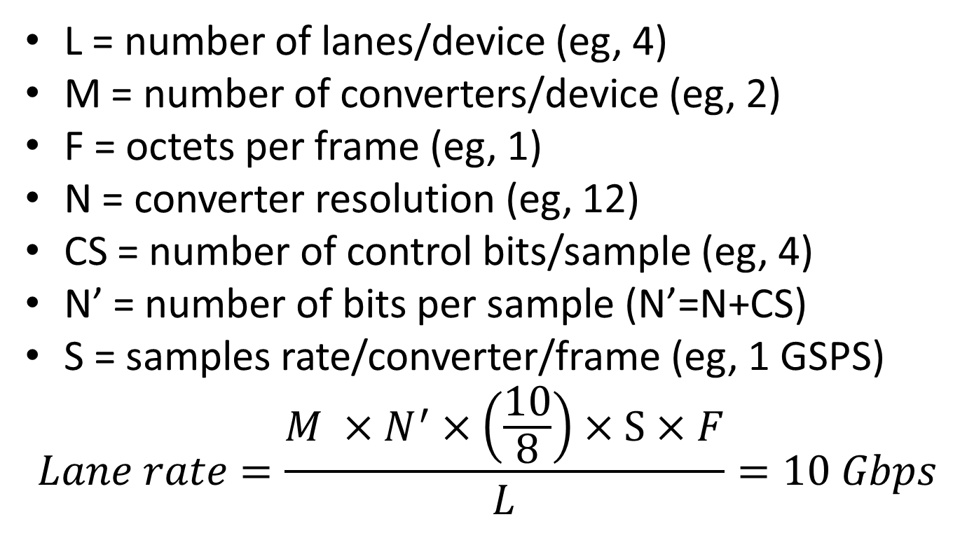
Link Bandwidth
L = number of lanes/device (eg, 4)
M = number of converters/device (eg, 2)
F = octets per frame (eg, 1)
N = converter resolution (eg, 12)
CS = number of control bits/sample (eg, 4)
N’ = number of bits per sample (N’=N+CS)
S = samples rate/converter/frame (eg, 1 GSPS)
$$Lane rate=\frac{M ×N^{′}×\left(\frac{10}{8}\right)×S×F}{L}=10 Gbps$$

Slide 15
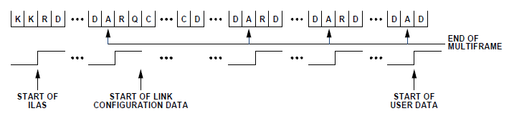
Aligning Multiple Lanes
Asserting SYNC~ initiates Code Group Synchronization (CGS): transmits /K/
After aligning to /K/ characters, SYNC~ is deasserted and the device transmits the Initial Lane Alignment Sequence (ILAS):
Second multi-frame transmits data link parameters
  Self-describing data link configuration
User data starts after fourth multiframe.

Slide 16
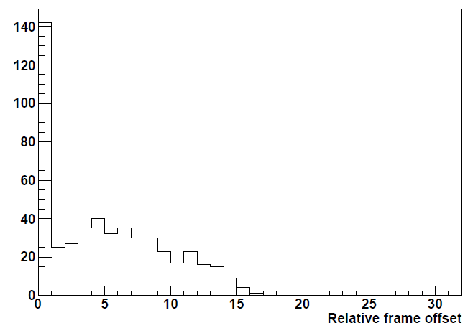
Aligning Multiple Lanes
AD9234 – 4 lanes
Relative offset must be less than 32 frames.
Determines the size of elastic buffer needed for lane alignment.

Slide 17
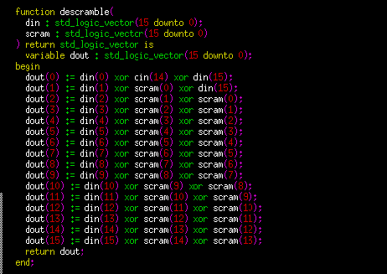
Scrambling/Descrambling
Output bits defined by linear feedback shift register:
1+x¹⁴+x¹⁵
Avoids spectral artifacts due to repetitive data.
Descrambling is efficient to implement in FPGA logic.

Slide 18
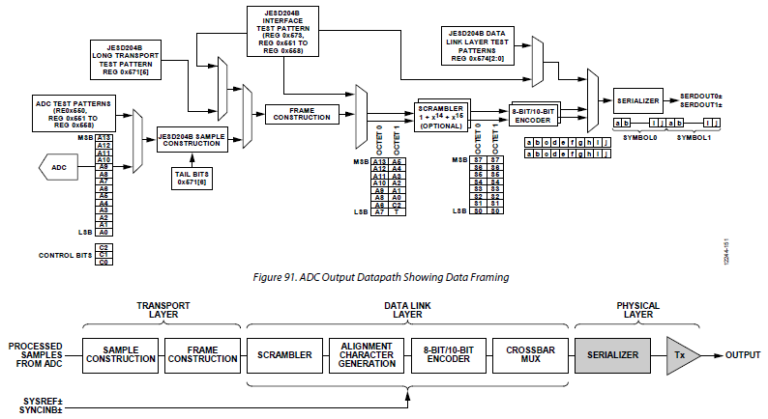
Complete Data Path

Slide 19
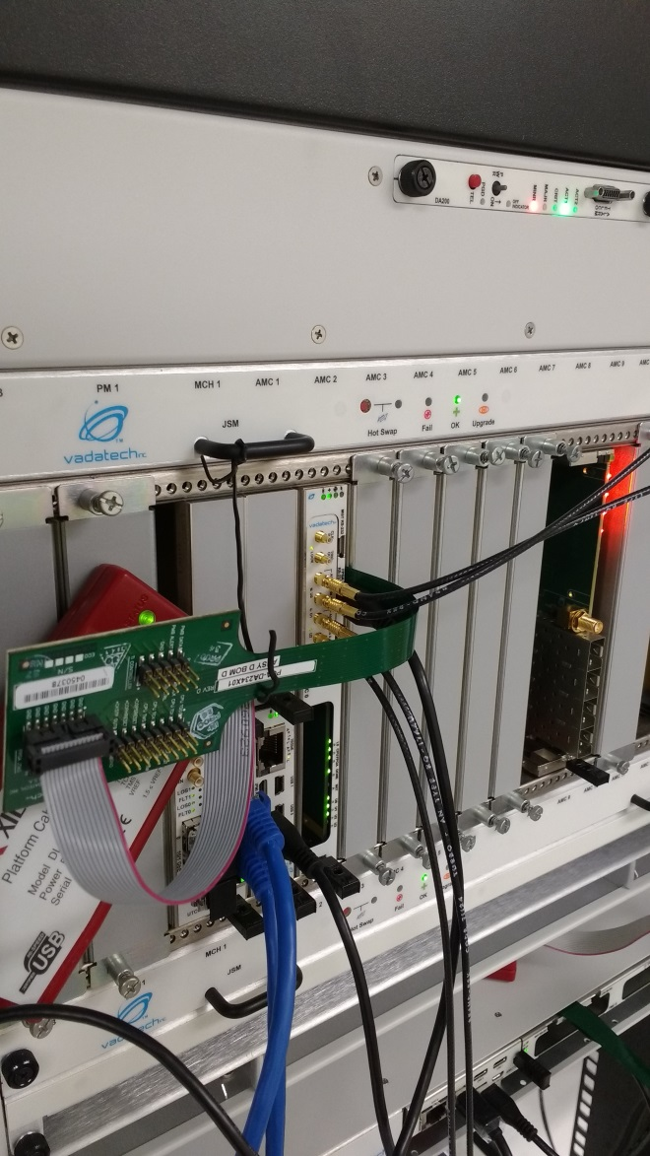
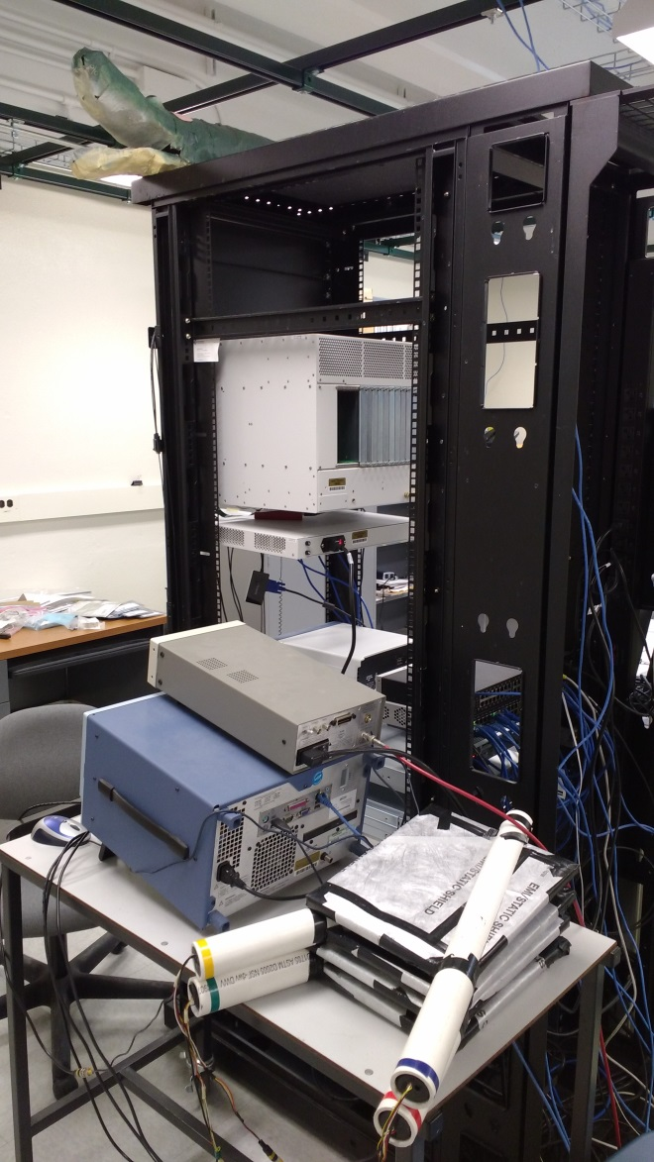
Example Application
FMC228 – 2xADC9234
→ Kintex-7 FPGA
Stack of 4 scintillators + photomultipliers

Slide 20
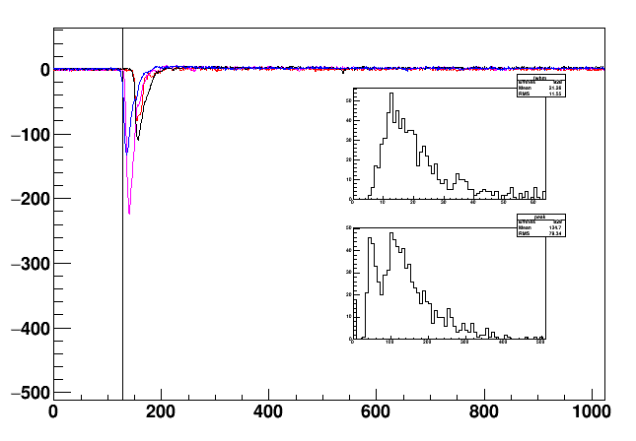
Decoded Waveforms
Channel 0: A,B
Channel 1: A,B
Firmware trigger on 3 out of 4 pulses above threshold.

Slide 21
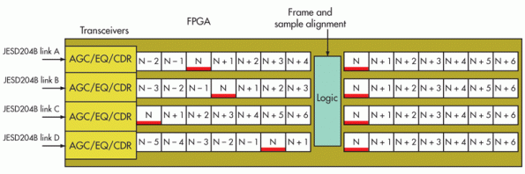
Alignment of Multiple Devices
Deterministic Latency refers to the ability to determine the absolute latency of the decoded data.
Each ADC maintains a Local Multi-Frame Clock (LMFC)
  Eg, 1/16 of the input clock frequency
  ILAS sequence starts on a LMFC boundary
JESD204B introduces the SYSREF~ signal.
  All LMFC clocks are synchronized to the SYSREF~ signal edge.

Slide 22

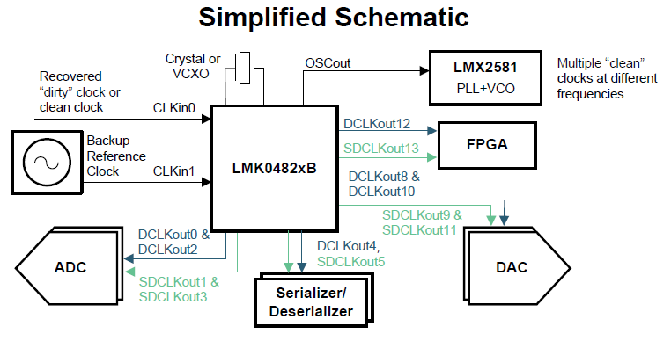
Support for Clock Synthesis
The standard allows interoperability of different vendor’s chip sets.
  Eg. Texas Instruments

Slide 23
Other Advantages
Reconfigurable through software
  Change sample resolution
  Pin-compatible devices with different resolution/sample rate
  Re-mapping of physical channels
ADC
BUS
D0
⁞
Dn
Dn
⁞
D0
Routing complexity on PCB due to opposite bit order
JESD204B lane order remapped by internal crossbar switch
ADC
BUS
Ln
⁞
L0

Slide 24
Comments
Deterministic latency is not the same as low latency
  LVDS may still be more appropriate in cases where low latency is of primary concern
Same issues apply to high speed DAC’s driven by an FPGA
Potentially interesting for high-speed serial interfaces exchanging trigger data
  No need to transmit bunch crossing counter with each data frame

Slide 25
Hardware/Firmware Support
Hardware:
  Analog Devices
  Texas Instruments
  Intersil
  Linear Technology
  Others…
Firmware vendors:
  Xilinx:
    JESD204 PHY v3.2 (free): physical interface
    JESD204 core (licensed): bus interface
  Altera:
    JESD204B IP Core (licensed)

Slide 26
Summary
The JESD204B standard is widely applicable to high-speed ADC and DAC applications
Widely accepted by industry
Solves several problems common to similar DAQ models
  High speed, low noise, low power
  Deterministic latency
  Versatile, reconfigurable links
Applicable beyond ADC/DAC interfaces
Implementation is not all that difficult but working examples can be quite helpful

